Slide 1


Use of Inorganic Mass Spectrometry for the screening of radio-pure material
S. Nisi
Laboratori Nazionali del Gran Sasso
Servizio di Chimica Impianti Chimici
stefano.nisi@lngs.infn.it
SoUP 2022

Slide 2
Outline
Gran Sasso National Laboratory (LNGS)
The relevance of background
Ultra-low level radioactivity measurement facilities at LNGS: Gamma ray & ICP-MS
What is mass spectrometry?
ICP-MS potentiality and limiting factor
Applications
Notes:
this section is dedicated to the ultra low level radioactive measurement. Lorenzo has just spoke about radiometric technique. Now we will focus on the massa spectrometry. We will see it’s potentiality and issues.
In this talk I will briefly introduce the LNGS,
We’ll see the relevance of background in the field of nuclear physic research and then the tools available at LNGS for screening of radiopure material to be used in the apparata building.
We’ll focus on the natural decay chains and secular equilibrium.
At the end, Some cases of study will be presented

Slide 3
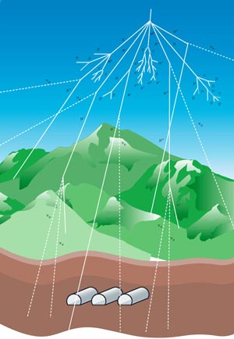
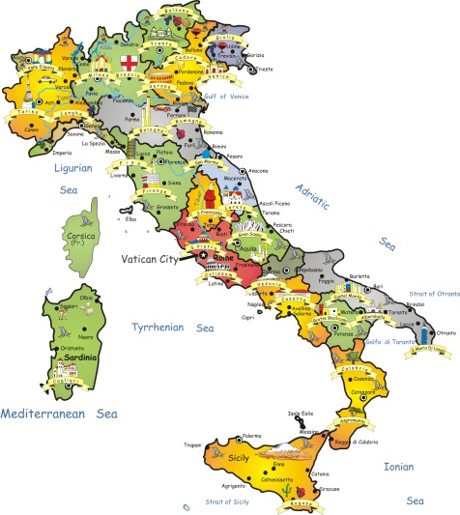
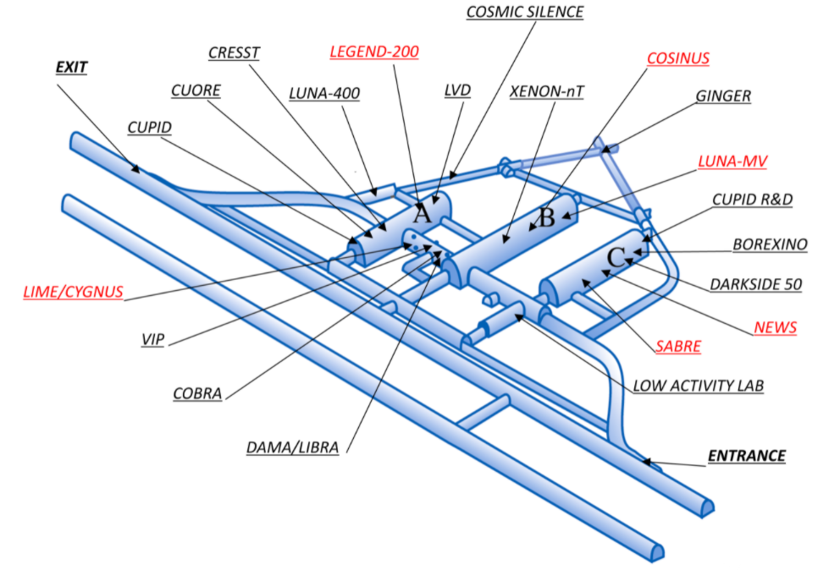
Gran Sasso National Laboratory
The LNGS underground laboratory provides the necessary ultra-low radioactive background
to detect extremely rare events
Cosmic ray flux reduction: ≈10⁶
Neutron flux reduction: ≈10³
- Selection of highly radio-pure materials
K
Pb
Th
U
Neutron Activation Analysis, α&γ-Ray Spectrometry, ICP-Mass Spectrometry
3
Notes:
The underground facility, protected by 1400 m of rock, provides the ....necessary to host several Experiments looking for extremely weak and rare astroparticle physics events.
Furthmore the internal background of the experimental apparatous must be as low as possible so that, the natural radioactive measurements is fundamental for the selection of the higly radio-pure materials.
3

Slide 4
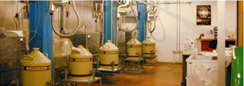
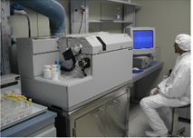
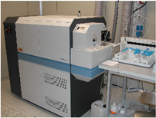
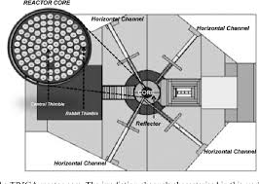
Ultra-low level radioactivity measurement facilities
STELLA (SubTErranean Low Level Assay)
ICP-Mass Spectrometry
ϒ-ray spectrometry with high purity Ge detectors (HPGE)
α spectrometry with Silicon PIPS detectors
Liquid scintillation counters
Quadrupole and double focusing ICPMS
ISO 6 Clean room
Reagent purification systems
Sample treatment device
Neutron Activation Analysis (NAA) Pavia
TRIGA Mark II reactor Pavia University
Radio-Chemical Lab
HPGE at Milan INFN&University
Notes:
The mass spectrometry facility is located in ISO6 clean room

Slide 5
Radiometric techniques are sensitive to the radiation emitted by radionuclide decay
Sensitivity f(T_{1/2}, Energy ϒ-ray line, branching ratio, sample mass, time of measurement)
ULL-GRS Ultra Low Level Gamma Ray Spectrometry
+ Sample treatment free
+ Non destructive technique
  - Sensitivity depend on the sample mass (Kg)
  - Long measurement time is requested to achieve high sensitivity (weeks)
  - Bulk measurement/homogeneous material
Mass spectrometry measures the concentration of radionuclides (number nuclides/mass)
ICP-MS Quadrupole Mass Analyzer equipped with collision cell
HR-ICP-MS High resolution ICP-MS
+ Small sample (g)
+ Relatively quick measurement
- Sample treatment is mandatory and delicate
- Destructive technique
R&MS are often applied both to check secular equilibrium of decay chain
Notes:
This is an overview about the Analytical techniques available for trace element detection.
ULLGRS does not need delicate sample treatment but its sensitivity depends on the sample mass. Furthermore long measurement time is requested to achieve high sensitivity.
In this presentation different ICP-MS method will be investigated and compared about the 90Sr measurement.

Slide 6
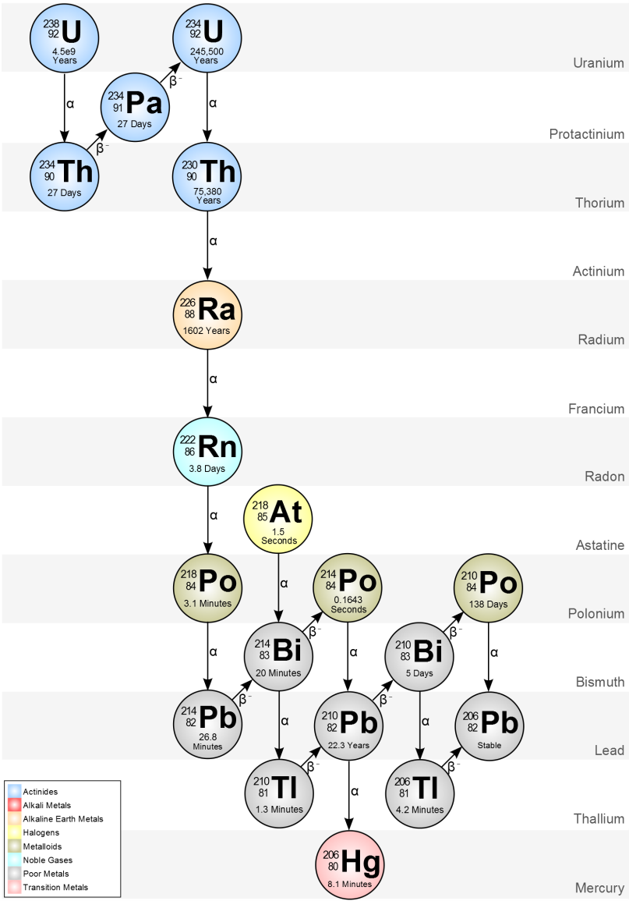
Look inside the decay chains
²³⁸U is the parent of its decay chain
²⁰⁶Pb is a stable nuclide, the finish line of the chain
In between there are many radionuclides, all undergoing α&β decay processes
If the secular equilibrium is respected
the number of atoms that decays for each nuclide per unit time is the same.
But the half-life time (T_{1/2}) is characteristic for each nuclide
their concentrations are inversely proportional to T_{1/2}
Radiometric techniques and mass spectrometry are intrinsically complementary
Notes:
We have already seen, in the last days, how the different chemical physical properties of artificial radionuclides, released during Fukushima accident, fluence the distribution and diffusion in the environment.

Slide 7
Look inside the decay chains
ICP-MS
Chemical & physical behaviour different for the nuclides
Rupture of SE is possible
γ-ray Spectrometry
Notes:
The ICPMS has the capability to measure The parents and the lead stable isotope with excellent sensitivity. In principle it is possible to measure some medium half life radionuclides such as….Concerning the 210Pb the sensitivity is very poor.
Applying gamma ray we add more pieces of the puzzle and become possible to have/suppose the complete picture and check for secular equilibrium.
Due to the different Chemical & physical behaviour of the radionuclides Sometimes there is a rupture of SE

Slide 8
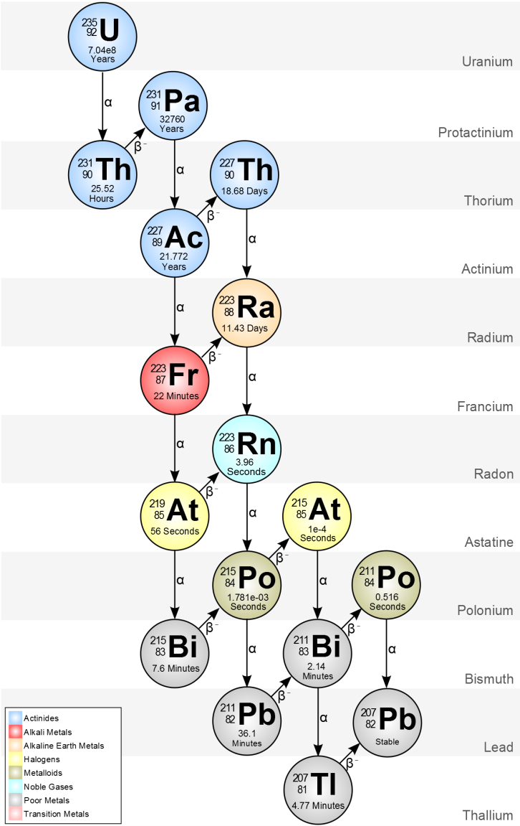
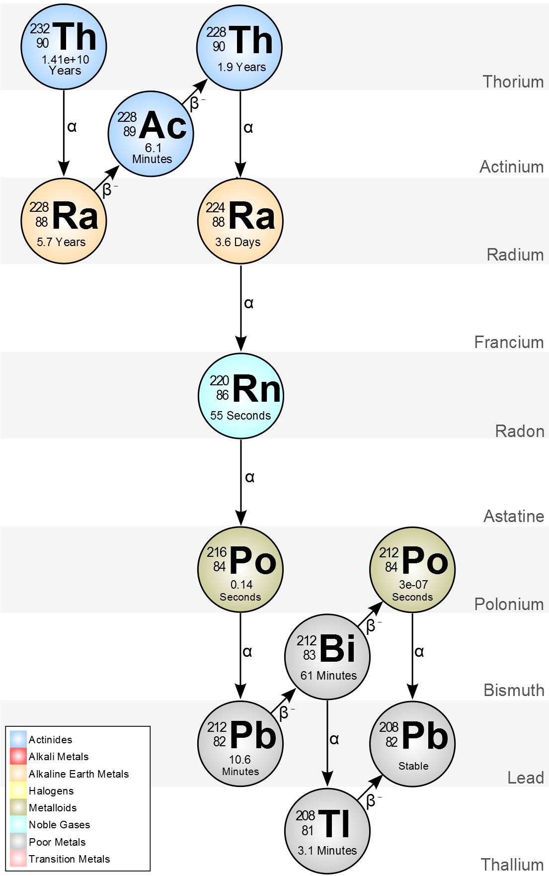
Others natural decay chains
ICP-MS
ICP-MS
γ-Ray Spectrometry
Notes:
With regard to the others natural decay chains the situation is similar. ICPMS has the capability to measure The parents and the lead stable isotopes only, which do not give contribute to the radioactive background.
Applying the gamma ray spectrometry we add some pieces of the puzzle

Slide 9
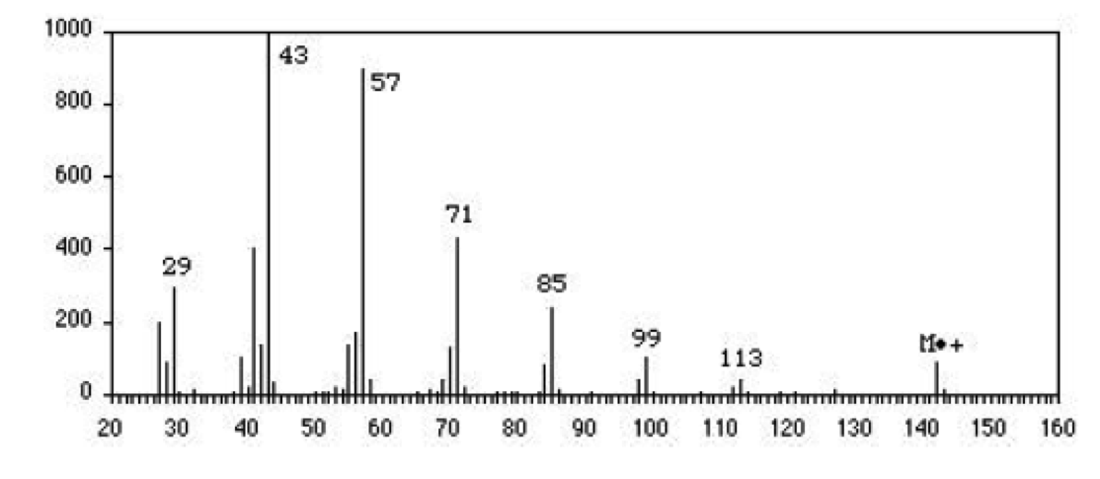

What is the mass spectrometry?
- Identification and quantification of molecules and elements
SAMPLE INTRODUCTION SYSTEM
SAMPLE IONIZATION (ION SOURCE)
MASS ANALYZER (m/z)
DETECTOR
Intensity
mass spectrum (intensity vs m/z)
Qualitative info
Semi-Quantitative
Quantitative
Isotopic ratio
9
m = ion mass
z = ion charge
m/z
Notes:
Chemical analytical technique that allows the identifification and quantification of atoms and molecules.
The results are presented as a mass spectrum, a plot of intensity as a function of the mass-to-charge ratio
Blok diagram
Combinations of different type of these components result in different…
9

Slide 10
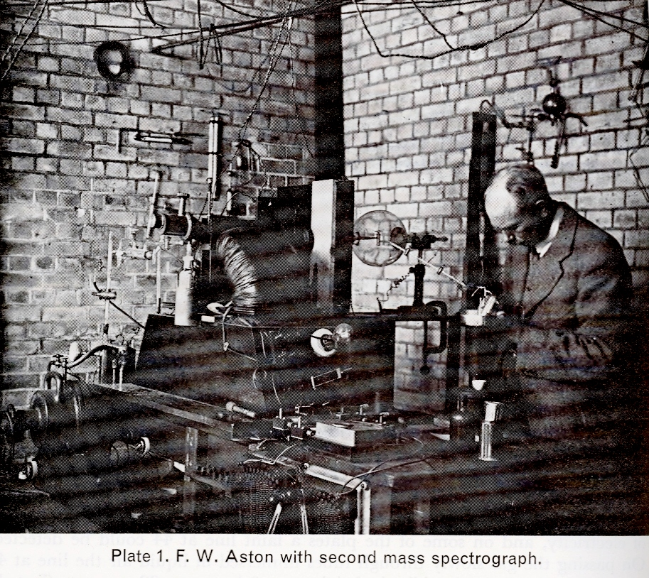
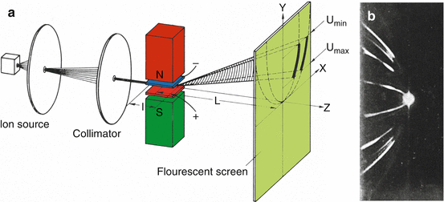
Mass Spectrometry History
Ion source = discharge tube
Mass analizer =magnet
Detector = Fluorescent screen
Notes:
The origin of mass spectrometry goes back to the beginning of previous century when the neon isotopes were observed for the first time.
In the picture Aston is working with second mass spettrograph. In the sketch we can see the Ion source

Slide 11
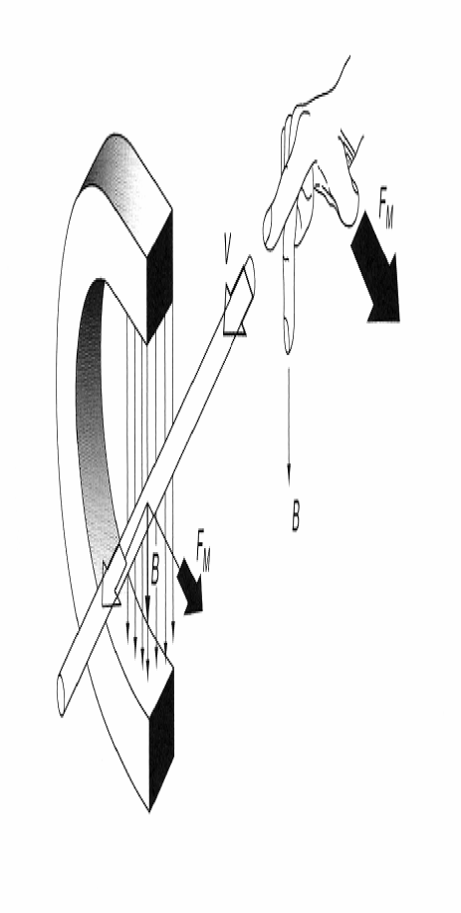
Operating principle of magnet sector
Lorentz force:
F_{L}=q(E+v x B)
Centrifugal force:
r=(m*v)/(e*B)
Notes:
The trajectory of an ion of mass m that flies into the constant magnetic field at velocity v became circular. The radius r depends on the ratio mass/charge. This is the effect of equilibrium between Lorentz and centrifugal forces.
In the figure m1 is lighter than m2 which is lighter than m3. Because the velocity of ion is determined by its kinetic energy acquired during acceleration is distributed around an average value (energy spread)

Slide 12
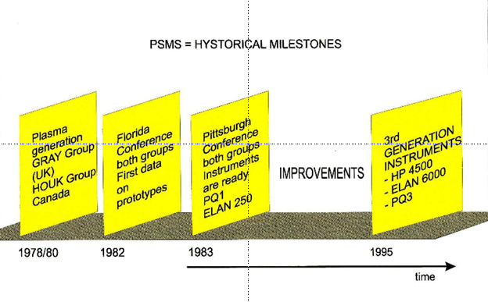
Plasma Source Mass Spectrometry: historical milestone
Notes:
In the evolution of mass spectrometry at beginning of eighties a milestone was set since a couple of groups used the plasma as ion source.
Then about ten years were spent to produce the first commercial instrumentation.

Slide 13
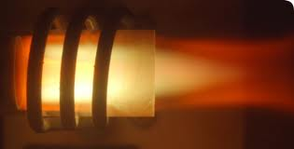
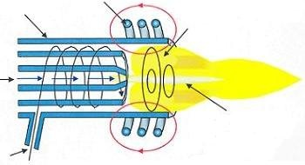
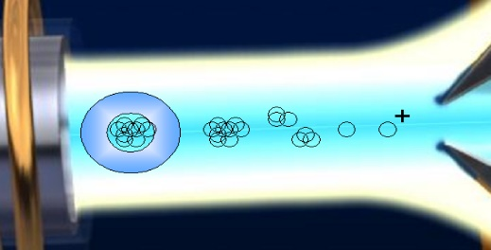
Inductively Coupled Plasma Mass Spectrometry
RF induction coils
Quartz tubes
Plasma
T ≈ 10000 K
Sample and carrier gas (Ar) flow
High energy!
The sample aerosol is dried, atomized and ionized
Argon flow
Plasma torch ion source
Complete (almost):
Desolvation
Atomization
Ionization
Plasma is capable to ionize almost all chemical elements
13
Notes:
In ICP MS the ion source is a plasma, generally Ar plasma, where the sample is introduced as an nebulized aqueous solution through a carrier gas flow.
The energy contribute of the torch is important, The plasma temperature is very high then the sample, along the torch profile, is almost completely desolvated, atomized and ionized. ICPMS is suitable for elemental analysis.
13

Slide 14
H
Measurable elements
He
AA / ICP / ICP-MS
Li
Be
B
C
N
O
F
Ne
ICP / ICP-MS
Na
Mg
Al
Si
P
S
Cl
Ar
K
Ca
Sc
Ti
V
Cr
Mn
Fe
Co
Ni
Cu
Zn
Ga
Ge
As
Se
Br
Kr
Radioactive
Rb
Sr
Y
Zr
Nb
Mo
Tc
Ru
Rh
Pd
Ag
Cd
In
Sn
Sb
Te
I
Xe
Cs
Ba
La
Hf
Ta
W
Re
Os
Ir
Pt
Au
Hg
Tl
Pb
Bi
Po
At
Rn
Not Measurable
Fr
Ra
Ac
Unstable Elements
Ce
Pr
Nd
Pm
Sm
Eu
Gd
Tb
Dy
Ho
Er
Tm
Yb
Lu
Th
Pa
U
Np
Pu
Am
Cm
Bk
Cf
Es
Fm
Md
No
Lw
Ultra - trace
Trace
majors…
14
1ppq
(10⁻¹⁵ g/g)
1ppt
(10⁻¹² g/g)
1ppb
(10⁻⁹ g/g)
1ppm
(10⁻⁶ g/g)
Notes:
In this slide we can see which are the elements that can be measured by ICP MS and at which concentration level.
It is possible to measure almost all the periodic table…
ranging
14

Slide 15
Quadrupole Theory
Consists of four Hyperbolic rod supplied with DC current and radio frequency
+ Vcoswt
X-axis field removes ions below a certain mass
Hyperbolic Q-pole
+ U
PB + ( U + Vcosωt )
PB - ( U + Vcosωt )
- U
Y-axis field removes ions above a certain mass
- Vcoswt
For a given combination of RF and DC voltages, the quadrupole only lets ions of a specific mass pass through to the detector. (In fact, mass spectrometer works on mass/charge ratio, not mass)
Notes:
The quadrupole mass analyzer consists…
The injected ions, moving along the z axix, are subjected to the influence of total electric field resulting from the application of potential to the rods.

Slide 16
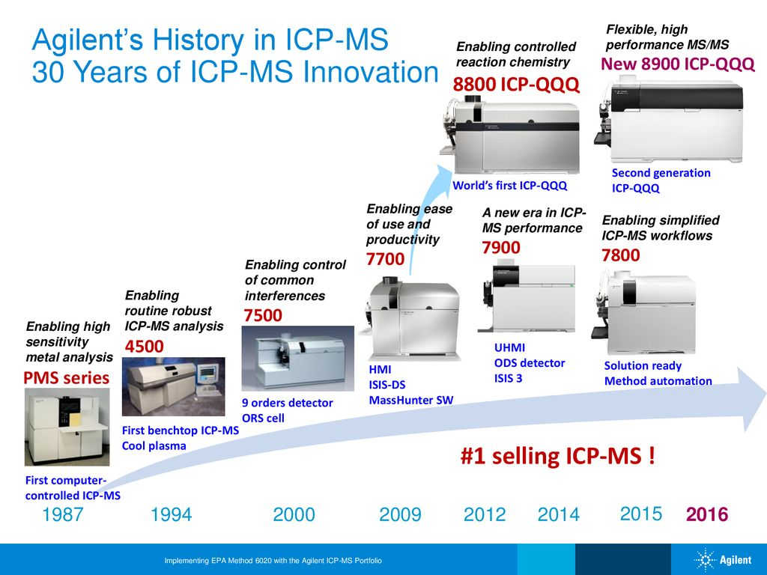
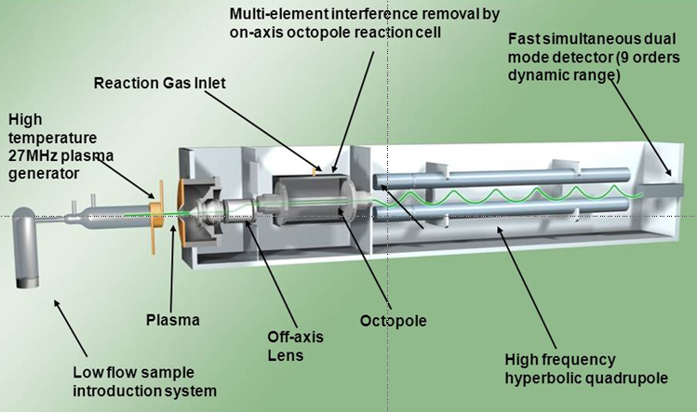
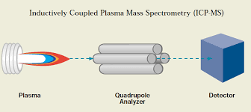
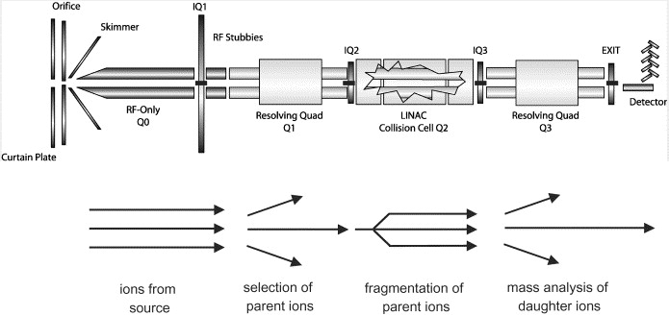
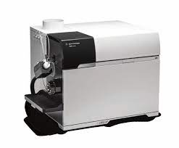

30 years of ICPMS Innovation
Notes:
In this slide the ICPMS development in the last 30 years is showed. Of course, the same happened for other companies: Elan and Nexiom series for Perkin Elmer, X serie for Thermo ect
In this period the technological innovations have been so relevant that at least 4 o 5 ICPMS generation have been introduced on the market.

Slide 17
Issues in ICP MS ultra-trace analysis
Isobaric interferences: polyatomic species, isotopes of different elements and double charged ions
Sensitivity, especially for solid samples (the instrument does not tolerate high matrix content, dilution is necessary) and matrix effect
Background (instrumental due to cross contamination and reagent, vials …)
High risk of contamination during sample preparation and measurement (we are looking for very very low concentrations!!!)

Slide 18
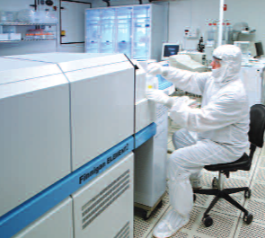
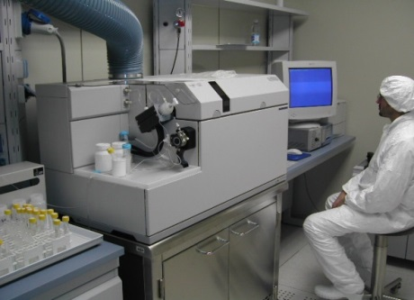
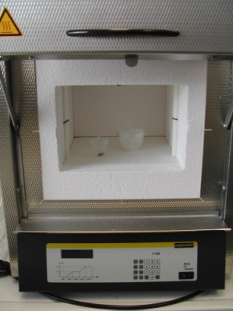
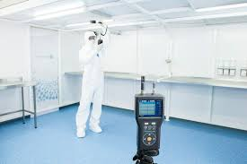
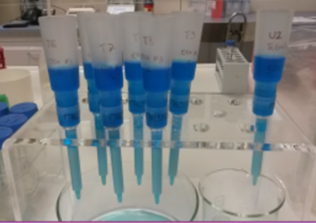
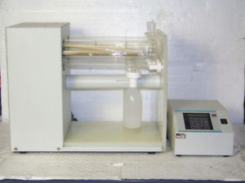
ICPMS Ultra Trace measurement “triangle”
Instrumentation
Ultra
trace
Sample preparation
“Clean chemistry”
Notes:
I prepared this slide thinking about the fire triangle where fuel, O2 and heat are concurrently needed for fire presence….
We briefly spoke about the ICPMS instrumentation but this is only the first condition to carry out ultra trace measurement.
Suitable lab and sample treatment procedures play a fundamental role in order to achieve excellent detection limit.
vertices of the triangle

Slide 19
Two ICP mass spectrometers @ LNGS
ICP QMS (quadrupole mass analyzer) – Agilent 7850
The polyatomic species interfering with the analytes are removed in the collision cell
19
19
Notes:
At LNGS there are two ICPMS, both installed in a clean room ISO6.

Slide 20
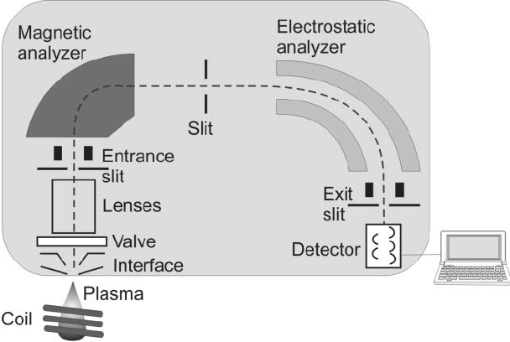
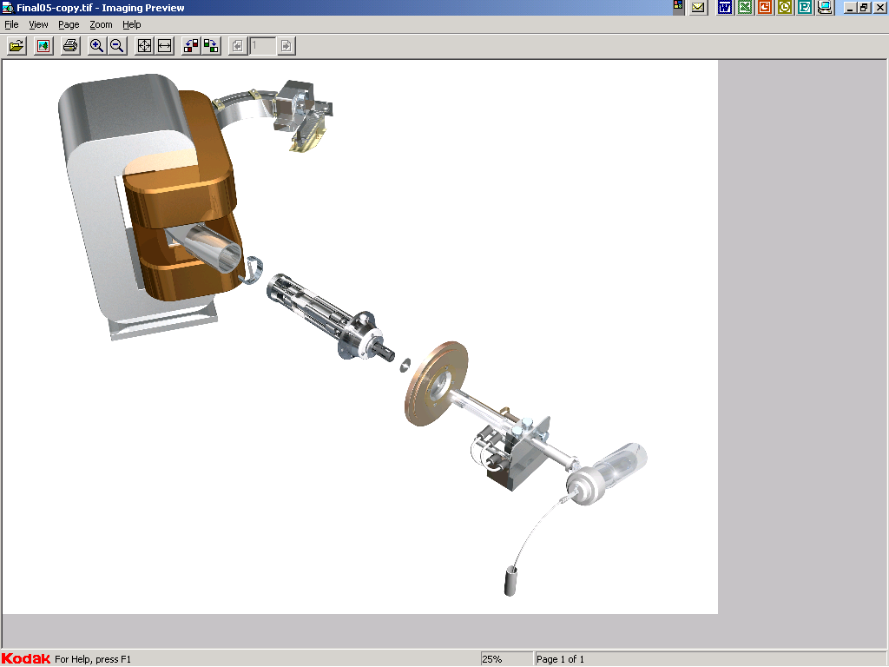
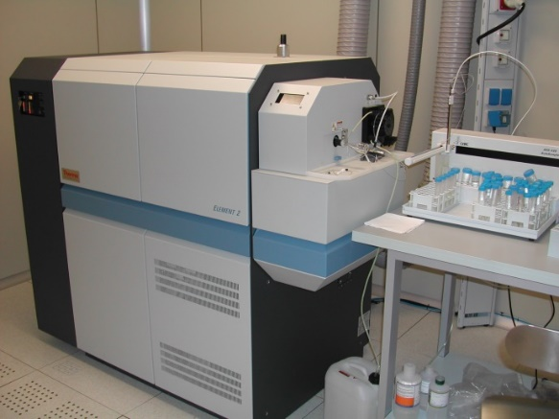
Double focusing ICP Mass Spectrometer
Detector (EM)
ESA
MSA
Interface
Plasma ion source
Spray chamber
Sample introduction
Reverse Nier-Johnson geometry
The peculiarity of double focusing ICPMS are sensitivity and the mass resolution
Notes:
In parallel the plasma source was applied also for magnetic analyzer MS. In particular the double focusing(HR) ICPMS were built. In this sketch the reverse Nier…..
Currently the direct Nier Johnson geometry has usually adopted on MC ICPMS

Slide 21
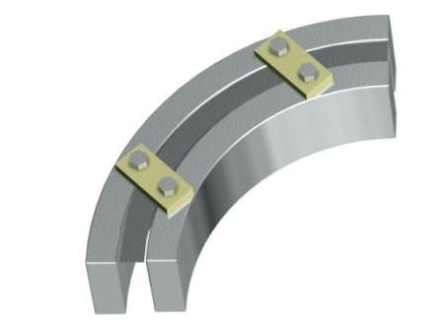
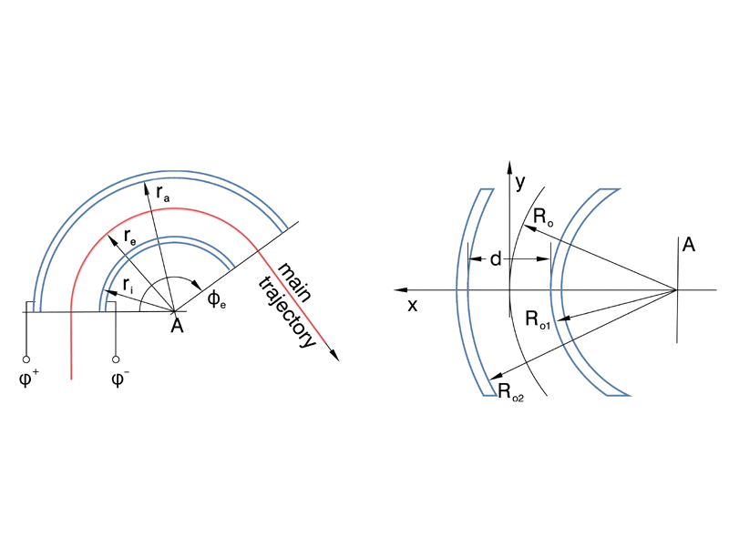
Electrostatic Sector
No Mass Dispersion
Slit at particular radius r, the system acts as an energy filter.
Notes:
21
The ESA works as an energy filter, in fact the Centrifugal force of motion must be equal to electrostatic force
The combination of Magnet and ESA allows to get the best mass resolution when the energy dispersion of magnet and ESA are equal in magnitude but of opposite direction, magnet and ESA focus both ion angles (first focusing) and ion energies (double focusing), while being dispersive for m/q

Slide 22
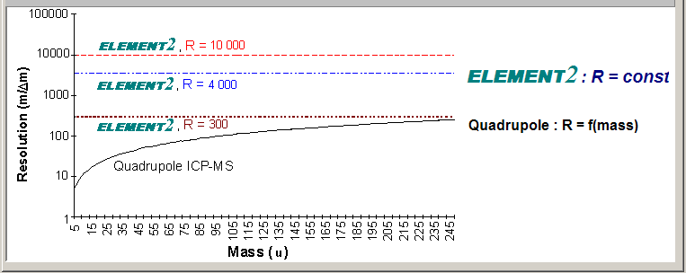
Mass resolution power
When two adjacent peaks m_{a} and m_{b} with comparable intensitiy and
the resolution is defined as the ratio:
h<10%H
R= m / (m_{a}-m_{b})

Slide 23
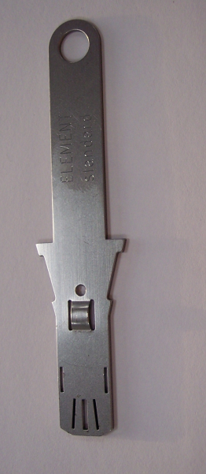
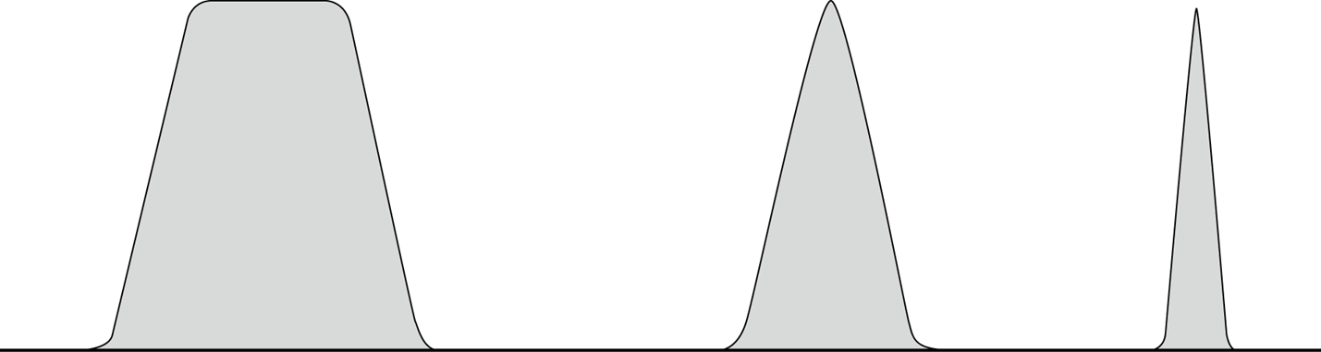
Low-Medium-High Resolution: peak shape
Using the Low Resolution mode, the sensitivity is the highest and the top of the peaks are flat. This is a successful approach for many isotopic systems also
In higher resolution the peaks have triangular shape, the resolution rise up, but the sensitivity degrease
2x10⁶ cps/ppb
2x10⁵ cps/ppb
5x10⁴ cps/ppb
Low resolution and now additionally
for R = 2000
Medium
resolution
High
resolution

Slide 24
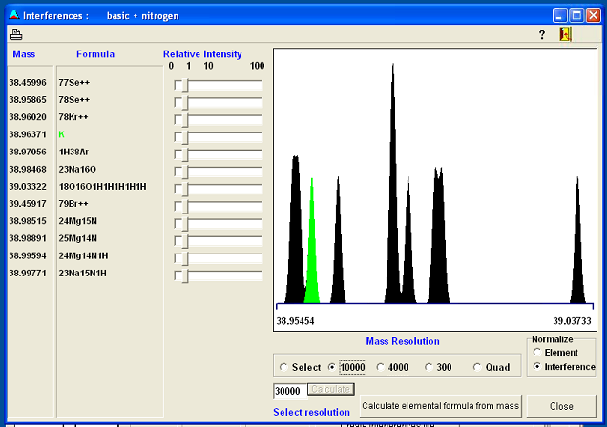
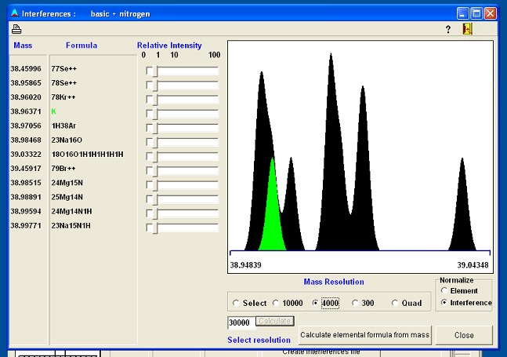
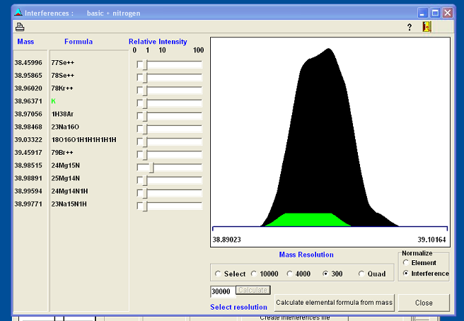

Slide 25
Measurement of K in NaI crystal
DM Direct detection experiments sensitivity = f(radioactivity background)
Some experiments looking for DM evidence are using or developing NaI crystal-based detectors
K is the most critical natural radio contaminant for Na due to their chemical affinity
The K final background budget is 10 ppb
The development of a high sensitivity analytical method is required in order to have a quick and reliable tool for NaI crystal production process monitoring (Detection Limit=ppb level).
Notes:
K is the most critical natural radio contaminant for Na due to their chemical affinity
For the same reason we are not yet performed an efficient matrix separation procedure, then we have worked mainly looking for the best instrumentation and parameter configuration.

Slide 26
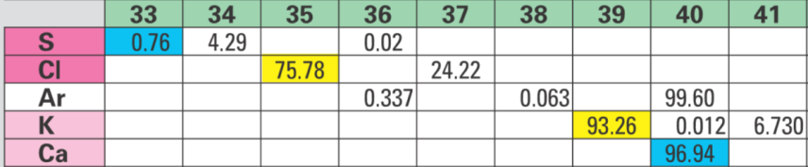
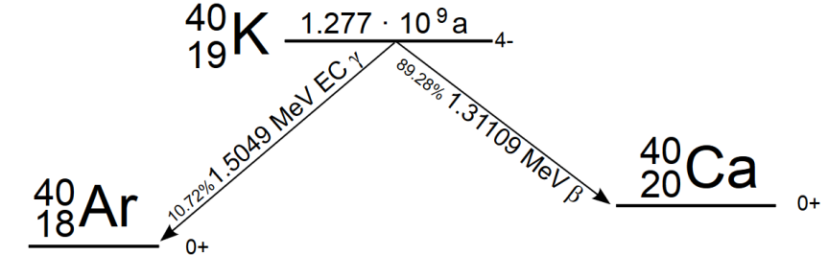
Drawbacks in ICP-MS ³⁹K measurement
Dilution is requested (at least 100)
Sensitivity reduction
Matrix effect (St. Add.method)
Ultrapure reagents
ISO6 Clean room
Vials conditioning
Contamination risk
Isobaric interferences
Kr⁺⁺
²³Na¹⁶O⁺
¹H³⁸Ar⁺
Chemical separation is hard
Collision cell ICP-MS (Cool pl.)
HR-ICP-MS Hot/Cool Plasma
Element II Thermofisher
 | Mass (amu) | Resolution
⁷⁸Kr⁺⁺ | 38.96020 | 11100
³⁹K⁺ | 38.96371
¹H³⁸Ar⁺ | 38.97056 | 5690
²³Na¹⁶O⁺ | 38.98468 | 1860

Slide 27
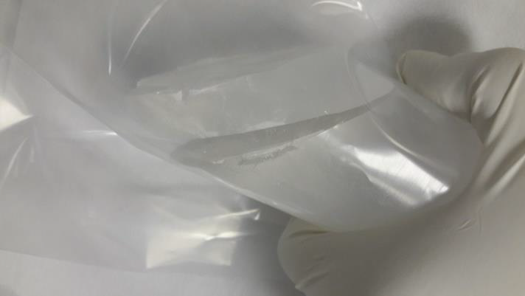
Crystal sampling procedure

Slide 28
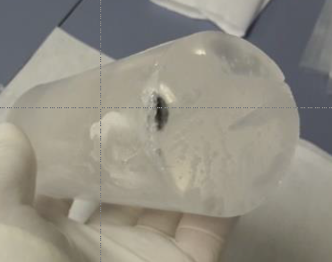
Study of the impurity distribution
Sample | 0 NOSE | 1 | 2 | 3 | 4 | 5 TAIL | 5B
K ppb | 230 | 320 | 360 | 340 | 350 | 1415 | ------
K ppb | <15 | <15 | <15 | <15 | <15 | 120 | 360
Th ppt | <1 | <1 | <1 | <1 | <2 | <1 | 280
U ppt | <1 | <1 | <1 | <1 | <1 | <2 | 130
K ppb | 10.2 | 11.5 | 11.2 | 11.6 | 11.6 | 13.3 | -----
Cry ST Powder
Hot plasma
Cry N1 UP Powder
Hot plasma
Cry N2 UP Powder
Cool plasma
The uncertainty of the reported concentration values is about 10-25 %

Slide 29
Techniques and labs comparison
HR-ICP-MS performance
Detection limit calculated with 3*SD_{BLK6} for NaI solid=3ppb
 | B5 | B5+13.25 | Mesured | Recovery %
ppb | 13.3 ± 2.5 | 26.5 ± 3 | 28 ± 5 | 105 ± 25
Recovery test
Technique | Laboratory | DL [ppb]
HR-ICP-MS | LNGS | 3
ICP-QMS | SICCAS | 10
ICP-OES | Ametek R&D | 5
ICP-QQQ-MS | PNNL | 0.6
Without matrix separation, the DLs achieved in different labs using different instrumentation are at ppb level

Slide 30
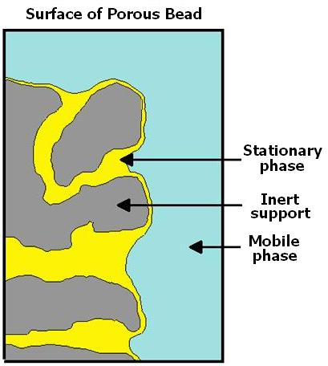
Development of an analytical procedure for the improvement of ICP MS detection limits for Th and U in copper
Extraction chromathography
Advantages:
Sample
Eluting solution
Matrix removal
Analyte pre-concentration
Analytes
Disadvantages:
Time consuming
Reagents
Risk of contamination
Higher amount of sample
Matrix
Analytes
V_{s}
Capacity factor k’:
k’ = D
V_{m}

Slide 31
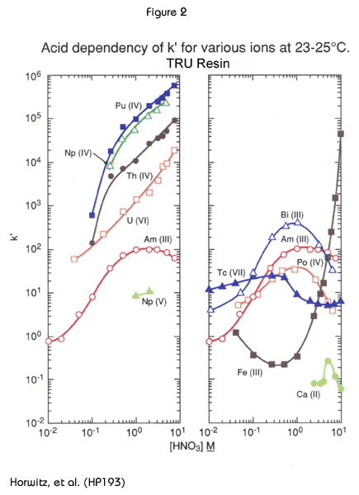
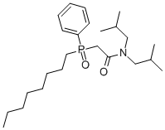
TRU resin (Triskem®)
octylphenyl-N,N-di-isobutyl carbamoylphosphine oxide (CMPO)
TRU column specifics
Stationary phase | CMPO/TBP (ρ= 0.37 g/mL)
Inert support
Grain dimension | 100-150 μm
CMPO content
Vs
Vs/Vm
Vm (FCV)

Slide 32
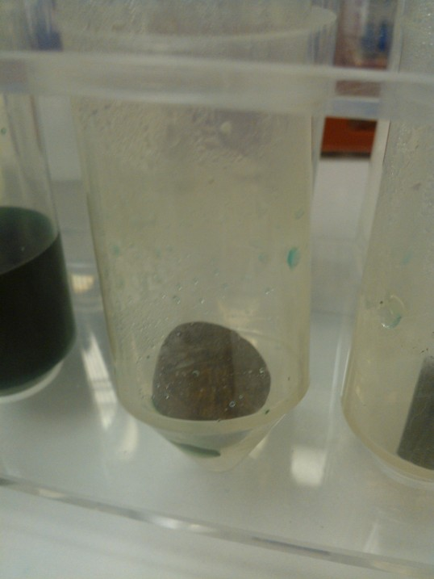
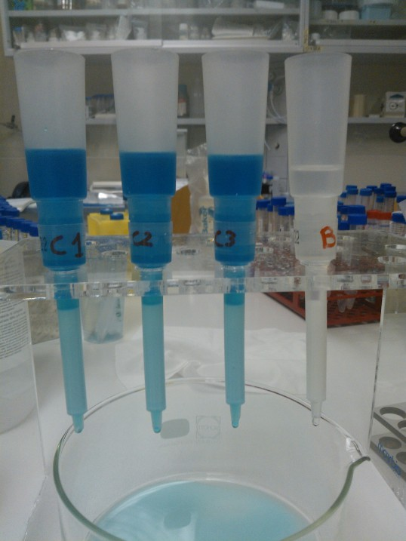
Experimental
Work in clean room (class 1000-ISO6)
Preliminary cleaning of all vials and labware involved in the analysis (10% UP HNO3 solutions + rinsing with MilliQ - 18.2 MΩ*cm – water)
Dissolution in UP HNO₃ solution
Several controlled etching steps: removal of likely contaminated surface and bulk analysis / depth profile
- Analytes separation and pre-concentration using extraction chromatographic columns loaded with selective resins

Slide 33
TRU results
 | DL* (in solid Cu) | Recovery %
Th | 2.6 ppt | 90.0 ± 0.6
U | 0.8 ppt | 97.9 ± 6.1
    Sample solution:
    10% Cu in 4M HNO3
    Th and U chromatographic extraction:
    Resin pre-wash and conditioning (0.1M ammonium oxalate)
    Rinse (4M HNO3, 5 mL)
    Sample load (10 mL)
    Rinse (4M HNO3, 5 mL)
    Th and U elution (0.1M ammonium oxalate 10 mL)
    *DL = 3 × BLKStdDev
Cu separation efficiency: >99%
 | Measured in Cu sample
Th | 4.6 ± 1.3
U | 1.0 ± 0.3
 | DL | Recovery %
Th | very good | excellent
U | excellent | excellent
    Solution 5 analyzed undiluted
    Total Dilution Factor: ≈10
    (vs ≈1500 without pre-concentration)

Slide 34
LRT performance comparison
 |  | ICPMS LNGS (LSC) | ULL GRS LNGS (LSC) | ULLGS+NAA LENA-Pavia
 |  | Primordial parents | ϒ emettitors | Primordial parents
 |  | Surface/bulk | BulK | Surface/bulk
Destructive |  | Yes | No | Yes
DL | [ 10⁻¹²g/g ] | Th=0.5 U=0.5 | Th= 10-20 U= 10-20 | Th(²³³Pa)= 0.1 U(²³⁹Np)= 3-5
Sample size | [ g ] | 0.1-10 | 1-10000 | 100
Sample treatment |  | Contamination risk not negligeble | Almost free | Hot sample handling Low cont risk
Analysis Time |  | days | weeks | days-week
R&MS are often applied both to check secolar equilibrium of decay chain
ICP-MS allows to perform the quality control of each single part (or lot )

Slide 35
Final remarks
The next generation of experiments focuses to detect rare low-energy events needs «zero background» conditions in fact the residual radioactive background rate drives the feasibility of the experiments in terms of detector mass (cost) and length of data taking period.
ICP mass spectrometry is an extremely versatile technique: it is a very powerful tool also for the screening of radiopure materials and whenever high chemical purity is important (eg. Crystal growth, 3D powder ect)
The sample treatment plays a fundamental role in order to achieve excellent sensitivity
Thanks to its rapidity of analysis and the use of a minimum amount of sample, it is a technique suitable for quality control (even on a single lot)
ICPMS allows to discriminate the contamination contributes for inhomogeneous material (for example PCB trace/support/components)
The combination of γ-ray and ICP-MS analyses allows to determine the background with the best sensitivity and to check for secular equilibrium insuring costant background over the lifetime of the experiment.

Slide 37




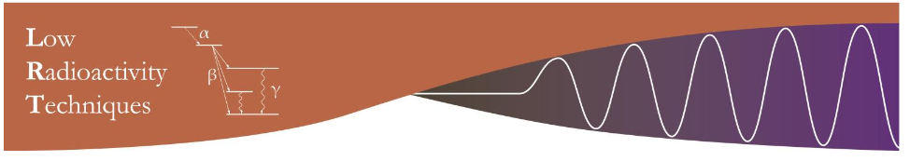
The most modern mechanical technologies and cutting edge radio-analytical techniques merged for extremely low background achievement
S.Nisi, Chemistry Department, Gran Sasso National Laboratory, INFN
D. Orlandi, Advanced Mechanics Service, Gran Sasso National Laboratory, INFN
On behalf of people who like the idea
20-23May, 2019Jaca, Spain

Slide 38
Why Low Radioactivity Technique (LRT) ?
Low Radioactive Techniques are essential to select the materials needed for assembling Low Background (LB) apparata
They are used for screening of semi-finished metal/plastic materials
The final component realization often requires heavy machining
Surface contamination is very critical (often dominant) for LB
Components need final surface treatment and cleaning
NEW APPROACH
LRTs play a fundamental role for production process monitoring
Production of finished components through Additive Manufaturing (AM)

Slide 39




Additive Manufacturing: Future Outlook in Designing Pure Metal Components for Particles Detectors
AM allows to produce parts:
Complex geometries
High Resolution
Hollow components
W/o final traditional machining
W/o surface cleaning
Mass save of a factor about 2-3
Components number reduction
Crystal Holder
Traditional CNC
mass=27g
M/3 !
AD same supports
mass=11g
AD new design
mass=9g

Slide 40
Ultrapure Copper component production process
Starting copper
Relatively good quality Cu
is available on the market
Copper Electtroforming
EF Purification efficiency has
been already tested
Contamination of atomization
must be investigated but...
Cu powder production (µm)
Raw Cu
Contamination risk
has been preliminary checked
3D printing
Quality control along the flow
Th U sub-ppt (uBq/Kg) level
Different LRTs are available:
ICPMS, ULL-GRS, NAA

Slide 41
Study of purification effect for EF at LSC
 |  |  | CURAW2ET.D |  | CUEF2ET.D |  | Removal efficiency
Element | Mass |  | [ ng/g ] |  | [ ng/g ] |  |  | [ % ]
Mn | 55 | ppb | 21 |  | <10 |  | > | 52.38
Fe | 57 | ppb | 13,000 |  | <3000 |  | > | 76.92
Co | 59 | ppb | 1,600 |  | <1 |  | > | 99.94
Ni | 60 | ppb | 26,000 |  | <10 |  | > | 99.96
Zn | 68 | ppb | 70,000 |  | <10 |  | > | 99.99
Ge | 72 | ppb | 5.6 |  | <1 |  | > | 82.14
As | 75 | ppb | 1,300 |  | <100 |  | > | 92.31
Valori misurati in modo Semi-Quantitativo incertezza=25%
Th ed U dopo separazione di matrice e preconcentrazione mediante estrazione cromatografica selettiva
Ag | 107 | ppb | 1,000 |  | 240 |  |  | 76.00
Cd | 110 | ppb | 520 |  | <5 |  | > | 99.04
In | 115 | ppb | 75 |  | <2 |  | > | 97.33
Sn | 118 | ppb | 19,000 |  | <5 |  | > | 99.97
Sb | 121 | ppb | 1,900 |  | <5 |  | > | 99.74
Te | 125 | ppb | 66 |  | <5 |  | > | 92.42
Pb | 208 | ppb | 49,000 |  | <50 |  | > | 99.90
Bi | 209 | ppb | 180 |  | <5 |  | > | 97.22
Th | 232 | ppb | <0.01 |  | <0.001 |  |  | ---
U | 238 | ppb | <0.005 |  | <0.001 |  |  | ---

Slide 42

ICP-MS ²²⁶Ra measurement
Low concentration of ²²⁶Ra in water
expected radium concentrations are
in the range 0.1-1 ppq (<36mBq/Kg)
Sample preconcentration
APEX-Q system
Acquisition Method
Spectral interference
due to polyatomic species
(Epov et al 2003)
 | Mass (amu) | Resolution
⁸⁸Sr¹³⁸Ba | 225.8106 | 1050
⁸⁶Sr¹⁴⁰Ce | 225.8147 | 1070
⁸⁷Sr¹³⁹La | 225.8152 | 1075
⁴⁰Ar⁴⁰Ar¹⁴⁶Nd | 225.8379 | 1200
²²⁶Ra | 226.0254
Resolution
Chemical purification of Ra
M/∆M=4000
Matrix effect
high concentration of some
elements (Ca,Mg, Na) affects the instrumental response
chemical separation
Internal calibration
Notes:
The drawbacks about ICPMS Ra measurement in groundwater depend on three facts.
First of all the 226Ra half life is 1600y, so that, assuming the secolar equilibrium of the 238U decay chain, the Expected Ra concentrations are in the range 0.1-1 ppq.
For this reason the sample preconcentration is necessary. Moreover, the hardware instrumental configuration and the acquisition method must be optimized for maximum sensitivity. More details will be discussed in the next slide.
The second issue are the spectral interferences caused by polyatomic species produced in the torch. In principle the easiest way to overcome this problem is to exploit the mass spectrometer ability to work at different resolution. In fact, the MR mode, which corrisponds to 4000 of Resolution power value, as you can see in the picture, could resolve the peak overlapping. On the other hand, working in MR mode, the sensitivity decreases ten times (by one order of magnitude). The chemical purification of Ra is definetely more fruitful(profitable).
Lastly, in ICPMS technique, the presence of high concentrations of some elements affects the instrumental response. In this case Ca,Mg, Na and K have to be removed and internal calibration has to be adopted.

Slide 43
²²⁶Ra: sample treatment optimization
(Lariviere et al. 2005, Copia et al. 2015)
AG-50W-X8
Sr*resin
HNO₃ 4M
HCl 2.5M
Sample
25 mL
Sample
25 mL
    Procedure steps:
    Pre-wash and conditioning
    Sample load
AG50WX8
Ra⁺⁺Ba⁺⁺
M⁺
    3.Wash: HCl
    4.Ra elution: HNO₃
    Sample load
    Rinse
Series
connection
Ca⁺⁺ Mg⁺⁺Sr⁺⁺
Pre-conc factor = 50
Step 3 | Recovery eff. (%) | Separation efficiency (%)
HCl M | ²²⁶Ra | ⁴³Ca | ²⁵Mg | ⁸⁸Sr | ¹³⁸Ba
1.7 | 86.9 | 68 | 98.2 | 19.8 | 23.4
2.5 | 100 | 99.7 | 99.9 | 96.4 | 12.1
4 | 64.2 | 99.8 | 99.9 | 99.7 | 96.2
6 | 9.1 | 99.8 | 99.9 | 99.6 | 76.4
Sr⁺⁺
Ba⁺⁺
Sr*
15 mL Ra⁺⁺ (Ba ⁺⁺)
0.5 mL
Notes:
The developed method, based on the Lariviere ones, uses a strong exchange cationic resin combined with Sr selective cartridge.
After prewashing and conditioning, 25 ml of acidified sample are loaded in the cationic resin.
then Ca, Mg and Sr were eluted by HCl. In literature this step was carried out using different concentrations of acid. For this reason we planed an experiment looking for the best value. As you can see in the table, the optimal HCl molarity is 2.5, in fact the Ra recovery is almost complete and the Ca and Mg separation efficiency is very good. Sr cartridge has been then connected in series to the cationic resin before the Ra elution by mean 4M HNO3. In comparison with the previous methods, we avoided the intermediate evaporation step saving precious time. 15 ml of solution containing Ra has been collected and evaporated to dryness in sub boiling condition. The Ra is then recovered with 0.5 ml of 3 M HNO3

Slide 44


Elution profiles for Ca, Mg, Ba, Sr, and Ra
Cationic exchange resin
high efficiency removal for Ca and Mg >99,7 %
Good separation for Sr 96.6 %
Poor for Ba
2.5M HCl
4M HNO₃
Sr Resin
Improves Sr separation to >99 %
Increases Ba separation to >95 %
Rinse with 3M HNO₃ complete the
Ra recovery
4M HNO₃
3M HNO₃
Notes:
Enfatizzare sul grafico che facciamo 5 ml di lavaggio Sr Resin con HNO3 3M anziche 10?
FARE Legende assi e soluzioni

Slide 45
Method performance
The developed method resulted to be relatively fast and economic then suitable for the measurement of large number samples
An excellent sensitivity was achieved. DL = 2*10⁻¹⁸ g mL⁻¹ (25 mL sample) thank to the improvements in the separation and pre-concentration techniques (PF=50)
The Ra recovery was completely satisfactory R_{E}= (100±3) %
The method has proved to be reliable, reproducible and robust
The proposed methodic allowed the reliable measurements of the ²²⁶Ra concentration in the different sites of LNGS and the Ra time series analysis

Slide 47

The new system combines the advantages of the latest generation triple quadrupole ICP-MS in terms of sensitivity and the ability to reduce interference problems with the possibility of performing punctual analyzes, imaging analyzes and studying the concentration profile in depth.
Future ICP-MS LNGS facility development
Laser Ablation-triple quadrupole -ICP-MS installation
Next months: the trade for triple quadrupole ICP-MS purchase will start. It will be equipped with Laser Ablation System for direct measuring of the solid sample.
Installation will be completed within next year
The new system combines the advantages of the latest generation triple quadrupole ICP-MS in terms of sensitivity and the ability to reduce interference problems with the possibility of performing punctual analysis, imaging analysis and studying the depth profile concentration.

Slide 48


Slide 49

Background rate & feasibility: the LEGEND example
1 ton of
(7.6% natural)
Neutrinoless double-beta decay half-life discovery potential as a function of exposure and background rate in LEGEND experiment.
The sensitivity is proportional with exposure:
The detector mass cannot increase indefinitely (costly: 100 Keuro/Kg)
The data taking period must be reasonable
The background drives the sensitivity:
an increase of a factor 10
0.1 c/t*y 1 c/t*y
Means to increase from 10 to almost 100 years exposure for 1 ton!
Notes:
This slide is crucial because explains How the background rate affects the feasibility of an experiment looking for rare events like LEGEND.
In the chart, the potential discovery of neutrinoless Dbeta decay half life is presented as function of exposure (that is the product of… ton*y).
The most probable value of half life is in the blue range around 10 at 28 years
Of course, in the Hypothesis of free background, the sensitivity increases linearly with exposure. There are some parametric curves depending on the background rate.
The first phase data-taking finished last year. Merging the Majorana demonstrator data (Sanford Underground research facility, Sud Dakota, US) with GERDA ones about 0.2 ton*y exposure was reached (about 40 Kg of en riched Ge 5years data collected)
The second phase is LEGEND 200 will start the data taking in next months; considering the expected background level, LEGEND200 aims to achieve half life limit around 10at27
The perspective for LEGEND1000 is to achieve 10at28 after 10 years data-taking assuming 0.1 Counts/ton*y BUT if the real background will increase of a factor 10, in order to reach the same sensitivity 100years would be necessary!!!

