Slide 1
FCCIS MDI & IR-Mock-Up workshop 2023 LNF, 16-17 Nov.`23 Welcome to Frascati
M. Boscolo and F. Zimmermann
Work supported by the European Commission under the HORIZON 2020 project FCCIS, grant agreement 951754

Slide 2
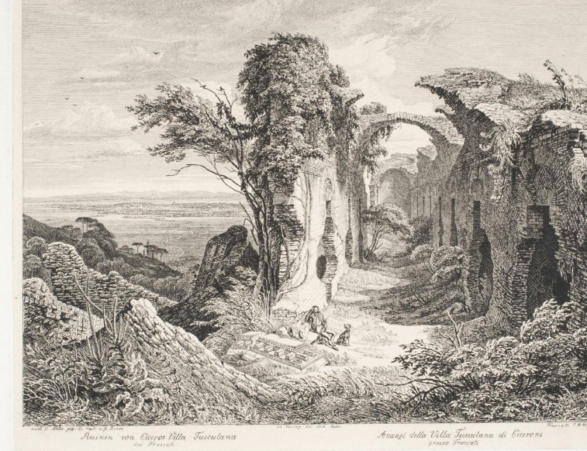
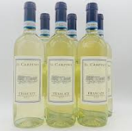
a historical site
close to the ancient city of Tusculum
many great and luxurious patrician country villas sited close to the city, notably the villas of Cicero and Lucullus
Frascati produces the white wine with the same name

Slide 3
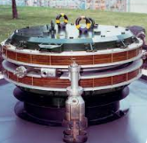
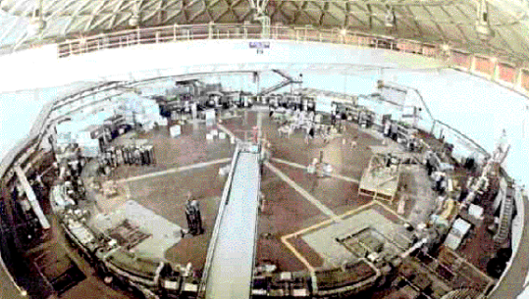
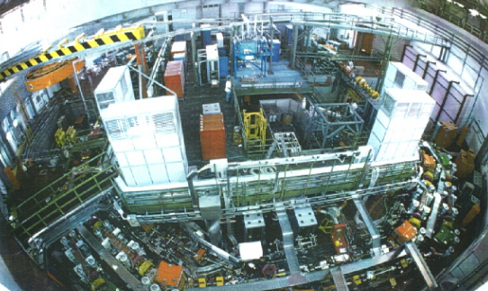
a historical accelerator site
DAFNE – yet another pioneering e+e- collider
World’s first crab waist collider
ADONE – another pioneering e+e- collider
AdA - the first e+e- collider

Slide 4
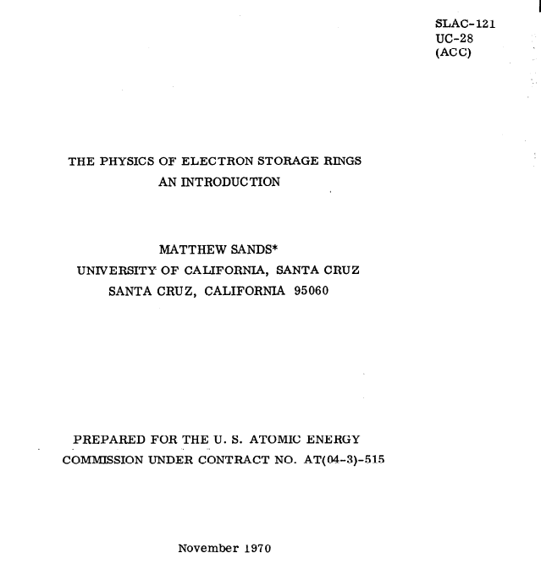
past highlights – 1
this is the place where Matt Sand’s wrote his famous report SLAC-R-121

Slide 5
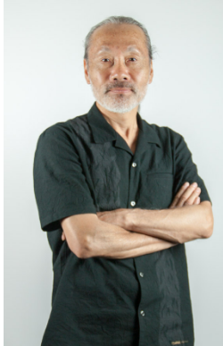
past highlights – 2
this is the place where Tsumoru Shintake got his great ideas

Slide 6
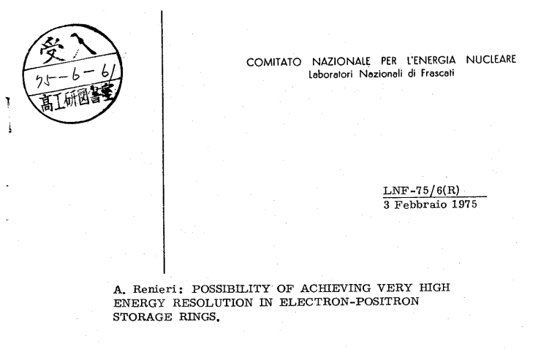
past highlights - 3
here monochromatization was invented !

Slide 7
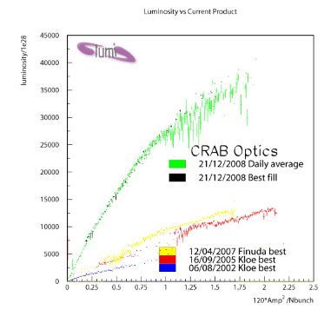
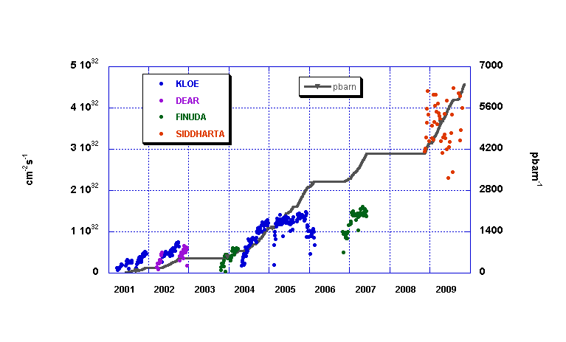
past highlights - 4
last not least, invention and first demonstration of crab waist collisions

Slide 8
future highlights
this may be the place for the DAFNE Open Accelerator Test Facility
first ever demonstration of monochromatized collisions is being prepared, ~50- years after Renieri’s proposal
this will be the place of the FCC-ee IR mock up !

Slide 9
wishing you a great & productive workshop !

