Slide 1
Synchrotron Radiation Background Studies @ FCC-ee
K.D.J. André for the MDI study group

Slide 2
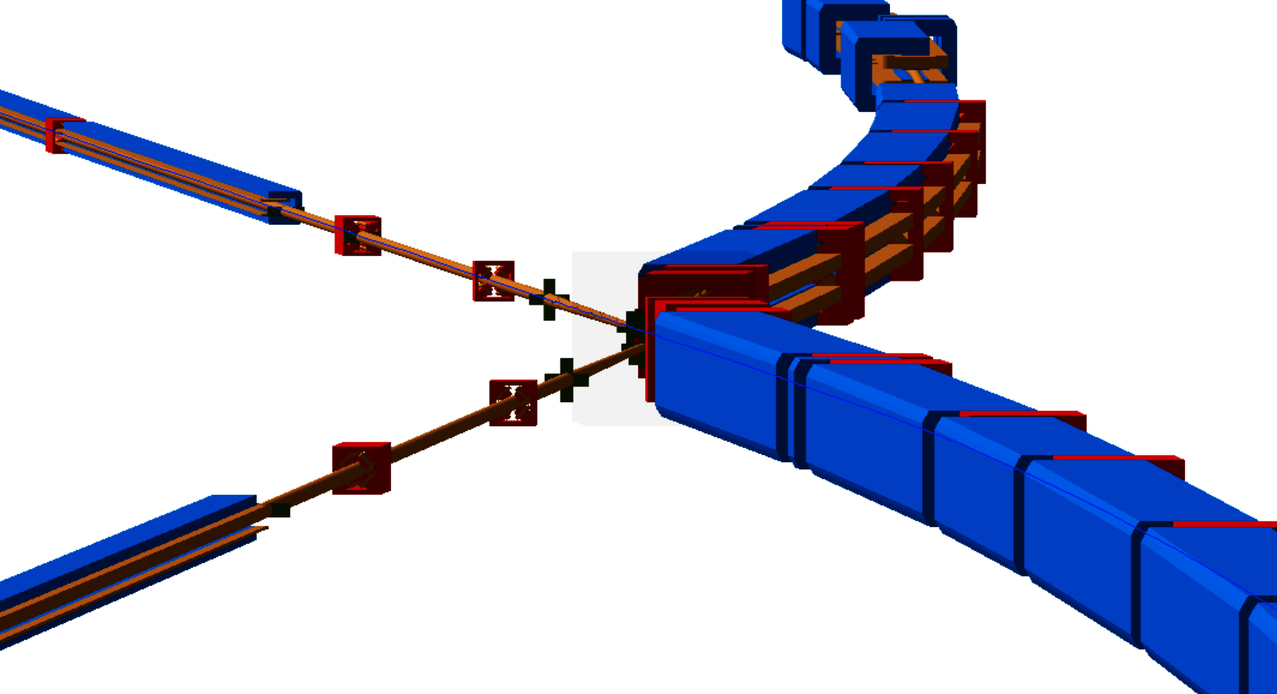
Outline
Beam parameters, lattice and optics details
Synchrotron radiation collimation scheme
Baseline V22 vs. baseline V23 vs. alternative HFD
Results from simulations including non-zero closed orbit and transverse beam halo
at the Z operation mode
at the tt operation mode
Masking discussion

Slide 3
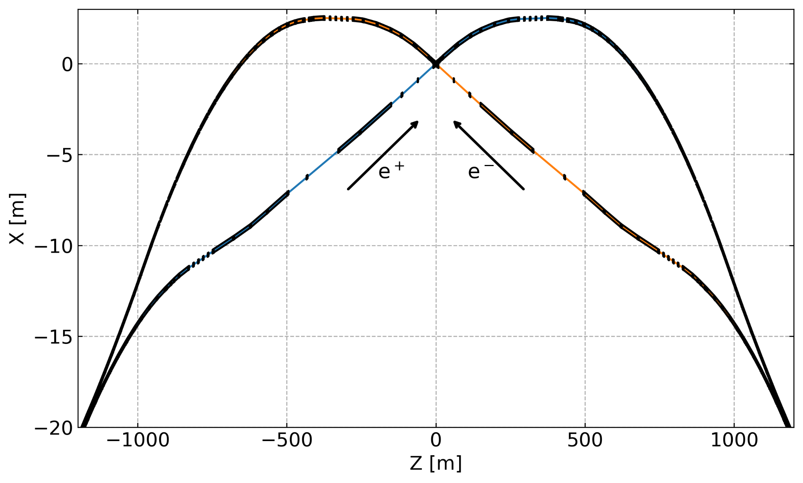
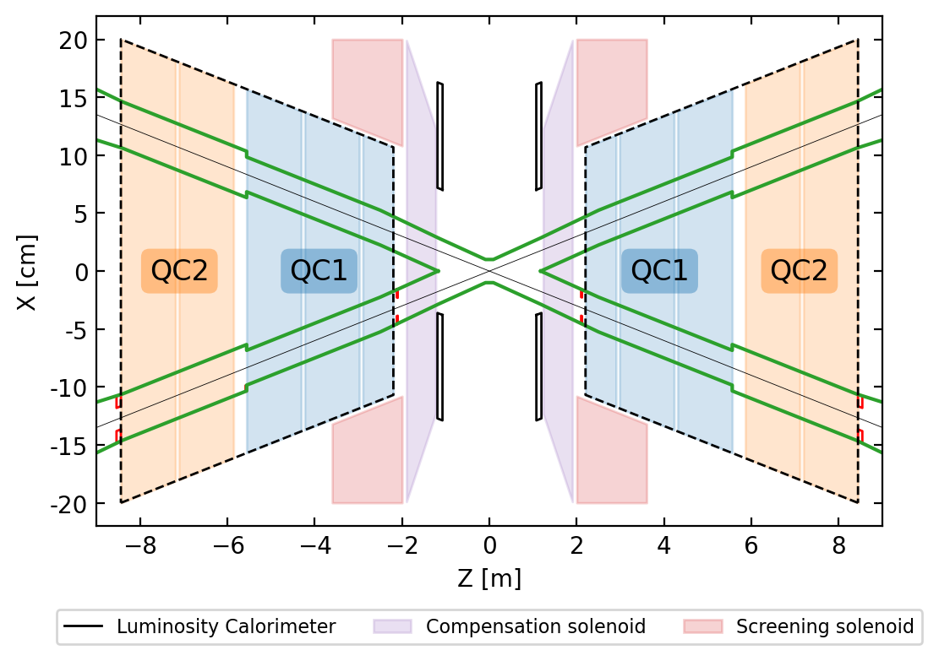
FCC-ee lattice | IR design
Detector solenoid
The lattice design upstream the IP is based on weak dipoles, long straight sections and implements a 30 mrad crossing angle at the IP.
The model features: the (anti-)solenoid field map, a detailed central beam pipe with a 10mm radius, 6 synchrotron radiation collimators, and 2 masks.
Screening solenoid
Compensating sol.
Luminosity Cal.

Slide 4
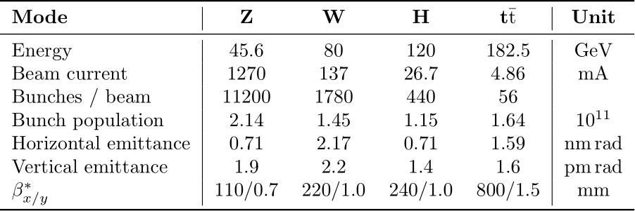
Beam model | Core and halo description
Studies from M. Sullivan [1, 2] showed that the transverse beam halo will create a large amount of synchrotron radiation mainly from the final focus quadrupoles, hence it needs to be modeled and studied.
The beam core is defined as a Gaussian distribution based on the linear optics parameters,
The beam halo is represented by a phase-space correlated distribution with
X ∈ [3.5σ_{x} to 11σ_{x}], X’ ∈ [3.5σ’_{x} to 11σ’_{x}], Y ∈ [4σ_{y} to 65σ_{y}] and Y’ ∈ [4σ’_{y} to 65σ’_{y}].
Assuming 99% of the particles in the core and 1% in the transverse halo.
The longitudinal beam distribution is Gaussian.
The rms positions and angles of the non-zero closed orbit have been implemented.
 | X/Y [μm] | X’/Y’ [μrad]
No BBA | >100 | >10
With BBA | 40/20 | 3
Beam parameters for V23 [3]

Slide 5
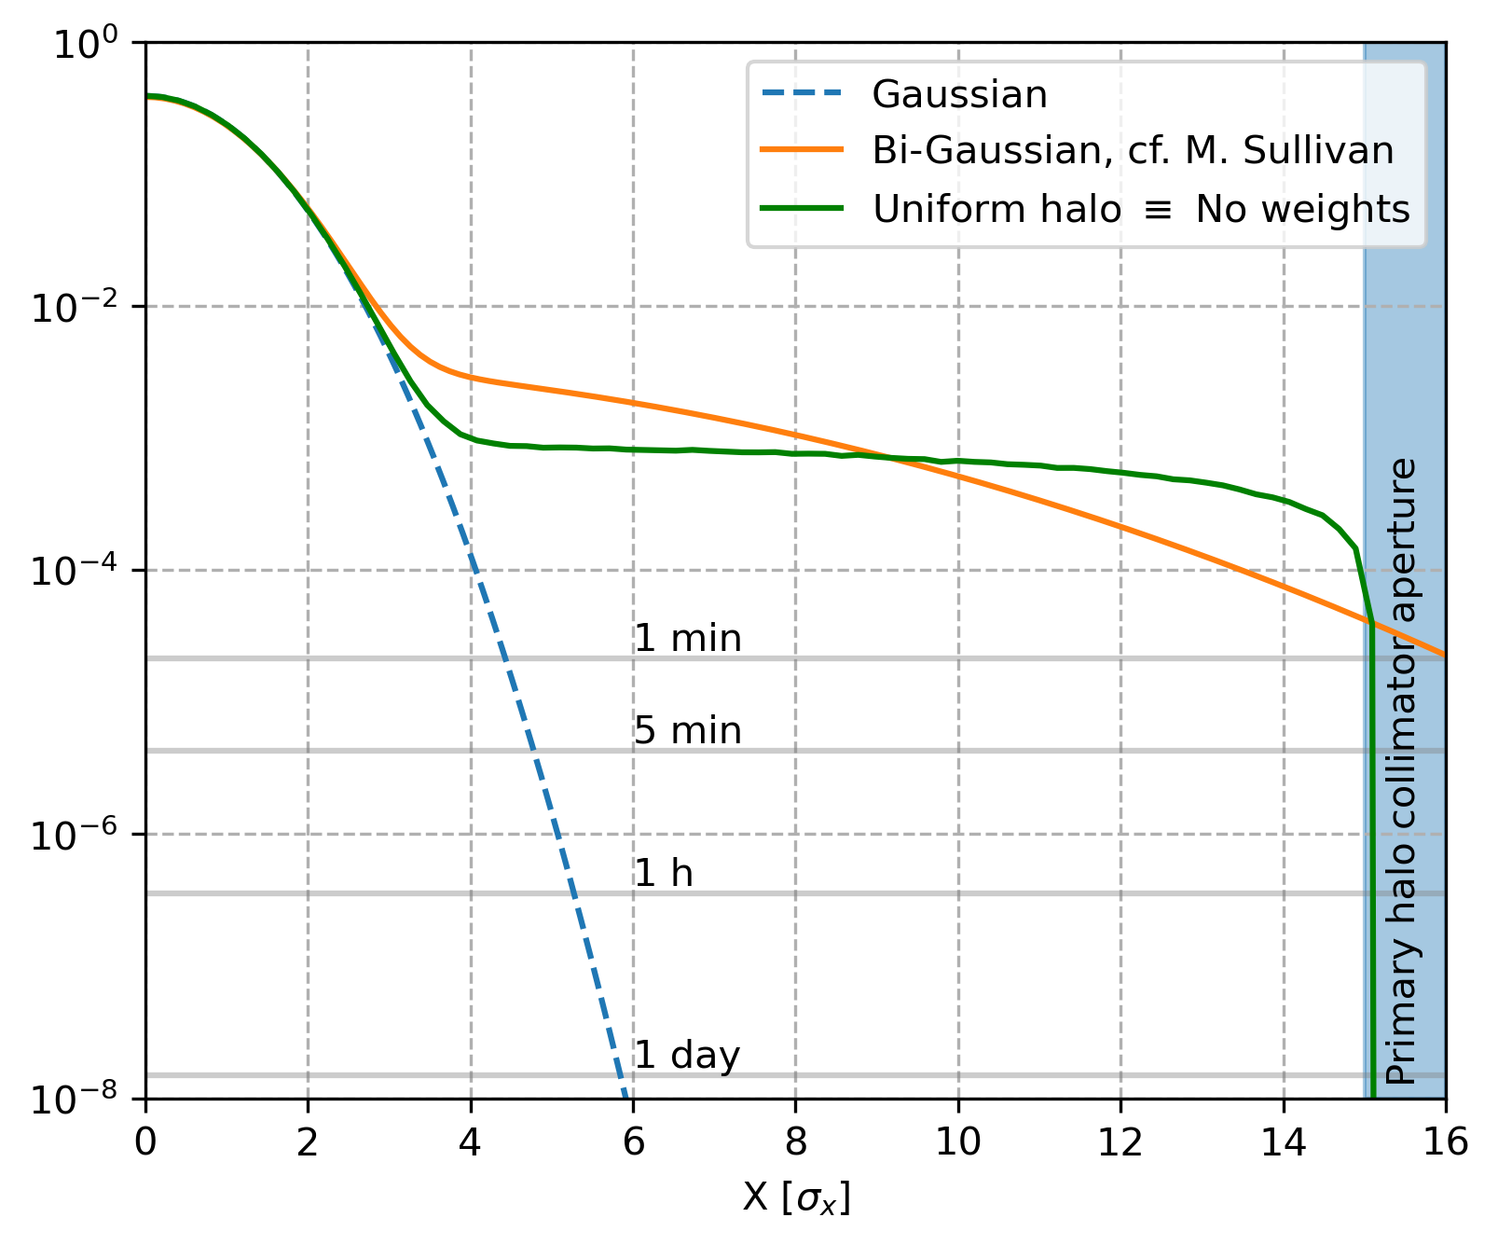
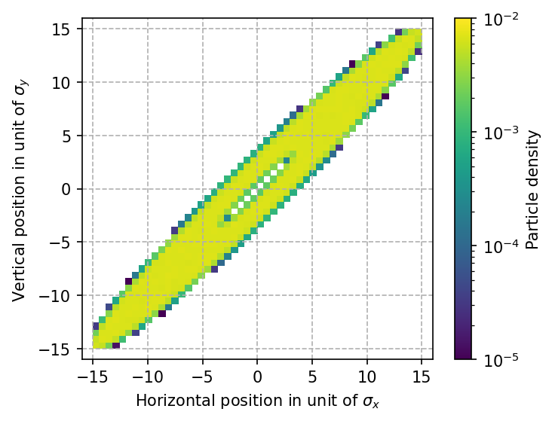
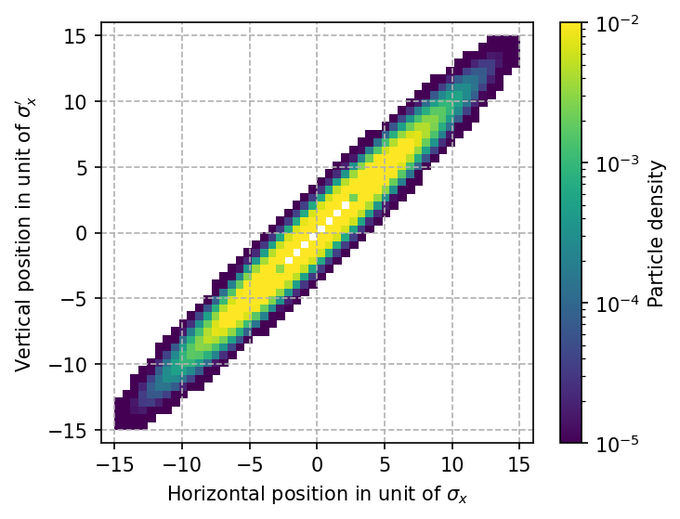
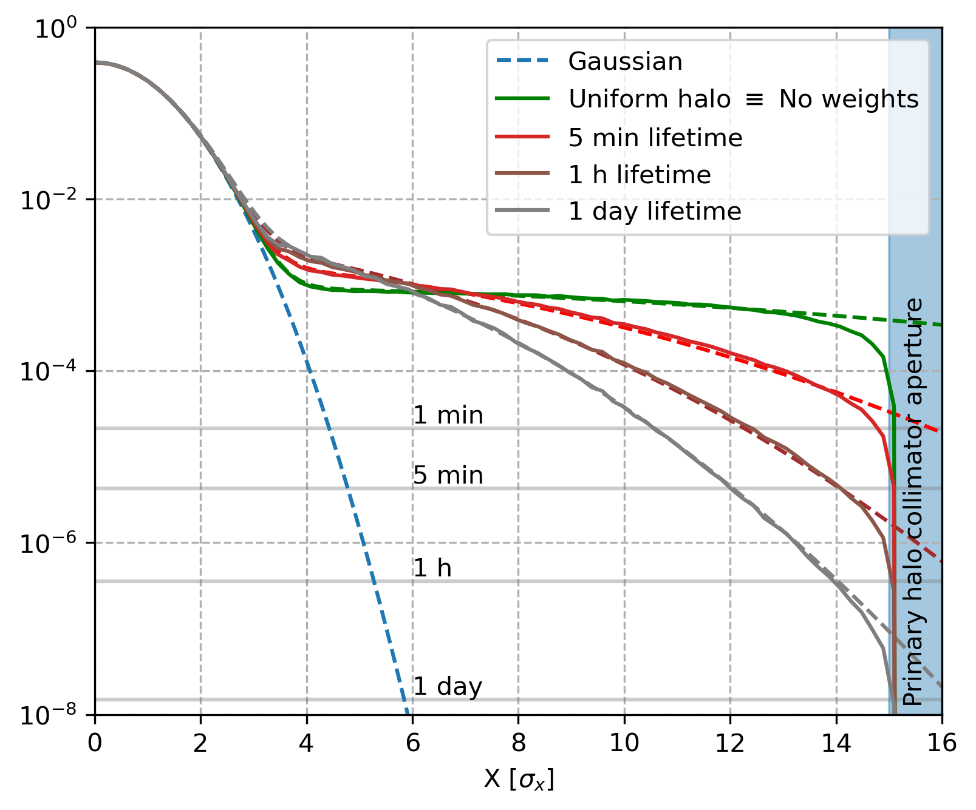
Beam model | Weighted halo description
Correlated uniform distribution vs. correlated exponential distribution.
Uniform - green
Exponential - grey
From the halo distribution one can extrapolate an equivalent beam lifetime [4] obtain from the halo distribution crossing the primary halo collimator aperture.
The halo tracked, extends to 100% of the primary collimator aperture to avoid particle losses in the aperture.
→ The impact of the beam lifetime and the transverse halo width are the variables that have been looked at in the following studies.

Slide 6
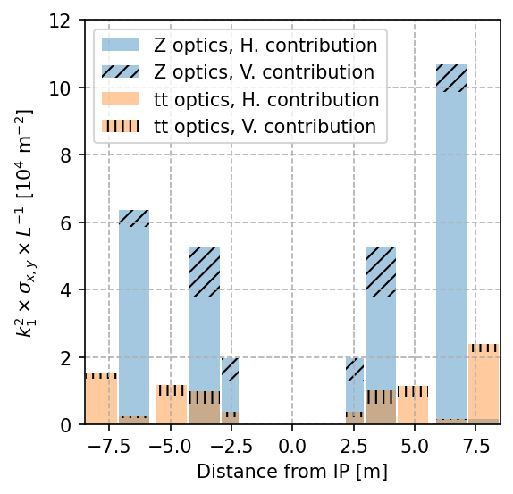
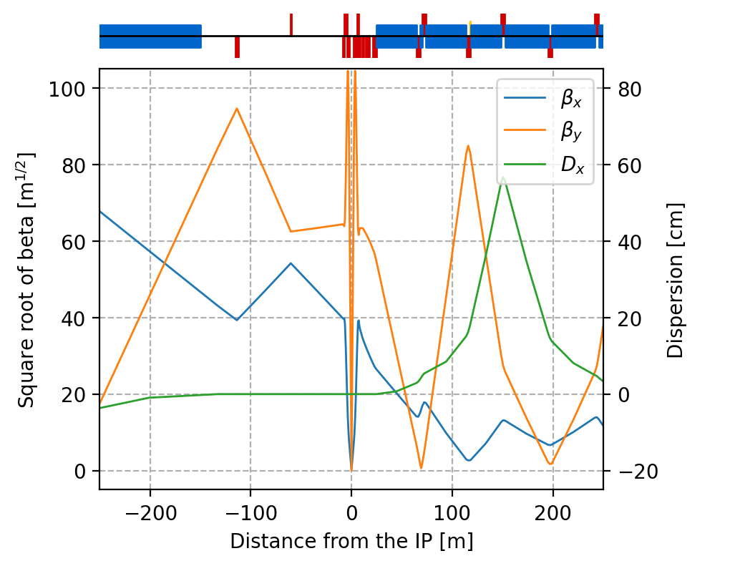
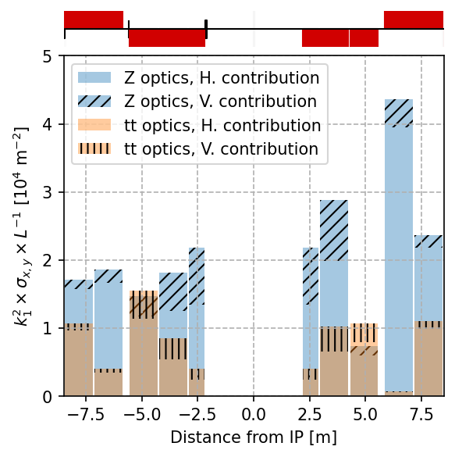
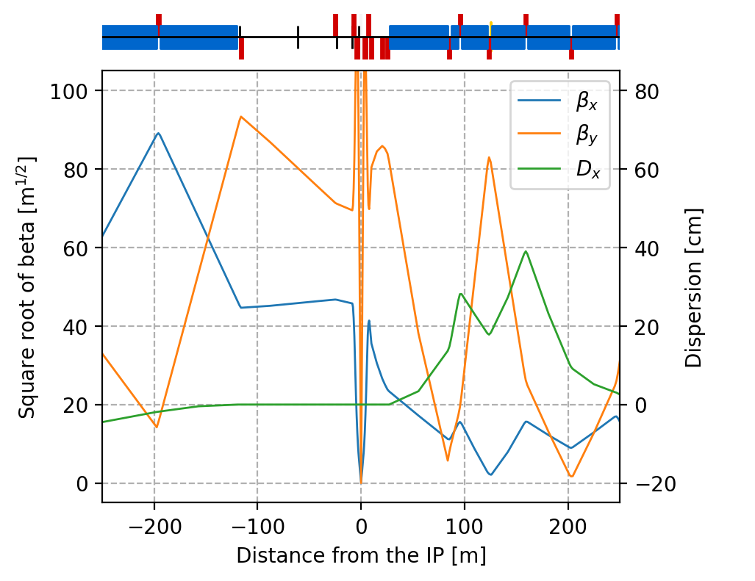
Optics changes
The estimation of the synchrotron radiation power from the final focus quadrupoles reduced from V22 to V23 lattice.
However, the contribution from the vertical beam size is not negligible, especially in QC1 because ꞵ*_{y} decreased and ε_{y} increased at Z energy.
The top-up injection should benefit from the ꞵ*_{x} increase at Z energy. It should be investigated as the max horizontal excursion and some FF quadrupole gradients are higher for V23.
V22
V23

Slide 7
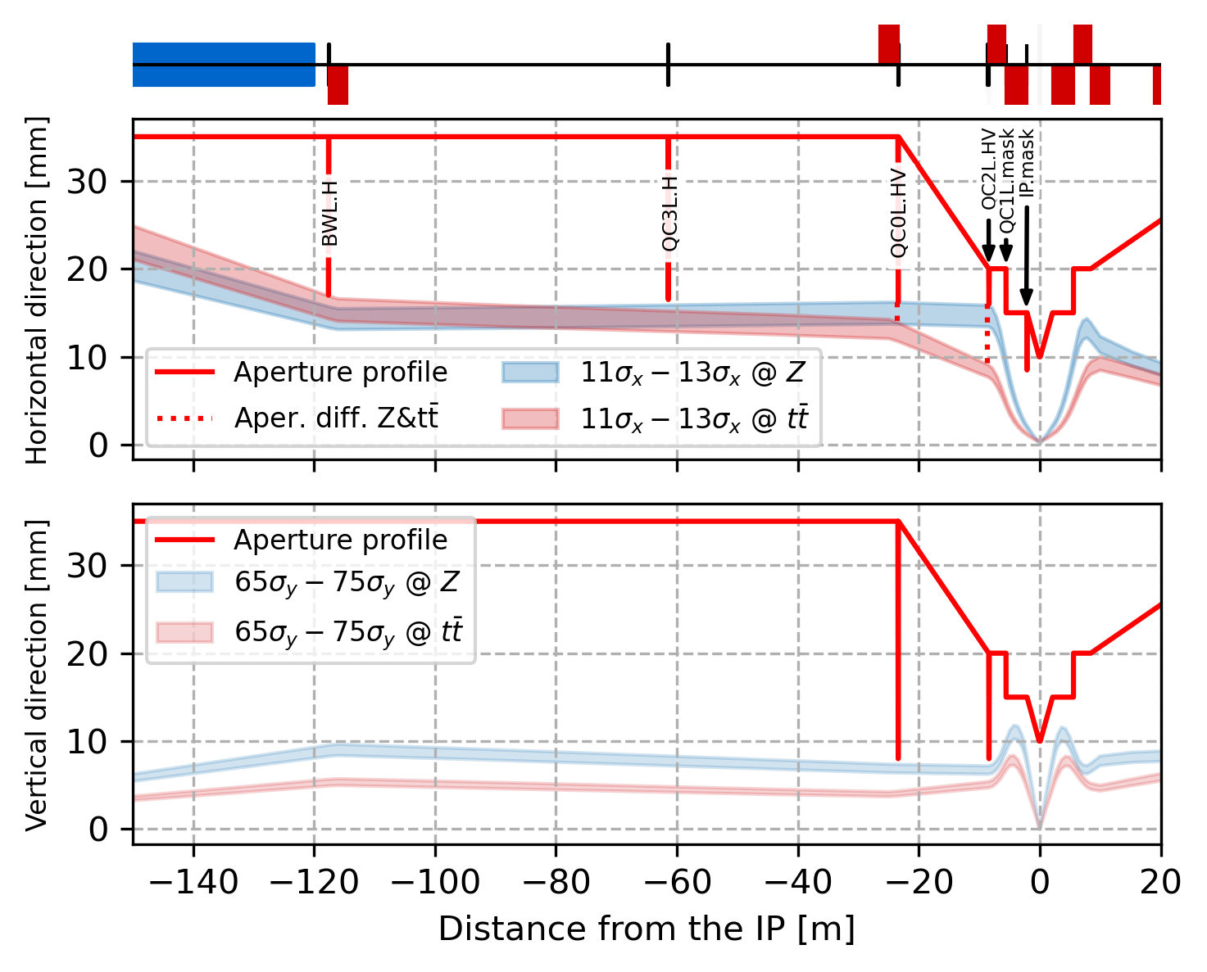
Synchrotron radiation collimation (V23)
Name | s_{end} [m] | HGAP [mm] | N sigma | plane
BWL.H | -117.5 | 17 | 14σ^{Z}|13σ^{tt} | H
QC3L.H | -61.37 | 16.5 | 13σ^{Z}|14σ^{tt} | H
QC0L.H | -23.25 | 16.2→14 | 13σ^{Z}|13σ^{tt} | H
QC0L.V | -23.35 | 8 | 81σ^{Z}|139σ^{tt} | V
PQC2LE.H | -8.45 | 16→9.1 | 13σ^{Z}|13σ^{tt} | H
PQC2LE.V | -8.55 | 8 | 83σ^{Z}|111σ^{tt} | V
MSK.QC2L | -5.58 | R = 15 | 20σ^{Z}|38σ^{tt} | H&V
MSK.QC1L | -2.10 | 7 | 41σ^{Z}|70σ^{tt} | H
The collimators closer to the IP need wider apertures at Z operation mode. The aperture reduction from the mask QC1L.mask is protected by the collimators upstream. The SR created in QC2L from vertical beam halo can not be prevented and a vertical collimation/masking might be necessary to cover the CC, e.g. elliptical mask.

Slide 8
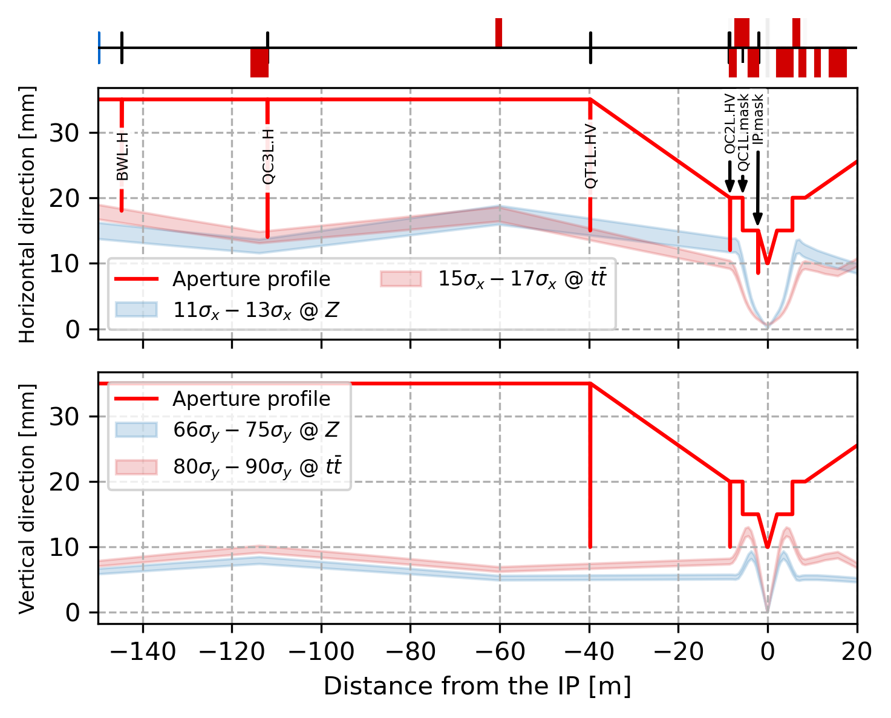
Synchrotron radiation collimation (V22 & V23)
Aperture bottleneck at 14.4 σ_{x} in BWL* or QC2L, primary and secondary halo collimators set to 11 and 13 σ_{x} respectively.
V22 lattice
V23 lattice

Slide 9
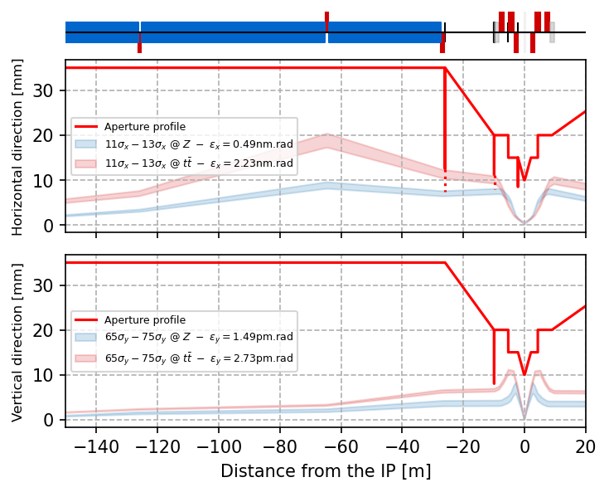
Synchrotron radiation collimation (V23 & HFD69)
Same primary and secondary halo collimators as in V23 (11 and 13 σ_{x}) for comparison.
V23 lattice
HFD lattice

Slide 10
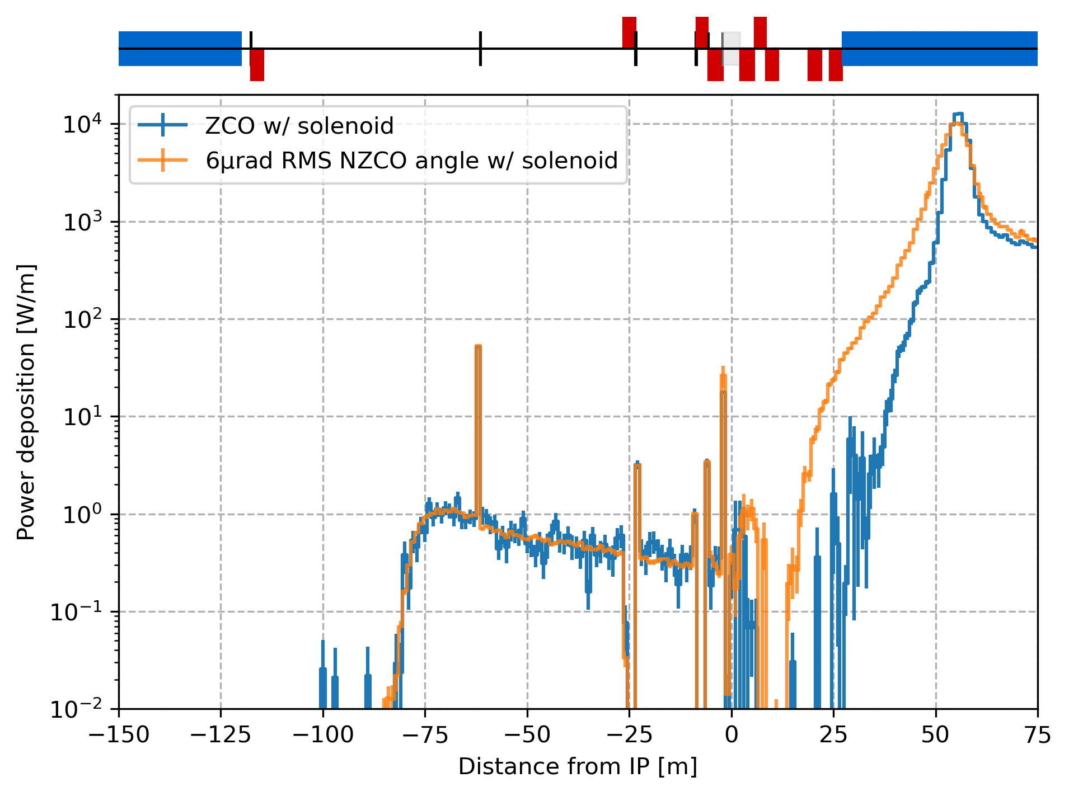
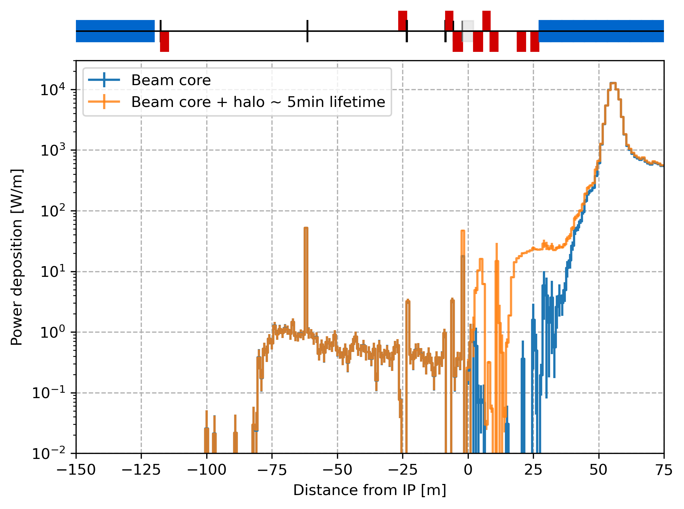
Results at Z energy
+5W onto the mask
+30W onto the mask
SR power deposition from beam core with NZCO
(100% of the particles in the core)
SR power deposition from beam halo
(1% of the particles in the tails)

Slide 11
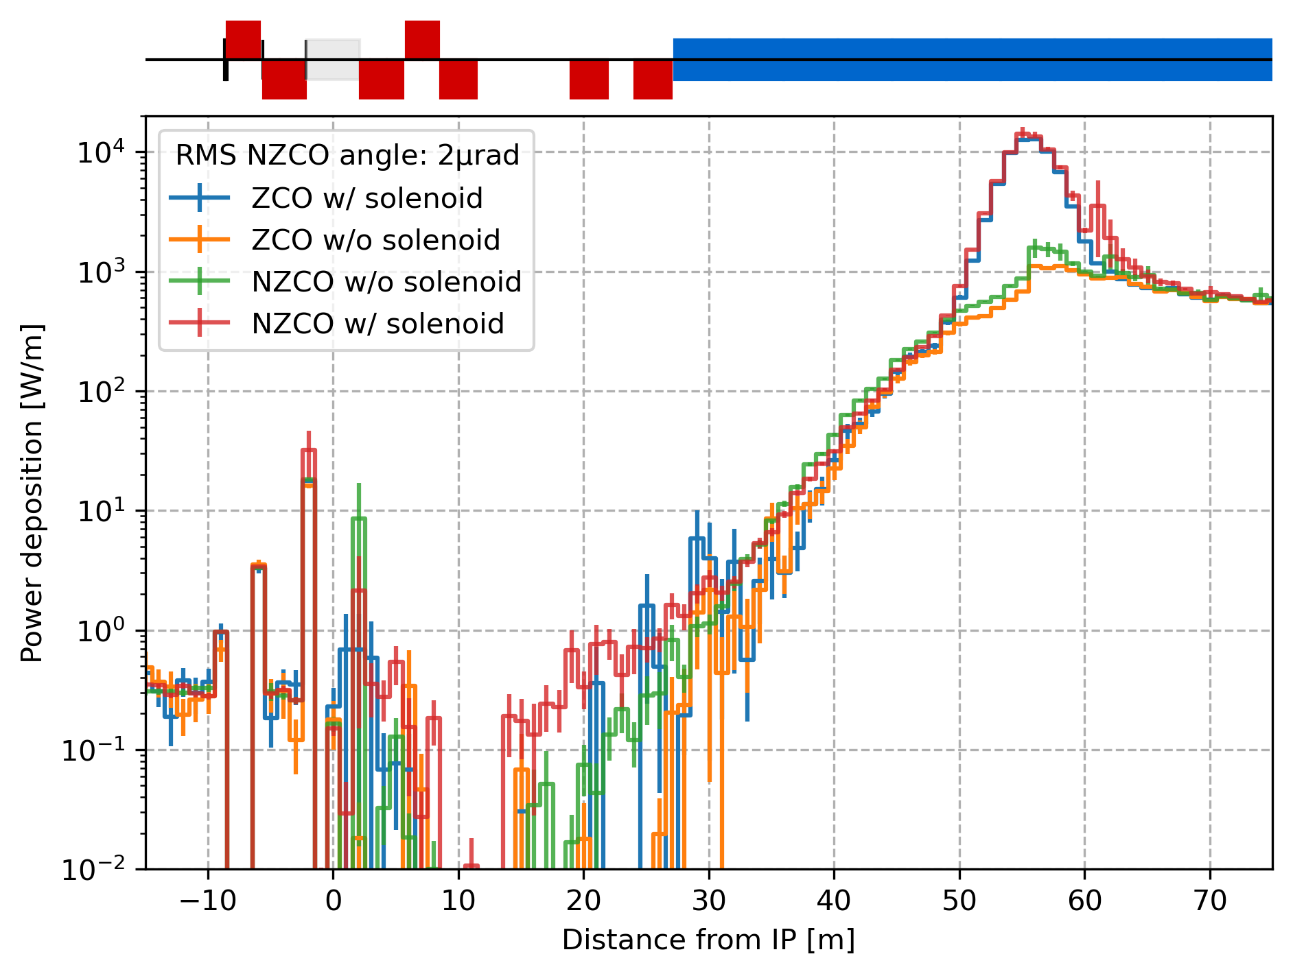
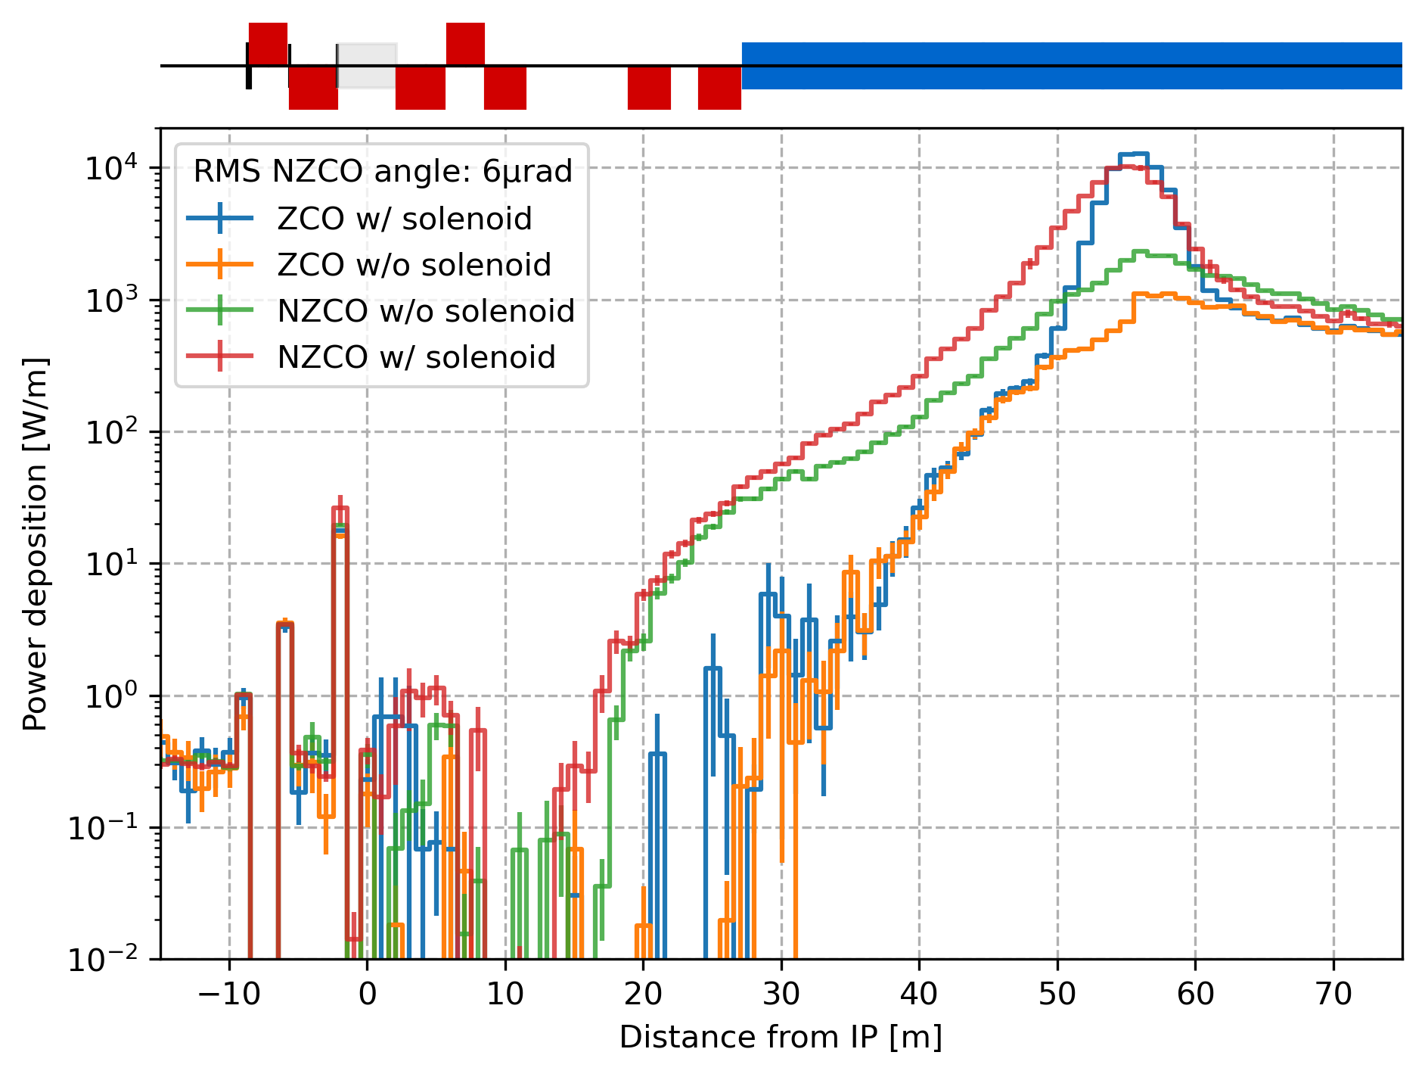
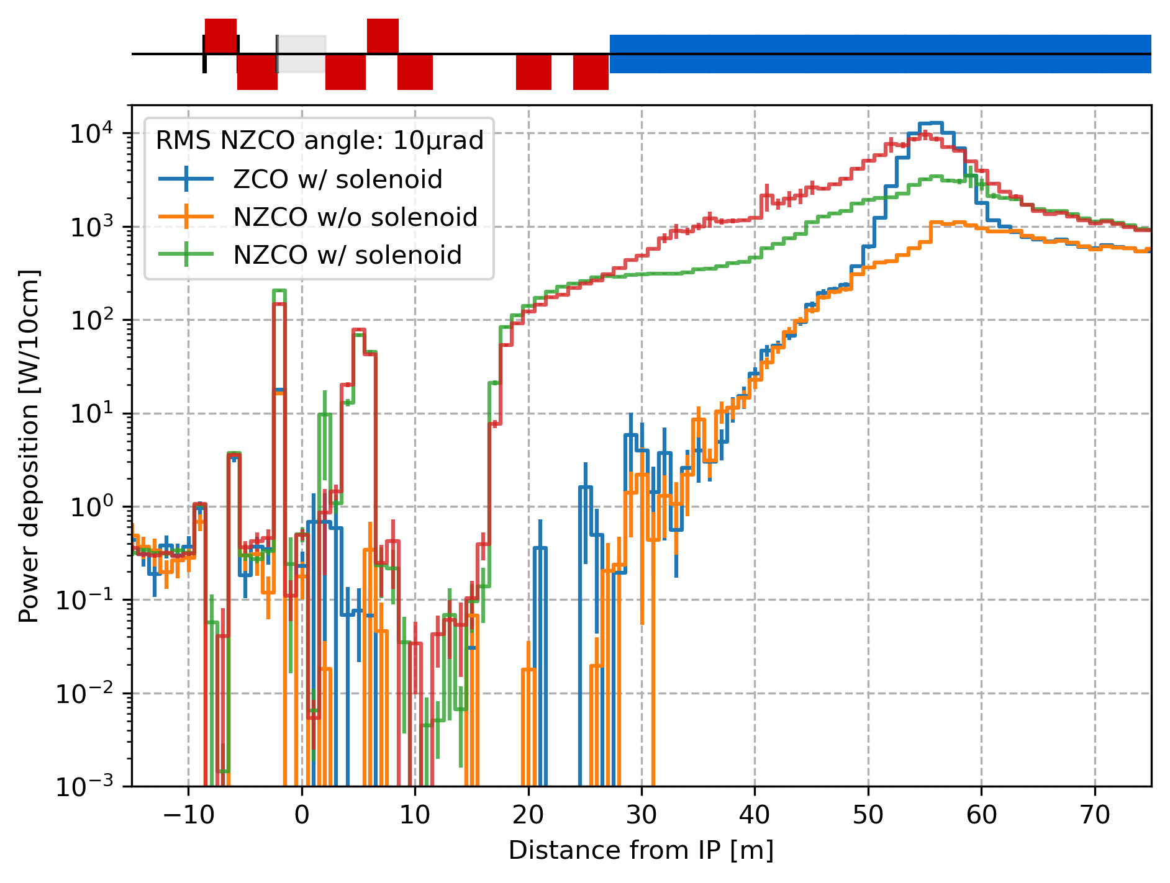
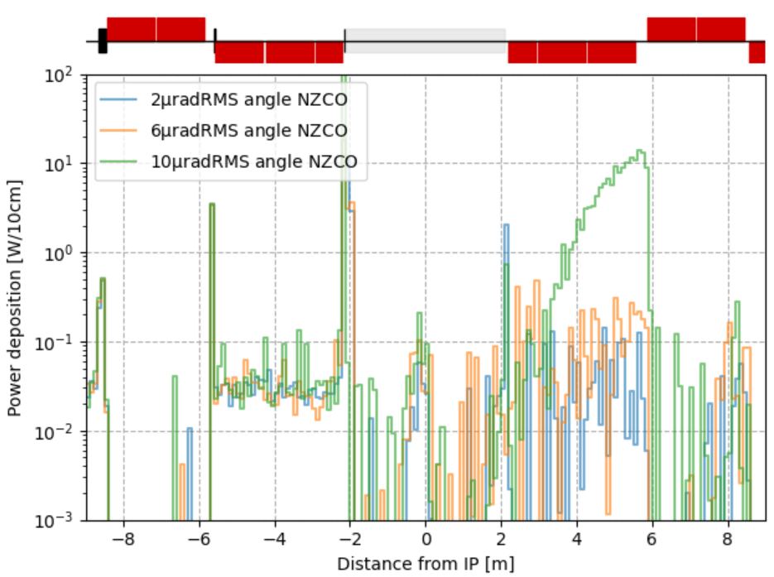
Gaussian core including non-zero closed orbit
SR power deposition from the beam core with varying rms angle of the non-zero closed orbit: 6, 8, 10 μrad
The rms angle of the closed orbit has little impact up to 6μrad. From ~8μrad onwards the mask gets more radiation protecting the CC. The region beyond s = 20m gets larger and larger heat load from the FF quadrupoles. The horizontal angle leads (mostly) to an increase of the heat load in the mask whereas the vertical angle leads to higher heat load 20 m after the IP, see details in annex.
The values of rms angle of the non-zero closed orbit after correction and BBA seem to be below 6μrad (to be confirmed for V23).

Slide 12
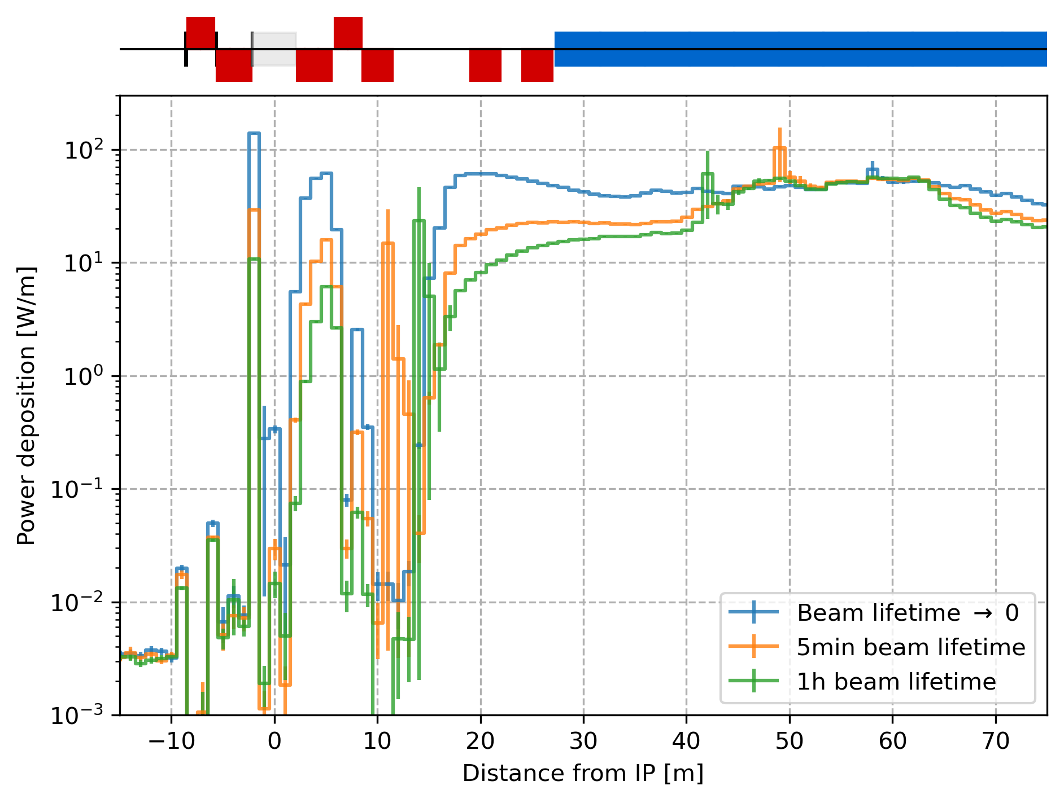
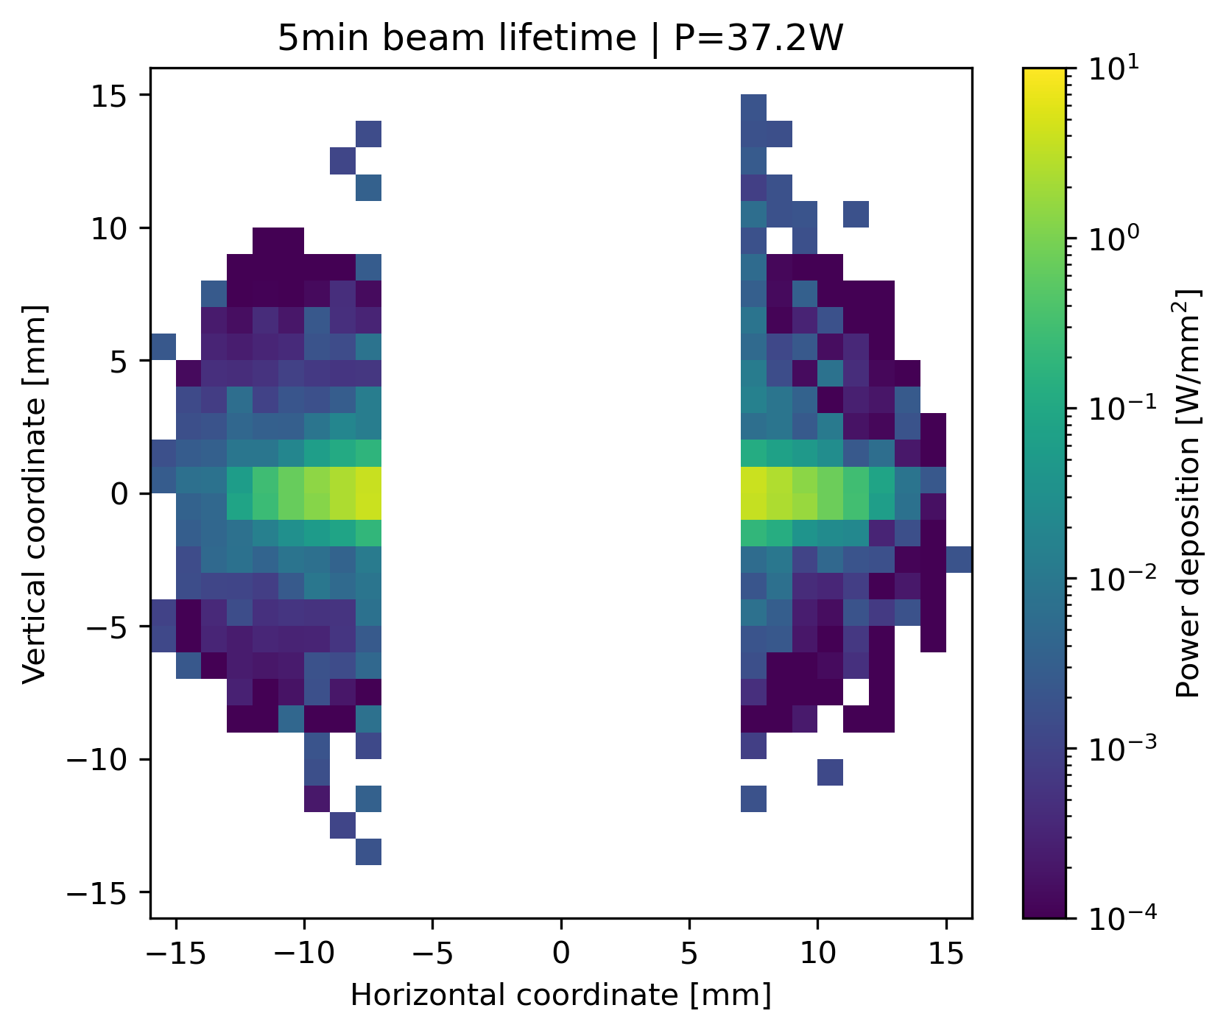
Transverse halo impact with beam lifetime
The transverse tails extend until the primary collimator apertures: 11σ_{x}/65σ_{y}. The “beam lifetime → 0” corresponds to a uniform tail distribution and is shown as worse case scenario. The “5min beam lifetime” is considered in the collimation studies, see G. Broggi slides. 1h beam lifetime is given as point of comparison.
The tails mostly impact
the mask,
QC1R beam pipe,
region s≳20m.
Power deposition on the mask

Slide 13
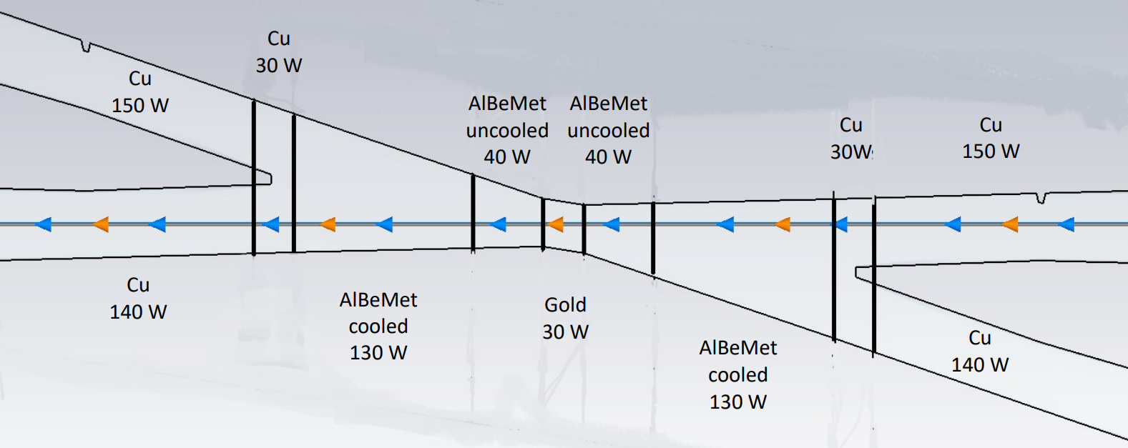
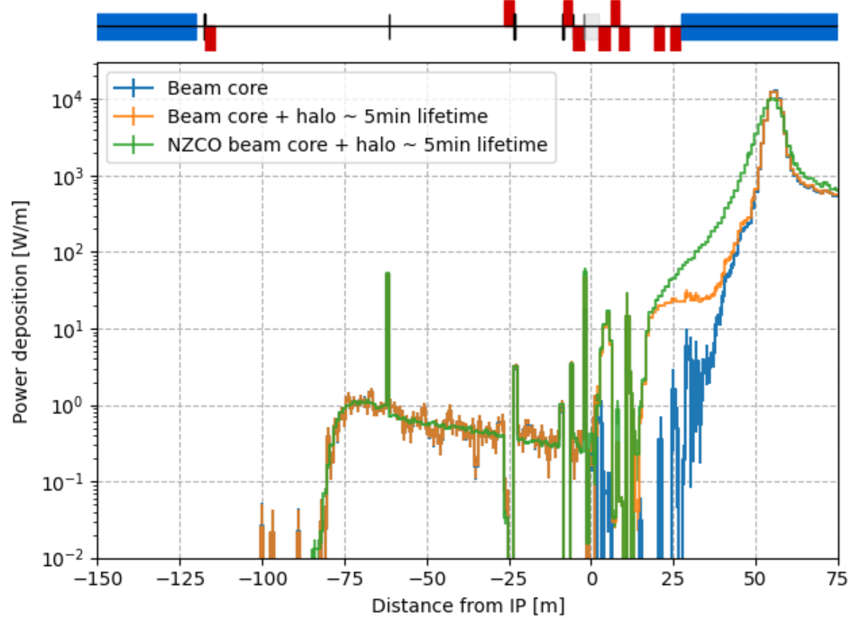
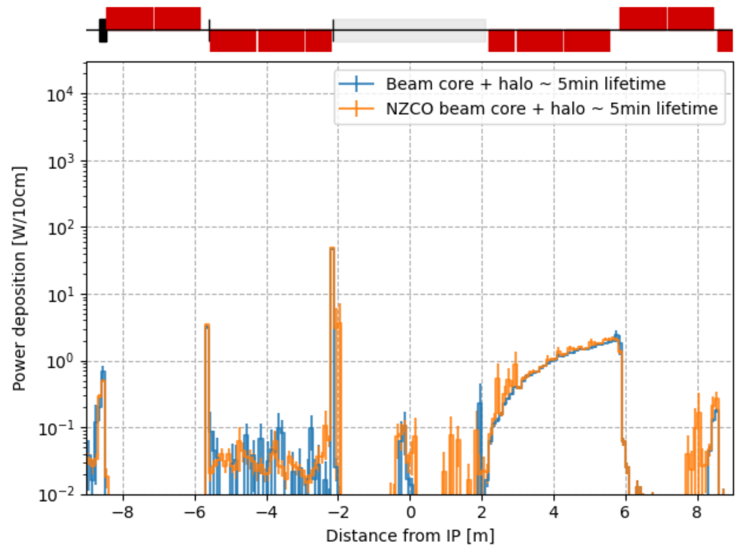
Core + halo | Summary @ Z
Main SR
heat load.
Beam core with 100μm rms position and 6μrad rms angle on non-zero closed orbit and beam halo with 5min extrapolated lifetime.
Result show a minimal contribution to the beam pipe heat load, wakefields dominates. <5W in QC1 beam pipe.
(Sub-)detector components occupancy and radiation hardness is expected to be minimal.
from the MDI workshop (24/10) ref

Slide 14
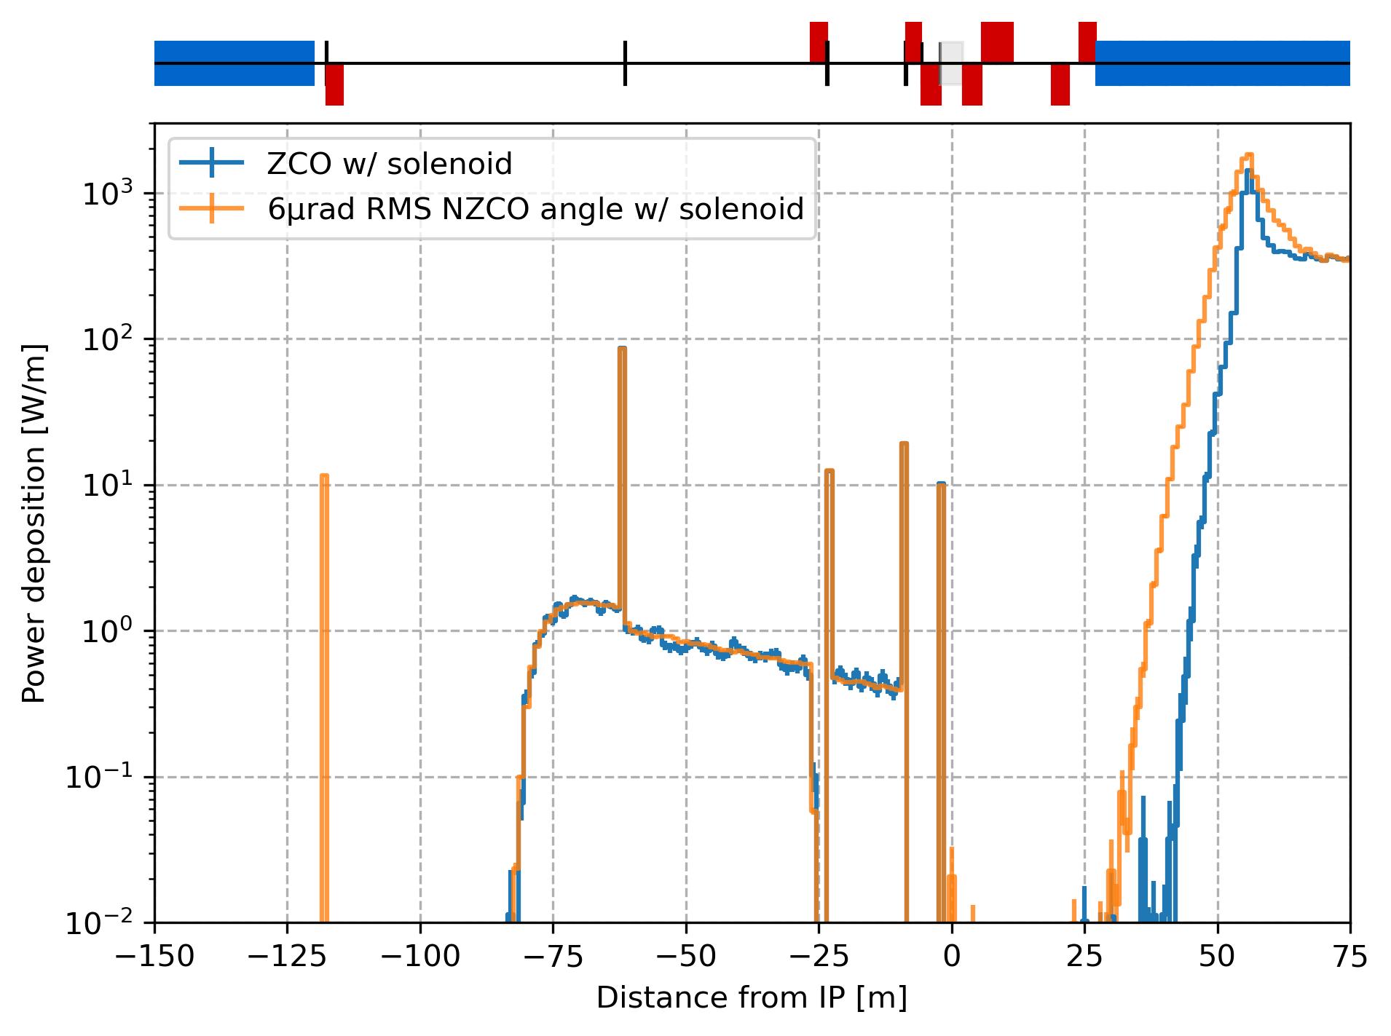
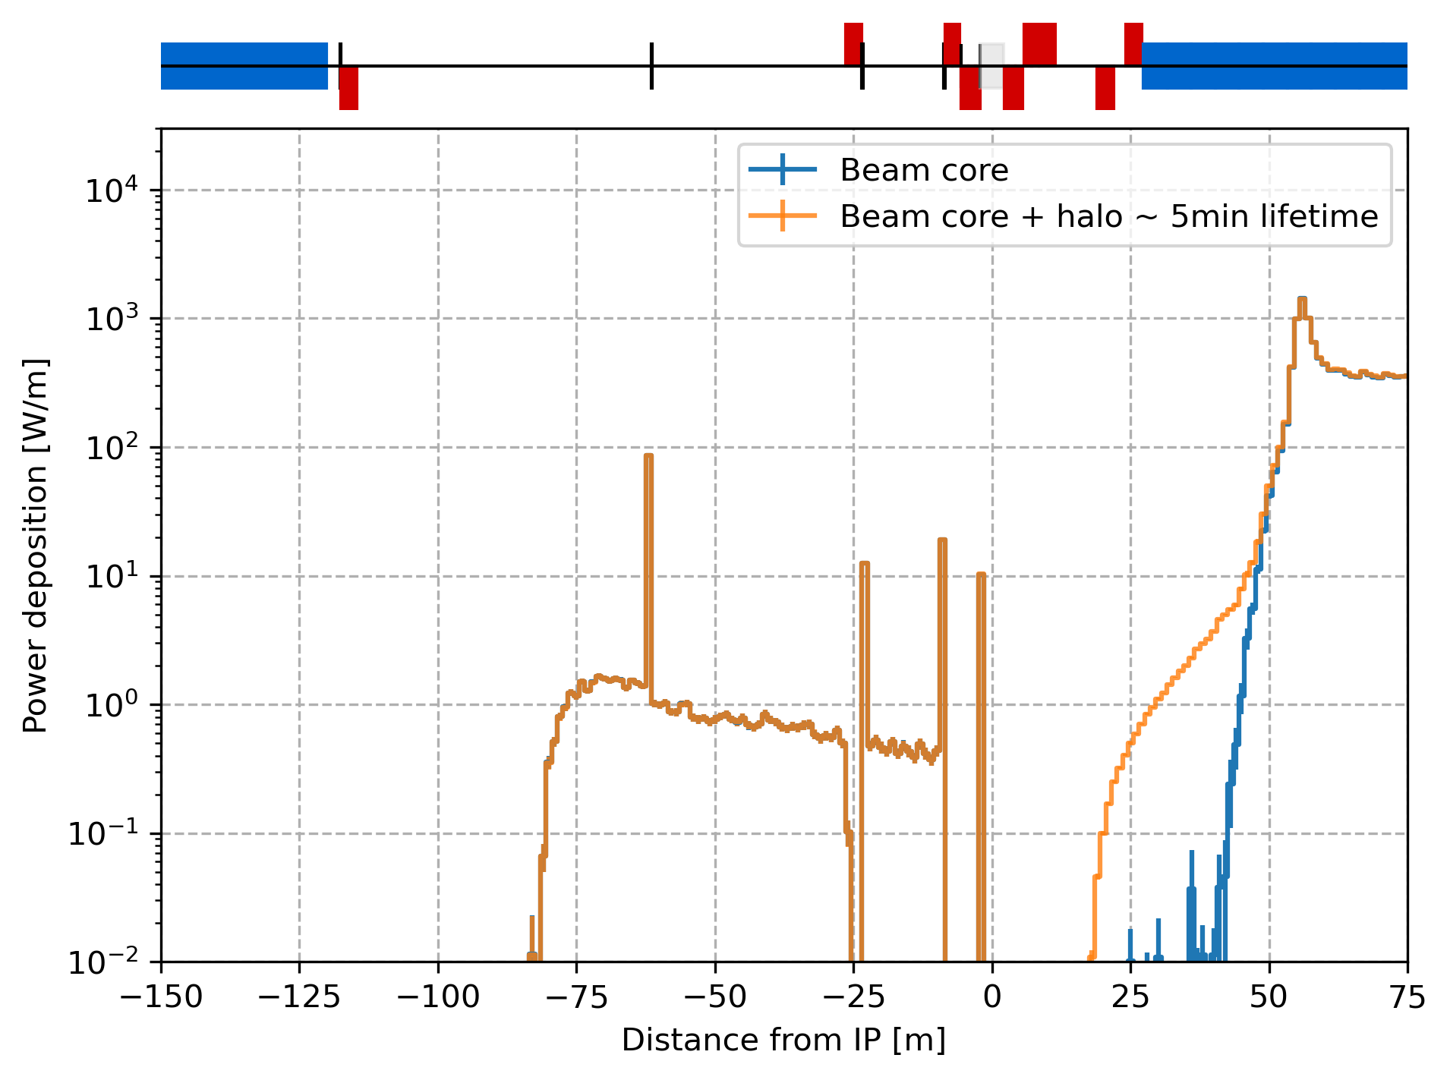
Results at tt energy
SR power deposition from beam core with NZCO
(100% of the particles in the core)
SR power deposition from beam halo
(1% of the particles in the tails)

Slide 15
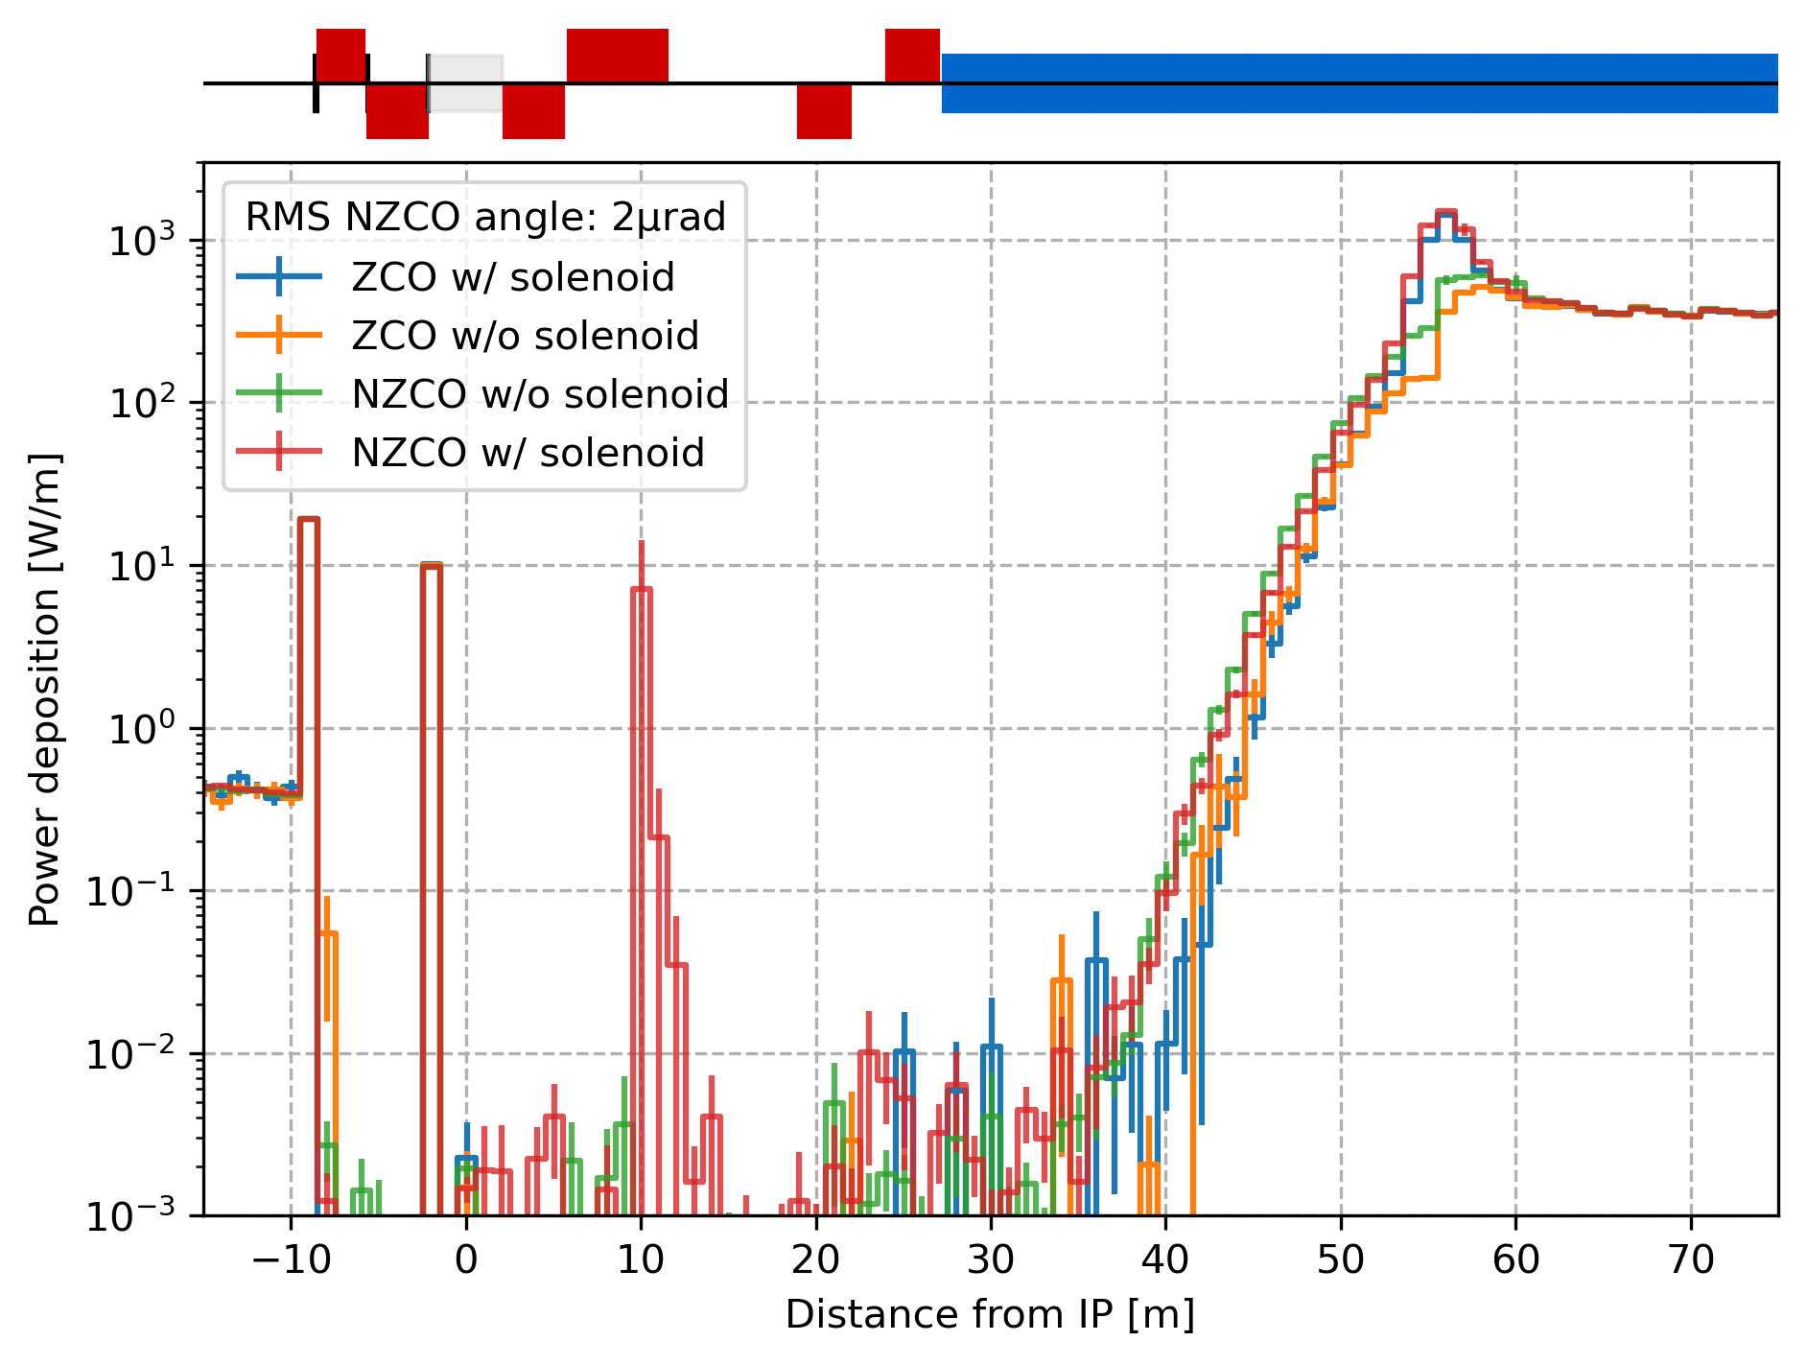
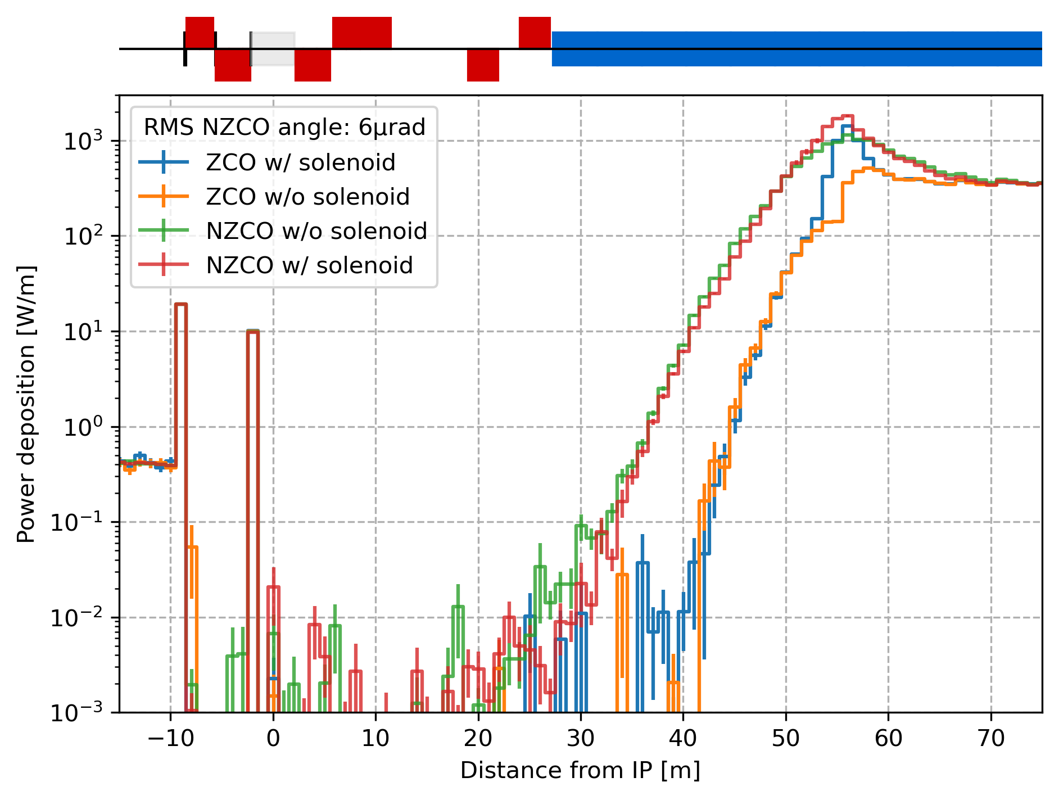
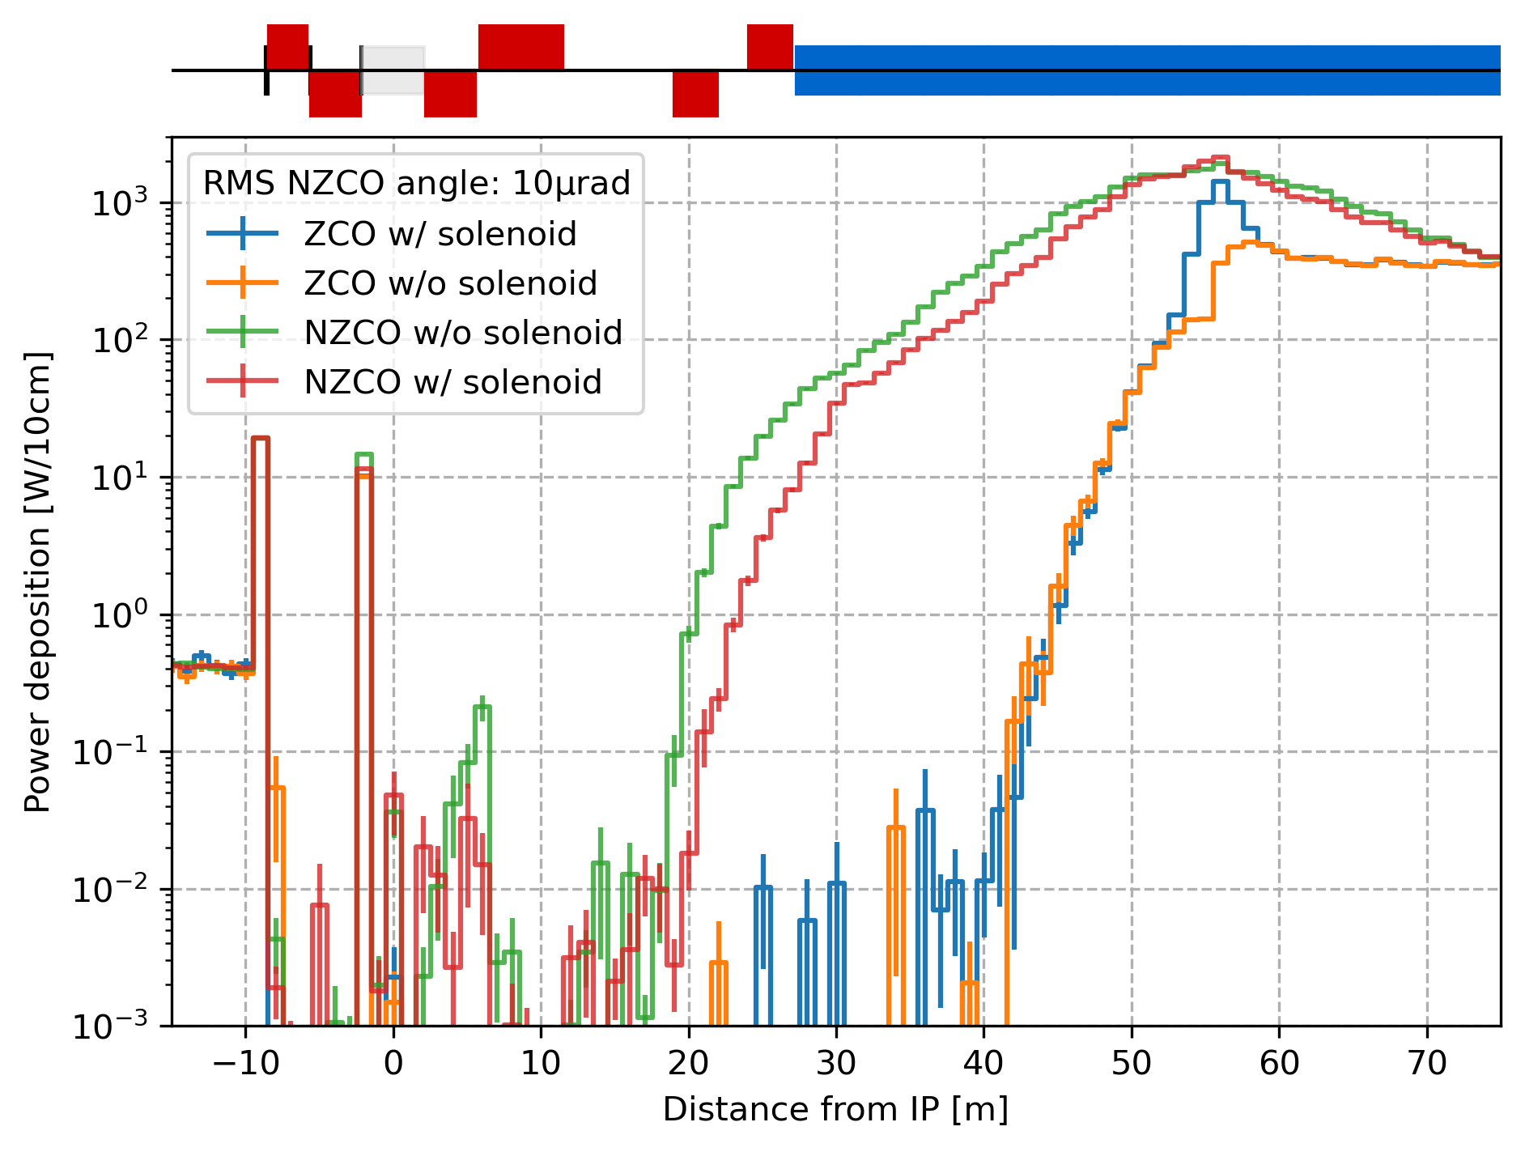
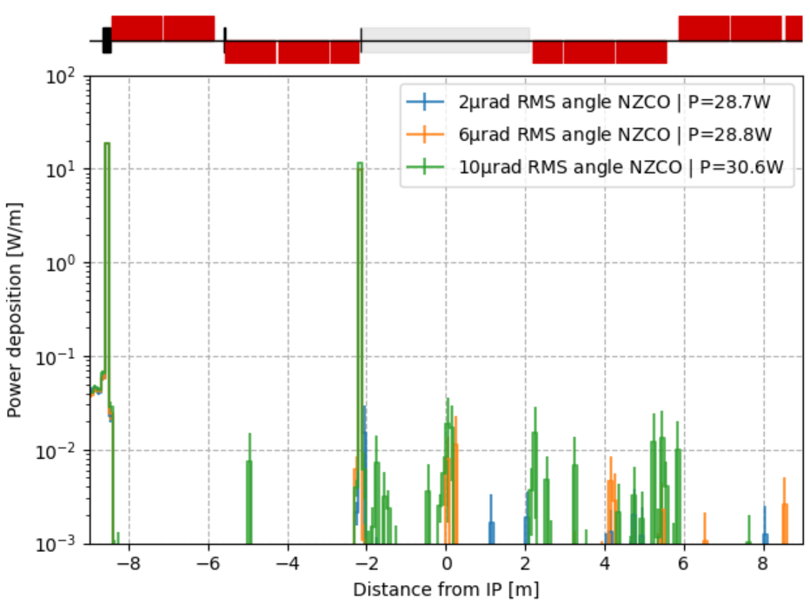
Gaussian core including non-zero closed orbit
SR power deposition from the beam core with varying rms angle of the non-zero closed orbit: 6, 8, 10 μrad
The rms angle of the closed orbit has little impact up to 10μrad. The mask protects well the CC. The region beyond s = 20m gets larger and larger heat load from the FF quadrupoles and they are high energy photons.
The results must be compared with achievable values of rms position and angle of the non-zero closed orbit after correction and BBA (to be confirmed for V23).

Slide 16
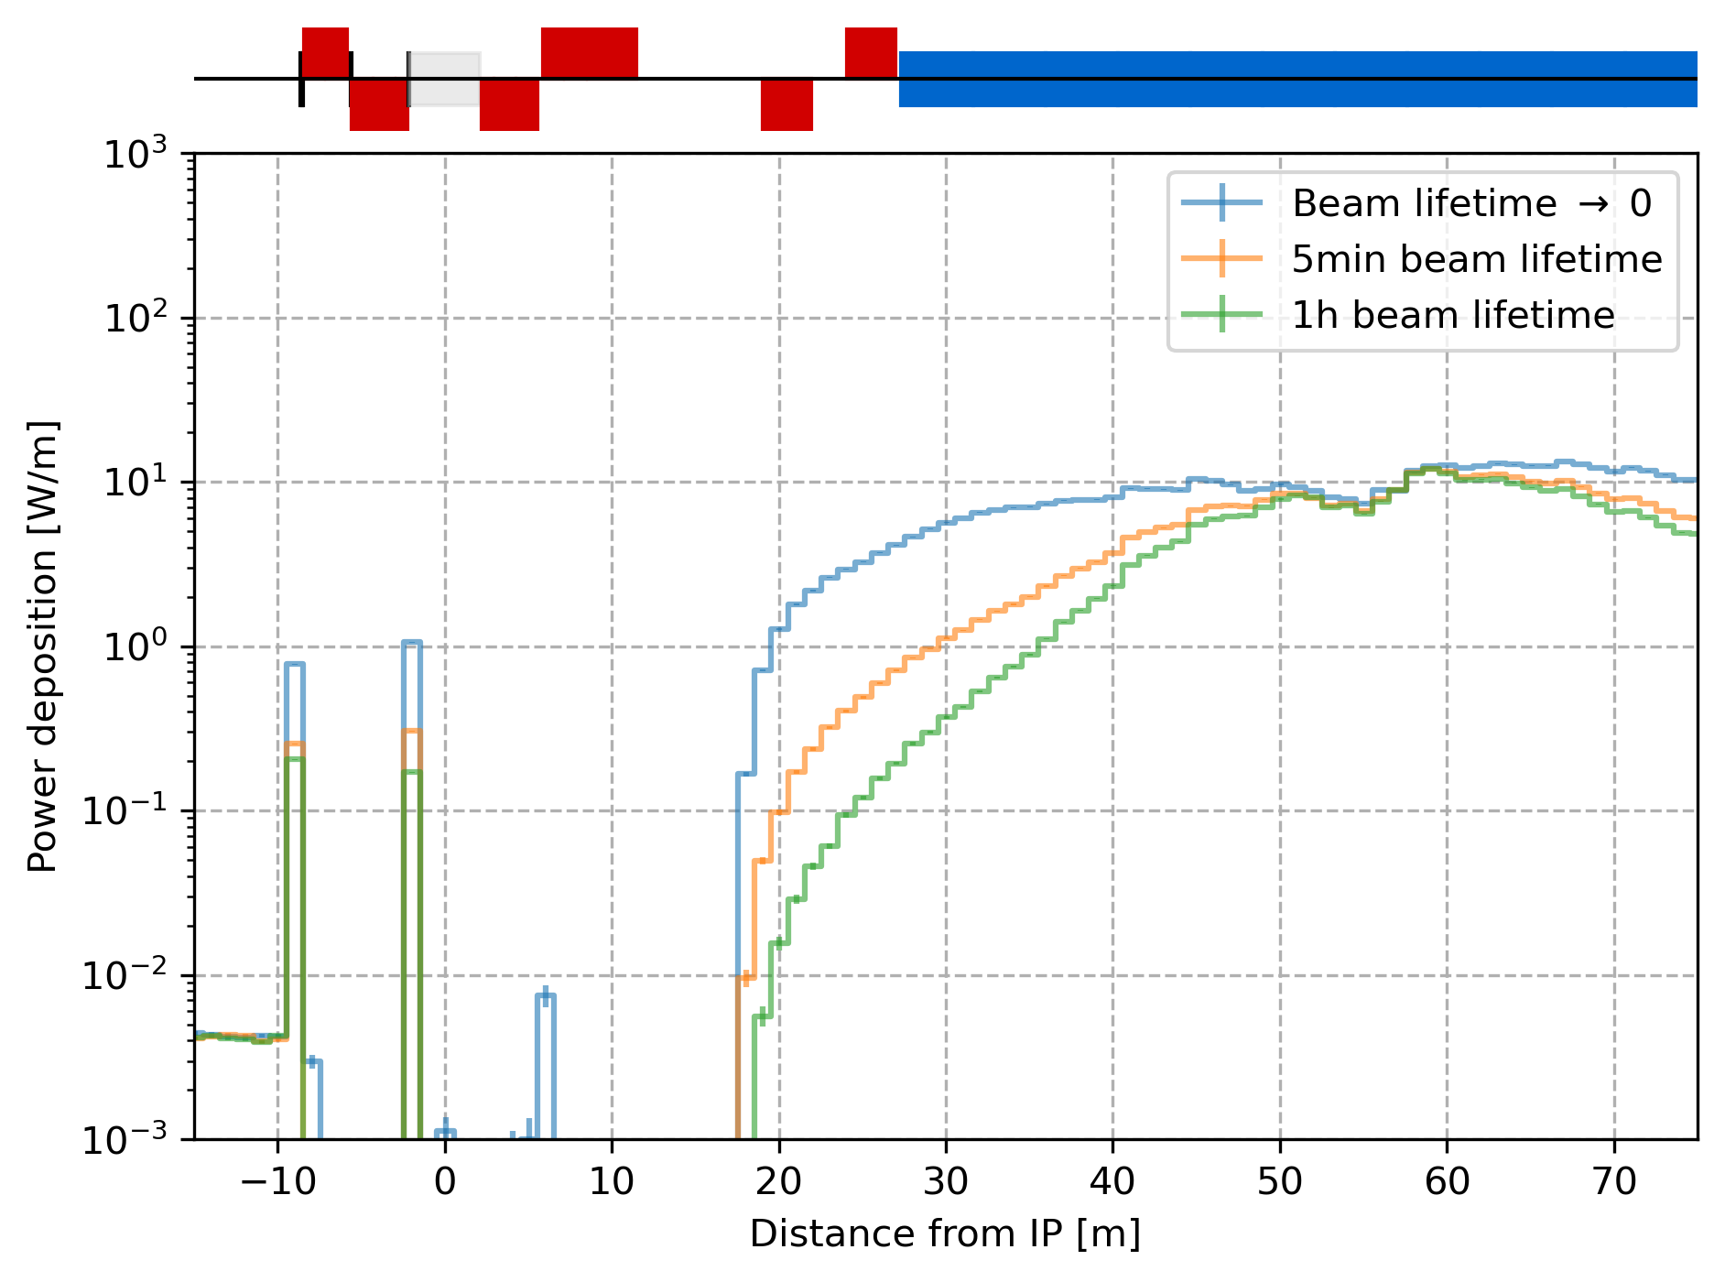
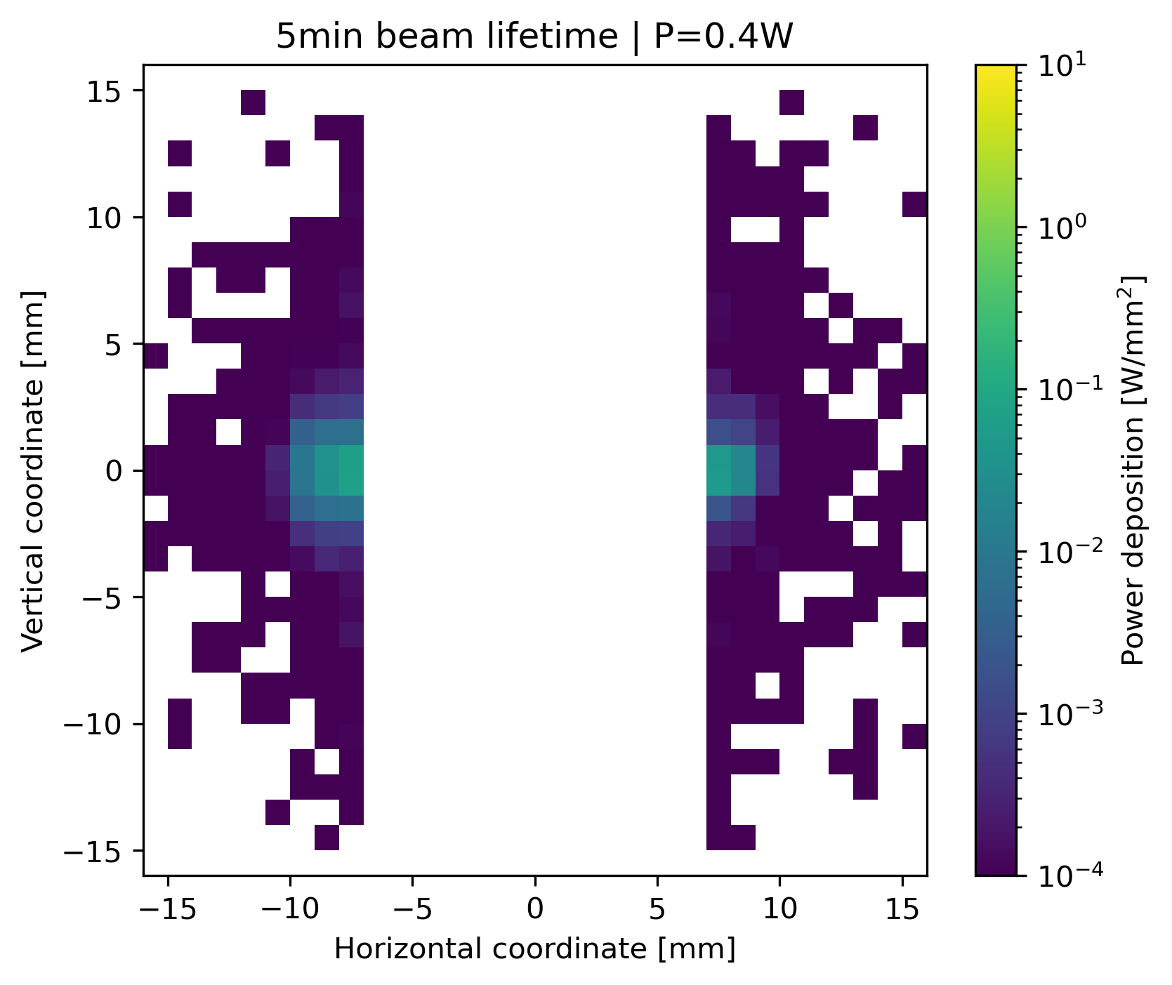
Transverse halo influence with beam lifetime
The transverse tails extend until the primary collimator apertures: 11σ_{x}/65σ_{y}. The “beam lifetime → 0” corresponds to a uniform tail distribution and is shown as worse case scenario. The “5min beam lifetime” is considered in the collimation studies, see G. Broggi slides. 1h beam lifetime is given as point of comparison.
Power deposition on the mask

Slide 17
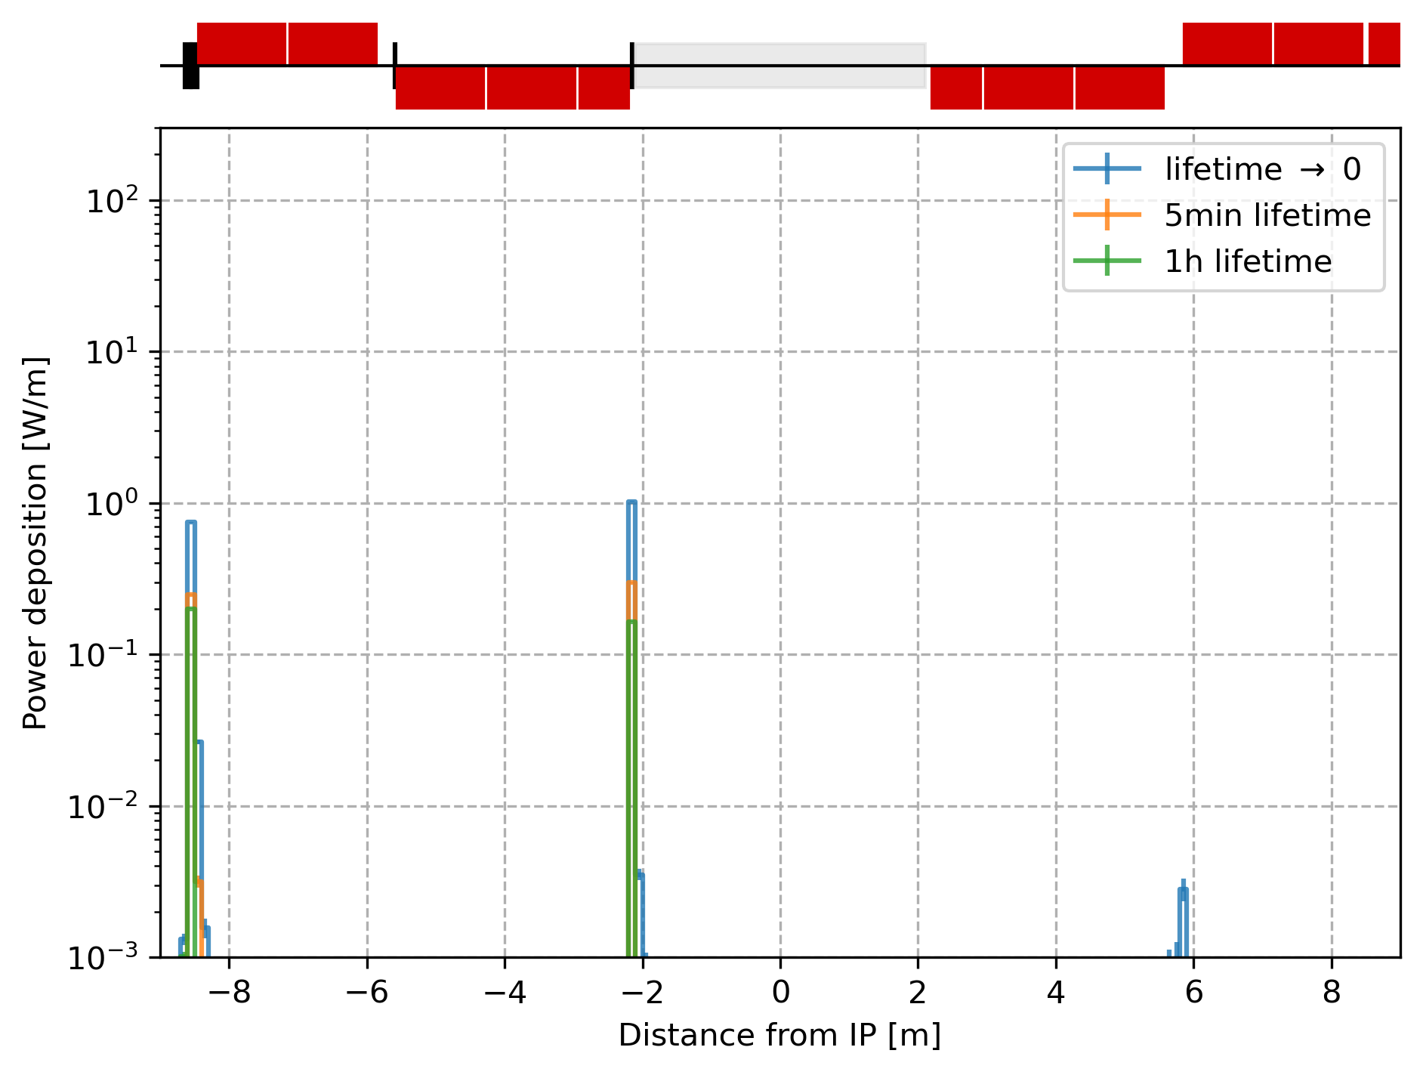
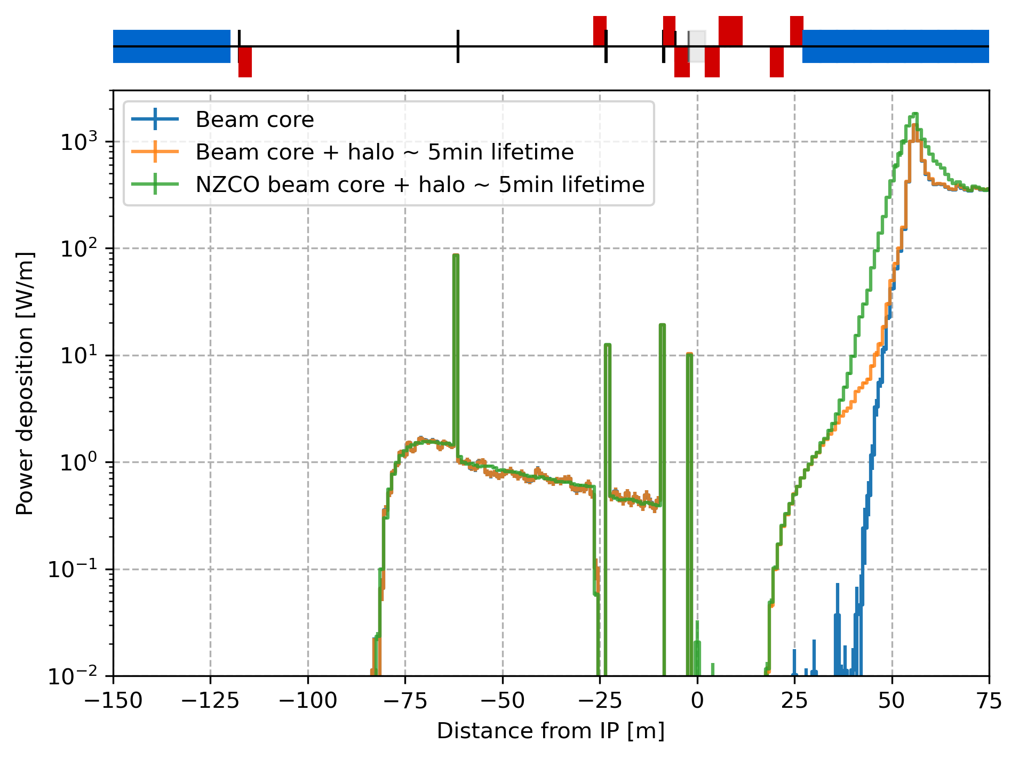
Core + halo | Summary
The heat load from synchrotron radiation appears much smaller in the vicinity of the IP:
The V23 vertical emittance is 60% smaller compared to V22 hence the vertical halo is not as harmful as it was expected in V22. (1.6pm.rad vs. 2.58pm.rad).
Even with 2.5pm.rad vertical emittance the heat load in the CC remains low (tens of mW) probably thanks to the different optics with respect to V22.

Slide 18
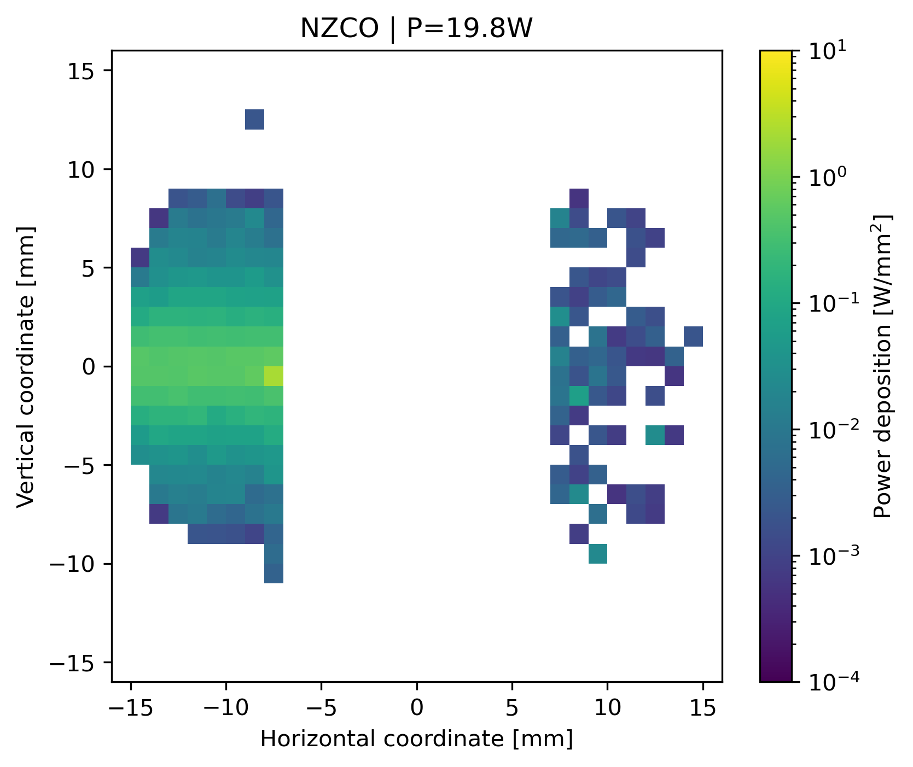
Mask designs - discussion
Objective of an elliptical mask: Protect downstream the IP from photons created in QC2L in case of large vertical halo.
Constraint: Will bring the heat load down downstream the IP and increase in the mask. Limit on cooling ? Large wakefields contribution.
Power deposition from tails
Power deposition from (non-)zero closed orbit

Slide 19
Summary
Simulations with beam core including non-zero closed orbit have been performed at Z and tt energies. The RMS angle of the non-zero closed orbit after correction and BBA must be evaluated at Z and tt energies for V23.
The SR collimation for Z and tt operation modes including transverse tails and non-zero closed orbit is effective. Tens of watts deposited on the mask, cooling ?
Overall the first studies of the V23 lattice and optics designs seem to produce less SR power deposition in the vicinity of the IP. An elliptical mask is not necessary in this lattice version (V23), only a symmetric horizontal mask is sufficient for now.
Top-up injection must be studied for the V23 lattice and optics design
Which other imperfection should be looked at ? dynamic beta, optics mismatch ?

Slide 20
Additional points initiated from the previous talk
Study the efficiency of the mask by being closer to the IP, outside the cryostat.
Extends the model to BC3L to investigate its synchrotron radiation impact on the IR.
One vertical SR collimator may need to be adjusted according to the collimation study.

Slide 21
Thank you for your attention.

Slide 22
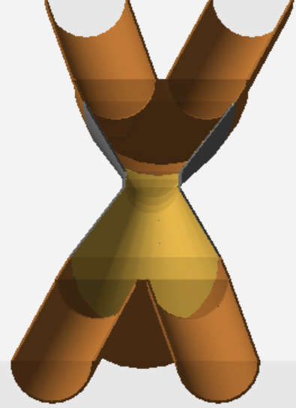
Simulation tool, field map and physics models
BDSIM simulation tool (ref & website) that is based on GEANT4.
Use of the synchrotron radiation (G4SynchrotronRadiation) and low-energy electromagnetic physics (G4EmPenelopePhysics) from GEANT4.
Production energy cut at 10 eV (below the default in GEANT4) to prevent infrared divergence.
Implementation of the solenoid and anti-solenoid field map.
Implementation of a realistic central beam pipe in a GDML format.
The beam pipe is made of Copper.
The collimators (10cm) and masks (2cm) are made of Tungsten.
The MAD-X sequences (link) are converted as input files for BDSIM.
The beam parameters can be found in (ref).

Slide 23
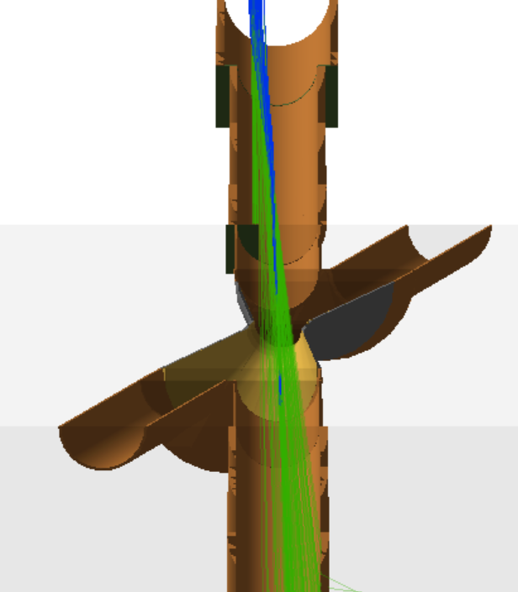
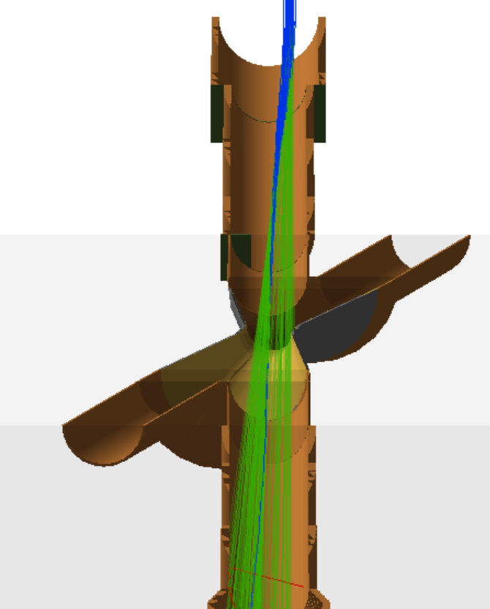
Illustration of the two extremes at Z
beam direction
ΔX=-8.5 mm
ΔX=8.5 mm
Mask
Hot spot

Slide 24
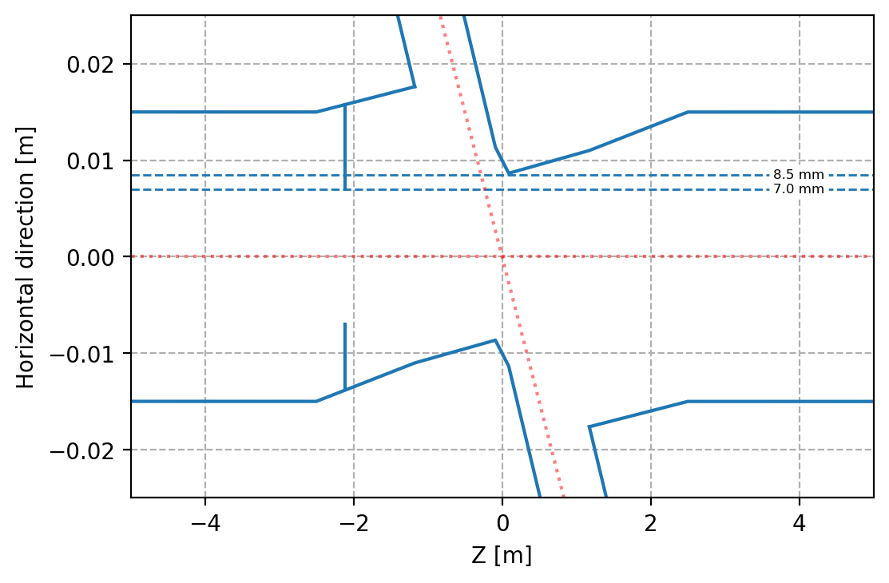
Illustration of the mask aperture with respect to the central chamber aperture.

Slide 25
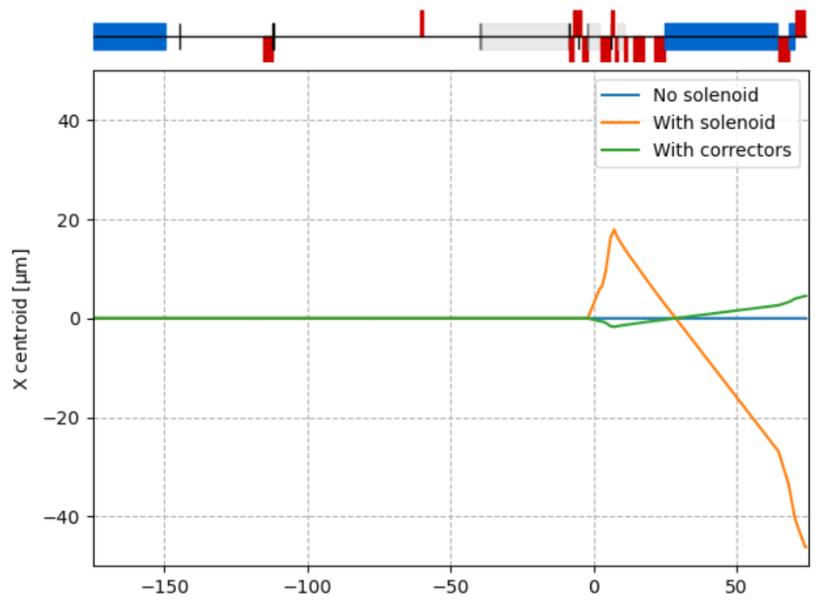
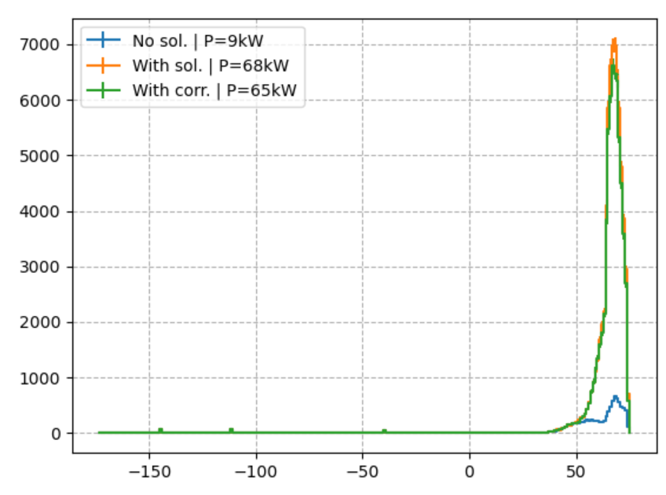
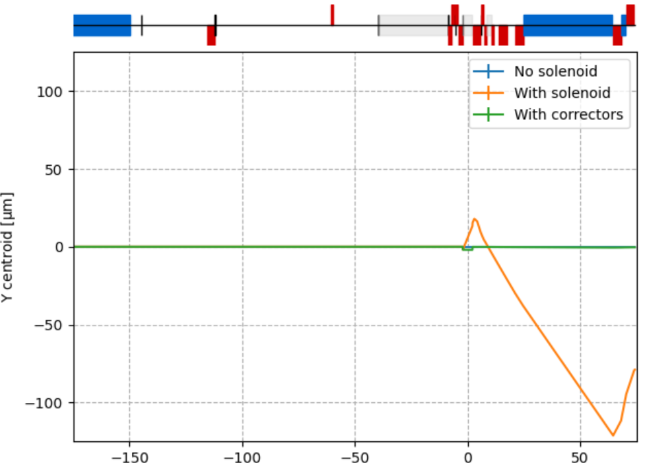
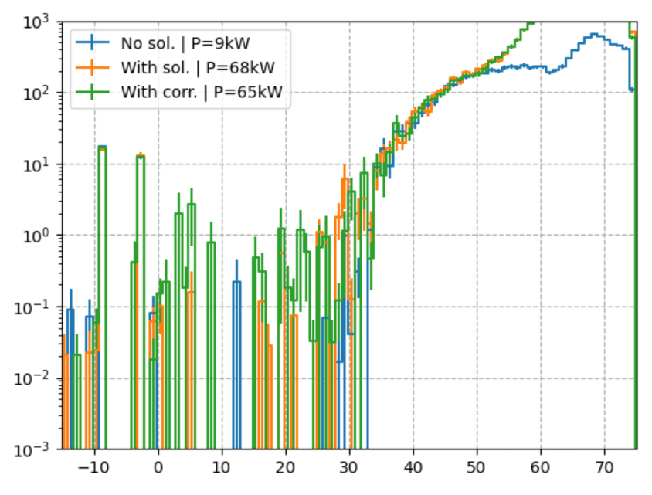
Orbit correctors around the IP | Z mode 45.6 GeV
The original (anti-)solenoid field map has been modified by H. Burkhardt with 2 correctors on either side of the IP to correct the orbit in position and angle.
The orbit is corrected at Z energy.
The field map with orbit correctors included radiate 3.2 kW additional SR power (at Z energy).
Next steps:
Does it reduce the SR from quadrupoles downstream ?
Impact considering transverse beam tail.
Impact with NZCO.

Slide 26
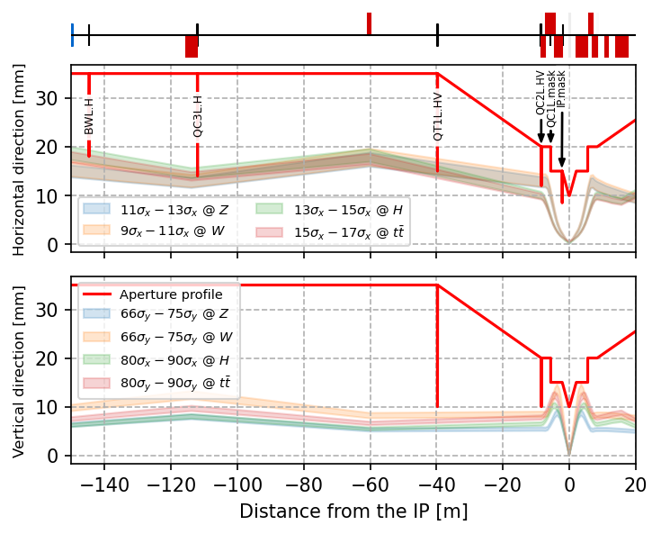
Annex: SR collimation for the other energy modes
Assuming the same beam sizes as the Z operation the beam halo collimator apertures for W should be (9-11 σ_{x}) and (66-75 σ_{y}).
Assuming the same beam sizes as the tt operation the beam halo collimator apertures for H should be (13-15 σ_{x}) and (80-90 σ_{y}).
The collimation for W and H energies are subject to evolve with further development of the optics and lattice designs, e.g. V23.

