Slide 1
FCC-ee IR beam chamber development and heat load due to electromagnetic fields excited by the beam
Alexander Novokhatski
SLAC National Accelerator Laboratory
November 16, 2023

Slide 2
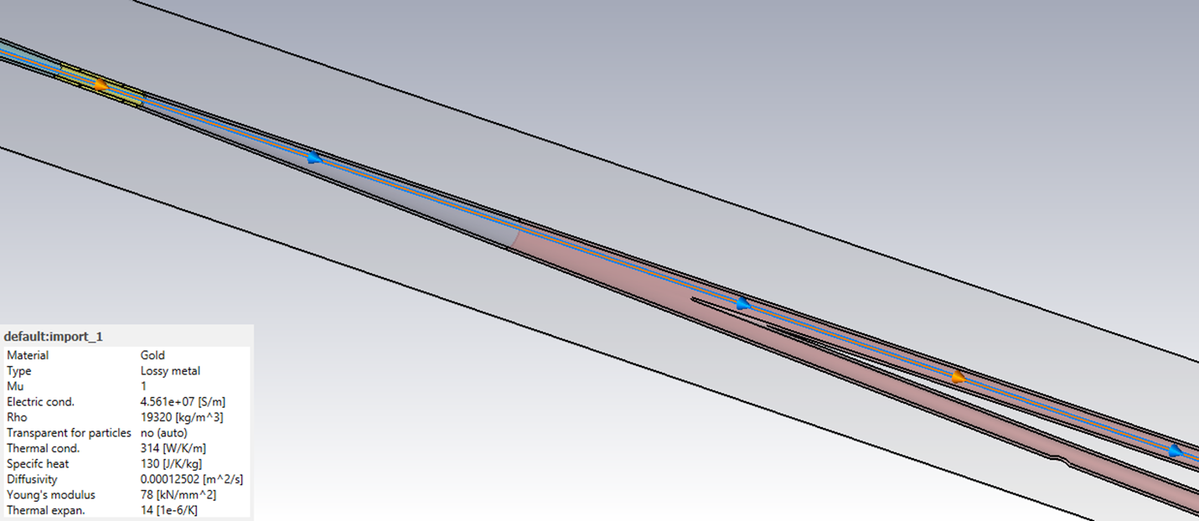
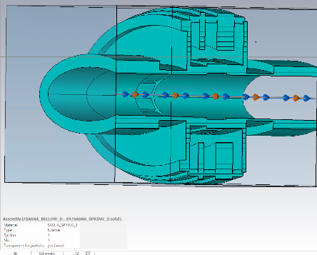
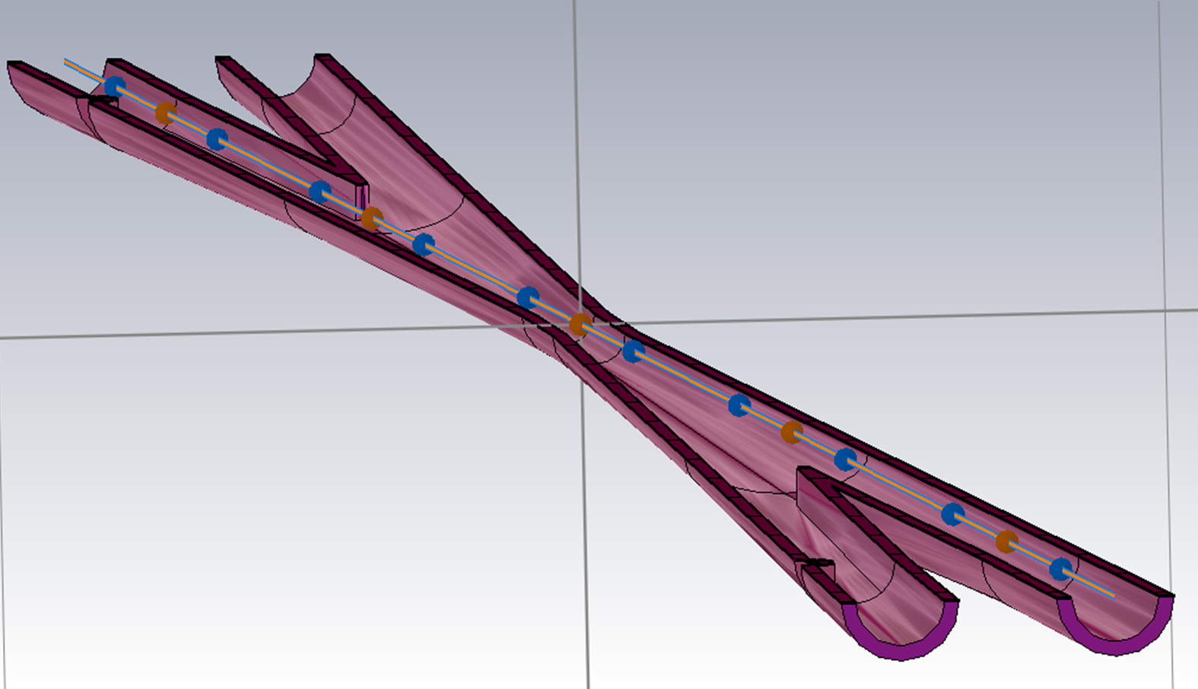
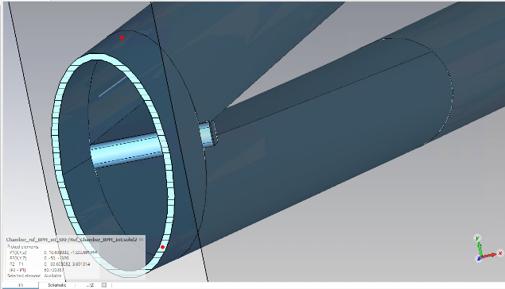
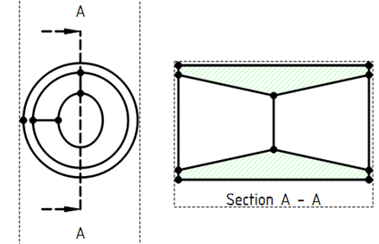
Historically the FCC IR beam pipe got several modifications, and this process seems to have no end: adding new elements, changing the geometry and modify the synchrotron mask
Miguel Gil Costa
Francesco Fransesini
Luigi Pellegrino

Slide 3
Why are we doing wake field calculations?
Developing the IR beam pipe, we tried to optimize the electromagnetic interaction of the beam field with the chamber metal walls or minimize the chamber impedance.
Minimum impedance means less heat load of the chamber and requires more simpler cooling system.
Large impedance may influence on the beam dynamics in the FCC rings.
We developed a smooth chamber, calculated the heat load and check how other IR elements may bring additional impedance

Slide 4
Heat load distribution for a smoothed chamber, which was used for the cooling system design
Cu
157 W
Cu
157 W
Gold
24 W
AlBeMet
130 W
AlBeMet
130 W
Cu
156 W
Cu
156 W
AlBeMet
30 W
Scale is distorted

Slide 5
Including important elements
The real mechanical design of the FCC-ee IR beam pipe needs to include bellows. So, we need to check what the additional heat problem will come with it.
BPMs for the beam optics
May be pump screens or NEG coating?

Slide 6
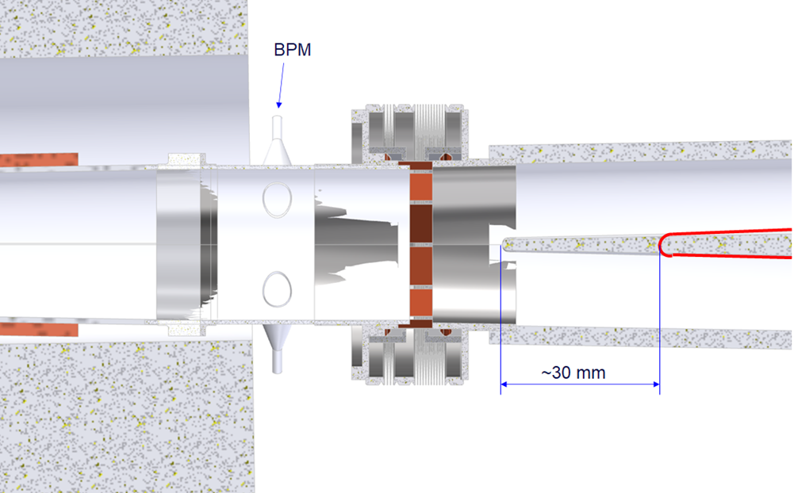
Changing the IR geometry in order to add BPMs
As usual adding new chamber elements leads to change of the previous geometry. In our case it was an extension of the mutual IR pipe.
Francesco Fransesini

Slide 7
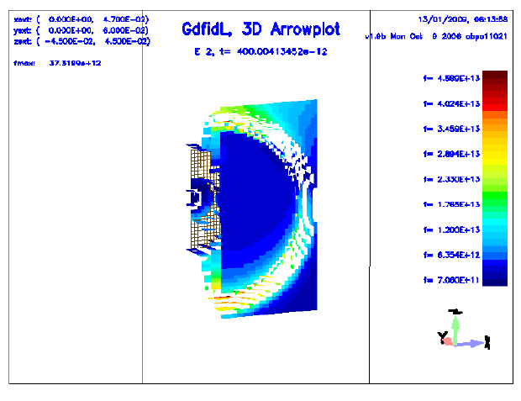
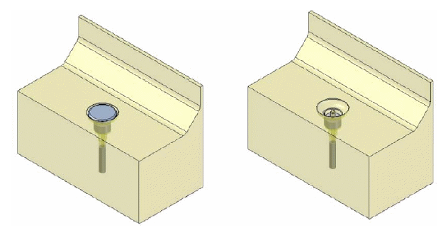
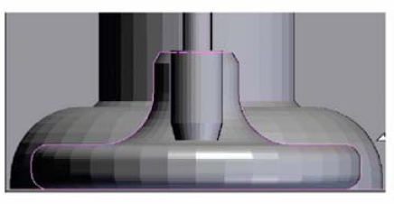
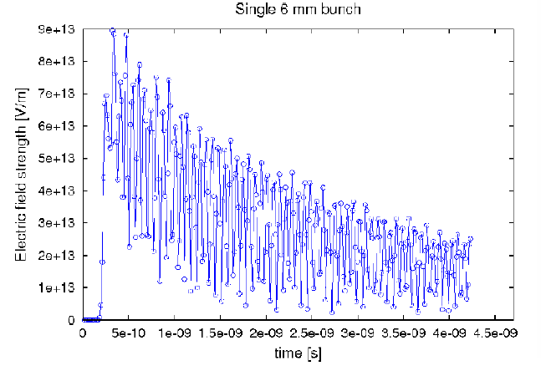
Previous simulations
Electric field strength at the button as a function of time just after the arrival of one 9 mm 1 C bunch as computed with Gdfidl. Maximum field strength is 4.59×1013 V/m near the gap between the button and vacuum chamber interior to the button housing.
Maximum electric field strength at the BPM as a function of time for one 6 mm Gaussian 1 C bunch. The 14 GHz oscillation correlates with a 7 GHz half cycle of electric field maximum at two ends of the button.
BPM BREAKDOWN POTENTIAL IN THE PEP-II B-FACTORY
STORAGE RING COLLIDERS. Weathersby, Al. Novokhatski, ICAP ‘2009

Slide 8
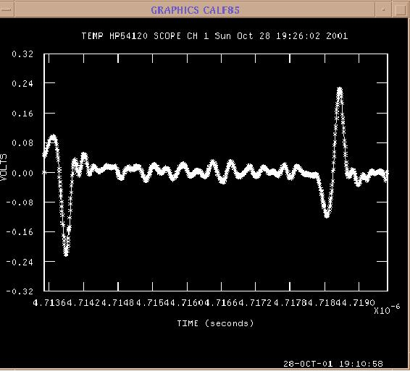
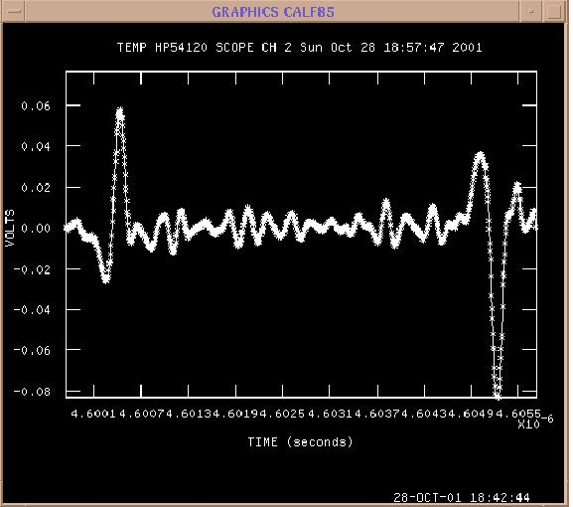
Real signals from the PEP-II IR BPMs for two beams. BMPs also see the wake fields.
Positrons Electrons
Electrons Positrons
B-side BPM
A-side BPM
Time arrival measurement
Distance to a collision point from BPM = (Δt*c)/2

Slide 9
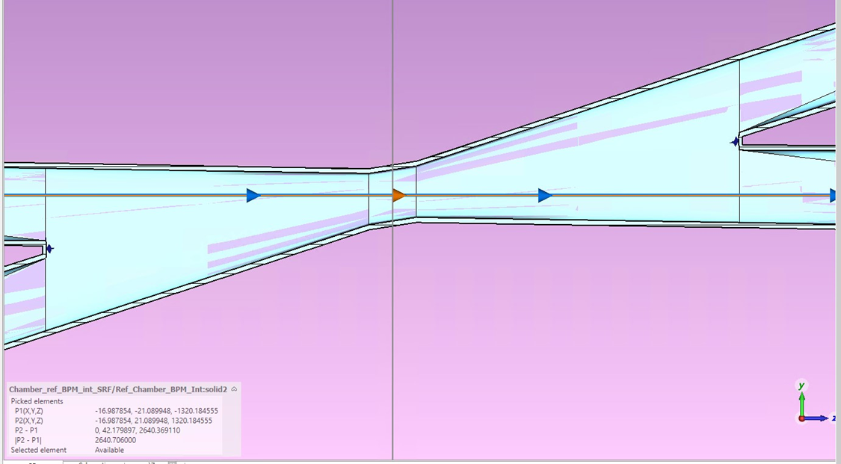
New FCC-ee IR beam chamber (Francesco Fransesini)
2640
Maximum size of the mutual part is increased a little

Slide 10
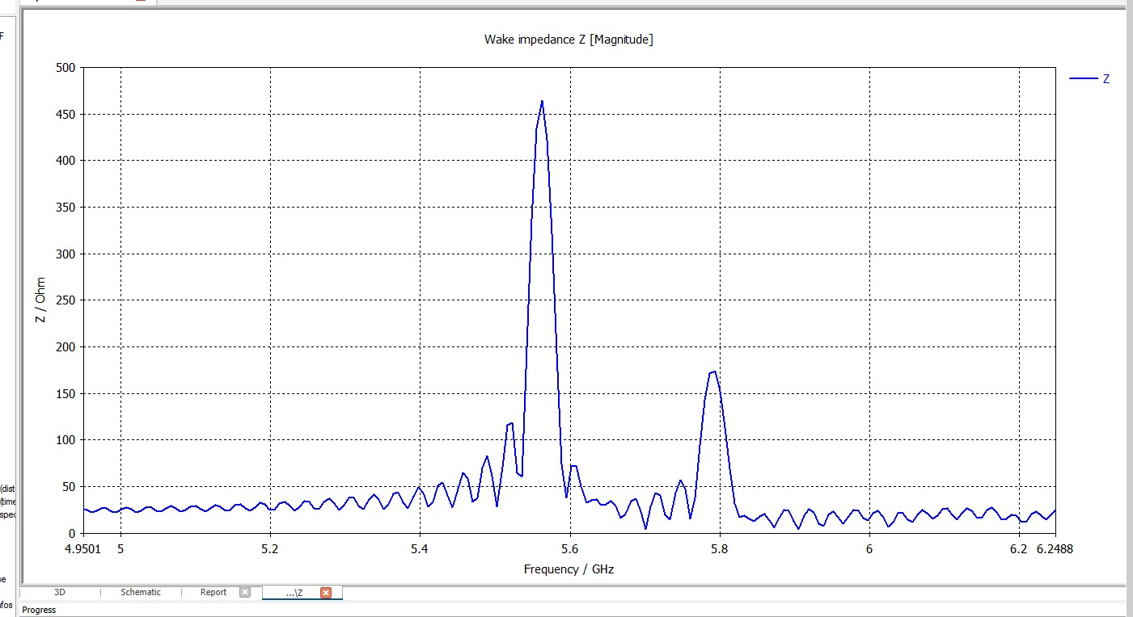
In the new IR beam pipe model, we found two trapped modes

Slide 11
In the new IR beam pipe model, we found two trapped modes. Longer mutual pipe more trapped modes
This is our unavoidable mode
What this?

Slide 12
Our trapped unavoidable mode

Slide 13
Second type of unavoidable mode – one variation in z-direction

Slide 14
New geometry is possible to use
The heat distribution does not change much in new geometry, even we got two trapped modes, but less interaction with the beam
So, now we can try to place IR BPMs
However, a proposal for a new SR mask comes and we decided to check the difference between old and new masks

Slide 15
Additionally, the SR mask trapped mode appears clearer.

Slide 16
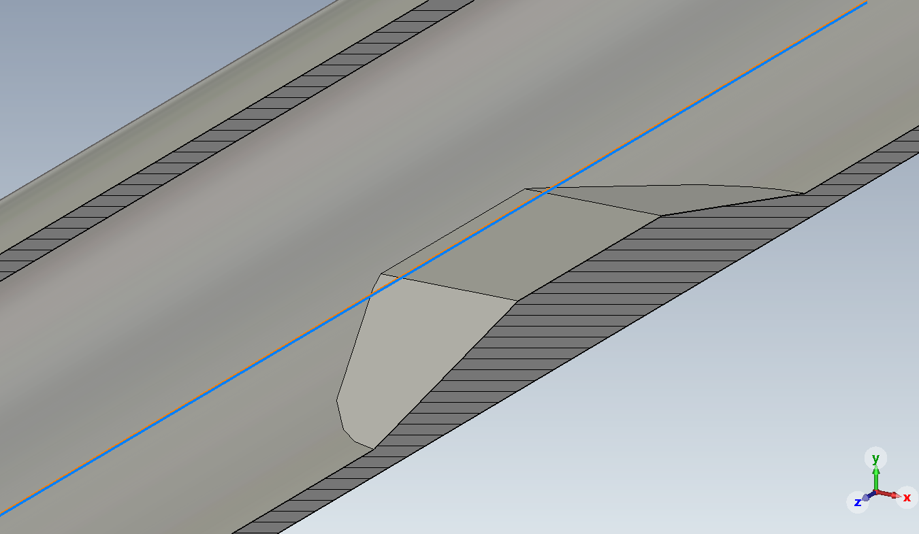
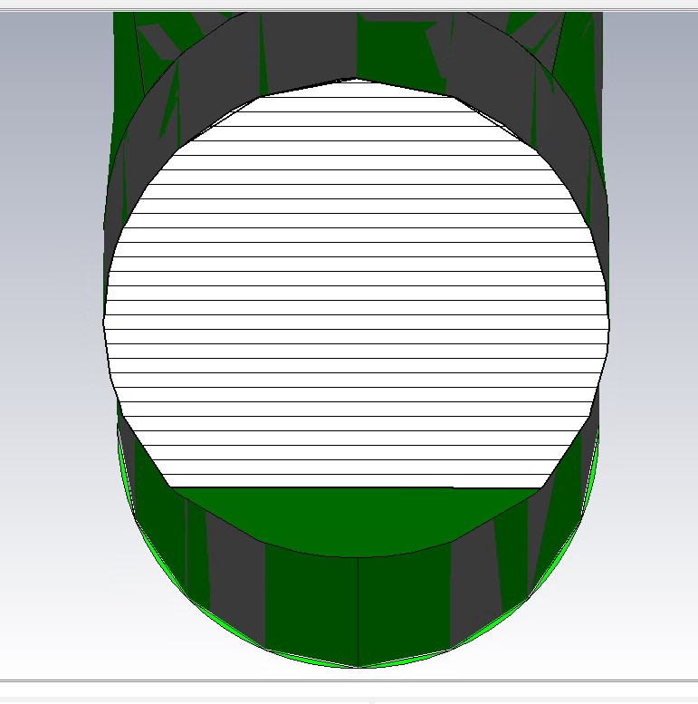
Mike Sullivan SR mask (old SR mask)

Slide 17
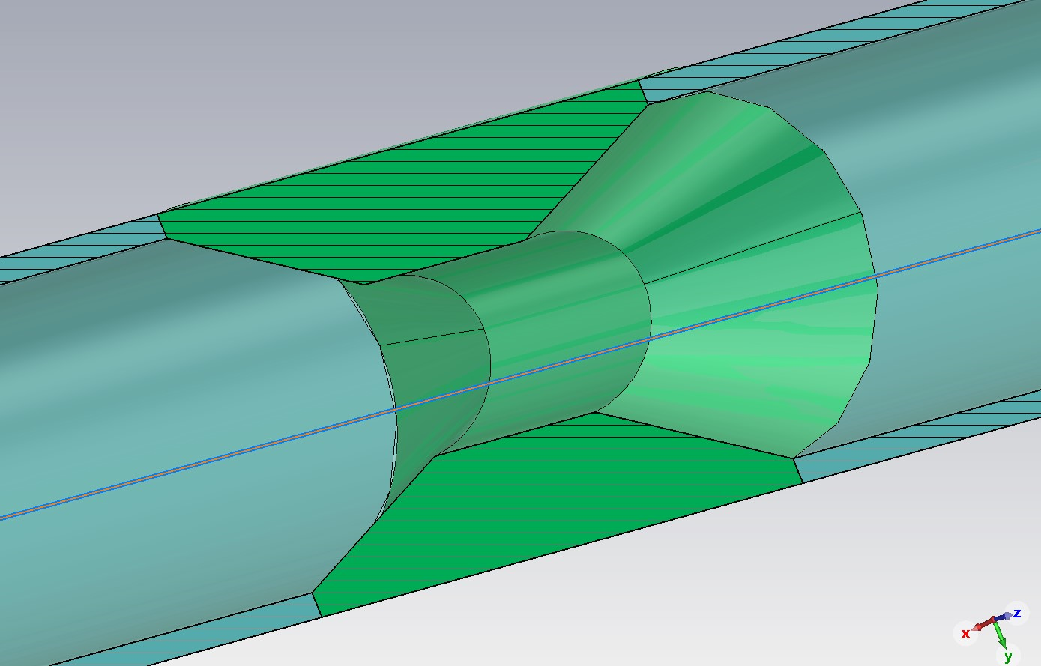
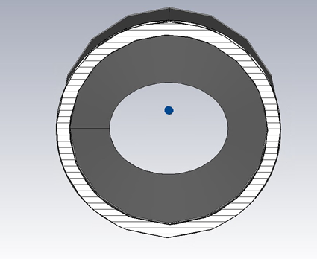
SR mask of Kevin Daniel Joel Andre (new SR mask)

Slide 18
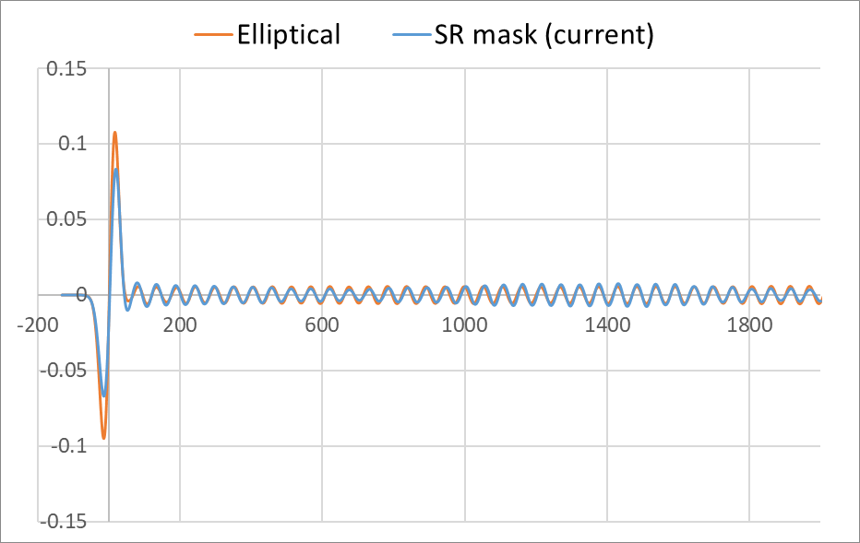
Wake potentials comparison
Elliptical mask has more inductive character.
The beam interacts with more trapped modes located between an elliptical mask and IP.
The “head” of the beam excites this modes and loos energy.
The “tail” of the beam is accelerated by the field of these modes and these modes are almost disappear.

Slide 19
New modes (due to elliptical mask) f=5.8772 GHz

Slide 20
F=5.90683

Slide 21
f=5.93237 GHz

Slide 22
f=5.96187 GHz

Slide 23
f=5.96551 GHZ

Slide 24
F=5.9769 GHz

Slide 25
Discussion: do we need an elliptical mask?
Due to the elliptical mask more trapped modes appeared in the beam pipe.
Even interaction with a beam has an inductive character, these modes will interact more when adding other beam pipe elements like bellow and BPMs Upper half of the elliptical mask does not catch SR, but may catch the beam
If we need an elliptical mask only for time of beam injection, then can we switch off the detector during beam injection, as we did at PEP-II.

Slide 26
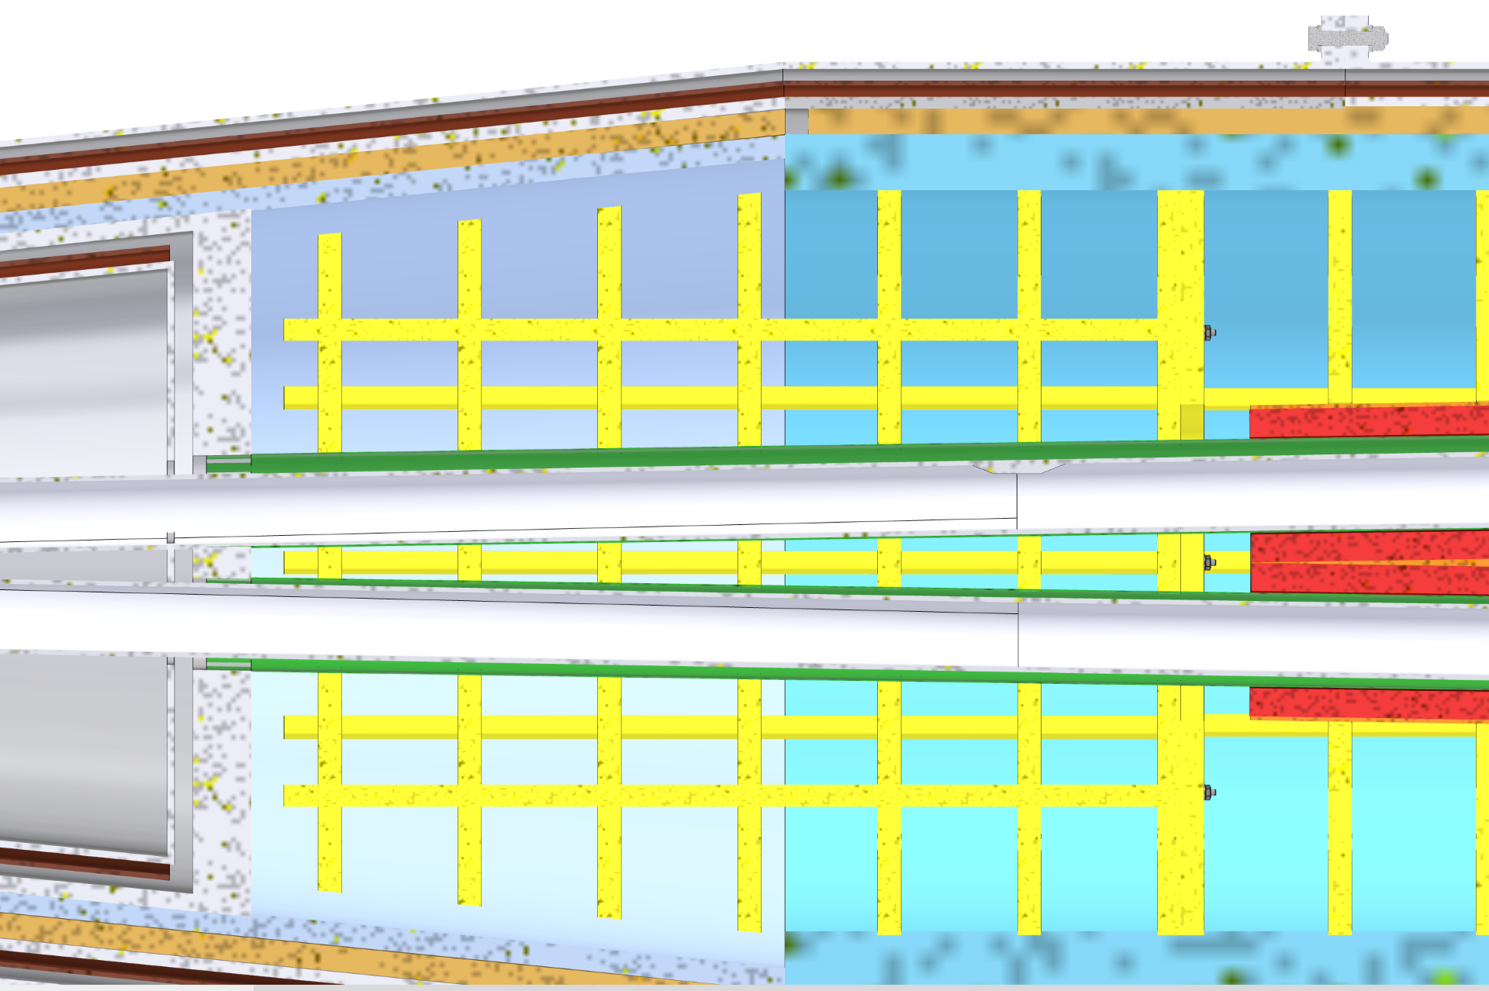
Can we move out the SR mask from the cryomodule?
SR MASK

Slide 27
Current status of calculations
Manage to speed the calculations
Understanding new results
Understanding the problem with a bellows model for calculation.

Slide 28
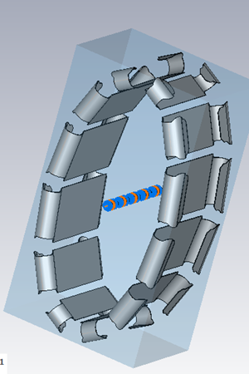
First attempt to study bellows
Bellows is a very delicate device.
It has thing springs and corrugations.
The code CST can do good calculations for small elements
So, we had to make a more simple model.

Slide 29
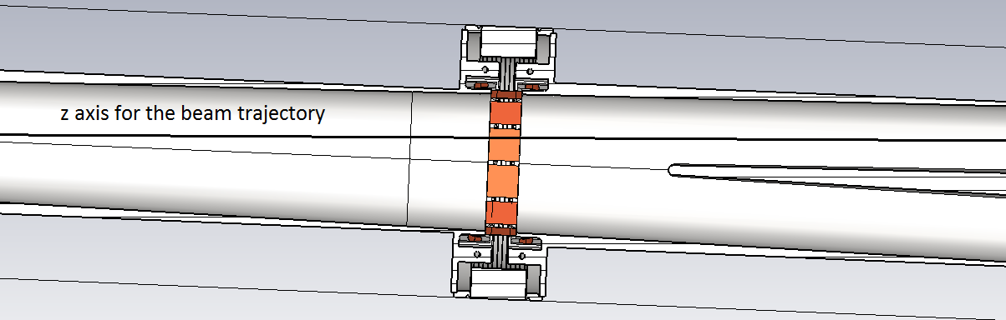
Simplified model What is important: the beam trajectory is not in the bellows center and the beam can easily excite transverse modes
Unfortunately, the simplified model had thick springs, and we did not find any excited fields

Slide 30
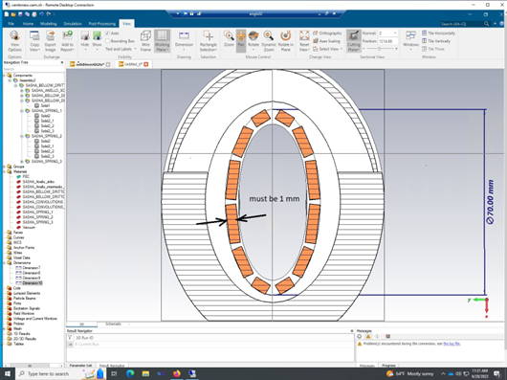
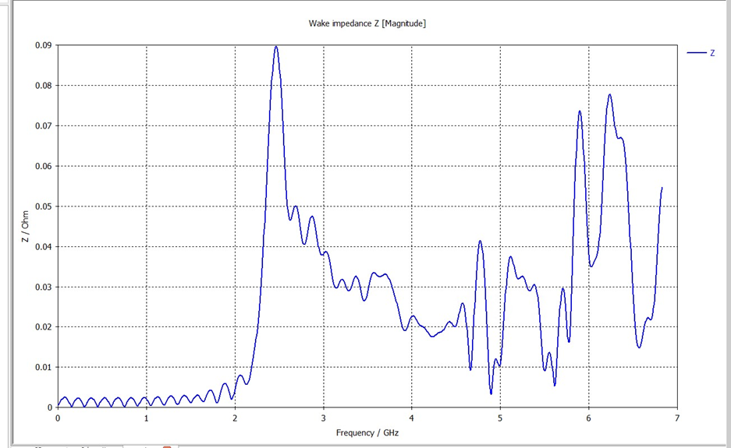
We decrease spring thickness to 1mm and found a lot of trapped modes inside the bellows cavity
Bellows spectrum
A new “simplified” model is needed to get more or less real results

Slide 31
Summary and future steps
Wake field study of the new chamber with extension of the mutual IR pipe showed not great change of the heat load, however a second trapped mode appeared due to larger common beam pipe.
Study of the new elliptical mask showed that it brings more inductive impedance, which may be important for the beam dynamics (bunch lengthening or instability) and also for the heat load when adding other beam pipe elements.
More precise bellows model for calculation is needed.
We will try to do calculations for a full model, which includes bellow, BPMs and possible new SR mask with different materials.
If we find the way how to cool a bellows then we suggest to design a special bellows: bellows-HOM absorber to capture increasing HOM power from a complicated IR beam pipe.

Slide 32
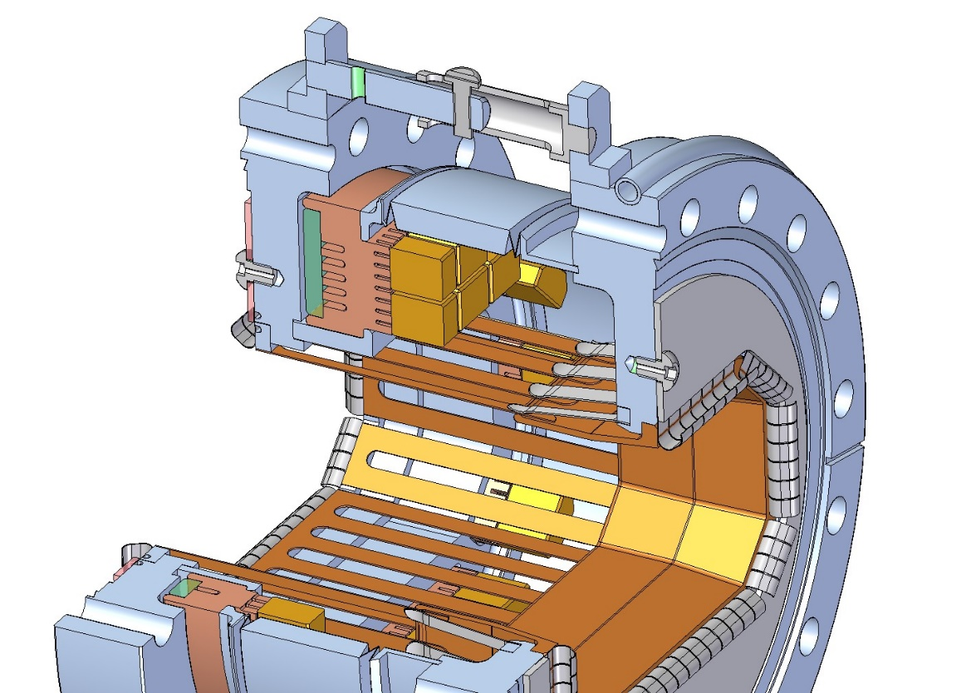
Possible IR bellows HOM absorber like at SLAC PEP-II
Restraint
Welded Bellows
OFE Cu Prong Body
Ceralloy Tile
SST Water
Jacket Cover
Glidcop Stub
SST Prong Support
J-Seal
Glidcop RF Fingers
Inconel Spring
Fingers

Slide 33
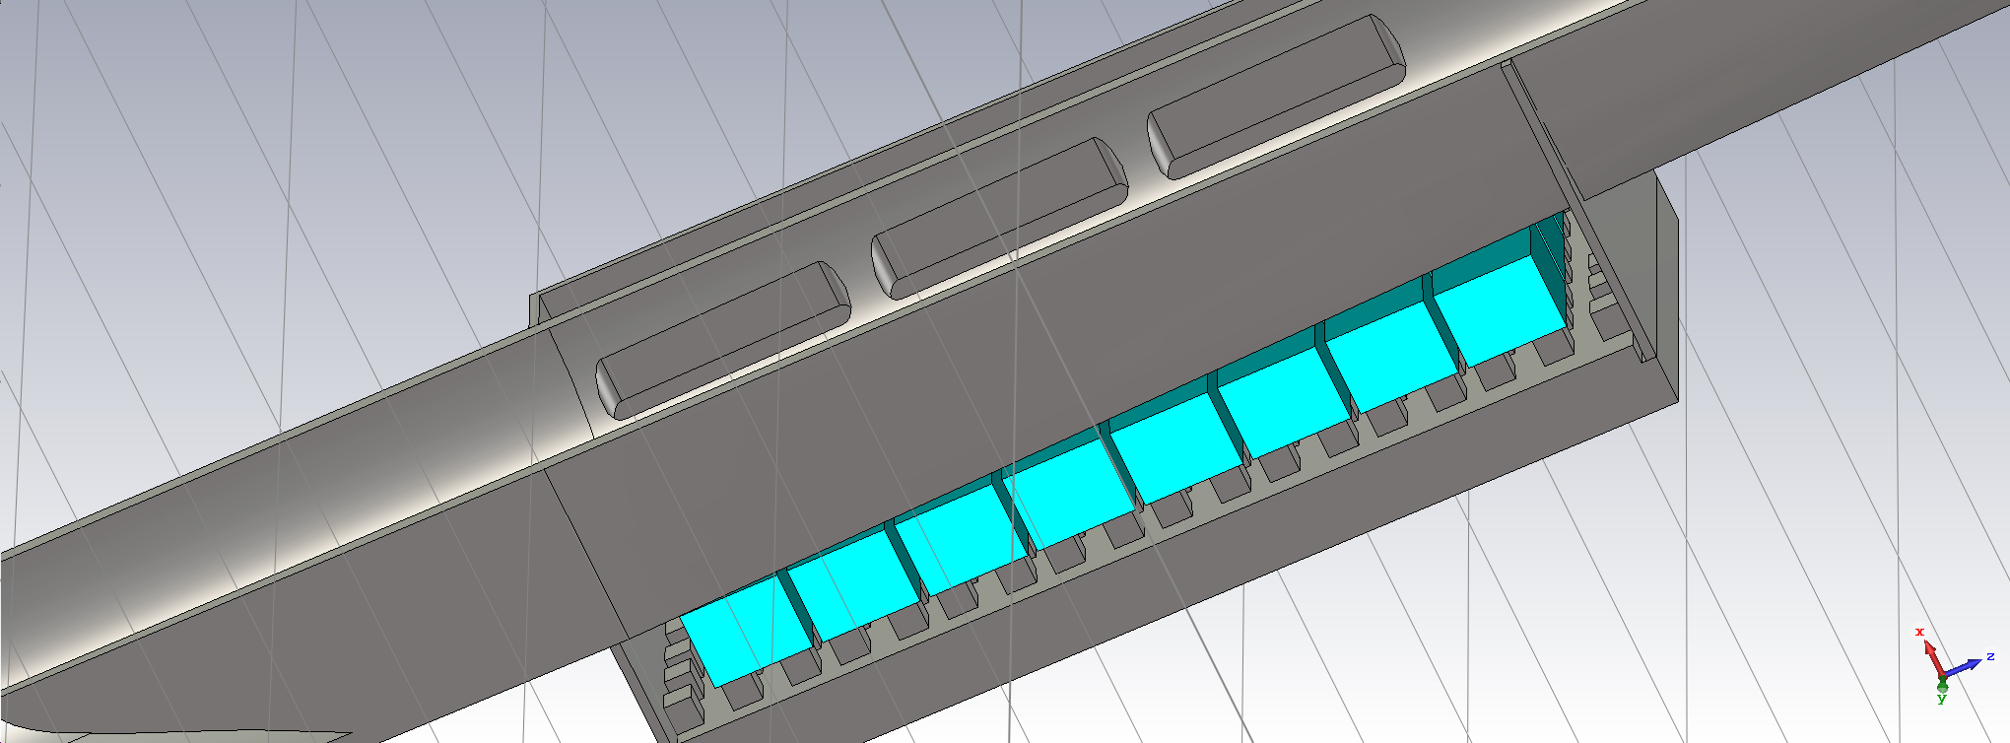
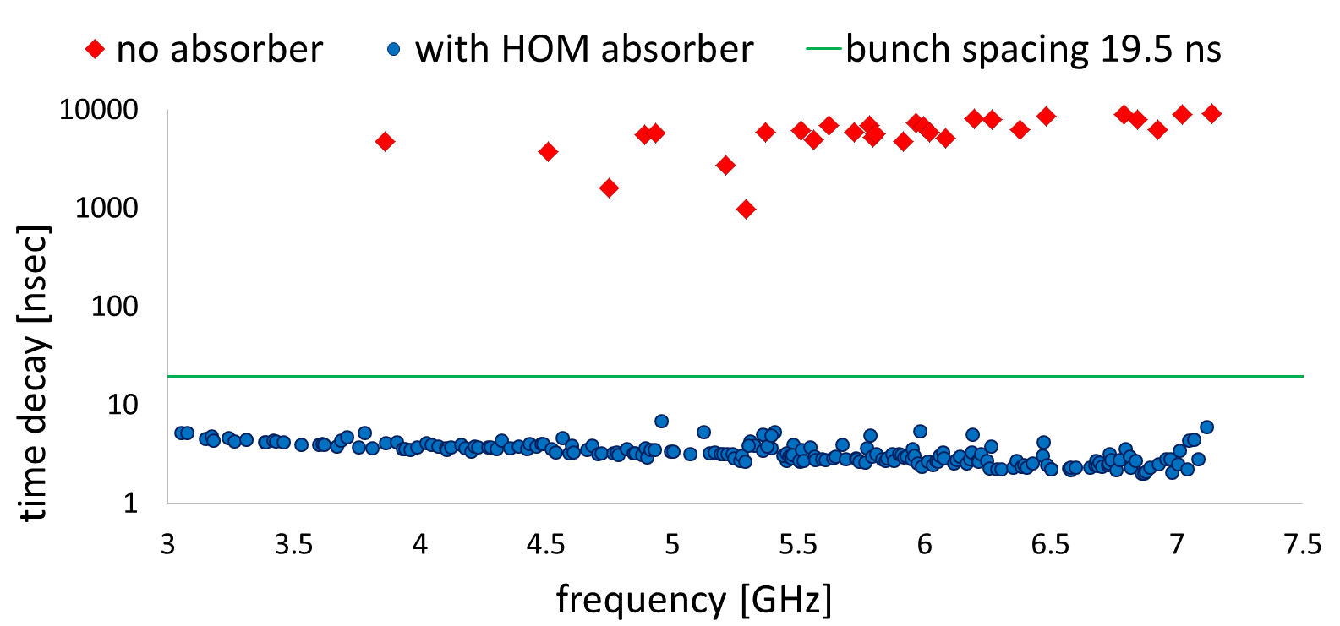
FCC ee IR beam pipe with water-cooled HOM absorbers
Efficiency of Damping
Trapped and Propagating Modes
HOM absorber design for 10 kW power

Slide 34
Acknowledgement
Many, many thanks to
Francesco Fransesini, this work cannot be done without him
Manuela Boscolo for leading and MDI team for many useful discussions and help
Frank Zimmermann, for great support and help with solving the computer speed problem
John Seeman, for supervising and support from SLAC

