Slide 1
New design of FF quads using HTS
M. Koratzinos
Frascati
17/11/2023

Slide 2
The final focus system of FCC
Three quadrupoles in a cryostat inside the detector (QC1)
Two more (QC2) outside the detector
QC1L1, closest to the IP, is the toughest challenge
  Distance at tip from the other beam is 66mm
  Distance at the other tip is 87mm
There are packaging and integration issues (which I believe are solvable)
There is a ~80W heat load coming from collision debris!

Slide 3
The CDR solution
Use CCT technology and NbTi conductor
CCT was used as it can eliminate crosstalk
NbTi was used as it was proven technology at the time
To get the 100T/m gradient needed, we need to operate at 1.9K (superfluid helium)
~100W would be expensive to extract at 1.9K

Slide 4
News regarding the FF quad prototype
As you know, a final focus quad prototype was built in 2019 and tested at warm.
The prototype was impregnated with wax at PSI (29 August 2023)
During October 23-31 it was tested at SM18 (Siegtag cryostat) at 1.9K (and 4.5K)

Slide 5
Impregnation
Using the experience gathered by different experts on wax impregnation, a new method was tried:
The magnet was impregnated and cooled in a controlled manner to avoid voids
(Wax contracts by 15% when it crystalizes. Voids can be avoided if crystallization occurs in a controlled manner inner to outer and bottom to top)

Slide 6
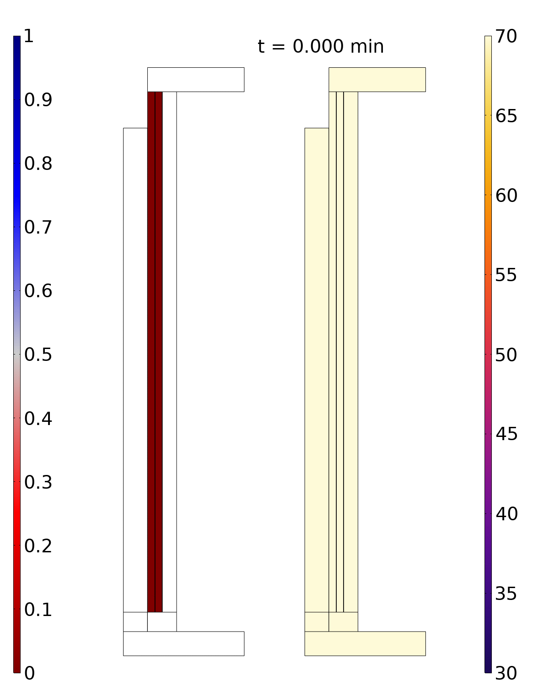
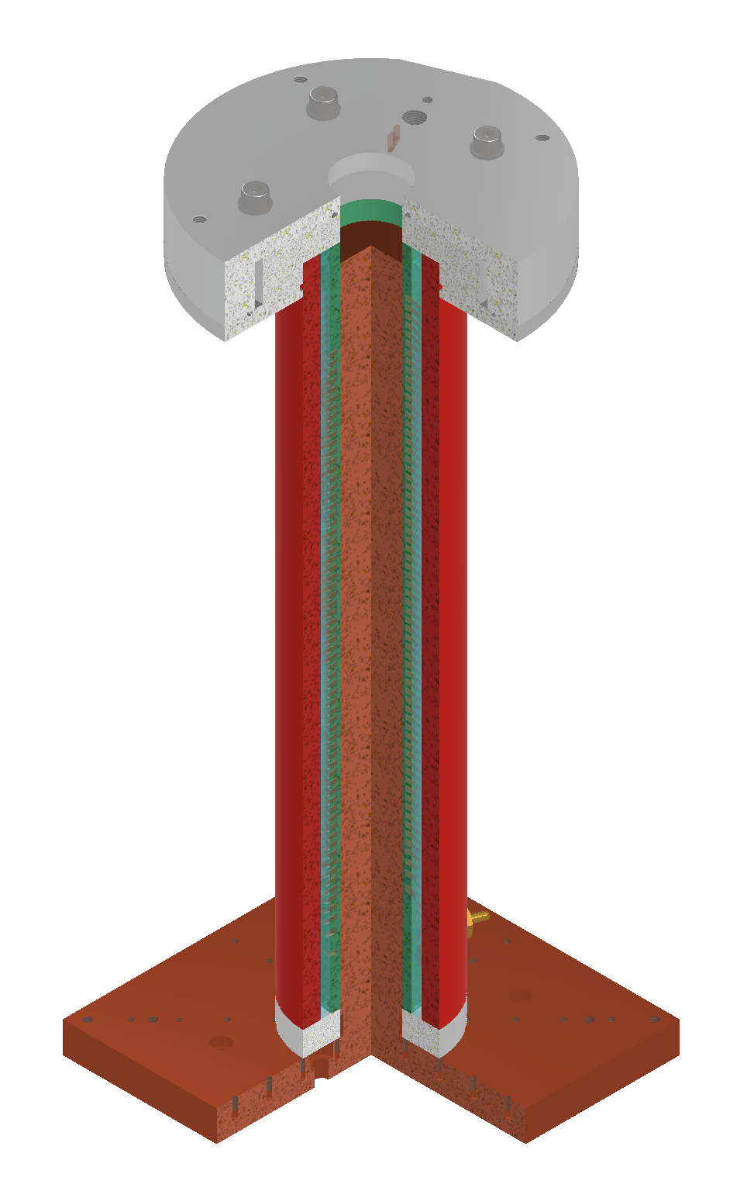
Simulation
Simulation plane
Crystallization range [51.5,54.5] Celsius
Solid fraction
Temperature [degC]
Jaap Kosse

Slide 7
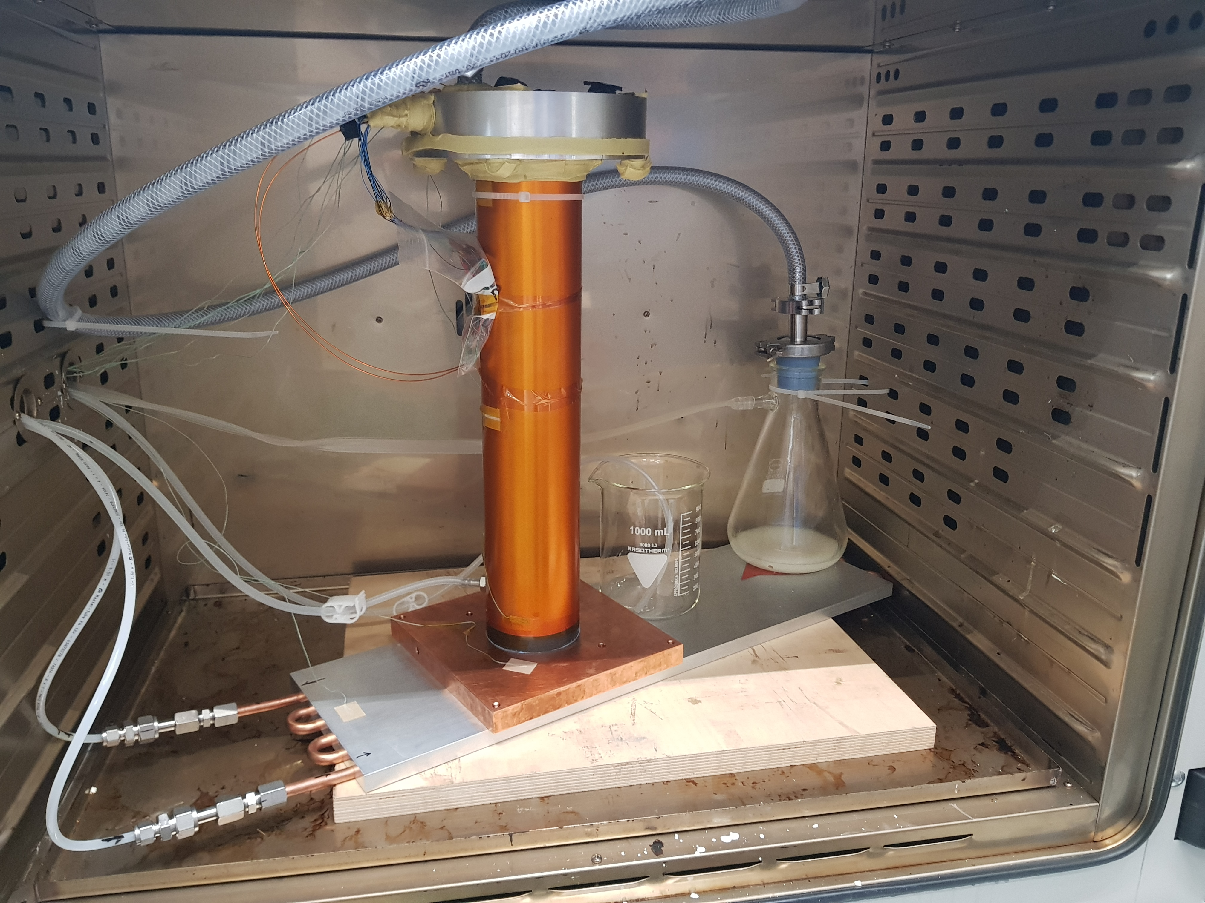
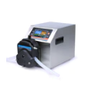
The setup
Wax upper “reservoir”
Many thanks to:
Michael Daly, Colin Müller, Jaap Kosse (PSI) Daniel Barna (Wigner Research Centre)
To vacuum pump
To peristaltic pump
Vacuum reservoir
From peristaltic pump
Wax reservoir (now empty
Water in/out

Slide 8
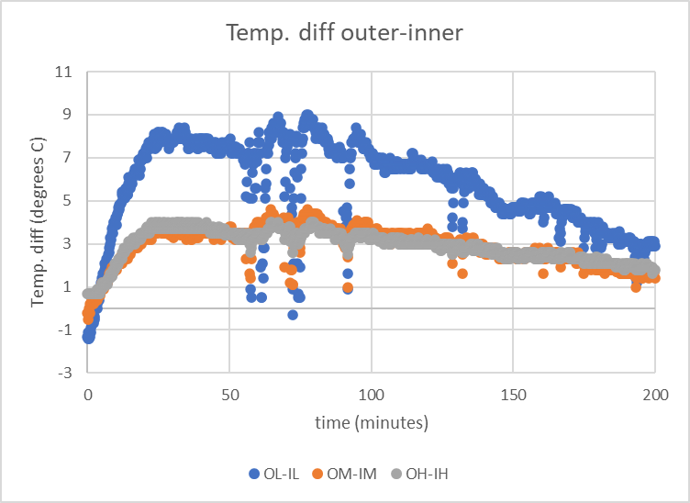
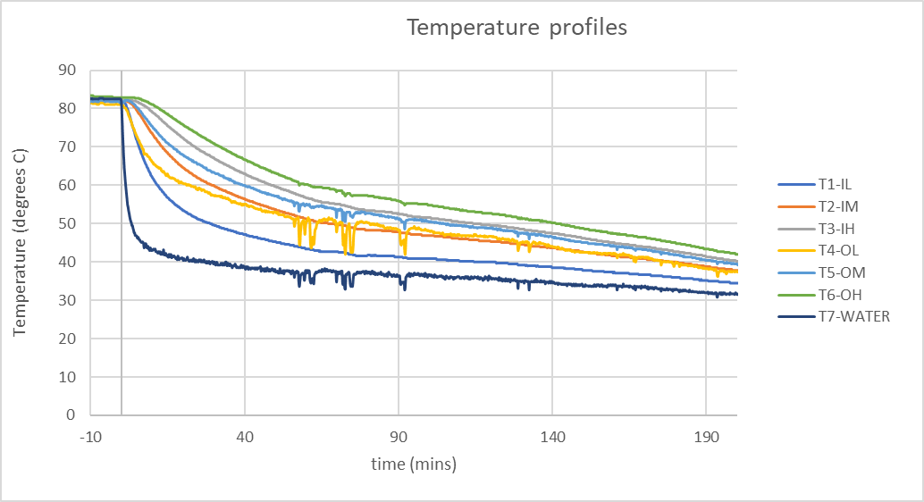
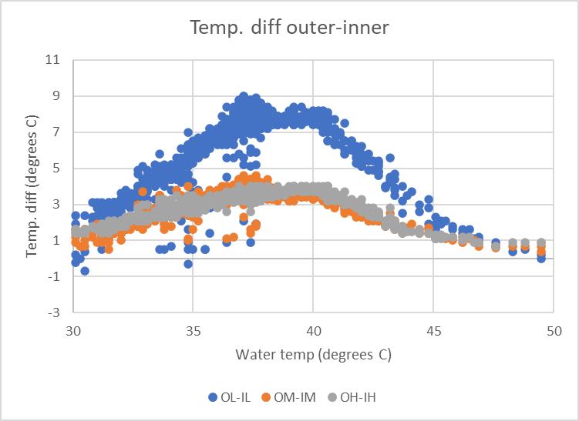
Temperature gradients
Transition temperature
A temperature difference of ~3⁰ C was achieved

Slide 9
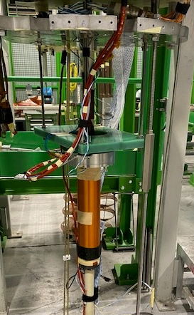
The test at SM18
Testing at cold at SM18 (CERN)
Cryostat supporting 1.9K superfluid helium
Training campaign
Measurement of splice resistance
Measurement of quenchback
Measurement of RRR

Slide 10
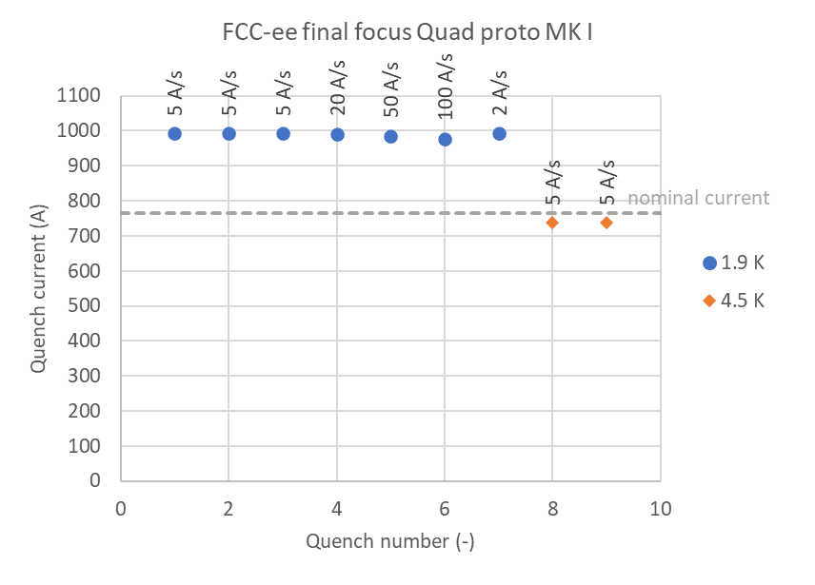
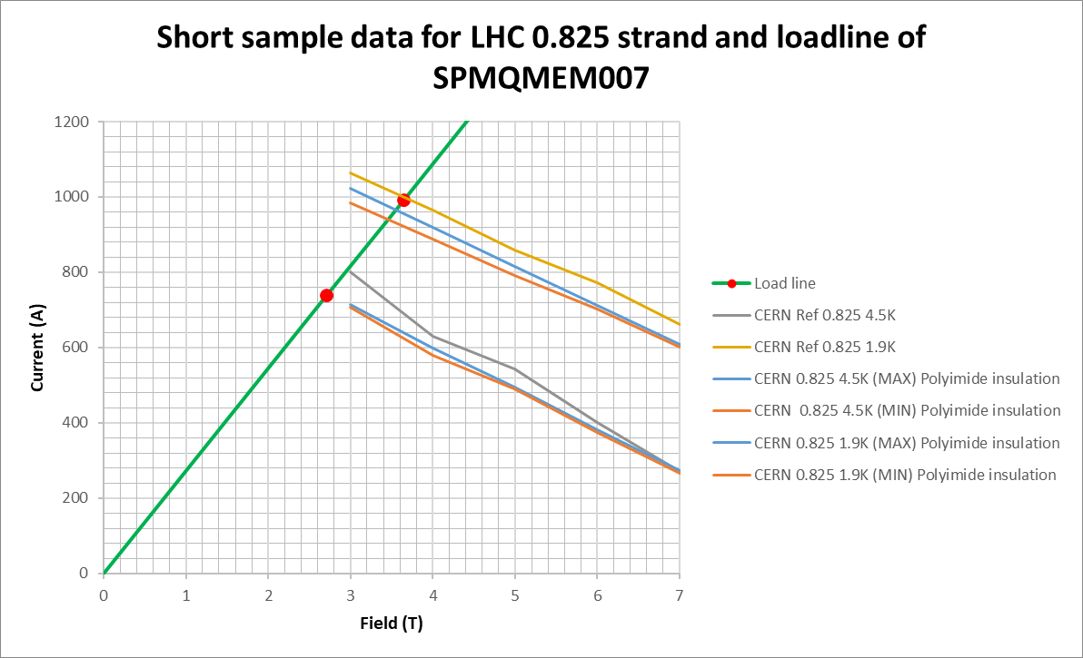
SM18 Test results Oct 27-31 - Training
Test report EDMS https://edms.cern.ch/document/2976492/1 Gerard Willering, Jerome Feuvrier for TE-MSC-TM
No training quenches were seen up to short sample limit
No degradation was seen for quenches at short sample limit
1.9 K: reached 991 A, peak field on conductor is 3.65 T
4.5 K: reached 738 A, peak field on conductor is 2.71 T
Short sample limit 1.9K
Field quality: work ongoing but less than one unit in 10⁻⁴ of multipole errors (Carlo Petrone, Melvin Liebsch TE/MSC/TM)

Slide 11
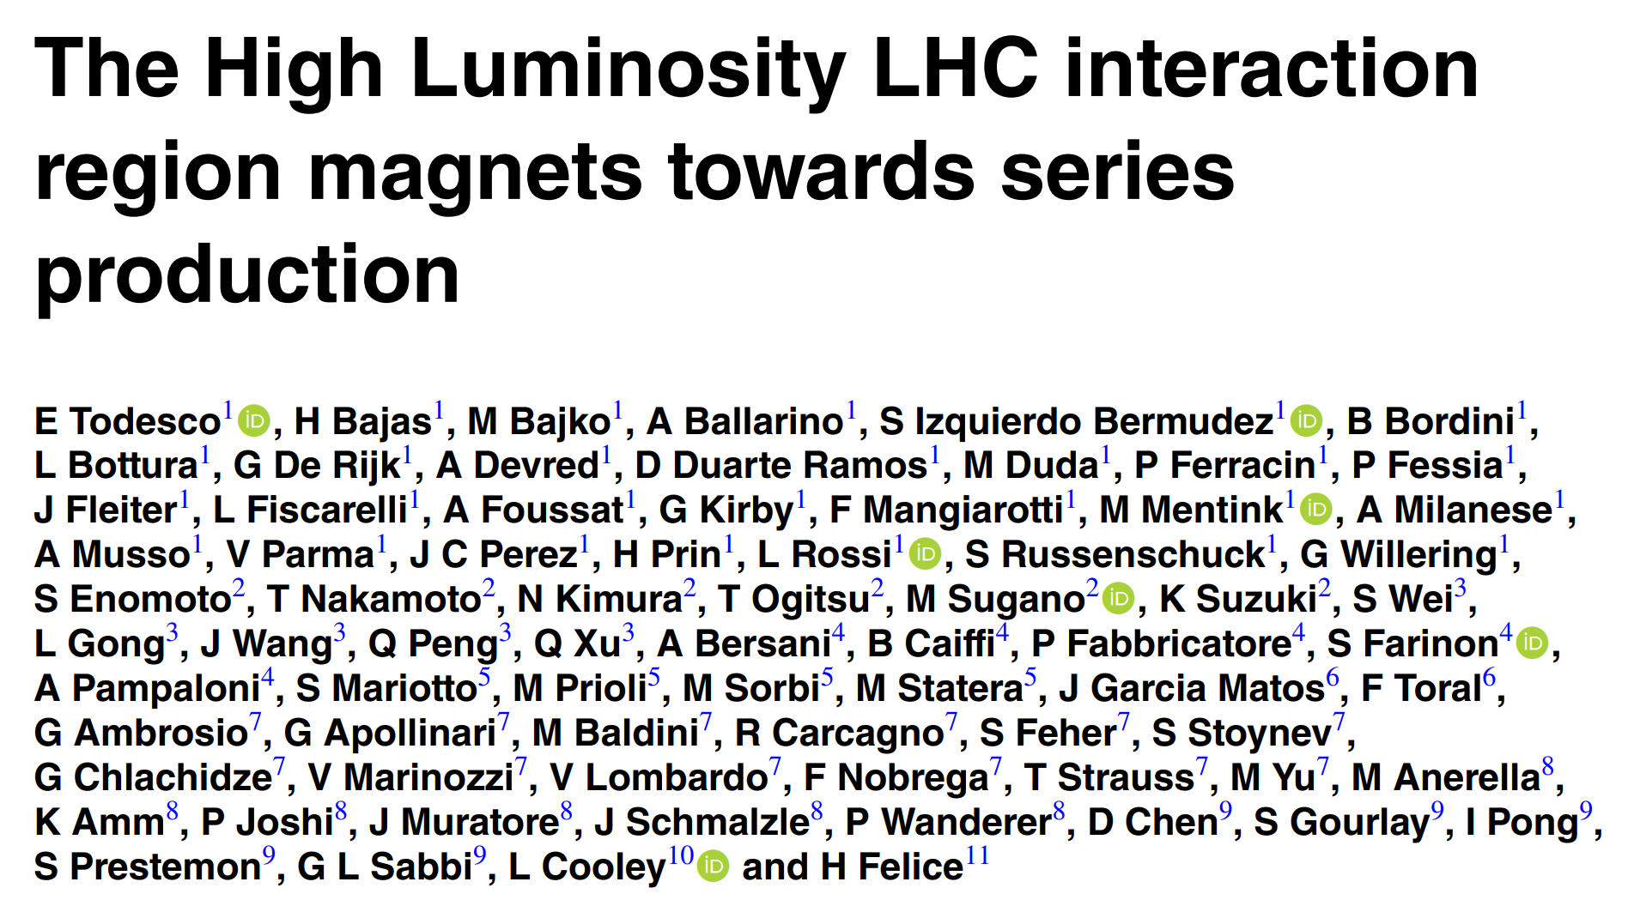
Comparison to similar projects
The review paper:
The magnet:
Magnet: MCBRD
Type: dipole
Technology: CCT
Conductor: NbTi
Field: bore field of 2.6 T
Aperture: 105mm
Operating temperature 1.9K
Field quality: 10 units a3/b3

Slide 12
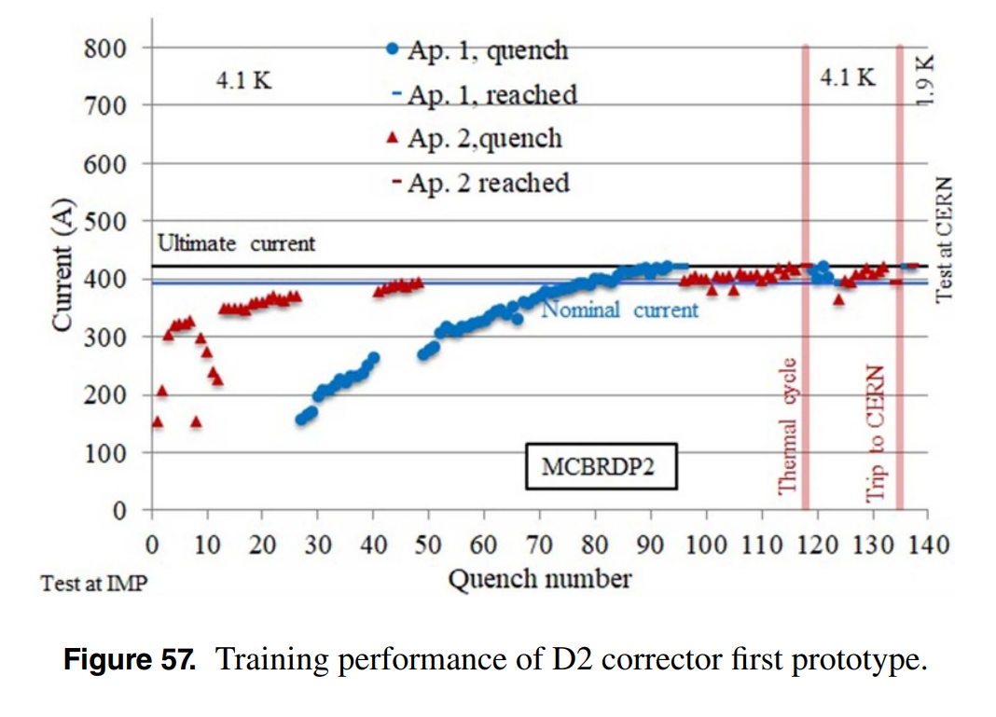
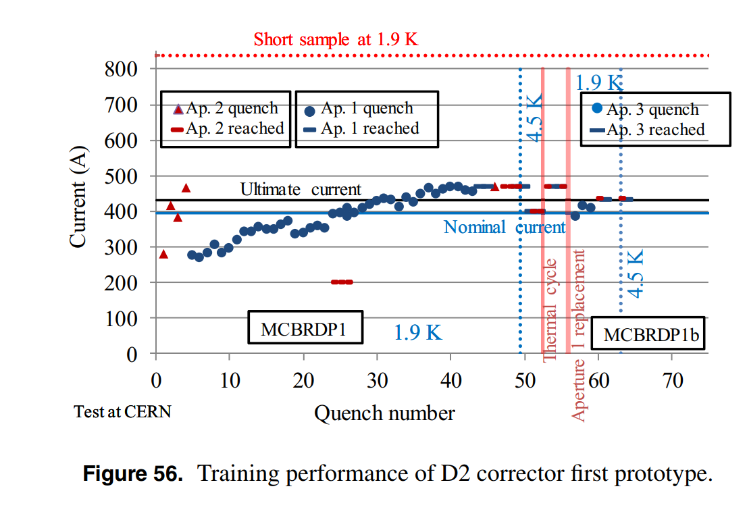
Comparison to similar projects
https://iopscience.iop.org/article/10.1088/1361-6668/abdba4/pdf
1000
This project
900
Chinese-made MCBRD HiLumi dipole corrector
CERN-made MCBRD HiLumi dipole corrector

Slide 13
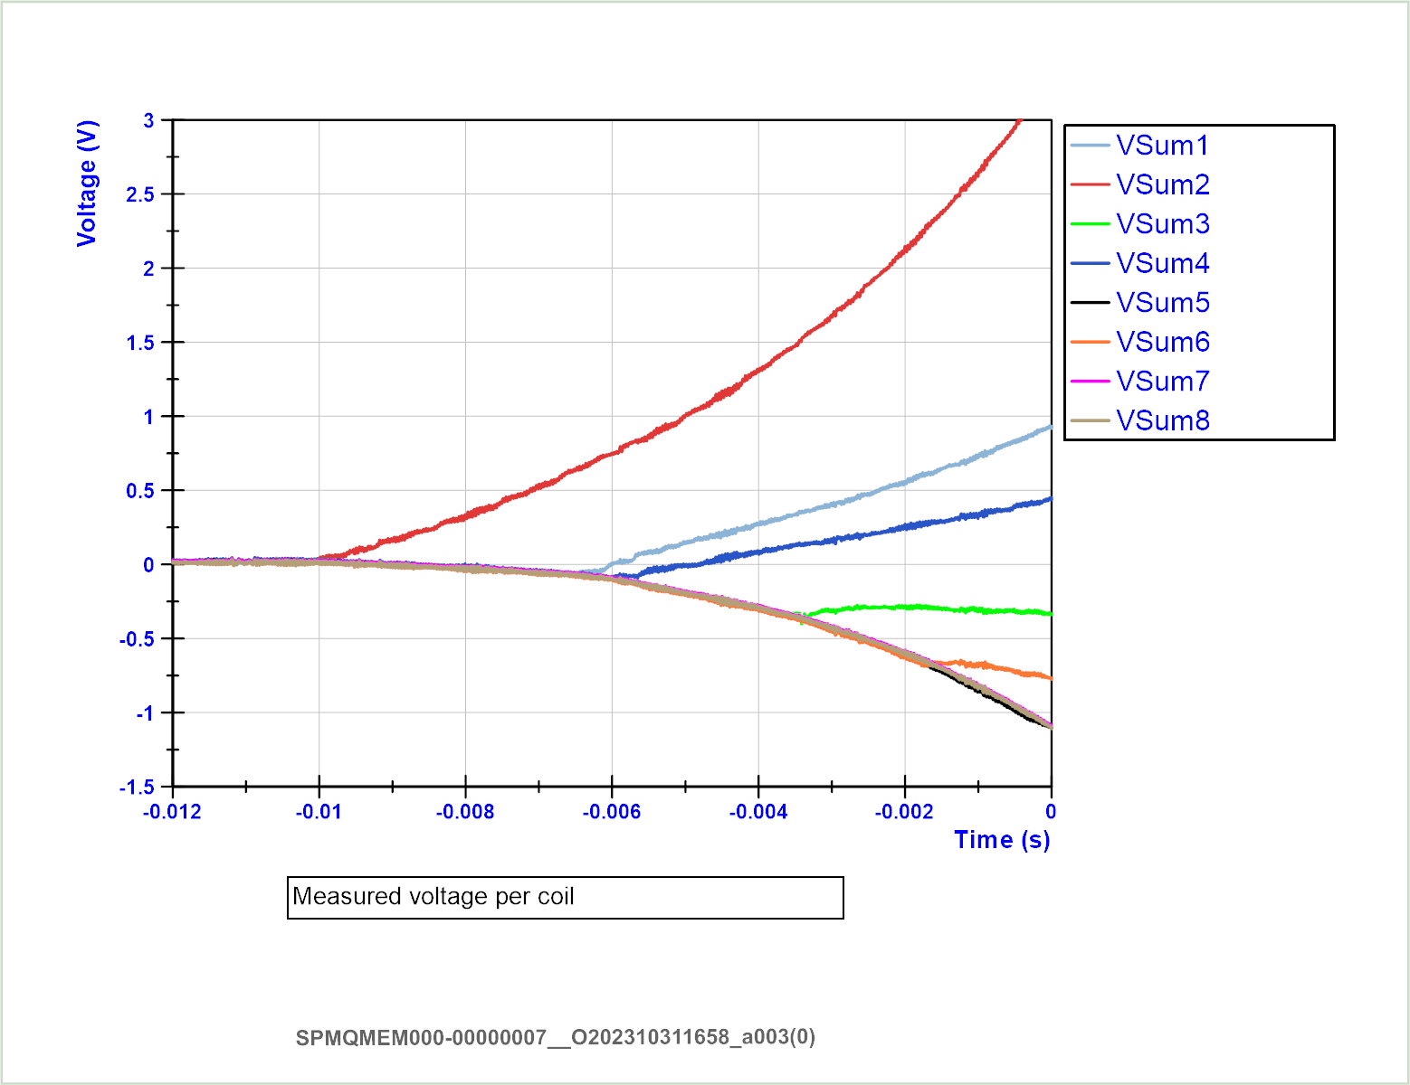
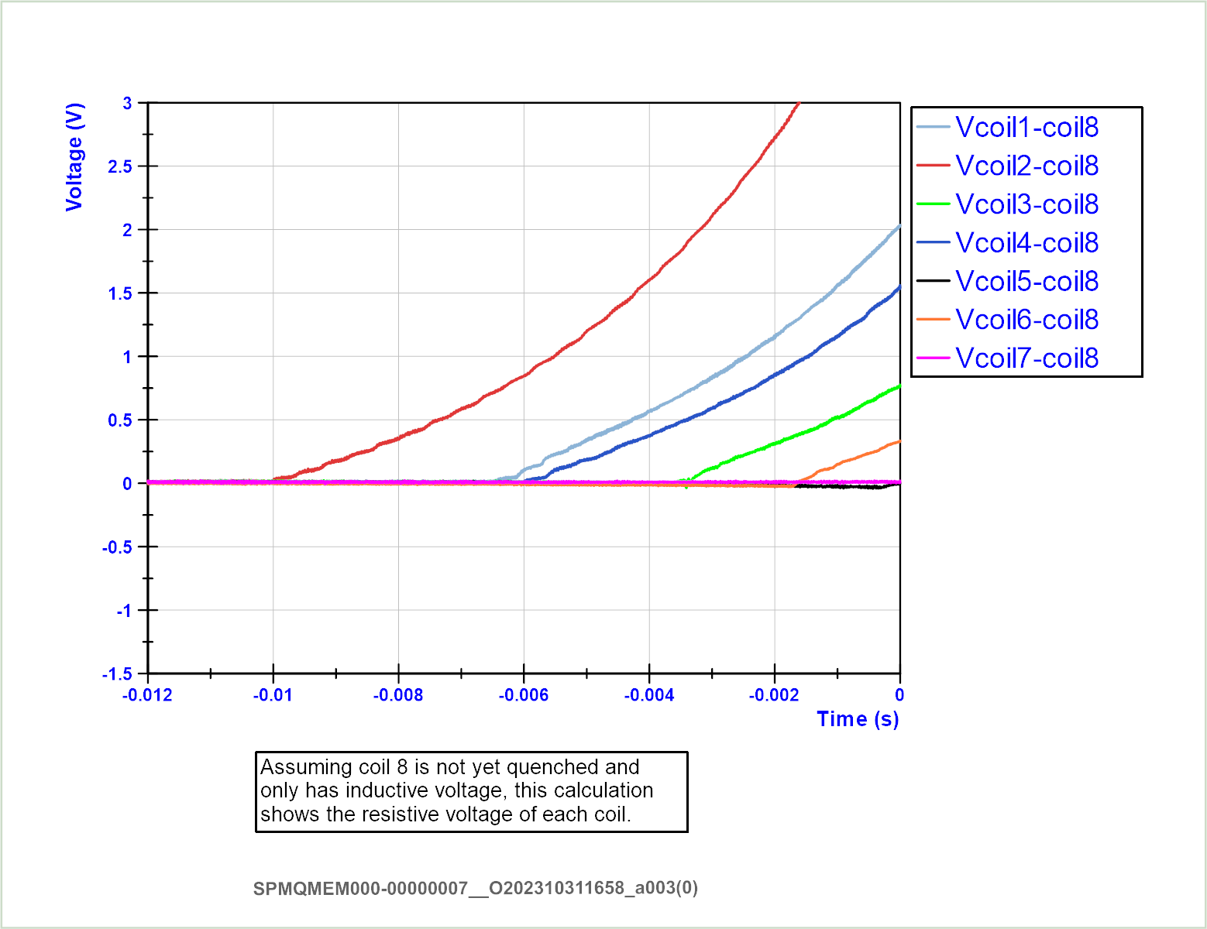
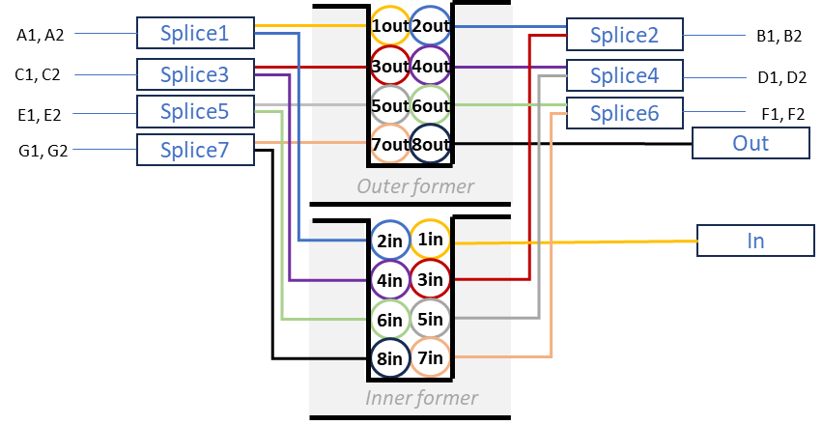
Quench analysis at short sample limit, 1.9 K at 991 A.
2
1
4
3
6
Negative (inductive) component due to dI/dt

Slide 14
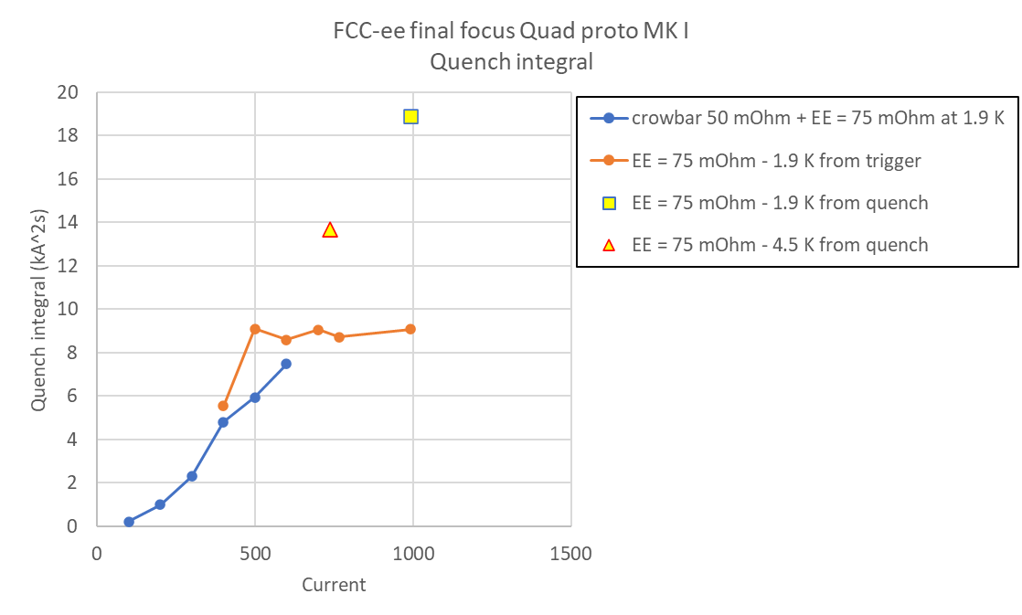
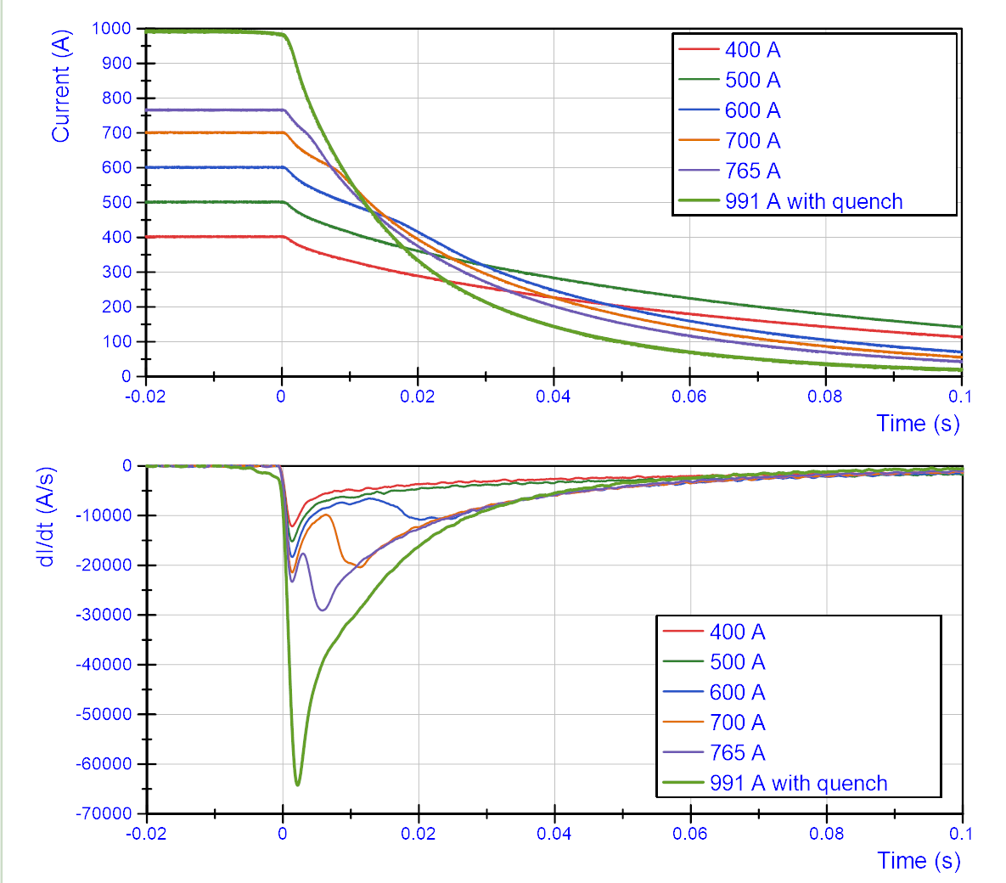
Quench integral and Quenchback
Above ~600A, the former absorbs some of the energy, so quench integral is about half of what simulation without former predicts
Effects to take into account:
Quench back starts between 400 and 500 A with 50 mOhm crowbar + 75 mOhm EE.
Quench back starts between 500 and 600 A for 75 mOhm EE.
The contribution of the former becomes more important at higher dI/dt. This could explain why the curve is flat above 500 A.

Slide 15
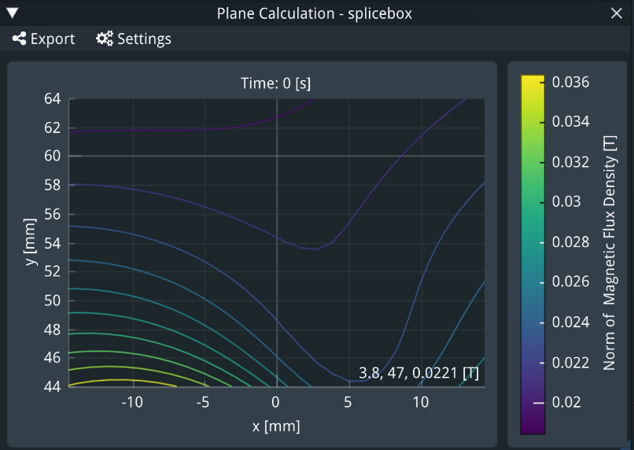
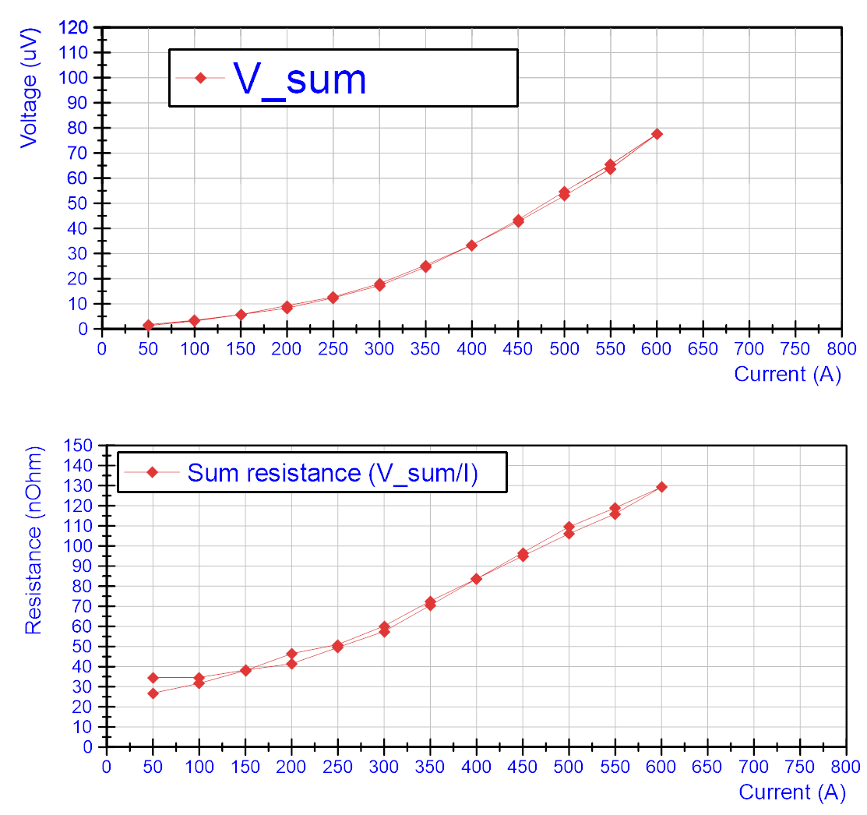
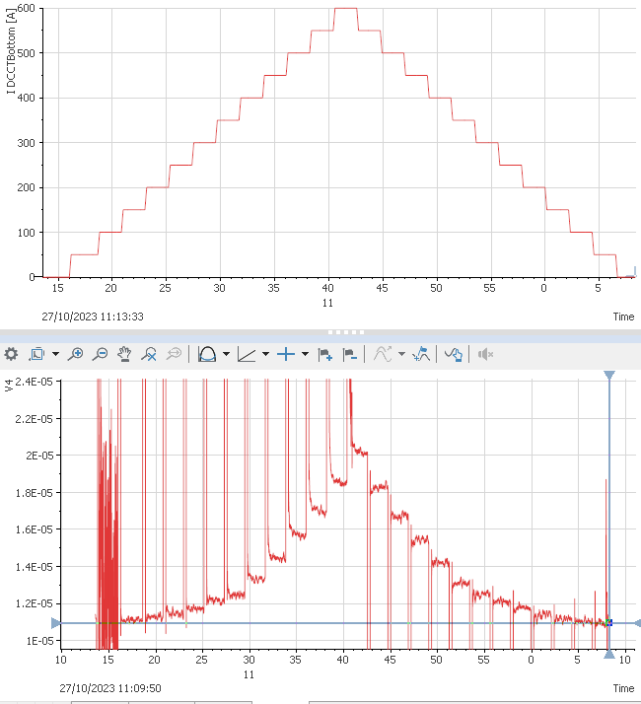
Splice resistance
Field at the splice box – around 30mT
Example raw data for V4 with non-linear voltage build up
Non-linear behaviour due to solder becoming superconducting

Slide 16
RRR of copper stabilizer
Measured resistance at 10K and 293K
RRR around 200

Slide 17
Field quality – the story before
Mysterious ‘environment’ component extracted after repeating warm measurement with a 42 degree tilt of the magnet

Slide 18
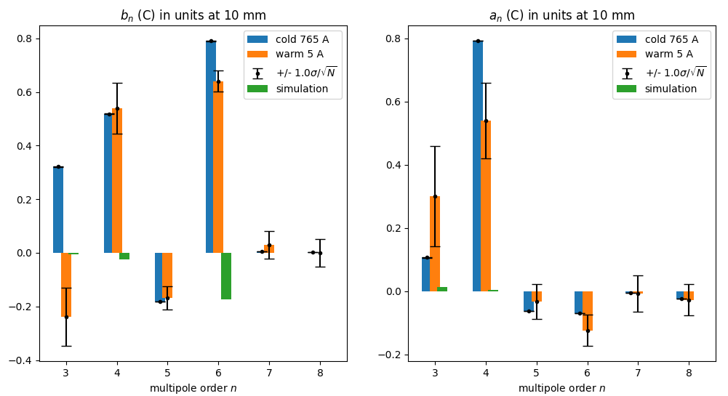
Field quality - cold
Work under way, but already <1unit for all multipoles
We did not do the same trick during cold measurements
The ‘warm’ measurements below come from the unrotated data

Slide 19
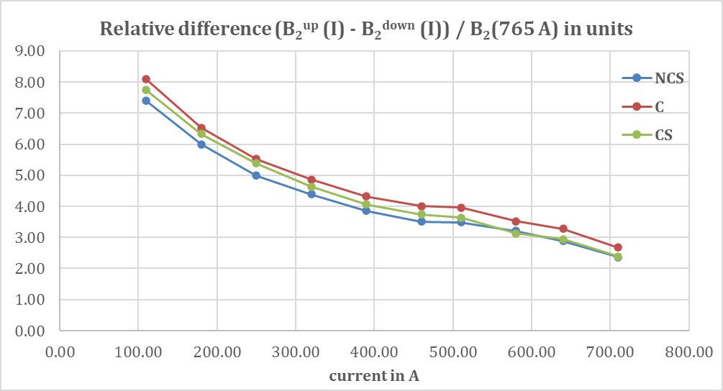
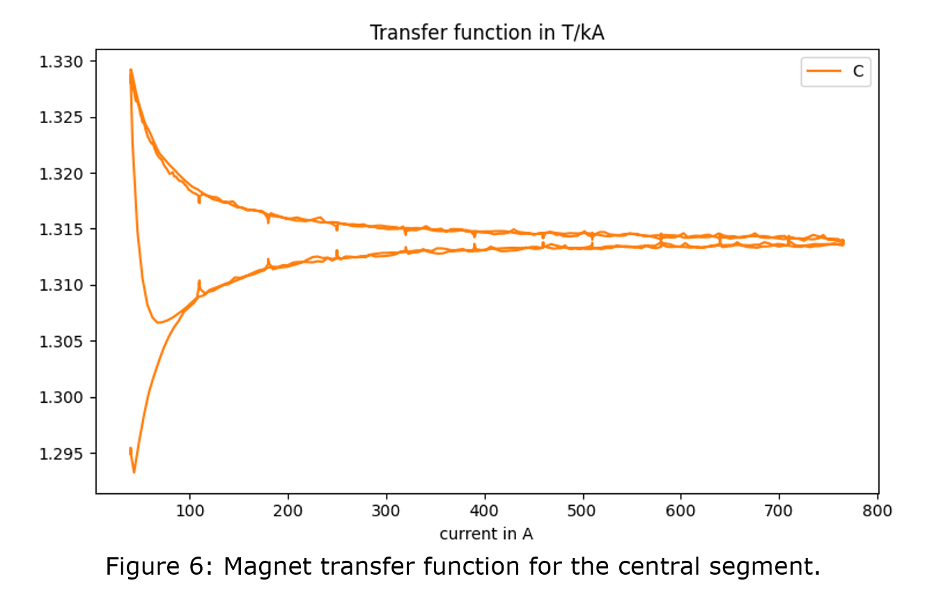

Transfer function
Exhibits quite a bit of hysteresis, although there is no iron
During ramping, this comes from eddy currents in the aluminium former
During flat tops, there should be some decay, then get dominated by persistent currents in the superconductor
Flat top
ramp

Slide 20
Next steps
Last (?) remaining question is the radiation resistance of wax.
The plan would be to irradiate and re-measure.
My request: can somebody calculate the expected dose of the QC1 magnets?
Second request: can the irradiation be done at Dafne?

Slide 21
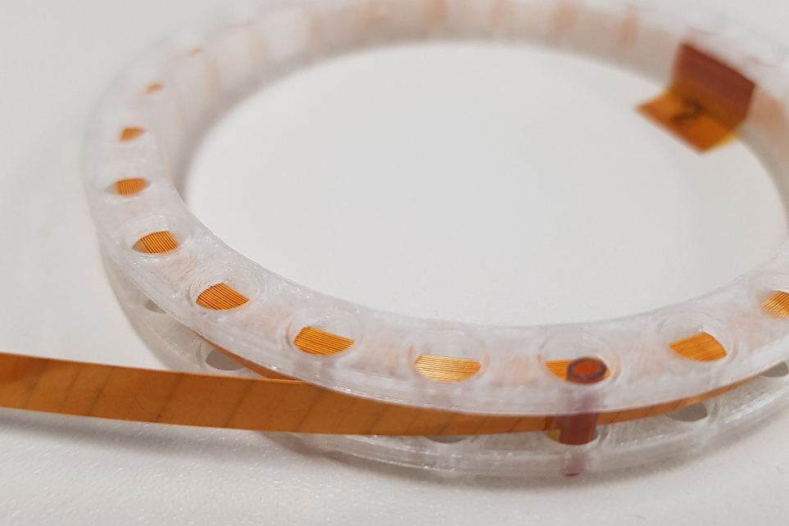
Upgrade to HTS
Changing the technology from NbTi to HTS would mean that we can operate at 30K instead of 2K.
BUT, HTS comes in form of tapes, not trivial to design a quadrupole with crosstalk compensation.
Earlier attempts resulted in large B6 (dodecapole) component which needed a dedicated corrector…
I am happy to report that I think I have solved all these technical problems.

Slide 22
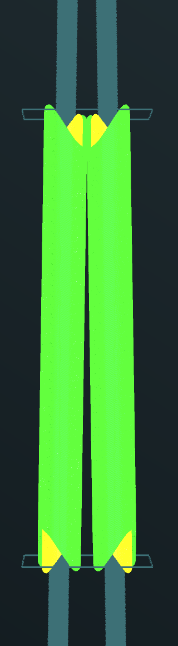
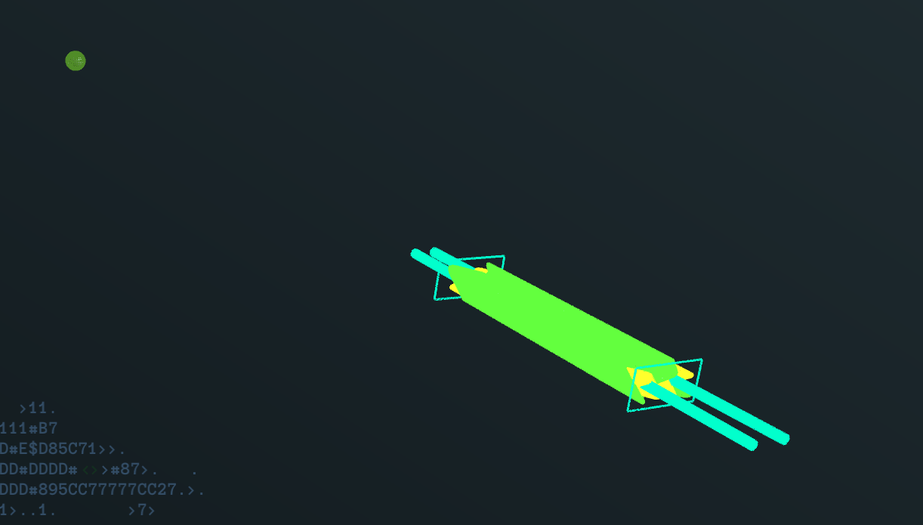
The new HTS design
View from the top
IP
QC1L1E, QC1L1P

Slide 23
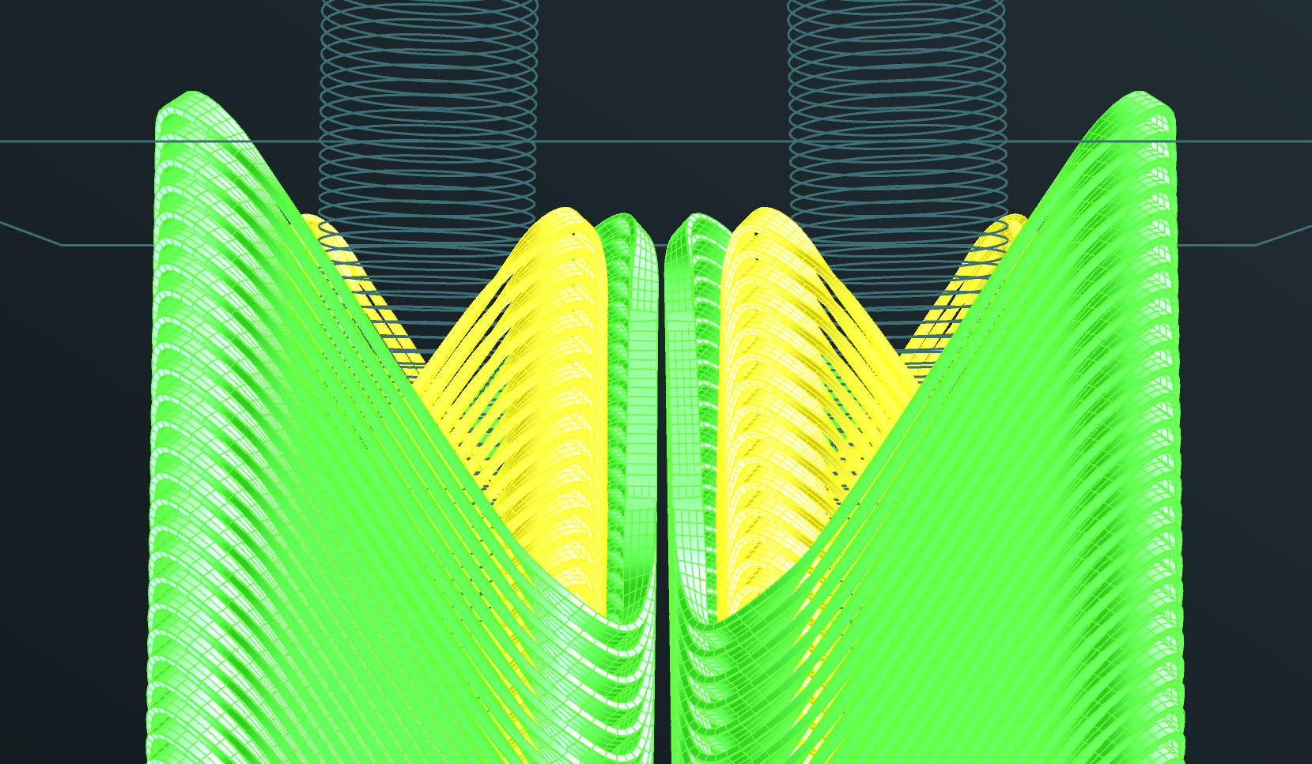
Detail at 2200mm from the IP
beampipe

Slide 24
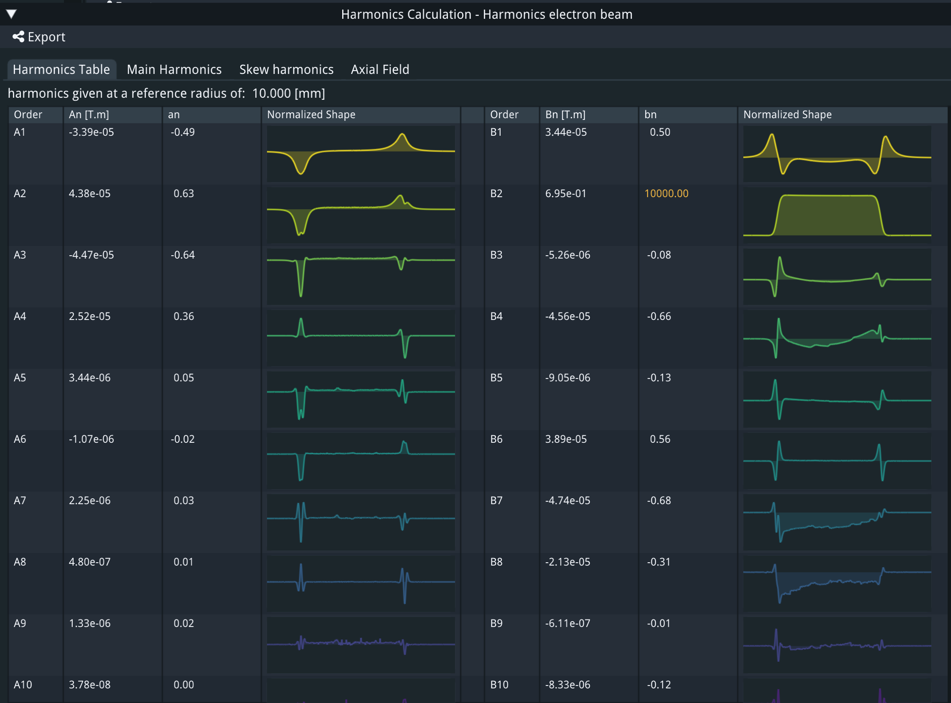
Crosstalk compensation e+ beam
All multipoles below 10⁻⁴. I stopped the optimization when I reached this level, but further improvement is possible and easy, up to the manufacturing tolerances (10⁻⁵??).

Slide 25
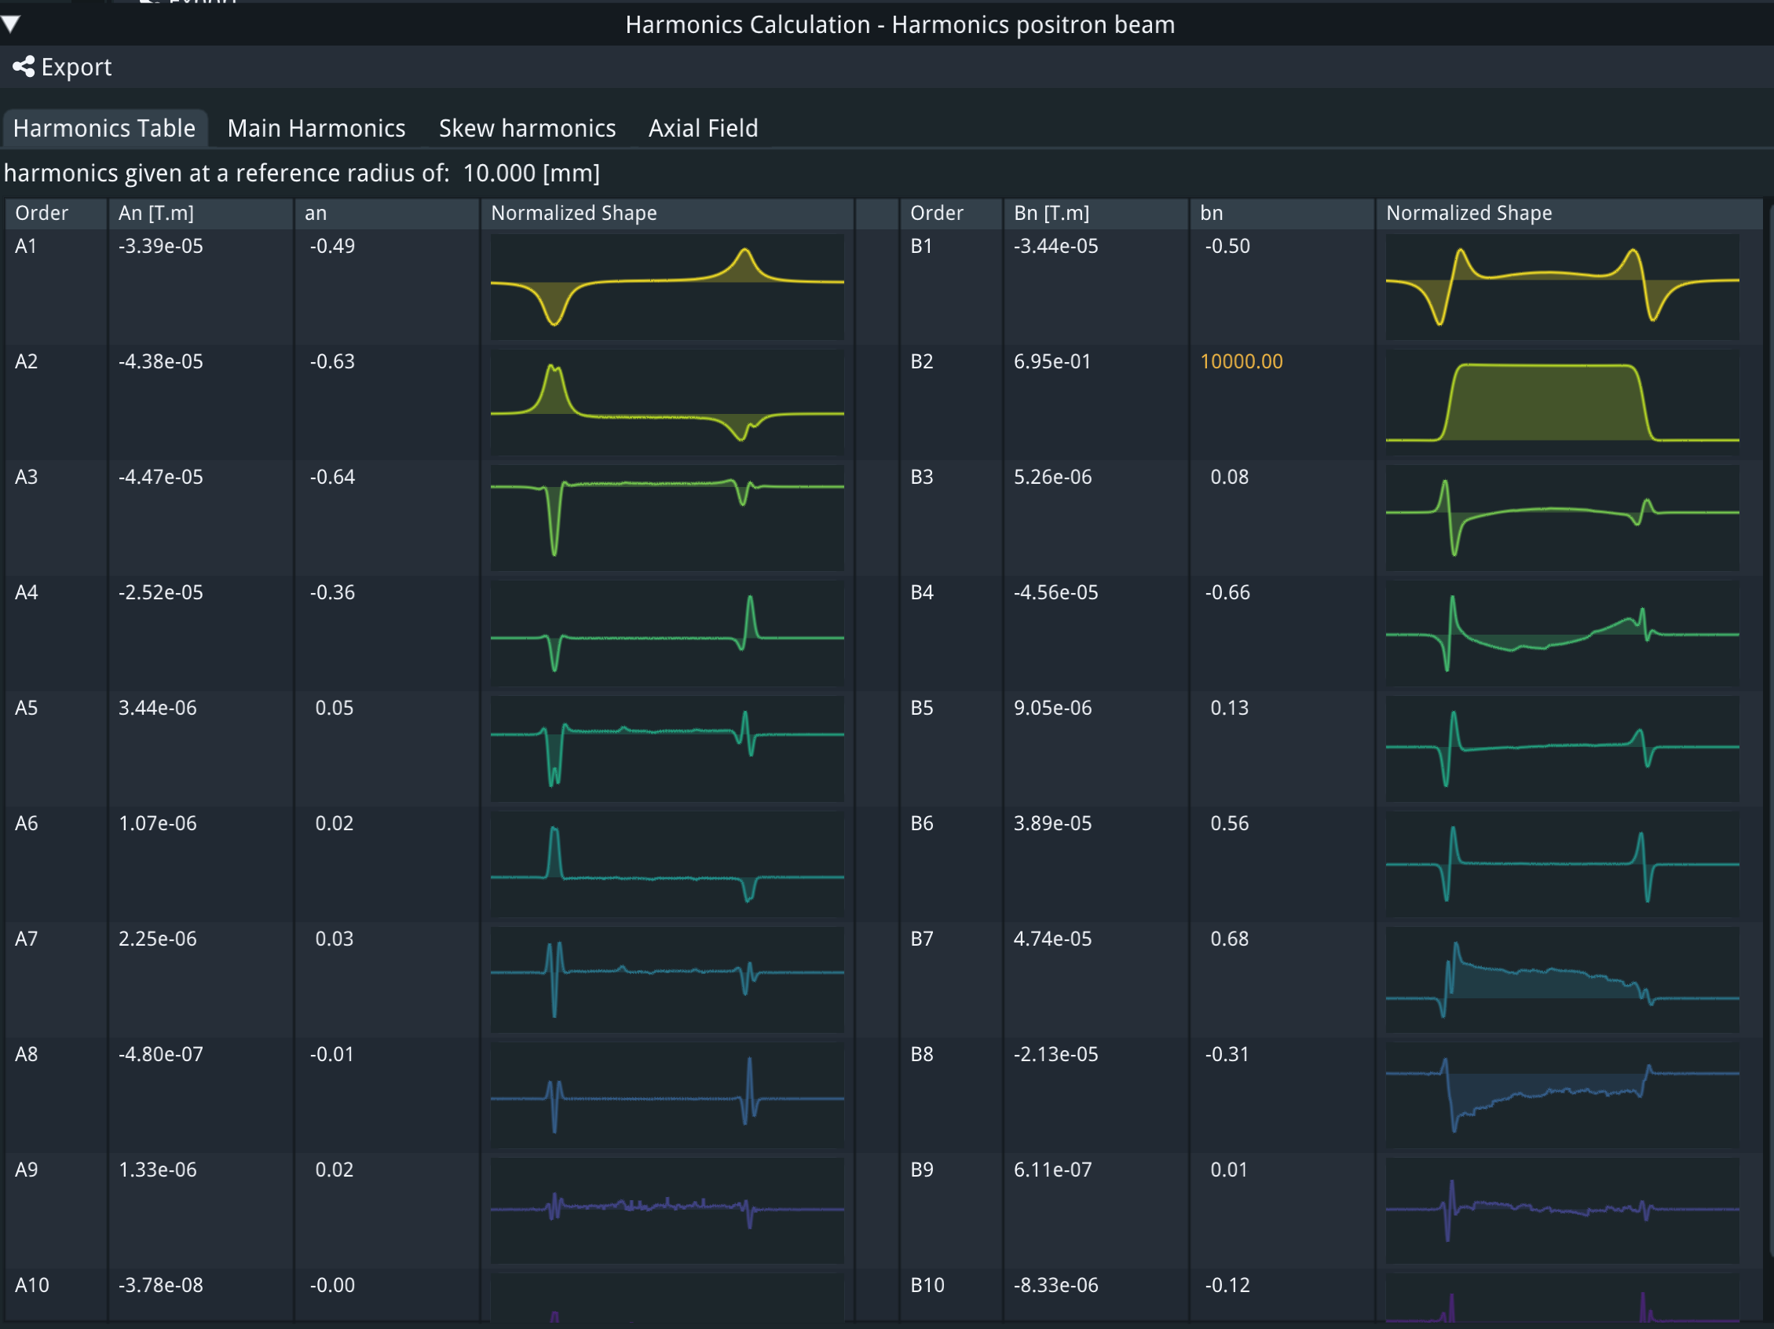
Crosstalk compensation e- beam
(System is symmetric)

Slide 26
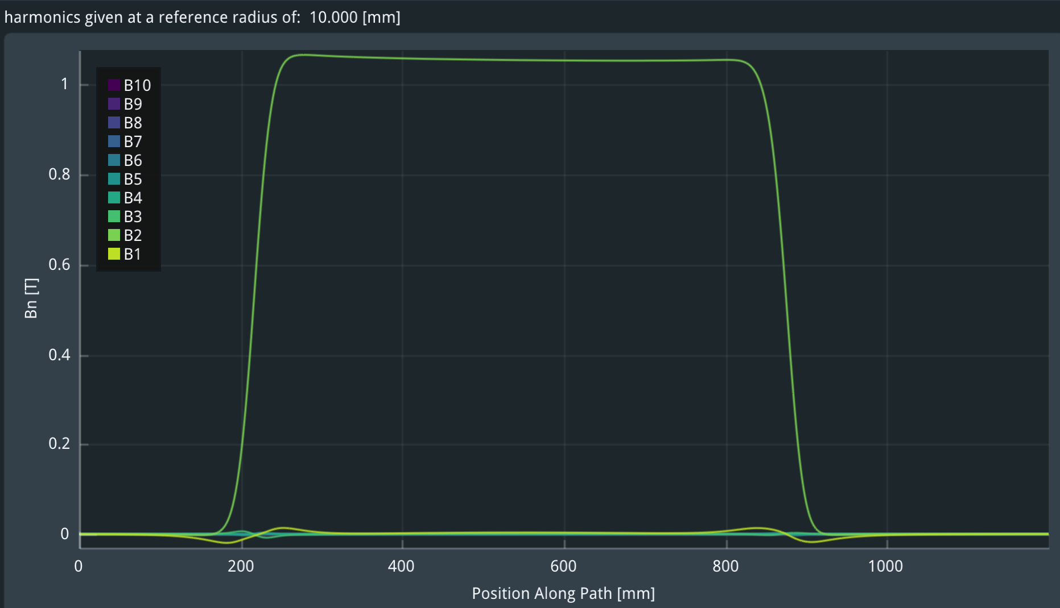
Field gradient
(7% higher than 100T/m since the magnetic length is 7% smaller)

Slide 27
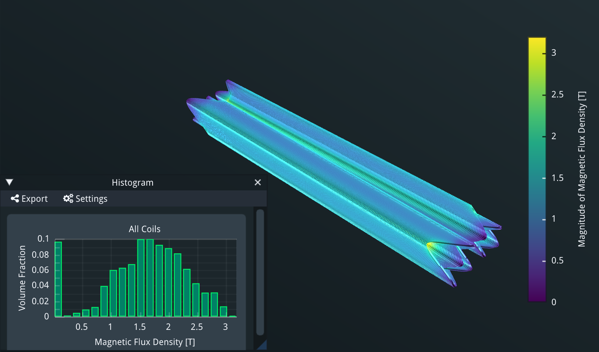
Magnetic field for 100T/m gradient

Slide 28
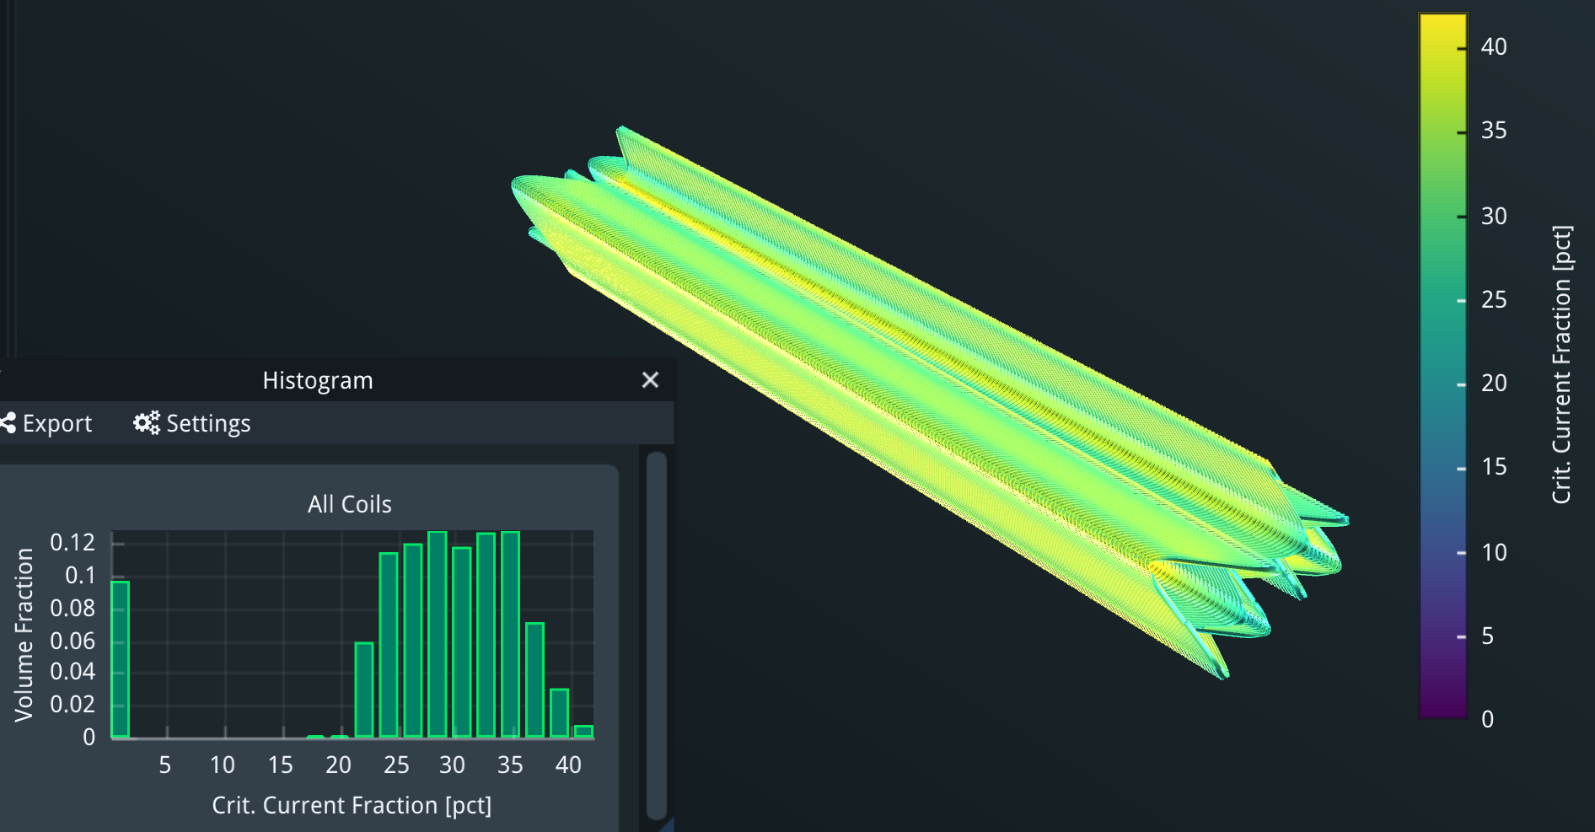
Critical current
10 turns of 400A per turn:
42% of critical current at 20K

Slide 29
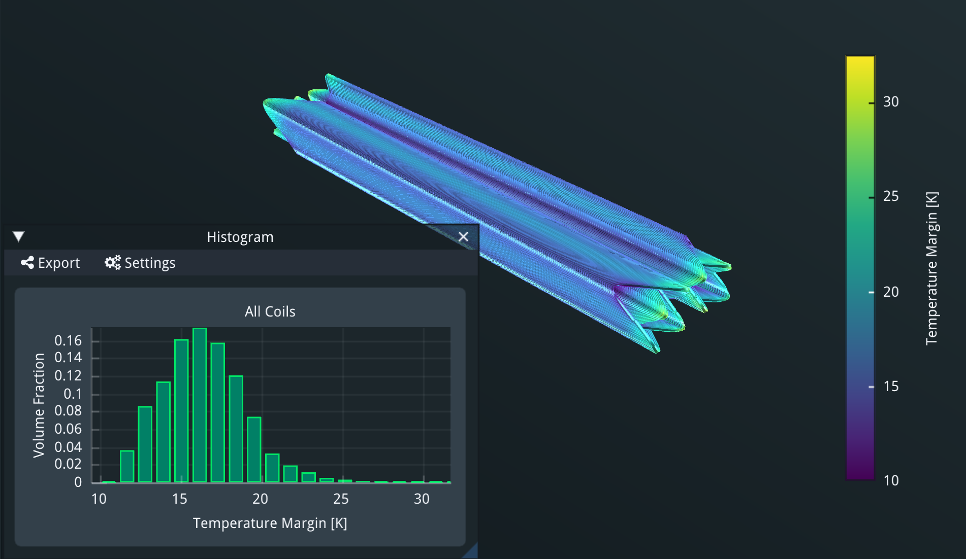
Temperature margin
If operating at 30K we have a margin of 10K

Slide 30
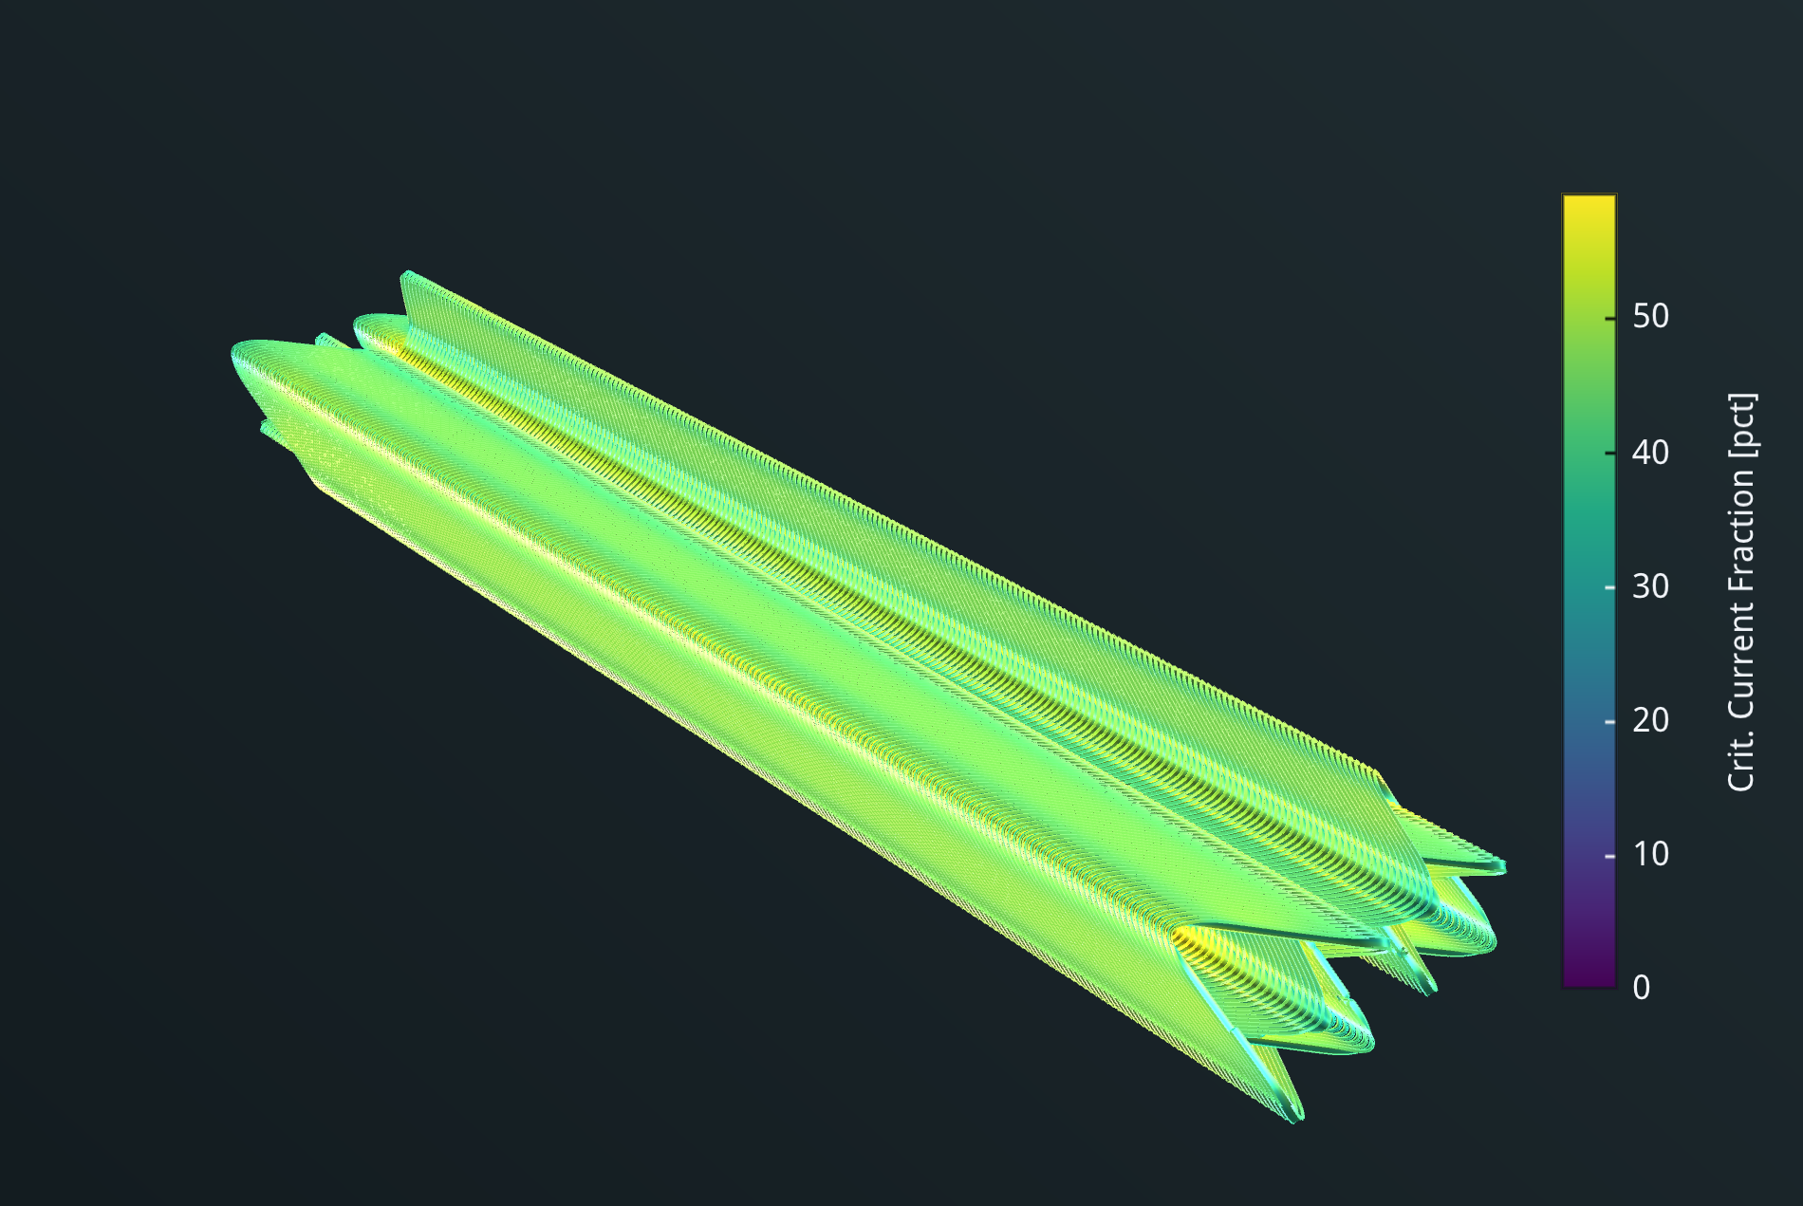
Running at 1.9K
Number of turns reduced to 4 (from 10) and current increased to 1000A
Critical current fraction ~60%

Slide 31
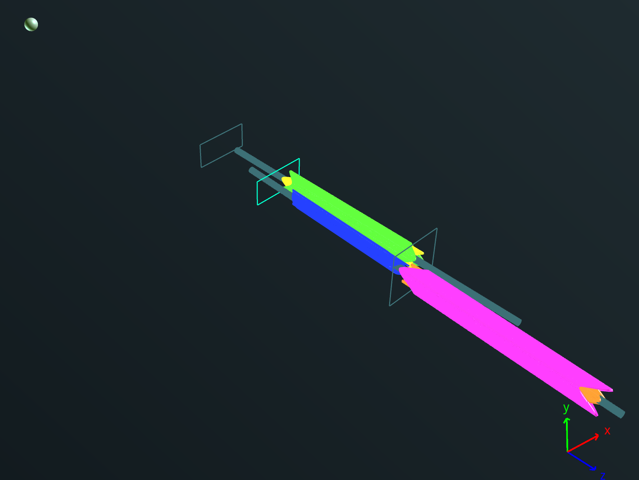
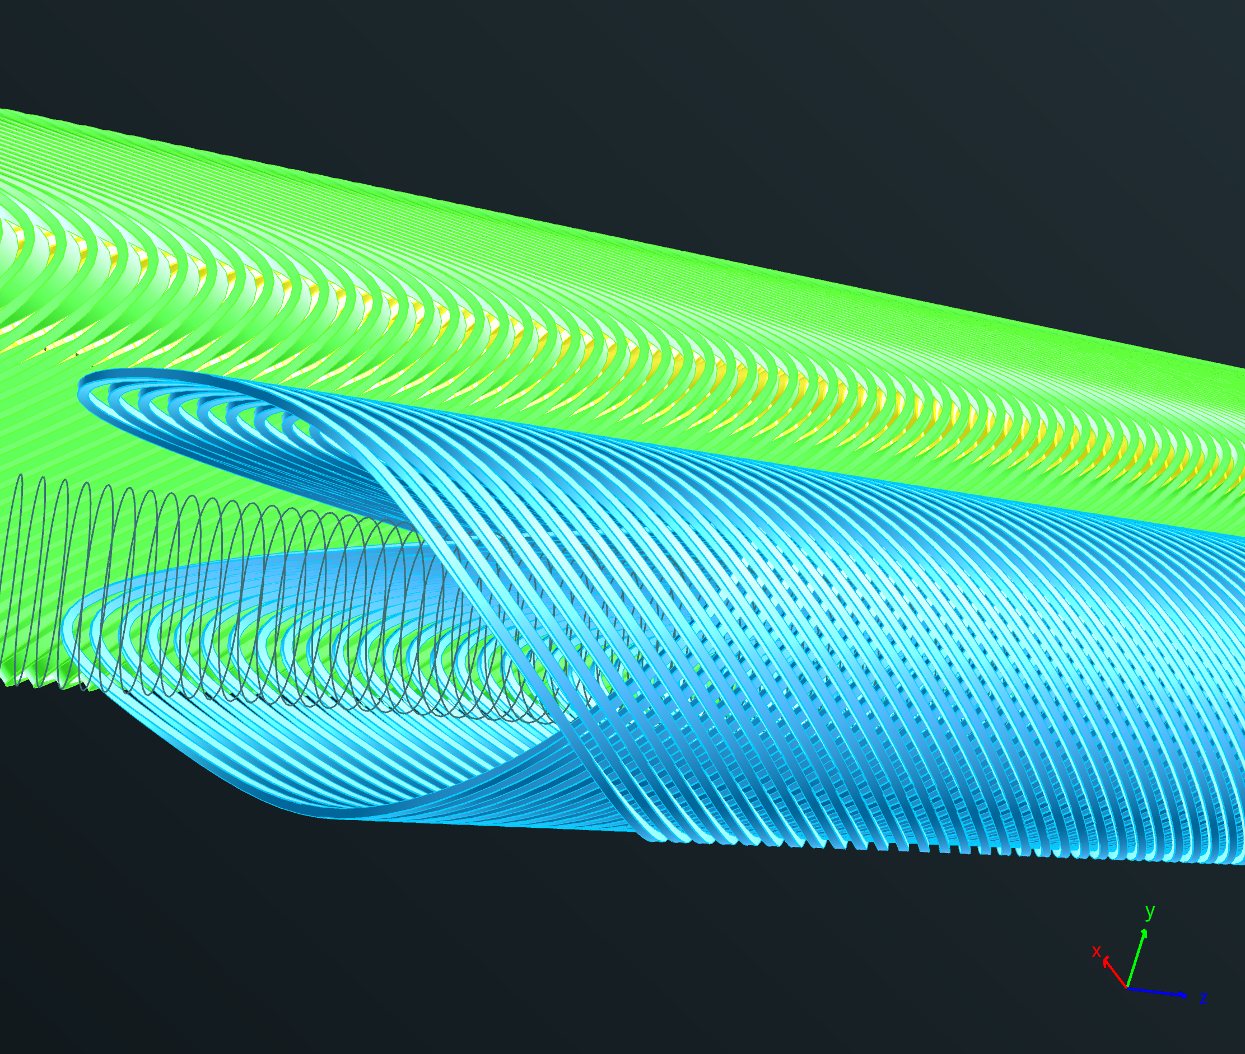
Asymmetric design
An asymmetric design, with e⁺ quad L*=1.6m, e⁻ quad L*=2.2m was developed, following a request by P. Raimondi
This necessitates the use to ‘cancel coils’ (like SuperKEKb) [here in blue] which are very thin but necessary.
Current design uses NbTi single 0.825mm wire (LHC strand)
Operating temperature will have to be 4.5K or below
IP
QC1L1_electron
Cancel coil
QC1L1_positron

Slide 32
Parasitic currents
A potential problem of HTS tapes is parasitic currents when running well below the critical current that could introduce multipole errors
The real answer of how important these are will be given when we measure the HTS arc sextupole, currently under manufacture for the FCCee-HTS4 project.
Simulations show that the problem for the HTS4 sextupole is well below 1 unit of 10⁻⁴
Need to measure!

Slide 33
Future development
I have used 4mm-wide HTS tapes, which are the norm these days.
However, some manufacturers also provide 3mm tapes, which are easier to bend and make for a more compact magnet (but less current can pass thorough).
Currently we have a gap of ~1mm between magnets at the tip. Using 3mm tapes will bring this up to ~5mm.

Slide 34
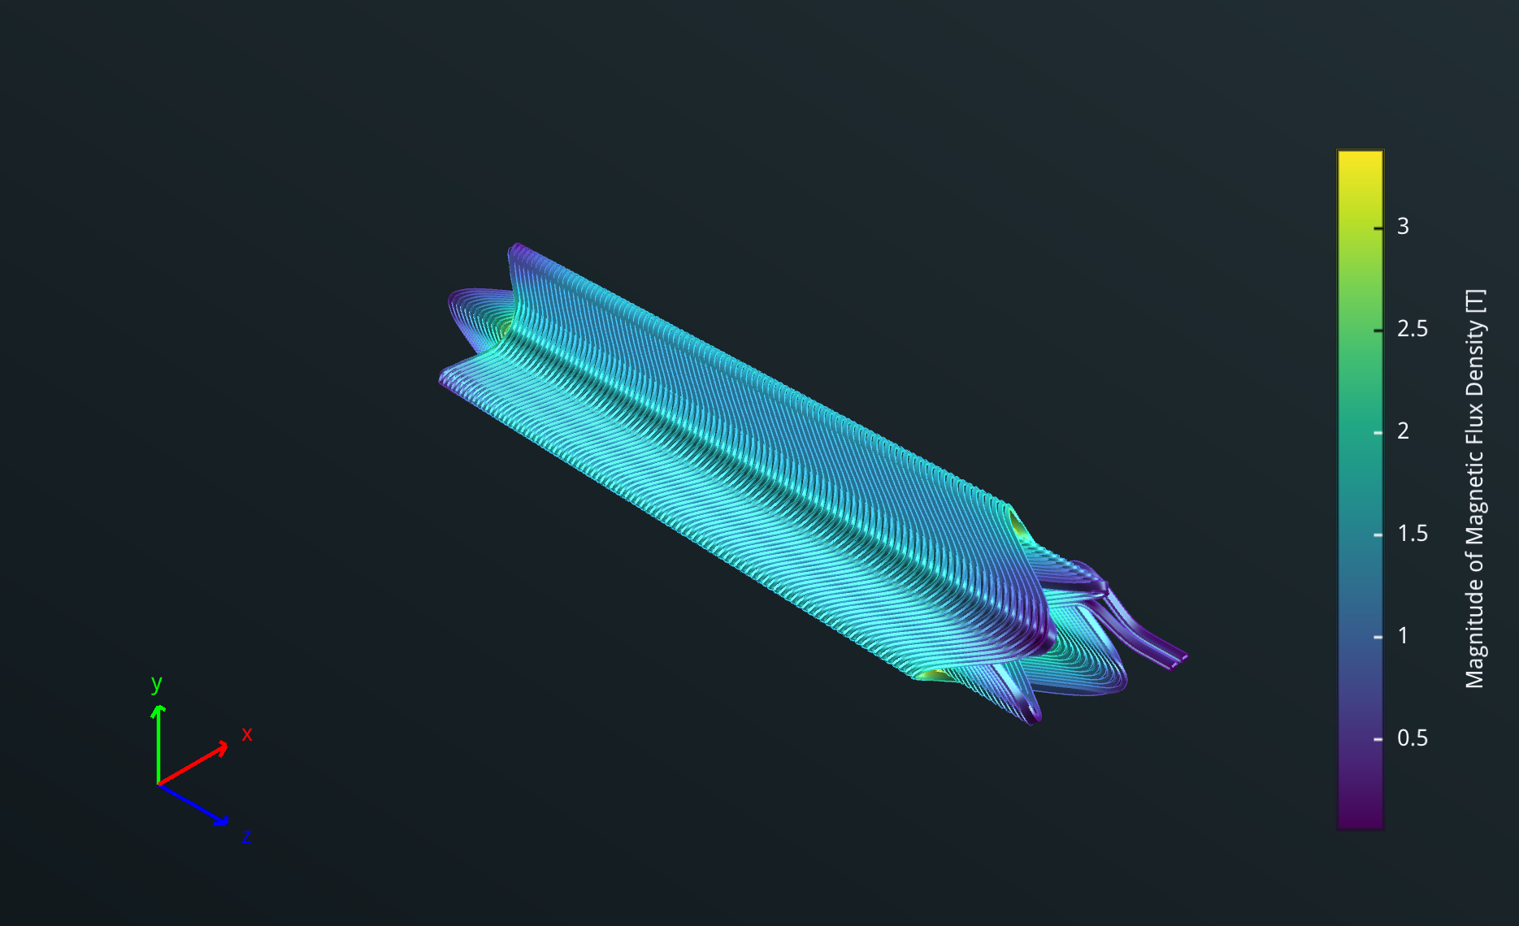
Magnetic design of single aperture prototype
Similar in size to NbTi prototype

Slide 35
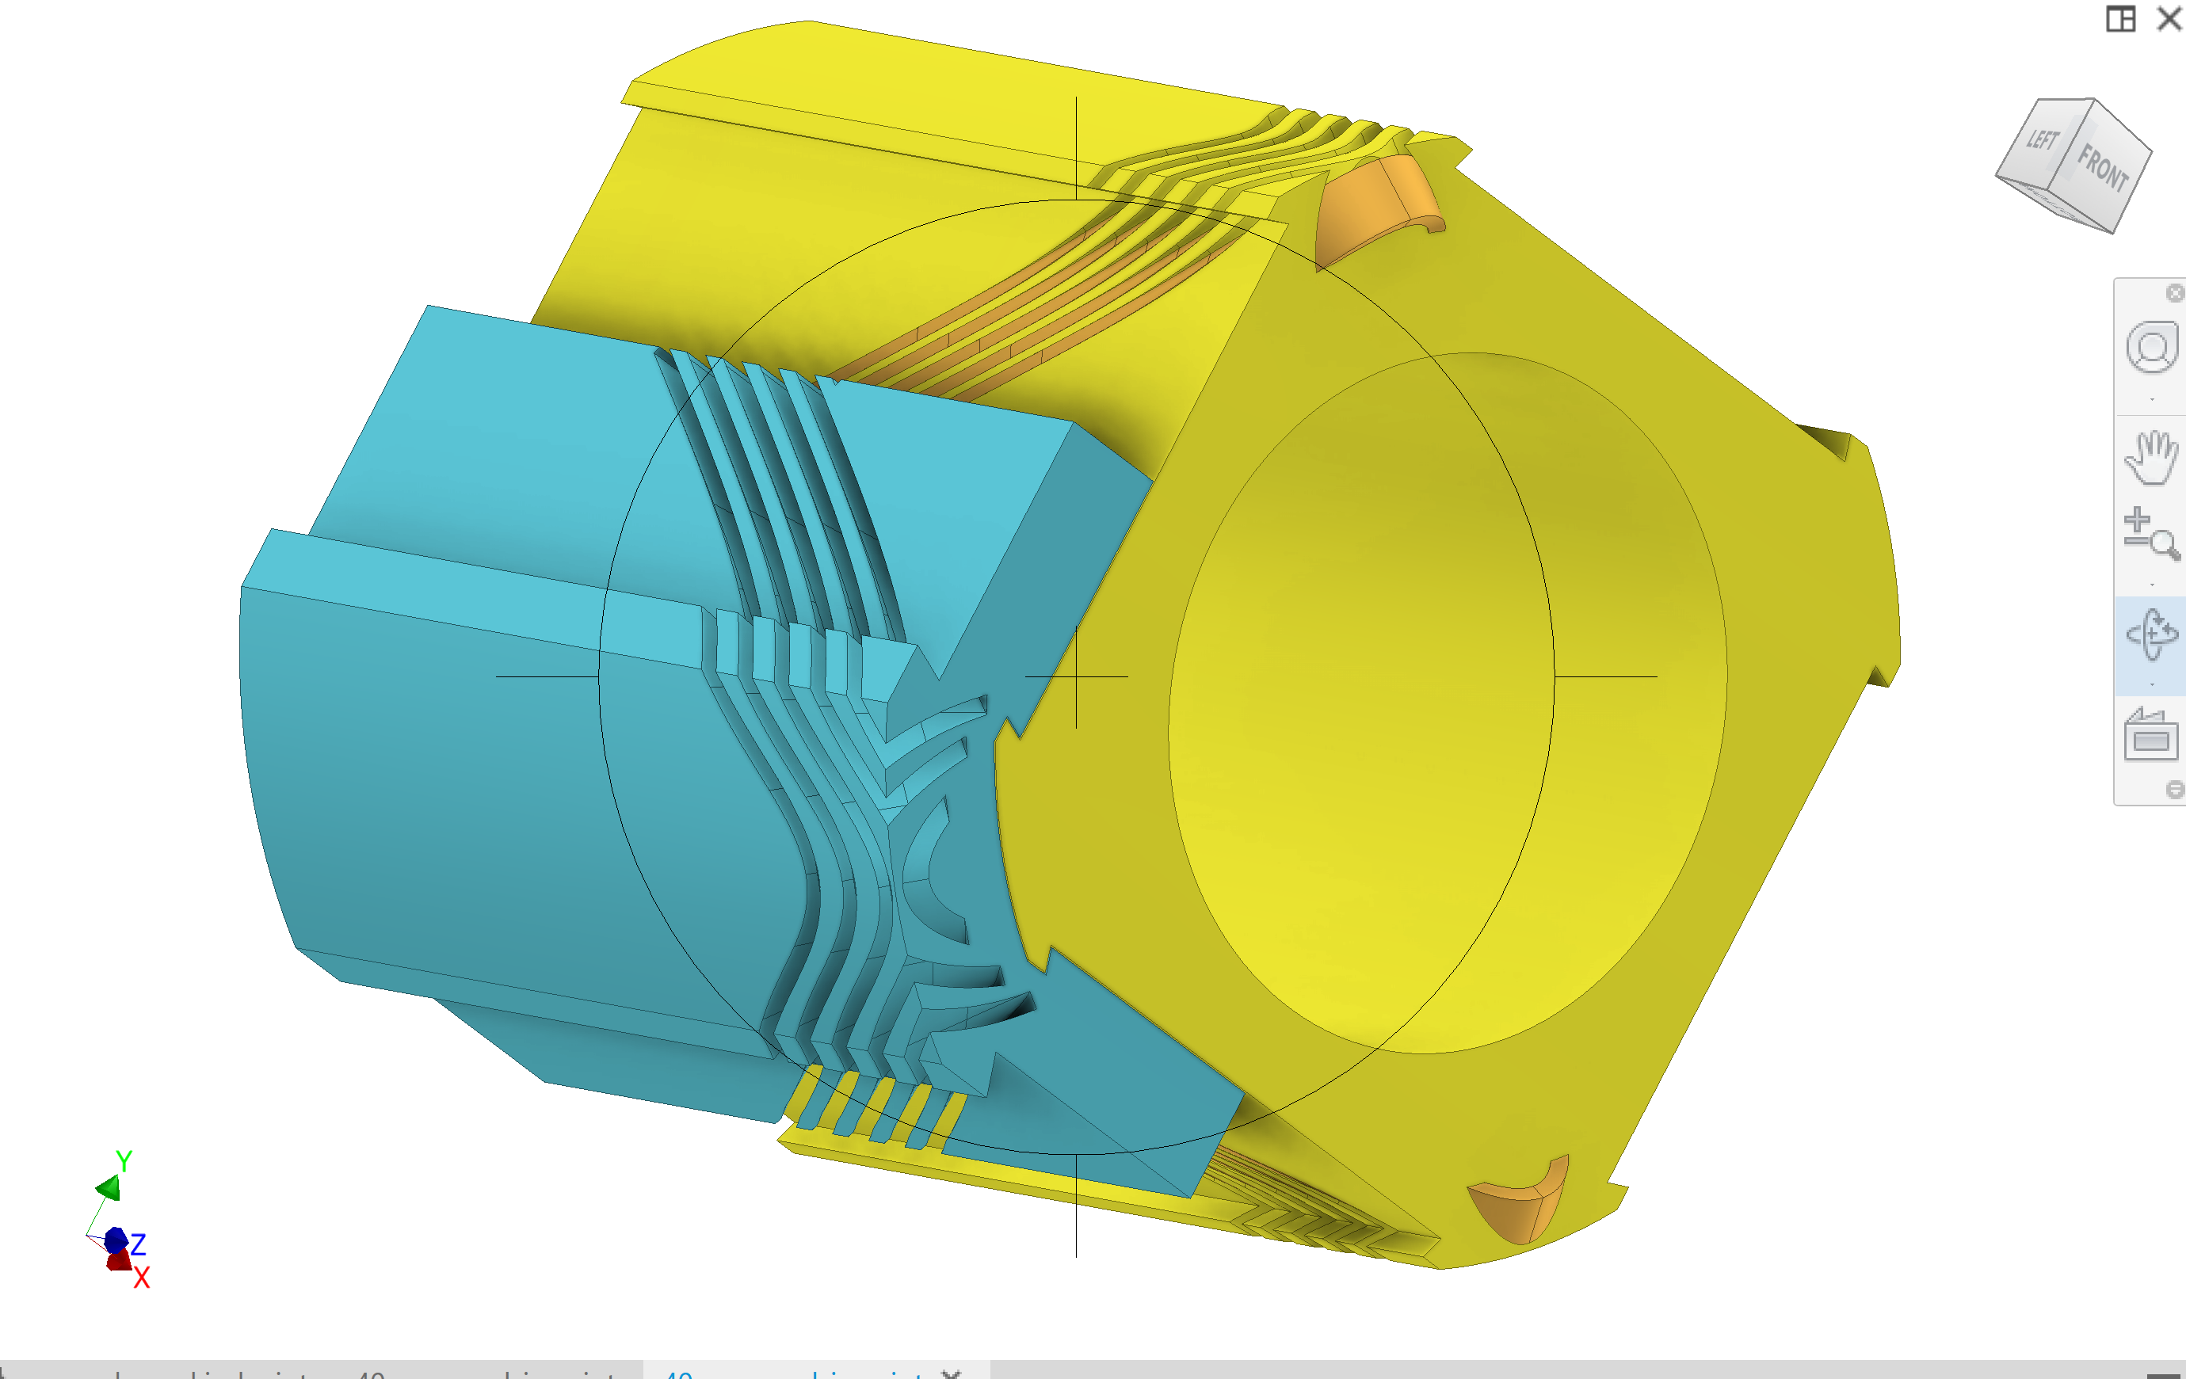
Mechanical design
I have started the mechanical design of a possible prototype

Slide 36
Request for resources
This upgrade is worth pursuing.
It is really state-of-the-art and will establish FCC as a world-class player in this field
I would like to request for recourses to make a prototype.

Slide 37
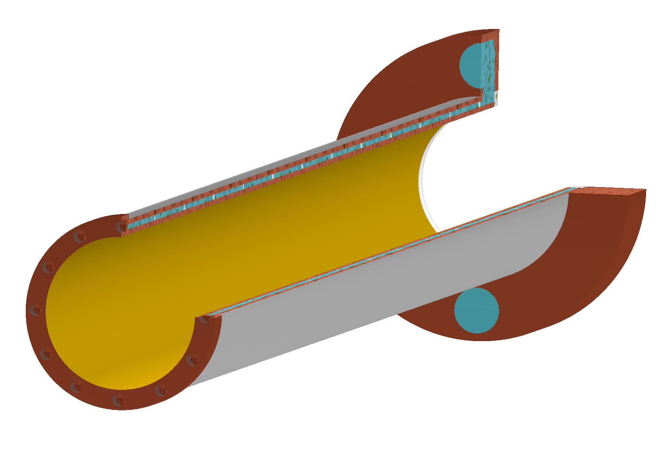
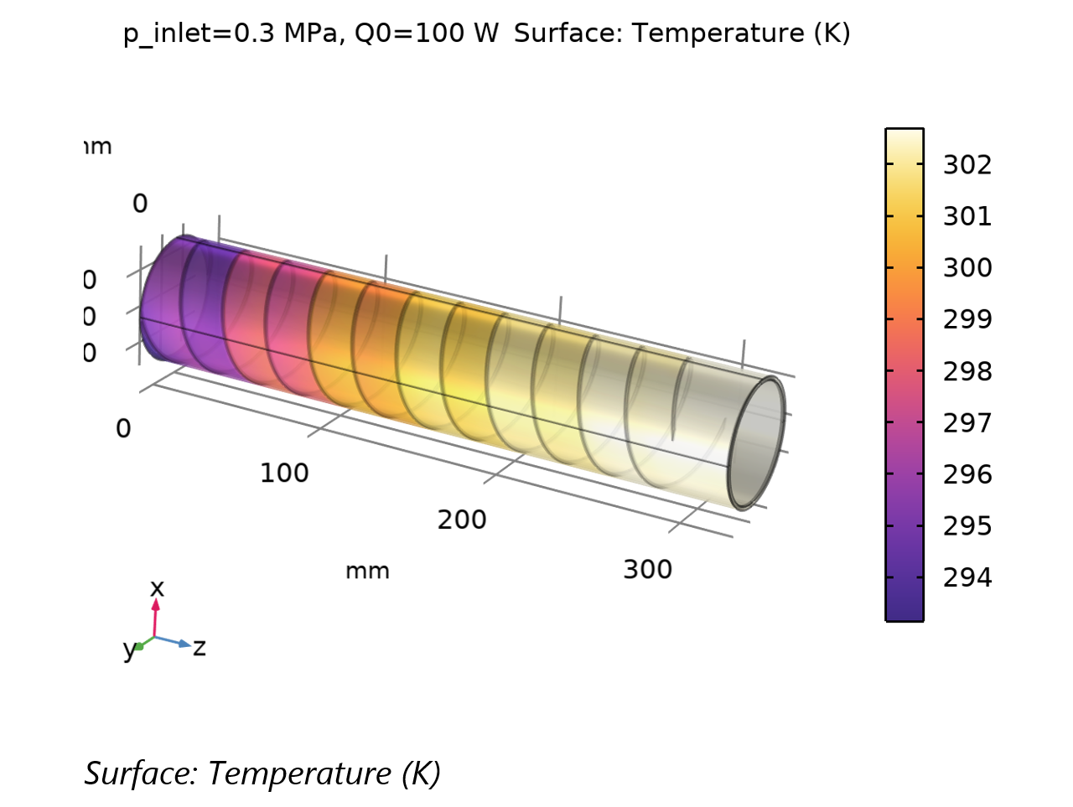
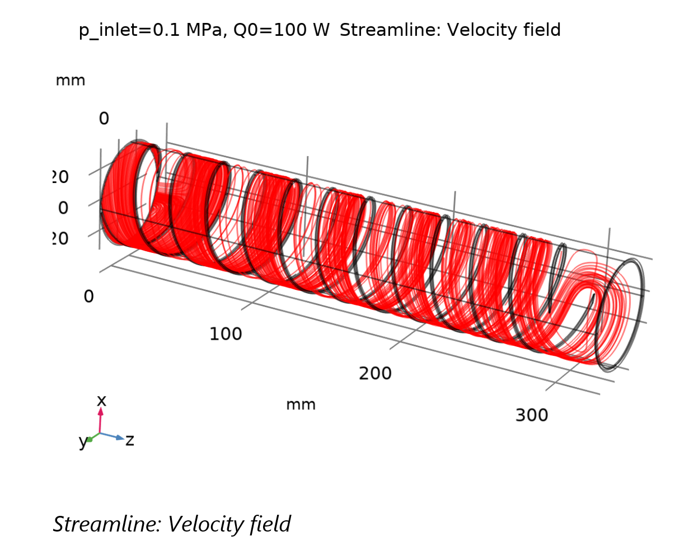
Water cooled sandwich beam pipe
Work started by A. Thabuis
ID: 15mm, 1mm aluminium, 1mm water, 1mm aluminium
Beam pipe is heated with 100W/m
Temperature
Fluid flow
Need a prototype!

Slide 38
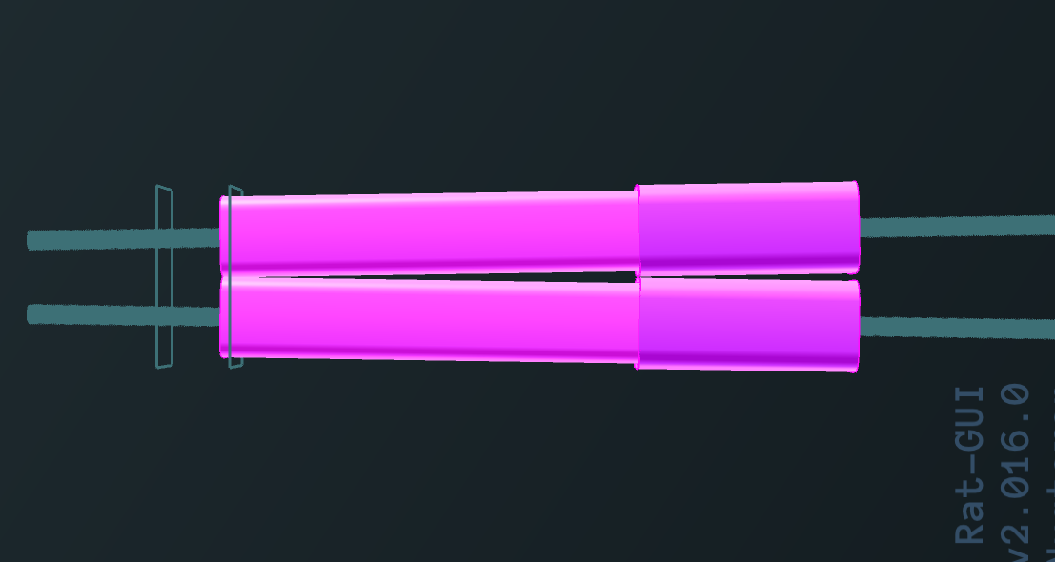
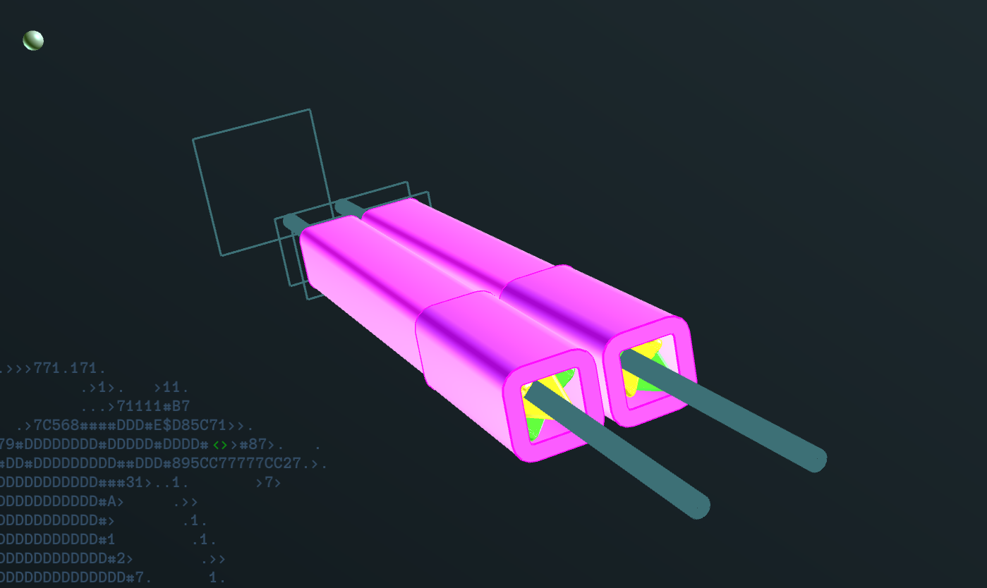
Nb: what is the effect of iron?
For QC1L1, there is not enough space. So I used iron for QC1L2 which resides at L=2980mm.
Bottom line is that, while improving things, crosstalk is reduced by less than a factor 2.

Slide 39
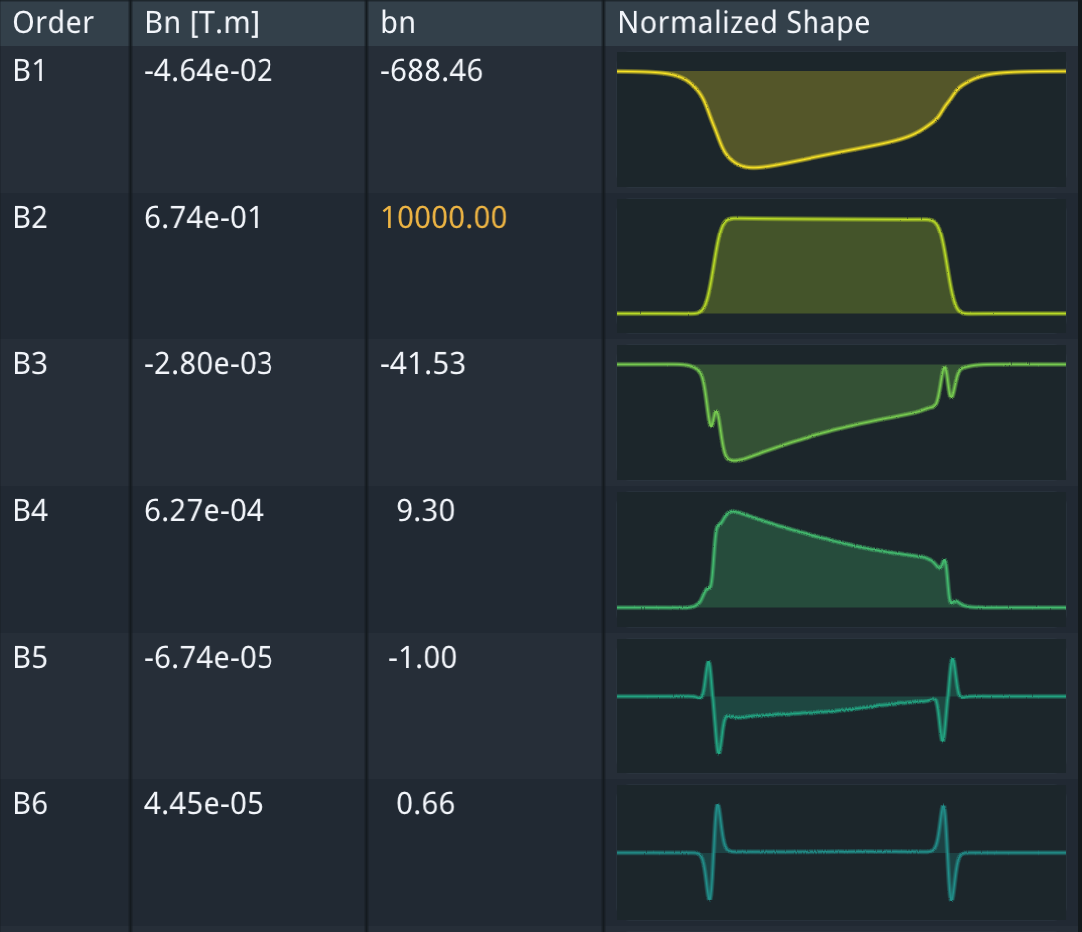
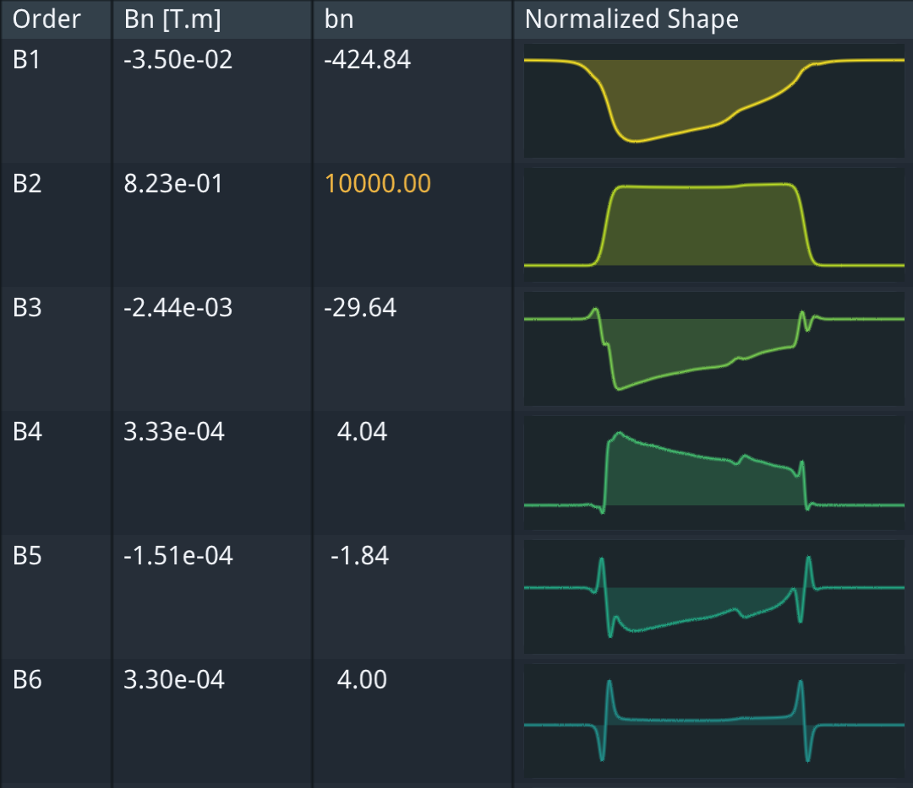
Multipoles with/without iron QC1L2
Without iron
With iron

Slide 40
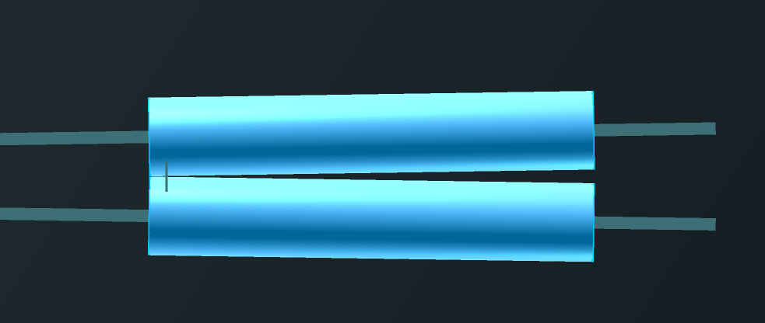
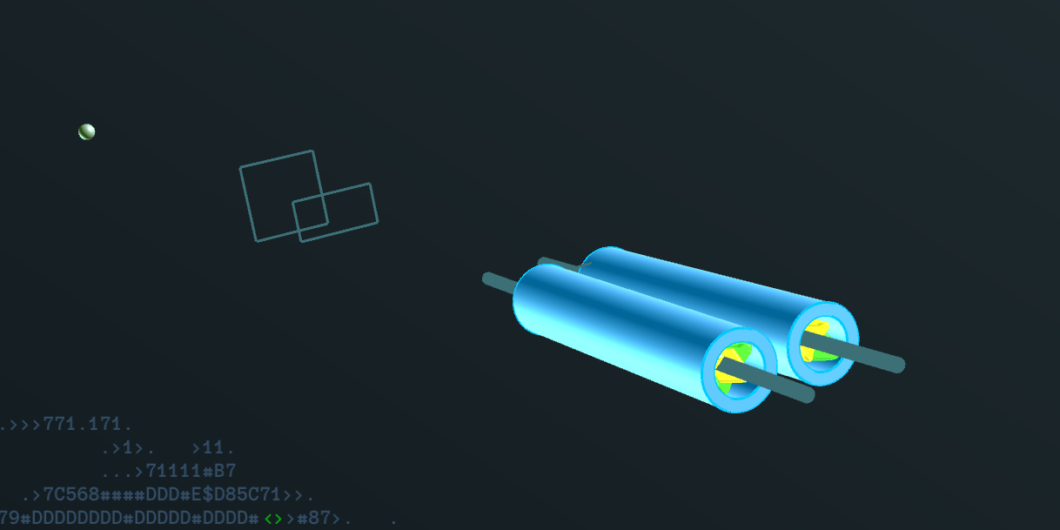
QC1L3
This is at L of 4310mm from the IP. Here there is space for more iron (40mm or more).
Iron gets rid of most multipoles, but not all…(small B1, B4 remaining)
This is not problem with the CCT approach, where these multipoles can be corrected.

Slide 41
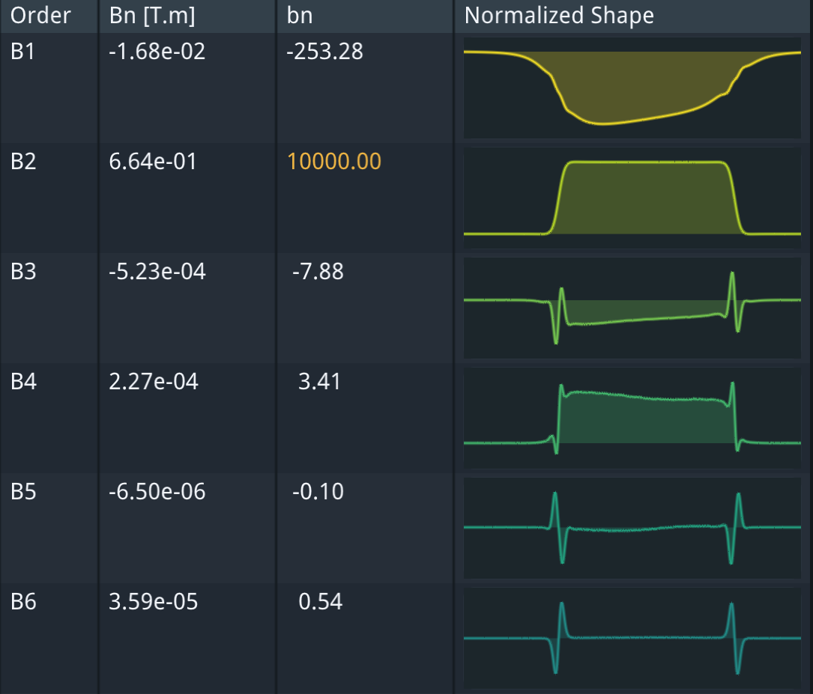
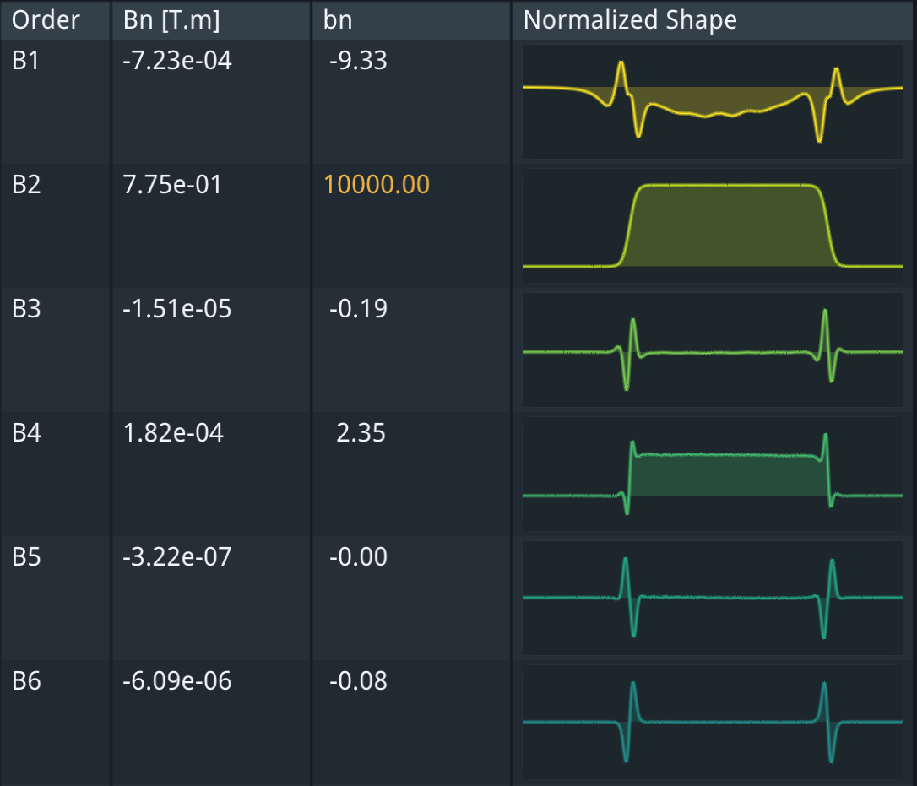
QC1L3 multipoles with/without iron

Slide 42
Corollary:
I do not see how the CEPC can shield all crosstalk with a few millimeters of iron…

Slide 43
Conclusions
The first FCC-ee FF quad prototype was tested at cold with excellent results
Making the FF quads of FCC using HTS tape conductors now appears possible.
This is a very promising development.
Making such a small aperture, cross-talk free magnet out of HTS tape is very (very) difficult.
We should build a prototype as soon as possible!
This development might be of interest for SuperKEKb.

Slide 44
Thank you

