Slide 1
Overview of MDI regions in different e-e colliders and their impact on detector design.
<The art of balancing conflicting requirements>
FCC-ee MDI Workshop at INFN/Frascati

Slide 2
Summary
Introduction
Main MDI components
MDI at ILC & CLIC & their impact on detector design
General issues to e-e detectors’ MDI
Exemples of Vertex integration
MDI at FCC-ee & impact on detector design (CLD case study)
Conclusions

Slide 3
Introduction
The Machine – Detector Interface is the region that encompasses the last accelerator components before the Interaction Point and those detector elements closest to the beam-pipe.
The design of the MDI region shall take into account the requirements from the machine (luminosity, reliability, serviceability, mechanical stability) and those from the detector (lowest background, largest acceptance, easy accessibility to detector parts for maintenance).

Slide 4
Main MDI components
from the machine side:
  Final focus quads
  Anti-solenoid / Compensator
  Beam Positioning Monitor
  Luminometer
  Beam-pipe + vacuum flanges/valves + bellows
from the detector side
  Vertex detector / Inner Tracker + services
  Mask for background suppression
common to both:
  Supporting structures
  Alignment system
  Vibration stability features
Cryostat (superconducting)

Slide 5
MDI at ILC & CLIC & their impact on detector design
 | L* (mm) | crossing-angle | beam-size at IP | stability
ILC | > 4,200 | 14 mrad | 10 nm | 20 nm RMS
CLIC | > 3,500 | 20 mrad | 2 nm | <1 nm RMS
Repetition rate
5 Hz
50 Hz
ILC
  Final focus with cryogenics magnets → cryostat & vacuum integration
  Moderate vibration stability
  Long L*
  Low repetition rate
CLIC
  Final focus with permanet magnets + resistive coils -> no cryostat
  Extreme vibration stability due to beam size
  Short L*
  High repetition rate
N.B: Detectors share the same IP → Push-pull design allowing detector swapping in 48 hours

Slide 6
General issues to e-e detectors’ MDI
focus on:
Segmentation of detector & detector opening on the beamline.
Alignment features.
Mechanical stability & support of forward instrumentation / shielding.

Slide 7
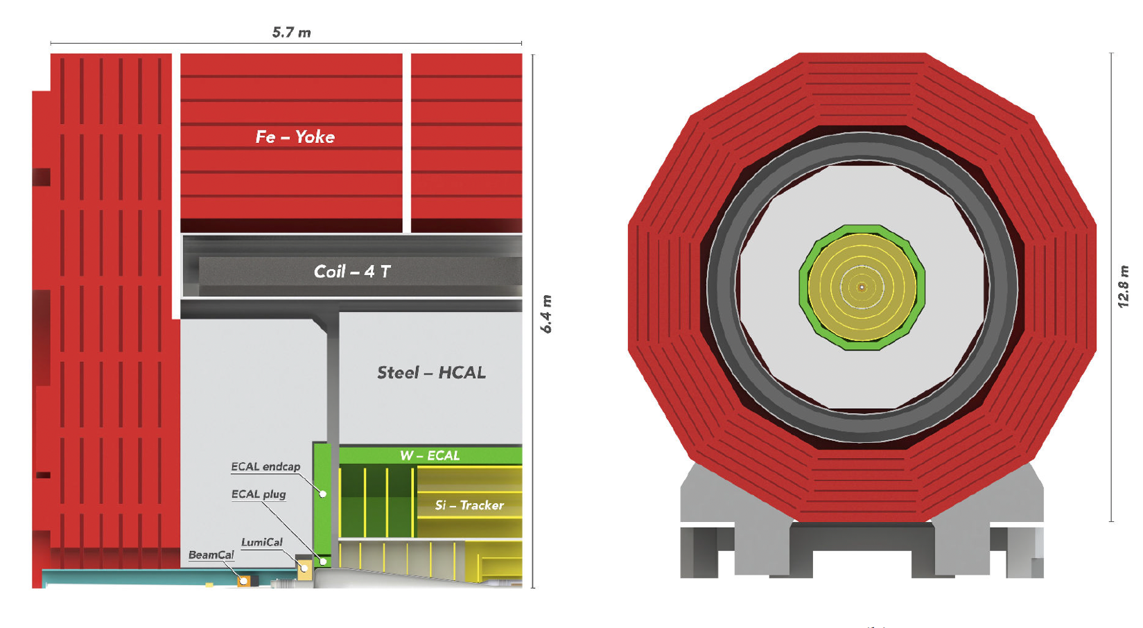
Typical detector structure.
Fixed solid
structure
Moving solid
structure
Moving solid
structure
Fixed solid
structure
CLICdp image
MDI
Light weight and/or fragile structures

Slide 8
General issues to e-e detectors’ MDI (I)
Segmentation of detector.
  Segmentation of detector shall be compatible with the assembly & maintenance scenario. In particular, the question whether the detector endcaps are split vertically or not, has great importance for the MDI design. For this latter point, the choices are the following.
  Endcaps split vertically – make the integration of the FF simpler, but require supporting FF elsewhere; large magnetic forces complicate the design of the endcaps in addition to detector hermeticity issues in the vertical forward plane.
  Endcaps not split – detector integrity respected, require longer longitudinal opening stroke, tight requirements on the external size of the FF to keep good acceptance for detector, installation and access to beam-pipe and machine elements more complex.
Opening of detector off the beamline.
  In this case, the detector is translated off the beam line to a “garage” position where the FF machine elements can be easily removed and the detector opened. It is the case for ILC & CLIC.
Opening of detector on the beamline.
  MDI design should allow for (partial) detector opening or closing to be performed on the beam-line, ideally without breaking the beam-pipe vacuum.

Slide 9
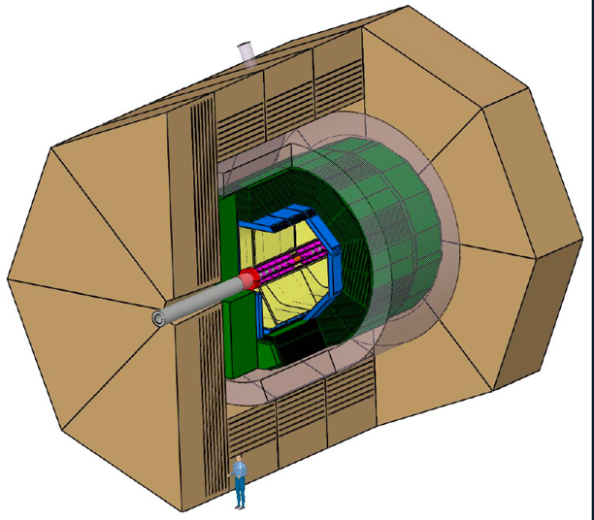
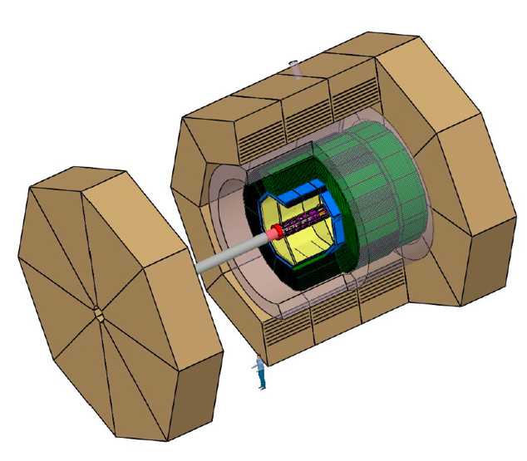
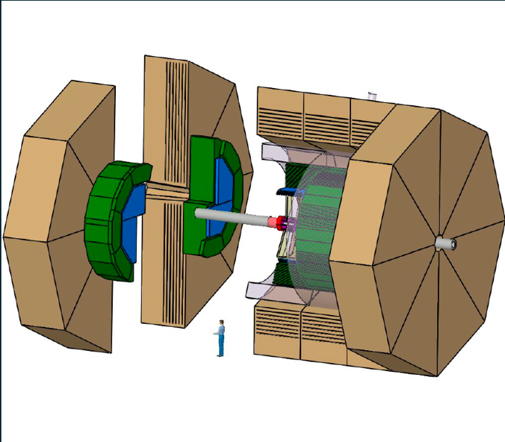
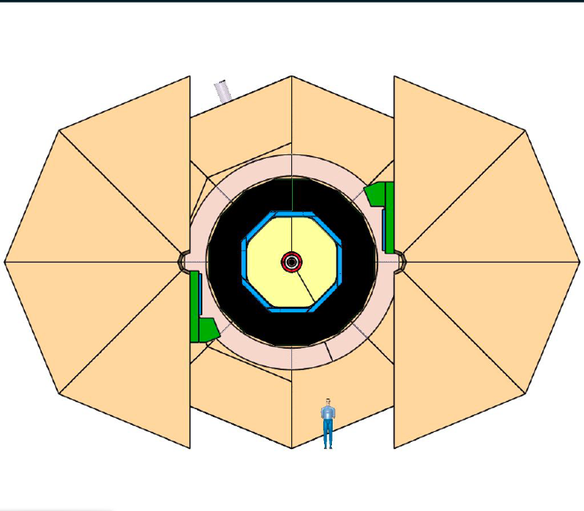
Detector opening (I)
Solid Endcaps
Split Endcaps &
FF external supporting column.
Detector moving on a platform aside the IP with the FF
Long longitudinal stroke
Rods
FF
Combined stroke
Split Endcaps

Slide 10
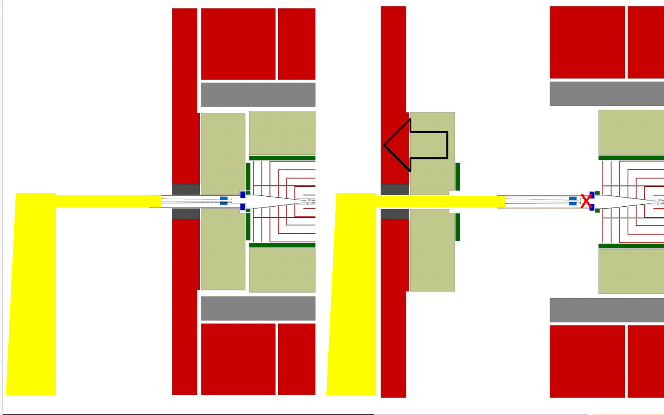
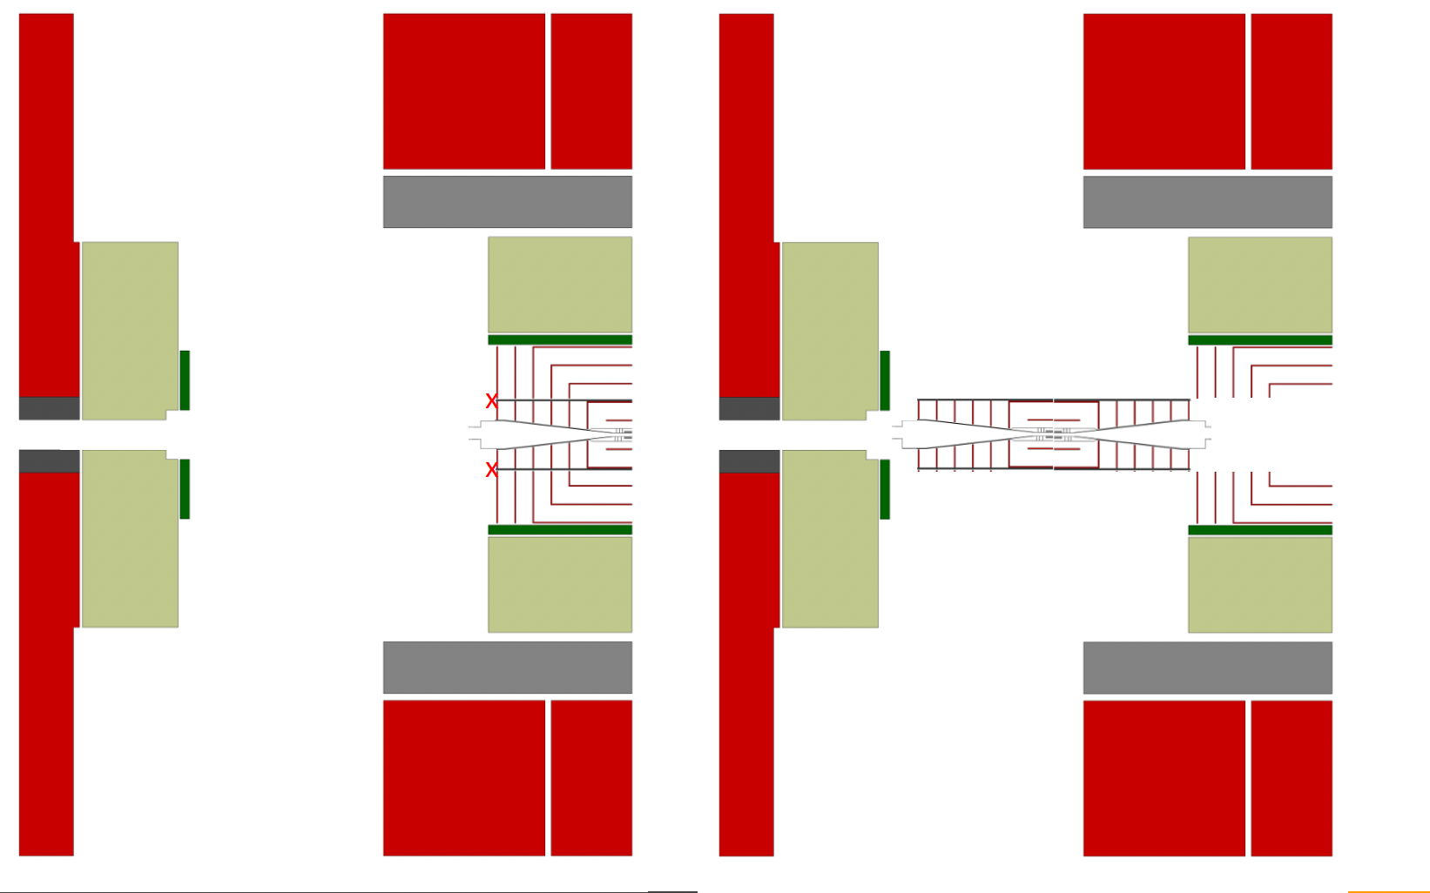
Detector opening (II)
Diameter of
machine elements!
6m stroke
1
2
3
4
Detector closed
Detector Endcap opened to access the double vacuum valve on the beam-pipe after the FF magnets
FF removed, access to the Inner Tracker
IT, Vertex & Beam-pipe removed.
Same process for OT.

Slide 11
General issues for e-e detectors’ MDI (II)
Alignment.
During construction and following any maintenance activity, the machine elements have to be (re)-aligned between them and with the detector.
A good target is to re-align the FF and the detector within few millimetres, using fiducials located on easily visible surfaces to check the position of every component. This activity can be done by a survey team equipped with standard tools (theodolite, laser meter, …).
When the detector is closed and its magnet is powered on, mechanical movements occur due to the magnetic forces and an alignment check of the internal parts is usually done via a dedicated system with remote reading. It shall be possible, at this stage, to re-align inner detector and machine parts within few millimetres via remote actuators.
Finally, with the beam-on during the machine commissioning period, a tracks-based alignment is done.

Slide 12
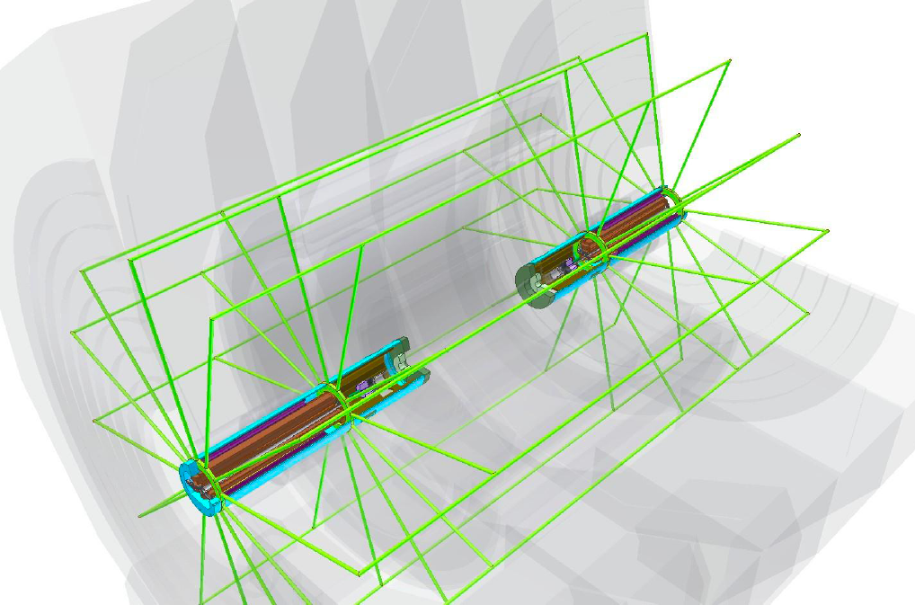
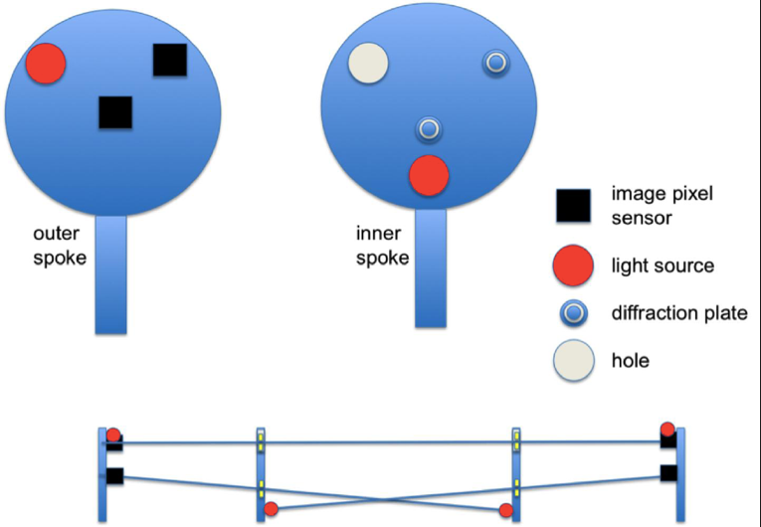
Study case: precision alignment of CLIC FF
Optical link (n)
Rigid spoke (4n)
10 meters
Fiducial ring (4)
RASNIK – An optical alignment system with nanometric precision has been originally developed for Atlas muon chambers alignment and position monitoring on 6 degrees of freedom.
Image by H. van der Graaf / NIKHEF

Slide 13
General issues for e-e detectors’ MDI (III)
Mechanical stability.
The needed mechanical stability of the Final Focus is an important machine parameter that influences the MDI design. It is usually measured as rms^{(*)} relative displacement of the two opposite FF, integrated over the period between two bunches (high frequency stability).
The low frequency stability refers any possible drift from the nominal position of the FF and interleaves with the alignment system of the FF.
Support of forward instrumentation / shielding
As the mechanical stability of the FF elements is a requirement that directly impacts on the machine luminosity, the supporting structure of the FF shall be optimized to achieve the highest vibration frequency (stiffness) and shall rest on a stable and massive support.
The background masks or any other IR heavy weight hardware (LumiCal, …) should not be supported from the same support of the final focus magnets, as it would significantly lower the vibration frequency of the latter (see next slide).
(*) The rms of a function is the square root of the integral of the squares of the instantaneous values during a cycle

Slide 14
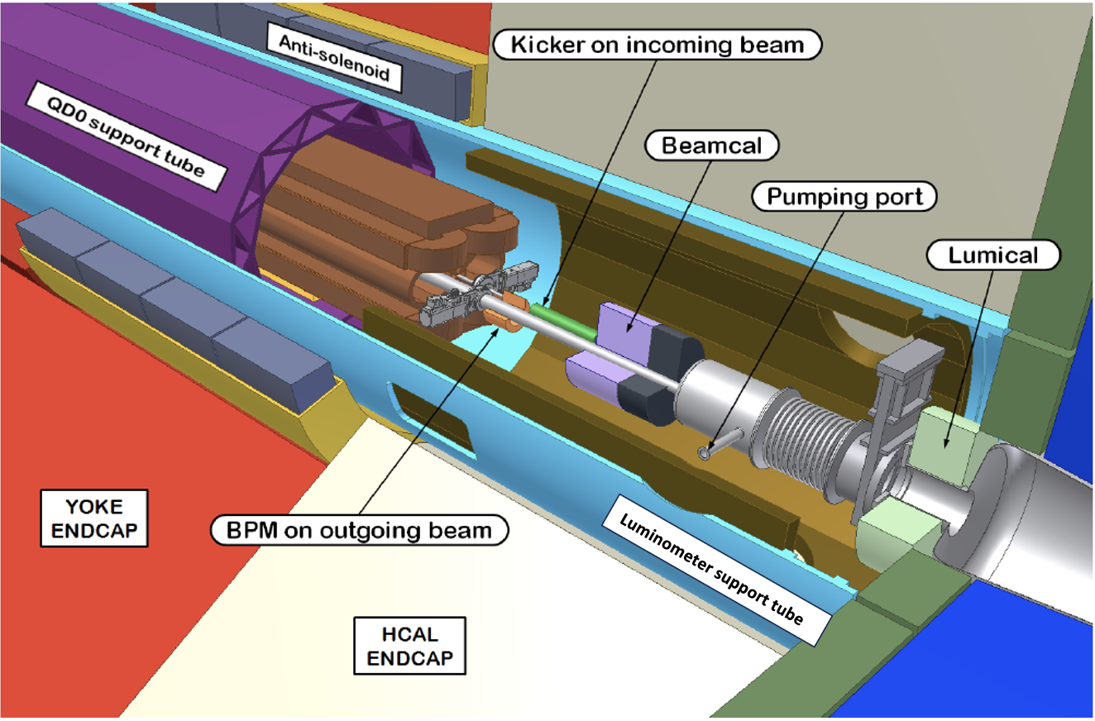
CLIC FF design with double supporting tube
Two coaxial supporting tubes for FF and LumiCal. Both cantilevered from the back of the detector Endcap.
Image by N. Siegrist / CLICdp

Slide 15
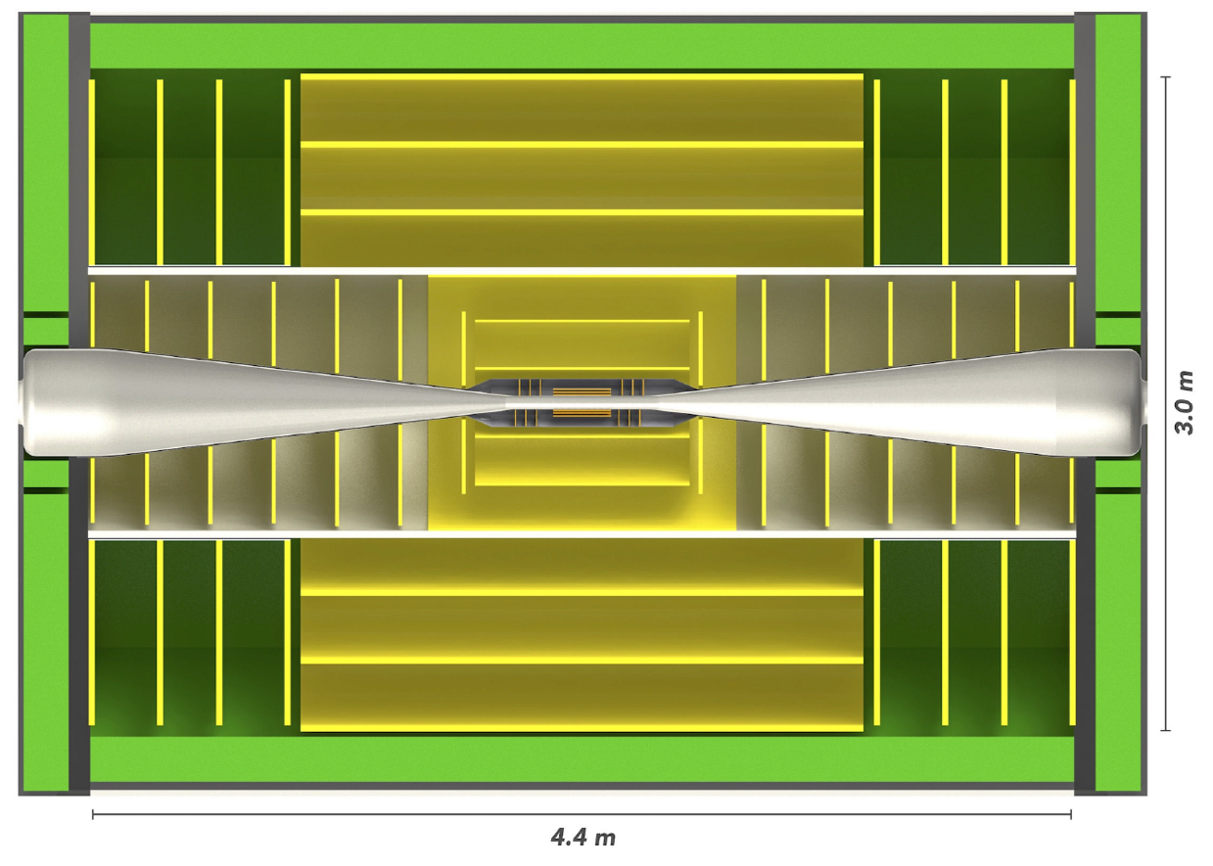
CLIC Vertex / Tracker integration (I)
The Vertex is supported by an external envelope attached to the Beam-pipe.
The Beam-pipe is supported by the Inner Tracker CFRP tube.
The Inner Tracker CFRP tube is supported by the Outer Tracker.
Beam-pipe, Vertex, Inner tracker, Outer Tracker constitute a single assembly.
The LumiCal is supported by the external tube coaxial with the FF support.
vertex
beampipe
IT barrel
IT endcap
OT barrel
OT endcap
ECal
CLICdp image

Slide 16
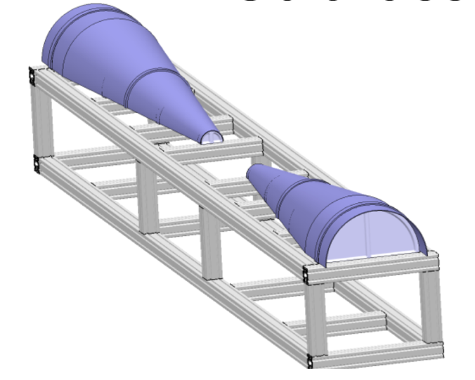
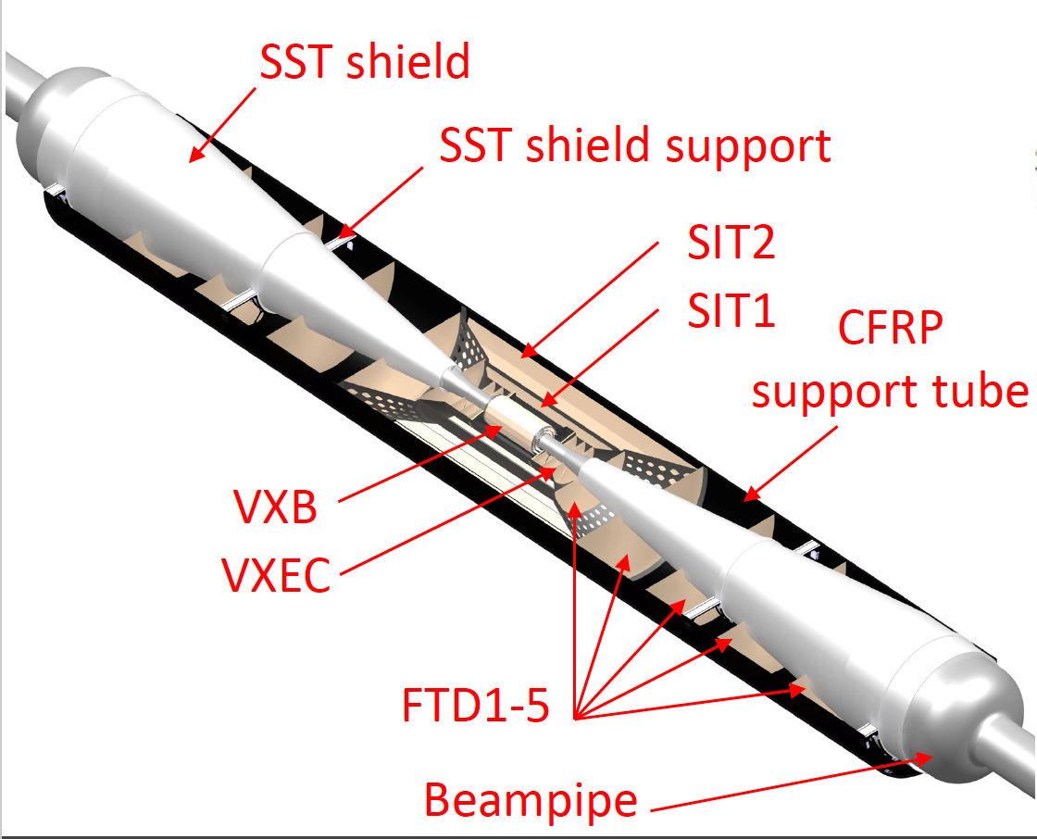
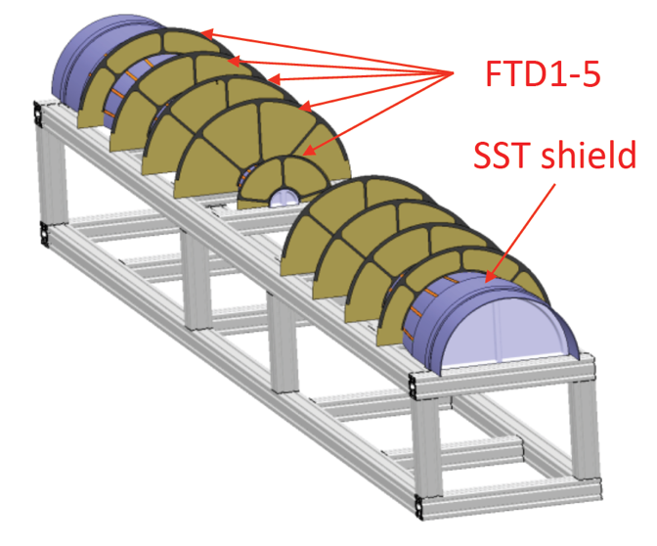
CLIC Vertex / Tracker integration (II)
Image by F. Duarte Ramos /CLICdp

Slide 17
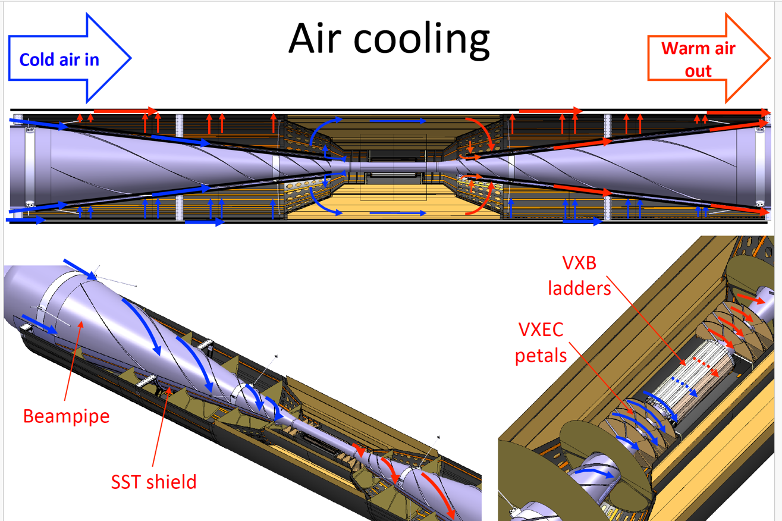
CLIC Vertex / Tracker integration (III)
Image by F. Duarte Ramos /CLICdp

Slide 18
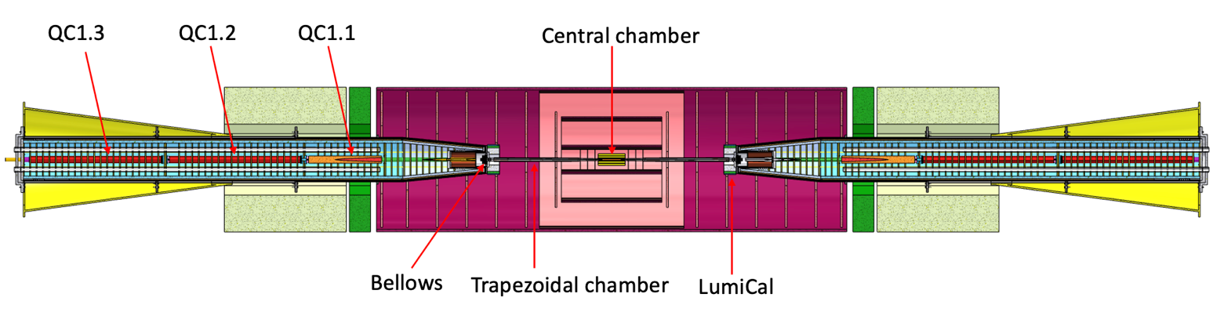
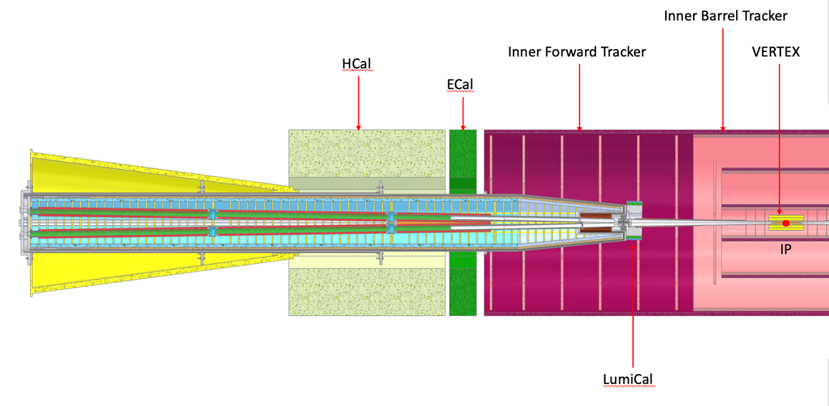
MDI at FCC-ee & impact on detector design (I)
The detector solid-angle previously reserved to the large conical shaped Beam-pipe of CLIC is now taken by the FF quads of FCC-ee.
Due to the shorter L*, the LumiCal is now closer to IP, thus shall it be supported by the Tracker CFRP tube (see next slide).
Image by F. Fransesini /INFN

Slide 19
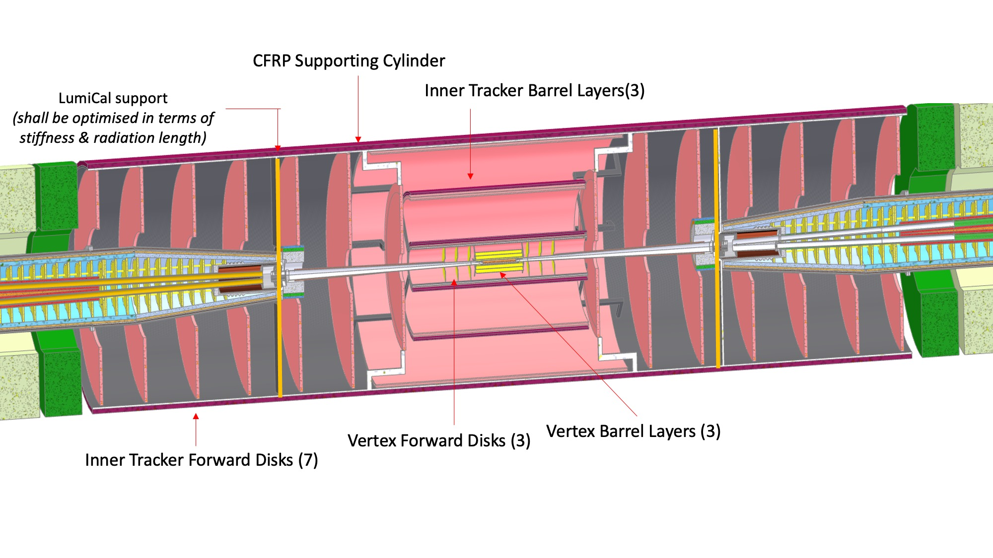
MDI at FCC-ee & impact on detector design (II)
CLD Inner Tracker
Image by F. Fransesini /INFN

Slide 20
Inner Tracker supports for CLD
possible solution:
Proceeding from inner to outer sub-detectors, the IT CFRP supporting cylinder, is supported by the nearest detector element, i.e. the Outer Tracker.
The easiest way is to have a light material budget CFRP rails + pads system at the interface between the IT cylinder and the OT boundary, e.g. at 3 and 9 o’clock to let the IT slide inside the OT inner tube.
The Outer Tracker is then supported by the barrel hadron calorimeter by three adjustable brackets / tie-rods per end.

Slide 21
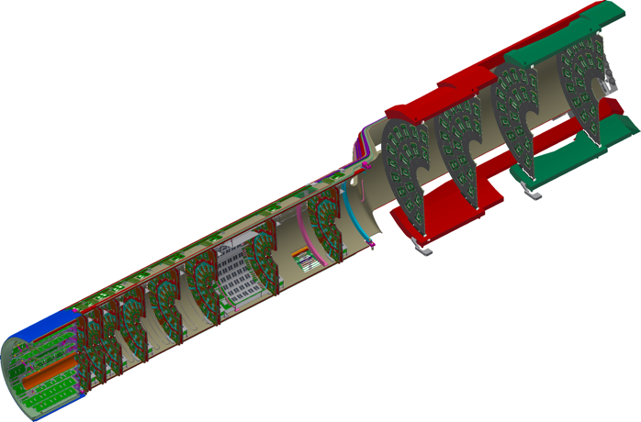
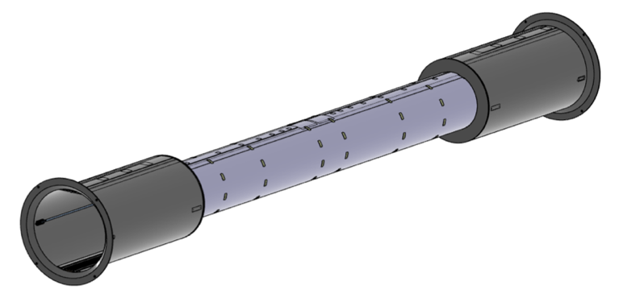
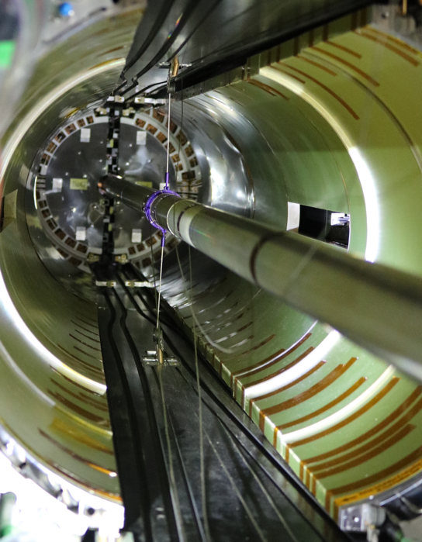
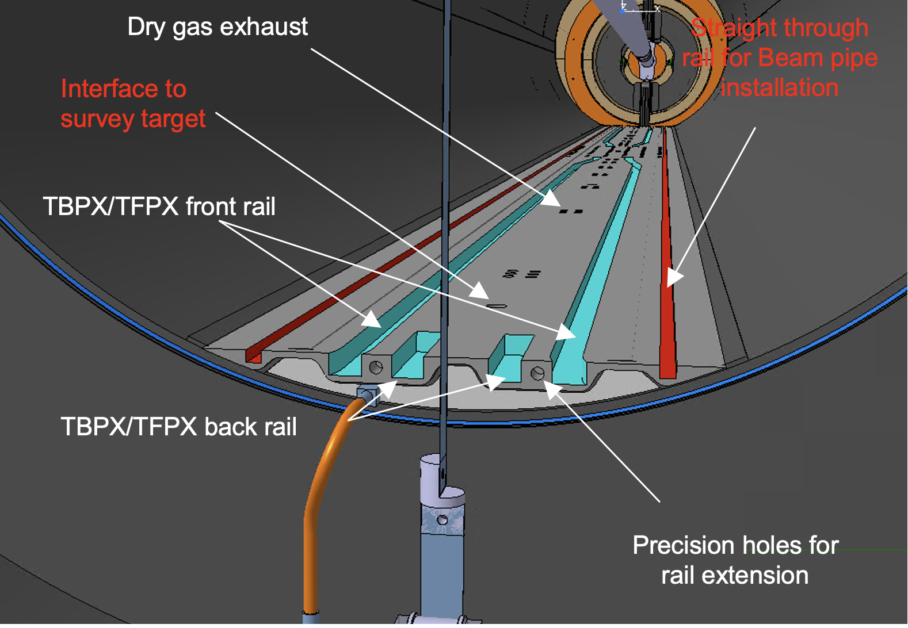
Exemple of IT and OT integration at CMS
Inner Tracker Support Tube CFRP
Inner Tracker internals
CAD model of the interface between the OT and the IT supporting tubes with the double railing system for both Beampipe and Vertex insertion. Note also some services embedded into the CFRP railing structure.
Mock-up of the IT/OT interfaces for clearance studies

Slide 22
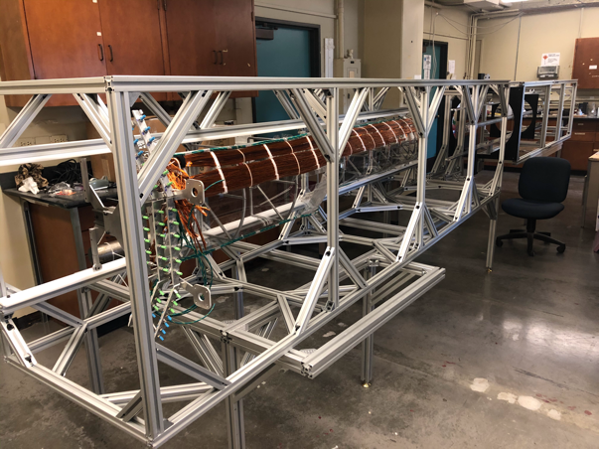
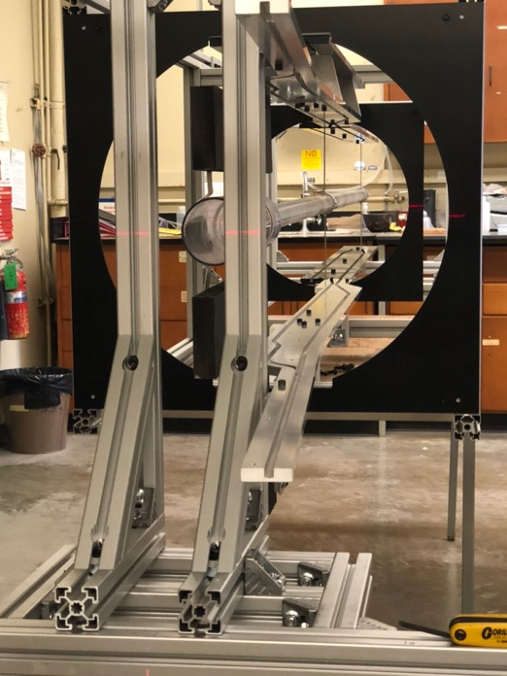
Exemple of IT and OT integration at CMS
Prototype of the Inner Tracker for services routing studies
ITST Mockup with temporary and extension rails

Slide 23
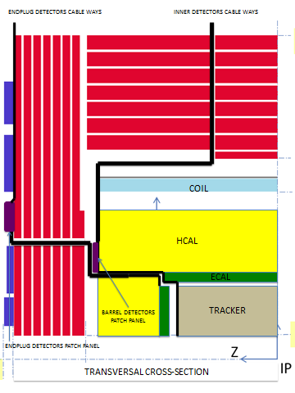
Detector Services routing
Barrel and Endcap sub-detectors shall follow indipendent paths to allow opening of the detector.
Patch-panels at the periphery of the detector allow for an easier services installation and troubleshooting.

Slide 24
Conclusions
MDI design has to take into account multiple conflicting requirements.
Detector wise, the choice of its segmentation and opening scheme plays a fundamental role.
Alignment and mechanical stability of the machine FF magnets plus services for detector elements are additional contraints.
Many study cases exist from past/present/future MDI regions.

Slide 25
Back-up slides

Slide 26
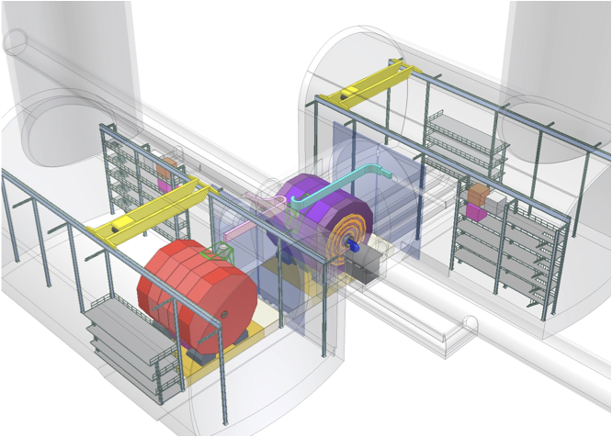
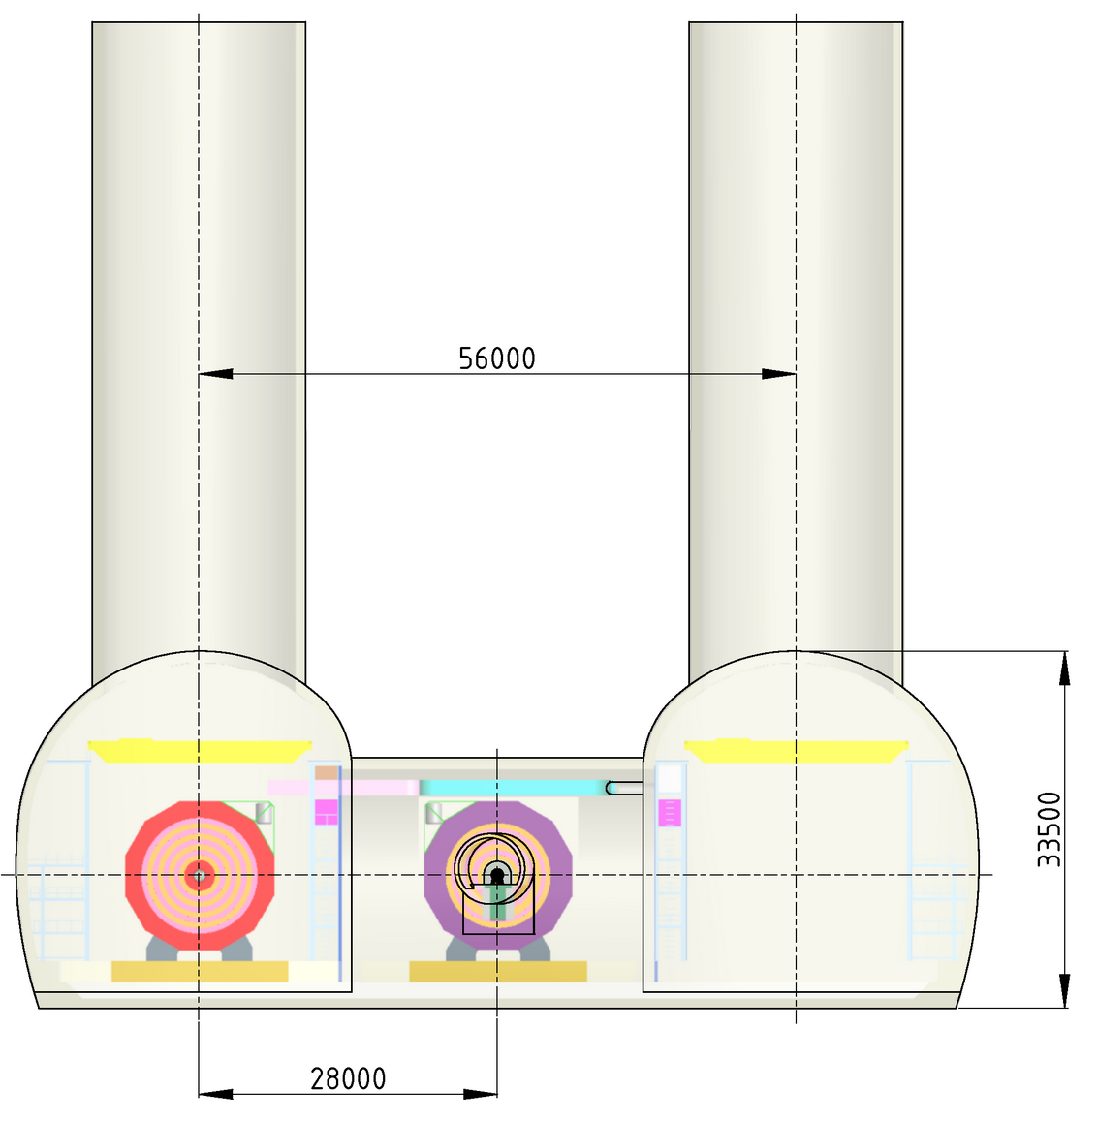
ILC / CLIC Push-Pull Cavern Layout
by A. Gaddi, H. Gerwig / CERN

Slide 27
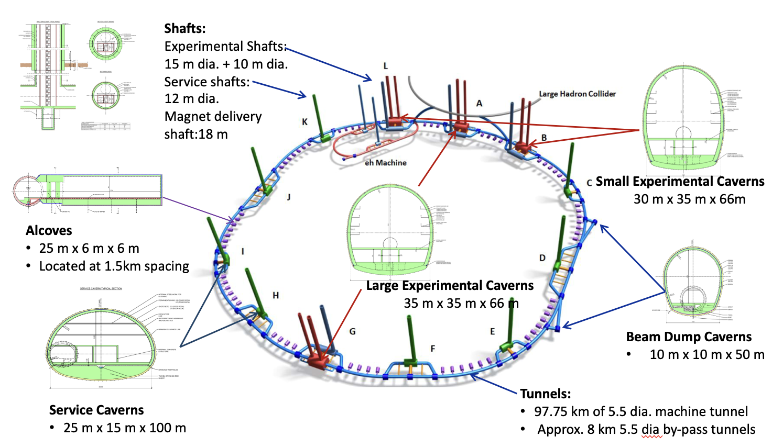
FCC Overview of Underground Structures
by J. Osborne / CERN

Slide 28
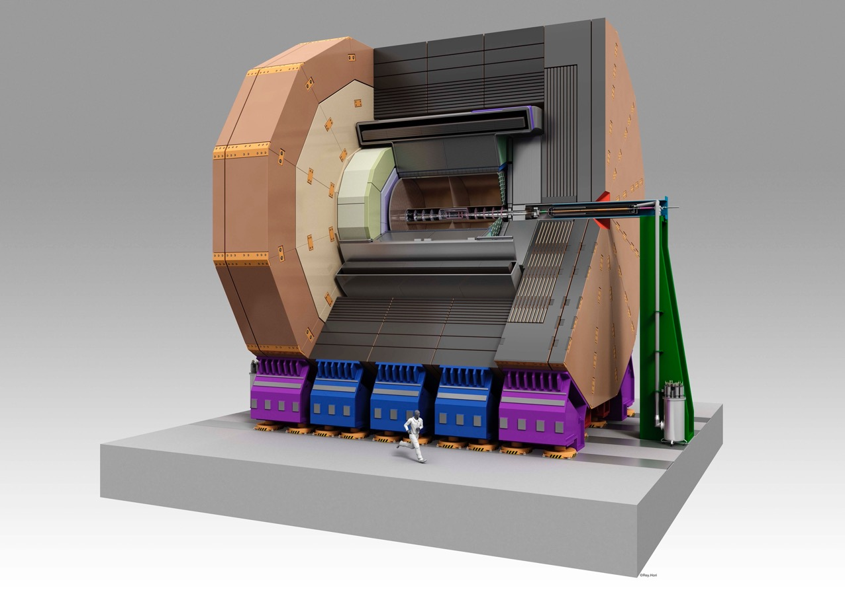
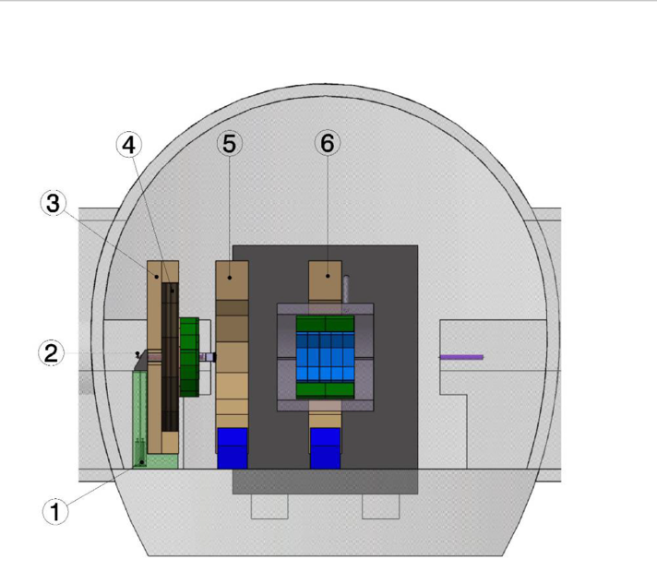
Rods
QD0
Pillar
Alternative solution of FF supported by an external column
plus rods attached to the detector magner cryostat

Slide 29
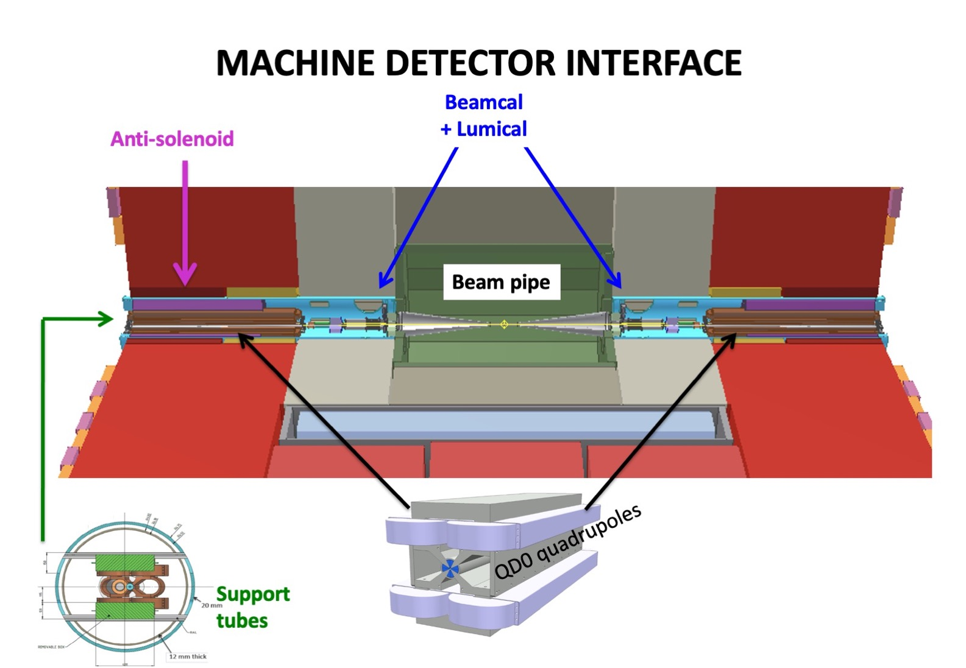
Remotely actuated
vacuum flange

