Slide 1
Giorgio Baldinelli¹
Francesco Bianchi ¹, Manuela Boscolo ², Filippo Bosi ³, Fabrizio Palla ³, Cristiano Turrioni ¹
¹INFN Sezione di Perugia, Italy
²INFN Laboratori Nazionali di Frascati (RM), Italy
³INFN Sezione di Pisa, Italy
Frascati, 16-17 November 2023

Slide 2
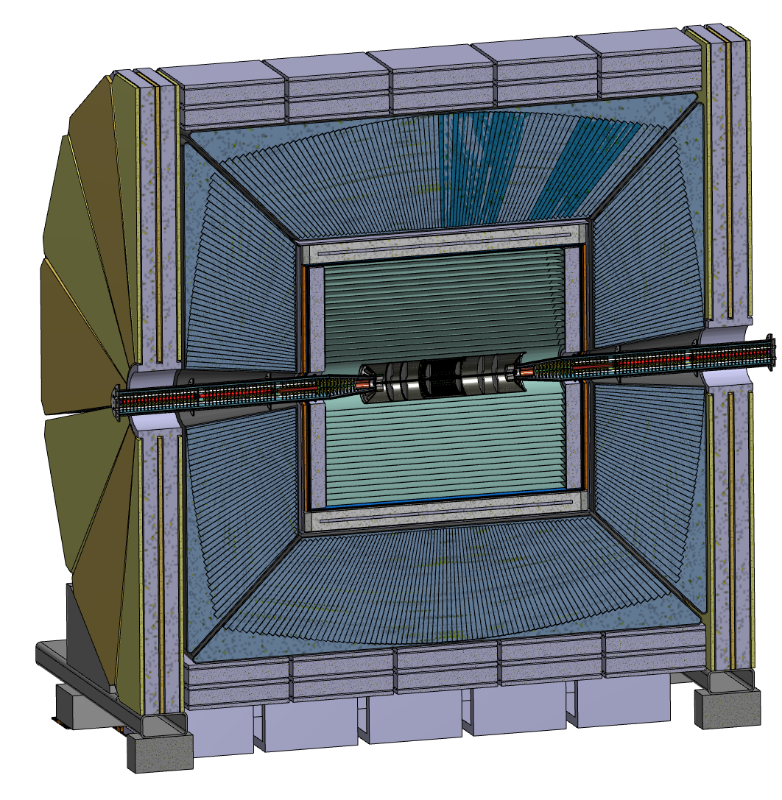
The IDEA Concept
Silicon detectors for precision measurements
(vertex detector, silicon internal tracker)

Slide 3
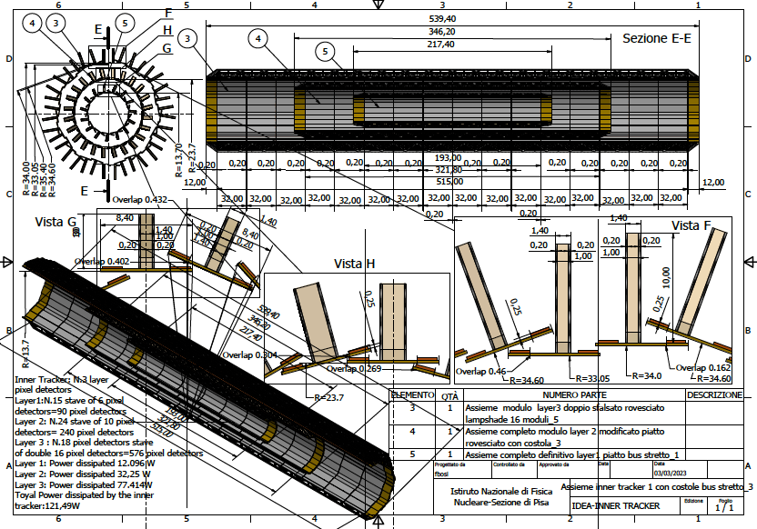
Overall Vertex layout
Total power ~120 W – Air cooled
Total weight ~230 grams
3 layers

Slide 4
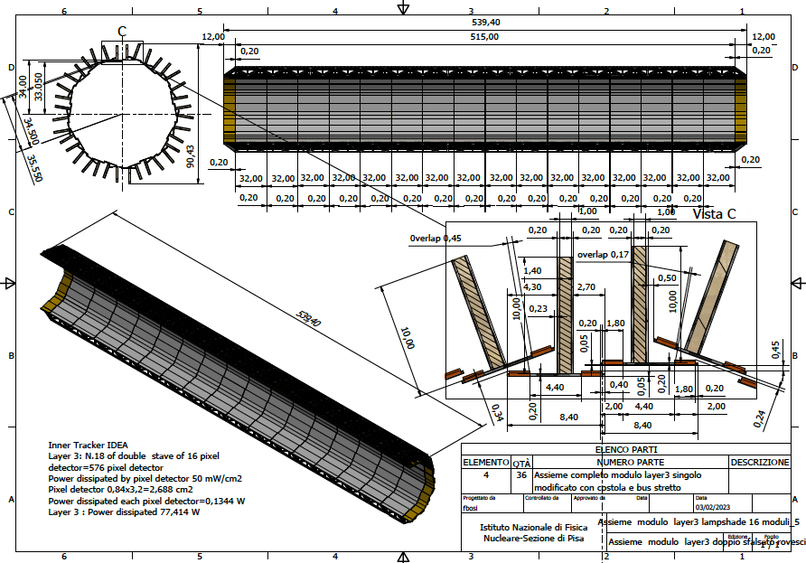
Layer 3
18 overlapping staves of double 16 modules each
Total weight ~150 grams
Power budget
~77 W

Slide 5
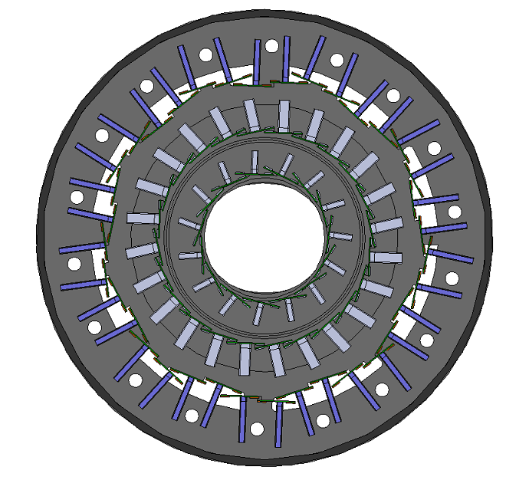
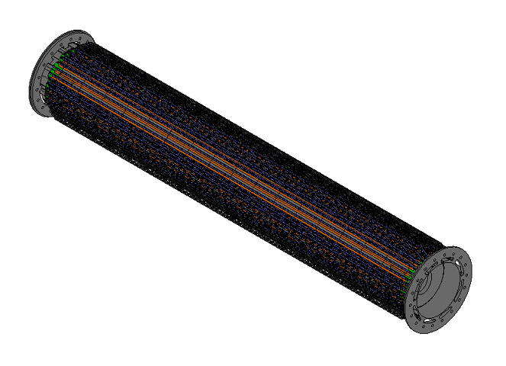
APPROACH FOR THERMAL SIMULATIONS
Heat transfer through solid bodies and to the fluid (air) must be taken into account in the thermal model.
The geometric complexity of the structure and the small thickness of the parts are the most challenging aspects: simplifications of the model are needed.
Full model of the three layers

Slide 6
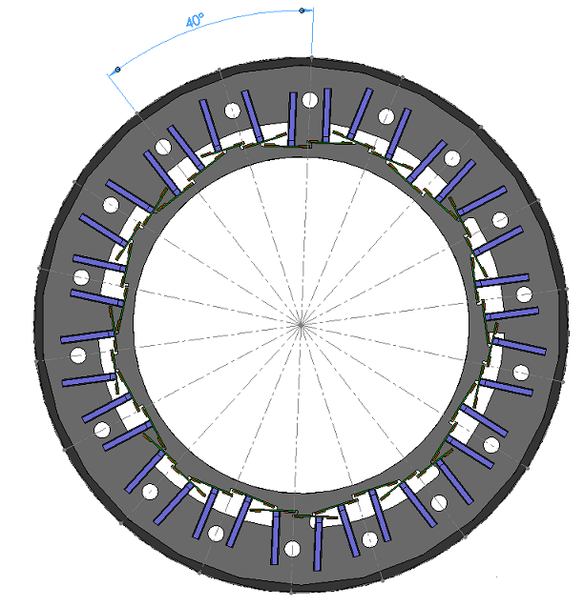
APPROACH FOR THERMAL SIMULATIONS
Focus, at the moment, on Layer 3

Slide 7
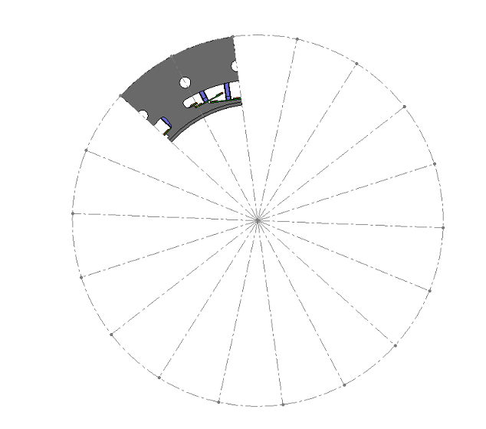
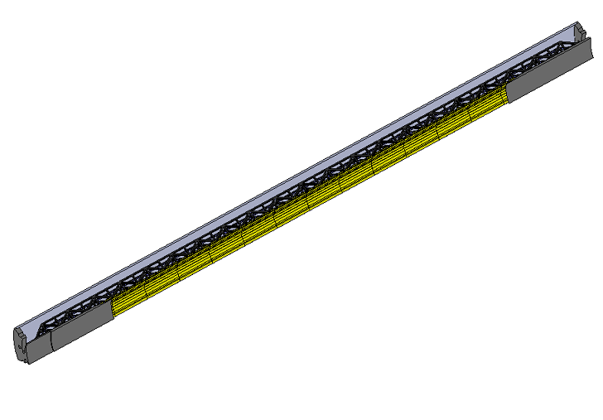
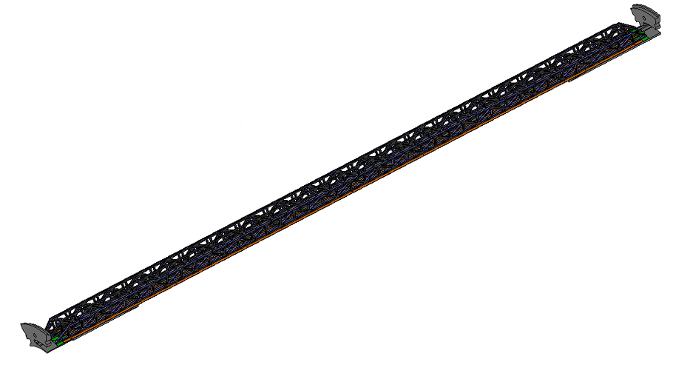
APPROACH FOR THERMAL SIMULATIONS
Extracting 40° sector (periodic)

Slide 8
THERMAL SIMULATIONS
MODELS AND BOUNDARY CONDITIONS
Steady state conditions
Turbulent flow
Reynolds Average Navier Stokes (RANS) approach
Viscous model k-ω SST
Pressure based solver
No radiation heat exchange
Pressure outlet
….
Power generation in the silicon
More details on:
https://indico.cern.ch/event/1292318/contributions/5467218/attachments/2681519/4651774/Baldinelli%2010th%20of%20July%20rev%201.pdf
All walls adiabatic
Air at 15°C – 20 m/s

Slide 9
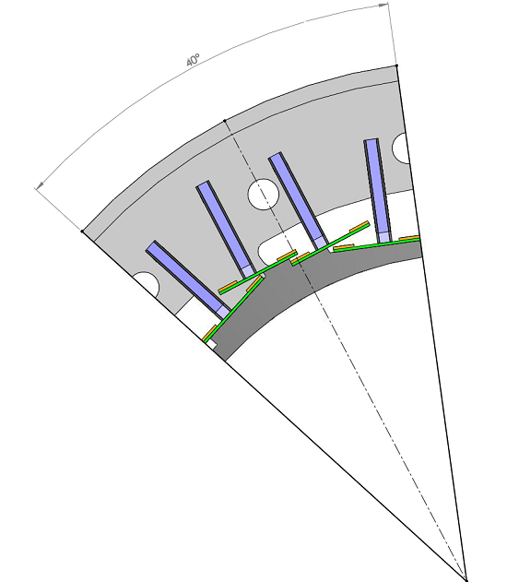
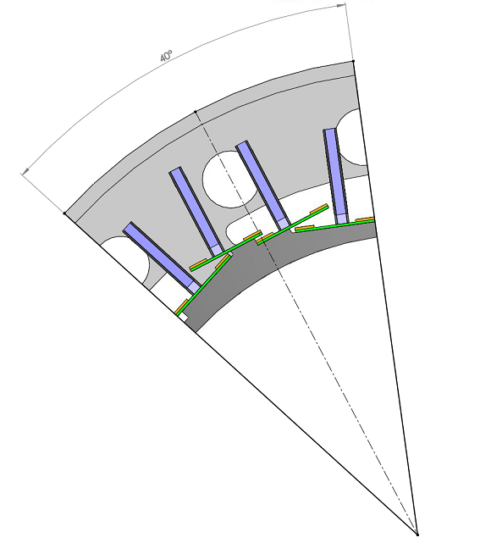
Analysis of air cooling
Same inlet air speed: 20 m/s
3 mm diameter holes
6 mm diameter hole

Slide 10
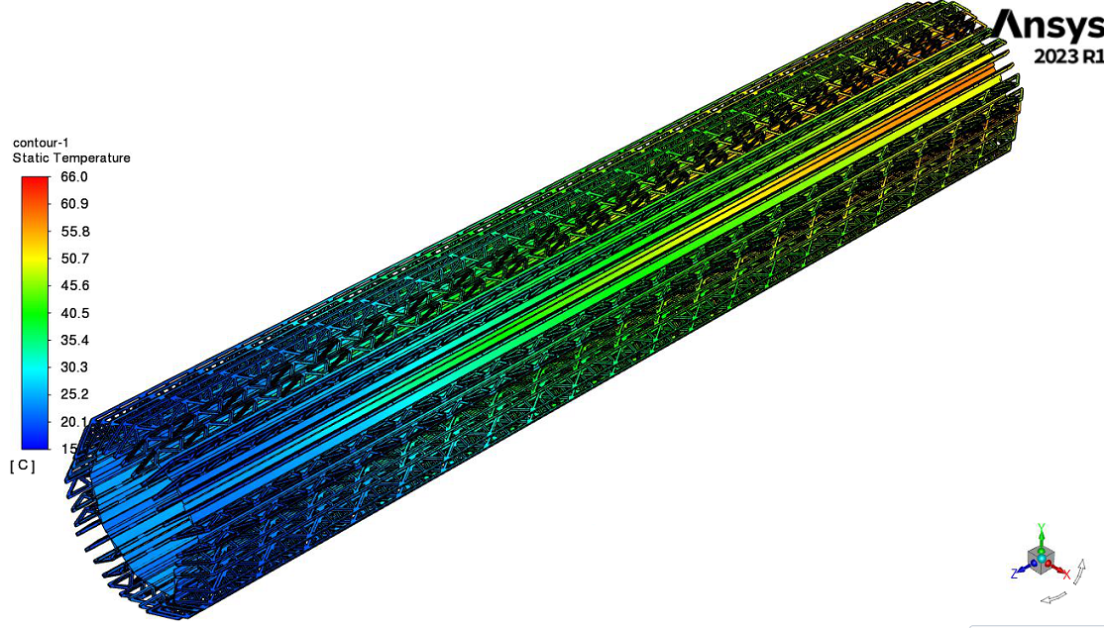
THERMAL SIMULATIONS
CASE 1: 3 mm diameter air inlet holes
GLOBAL TEMPERATURES
Thermal figure of merit:
Modules maximum temperature – air inlet temperature
66.0-15.0 = 51.0°C
Tavg_modules = 40°C
Tmax_modules = 66°C
Tair_in = 15°C
Tair_out = 40°C
Vair_in = 20 m/s
Vair_avg = 0.99 m/s
Linear behaviour with the inlet temperature

Slide 11
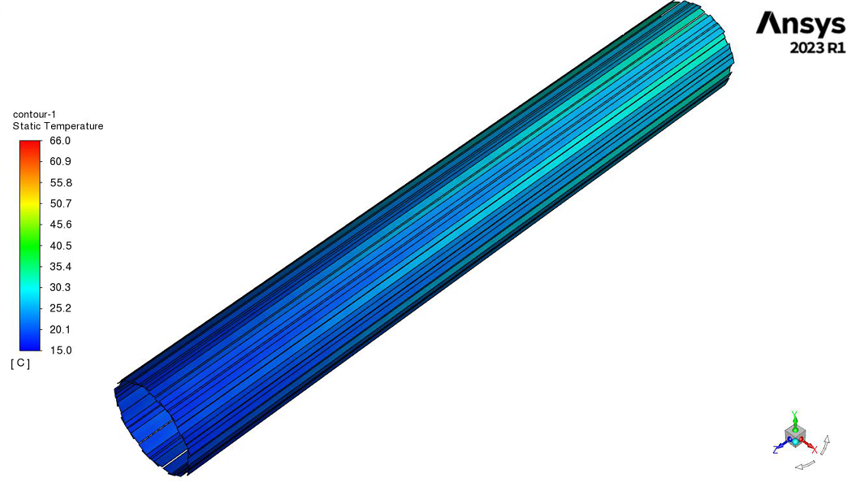
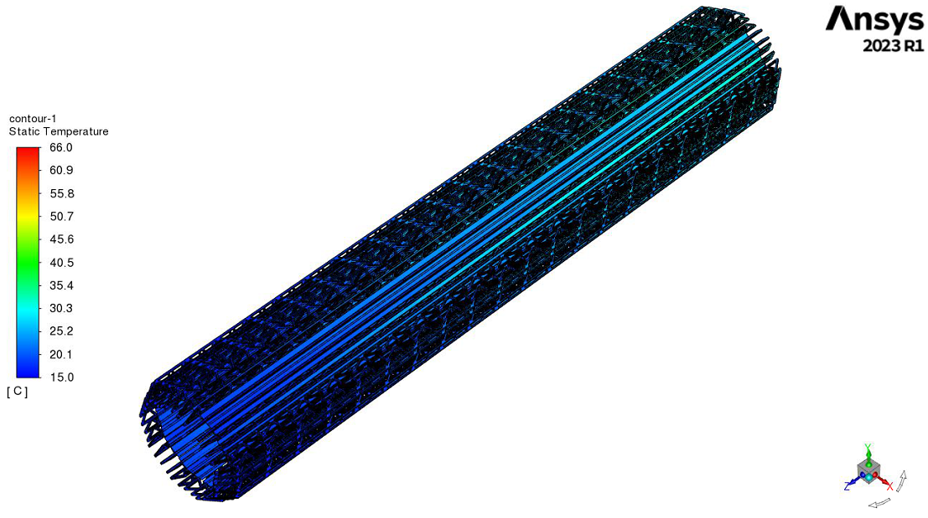
THERMAL SIMULATIONS
CASE 2: 6 mm air inlet holes
GLOBAL TEMPERATURES
Tavg_modules = 25.5 °C
Tmax_modules = 32.9 °C
Tair_in = 15 °C
Tair_out = 20.8 °C
Vair_in = 20 m/s
Vair_avg = 3.28 m/s
Thermal figure of merit:
32.9-15.0 = 17.9°C
Linear behaviour with inlet temperature

Slide 12
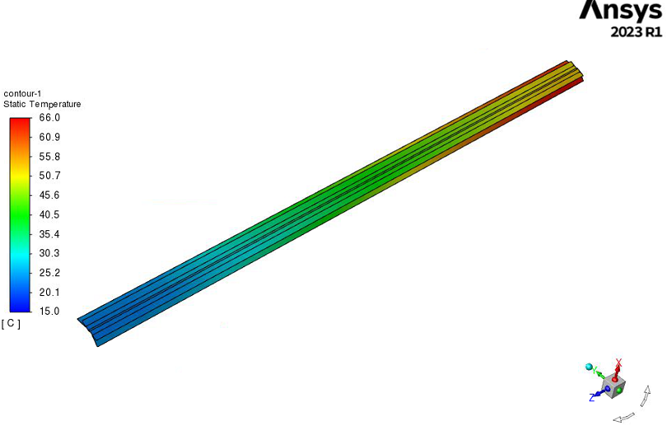
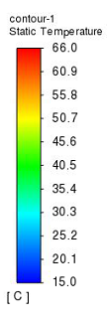
THERMAL SIMULATIONS
3 and 6 mm air inlet holes comparison (20 m/s)
GLOBAL TEMPERATURES
3 mm
6 mm

Slide 13
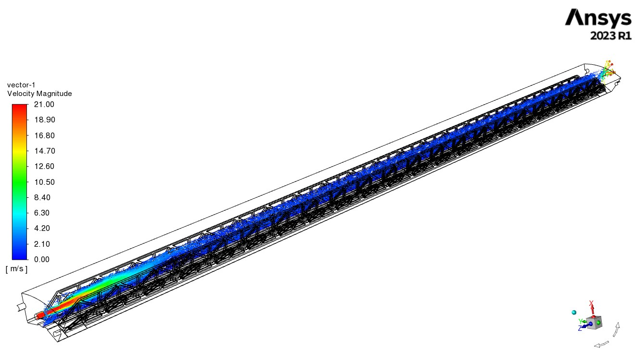
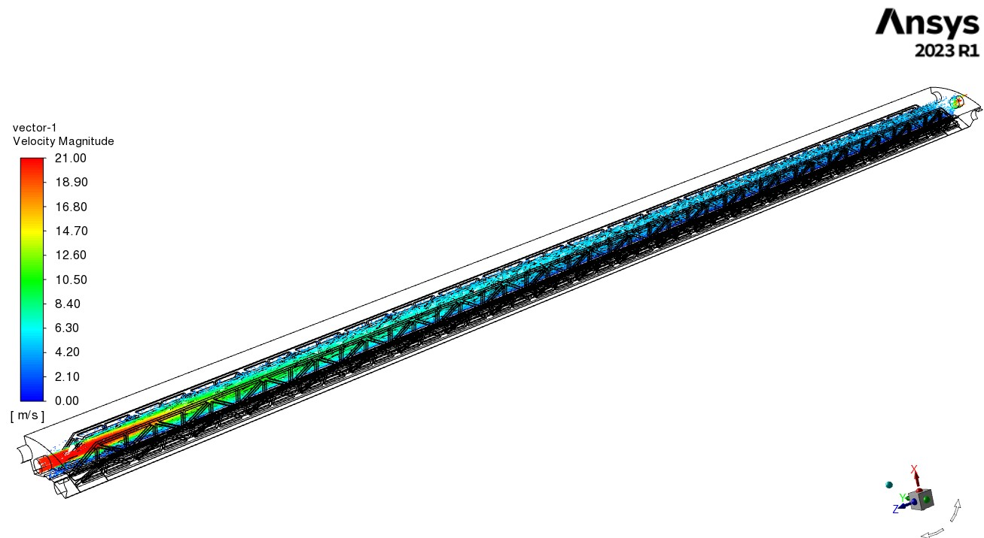
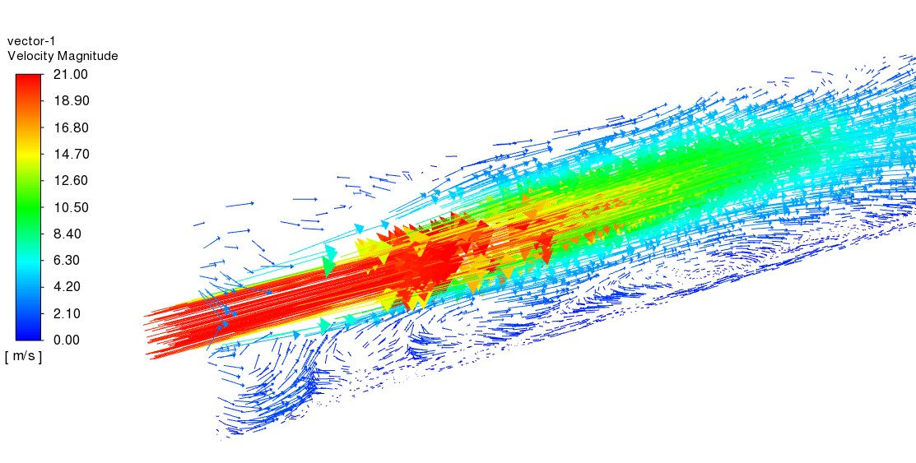
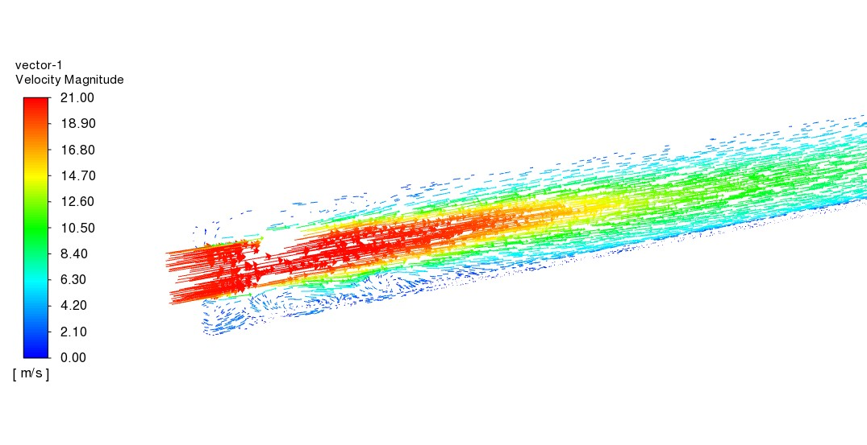
THERMAL SIMULATIONS
3 and 6 mm air inlet holes comparison (20 m/s)
FLOW PATTERNS
3 mm diameter holes
6 mm diameter holes

Slide 14
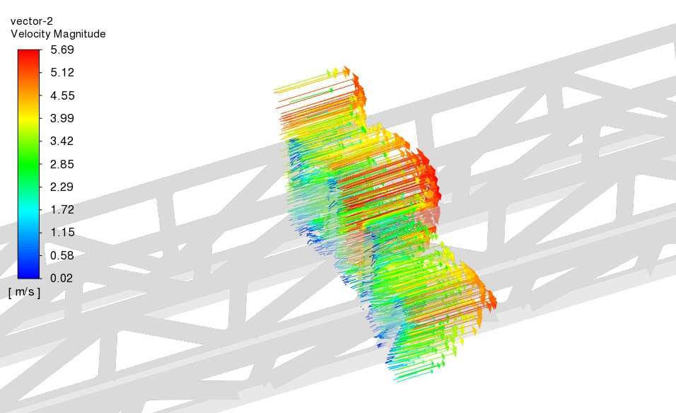
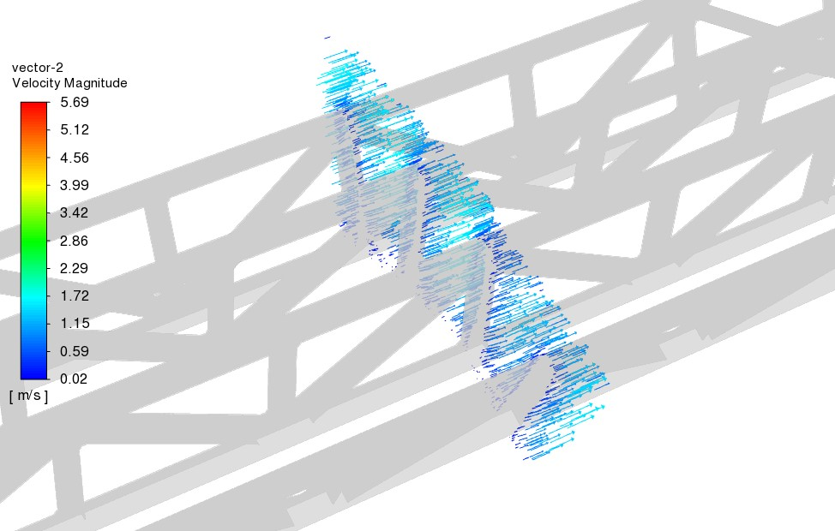
THERMAL SIMULATIONS
3 and 6 mm air inlet holes comparison (20 m/s)
FLOW PATTERNS
3 mm diameter holes
6 mm diameter holes

Slide 15
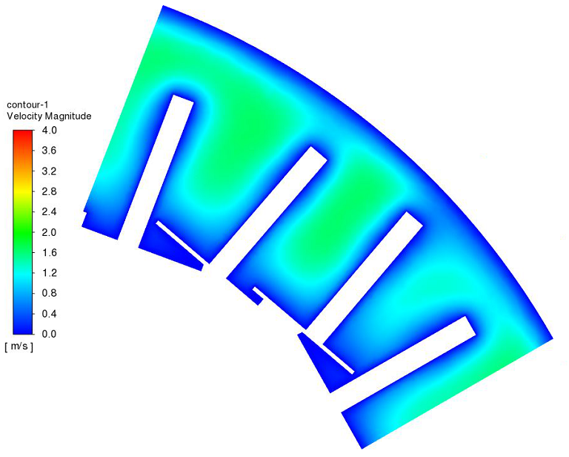
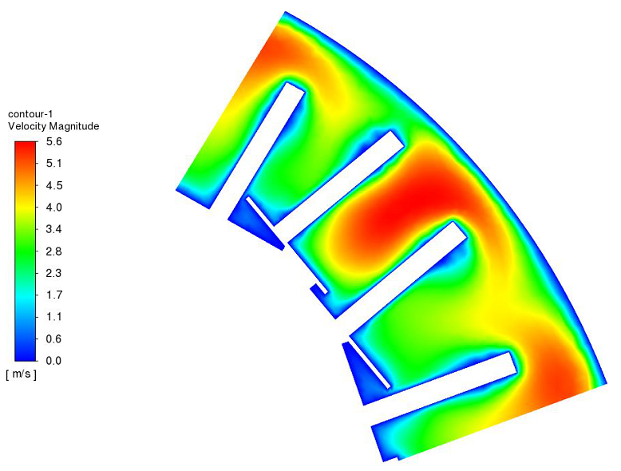
THERMAL SIMULATIONS
3 and 6 mm air inlet holes comparison (20 m/s)
AIR SPEED
3 mm diameter holes
6 mm diameter holes

Slide 16
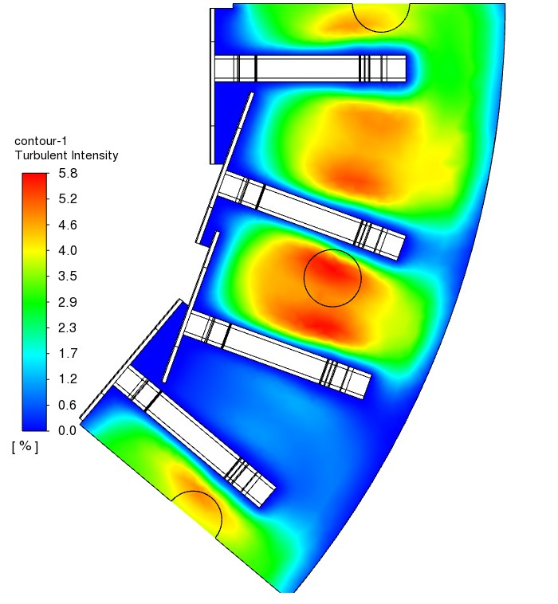
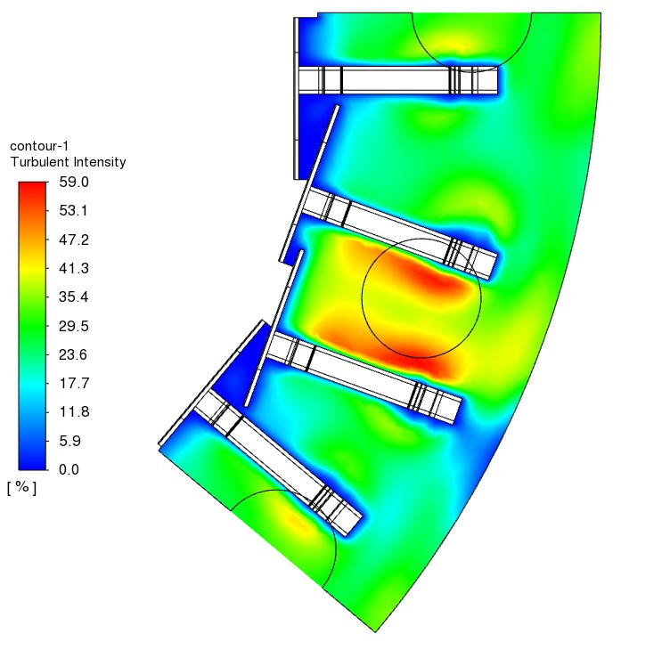
THERMAL SIMULATIONS
3 and 6 mm air inlet holes comparison (20 m/s)
TURBULENT INTENSITY
3 mm diameter holes
6 mm diameter holes

Slide 17
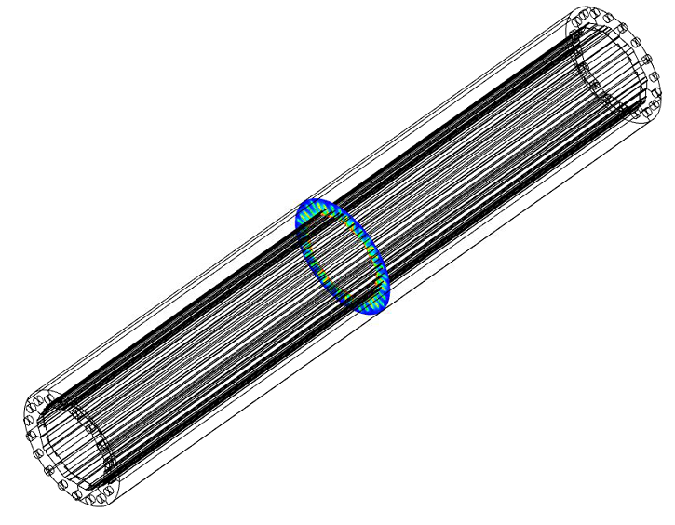
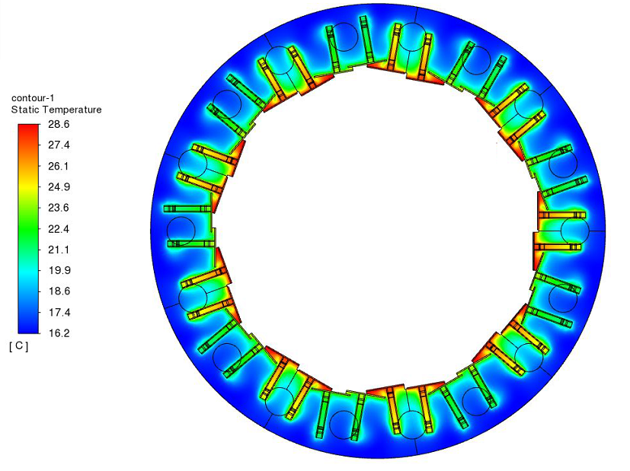
THERMAL SIMULATIONS
CASE 2: 6 mm air inlet holes (20 m/s)
TEMPERATURES

Slide 18
THERMAL SIMULATIONS
EFFECT OF THE AIR SPEED
What is the influence of the air speed on the cooling performance, keeping constant all the other boundary conditions?
SIMULATIONS IMPLEMENTED AT:
10 m/s
20 m/s
30 m/s
3 mm diameter holes
6 mm diameter hole

Slide 19
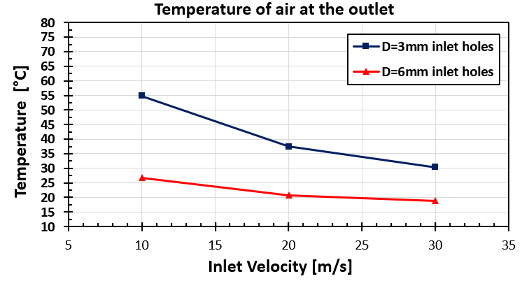
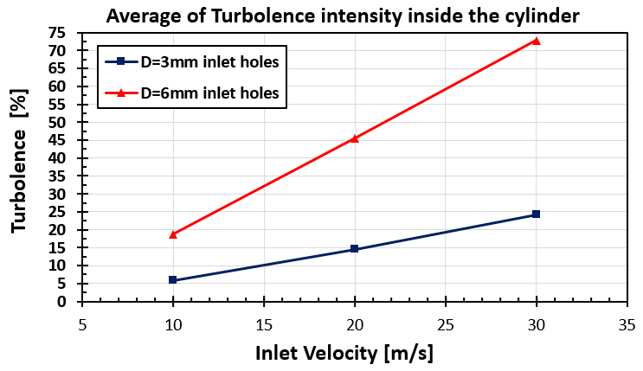
THERMAL SIMULATIONS
EFFECT OF THE AIR SPEED
Air inlet temperature = 15°C

Slide 20
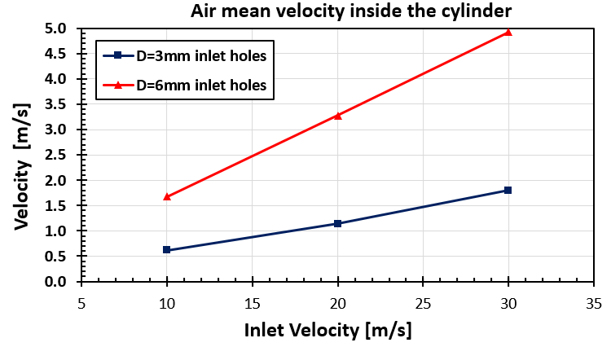
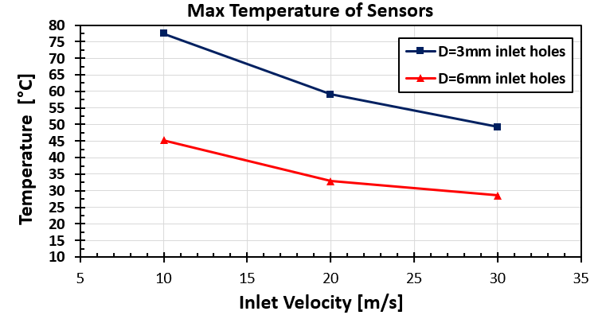
THERMAL SIMULATIONS
EFFECT OF THE AIR SPEED
Air inlet temperature = 15°C

Slide 21
THERMAL SIMULATIONS
CONCLUSIONS AND FUTURE WORK
The holes diameter and the air inlet speed optimisation affent strongly the thermal field
of the modules.
An increase in air mass flow rate, turns to an obvious decrease of the maximum temperature of the modules, a plateau exists and it has been detected.
The model still needs improvement:
Anisotropy of the materials
Turbulent model
Refinement of the boundary conditions
Simulations of the three layers together.
Optimisation of the system: speed and temperature of air, proper direction of the inlet flow, materials,, change of gas, if needed, etc…).
Experimental validation of the simulations.
A parallel mechanical analysis is ongoing, with a particular focus on the vibrational point of view.

