Slide 1
IDEA Vertex mockup
Fabrizio Palla
Fabrizio Palla and Filippo Bosi
INFN Sezione di Pisa, Italy
FCC-ee MDI & IR Mockup Workshop
Frascati, Italy
16-17 November 2023

Slide 2
Outline
Inner vertex mechanical description
Proposed inner vertex fabrication and tests
Outer vertex mechanical description
Proposed outer vertex fabrication and tests
Critical areas and intereferences with other sub-systems

Slide 3
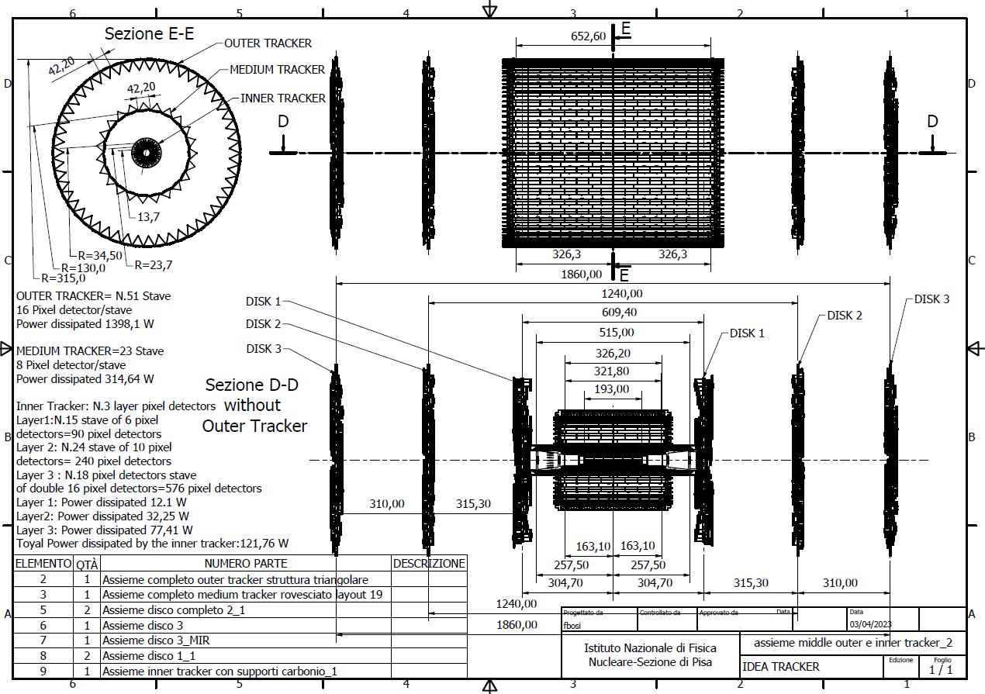
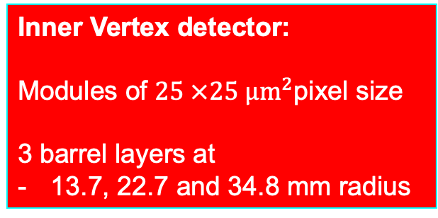
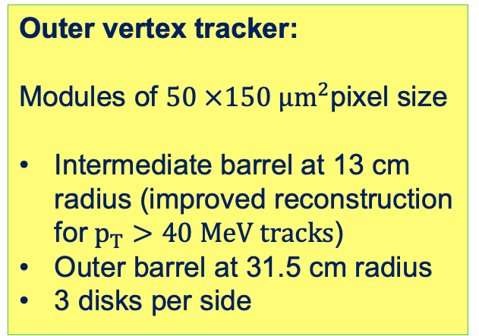
Overall layout and dimensions
Outer vertex tracker:
Modules of $50 ×150 µm^{2}$pixel size
Intermediate barrel at 13 cm radius (improved reconstruction for$p_{T}>40 MeV tracks$)
Outer barrel at 31.5 cm radius
3 disks per side
Inner Vertex detector:
Modules of $25 ×25 µm^{2}$pixel size
3 barrel layers at
13.7, 22.7 and 34.8 mm radius

Slide 4
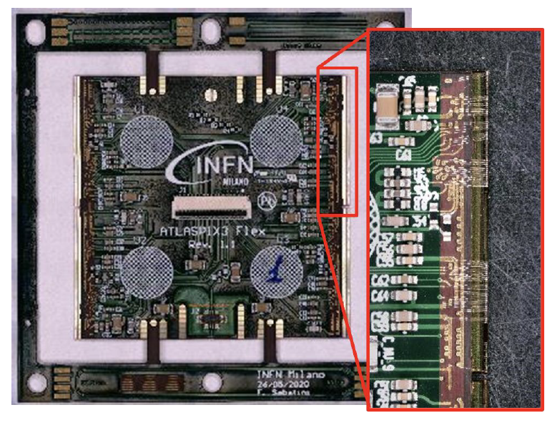
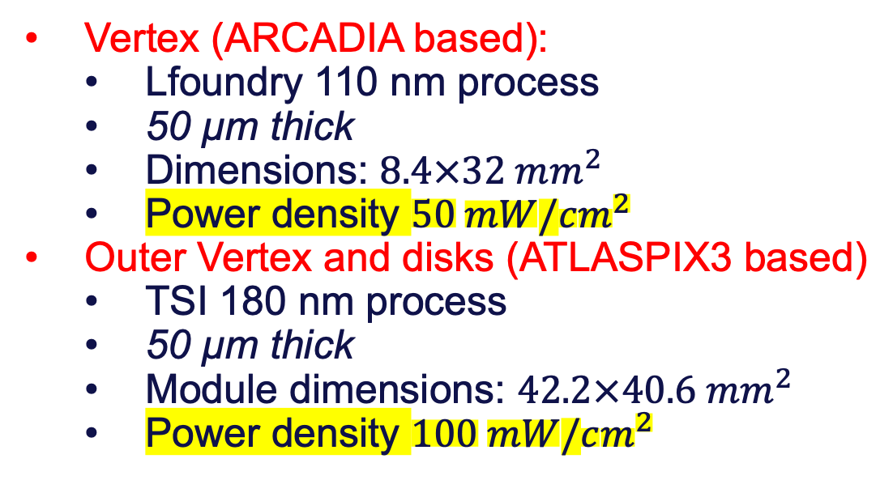
Sensors technology and dimensions
Depleted Monolithic Active Pixel Detectors
32 mm
  Vertex (ARCADIA based):
    Lfoundry 110 nm process
    50 µm thick
    Dimensions: $8.4×32 mm^{2}$
    Power density $50 mW/cm^{2}$
  Outer Vertex and disks (ATLASPIX3 based)
    TSI 180 nm process
    50 µm thick
    Module dimensions: $42.2×40.6 mm^{2}$
    Power density $100 mW/cm^{2}$
Chip 1
Chip 2
8.4 mm
Readout

Slide 5
Layer 1
15 overlapping staves of 6 modules each
Overlap to allow alignment ~500 µm
Pinwheel geometry: all modules at the same (smallest) radius
Power budget ~12 W
Total weight ~22 grams
Total thickness 0.25% X₀
Silicon: 0.053% X₀
Power and readout bus: 0.056% X₀

Slide 6
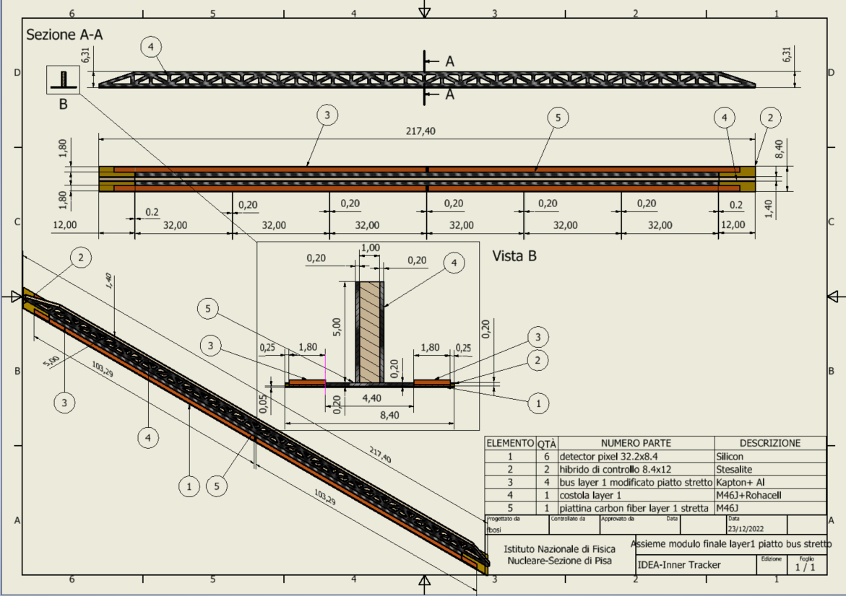
Layer 1 stave detail
Reticular lightweight support to provide stiffness
Thin carbon fiber walls interleaved with Rohacell
2 buses (data and power) 1.8 mm wide and 250 µm thick (50 µm Al, 200 µm kapton) per side
  Inspired to low mass hybrid R&D
Sensors facing interaction point w/o any other material in front
Readout chips either sides
Air cooled

Slide 7
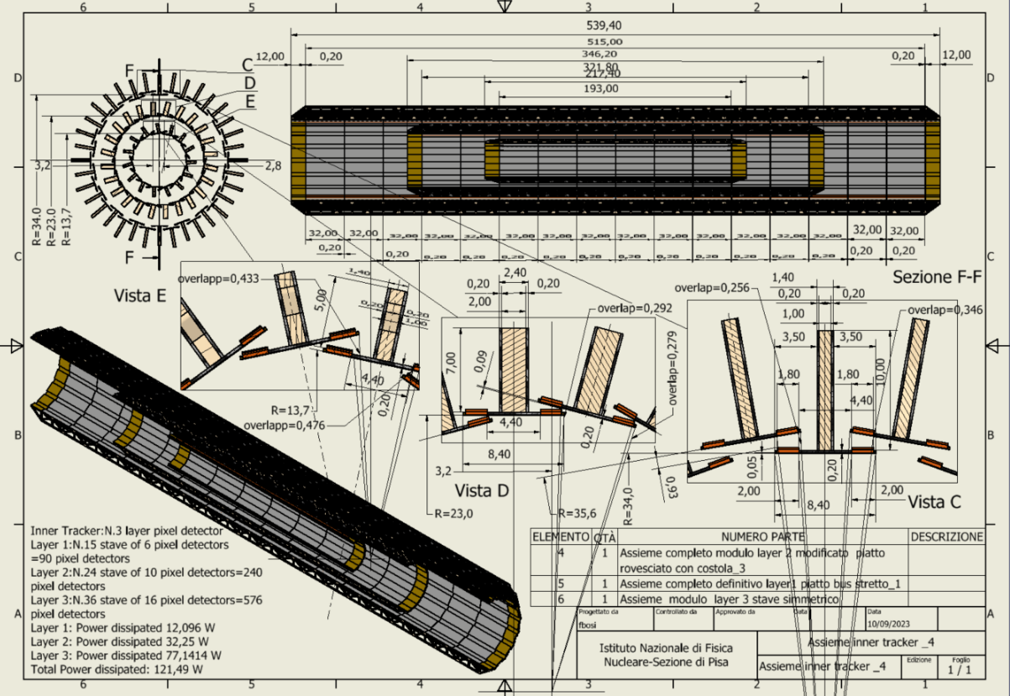
Overall Inner Vertex layout
Total power ~120 W
Total weight ~230 grams

Slide 8
Inner Vertex mechanical facts
Layer # | Radius [mm] | No staves | No modules /stave | Total Length [mm] | Active Area [cm²] | Power [W]
1 | 13.7 | 15 | 6 | 217.40 | 241.92 | 12
2 | 23.7 | 24 | 10 | 346.20 | 645.12 | 32
3 | 34 & 35.60 | 36 | 16 | 539.40 | 1548.29 | 77
TOTAL |  | 75 |  |  | 2435.33 | 121

Slide 9
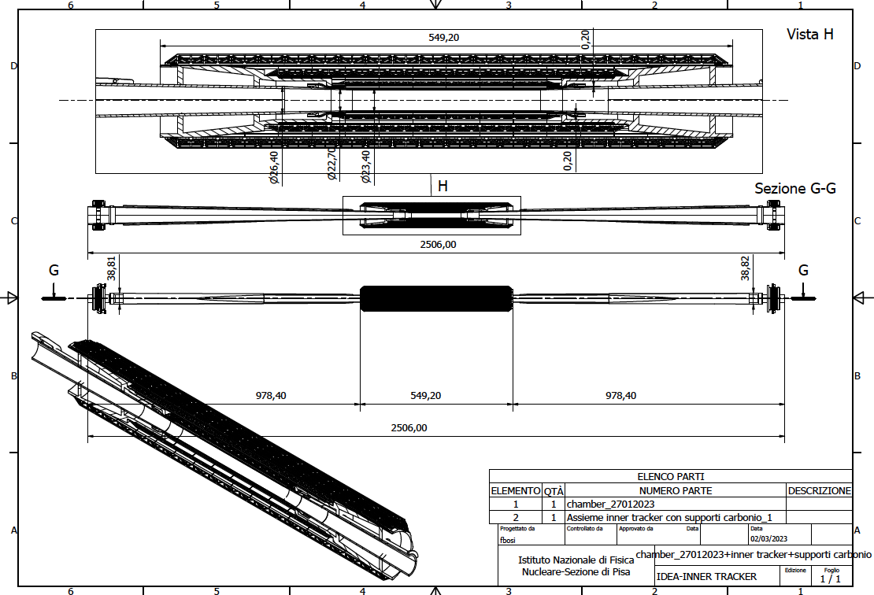
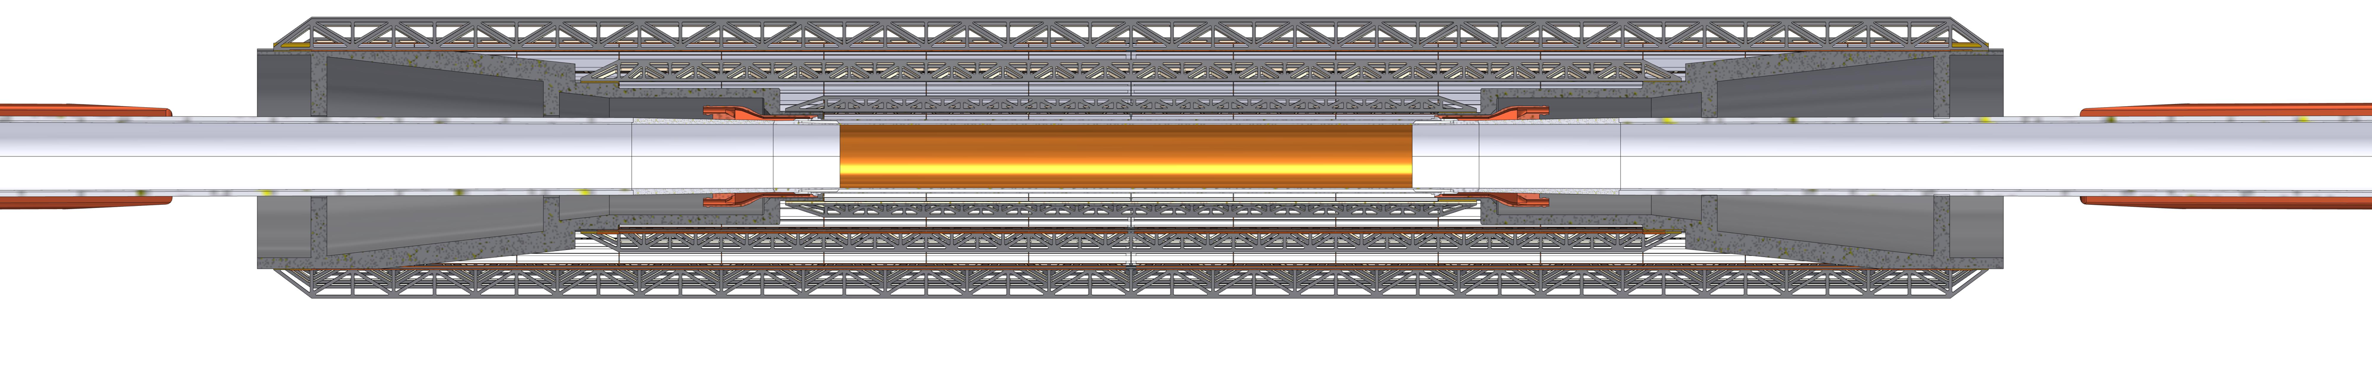
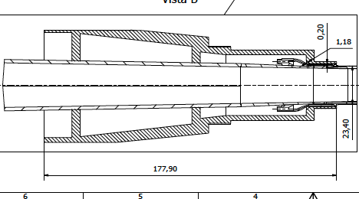
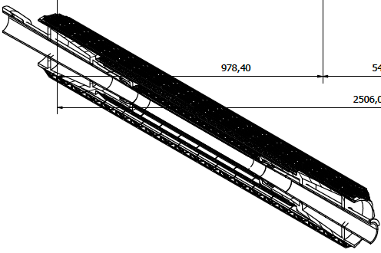
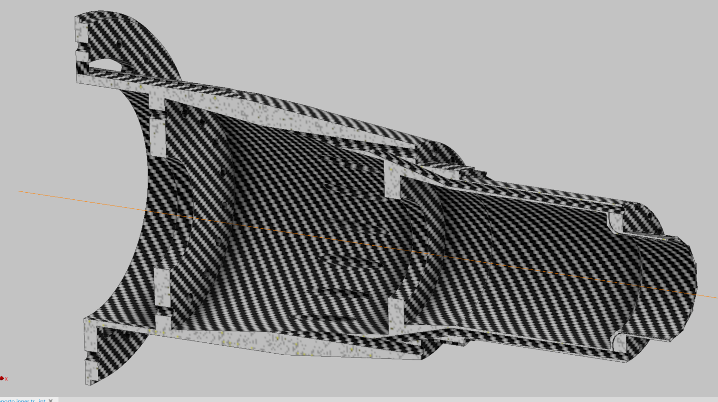
Inner vertex detector supporting conical structures on elliptical chamber
~450 grams
Engineered for air ducts and thermal isolation from the beam pipe during bakeout
Cooling Third layer
Cooling Second Layer
Cooling First Layer
Cooling Pipe

Slide 10
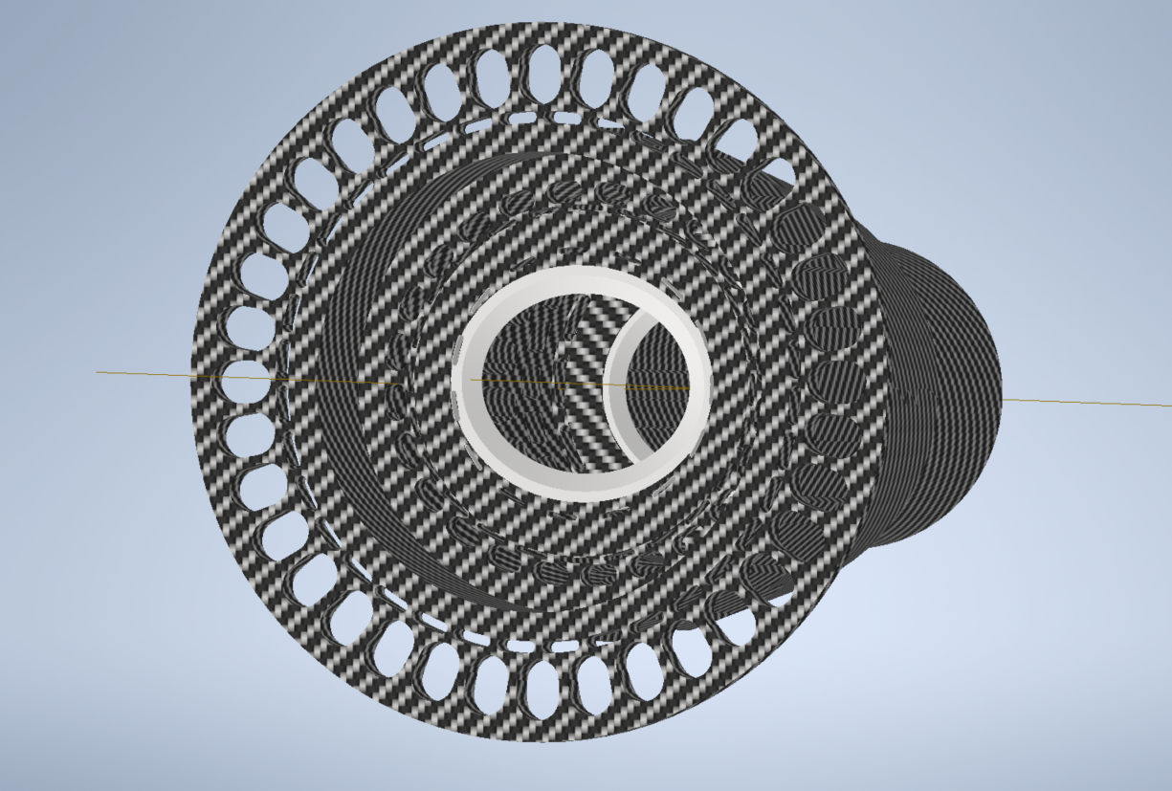
View from Lumical
Cable tunnel Layer 3
Air cooling Layer 3
Air cooling Layer 2-1
Cable tunnel Layer 2-1
Peek Insert 1
Peek Insert 2

Slide 11
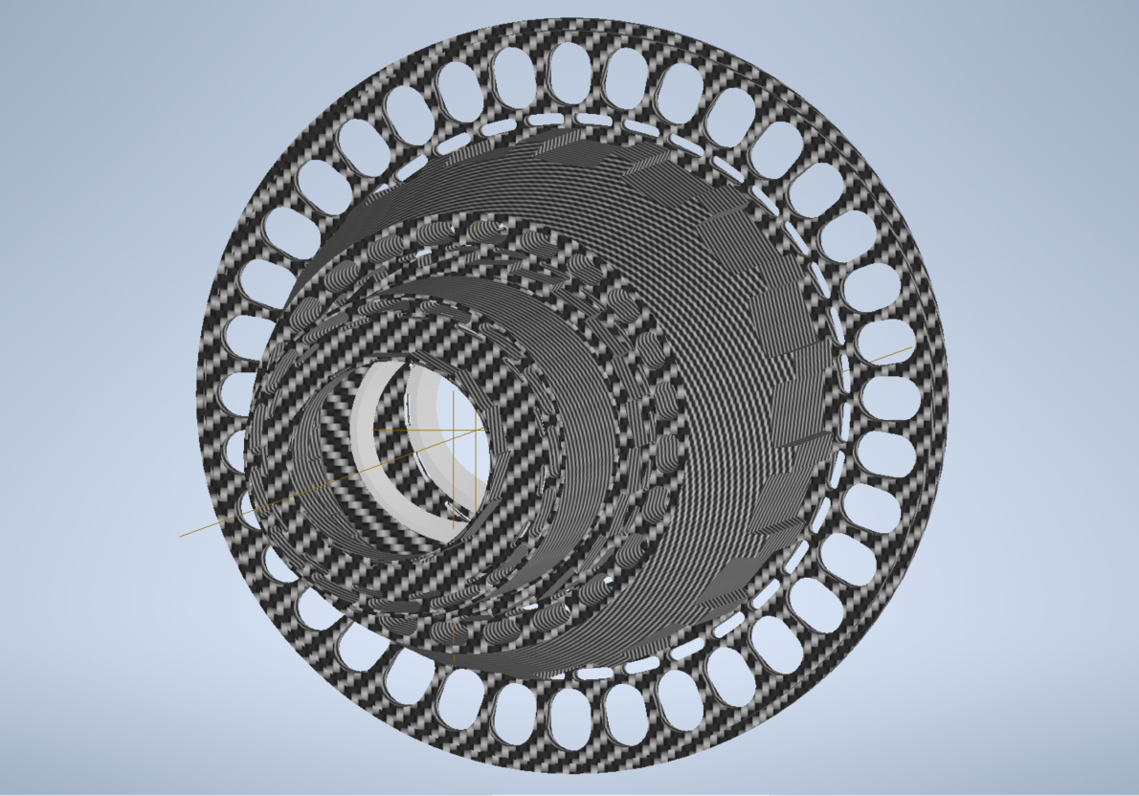
View from Interaction Point
Cable tunnel Layer 3
Air cooling Layer 3
Cable tunnel Layer 2
Air cooling Layer 2-1
Cable tunnel Layer 1
Peek Insert 1
Peek Insert 2
Air cooling Layer 1

Slide 12
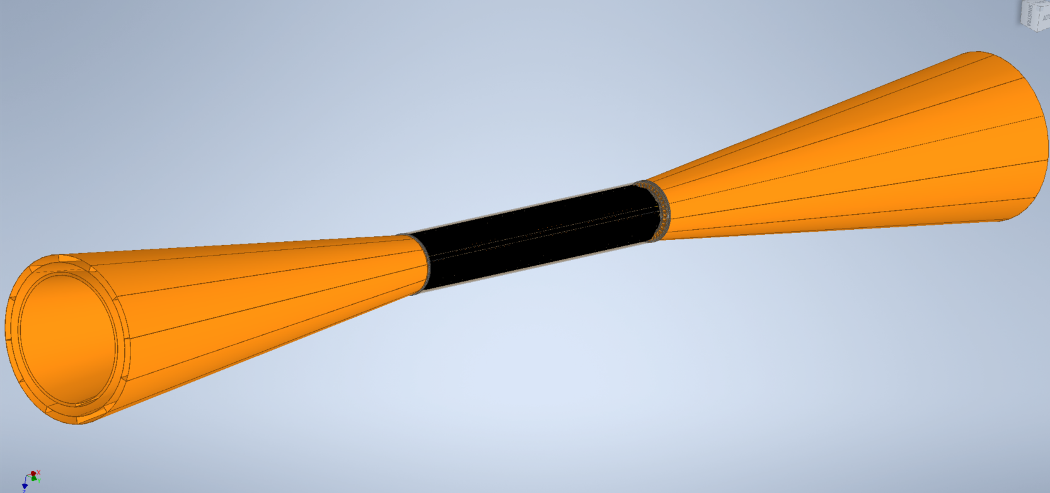
Cones for Cooling Inner Vertex and exit cables
Cone exit cable layer3-Cooling out layer3
Cone exit cable layer3-Cooling in layer3
VTX
Cone exit cable layer2-1-Cooling out layer 2-1
Cone exit cable layer2-1-Cooling in layer 2-1

Slide 13
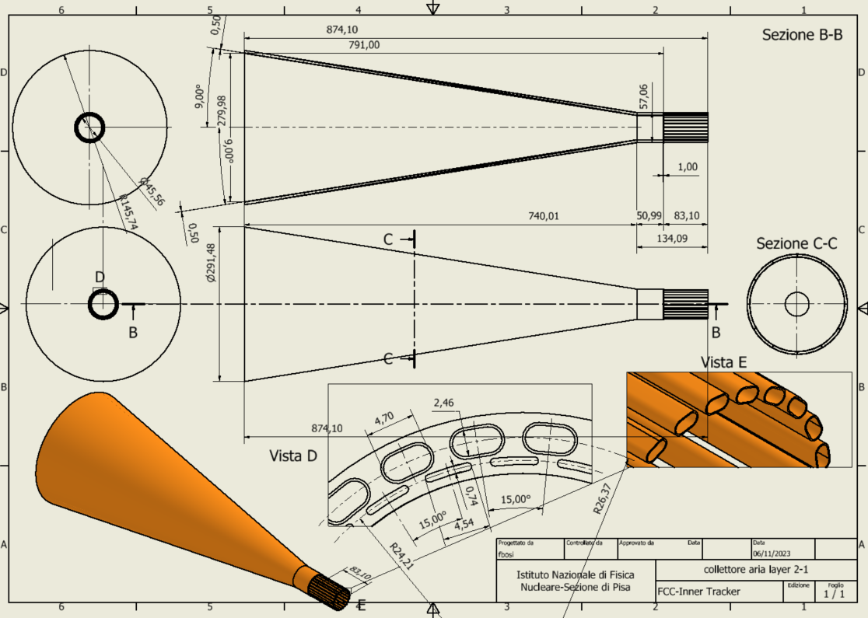
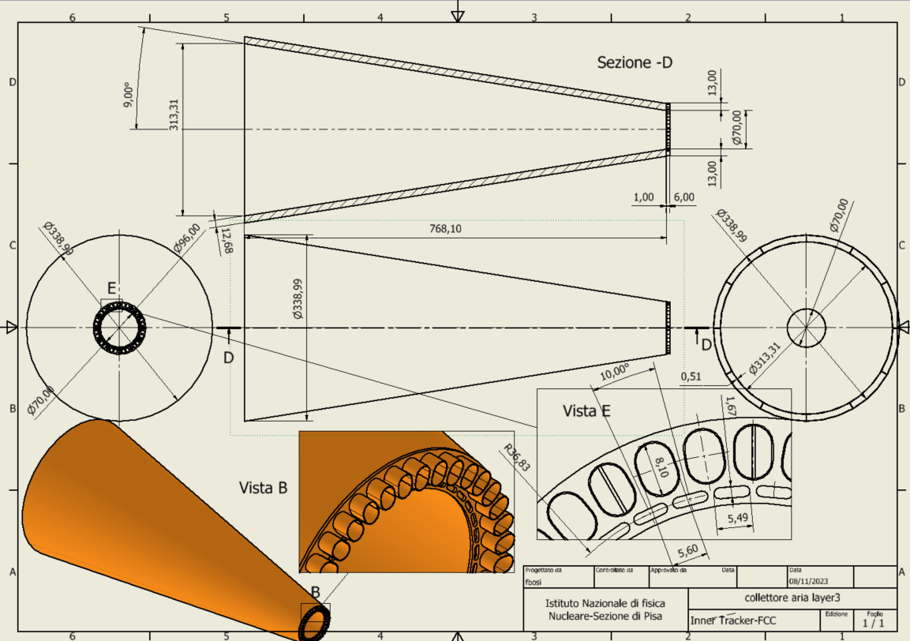
Cones of air cooling and Cables Distribution

Slide 14
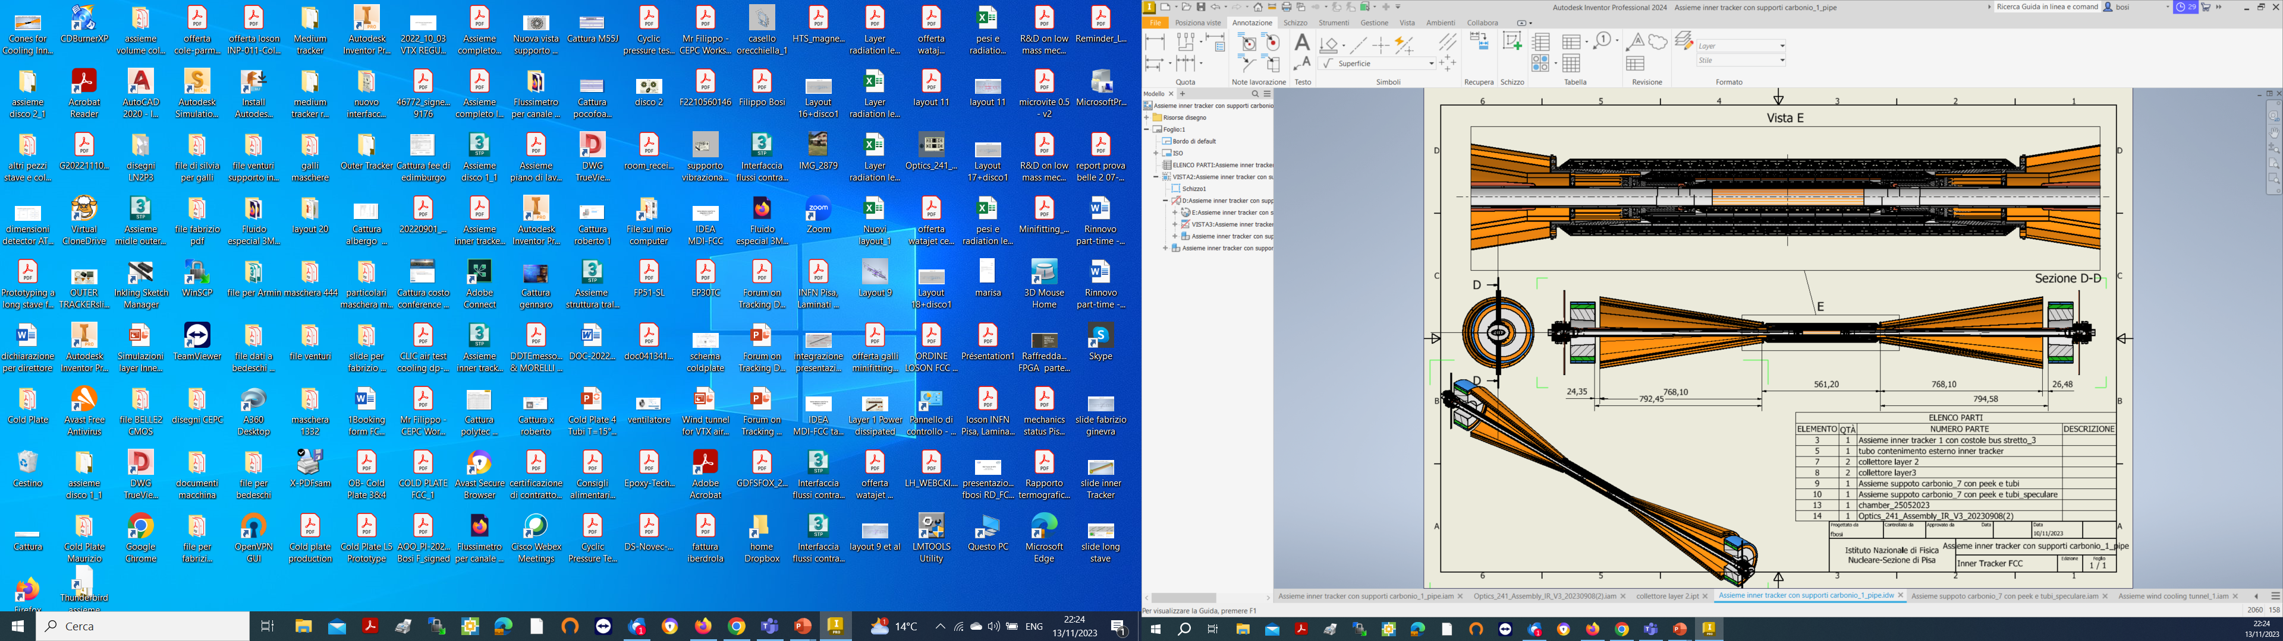
Cables Out
Cooling Out
Cables Out
Cooling In

Slide 15
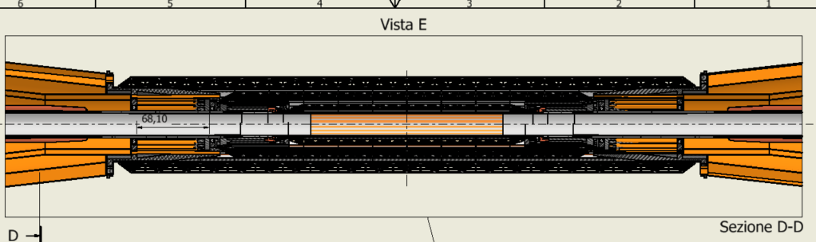
Need to integrate also paraffin channels for the pipe
Cooling in layer 3
Cooling out layer 3
Cables out layer 3
Cables out layer 3
Cooling in layer 2-1
Cooling out layer 2-1
Cables out layer 2-1
Cables out layer 2-1
Air Cooling
Cooling pipe paraffin
Cables

Slide 16
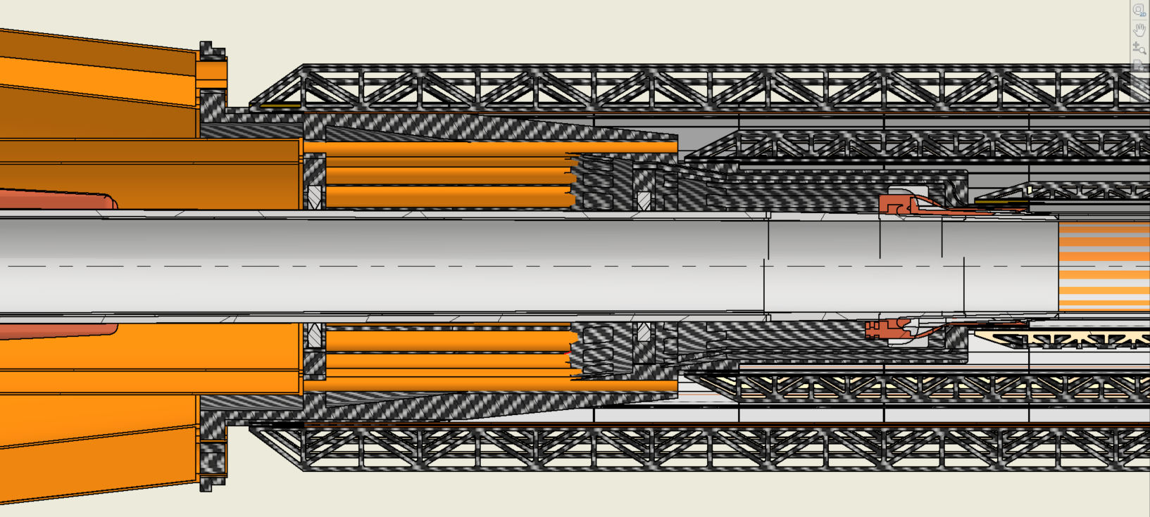
Cooling in Layer 3
Cables Out Layer 3
Cooling in Layer 2-1
Cables Out Layer 2-1
Peek ring 2
Peek ring 1
Cooling Pipe

Slide 17
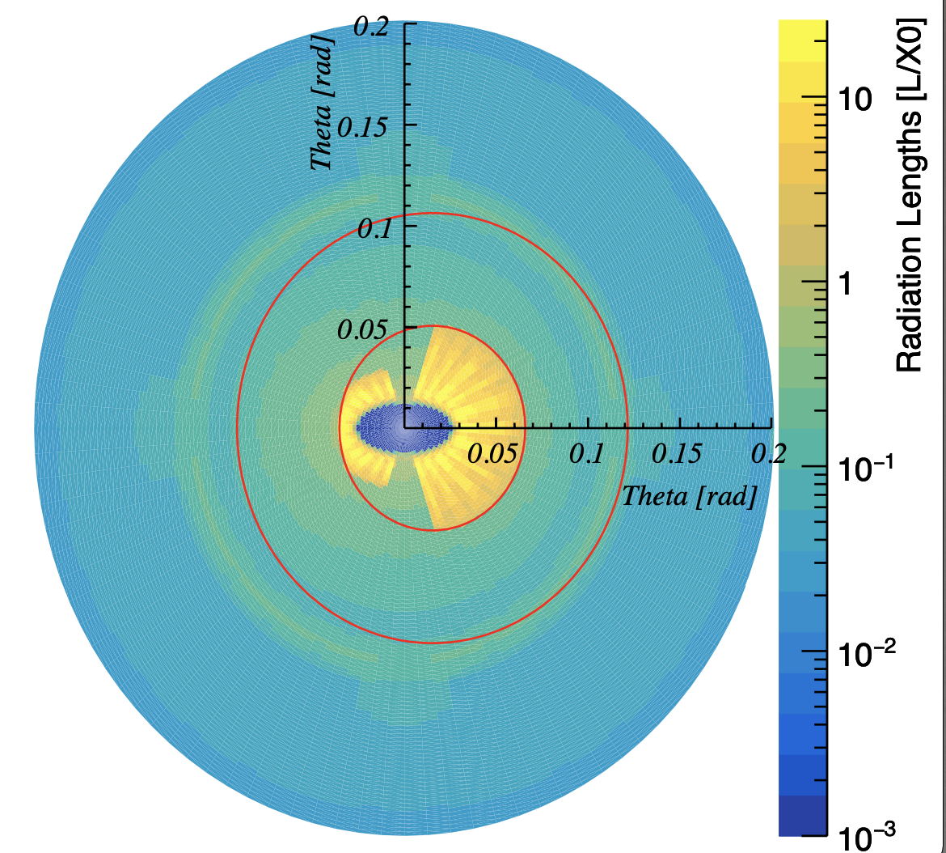
Where to anchor the conical structure?
To the support tube
  Decouple relative movements (or vibrations) between the vertex (attached to the beam pipe) and the support tube
    Needs special joints to be engineered
2) Supported by the beam pipe
  Material in front of the Lumical (1 mm thick CF ~0.2% X0 for 5 mm CF)

Slide 18
Proposed tests and goals
For the inner vertex air-cooling demonstration (aka wind tunnel):
  Fabrication of staves and its conical support
  Assembly (with option for 1/3 only)
  Air ducts direct attach (see Filippo presentation)
  Test full thermal loaded vertex temperature distribution, fluid dynamics and vibration, including pipe bakeout thermal resistance
For the mockup:
  Assembly of the vertex and air cones
  Air cones anchoring
  Mounting procedure of the vertex on the beam pipe (including dressing with cables)
  Services routing
  Air cooling possible operation but not modules

Slide 19
Proposed mechanical fabrication
Inner Vertex dummy setup components
  Staves
    Stiffners and baseplates: use carbon fibre and rohacell, specially cut
    Sensors: use heating foils
    On-going quotations by specialised dealers
  Conical support structure
    3D printed in 4 half parts, includes cables supports, air and paraffine ducts

Slide 20
Demonstration of inner vertex Air Cooling capability
(see next two presentations)
Goal: Optimzation of thermodinamic performances
  Air speed
  Air and modules temperatures
  Direction of air inlet flow
  Study mechanical deformations
  Vibrational analysis
Simulation studies
  Import mechanical model of the vertex in ANSYS FEA
Experimental verification
  Small stave prototypes to validate ANSYS simulations assumptions
  Full mock-up in a wind tunnel

Slide 21
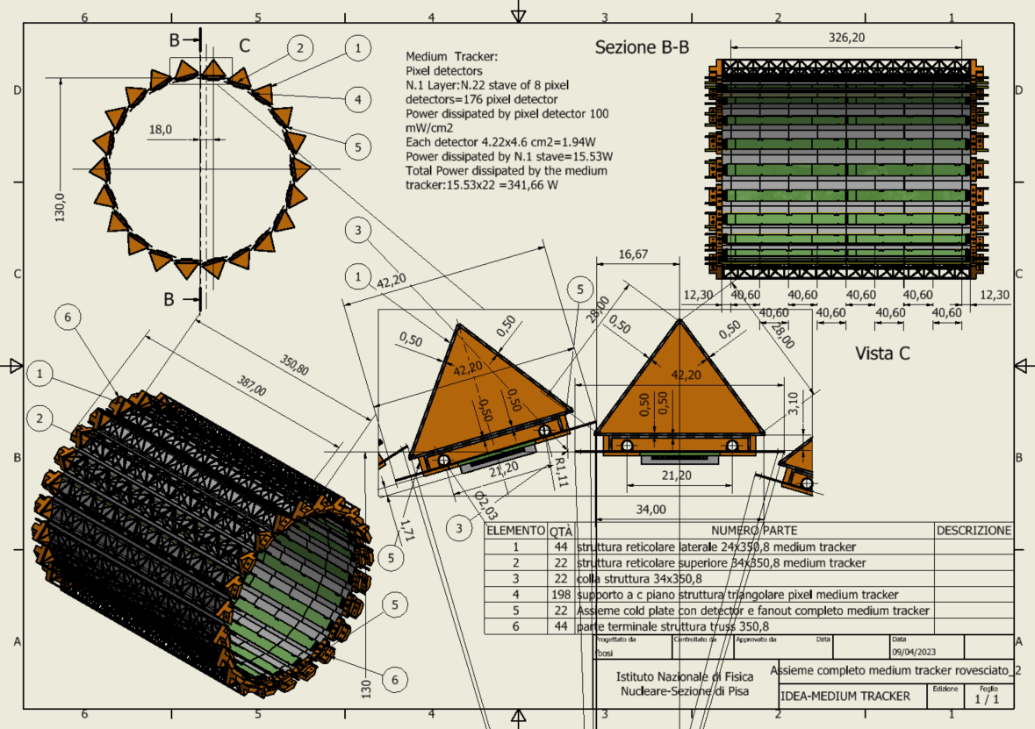
Middle Vertex Barrel
At 13 cm radius
22 staves of 8 modules each.
Lightweight reticular support structure (ALICE/Belle-II like)
Readout chips either side
Power budget
~342 W
Total weight ~1 kg
Water cooled (2 pipes of 2 mm diameter)

Slide 22
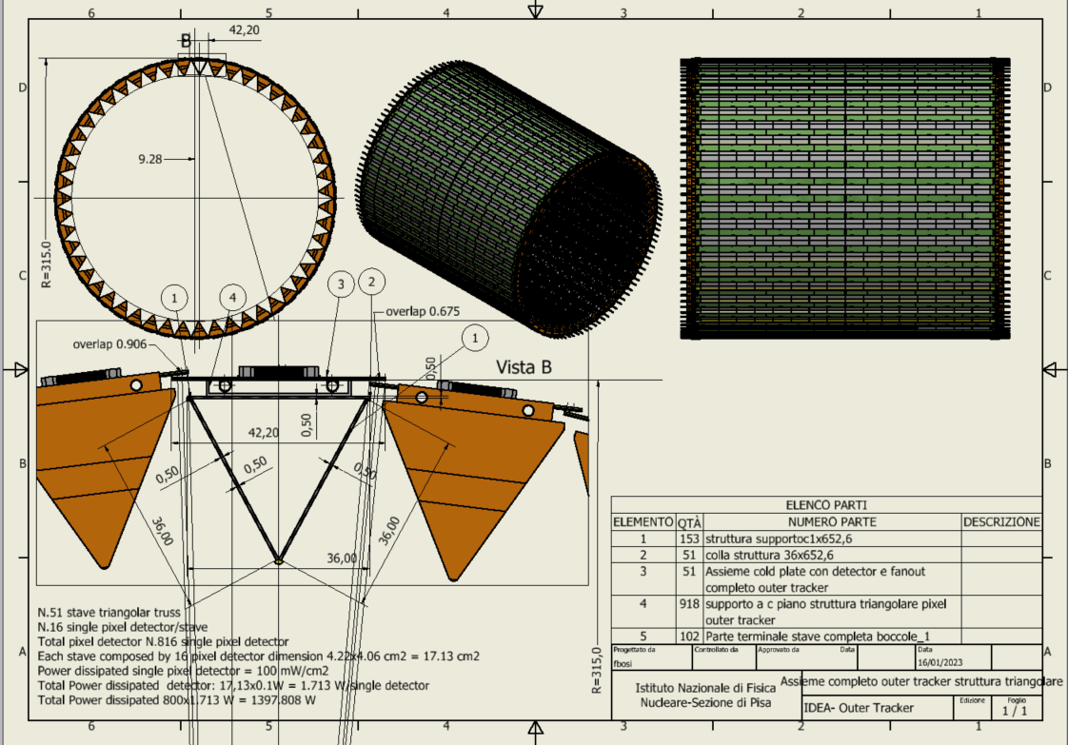
Outer Vertex Tracker Barrel
At 31.5 cm radius
51 staves of 16 modules each
Lightweight reticular support structure (ALICE/Belle-II like)
Total weight ~3.7 kg
Readout chips either side
Power budget
~1400 W
Water cooled (2 pipes of 2 mm diameter)
Notes:
NB. Qui la struttura reticolare deve stare giù perché sennò non si riesce ad ottenere il raggio esterno più grande e vicino alla DCH.

Slide 23
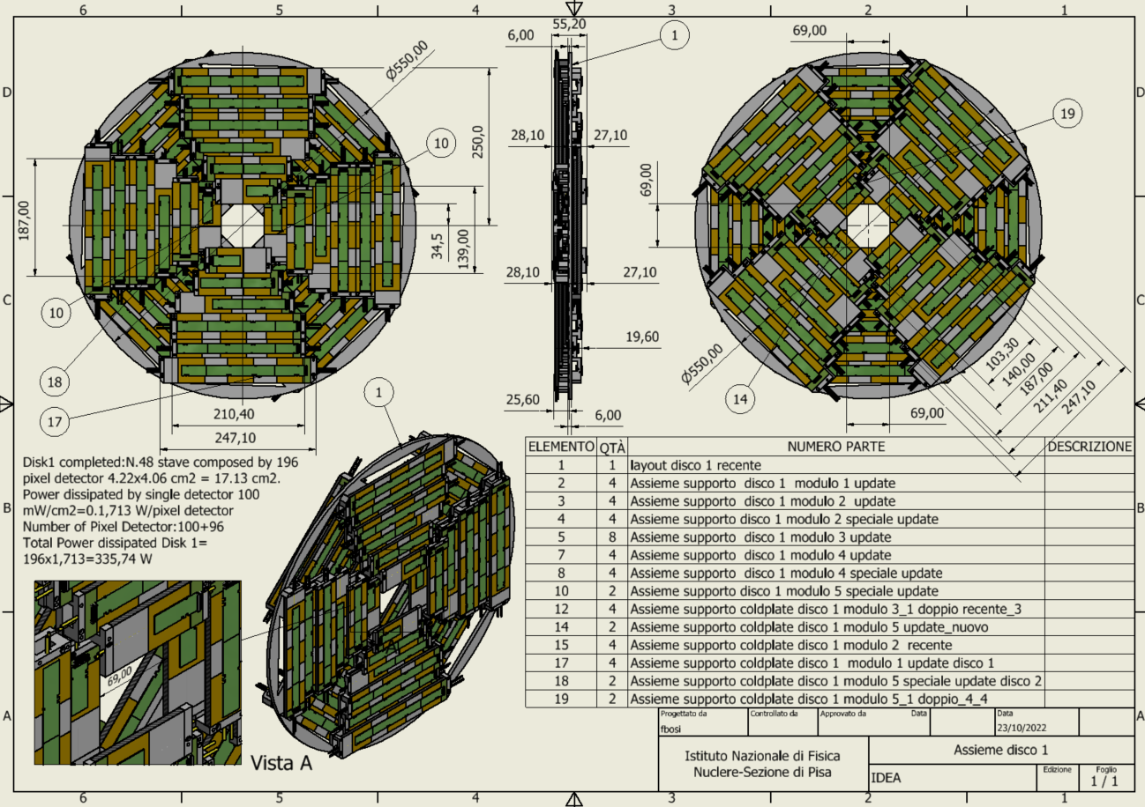
Outer Vertex Tracker Disk 1
2 sides (front and back) each with 4 petals.
One petal is made of different staves of overlapping modules
Total modules per disk: 196
Total weight ~850 grams
Power budget ~ 336 W
Cooling using 1 water pipe (2 mm diameter)
Similar geometry for the other two disks

Slide 24
Proposed tests and mechanical fabrication
Middle, Outer Vertex and disks
  Aluminum mechanical structures only for weights distributions
  Proposed tests
    Study one sector for cables and pipes routings
    Study water manifolds distribution
    Study integration and mounting (also with Disk 1)
  Study disk clearance for free space optical data transmission (off detector)

Slide 25
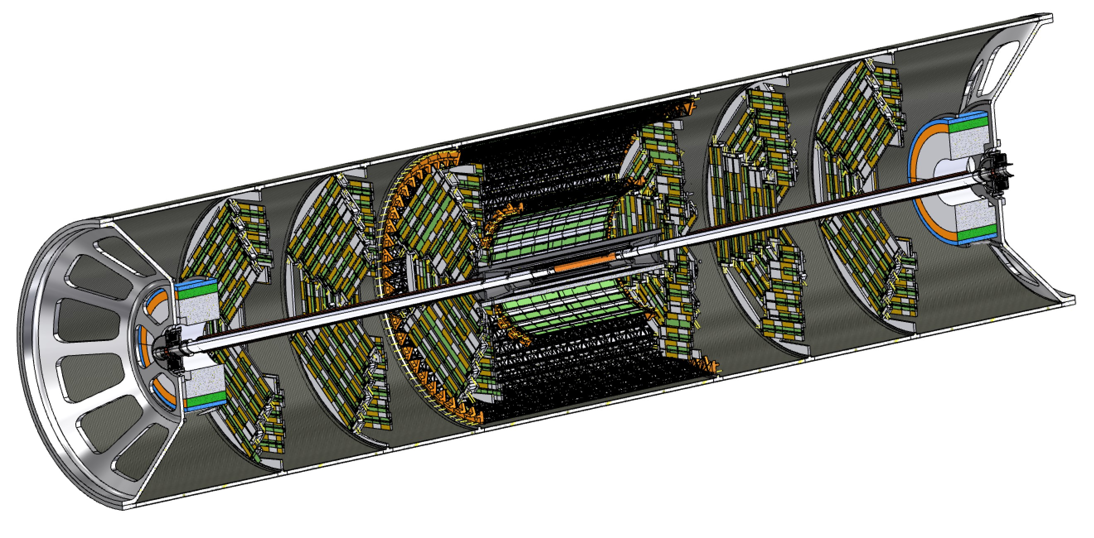
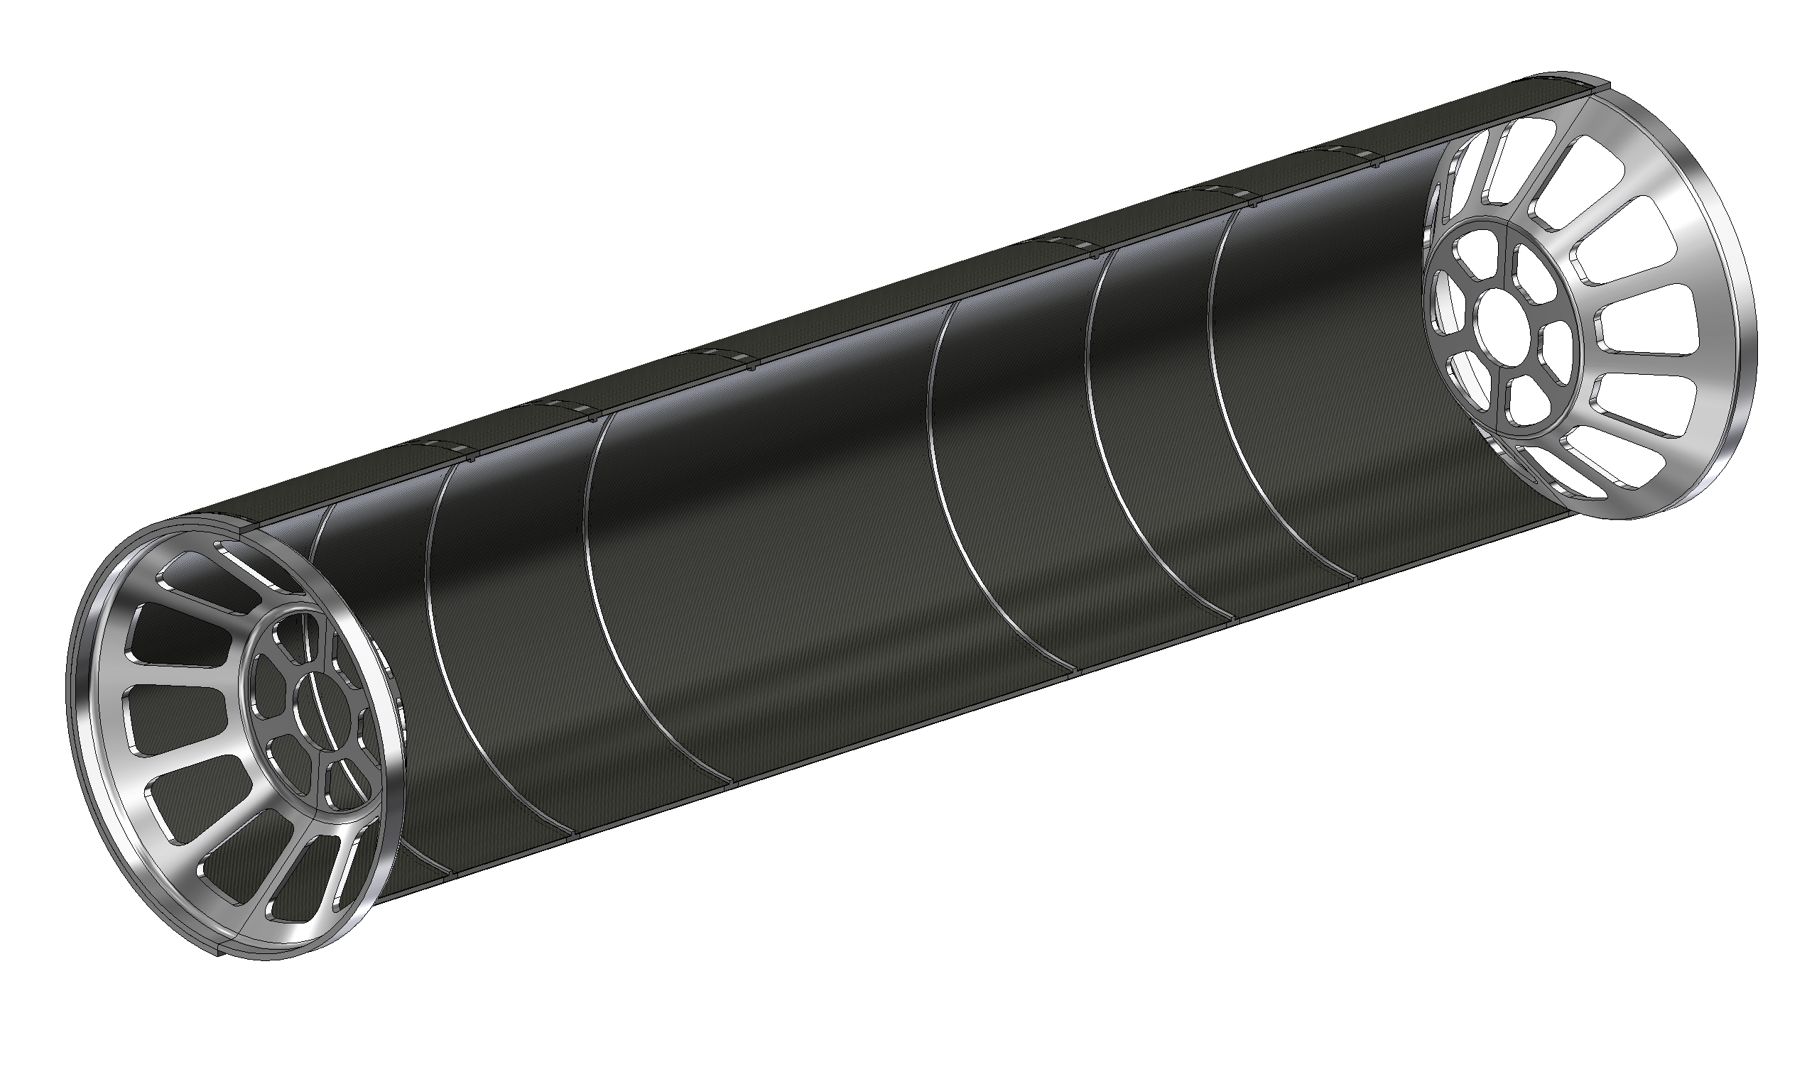
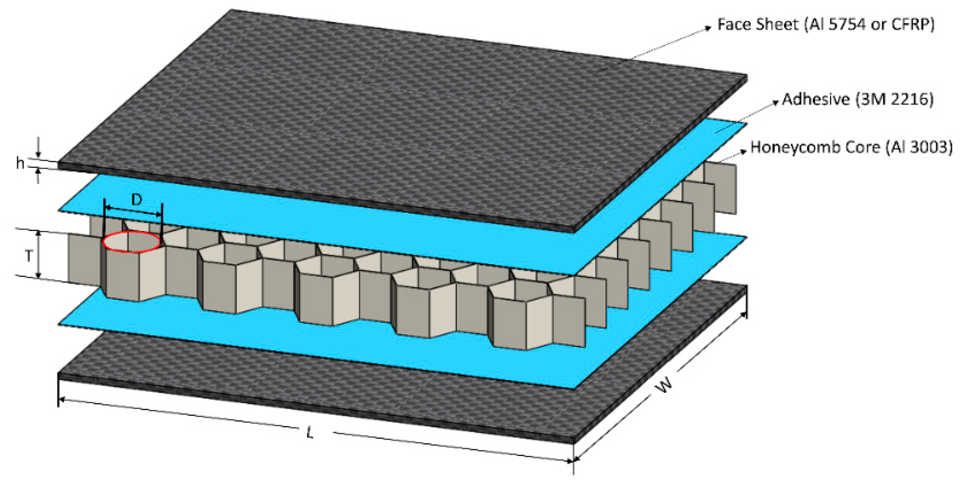
Support cylinder
All elements in the interaction region (Vertex and LumiCal) are mounted rigidly on a support cylinder that guarantees mechanical stability and alignment
  Once the structure is assembled it is slided inside the rest of the detector
  Studies on-going where to anchor it
Aluminium endcaps
Aluminium ribs
1mm CF + 4mm HC + 1mm CF

Slide 26
Critical areas – I
Integration of services near the inner beam pipe (first working version)
  Bias and readout cables of the vertex
  Air cooling ducts integration
  Inner beam pipe paraffin cooling manifolds integration
Cooling in Layer 3
Cables Out Layer 3
Cooling in Layer 2-1
Cables Out Layer 2-1
Peek ring 2
Peek ring 1
Cooling Pipe

Slide 27
Critical areas – II
Middle + Outer tracker + disk 1 integration
  Water cooling manifolds routings
  Power and readout cables
    Possible variant of a free space optical readout solution to be investigated

Slide 28
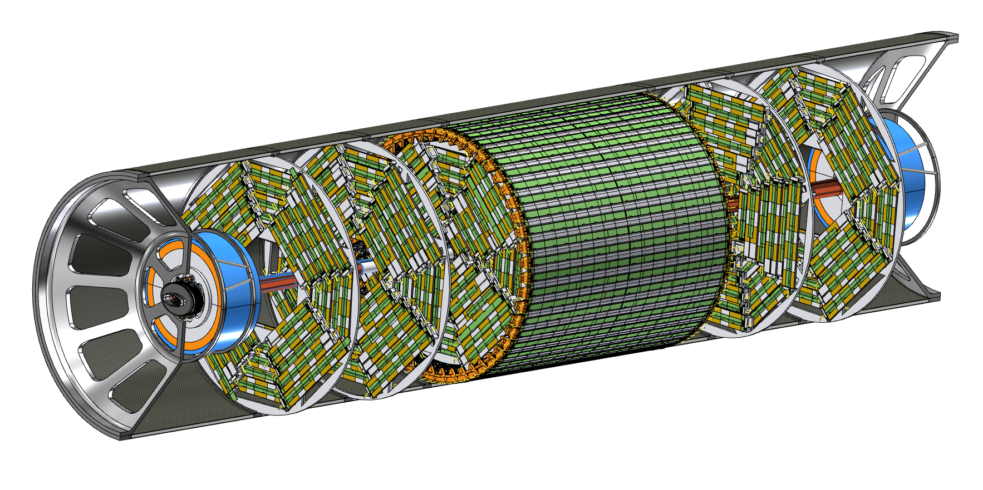
Critical areas – III
Assembly sequence
  Need to be revised given the presence of cones

Slide 29
Conclusions
The mock up of the vertex detector is being designed
  Detailed mechanical components defined
  Started to have a look at services
The goals of the mock up have been outlined
  Emphasis on system integration, air cooling and maintenance
    A dedicated system is designed to study the parameters, give inputs to the simulation and demontrate the feasibility
  Interference with machine elements studied
Before embarking construction, a few details of system integration need to be decided, especially wrt LumiCal
Gannt chart will come

Slide 30
Backup

Slide 31
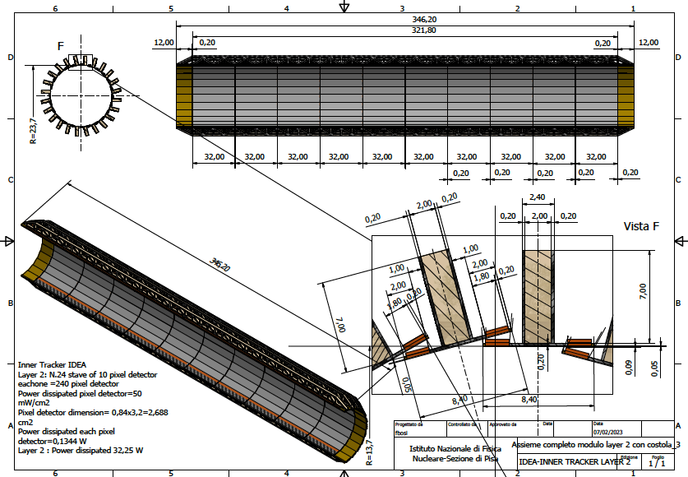
Layer 2
24 overlapping staves of 10 modules each
Pinwheel geometry
Counter-rotated wrt layer 1 to mitigate charge-asymmetry effects in track reconstruction
Power budget
~32 W
Total weight ~63 grams
Total thickness 0.25% X₀

Slide 32
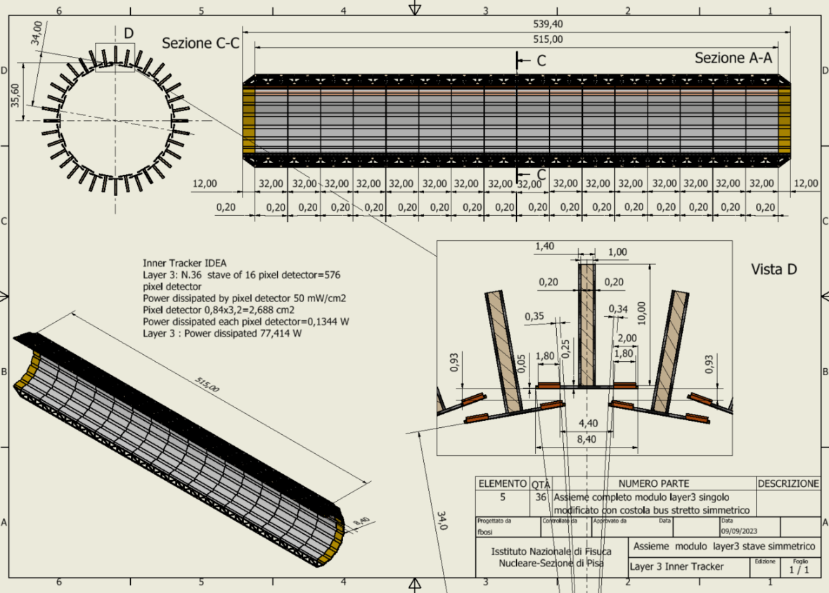
Layer 3
36 staves of 16 modules each
Lampshade geometry.
Charge symmetric track reconstruction
Total weight ~150 grams
Total thickness 0.25% X₀
Power budget
~77 W

Slide 33
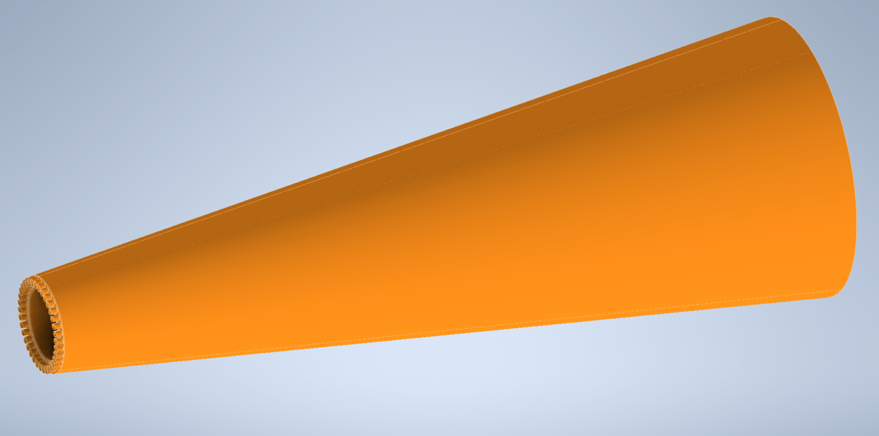
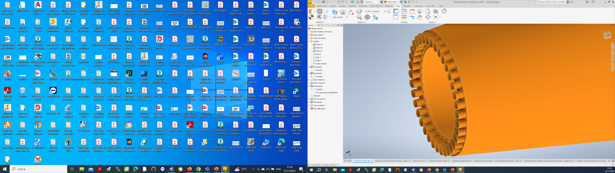
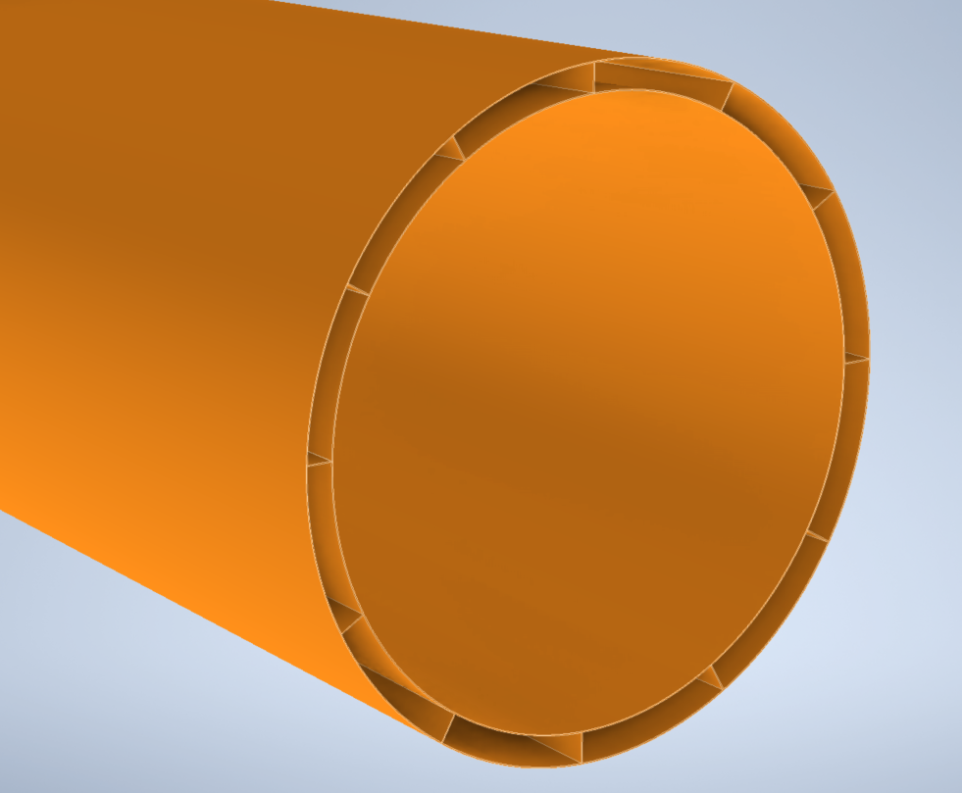
Cone Collector Layer 3

Slide 34
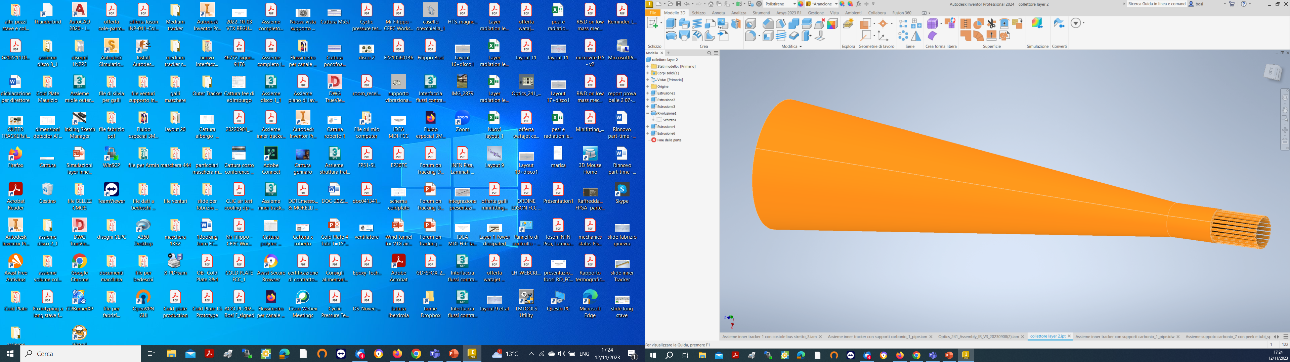
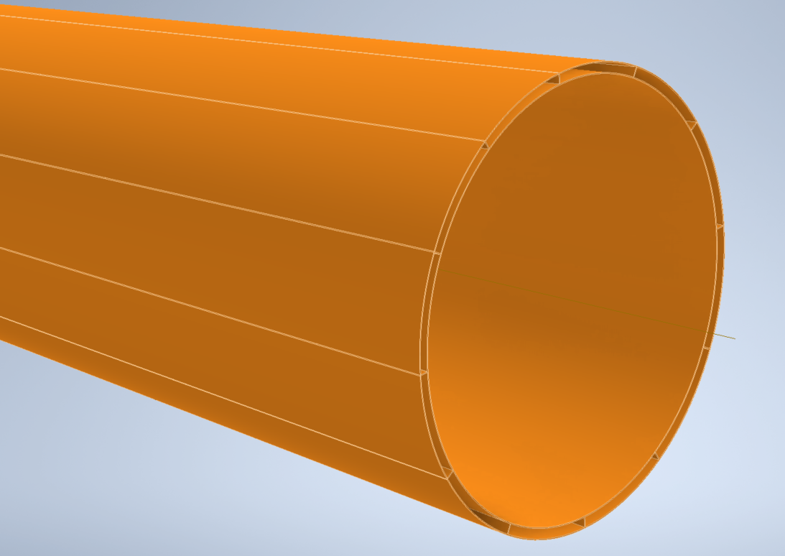
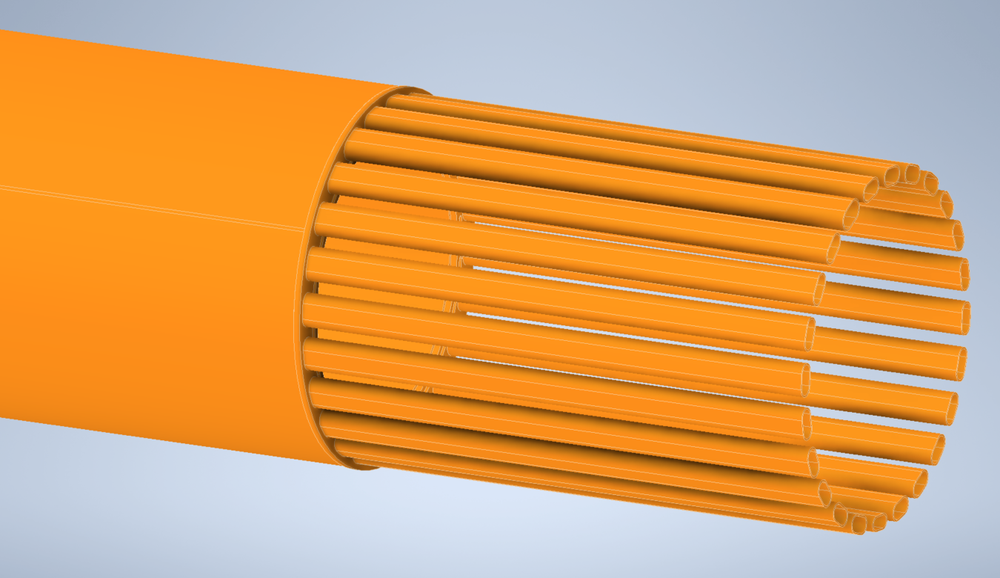
Cone Collector layers 2-1

Slide 35
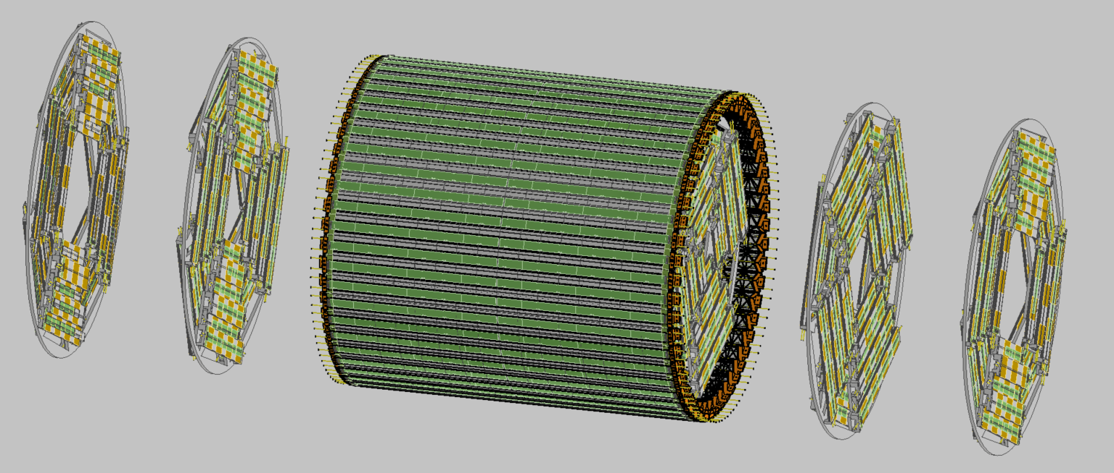

Slide 36
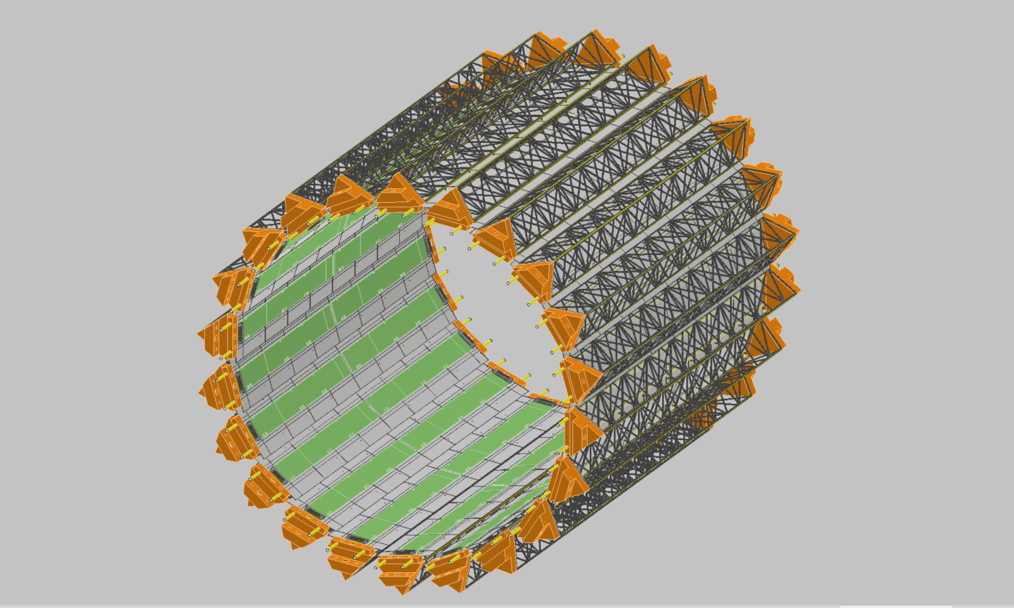
MIDDLE TRACKER

Slide 37
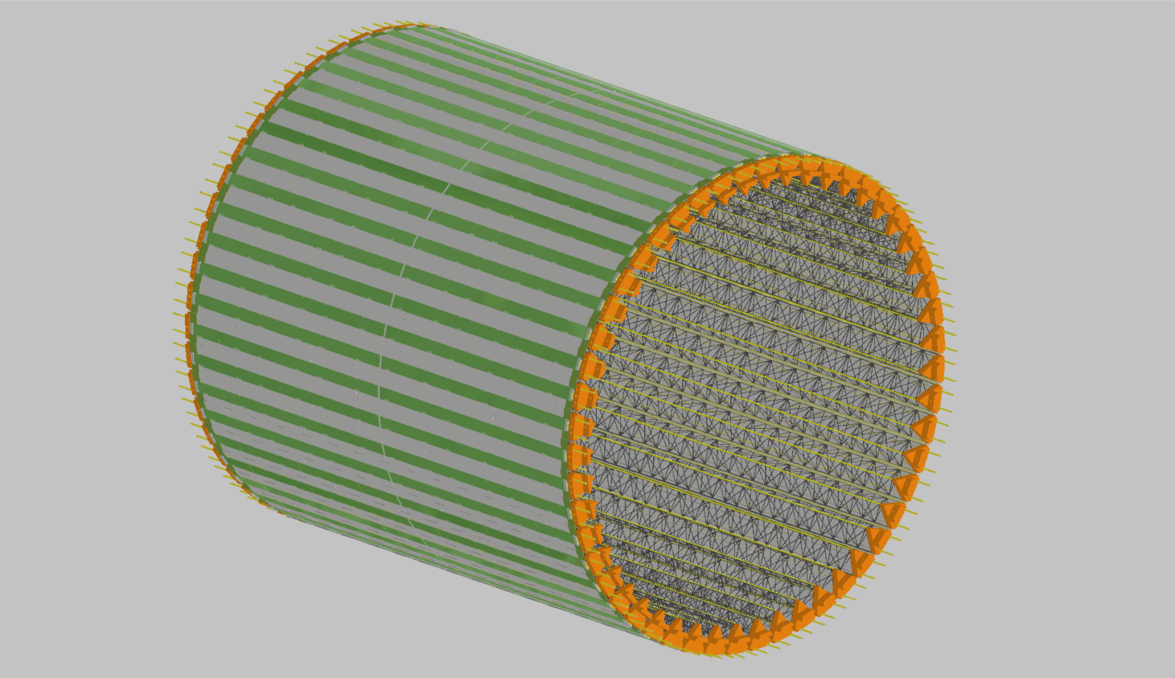
OUTER TRACKER

Slide 38
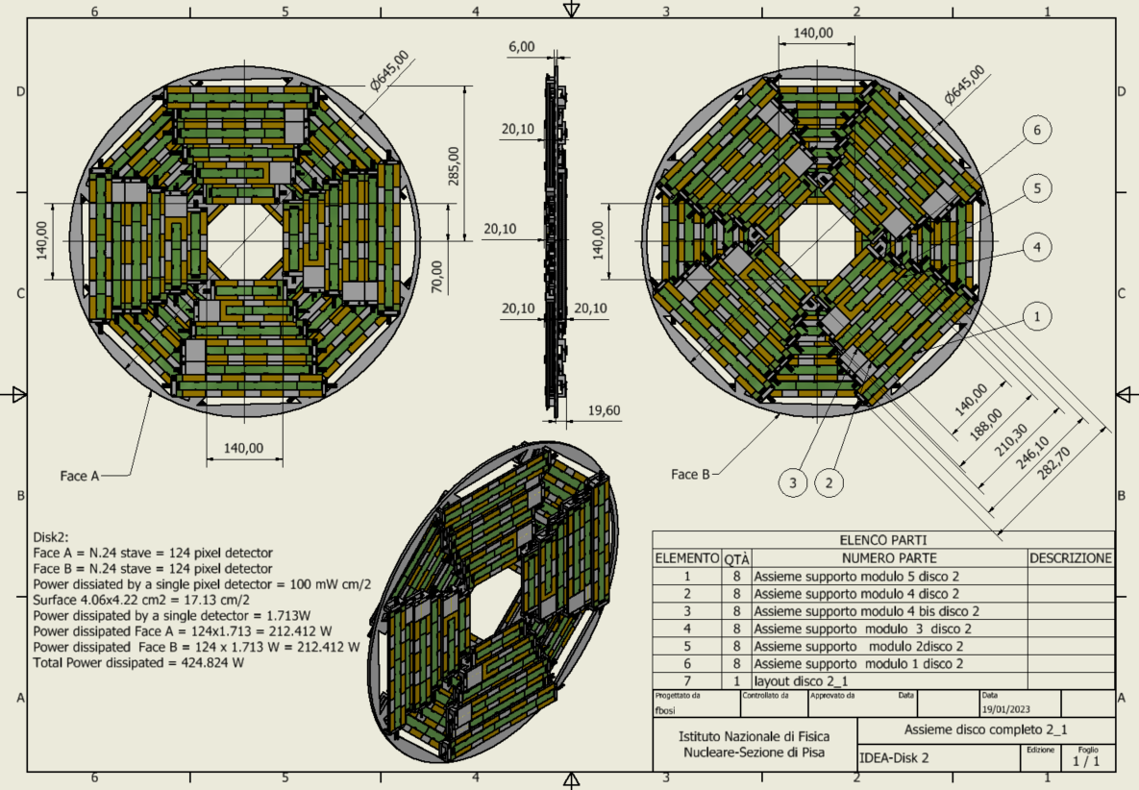
DISK 2

Slide 39
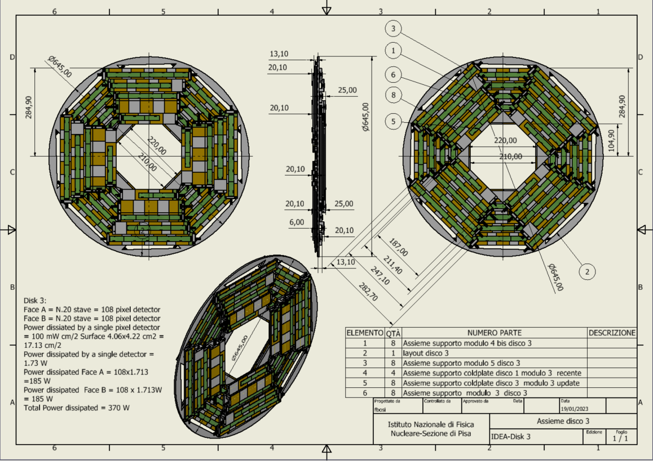
DISK 3

Slide 40
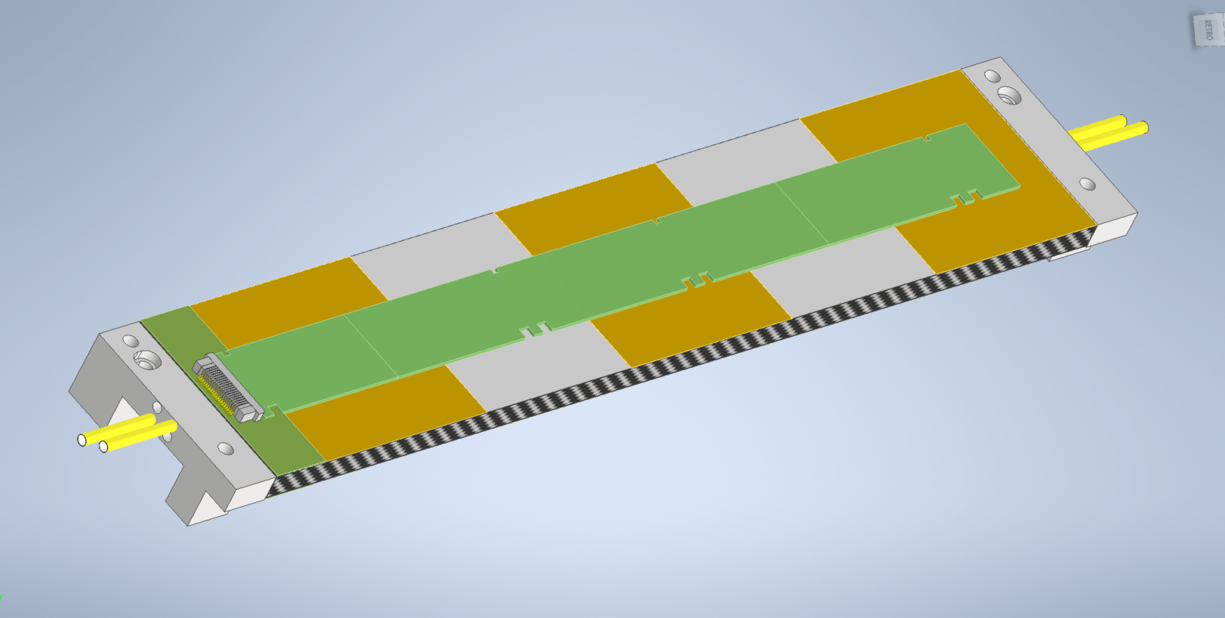
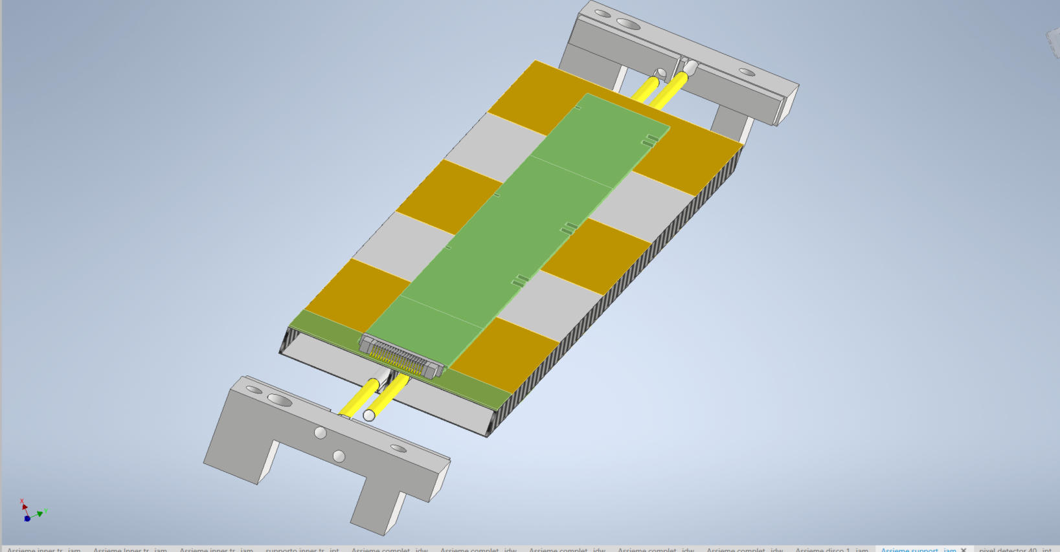
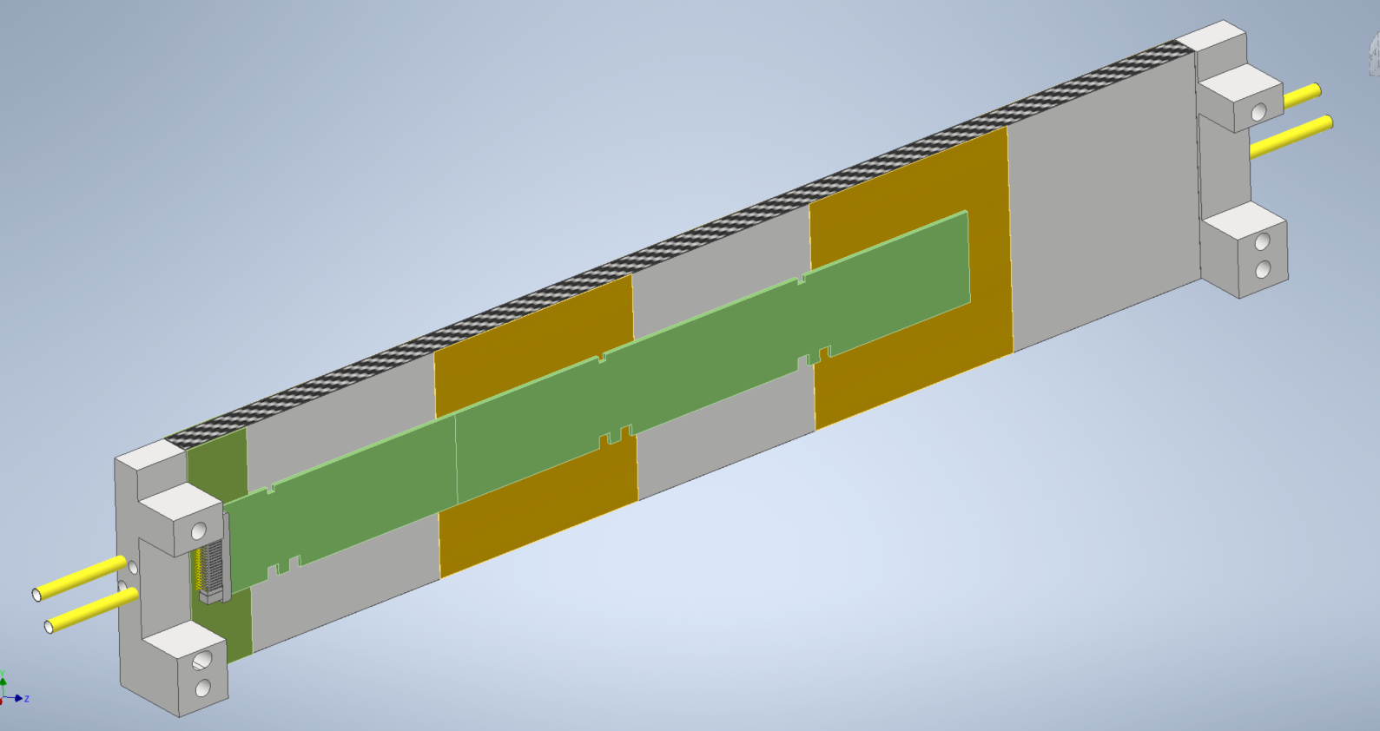
Typical disk module stave
Front
Upper modules
Electrical bus
Carbon fibre spacer
Cooling pipes
Lower modules
Carbon fibre pacers
Back

Slide 41
Inner vertex (all 3 layers)
A. Ilg

Slide 42
Middle and Outer vertex
Middle
Outer
A. Ilg

Slide 44
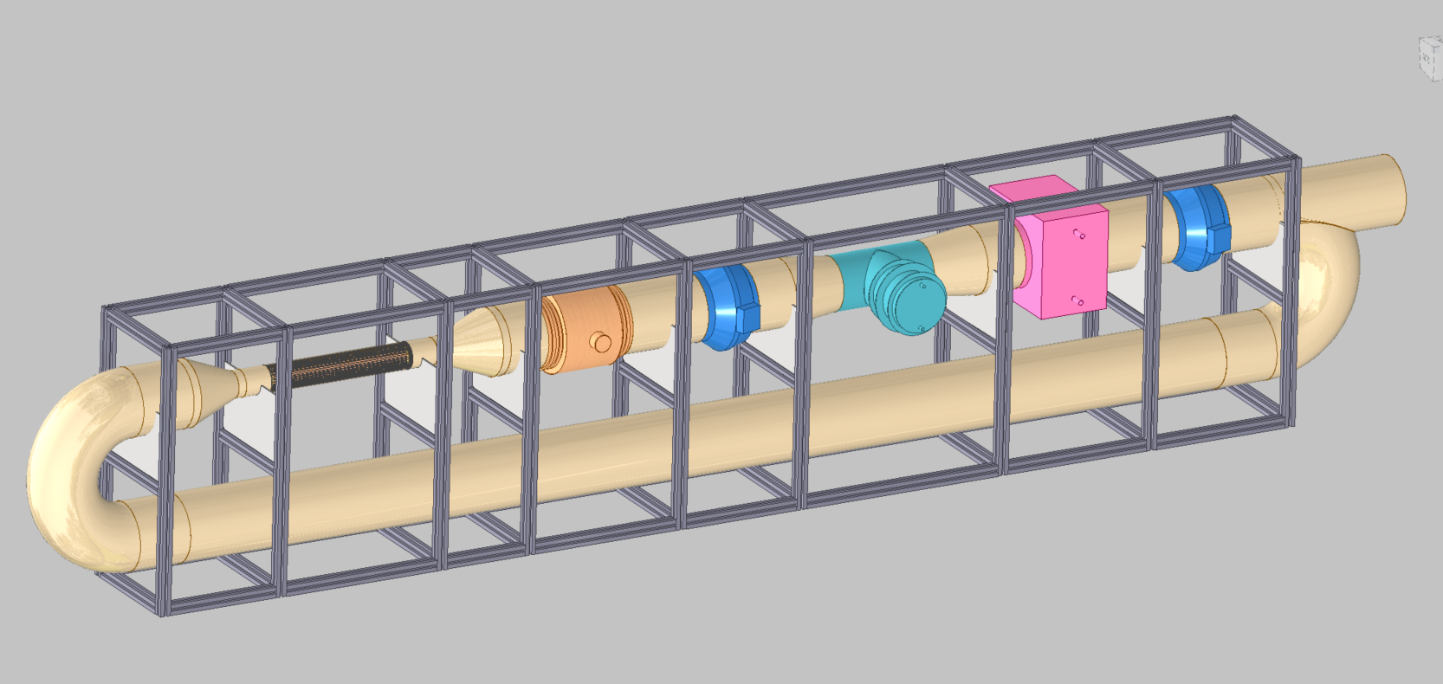
Wind tunnel for VTX air cooling
Dummy Inner Tracker
Heath Exachanger
Support Structure
Duct Fan
Connecting Tube
Duct Fan
Electrical Resistance
Support Structure
Adjustable Restriction
Connecting Tube

Slide 45
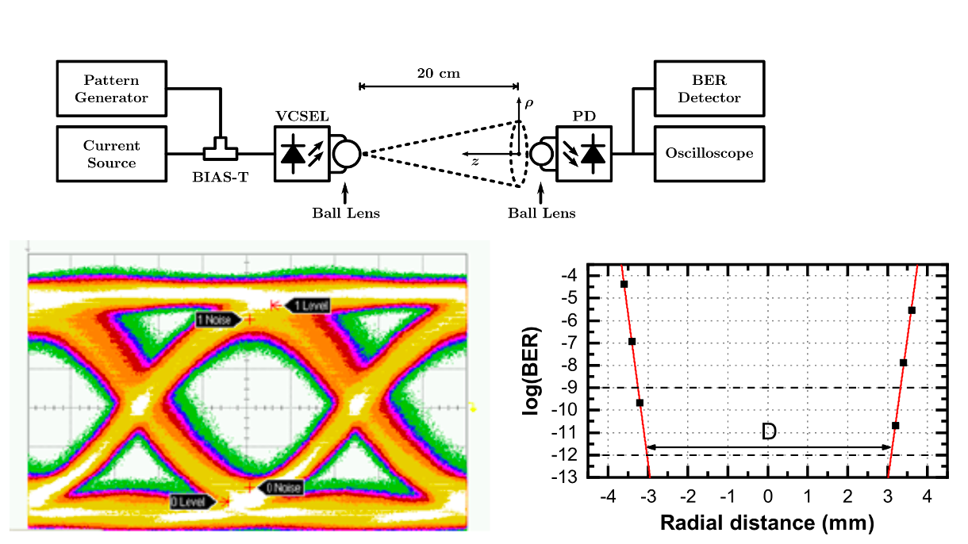
Free Space Optical (FSO) based links
(INFN Phos4brain project)
VCSEL 10 Gb/s 1310 nm, 2 mW output optical power (7.5 mA forward current ) + beam collimation ball lens
PIN diode (50 µm diameter, -3dB bandwidth 12 GHz, TIA integrated) + focusing ball lens
BER <10⁻¹² @ 10 Gb/s up to 20 cm distance
Misalignment up to ±3 mm
Limited cross-talk (precision mounting)
@ 3 cm ~-55 dB
@ 10 cm ~-30 dB

Slide 46
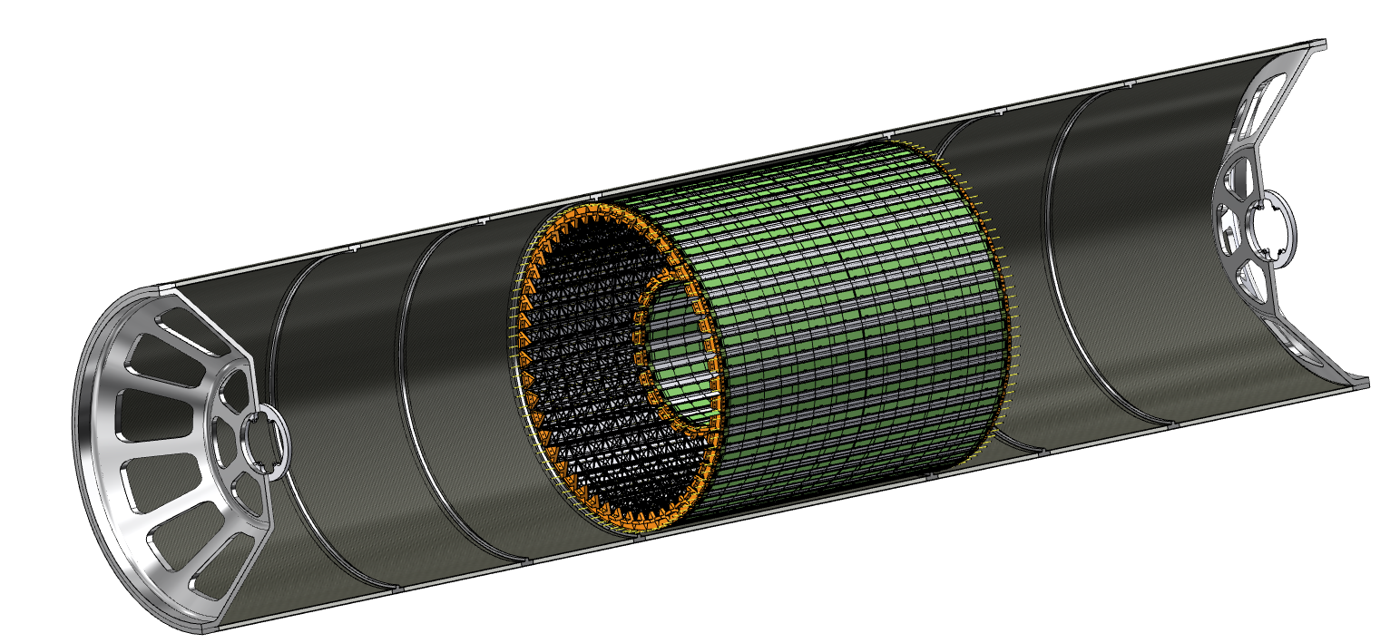
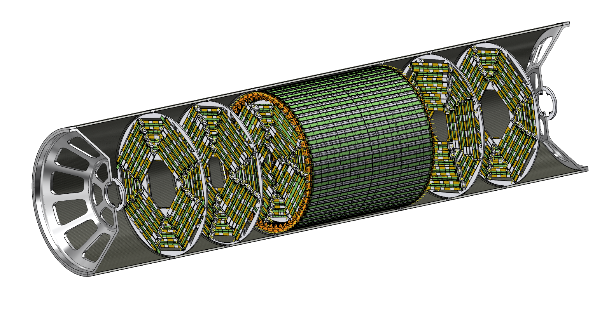
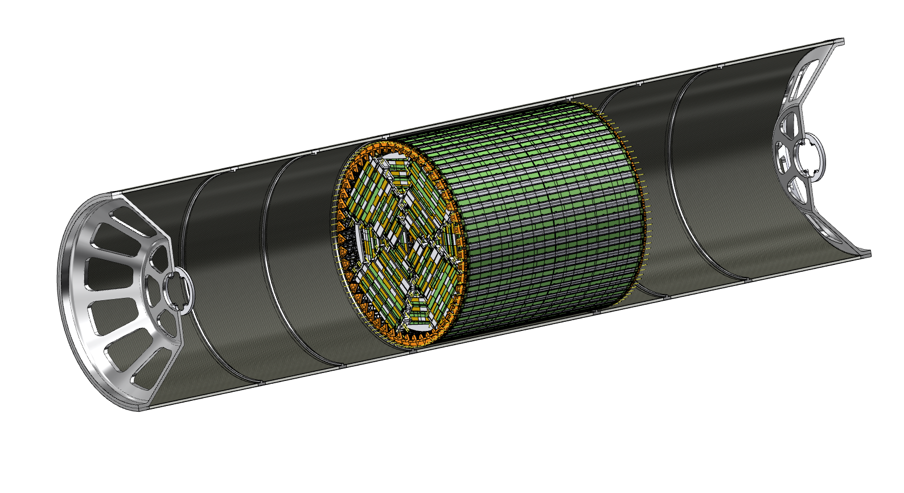
Proposed “old” Assembly procedure – I
1) Outer vertex tracker, middle vertex tracker and disks 1 are installed as a rigid structure inside the support tube
2) Disks 2 and 3 are installed inside the support tube

Slide 47
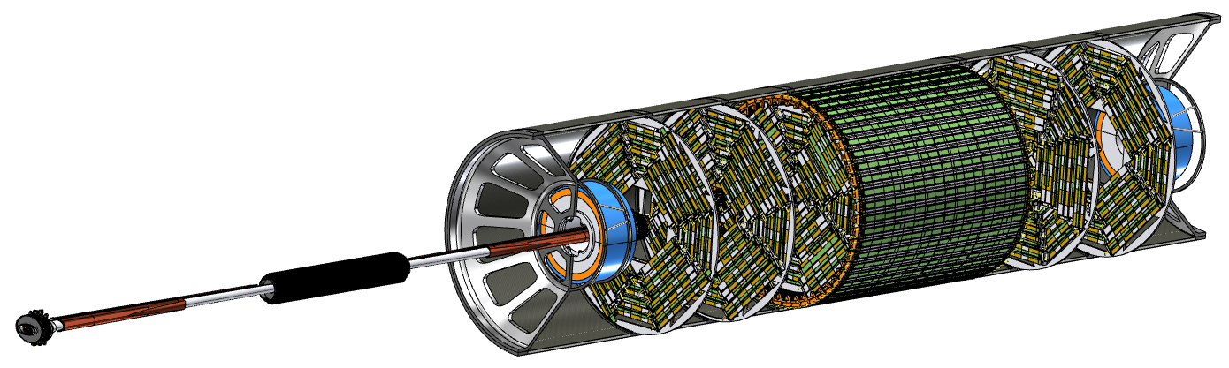

Assembly procedure – II
3) LumiCal is installed in centered position, then beam pipe with inner vertex detector is inserted with a dedicated tool inside disks and outer vertex tracker, then fixed to both endcaps
4) LumiCal can be aligned in the correct position on the outgoing beams
5) Support tube can be closed

