Slide 1
2023 CNAO data taking
Matteo Morrocchi, Francesca Cavanna

Slide 2
Schedule
Monday | Tuesday | Wednesday | Thursday | Friday | Saturday | Sunday
18 Sept. Start of Calorimeter Assembly | 19 Sept. | 20 Sept. | 21 Sept. | 22 Sept. End of Magnet Assembly | 23 Sept. | 24 Sept.
25 Sept. Measurement B Field LNF | 26 Sept. Measurement B Field LNF | 27 Sept. Measurement B Field LNF | 28 Sept. Measurement B Field LNF | 29 Sept. Measurement B Field LNF | 30 Sept. All materials for Table at PI | 1 Oct.
2 Oct. Measurement B Field LNF | 3 Oct. Measurement B Field LNF | 4 Oct. Measurement B Field LNF | 5 Oct. Measurement B Field LNF | 6 Oct. Measurement B Field LNF | 7 Oct. | 8 Oct.
9 Oct. IT integration | 10 Oct. IT integration | 11 Oct. IT integration | 12 Oct. Accelerator downtime IT integration | 13 Oct. Accelerator downtime IT integration | 14 Oct. Accelerator downtime | 15 Oct. Accelerator downtime

Slide 3
Schedule
Monday | Tuesday | Wednesday | Thursday | Friday | Saturday | Sunday
16 Oct. Accelerator downtime | 17 Oct. | 18 Oct. | 19 Oct. | 20 Oct. | 21 Oct. Night Shift (8h) Beam Tuning | 22 Oct. Night Shift (6h) Beam Tuning
23 Oct. Table, calo and magnet at CNAO Installation | 24 Oct. Installation | 25 Oct. Installation | 26 Oct. Installation | 27 Oct. Night Shift (8h) Calo Screen Saver Run | 28 Oct. Night Shift (8h) Installation Vertex + IT Calibration | 29 Oct. Night Shift (6h)
30 Oct. | 31 Oct. | 1 Nov. | 2 Nov. | 3 Nov. | 4 Nov. After. Shift (8h) | 5 Nov. After. Shift (8h)
6 Nov. Night Shift (6h) | 7 Nov. Night Shift (6h) Emulsion Run TW calib | 8 Nov. Uninstallation | 9 Nov. Uninstallation | 10 Nov. No Material in the room | 11 Nov. Next Exp. In Exp. Room. | 12 Nov.

Slide 4
Documentation
Need to fill the required safety modules:
- Module for radioprotection, one for each participant (please check the expiration date of your medical certificates and send a copy to me)
- Declaration of possession of requirements for professional and technical suitability, one for each institution (the module expires after 1 year)
- Safety Approval Form, one for the whole experiment
All modules are available here. The deadline to collect the documentation is September, the 22nd
In addition:
- An online course (0.5 h) needs to be attended, and a form needs to be filled. The course expires after 3 years.
- Each Local Coordinator should send to us the participant list specifying (if possible) dates of arrival and departure, radioprotection status, and the means of transportation used by each group (i.e. to optimize the number of vans to be used).

Slide 5
Measurement Plan - Calibration
Calorimeter (8h)
Calibration with screen saver, 4 positions, as many energies as possible.
Reconstruction of the response curve for each crystal
10000 evts x crystal x energy
2h → 9 energies for ¼ of the calorimeter
No other detectors in the beamline
Vertex and IT (6h, very low beam intensity)
Cross-check the threshold for each sensor
Collect statistics with tracks in different region of the detector
→ need for a thick target in front of the vertex to scatter the beam
The calibration needs to be done with and without magnetic field, with more than one energy
TW (1-2h)
Scan of the TW using the same energy used in the fragmentation runs. Also protons (few energies).
MSD
Just a quick alignment run without magnet
→ 5 different points in the detector (same energy used in the frag. runs)

Slide 6
Measurement Plan - Frag. Measurements
4 Shifts - 28 hours total (6 + 8 + 8 + 6)
1-2 hours at the begin of the first run needed for alignment acquisitions
In the last data taking we acquired data with the following event rate:
about 200 Hz with MB trigger (TBC)
below 100 Hz with fragmentation trigger (TBC)
To demonstrate the capability to work in inverse kinematic we need to acquire data with C₂H₄ target
29 Oct.
Align.
Align.
4 Nov.
5 Nov.
6 Nov.
200 MeV/u
C, MB
C Frag
C₂H₄, MB
C₂H₄, Frag
No target
No Magnet

Slide 7
Measurement Plan - Emulsion Run
Two bricks, C and C₂H₄.
Emulsions need to leave CNAO the 8 of November (preferably in the morning) to go back to Naples.
A radioprotection survey is needed before emulsions leave CNAO
→ Naples will send a sample to CNAO ad a brief description of the samples that will be irradiated with the estimated total number of particles. The sample will be irradiated the nights of the beam tuning.
Integration of the Emulsion support in the table needs to be discussed. (today, mechanics section)
Need for a scan spanning an area of 2.4 cm x 2.4 cm with a 15-18 kg brick.
→ Use of CNAO magnets and SC to count the particles impinging on the brick and to veto the beam.
Separated meetings with a working group to understand how to execute the irradiation with the required resolution on the number of particles. First meeting Sept. 19th at 9:00.

Slide 8
Detector Geometry
Need to provide a final sketch of the detector geometry with all the detailed positions of the detectors.
→ A power-point with all the distances will be provided in a week.
A document with all the channel maps and geometry of the detectors is also in preparation.
→ The Channel map of the TW remains the same
→ The Channel map of the Calo will be integrated
Question: Which other infos do we need for the online analysis?

Slide 9
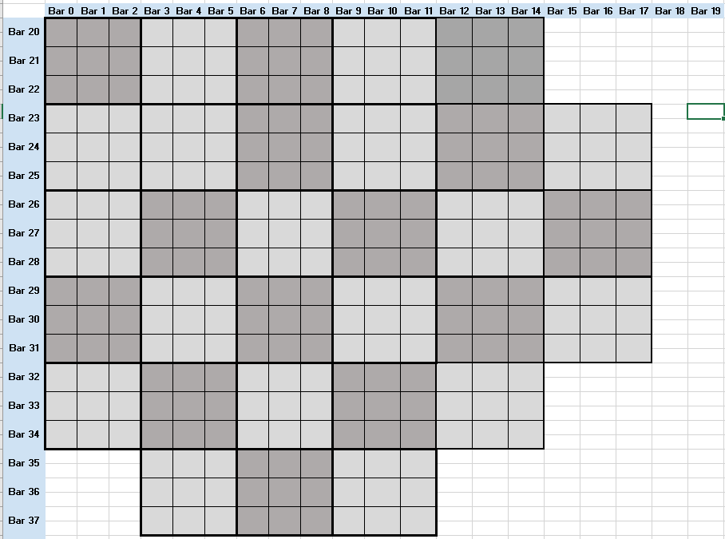
Detector Geometry

Slide 10
Installation
For the CALO screen saver run, no other detector should be on the beam line, this calibration will be performed at the beginning of the data taking. So it would be nice that:
All the detectors will be installed on the beamline by the 26th to test the whole apparatus (without beam).
Move the detectors out of the beamline, except for the calorimeter, the 27th.
Mount again the morning of the 28th
Remember: Installation dates may change according to the availability of the construction site for the access with the van(s). The site need to be informed few days in advance to have access granted.
The more the system gets complex, the more the installation needs to be planned and performed in steps…
Let’s avoid having 20 people at the same time in the cave
Space will be reduced compared to last data taking
Step by step plan divided into 3-4 days to coordinate the activities in the room (4-5 shifts)

Slide 11
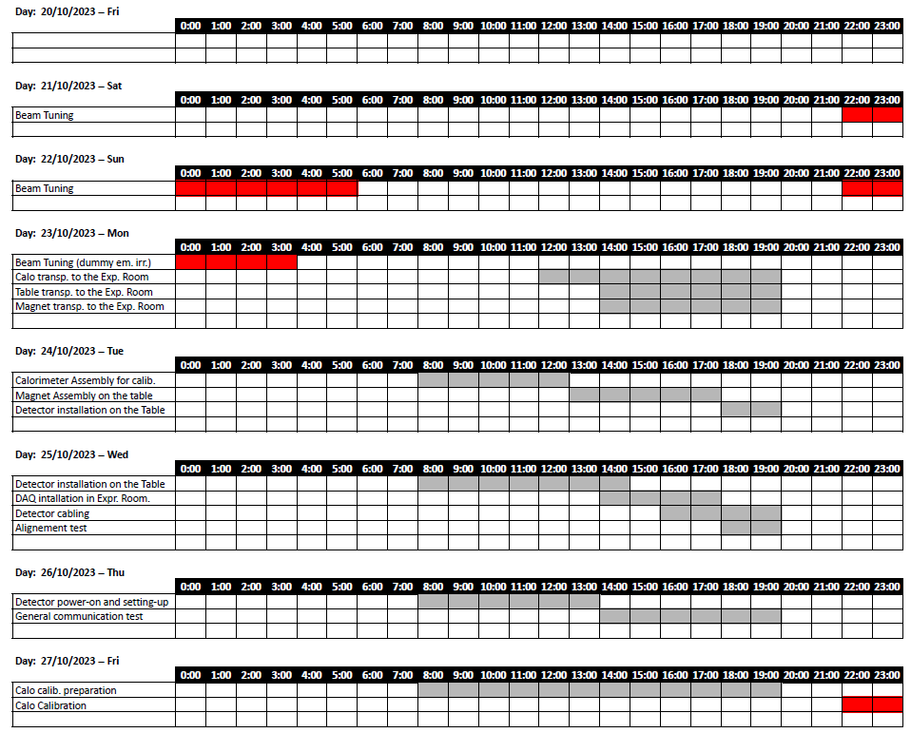
Installation
Since the installation will be complex, we are preparing a document summarizing the single procedures. A tentative schedule is the following:
https://docs.google.com/spreadsheets/d/1IqRL4kOycADrqjhl-oJBJijQHcKq9icJ/edit#gid=275983815

Slide 12
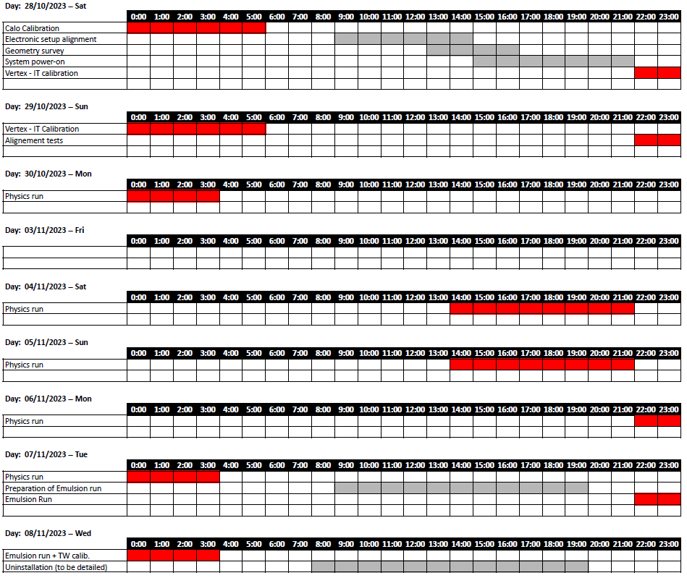
Installation

Slide 13
Logistic
The following “big” components need to be moved to CNAO:
Calorimeter (about 400 kg)
Table (... kg)
Magnet (... kg)
(Also a transpallet from Perugia is needed for the installation)
From Pisa: van with tail lift to load and unload the table without need for a forklift in the construction site. (23-26 October, 7-10 November) → maximum load of tail lift: … kg.
From Torino: van of the institution with calorimeter top and calorimeter base on two pallets, another pallet for the lifter to use during calibration
From Frascati:
A gas bottle need to be transported from Milano to CNAO
A forklift is available at CNAO, outside the construction site and can be used to transfer the materials from a van to another, if necessary, or to simply unload the van.
Fix in advance the date to enter in the construction site, to coordinate with the builders

Slide 14
Logistic
Calorimeter transportation in the Expr. Room: The calorimeter will be unloaded from the van using the CNAO forklift and will be transferred in the experimental room using the transpallet (top and bottom separately). In case this would not be possible the pallets will be transferred to the Pisa van and moved in the construction site, so to enter from there.
Table transportation in the Expr. Room: The table will be unloaded in the construction site from the tail lift of the van.
Use of the crane in the experimental room

Slide 15
Uninstallation
All the materials have to be removed from the experimental room before November, 11th.
Materials cannot be left at CNAO, some exceptions for limited volumes can be discussed with Marco, but please let us know in advance if this is needed, so to identify a possible solution.
Also the uninstallation needs the coordination with the construction site.
It is difficult to perform the whole radioprotection survey on November, 8th, the exact schedule of the surveys will be decided later (need to be known a bit in advance to schedule the rent of the vans)
Uninstallation follows the same logistic unless specified.

Slide 16
Mechanics
- Update on the status of the realization of the table
- Update on the magnet assembly
- Magnet-Table integration
→ Integration test before CNAO data taking
- Emulsion-table integration

Slide 17
Notes
Documents in preparation:
FOOT Installation documentation
Geometry and detector maps documentation
Safety Approval Form
This presentation is continuously updated and can be found at the following link:
https://docs.google.com/presentation/d/1Z5GhAc4msEjNLL_mqJcTx-BF5PDRneSg/edit#slide=id.p1

