Slide 1







Study of the $Λ_{b}^{0}→D^{0}pK^{−}$ decay for a measurement of the CKM angle 𝛾
Chiara Mancuso, Nicola Neri, Patrick Robbe
15/09/2023
Second year seminar
chiara.mancuso@cern.ch

Slide 2
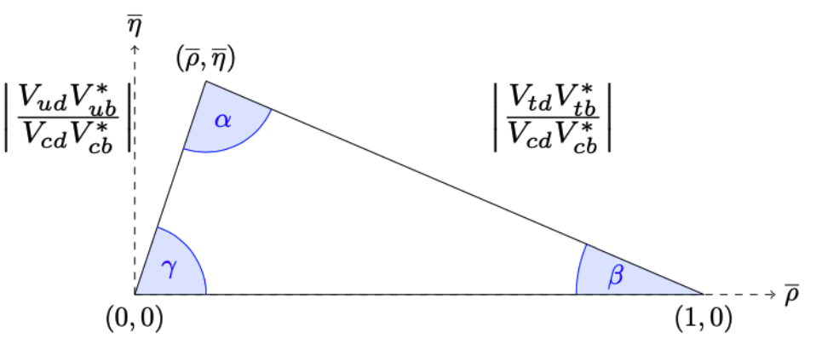
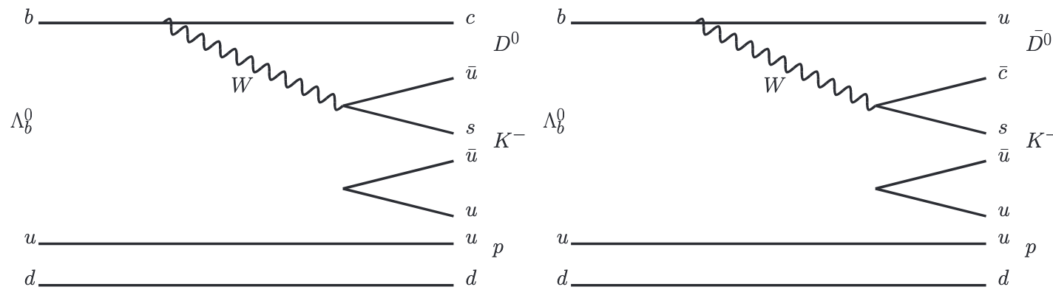
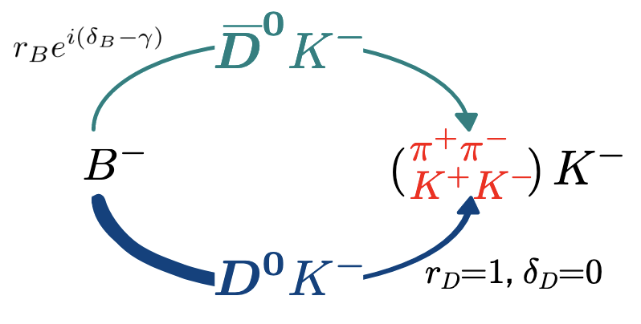


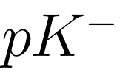


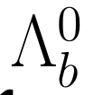





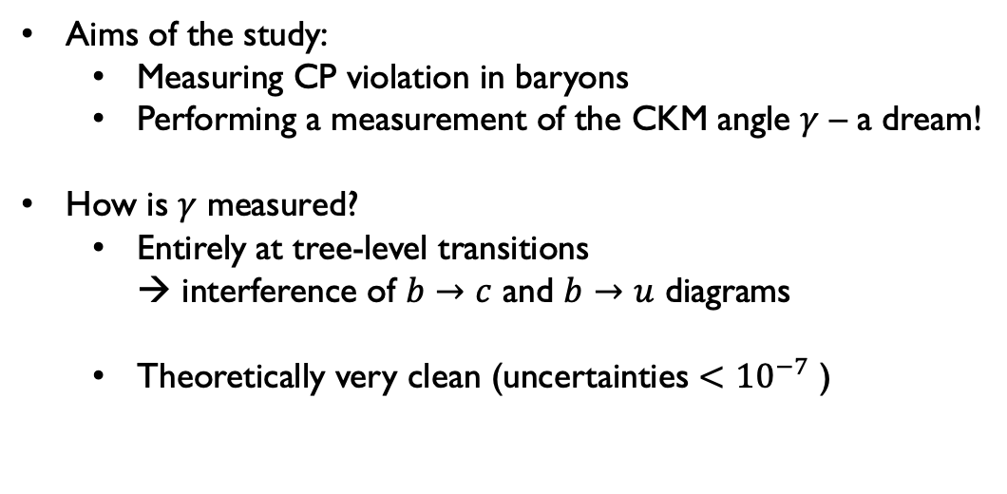

Introduction and motivations
Aims of the study:
  Measuring CP violation in baryons
  Performing a measurement of the CKM angle 𝛾 – a dream!
How is 𝛾 measured?
  Entirely at tree-level transitions
  → interference of $b→c$ and $b→u$ diagrams
  Theoretically very clean (uncertainties $<{10}^{−7}$ )
[Brod, Zupan, JHEP 1401 (2014) 051]
$$∓$$
$$(−)$$
$$∓$$
$$∓$$
Notes:
Address a comment on the polarization of Lambda and the measurement of the gamma angle. Remember we want to perform an amplitude study

Slide 3
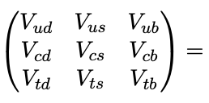
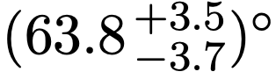
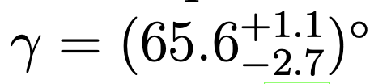
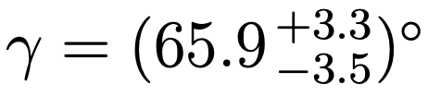
Introduction and motivations
Aims of the study:
  Measuring CP violation in baryons
  Performing a measurement of the CKM angle 𝛾 – a dream!
Why 𝛾?
How could this result be improved?
  Reducing the statistical uncertainty
  Exploring new decays sensitive to 𝛾
[http://ckmfitter.in2p3.fr]
[LHCb-CONF-2022-002]
$$∓$$
$$(−)$$
$$∓$$
$$∓$$
Notes:
Address a comment on the polarization of Lambda and the measurement of the gamma angle. Remember we want to perform an amplitude study

Slide 4
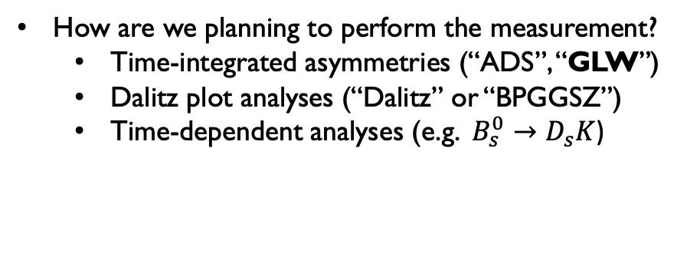
Introduction and motivations
How are we planning to perform the measurement?
  Time-integrated asymmetries (“ADS”, “GLW”)
  Dalitz plot analyses (“Dalitz” or “BPGGSZ”)
  Time-dependent analyses (e.g. $B_{s}^{0}→D_{s}K$)
$$∓$$
$$(−)$$
$$∓$$
$$∓$$
Notes:
Address a comment on the polarization of Lambda and the measurement of the gamma angle. Remember we want to perform an amplitude study

Slide 5
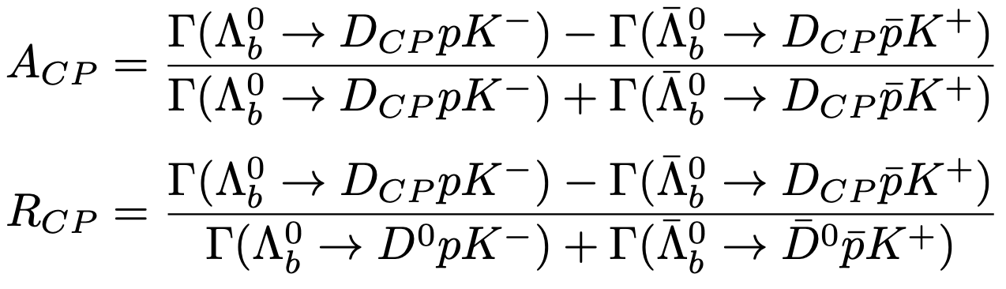
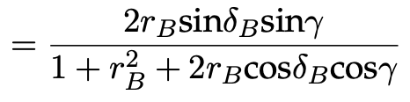

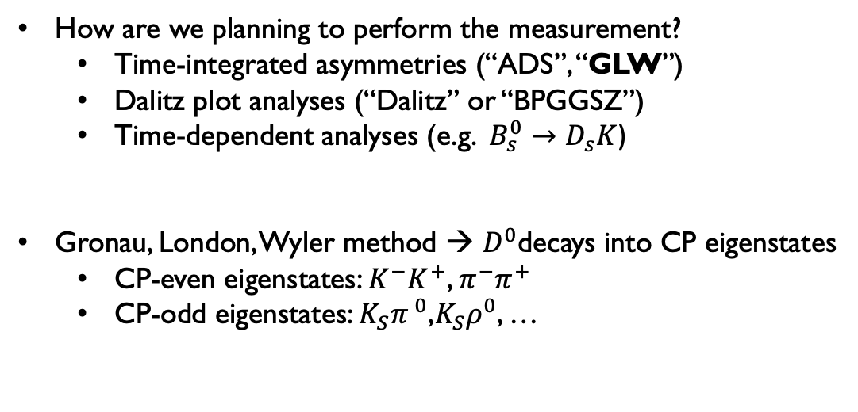
Introduction and motivations
How are we planning to perform the measurement?
  Time-integrated asymmetries (“ADS”, “GLW”)
  Dalitz plot analyses (“Dalitz” or “BPGGSZ”)
  Time-dependent analyses (e.g. $B_{s}^{0}→D_{s}K$)
Gronau, London, Wyler method → $D^{0}$decays into CP eigenstates
  CP-even eigenstates: $K^{−}K^{+}$, $π^{−}π^{+}$
  CP-odd eigenstates: $K_{S}π^{ 0}$,$K_{S}ρ^{0}$, …
[Phys. Lett. B265 (1991), pp. 172–176]
Observables:
Notes:
Address a comment on the polarization of Lambda and the measurement of the gamma angle. Remember we want to perform an amplitude study

Slide 6
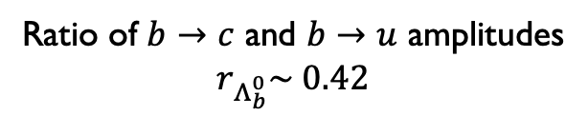
Introduction and motivations
How are we planning to perform the measurement?
  Time-integrated asymmetries (“ADS”, “GLW”)
  Dalitz plot analyses (“Dalitz” or “BPGGSZ”)
  Time-dependent analyses (e.g. $B_{s}^{0}→D_{s}K$)
Gronau, London, Wyler method → $D^{0}$decays into CP eigenstates
  CP-even eigenstates: $K^{−}K^{+}$, $π^{−}π^{+}$
  CP-odd eigenstates: $K_{S}π^{ 0}$,$K_{S}ρ^{0}$, …
[Phys. Lett. B265 (1991), pp. 172–176]
Strong phase difference
Ratio of $b→c$ and $b→u$ amplitudes
$r_{Λ_{b}^{0}}\sim 0.42$
Notes:
Address a comment on the polarization of Lambda and the measurement of the gamma angle. Remember we want to perform an amplitude study

Slide 7


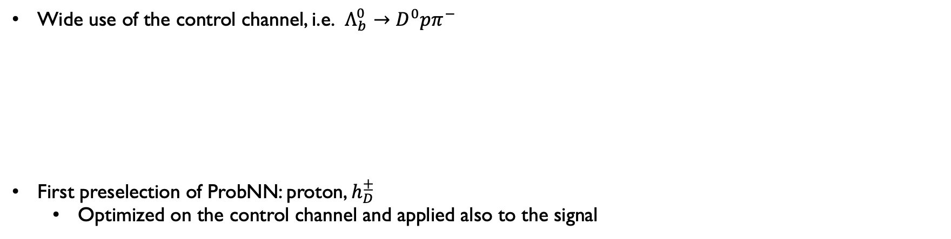
Analysis strategy
Analysis performed on RunI and RunII data (2011 – 2018)
Wide use of the control channel, i.e. $Λ_{b}^{0}→D^{0}pπ^{−}$
First preselection of ProbNN: proton, $h_{D}^{±}$
  Optimized on the control channel and applied also to the signal
Notes:
So we decided to reproduce the computation done in the electreonics, which assignes a conversion factor to each cell of each FEB, depending on the angle theta at which the cell is located wrt the interaction point

Slide 8










Analysis strategy – the challenge
Preliminary studies shown:
The charmless background (i.e. $Λ_{b}^{0}→ph^{−}h^{+}h^{−}$ ) is an highly contaminating background
Could it be removed in a more efficient way than with a rectangular cut? [Phys. Rev. D 104, 112008 (2021)], [CERN-THESIS-2020-314]
Why are we so concerned by this specific background?
$$h^{−}$$
No $D^{0}→$ diluted sensitivity to 𝛾
$$h^{+}$$
$$h^{−}$$
$$h^{+}$$
$$D^{0}$$
p
p
$$Λ_{b}^{0}$$
$$K^{−}$$
$$Λ_{b}^{0}$$
$$K^{−}$$
$$Λ^{∗}$$
p
p
p
p
Notes:
So we decided to reproduce the computation done in the electreonics, which assignes a conversion factor to each cell of each FEB, depending on the angle theta at which the cell is located wrt the interaction point

Slide 9

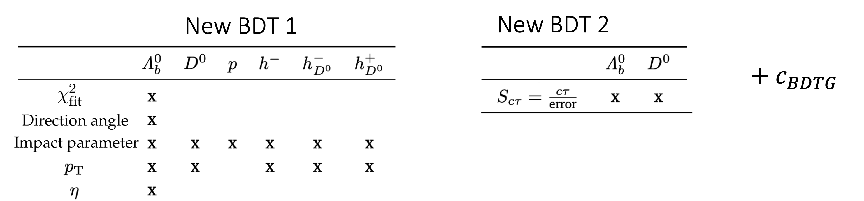
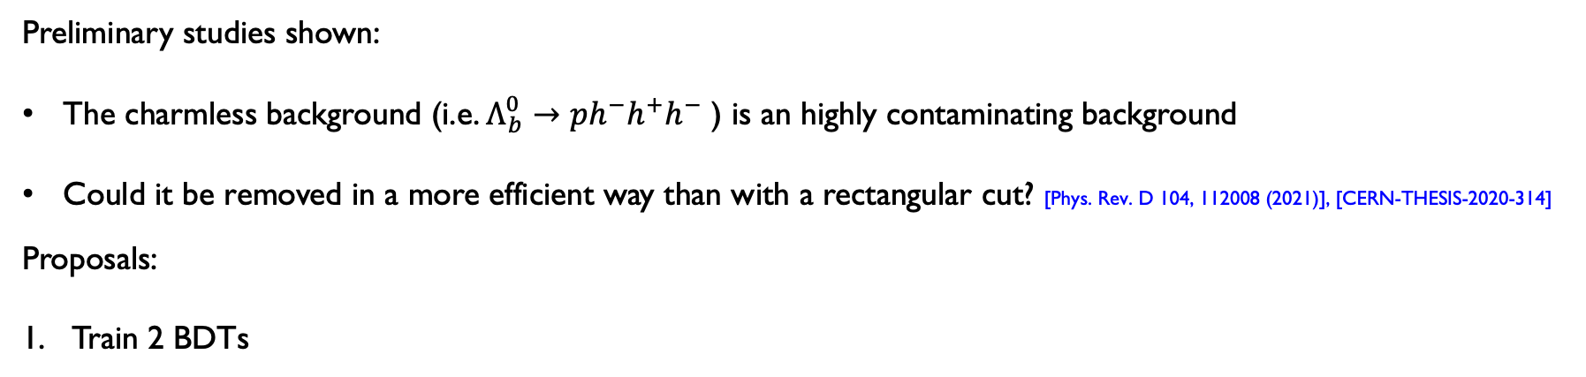
Analysis strategy – the challenge
Preliminary studies shown:
The charmless background (i.e. $Λ_{b}^{0}→ph^{−}h^{+}h^{−}$ ) is an highly contaminating background
Could it be removed in a more efficient way than with a rectangular cut? [Phys. Rev. D 104, 112008 (2021)], [CERN-THESIS-2020-314]
Proposals:
Train 2 BDTs
1.
2.
Output variable from
the first BDT
Notes:
So we decided to reproduce the computation done in the electreonics, which assignes a conversion factor to each cell of each FEB, depending on the angle theta at which the cell is located wrt the interaction point

Slide 10
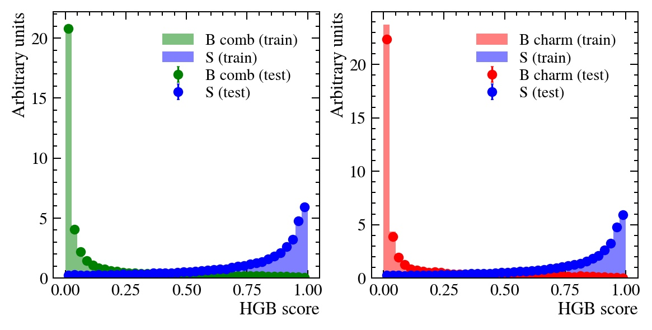
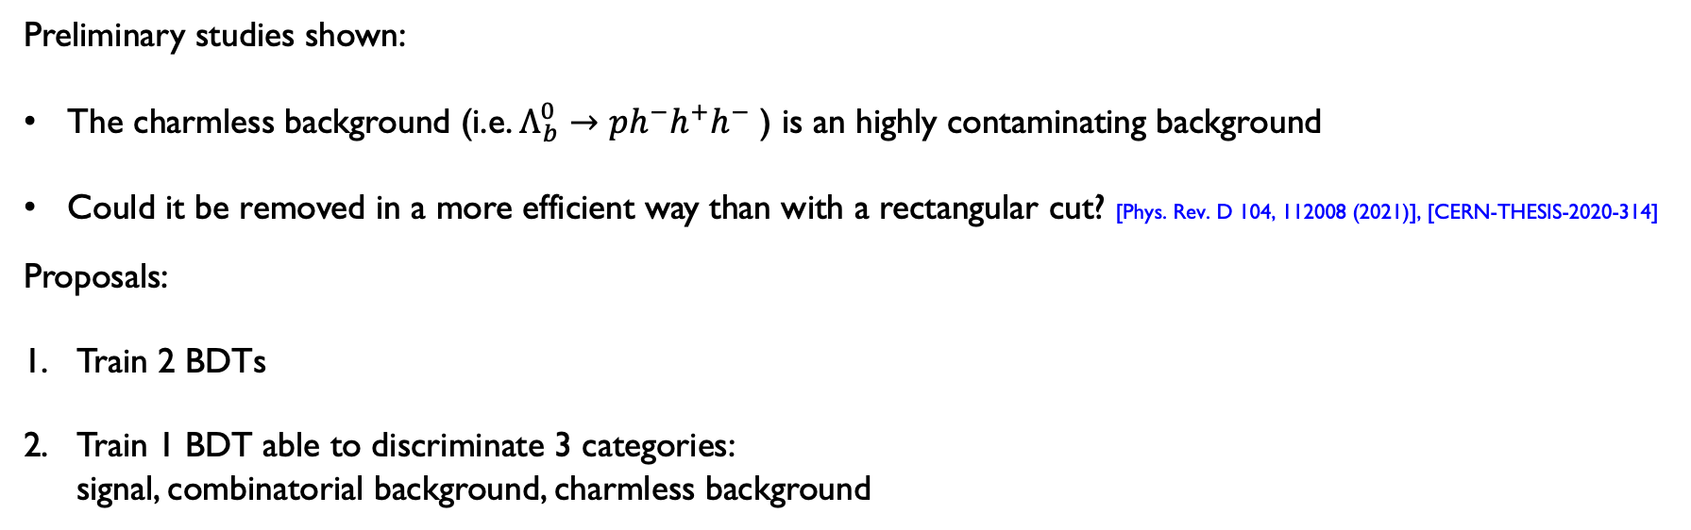
Analysis strategy – the Challenge
Preliminary studies shown:
The charmless background (i.e. $Λ_{b}^{0}→ph^{−}h^{+}h^{−}$ ) is an highly contaminating background
Could it be removed in a more efficient way than with a rectangular cut? [Phys. Rev. D 104, 112008 (2021)], [CERN-THESIS-2020-314]
Proposals:
Train 2 BDTs
Train 1 BDT able to discriminate 3 categories:
signal, combinatorial background, charmless background
Notes:
So we decided to reproduce the computation done in the electreonics, which assignes a conversion factor to each cell of each FEB, depending on the angle theta at which the cell is located wrt the interaction point

Slide 11

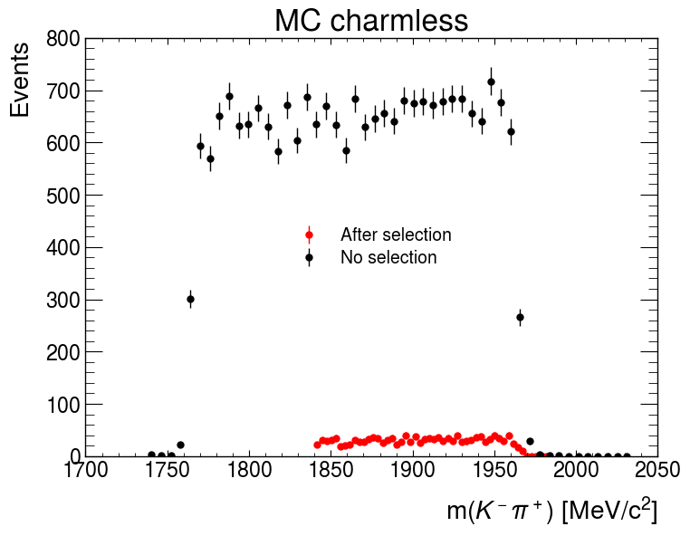

Analysis strategy – the Challenge
Fundamental characteristic of the BDT → not distorting the shape of the $m\left(K^{−}π^{+}\right)$ distribution of the background
Montecarlo $Λ_{b}^{0}→pK^{−}π^{+}π^{−}$
Notes:
So we decided to reproduce the computation done in the electreonics, which assignes a conversion factor to each cell of each FEB, depending on the angle theta at which the cell is located wrt the interaction point

Slide 12
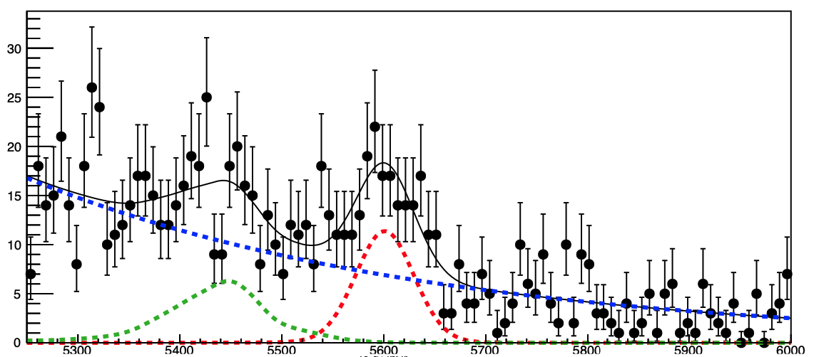


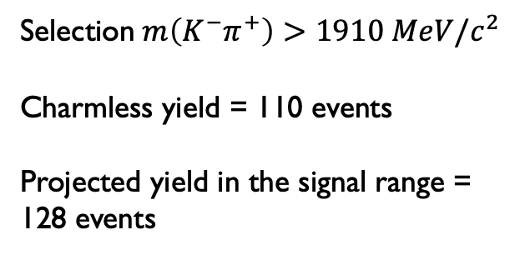
Analysis strategy – the Challenge
Fundamental characteristic of the BDT → not distorting the shape of the $m\left(K^{−}π^{+}\right)$ distribution of the background
Reasonable estimation of the charmless background considering the tail of the $m\left(K^{−}π^{+}\right)$distribution on data
$Λ_{b}^{0}$ invariant mass
Selection$m\left(K^{−}π^{+}\right)>1910 MeV/c^{2}$
Charmless yield = 110 events
Projected yield in the signal range = 128 events
Acceptable?
m$\left(D^{0}pπ^{−}\right)[\frac{MeV}{c^{2}}]$
Notes:
So we decided to reproduce the computation done in the electreonics, which assignes a conversion factor to each cell of each FEB, depending on the angle theta at which the cell is located wrt the interaction point

Slide 13
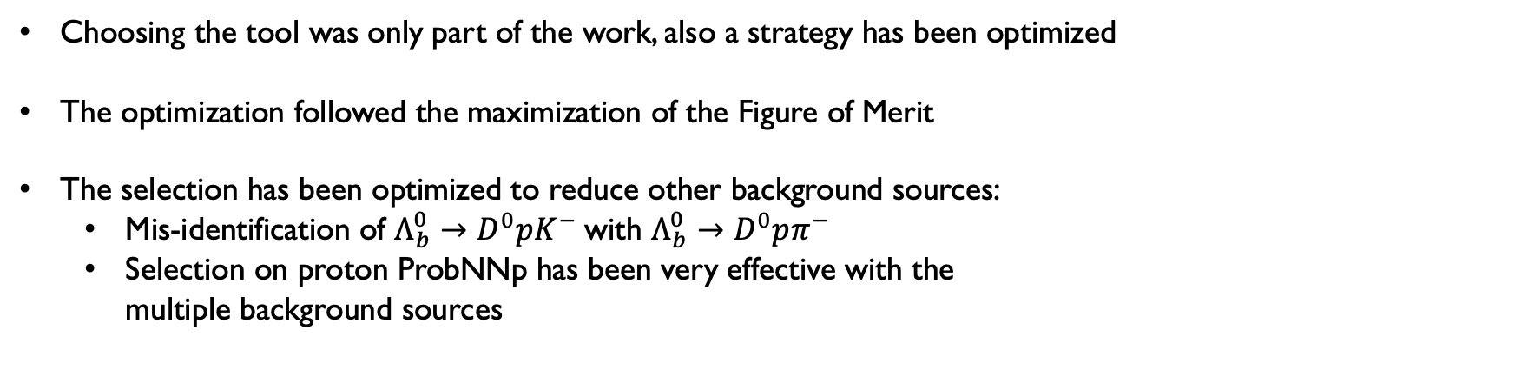
Analysis strategy – the selection
Choosing the tool was only part of the work, also a strategy has been optimized
The optimization followed the maximization of the Figure of Merit
The selection has been optimized to reduce other background sources:
  Mis-identification of $Λ_{b}^{0}→D^{0}pK^{−}$with $Λ_{b}^{0}→D^{0}pπ^{−}$
  Selection on proton ProbNNp has been very effective with the
  multiple background sources
Notes:
So we decided to reproduce the computation done in the electreonics, which assignes a conversion factor to each cell of each FEB, depending on the angle theta at which the cell is located wrt the interaction point

Slide 14
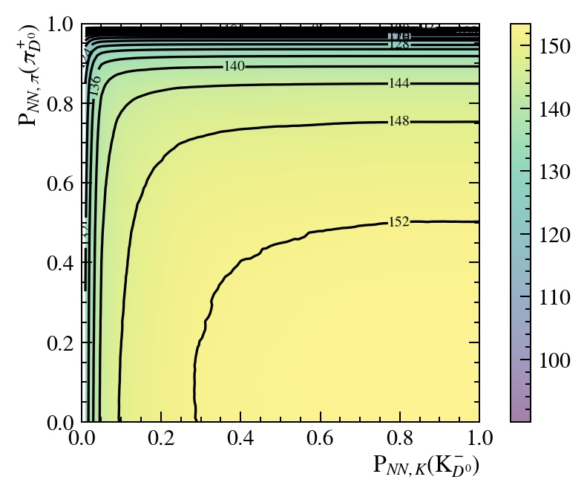




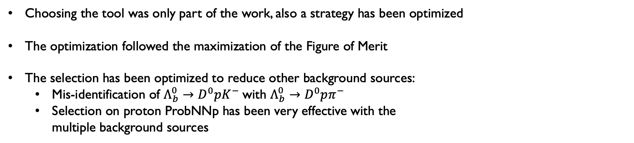
Analysis strategy – the selection
Choosing the tool was only part of the work, also a strategy has been optimized
The optimization followed the maximization of the Figure of Merit
The selection has been optimized to reduce other background sources:
  Mis-identification of $Λ_{b}^{0}→D^{0}pK^{−}$with $Λ_{b}^{0}→D^{0}pπ^{−}$
  Selection on proton ProbNNp has been very effective with the
  multiple background sources
Notes:
So we decided to reproduce the computation done in the electreonics, which assignes a conversion factor to each cell of each FEB, depending on the angle theta at which the cell is located wrt the interaction point

Slide 15
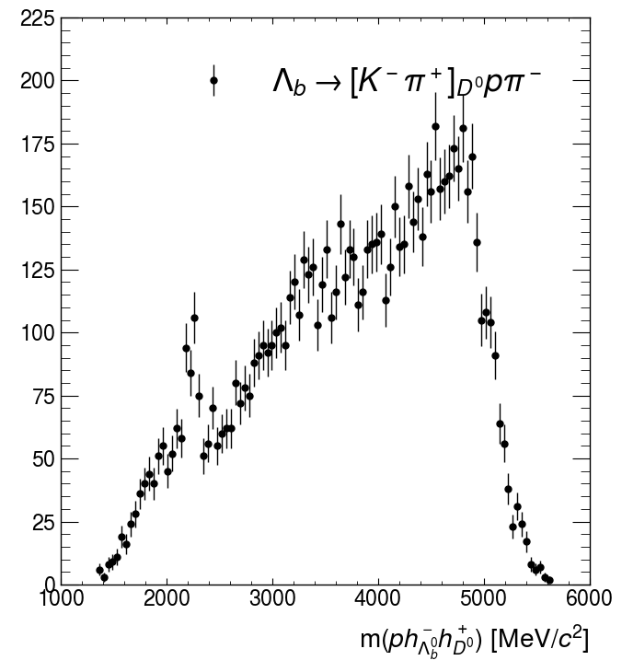
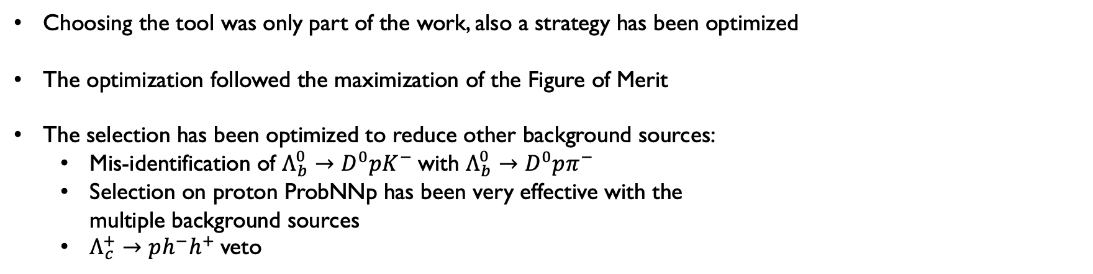
Analysis strategy – the selection
Choosing the tool was only part of the work, also a strategy has been optimized
The optimization followed the maximization of the Figure of Merit
The selection has been optimized to reduce other background sources:
  Mis-identification of $Λ_{b}^{0}→D^{0}pK^{−}$with $Λ_{b}^{0}→D^{0}pπ^{−}$
  Selection on proton ProbNNp has been very effective with the
  multiple background sources
  $Λ_{c}^{+}→ph^{−}h^{+}$veto
Notes:
So we decided to reproduce the computation done in the electreonics, which assignes a conversion factor to each cell of each FEB, depending on the angle theta at which the cell is located wrt the interaction point

Slide 16
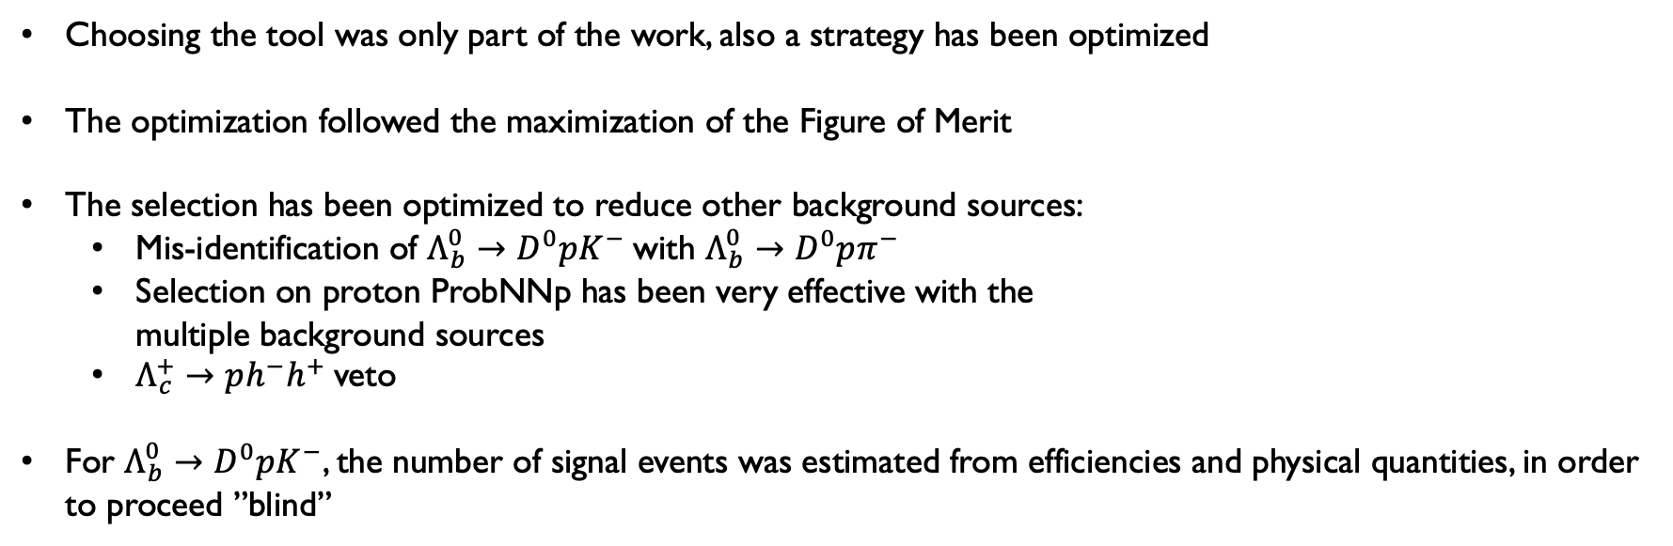
Analysis strategy – the selection
Choosing the tool was only part of the work, also a strategy has been optimized
The optimization followed the maximization of the Figure of Merit
The selection has been optimized to reduce other background sources:
  Mis-identification of $Λ_{b}^{0}→D^{0}pK^{−}$with $Λ_{b}^{0}→D^{0}pπ^{−}$
  Selection on proton ProbNNp has been very effective with the
  multiple background sources
  $Λ_{c}^{+}→ph^{−}h^{+}$veto
For $Λ_{b}^{0}→D^{0}pK^{−}$, the number of signal events was estimated from efficiencies and physical quantities, in order to proceed ”blind”
Notes:
So we decided to reproduce the computation done in the electreonics, which assignes a conversion factor to each cell of each FEB, depending on the angle theta at which the cell is located wrt the interaction point

Slide 17
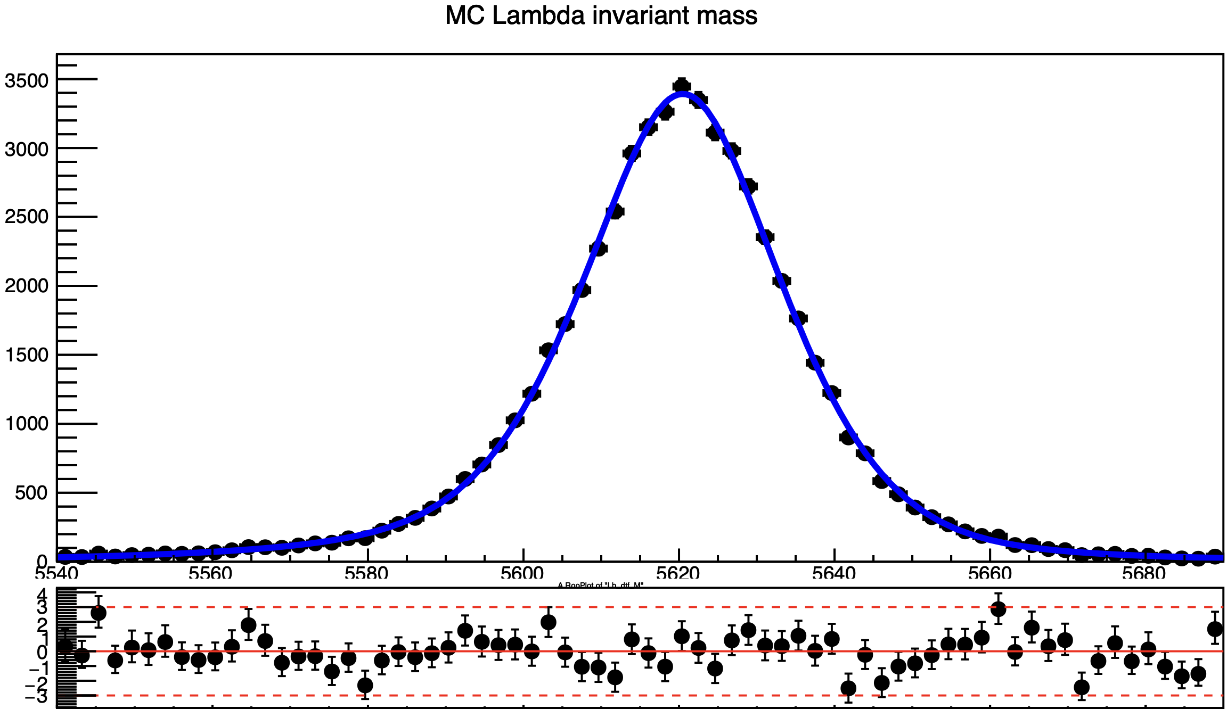

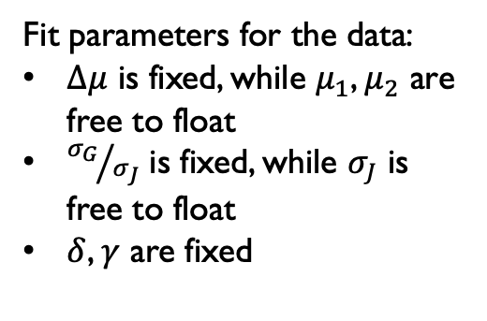
Fit Model
Playground to test the fit model → $Λ_{b}^{0}→D^{0}pπ^{−}$
MC
Several combinations have been tested to fit the signal:
2 Crystal Balls
2 Gaussians
Crystal Ball + Gaussian
Johnson + Crystal Ball
Johnson + Gaussian
Fit parameters for the data:
$Δμ$ is fixed, while $μ_{1}$, $μ_{2}$ are
free to float
${σ_{G}}/{σ_{J}}$ is fixed, while $σ_{J}$ is
free to float
$δ$, $γ$ are fixed
Data RunII
Notes:
First I would like to address the problem, we were extracting the ADC from the banks in the MC, but these are decoded in 12 bits, so to convert them into LLTADC, an implementation is required, knowing that 10 bits in the LLT correspond to 10GeV. A first approximation was done dividing the adc exracted by 4 and then settin a threshold at 2. This conversion, though, was showing some non linearities in the quantities measured, which I will talk about later

Slide 18
Fit Model
Playground to test the fit model → $Λ_{b}^{0}→D^{0}pπ^{−}$
MC
Several combinations have been tested to fit the signal:
2 Crystal Balls
2 Gaussians
Crystal Ball + Gaussian
Johnson + Crystal Ball
Johnson + Gaussian
At first, we described the shapes with
RooKeys PDFs on the phasespace Monte Carlo
Data RunII
But it is clearly not enough precise
Notes:
First I would like to address the problem, we were extracting the ADC from the banks in the MC, but these are decoded in 12 bits, so to convert them into LLTADC, an implementation is required, knowing that 10 bits in the LLT correspond to 10GeV. A first approximation was done dividing the adc exracted by 4 and then settin a threshold at 2. This conversion, though, was showing some non linearities in the quantities measured, which I will talk about later

Slide 19
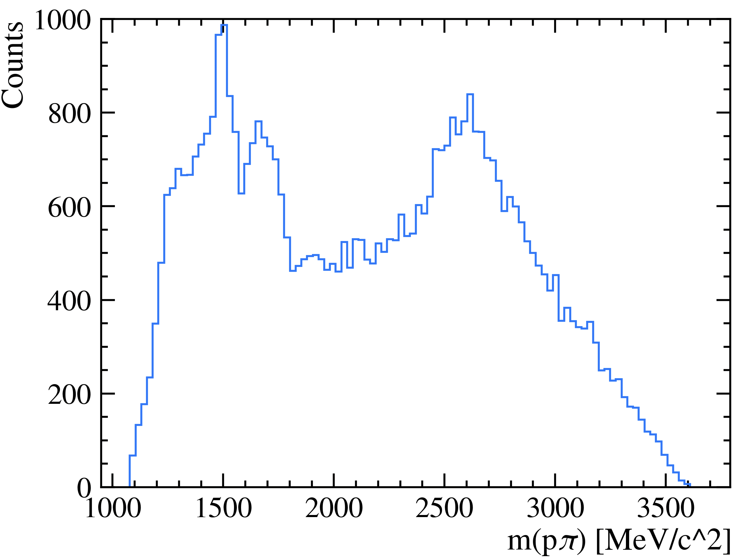
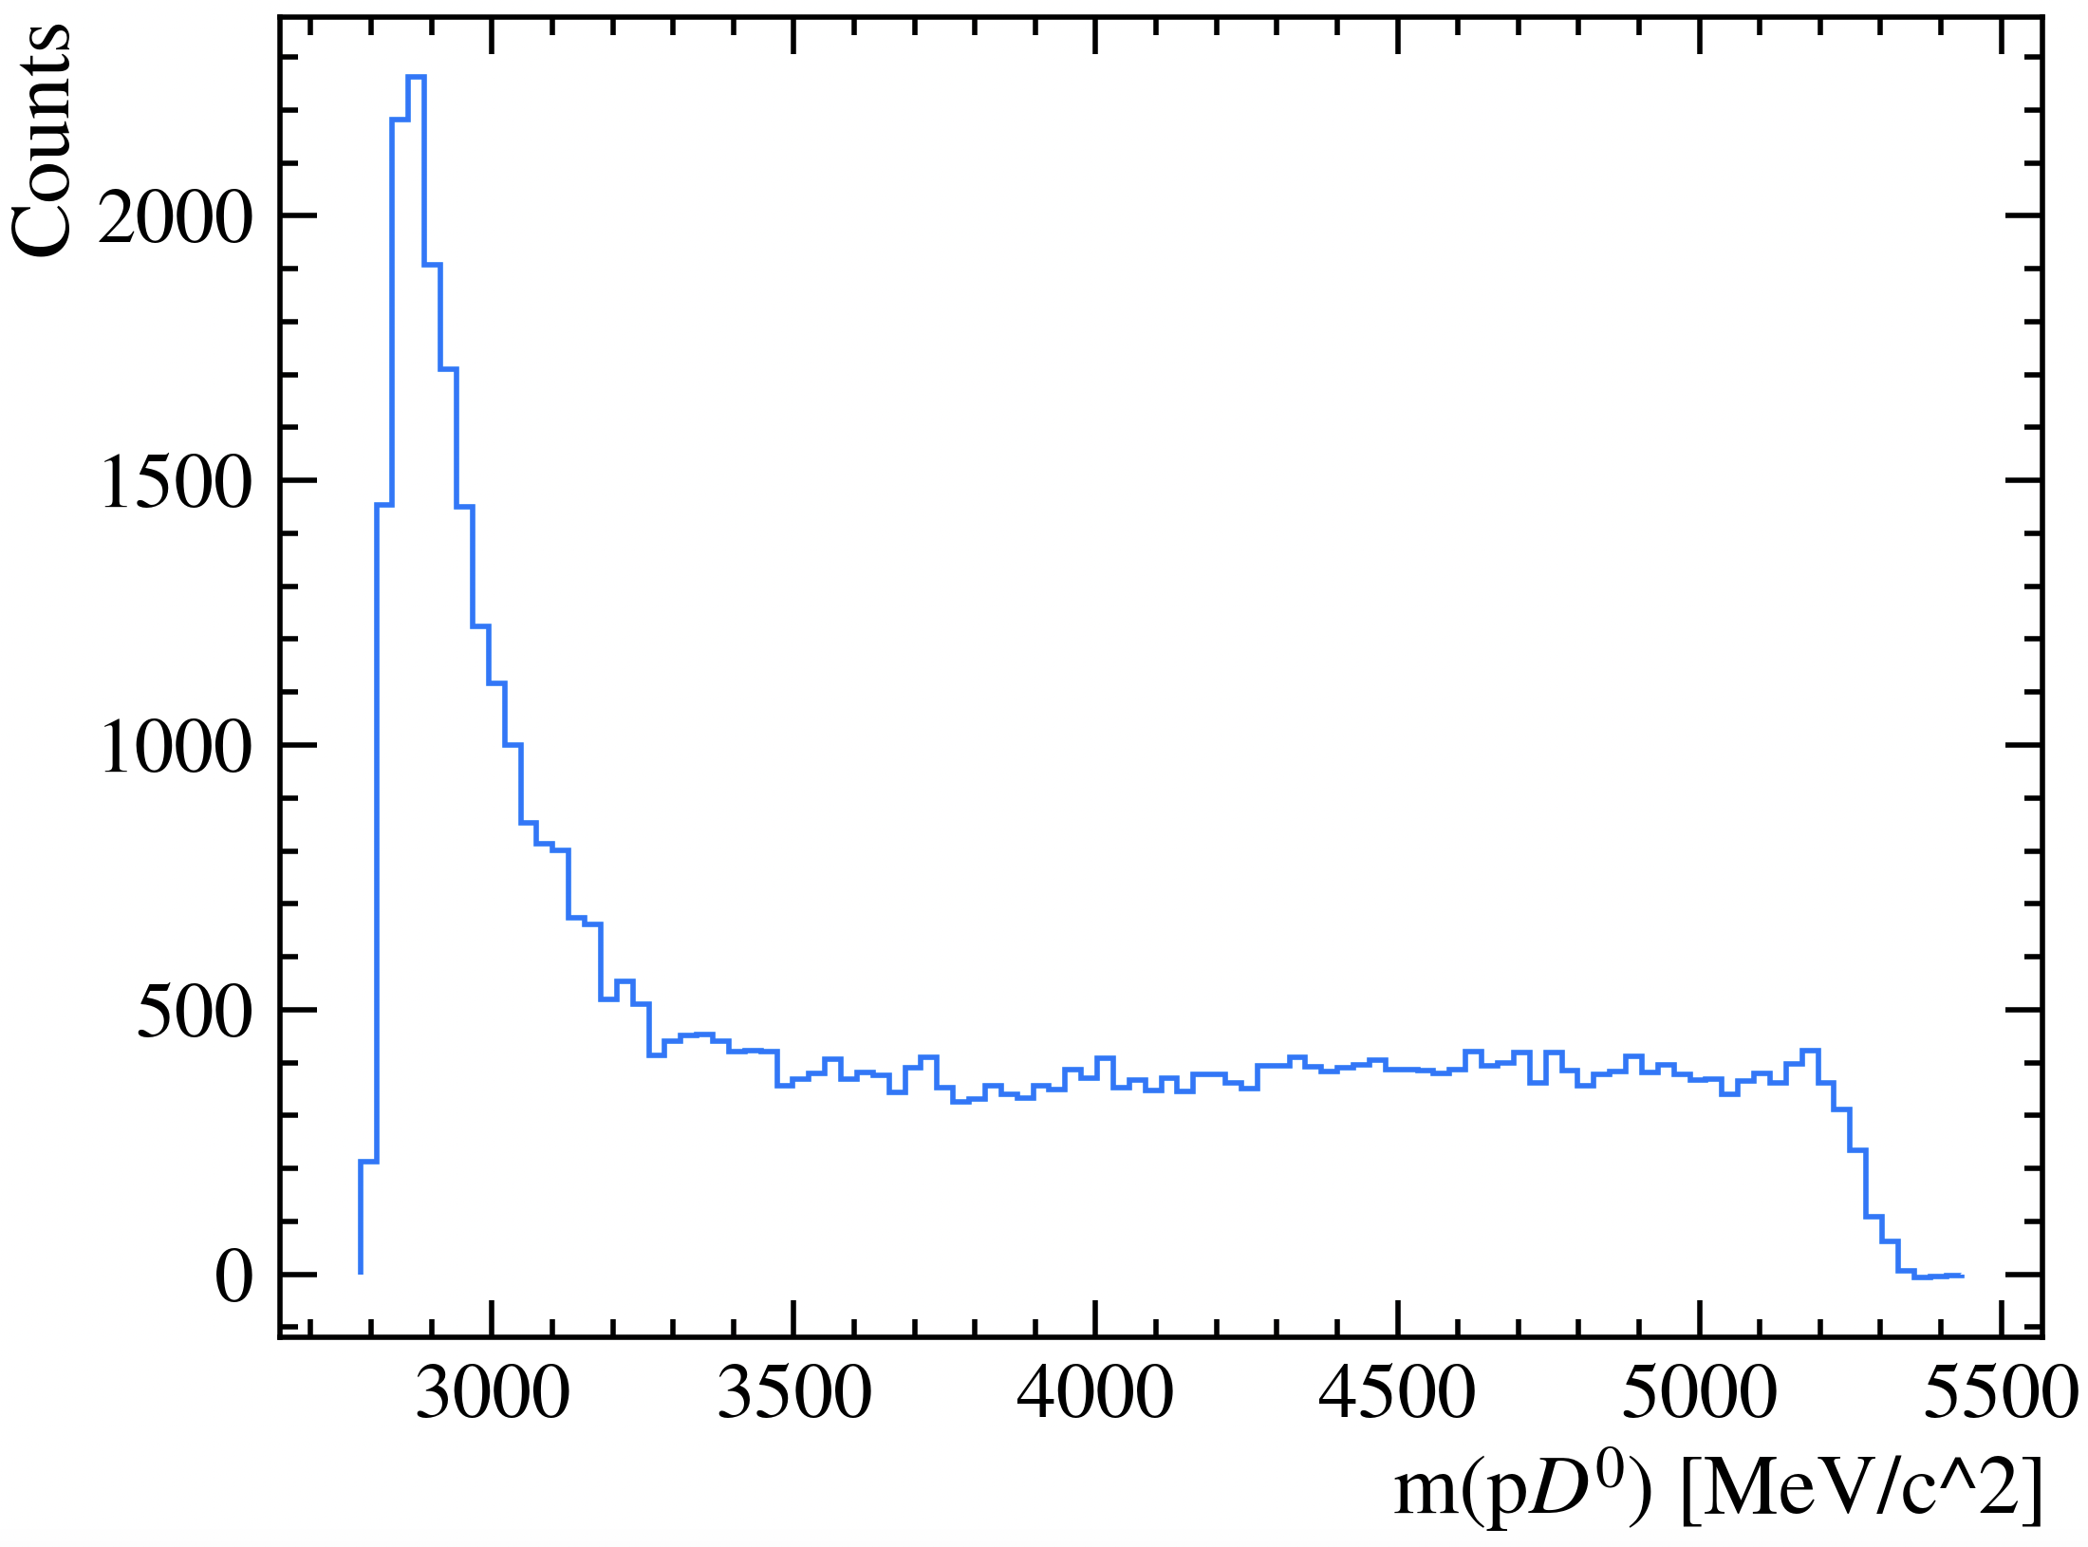
partially reconstructed background
Strategy: we started an investigation of the resonances that were appearing in that mass reagion, to reproduce
them with the HELAMP model on EvtGen
Notes:
First I would like to address the problem, we were extracting the ADC from the banks in the MC, but these are decoded in 12 bits, so to convert them into LLTADC, an implementation is required, knowing that 10 bits in the LLT correspond to 10GeV. A first approximation was done dividing the adc exracted by 4 and then settin a threshold at 2. This conversion, though, was showing some non linearities in the quantities measured, which I will talk about later

Slide 20
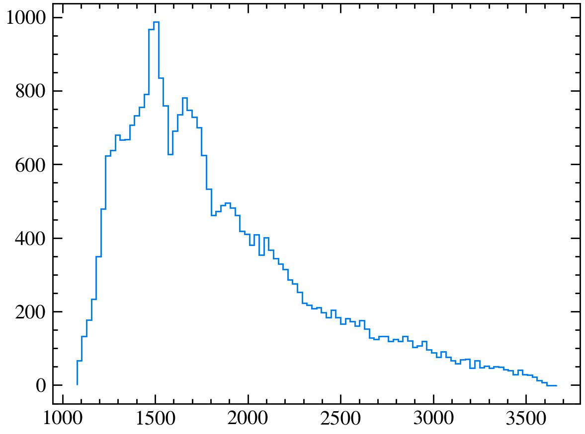
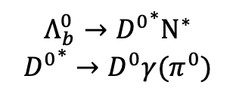
partially reconstructed background
Strategy: we started an investigation of the resonances that were appearing in that mass reagion, to reproduce
them with the HELAMP model on EvtGen
$$Λ_{b}^{0}→{D^{0}}^{∗}N^{∗}$$
$${D^{0}}^{∗}→D^{0}γ(π^{0})$$
Notes:
First I would like to address the problem, we were extracting the ADC from the banks in the MC, but these are decoded in 12 bits, so to convert them into LLTADC, an implementation is required, knowing that 10 bits in the LLT correspond to 10GeV. A first approximation was done dividing the adc exracted by 4 and then settin a threshold at 2. This conversion, though, was showing some non linearities in the quantities measured, which I will talk about later

Slide 21
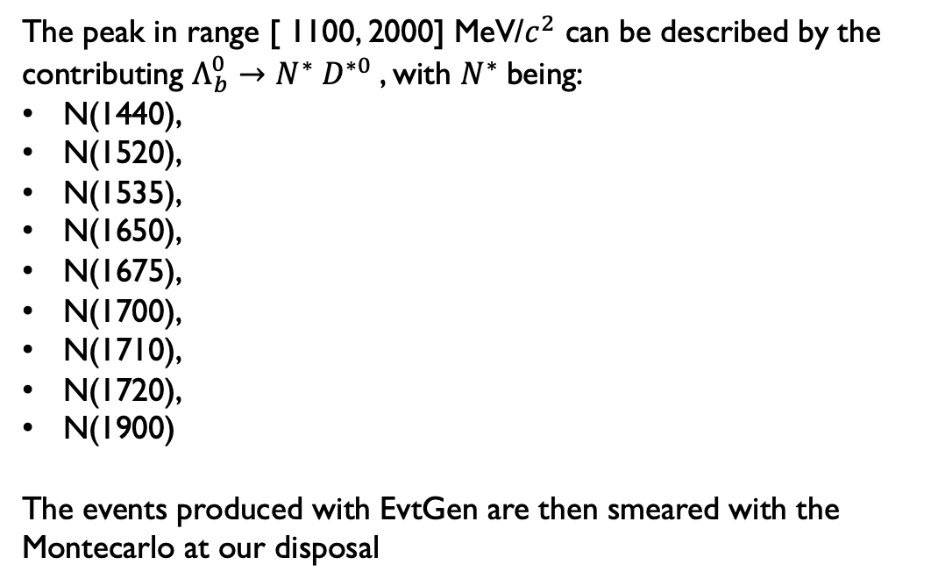
partially reconstructed background
Strategy: we started an investigation of the resonances that were appearing in that mass reagion, to reproduce
them with the HELAMP model on EvtGen
The peak in range [ 1100, 2000] MeV/$c^{2}$ can be described by the
contributing $Λ_{b}^{0}→N^{∗} D^{∗0}$, with $N^{∗}$being:
N(1440),
N(1520),
N(1535),
N(1650),
N(1675),
N(1700),
N(1710),
N(1720),
N(1900)
The events produced with EvtGen are then smeared with the
Montecarlo at our disposal
Notes:
First I would like to address the problem, we were extracting the ADC from the banks in the MC, but these are decoded in 12 bits, so to convert them into LLTADC, an implementation is required, knowing that 10 bits in the LLT correspond to 10GeV. A first approximation was done dividing the adc exracted by 4 and then settin a threshold at 2. This conversion, though, was showing some non linearities in the quantities measured, which I will talk about later

Slide 22
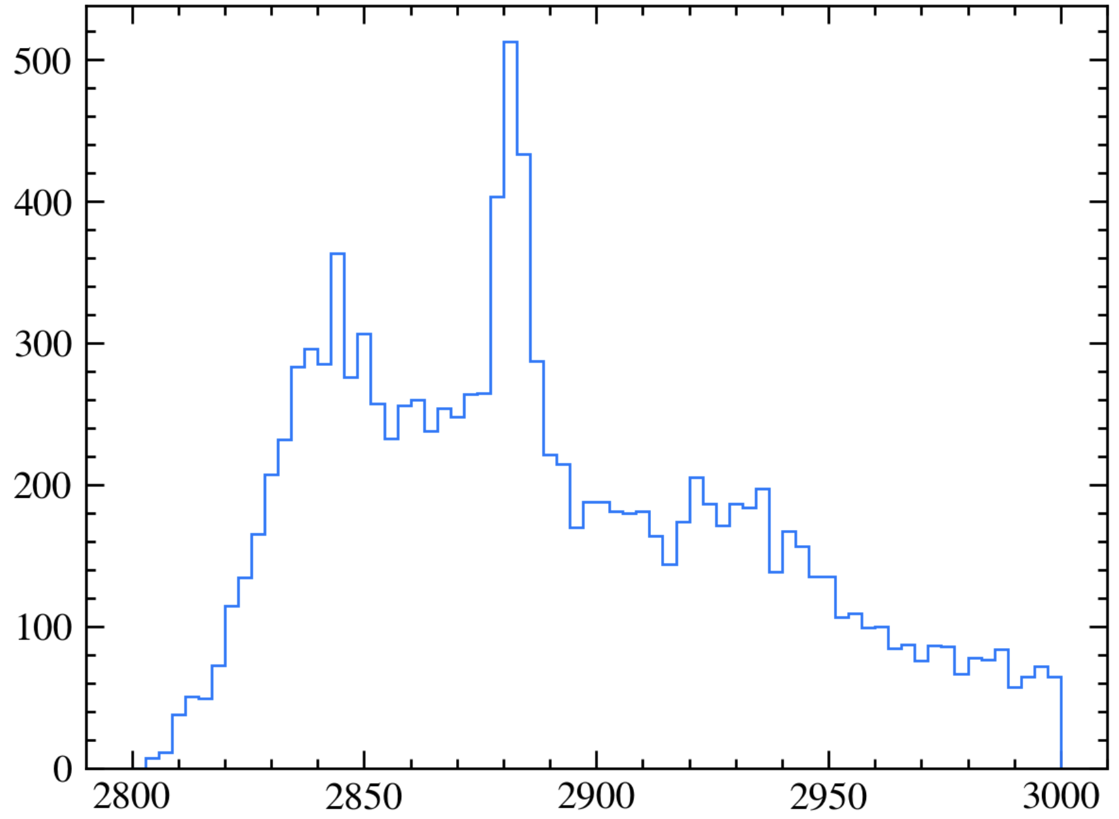




partially reconstructed background
$$Λ_{c}^{∗}(2860)$$
$$Λ_{c}^{∗}(2880)$$
$$Λ_{c}^{∗}(2940)$$
Let’s continue with the EvtGen
description of the $Λ_{c}^{∗}$ resonances
Notes:
Address a comment on the polarization of Lambda and the measurement of the gamma angle. Remember we want to perform an amplitude study

Slide 23
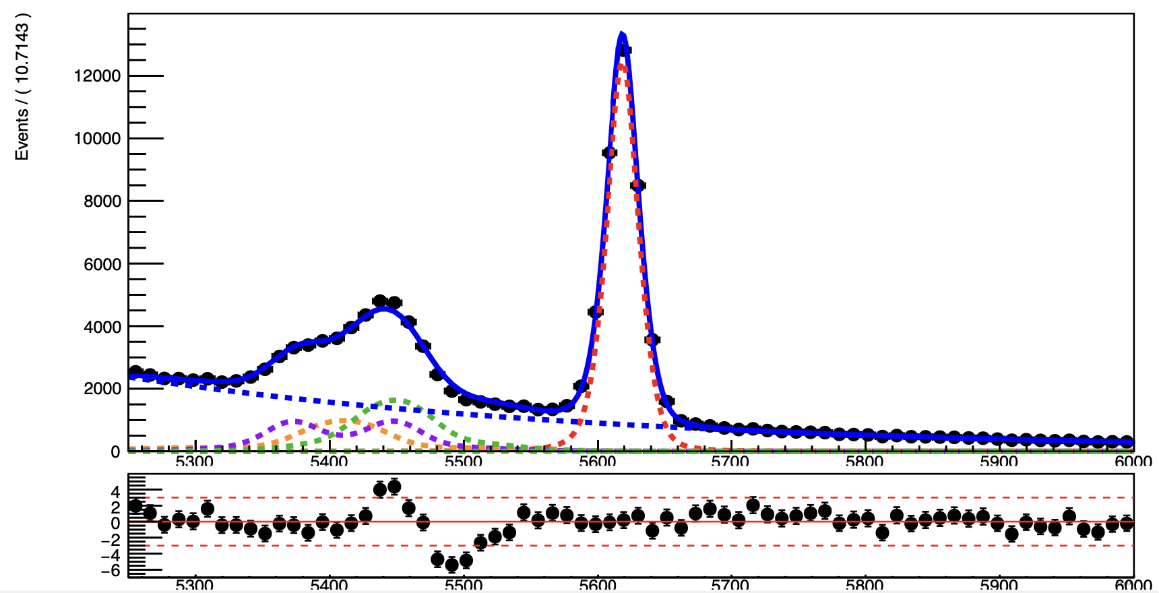

partially reconstructed background
$Λ_{b}^{0}→{\left[K^{−}π^{+}\right]}_{D^{0}}pπ^{−}$ RunII
Results have improved, but yet
something is missing
There could be other physical
contributions?
Notes:
Address a comment on the polarization of Lambda and the measurement of the gamma angle. Remember we want to perform an amplitude study

Slide 24
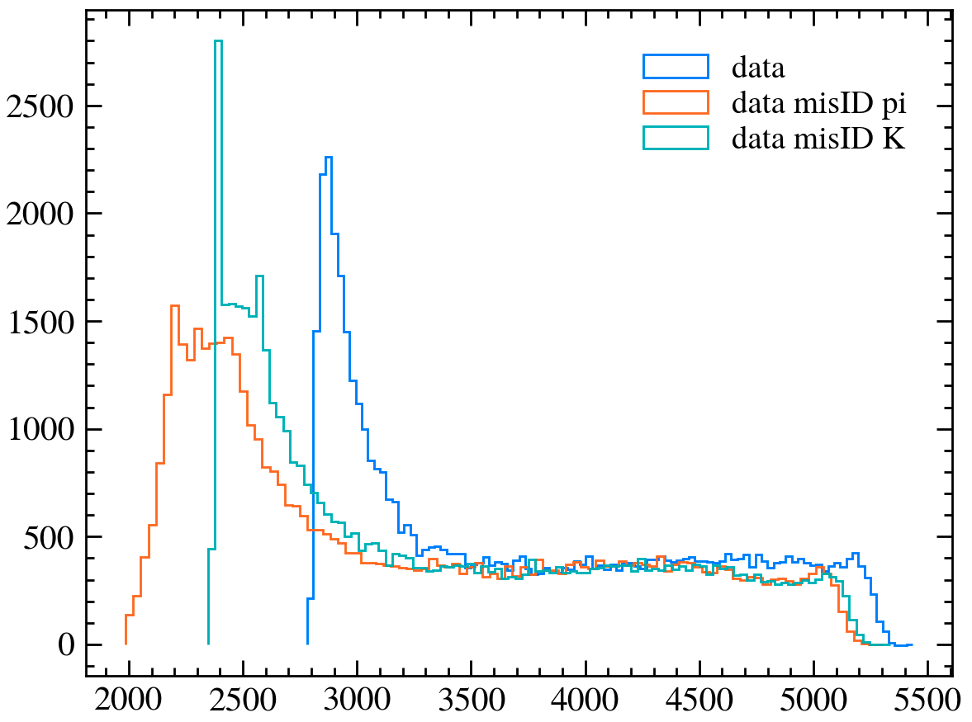
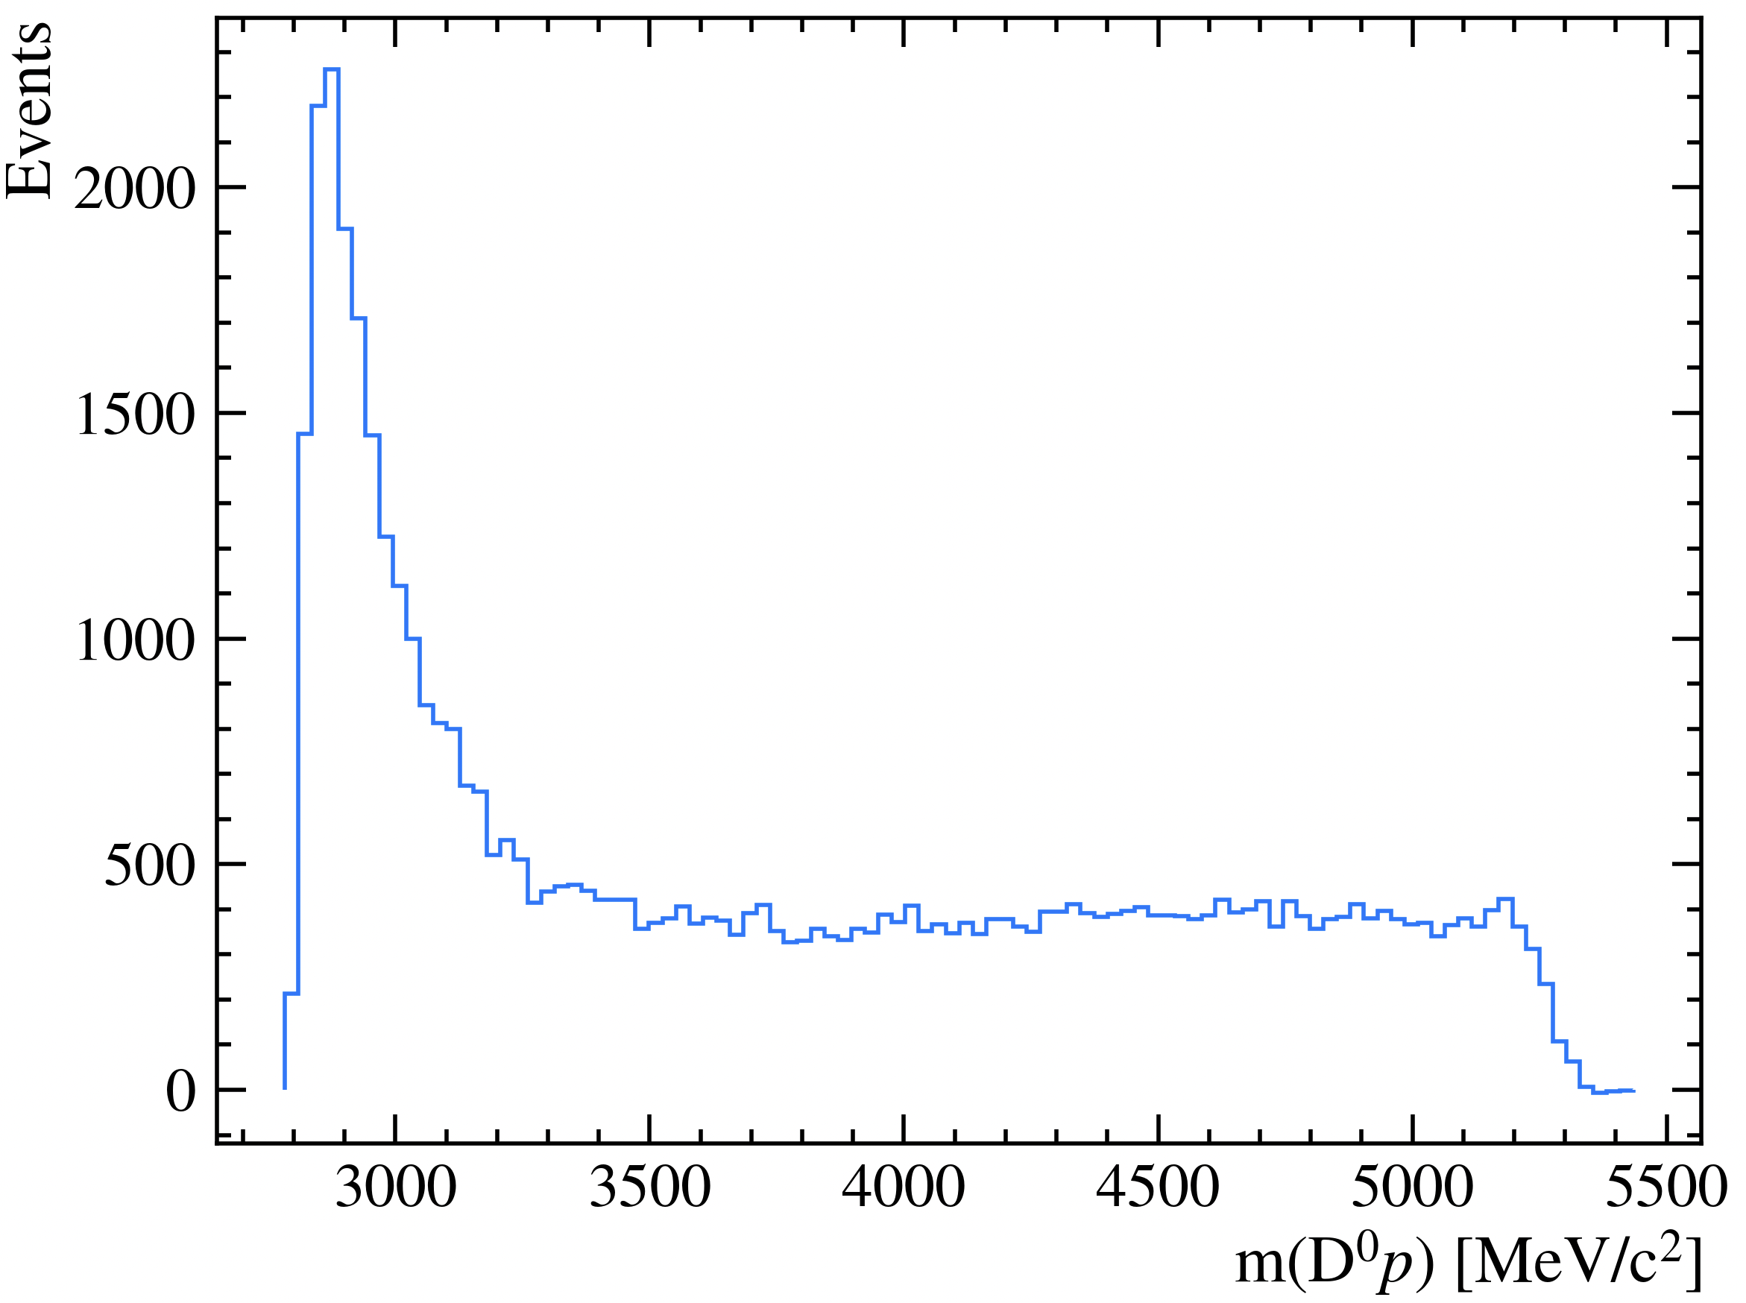
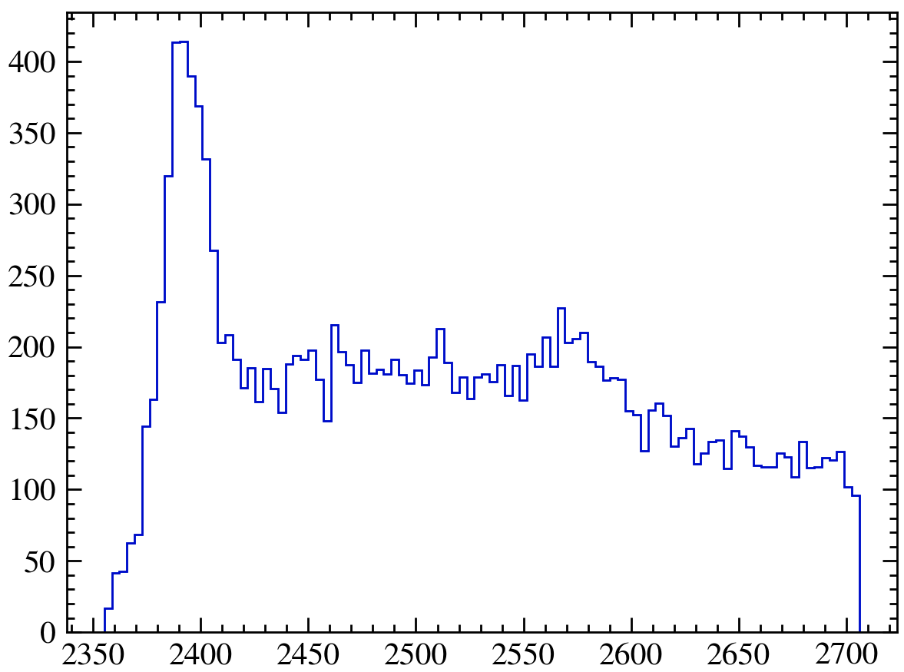
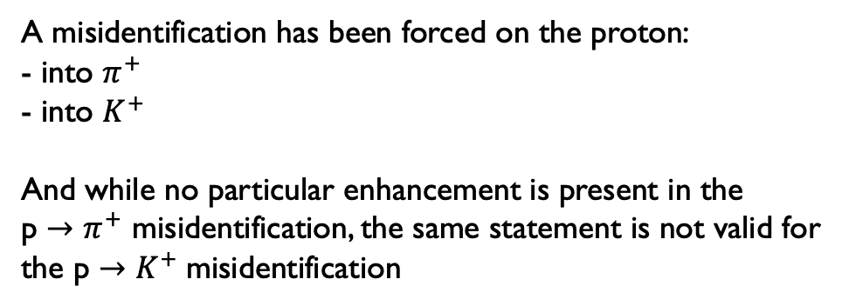
Surgery of the resonances - $D^{∗}p π^{−}$ region
5300 < Lb_M < 5550
A misidentification has been forced on the proton:
- into $π^{+}$
- into $K^{+}$
And while no particular enhancement is present in the
p $→$ $π^{+}$ misidentification, the same statement is not valid for
the p $→$ $K^{+}$misidentification
Notes:
Address a comment on the polarization of Lambda and the measurement of the gamma angle. Remember we want to perform an amplitude study

Slide 25
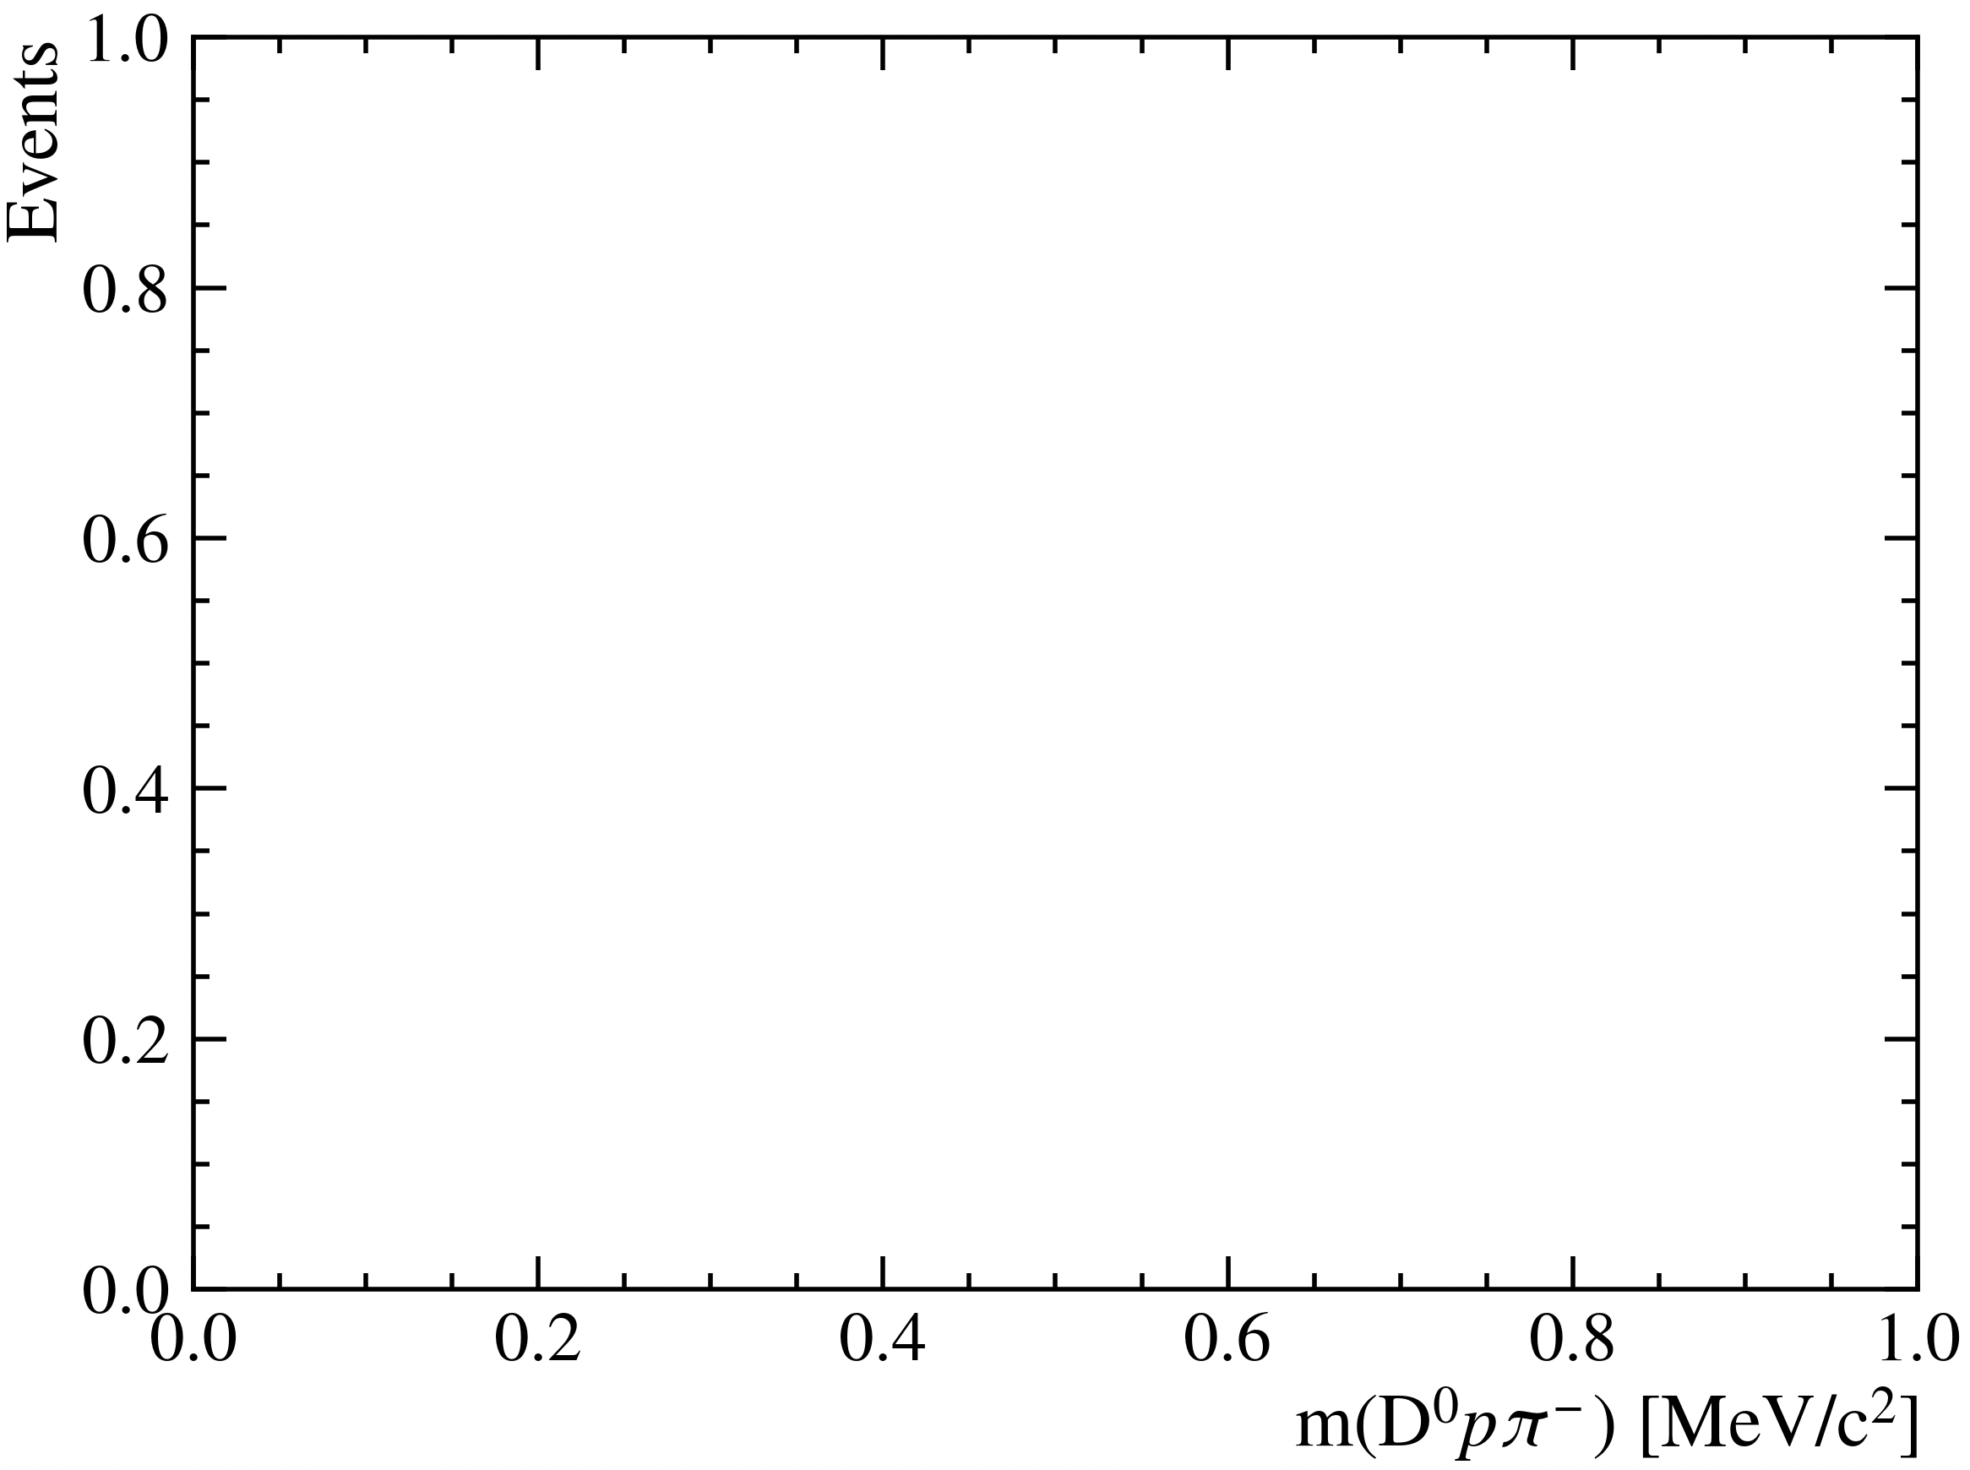
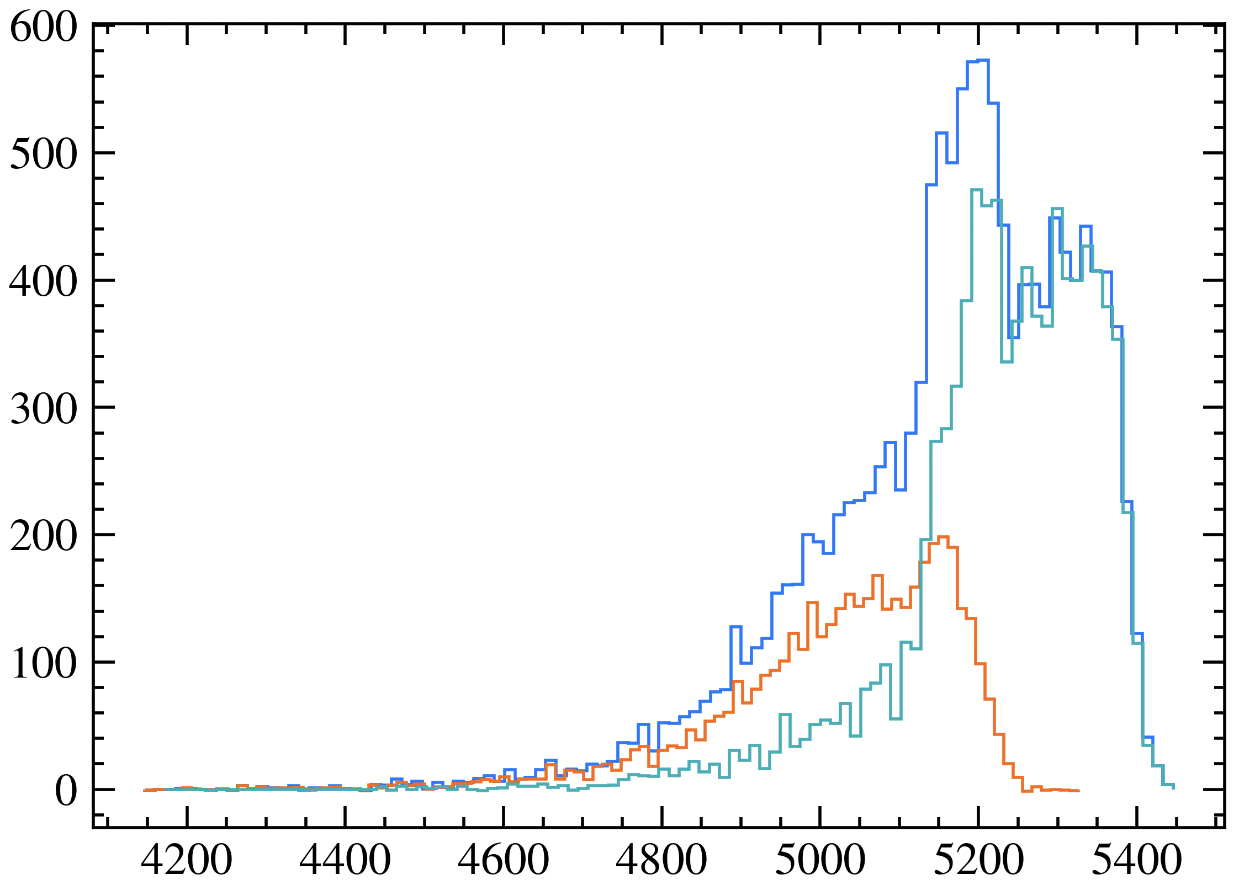

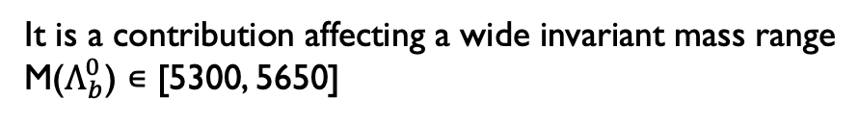
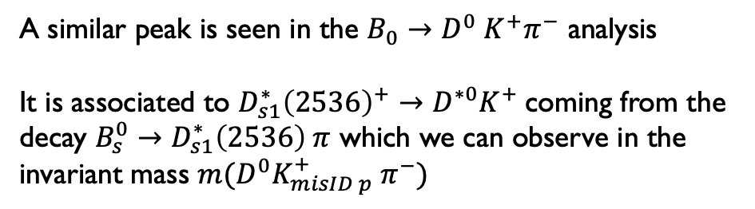


Surgery of the resonances - $D^{∗}p π^{−}$ region
A misidentification has been forced on the proton:
- into $π^{+}$
- into $K^{+}$
And while no particular enhancement is present in the
p $→$ $π^{+}$ misidentification, the same statement is not valid for
the p $→$ $K^{+}$misidentification
M($Λ_{b}^{0}$) ∊ [5300, 5550]
M($Λ_{b}^{0}$) ∊ [5550, 5650]
M($Λ_{b}^{0}$) ∊ [5300, 5650]
A similar peak is seen in the $B_{0}→D^{0} K^{+}π^{−}$ analysis
It is associated to $D_{s1}^{∗}{\left(2536\right)}^{+}→D^{∗0}K^{+}$coming from the
decay $B_{s}^{0}→D_{s1}^{∗}\left(2536\right) π$ which we can observe in the
invariant mass $m(D^{0}K_{misID p}^{+} π^{−})$
It is a contribution affecting a wide invariant mass range
M($Λ_{b}^{0}$) ∊ [5300, 5650]
Notes:
Address a comment on the polarization of Lambda and the measurement of the gamma angle. Remember we want to perform an amplitude study

Slide 26
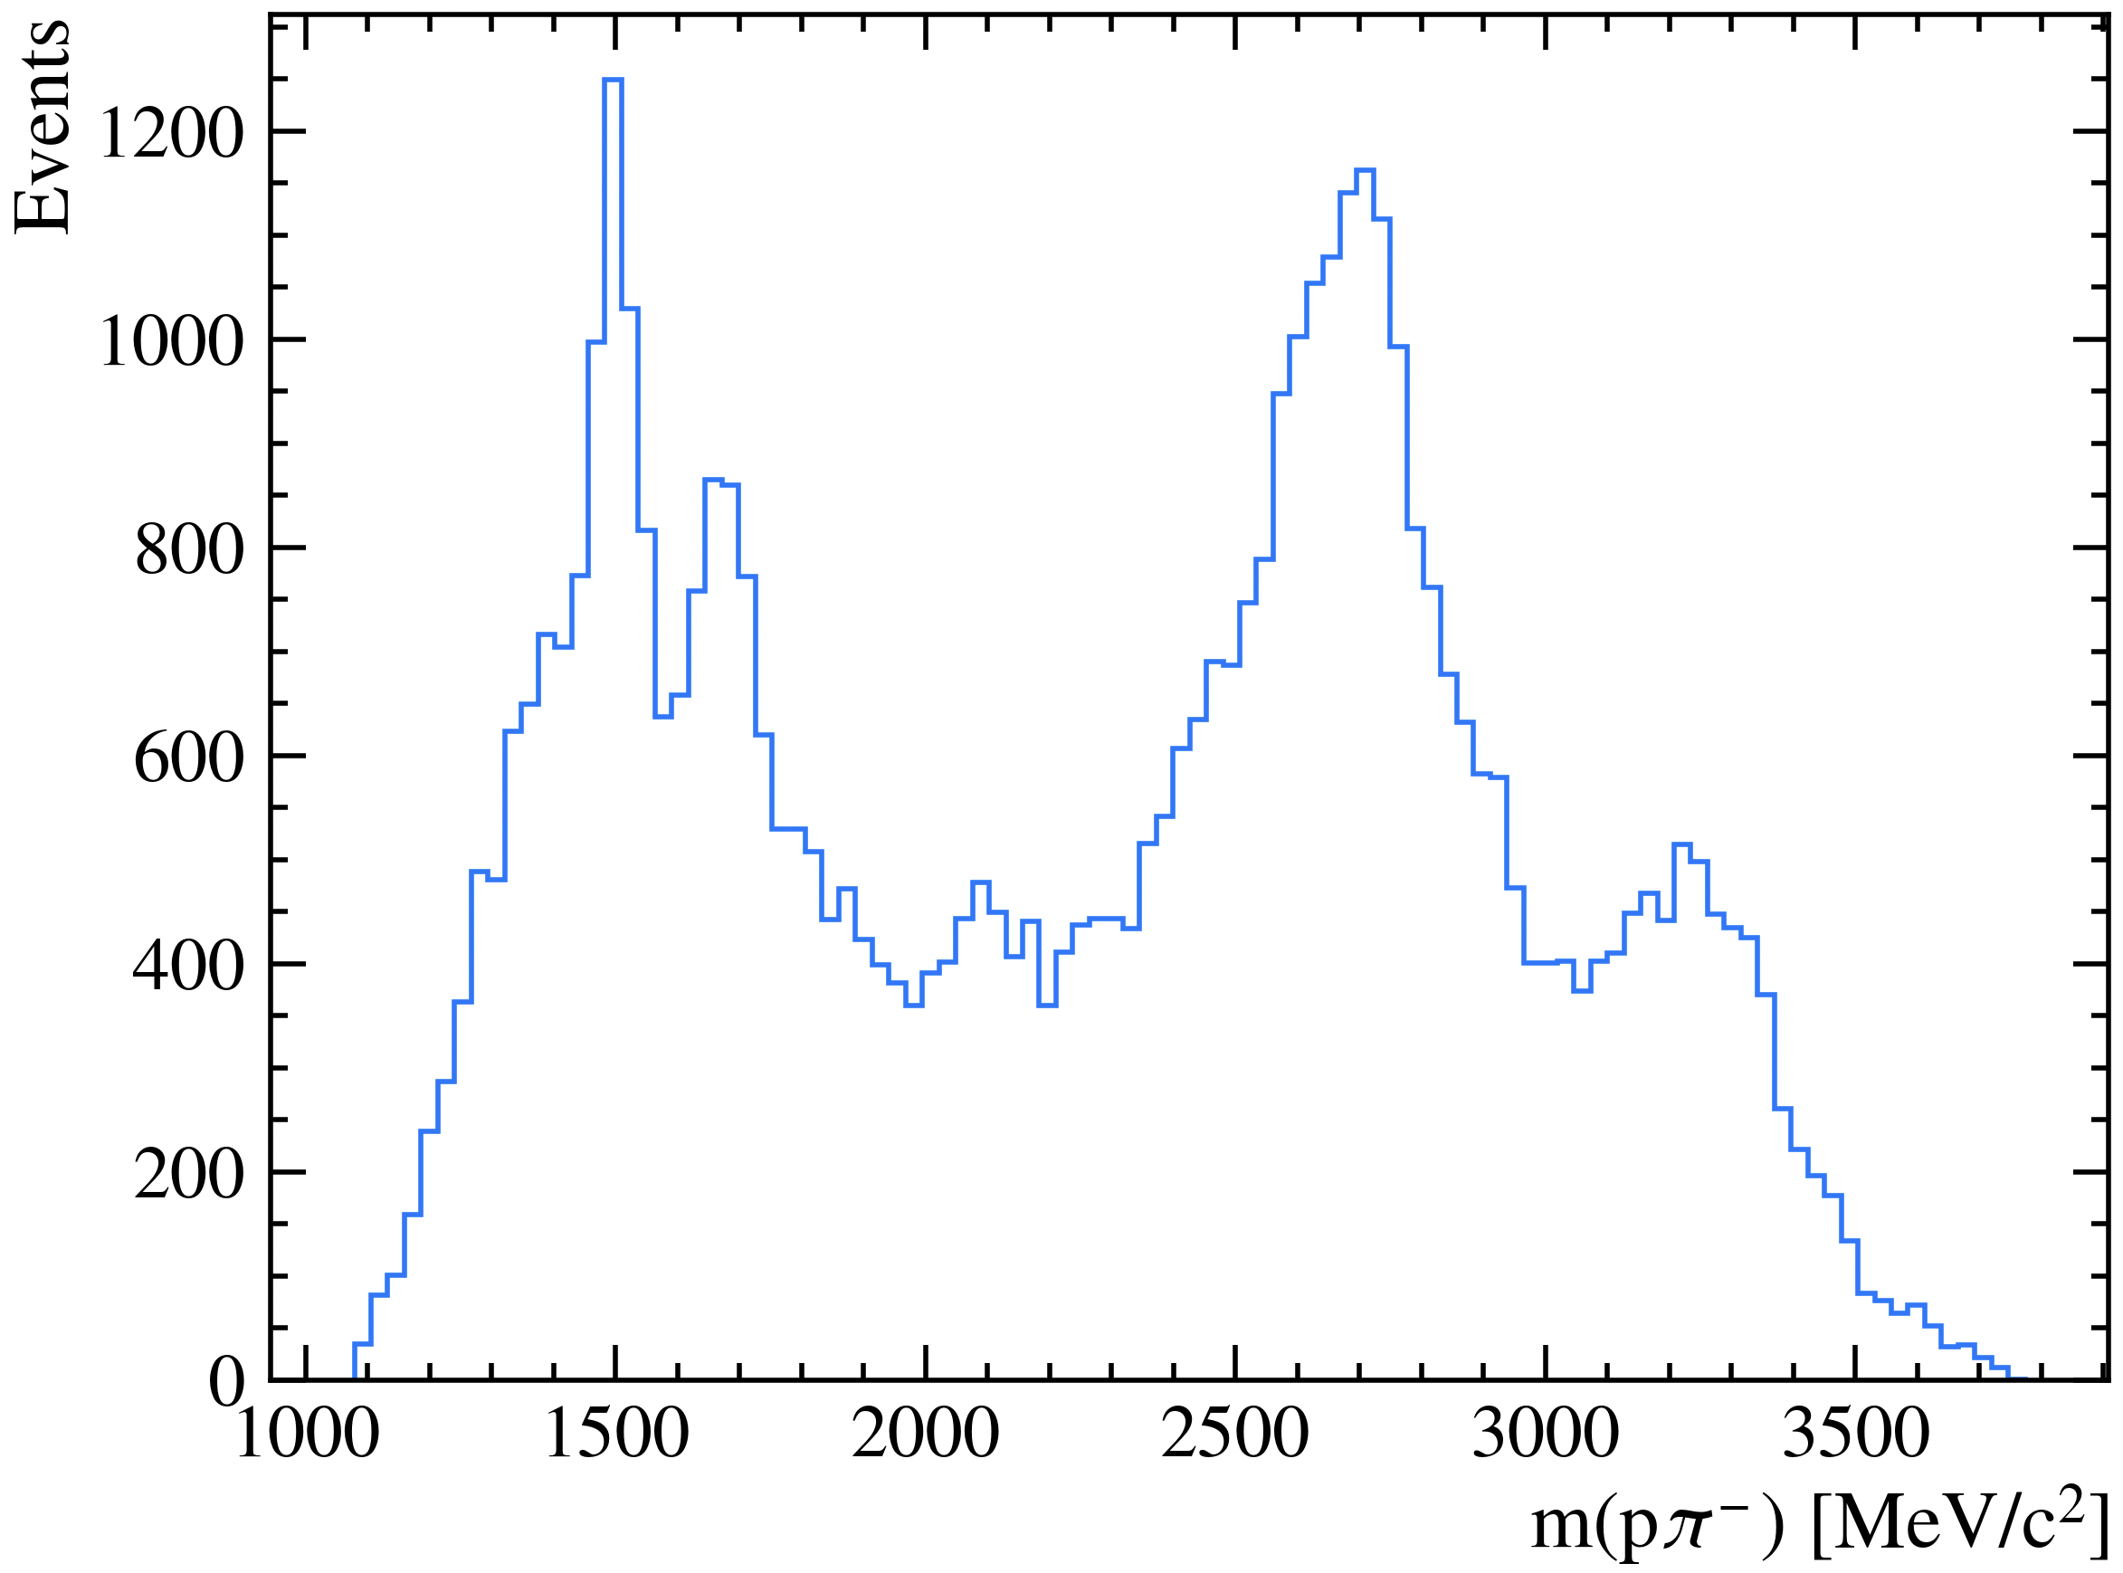
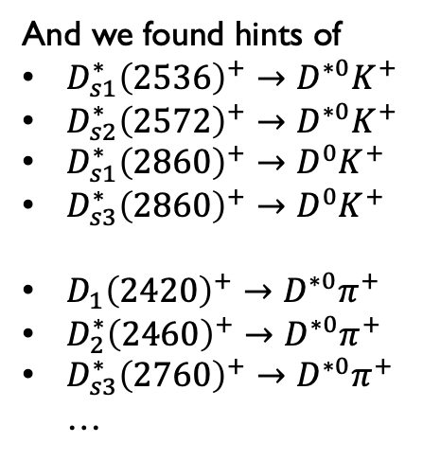

Surgery of the resonances - $D^{∗}p π^{−}$ region
The study continued forcing the misID of the proton in ranges of $m(D^{0}p π^{−}/K^{−})$ corresponding to the partially
reconstructed background and to the signal, further selecting on the $m(p π^{−}/K^{−})$
Example
5550 < $m(D^{0}p π^{−})$ < 5650
And we found hints of
$D_{s1}^{∗}{\left(2536\right)}^{+}→D^{∗0}K^{+}$
$D_{s2}^{∗}{\left(2572\right)}^{+}→D^{∗0}K^{+}$
$D_{s1}^{∗}{\left(2860\right)}^{+}→D^{0}K^{+}$
$D_{s3}^{∗}{\left(2860\right)}^{+}→D^{0}K^{+}$
$D_{1}{\left(2420\right)}^{+}→D^{∗0}π^{+}$
$D_{2}^{∗}{\left(2460\right)}^{+}→D^{∗0}π^{+}$
$D_{s3}^{∗}{\left(2760\right)}^{+}→D^{∗0}π^{+}$
…
Notes:
Address a comment on the polarization of Lambda and the measurement of the gamma angle. Remember we want to perform an amplitude study

Slide 27
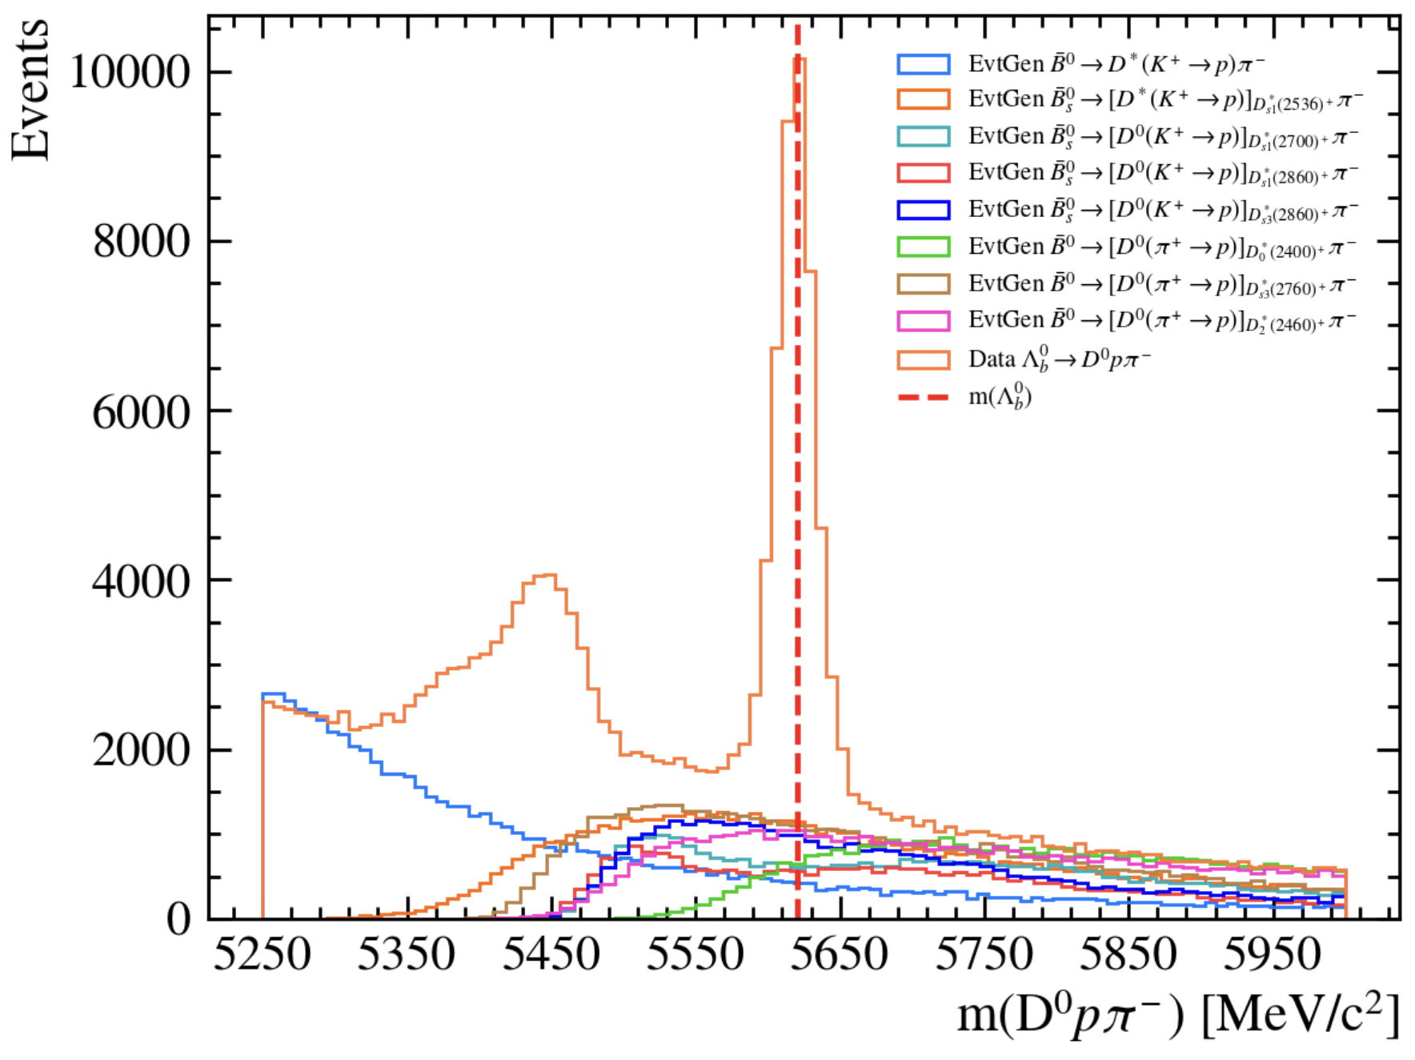
Surgery of the resonances - $D^{∗}p π^{−}$ region
The study continued forcing the misID of the proton in ranges of $m(D^{0}p π^{−}/K^{−})$ corresponding to the partially
reconstructed background and to the signal, further selecting on the $m(p π^{−}/K^{−})$
Example
5550 < $m(D^{0}p π^{−})$ < 5650
And we found hints of
$D_{s1}^{∗}{\left(2536\right)}^{+}→D^{∗0}K^{+}$
$D_{s2}^{∗}{\left(2572\right)}^{+}→D^{∗0}K^{+}$
$D_{s1}^{∗}{\left(2860\right)}^{+}→D^{0}K^{+}$
$D_{s3}^{∗}{\left(2860\right)}^{+}→D^{0}K^{+}$
$D_{1}{\left(2420\right)}^{+}→D^{∗0}π^{+}$
$D_{2}^{∗}{\left(2460\right)}^{+}→D^{∗0}π^{+}$
$D_{s3}^{∗}{\left(2760\right)}^{+}→D^{∗0}π^{+}$
…
Superimposed,
not to scale
Notes:
Address a comment on the polarization of Lambda and the measurement of the gamma angle. Remember we want to perform an amplitude study

Slide 28


Fit Model $Λ_{b}^{0}→D^{0}pK^{−}$
$Λ_{b}^{0}→{\left[K^{−}π^{+}\right]}_{D^{0}}pK^{−}$ RunII
$Λ_{b}^{0}→{\left[K^{−}π^{+}\right]}_{D^{0}}pK^{−}$ = 2618
$Ξ_{b}^{0}→{\left[K^{−}π^{+}\right]}_{D^{0}}pK^{−}$ = 967
misID $Λ_{b}^{0}→{\left[K^{−}π^{+}\right]}_{D^{0}}pπ^{−}$ = 956
$Λ_{b}^{0}→{\left[K^{−}π^{+}\right]}_{D^{∗}}pK^{−}$ shape 1 - $Λ^{∗}$
$Λ_{b}^{0}→{\left[K^{−}π^{+}\right]}_{D^{∗}}pK^{−}$ shape II - $Λ^{∗}$ 2170
$Λ_{b}^{0}→{\left[K^{−}π^{+}\right]}_{D^{∗}}pK^{−}$ shape $Λ_{c}^{+∗}$
misID $Λ_{b}^{0}→{\left[K^{−}π^{+}\right]}_{D^{∗}}pπ^{−}$ = 792
$Ξ_{b}^{0}→{\left[K^{−}π^{+}\right]}_{D^{∗}}pK^{−}$ = 802
Combinatorial background = 13525
Studies on the systematics will follow
Notes:
First I would like to address the problem, we were extracting the ADC from the banks in the MC, but these are decoded in 12 bits, so to convert them into LLTADC, an implementation is required, knowing that 10 bits in the LLT correspond to 10GeV. A first approximation was done dividing the adc exracted by 4 and then settin a threshold at 2. This conversion, though, was showing some non linearities in the quantities measured, which I will talk about later

Slide 29





Sensitivity to CP violation
The uncertainty on $A_{CP}$ is estimated to be:
$$σ_{A_{CP}}= \frac{1 −A_{CP}^{2}}{2} \sqrt{\frac{1}{N}+ \frac{1}{\overline{N}}}$$
Estimating the number of events of $Λ_{b}^{0}→{\left[K^{−}K^{+}\right]}_{D}pK^{−}$ and $Λ_{b}^{0}→{\left[π^{−}π^{+}\right]}_{D}pK^{−}$ candidates from the yields just
obtained
$σ_{A_{CP}}(K^{−}K^{+})=$ 0.04
RunI + RunII (9fb⁻¹)
$σ_{A_{CP}}(π^{−}π^{+})=$ 0.06
$σ_{A_{CP}}(K^{−}K^{+})=$ 0.02
RunI + RunII + RunIII (23fb⁻¹)
$σ_{A_{CP}}(π^{−}π^{+})=$ 0.04
Notes:
So we decided to reproduce the computation done in the electreonics, which assignes a conversion factor to each cell of each FEB, depending on the angle theta at which the cell is located wrt the interaction point

Slide 30

conclusions and Future plans
We are studying $Λ_{b}^{0}→D^{0}pK^{−}$and $Λ_{b}^{0}→D^{0}pπ^{−}$ to try to measure CP violation in baryons
The selection has been optimised and a fitting strategy has been chosen
Foreseen amplitude analysis of the decay
Active collaboration with UCAS group for binning optimization in their CKM angle 𝛾 measurements using $Λ_{b}^{0}→D^{0}pK^{−}$, with $D^{0}→K^{−}3π$ , $D^{0}→K_{S}^{0}π^{−}π^{+}$
Thanks for your attention!

Slide 31

Backup – charmless Branching fraction
Notes:
So we decided to reproduce the computation done in the electreonics, which assignes a conversion factor to each cell of each FEB, depending on the angle theta at which the cell is located wrt the interaction point

