Slide 1
2023 CNAO data taking
Matteo Morrocchi, Francesca Cavanna

Slide 2
Schedule
Monday | Tuesday | Wednesday | Thursday | Friday | Saturday | Sunday
18 Sept. Start of Calorimeter Assembly | 19 Sept. | 20 Sept. | 21 Sept. | 22 Sept. | 23 Sept. | 24 Sept.
25 Sept. | 26 Sept. | 27 Sept. | 28 Sept. | 29 Sept. | 30 Sept. All materials for Table at PI | 1 Oct.
2 Oct. Measurement B Field LNF | 3 Oct. Measurement B Field LNF | 4 Oct. Measurement B Field LNF | 5 Oct. Measurement B Field LNF | 6 Oct. Measurement B Field LNF | 7 Oct. | 8 Oct.
9 Oct. | 10 Oct. | 11 Oct. | 12 Oct. Accelerator downtime | 13 Oct. Accelerator downtime | 14 Oct. Accelerator downtime | 15 Oct. Accelerator downtime

Slide 3
Schedule
Monday | Tuesday | Wednesday | Thursday | Friday | Saturday | Sunday
16 Oct. Accelerator downtime | 17 Oct. | 18 Oct. | 19 Oct. | 20 Oct. | 21 Oct. Night Shift (8h) Beam Tuning | 22 Oct. Night Shift (6h) Beam Tuning
23 Oct. Table and magnet at CNAO Installation | 24 Oct. Installation | 25 Oct. Installation | 26 Oct. Installation | 27 Oct. Night Shift (8h) Calo Screen Saver Run | 28 Oct. Night Shift (8h) Vertex + IT Calibration Installation | 29 Oct. Night Shift (6h)
30 Oct. | 31 Oct. | 1 Nov. | 2 Nov. | 3 Nov. | 4 Nov. After. Shift (8h) | 5 Nov. After. Shift (8h)
6 Nov. Night Shift (6h) | 7 Nov. Night Shift (6h) Emulsion Run TW calib | 8 Nov. Uninstallation | 9 Nov. Uninstallation | 10 Nov. No Material in the room | 11 Nov. Next Exp. In Exp. Room. | 12 Nov.

Slide 4
Documentation
Need to fill the required safety modules:
- Module for radioprotection, one for each participant (please check the expiration date of your medical certificates and send a copy to me)
- Declaration of possession of requirements for professional and technical suitability, one for each institution (the module expires after 1 year)
- Safety Approval Form, one for the whole experiment
All modules are available here. The deadline to collect the documentation is September, the 22nd
In addition:
- An online course (0.5 h) needs to be attended, and a form needs to be filled. The course expires after 3 years.
- Each Local Coordinator should send to us the participant list specifying (if possible) dates of arrival and departure, radioprotection status, and the means of transportation used by each group (i.e. to optimize the number of vans to be used).

Slide 5
Measurement Plan - Calibration
Calorimeter (8h)
Calibration with screen saver, 4 positions, as many energies as possible.
Reconstruction of the response curve for each crystal
10000 evts x crystal x energy
2h → 9 energies for ¼ of the calorimeter
No other detectors in the beamline
Vertex and IT (6h)
Cross-check the threshold for each sensor
Collect statistics with tracks in different region of the detector
→ need for a thick target in front of the vertex to scatter the beam
The calibration needs to be done with and without magnetic field, with more than one energy
TW (1h)
Scan moving the TW using the same energy/ies used in the fragmentation runs.
MSD
Just a quick alignment run without magnet
→ 5 different points in the detector (same energy/ies used in the frag. runs)

Slide 6
Measurement Plan - Frag. Measurements
4 Shifts - 28 hours total (6 + 8 + 8 + 6)
1-2 hours at the begin of the first run needed for alignment acquisitions
In the last data taking we acquired data with the following event rate:
about 200 Hz with MB trigger
below 100 Hz with fragmentation trigger
To demonstrate the capability to work in inverse kinematic we need to acquire data with C₂H₄ target
29 Oct.
Align.
Align.
4 Nov.
5 Nov.
6 Nov.

Slide 7
Measurement Plan - Emulsion Run
Two bricks, C and C₂H₄.
Emulsions need to leave CNAO the 8 of November (preferably in the morning) to go back to Naples.
Is a radioprotection survey needed before emulsions leave CNAO?
→ Naples will send a sample to CNAO ad a brief description of the samples that will be irradiated with the estimated total number of particles.
Integration of the Emulsion support in the table needs to be discussed.
Need for a scan spanning an area of 2.4 cm x 2.4 cm with a 15-18 kg brick.
→ Use of CNAO magnets, verify the method to counts the impinging particles on the brick.
Separated meetings with a working group to understand how to execute the irradiation with the required resolution on the number of particles. First meeting Sept. 19th at 9:00.

Slide 8
Detector Geometry
Since we have new/larger detectors compared to the last data taking, it would be nice to collect the channel map (including the right orientation and position of each channel) for each detector before the data taking.
31 Calorimeter modules (9 scintillator each). How do we arrange the modules respect to the TW?
→ 279 X-Y TW crossing can be covered.

Slide 9
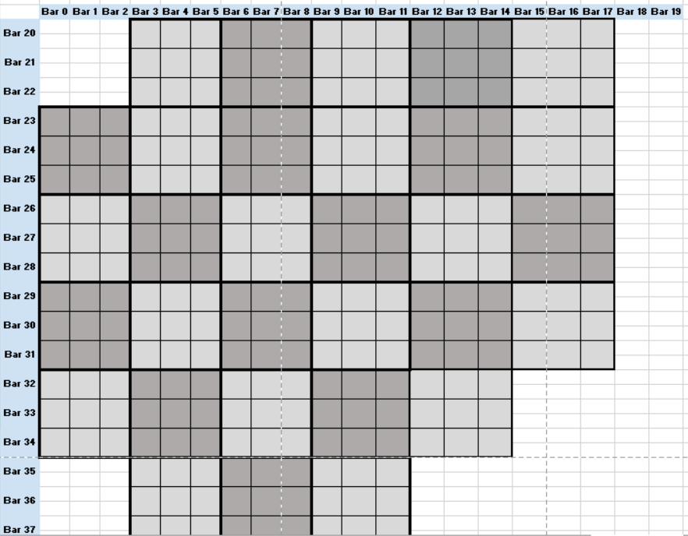
Detector Geometry

Slide 10
Installation
For the CALO screen saver run, no other detector should be on the beam line, this calibration will be performed at the beginning of the data taking. So it would be nice that:
All the detectors will be installed on the beamline by the 26th to test the whole apparatus (without beam).
Move the detectors out of the beamline, except for the calorimeter, the 27th.
Mount again the morning of the 28th
Remember: Installation dates may change according to the availability of the construction site for the access with the van(s). The site need to be informed few days in advance to have access granted. Since the calorimeter will be transported at CNAO fully assembled, it would be easier to access from the construction site also with this detector.
The more the system gets complex, the more the installation needs to be planned and performed in steps…
Let’s avoid having 20 people at the same time in the cave
Space will be reduced compared to last data taking
Step by step plan divided into 3-4 days to coordinate the activities in the room (4-5 shifts)

Slide 11
Installation
The following “big” components need to be moved to CNAO:
Calorimeter
Table
Magnet
(Also a transpallet from Perugia is needed for the installation)
I would like to check that we have a plan for each component
From Pisa: van with tail lift to load and unload the table without need for a forklift in the construction site. (23-26 October, 7-10 November)
From Torino:
From Frascati:

Slide 12
Uninstallation
All the materials have to be removed from the experimental room before November, 11th.
Materials cannot be left at CNAO, some exceptions for limited volumes can be discussed with Marco, but please let us know in advance if this is needed, so to identify a possible solution.
Also the uninstallation needs the coordination with the construction site.
It is difficult to perform the whole radioprotection survey on November, 8th, the exact schedule of the surveys will be decided later (need to be known a bit in advance to schedule the rent of the vans)

Slide 13
Notes
Documents in preparation:
FOOT Installation documentation
Geometry and detector maps documentation
Safety Approval Form
This presentation is continuously updated and can be found at the following link:
https://docs.google.com/presentation/d/1Z5GhAc4msEjNLL_mqJcTx-BF5PDRneSg/edit#slide=id.p1

