Slide 1
Corso reti avanzato per neo assunti (PNRR)
Netgroup

Slide 2
Introduction
This is the second part of the course, and it addresses some advanced and more specific network related concepts.
It will:
Security
Overview of the INFN network infrastructure
Describe the network context on the international peerings
Give a glance to new technologies

Slide 3
SECURITY ACCESS CONTROL LISTS

Slide 4
Definition of ACL (Access Control List)
In computer security, an access-control list (ACL) is a list of permissions associated with a system resource.
In networking, ACLs are lists of rules to be applied to specific traffic flows.
ACLs are generally managed by specific hardware devices like Routers, Switches, and Firewalls.
An ACL contains a sequential list of permit or deny statements and are evaluated from the first to the last. (e.g. cisco “exits” on first match).
In general Security ACLs are applied on the WAN access interface to protect the entire network and or on the internal devices to protect specific parts of the network
GARR
ACL
Access
Router
Aggregation
Switch
LAN

Slide 5
ACL Creation (Example)
In an ACL it is possible to discriminate a data flow by: IP Source, IP Destination, Protocol used (IP, TCP , UDP, ICMP…) and eventually the port number.
Ip access-list extended <ACL Name>
permit/deny <Protocol> <Source Address> <port> <Destination Address> <port> <log>
The addresses definition can be a single host or a network.
To identify a network, it is necessary to use the wildcard address.
Netmask / Wildcard correspondence
Slash | Netmask | Wildcard mask
/32 | 255.255.255.255 | 0.0.0.0
/31 | 255.255.255.254 | 0.0.0.1
/30 | 255.255.255.252 | 0.0.0.3
/29 | 255.255.255.248 | 0.0.0.7
/28 | 255.255.255.240 | 0.0.0.15
/27 | 255.255.255.224 | 0.0.0.31
/26 | 255.255.255.192 | 0.0.0.63
/25 | 255.255.255.128 | 0.0.0.127
/24 | 255.255.255.0 | 0.0.0.255
/23 | 255.255.254.0 | 0.0.1.255
... | … | …
Example of ACL (Cisco CLI)
ip access-list extended 103
10 permit tcp any any established
20 permit ip 131.154.10.0 0.0.0.255 any
30 permit ip host 193.206.144.61 host 131.154.1.238
40 permit tcp any host 131.154.1.238 eq domain
50 permit tcp host 130.186.16.113 host 131.154.128.31 eq 88
60 deny ip 179.43.175.0 0.0.0.255 any
70 deny tcp any any range 1 1024
80 deny udp any any range 1 1024 log
ACL Name
Permit all established TCP Connections
Permit all traffic from the net 131.154.10/24 (In wildcard format)
Host to host rule
Name of the service specified
Port number specified
Deny all traffic from the net 179.43.175.0/24 (In wildcard format)
Deny all traffic in a port range
Generate a log entry in the log every hit
(CPU demanding)

Slide 6
Application of ACL (Access Control List)
ACLs are generally applied to: Physical Interfaces (ports), VLANs, IP Interfaces associated to VLANs
ACLs are applied for a specific traffic direction (Input or output)
ACLs control traffic in only one direction, so if you want to control inbound and outbound traffic you must create two distinct ACLs per interface.
Example of ACL application (Cisco CLI)
interface Vlan1000
description general-internet
ip address 193.206.128.XX 255.255.255.252
no ip redirects
no ip unreachables
ip mtu 9178
ip nat outside
ip access-group 103 in
ip access-group 104 out
ipv6 address 2001:760:FFFF:110::XX/127
ipv6 traffic-filter IPv6-103 in
ipv6 traffic-filter IPv6-104 out
Interface to which apply the ACL
GARR
ACL (103) acting on IPv4
Input traffic
ACL A for Inbound Traffic
ACL (104) acting on IPv4 Output traffic
ACL B for Outbound Traffic
ACL (IPv6-103) acting on Input IPv6 traffic
Access
Router
ACL (IPv6-104) acting on Input IPv6 traffic

Slide 7
FIREWALL

Slide 8

Definition of Firewall
A firewall is a network security appliance that restricts data communication traffic to protect your network from unwanted accesses.
Firewalls can be:
Stateful firewalls: aging on the connections in a similar way as simple ACLs do but using dedicated hardware resources (at line rate). These firewalls can evaluate also the status of the TCP connection.
Next Generation Firewalls:
Deep Packet Inspection (ASIC/FPGA)
Application recognition (not only on the base of the ports used for the connections)
Can recognize in real time malicious traffic coming from Internet or directed to Internet (for example by malware) using continuously updated signature database
Can perform URL Filtering and Online Antivirus control
SSL inspection (Need to use the firewall as an SSL proxy)
Signature DB Continuously updated (with relative recurring costs for subscriptions)
GARR
NG Firewall
Access
Router
Aggregation
Switch
LAN

Slide 9
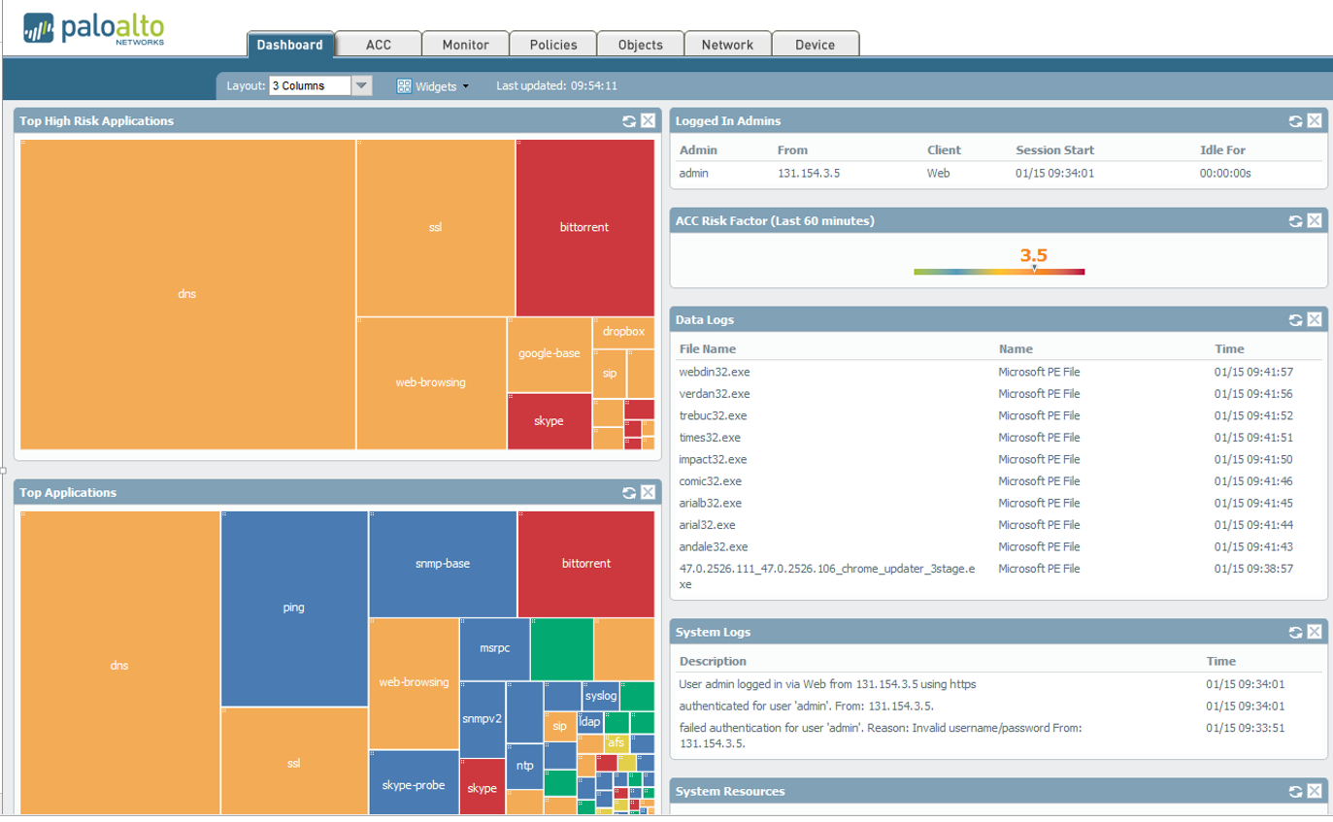
NG Firewall features
NGFW provides dashboards giving a status at a glance of the traffic and potential threats detected.

Slide 10
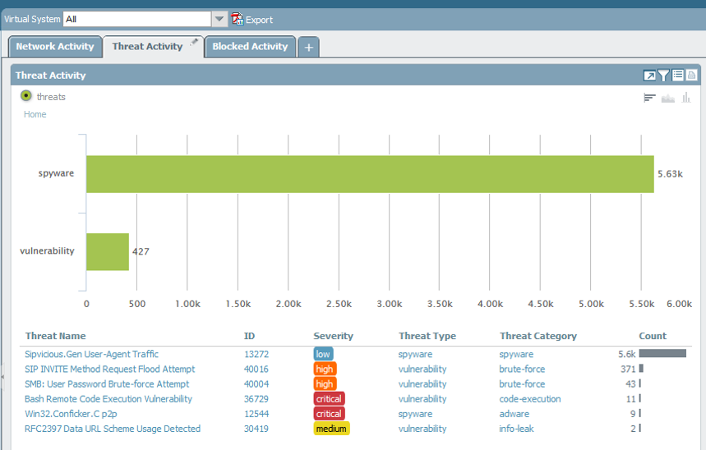
NG Firewall features
NGFW provides an automatic classification of the threats

Slide 11
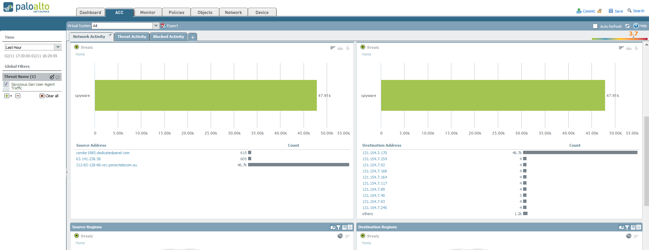
NG Firewall features
For each threat it is possible to view all the involved hosts ( source and destination)

Slide 12
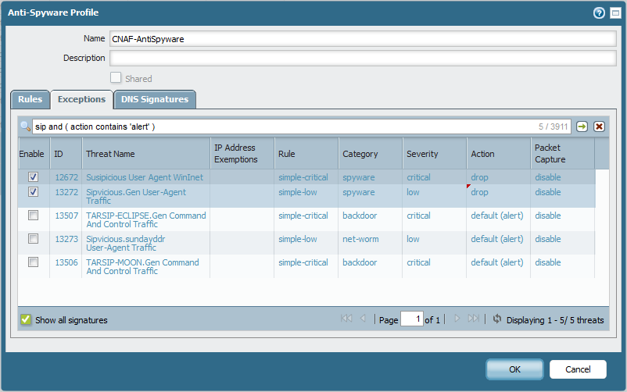
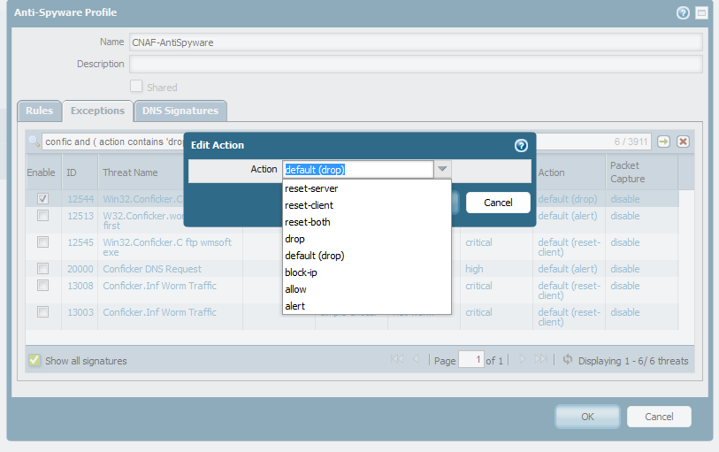
NG Firewall features
For each recognized threat it is possible to setup the specific rule to eventually block the malicious traffic in many different modes (drop, block-IP, alert, reset both sides…).

Slide 13
Firewall features
Automatically block suspicious activities
NGFWs can block traffic according to specific policies, manually defined traffic profiles or based on the automatic classification of detected threats.
URL Filtering
URL filtering can be fine-tuned defining the specific forbidden URLs or simply using the continuously updated lists of URL considered related to malware or in general malicious.
INFN does not enforce strict URL control to preserve users' privacy.
Only malicious URL filtering related to virus or malware is enabled.
DDOS protection
It is not easy to mitigate a well-organized Distributed Denial of Service attack but some NGFWs provide DoS protection mechanisms allowing a maximum number of sessions for each client and for specified applications. Setting maximum “hit rate” per client could help with DoS mitigation.

Slide 14
Firewall (Transparent or Routed)
Transparent mode:
Firewalls can be configured to be completely transparent to the network. In this configuration firewalls don’t have any IP address and are traversed by all traffic configuring the ports to simulate a virtual “wire” in certain cases not participating neither to LACP or other L2 protocols.
Routed Mode:
Firewalls are participating in the routing process (behave as a router) and can operate for example as NAT. In this case firewall have an IP address and are a visible hop in the network path.
TRANSPARENT
ROUTED
WAN
WAN
.
GW
GW
LAN
LAN

Slide 15
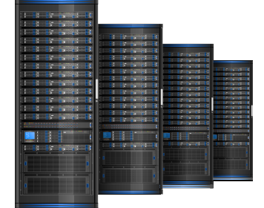

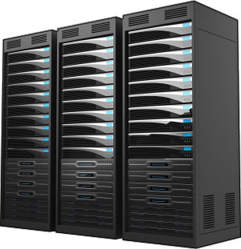
NG Firewall
Next Generation Firewalls can operate at line rate as IDS/IPS.
The limits in term of throughput depends on the HW resources (ASIC or FPGA adopted).
In general NG Firewalls are expensive devices and in order to reduce costs, it’s recommended, where possible to use bypass rules (whitelists) in order to avoid deep inspection on trusted traffic.
WAN
White Listing
of high volume well known
scientific traffic
Firewall (HW)
(FPGA/ASIC)
Router
LAN
Trusted scientific data transfer
Server or services to protect
User Pcs

Slide 16
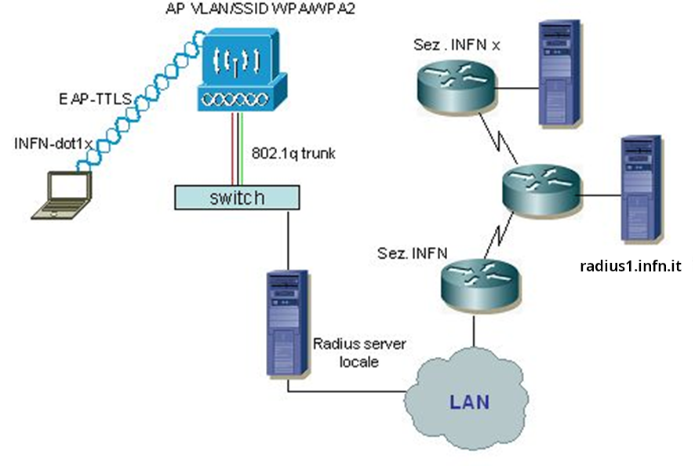
INFN Wi-Fi: radius servers and authentication
INFN wi-fi infrastructure is based on a distributed authentication model (radius servers), using INFN-dot1x as SSID. Only CNAF site uses a different SSID for INFN users: CNAF-dot1x.
An INFN user located at any INFN site associates with the access point using INFN-dot1x as the SSID and EAP-TTLS as the authentication protocol. This allows tunneling of credentials within a TLS encrypted channel.
The username syntax is : uid@site.infn.it
Local users are authenticated by the local radius.
Roaming users are authenticated by their own radius server via proxy mechanism and the response will reach the access point which will allow or deny access to the network.
Eduroam (EducationRoaming) uses the same technology but gains access to all education and research organizations included in the worldwide federation.

Slide 17
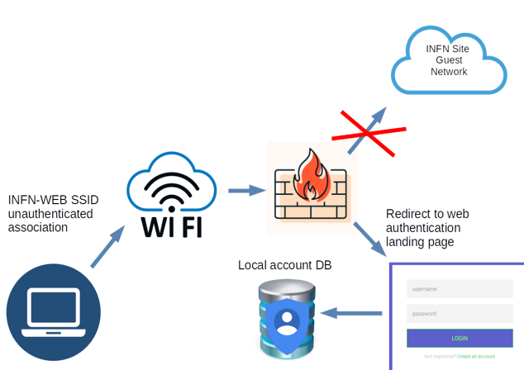
INFN-WEB Captive Portal
Many INFN sites provide a captive portal authenticated SSID for temporary guests: INFN-WEB
Once the guest device associates to the WIFI SSID, the user must open a web browser (some devices recognize automatically the authentication system)
It will be redirected to a web login page connected to a local authentication system

Slide 18
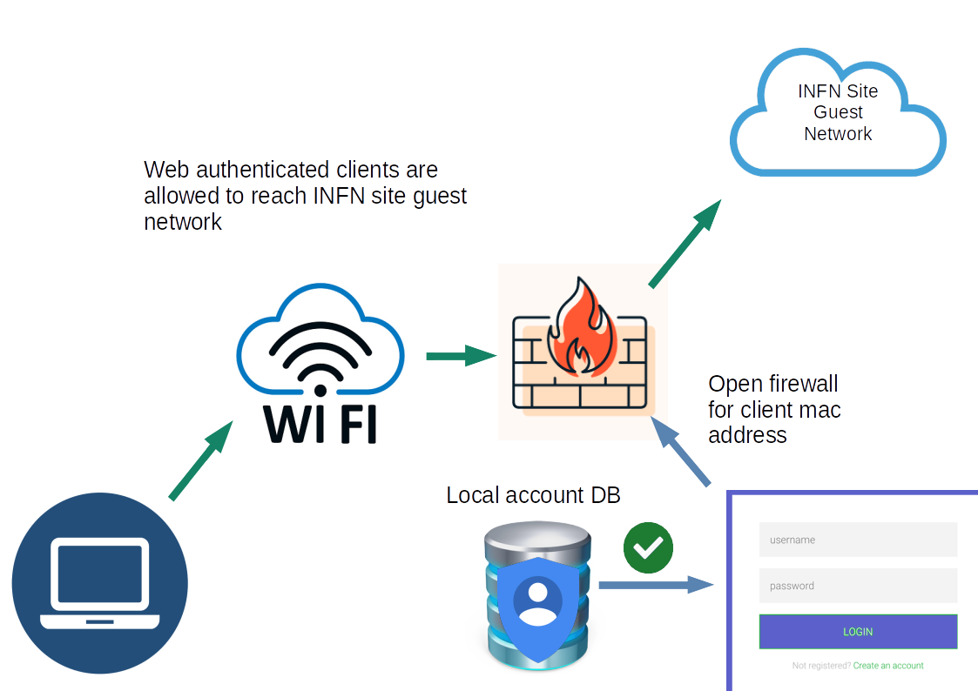
INFN-WEB Captive Portal
If web authentication ends successfully, the client mac address is registered in the system and the firewall allows access to the site guest network

Slide 19
INFN Wi-Fi Summary
INFN-dot1x (CNAF-dot1x)
  INFN people only (preferred on INFN sites)
EDUROAM
  Worldwide education and research people (outside INFN sites)
INFN-WEB
  Local Guests
  Not INFN or education people
  Every INFN sites can implement local different security policies

Slide 20
Virtual Private Network (VPN)
VPN is a mechanism for creating a secure connection between a computing device and a computer network, or between two networks, using an insecure communication medium such as the public Internet.
A VPN can extend a private network and enables users send and receive data across public networks as if the public networks' devices were directly connected to the private network.
The benefits of a VPN include security, reduced costs for dedicated communication lines, and greater flexibility for remote workers. Encryption is common, although not an inherent part of a VPN connection.

Slide 21
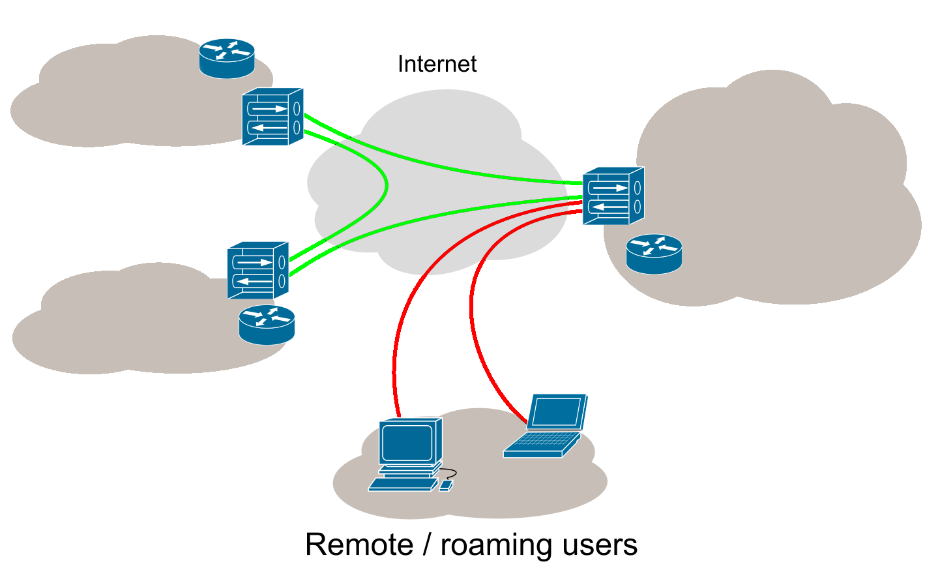
VPN Types
Remote access VPN
  to connect users from internet (Client/Server)
Site to site
  to stretch the LAN over multiple sites using internet (Peer to Peer)
SITE 2
SITE 1
SITE 3

Slide 22

How does it work
Authentication
  User-created remote-access VPNs may use passwords, biometrics, two-factor authentication, or other cryptographic methods (INFN AAI or Certificate)
Secure tunnel creation and routing rules
  Using a secure protocol (e.g. IPsec or SSL) a “tunnel” from client to server is created and a virtual network is added to the client.
  A routing rule is added to the OS routing table to permit:
    All the traffic flows thru the tunnel TUNNEL ALL
    Only the traffic to the LAN is routed to the tunnel and the internet traffic is routed normally aka SPLIT TUNNEL
internet
LAN
VPN
SERVER
tunnel

Slide 23
Science DMZ

Slide 24

WLCG (Worldwide LHC Computing Grid)
Particle Physics scientific collaborations are international and have a worldwide scope.
WLCG project is the global collaboration that includes all the computing centers (about 170) distributed in more than 40 countries providing HEP community the computing resources.
“The mission of the WLCG project is to provide global computing resources to store, distribute and analyse the ~200 Petabytes of data expected every year of operations from the Large Hadron Collider (LHC) at CERN”
The distributed computing model of the experiments and the necessity to “Move” large amount of data between different data centers have a huge impact on the network evolution.
https://wlcg.web.cern.ch/

Slide 25
Network challenges inside the datacenters (LAN)
LHC Computing Centers are the typical example of High Throughput Computing (HTC).
These computing centers are made of a huge number of CPUs (Standard CPUs) installed in hundreds of servers and storage systems of the order of tens of PB Petabyte of data.
  INFN CNAF TIER1 datacenter consists of about 60000 CPU cores, 50PB disk storage
  INFN Bari Italian T2 consists of about: 20000 CPU cores, 20PB disk storage
Every Job must have access to data at high throughput to perform the necessary analysis.
In general, the LAN of an LHC datacenter has to provide an aggregate throughput between CPU and storage of several Tbps (Terabit per second).

Slide 26
Network challenge between datacenters (WAN)
WLCG Datacenters TIER classification
  TIER-0: CERN Datacenter where data are generated
  TIER-1: 15 sites in 12 Countries ( Main Datacenters for data custodial and analysis)
  TIER-2: 140 sites in 40 Countries for analysis and simulation
In order to guarantee the data transfer from CERN to the TIER1s it has been created the LHC Optical Private Network (LHC OPN https://lhcopn.web.cern.ch/).
Connectivity between all T2s and between T1s and T2s is provided by LHC Open Network Environment (LHC ONE https://lhcone.web.cern.ch/) network as an L3VPN on the Internet (But using links dedicated to scientific applications).
Other scientific communities asked to be part of LHCONE in last 5 years and now is supporting the WAN traffic of: LHC, BELLEII, Pierre Auger Observatory, Juno, and Xenon.

Slide 27
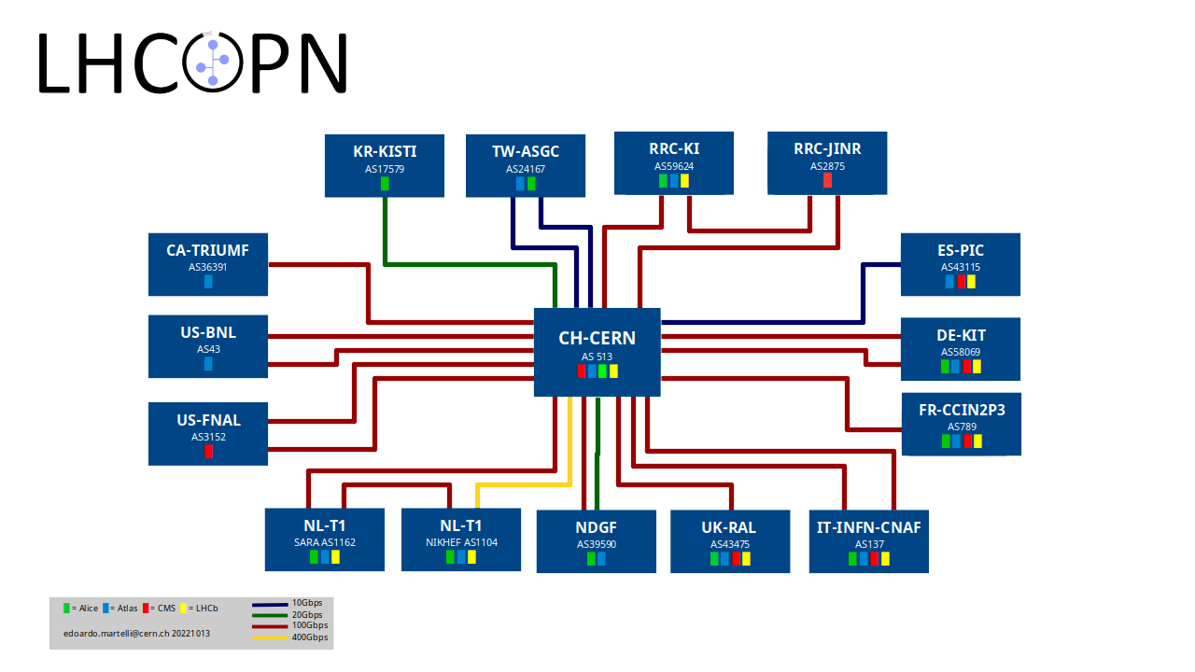
Every TIER1 has a dedicated
high speed link to CERN.
Optical
Private
Network
Korea
Taiwan
Russia
Russia
CANADA
Spain
USA
Germany
France
USA
Italy
Nederland
Nederland
Sweden
Norway
Finland
Denmark
United Kingdom
INFN CNAF, the Italian TIER1 is connected to CERN at 2x100Gbps

Slide 28
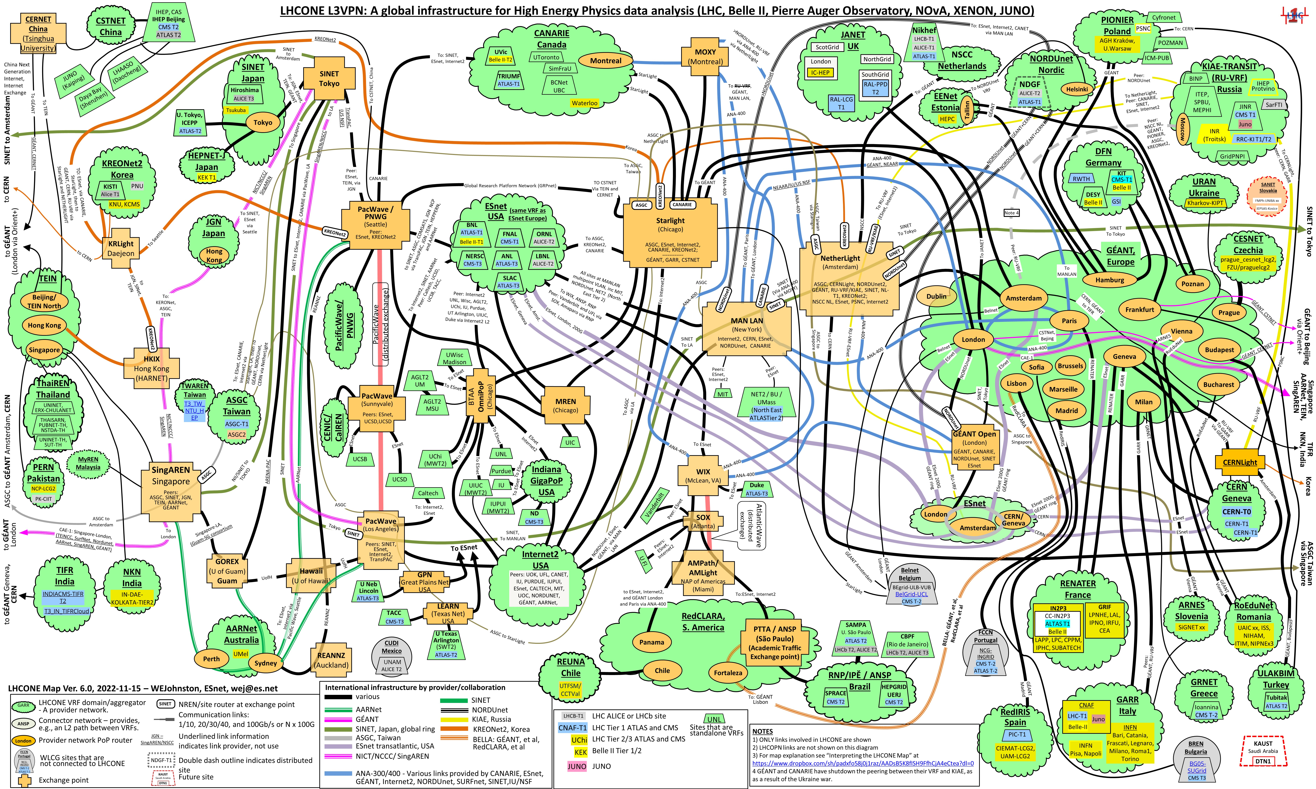
LHC ONE (Open Network Environment)
This worldwide Overlay Network is quite complex and requires the collaboration between:
1)HEP Sites (Datacenters)
2)NREN (National
Research ad Education Networks)
The Italian NREN is GARR
(www.garr.it)
You are Here!
Thanks to William Johnston (ES NET)

Slide 29
LHCOPN and LHCONE in Italy
Italian TIER1 and TIER2s datacenter connectivity
T1
BNL
T1
NL
TO
T2
T1
FNAL
T1
RAL
GEANT
LHCONE
VRF
T1
Triumph
T1
IN2P3
MI
T2
T1
ASGC
10Gb/s
…
LHCOPN
CERN
T0
10Gb/s
T1
PIC
2x10Gb/s
LNL
T2
T1
RRC -JiNR
GARR
LHC-ONE
VRF
T1
DE-KIT
2x10Gb/s
PI
T2
2x100 Gb/s OPN
2x100Gb T1-T2 LHCONE
10Gb/s
10Gb/s
20Gb/s
CNAF
T1
NA
T2
20Gb/s
100 Gb/s
RM
T2
BA
T2
LNF
T2
CT
T2
BA
T2

Slide 30
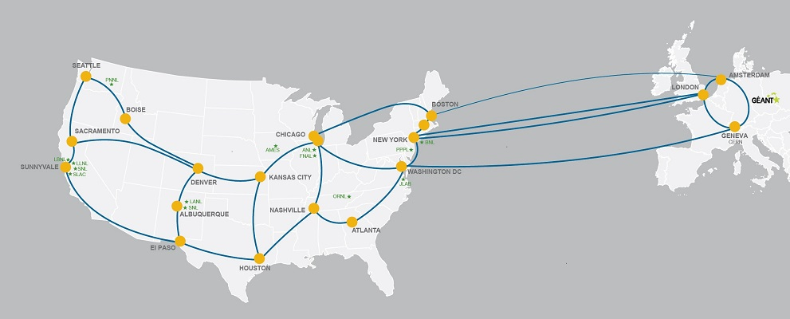







Global Collaboration for global connectivity
In order to guarantee the global connectivity many NRENs are involved on the management and evolution of the complex network of international links
At the time of writing this document transatlantic links consists of about 800Gbps
Trans-Atlantic connectivity provided by ESnet, GEANT, Internet2, NORDUnet and SURFnet
Washinghton-London (I2+Canarie)
London-NY (Internet2+Canarie)
London-NY (I2+EsNet)
Washinghton-Geneva (ES-Net)
Paris-NY (GEANT)
NY-Amsterdam- (NII-Sinet)
Amsterdam-Montreal (Nordunet,SURFnet)
Boston-Amsterdam (ES-Net)
Trans-Pacific connectivity provided by ASGCnet, KREOnet, SINET, TransPAC
Interconnections at Open Exchange Points including NetherLight, StarLight, MANLAN, WIX, CERNlight and others

Slide 31
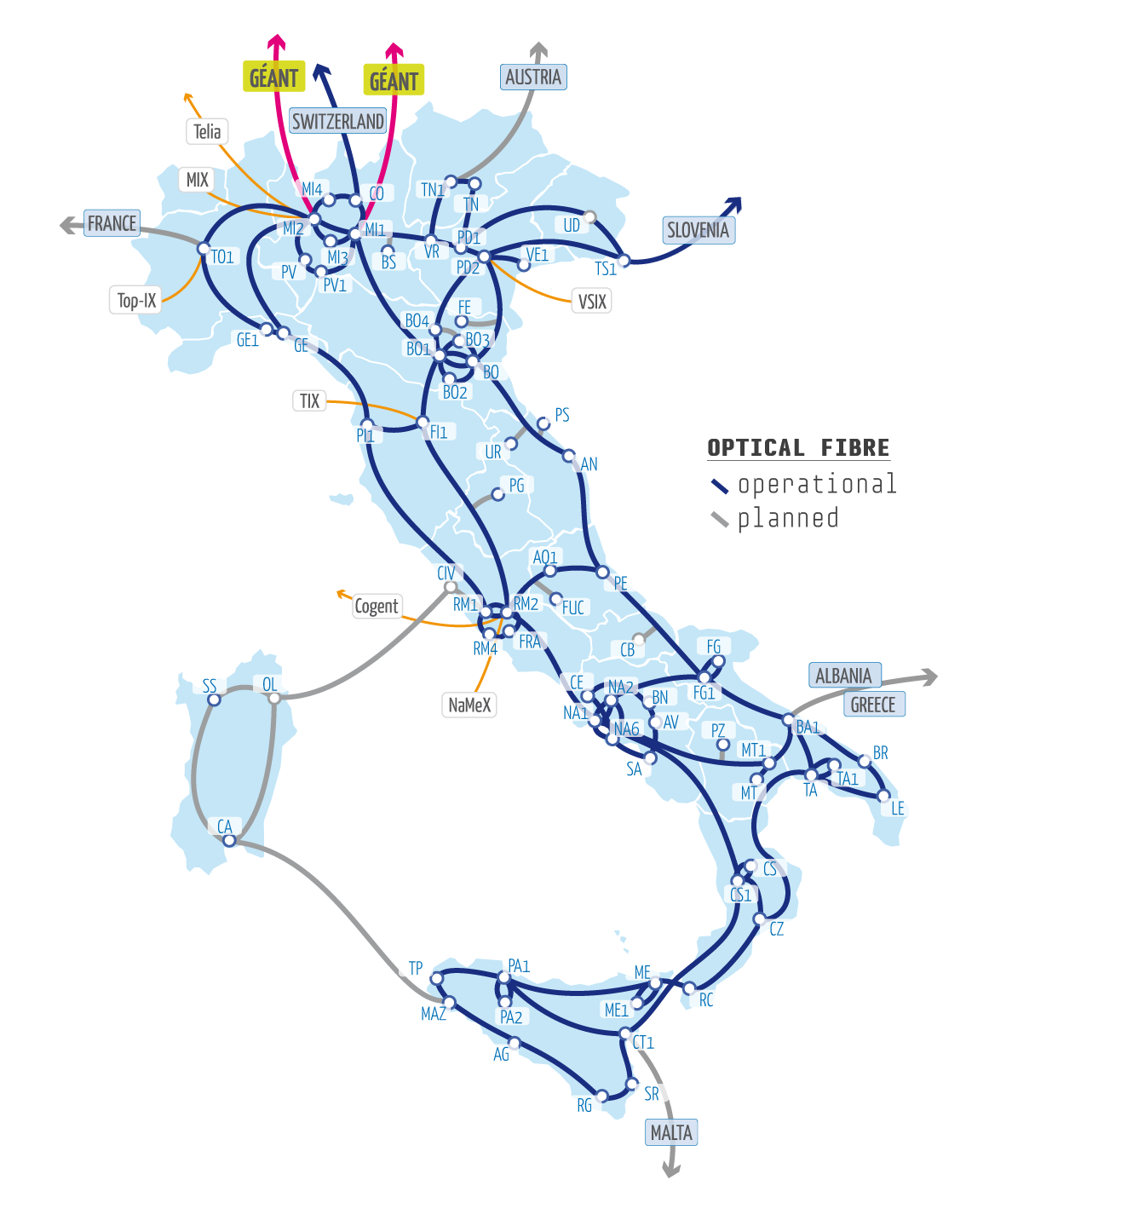


GARR (The Italian Research Network)
GARR (Gruppo Armonizzazione Rete della Ricerca) provides network access and services to about 1000 organisations
100 Universities
350 Research Institutes and Laboratories
60 Biomedical Research Institutes
65 Music Conservatories, Art Academies, Libraries, Museums & other Cultural Institutions
500 Schools
The Backbone is multi Terabit capable and It is made of more than 100 PoPs (Point of Presence)
GARR is part of the European Research Network
Backbone topology
https://www.garr.it
Courtesy of GARR

Slide 32
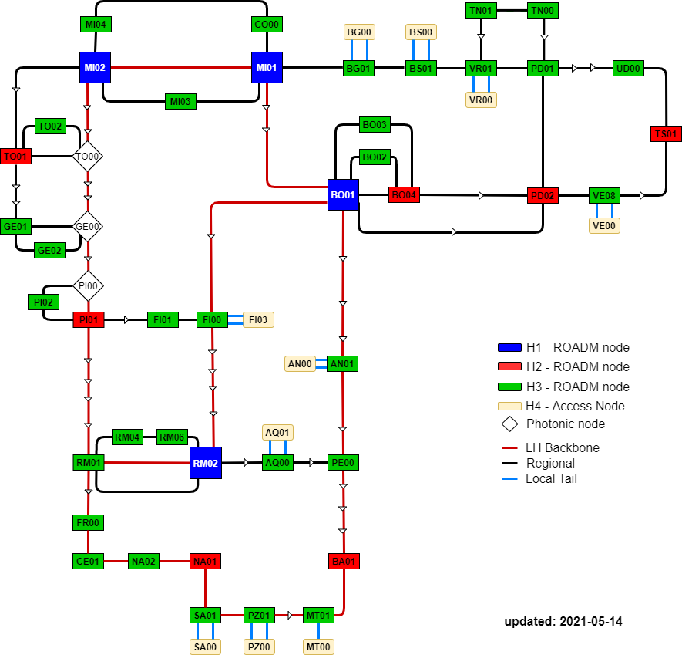
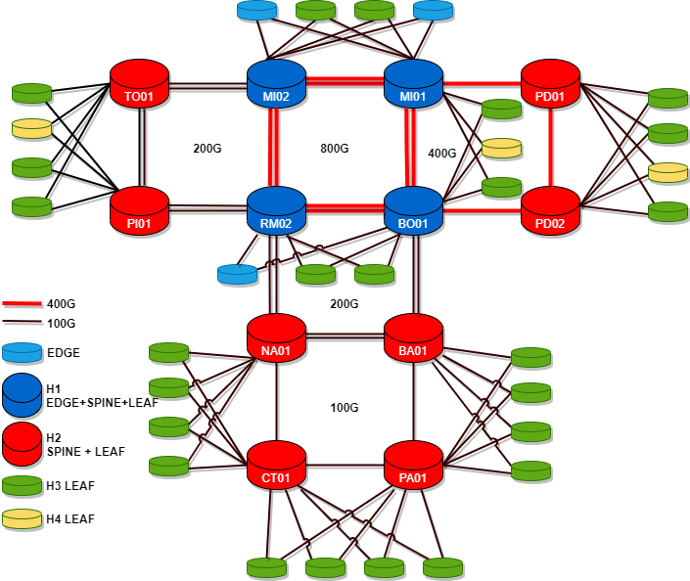
GARR-T (Next generation network)
Packet Layer
Optical transport layer
Courtesy of GARR

Slide 33
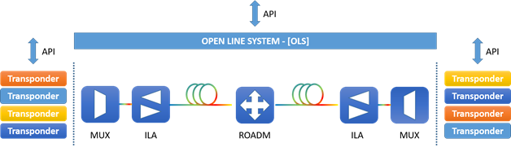
GARR-T some numbers
Courtesy of GARR
OPTICAL Network
PACKET Network
Fiber network | 6155 km
New optical fiber infrastructure | 740 km
line system directions | 128
PoP ROADM | 42
In Line Amplifier (ILA) | 35
New Metro POP | 9
Doubling POP in some City | 6
100GEth Services | 130
400GEth Services | 11
Day1 backbone capacity | 17.4 Tbps
Device Capacity | Capacity MAX | Day 1 Capacity
Total LEAF/EDGE/CSD | 144.6 Tbps | 61.28 Tbps
Total SPINE | 307.2 Tbps | 108.8 Tbps
Backbone |  |  |  |  | End user Acces
400G | 100G | 40G | 10G | 1G | 100G | 10G | 1G
34 | 622 | 32 | 265 | 59 | 67 | 290 | 876

Slide 34
GARR Accepable Use Policy (AUP)
An acceptable use policy (AUP) is a document stipulating constraints and practices that a user must agree to for access to a network, the internet or other resources.
e.g., “All users to whom access to the GARR Network and its services shall be provided must be recognized and identifiable.”
“Responsibility for the content of materials being produced and disseminated using the network and its services is attributable to the persons producing and disseminating said materials.”
“damaging, destroying, or seeking unauthorized access to data, or violating other users' confidentiality, including interception or dissemination of passwords, confidential cryptographic codes, and any other personal data, as it is defined by legislation pertaining to privacy protection”
https://www.garr.it/it/regole-di-utilizzo-della-rete-aup
https://www.garr.it/en/acceptable-use-policies

Slide 35
Science DMZ- Accepable Use Policy
As it is considered a scientific DMZ with very high bandwidth uplinks there are some rules to respect in order to take part to LHCONE
The OPN/ONE access must be distinct from the General Internet access
An agreement on LHCONE Acceptable Use Policy (AUP)
  Traffic injected into the LHCONE must originate only from addresses that belong to a LHCONE prefix;
  Traffic injected into the LHCONE must be directed only to addresses that belong to a LHCONE prefix.
  Compliance with WLCG Security policies
  Not all links could be protected by a NG Firewall
  https://twiki.cern.ch/twiki/bin/view/LHCONE/LhcOneAup

Slide 36
New Technologies

Slide 37
DataCenter Interconnection and
Spectrum sharing

Slide 38




Optical DCI (General Concept)
  A possible solution to implement a Tbps DCI between two remote datacenters is the use of packet/optical transponders in the sites connected through an Open Line System transport infrastructure provided by the Network Research Networks.
Data Center 1
Data Center 2
Provider 1
Peering POP
Provider 2
Nx100 G
or
Nx400 G
>1 Tbps
Connection
>1 Tbps
Connection
Nx100 G
or
Nx400 G
Mux-Demux
Mux-Demux
Transponder
DC1 side
ROADM
Ampli
Ampli
ROADM
Transponder
DC2 Side
Open Line System
Open Line System
ROADM: Reconfigurable Add/Drop Multiplexer

Slide 39

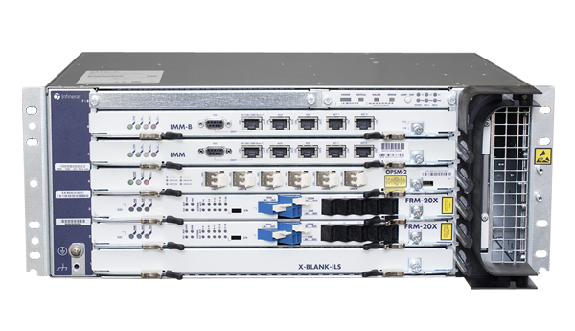
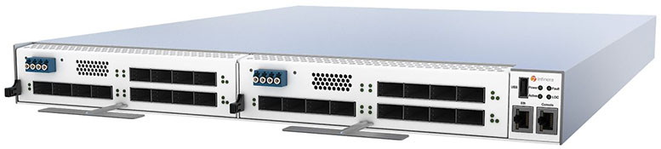
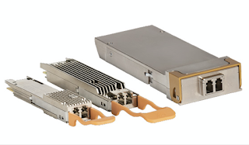
Data Center Interconnection (DCI)
Physical Elements of an optical DCI
Enabling Technologies
Optical Network (disaggregated model):
Open Optical Line System
  ROADM (Reconfigurable Optical Add/Drop Multiplexer)
  Amplifier
  Multiplexer/Demultiplexer
Transponder boxes (manageable with SMNP,gRPC) with:
  Optical interfaces on line side
  Packet interfaces (100/400G Ethernet) on LAN side
Pluggable coherent transceivers (For example ZR e ZR+) able to directly connect to DWDM line systems

Slide 40
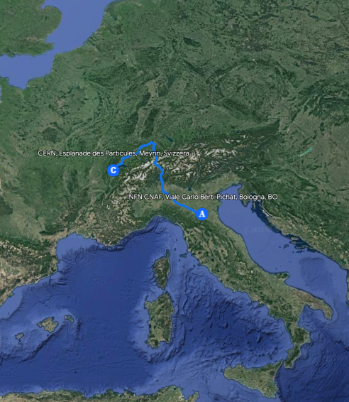





It has been proposed in WP7-T2 di GN4-3 (GEANT) a multi domain Spectrum Connection Service (SCS) that allows the creation of high speed “Optical Links” between sites belonging to different National Research Networks.
CERN-CNAF has been identified as a good use case (~1000 Km fiber distance)
DCI CERN-CNAF
Geneva
CERN DC
Bologna
CNAF DC
Nx100 G
or
Nx400 G
Nx100 G
or
Nx400 G
TRX
TRX
Add/Drop
Add/Drop
GEANT
Open Line System
ROADM
ROADM
GARR
Open Line System
8x AMP
3x AMP
Milan PoP

Slide 41
Current state of pilot DCI (CERN-CNAF)
1,6 Tbps potentially available today
Now:
Setup completed in both sites (CERN e CNAF).
We used a 16 QAM* /69 Gbaud with 100GHz spectrum for each channel on the distance of ~1000 km.
With this setup we can reach 400Gbps on every line port and having 2 CHM2T boards we already have 1.6Tbps using 400GHz that is the 10% of the whole C-Band extended frequency (4.8THz)
On client side we can have a CERN-CNAF connection using 16 100Gps or 4 400Gpbs ethernet ports.
We installed 2x100G servers @CNAF and 2x100Gservers@CERN to generate traffic (iperf3) to test the connection stability (~150Gbps)
Next steps:
We could connect a CERN switch as a local CNAF TOR switch or leaf or vice versa doing a true 1000km datacenter stretching
We will connect TIER1 switch/routers and CERN routers to route part of the OPN traffic to create pre-production transfers with the main goal of move all the OPN traffic on the new optical link.
*Quadrature Amplitude Modulation

Slide 42
Considerations
Direct connections with optical circuits have several advantages in terms of latency and costs but there is no resiliency because it’s an end-to-end circuit and there’s no automatic re-routing.
Backup connection are highly recommended considering that can occur up to 5 fibre-cut per year on 1000km links
 | Packet switching | Optical Circuit
Latency | Higher | Lower
Jitter | Higher | Lower
Capacity | Statistically muxed | Dedicated
Security | IP-address based | Almost for free
Scalability | Lower | Higher
Consumption | Higher | Lower
Provisioning | Days (if available) | Months
It’s not true if we are operating on an existing line system based on overprovisioned fiber circuits.

Slide 43
Next generation datacenter networks
(Special Thanks to Giancarlo Viola and Nino Ciurleo @GARR)

Slide 44
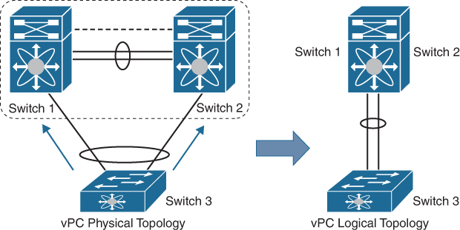
Datacenter Network Tier 1 @CNAF
Is based on CISCO Virtual Port Channel (aka MLAG VLT VLAG …) enables two switches (cores) to be one single L2 switch but not at L3 (they still be two different routers).
HSRP active-active guarantee the distributed routing

Slide 45
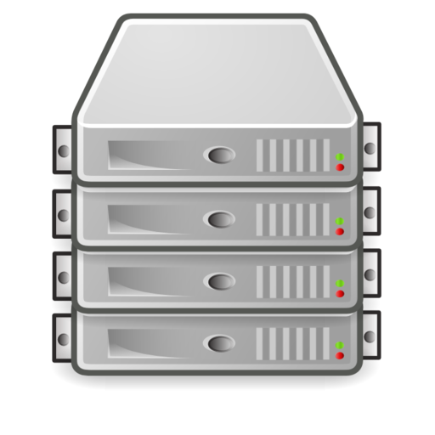
Tier1 @CNAF
CINECA
INFN CNAF
Licensed 8x100Gb (up to 12 x100Gb)
CX 1200
CX 1200
n. 1 dark fiber (16 Km)
8x100Gb (LACP port channel)
8x100Gb (LACP port channel)
VPC
NE 10032
NE 10032
INFN TIER1 transparent LAN Extension
RTT as in LAN: (0.4 ms)
0
Nexus 9516
Nexus 9516
VLAG
INFN T1
TOR
TOR
….
TOR
TOR
VPC
TOR
TOR
TOR
TOR
Local
Resources

Slide 46
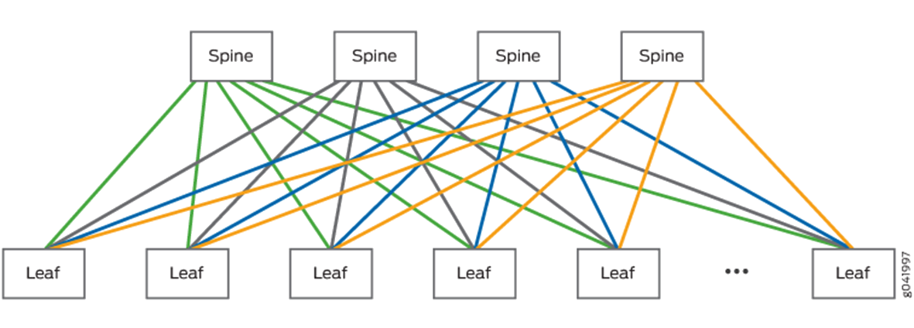

Spine – Leaf topology + IP Fabric
To scale out the Ethernet fabric limits (MLAG) and VLAN number IP Fabric can be implemented (is it worth it?)
Loop Free
Scalability
Redundancy
Flexibility
Distributed Routing
Expensive
High Complexity
More bandwidth
More resources

Slide 47
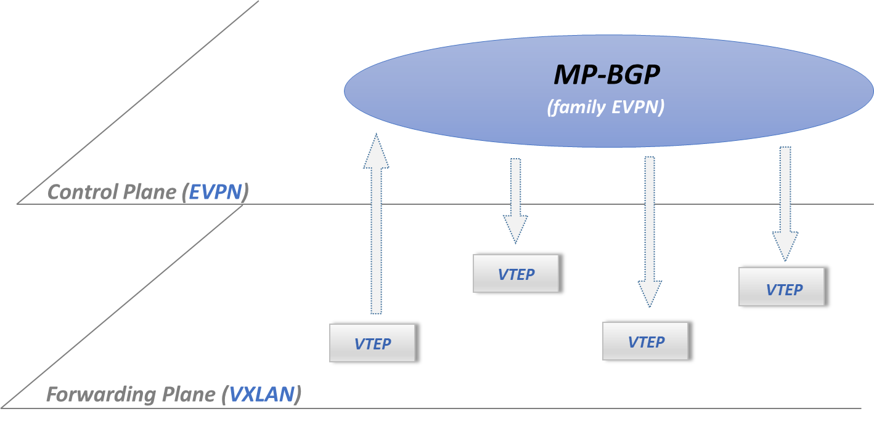
IP Fabric: WAN on LAN
IP fabric is based on WAN protocols applied to LAN and consists of two main building blocks
Underlay network
  The primary network that enables the IP reachability of network elements and where the services can be implemented
    IS-IS OSPF BGP
Overlay network
  The network that “simulates”
  the L2 layer on top the L3 underlay network
    Control Plane
      BGP + EVPN
      Mac learning -> Mac address routing
    Data Plane
      VXLAN

Slide 48
IP Fabric: Underlay
The best practice is to define a loopback interface on every network element involved in the IP fabric this interface identifies the network element.
Choose an IGP: Underlay network is can be based on IS-IS OSPF or BGP.
Build a full mesh using loopback interfaces
  for example, if you choose BGP you will have all to all (Point to Point) BGP sessions and every network device announces his own loopback.
LoopbackS1
LoopbackS2
LoopbackS3
LoopbackS4
LoopbackL1
LoopbackL2
LoopbackL3
LoopbackL4
LoopbackL5
Loopback LN

Slide 49
IP Fabric: Underlay
show ip route vrf default
B I 10.1.20.1/32 [200/0] via 192.168.108.131, Ethernet45
via 192.168.108.133, Ethernet46
B I 10.1.20.2/32 [200/0] via 192.168.108.131, Ethernet45
via 192.168.108.133, Ethernet46
B I 10.1.20.3/32 [200/0] via 192.168.108.131, Ethernet45
via 192.168.108.133, Ethernet46
B I 10.1.20.4/32 [200/0] via 192.168.108.131, Ethernet45
via 192.168.108.133, Ethernet46
B I 10.1.20.5/32 [200/0] via 192.168.108.131, Ethernet45
via 192.168.108.133, Ethernet46
B I 10.1.20.6/32 [200/0] via 192.168.108.131, Ethernet45
via 192.168.108.133, Ethernet46

Slide 50
IP Fabric: Underlay
BGP summary information for VRF default
Router identifier 10.8.20.3, local AS number 64743
Neighbor AS Session State AFI/SAFI AFI/SAFI State NLRI Rcd NLRI Acc
---------- ----------- ------------- -------------- ----------- ---------- ----------
10.8.20.64 64743 Established IPv4 Unicast Negotiated 98 98
10.8.20.64 64743 Established IPv6 Unicast Advertised 0 0
10.8.20.64 64743 Established L2VPN EVPN Negotiated 6775 6775
10.8.20.65 64743 Established IPv4 Unicast Negotiated 98 98
10.8.20.65 64743 Established IPv6 Unicast Advertised 0 0
10.8.20.65 64743 Established L2VPN EVPN Negotiated 6775 6775

Slide 51
Overlay Network the Control Plane
The control plane is implemented by BGP adding EVPN family that is a BGP extension that enables the distribution MAC addresses, Ips and more…
Via specific BGP announcements hosts belonging to the same LAN can communicate each others in a “simulated” layer2
ARP suppression (BUM traffic reduction)
Distributed default gateway
Datacenter Stretching (can be implemented geographically)

Slide 52
Overlay Network the Data Plane
The data plane is implemented by Virtual eXtensible LAN (VXLAN) that is is a mechanism where Ethernet Frames are encapsulated inside UDP packets and sent through the overlay network a tunnel established on the underlay network. This is also called MAC-In-UDP and is implemented by a VXLAN Tunnel Endpoint (VTEP).
Ethernet over UDP
UDP (port 4789)
Ethernet over UDP
Ethernet
Ethernet
VLAN 100
VLAN 100
h1
h2

Slide 53
VXLAN Tunnel Endpoint (VTEP)
VXLAN Tunnel Endpoint (VTEP)
A VTEP is a function implemented on a network device (or hypervisor) via software or dedicated hardware (ASIC)
Encapsulates/de-encapslutates Ethernet frames in UDP (MAC-in-UDP) packets
Manages the FIB MAC - VNI - destination VTEP or port
UDP
UDP
VTEP
VTEP
IP interface
Network side
(IP that identifies the VTEP
on the network)
Ethernet
Local Port
Ethernet
VLAN 100
LAN side
VLAN 100
(Traditional forwarding)
h1
h1

Slide 54
Mac table example
show mac address-table
Mac Address Table
------------------------------------------------------------------
Vlan Mac Address Type Ports Moves Last Move
---- ----------- ---- ----- ----- ---------
1199 807f.f854.e21c DYNAMIC Vx1 0 6 days, 15:59:43 ago
1199 968e.d343.0f64 DYNAMIC Vx1 0 6 days, 15:59:43 ago
1199 968e.d343.2b94 DYNAMIC Vx1 0 6 days, 15:59:45 ago
1199 968e.d343.3e7a DYNAMIC Vx1 0 6 days, 15:59:43 ago
1199 968e.d343.9bb0 DYNAMIC Vx1 0 6 days, 15:59:44 ago
1199 968e.d343.a82e DYNAMIC Vx1 0 6 days, 15:59:44 ago
1199 968e.d343.b646 DYNAMIC Vx1 0 6 days, 15:59:44 ago
1199 968e.d343.beec DYNAMIC Vx1 0 2 days, 22:48:29 ago
1699 0000.0000.0001 STATIC Router
1699 0050.5682.3b65 DYNAMIC Et16 2 9 days, 13:31:26 ago
1699 0050.5682.5607 DYNAMIC Po47 2 9 days, 15:07:59 ago

Slide 55
VXLAN table example
show vxlan address-table
Vxlan Mac Address Table
----------------------------------------------------------------------
VLAN Mac Address Type Prt VTEP Moves Last Move
---- ----------- ---- --- ---- ----- ---------
1182 4c73.4f20.7820 EVPN Vx1 10.8.20.64 6 days, 16:05:03 ago
1182 4c73.4f23.7020 EVPN Vx1 10.8.20.65 6 days, 16:04:59 ago
1182 968e.d343.a82e EVPN Vx1 10.4.30.5 6 days, 15:59:59 ago
1182 968e.d343.b646 EVPN Vx1 10.4.30.7 6 days, 15:59:58 ago
1182 968e.d343.beec EVPN Vx1 10.4.30.3 6 days, 15:59:59 ago
1187 4c73.4f21.e820 EVPN Vx1 10.4.20.65 6 days, 15:59:57 ago
1187 807f.f854.e21c EVPN Vx1 10.4.20.64 6 days, 15:59:57 ago
1187 968e.d343.a82e EVPN Vx1 10.4.30.5 6 days, 15:59:59 ago
1187 968e.d343.b646 EVPN Vx1 10.4.30.7 6 days, 15:59:59 ago
1187 968e.d343.beec EVPN Vx1 10.4.30.3 6 days, 15:59:59 ago

Slide 56
IP Fabric: Overlay
show ip route vrf l3vpn-infra-site2site
B I 10.1.56.5/32 [200/0] via VTEP 10.1.30.5 VNI 123 router-mac 96:8e:d3:43:9b:b0
B I 10.1.56.6/32 [200/0] via VTEP 10.2.30.3 VNI 123 router-mac 96:8e:d3:43:2b:94
B I 10.1.56.7/32 [200/0] via VTEP 10.3.30.3 VNI 123 router-mac 96:8e:d3:43:0f:64
B I 10.1.56.8/32 [200/0] via VTEP 10.1.30.5 VNI 123 router-mac 96:8e:d3:43:9b:b0
B I 10.1.56.9/32 [200/0] via VTEP 10.1.30.5 VNI 123 router-mac 96:8e:d3:43:9b:b0
B I 10.1.56.0/24 [200/0] via VTEP 10.2.30.3 VNI 123 router-mac 96:8e:d3:43:2b:94
via VTEP 10.1.30.5 VNI 123 router-mac 96:8e:d3:43:9b:b0
via VTEP 10.3.30.3 VNI 123 router-mac 96:8e:d3:43:0f:64
via VTEP 10.1.30.3 VNI 123 router-mac 96:8e:d3:43:3e:7a
B I 10.1.100.0/24 [200/0] via VTEP 10.8.20.64 VNI 123 router-mac 4c:73:4f:20:78:20
via VTEP 10.8.20.65 VNI 123 router-mac 4c:73:4f:23:70:20
B I 10.2.5.0/24 [200/0] via VTEP 10.8.20.64 VNI 123 router-mac 4c:73:4f:20:78:20
via VTEP 10.8.20.65 VNI 123 router-mac 4c:73:4f:23:70:20

Slide 57
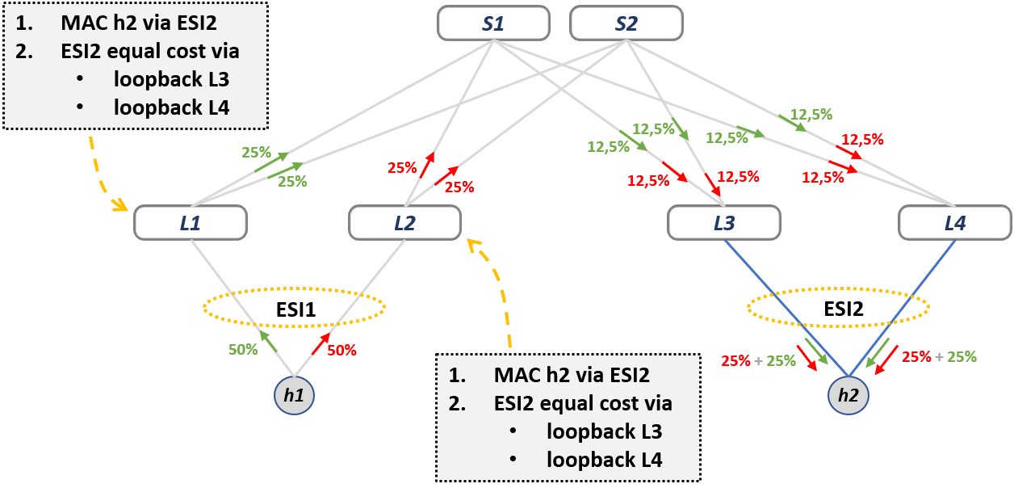
IP Fabric: ESI Load Balancing
For Dual Homed hosts with normal LAG (LACP) EVPN uses the Ethernet Segment Identifier on routers
LAG1
LAG2

Slide 58
Orchestration and Automation
Network devices can be configured via API
To configure and manage a big and complex network, some vendor has implemented his own “orchestrator”. (e.g., Arista Cloud Vision) that “masquerade” the complexity.
It is possible to automate deployment and configuration with Zero Touch Provisioning (ZTP) and for example Ansible.
This interaction can be with the orchestrator (e.g., cloud vision) or directly with network devices

Slide 59
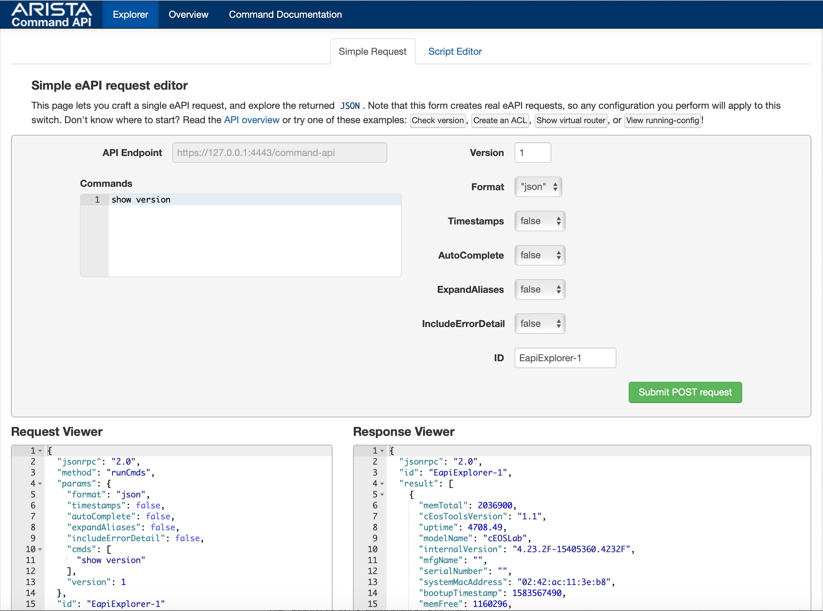
Arista switch API example

Slide 60
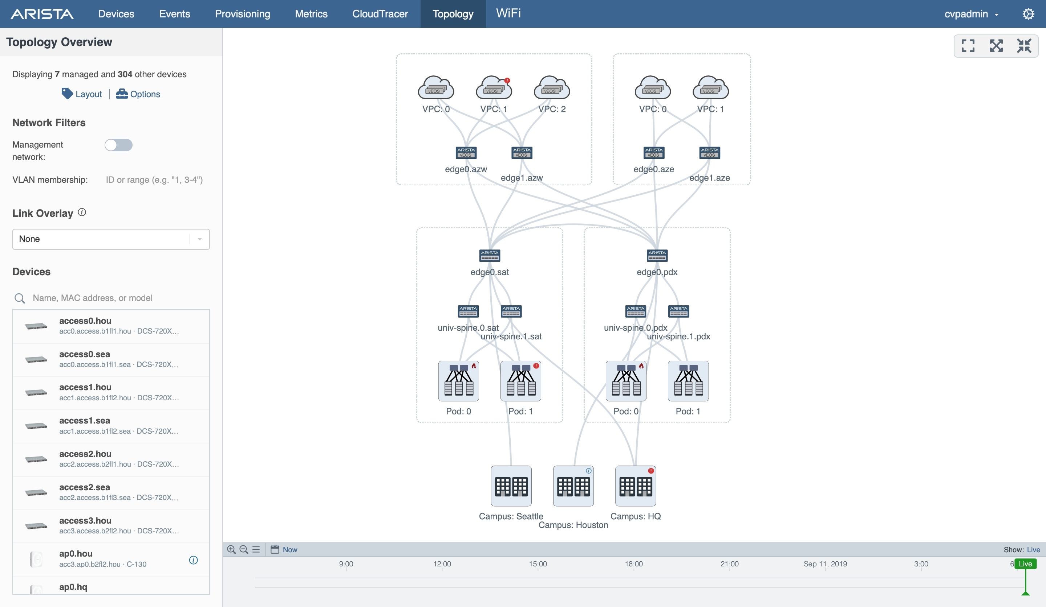
Arista Cloud Vision example

Slide 61
