Slide 1
Corso reti per neo assunti (PNRR)
Netgroup

Slide 2
Introduction
This course is thought as an introduction on networking themes.
It will focus on the general concepts of networking
  Main protocols
  Network Devices
  Network Services
  Common configurations
  Best practices

Slide 3
ISO/OSI Model

Slide 4
ISO/OSI Model
The OSI model (an acronym for Open Systems Interconnection, also known as the ISO/OSI model) is a standard established in 1984 by the International Organization for Standardization (ISO) as a conceptual framework that describes how network communication should occur. It is a layered model that defines a set of protocols and standards for communication between devices on a network.
The ISO/OSI model consists of seven layers, each of which is responsible for a specific aspect of network communication. The layers are as follows.
The ISO/OSI model is a conceptual framework, meaning that it does not specify the exact protocols or technologies that should be used at each layer. Instead, it provides a guide for the development of networking standards and protocols. Different networking technologies, such as Ethernet or TCP/IP, implement the ISO/OSI model in different ways, but the general principles of the model remain the same.

Slide 5
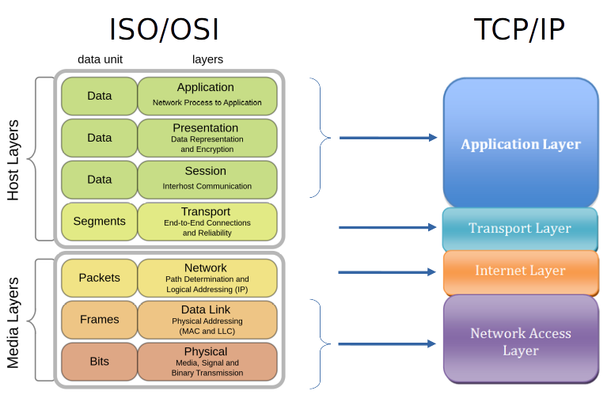
ISO/OSI Model vs TCP/IP Model

Slide 6
Physical layer (1)
The Physical layer is the lowest layer in the ISO/OSI model and is responsible for transmitting raw data bits over a physical medium, such as copper or fiber optic cables, the voltage levels used to transmit data, and the frequency of the signal.
It provides the physical and electrical interface between the network device and the transmission medium.
It is responsible for encoding and decoding data, as well as converting digital signals to analog signals and vice versa.
It is also responsible for maintaining the quality of the signal as it is transmitted over the network, by amplifying or repeating the signal as needed.

Slide 7
Data link layer (2)
The Data Link layer is the second layer in the ISO/OSI model and provides a reliable, error-free transfer of data between adjacent network devices over a physical medium, such as a cable.
The Data Link layer provides the following services.
  Framing: The Data Link layer frames the data into packets for transmission over the physical medium. It adds a header and trailer to the data to create a frame and includes information such as the source and destination MAC addresses, frame type, and error checking information.
  Flow control: The Data Link layer controls the flow of data between network devices to prevent data loss or congestion. It uses techniques such as windowing or buffering to ensure that data is transmitted at an appropriate rate.
  Error detection and correction: The Data Link layer detects and corrects errors that may occur during transmission. It uses techniques such as cyclic redundancy checking (CRC) to detect errors, and retransmission of lost packets to correct errors.
  Access control: The Data Link layer controls access to the physical medium, preventing multiple devices from transmitting at the same time and causing collisions. It uses techniques such as Carrier Sense Multiple Access with Collision Detection (CSMA/CD) or Carrier Sense Multiple Access with Collision Avoidance (CSMA/CA) to coordinate access to the medium.
  Addressing: The Data Link layer uses MAC addresses to identify devices on the network. MAC addresses are unique identifiers assigned to each network interface and are used by the Data Link layer to transmit data between devices.
The Data Link layer and Physical layer of the ISO/OSI model are roughly equivalent to the Network Access layer of the TCP/IP model.

Slide 8
Network layer (3)
The Network layer is the third layer in the ISO/OSI model and provides logical addressing and routing of data between different networks. It is responsible for delivering data between end devices, regardless of their physical location in the network.
The Network layer provides the following services.
  Logical addressing: Network layer uses logical addressing to identify devices on the network. IP addresses are commonly used for logical addressing in the Internet Protocol (IP) suite. Logical addressing provides a hierarchical structure that allows efficient routing of data across large networks.
  Routing: Network layer is responsible for selecting the best path using static or dynamic routing protocols for data to travel between devices on different networks. Typical Routing protocols are: RIP (Routing Information Protocol), OSPF (Open Shortest Path First) and BGP (Border Gateway Protocol).
  Fragmentation and reassembly: Network layer can fragment (and finally reassemble) large packets into smaller ones for transmission over networks with smaller Maximum Transmission Units (MTUs).
  Quality of Service (QoS): Network layer can provide QoS by prioritizing certain types of traffic, for example, real-time traffic such as voice or video.
  Error detection and handling: Network layer can detect and handle errors that may occur during transmission. It uses protocols such as Internet Control Message Protocol (ICMP) to detect errors and notify the sender or receiver of them.
The ISO/OSI Network layer is roughly equivalent to the Internet layer in the TCP/IP model.

Slide 9
Transport layer (4)
The Transport layer is the fourth layer in the ISO/OSI model and is responsible for providing reliable end-to-end communication between applications running on different devices. The Transport layer provides the following services.
  Connection-oriented communication: the Transport layer provides a connection-oriented communication mode, in which a connection is established between the sender and receiver before data transmission can begin.
  Connectionless communication: the Transport layer also provides a connectionless communication mode, in which data is transmitted without a connection being established between the sender and receiver. This mode is useful for applications that require low overhead and do not require reliability guarantees.
  Flow control: the Transport layer controls the flow of data between devices to prevent data loss or congestion. It uses techniques such as windowing or buffering to ensure that data is transmitted at an appropriate rate.
  Error recovery: the Transport layer provides error recovery mechanisms to ensure that data is transmitted accurately and completely. It uses techniques such as acknowledgement, retransmission, and error correction to recover from errors.
  Multiplexing and demultiplexing: the Transport layer can support multiple applications running on a single device, and can multiplex or demultiplex data from different applications to ensure that the data is delivered to the correct application.
The TCP/IP Transport layer is roughly equivalent to the ISO/OSI Transport layer.
The Transport layer is implemented in two main protocols: the Transmission Control Protocol (TCP) and the User Datagram Protocol (UDP). TCP provides connection-oriented communication and reliable delivery of data, while UDP provides connectionless communication and is useful for applications that require low overhead and do not require reliability guarantees.

Slide 10
Session (5) and Presentation(6) layer
The Session layer provides a mechanism for applications to communicate and exchange data in a structured and organized way and provides the following services: Session establishment, Session management and Session termination.
The Presentation layer is the sixth layer in the ISO/OSI model, and it is responsible for managing the way data is presented to the Application layer and performs the following functions: Translation, Encryption, compression and formatting.
The ISO/OSI Session and Presentation layers are included in the TCP/IP Application layer

Slide 11
Application layer (7)
The Application layer is the seventh and topmost layer in the ISO/OSI model, and it is responsible for providing a user interface to access network services. The Application layer interacts directly with the end user or application and provides high-level services such as file transfer, email, remote login, and web browsing.
It also provides protocols for applications to exchange data with each other, such as the Simple Mail Transfer Protocol (SMTP) for email, or the Hypertext Transfer Protocol (HTTP) for web browsing.

Slide 12
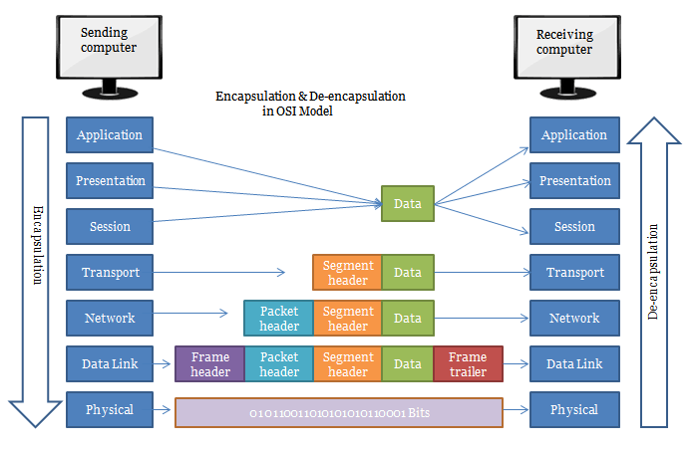
Encapsulation
Packet encapsulation is the process of adding headers and trailers to a packet as it travels through the layers of the network protocol stack. Each layer in the protocol stack adds its own header and trailer to the data, forming a new encapsulated packet that is sent to the next layer in the stack.
When the packet is received by the receiving device, the headers and trailers are removed in the reverse order. The receiving device uses the information in the headers to route the packet to its intended destination, and the data payload is passed up from physical to application layer.
With this workflow, different network devices communicate each other using its own level headers and trailers

Slide 13
ETHERNET

Slide 14
Ethernet History
Ethernet starts as a collaboration between DEC/Intel/Xerox and was standardized in 1978 and few years later the IEEE 802.3 standard was published.
The protocol allow a data communication on a shared medium and constitutes an implementation of the CSMA/CD protocol (Data Link Layer).
First version of Ethernet protocol specified a speed of 10/100 Mbps, followed by 1/10/25/40/50/100/400 Gbps

Slide 15
Ethernet and ISO/OSI model
IEEE 802.3 defines both the physical layer and the datalink layer ( LLC and MAC)
The naming convention of the physical layer specify the transmission speed, the frequency range of the band (base, broad, pass) and the transmission medium (T = twisted pair, -T1 = single-pair twisted pair, S = 850 nm short wavelength on fiber, etc.).
  Ex.: 10GbaseT = 10 Gbps in baseband on UTP copper cable
The datalink layer has two sublayers:
  MAC (Media Access Control): different for each type of physical layer. Determines the access modes to the medium
  LLC (Logical Link Control): provides a common interface to the higher layers

Slide 16
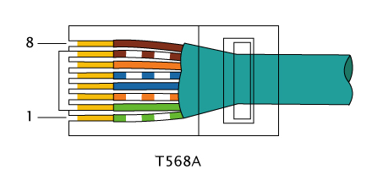

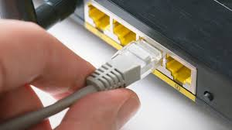
Physical layer example: BaseT
Wiring that uses copper pairs
Each station is connected via a UTP cable (cat. 5e or higher for 1Gbs) to a multi-port device (HUB or Switch)
Use of RJ45 connectors
Data transmission for 10/100Mbps on two pairs (pin 1-2 and 3-6) and for higher speed all pairs are used.

Slide 17
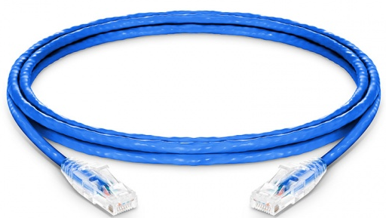
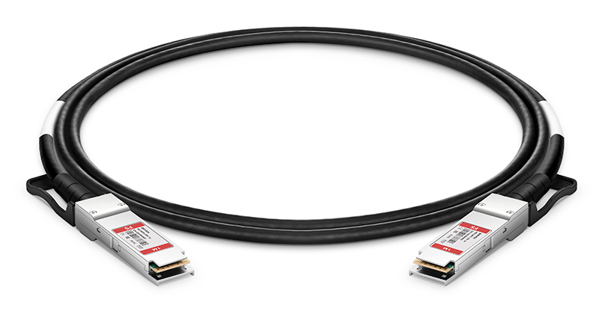
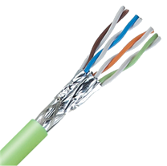
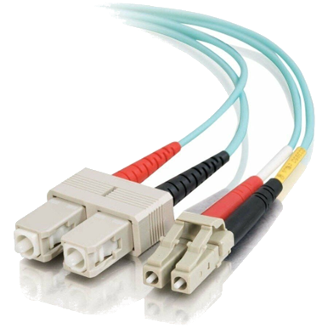
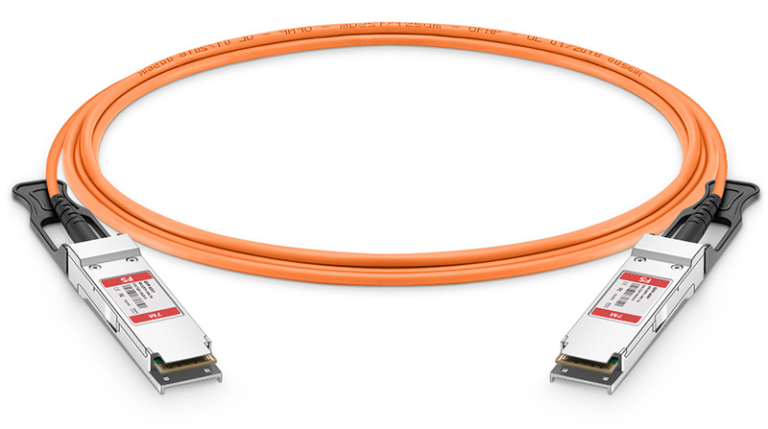
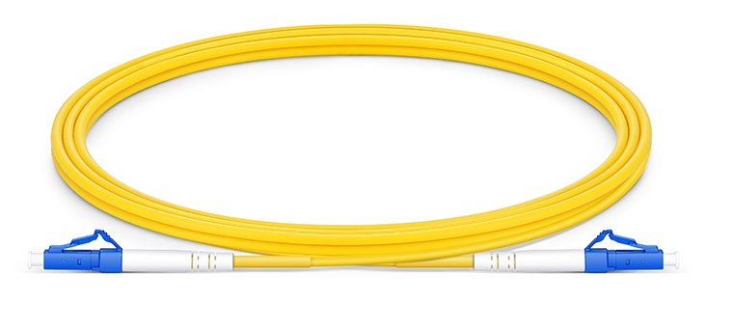
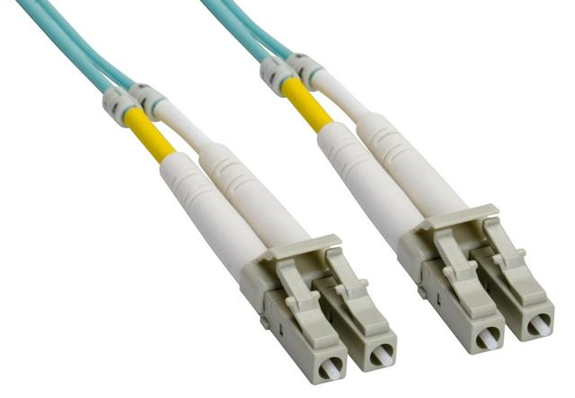
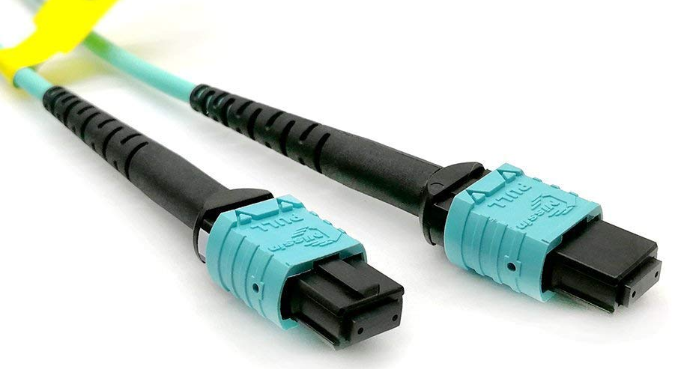
Some cables
COPPER
Direct Attached Copper (DAC)
Active Optical Cable (AOC)
Active Optical Cable
Single mode Fiber with LC connectors
Multimode Fiber with LC SC connectors
Multimode Fiber with MPO connectors
FIBER

Slide 18
The Media Access Control
The MAC manages the shared access to the transmission medium and the possible presence of collisions (simultaneous accesses) using the CSMA/CD technique
  The station that has to transmit, waits and listens on the medium
  if it finds the medium free, it transmits immediately
  if it finds the medium busy, it stays listening, and as soon as it frees up it transmits
During transmission, the station stays listening, in order to detect a possible collision; in case of collision the station transmits a short invalid sequence, then terminates the transmission of the frame immediately
the contention phase starts, regulated by a mechanism called binary exponential backoff

Slide 19
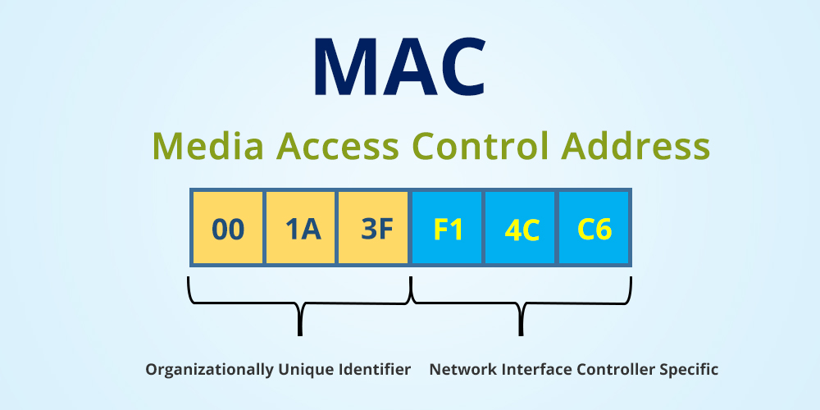
The MAC address
Each Ethernet connected devices must be equipped with a network card NIC (Network Interface Card) which is identified by a worldwide unique MAC Address
The address (MAC address) consists of 6 bytes.
  The first 3 octets are called OUI (Organizationally Unique Identifier) and refer to the manufacturer, the others are an identifier of the single card

Slide 20
The transmission
The Protocol Data Unit (PDU) of the datalink layer is called frame and allows to separate the data flow into smaller and more easily manageable units
Depending on the network topology, a frame sent by a NIC (Network Interface Card) should directly reach another device or be retransmitted by intermediate devices :
  HUB: device with multiple interfaces that acts as a repeater on each network connection
  SWITCH: device that maintains a mapping between destination addresses and ethernet ports
Normally a NIC accepts only frames sent to its MAC address. It is possible to force it to allow every frame transmitted on the medium, putting it in promiscuous mode.

Slide 21
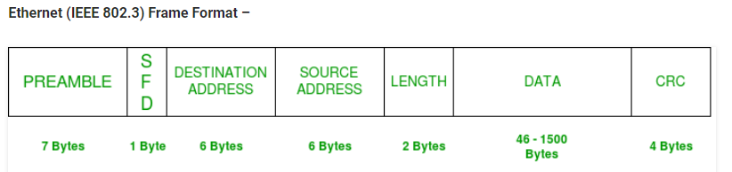
The frame
The frame begins with a "preamble" of 8 bytes with sequence 10101010
The last byte of the preamble is a "start of frame" byte with value of 10101011
Two fields contain to the destination address and source address of the frame
The "length" field contains the length of the data field expressed in octets
  The default size of the data field (MTU) is 1500 bytes. Sometimes applications performs better with larger MTUs, and 9000 bytes is the default for jumbo frames.

Slide 22
The Cyclic Redundancy Check (CRC)
The last field is dedicated to the checksum, realized by a 32-bit CRC code
The field is used only to identify any data corruption and discard bad frames
Protocols at higher level are in charge to retransmit any missing packets

Slide 23
VLAN 802.1q
A VLAN is a logical grouping of devices on a network, usually based on function or department, that allows network administrators to control network traffic and improve network performance and security.
The 802.1q is a standard protocol that defines how VLAN information is carried over Ethernet networks. It adds a 4-byte VLAN tag to Ethernet frames, which allows switches and other network devices to identify the VLAN to which the frame belongs
VLANs can improve network performance and security by reducing the amount of broadcast traffic on the network, enabling network administrators to apply security policies to specific VLANs, and allowing different VLANs to have different Quality of Service (QoS) policies to prioritize different types of traffic.
Switches use the VLAN tag to forward traffic between VLANs. They maintain a VLAN database that maps VLAN IDs to physical switch ports and use this information to route traffic between VLANs based on the VLAN ID in the frame's VLAN tag.

Slide 24
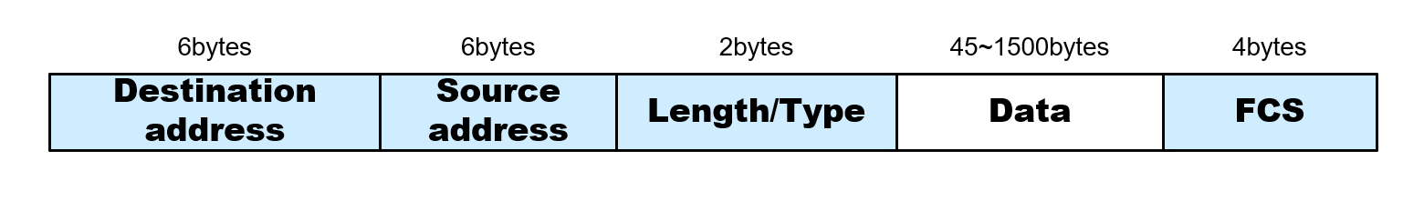
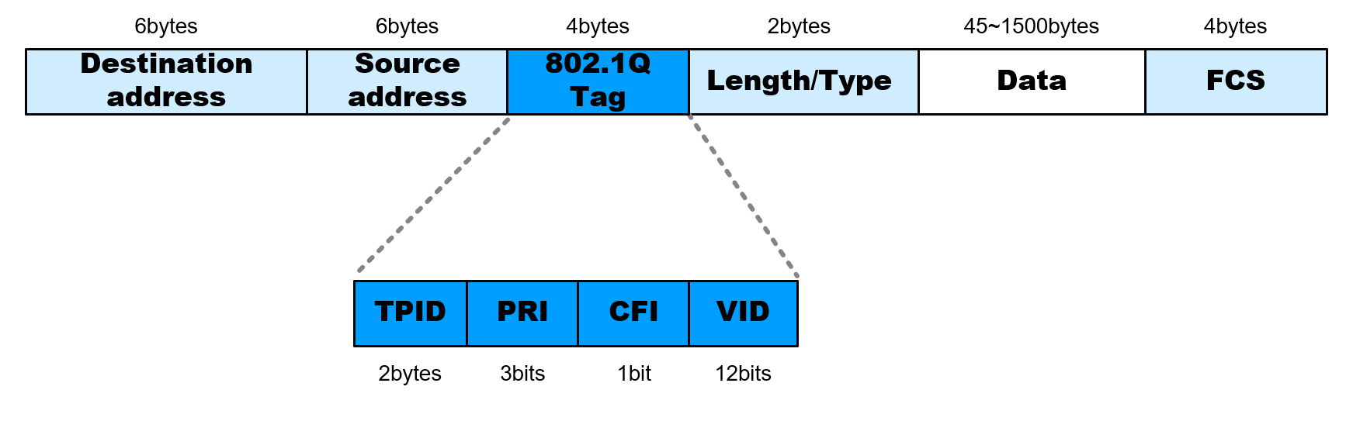
VLAN tagging
The VLAN tag consists of a 12-bit priority field, a 3-bit drop eligibility indicator, and a 16-bit VLAN ID field.
An Ethernet frame is encapsulated with the Length/Type
field for an upper-layer protocol following the Destination
address and Source address fields.
IEEE 802.1Q adds a 4-byte field between the Source address
and the Length/Type fields of the original frame.

Slide 25
Link Aggregation Group (LAG)
It is the aggregation of ports on a device. It can improve some aspects of transmission:
Increase in bandwidth: the transfer speed of a LAG can reach the sum of the speeds of the individual ports
Fault tolerance: the disconnection of a single link does not compromise the functionality of the LAG
Traffic balancing: the LAG can be configured to route different packets through different ports of the aggregation, depending on the characteristics of the packet

Slide 26
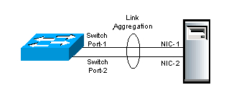
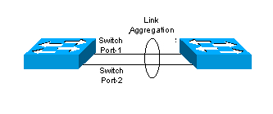
Link Aggregation - dictionary
LA - Link Aggregation: the combination of multiple physical links that work as if they were one. The standard that regulates LA is IEEE 802.3ad
  Synonyms: trunking, bundling, bonding, port-channeling, teaming.
LAG - Link Aggregation Group: a group of links that forms an aggregation. Each port of a switch can be part of a single LAG
LACP – Link Aggregation Control Protocol: the protocol that declares the standard for the automatic configuration of a LAG (IEEE 802.3ad-2000)

Slide 27
Frame distribution and LACP
Data transmission through a LAG occurs by distributing the individual frames on the available ports.
Generally, the distribution algorithms use a hash calculated on combinations of data included in the frame headers, at one or more levels of the stack:
  L2, e.g.: destination mac address and/or source mac address
  L3, e.g.: source IP address and/or destination IP address
  L4, e.g.: source port and/or destination port
Static LAG:
  Both devices will be manually configured with the same parameters and the same number of ports
Dynamic LAG:
  Through the activation of the LACP protocol
LACP: the operating principle consists in sending LACP packets to the partner equipment, directly connected and configured to use LACP.
The LACP mechanism will allow to identify if the equipment in front supports LACP and will group the ports configured similarly (speed, duplex mode, VLAN, trunk vlan, etc.)

Slide 28
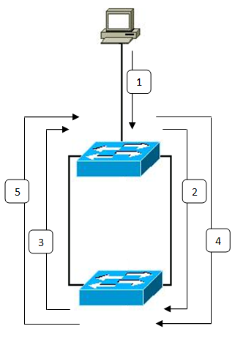
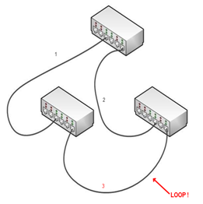
Avoiding ethernet switching loop
A network loop occurs when a network has more than one active path that carries information from the same source to the same destination
It can give rise to a broadcast storm that damages LAN availability:
  The host sends a broadcast message on the network
  The first switch analyzes the packet received and forwards it to the lower part of the network
  The second switch receives the copy of the packet and operates accordingly as the first switch, forwarding it to the upper part of the network
  Since the packet is of broadcast type, the switches always repeat it on all ports excluding the port from which it arrived. The cycle is thus destined to continue indefinitely.

Slide 29
Spanning Tree Protocol (802.1d)
The 802.1d standard defines a protocol through which it is possible to realize a redundant topology avoiding ethernet loops.
The switches communicate each other to elect the root spanning tree node which collects data and reconstructs the network topology.
Based on the topology, one or more links of the LAN are identified and dynamically disabled in order to remove circular paths.
The disabled links can be automatically re-enabled in the event of problems that generate a network partition, in order to regain connectivity
STP can be implemented at VLAN level

Slide 30
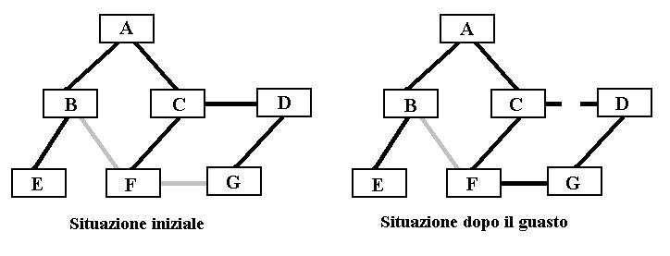
Spanning tree example
Initially, the spanning tree protocol disables the links between switches B-F and F-G
The failure of the C-D link makes D and G unreachable
The activation of the F-G link restores connectivity to both switches without introducing circular paths that would give rise to a switching loop
Before
After

Slide 31
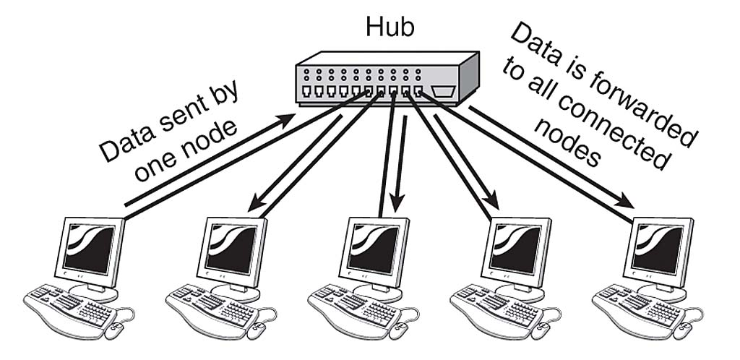
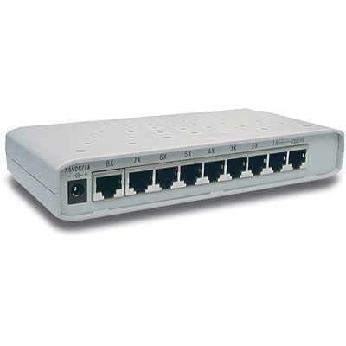
Hub
A hub is a simple network device (physical layer) that connects multiple devices together within a local area network. It broadcasts all network traffic to all ports and consequently to all connected devices, which can lead to network congestion and reduced performance. Hubs are generally not suitable for larger networks or networks that require high performance because they do not provide dedicated bandwidth to each connected device and can cause unnecessary network traffic.

Slide 32
Switch
SWITCH
A network switch commonly operates at the Data Link layer of the ISO/OSI model, uses MAC address to identify different network devices and provides a way for devices to communicate with each other.
Data forwarded
only to
destination
Data sent by
one node
When a data packet arrives at a switch, the switch reads the destination address in the packet's header and forwards the packet to the appropriate port that connects to the destination device.
When a switch receives a data packet, it examines the source MAC address in the packet's header and stores this address along with the port number that the packet was received on in its MAC address table. The switch then forwards the packet to the appropriate port based on the destination MAC address in the packet's header.
If the switch receives a packet with a destination MAC address that is not in its MAC address table, it will broadcast the packet to all ports on the switch except the port that received the packet. This process is known as flooding, and it is used to ensure that the packet reaches its intended destination device. When the destination device responds, the switch adds the device's MAC address to its MAC address table so that future packets can be forwarded directly to the device.

Slide 33
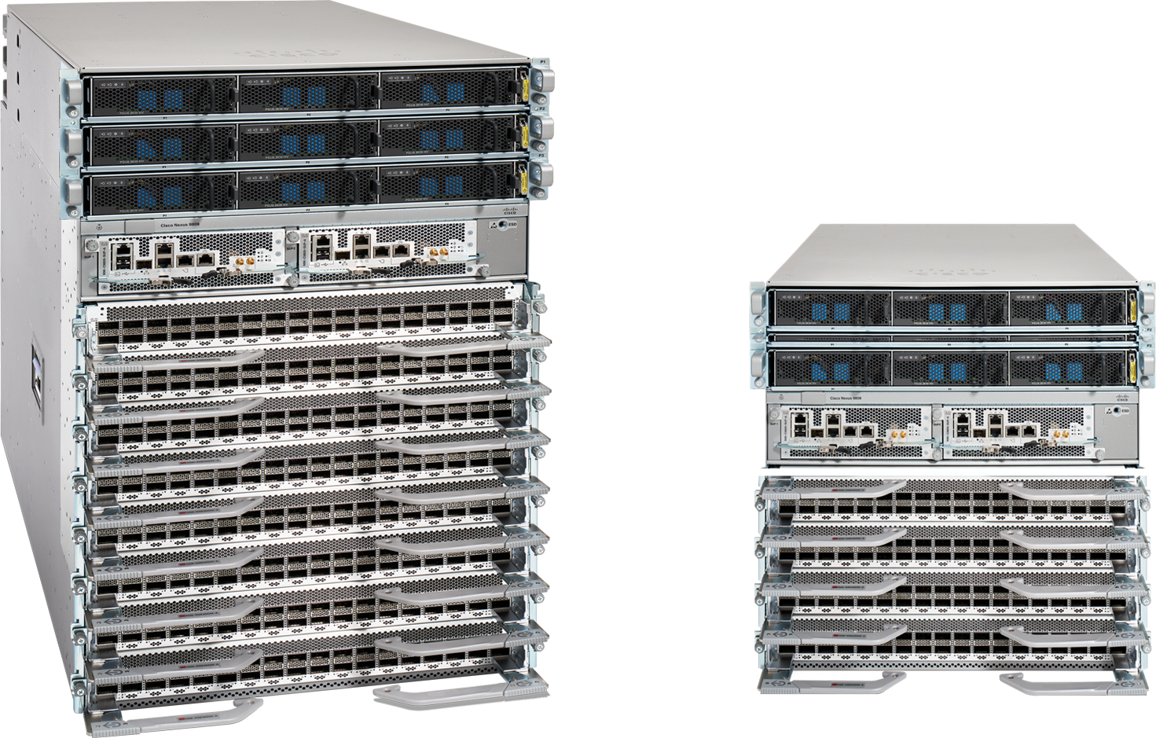
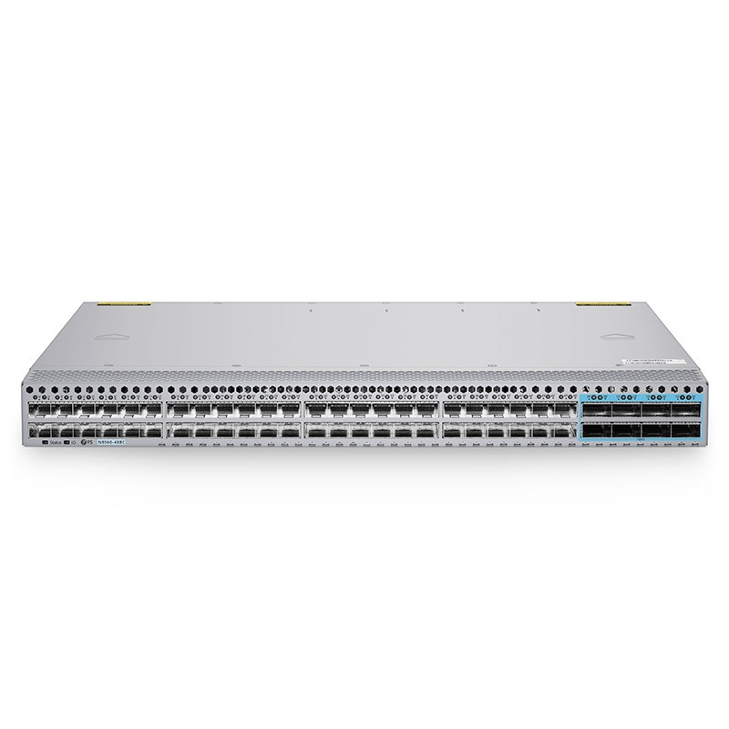
Switch
There are several types of switches: 1U stand alone and modular switches. layer 2 and layer 3 switches.
Characterized by the aggregate throughput and by the speed of the interfaces from 1 Gbps to 400 Gbps
Layer3 switches can operate at the Network layer of the ISO/OSI model and provide advanced routing and filtering capabilities.
Switches now can support advanced features such as quality of service (QoS), virtual LANs (VLANs
Modern L3 switches can operate a routers including dynamic routing protocols like OSPF and BGP and supports and overlay protocols such as EVPN VXLAN.

Slide 34
MAC address Table example
vlan mac address type learn age ports
------+----------------+--------+-----+----------+--------------
* 126 001e.791d.0400 static No - Router
* 2048 ccc5.e5f8.cd47 dynamic Yes 5 Po1
* 8 a078.175b.dbec dynamic Yes 15 Gi3/37
* 6 0050.b625.e946 dynamic Yes 0 Gi8/40
* 1052 dcf4.012c.3a4d dynamic Yes 120 Po1
* 4 88ae.dd59.ced4 dynamic Yes 0 Po20
* 6 001a.4aa8.3107 dynamic Yes 190 Po1
* 6 482a.e373.0c06 dynamic Yes 0 Gi3/13
* 2048 ccc5.e5f8.d3b6 dynamic Yes 0 Po1
* 1 44d9.e7fc.b1ae dynamic Yes 0 Gi3/12

Slide 35
Internet Protocol

Slide 36
Internet Protocol addressing: why ?
The IP project had one main goal: to allow hosts interconnected by any Local Area Network protocol to talk to each other.
This required at least a global scheme for identifying/addressing each host.
We'll be covering the two versions of the IP protocols in use (v4 and v6) in parallel, as the semantics is the same.

Slide 37
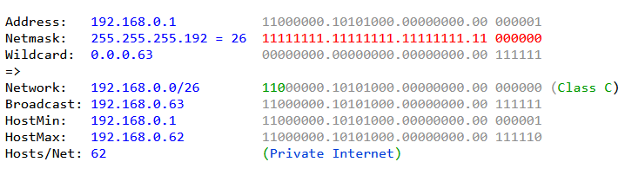
Internet Protocol IPv4 addressing
The IP address is divided into a network part (fixed) and a host part (variable), which determines the group of hosts belonging to the same network and the number of possible hosts in that network.
The netmask identifies which part of the IP belongs to network or host
The same for IPv6 but 128-bit long

Slide 38
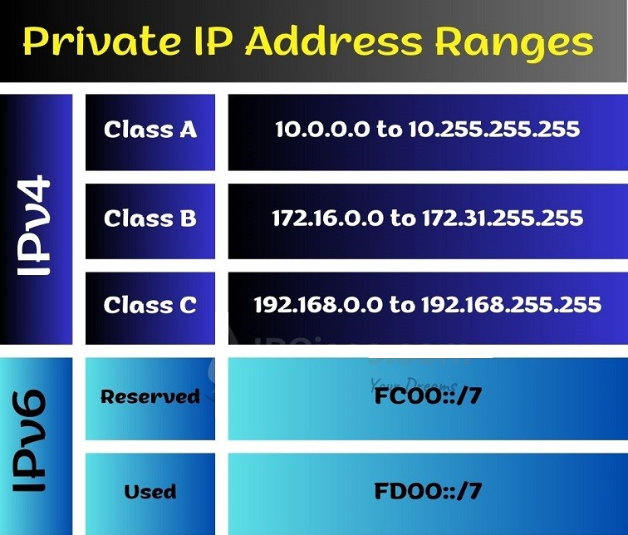
Private IP Address ranges
Private IP networks are local networks that use reserved IP addresses that are not routable on the Internet
Private IP networks have the advantage of reducing the requests for public IP addresses

Slide 39
Address notation
IPv4 | IPv6
A 32-bit number is used to identify a host globally. Notation: dotted quad (4 bytes in decimal format, separated by dots): 192.167.140.123 - 127.0.0.1 | A 128-bit number is used to identify a host globally Notation: 8 16-bit words in hexadecimal format, separated by colons. A double colon represents one contiguous range of zero bits: 2001:0760:4206:baba:cafe:f00d:0000:0001 == 2001:760:4206:baba:cafe:f00d::1 - ::1
Hosts that communicate to each other directly (no routing needed) are said to belong to the same subnet and share a leading address prefix. Bit count format: 192.167.140.123/24 Or Subnet mask: 255.255.255.0 | The same goes for IPv6, but the subnet mask format would be too clumsy and was dropped: 2001:0760:4206:baba::/64 /64 subnets are the most frequently used for IPv6 – almost a default.
IP addresses that circulate globally must be unique => their assignment has to be managed. A host can be configured with any number (and any 6/4 combination) of addresses assigned to it. A global Domain Name resolution Service exists, that can translate both styles of addressed to and from a human-readable names. More on this later.

Slide 40
Address assignment
IPv4 | IPv6
Manual address assignment is always an option!
'Zero configuration' protocols can automatically assign a link-local address (in the 169.254.0.0/16 subnet). | A link-local address in the fe80::/10 subnet is always automatically assigned to any IP-enabled interface.
DHCPv4 (Dynamic Host Configuration Protocol): a request is broadcast on the local network – where the requesting host is usually identified by its Ethernet address. A server then replies with address assignment and other config info. | DHCPv6: almost the same, except that the host and interface issuing the request are identified by unique DUID and IAID numbers. The Ethernet address of the interface may be used to generate the DUID, but this can also be randomized for privacy.
 | Stateless autoconfiguration (SLAAC): the non-subnet (least significant) part of the public address is assigned automatically by the host using a unique ID known to the host. Usually the DUID (see above).

Slide 41
ARP and Neighbor Discovery
Hosts are only able to communicate via their local LAN protocol (e.g., Ethernet). Some mechanism to translate destination IP addresses to the corresponding LAN (Ethernet) address is needed.
IPv4 | IPv6
The Address Resolution Protocol (ARP), that transfers messages using directly the LAN (e.g. Ethernet) protocol was developed. An ARP request is broadcast on a network segment, triggering a reply identifying the LAN (MAC/Ethernet) address of the destination node. | Every IPv6-enabled interface is able to communicate via IPv6 out of the box, via link-local addresses. The resolution of IP addresses to LAN address is done via ICMPv6 'Neighbour disccovery' messages.
$ ip neigh show nud reachable 192.135.8.190 dev br0 lladdr 14:9d:99:83:4b:6f REACHABLE 192.84.138.254 dev br0 lladdr f8:c1:16:68:f7:00 REACHABLE 2001:760:4210:1::21:180 dev br0 lladdr 00:26:18:fd:a1:9e REACHABLE

Slide 42
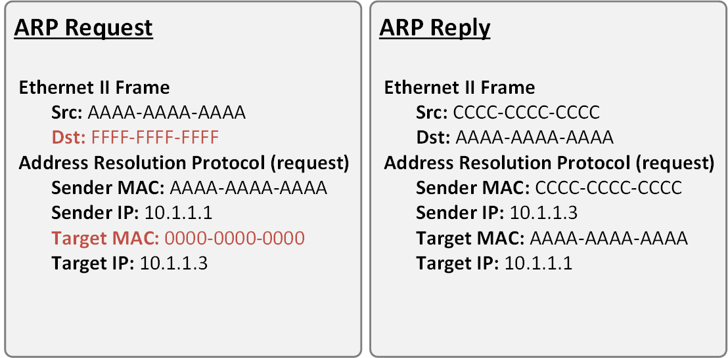
ARP mechanism
When a host with IP address IP1 and hardware address HW1 has to send an IP packet to a host with IP address IP2 on the same network, ARP obtains the necessary information in this way:
  a data link packet (ARP request) containing IP1, HW1, and IP2 is built, with a field dedicated to HW2 filled with all 0s
  this packet is broadcast on the local network
  everyone receives the ARP packet, but only the host that has the IP2 address processes it (the others discard it)
  the destination host builds a data link packet (ARP response) containing the missing information, and sends it directly to HW1 (not broadcast)
  ARP on the first host then acquires the information of the Ethernet address of the remote host, and communicates it to IP, which can thus encapsulate its own IP packets in frames of the data link protocol addressed to the correct destination

Slide 43
ARP Table example
Protocol Address Age (min) Hardware Addr Type Interface
Internet 192.168.150.253 62 c89c.1d67.f9ff ARPA Vlan1
Internet 192.168.150.250 0 5254.007f.e625 ARPA Vlan1
Internet 192.168.150.249 225 5254.005b.6e23 ARPA Vlan1
Internet 192.168.10.74 8 544b.8ce3.8dcf ARPA Vlan126
Internet 192.168.10.73 - 001e.791d.0400 ARPA Vlan126
Internet 192.168.150.158 31 c89c.1def.567f ARPA Vlan1
Internet 192.168.150.156 211 6c8b.d380.bb1f ARPA Vlan1
Internet 192.168.150.157 - 001e.791d.0400 ARPA Vlan1
Internet 192.168.150.140 95 24e9.b327.3bbf ARPA Vlan1
Internet 192.168.150.139 94 24e9.b327.37bf ARPA Vlan1
Internet 192.168.150.89 0 0004.9636.a0e0 ARPA Vlan1

Slide 44
ARP Cache
To improve performance, ARP can manage a cache in memory on the local host
Every time a new IPaddress - HWaddress association is learned, it is stored in the cache
When ARP has to locate an HW address, it first checks in the cache: if the information is present it is used without sending packets on the network
The entries in the ARP cache have an expiration time, to avoid that events such as replacement of network cards or redirection of hosts can make communication impossible
  At the expiration of the validity time the entry is removed from the cache, and a subsequent request for that address will cause a new emission of ARP request on the LAN

Slide 45
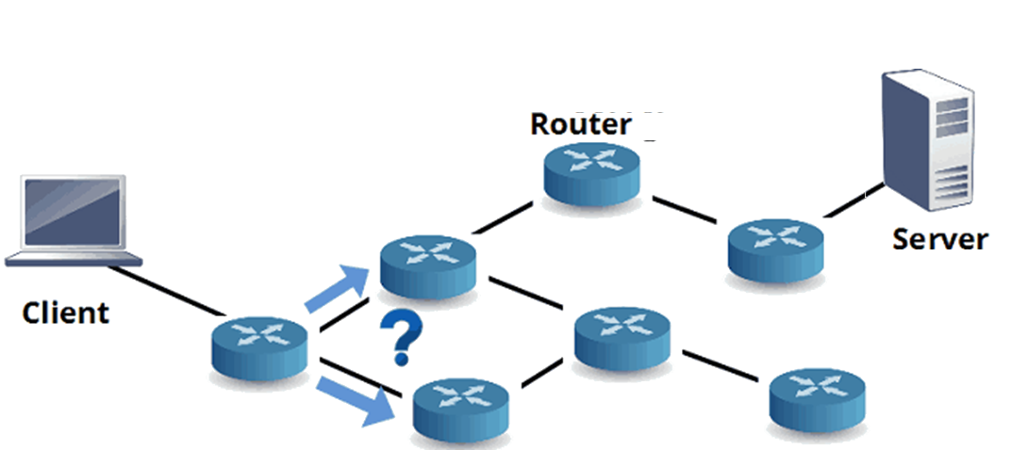
IP Routing
“In a packet switching system, routing refers to the process of choosing a path over which to send packets, and router refers to any computer making such a choice” - Douglas E. Comer ‘Internetworking with TCP/IP’.
The router is a device with at least two interfaces that connects two or more different IP networks.
Every router has a so-called routing table which contains the list of all reachable destinations.
Routing table

Slide 46
Routing types
The path selection can be based on static or dynamic routes:
Static: predefined routes, manually configured by the network manager.
Dynamic: routes generated by an algorithm specific to the routing protocol.

Slide 47
Routing protocols
  Basically, there are two kind of dynamic protocols:
  Distance Vector: in these protocols, each router does not possess information about the full network topology. It advertises its distance value (DV) calculated to other routers
  Link State: in link-state routing protocols, each router possesses information about the complete network topology. Each router then independently calculates the best next hop from it for every possible destination in the network using local information of the topology. The collection of best-next-hops forms the routing table.

Slide 48
Distance vector protocols
RIP: Routing Information Protocol (RIP) is a dynamic routing protocol that uses hop count as a routing metric to find the best path between the source and the destination network. Hop count is the number of routers occurring in between the source and destination network. The path with the lowest hop count is considered as the best route to reach a network and therefore placed in the routing table. RIP prevents routing loops by limiting the number of hops allowed in a path from source and destination. The maximum hop count allowed for RIP is 15.
IGRP: It supports multiple metrics for each node which includes delay, load, and bandwidth, to compare the 2 routes which are combined into single metrics. By default, every 90 seconds it updates the routing information.
EIGRP: It’s an evolution of IGRP, in a stable configuration only few protocol packets need to be transmitted and when network topology changes occur only the route changes are transmitted. Furthermore, convergency time is significantly lower than IGRP, something can be almost instantaneous.

Slide 49
Link state protocols
OSPF: Based on Dijkstra’s algorithm, it calculates the shortest path to all destinations. Upon initialization or due to any change in routing information, a router generates a link-state advertisement. All these information are collected by every router and used to compute the shortest path tree, destinations, associated cost, and next hop to reach those destinations form the IP routing table.
IS-IS: As OSPF, it uses the same algorithm but has two major strengths. The first is its scalability. It’s much easier to build large networks with IS-IS than it is with OSPF. This makes it a common choice with service providers for their infrastructure. The second strength is its agnostic approach to the data it carries. IS-IS carries a payload of reachability data, but for the most part it doesn’t care what’s in the payload.

Slide 50
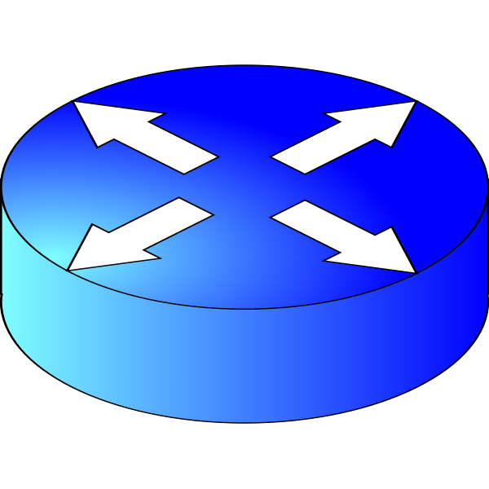
Border Gateway Protocol
An Autonomous System (AS) is a set of a networks that are all managed, controlled and supervised by a single entity or organization
BGP is the protocol that enables different AS to exchange routing information. This connection is called peering.
Routers that runs BGP are usually called border gateway.
Border Router GARR
Border Router CERN
GARR AS 137
(INFN)
Peering
CERN 513

Slide 51
Internet Control Message Protocol
  ICMP (Internet Control Message Protocol) is an error-reporting protocol that network devices such as routers use to generate error messages to the source IP address when network problems prevent delivery of IP packets. It does not provide suggestions about the action to take in response to error reports.
  Unlike the Internet Protocol, ICMP is not associated with a transport layer protocol such as TCP or UDP. This makes ICMP a connectionless protocol: one device does not need to open a connection with another device before sending an ICMP message.

Slide 52
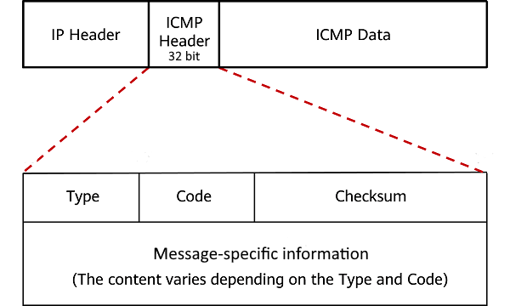
ICMP message format
Type | ICMP Message Type
0 | Echo Reply
3 | Destination Unreachable
4 | Source Quench
5 | Redirect (change a route)
8 | Echo Request
30 | Traceroute
Code | Destination Unreachable Code (some examples)
1 | Host is unreachable
4 | Fragmentation is needed and Don't Fragment was set
6 | Destination network is unknown

Slide 53
Your network companion: “The ping”
One of the mostly used application of the ICMP protocol is ping, its main scope is to check host reachability and measure the round trip time. RTT, is the amount of time it takes for a signal to be sent plus the amount of time it takes for acknowledgement of that signal having been received.
Ping, without any doubt, represents one of the most used tools to carry out troubleshooting operations.
ping www.infn.it
Pinging wwwinfn.lnf.infn.it [193.206.84.44] with 32 bytes of data:
Reply from 193.206.84.44: bytes=32 time=10ms TTL=54
Reply from 193.206.84.44: bytes=32 time=10ms TTL=54
Reply from 193.206.84.44: bytes=32 time=10ms TTL=54
Reply from 193.206.84.44: bytes=32 time=10ms TTL=54
Ping statistics for 193.206.84.44:
Packets: Sent = 4, Received = 4, Lost = 0 (0% loss),
Approximate round trip times in milli-seconds:
Minimum = 10ms, Maximum = 10ms, Average = 10ms

Slide 54
Your network companion: “traceroute”
$ traceroute www.infn.it
traceroute to www.infn.it (193.206.84.44),
1 switch-lan-cnaf-3.infn.it (131.154.3.57)
2 ru-cnaf-rx1-bo1.bo1.garr.net (193.206.128.17)
3 rl1-bo01-rs1-bo01.bo01.garr.net (185.191.180.53)
4 rs1-bo01-rs1-rm02.rm02.garr.net (185.191.181.76)
5 rx2-rm2-rx1-fra.fra.garr.net (90.147.81.162)
6 193.206.136.62 (193.206.136.62)
7 lnfgw-lnf.lnf.infn.it (193.205.228.122)
8 swcorebb900.lnf.infn.it (193.205.228.118)
9 wwwinfn.lnf.infn.it (193.206.84.44)
traceroute (or tracert) is a command that helps you find out the path taken by a packet from source to destination reporting the number of hops
$ traceroute6 www.mi.infn.it
traceroute to www.mi.infn.it (2001:760:4210:1::13), 30 hops max, 80 byte packets
1 gw2-128.cr.cnaf.infn.it (2001:760:4205:128::52) 0.793 ms 0.856 ms 0.904 ms
2 fd00:0:0:150::156 (fd00:0:0:150::156) 0.353 ms 0.402 ms 0.540 ms
3 2001:760:ffff:110::1c (2001:760:ffff:110::1c) 0.425 ms 0.405 ms 0.407 ms
4 2001:760:ffff:ffaa::180:51 (2001:760:ffff:ffaa::180:51) 3.300 ms 3.493 ms 3.674 ms
5 2001:760:ffff:ffbb::180:172 (2001:760:ffff:ffbb::180:172) 3.131 ms 3.190 ms 3.114 ms
6 rx1-mi3-ru-infnmi.mi3.garr.net (2001:760:ffff:128::45) 4.495 ms 4.263 ms 4.235 ms
7 joomla-mi.mi.infn.it (2001:760:4210:1::13) 3.203 ms !X 3.225 ms !X 3.235 ms !X

Slide 55
ICMP in IPv6?
Internet Control Message Protocol version 6 (ICMPv6) is the implementation of the Internet Control Message Protocol for Internet Protocol version 6. ICMPv6 is an integral part of IPv6 and performs error reporting and diagnostic functions. The new protocol extensions make ICMPv6 mandatory for IPv6 to function properly.
Of course, there is a version 6 of ping:
ping6 -c4 storm-cms.cr.cnaf.infn.it.
PING storm-cms.cr.cnaf.infn.it.(storm-cms.cr.cnaf.infn.it (2001:760:4205:128::128:27)) 56 data bytes
64 bytes from storm-cms.cr.cnaf.infn.it (2001:760:4205:128::128:27): icmp_seq=1 ttl=64 time=0.239 ms
64 bytes from storm-cms.cr.cnaf.infn.it (2001:760:4205:128::128:27): icmp_seq=2 ttl=64 time=0.205 ms
64 bytes from storm-cms.cr.cnaf.infn.it (2001:760:4205:128::128:27): icmp_seq=3 ttl=64 time=0.276 ms
64 bytes from storm-cms.cr.cnaf.infn.it (2001:760:4205:128::128:27): icmp_seq=4 ttl=64 time=0.268 ms
--- storm-cms.cr.cnaf.infn.it. ping statistics ---
4 packets transmitted, 4 received, 0% packet loss, time 3000ms
rtt min/avg/max/mdev = 0.205/0.247/0.276/0.027 ms

Slide 56
TCP/UDP (Transport Layer)

Slide 57
Transport Layer (Layer 4)
  The transport layer main goal is to provide end-to-end communication services for applications.
  The transport layer's tasks include error correction as well as segmenting and de-segmenting data before and after it's transported across the network. This layer is also responsible for flow control and making sure that segmented data is delivered over the network in the correct sequence.
  The main actors in this layer are the Transmission Control Protocol (TCP) and User Data Protocol (UDP) to carry out its tasks.

Slide 58
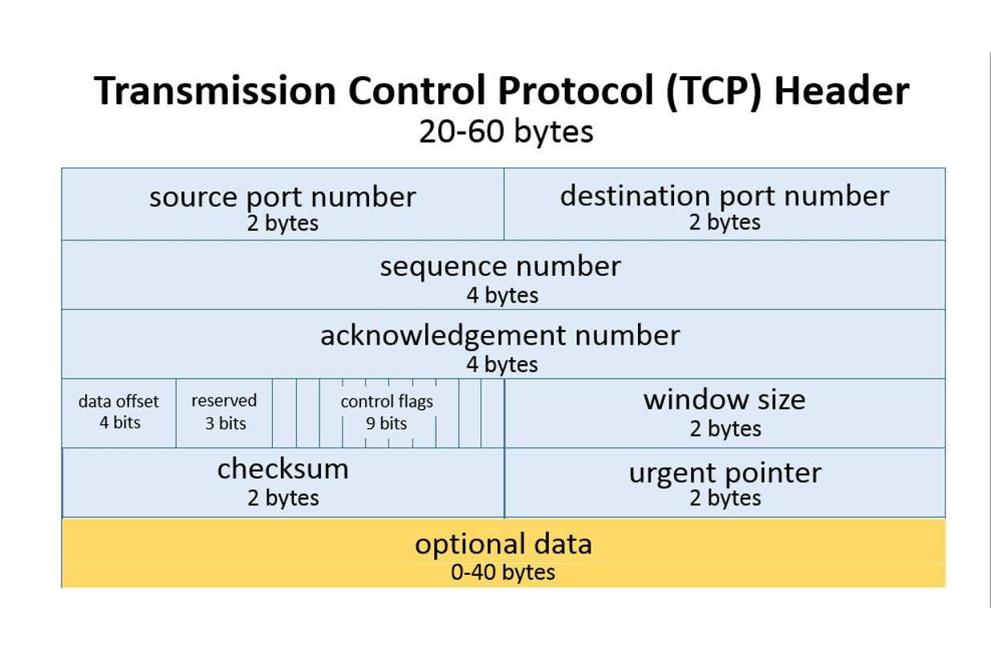
Transmission Control Protocol
Connection oriented:
  Establishing a TCP (3way handshake) connection permits data to be transferred from both sides.
  Reliable (retransmission)
  Error detection (checksum)
  Slow start
  Congestion management
  Slower than UDP but reliable, is used by application that needs a guaranteed delivery of the data like HTTP/S, FTP, SMTP, IMAP, etc...

Slide 59
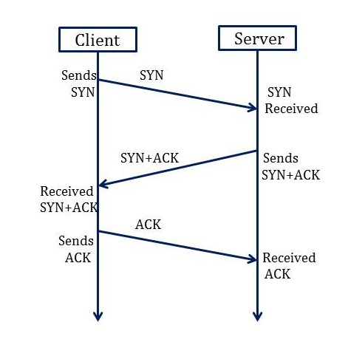
TCP connection (3-way handshake)
Synchronization Sequence Number (SYN) The client sends the SYN to the server
  When the client wants to connect to the server sends the message to the server by setting the SYN flag as 1.
  The ACK is set to 0.
Synchronization and Acknowledgement (SYN-ACK) to the client
  The server acknowledges the client request by setting the ACK flag to 1.
  The ACK indicates the response of the segment it received, and SYN indicates with what sequence number it will start the segments.
  The server will set the SYN flag to '1' and send it to the client if the server also wants to establish the connection.
Acknowledgment (ACK) to the server
  The client sends the acknowledgment (ACK) to the server after receiving the synchronization (SYN) from the server.
  After getting the (ACK) from the client, the connection is ESTABLISHED between the client and the server.
The connection will eventually end with an RST (reset or tear down the connection) or FIN (gracefully end the connection).
  Data can be transmitted between the client and server

Slide 60
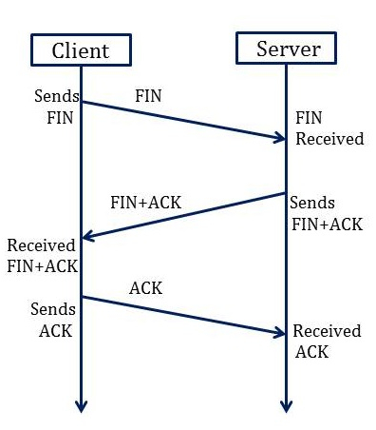
Closing a TCP connection
3 -Way Handshake Closing Connection Process
To close a 3-way handshake connection,
First, the client requests the server to terminate the established connection by sending FIN.
After receiving the client request, the server sends back the FIN and ACK request to the client.
After receiving the FIN + ACK from the server, the client confirms by sending an ACK to the server.

Slide 61
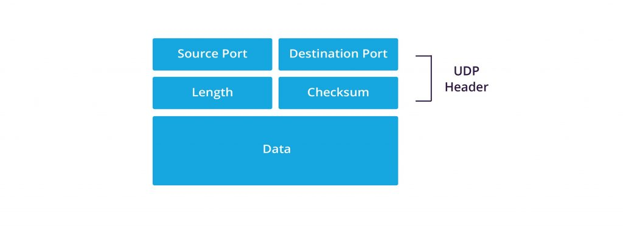
User Datagram Protocol (UDP)
Connectionless:
  User Datagram Protocol (UDP) is a communications protocol that is primarily used to establish low-latency and loss-tolerating connections between applications on the internet.
  Mostly used for process-to-process communication
  No overhead due to a connection creation
  Not reliable
  Faster than TCP is used for real time application like streaming or video calls

Slide 62
TCP and UDP ports
  A single IP address permits the establishment of a single connection between two hosts, since we want to make possible the communication among multiple hosts it’s mandatory to introduce the concept of ‘port’. The port number is a 16-bit number (0-65535).This range has been separated by the IANA (Internet Assigned Numbers Authority) into several different segments:
    Port 0 is not used for internet/network traffic, but it’s sometimes utilized in communications going down between different programs on identical computers.
    Ports 1-1023 are alluded to as system ports (a.k.a. well-known ports).
    Ports 1024-49151 are known as registered ports.
    Port 49152-65535 are known as ephemeral ports.
    Examples
    TCP 80 HTTP UDP 161 SNMP
    TCP 443 HTTPS UDP 53 DNS
    TCP 22 SSH

Slide 63
TCP/UDP typical flows
TCP (HTTP)
c/s:open connection (host, port)
c:http get (url)
s:http response (status,headers,body)
c:http post (form)
s:http response (status, headers, body)
c/s :close connection
UDP (DNS)
c:dns query (domain name,type,class)
s:dns response (domain name,type,class,ttl,data)
c:dns query (domain name,type,class)
s:dns response (domain name,type,class,ttl,data)
Notes:
Il verde indica il server mentre il giallo indica il client, lo scopo della slide è di sottolineare la maggior complessità del TCP rispetto l’UDP.

Slide 64
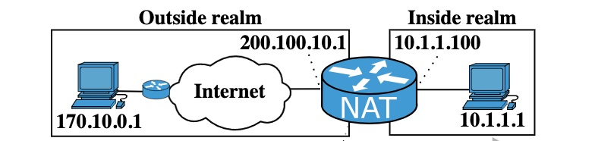
NAT: IP Network Address Translation
Network Address Translator [RFC 2663] is a method by which IP addresses are mapped from one realm to another, in an attempt to provide transparent routing to hosts.
Address translation allows for example hosts in a private network to transparently communicate with destinations on an external network.

Slide 65
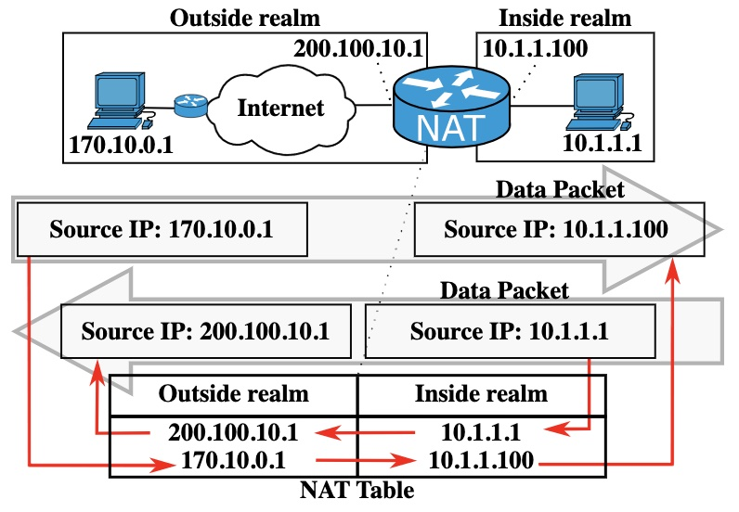
NAT: How it works
NAT modifies the addresses in the IP header of a packet to be valid in the addresses realm into which the datagram is routed.
The translations are session based.
E.g., TCP sessions are uniquely identified by the tuple of
(source IP address, source TCP port, target IP address , target TCP port)
The NAT service maintains a translation table for every sessions.

Slide 66
NAT: Main usage @INFN
NAT in INFN computing infrastructures is mainly used to:
provide outbound connectivity for computing farm nodes with IP addresses in private range [rfc 1918].
provide WiFi connectivity for non local users (e.g. eduroam)
Any other circumstance where insulation and connectivity are needed at the same time.

Slide 67
NAT: implementation
NAT can be done in several different ways. Here are some examples:
enabling NAT on a network device (switch/router);
iptables on a linux host;
pf on a FreeBSD host;
any other circumstance where insulation and connectivity are needed at the same time.

Slide 68
NAT: pf on FreeBSD
The pf firewall is a BSD licensed stateful packet filter.
It should be enabled in /etc/rc.conf:
Here is a simple configuration (/etc/pf.rules):
pf_enable="YES”
pf_rules="/etc/pf.rules"
ext_if = "bce0" # External network interface for IPv4
ext_addr = "193.205.66.144" # External IPv4 address (i.e., global)
int_if = "ix1" # Internal network interface for IPv4
int_addr = "192.168.128.254" # Internal IPv4 addr (i.e., gateway for priv net)
nat log (to pflog1) on $ext_if from 192.168.128.0/24 to any -> 193.205.66.144

Slide 69
NAT translation table example
gw-cnaf#show ip nat translations
Pro Inside global Inside local Outside local Outside global
tcp 131.154.4.3:4623 172.16.10.40:33938 52.108.196.24:443 52.108.196.24:443
tcp 131.154.4.3:4119 172.16.10.40:37550 142.251.209.14:443 142.251.209.14:443
tcp 131.154.4.3:4919 172.16.10.40:38656 52.113.194.132:443 52.113.194.132:443
Udp 131.154.4.3:1408 172.16.1.10:47659 217.61.62.224:123 217.61.62.224:123
udp 131.154.4.3:1467 172.16.1.14:123 162.159.200.1:123 162.159.200.1:123
NAT Public IP
Hosts Private IP
Public IP (Destinations)

Slide 70
Application layer

Slide 71
DHCP
Why do we need dynamic IP assignment?
To communicate via TCP/IP a host must
  know its own IP address
  know its own network (netmask)
  know the address of a router on its own network
In addition to this, the complete functioning of the TCP/IP protocols require other information
  the address of one or more DNS servers
  its own domain name
  the address of one or more NTP servers
  the address of one or more WINS servers
This information can be statically configured on the host, however, it’s convenient to dynamically configure it during the network configuration process.

Slide 72
DHCP
The Dynamic Host Configuration Protocol was developed to enable dynamic configuration of hosts and is essentially an application of the TCP/IP suite that uses UDP (and therefore IP at the network level) to transmit information
The protocol works through a client-server interaction
  the client is the node that performs the network initialization, and broadcasts a query on the network from port 68 (UDP) using local broadcast address (255.255.255.255), which is realized by transmitting a level 2 broadcast frame
  the DHCP server must be properly configured to respond to requests, providing the necessary parameters (server listens on port 67)

Slide 73
DHCP Lease
DHCP manages address assignments as a lease
  When a client requests an address, and this is granted, the assigned address is considered by the server to be no longer usable for other clients for a certain period of time (configurable lease time)
  At the end of the lease period, the client must renew the request or stop using the assigned address
  if it renews the request, it is granted to use the same address for a new lease time period
  When the lease time expires and the client does not renew the request, the server can use the same address for another client
it is not guaranteed (unless specified in configuration) that the same client receives the same address in two different and non-consecutive periods
the server has a default value and a maximum limit

Slide 74
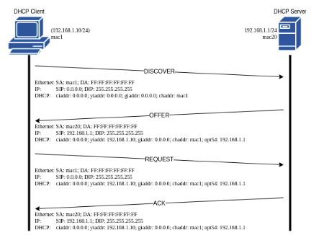
DHCP messages (DORA process)
At initialization the client sends a broadcast message of DHCPDISCOVER (configuration request)
The server (or servers) respond to the request with a DHCPOFFER message (offer), containing the configuration information
The client chooses the first response that arrives, and configures itself in the defined way, but must negotiate the lease parameters: it then sends a DHCPREQUEST message to the server from which it accepted the offer
  this serves to notify the server that offered the address that the client has accepted its offer
  the servers that do not receive the DHCPREQUEST message consider the offer rejected, and keep the offered address among those available
The server that receives the DHCPREQUEST message sends a confirmation with a DHCPACK message
from this moment the address is assigned, for the agreed lease time

Slide 75
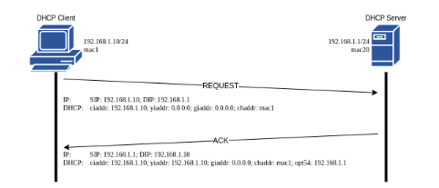
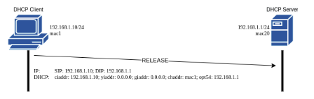
DHCP Messages (Renew)
At the expiration of a timer of half the lease time, the client must renew the lease: it sends a new DHCPREQUEST message to the server
The server can:
  accept the renewal, with a DHCPACK message
  in this case the client resets the timers and continues to use the new proposed configuration (it can have different parameters)
  refuse the renewal with a DHCPNACK message
The client can:
  Ask for a renewal, with a DHCPREQUEST message
  Release an ip address, with a DHCPRELEASE message

Slide 76
The "Options" field
In the DHCP packet there is an options field in which the server can provide additional information.
In the OPTIONS field can be inserted:
  NTP time server name
  host name and domain name
  print server
  DNS server and search list
  WINS server
  TFTP server name for PXE boot
not all are standard, and not all will be used by the client

Slide 77
Domain Name System
The Domain Name System (DNS) is charge of translating IP addresses into human readable hostnames.
It’s a hierarchical and distributed database naming system for computers, services, and other resources on the Internet.
Each domain name is essentially just a path in a large inverted tree called domain namespace.
The service listens on TCP/UDP 53 port
root
it
org
garr
com
edu
DELEGATION
…
infn
Managed by
INFN
repubblica
…
bo
lnf
…

Slide 78
Hierarchy and INFN convention
A domain name is formed by a sequence of strings dotted separated
Every level is child of his previous level
infn.it is usually used for national services otherwise a third level domain is added and refers to an INFN Sites or Laboratory
ftp.mi.infn.it www.lnf.infn.it dsx001.cr.cnaf.infn.it
www.infn.it
.it is the Top-Level Domain (first level)
.infn is the second level
Eventually more levels 3,4,etc (up to 127 levels)
www is the server’s hostname

Slide 79
Domain Name System
Requesting an IP address from a domain name is called “DNS resolution”
  www.infn.it 193.206.84.44
  mastercr.cnaf.infn.it 2001:760:4205:128::128:2
  $ [nslookup|host|dig] www.infn.it
Requesting a domain name from an IP address is called “Reverse resolution”
  193.206.84.44 www.infn.it
  2001:760:4205:128::128:2 mastercr.cnaf.infn.it
  $ [nslookup|host|dig] 193.206.84.44

Slide 80
DNS records type
Type
A AAAA | Name -> IP(v4) IPV6
PTR | IP (IPV6) -> NAME
CNAME | Common Name -> Name aka “alias”
MX | Mail eXchange to define servers responsible to menage mails for a domain
NS | Name Server to define authoritative DNS servers for a domain
SOA | Start Of Autority Specifies authoritative information about a DNS zone, including the primary name server, the email of the domain administrator, the domain serial number, and several timers relating to refreshing the zone.
TXT | Used to define arbitrary text for human or machine to implement some specific service
FULL LIST https://en.wikipedia.org/wiki/List_of_DNS_record_types
RR EXAMPLE: www.infn.it (NAME) 60 (TTL) IN(CLASS) A(TYPE) 193.206.84.44 (RDATA)

Slide 81
DNS zone examples
@ 86400 IN SOA ns1.dr.infn.it. sysop.dr.infn.it. (
2023062701 ; Serial
3600 ; Refresh ogni 24 ore
600 ; Retry ogni 2 ore
604800 ; Expire 30 giorni
3600 ; Minimum ttl 4 giorni
)
IN NS ns1.dr.infn.it.
IN NS server2.infn.it.
;
$ORIGIN dr.infn.it.
$TTL 86400
;
gw-31 IN A 192.135.31.1
ns1 IN A 192.135.31.2
@ 84600 IN SOA ns1.dr.infn.it. sysop.dr.infn.it. (
2023062701 ; serial
3600 ; refresh (1 day)
600 ; retry (2 hours)
604800 ; expire (4 weeks 2 days)
3600 ; minimum (4 days)
)
IN NS ns1.dr.infn.it.
IN NS server2.infn.it.
;
$ORIGIN 31.135.192.in-addr.arpa.
$TTL 86400
;
1 IN PTR gw-31.dr.infn.it.
2 IN PTR ns1.dr.infn.it.

Slide 82
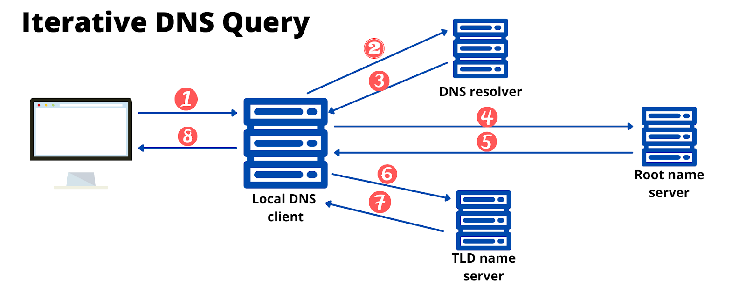
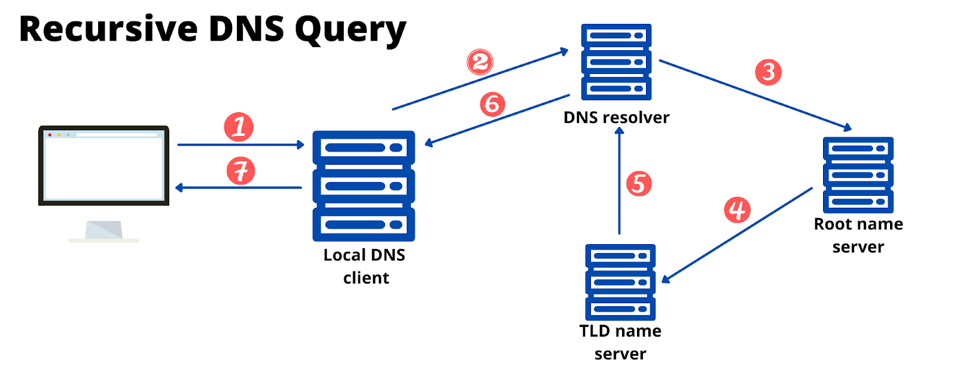
Resolution
DNS servers can act as recursive, not recursive or caching only server
Iteration (not recursive)
  The DNS server allows the querier to resolve only names that the server directly knows.
Recursion
  The DNS server is in charge of resolving names that the server doesn’t directly knows and returns it to the querier.
Caching nameservers
  DNS that only caches the queries for a specific purpose

Slide 83
Views
Sometimes is useful to implement different behaviors depending on the querier.
Example:
Query from local networks can be used to resolve everything with recursion and maybe resolve some internal resources accessible only from the internal network (eg printers or private network)
People from internet can only do iterative requests but not resolve some internal resources because of security. (no printer or private network is resolved)
This can be implemented on a single server with different views filtering source/destination with Access Control Lists (ACLs) and pointing to different SOA files.

Slide 84
INFN Domain Name System
Legenda
Other
Domains
Dominio
Master
Master esterno
server2.infn.it
backup.lngs
roma2
ha
dns-backup.lngs.infn.it
Slave
slave esterno
server2.infn.it
cr.cnaf
gssi
server2.infn.it
sertov1.roma2.infn.it
roma1
ns1.ha.infn.it
mastercr.cnaf.infn.it
sertov2.roma2.infn.it
dns1.roma1.infn.it
ns2.ha.infn.it
gssidns.gssi.infn.it
pd
cnaf
dns1.roma1.infn.it
dns2.roma1.infn.it
mastercr2.cnaf.infn.it
rsgs02.lngs.infn.it
bsdsz1.pd.infn.it
t2-dns.roma1.infn.it
roma3
ns3.ha.infn.it
server2.infn.it
gsnet0.lngs.infn.it
bsdsz2.pd.infn.it
dxcnaf.cnaf.infn.it
ccr
na
lnfnet.lnf.infn.it
stargw.roma3.infn.it
ns4.ha.infn.it
ns1.garr.net
server2.infn.it
bsdsz3.pd.infn.it
server2.infn.it
server2.infn.it
dnsna1.na.infn.it
nemesis.roma3.infn.it
ns5.ha.infn.it
ext-dns-2.cern.ch
ns1.garr.net
server2.infn.it
dnsna6.na.infn.it
presid
dns1.roma1.infn.it
infn.it
t2-dns.na.infn.it
dnsmail.presid.infn.it
cloud
mailing.ha
ca
server2.infn.it
bo
ns1.ha.infn.it
cavssy.ca.infn.it
dns1.roma1.infn.it
dnsm.bo.infn.it
cc-dnsha.recas.ba.infn.it
ns2.ha.infn.it
server2.infn.it
lnl
server2.infn.it
dnsi.bo.infn.it
cc-dnsha.recas.ba.infn.it
server2.infn.it
cloud-dns.infn.it
ns3.ha.infn.it
dxcnaf.cnaf.infn.it
dns1.lnl.infn.it
ts
server2.infn.it
cc-dnsha-cnaf.infn.it
ns4.ha.infn.it
to
dns2.lnl.infn.it
afs.ts.infn.it
win
ns5.ha.infn.it
ns1.garr.net
dns3.lnl.infn.it
dnssrvd.ts.infn.it
lnf
sa
moebius.to.infn.it
dns4.lnl.infn.it
server2.infn.it
dc1.win.infn.it
ge
lnfnet.lnf.infn.it
carmen.to.infn.it
ext-dns-2.cern.ch
server2.infn.it
ns1.units.it
backupsrv.sa.infn.it
dc2.win.infn.it
dns1.ge.infn.it
dns2.lnf.infn.it
proxy.sa.infn.it
mib
dns2.ge.infn.it
dns3.lnf.infn.it
server2.infn.it
pv
virgo
rmlab
server2.infn.it
dns1.roma1.infn.it
aquila
ns1.virgo.infn.it
schiller.mib.infn.it
server2.infn.it
dns1.pv.infn.it
infnsun.aquila.infn.it
ns2.virgo.infn.it
rmlabns.roma2infn.it
polluce.mib.infn.it
dns2.pv.infn.it
wsgs00.lngs.infn.it
server2.infn.it
ac
lngs
server2.infn.it
server2.infn.it
dsi
dr
Infnnet.lnf.infn.it
dns-server3.lngs.infn.it
fi
pr
lns
ct
ba
server2.cnaf.infn.it
ns1.dr.infn.it
dns1.lnf.infn.it
gsnet0.lngs.infn.it
avaxfi.fi.infn.it
server.fis.unipr.it
spawn.ba.infn.it
dxcnaf.infn.it
server2.infn.it
dns2.lnf.infn.it
dns-server2.lngs.infn.it
ercolino.fi.infn.it
lnsuni1.lns.infn.it
ns.ct.infn.it
dns3.lnf.infn.it
dns-backup.backup.lngs.infn.it.
server2.infn.it
caio.cce.unipr.it
lnsuni2.lns.infn.it
server2.infn.it
server2.infn.it
pg
server2.infn.it
server2.infn.it
mi
pi
tn
tifpa
le
cs
ccsem
emfcsc
vaxmi.mi.infn.it
dns1.pg.infn.it
ns1.pi.infn.it
ns1.unitn.it
ns1.unitn.it
terra.le.infn.it
ns.cs.infn.it
emcsc.ccsem.infn.it
emcsc.emfcsc.infn.it
dsmicc.mi.infn.it
dns2.pg.infn.it
dspi01.pi.infn.it
ns2.unitn.it
ns2.unitn.it
dns.le.infn.it
server2.infn.it
server2.infn.it
server2.infn.it
server2.infn.it
server2.infn.it
server2.infn.it
server2.infn.it
Notes:
84

Slide 85
