Slide 1

Infrastrutture per il calcolo scientifico nell’INFN
Giacinto Donvito
INFN-Bari
donvito@INFN.it

Slide 2
Chi sono?
Laureato in fisica nel 2004 in CMS, mi occupo di calcolo scientifico da allora
Non solo a servizio della fisica, ma anche di altre scienze
Partecipa ad attività di R&D sia su progetti interni che in progetti competitivi finanziati
Si occupa di progettazione e implementazione di architetture di distributed and cloud computing and storage
Responsabile tecnico del data center ReCaS-Bari
Responsabile INFN del progetto Terabit e di un po’ di altri progetti R&D Europei

Slide 3
DI COSA VORREI PARLARVI
I componenti principali dell’infrastruttura di calcolo nazionale dell’INFN
Come è organizzata da un punto di vista tecnico
Alcuni dettagli tecnici dei progetti PNRR in corso che avranno un impatto importante sulla infrastruttura esistente
La visione su come vogliamo evolvere la nostra infrastruttura di calcolo ***grazie al vostro contributo***
Come è organizzata l’attività di tutte le persone che lavorano sul calcolo (si anche voi!!)

Slide 4






Qualche definizione di base

Slide 5
Perchè non basta un singolo computer?
Biologia:
  Confronto del genoma dell’essere umano con quello del Topo:
    Circa 80anni di CPU
Fisica:
  Avete già visto quanti dati produce un esperimento di fisica moderno
Rendering:
  Per produrre Avatar è stato necessario costruire un cluster ad-hoc di 4’000 nodi e 35’000 processori
  Per Avatar 2: «Rendering each frame took 8,000 thread hours, or the combined power of 3,000 vCPUs in the cloud for an hour.»

Slide 6
Cos’è il calcolo distribuito?
Il calcolo distribuito è un campo dell'informatica che studia i sistemi distribuiti.
Un sistema distribuito consiste in tanti ed autonomi computer che comunicano attraverso una rete.
I computer interagiscono tra loro al fine di raggiungere un obiettivo comune.
Il calcolo distribuito si riferisce all'uso di sistemi distribuiti per risolvere problemi computazionali.
Nel calcolo distribuito, un problema è diviso in molti compiti ognuno dei quali è risolto da un singolo computer.

Slide 7
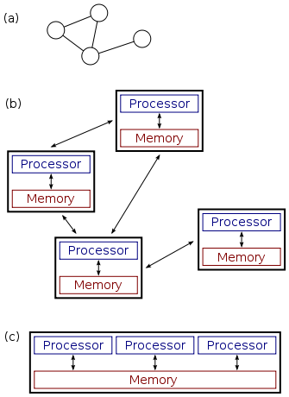
C’è differenza fra Calcolo distribuito e parallelo?
Nel calcolo parallelo tutti i processori devono accedere ad una memoria condivisa. Le informazioni fra i processori possono essere scambiate usando la memoria condivisa o tramite passaggi di messaggi sulla rete di collegamento
Nel calcolo distribuito ogni processore ha la propria memoria privata (memoria distribuita). I processi non comunicano durante la loro esecuzione con gli altri. Di solito la comunicazione con l’esterno può avvenire solo all’inizio e/o alla fine del processo

Slide 8
C’è differenza fra Calcolo distribuito e parallelo?
Calcolo Parallelo: High Performance Computing (HPC)
  HPC tasks are characterized as needing large amounts of computing power for short periods of time, whereas HTC tasks also require large amounts of computing, but for much longer times (months and years, rather than hours and days). HPC environments are often measured in terms of FLOPS.
Calcolo Distribuito: High Throughput Computing (HTC)
  The HTC community, however, is not concerned about operations per second, but rather operations per month or per year. Therefore, the HTC field is more interested in how many jobs can be completed over a long period of time instead of how fast an individual job can complete.

Slide 11
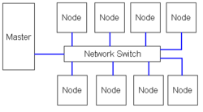
Le origini del calcolo distribuito
Questi concetti che grazie alla diffusione di internet hanno raggiunto il “grande pubblico” partono dai laboratori dove si effettuavano complessi calcoli scientifici
Il tutto è nato con i cluster di calcolo scientifico:
  Beowulf cluster
    Tutti i nodi possono essere usati per eseguire processi singoli in cui un problema scientifico viene suddiviso
  La distribuzione dei programmi fra i nodi viene effettuato con un software chiamato:
    Batch System (NDR!)

Slide 12
Facciamo un passo indietro: le origini del calcolo distribuito
Gli utenti ottengono un account sul cluster
  Sul nodo di login
  Installa il software di cui ha bisogno
  Trasferisce i dati di input
  Sottomette i “job”
    Programma “atomico” in cui può essere suddiviso il problema
  Controlla lo stato dei singoli job e quando sono finiti…
  …recupera e colleziona l’output
Tutte le operazioni possono essere eseguite manualmente o per mezzo di script o simili

Slide 13
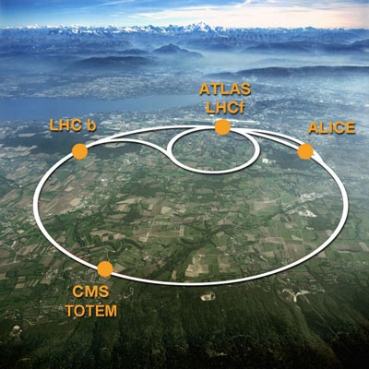

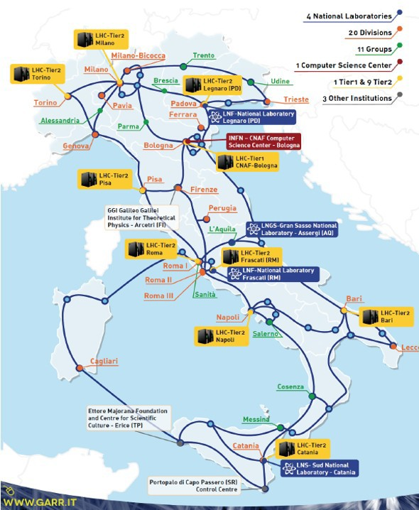
LHC and Grid era
●
INFN was one of main promoters of the GRID project to address LHC computing needs. Since then INFN has been participating to WLCG that includes more than 170 sites around the world, loosely organized in a
tiered model.
In Italy, there are the Tier-1 at CNAF, Bologna and 9 “Tier-2” centers.
INFN has been running for more than 20 years a distributed infrastructure which currently offers about 150000 CPU cores, 120 PB of enterprise-level disk space and 120 PB of tape storage, serving more than 40 international scientific collaborations.
All the INFN centers are connected through 10-100 Gbit/s dedicated links via the GARR network.
INFN manages and supports the largest public computing infrastructure for scientific research spread throughout the country.
–
●
●
●
4

Slide 14
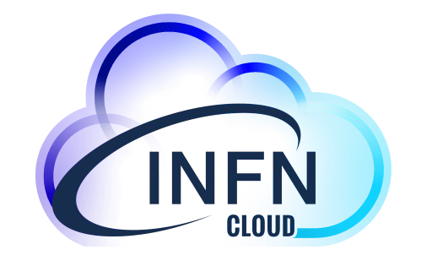
From local experiences to INFN Cloud
●
To support and evolve use cases that could not easily exploit the Grid paradigm, for many years several INFN sites have been investing in Cloud computing infrastructures
–
heterogeneous in hardware, software and cloud middleware.
Cloud at CNAF Cloud at Bari CloudVeneto Cloud at Torino...
●
To optimize the use of available resources and expertise, INFN decided to implement a national Cloud infrastructure for research
–
as a federation of existing distributed infrastructures extending them if necessary in a transparent way to private and commercial providers;
as an “user-centric” infrastructure making available to the final users a dynamic set of services tailored on specific use cases;
leveraging the outcomes of several national and European cloud projects where INFN actively participated.
–
–
●
INFN Cloud was officially made available to users in March 2021.
Federation of data, resources and knowledge
https://www.cloud.infn.it

Slide 15
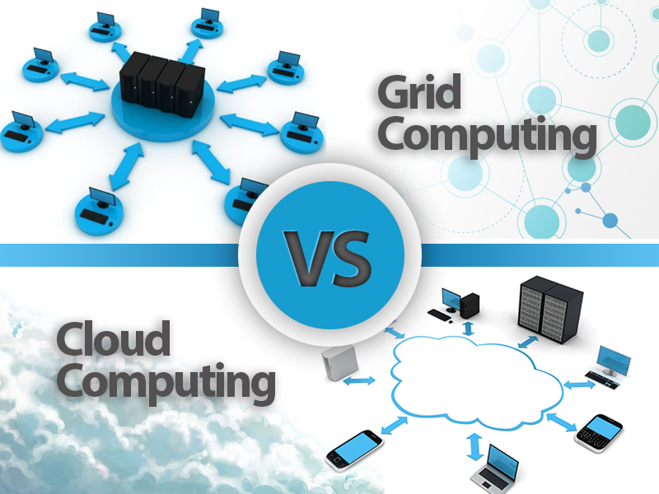

Slide 16
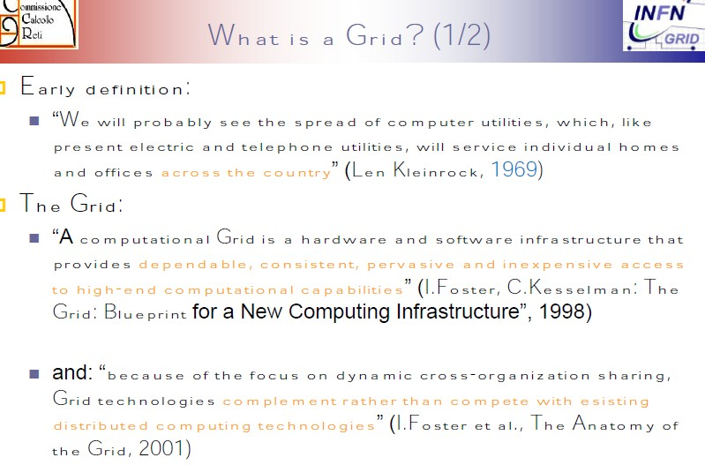
Concetti di Base

Slide 17
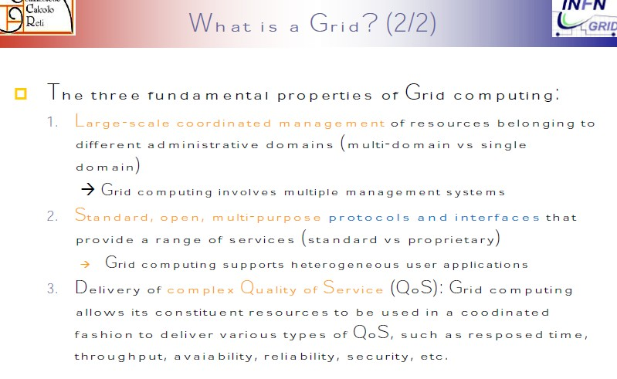
Concetti di Base

Slide 18
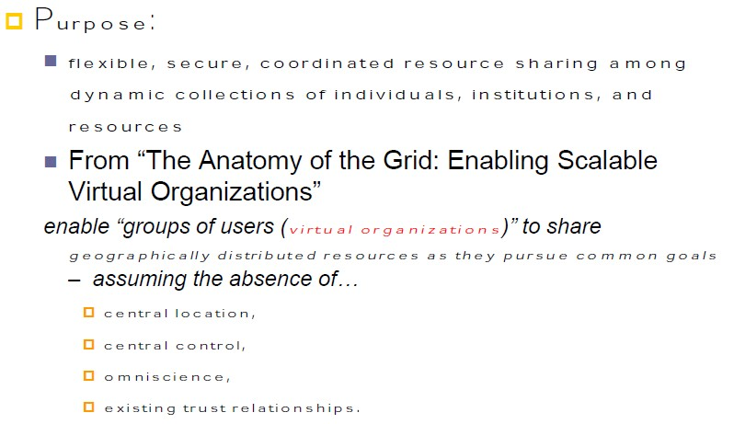
Concetti di Base

Slide 19
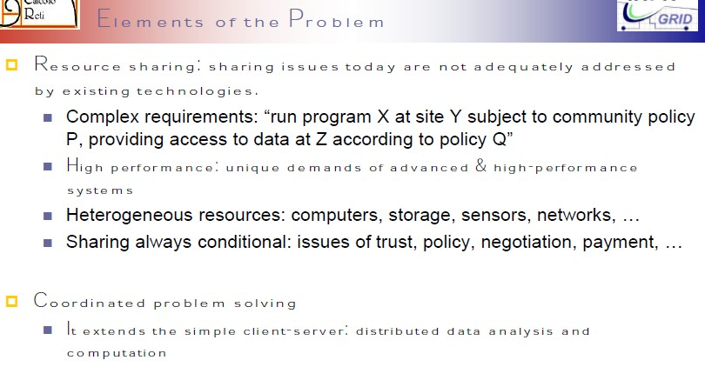
Concetti di Base

Slide 20






Middleware services
User Interface
Workload Management
Logging & Bookkeeping
Information System
submit
query
retrieve
discover
services
update
credential
publish
state
query
submit
publish
state
retrieve
submit
Site X
Computing Element
Storage Element
File and Replica
Catalogs
Authorization
Service

Slide 21
Glidein-WMS based pilot jobs
UI
Global Task Queue
Resource
allocation
Glidein Factory
Site boundary
schedd
CE
LRMS
collector
Local Task Queue WMAgent
WN
schedd
Glidein Frontend
Grid job
Central Manager
collector
negotiator
Glidein Startup
startd
Job management
CMS job

Slide 22
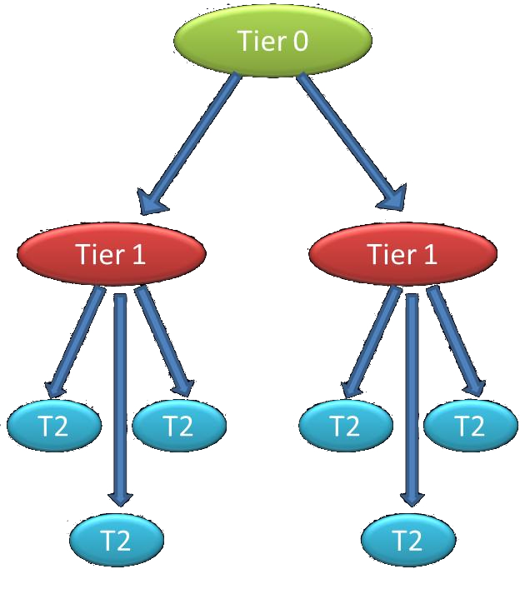
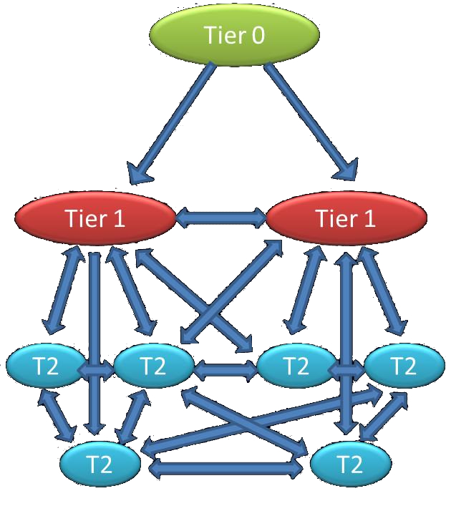
Data access/movement evolution
In this first two years of data taking at least two issues were evident:
  The network and storage technologies are evolving different from what expected
  The schematic and rigid data movement foreseen by the computing model was not strictly respected
CMS Italia - Bologna
13-11-2012
22
Notes:
22

Slide 23
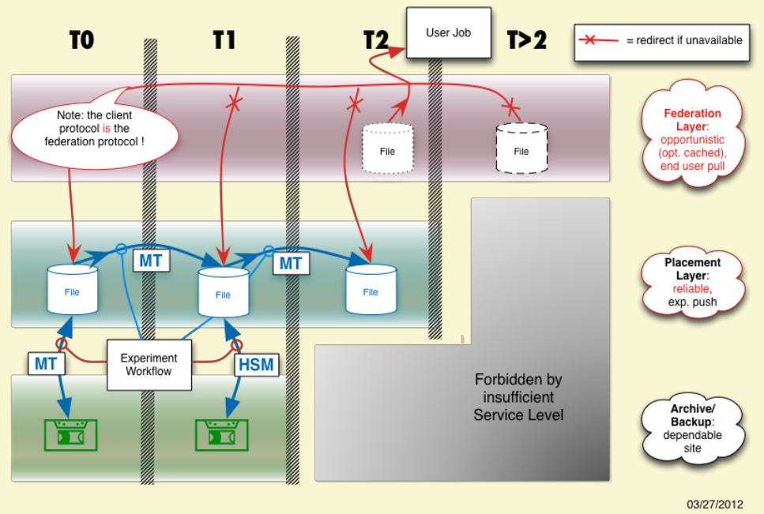
Data layers in LHC experiments
Notes:
23

Slide 29
What is Software as a Service? (SaaS)
SaaS is a software delivery methodology that provides licensed multi-tenant access to software and its functions remotely as a Web-based service.
  Usually billed based on usage
  Usually multi tenant environment
  Highly scalable architecture

Slide 30
What is Software as a Service? (SaaS)
Cloud application services or “Software as a Service” (SaaS) are probably the most popular form of cloud computing and are easy to use. SaaS uses the Web to deliver applications that are managed by a third-party vendor and whose interface is accessed on the clients’ side. Most SaaS applications can be run directly from a Web browser, without any downloads or installations required. SaaS eliminates the need to install and run applications on individual computers. With SaaS, it’s easy for enterprises to streamline their maintenance and support, because everything can be managed by vendors: applications, runtime, data, middleware, O/S, virtualization, servers, storage, and networking. Gmail is one famous example of an SaaS mail provider.

Slide 31
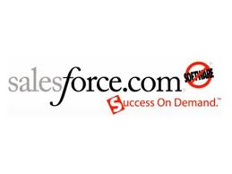

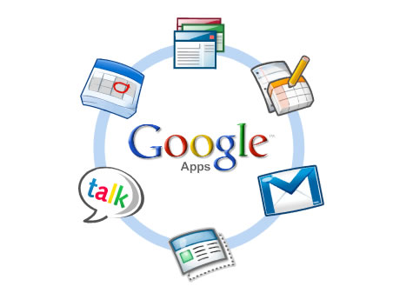

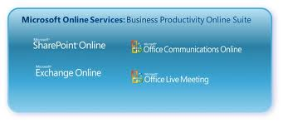

SaaS Examples

Slide 33
Platform as a Service (PaaS)
PaaS provides all the facilities required to support the complete life cycle of building and delivering web applications and services entirely from the Internet.
  Typically, applications must be developed with a particular platform in mind
  Multi tenant environments
  Highly scalable multi tier architecture

Slide 34
Platform as a Service (PaaS)
The most complex of the three, cloud platform services or “Platform as a Service” (PaaS) deliver computational resources through a platform. What developers gain with PaaS is a framework they can build upon to develop or customize applications. PaaS makes the development, testing, and deployment of applications quick, simple, and cost-effective, eliminating the need to buy the underlying layers of hardware and software. One comparison between SaaS vs. PaaS has to do with what aspects must be managed by users, rather than providers: With PaaS, vendors still manage runtime, middleware, O/S, virtualization, servers, storage, and networking, but users manage applications and data.
PaaS provides the computing infrastructure, the hardware, and the platforms that are installed on top of the hardware. Similar to the way that you might create macros in Excel, PaaS allows you to create applications using software components that are controlled by a third-party vendor. PaaS is highly scalable , and users don’t have to worry about platform upgrades or having their site go down during maintenance. Users who benefit most from PaaS include companies who want to increase the effectiveness and interactivity of a large staff. For the needs of larger companies and independent software vendors, Apprenda is one provider of a private PaaS for .Net business-application development and deployment.

Slide 35


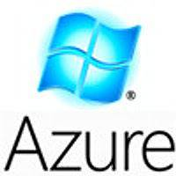




PaaS Examples

Slide 37
Infrastructure as a Service (IaaS)
IaaS is the delivery of technology infrastructure as an on demand scalable service
  Usually billed based on usage
  Usually multi tenant virtualized environment
  Can be coupled with Managed Services for OS and application support

Slide 38
IaaS: Infrastructure as a Service
Cloud infrastructure services, known as “Infrastructure as a Service” (IaaS), deliver computer infrastructure (such as a platform virtualization environment), storage, and networking. Instead of having to purchase software, servers, or network equipment, users can buy these as a fully outsourced service that is usually billed according to the amount of resources consumed. Basically, in exchange for a rental fee, a third party allows you to install a virtual server on their IT infrastructure. Compared to SaaS and PaaS, IaaS users are responsible for managing more: applications, data, runtime, middleware, and O/S. Vendors still manage virtualization, servers, hard drives, storage, and networking. What users gain with IaaS is infrastructure on top of which they can install any required platforms. Users are responsible for updating these if new versions are released.

Slide 39
Infrastructure as a Service (IaaS)
Advantages
  Customized environment with “root” access
  Easy access to scalable resources
Disadvantages
  Variety of APIs and interfaces
  VM image creation is difficult and time-consuming
Trends
  Lots of specialized cloud providers appearing
  Orchestration pushing into PaaS space

Slide 40
IaaS is not Managed Hosting
Traditional managed hosting is a form of web hosting where a user chooses to lease entire server(s) housed in an off-site data center.
  Term based contracts based on projected resource requirements

Slide 41









IaaS Examples

Slide 43
Deployment Models
Public cloud
Public cloud (off-site and remote) describes cloud computing where resources are dynamically provisioned on an on-demand, self-service basis over the Internet, via web applications/web services, open API, from a third-party provider who bills on a utility computing basis.
Private cloud
A private cloud environment is often the first step for a corporation prior to adopting a public cloud initiative. Corporations have discovered the benefits of consolidating shared services on virtualized hardware deployed from a primary datacenter to serve local and remote users.
Hybrid cloud
A hybrid cloud environment consists of some portion of computing resources on-site (on premise) and off-site (public cloud). By integrating public cloud services, users can leverage cloud solutions for specific functions that are too costly to maintain on-premise such as virtual server disaster recovery, backups and test/development environments.
Community cloud
A community cloud is formed when several organizations with similar requirements share common infrastructure. Costs are spread over fewer users than a public cloud but more than a single tenant.

Slide 45

Cloud Federation

Slide 46
Tipi di Federazioni di Cloud
Loosely Coupled Federation

Slide 47
Cloud Federation
Cloud federation, which enables cloud providers and IT companies to collaborate and share their resources, is associated with many portability and interoperability issues.
Cloud developers and researchers have proposed or implemented numerous federation architectures, including cloud bursting, brokering, aggregation, and multitier.
These architectures can be classified according to the level of coupling or interoperation among the cloud instances involved, ranging from loosely coupled (with no or little interoperability among cloud instances) to tightly coupled (with full interoperability among cloud instances).

Slide 48
Loosely Coupled Federation
This scenario is formed by independent cloud instances—for example, a private cloud complementing its infrastructure with resources from an external commercial cloud—with limited interoperation between them.
A cloud instance has little or no control over remote resources (for example, decisions about VM placement are not allowed), monitoring information is limited (for example, only CPU, memory, or disk consumption of each VM is reported), and there is no support for advanced features such as cross-site networks or VM migration.

Slide 49
Partially Coupled Federation
This scenario typically consists of various partner clouds that establish a contract or framework agreement stating the terms and conditions under which one partner cloud can use resources from another.
This contract can enable a certain level of control over remote resources (for example, allowing the definition of affinity rules to force two or more remote VMs to be placed in the same physical cluster); can agree to the interchange of more detailed monitoring information (for example, providing information about the host where the VM is located, energy consumption, and so on); and can enable some advanced networking features among partner clouds (for example, the creation of virtual networks across site boundaries).

Slide 50
Tightly Coupled Federation
This scenario usually includes clouds belonging to the same organization and is normally governed by the same cloud OS type.
In this scenario, a cloud instance can have advanced control over remote resources—for example, allowing decisions about the exact placement of a remote VM—and can access all the monitoring information available about remote resources.
In addition, it can allow other advanced features, including the creation of cross-site networks, cross-site migration of VMs, implementation of high availability techniques among remote cloud instances, and creation of virtual storage systems across site boundaries.

Slide 51
Cloud Federation Architectures
Notes:
Virtualizing the x86
architecture requires placing a virtualization layer under
the operating system (which expects to be in the
most privileged Ring 0) to create and manage the
virtual machines that deliver shared resources.
Further complicating the situation, some sensitive
instructions can’t effectively be virtualized as they have different semantics when they are not
executed in Ring 0. The difficulty in trapping and translating these sensitive and privileged
instruction requests at runtime was the challenge that originally made x86 architecture
virtualization look impossible.

Slide 52
Bursting (Hybrid) Architecture
Cloud bursting or hybrid architecture combines the existing on-premise infrastructure (usually a private cloud) with remote resources from one or more public clouds to provide extra capacity to satisfy peak demand periods.
Because the local cloud OS has no advanced control over the virtual resources deployed in external clouds beyond the basic operations the providers allow, this architecture is loosely coupled. Most existing open cloud managers support the hybrid cloud architecture and is used in infrastructures such as StratusLab (http://stratuslab.eu).

Slide 53
Broker Architecture
The central component of the broker architecture is a broker that serves various users and has access to several public cloud infrastructures. A simple broker should be able to deploy virtual resources in the cloud as selected by the user.
An advanced broker offering service management capabilities could make scheduling decisions based on optimization criteria such as cost, performance, or energy consumption to automatically deploy virtual user service in the most suitable cloud, or it could even distribute the service components across multiple clouds. This architecture is also loosely coupled since public clouds typically do not allow advanced control over the deployed virtual resources.
Brokering is the most common federation scenario. Examples include BonFIRE (www.bonfire-project.eu), Open Cirrus, and FutureGrid (http://futuregrid.org).

Slide 54
INFN Cloud
È un mix (la somma) di due approcci diversi:
  Tightly Coupled Federation
    Lo chiameremo INFN-Backbone
  Loosely Coupled Federation
    Cloud Federate via Layer PaaS

Slide 55
INFN Cloud
Federation approach
User level service/application deployment
Docker Orchestrators
(Mesos)
PaaS
Layer
Federated IaaS
Infrastructure level mirror
Backbone
Federated IaaS
L3 VPN

Slide 56
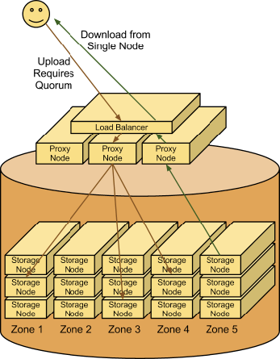
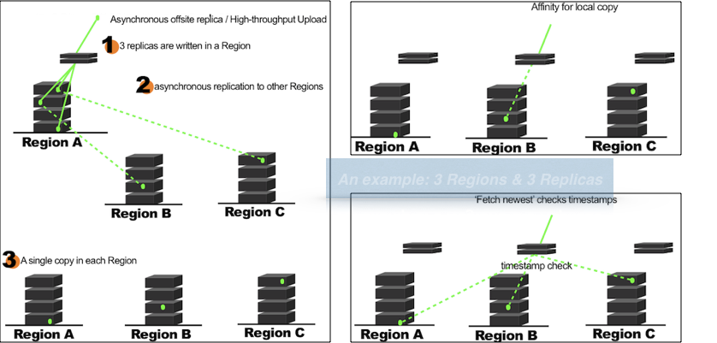
INFN Cloud
Federation approach
Swift highlight

Slide 57
INFN Cloud: modello di Federazione
La federazione «Loosely Coupled» permette di:
  Avere una buona indipendenza nei singoli siti per quanto riguarda la gestione di hw e sw stack di cloud
    Siamo riusciti a federare non solo OpenStack, ma anche OpenNebula, AWS, Azure, etc insieme a Mesos, etc.
  È sufficiente individuare attentamente le APIs e le configurazioni supportate (e richieste) dal layer di federazione
È però necessario fare attenzione alle seguenti criticità (gestite a livello di PaaS e anche di IaaS):
  La presenza di una buona gestione delle SLAs
  Un buon monitoring della risorse da federare

Slide 58
INFN Cloud: modello di Federazione
La federazione «Tightly Coupled» permette di:
  Avere una replica di dati e servizi a livello di infrastruttura senza richiedere lavoro a livello applicativo
  Non si aggiungono layer aggiuntivi richiesti per il funzionamento
  Le operazioni possono essere gestite in modo distribuito fra i due team di lavoro
È però necessario fare attenzione alle seguenti criticità (gestite a livello di PaaS e anche di IaaS):
  I siti devono avere un elevato livello di trust
  È necessario che il sw stack sia perfettamente allineato
  I team che si occupano delle risorse devono avere un buon coordinamento

Slide 59
INFN Cloud: Modello di PaaS
SDK-like: PaaS come un toolkit in cui sviluppare codice in una serie di linguaggi supportati dal cloud provider
automation-like: PaaS con un set di servizi già pronti che possono essere usati:
  Per sviluppare applicazioni
  Per deployare servizi
  Per automatizzare il deployment di servizi e applicazioni

Slide 60
INFN Cloud: Caratteristiche dei modelli di PaaS
SDK-like:
  PRO:
    Se il linguaggio è quello dell’applicazione di interesse, il porting è facile è la piattaforma pensa a tutto
  Contro:
    Spesso sono funzionalità/librerie proprietarie da usare per ottenere il massimo dalla piattaforma.
    Se l’applicazione usasse un linguaggio diverso da quello supportato non esiste modo di fare il porting, l’applicazione va riscritta.
automation-like:
  PRO:
    È molto semplice aggiungere linguaggi framework non già supportati dalla piattaforma
    È possibile orchestrare servizi già disponibili senza bisogno di pensate code-rafactoring.
    È semplice fare il porting su altri provider cloud, perché non si usano librerie o funzionalità specifiche
  Contro:
    Meno trasparente per dell’altro approccio: richiedere uno studio preventivo dello use case per trovare l’implementazione migliore per il determinato problema

Slide 61
INFN Cloud: Caratteristiche dei modelli di PaaS
INFN Cloud ha adottato un approccio a orchestrazione/automazione
I servizi sono definiti da «TEMPLATE TOSCA»
  Che descrivono:
    i componenti
    Le relazioni fra i componenti
    Come installare/configurare i componenti

Slide 62
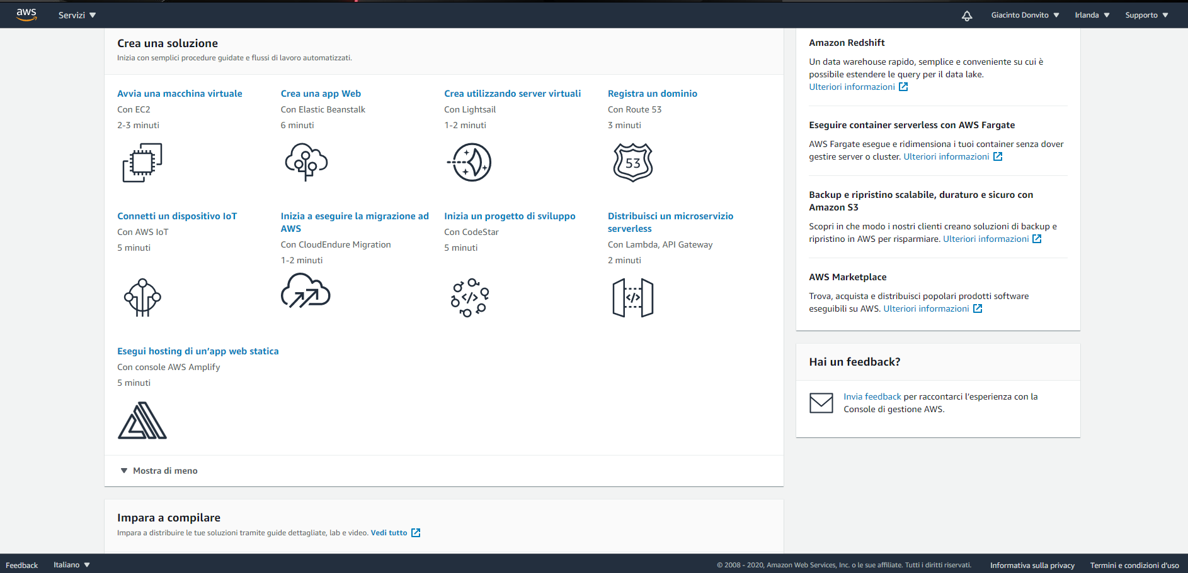
INFN Cloud: «Marketplace»
Se ASW ha la sua dashboard…
cosa abbiamo in INFN Cloud??

Slide 63
Che cosa fornisce INFN Cloud?
Un «portafoglio» di servizi che include la possibilità di istanziare:
  Macchine virtuali (VM) di differenti dimensioni e tipi, con o senza volumi esterni.
  Docker containers oppure applicazioni a container multipli definite attraverso file docker-compose.
  Cluster basati su orchestratori di container come Mesos e Kubernetes. Un utente può cioè chiedere autonomamente ad esempio un «cluster Kubernetes as a service» e poi utilizzarlo per istanziarvi le proprie applicazioni.
  Ambienti pre-configurati per data analytics (che usino es. Spark e/o ElasticSearch e Kibana, R, etc.).
  Soluzioni di storage a oggetti e posix, anche connesse a servizi applicativi ad alto livello; ad esempio, Jupyter Notebooks dotati di storage permanente e automaticamente replicato.
  Cluster dinamici realizzati secondo specifiche di esperimento o collaborazione; ad esempio, cluster con un HTCondor batch system, ambienti ottimizzati per ML con GPU, notebook pre-configurati con simulatori di Quantum Computing, etc.).
  Servizi che necessitino di user-level encryption di dischi (sull’intera infrastruttura INFN Cloud) o dedicati al trattamento di dati sensibili (per ora solo sulla infrastruttura Cloud certificata IEC/ISO 27001 presso il CNAF).
Il portafoglio di INFN Cloud può venire facilmente esteso a fronte di nuove esigenze, grazie ad un linguaggio ad alto livello che ci consente di riusare e comporre una serie di moduli standard («service composition»).

Slide 64
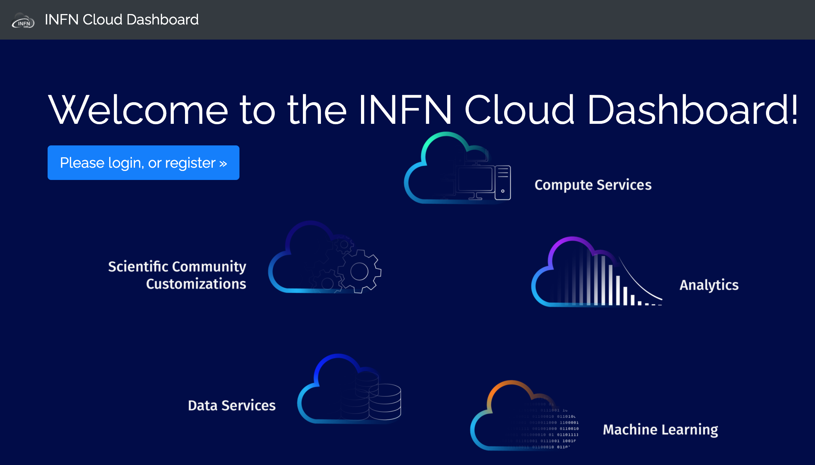
La nuova Dashboard: https://my.cloud.infn.it

Slide 65
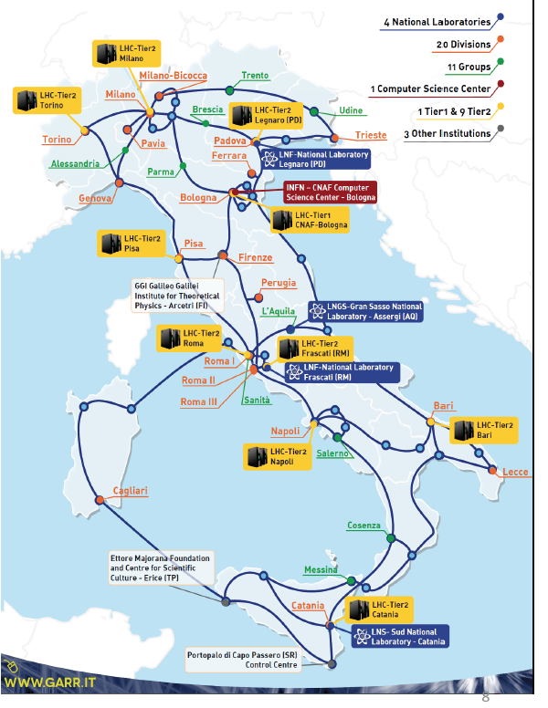
INFN Cloud, https://www.cloud.infn.it/
In production since March 2021.
The seed of a National Datalake for research and beyond, building on existing, renewed or new e-Infrastructures.
The base of the evolution of the INFN Distributed Computing vision.
Built on a thin middleware layer running on top of federated clouds, decoupling physical and logical views via a service composition mechanism.
The INFN foundation of all the NRRP computing-related initiatives.
A multi-site, federated Cloud infrastructure integrating HPC and HTC resources.

Slide 66
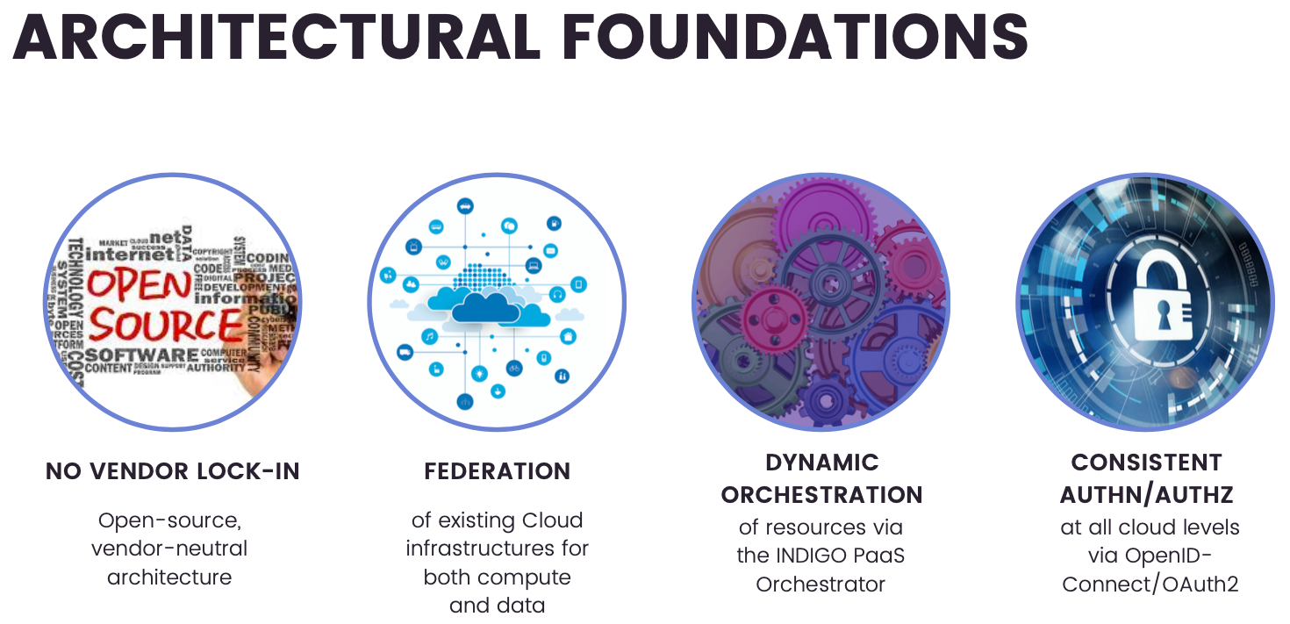
INFN Cloud

Slide 67
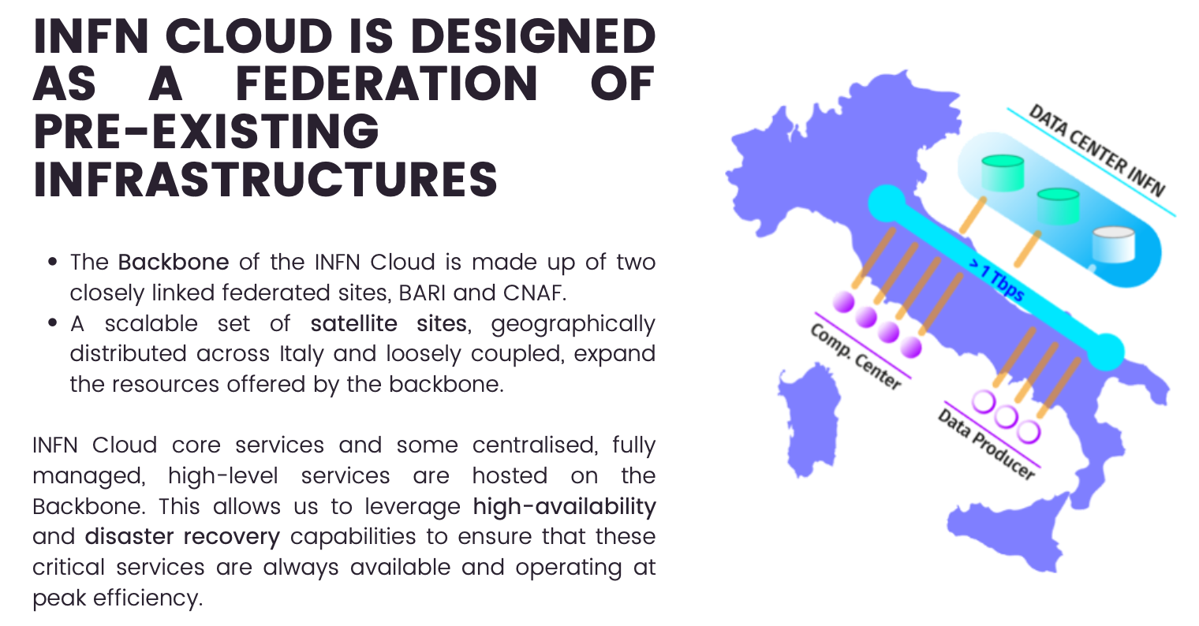
Federation

Slide 68
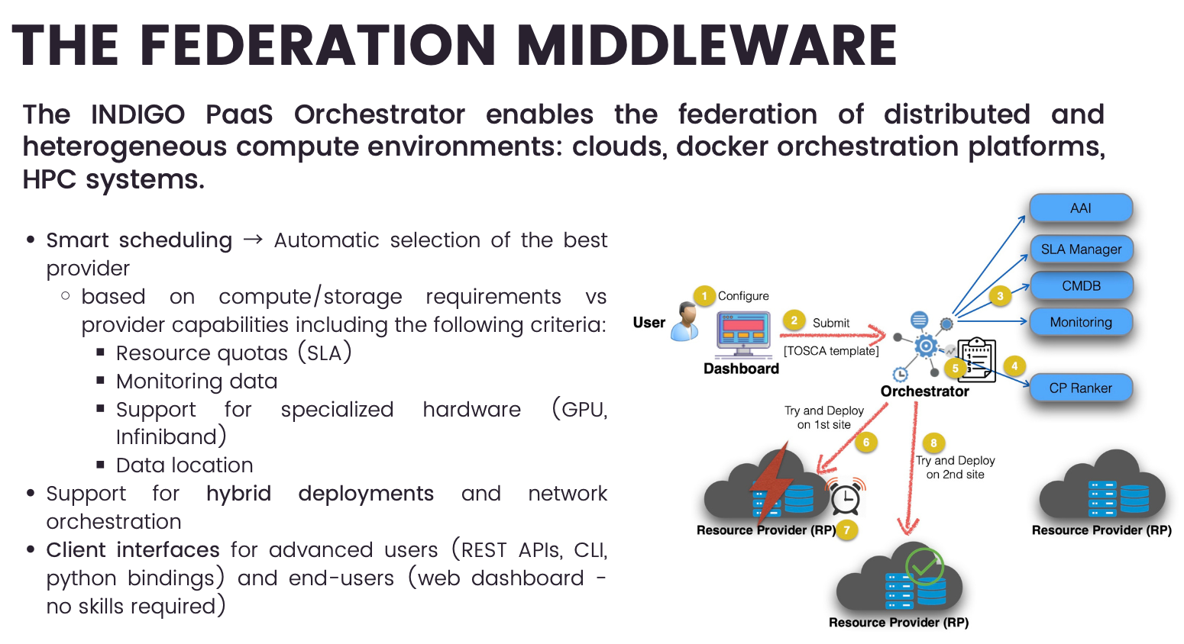
Middleware

Slide 69






Large scale datalake: Architectural overview
Object
Storage as a
Service
Cloud
Storage
(Object + POSIX)
Distributed
File System
Tape
Sync and
Share
Software Distribution Tool
Portfolio
Data Management Service
PaaS Layer
Site 1
Site 2
…
Site n
INFN Cloud

Slide 70
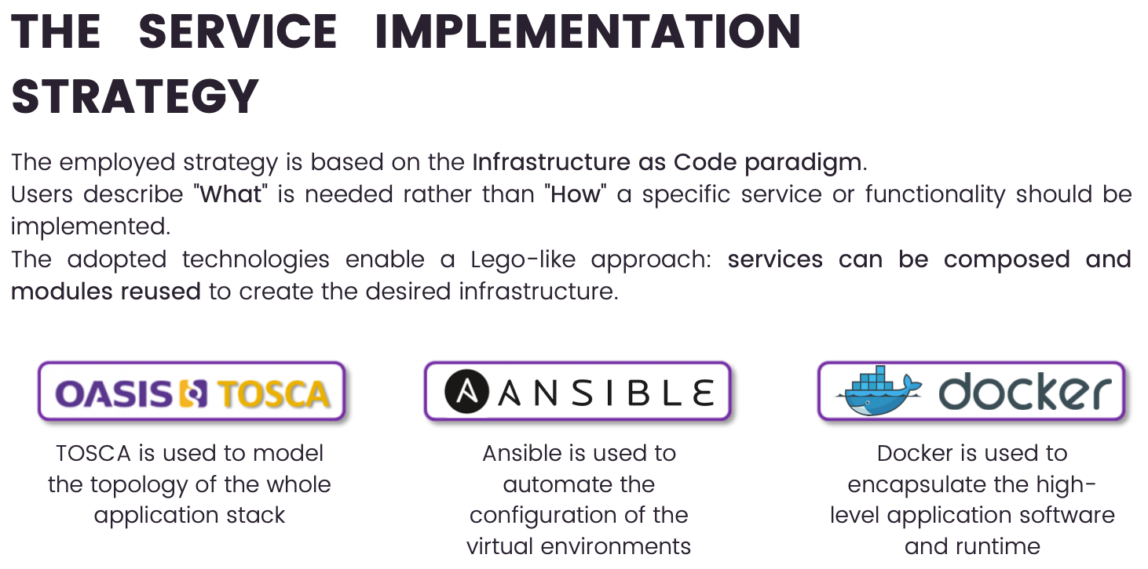
Implementation: adaptive solutions
Keyword:
Service Composition

Slide 71
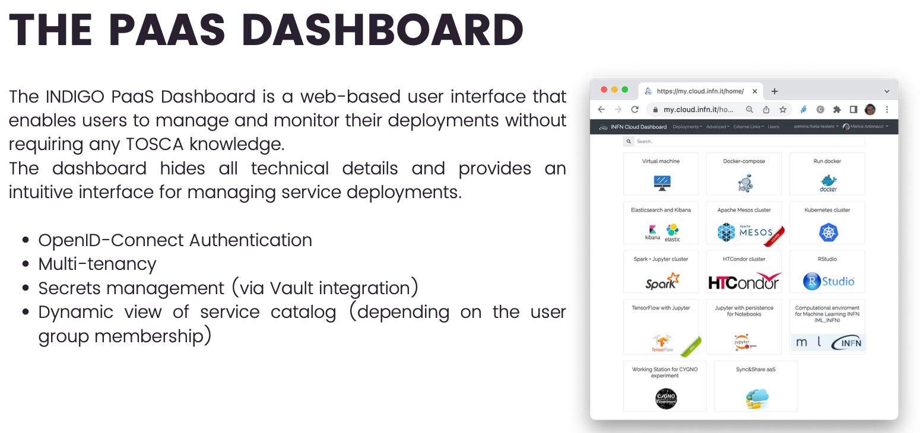
Front-ends

Slide 72
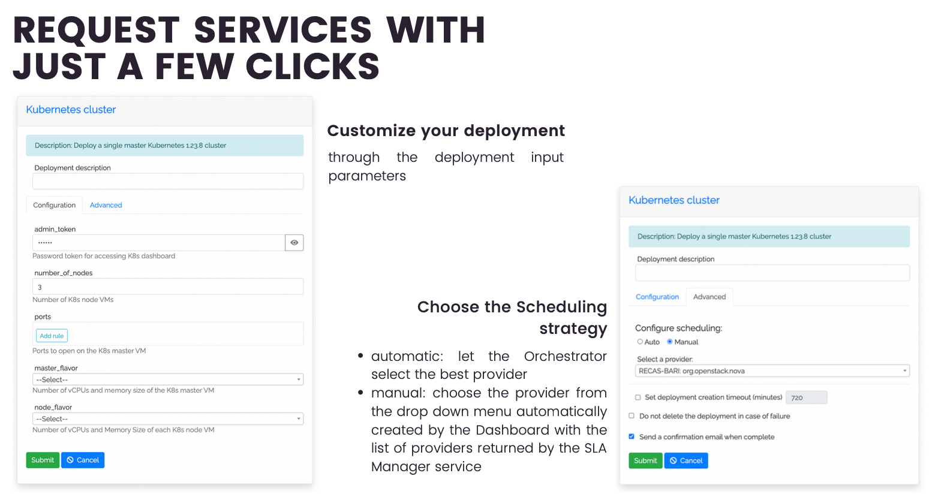
Self-provisioning

Slide 73
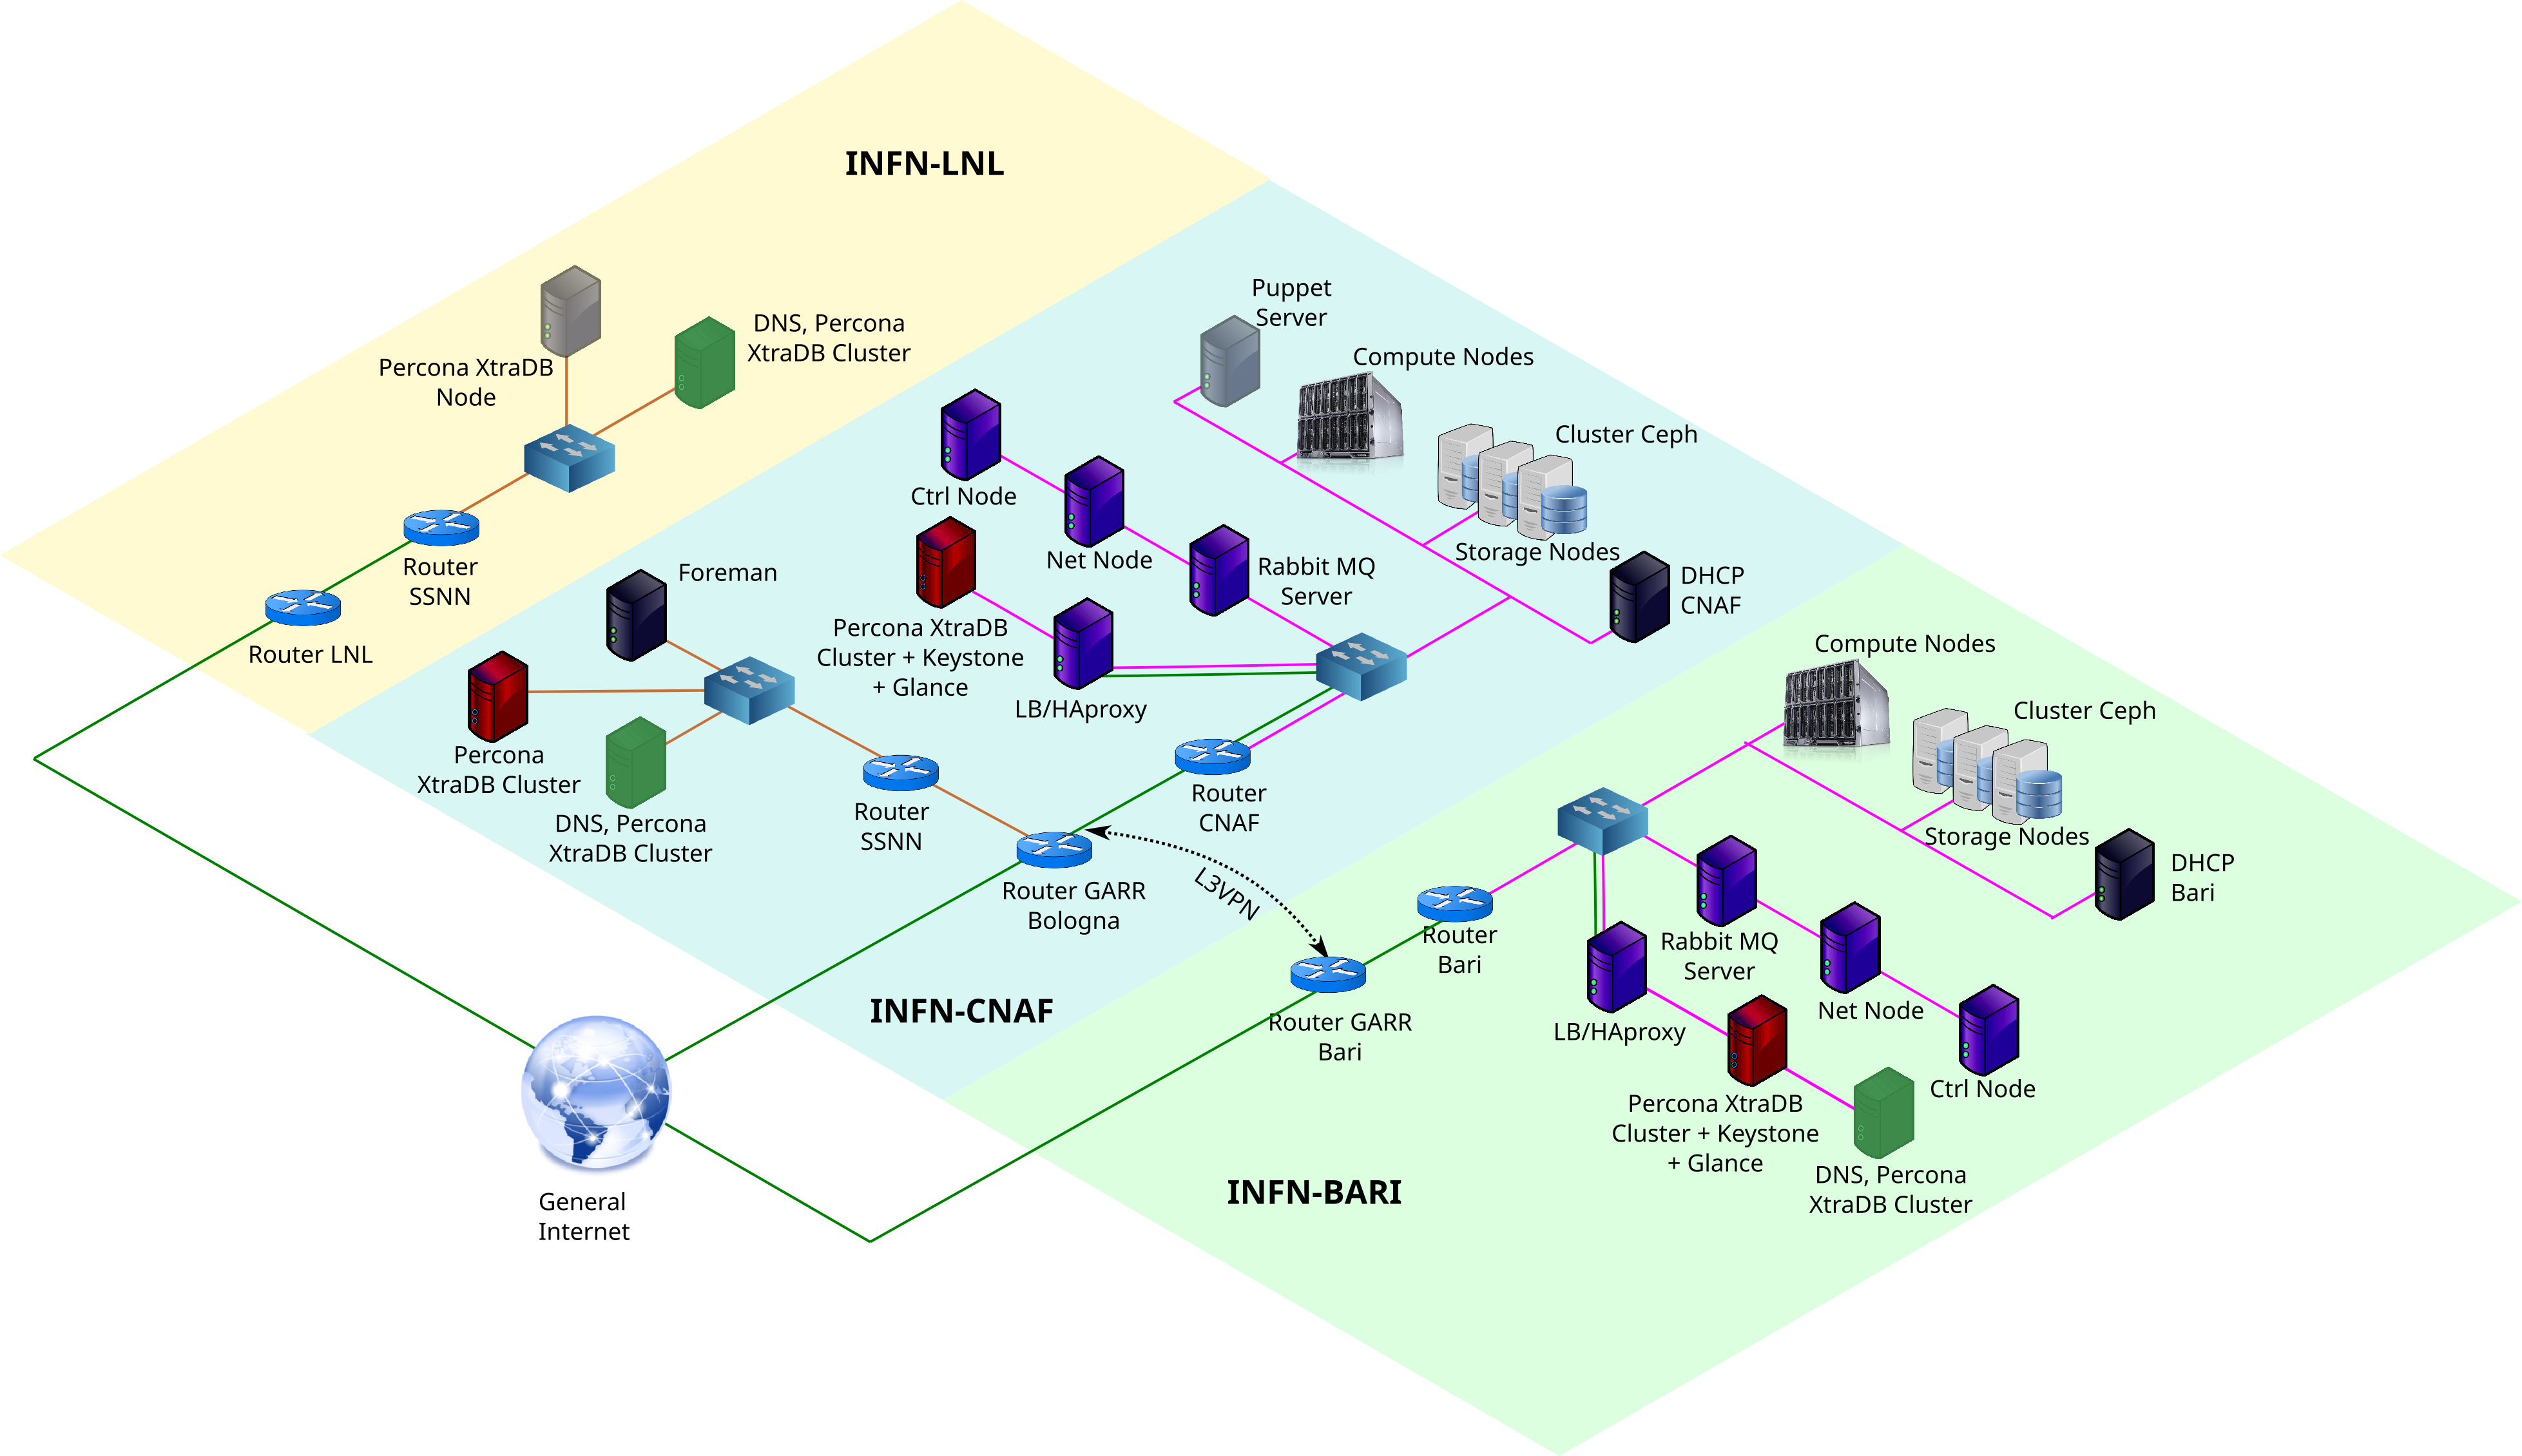
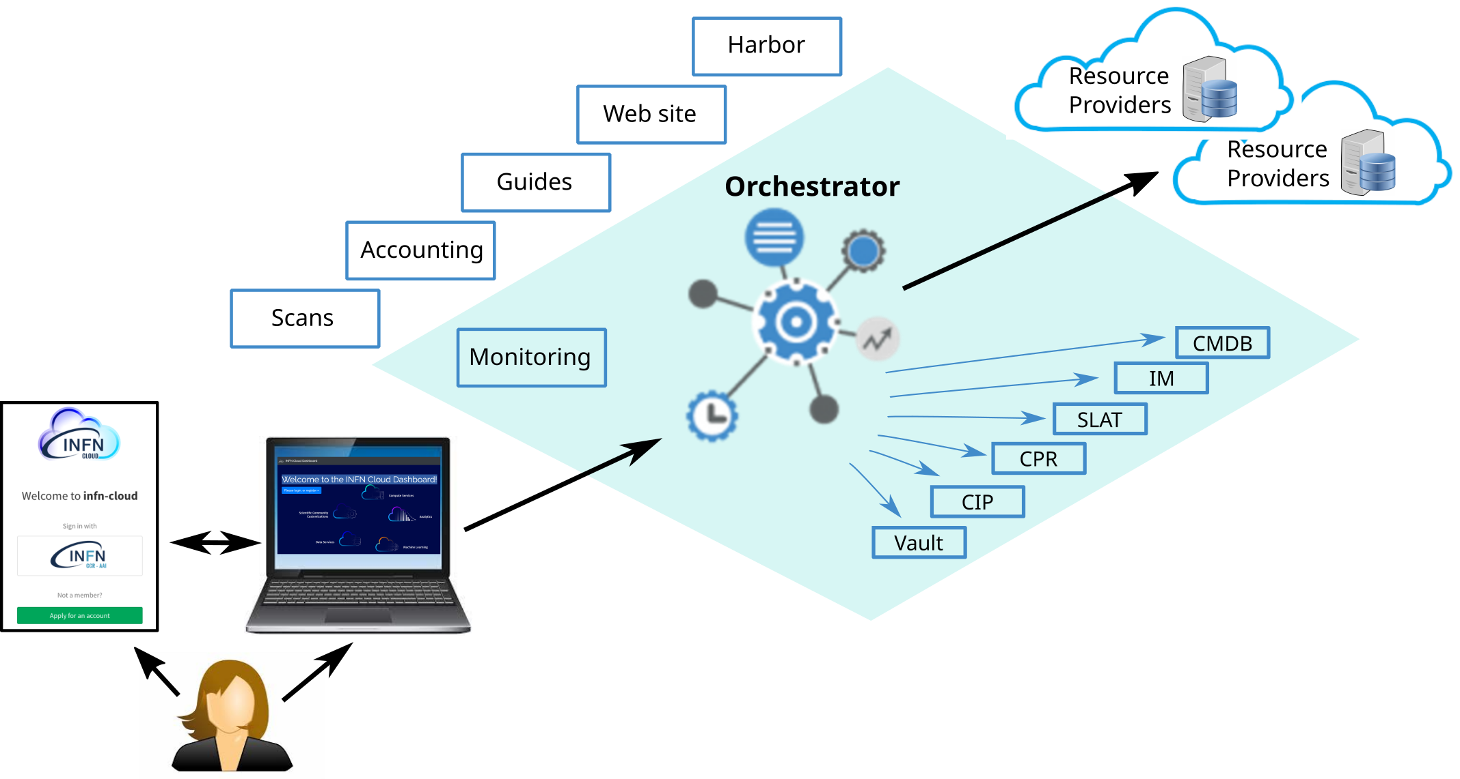
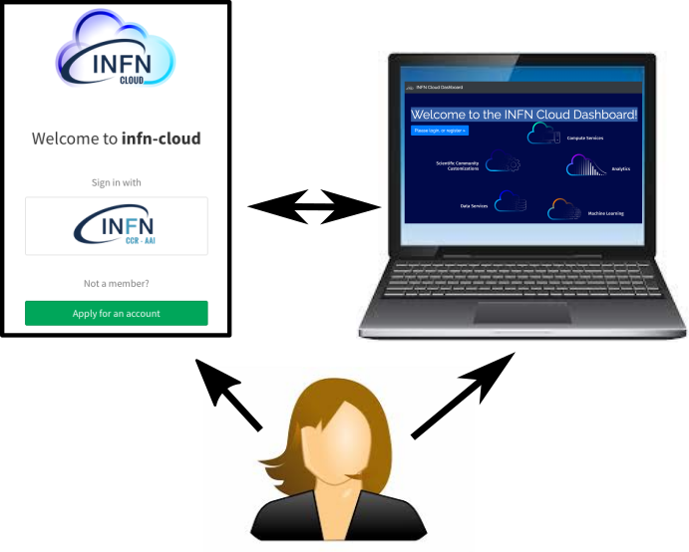
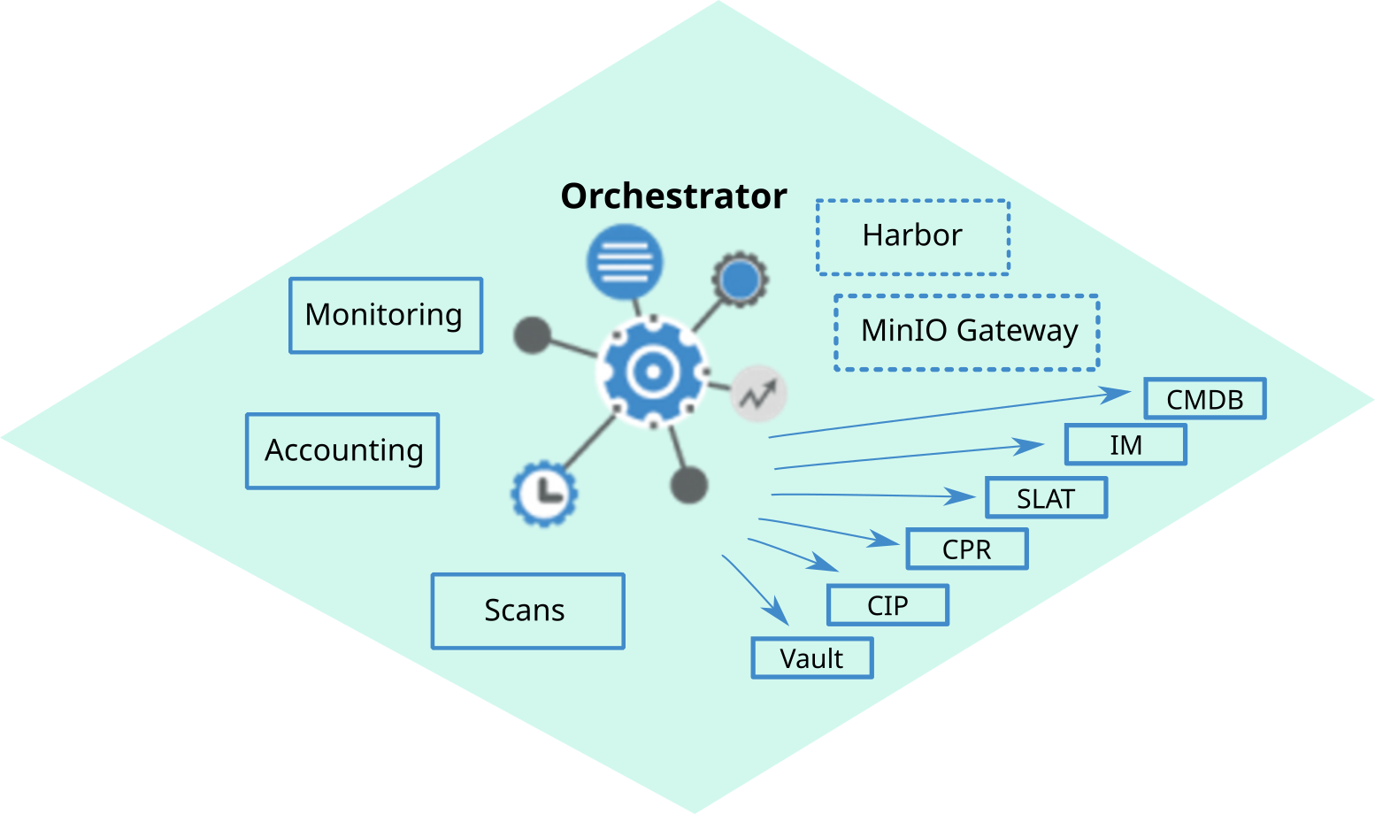

Architettura vari livelli
IaaS
PaaS
Infrastrutture federate
ReCAS Bari
Cloud@CNAF
CloudVeneto
Backbone Bari
Backbone CNAF

Slide 74


Mesos PaaS solution exploiting INDIGO platform
2) Deploy TOSCA with Vanilla VM / Container
SaaS
Future Gateway API Server
User
6) Access Mesos Services
1) Stage Data
PaaS
Orchestrator
Other PaaS Core Services
Provider
IM
5) Mount
IaaS
Virtual Elastic Mesos
Cluster
Public IP
4) Install / Configure
IM
Cloud Site
Chronos/Marathon
Clues
Heat
Workers
…
Workers
Mesos Masters
OpenNebula
OpenStack

Slide 75
Chi usa INFN Cloud già oggi
A parte casi d’uso «semplici» (creazione di VM, container, etc.), abbiamo realizzato soluzioni (che possono poi essere riutilizzate da altri in modo generale) in collaborazione con e adottate da:
  ML-INFN (gruppo 5) → interfaccia Jupyter con soluzione di cache embedded per sfruttare NVME, con accesso a GPU.
  CYGNO (gruppo 2) → integrazione nativa di storage a oggetti (con interfaccia S3) fornito dal backbone, dove attualmente ci sono i dati di esperimento.
  CMS (gruppo 1) → utilizzo di Cloud-INFN per l’implementazione di DODAS, cioè risorse opportunistiche on-demand che si connettano in modo trasparente alla CMS main job queue al CERN, e potenzialmente per analysis facility HL-LHC.
  AMS (gruppo 2) → calcolo opportunistico su infrastrutture Cloud (risorse INFN Cloud integrate con risorse reperite presso ASI, Google e T-Systems in modo trasparente).
  TIFPA → storage basato su Owncloud con backend S3 realizzato sul backbone di INFN Cloud, con setup completamente automatizzato e completato con monitoring.
  FERMI (gruppo 2) → (work in progress) sistema batch integrato con cloud storage per i workflow di analisi dati.
  Jennifer II (gruppo 1) →(work in progress) integrazione tra un sistema esterno (vcycle) e l’orchestratore di INFN Cloud.

Slide 76
Altre comunità «in Cloud»…
Ci sono anche diversi altri esperimenti che già usano risorse fornite in Cloud e magari non lo sanno / non lo vedono. Non c’è in questi casi ancora esplicita connessione a INFN Cloud ma per tutti prevediamo la possibilità di utilizzare in futuro il portafoglio di INFN Cloud. Alcuni esempi su Cloud@CNAF:
  Neutrino/Dune (gruppo 2) → interactive node (16CPU) for analysis with scratch space on cloud volumes - archive storage on t1 storage – graphical access via x2go.
  AMS e Darkside (gruppo 2) → ancillary services (monitoring information).
  Virgo (gruppo 2) → ancillary services (monitoring information), Kubernetes cluster (5 nodes, it might become a Kubernetes as a Service with INFN Cloud for low-latency analysis (to avoid batch system queues delay), plus several powerful user interfaces for interactive access (currently only virtualized but not cloudified yet).
  Icarus (gruppo 2) → interactive node (16CPU), for analysis with scratch space on cloud volumes.
  JUNO (gruppo 2) → ancillary services for Testbeds (RUCIO+FTS) and infrastructure developments plus INDIGO-IAM test instance (to be moved to production).
  FAZIA, N_TOF (gruppo 3) → small clusters (4/5 nodes) for production/analysis, with scratch space on Cloud volumes, instantiated on demand.
  ASFIN (gruppo 3) → powerful (16 cores) node for interactive/graphical HPC jobs – performance issues more cores needed, with scratch space on cloud volumes.
Vogliamo dunque discutere se e in che modo integrare o espandere i servizi di INFN Cloud per queste comunità e le loro applicazioni, eventualmente portate in modalità cloud-native.

Slide 77
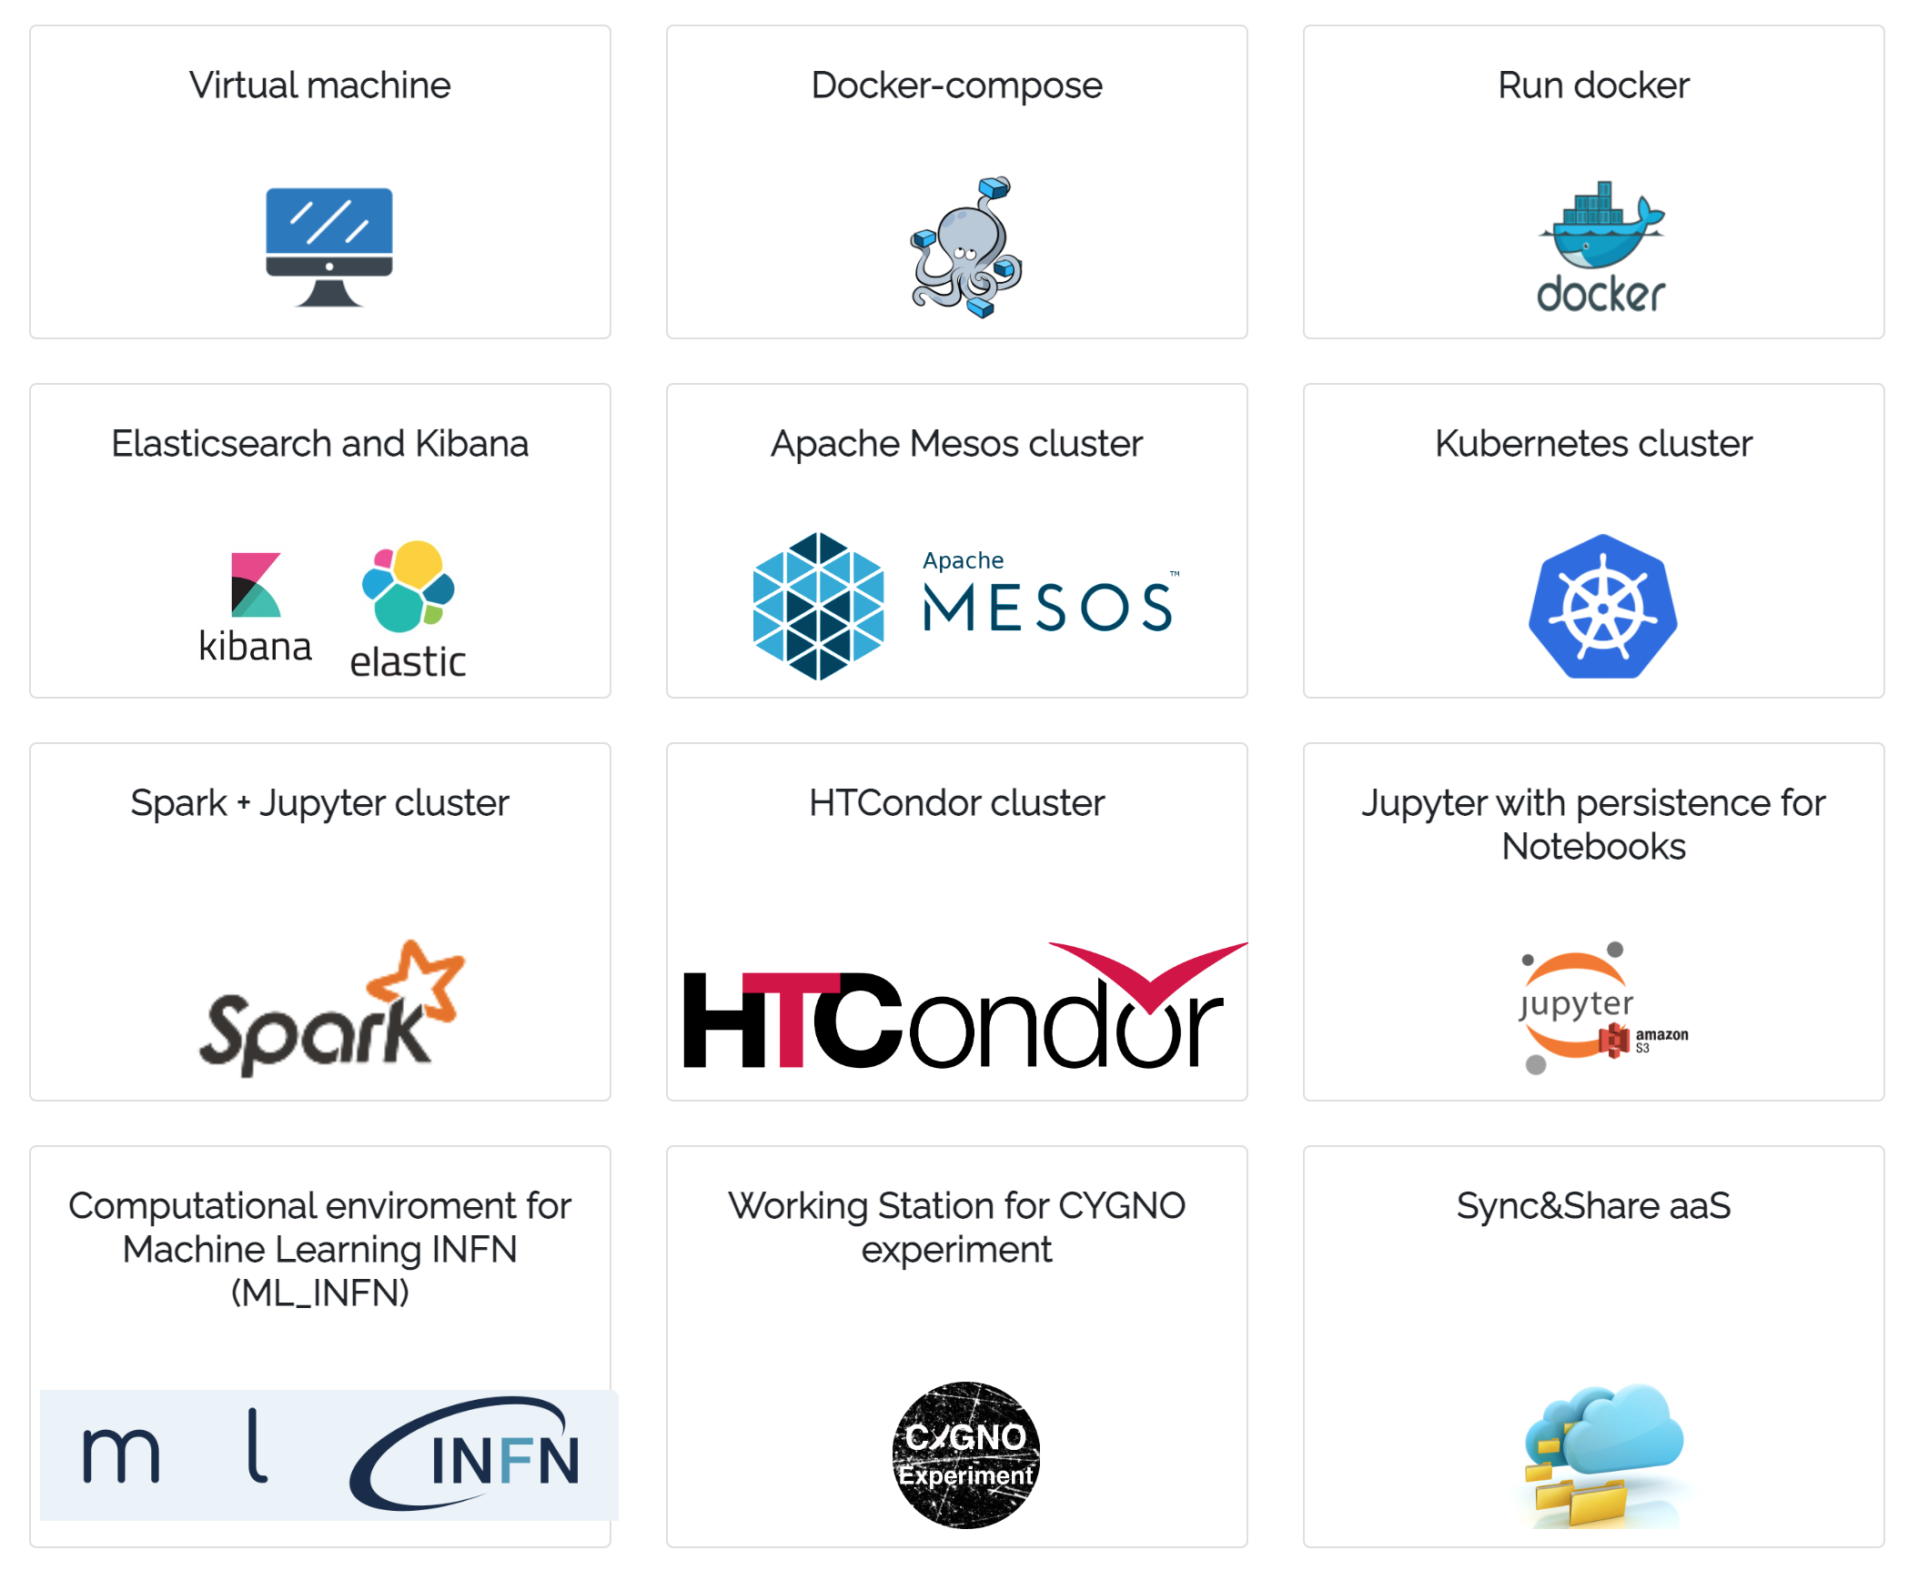
Risultati: il catalogo dei servizi
Abbiamo sviluppato e messo a disposizione molti servizi di alto livello tra cui:
  ambienti di sviluppo interattivi, dinamici, multi-utente, basati su Jupyter Notebook
    Facilmente customizzabili in base alle esigenze
    Soluzioni integrate pre la persistenza dei dati
  ambienti di calcolo per l’esecuzione di job in modalità batch (basati su cluster HTCondor)
    Integrazione con soluzioni di data access
  accesso allo storage con modalità diverse (posix, S3) a seconda degli use-case
Abilitatato un notebook as a service
  Esempio di sinergia tra WPs
Il catalogo è costruito a partire da componenti modulari altamente configurabili.

Slide 78
Risultati: funzionalità avanzate
L’Orchestrator e gli altri componenti della PaaS sono stati modificati ed estesi per migliorare le capacità di federazione dei siti e di scheduling dei deployment.
Highlights:
  Disk QoS: È possibile richiedere volumi di diverso tipo (p.e. in base alla replica, performance, etc.);
  Acceleratori: è possibile scegliere il modello per le GPU;
  Networking: è possible configurare le porte aprendole solo verso subnet o ip specifici;
  Security: è possibile creare deployment su rete private (accessibile tramite VPN con autenticazione IAM)
Dashboard evolution:
  Obiettivo è semplificare l’interazione utente-PaaS nella gestione di parametri di configurazione dei template ( TOSCA ) i.e. prendendo automaticamente authN information, etc.

Slide 79
Altri servizi / object storage
Il backbone di INFN Cloud offre un servizio di Object storage remoto e geograficamente replicato
  Use case di vario genere (backup, archiving, distribuzione dei dati)
  Servizio a livello basso, integrabile con applicazioni di alto livello
  API Swift, prevista disponibilità anche API S3 dopo aggiornamento software OpenStack

Slide 80
INFN Cloud: la vision
INFN Cloud offre un catalogo di servizi in continua evoluzione
  fornendo supporto tecnico per il porting di nuove applicazioni in cloud
INFN Cloud è una federazione di infrastrutture cloud esistenti
  Il backbone, fatto di 2 siti: CNAF e Bari
  Un set di infrastrutture cloud distribuite geograficamente (p.e. RECAS-BARI, CLOUD@CNAF, CLOUD-Veneto)
La federazione delle risorse è abilitata tramite
  uno stesso layer di autenticazione/autorizzazione basato su INDIGO-IAM
  un set di policy consistenti per la gestione degli utenti, delle risorse (reti, compute, storage), etc.
  orchestrazione trasparente e dinamica delle risorse su tutte le infrastrutture federate tramite l’INDIGO PaaS Orchestrator

Slide 81
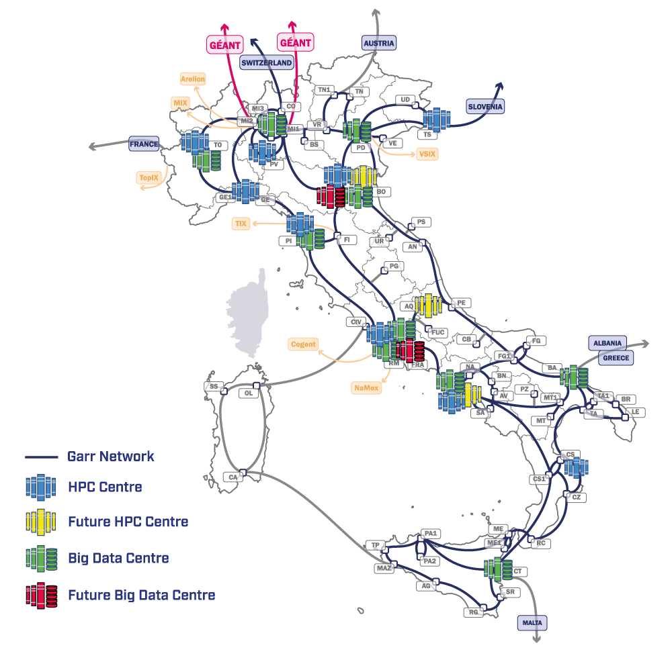
SUPERCOMPUTING CLOUD INFRASTRUCTURE
2
0
1
ISTRUZIONE E FORMAZIONE, IMPRENDITORIALITÀ,
TRASFERIMENTO DI CONOSCENZE, POLICY, OUTREACH
FUNDAMENTAL RESEARCH
& SPACE ECONOMY
FUTURE HPC
& BIG DATA
3
4
L’ICSC includes
10 thematic spokes
1 infrastructure spoke
ASTROPHYSICS & COSMOS OBSERVATIONS
EARTH
& CLIMATE
5
6
ENVIRONMENT
& NATURAL DISASTERS
MULTISCALE MODELING
& ENGINEERING APPLICATIONS
7
8
IN-SILICO MEDICINE
& OMICS DATA
MATERIALS &
MOLECULAR SCIENCES
9
10
DIGITAL SOCIETY
& SMART CITIES
High-level teams of experts integrating
the Spokes working groups (mixed cross-sectional teams)
QUANTUM COMPUTING
ICSC Italian Research Center on High-Performance Computing, Big Data and Quantum Computing
Missione 4 • Istruzione e Ricerca

Slide 82



Role of INFN and HEP
INFN has been chosen by the Italian Ministry for University and Research (MUR) for driving the preparation and execution of the ICSC project
  Acknowledgement of the experience in computing technologies and Big Data in particular of INFN and HEP in general
  Strategic partners for the Supercomputing Infrastructure Cloud:
  CINECA for HPC
  GARR for networks
INFN leading role also in spoke 2 and 3:
Fundamental Research & Space Economy
Astrophysics & Cosmos Observations
ICSC Italian Research Center on High-Performance Computing, Big Data and Quantum Computing
Missione 4 • Istruzione e Ricerca

Slide 83



TeRABIT: Terabit Network for Research and Academic Big Data in ITaly
INSERIRE LOGO
https://www.terabit-project.it/
TeRABIT is a Research Infrastructure project synergic with ICSC
Partners are the same of the ICSC Spoke-0 (Supercomputing Cloud Infrastructure):
INFN, CINECA and GARR
Covers areas complementary to those of the ICSC infrastructure
ICSC Italian Research Center on High-Performance Computing, Big Data and Quantum Computing
Missione 4 • Istruzione e Ricerca

Slide 84
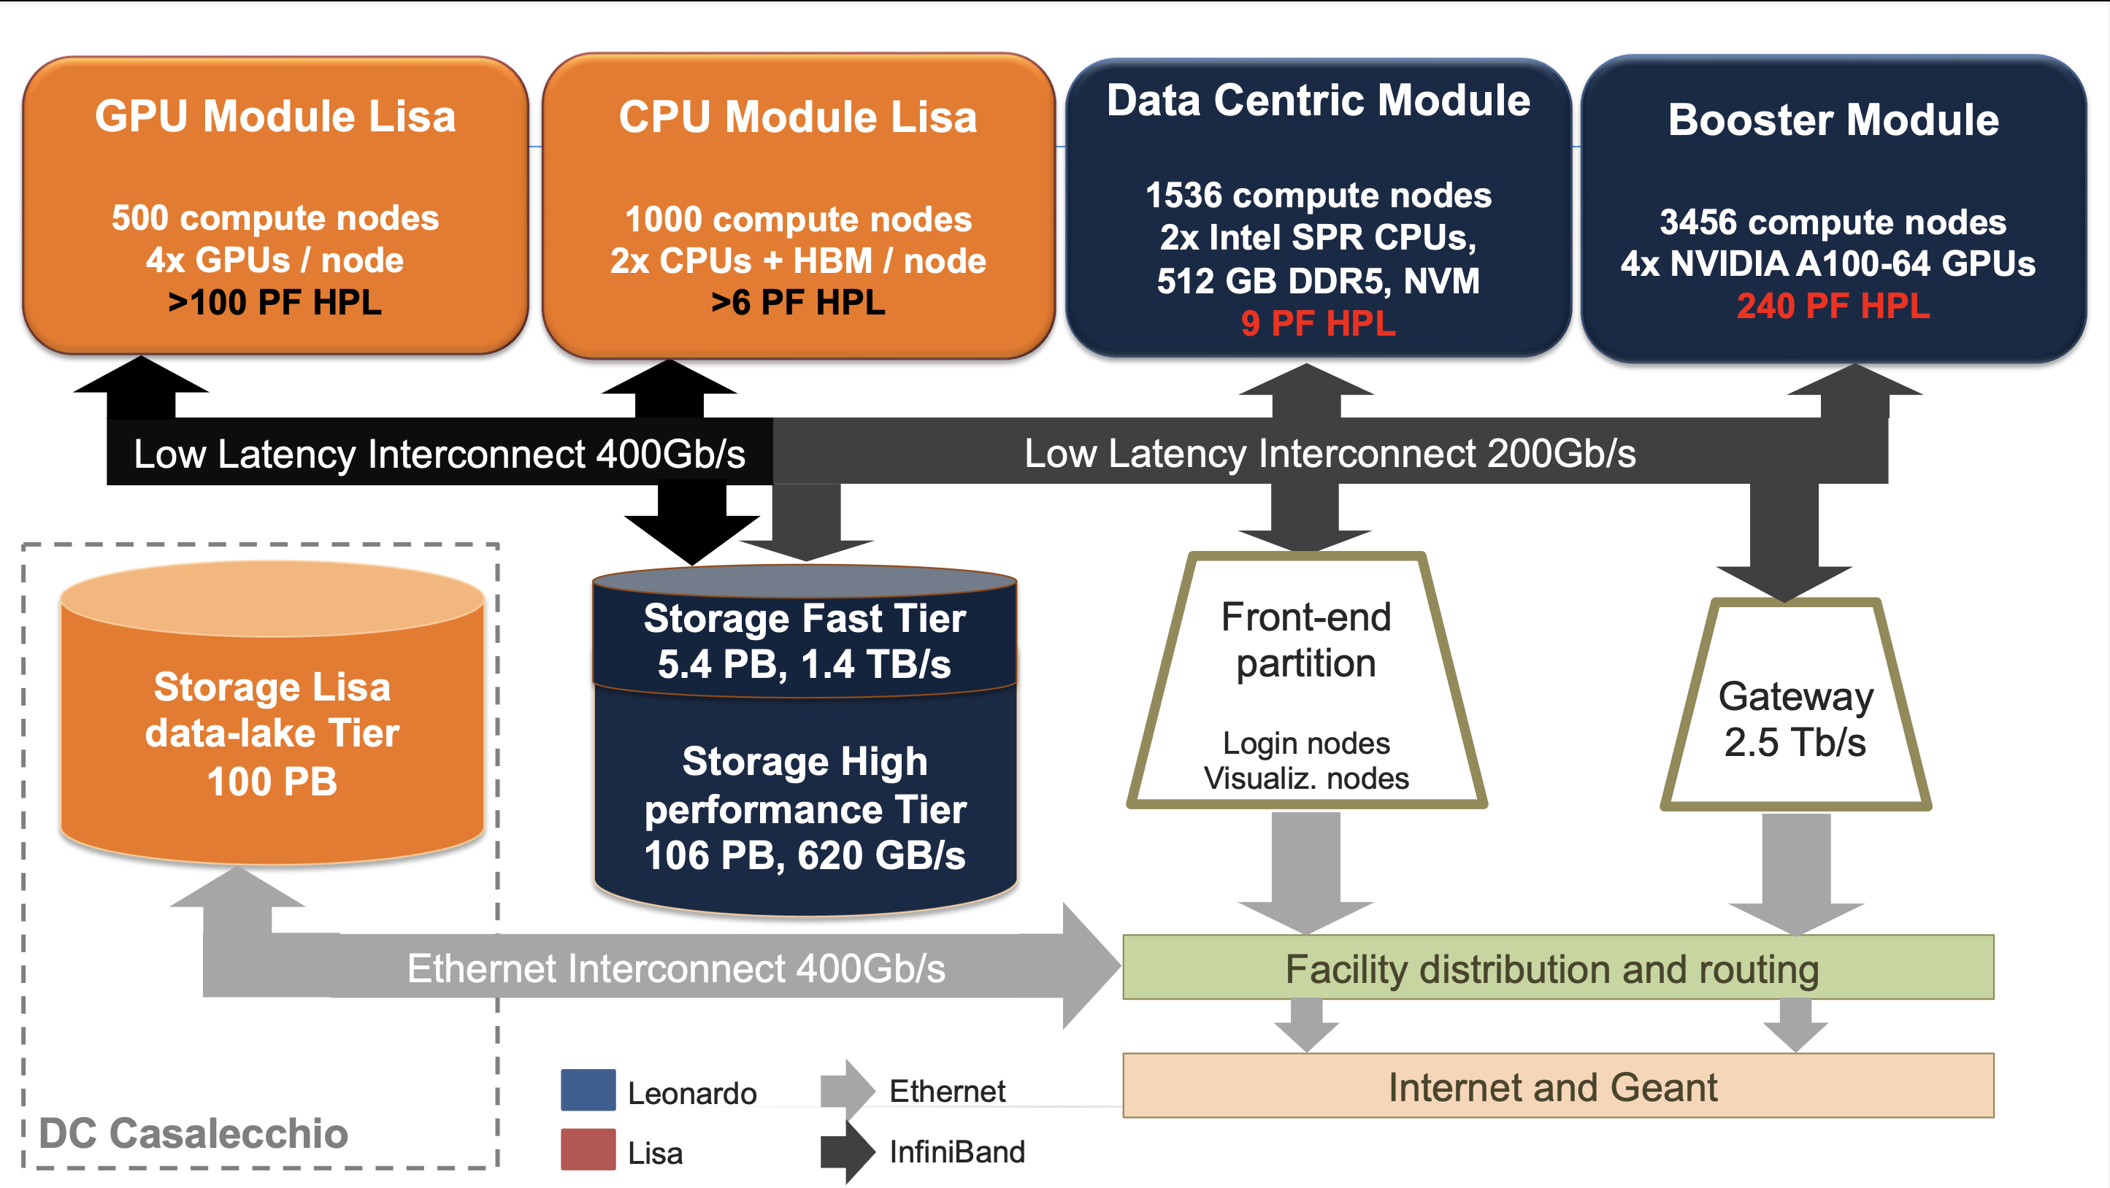
HPC
ICSC Italian Research Center on High-Performance Computing, Big Data and Quantum Computing
Missione 4 • Istruzione e Ricerca

Slide 85
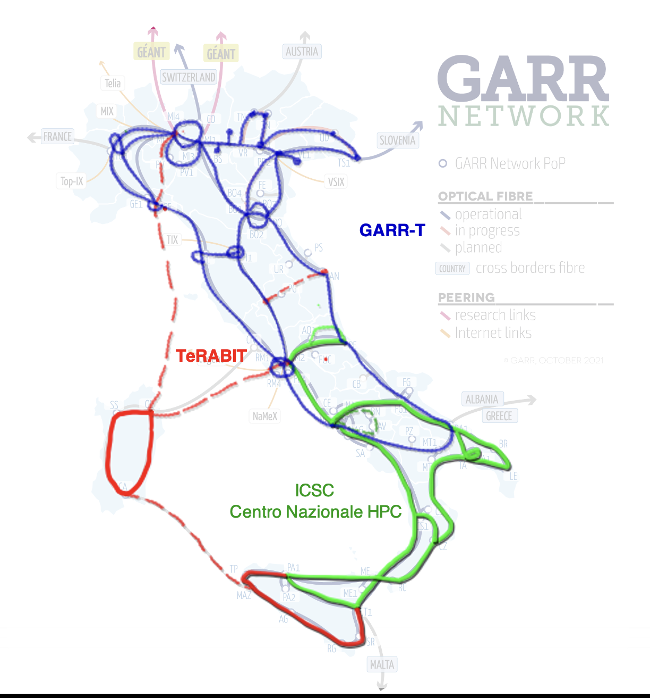
Network
  GARR-T
  Upgrade of the optical network centre-north
  OLS+DCI (100G+, 400G+)
  ICSC
  Upgrade of the GARR-X Progress network
  (OLS) upgrade (100G+, 400G+)
  TeRABIT
  Acquisition of optical fibre in Sardinia and interventions in souther
ICSC Italian Research Center on High-Performance Computing, Big Data and Quantum Computing
Missione 4 • Istruzione e Ricerca

Slide 86
Big Data and Federated Cloud
INFN WLCG Tier-1 & Tier-2 infrastructure
  Currently about 100,000 CPU cores, 100 PB disk (net), 150 PB tape
  About 100,000 more CPU cores, 80 PB disk (net), >30 PB tape + a new library at CNAF
  30 M€ investment in ICSC
  HPC bubbles: HPC systems in a selected number of sites, equipped with CPUs, GPUs (Nvidia H100), FPGA, fast storage, Infiniband
  ~10 M€ investment in TeRABIT
New data centres for Disaster Recovery (Gran Sasso) and Space Economy (Frascati)
  9 M€ investment in ICSC
ICSC Italian Research Center on High-Performance Computing, Big Data and Quantum Computing
Missione 4 • Istruzione e Ricerca

Slide 87
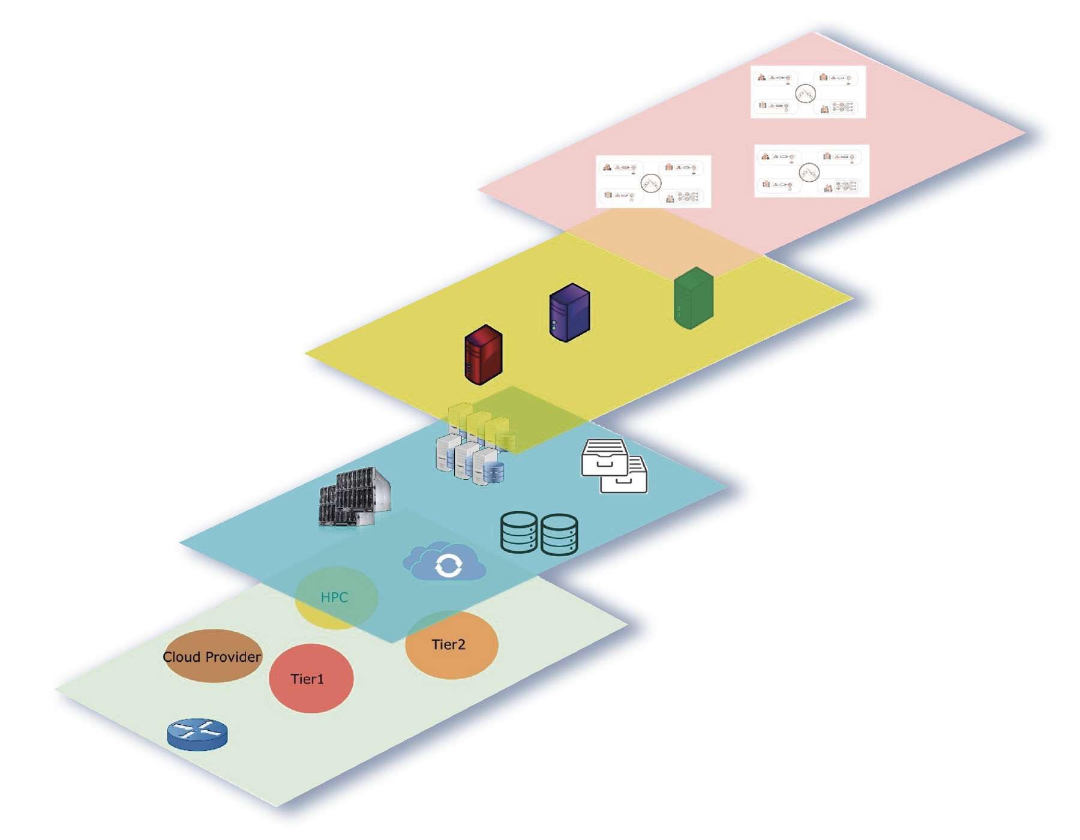
A data lake for research – High-level view
Data Lake Entry Point
The proposed model is based on:
Existing infrastructures aggregation, upgraded and made available to scientific domains
A dynamic model, where infrastructures and domains can also be temporary
A clear separation between the physical and the logical levels
A high speed network interconnection to hide the actual resource locations
A unified vision (when needed) of an Italian research data-lake
Unified vision
User Community Services
Individual communities
services
General Services
Generic services
Infrastructure sites
Data centres and
resource providers
ICSC Italian Research Center on High-Performance Computing, Big Data and Quantum Computing
Missione 4 • Istruzione e Ricerca

Slide 88
The “Cloud-Data lake” model
●
It is the evolution of the computing infrastructure for both Hep and not Hep experiments.
Resources no longer provisioned only through dedicated grid sites
●
–
inclusion of HPC systems and commercial clouds as part of the resources we must be able to take advantage of
●
INFN already demonstrated the capability to execute LHC workflows on HPC systems (in particular @ CINECA) and on commercial clouds (e.g. ARUBA).
●
Optimize storage access and management
–
reduce the number of replicas, few big sites high speed connected; cpu and storage no longer coupled together;
deploy caches where needed.
–
–
INFN Cloud is the initial seed of a national data lake infrastructure for research and beyond. It also has a central role in the Italian National Recovery and Resilience Plan (PNRR) computing related initiatives.

Slide 89

Le “HPC Bubbles”
Sono regioni, distribuite sul territorio nazionale e accessibili in modalità Cloud Computing che espanderanno l’infrastruttura INFN HPC-BD-AI e su cui sarà possibile eseguire calcoli ad altissime prestazioni (HPC).
Forniranno cluster e soluzioni modulari e flessibili con risorse di tipo CPU, GPU, FPGA e storage veloce, saranno combinabili tra di loro e si integreranno con i grandi centri HPC nazionali, come Leonardo o PRACE-Italy, con il Centro Nazionale ICSC e con altre Cloud o centri HPC internazionali.

Slide 90
Terabit project will provide “HPC Bubbles”
Founded on TERABIT PNRR project we will acquire HPC-Bubbles on several INFN data centers
CPU clusters:
  > 1.5TB / server
  > 200 core / server)
  InfiniBand Connected
CPU+GPU clusters:
  At least 4 x GPU [h100] / server
  InfiniBand Connected
CPU+FPGA Clusters:
  2 vendors FPGAs
  FPGA-mesh
Fast storage Clusters
  > 1 PB ssd+hdd
Services specification:
  Perfectly integrated with INFN-Cloud Services
  Connections among the HPC Bubbles (Virtual HPC Bubbles)
  Connections among HPC Bubbles and HPC traditional centres (i.e. Leonardo, PRACE-Italy, VEGA and others)
Giacinto Donvito INFN-Bari EGI Conference 2023

Slide 91
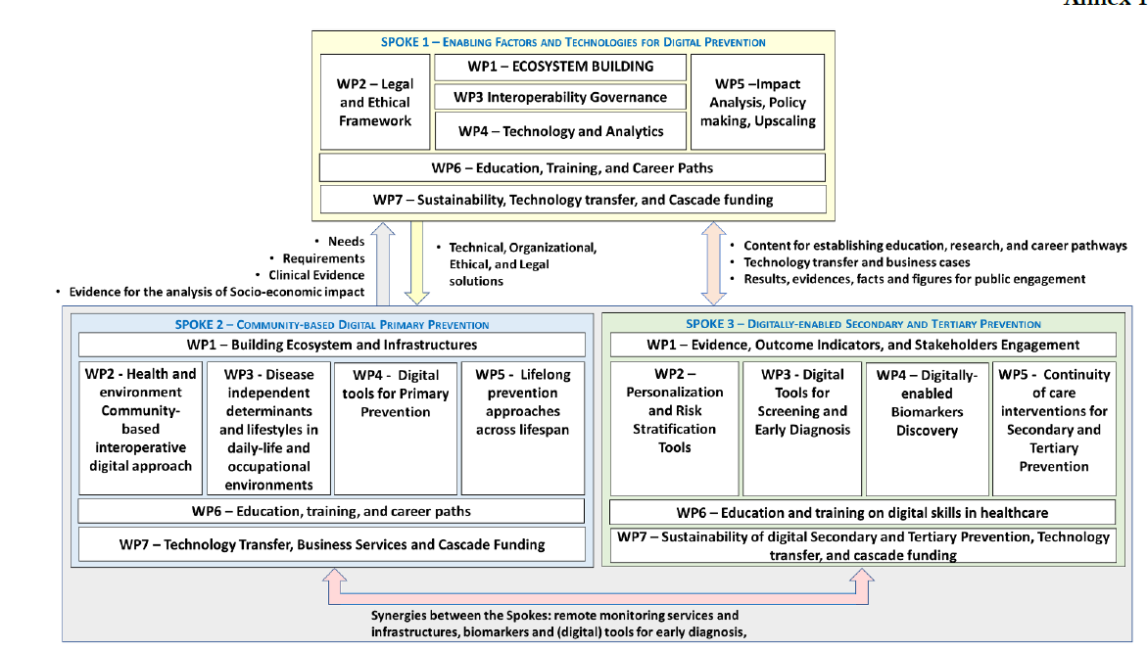
PNRR: DigitAl lifelong pRevEntion (DARE)

Slide 92
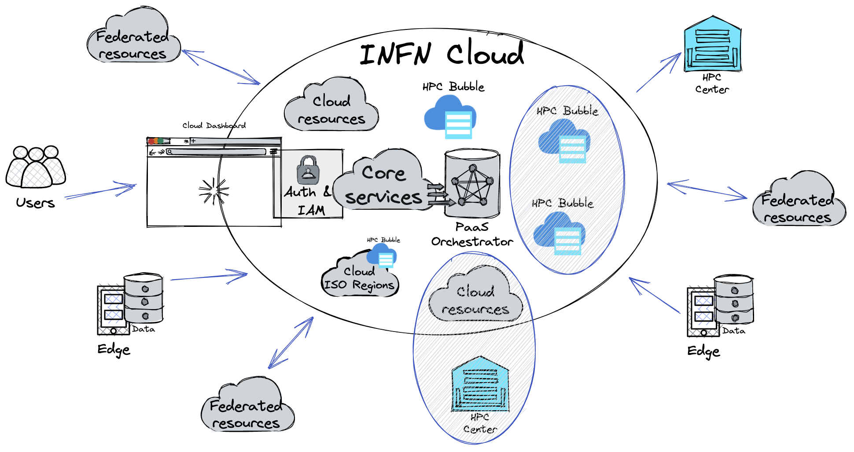
The continuum from Edge, to Cloud, to HPC
Giacinto Donvito INFN-Bari EGI Conference 2023

Slide 93
EPIC Cloud
Enhanced Privacy and Compliance Cloud – The INFN Cloud partition located at CNAF for personal and confidential data processing
Motivation: the GDPR states that Clinical and medical data (in particular genomic) is personal data (it fits in the Art.9 special categories of personal data).
  Genomic data is mostly impossible to be anonymized → GDPR shall always be applied
  ISO/IEC 27001 is the main certification mechanism compliant with GDPR requirements (Art. 43, 58, 63)
In order to comply with the requirements of health research projects INFN is involved in, we created a region of the INFN Cloud infrastructure, applied specific organizational and technical security measures, and certified it ISO/IEC 27001, 27017, 27018.
  This is the EPIC Cloud: a reference Cloud implementation for the treatment of sensitive data at INFN.
See the presentation on EPIC on 11/10 for more details
From the Data Controller side, the fact that EPIC Cloud is ISO-certified is a way to demonstrate that processing is performed in accordance with the GDPR.

Slide 94

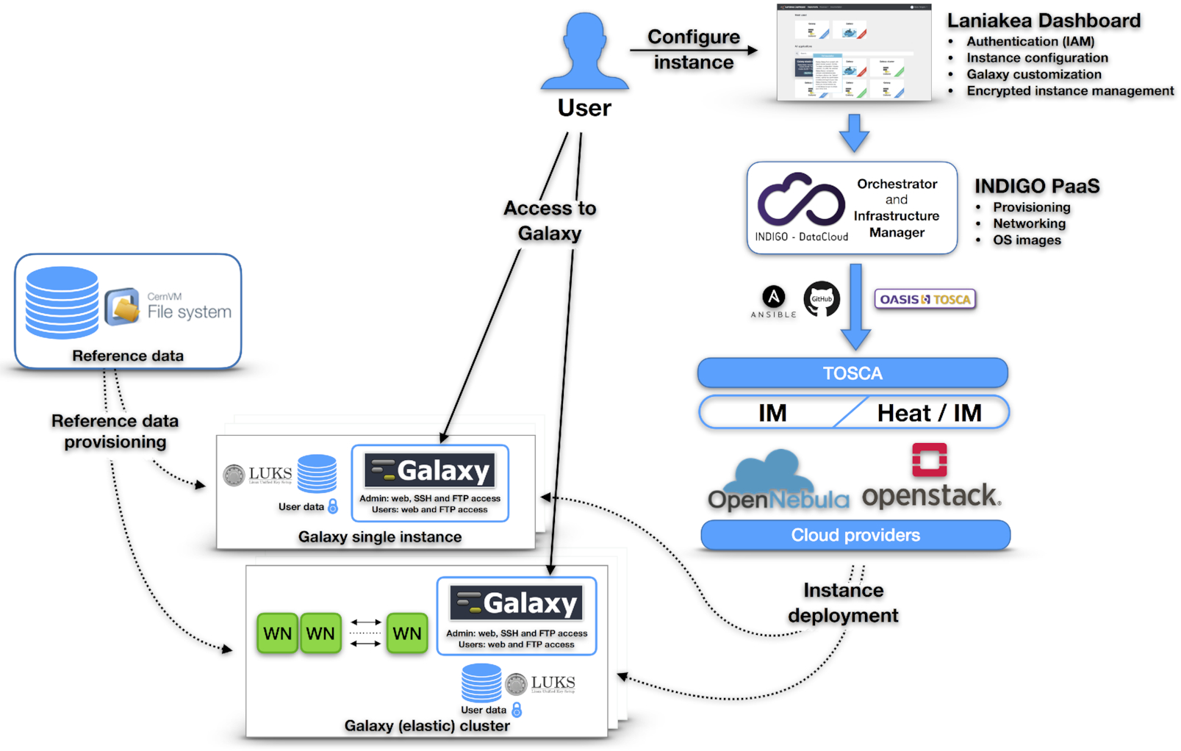
Laniakea architecture
Dashboard - User friendly access to configuration and and launch of a Galaxy instance
INDIGO-IAM - Authentication and Authorization system
INDIGO-PaaS - PaaS layer for Galaxy deployment
Cloud Provider - ReCaS Bari
Persistent storage with/without encryption
Hashicorp Vault - secrets management
Reference data availability with CERN-VM FS

Slide 95
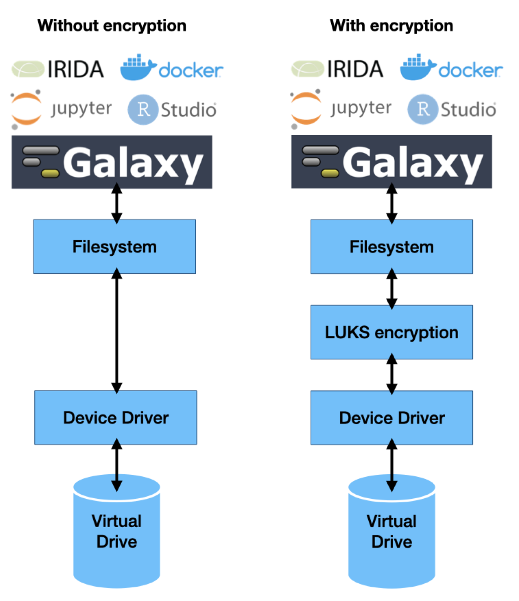
The underlying infrastructure
LUKS - Linux Unified Kernel Setup
A python package (pyLUKS) is used to encrypt the storage using a random passphrase and then store it on Hashicorp Vault.
The encryption layer sits between the physical disk and the file system.
Galaxy, or any other application, is unaware of storage encryption.
Galaxy exploits a specific mount point in order to store and retrieve files. Files are encrypted when stored to disk and decrypted when read.
Default encryption algorithm:
aes-xts-plain64 encryption
256 bit key
sha256 as hash algorithm used for key derivation.

Slide 96
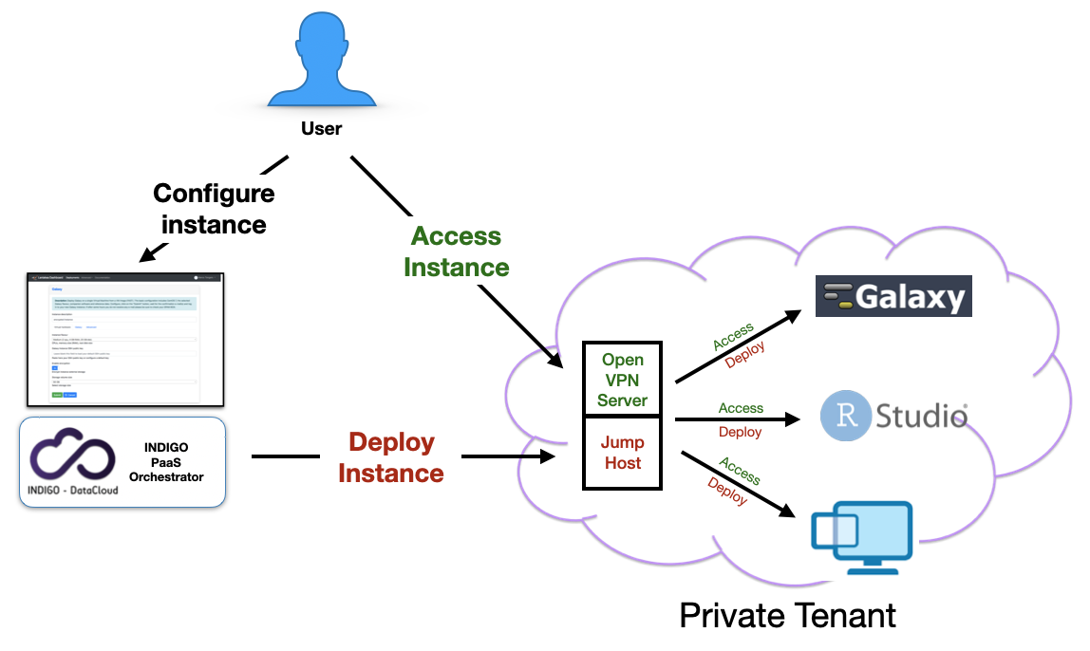

Deployments under VPN
VPN isolated environments - Automatic deployments of virtual environments on private networks.
Isolation is reached using Tenant and security groups properties, granting the access only through VPN authentication.
User authentication to the VPN using the same Laniakea credentials.

Slide 97
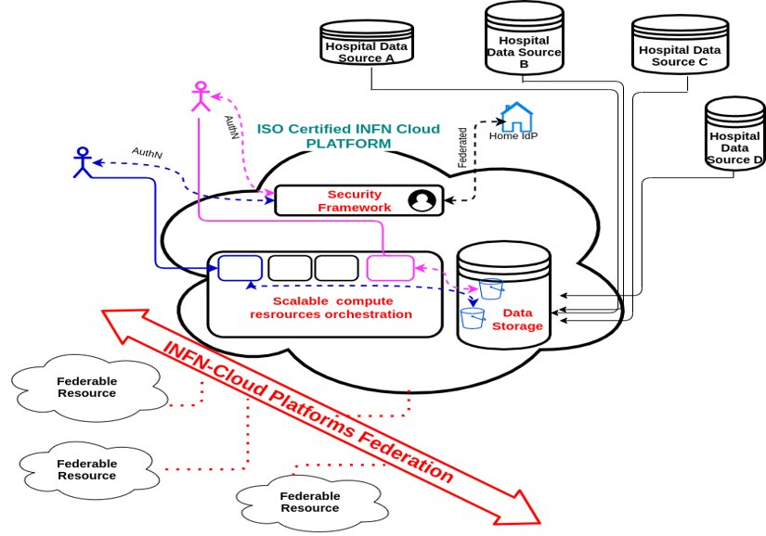
The goal: a federated datalake
Multiple ways to ingest and process data are possible. For example, to handle sensitive data (e.g., in the nation-wide Health Big Data project), we are working on supporting these options:
Central harvesting of data generated remotely
Edge-level anonymization, followed by central ingestion and analysis of data
Edge-level feature extraction, followed by central ingestion and analysis of features
Federated learning based on edge-level training, followed by publishing of the trained methods and by inference performed either centrally or at other edge locations.
Edge-Cloud-HPC Continuum
https://www.physicamedica.com/article/S1120-1797(21)00320-3/fulltext

Slide 98
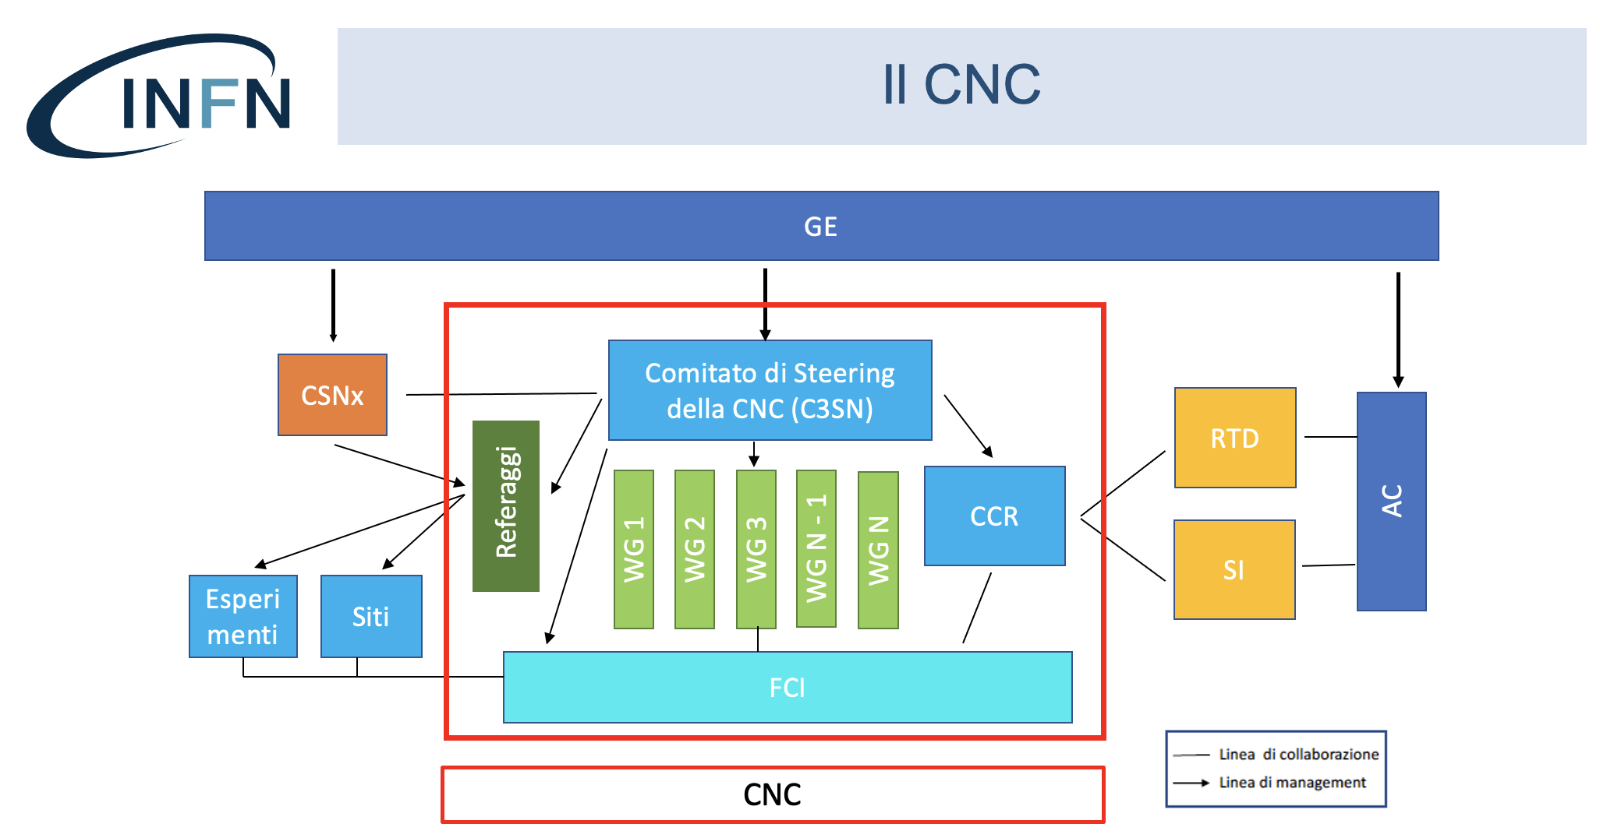

The New INFN Computing Structure
One of these WGs is the
DataCloud WG, extending and evolving the existing INFN Cloud project.
Datalake +
INFN Cloud
⬇️
DataCloud

Slide 99
The mandate of the DataCloud WG
The DataCloud WG deals with several core activities related to computing @ INFN:
  Development, implementation & management of the INFN Datalake architecture.
  Development of ISO-Certified solutions. These have been seeing strong demand, thanks also to activities linked to the National Recovery and Resilience Plan (NRRP) and to various collaborations.
  Support to users and to the management and operation of INFN Tier-x sites.
  Development of new services.
A key point of this WG is the integration between the traditional, WLCG-like Tier-x infrastructure and the “Cloud Native” model (currently represented by INFN Cloud).
  Integration of what? → Of resources, methods, people, solutions.

Slide 100
The DataCloud WG structure
Projects WG
The DataCloud WG
WP2: User & Project
Support
New Technologies
WG
WP3: Resources,
Data Lake,
Sustainability
WP1: Operations
WP7: Integrated Management
System, Legal Compliance
Other WGs
WP4: Security,
Policies
WP6: R&D, Testbeds,
Use cases
WP5: Middleware,
New Services
External Activities
(DOMA,
WLCG AuthZ, etc.)

Slide 101
Le attività dei progetti PNRR (e non solo) e i WPs Data Cloud
Tutte le attività legate anche ad iniziative esterne (PNRR, EU, Nazionali) devono sempre trovare una collocazione/riferimento nei WP di Data Cloud
  Le operation del ICSC e TERABIT ➔ WP1
  Lo user support delle nuove comunità di utenti di ICSC ➔ WP2
  Il planning dell’allocazione delle risorse (IT e personale) ➔ discusso nel contesto di WP3
    C’è stata una intensa attività di pianificazione, di concerto con i responsabili locali delle varie sedi, per ottimizzare la distribuzione delle nuove persone sulle vari attività in corso e necessarie per l’infrastruttura distribuita DataCloud
  La security e il supporto a use case con dati sensibili, i problemi per l’accesso alle risorse da persone esterne a INFN ➔ WP4/WP7
  Le attività di R&D per l’implementazione di nuovi servizi, use case dei progetti, sviluppo/supporto middleware ➔ WP5/WP6

Slide 102
I WP di DataCloud e i WP Leader
WP 1 – Operations: Stefano Stalio (LNGS), Diego Michelotto (CNAF)
WP 2 – User & Project Support: Carmelo Pellegrino (CNAF), Emidio Giorgio (LNS)
WP3 – Risorse, Data Lake, Sostenibilità: Giacinto Donvito (Bari), Daniele Cesini (CNAF)
WP4 – Security, Policies: Vincenzo Ciaschini (CNAF), Luca Carbone (MIB)
WP5 – Middleware, Nuovi Servizi: Marica Antonacci (Bari), Enrico Vianello (CNAF)
WP6 – R&D, Testbeds, Use Cases: Daniele Spiga (Perugia), Massimo Sgaravatto (Padova)
WP7 – Sistemi Integrati di Gestione e Legal Compliance: Barbara Martelli (CNAF), Nadina Foggetti (Bari)

Slide 103
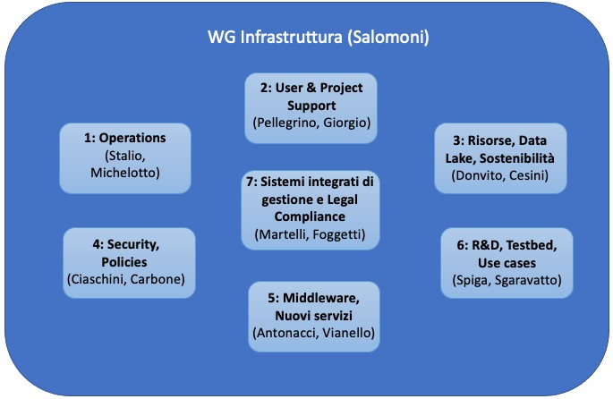
WP1: Operations
Monitoring dello stato delle risorse, accounting, reportistica.
Manutenzione e aggiornamento dell’infrastruttura.
  Grid (federazione di Tier-2) e Cloud (per backbone e in alcuni casi per le cloud federate).
Gestione dell’operatività e dei processi delle infrastrubure ISO del datalake.
Rapporti operativi con la rete GARR, ad esempio per le soluzioni di virtual availability zones previste da TeRABIT.

Slide 104
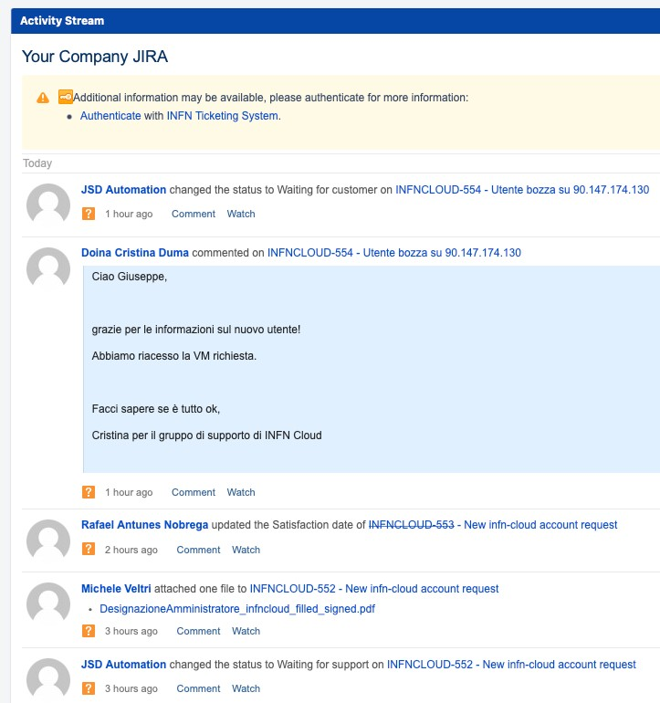
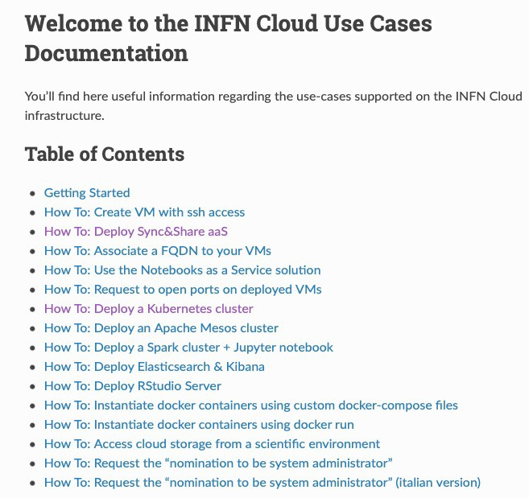
WP2: User & project support
Supporto ai siti (Tier-2, Cloud federate con INFN Cloud).
Supporto ai progetti implementati sull’infrastruttura, inclusi quelli derivanti da proposte PNRR.
Supporto di primo livello per tutte le risorse e servizi (Grid e Cloud).
  Il secondo livello è gestito a seconda del problema negli altri WP.
Formazione (corsi, webinar) e comunicazione.
Ticketing system, documentazione, knowledge base.

Slide 105
WP3: Risorse, data lake, sostenibilità
Report a C3SN per validazione gare o bandi legate ad acquisizione risorse. Questo comprende sia hardware sia personale.
Definizione di modelli di sostenibilità.
  Relazione con le CSN, ad esempio per utilizzo di risorse cloud vs. grid vs. local.
  Relazione per quanto riguarda l’uso delle risorse con i progetti nazionali ed europei, in collaborazione con il WG Progetti.
Data lake:
  Analisi dell’evoluzione dei Tier-x e del backbone di INFN Cloud.
  Evoluzione del modello architetturale di data lake, anche in collaborazione diretta con WLCG e con altri progetti o iniziative collegate.
Rapporto con infrastrutture HPC (in particolare CINECA), in collaborazione con il WG HPC.

Slide 106
WP4: Security e policies
Interfacciamento dell’infrastruttura di calcolo nazionale con CSIRT nazionali e internazionali.
Creazione e gestione di un «SOC Infrastruttura». Tra i suoi compiti, la revisione e l’approvazione delle misure tecniche legate alla sicurezza informatica dell’infrastruttura.
Definizione delle Rules of Participation per l’accesso alle risorse.
Definizione delle policies di sicurezza e di accesso alle risorse, in collaborazione con il WP7 «Sistemi integrati di gestione e legal compliance».

Slide 107
WP5: Middleware, Sviluppo di nuovi servizi
Supporto e sviluppo di:
  Middleware: IAM, PaaS, dashboard cloud, StoRM, VOMS, Argus
  Tool: monitoring, accouning
Sviluppo di nuovi servizi a seconda dei casi d’uso (ex WP5 di INFN Cloud).
Sviluppo di soluzioni idonee alle infrastrubure ISO, che spesso richiedono «bespoke soluEons» o comunque parEcolari.
In generale, questo è il WP responsabile delle attività di «software management» (compresa la Software Quality Assurance).
Quanto testato o sviluppato, nel caso di passaggio in produzione, passerà a WP1 «Operations».

Slide 108
WP6: R&D, testbed, use cases
In collaborazione con il WG nuove tecnologie.
Raccolta e analisi di use case dalle comunità scientiﬁche.
Esempi di testbed per il data lake:
  Test di implementazione tecnica ed evoluzioni. Ad esempio: replica automaica, uilizzo di Rucio, gerarchia di cache.
  Integrazione di infrastruyure HPC.
  Per infrastrutture ISO: federazione di risorse e ingesion (anche in streaming) di dai distribuii di natura sensibile.
Quanto testato o sviluppato, nel caso di passaggio in produzione e in collaborazione con WP5, passerà a WP1 «Operations».

Slide 109
WP7: Sistemi integrati di gestione e Legal Compliance
Pianificazione, organizzazione e conduzione del sistema di gestione integrato
della Infrastruttura di calcolo INFN, che comprende l’insieme dei processi per
garantire Information security, Qualità dei servizi e Business continuity.
Nel campo della information security: gestione, in stretta collaborazione con WP4 «Security»,
dei processi di definizione dei requisiti/obiettivi di sicurezza, valutazione dei rischi, audit
interni ed esterni, gestione incidenti, misurazione della conformità e dell’andamento dei
risultati raggiunti nel tempo.
Definizione, in stretta collaborazione con il WP4 «Security,» delle security
policies.
Supporto alla definizione di: DMP, legal ed ethical requirements per nuovi
progetti e/o convenzioni, in collaborazione con il WG Progetti.
Data protection, in collaborazione con il DPO INFN.
Certificazione ISO per i diversi siti e servizi INFN (a livello IaaS, PaaS o SaaS).
Questi temi non sono da intendersi esclusivamente per i «siti ISO-certified».
Collaborazione con Ufficio Trasferimento Tecnologico.

Slide 110
Conclusioni
Sicuramente ciascuno di voi è stato già contattato da un WP di DataCloud
  Se non è successo scrivetemi (donvito@infn.it)
Ricordate i WP di DataCloud non sono i WP dei progetti su cui rendicontate!! ☺
Per noi questo è un periodo molto importante: possiamo veramente realizzare una piattaforma flessibile, scalabile, moderna e aperta a supportare molte comunità scientifiche diverse
Ci serve tutto il vostro aiuto
Ma non partiamo da zero… vi trovate in un ambiente dinamico con un elevato tasso di know-how sulle più moderne tecnologie ICT.
Siamo sicuri che questo movimento sarà anche molto importante per il «sistema paese»
Se riusciamo a mettere a fattor comune le nostre esperienze a supporto della comunità scientifica italiana

