Slide 1
Electron & Positron beams in the CERN secondary areas
N. Charitonidis [CERN, BE-EA] on behalf of BE-EA-LE colleauges
05.10.2023

Slide 2
Outline
Introduction – Scope of the presentation
Overview of the CERN secondary areas
Possibilities of today’s available electron / positron beams
Outlook for the future

Slide 3
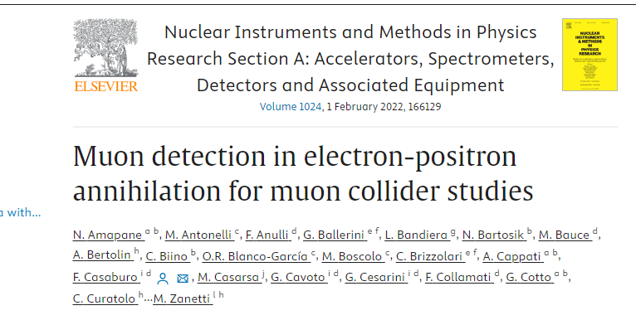
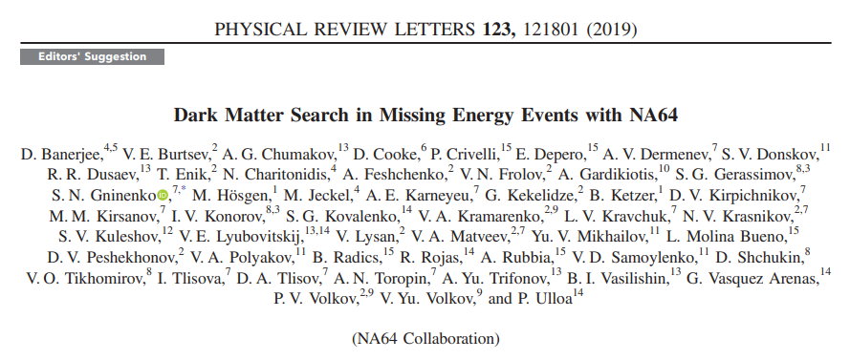
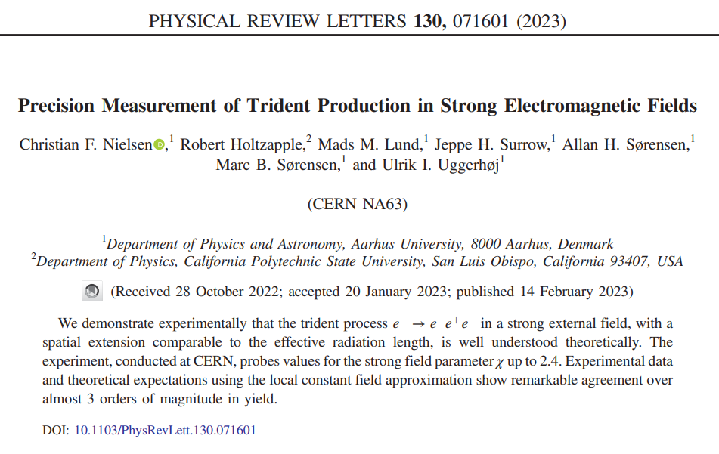
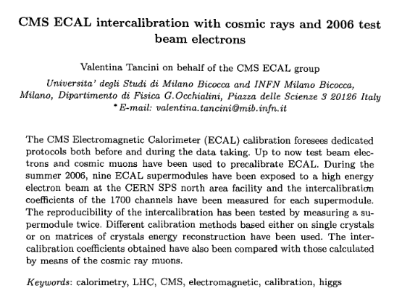
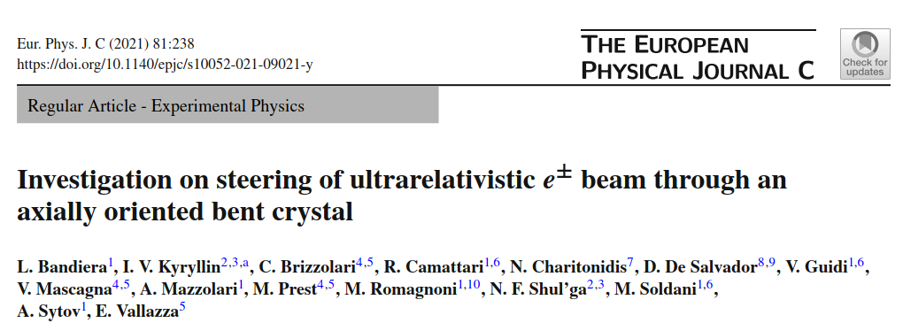
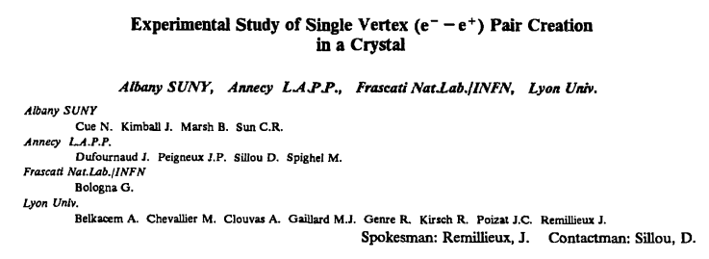
Introduction
The secondary beam areas of CERN are unique, versatile facilities that can offer particle beams of a very broad range of momenta and intensities.
Electron & positron beams of high purity have been and are available, while they are recently requested more and more for physics & R&D purposes
LEMMA
NA64
NA63
CMS
NA33
NA42

Slide 4
Existing Proton-driven Facilities
Present
Future

Slide 5
The secondary beam areas today
SPS : protons/ions @ 400 GeV/c/Z
PS: protons /ions @ 24 GeV/c/Z
North Area → $≤$400 GeV/c/Z (primary beam) or $≤$360 GeV/c/Z (secondary beams)
East Area → $≤$ 10 GeV/c secondary beams
Electrons / positrons available both in North & East areas.

Slide 6
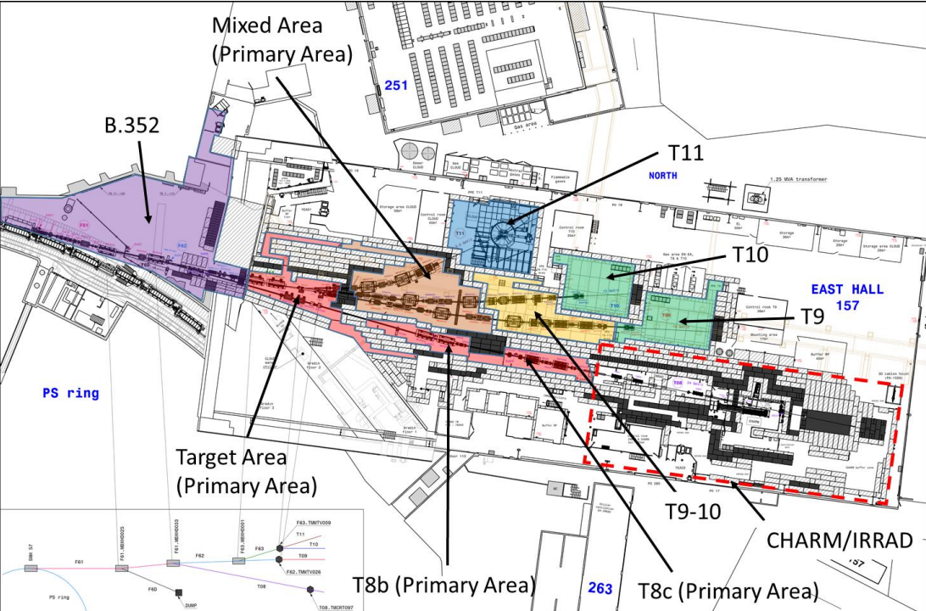
East Area of CERN/PS
Two beamlines available for tests : T9 and T10
Electrons of momenta 0.5 GeV/c – 10 GeV/c available
Purity variable between 99% - 50% (lower – higher momenta)
Spill structure from PS accelerator:
400 ms spill length
~1 spill every 18s, more on request
Quick access, short routes from control to experimental areas

Slide 7
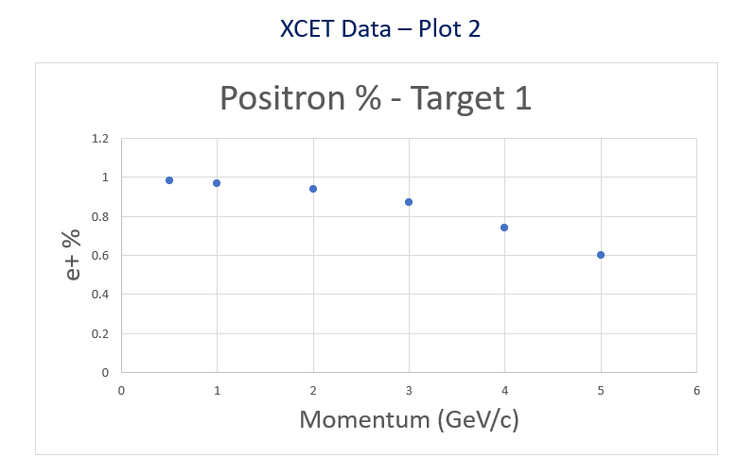
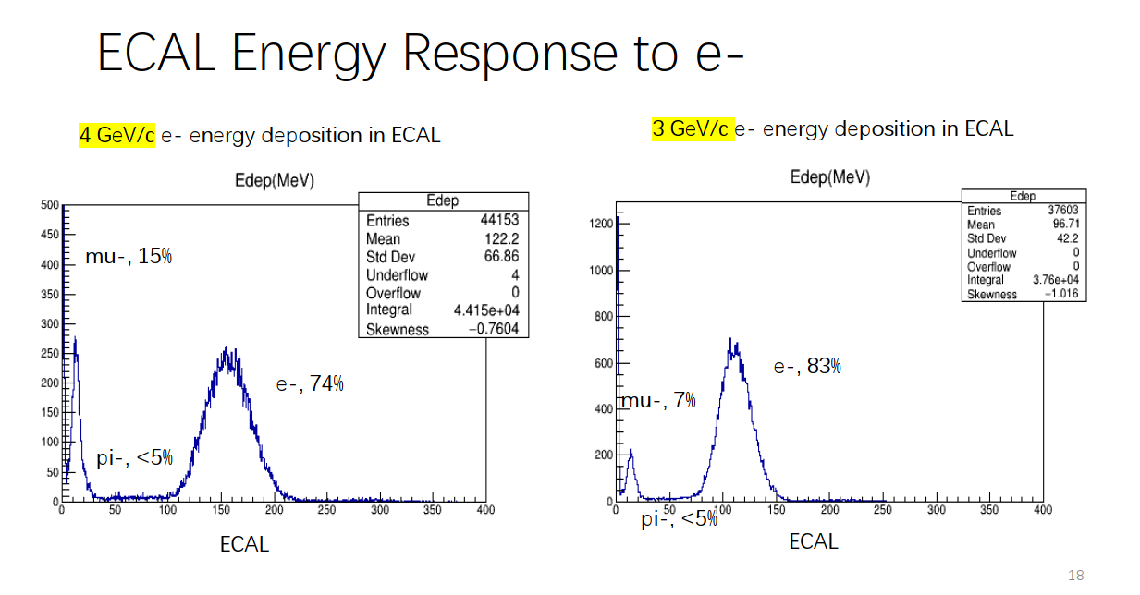
Electron beam properties in the East Area
Electrons beams of various purities and intensities are available, between 0.1 & 5 GeV/c
Electrons & positrons produced equally, choice to transfer one of the two signs in the various experiments
> 90% electron purity for momenta <5 GeV/c reaching ~99% at 1 GeV/c
Rates, in all momenta up to ~10⁵ particles / spill
Courtesy: D. Banerjee
Courtesy: CALICE

Slide 8
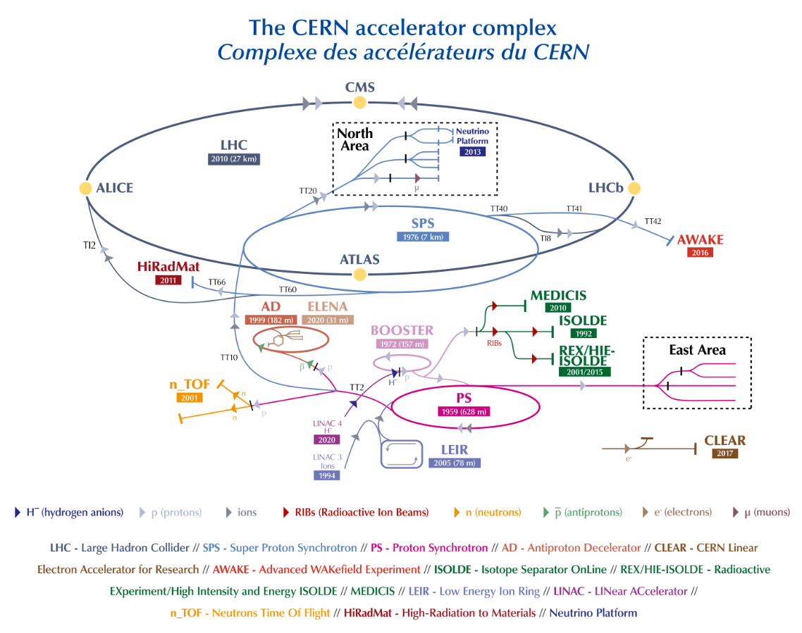
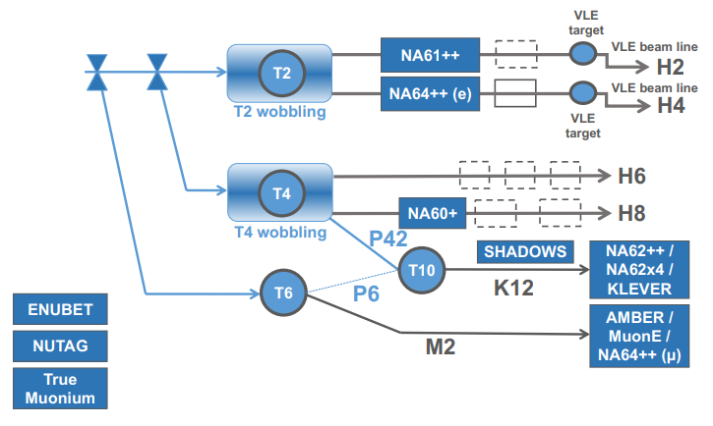
North Area of CERN SPS
Beam from SPS
400 GeV/c beam from the SPS impinges on 3 Be targets, producing essentially all the secondaries that can be chosen with the magnetic spectrometers of the secondary lines.
N.B: Slow extraction, 4.8s spill duration, 1 spill ~20 seconds
Electron beams available for test-beams only in EHN1 (H2/H4/H6/H8 lines)

Slide 9
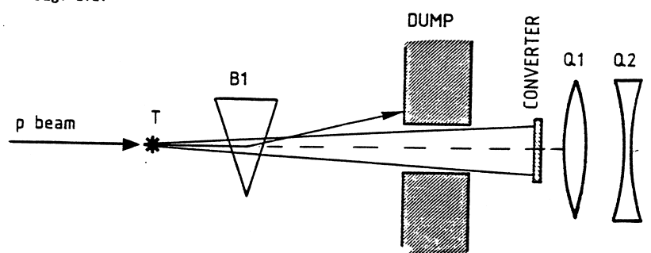
Electron beam properties in the North Area (1)
Mechanism 1 : Production of electrons / positron from the neutral channel (π0→ γγ and then, in a Pb converter γ → e+e- )
Intensities between 10³ – 10⁷ particles per spill, depending on the collimation & momentum selection precision
Purity between 50 – 100% depending on the beamline, momentum & exact target station configuration
Converter: Pb, 4mm thickness
Only available in H2 / H4 lines – H6 & H8 don’t have this option
Momentum selection
e+ or e-
Experiments
e+ or e-
Protons and other charged
Figure: ~5x10¹² protons on target ~1E7 electrons/spill in H4 line

Slide 10
Electron beam properties in the North Area (2)
Mechanism 2 : Bremsstrahlung of electrons/positrons produced at the upstream targets, using a secondary target
Intensities between 10²– 10⁴ particles per spill, depending on the collimation & momentum selection precision
Purity between 10 – 90% depending on the beamline, momentum & exact target station configuration
Secondary target: Cu, Pb, 3 – 300mm
Available in H6 & H8 beamlines
High energy mixed hadron & electron beam
Momentum selection
Lower energy e+ or e-
Experiments
Secondary target

Slide 11
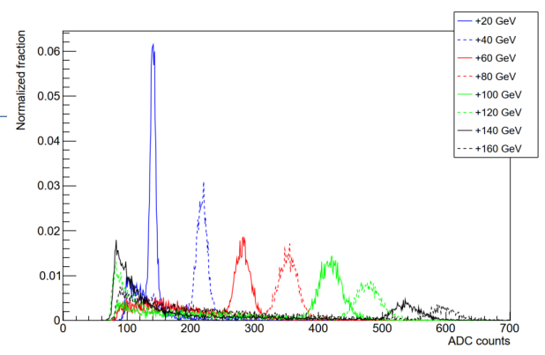
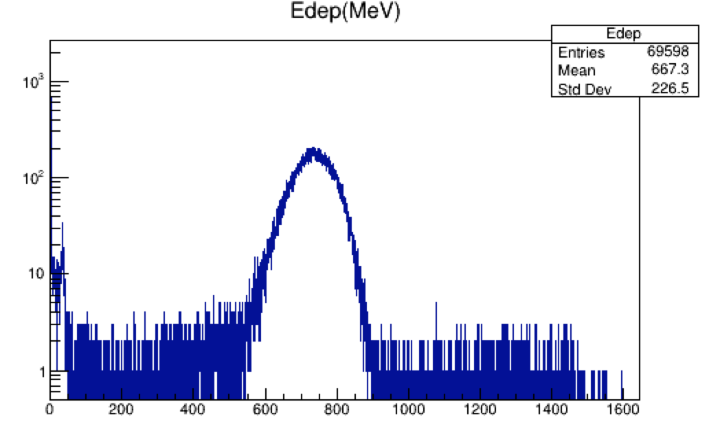
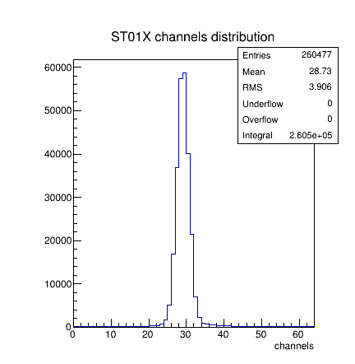
Examples of electron beams in EHN1 ...as measured by the various experiments
Courtesy: A. Baratto, M. Van Dijk
Electrons 100 GeV/c
H8
H8
Hadrons / muons
Courtesy: CALICE
H2
H4
Courtesy: ΝΑ64
H4
Courtesy: FASER

Slide 12
Future Proton-driven Facilities
Present
Future

Slide 13
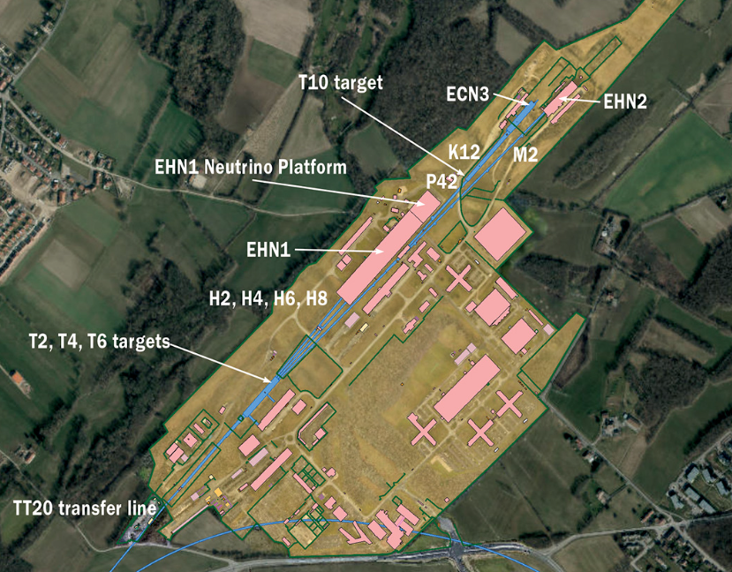
Future Proton Facilities – CERN HI ECN3
New proposals are coming up for the North Area
Within the Physics Beyond Colliders initiative and the ECN3-HI TF, three proposals are being considered for post-LS3 (2029) operation :
HIKE : A proposed expansion of the current NA62 experiment for studying rare decays of charged kaons and (later) neutral kaons ;
SHADOWS : A new experiment that would look for visible feebly-interacting particle (FIP) decays off-axis and could run in parallel to HIKE ;
BDF/SHiP : A proposal that would allow a full investigation of hidden sectors in the GeV mass range.
All experiments would require unprecedented intensity extracted towards the CERN North Area (4x10¹³ protons / slowly extracted spill – O(10¹⁹) protons per year)
More requests for electron beams are to come up ?
higher intensities...?
Crystal studies ...? More collimated and bright beams ?
https://cds.cern.ch/record/2802785/files/2204.03549.pdf

Slide 14
Summary
The CERN’s secondary beam areas are excellent facilities for providing high quality electron beams, in a variety of intensities and purities
Many fixed target experiments & R&D efforts have made use up-to date and more are to come
The future “landscape” has yet to be fully explored – also many new ideas will be coming from Physics Beyond Colliders or other inititatives in the upcoming years
If there are requests for exciting experiments, don’t hesitate to contact us !

