Slide 1
Version: 1.1 (October 2023)
Crystal analysis at the Diamond Light Source
John P. Sutter and Kawal Sawhney
Optics and Metrology Group
Diamond Light Source Ltd, Harwell Science and Innovation Campus, Chilton, Didcot, OX11 0DE, United Kingdom

Slide 2
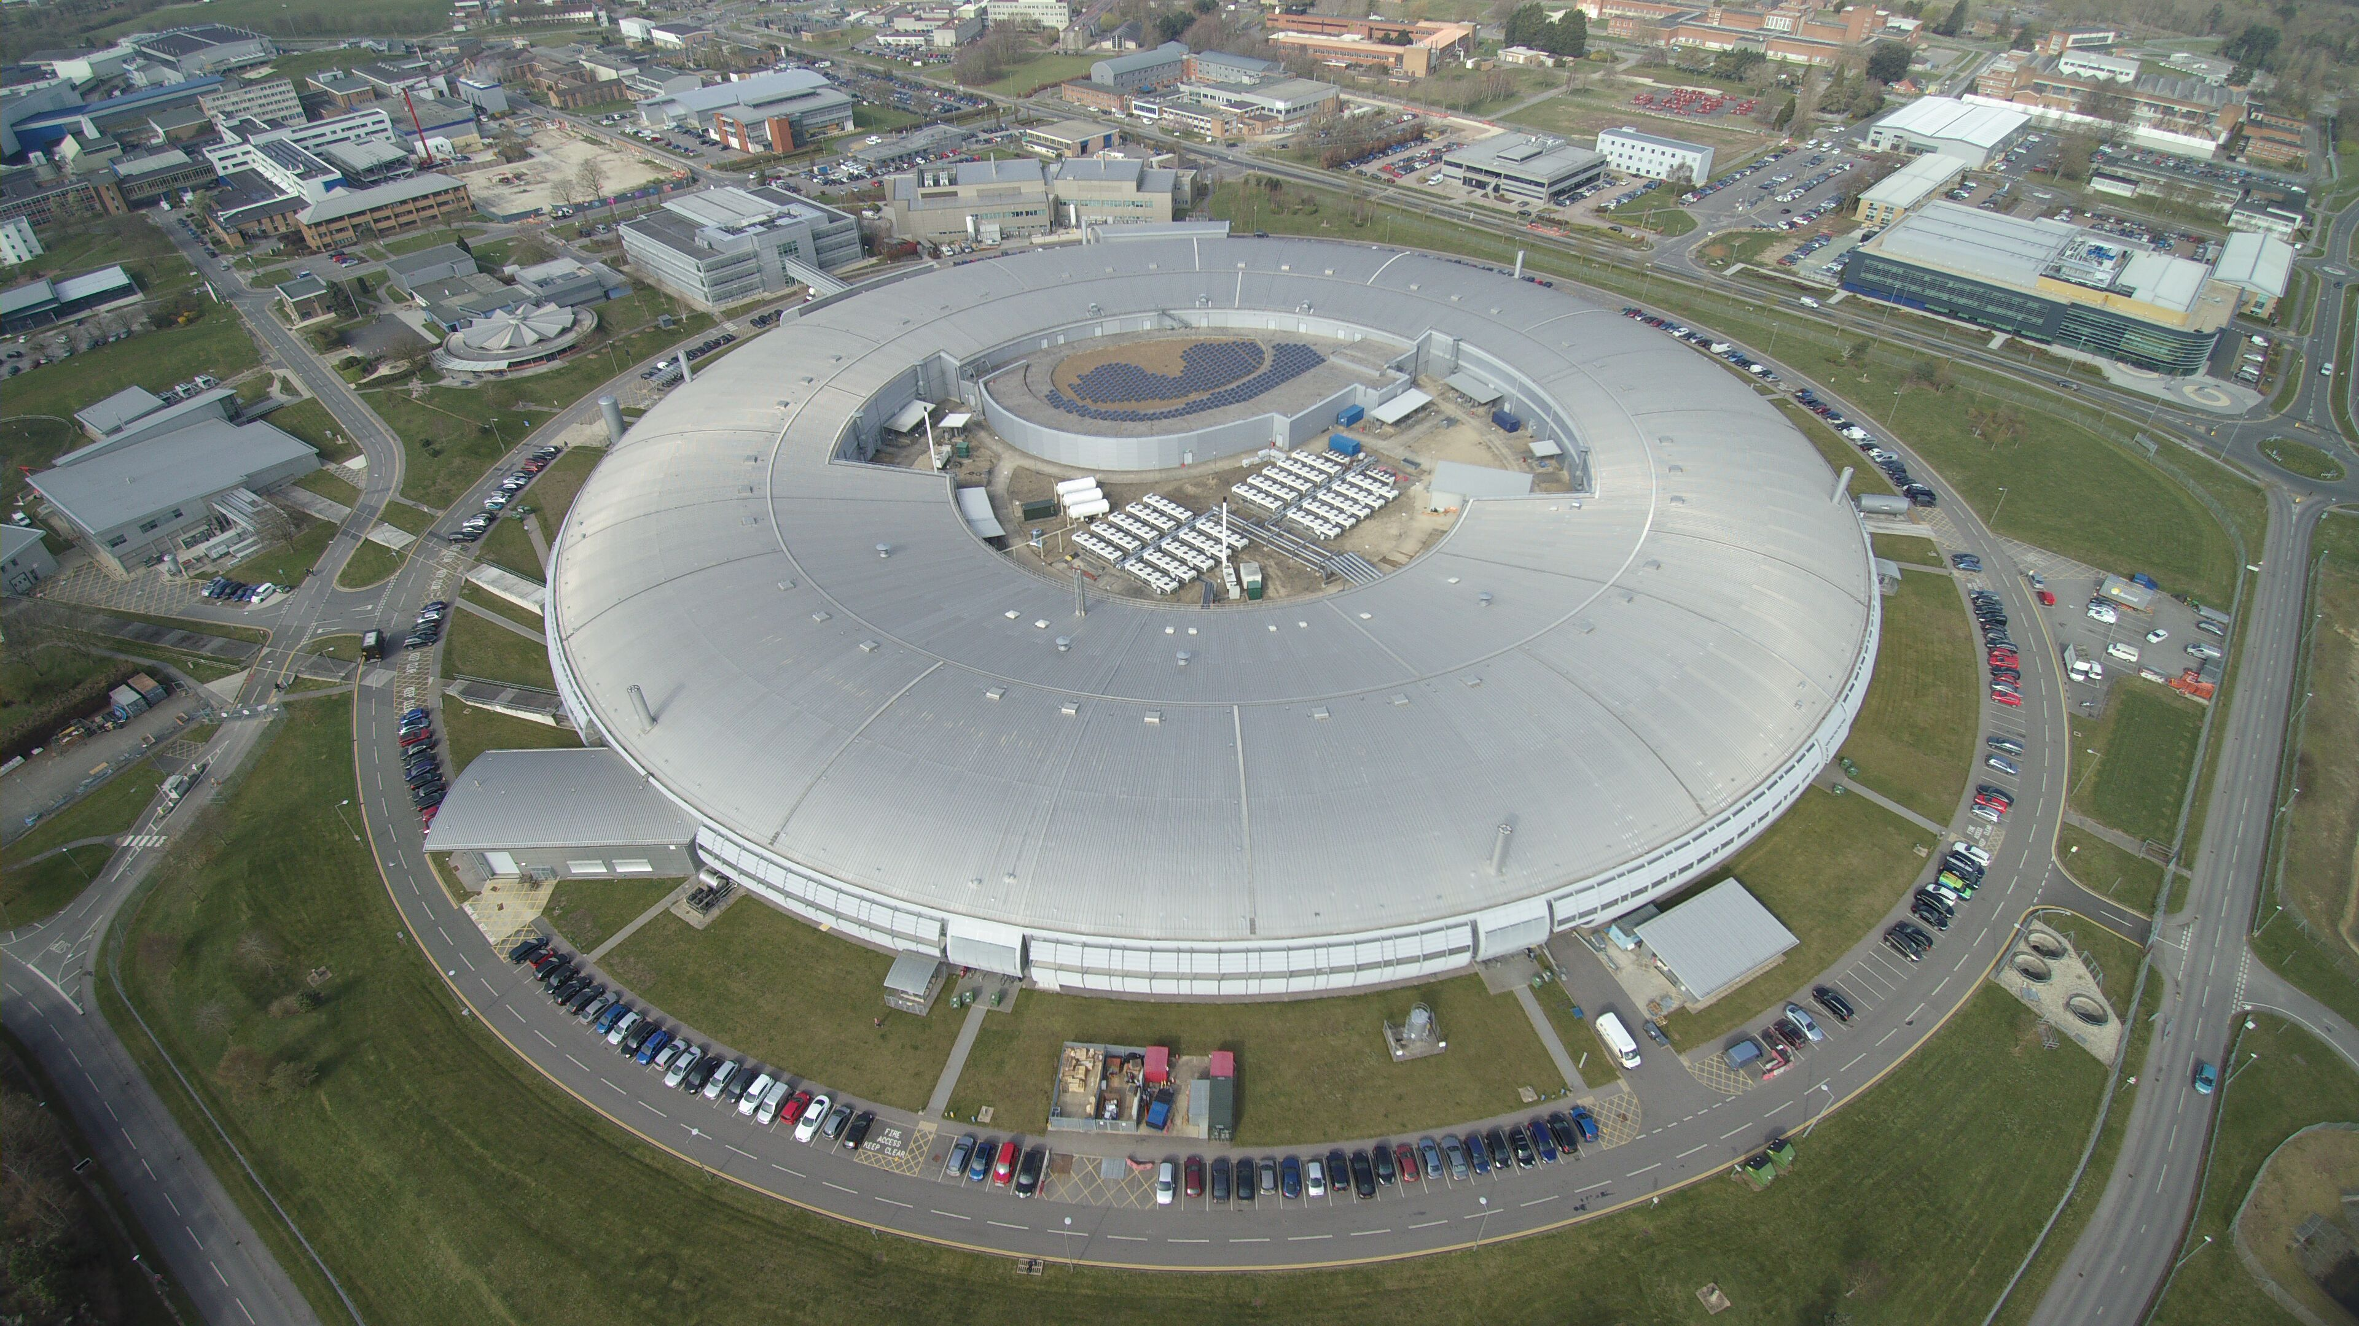

Slide 3
Who we are
The Diamond Light Source (DLS) has been the United Kingdom’s national synchrotron science facility since 2007.
Less than 30 km from Oxford and easily reached from Cambridge and London.
Joint venture between two UK agencies:
Science and Technology Facilities Council (STFC)
Wellcome Trust, UK’s largest provider of non-governmental funding for scientific research
The largest scientific investment in the UK for 40 years.

Slide 4
What we do
We provide intense, well collimated beams of electromagnetic radiation (“light”) for precise studies of many types of samples – infrared to 150 keV X-rays.
We serve users – both academic and industrial users may submit proposals for experiments.
Our user community numbers ~ 14000 scientists worldwide.
April 2022 – March 2023 (16th year of operation, 1st full year after pandemic restrictions lifted): approx. 7780 onsite user visits and 5870 remote user visits
For more information see the Technopolis Group’s “Socio-Economic Impact Study”:
https://www.technopolis-group.com/wp-content/uploads/2021/06/Socio-Economic-Study-Report-Diamond.pdf

Slide 5
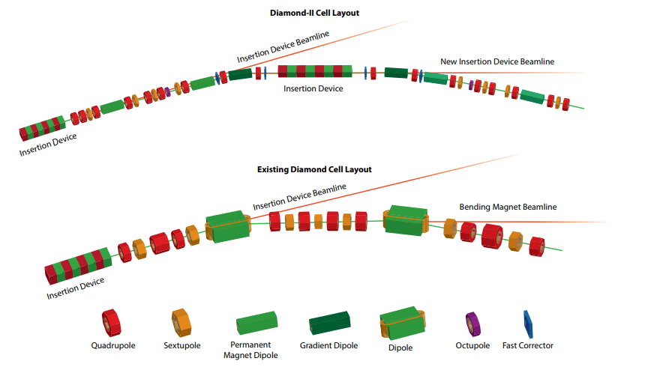
Future upgrade to Diamond-II
Change from current accelerator design to diffraction-limited storage ring
Will reduce horizontal emittance (size × divergence) of electron beam by over ×10 → brighter and more coherent X-ray beams
Electron energy will be raised from 3.0 GeV to 3.5 GeV → greater X-ray flux at higher energies
3 new flagship beamlines in design stage with 2 more in the works
Latest news (5th September 2023):
A funding award of GBP 519.4 million was formally announced by
UK’s Secretary of State for Science, Innovation & Technology
Science and Technology Facilities Council
Wellcome Trust

Slide 6
Crystals – why are they important?
Crystals are extensively used in X-ray synchrotron sources as
Monochromators (to select X-rays of a chosen wavelength)
Spectrometers (to determine the spectrum of X-rays)
Phase retarders (to alter the polarization state of X-rays).
Diamond Optics & Metrology group can test for the presence of defects in crystals.
Our techniques:
Ex-situ: crystal’s surfaces are examined with visible light
In-situ: crystal’s atomic planes are examined with X-rays.
Our experience has been applied to crystal undulators for the TECHNO-CLS project.

Slide 7
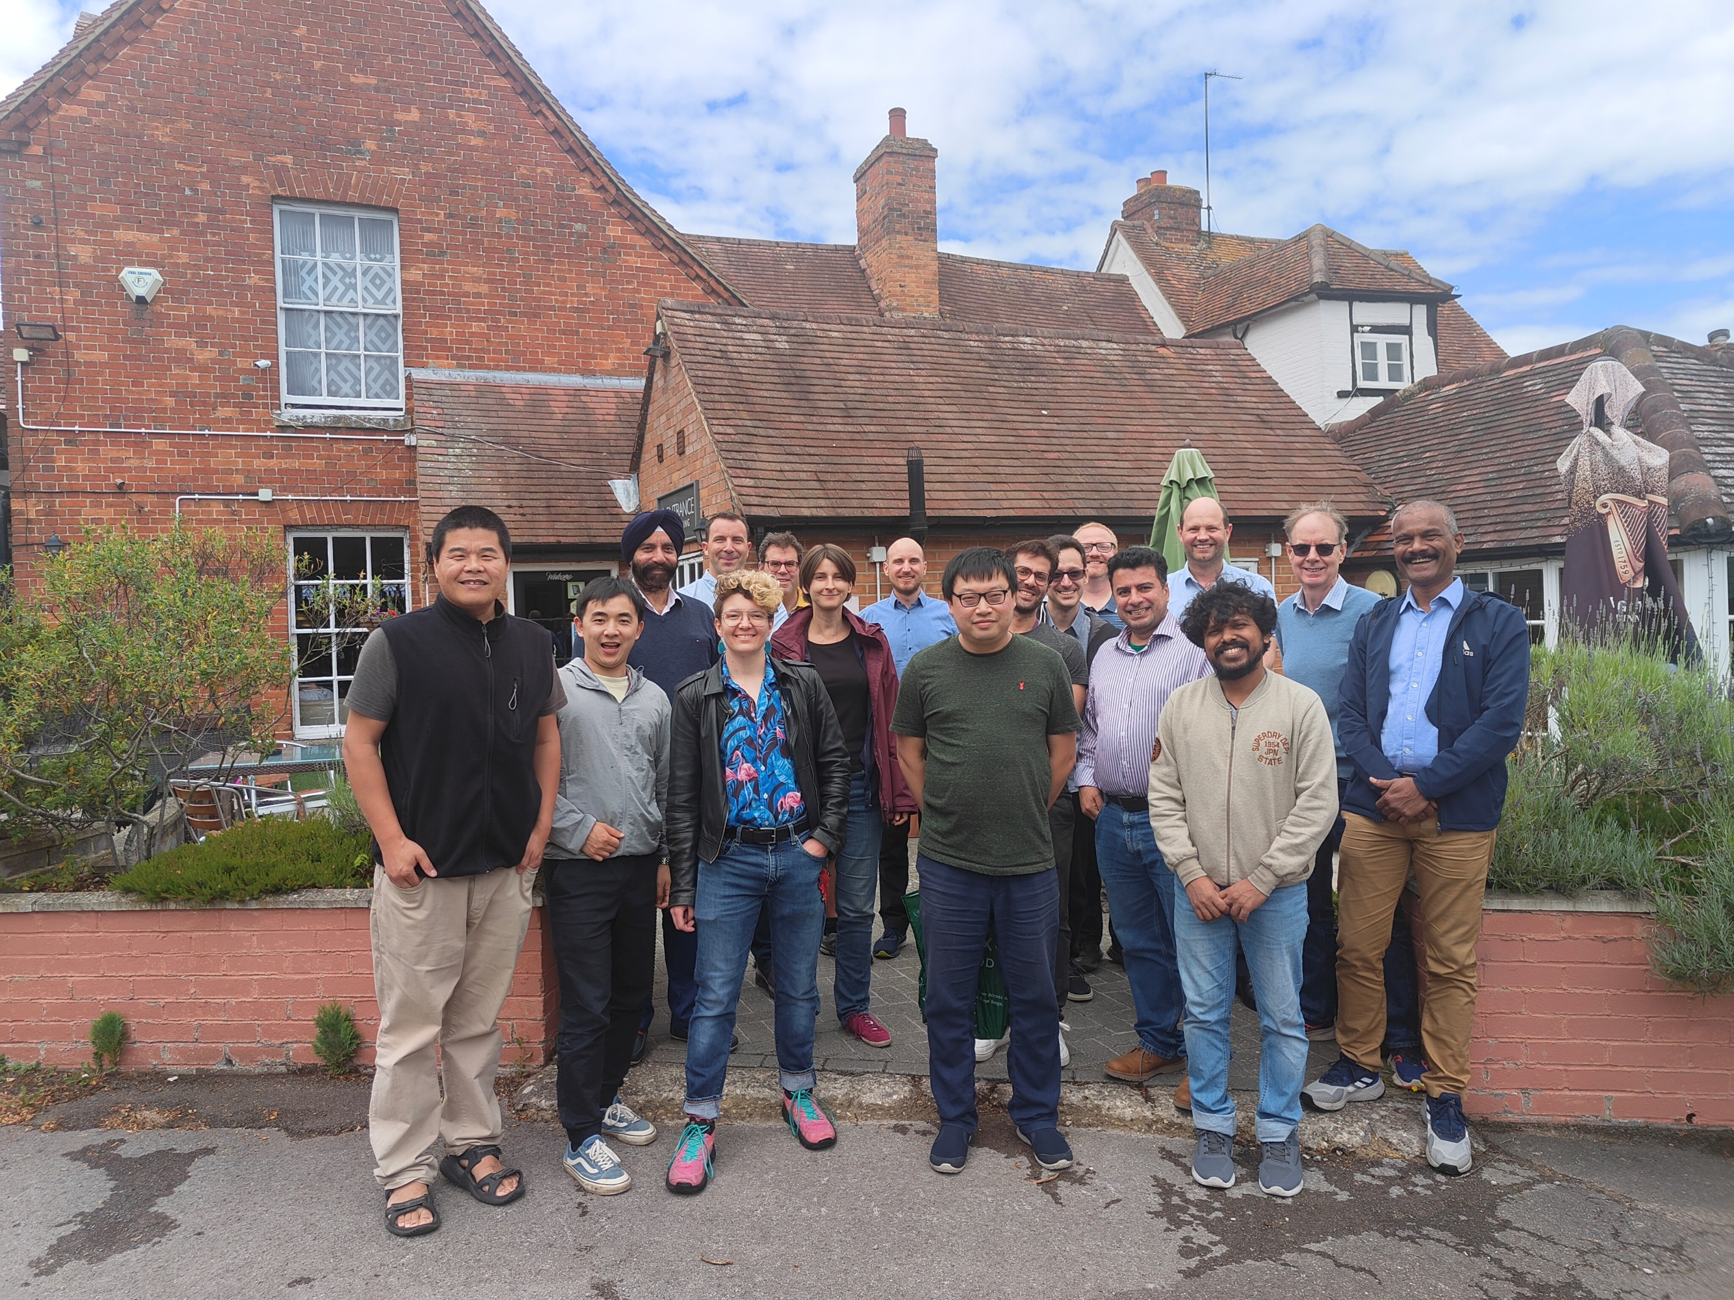
Diamond’s Optics & Metrology group

Slide 8
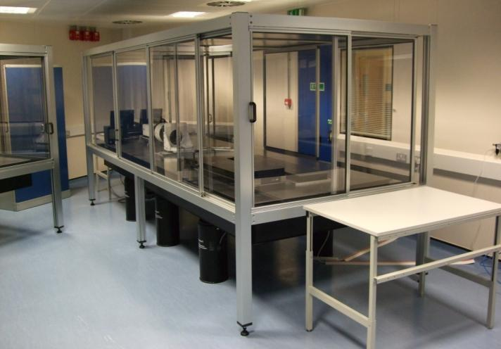
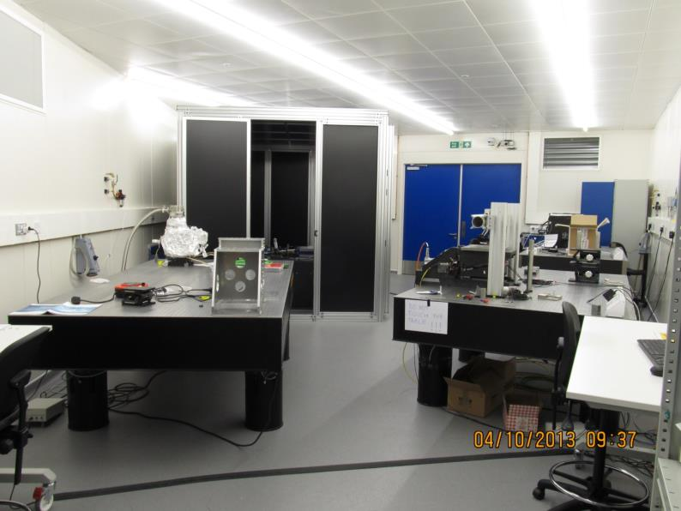
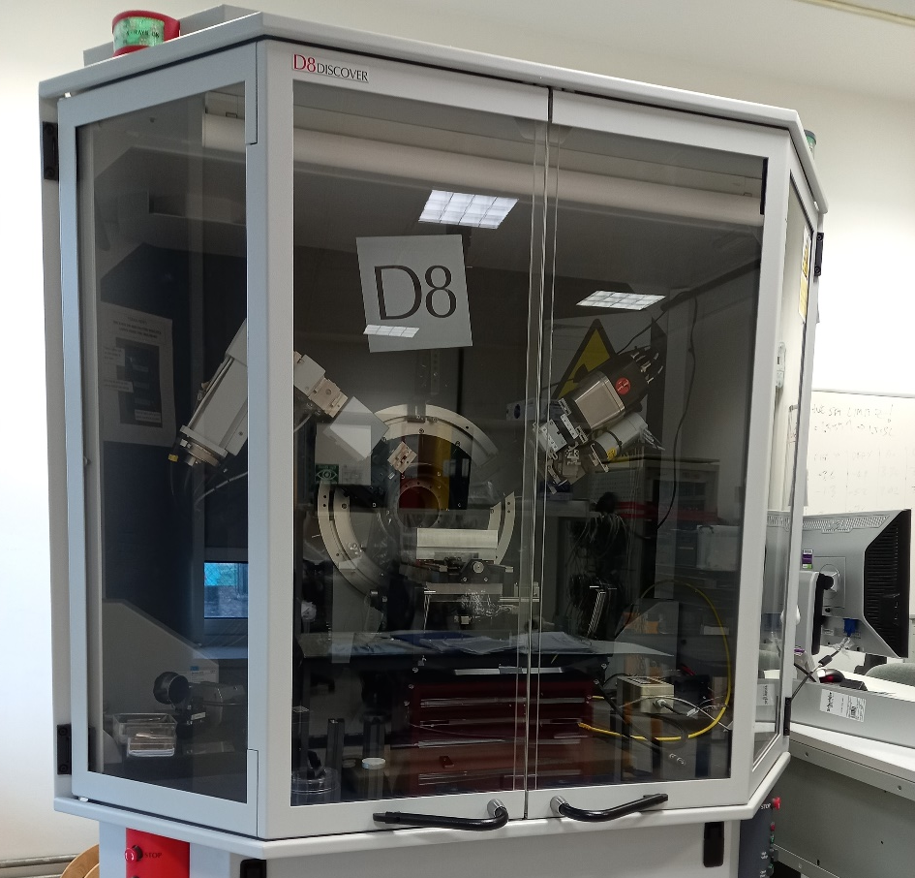
Our off-beam facilities
Optical metrology laboratory (OML)
Class 10,000 cleanroom with active temperature control
Examination of optics’ surface quality
Physical metrology laboratory (PML)
Examination of fine motion control stages
X-ray diffractometer
Crystal orientation and rocking curve measurements

Slide 9
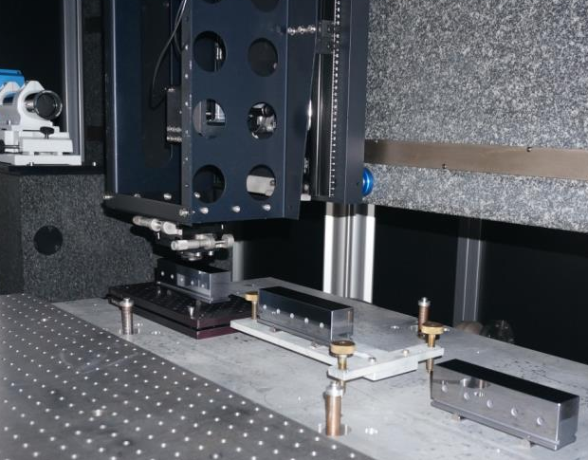
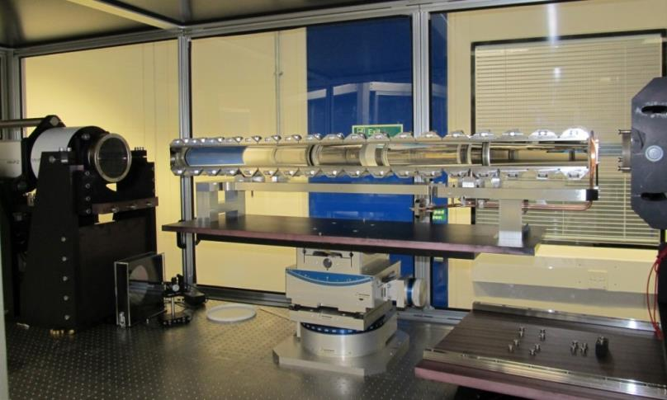
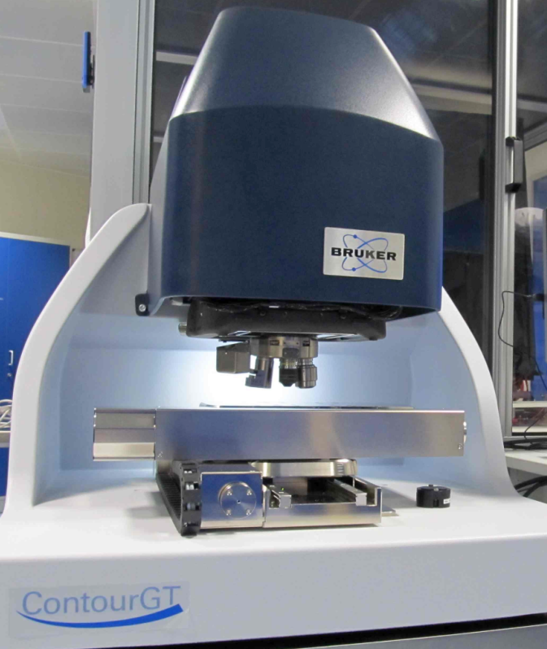
In the optical metrology laboratory
Contains an array of devices using visible light to measure surface shapes with high accuracy
“Nanometer Optical Metrology” (NOM) profiler
Measures surface slopes with < 50 nrad precision
Optics up to 1.5 m long
MiniFiz150 Fizeau interferometer
Rapid 2D surface height maps
Sub-nm repeatability
GTX stitching micro-interferometer
µm-resolution surface height maps

Slide 10
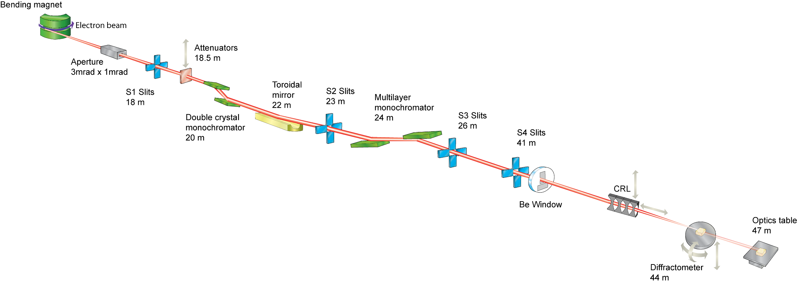
Our beamline
We have our own beamline – the versatile optics test beamline B16.
50 m long with complex instrumentation
that suits a variety of techniques!
For more information:
“A test beamline on Diamond Light Source,” K. J. S. Sawhney, I. P. Dolbnya,
M. K. Tiwari, L. Alianelli, S. M. Scott, G. M. Preece, U. K. Pedersen and R. D.
Walton, AIP Conf. Proc. 1234, 387-390 (2010).

Slide 11
X-ray topography
Image of X-ray beam diffracted by a test crystal through Bragg reflection.
Good for detecting imperfections in crystal structure:
Surface scratches and pits left by fabrication process
Dislocations created during crystal growth
Bending and warping of atomic planes
Diamond Light Source has an active program of X-ray topography for
Our own needs e.g. monochromator crystal surface quality, clamping & cooling
External users
At Diamond, X-ray topography is performed at B16. See “X-ray topography of diffracting crystal optics at the Diamond Light Source,” J. P. Sutter, V. Dhamgaye, O. J. L. Fox and K. Sawhney, Proc. SPIE 12694, 12694-12 (2023).

Slide 12
Crystal undulators
Charged particles incident on atomic planes of crystal at small grazing angle can be channelled along those planes by the crystal’s internal electric fields.
Bent crystals can be used to steer charged particles.
Sinusoidally deformed crystals could potentially yield MeV gamma rays with high brilliance.
Such “undulators” exist at X-ray sources and free electron lasers, but they are large rows of magnets and emit keV X-rays.
See R. Camattari et al, “Silicon crystalline undulator prototypes,” Physical Review Accelerators and Beams 22, 044701 (2019)

Slide 13
Current developments
Members of the TECHNO-CLS project (Horizon-EIC-Pathfinder-2021) applied for beamtime at B16.
We used X-ray topography to look for imperfections in their bent and wavy crystals.
The results are still under analysis, but they may show whether the channelling can work as planned.

Slide 14
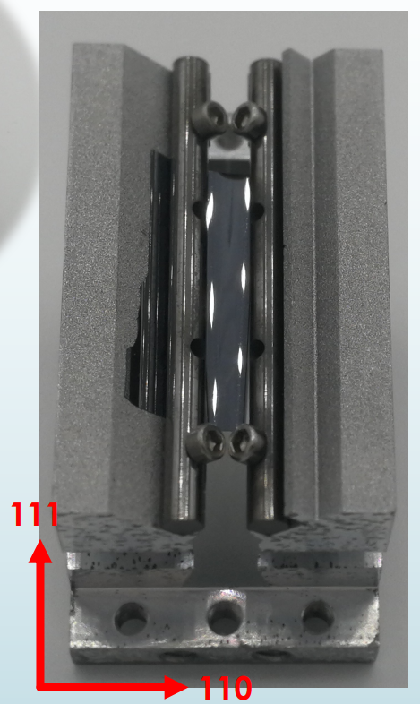
Examples of crystal channellers: 15 µm bent Si
Active area
3.9 mm
3.9 mm
15 keV X-rays from Si (111) double-crystal mono
Contour plots showing pixel-by-pixel variation of peak angle over rocking curve:
Varying width of bright region with height indicates non-uniform curvature.
Slant of bright region from top to bottom indicates torsion.
16 mm
Peak: range
0.702-0.847 deg
Peak: range
0-0.850 deg
15 µm thick bent Si crystal
Nominal radius: 3 cm

Slide 15
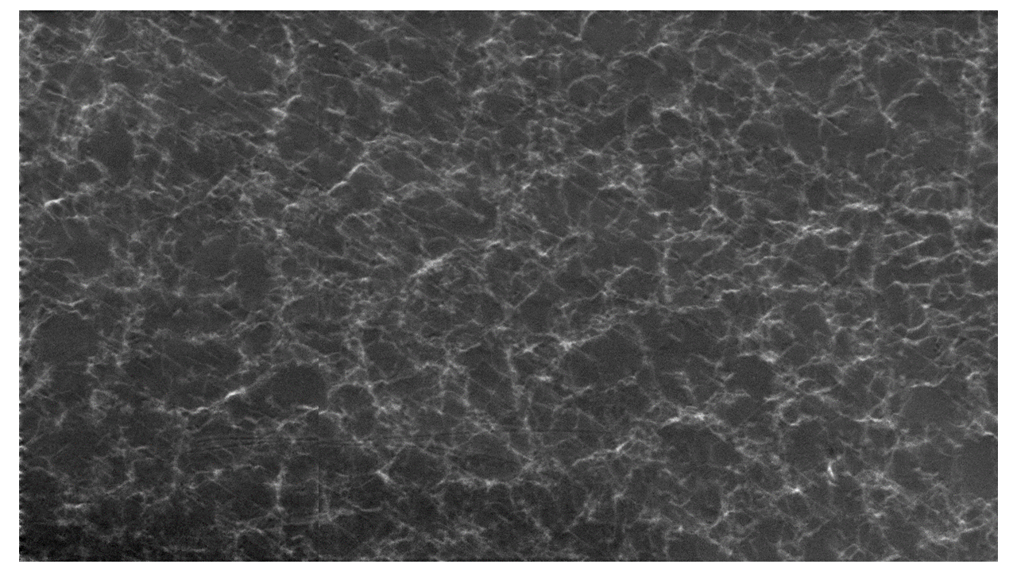
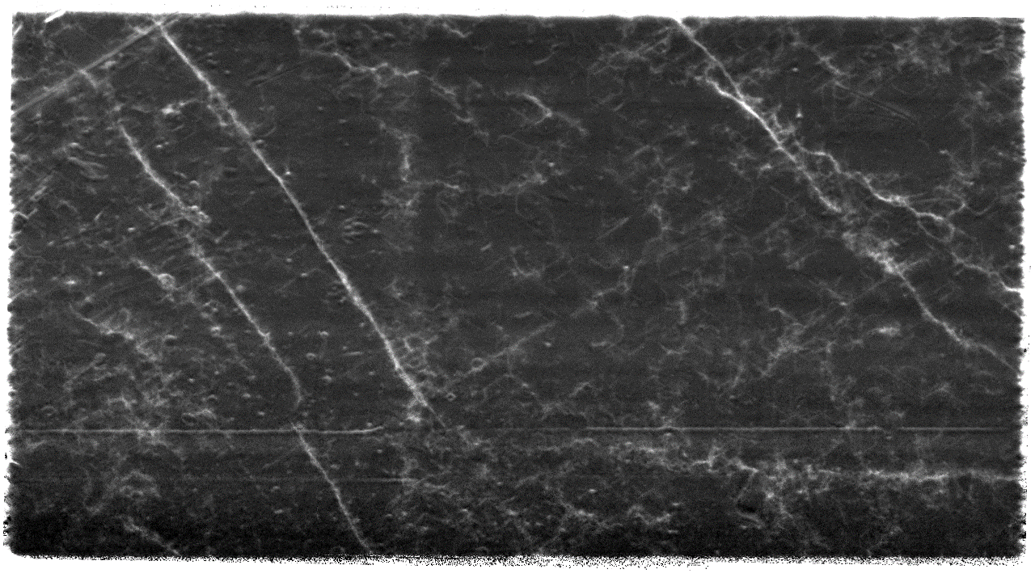
Examples of crystal channellers: Ge
Area 8 × 9 mm²
Thickness 0.17 mm
Feature of interest: dislocations
Viewing (220) reflection in Laue (transmission) geometry
10.5 keV X-rays from Si (111) double-crystal mono
Undoped Ge
Ge with 100 nm thick Ge-Sb alloy
created by sputtering and pulsed
laser melting
Contour plot showing pixel-by-pixel variation of width of rocking curve
Range 1.5-2.9 millidegrees.

Slide 16
Conclusions
Diamond Light Source is the United Kingdom’s synchrotron source for high-intensity, well collimated radiation from infrared to 150 keV X-rays.
Planned “Diamond-II” upgrade of synchrotron will produce even brighter X-ray beams.
Users are from academic and industrial institutes in the UK and worldwide.
Optics & Metrology group examines crystals by using its own metrology labs and versatile optics test beamline B16.
Potential novel gamma ray sources examined at B16 – early analysis has revealed features that may affect performance.

Slide 17
Acknowledgments
Diamond Light Source Ltd
Simon Alcock & Ioana Nistea (Optical Metrology Lab)
Hiten Patel & Rabia Ince (Physical Metrology Lab)
Nataliia Novokhatska & Molly Pekarik-Fry (Web & Digital Content Manager)
Lorna Goldsmith (User Office)
Techno-CLS consortium
Andrey Solov’yov (Scientific and Executive Director - MBN Research Center, Frankfurt am Main, Germany)
Nigel Mason & Matthew Dickers (School of Physics & Astronomy, University of Kent, UK)
Vincenzo Guidi, Marco Romagnoni & Nicola Canale (INFN Ferrara Division, Ferrara, Italy)
Francesco Sgarbossa (Dept. of Physics & Astronomy, University of Padova, Italy)

