Slide 1

Extending photon energy of X-ray sources up to γ -rays using Symmetric Compton Scattering
Luca Serafini – INFN-Milan and LASA
co-authors V. Petrillo, C. Curatolo, I. Drebot, S. Samsam, M. Rossetti, A. Bacci, A. Puppin
Electron-photon interaction in linear QED (in vacuum) is characterized by 2 dimensionless parameters: Recoil X = 4γ² hν /E_{e} and Asymmetry A = βγ²− X/4 = γ² (β−hν/E_{e})
When Recoil is large (X»1) we have “cooling of photons”, i.e. monochro-maticity of incident electron beam is mapped into the scattered photon beam
When the scattering is symmetric (A=0, the divide between Inverse and Direct Compton Scattering) the energy-angular correlation (so-called γ²θ² disease) vanishes and, at low recoil, the electron beam is heated by the photon beam
SCS or Quasi-SCS married to deep recoil will allow to extend the photon energy range of X-ray sources to γ -rays using low energy e⁻ (10-40 MeV)
All I.C.S. X/γ ray Sources work at X<1 and A » 1
STAR (350 keV) X_{STAR} < 2.6.10⁻³ A_{STAR} > 10⁴
ELI-NP (20 MeV) X_{ELI-NP} < 0.026 A_{ELI-NP} > 2.4.10⁵

Slide 2
Energy Budget towards γ -rays with high spectral density
25 GeV electrons would be needed to generate 2 MeV photons via synchrotron radiation (highest spectral density S 10¹² s⁻¹eV⁻¹, very small bdw 10⁻⁴)
850 MeV electrons were used to Channeling Radiate 2 MeV γ -rays (high S 10⁵-10⁶ s⁻¹eV⁻¹, broad bdw 10 %)
350 MeV e⁻s are needed to Inverse Compton Scatter 2 MeV γ -rays (good S 10⁴-10⁵ s⁻¹eV⁻¹, small bdw 10⁻³)
3.5 MeV electrons to bremsstrahlung 2 MeV γ -rays (poor S 1 s⁻¹eV⁻¹, very broad bandwidth)
2 MeV e⁻s to Symmetric Compton Scatter a photon target 2 MeV γ -ray photons (S 10⁴ s⁻¹eV⁻¹) spectral purification!

Slide 3
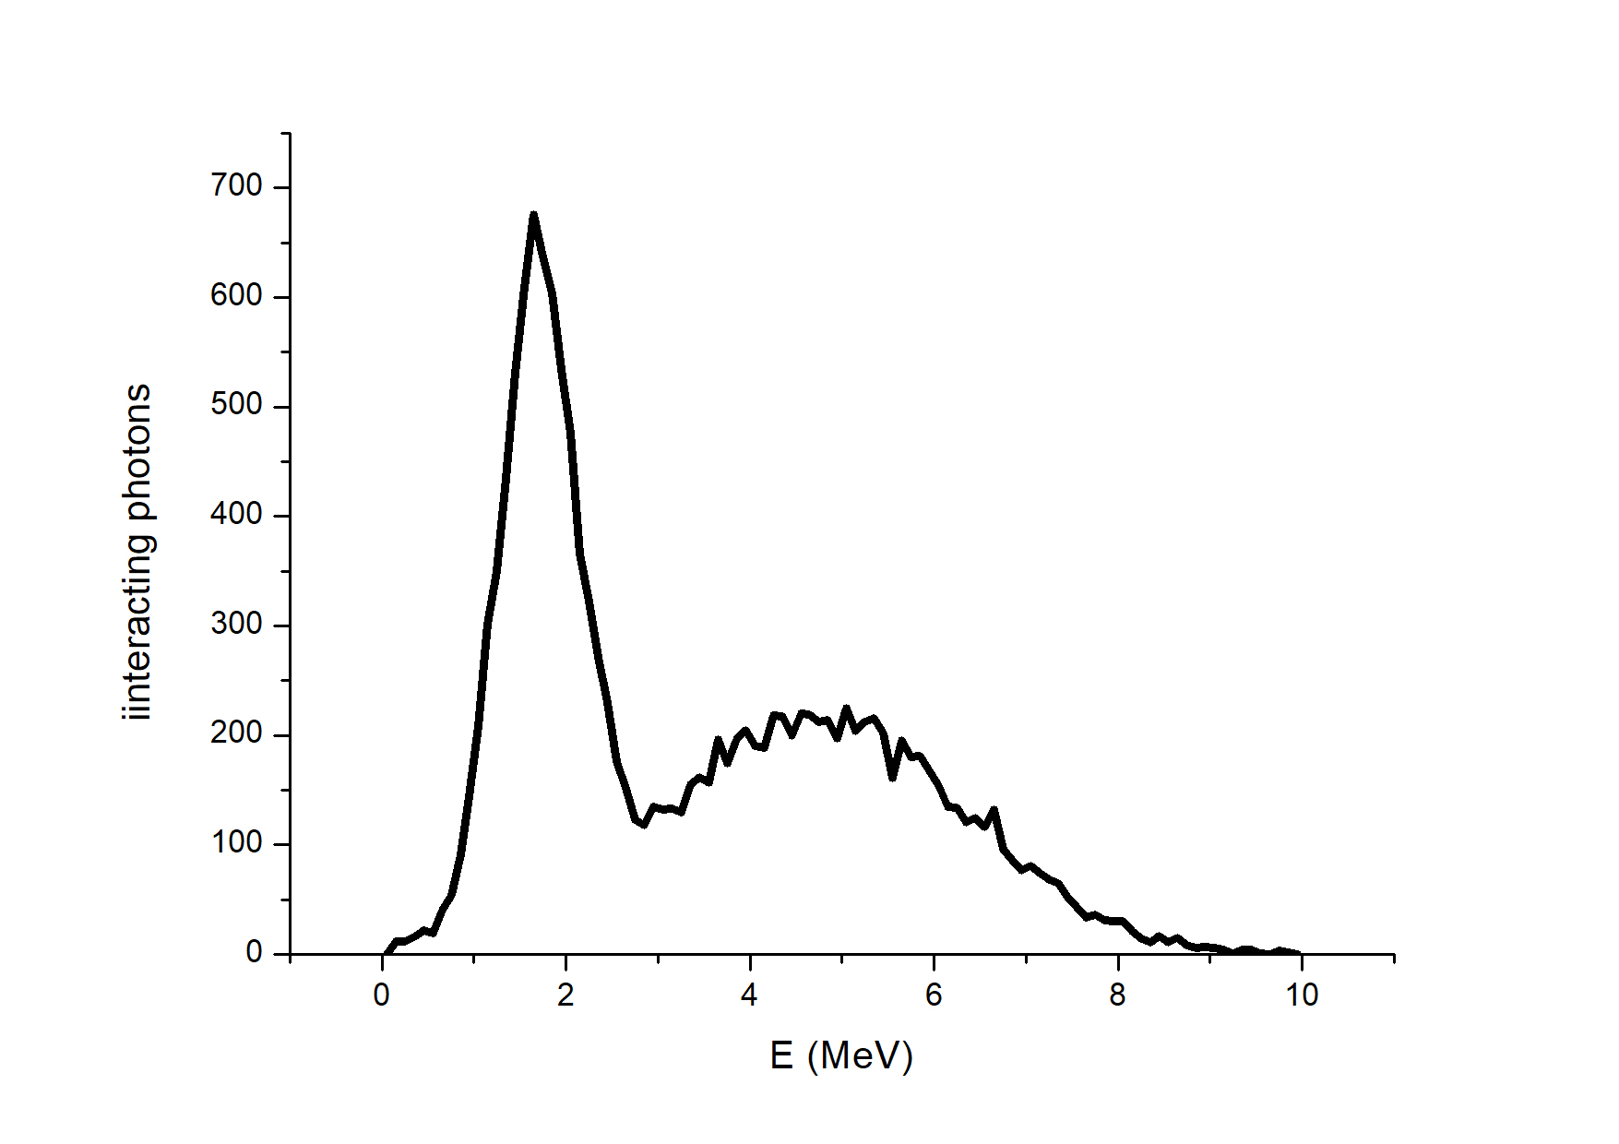
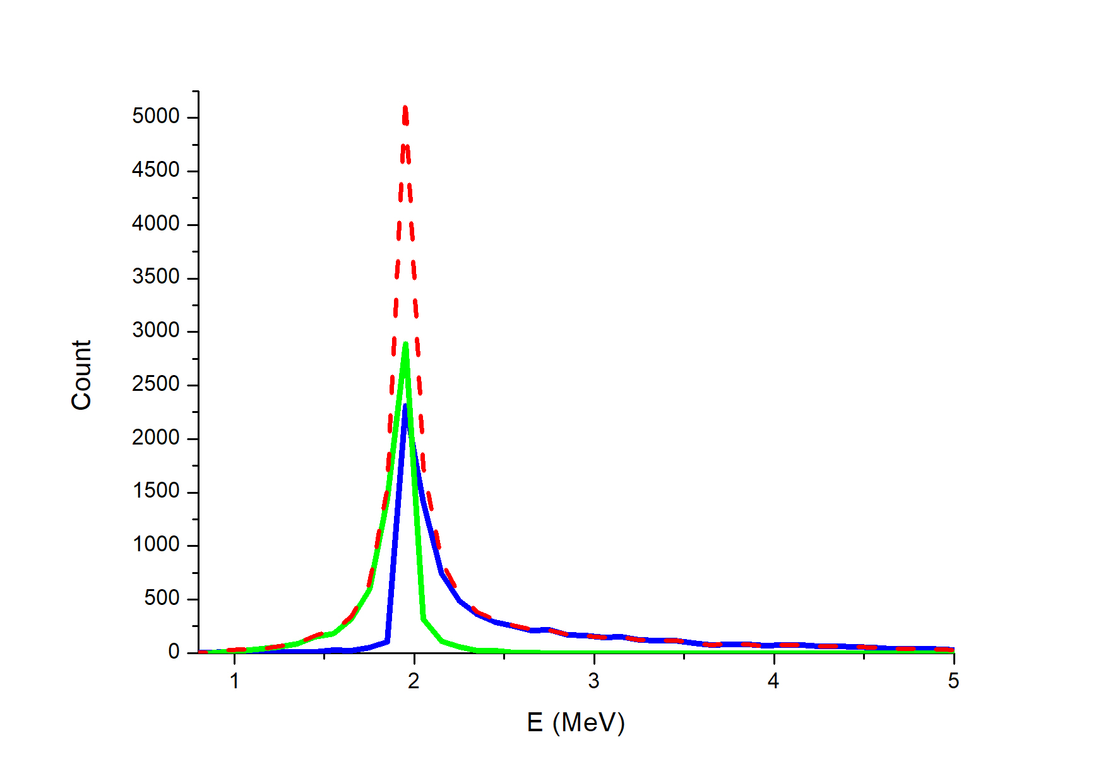
broad bandwidth
spectral purification
tunability

Slide 4
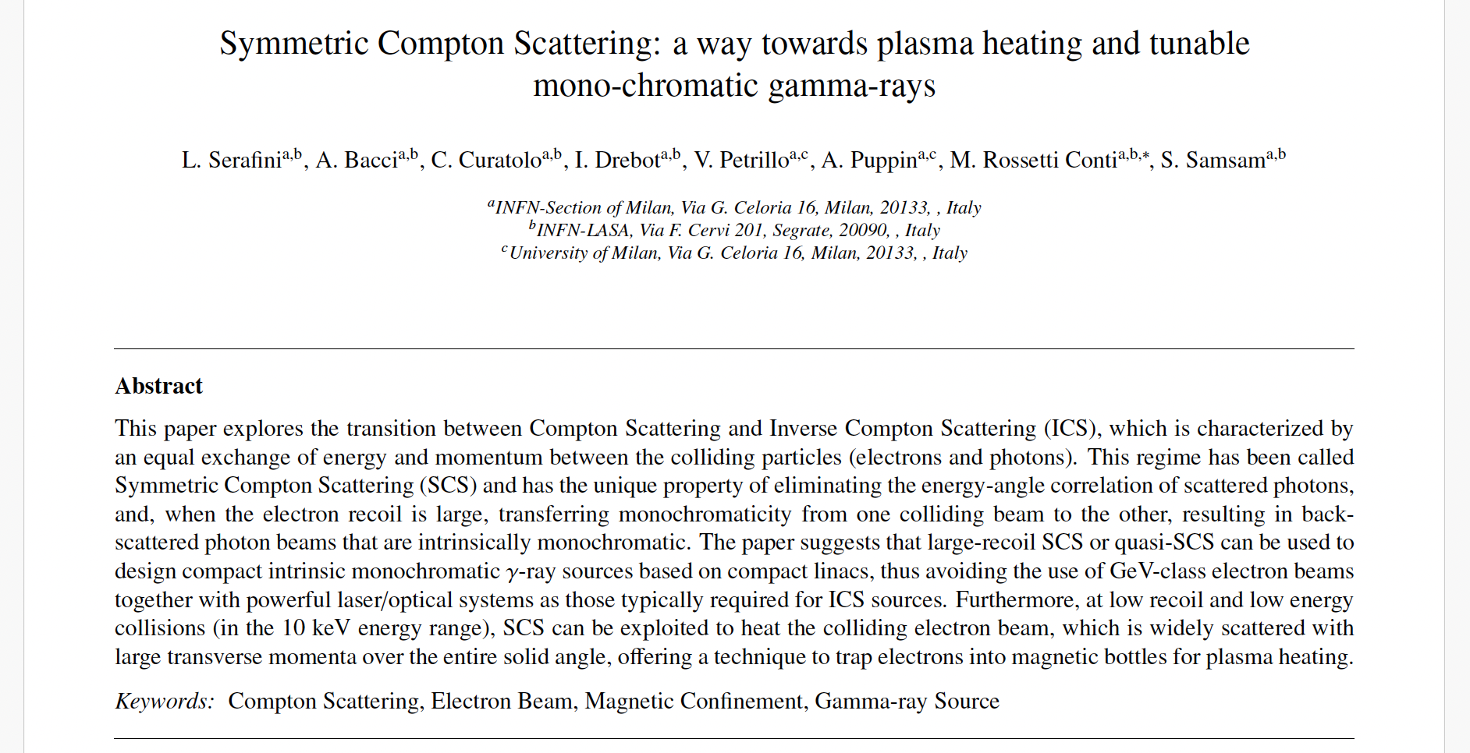
Everything about Symmetric Compton Scattering is reported in this paper, that is in publication on
Fundamentals of Plasma Physics

Slide 5
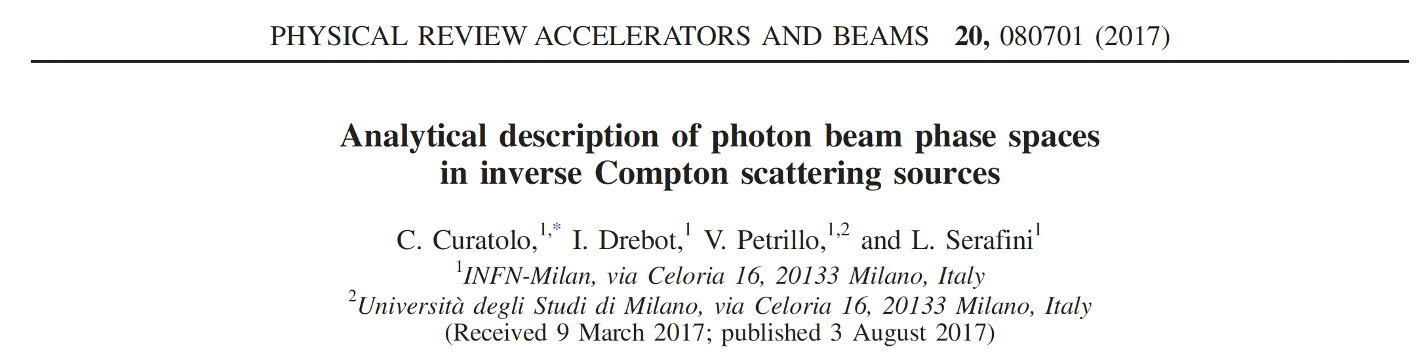
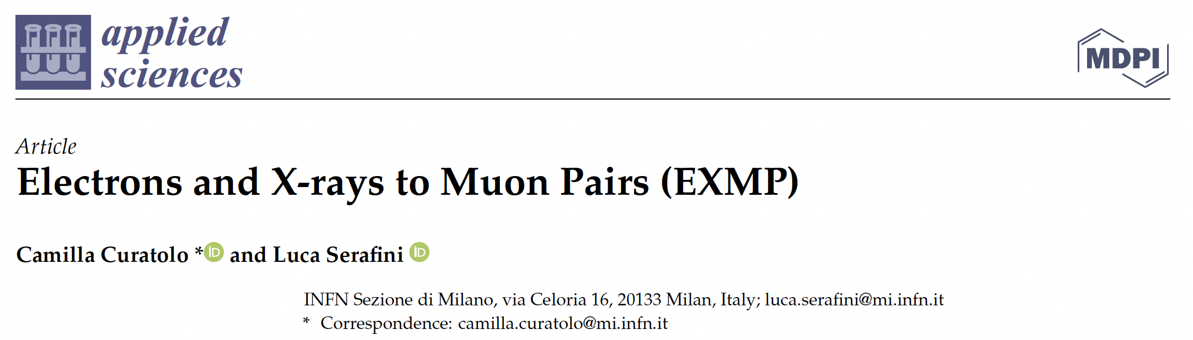
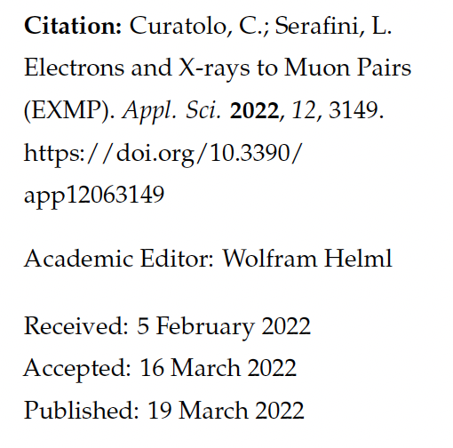
This Study on Symmetric Compton Scattering and muon beam generation is a follow up of 2 papers

Slide 6
Large Recoil in ICS damps the effect of large bandwidth incident photon beams onto the bandwidth of scattered photons
equivalent to FELs Kim-Pellegrini crit. on 3D inhomogeneous effects on photon bandwidth
beam
en. spread
diffraction
collimation
angle
incident
photons
en. spread
beam
emittance
non
linearity

Slide 7
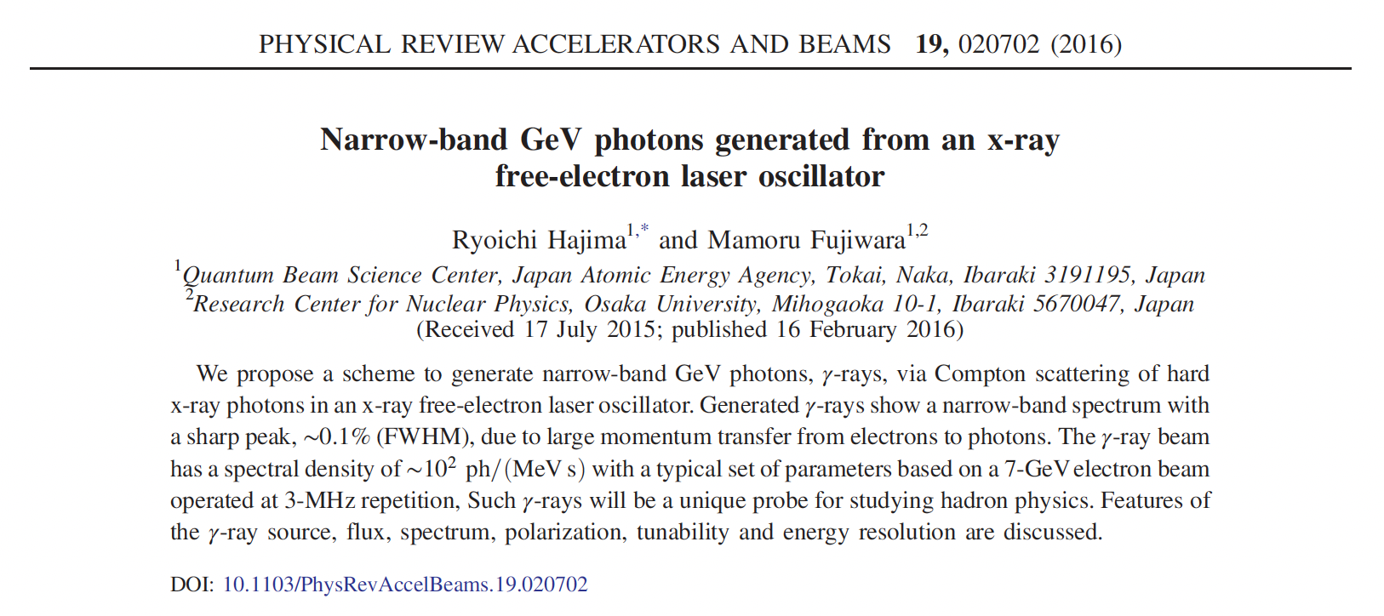
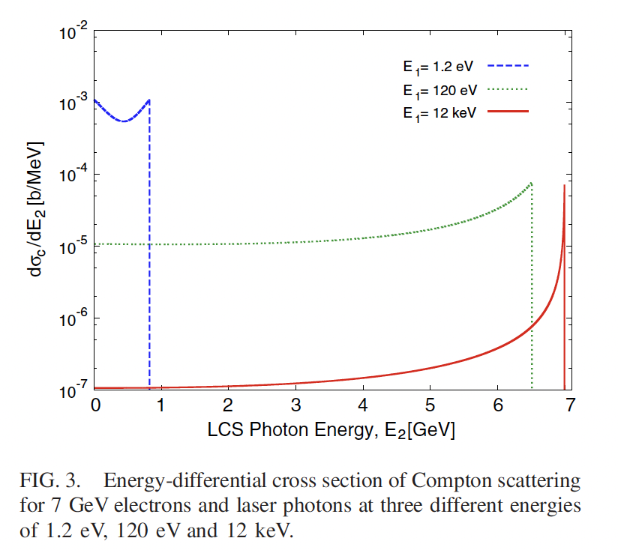
Deep Recoil
and its 2 benefits:
spectral purification
and
suppression of γ²θ² desease

Slide 8
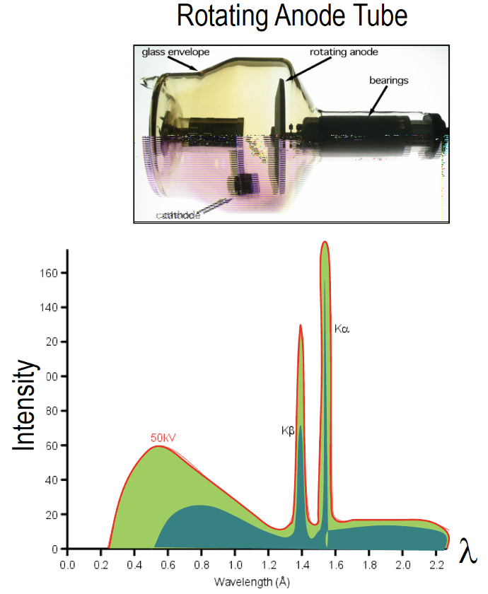
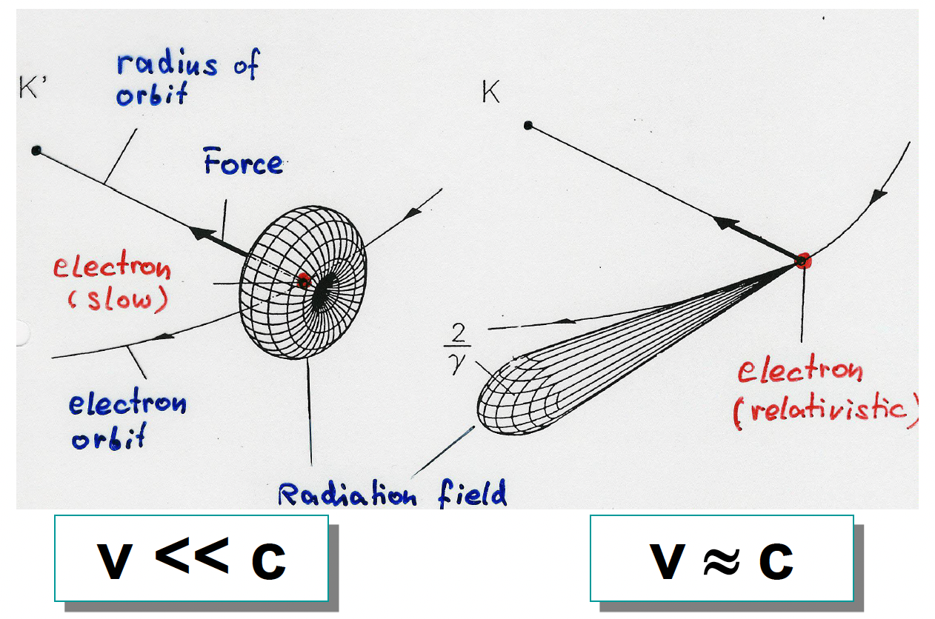
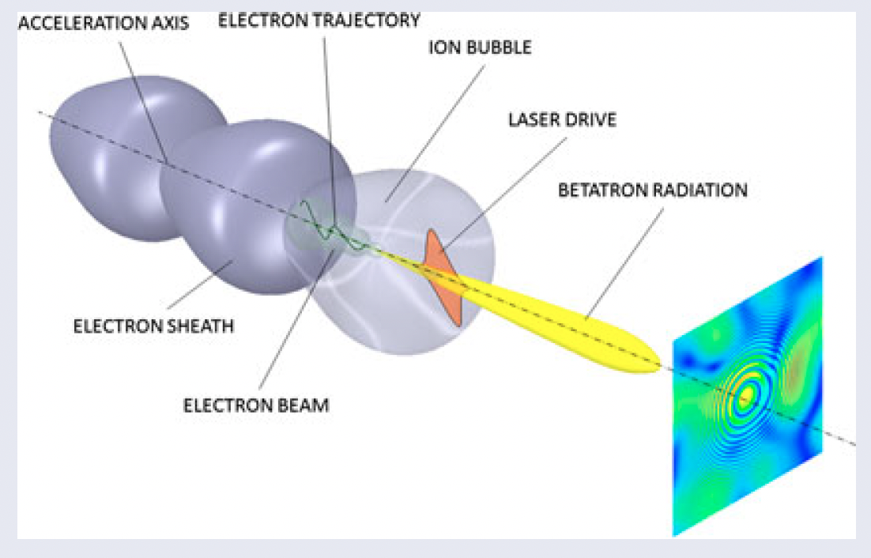
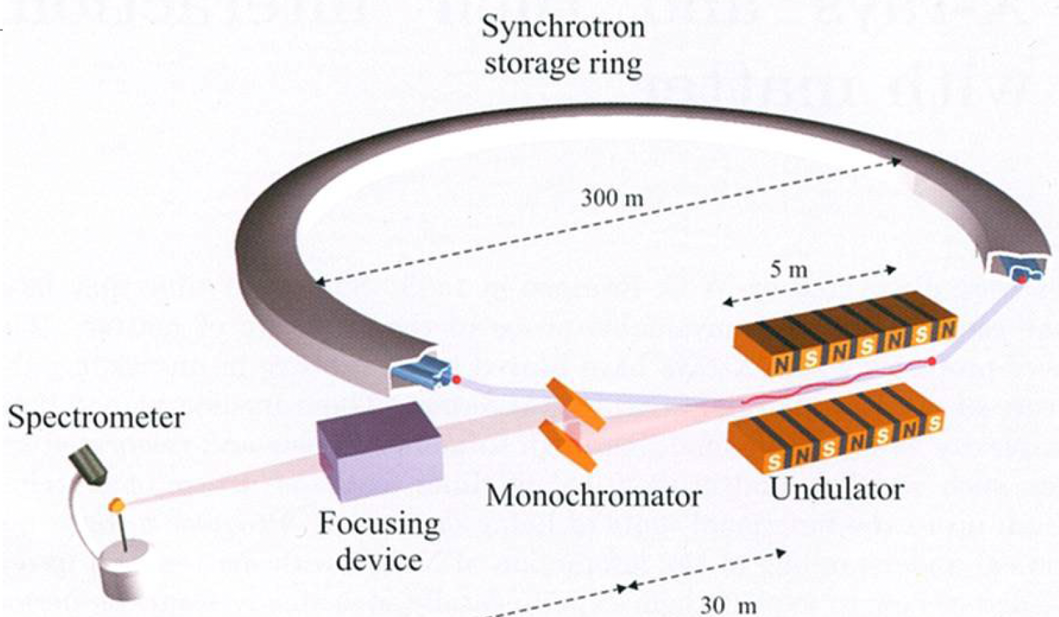
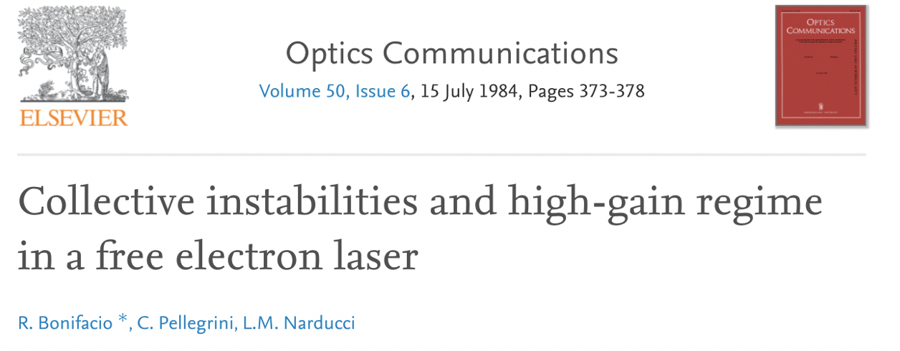
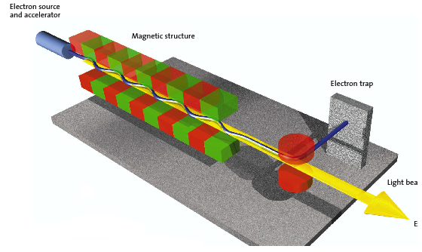


Schematic recap of X/γ Radiation Sources
(keV, MeV, GeV…)
Spontaneous undulatory radiation (synchrotron, wiggler, betatron, channeling, bremsstrahlung)
Resonant/amplified undulatory radiation (undulator, FEL)
$$E_{X}=f\left(γ^{2}θ^{2}\right)$$
courtesy B. Paroli, M. Potenza
courtesy L. Rivkin
$$E_{X}≠f\left(γ^{2}θ^{2}\right)$$

Slide 9
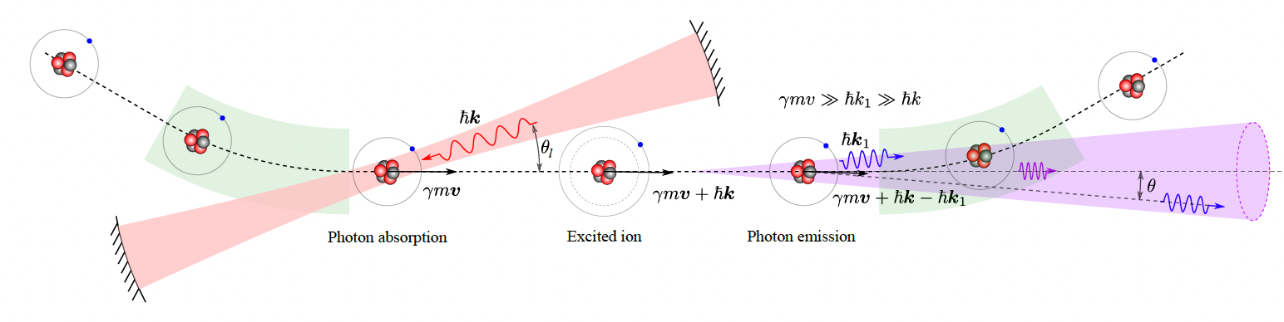
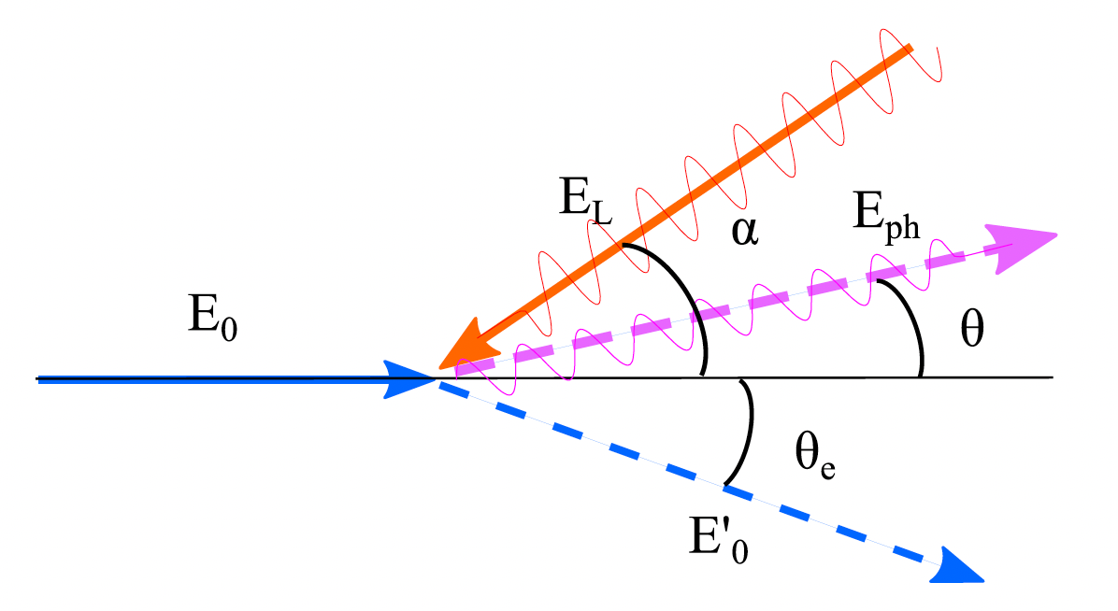
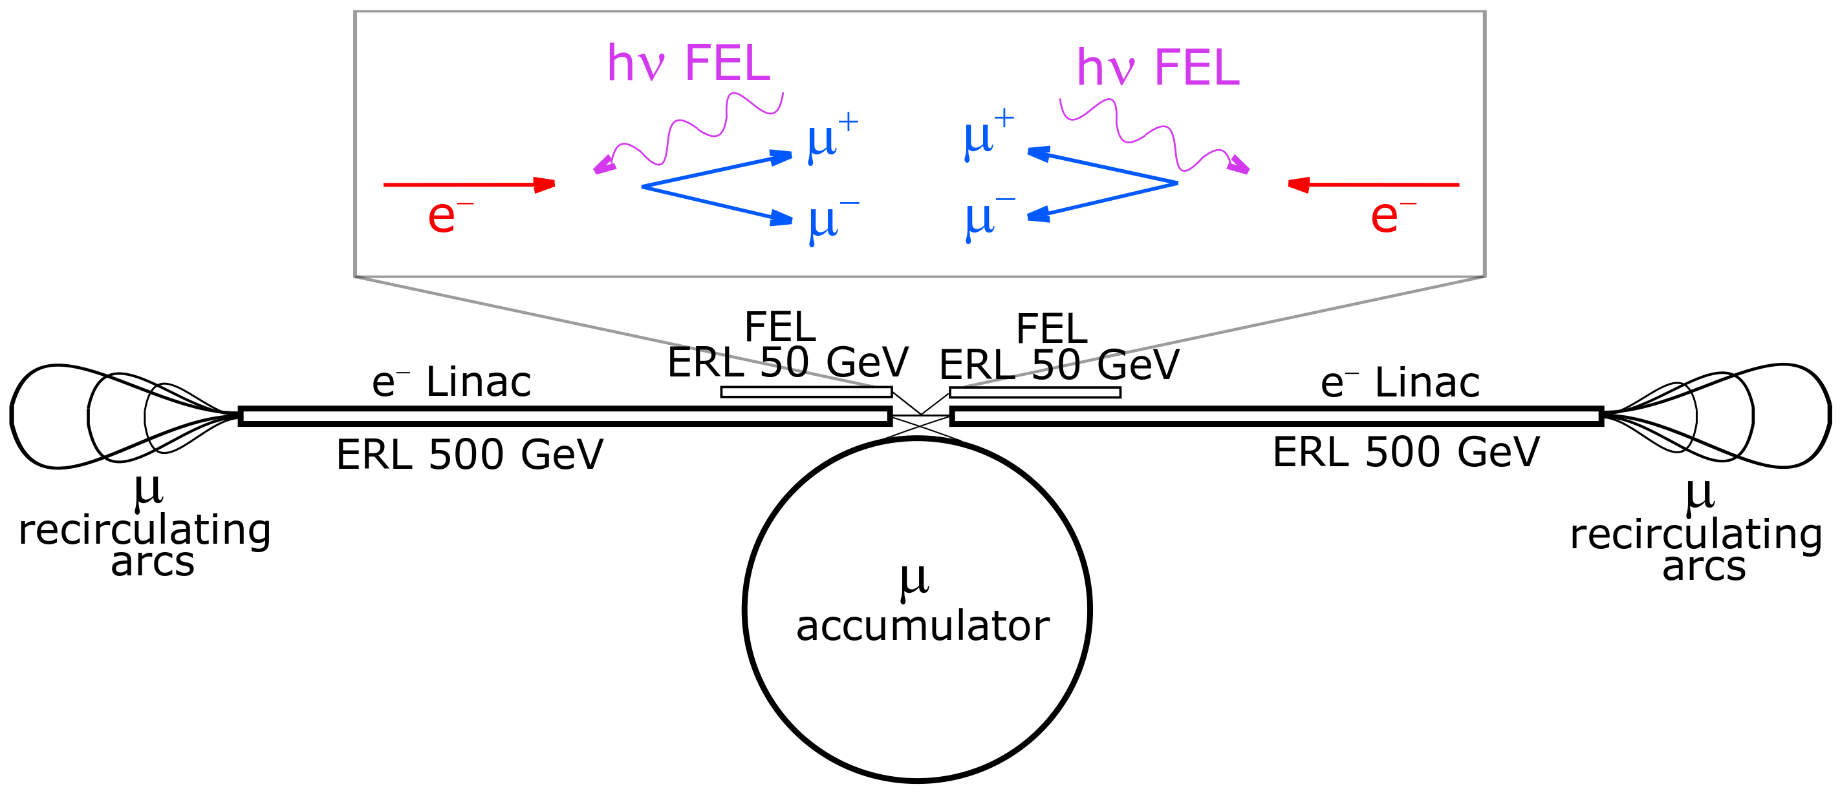
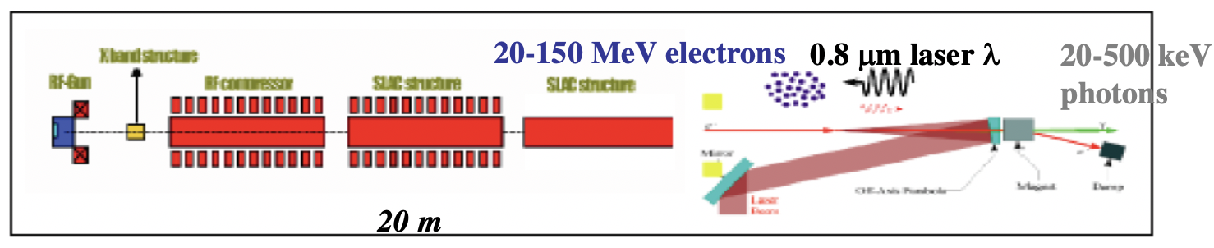
Collisional radiation
(Relativistic Rayleigh Scattering aka Gamma Factory, Inverse Compton Scattering, Large Recoil ICS, Symmetric Compton Scattering)
Gamma Factory
deep recoil I.C.S.
I.C.S.
EXMP
low recoil
I.C.S. - STAR

Slide 10
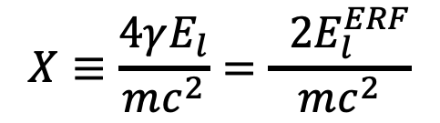

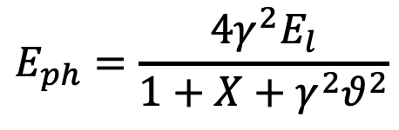
The γ²θ² issue/disease
All radiation originated by a Lorentz Boost associated to relativistic emitting particles (electrons, heavy ions) is intrinsically poli-chromatic because of γθ correlation (energy boost of scattered photons depends on scattering angle, at θ=1/γ photon energy is 50% of max photon energy at θ =0 ) of single electron spectrum (on top of inhomogeneous effects)
True for all kinds of Undulatory and Collisional radiation (bremsstrahlung, wiggler/betatron, synchrotron, RRS, ICS), while resonant or amplified radiation (undulators, FELs), that are diffraction limited thanks to their beam quality, are not (or only partially) affected
$$E_{ph}=\frac{4γ^{2}E_{l}}{1+X+γ^{2}θ^{2}}$$
$$E_{0}=γmc^{2}$$
$$X≡\frac{4γE_{l}}{mc^{2}}=\frac{ 2E_{l}^{ERF}}{mc^{2}}$$

Slide 11
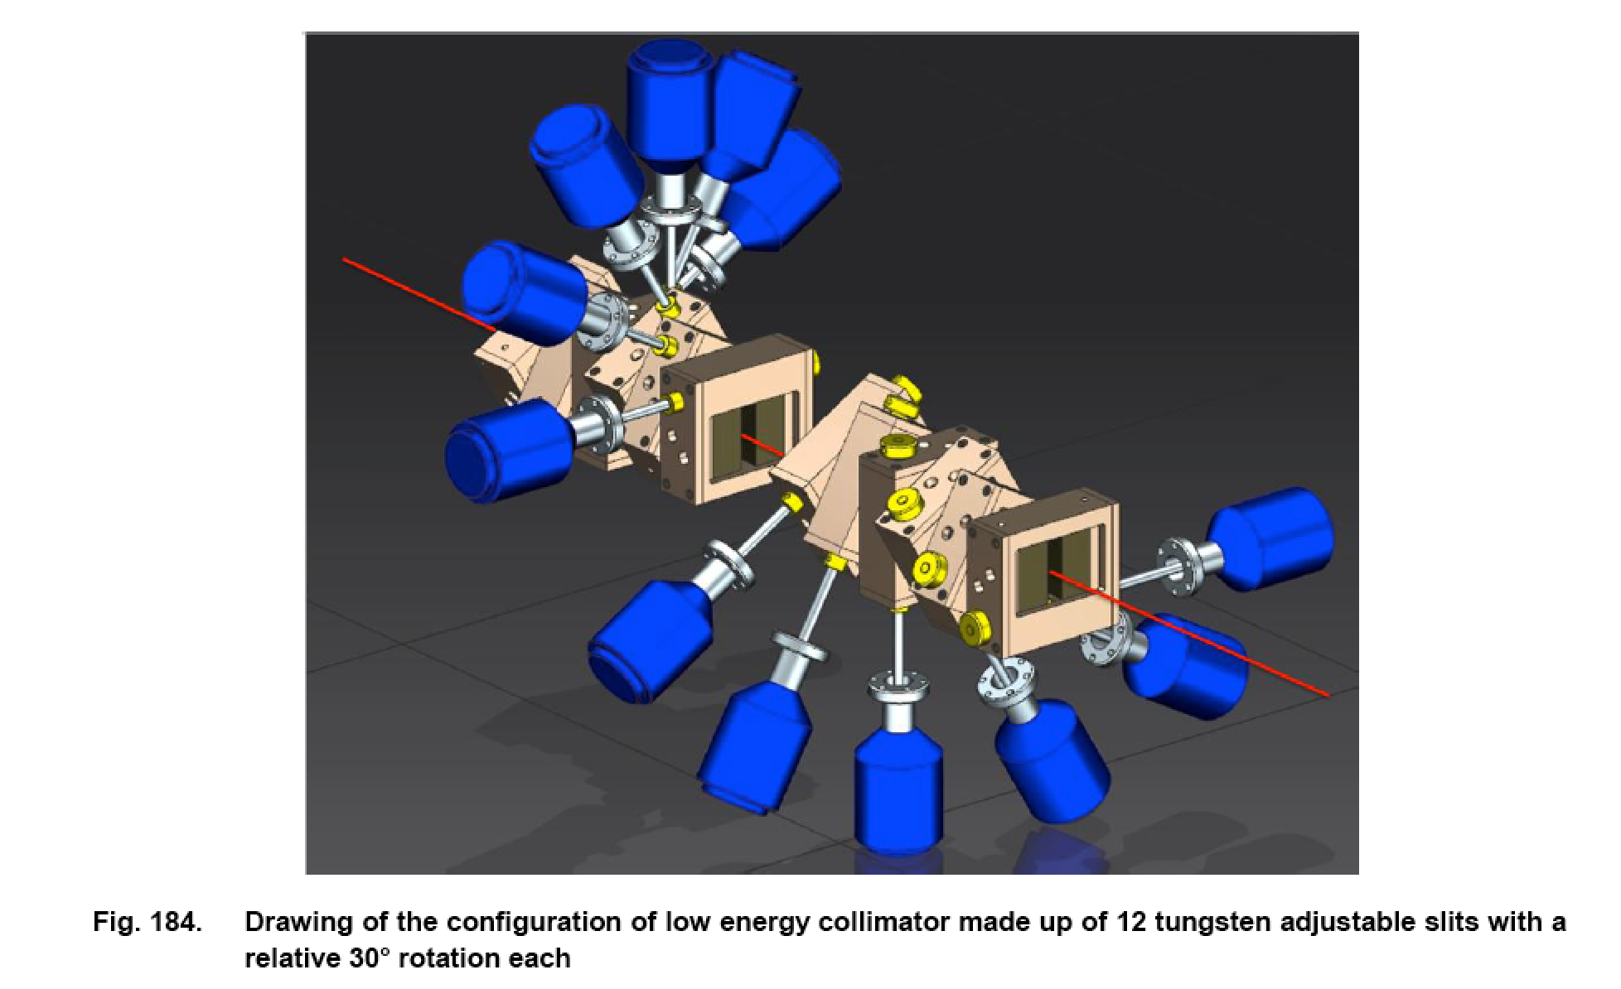
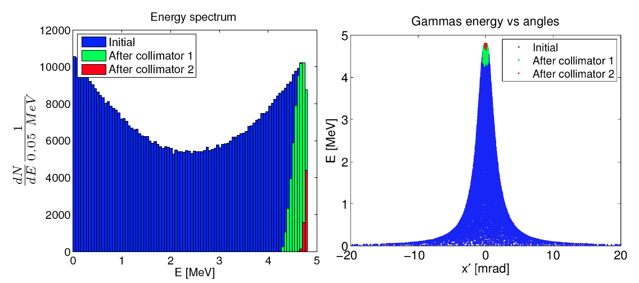
Poli-chromaticity implies using mono-chromators of different kinds (bragg-reflectors, collimators) to select a narrow bandwidth line from a broad-band spectrum
ELI-NP-GBS γ –beam
collimator (2-19 MeV)
X-ray monochromator

Slide 12

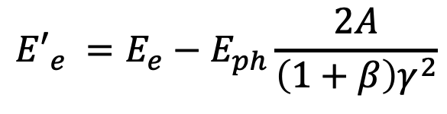
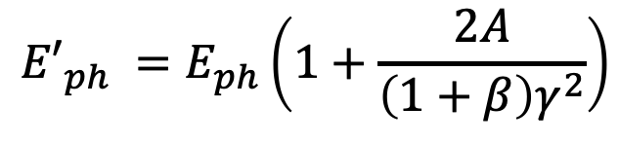

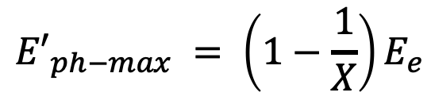



$${E′}_{ph}$$
$$E_{e}$$
$$E_{ph}$$
$${E′}_{e}$$
I.C.S. low recoil X<<1
${E′}_{ph−max} = 4γ2$ $E_{ph}$
$${E′}_{ph−max} = \left(1−\frac{1}{X}\right)E_{e}$$
I.C.S. large recoil X>>1
$${E′}_{ph} =E_{ph}\left(1+\frac{2A}{\left(1+β\right)γ^{2}}\right)$$
S.C.S. (A=0) or
quasi-SCS (A<<1)
$${E′}_{e} ={E_{e}−E}_{ph}\frac{2A}{\left(1+β\right)γ^{2}}$$

Slide 13
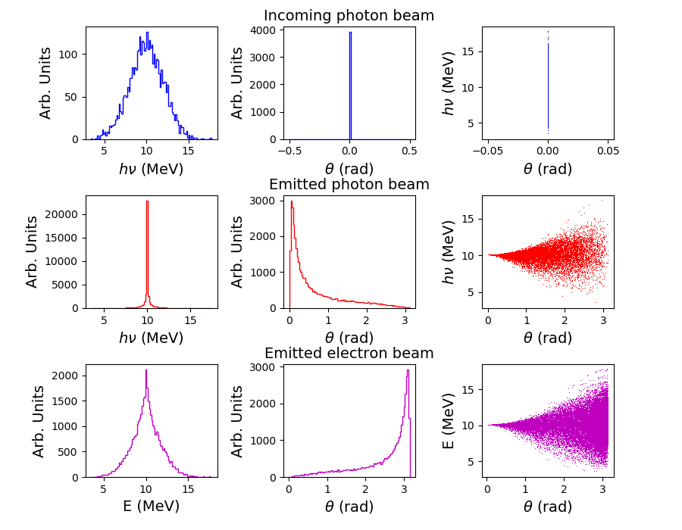
γ -ray in-vacuum mono-chromatization, SCS at large Recoil
20% rms spread
Incoming e- beam 10⁻⁴ rms spread
Electron
Cooling of
photons!!
2.10⁻⁴
rms spread
no energy-
angular
correlation
10⁻¹ spread
e- beam
is heated
C. Curatolo - Whizard

Slide 14
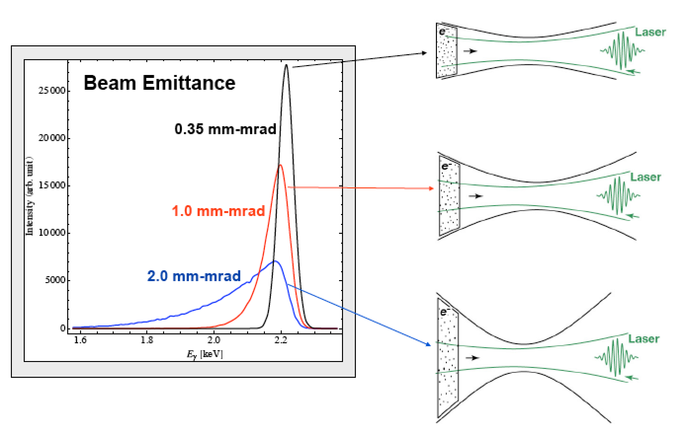
Lorentz boosted radiation (synchrotron, ICS, FEL, etc)
is strongly affected by the emittacne of the electron beam
Courtesy C. Barty - LLNL

Slide 15
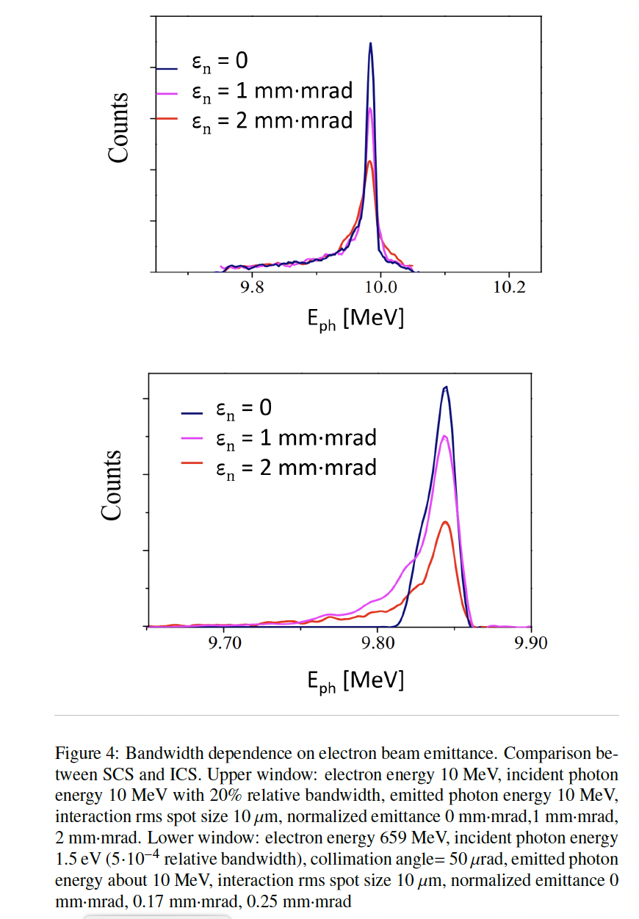
Deep Recoil suppresses the
γ²θ² disease and the effect of
electron beam emittance

Slide 16
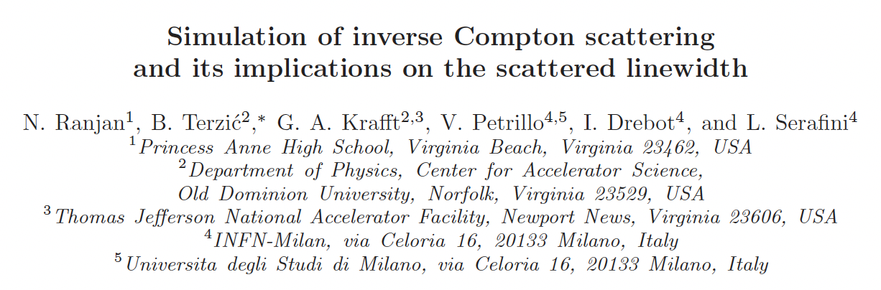
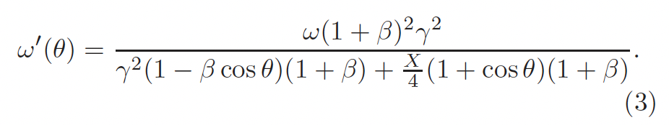
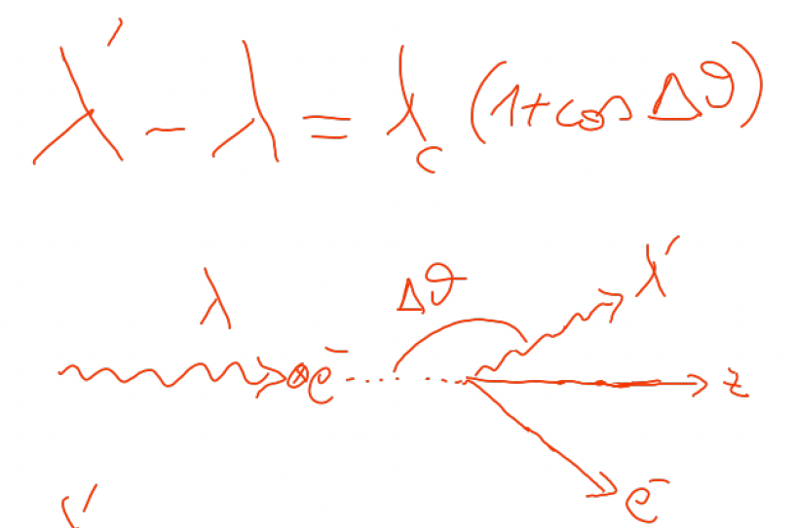


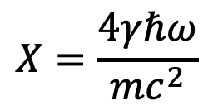


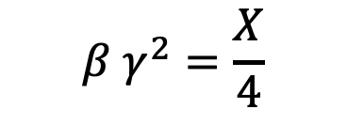
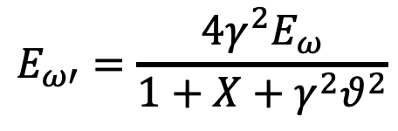
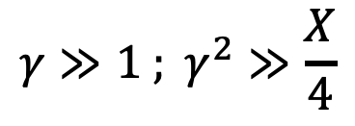

An invariant view at Compton effect - 1
(any inertial ref. frame)
Phys. Rev. AB (2018)
21, 030701
$$X=\frac{4γℏω}{mc^{2}}$$
Arthur Compton,
Nobel Prize 1927
A<0
$$γ≫1 ; γ^{2}≫\frac{X}{4}$$
A<0
A=0
photon looses energy
electron looses energy
$$β=0$$
S.C.S.
I.C.S.
$$β γ^{2}=\frac{X}{4}$$
$$E_{ω′}=\frac{4γ^{2}E_{ω}}{1+X+γ^{2}θ^{2}}$$
$$E_{ω′}={βE}_{e}=βγmc^{2}$$
$$λ′≠∞$$
$$E_{ω′}≠f\left(γ^{2}θ^{2}\right)$$
$$\lim_{X→∞}{E_{ω′}}=E_{e}$$
isolated e⁻ cannot absorb a photon

Slide 17
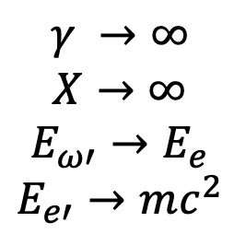

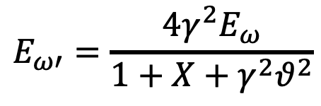
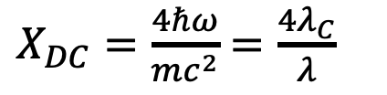


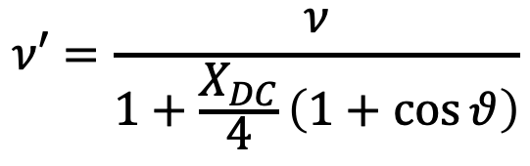
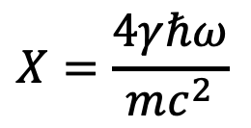




An invariant view at Compton effect - 2
(any inertial ref. frame)
$$X=\frac{4γℏω}{mc^{2}}$$
A<0
A=0
A<0
photon looses energy
electron looses energy
$$\overset{⃑}{p_{e}}=−\overset{⃑}{p_{ω}}$$
Direct Compton
S.C.S.
I.C.S.
$$β=0 ; γ=1$$
$$X=4β γ^{2}$$
$$E_{ω′}=\frac{4γ^{2}E_{ω}}{1+X+γ^{2}θ^{2}}$$
$$ν′=\frac{ν}{1+\frac{X_{DC}}{4}\left(1+\cos{θ}\right)}$$
$$E_{ω}=p_{e}c=βγmc^{2}$$
$E_{ω′}=E_{ω}$ $∀θ$
$$γ →∞$$
$$X→∞$$
$$E_{ω′}→E_{e}$$
$$E_{e′}→mc^{2}$$
$X_{DC}=\frac{4ℏω}{mc^{2}}$ $=\frac{4λ_{C}}{λ}$
$$E_{e′}=E_{e}= γmc^{2} ∀θ$$
$$γ_{cm}=1$$
CM ref. frame = Lab ref. frame

Slide 18
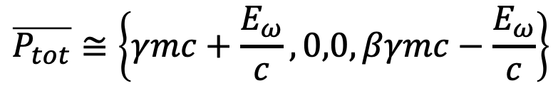
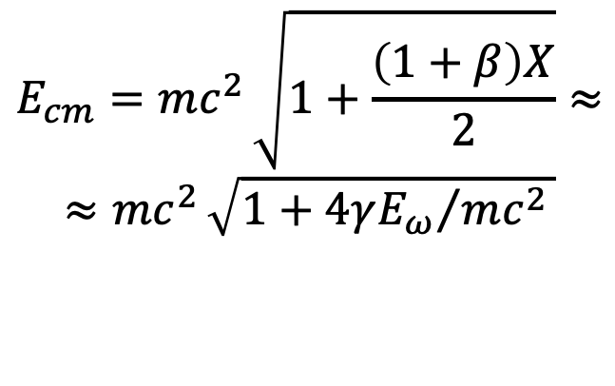

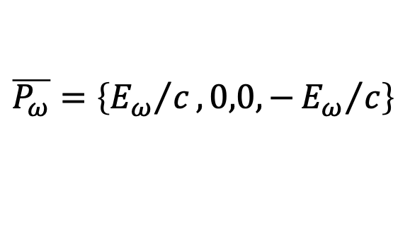
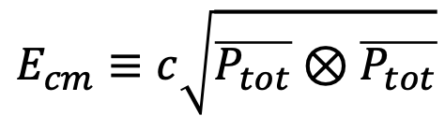
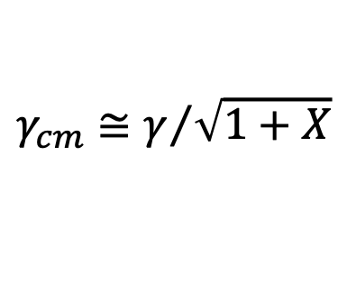
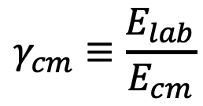






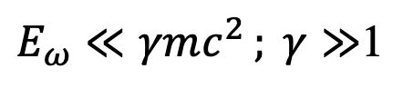


A look at 4-vectors (head-on collision)
Inverse Compton
Symmetric Compton
$E_{ω}≪γmc^{2 }; γ≫$1
$$E_{ω}=p_{e}c=βγmc^{2}$$
$$\overline{P_{e}}=\left\{γmc,0,0,βγmc\right\}$$
$$\overline{P_{e}}=\left\{γmc,0,0,βγmc\right\}$$
$$\overline{P_{ω}}=\left\{{E_{ω}}/c,0,0,−{E_{ω}}/c\right\}$$
$$\overline{P_{ω}}=\left\{βγmc,0,0,−βγmc\right\}$$
$$\overline{P_{tot}}≅\left\{γmc+\frac{E_{ω}}{c},0,0,βγmc−\frac{E_{ω}}{c}\right\}$$
$$\overline{P_{tot}}=\left\{\left(1+β\right)γmc,0,0,0\right\}$$
$$E_{cm}≡c\sqrt{\overline{P_{tot}}⊗\overline{P_{tot}}}$$
$$E_{cm}=mc^{2 }\sqrt{1+\frac{\left(1+β\right)X}{2}}≈$$
$$≈mc^{2 }\sqrt{1+{4γE_{ω}}/{mc^{2 }}}$$
collider
fixed target
$$γ_{cm}≡\frac{E_{lab}}{E_{cm}}$$
$$E_{cm}=\left(1+β\right)γmc^{2 }$$
$$γ_{cm}≅γ/{\sqrt{1+X}}$$
$${; γ}_{cm}$$
1
$$γ_{cm}=1$$
$$γ→∞$$

Slide 19
Symmetric Compton Scattering suppresses the γ²θ² correlation
Photons are scattered at same energy at any angle
Lorentz Boost is damped
Radiation emission is intrinsically mono-chromatic
Poli-chromaticity of incident photon beam is transferred to the scattered electron beam and viceversa (photon cooling, electron heating)

Slide 20
SCS - What Matters?
SCS may allow to design a laser-less γ-ray source for nuclear photonics, aka ELI-NP-GBS, using a compact low energy Linac (20-30 MeV versus 750 MeV)
It can be used to extend the photon energy range of Light Sources and Free Electron Lasers up to MeV’s photon beams (LCLS 12 keV, XFEL 19 keV, ESRF 100 keV ⇒ 1-10 MeV)
Follow-ups in Astrophysics: Synchro-Compton catastrophe (see Malcolm Longair, High Energy Astro-Physics)
Applications to Plasma Physics: additive trapping of electrons (positrons?) in magnetic bottles

Slide 21
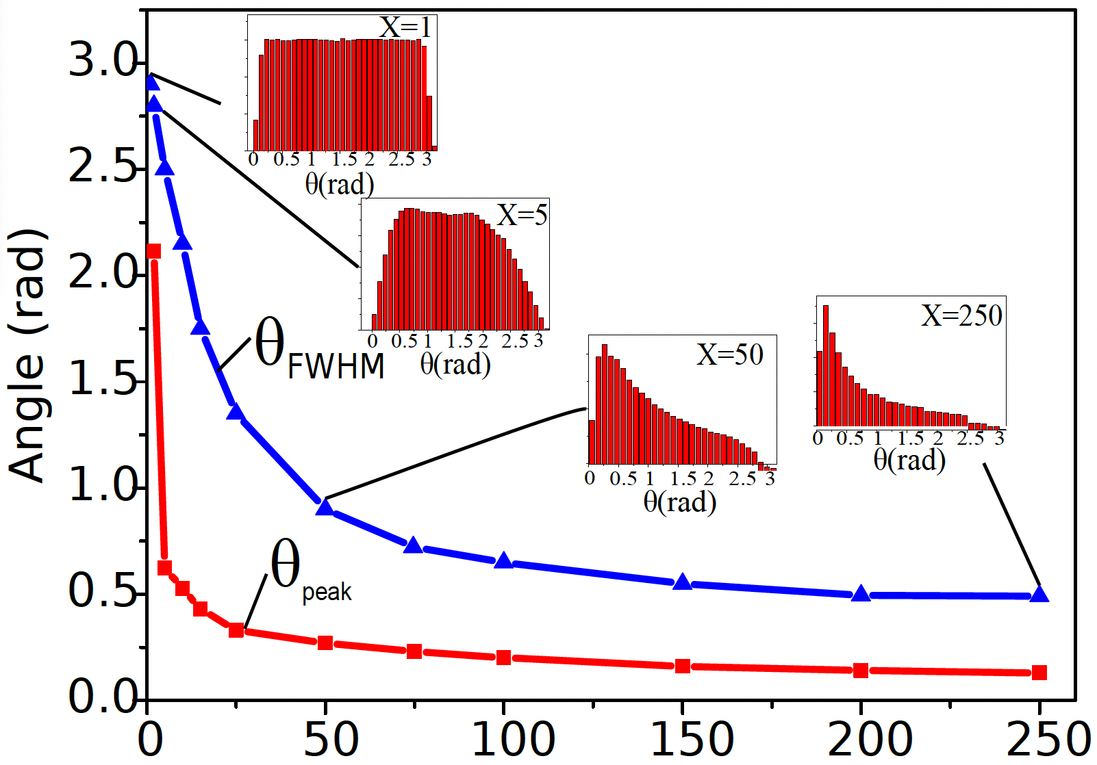
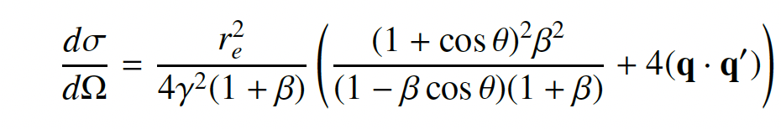
S.C.S. Spectra at different Recoils

Slide 22
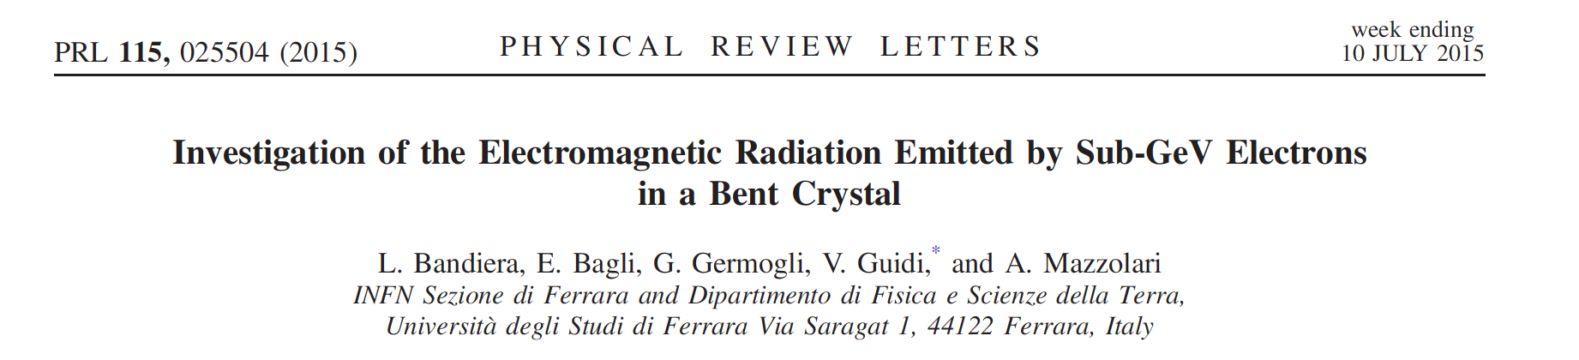


Slide 23
Colliding a gaussian distributed (20% rms spread) broad-band
radiation beam, representing the first peak
of channeling spectrum at 2 MeV,
with a low energy (variable) electron beam (2,3,5,10 MeV)
Mono-chromatization, Tunability

Slide 24
SCS
Colliding the full spectrum
ICS
DC
Spectral purification
Compton Scattering across SCS

Slide 25


Collliding the X-ray beam produced in an undulator at a
Synchrotron Light Source with a few MeV e⁻ beam of an
Energy Recovery Linac (100 MHz)
BriXSinO ERL

Slide 26


Undulator radiation (33 keV from Elettra) vs.
20 MeV e- beam from BriXSinO ERL
about 10⁹ photons/s in 1% bdw (100 MHz rep rate)
V. Petrillo, I. Drebot (INFN-Milan)
S. Dimitri (Elettra)

Slide 27
Grazie per l’attenzione

Slide 29


Symmetric Compton (CSC)
(10 MeV Linac vs. bremsstrahlung/betatron/
channeling/coherent bremsstrahlung beam)
Electron energy=10.013 MeV, Photon energy=10 MeV, ΔE_{phot}/E=20% Deep Recoil X=1533
Q=1.e-9 C N_X=2.*10⁸ σ₀=1 μm rep-rate=200 MHz
HWHM = 10 keV = 0.1%
ΔE_{phot}/E=0.2
ΔE_{e}/E=0.155
FWHM=2.4 MeV
N_el=6.*10⁹ N_X=2.*10⁸ Σ=2.6*10⁻²⁷ =2.6 mbarn N_X’ (s⁻¹)=5*10⁶ S=500 s-¹eV⁻¹
Vittoria Petrillo – Compton montecarlo

Slide 30
Symmetric Compton at moderate recoil
Initial Electron energy=611 keV, Initial Photon energy=335 keV , ΔE_{phot}/E=0.1
Symmetric Compton (p_{e}=-p_{phot}), moderate recoil X=3.13
ΔE_{phot}/E=0.1
ΔE_{phot}/E=0.071
ΔE_{e}/E=0
ΔE_{e}/E=0.023
SCS and large recoil factors are both needed to mono-chromatize broad band incident photon beams

Slide 31

BriXSinO’s ICS source – Illya Drebot with CAIN –
ICS Moustache
BriXSinO T.D.R. @ www.marix.eu

Slide 32
FEL beam vs. compact Linac
Initial Electron energy=20 MeV, Initial Photon energy=20 keV , ΔE_{phot}/E=0.0001
moderate recoil X=6.12
up to 10⁸ photons/s at 17 MeV with 50 keV bdw: S 2000 s⁻¹eV⁻¹

Slide 33

X-ray beam from Light Source vs. compact Linac
Electron energy=20 MeV, Photon energy=100 keV , ΔE_{phot}/E=0.001 recoil X=30.63
up to 10⁷ photons/s at 17 MeV with 50 keV bdw

Slide 34

Turning a radio-active Cobalt-60 fixed energy
gamma-ray source into a tunable sorce of gamma-rays

Slide 35


2 spectral lines merged into a single tunable line

Slide 36


Slide 37
Conclusions
If S.C.S. will be the base of
Next Generation hard-X-Ray and gamma-rays,
we are not yet able to say,
but chances are quite promising.
If S.C.S. will play a role in plasma heating,
soon we’ll be able to say.
Within Astro-physics context more studies
must be pursued to check about
Compton Catastrophe and related topics.

Slide 38

Inverse Compton Sources rivaling/overcoming
Synchrotron Light Sources at photon energies above 80-100 keV
ELI-NP-GBS
STAR
I.C.S.

Slide 39

Inverse Compton Sources, Overview, Theory, Main Technological Challenges – Photonic Colliders
New Generation of X/γ ray beams via electron-photon beam collisions for advanced applications in medicine/biology-material science/cultural heritage/national security and fundamental research in nuclear physics and high energy physics (e-γ, γ-γ colliders, pol. e⁺ beams, hadron. physics, etc)
Inverse Compton Sources (ICS) are e⁻/photon colliders aimed at producing secondary beams of photons
Several Test-Facilities world-wide: after a decade of machine test&development we are entering the era of User Facilities in X-ray imaging and γ-ray Nuclear Physics and Photonics

Slide 40
Challenges of electron-(optical)photon colliders as X/γ beam Sources using Compton back-scattering
Need of high peak brightness/high average current electron beams (cmp. FEL’s drivers) fsec-class synchronized and μm-μrad-scale aligned to high peak/average power laser beams
Main goal for Nuclear Physics and Nuclear Photonics: Spectral Densities > 10⁴ N_{ph}/(s.eV) photon energy range 1-20 MeV, bandwidths 10⁻³ class
Main goal for Medical Applications with X-rays: tunability in the 20-120 keV range, good mono-chromaticity (1-10 %), high flux (10¹¹ min., 10¹² for radio-imaging, 10¹³ for radio-therapy)

Slide 41
Main goal for MeV-class γ − γ and TeV γ - nucleon colliders: Peak Brilliance > 10²¹ N_{ph}/(s.mm^{2.}mrad^{2.}0.1%) 10⁹<N_{ph}<10¹³ Source spot size μm-scale (low diffraction, few μrad) Tunability, Mono-chromaticity, Polarization (H,V,C)
Photon-Photon scattering (+ Breit-Wheeler: pair creation in vacuum) is becoming feasible with this new generation γ-beams: a γ-γ low energy collider

Slide 42


3rd-4th Generation Light Sources
Synchrotron light sources: < 50 keV, > 50 ps (100 m, 300 M$)
X-ray FEL (LCLS): energy ≤25 (50?) keV, 1-100 fs (1 km, 1 G$)
New approach: inverse Compton scattering (ICS) 20-200 keV , sub-ps, (10 m , 10 M$) – sometimes called Laser Synchrotron since a laser pulse substitutes the magnetic undulators

Slide 43



Brilliance of Lasers and X-ray sources
ELI
12.4
1.24
0.124
λ (nm)
BELLA
FLASH
$$B_{peak}=\frac{N_{ph}}{{\sqrt{2π}σ_{t}ε}_{x}^{2}\frac{ΔE_{X}}{E_{X}}}$$
Thomson/Compton Sources
$$B_{av}=\frac{N_{ph}f}{ε_{x}^{2}\frac{ΔE_{X}}{E_{X}}}$$

Slide 44


Rivaling with Synchr. Light Sources for energies above 50 keV
$$B_{av}=\frac{N_{ph}f}{ε_{x}^{2}\frac{ΔE_{X}}{E_{X}}}$$

Slide 45

Photon / Particle Beams: diffraction, envelope, matching, co-propagation.
Example: TEM₀₀ Gaussian Laser mode (circ. pol. M²=1 diffr. limited)

Slide 46
LASER
PARTICLE BEAM

Slide 47

with
electron recoil
without
electron recoil

Slide 48


Slide 49

Ultra-low emittance positron beams from deep recoil
electron-photon collider: 5 GeV ERL vs. 5 keV FEL, X=391
up to 10¹³⁻¹⁴ e⁺/s at 50 MeV within 5% en. spread
Son of
EXMP
E_{cm}=10 MeV
E_{cm}=346 MeV
0.5 MeV/c rms
transv. momentum
0.5-1*10⁻⁷ m.rad rms norm. transv. emittance with round beam (no-cooling)
V. Petrillo, A. Puppin – Whizard

Slide 50


Trapping electrons (positrons) into a magnetic bottle by SCS
at low recoil ( 72 keV photon beam heats up 5 keV e⁻ beam)

Slide 51

S.C.S. – incident photon energy vs.
incident electron kinetic energy
E_{ph} (keV)
T_{e} (MeV)

Slide 52


Slide 53

60% of scattered electrons are (additively) trapped
into the magnetic bottle (w.o. any external field)

Slide 54


Large Recoil in MPP damps the normalized emittance of the secondary generated muon beam
muon beam norm. emittance
cmp. MAP norm. emitt. 2.5.10⁴ nm.rad
after ionization cooling

Slide 55

Hadronic Physics was the original motivation for Compton back-scattering experiments (cfr. Ladon at INFN-LNF, Graal at ESRF, etc): single photon per bunch collision at energies > 50 MeV with tagging (quite popular decades ago)
L. Federici, G. Giordano, G. Matone, G. Pasquariello, P. G. Picozza, et al. Backward compton scattering of laser light against high-energy electrons: the ladon photon beam at frascati.
Il Nuovo Cimento B (1971-1996), 59(2):247–256, 1980.

Slide 56



Slide 57
The Classical E.M. view (Maxwell eq.): Thomson Sources as synchrotron radiation sources with electro-magnetic undulator
FEL’s and Thomson/Compton Sources common mechanism:
collision between a relativistic electron and a (pseudo)electromagnetic wave
3 km
cm und. period λ_{u}
1-25 GeV
electrons
100-0.5 Å
photons
20-150 MeV electrons
0.8 μm laser λ
20-500 keV
photons
20 m

Slide 58

CALA
ELI-NP
HigS
STAR
ICS are the most effective “photon accelerators” (boost twice than FELs)
“4γ² boost effect”
Courtesy A. Variola

Slide 59

Total cross-section for MPP (muon pair production), Bethe-Heitler:
fraction of a μbarn at photon energies > 100 GeV onto electrons at rest
$$e^{−}+γ→e^{−}+{e^{+}}/{e^{−}}$$
$$e^{−}+γ→e^{−}+γ$$
$$e^{−}+γ→e^{−}+{μ^{+}}/{μ^{−}}$$
EXMP
$σ^{MPP}= αr_{μ}^{2}\left(\frac{28}{9}ln\left(\frac{2γhν}{M_{μ}}\right)−\frac{218}{27}\right)$ ${− σ}^{Borsellino}$
Bethe-Heitler
$$E_{CM}=2\sqrt{M_{e}γhν}$$
$$E^{′}=2γhν=\frac{E_{CM}^{2}}{2M_{e}}$$

Slide 60

Spread of incidence angle
(resembles emittance)
cooling of
photons still
effective
as well as
heating of
electrons

Slide 61



E’_{ph} - energy of scattered photon at θ
red shift at θ≠0
θ
scattered electron
E’_{e} = γmc² + E_{ph} – E’_{ph}
All I.C.S. X/γ ray Sources work at X<1 and A » 1
STAR (350 keV) X_{STAR} < 2.6.10⁻³ A_{STAR} > 10⁴
ELI-NP (20 MeV) X_{ELI-NP} < 0.026 A_{ELI-NP} > 2.4.10⁵
X = recoil parameter – twice the energy of the photon seen
by the electron in its own reference frame normalized to mc²

Slide 62

Courtesy L. Rivkin

Slide 63

To transform to the Lab ref. system we need to compute
Then apply a Lorentz transformation

Slide 64

I.C.S. : Inverse Compton Scattering
Inverse Compton Scattering: why Inverse?
(direct) Compton Scattering is performed by an energetic photon (X-rays) interacting with an atomic electron (eV)
Inverse Compton Scattering is performed by an energetic electron (MeV-GeV) onto a visible (eV) photon (“inverse” refers to the reaction kinematics, not the dynamics)

Slide 65
where is the Continental Divide
between
Compton Scattering
and
Inverse Compton Scattering?
when the electron becomes
a projectile (as in ICS)
instead of
a target (as in Compton)?
Does it depend only on electron energy?
No, it depends only on asymmetry in colliding momenta

Slide 66







CM rest frame moves with
the photon in Direct Compton
CM rest frame moves with the electron in
Inverse Compton, FEL, Synchrotron light
$$γ_{cm}\sim γ$$
CM rest fr. slows down in Inv. Compton with deep recoil
CM rest frame is steady in Symmetric Compton
$$γ_{cm}=1$$
$$γ_{cm}≪γ$$
M. Rossetti Conti

Slide 67





Deep Recoil I.C.S. helps attenuating the γ²θ² problem through slowing down of Lorentz boost γ_{cm}<<γ
7 GeV e⁻ beam
laser
UV FEL
X FEL
$$Ψ=\frac{γθ}{\sqrt{1+X}}$$
$$\overline{P}=\frac{\sqrt{2}ε_{n}}{σ_{x}\sqrt{1+X}}$$
X=0.13
X=13.
X=1300.
$$γ_{cm}=\frac{γ}{\sqrt{1+X}}$$
R. Hajima and M. Fujiwara, Narrow-band GeV photons
generated from an x-ray free-electron laser oscillator, Phys.
Rev. Accel. Beams 19, 020702 (2016). XFELO Project

Slide 68


E’_{ph}
(keV)
ICS
1 eV – O(100) MeV

Slide 69


Slide 70



Symmetric Compton
Scaling of photon energy vs. electron kinetic energy
$$E_{ω}=p_{e}c=βγmc^{2} (MeV)$$
$$T_{e}=E_{e}−mc^{2}= \left(γ−1\right)mc^{2} (MeV)$$

Slide 71




Symmetric Compton
Scaling of X, recoil factor, vs. electron kinetic energy
$$E_{ω}=p_{e}c=βγmc^{2}$$
$$X=4β γ^{2}$$
$T_{e}=E_{e}−mc^{2}= \left(γ−1\right)mc^{2}$ (MeV)

Slide 72
Fixed recoil X=1531
Moving away from Symmetric Compton
incident ΔE_{phot}/E=20%
Initial Electron energy=10.013 MeV,
Initial Photon energy=10.0MeV
Initial Electron energy=11.0 MeV,
Initial Photon energy=9.08MeV
Initial Electron energy=12.0 MeV,
Initial Photon energy=8.33 MeV
No γ²θ² disease
The onset of γ²θ² disease

Slide 73



Fixed recoil X=1531
going from SCS to ICS
Initial Electron energy=20.0 MeV,
Initial Photon energy=5 MeV,
ΔE_{phot}/E=0.2
Initial Electron energy=100.0 MeV,
Initial Photon energy=1 MeV,
ΔE_{phot}/E=0.2
Initial Electron energy=40.0 MeV,
Initial Photon energy=2.5 MeV,
ΔE_{phot}/E=0.2
full γ²θ² disease – the moustache pattern

Slide 74
BriXSinO: an innovative accelerator towards energy sustainability and advanced applications with mono-chromatic X-rays and coherent high-power THz radiation.
Luca Serafini and BriXSinO’s TDR Collaboration
INFN-Milano and LASA
Prof.ssa C. Lenardi – Tecniche di imaging per applicazioni biomediche, Dip. di Fisica – 25/10/2022

Slide 75

BriXSinO Conceptual Layout - 1
BriXSinO is a linear electron accelerator (Linac) with beam current and time structure similar to a storage ring: 5 mA, 100 MHz (normal Linac 0.1 μA, 100 Hz)
BriXSinO must be operated in Energy Recovery mode in order to sustain the large beam power (up to 225 kW at 45 MeV, cmp. normal Linac 10-50 W )

Slide 76
BriXSinO Conceptual Layout - 2
22 kW disposed
225 kW available
Energy Recovery is accomplished recirculating back the electron beam and decelerating through the Super-Conducting RF Cavities (90% recovery effectiveness)
100s kW electron beams would not be sustainable without Energy Recovery

