Slide 1

INFN-ACCELERATORI
David Alesini
(INFN-Laboratori Nazionali di Frascati)

Slide 2

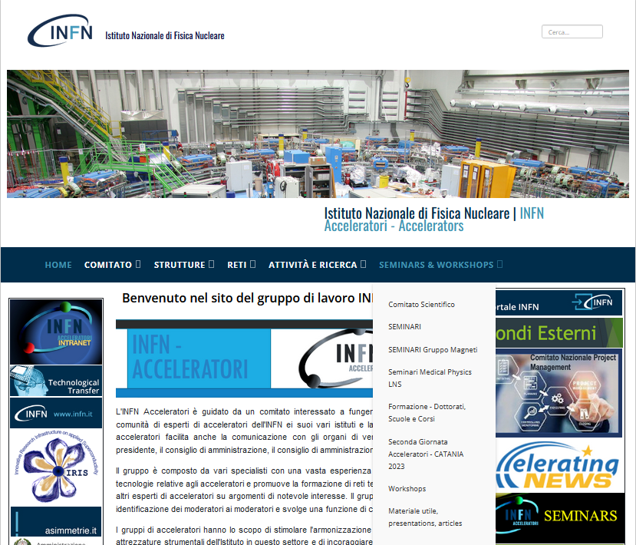
INFN-A: tasks and mission
The tasks of the INFN-Accelerators Committee are:
Act as a link between the community of accelerators experts in the INFN and the management of the INFN (President, Giunta Esecutiva, Consiglio Direttivo);
Promote the formation of thematic networks among accelerator experts on topics of relevant interest, with the identification of their coordinators, and to play a coordinating role among them;
Stimulate the harmonization of the Institute’s competences and equipment in this field;
Encourage and promote participation in regional, national and international funding calls;
Play an advisory role, at the request of management, in the field of particle accelerators with regard to the promotion of, or participation in, projects and the strategic direction of INFN in this field.
Regular committee meetings
two-day accelerator meeting 2022-2023
Promoting Training/teaching: advertise on
-courses
-Accelerators in the Universities
  Mapping:
  ongoing activities
  instrumentation available
  competence of the various groups
  information (activities, projects,...)
  Companies
  Seminars
  Networks:
  Superconducting Magnets and Associated Technologies
  Medical network
  Proto-RF network
Web page
  ACCELERATOR INFN GLUE: UNITARY GROUP

Slide 3
WEB PAGE
(https://acceleratori.infn.it/index.php/it/)

Slide 4
THE NEW COMMETTEE
(in charge from 1/7/23)
David Alesini (LNF-INFN) Coordinator (previous mandate Lucio Rossi, Uni Milano & INFN MI LASA)
Francesco Grespan (LNL) (previous mandate Giovanni Bisoffi (LNL))
Stefania Farinon (INFN GE) (previous mandate Pasquale Fabbricatore, INFN GE)
Alessandro Gallo (LNF)
Dario Giove (INFN MI LASA) → observer in CNS5 e INFN4LNS
Enrica Chiadroni (Univ. La Sapienza) (previous mandate Susanna Guiducci, LNF)
Giorgio Keppel (LNL) → observer in CNTT
Giuseppe Torrisi (LNS)
Veronica Valsecchi (MIB) → Fondi Esterni
ex-officio: P. Campana (Giunta INFN)
invited:
G. Cuttone (LNS, INFN4LS),
E. Nappi (INFN-BA, INFN-E)
David Mascali (LNS): observer from INFN-A da INFN-E
Cristina Vaccarezza observer from CSN5
Leonardo Roscioli (LNF) previous mandate Tiina Benson (INFN MI LASA)

Slide 5

WHAT IS ON GOING
Network of irradiation facilities
Vacuum network (kickoff 11-12 Sept 2023)
Open letter related to the University teaching of particle accelerators in Italy
Internal Network to promote scientific, technological, technical and infrastructural exchange
Generalized Infrastructure: use a generalized infrastructure based on national services including information, time-beam calls (calls) and access procedures to INFN irradiation facilities
Support experimental projects: i.e. CSN-V oriented to funding and implement operational solutions (e.g. detectors, hardware and software infrastructure) of innovative and experimental type
Organizing school at national level shared between laboratories
Share list of companies, suppliers, components, experience
Main instrumentation at the various units (to be used in other units), skills, ISO standards, manuals
Create a Forum
Annual meeting

Slide 6
PROMOTING ACCELERATORS TEACHING IN UNIVERSITIES
The presence of accelerator physicists, researchers and engineers in universities is crucial to continue building new accelerators, develop ideas, operate-improve existing facilities
The INFN plays a strategic role in this area and an action of "lobby" to change the parameters of access to university education is necessary to prevent a serious crisis in this sector in Italy in the coming years, (as is done in other countries of Europe).
University positions for accelerators and a 4th range (for evaluation of bibliometric parameters) whereas acceleratorists are a small community compared to large experiments and if evaluated with the same parameters they have little access to Italian universities.
Open letter prepared by INFN-A ready to be sent to CUN, SIF president, directors of physical/engineering departments with prayer of dissemination also to the coordinators of the courses of study, Presidents and general directors Elettra and CNAO. Joint INFN, all the chairs of the scientific committee INFN, all the directors INFN.

Slide 7
NEAR FUTURE ACTIVITIES
INFN-A & INFN-E Workshop on Energy and Accelerators (February-March 2024) to explore ideas and possibilities related to energy production through accelerators et al., sustainability etc…
NEW NETWORK: EPICS network
Seminar open to industries on particular topics interesting for Companies
Modifications of the web page to include job open positions on particle accelerator field
Promote accelerators physics&technology teaching/seminars in secondary schools and Universities

Slide 8
HOW INFN-A CAN SUPPORT PROJECTS
Seminars dedicated to the project (Laura officially invited)
Promote/advertise within the community accelerators workshops related to a particular project
Promote/Advertise for open positions (scholarship, postdoc, positions…)
Review proposals for fundings in a constructive way, promoting projects

Slide 9

ACCELERATORS DRIVEN SYSTEMS BASED ON HIGH INTENSITY ELECTRON ACCELERATORS: GAMMA SOURCES
Strong motivation and impact: energy for the future, environment impact of fossil fuels etc… energy bridge waiting for fusion
Personal opinion: as physicists or engineers, working for public institutions, we should invest part of our time (especially today) to the “energy crise” problem (CO2…)
High intensity, low energy, electron accelerators for photonuclear production and controlled fission (thorium based reactors, transmutation), ⇒several advantages with respect to facilities based on protons.
Short term R&D oriented to international collaborations (EU programs):
    test of targets at low intensity for validation of photonuclear models
    Implementation of high efficiency superconducting strictures (synergies with FCCee R&D)
    Design studies for low-medium power nuclear plants accelerator based
    R&D also useful for proton beam ADS facilities
    Interdisciplinary studies: neutron diagnostics, accelerators, nuclear modeling, power plants,… on a reasonable scale
-H. Feizi and A.H. Ranjbar, "Developing an Accelerator Driven System (ADS) based on electron accelerators and heavy water", JINST 11 P02004, 2016
-Bin Liu et al., The electron accelerator driven sub-critical system, Nuclear Engineering and Design 386 (2022) 111567

Slide 10
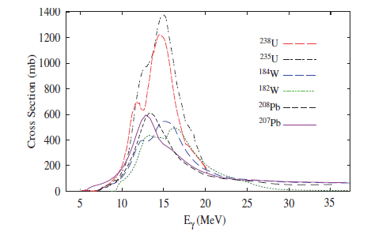
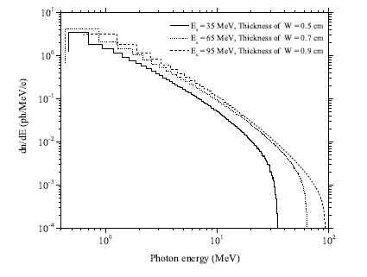
TUNED GAMMA SOURCES VS BREMSTRALUNG
Total photoneutron production cross sections of uranium, tungsten and lead isotopes [IAEATECDOC-1178].
A gamma-Factory tuned at 15 MeV is feasible with Crystals undulators? What are the parameters? Average flux etc…
Bremsstrahlung radiation spectra produced by electrons of various energy and tungsten targets of optimized thicknesses.
∼10¹⁵ ph/s/mA in the 10-20 MeV range

Slide 11
CONCLUSIONS
INFN-ACCELERATORI is a Committee that aims to create a glue within the INFN accelerator Community promoting:
Networks
Seminars
Interactions
Training/teaching
Projects reviews, support
….
THANK YOU FOR YOUR ATTENTION!

