Slide 1
Effect of Dopant Concentration on Crystalline Structure: Molecular Dynamics Studies
Matthew Dickers
School of Physics and Astronomy, University of Kent, United Kingdom
M.D.Dickers@kent.ac.uk
TECHNO-CLS Workshop
Ferrara, Italy, October 05-06, 2023

Slide 2
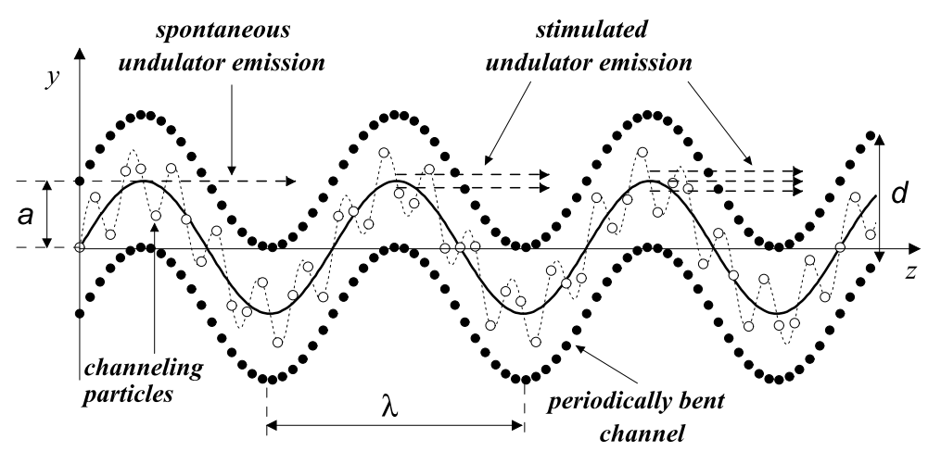
Motivation
Bent crystals can be produced without the need for active modifications through doping
High-quality crystals needed to allow for channelling
High dopant concentration leads to defect formation
Characterisation experiments are limited to ~nm scale
Molecular dynamics simulations allow for models of crystals on an atomistic scale
We consider both Si-Ge and C-B crystals
Kolor, A. V. et al. International Journal of Modern Physics E. 13, 867-916 (2004)

Slide 3
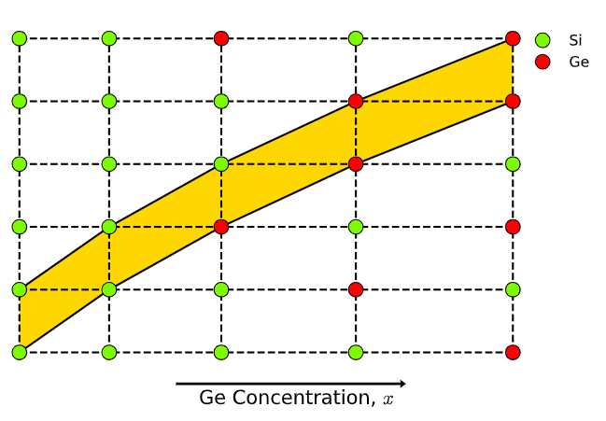
Bending Crystals through Doping
Crystals can be bent by various means; we are interested in doping
Dopant atoms with slightly different lattice constant are used
Dopant atom changes inter-planar distance
Si-Ge:
$$a_{Si}=5.43\text{Å}$$
$$a_{Ge}=5.66\text{Å}$$
C-B:
$$a_{C}=3.57\text{Å}$$
$$Δa_{B−C}=a_{C}\left(0.144{∙x}_{B}\right)$$
Grade dopant concentration
Crystal bends
H. Aharoni, Vacuum, 28, 571 (1978) S. H. Connell, et. al, Proceedings of SAIP2014 (2014) M. D. Dickers, et. al, In Preparation (2023)

Slide 4
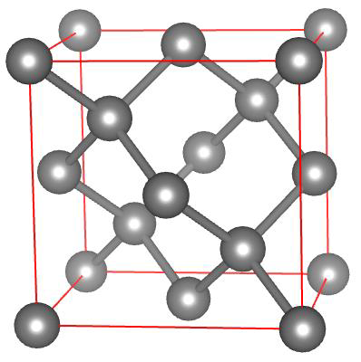
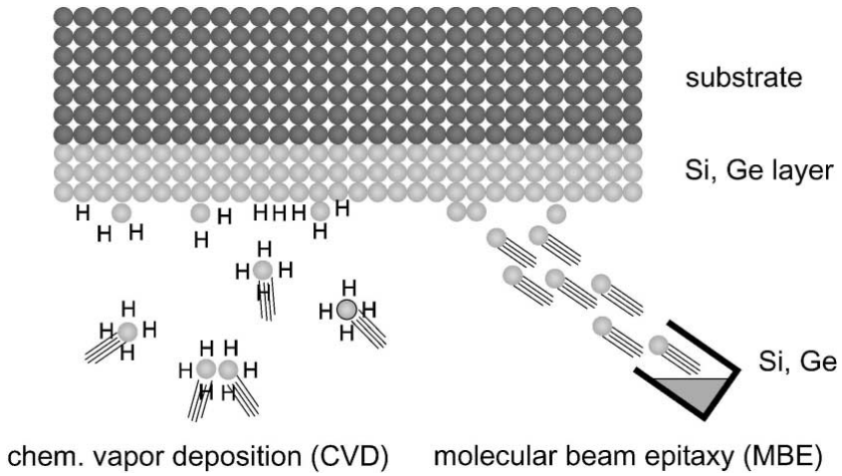
Crystal Generation
MBN Studio is used to generate crystals
Crystals generated from a diamond unit cell
Makes generating large crystals very quick
Single Si or C unit cell generated
Unit cell duplicated across full sim box
Atoms randomly replaced with dopant atoms
Not accurate to growth methods:
Molecular Beam Epitaxy (MBE)
Chemical Vapour Deposition (CVD)
In current simulations doping is not graded; single dopant concentration in each crystal
B. Voigtländer, Surface Science Reports. 43, 5-8 (2001)

Slide 5
Simulation Details
Simulations are conducted using MBN Explorer and MBN Studio
Fixed Si-Ge crystal sizes of $(110×110×110){\text{Å}}^{3}$ - 66420 atoms
Interaction between Si and Ge modelled using the Stillinger-Weber potential
For statistics, 1000 systems generated and optimised; 50 randomly chosen for MD
Generate crystal structure in MBN Studio
For statistics, 1000 systems generated and optimised
50 randomly chosen for MD
Optimisation over 5000 steps
10ps MD simulation at 10K and 300K
Solov’yov, I.A. et al. J. Comput. Chem. 33, 2412–2439 (2012) Sushko, G.B. et al. J. Mol. Graph. Model. 88, 247–260 (2019) M. D. Dickers, et. al, In Preparation (2023)

Slide 6
Data Analysis
Final 20 frames (1ps) of simulation used for analysis
Frames are averaged to account for thermal vibrations
15$\text{Å}$ excluded from each edge; accounts for edge effects
Inter-planar distance calculated:
Atoms are grouped into 110 planes
Determine average position of each plane
Average over all planes and all simulations
Calculate distance between neighbouring planes

Slide 7
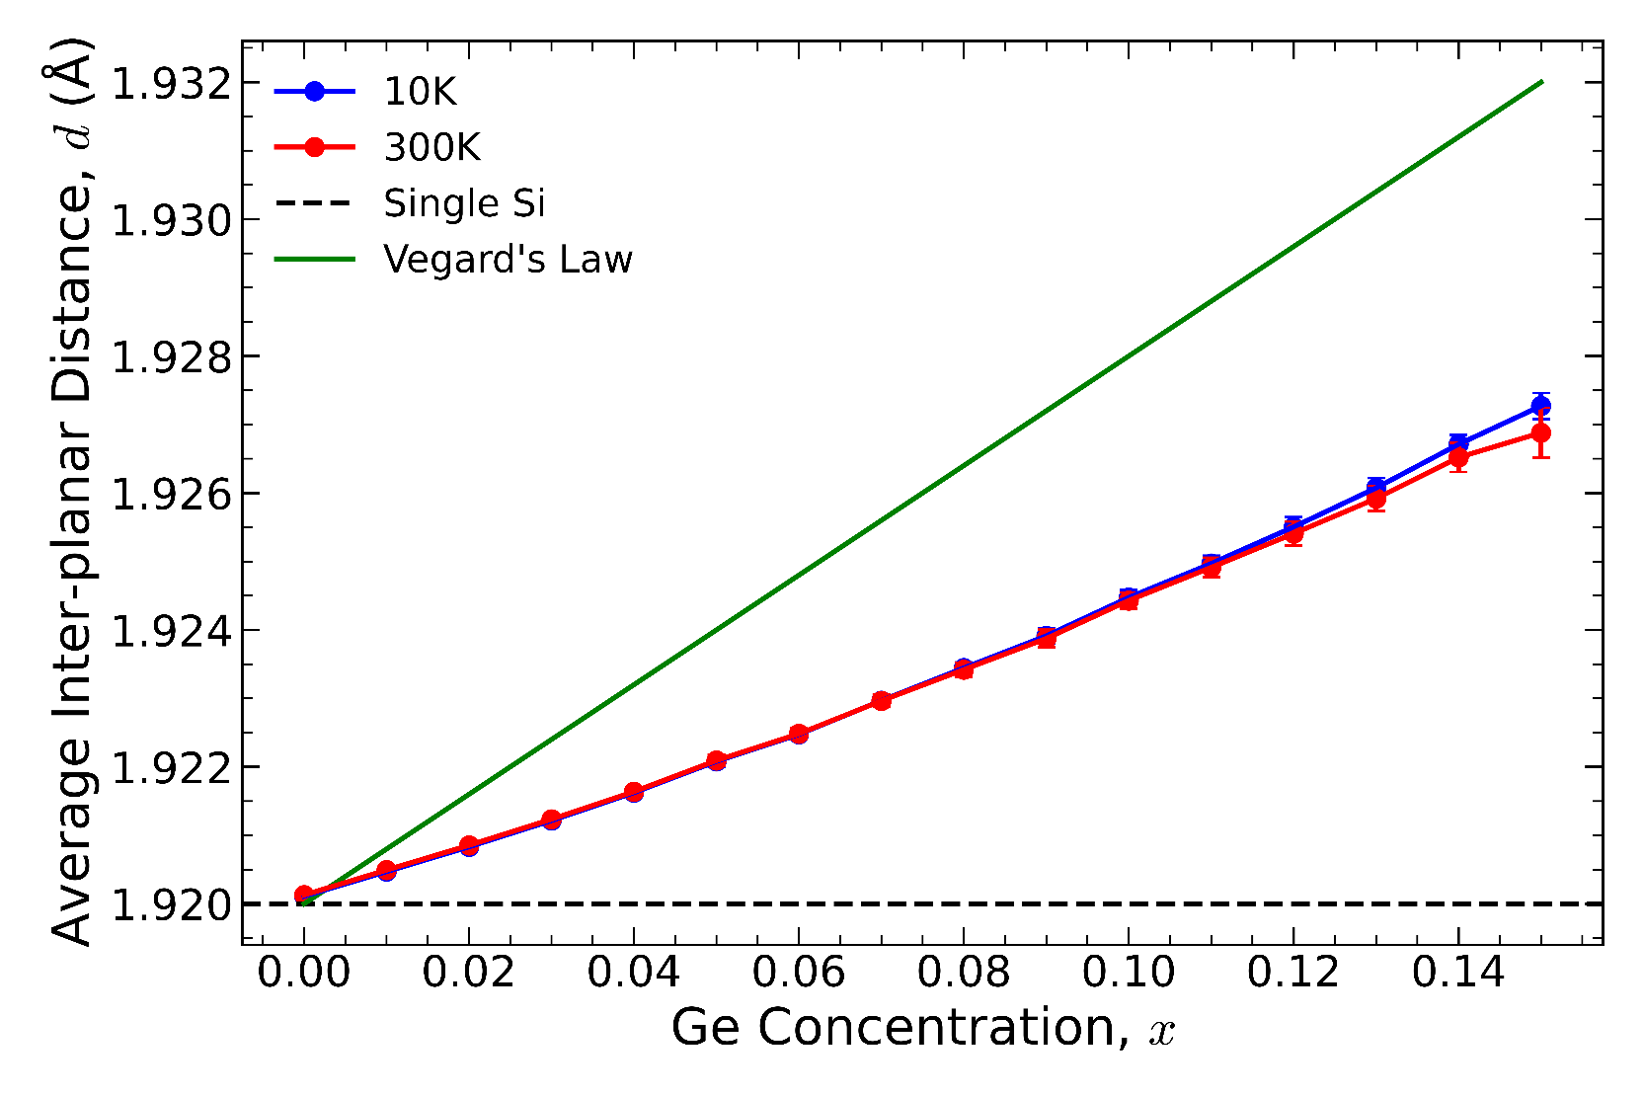
Results – Si-Ge Inter-planar Distances
Results shows a clear linear dependence on inter-planar distance with concentration
No temperature dependence
Linear up to $x≈0.15$; beyond this the crystal becomes amorphous
Do not agree with Vegard’s Law (discussed shortly)
M. D. Dickers, et. al, In Preparation (2023) L. Vegard, Zeitschrift für Physik 5, 17 (1921)

Slide 8
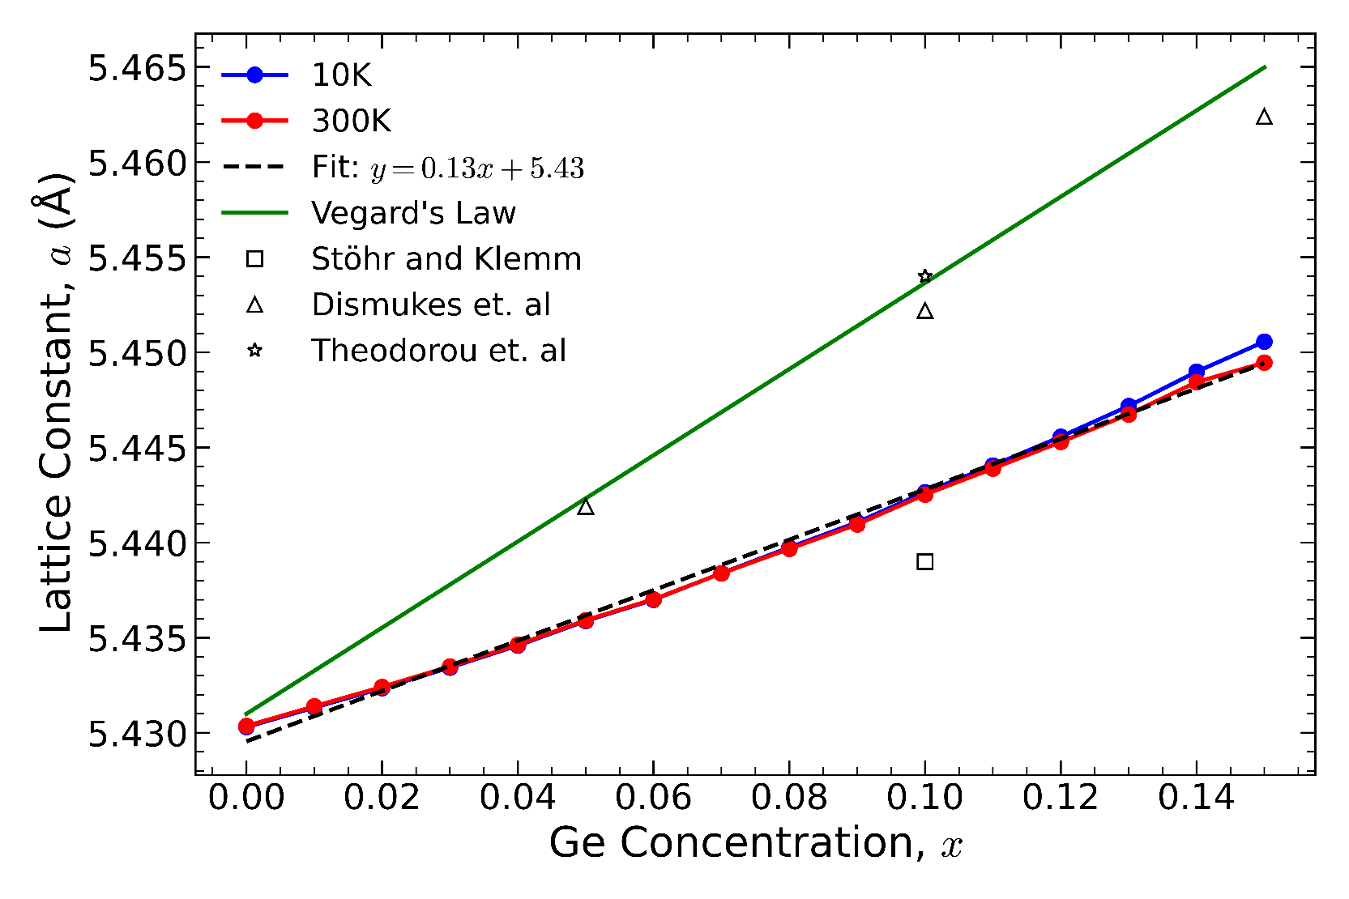
Results – Si-Ge Lattice Constant
Lattice constant gives better comparison to other data
Vegard’s Law is an empirical relationship between lattice constant of two materials:
$a_{A_{(1−x)}B_{x}}=a_{A}\left(1−x\right)+a_{B}x$
We see that most data follows Vegard’s Law; ours does not!
L. Vegard, Zeitschrift für Physik 5, 17 (1921) H. Stöhr and W. Klemm, Zeitschrift für anorganische und allgemeine Chemie 241, 305 (1939)
J. P. Dismukes, et. al, Phys. Chem. 68, 3021 (1964) G. Theodorou, et. al, Phys. Rev. B 50, 18355 (1994) M. D. Dickers, et. al, In Preparation (2023)

Slide 9
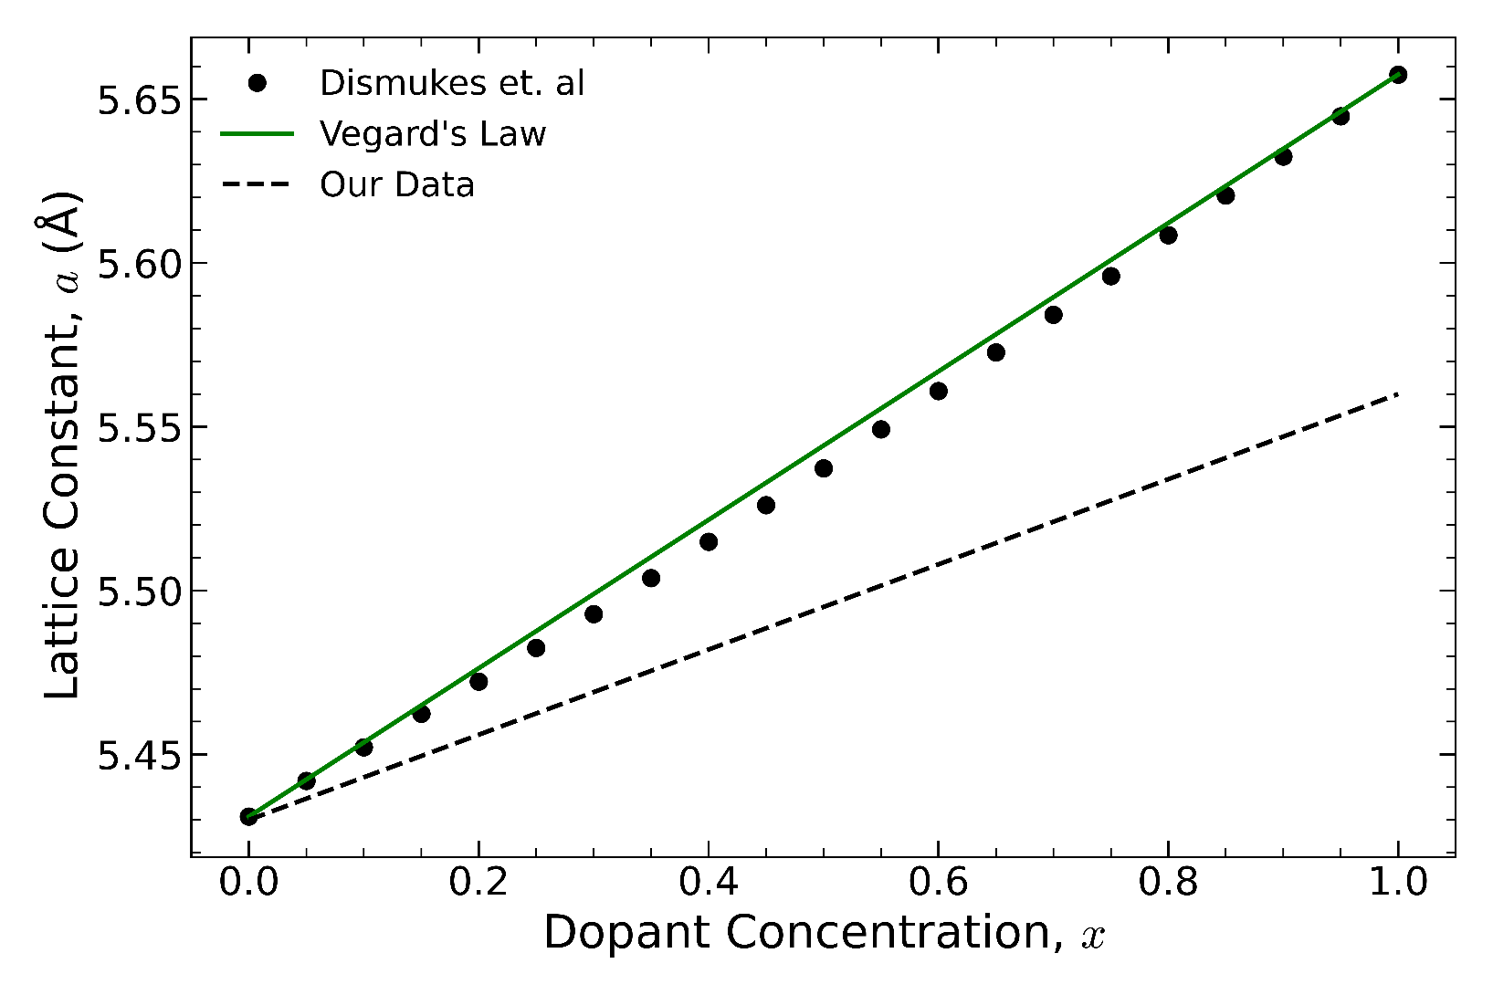
Deviation From Vegard’s Law
Deviations from Vegard’s Law in semiconductor materials are well known from Dismukes et. al
Deviation in our data is much larger
Vegard’s Law: $a_{SiGe}=0.23x+5.43$
Our Data: $a_{SiGe}=0.13x+5.43$
Reasons for this could be:
Our crystals are too good
Our crystals are too small
L. Vegard, Zeitschrift für Physik 5, 17 (1921) J. P. Dismukes, et. al, Phys. Chem. 68, 3021 (1964) M. D. Dickers, et. al, In Preparation (2023)

Slide 10
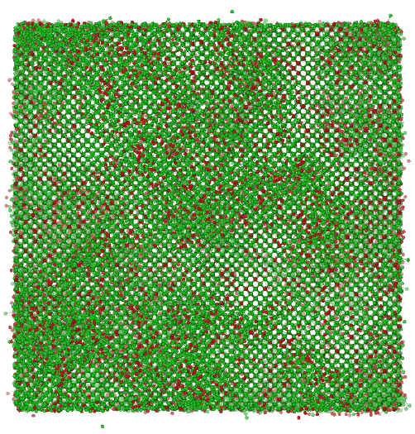
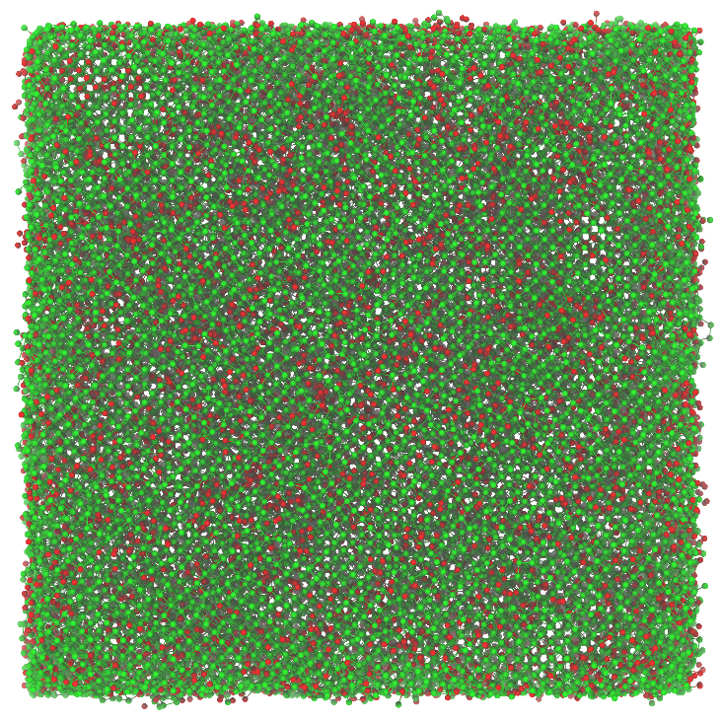
Higher Dopant Concentrations
Beyond $x=0.15$ crystal begins to become amorphous
These are not defects; too small scale
Perhaps caused by edge effects and high local dopant concentrations
$$x=0.05$$
$$x=0.15$$
$$x=0.20$$
$$x=0.26$$

Slide 11
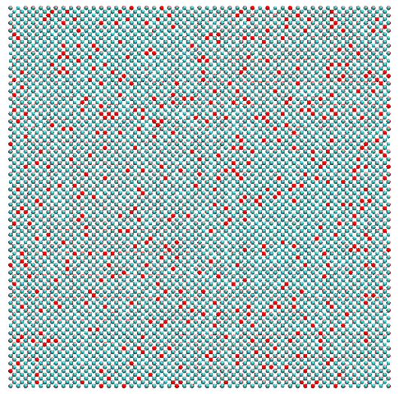
Diamond-Boron Crystals
Smaller box size $(90×90×90){\text{Å}}^{3}$; more atoms – 128826
Simulation process is the same; only $300K$
B-C interactions modelled using the composite Tersoff potential
This increased number of atoms adds limitations to the crystal size!
M. D. Dickers, et. al, In Preparation (2024)

Slide 12
Initial Results – C-B Inter-planar Distances
Results for C-B systems are still under analysis
Like Si-Ge our results are very different from theory:
$a_{C−B}=a_{C}(1+0.144x)$
At $x=0$ inter-planar distance does not agree with theory
The reasons for these are still under investigation
S. H. Connell, et. al. Proceedings of SAIP2014 (2014) M. D. Dickers, et. al, In Preparation (2024)

Slide 13
Upcoming Work
Outline of upcoming plans for models:
More accurate crystal generation method
Periodic Crystals
Compare results of crystal simulations to characterisation at ESRC and DIAMOND
Channelling simulations:
Develop a general model to simulate channelling

Slide 14
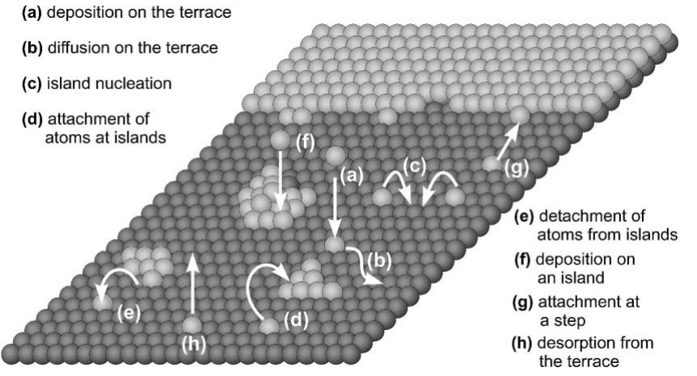
Upcoming Work – Crystal Generation
MD simulations with Si-Ge and C-B have highlighted some major areas for improvement:
Crystals are too small
Simulate periodic crystals
Crystals are too high quality
Model real crystal growth methods; Molecular Beam Epitaxy (MBE) Chemical Vapour Deposition (CVD)
These can be modelled using stochastic dynamics
B. Voigtländer, Surface Science Reports. 43, 5-8 (2001)

Slide 15
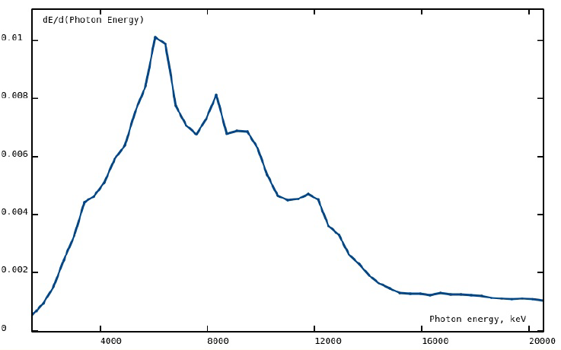
Upcoming Work – Channelling Simulations
Want to develop a generalised model for simulating channelling
Model Inputs:
Structure of CU crystal
Beam parameters; size, homogeneity, divergence, energy, etc.
Beam type; electron or positron
Model Outputs:
CU radiation spectra
Wavelength, brilliance, energy, etc.
Spectral distribution integrated over all polar angles. Image taken from MBN Studio tutorials

Slide 16
Upcoming Work – Channelling Simulations
Using this model with various crystal types, structures, and beam parameters we define tolerances for crystal manufacturing
Model also allows us to replicate experiments that will be conducted
We can model the channelling experiments that will take place at MAMI in January
Will be able to model the crystals discussed today
Can model channelling at any accelerator provided the beam parameters are known
Even future accelerators!?

Slide 17
New PhD Student
This year we are joined by Klaudia Cielinska from the University of Kent
She will assist with the development of the general model
The scope of her work is still to be defined
Maybe acoustically bent crystals?
Maybe damage caused by irradiation?

Slide 18
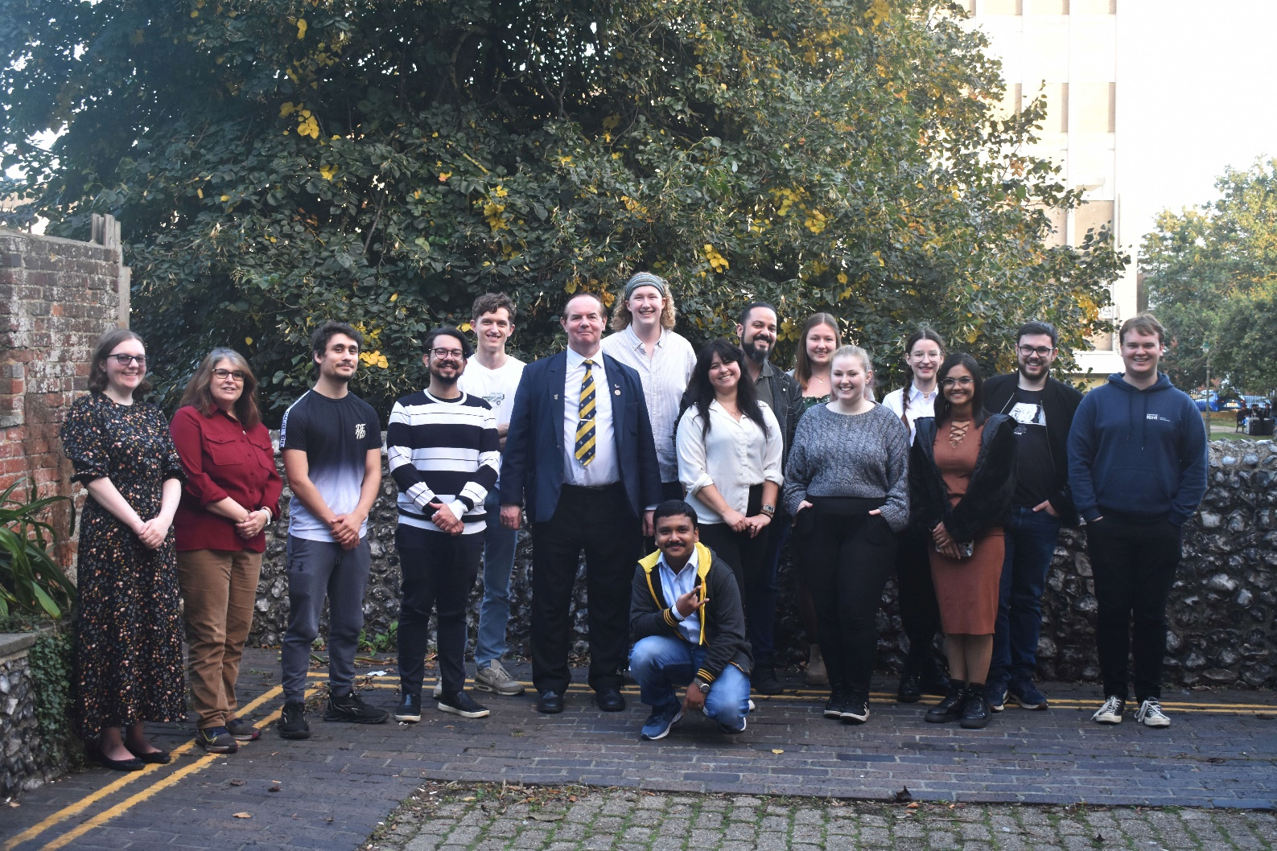
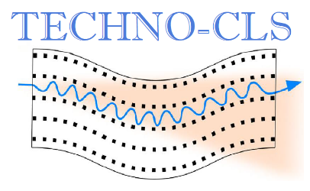
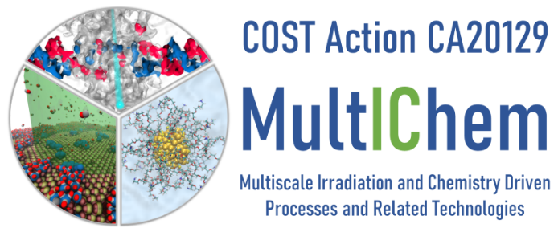
Financial Support:
The RADON project (GA 872494) within the H2020-MSCA-RISE-2019
COST Action CA20129 MultIChem, supported by COST (European Cooperation in Science and Technology)
Horizon Europe-EIC-Pathfinder-Open TECHNO-CLS (G.A. 101046458)
Thank you for your attention!

