Slide 1
New design for Boron-doped diamond undulator
Modelling, Growth, characterization
Thu Nhi Tran CALISTE @ ESRF

Slide 2
Old model
@ Mainz
New model
@ MBN
2020
2023
$$B^{+}$$
$$t_{layer=14.14μm}$$
$$B^{+}$$
$$B^{+}$$
$$B^{+}$$
$$B^{+}$$
$$t_{layer}=3.75μm$$
$$B^{+}$$
$$B^{+}$$
$$B^{+}$$
Diamond
Key parameters:
Layers thickness
Doping profile
Doping extremums
Diamond
Period thickness: (100): 3.75 µm → (110): 5 µm
Period thickness: (100): 14.14 µm → (110): 15 µm
[B]
[B]
1 period
1 period
$${[B]}_{max}=24×{10}^{20}{cm}^{−3}$$
$${[B]}_{max}=2×{10}^{21}{cm}^{−3}$$
$${[B]}_{min}=6×{10}^{20}{cm}^{−3}$$
5 µm
$${[B]}_{min}={10}^{19}{cm}^{−3}$$
15 µm
Fabrication: Done
Characterization : Done
MAMI measurement
Initiating with a two-layer sample for testing purposes, due to the increased thickness of each layer in the new model.
No channeling signal, do we continue???
For more information about the new model design@ Andrey V.Solov’yov

Slide 3
Characterization steps for the new model
Substrate
Growth
Surface characterization
SIMS
Synchrotron characterization
Measurement at MAMI

Slide 4
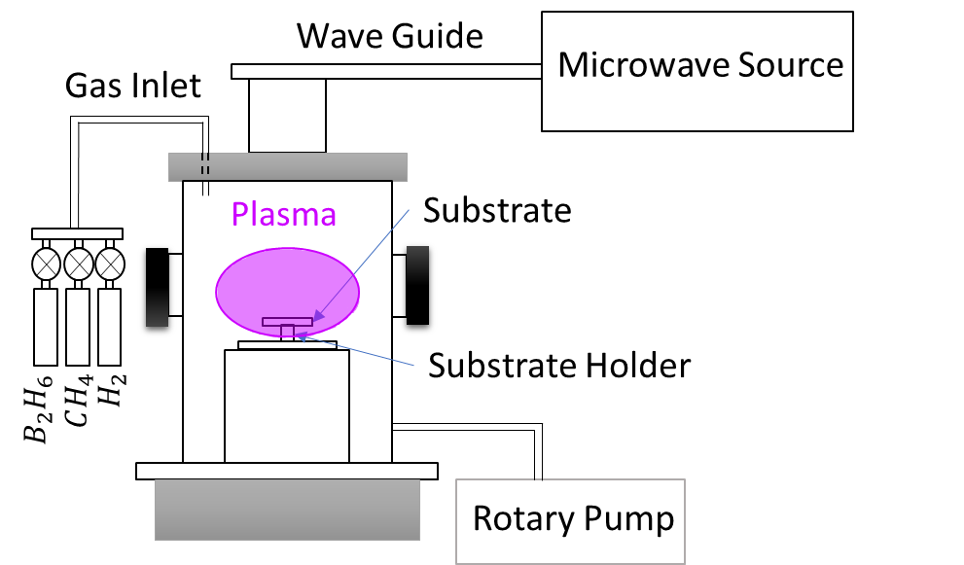
Growth: MPCVD PROCESS
Simplified schematic of the MPCVD principle
Ultra high Vacuum of 10⁻⁶ Torr inside the MPCVD reactor chamber
Diamond substrate temperature: 850°C
Microwave power: 300W
Microwave pressure: 33 Torr
Hydrogen flow: 100sccm
Methane flow: 4sccm (3.5% methane in the mixture)
Diborane flow is set by a GBF that follows the doping profile determined previously
Growth rate: 25nm/min

Slide 5
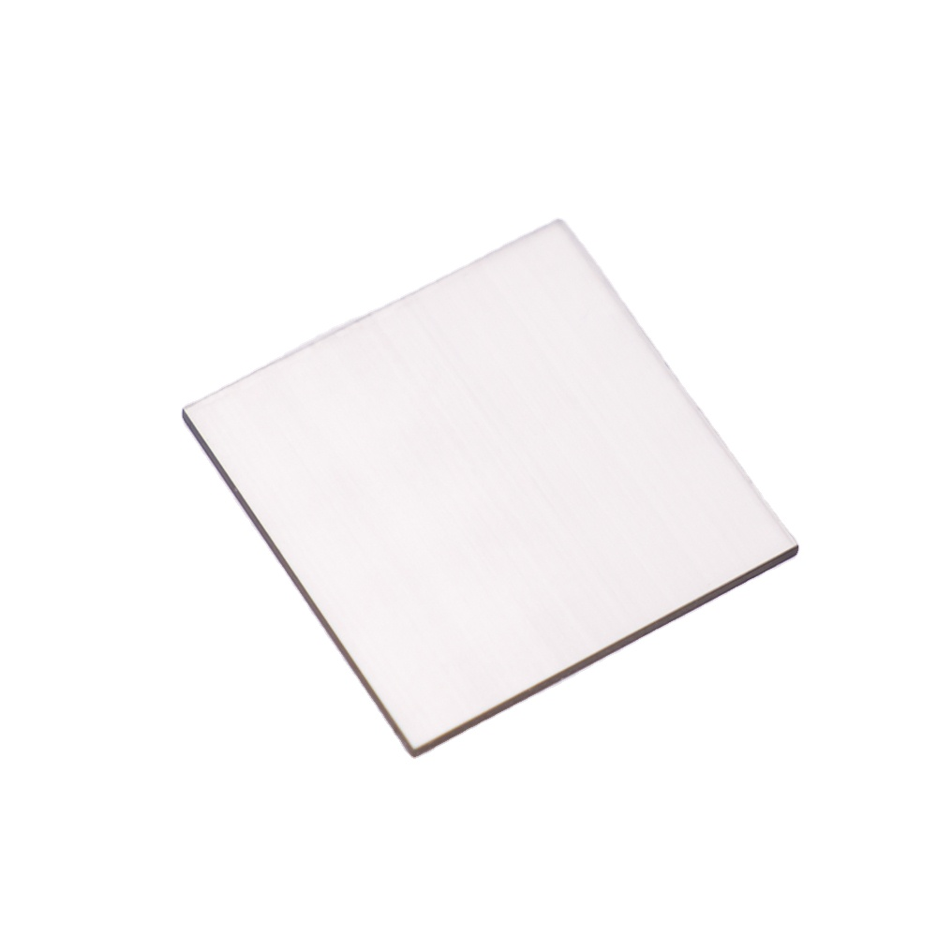
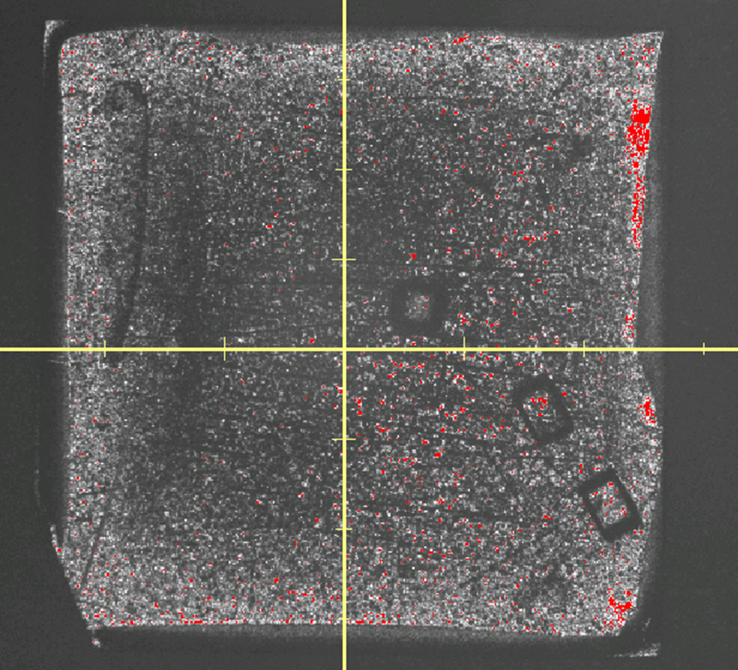
Substrate
Subtract: HPHT Ib standard quality diamond, (100) surface, dislocations density ~10²/cm²
The starting diamond substrate.
The sample surface after doping.
$$3mm$$
Thickness: $250μm$
$$3mm$$
$$3×3×0.235 {mm}^{3}$$
The sample's color darkened as a result of the Boron doping process, given that Boron itself possesses a dark hue.
Dislocation density: 10³/cm²

Slide 6
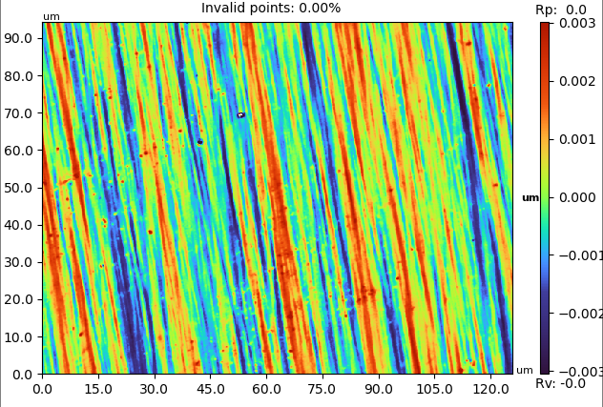
Backside of the sample
The substrate’s surface characterization of the samples before the growth process .
$$R_{p}=8.97nm$$
The surface is dominated by the polishing lines and waves induced by the mechanical polishing

Slide 7
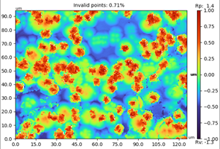
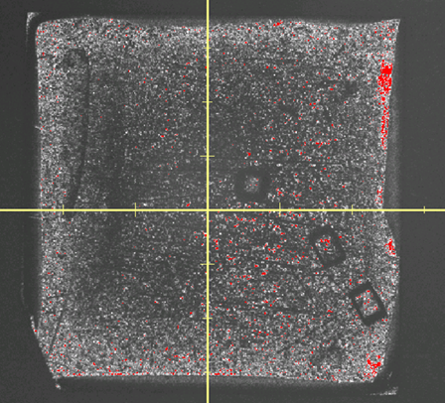
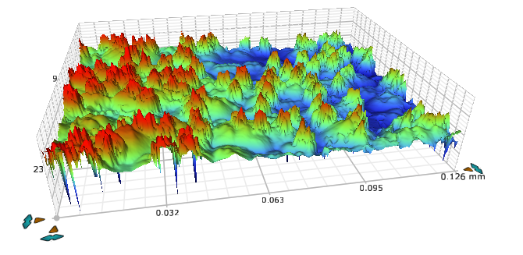
Front side of the sample
The surface characterization of the sample after the growth process .
$$3mm$$
$$R_{a}=0.28μm ; R_{p}=1.4μm$$
$$3mm$$
By doping the diamond with Boron, Hillocks are formed at the sample’s surface

Slide 8
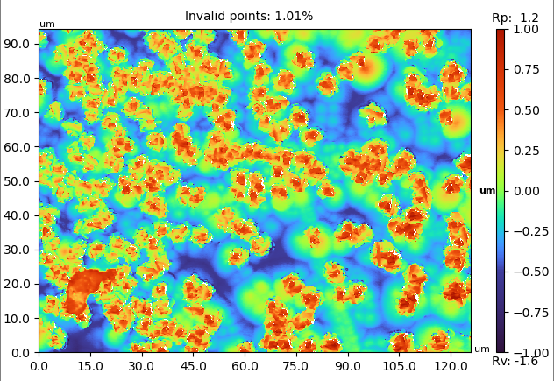
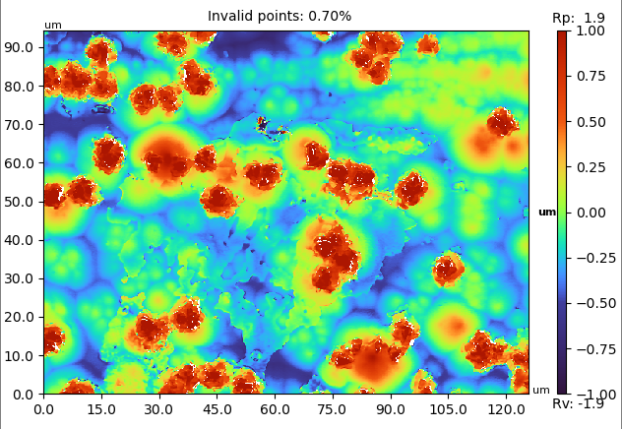
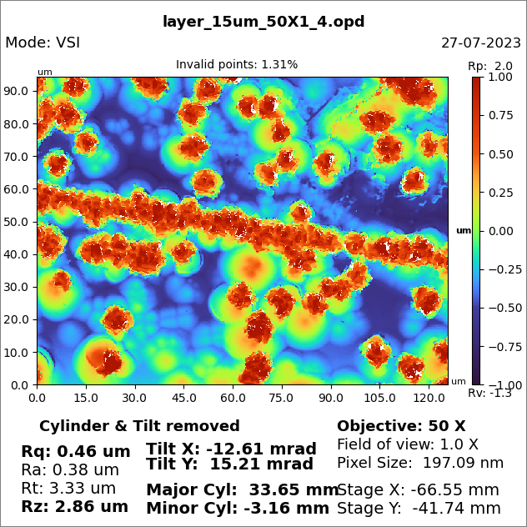
Surface characterization
borders
near center
center
$$R_{a}=0.26μm ; R_{p}=1.21μm$$
$$R_{a}=0.29μm ; R_{p}=1.94μm$$
$$R_{a}=0.38μm ; R_{p}=2.05μm$$
Non uniform surface
More uniformity at the center
Hillocks aligning with the polishing lines on the substrate surface
Hillocks density | $$9×{10}^{3}{mm}^{−2}$$
Hillocks size (diameter): | $$8 μm$$

Slide 9
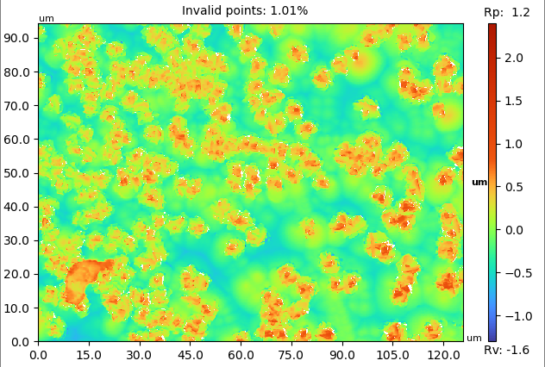
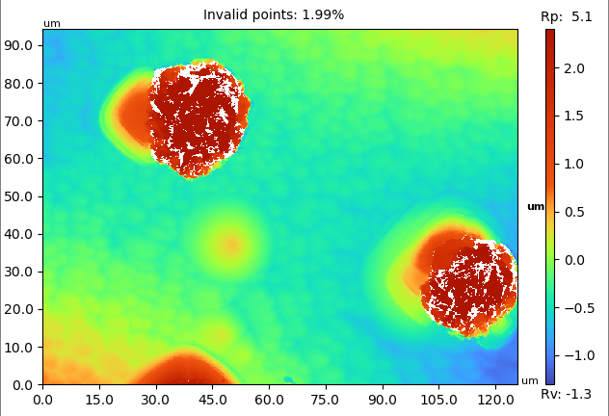
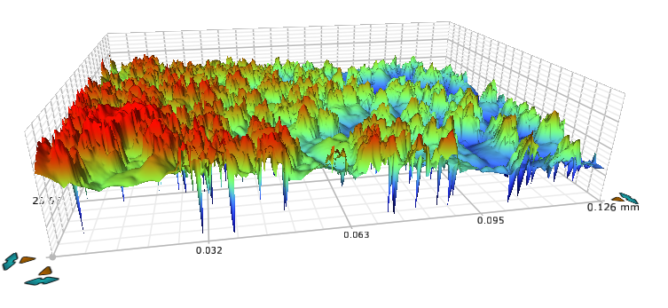
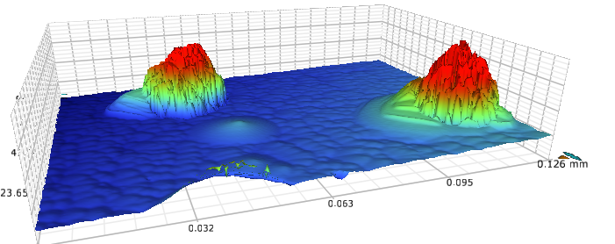
Old sample
2020
New sample
2023
$$R_{a}=0.26μm ; R_{p}=1.21μm$$
$$R_{a}=0.53μm ; R_{p}=5.27μm$$
Growing thicker layers introduces fewer hillocks on the surface with a larger size
Growth process is improving

Slide 10
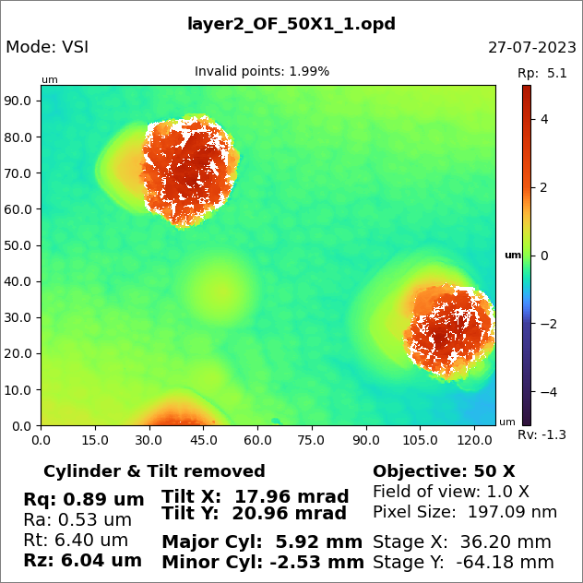
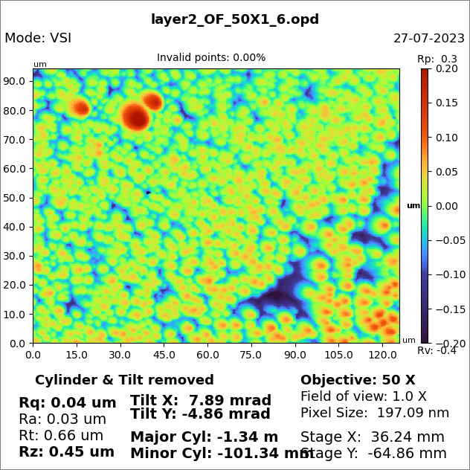
Characterization of the new sample
Non-flat surface with very tiny circular figures in the nanometer range on the top surface of the sample.
$$R_{a}=0.53μm ; R_{p}=5.27μm$$
$$R_{a}=0.07μm ; R_{p}=398nm$$

Slide 11
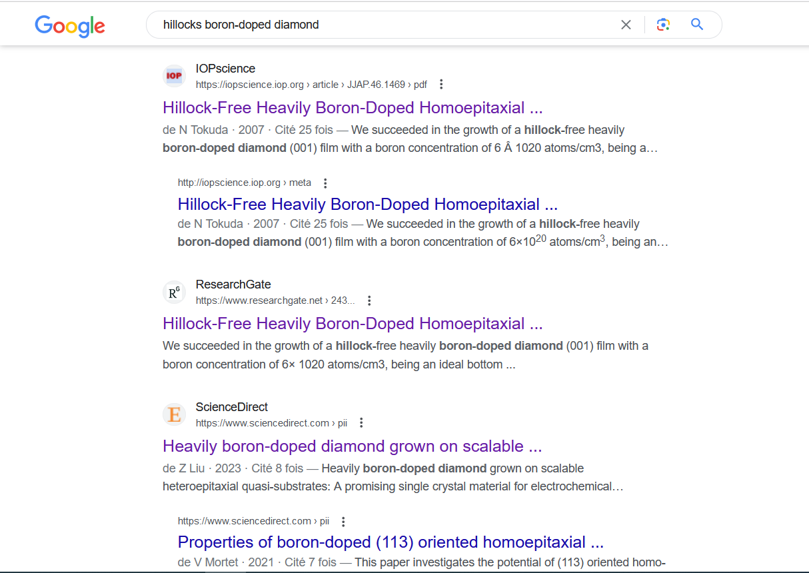
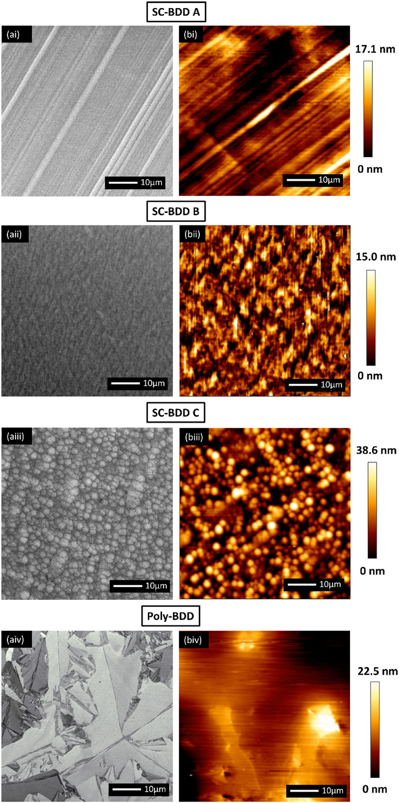
Hillocks
The introduction of Boron atoms disrupts the crystal lattice, creating localized stress points.
The stress points lead to the migration of atoms and the accumulation of material at certain locations on the diamond surface, resulting in the formation of hillocks.
Heavily boron-doped diamond grown on scalable heteroepitaxial quasi-substrates: A promising single crystal material for electrochemical sensing applications.

Slide 12
Synchrotron characterization:
Rocking Curve Imaging techniques at BM05 - ESRF

Slide 13
$$B^{+}$$
$$t_{layer=14.14μm}$$
From the X-ray Bragg diffraction point of view:
In this case the variation of the effective misorientation δ over the extinction length Λ is of the order of the intrinsic diffraction width ω_{D}.
The layer is therefore, not anymore expected to diffract “kinematically” and the “distorted regions” could exhibit a higher integrated intensity than the “perfect crystal matrix”
$$B^{+}$$
$$B^{+}$$
$$B^{+}$$
Diamond
[B]
$${[B]}_{max}=20×{10}^{20}{cm}^{−3}$$
14.14 µm
$${[B]}_{min}={10}^{19}{cm}^{−3}$$
Only two-layers sample for testing purposes

Slide 14
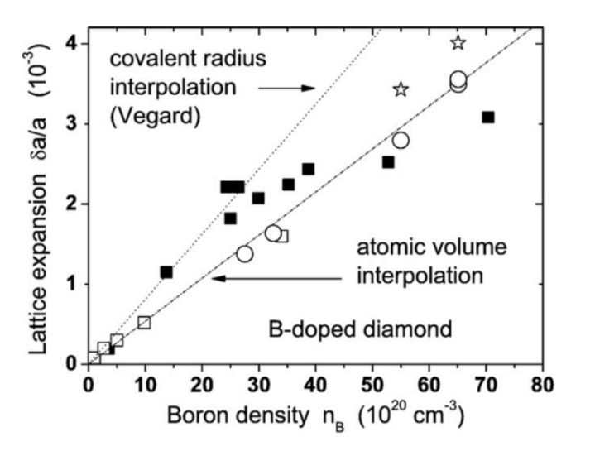
Characterization: Bragg diffraction imaging
Lattice parameter of the layer > lattice parameter of the substrate
Bragg’s law 2d_{hkl}sinθ = λ
d_{hkl} distance between reflecting planes
θ angle beam - reflecting planes
λ Wavelength of X-rays
θ_{layer} < θ_{substrate}
Rocking curves of the layer and substrate separated
layer
Reflection mode
substrate
The layers display, around an « average lattice parameter » d_{layer} , a range of lattice parameters (Δd/d) associated to the variation of the doping
FWHM of the peak of the layer ~ (Δd/d) tgθ
Transmision mode

Slide 15
Relaxed or strained layer
If the layer is not completely relaxed (usual case) the « average lattice parameter » d_{average} is strained by the interface with the undoped diamond, and is consequently smaller than the one corresponding to a free doped crystal
è the rocking curves for the layer and the substrate are closer, and can even merge
layer
substrate
Each of the layers is grown on the previous one, which displays an « average lattice parameter » d_{average} that is bigger than the one of the substrate è the successive layers can therefore exhibit increasing d_{average} , and peaks that are increasingly displaced with respect to the one of the substrate
è the successive layers can be associated to peaks on the rocking curve that are increasingly displaced towards small θ
1
2
3
substrate
1
2
3

Slide 16
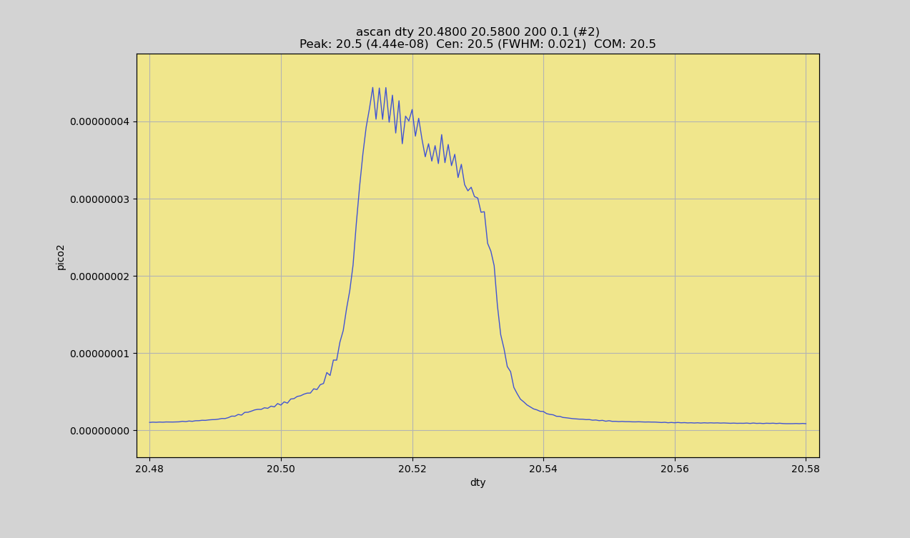
Global Rocking Curve / Reflection case
layer
layer
substrate
degree
FWHM 0.02°, as before, but « more uniform » peak

Slide 17
RC in reflection
Beam width ~0.5 mm
Integrated intensity map
1.6 mm
Substrate only
Substrate + layer
Layer only
1.2 mm
Tentative Preliminary conclusions:
- Observation of dislocations in the substrate ( ~2 x 10³ cm⁻² )
- Small curvature (upper to the lower part) of the substrate (R ~ 40 m)
- Vertical lines on the layer image : dislocations?
1.2mm

Slide 18
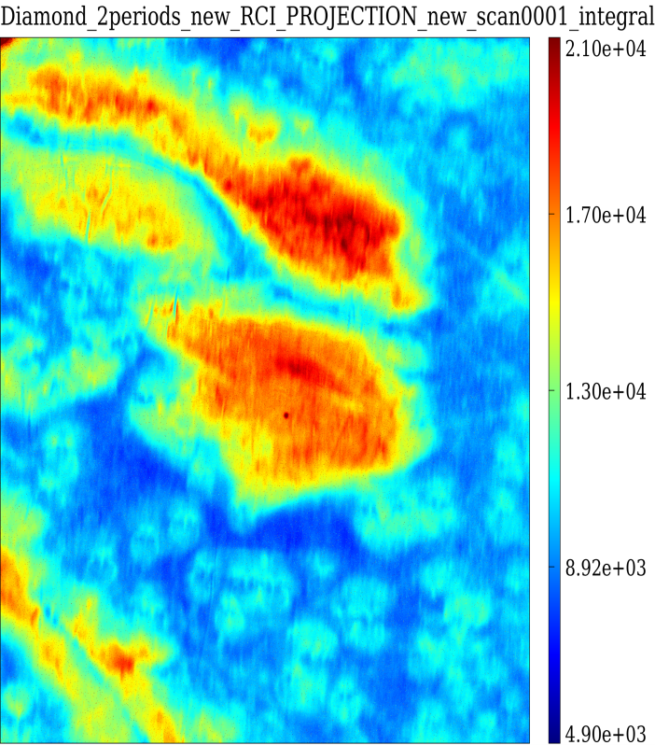
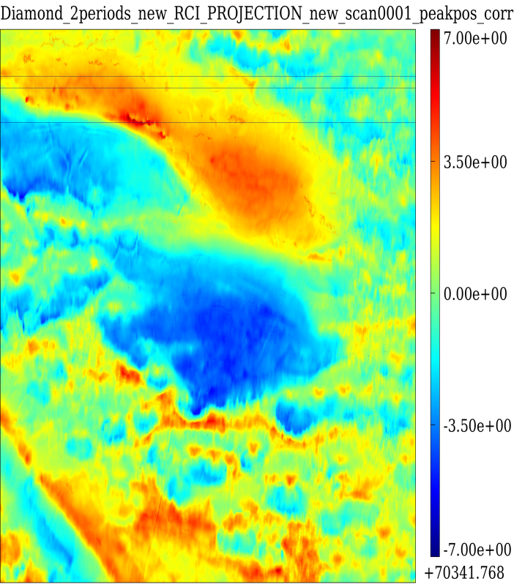
RCI maps in transmission mode
Integrated Intensity
Peak Position
We mainly see a large scale waviness of the layer planes (pseudo period ~0.5 mm; ~75 µm for the « old design »)
1.2mm
1.2mm
This waviness implies a variation of the angular position of the reflecting planes that is ~ 6 arcseconds

Slide 19
Present Conclusions
The “old design” :
1) 2 layers exhibit an average lattice parameter that increases when the layer departs from the substrate. These layers are only partially relaxed and display an “egg foam crate” like curvature that could help accommodating the variation of lattice parameter.
2) Similar features for the “old design” 4 layers The “new design”:
for the Boron-doped diamond appears to be associated with changes in the observed features (preliminary):
dislocations are observed on the “substrate only” image, and maybe also (as vertical lines) on the “layer only” image.
2) the waviness is a large scale one with a “period” one order of magnitude bigger than for the “old design”

Slide 20
Characterization steps for the new model
Substrate
Growth
Surface characterization
Synchrotron characterization
SIMS
6. Measurement at MAMI ( for 4 periods)

