Slide 1
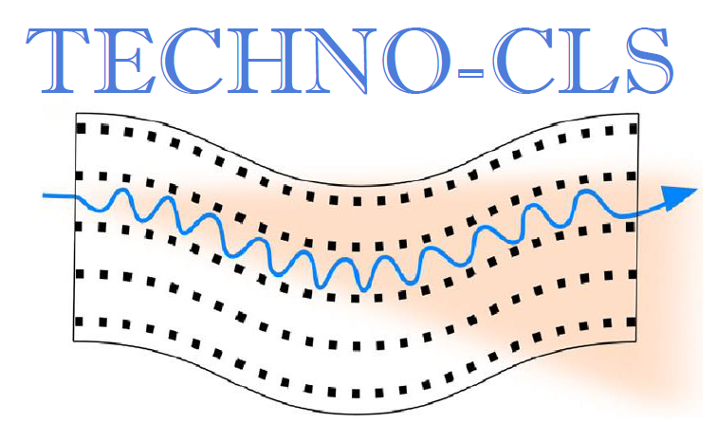
Progress on acoustically driven lattice modulation of crystals for CLS applications
K. Kaleris^{1,2}, E. Kaselouris^{1,2}, E. Kaniolakis Kaloudis^{1,2}, M. Tatarakis^{1,3}, V. Dimitriou^{1,2}, M. Bakarezos^{1,2}, N. Α. Papadogiannis^{1,2}
¹ Institute of Plasma Physics & Lasers, Hellenic Mediterranean University, Tria Monastiria, 74100 Rethymno, Greece
² Physical Acoustics & Optoacoustics Laboratory, Dept. of Music Technology & Acoustics, Hellenic Mediterranean University, 74100 Rethymno, Greece
³Dept. of Electronics Engineering, Hellenic Mediterranean University, Romanou 3, Chalepa, 73133 Chania, Greece
Email: npapadogiannis@hmu.gr

Slide 2
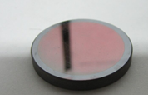
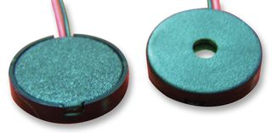
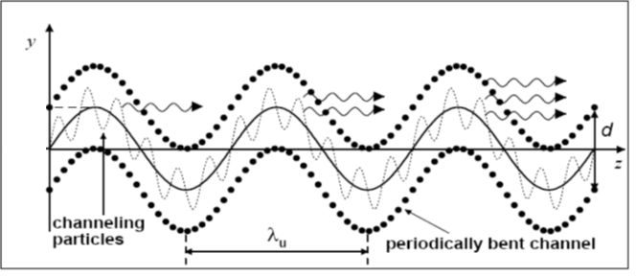
Role of the HMU
Design, development and characterization of Crystalline Undulator (CU) devices based on acoustic wave modulation of the crystal lattice
Ultra-high frequency
Crystal
Piezoelectric transducer
Ultra-relativistic $e^{+}$ beams
From: A. V. Korol, A. V. Solov'yov, W. Greiner, Channeling and Radiation in Periodically Bent Crystals, Springer (2013)

Slide 3
Acoustic Wave CUs: benefits and challenges
Tunability:
Acoustic wave (AW) frequency $f_{AW}$
Number of periods $N_{u}$
Channel bending amplitude $a$
Control:
Undulation period $λ_{u}$
Radiation intensity $I$
Undulation amplitude $a,I$
AW CUs will allow for real-time experimental optimization and scanning of a broad parameter range.
Challenges:
Construction (small crystal dimensions)
Pressure homogeneity
Experimental characterization
Notes:
Advantages mainly related to tunability
In situ experimental optimization
There is NO experiment so far carried out with dynamic acoustic bending

Slide 4
State-of-the-art
Theoretical findings:
Channelling and undulation radiation quantum and classical description [1,2]
Estimation of undulator radiation characteristics in Crystalline Undulators [3]
Positron channeling through grooved Silicon wafer [7]
Experiments with bent crystals
Electron channelling in Quasimosaic bended Si and Ge Crystals. Experiments in Mainzer Microtron MAMI [4,5]
Channelling radiation measurements in Diamond-based bent crystals [6]
Experiments with undulators
Epitaxially-grown Si-Ge Crystalline undulator, using 855 and 1508 MeV electron beams [8]
Molecular beam epitaxy in the Short-amplitude short-period (SASP) regime. Experiments in MAMI. [9,10]
Εlectrons channeling through Si-Ge based CU, performed in SLAC via molecular beam epitaxy [11,12]
No experiments so far with dynamic acoustic bending!
[1] A. V. Korol, A. V. Solov'yov, W. Greiner, Channeling and Radiation in Periodically Bent Crystals, Springer (2013)
[2] A. V. Pavlov , A. V. Korol, V. K. Ivanov, A. V. Solov’yov, Channeling of electrons and positrons in straight and periodically bent diamond(110) crystals, Eur. Phys. J. D. 74, 21 (2020)
[3] A. V. Korol, A. V. Solov’yov, Crystal-based intensive gamma-ray light sources, EPJD 74, 201 (2020)
[4] A. I. Sytov, D. De Salvador, A. Mazzolari, E. Bagli, A. Berra, S. Carturan, C. Durighello, G. Germogli, V. Guidi, P. Klag, W. Lauth, G. Maggioni, M. Prest, M. Romagnoni, V. V. Tikhomirov & E. Vallazza Steering of Sub-GeV electrons by ultrashort Si and Ge bent crystals, EPJC 77, 901 (2017)
[5] L. Bandiera,, A. Sytov, D. De Salvador, A. Mazzolari, E. Bagli, R. Camattari, S. Carturan, C. Durighello, G. Germogli, V. Guidi, P. Klag, W. Lauth, G. Maggioni, V. Mascagna, M. Prest, M. Romagnoni, M. Soldani, V. V. Tikhomirov, E. Vallazza, Investigation on radiation generated by sub-GeV electrons in ultrashort silicon and germanium bent crystals, EPJC 81, 284 (2021)
[6] H. Backe, W. Lauth, T. N. Tran Thi, Channeling experiments at planar diamond and silicon single crystals with electrons from the Mainz Microtron MAMI, JINST 13, (2018)
[7] V. T. Baranova, et al. First Results of Investigation of Radiation from Positrons in a Crystalline Undulator, JETP Lett. 82, 562-564 (2005)
[8] H. Backel, W. Lauth, P. Kunz, A. Rueda, J. Esberg, K. Kirsebom, J. I. Hansen, U. K. Uggerhor, Photon emission of electrons in a crystalline undulator, World Sci. Res., 281-290 (2010)
[9] T. N. Wistisen, K. K. Andersen, S. Yilmaz, R. Mikkelsen, J. L. Hansen, U. I. Uggerhøj, Experimental Realization of a New Type of Crystalline Undulator, PRL 112, 254801 (2014)
[10] T. N. Wistisen, U. I. Uggerhøj, J. L. Hansen, W. Lauth, P. Klag, Radiation collimation in a thick crystalline undulator, EPJD 71, 124 (2017)
[11] U. Wienands, et al., Channeling and radiation experiments at SLAC, Nucl. Instrum. 402, 11-15 (2017)
[12] T.N. Wistisen, et al. A study of Channeling, Volume Reflection and Volume Capture of 3.35 - 14.0 GeV Electrons in a bent Silicon Crystal, Slac-pub-16435, (2015)
Notes:
High risk venture

Slide 5
Design of appropriate AW CU schemes
Notes:
The roadmap to reach this goal starts with

Slide 6
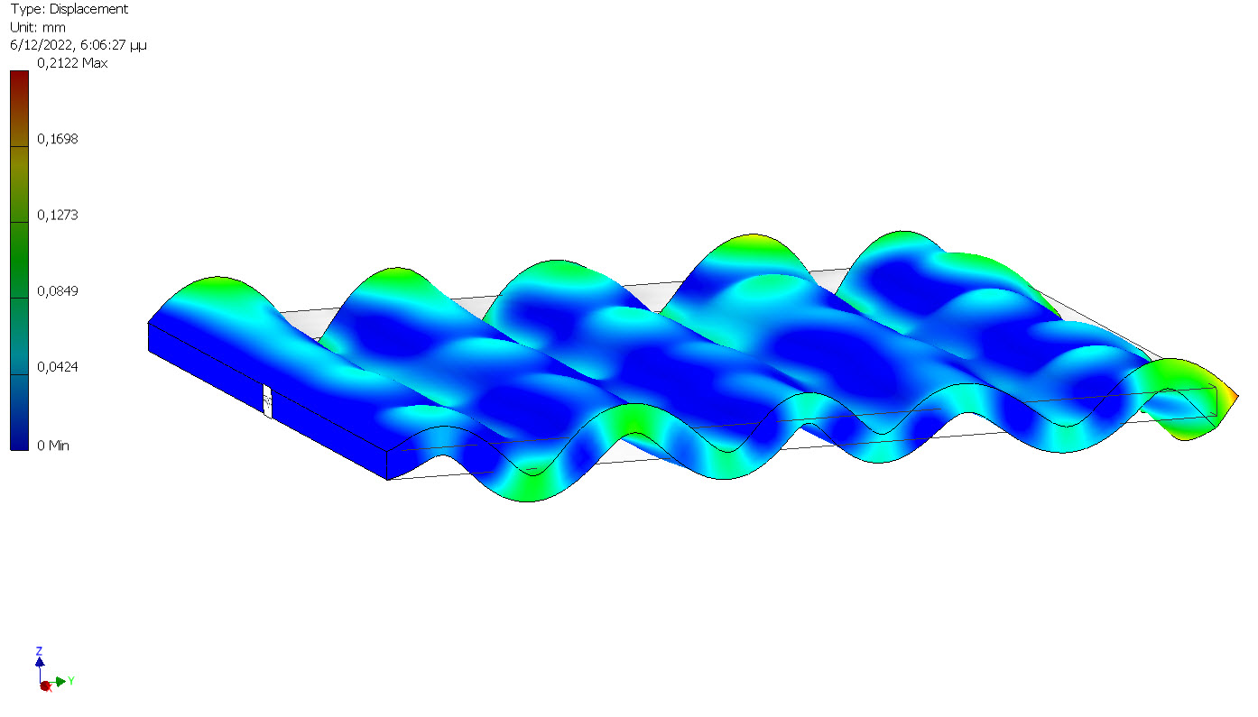
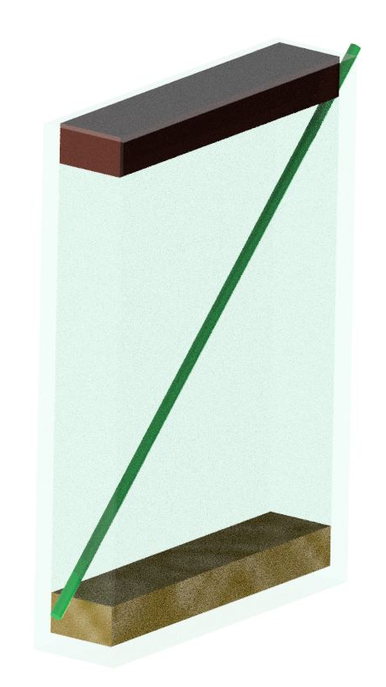
CUs by acoustic wave lattice modulation
Investigated schemes
Acousto-Optic Modulator
Vibrating plate
Transducer
Particle beam
Crystal
Absorber

Slide 7
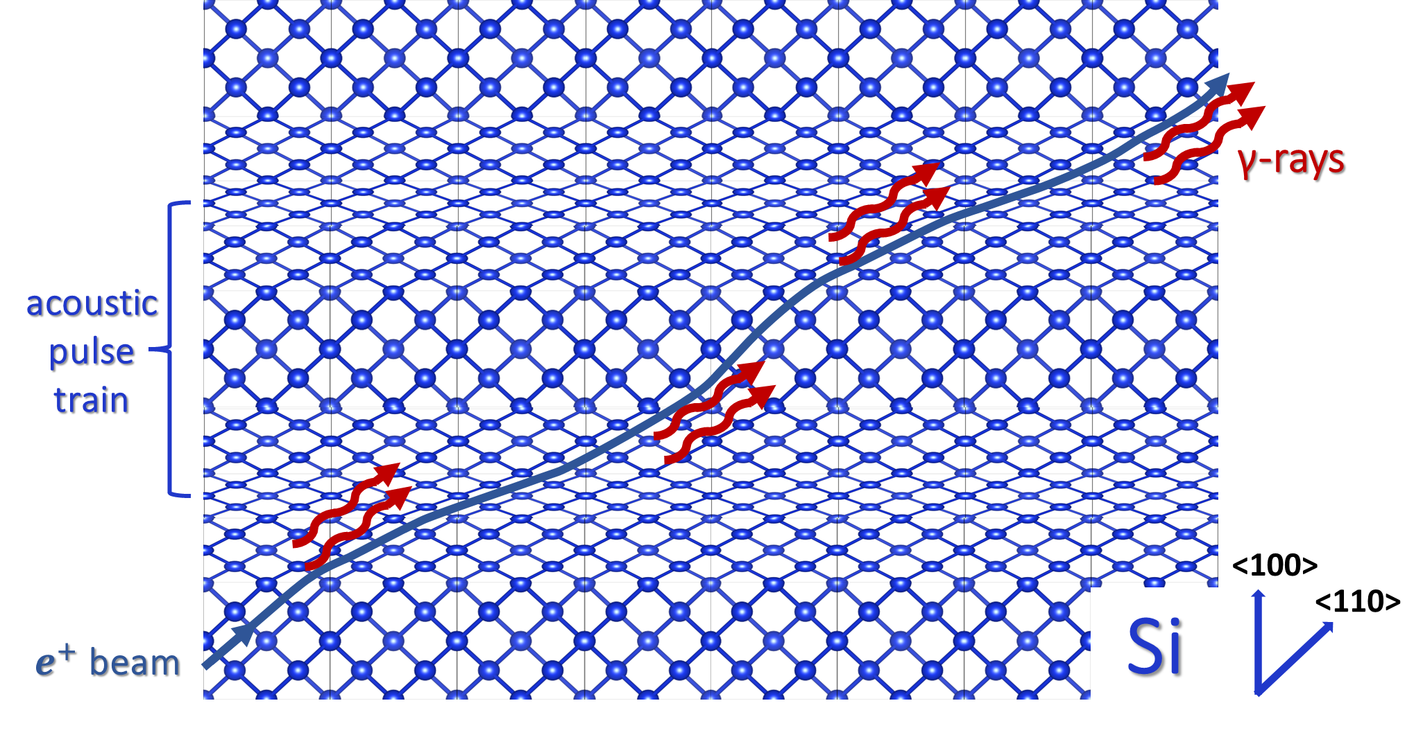
Acousto-Optic Modulator CU
Operation principle
Acoustic waves
Input angle ${45}^{0}$
Adapted from: K. Kaleris, E. Kaniolakis-Kaloudis, E. Kaselouris, K. Kosma, E. Gagaoudakis, V. Binas, S. Petrakis, V. Dimitriou^{1,2}, M. Bakarezos^{1,2}, M. Tatarakis, N. A. Papadogiannis, Efficient ultrafast photoacoustic transduction on Tantalum thin films, submitted in Appl. Phys. A (2023).
Notes:
Schematic representation of crystal under the influence of a harmonic AW

Slide 8
CUs by acoustic wave lattice modulation
Acousto-Optic Modulator CU
Transducer
Standing waves (SW):
1. Strain oscillates with SW frequency → potentially reduced efficiency
2. Limited tunability due to SW condition
Travelling waves (TW):
1. Strain distribution always apparent
2. No limitations in tunability of the undulation period
Particle beam
Crystal
Absorber / Reflector
Notes:
There are two ways to implement the device
Standing waves oscillate at the excitation frequency, so that within a period the crystal can be fully modulated, completely unmodulated or at any intermediate state.
Excitation frequency needs to coincide with a natural frequency of the crystal

Slide 9
Acousto-Optic Modulator
Specifications
Silicon, 0.5GeV positrons (MAMI)
$σ=500 μm, θ_{in}∈{45}^{o}$
$x_{c}=y_{c}=4\text{00} \text{μ}\text{m}$, $z_{c}≥3σ$
$L_{d}=330 μm$, $L=566 μm$
Silicon, 20GeV positrons (SLAC)
$σ=150μm, θ_{in}∈{45}^{o}$
$x_{c}= y_{c}=4$ mm, $z_{c}≥3σ$
$L_{d}=12mm, L=5.66mm$
Excitation
$$x_{c}$$
$$N_{d}$$ | 2
$$λ_{u} (μm)$$ | $28$3
Material | $$Si$$ | Ge
$$f_{AW} (MHz)$$ | $$42. 2$$ | 27
$$N_{d}$$ | 5
$$λ_{u} (μm)$$ | $$1130$$
Material | $$Si$$ | Ge
$$f_{AW} (MHz)$$ | $$10.5$$ | 6.75
$$y_{c}$$
$$L$$
Absorp/Refl

Slide 10
Proposal: laser-driven acoustic wave CUs

Slide 11
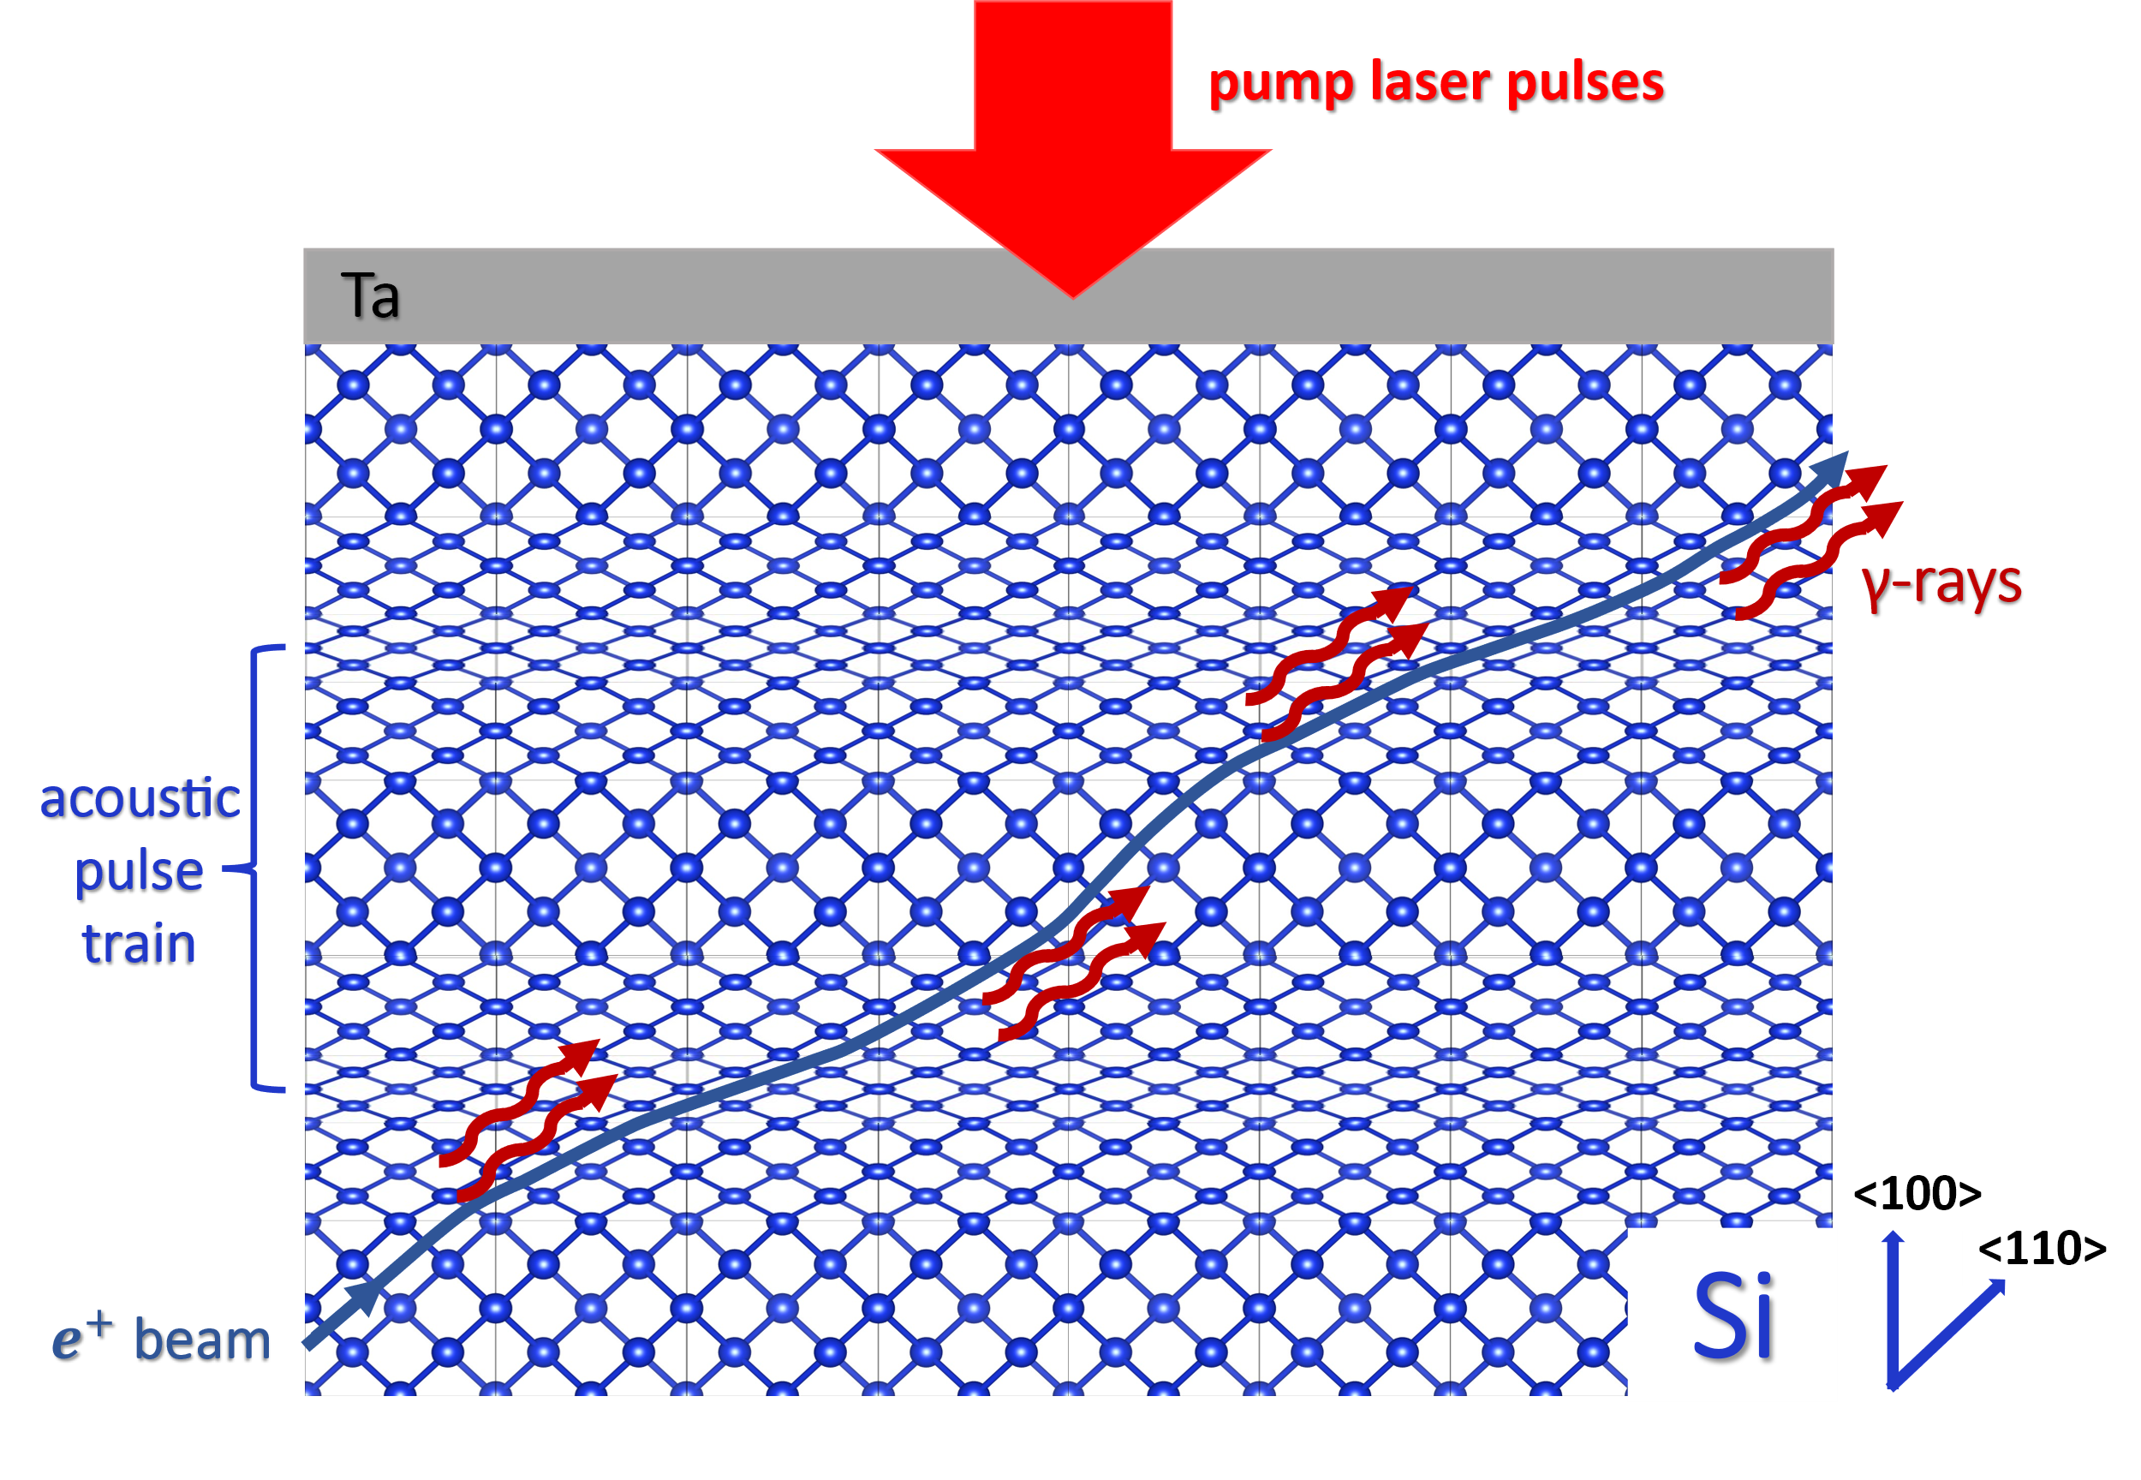
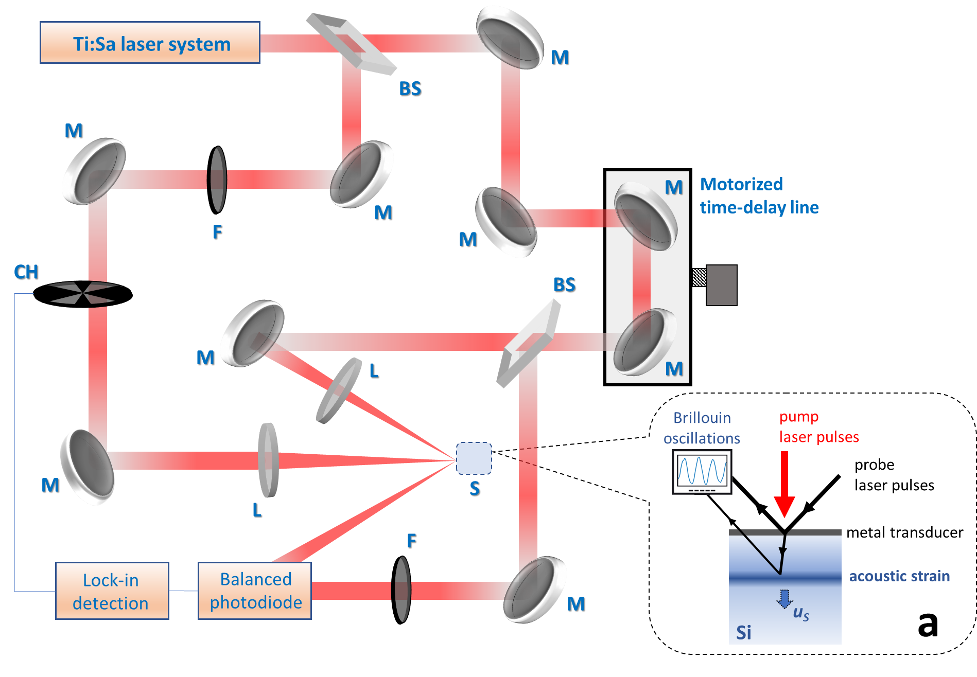
Proposal: laser-driven acoustic wave CUs
Pump-probe transient reflectivity method
From: K. Kaleris, E. Kaniolakis-Kaloudis, E. Kaselouris, K. Kosma, E. Gagaoudakis, V. Binas, S. Petrakis, V. Dimitriou^{1,2}, M. Bakarezos^{1,2}, M. Tatarakis, N. A. Papadogiannis, Efficient ultrafast photoacoustic transduction on Tantalum thin films, submitted in Appl. Phys. A (2023).

Slide 12
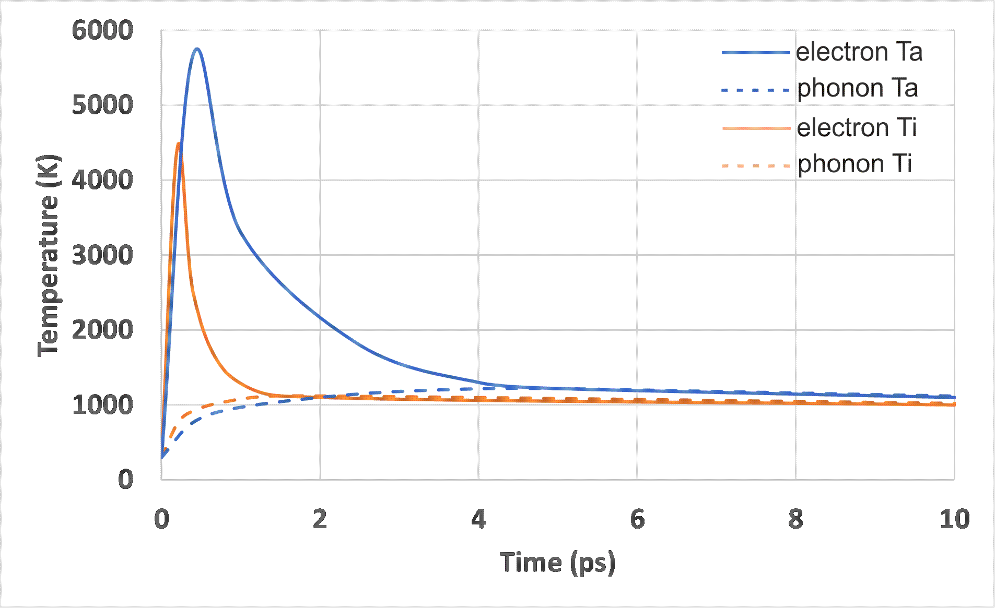
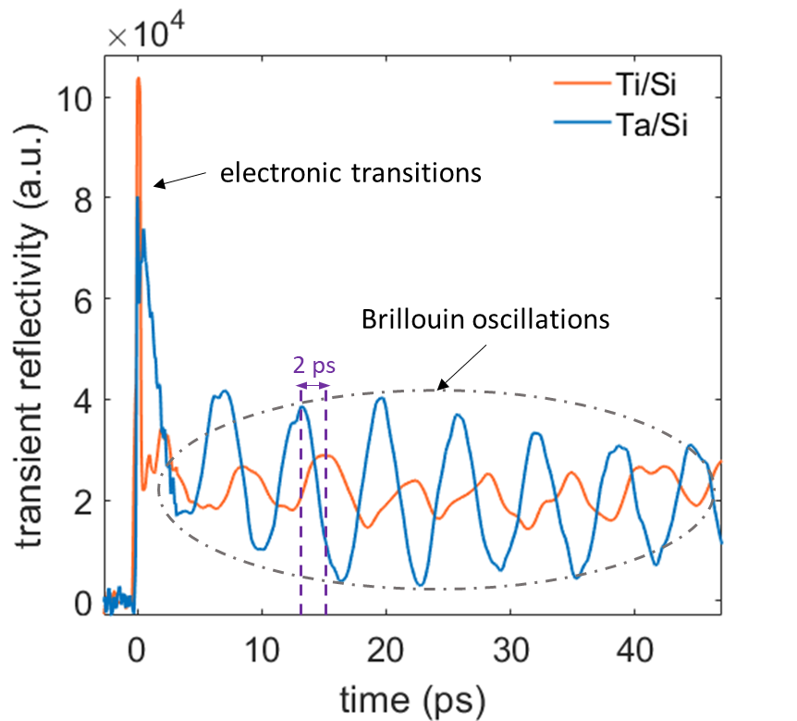
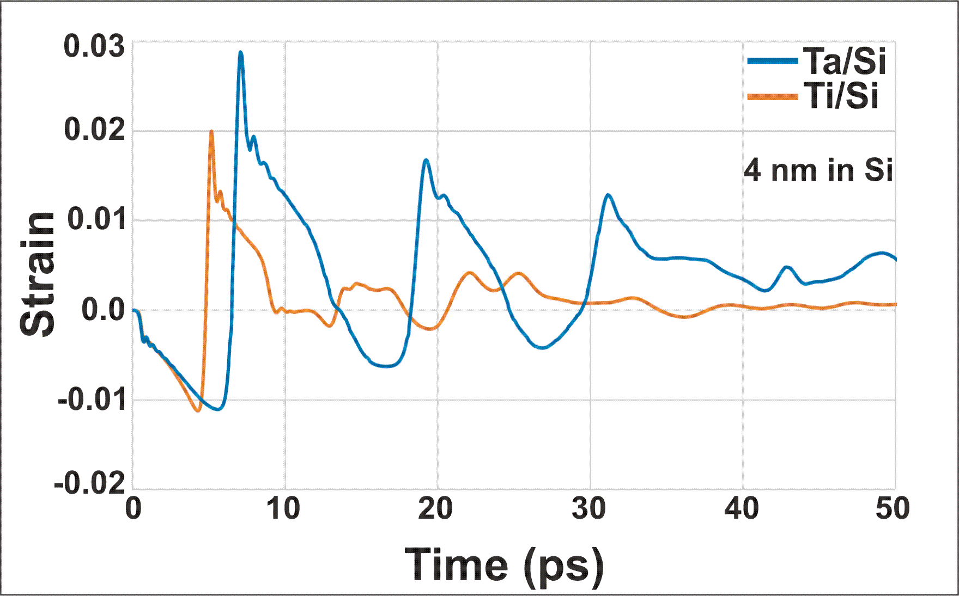
Proposal: laser-driven acoustic wave CUs
Simulations
Measurements
From: K. Kaleris, E. Kaniolakis-Kaloudis, E. Kaselouris, K. Kosma, E. Gagaoudakis, V. Binas, S. Petrakis, V. Dimitriou^{1,2}, M. Bakarezos^{1,2}, M. Tatarakis, N. A. Papadogiannis, Efficient ultrafast photoacoustic transduction on Tantalum thin films, submitted in Appl. Phys. A (2023).

Slide 13
Progress on the development and characterization of AW CUs

Slide 14
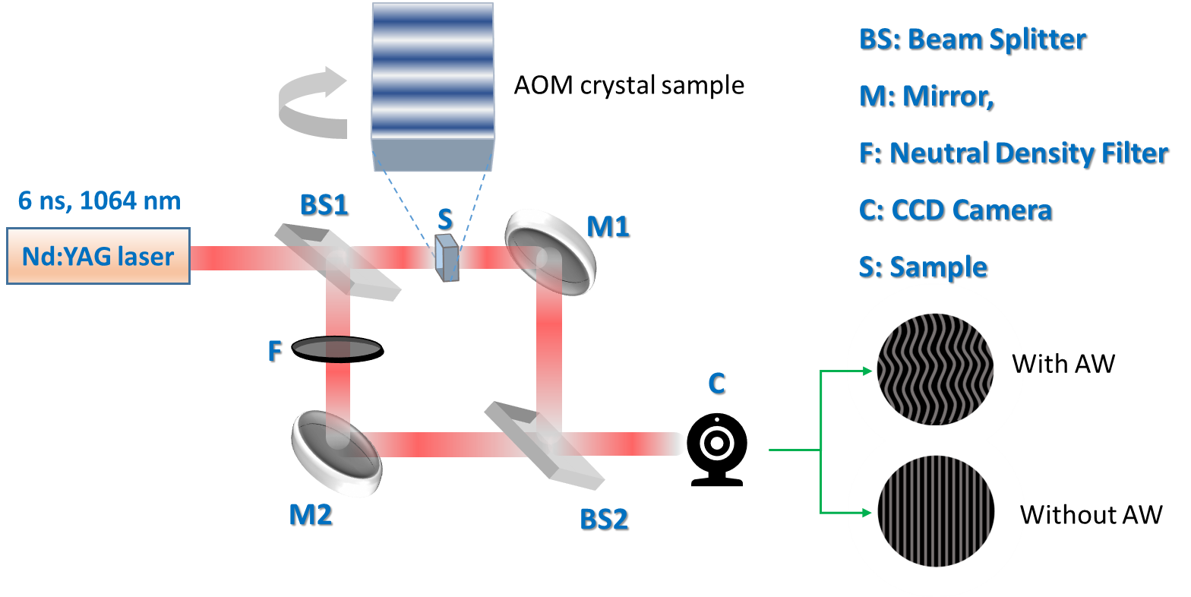
Characterization: Fast laser imaging interferometry
$Δφ=\int_{0}^{L}{Kdz}$, $Κ=\frac{nω}{c}$
$$Δn=\frac{cΔφ}{ωz_{c}}$$
$$ε=−\frac{2Δn}{qEn_{0}^{3}}=−\frac{2Δφc}{qEn_{0}^{3}ωz_{c}}$$
Κ: wave vector
q: piezo-optic tensor
$n_{0}$: unperturbed refr. Index
ε: strain

Slide 15
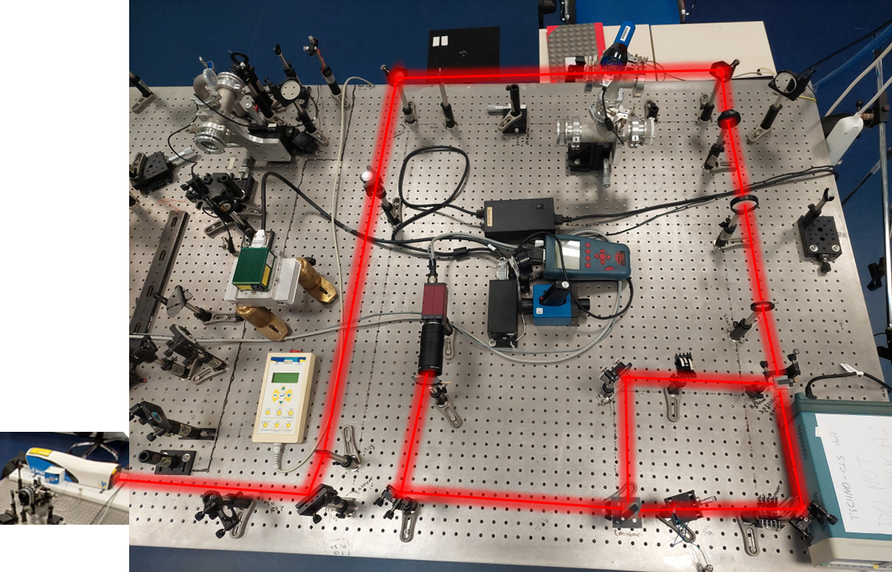
Characterization: fast laser imaging interferometry
Interferometer
Sample

Slide 16
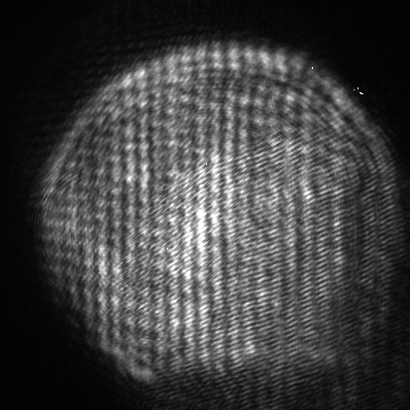
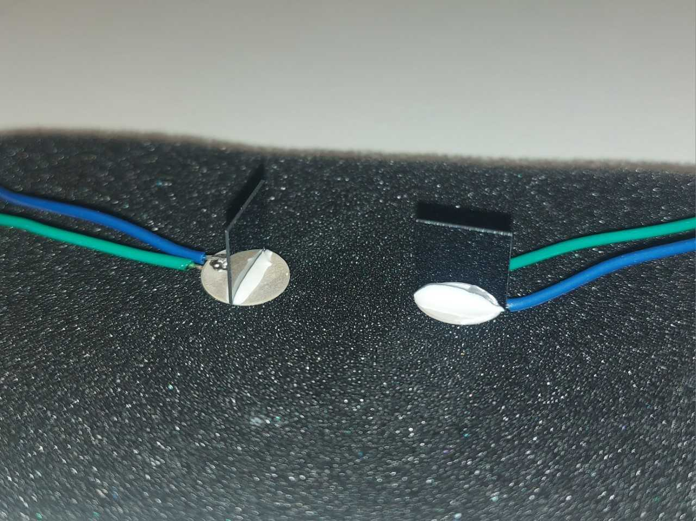
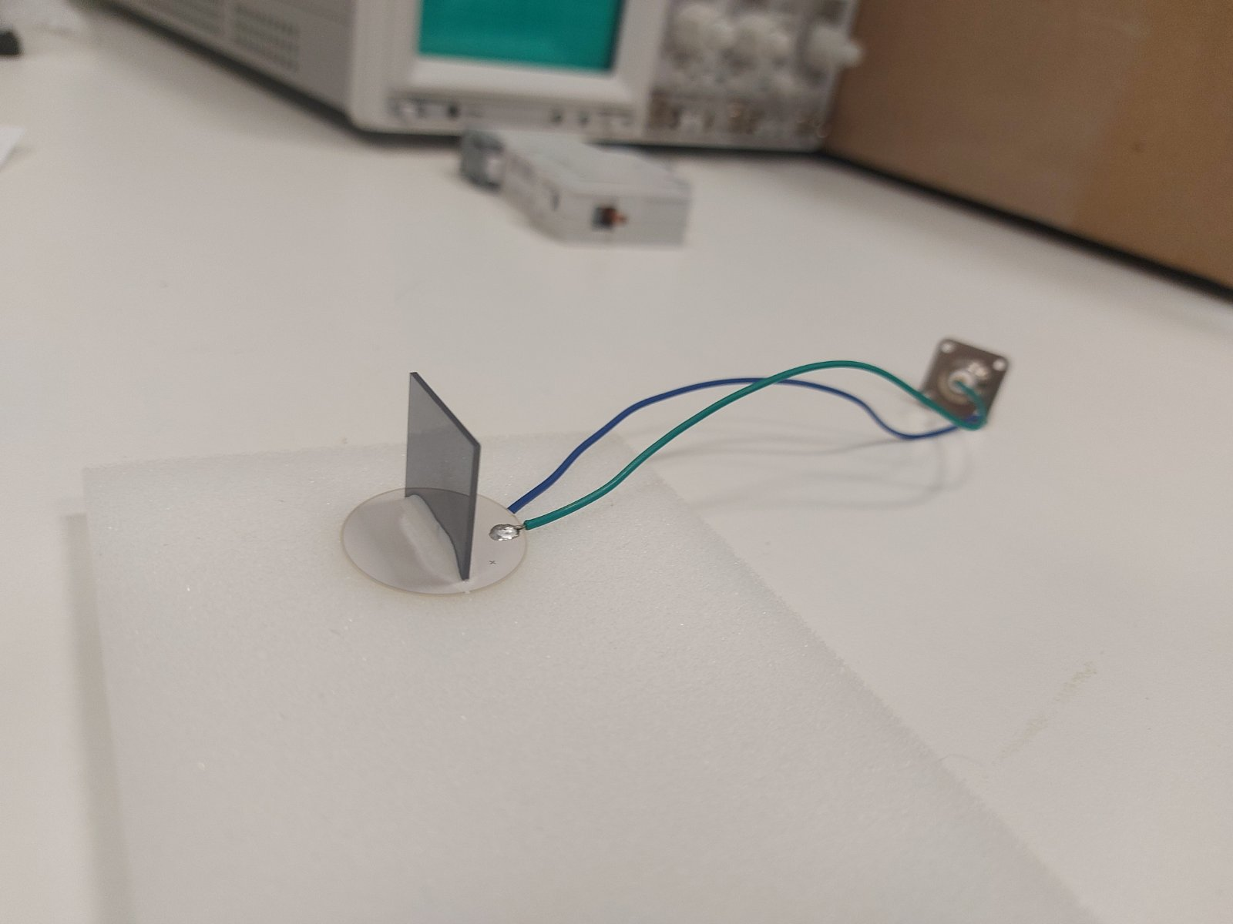
Sample development and characterization
Spectrometer Images
Ultrafast piezo driver
For 0.5 GeV positron beam (MAMI)
10 x 10 x 0.4 mm
< 15 MHz transducer
Vacuum epoxy
For 5 - 15 GeV e+ beams (DESY, CERN)
Vertical interference patterns
Crystal shadow
20 x 20 x 1 mm

Slide 17
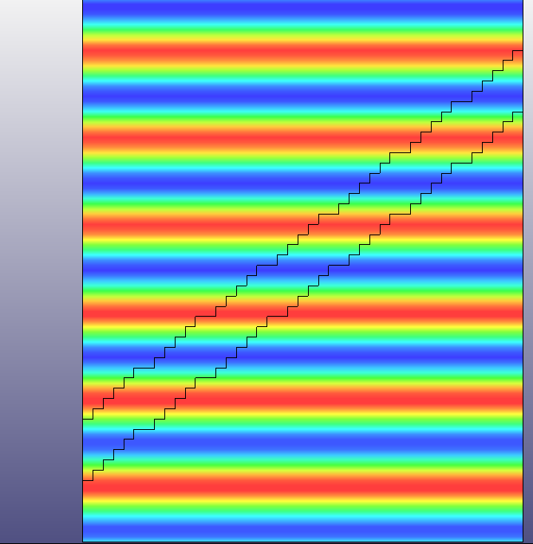
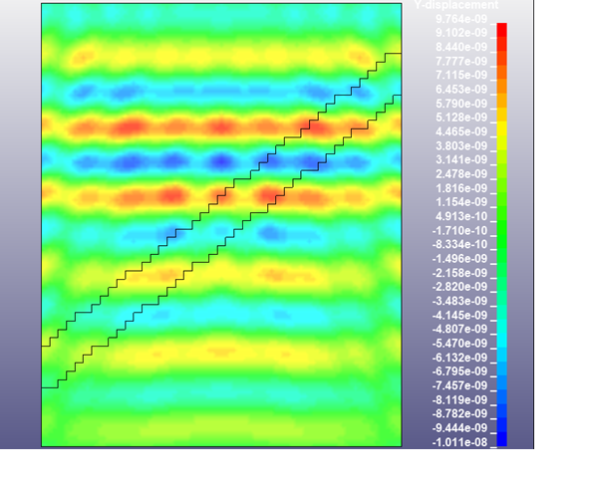
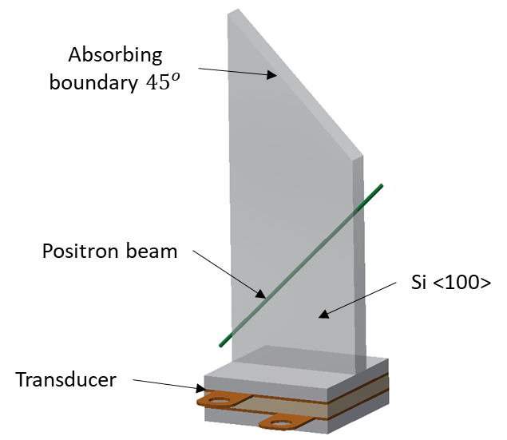
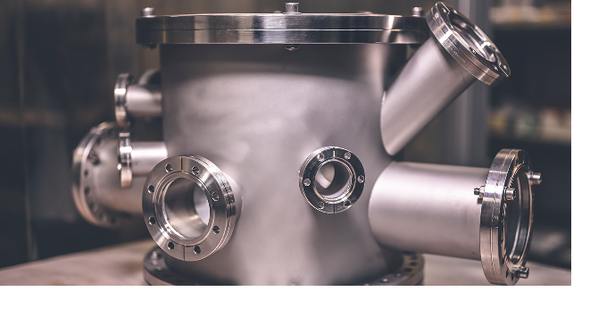
High-spec Acousto-Optic Modulator (AOM)
Technical requirements
Fast acoustic excitation ($≥$ 60 MHz)
Ultra-high frequency piezoelectric transducer
Ultra-high frequency driver
Tunability
Frequency (undulation period)
Pressure amplitude
High-quality design and construction
Low crystal dislocation density
High homogeneity of crystal lattice modulation by acoustic wave excitation
Small dimensions
Submillimeter width
More than 10 companies were contacted for designing such an AOM during the 1st phase of the project
None of them accepted to undertake the construction, except for one, which asked for a very large amount of money!!
Vacuum compatibility

Slide 18
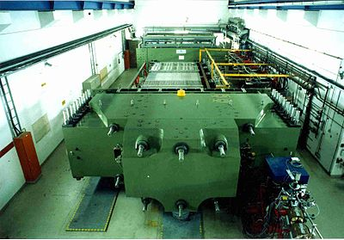
Near future activities (2nd year)
Interferometer optimization
Characterization of test samples
Transition to a fully functional 60 MHz AOM prototype
Experiments for γ-ray generation in MAMI and/or CERN

Slide 19
AOM CU Simulations

Slide 20
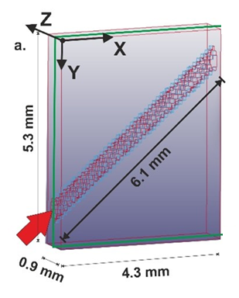
Simulation of AOM
XZ top plane: Excitation (loading conditions)
Transient mechanical FEM run at HPC ARIS grnet (LS-DΥΝΑ)
1.5 million elements, size:
50 μm × 50 μm × 9 μm
Crystalline Silicon properties
from L. Lanzoni et al. / International Journal of Engineering Science 46 (2008) 917–928)
XY and ZY planes (all).
Case 1: free boundary conditions Case 2: simply supported conditions
XZ bottom plane: Absorption (non-reflecting conditions)

Slide 21
Simulation of AOM
Case 2
f =10MHz
Notes:
This is a video from the boundary conditions of case 2 and excitation frequency of 10MHz

Slide 22
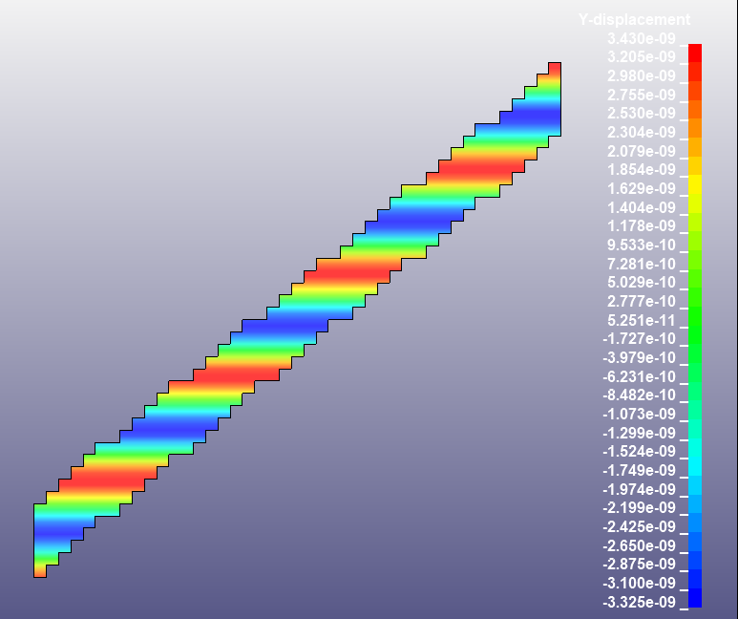
Simulation analysis
$$θ_{in}={45}^{ο}$$
$$θ_{rot}=θ_{in}={45}^{ο}$$

Slide 23
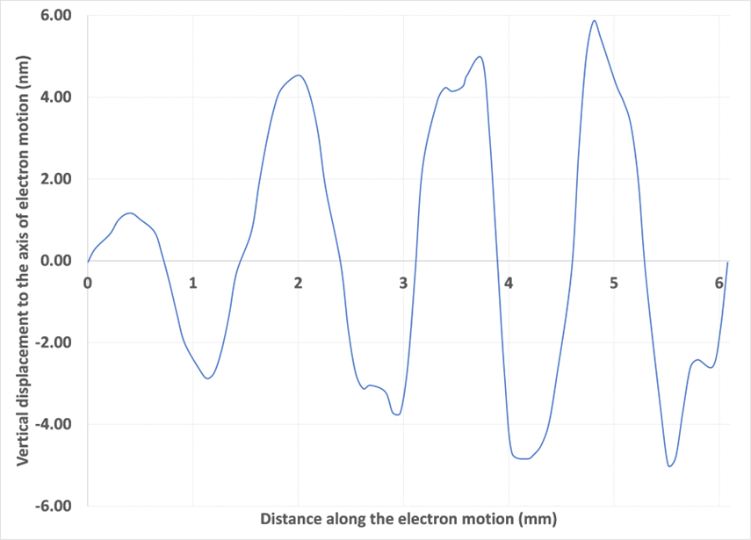
Simulations
f = 10MHz
Case 1: free boundary
Case 2: simply supported

Slide 24
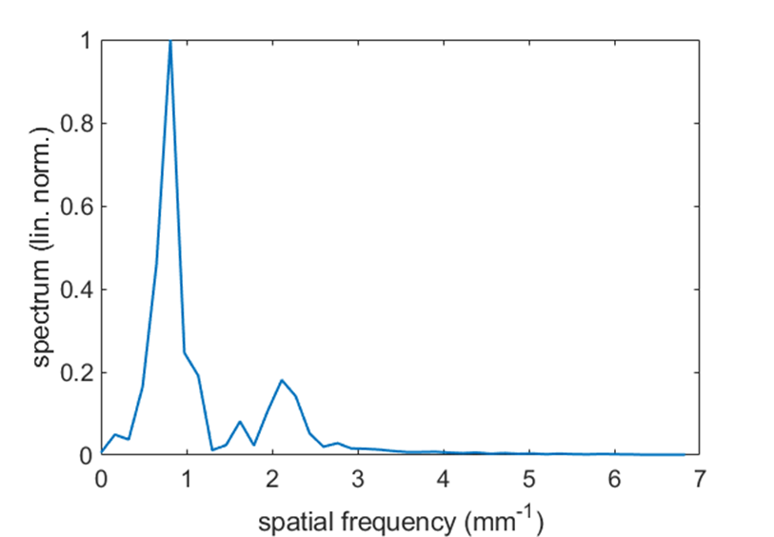
Simulations
Case 1
Space
Frequency

Slide 25
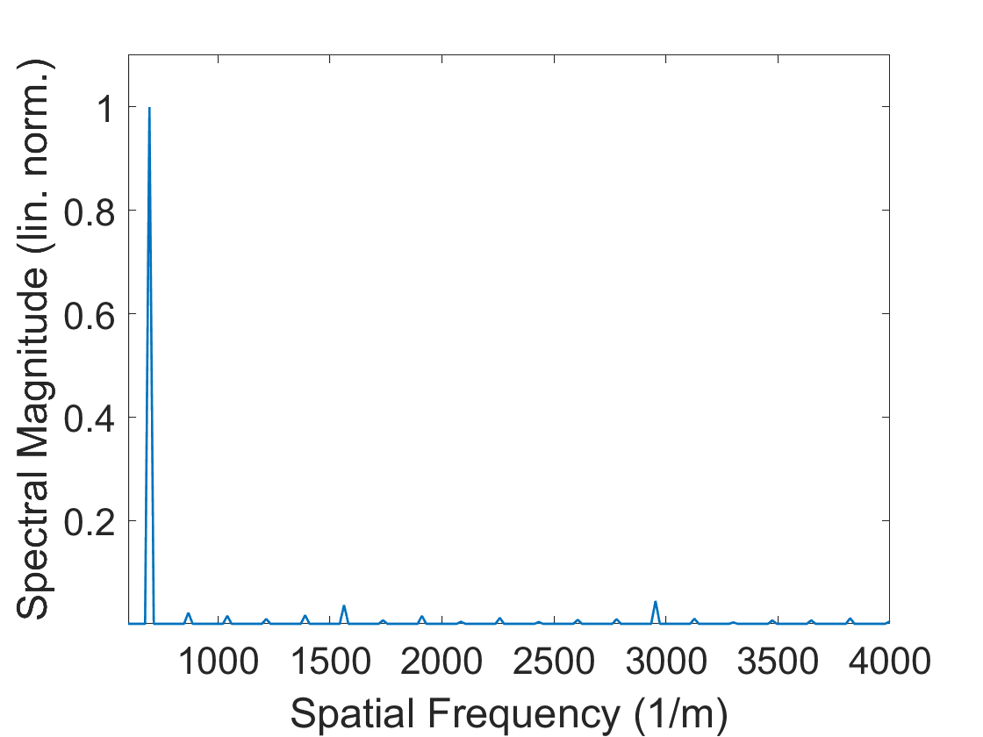
Simulations
Case 2
Space
Frequency

Slide 26
Simulations
Ζ
Χ
Elongation of y-dimension
Excitation frequency: 10 MHz
4 MPa harmonic loading
NEW Crystal Si dimensions modelled:
X=4.3 mm
Y=26.5 mm
Z=0.9 mm
Excitation frequency: 10 MHz
4 MPa harmonic loading
Initial Crystal Si dimensions modelled:
X=4.3 mm
Y=5.3 mm
Z=0.9 mm
PATH - 1
PATH - 2
Υ

Slide 27
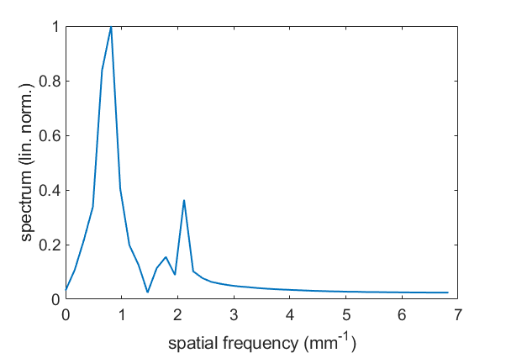
Simulations
Excitation frequency: 10 MHz
4 MPa harmonic loading
Crystal Si dimensions modelled:
X=4.3 mm
Y=26.5 mm
Z=0.9 mm
Elongation of y-dimension
Lattice displacement vs the diagonal distance along the central positron path
Path 1 (near crystal center)
Spatial frequency spectrum
Prominent unwanted spectral feature

Slide 28
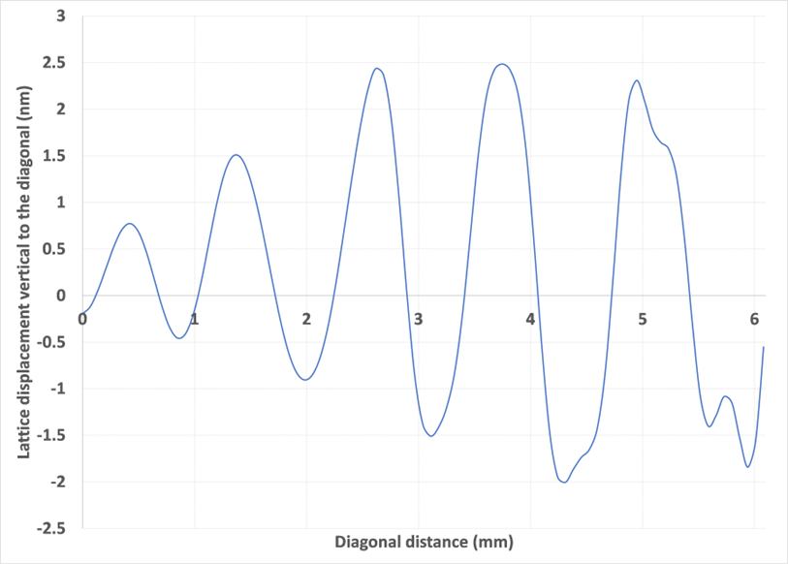
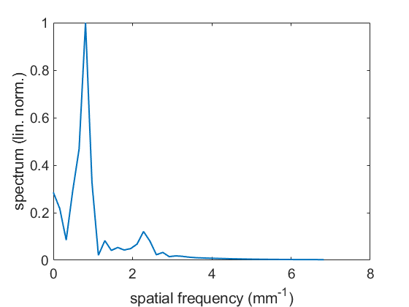
Simulations
Excitation frequency: 10 MHz
4 MPa harmonic loading
Crystal Si dimensions modelled:
X=4.3 mm
Y=26.5 mm
Z=0.9 mm
Elongation of y-dimension
Lattice displacement vs the diagonal distance along the central positron path
Path 2 (lower end of crystal)
Spatial frequency spectrum
Suppressed unwanted spectral feature

Slide 29
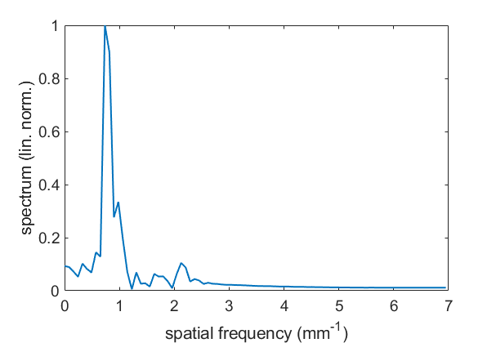
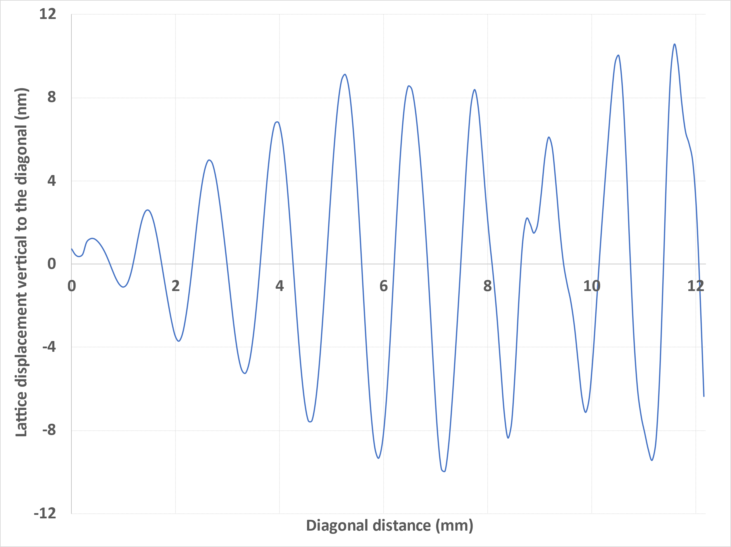
Simulations
Excitation frequency: 10 MHz
4 MPa harmonic loading
Crystal Si dimensions modelled:
X=8.6 mm
Y=10.6 mm
Z=0.9 mm
Elongation of x and y-dimension
Lattice displacement vs the diagonal distance along the central positron path
Lower end of crystal
Spatial frequency spectrum
Suppressed unwanted spectral feature

Slide 30
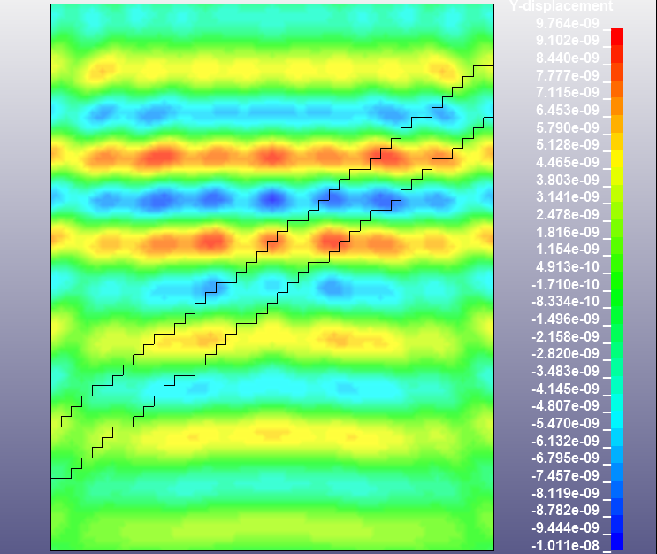
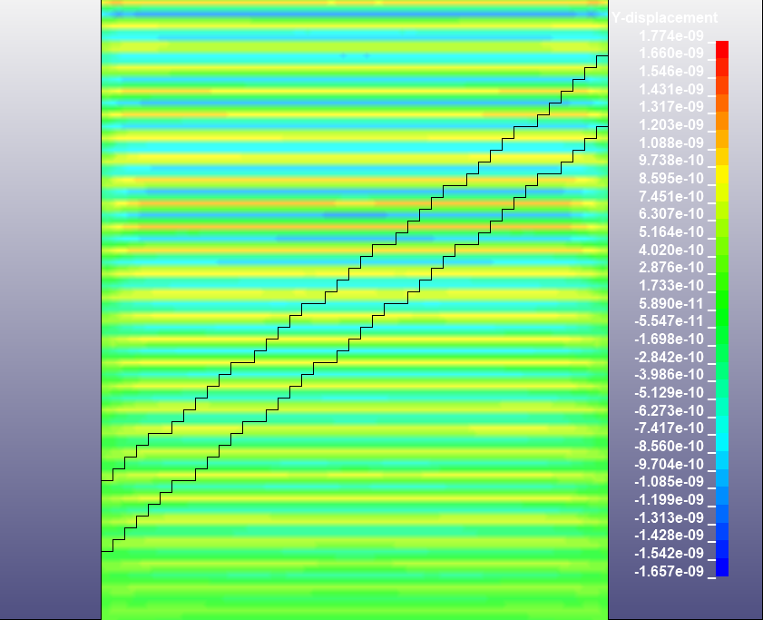
Simulations
Increasing the excitation frequency
f = 10MHz
f = 40MHz

Slide 31
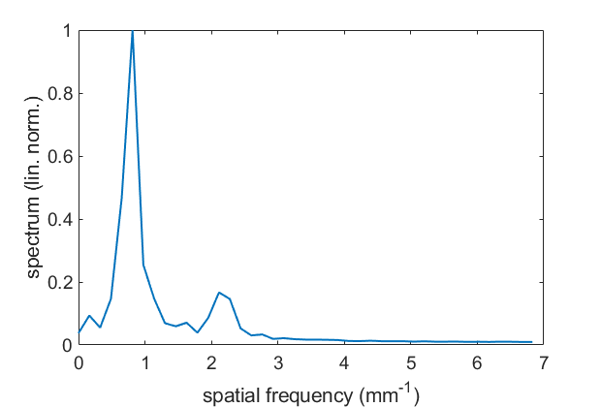
Modeling and Simulations
Ge
Excitation frequency: 6 MHz
4 MPa harmonic loading
Crystal Ge dimensions modelled:
X=4.3 mm
Y=5.3 mm
Z=0.9 mm
Lattice displacement vs the diagonal distance along the central positron path
(PATH 1)

Slide 32
Modeling and Simulations
Ge
Increase of y-axis dimension
Excitation frequency: 6 MHz
4 MPa harmonic loading
Crystal Ge dimensions modelled:
X=4.3 mm
Y=26.5 mm
Z=0.9 mm
Lattice displacement vs the diagonal distance along the central positron path

Slide 33
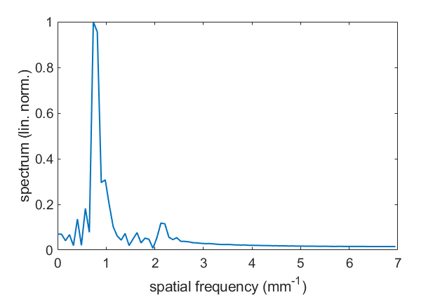
Modeling and Simulations
Ge
Increase of both x,y axes dimensions
Excitation frequency: 6 MHz
4 MPa harmonic loading
Crystal Ge dimensions modelled:
X=8.6 mm
Y=10.6 mm
Z=0.9 mm
Lattice displacement vs the diagonal distance along the central positron path

Slide 34
Near future activities (2nd year)
Interferometer optimization
Characterization of test samples
Transition to a fully functional 60 MHz AOM prototype
Experiments for γ-ray generation in MAMI and/or CERN
Models upgrade based on the measurements and characterization experiments
Simulations update
based on the experimental findings
in collaboration with the MBN research team and the MD simulation findings

Slide 35
Acknowledgement
Funding
HMU-IPPL team
Dr. Konstantinos Kaleris
As. Prof. Evangelos Kaselouris
MSc Emmanouil Kaniolakis-Kaloudis
Prof. Michael Tatarakis
Prof. Vassilis Dimitriou
Prof. Makis Bakarezos
Prof. Nektarios A. Papadogiannis
101046458 — TECHNO-CLS — HORIZON-EIC-2021-PATHFINDEROPEN-01
Greek Research & Technology Network (GRNET) in the National HPC facility ARIS-under project ID pr013024-LaMPIOS II.

Slide 36
Thank you for your attention

Slide 37
TECHNO-CLS research project
TECHNO-CLS: Emerging technologies for crystal-based gamma-ray light sources
Pathfinder Programme - European Innovation Council (EIC)
101046458 — TECHNO-CLS — HORIZON-EIC-2021-PATHFINDEROPEN-01
https://mbnresearch.com/TECHNO-CLS/Main
Partners
Coordinator
Notes:
The project is based on research that was founded by the MBN group, prof. Solov’yov, prof. Korol and our group has been involved thanks to the COST TUMIEE action, when prof. Solov’yov heard the presentation of prof. Papadogiannis on the generation and diagnostics of nanoacoustic strains. So we are the rookies of the project but we were also involved for a particular purpose

Slide 38
Characterization: Bragg diffraction
Bragg condition for constructive interference:
$nλ_{opt}=2λ_{ac}\sin{θ}$
$n$: diffraction order
Evaluation with 1064 nm laser $\left(n=1\right)$:
Peak diffracted brilliance at $θ_{dif}=\arcsin\left(\frac{λ_{opt}}{2λ_{ac}}\right)=76$mrad
Diffracted intensity:
$I_{dif}=I_{0}\sin^{2}\left(\frac{π}{λ_{opt}}\sqrt{\frac{1}{2}M_{2}\frac{L}{H}P}\right)$, with $0≤\frac{I_{dif}}{I_{0}}≤0.8$
$M_{2}:$ acousto-optic figure of merit of crystal
$P$: acoustic power
$$I_{0}$$
$$I_{dif}$$
$$θ_{dif}$$
$$θ_{dif}$$

