Slide 1
Radiation characteristics of a four-period diamond undulator at 855 MeV
H. Backe
Institute for Nuclear Physics
University of Mainz, Germany
Annual Workshop of Horizon Europe EIC-Pathfinder Project
5.–6. Okt. 2023 Palazzo Bevilacqua Costabili, Germany

Slide 2
Outline
Introduction
Original design characteristics of the Undulator
Improvements of the calculations
Generation of mean spectra from unselected trajectories
Comparison with another calculation
Conclusions

Slide 3
2. Original design characteristics of the Undulator

Slide 4
4 Period Diamond Undulator
e-beam
Boron concentration
Undoped diamond crystal
(110)
Period length
(100)

Slide 5
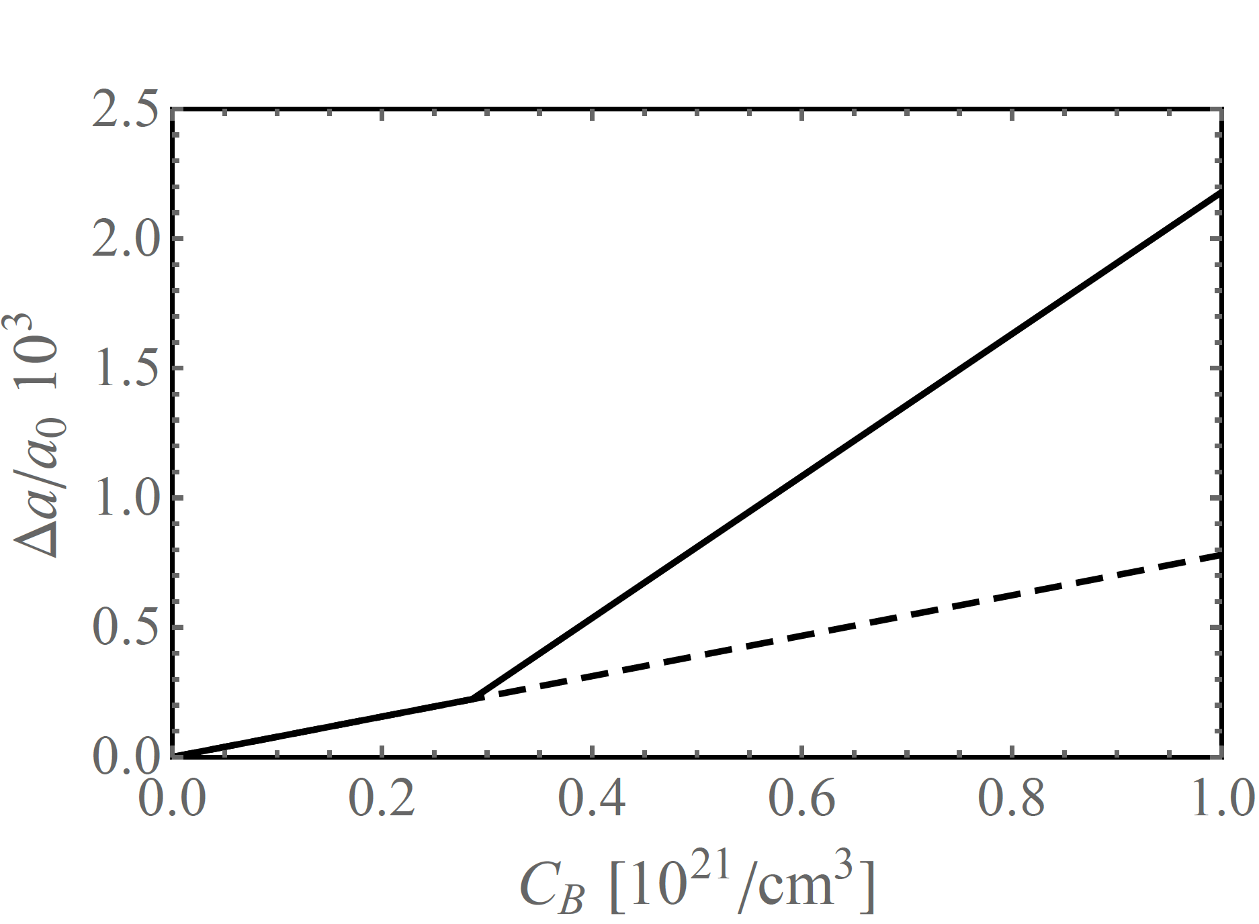
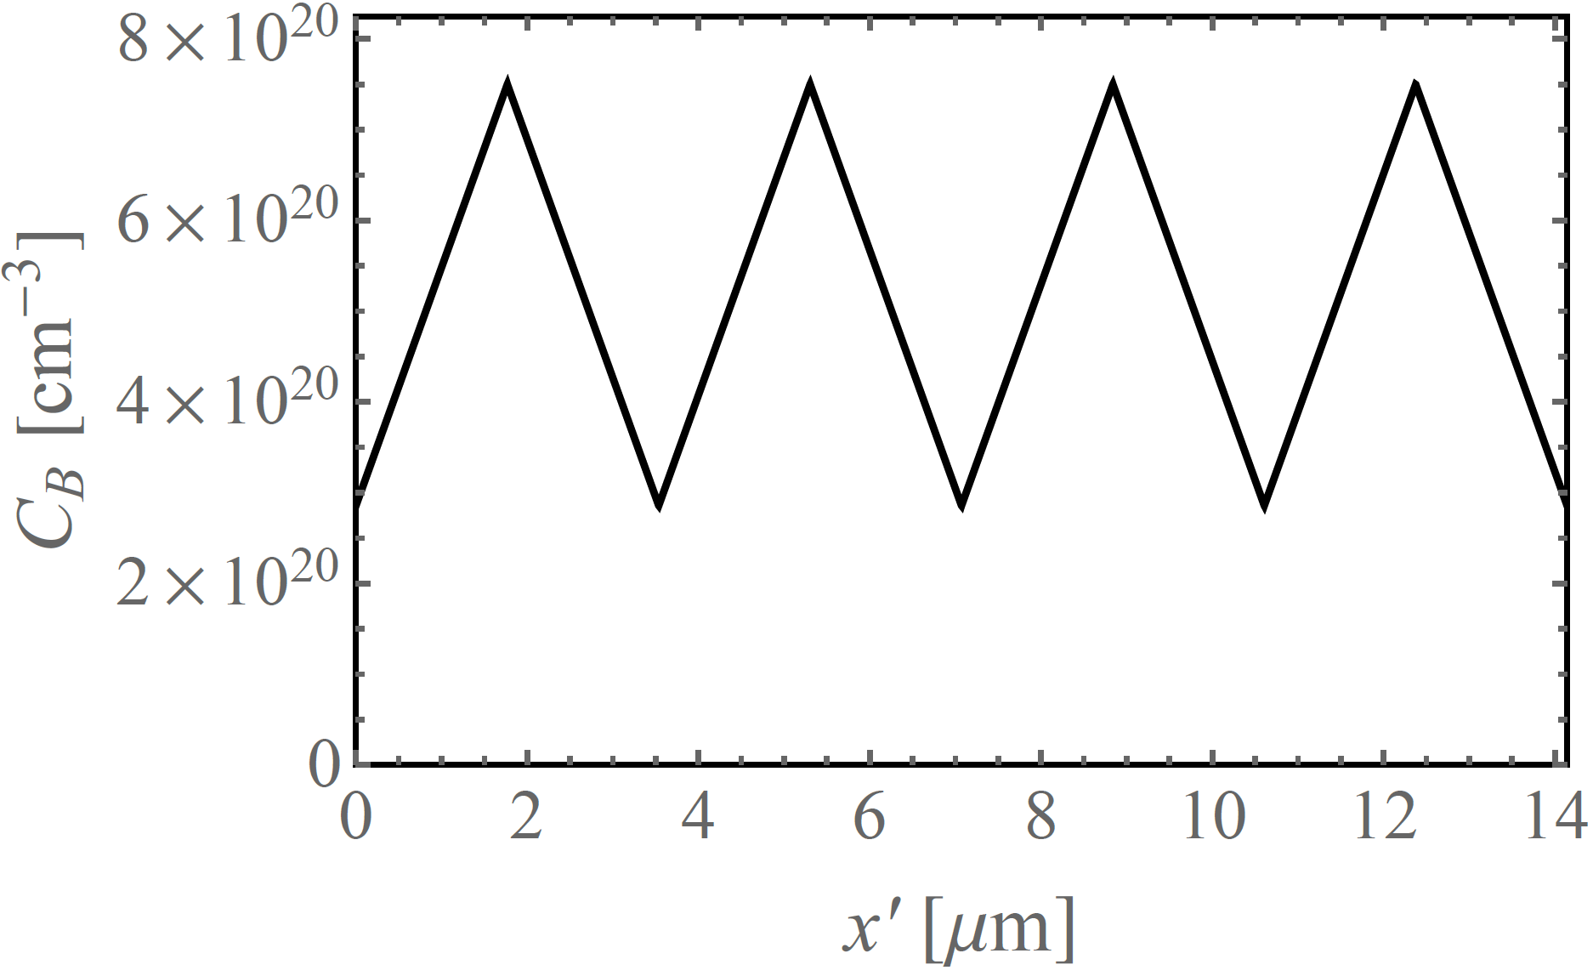
Lattice constant Δa/a₀ as function of atomic boron concentration C_{B}
F. Brunet et al., Diamond and Related Materials 7 (1998) 869-873, Fig. 4
Minimum boron concentration: C_{Bmin} = 2.86 •10²⁰/cm^3
Maximum boron concentration: C_{Bmax} = 7.5 •10²⁰/cm^3

Slide 6
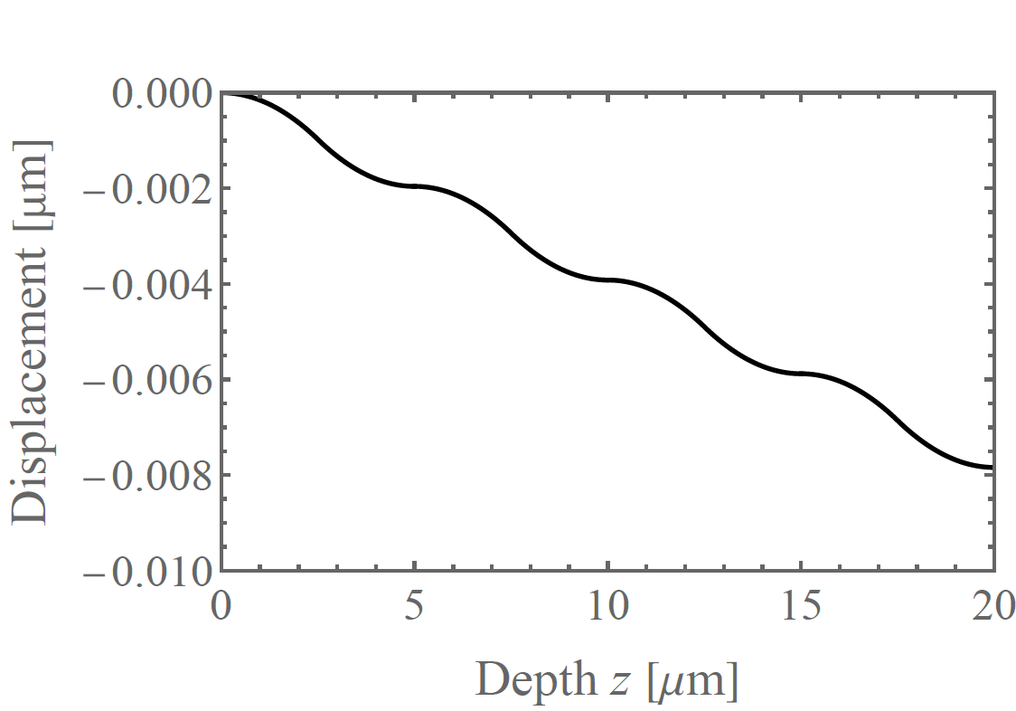
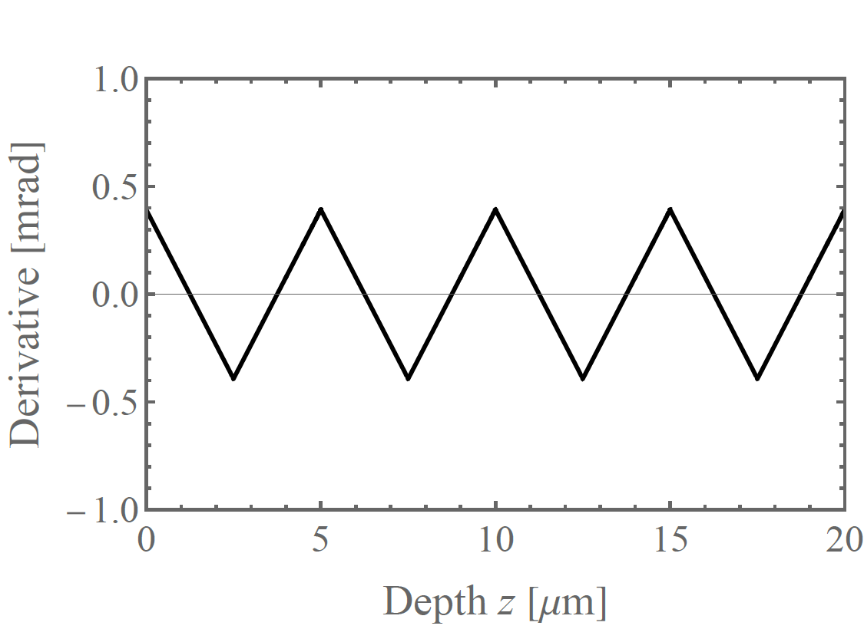
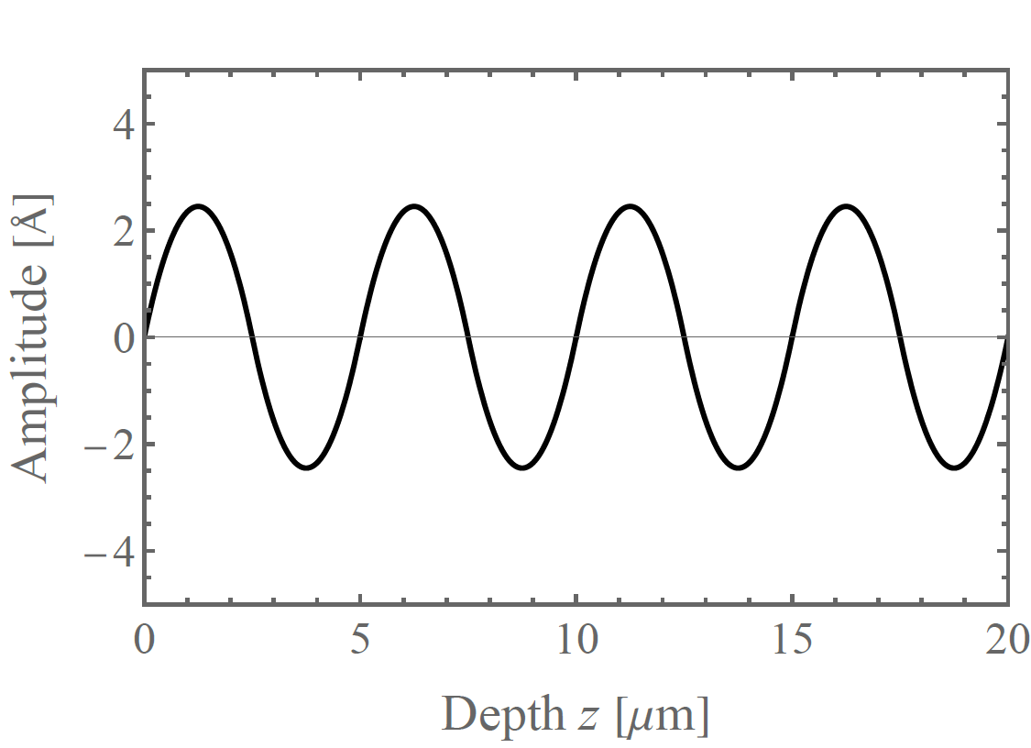
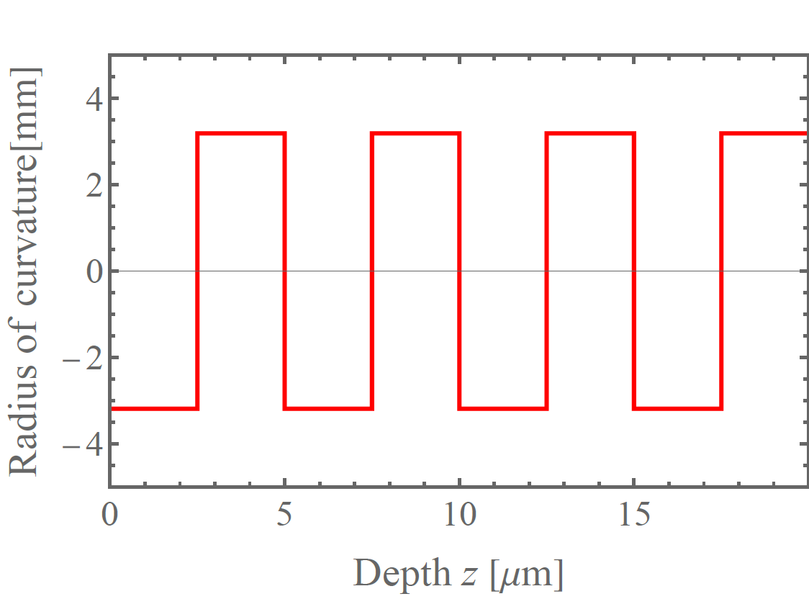
Design of the diamond undulator

Slide 7
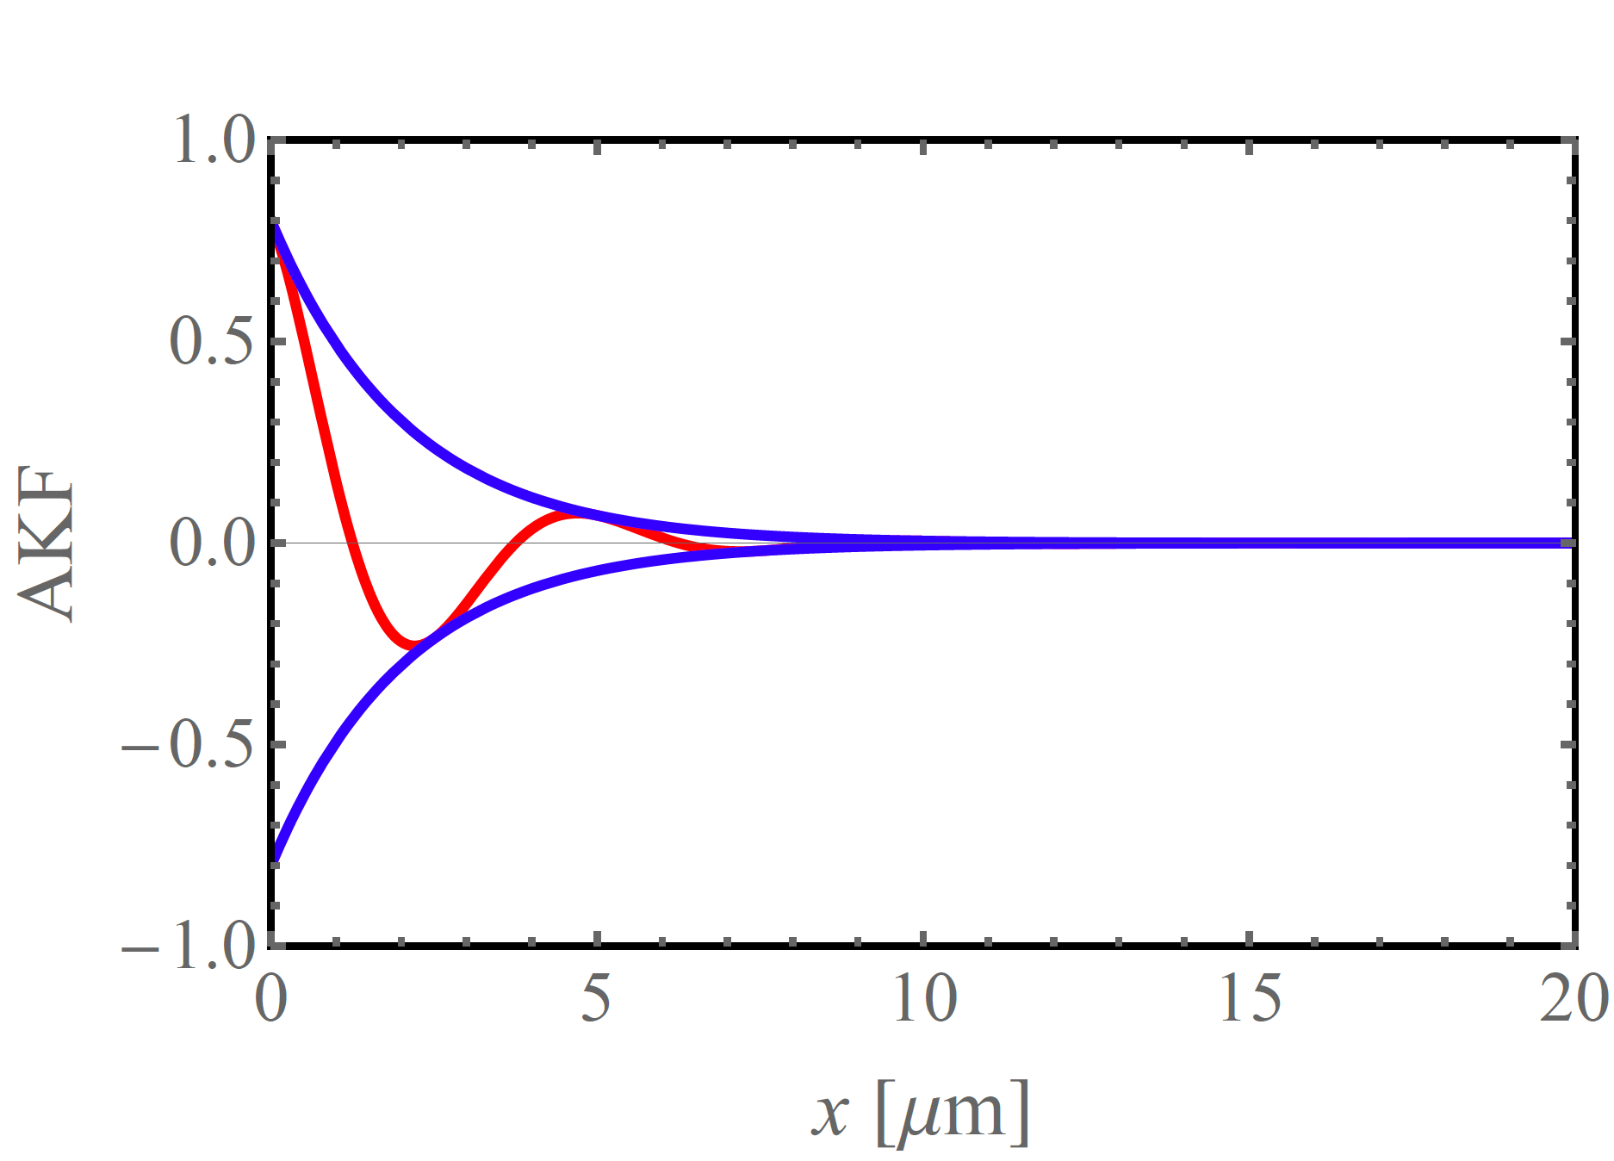
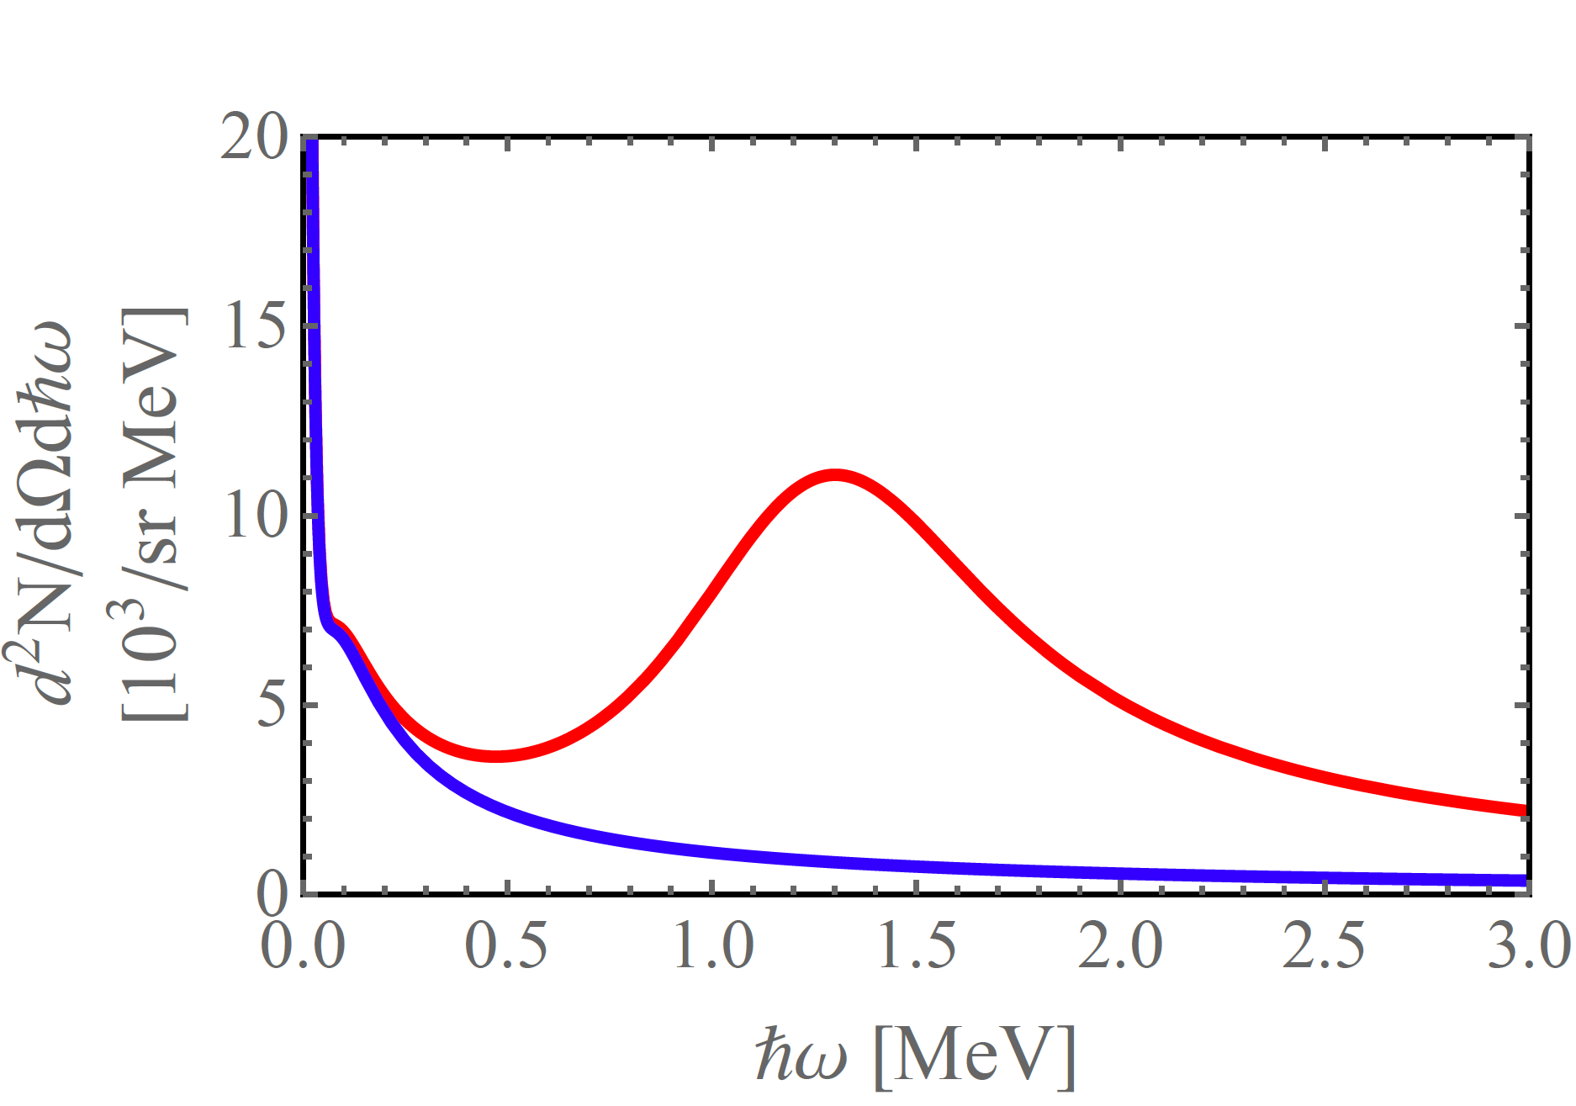
Estimation of spectral number density
Photon number density Channeling radiation neglected
Autocorrelation function
L_{dech} = 3 µm
Undulator
Bremsstrahlung

Slide 8
3. Improvements of the calculations
H. Backe
De-channeling in terms of instantaneous transition rates:
computer simulations for 855 MeV electrons at (110) planes of diamond
Eur. Phys. J. D (2022) 76:153

Slide 9
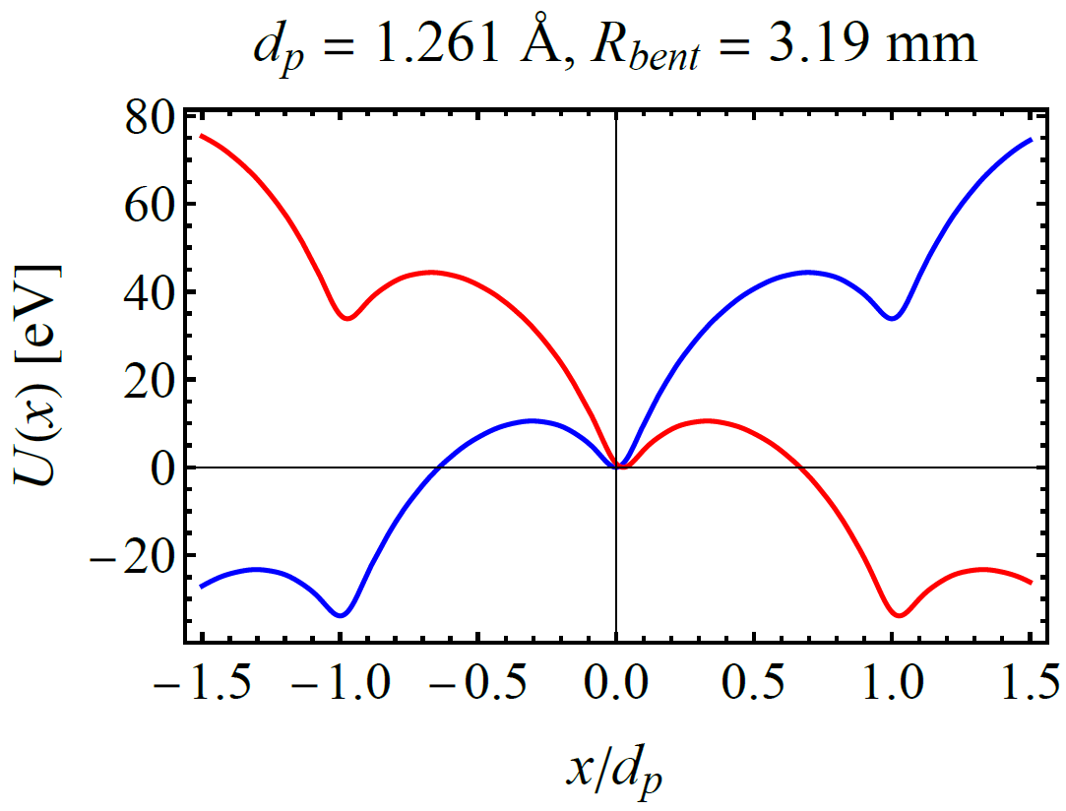
Potentials

Slide 10
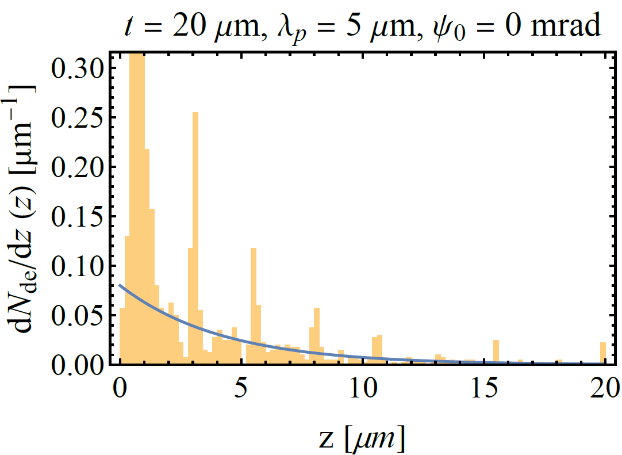
Dechanneling characteristics
65% dechannel within 1.5 µm
L_{dech} = 4.2 µm
0.45 %

Slide 11
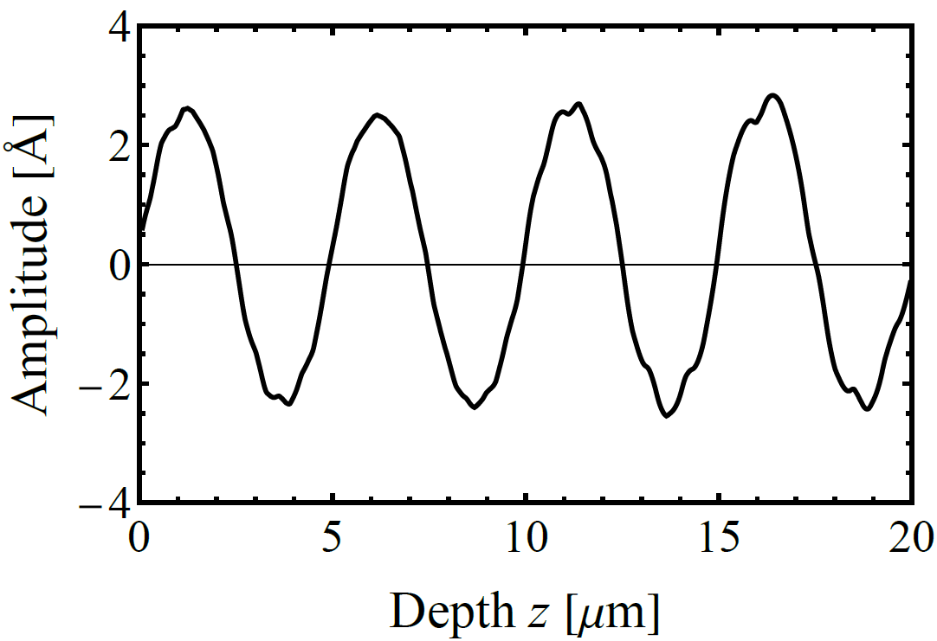
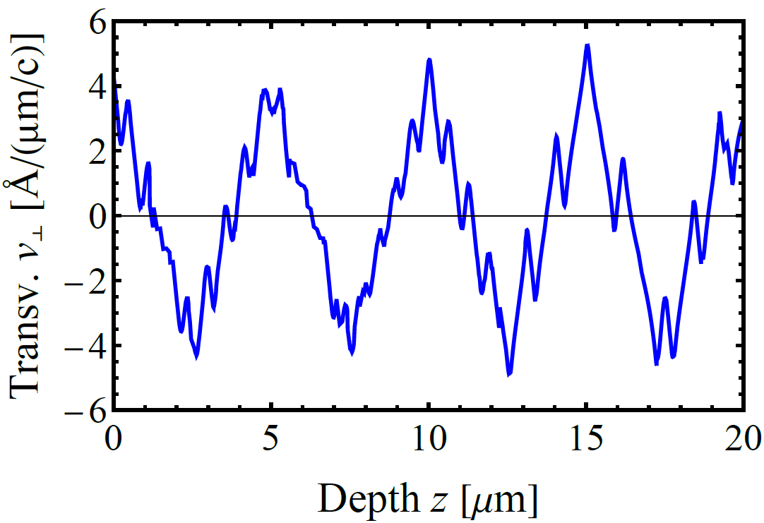
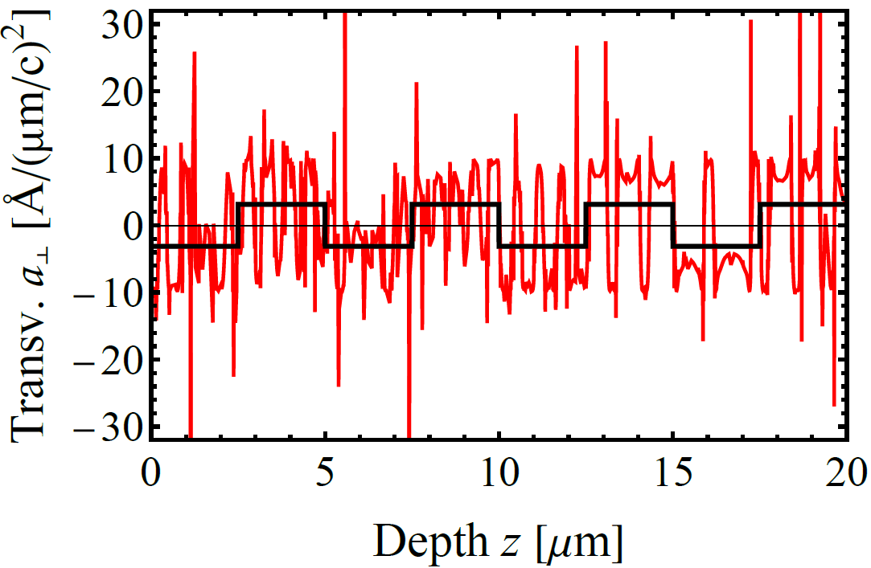
Characteristics of a full channeling trajectory
Transverse velocity
Transverse acceleration

Slide 12
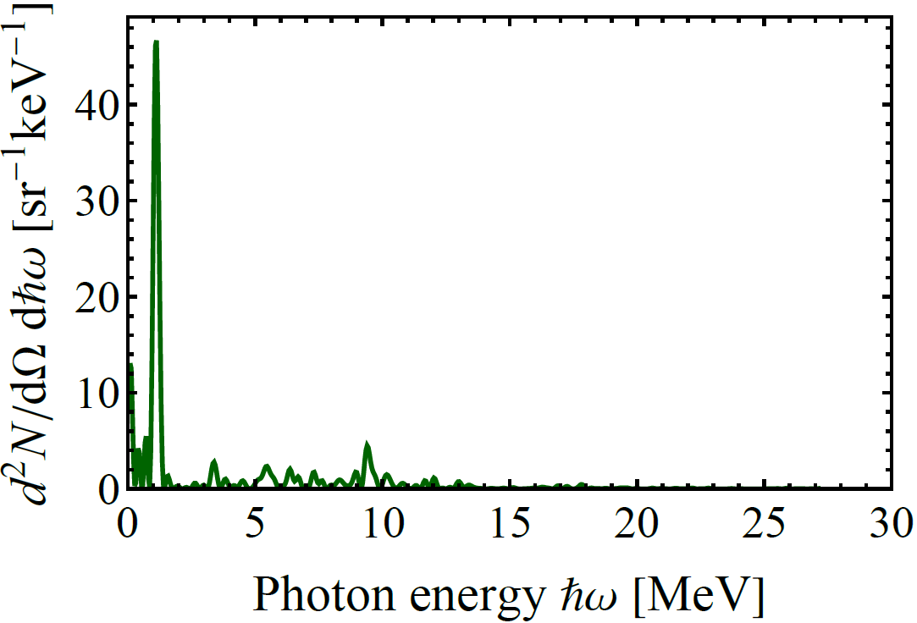
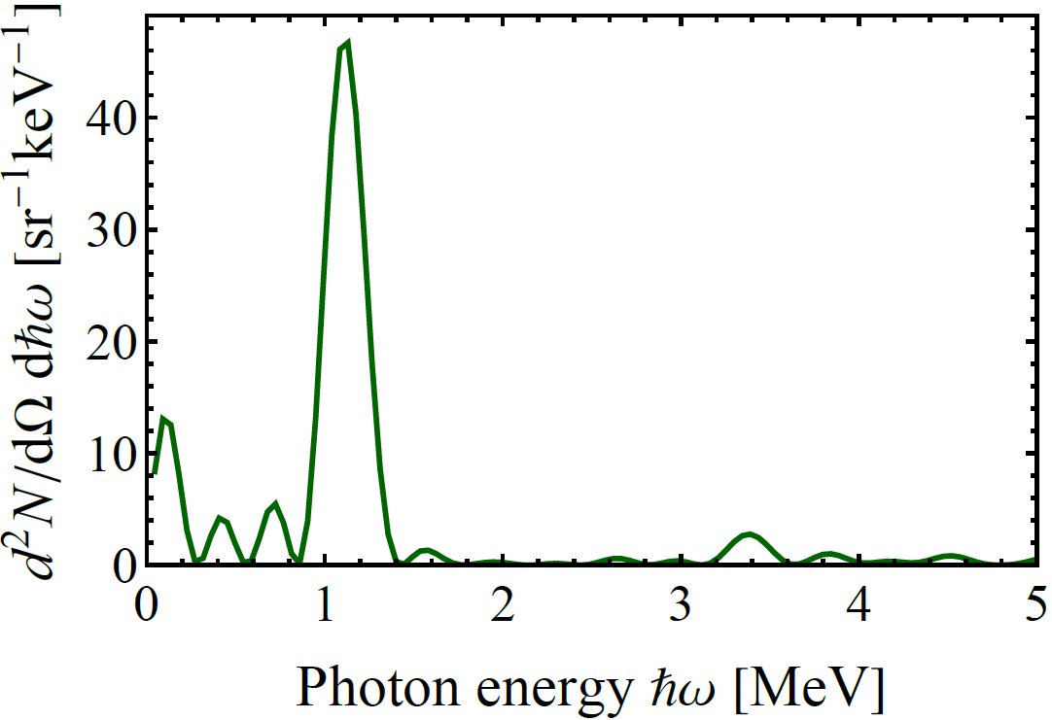
Number spectra for the full trajectory without de-channeling

Slide 13
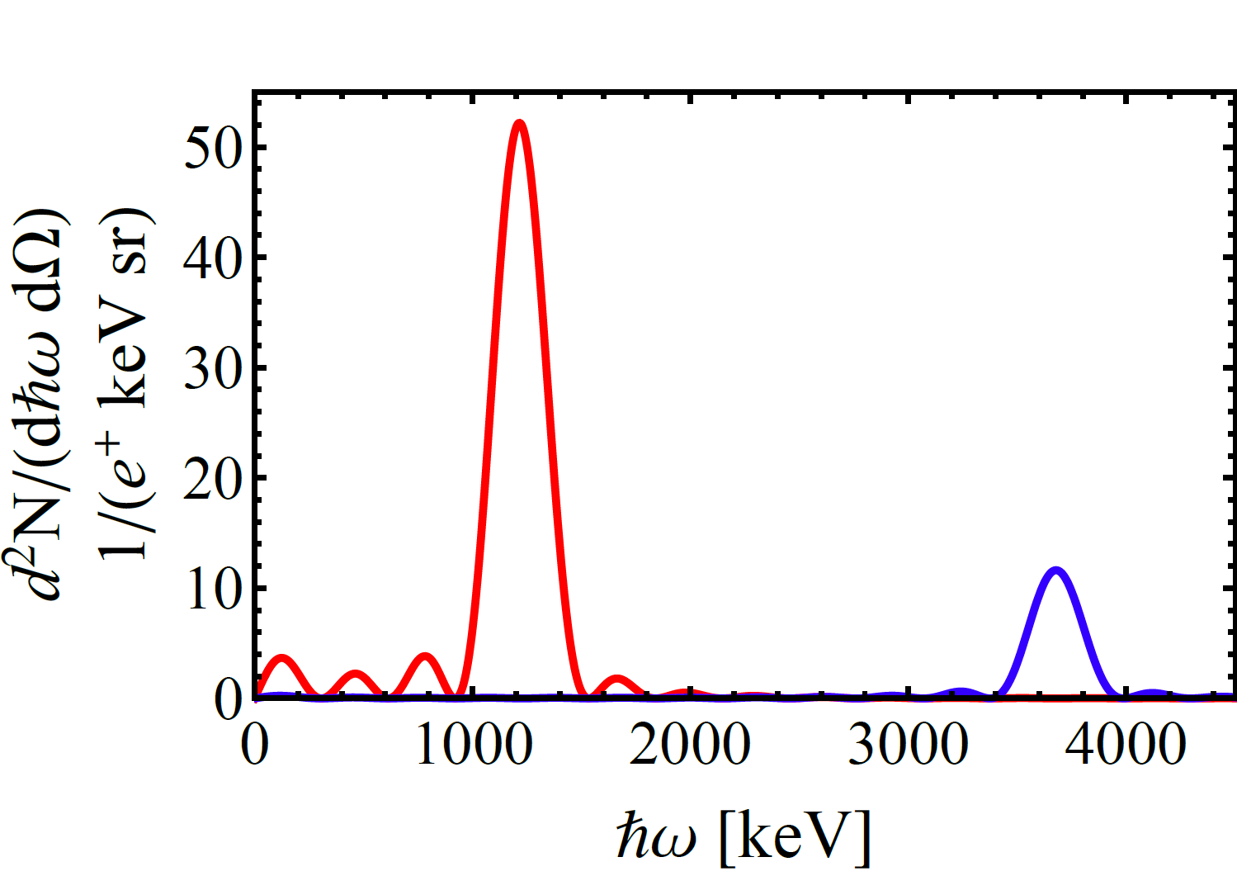
Check with undulator theory of Dattoli et al.
G. Dattoli, L. Giannessi, L. Mezi, M. Richetta, and A. Torreet al., Phys. Rev. A 45, 4023 (1992)
first harmonics
third harmonics
× 10

Slide 14
4. Generation of mean spectra from unselected trajectories

Slide 15
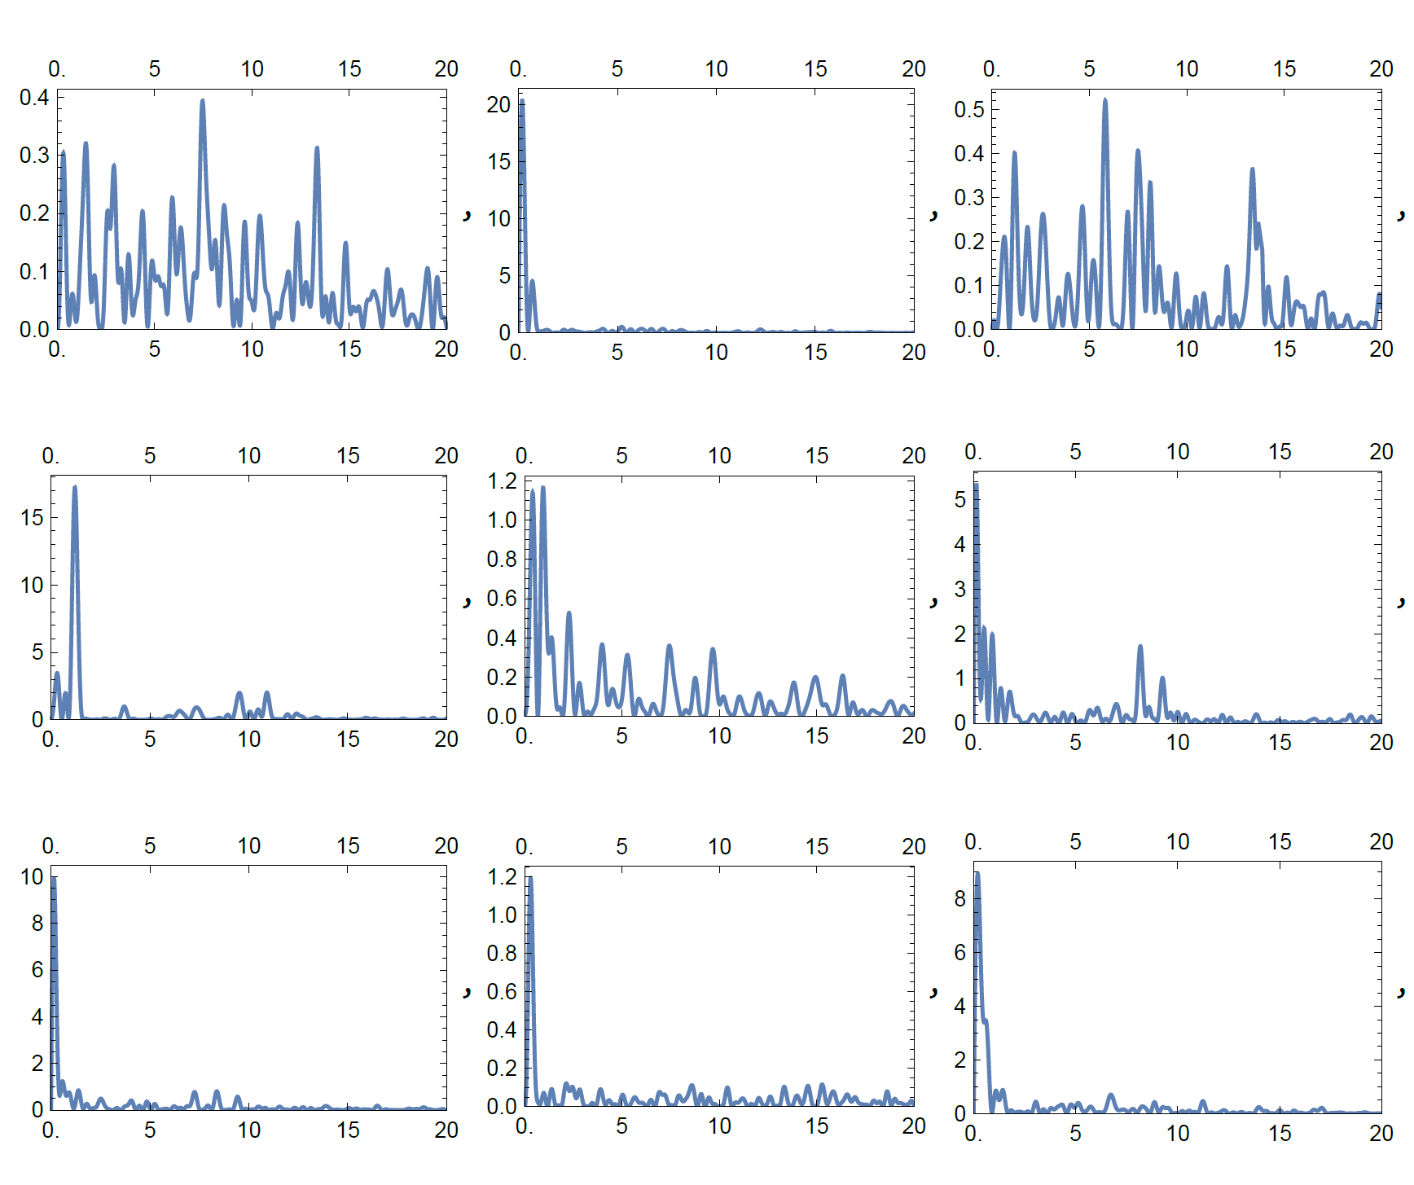
Samples of power spectra from randomly generated trajectories

Slide 16
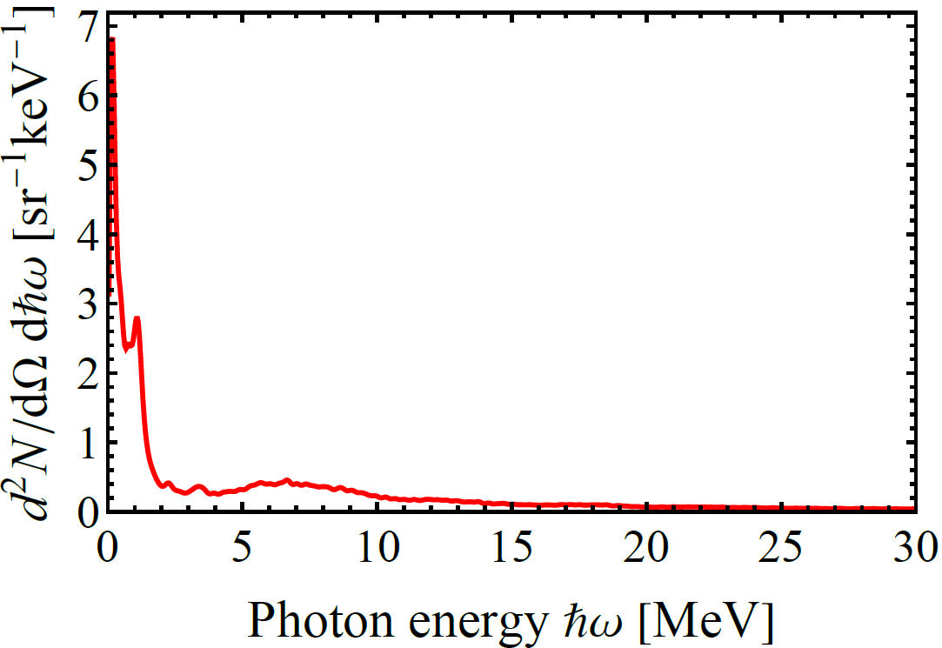
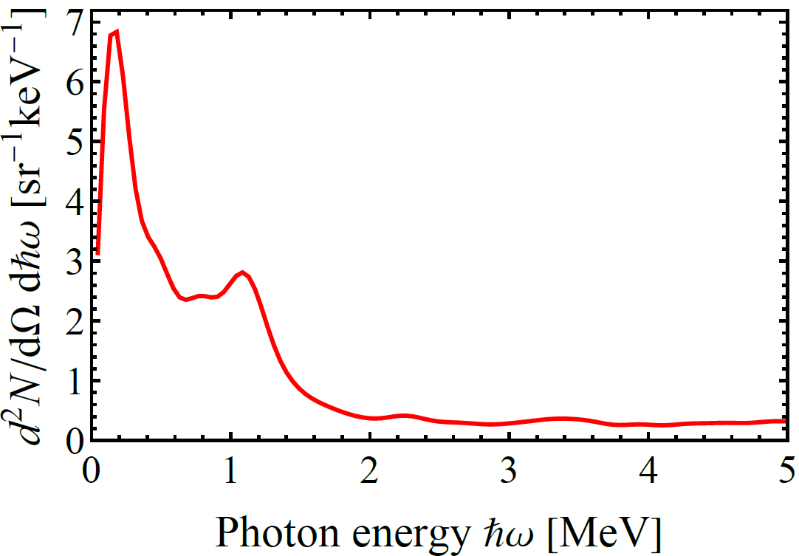
Mean number spectrum from 800 unselected single trajectories

Slide 17
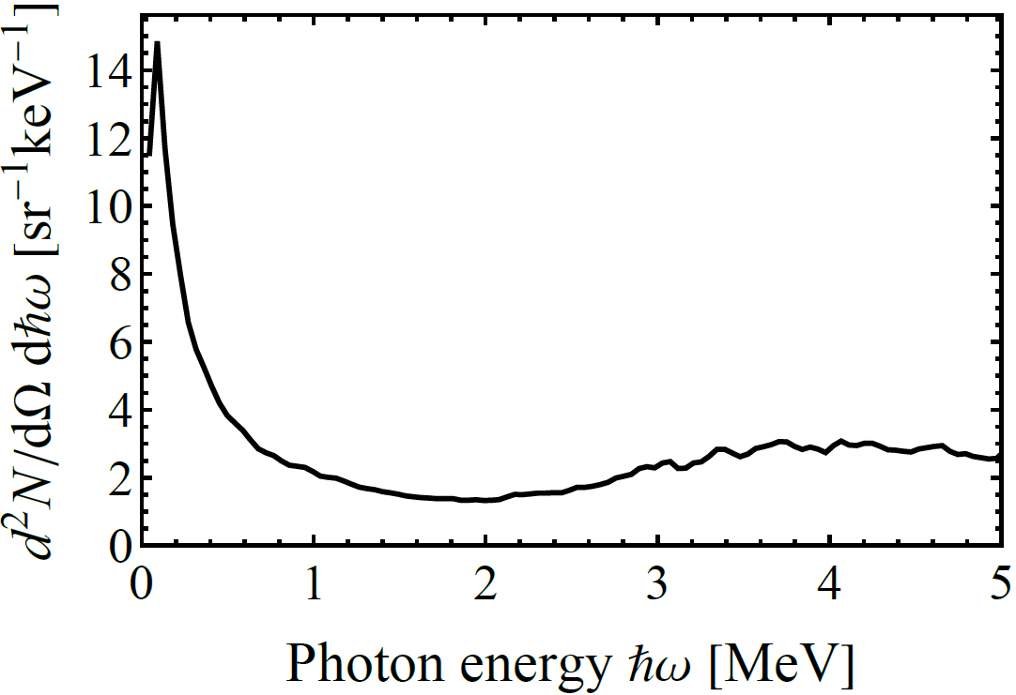
Comparison number spectra for 4-period undulator and 50 µm plane crystal (backing)
4-period undulator
50 µm plane crystal (backing)

Slide 18
5. Comparison with another calculation
Andrei V. Korol, Victor G. Bezchastnov, and Andrey V. Solov’yov
Channeling and radiation of the 855 MeV electrons enhanced
by the re-channeling in a periodically bent diamond crystal
Eur. Phys. J. D (2017) 71: 174

Slide 19
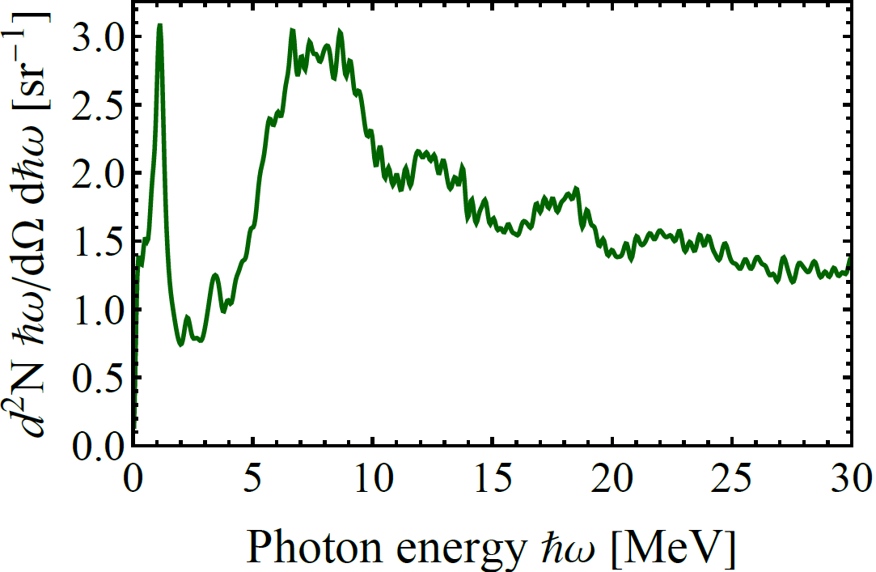
Mean power spectrum from 800 unselected single trajectories

Slide 20
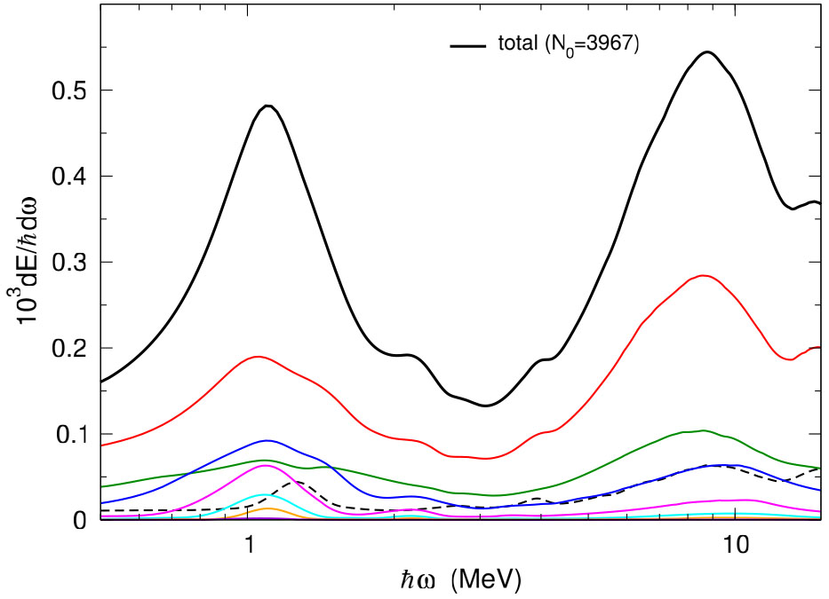
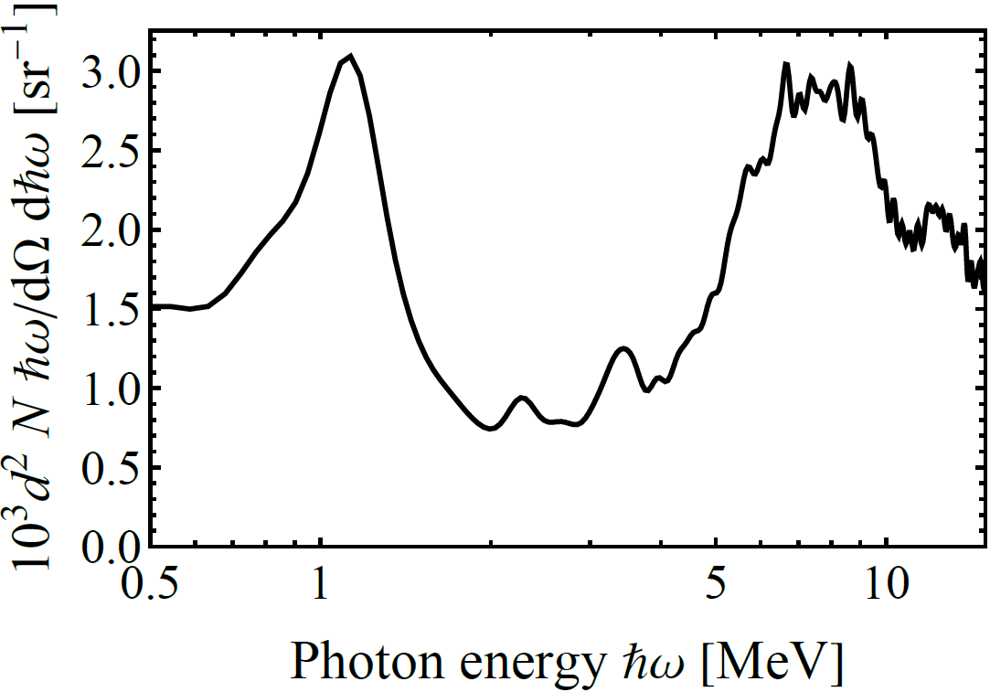
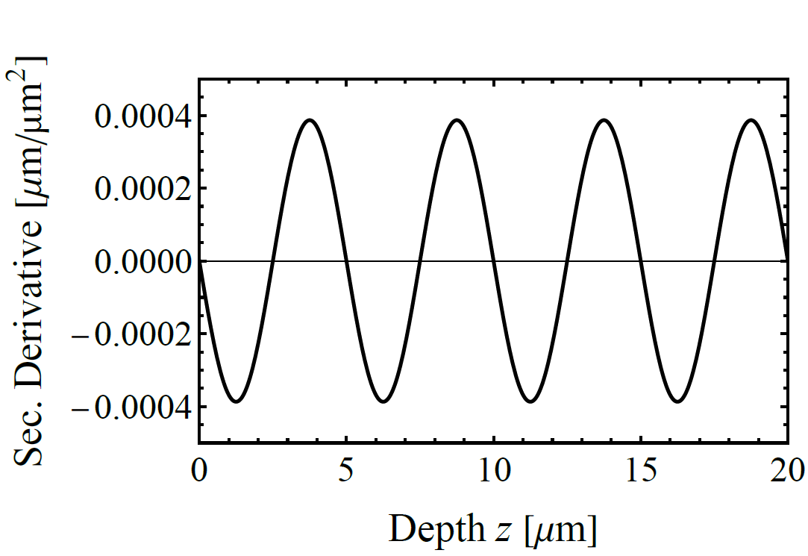
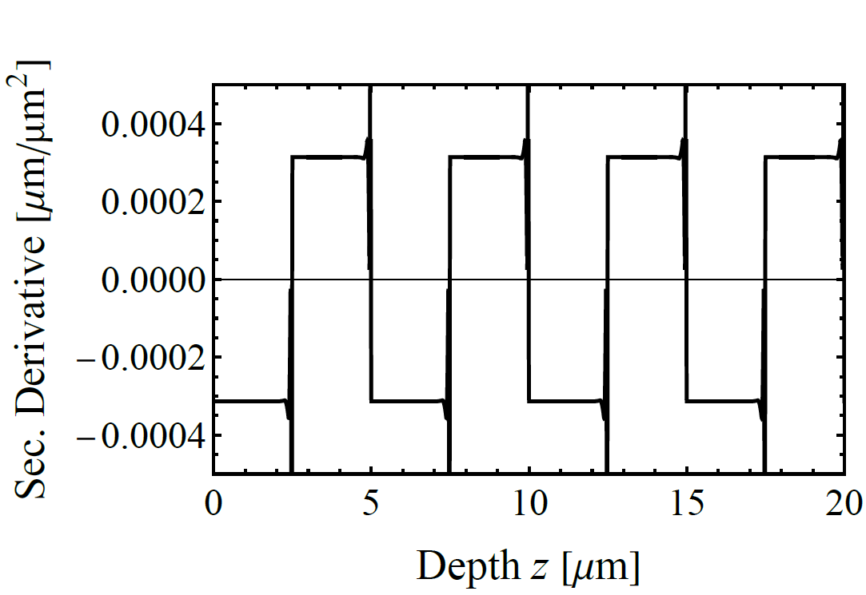
Comparison with results of Korol et al. Eur. Phys. J. D (2017) 71: 174

Slide 21
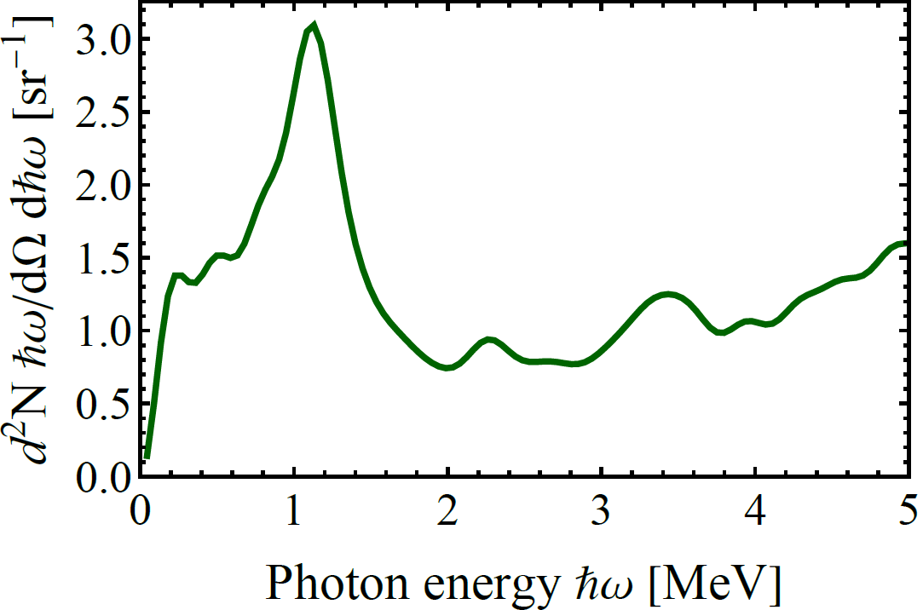
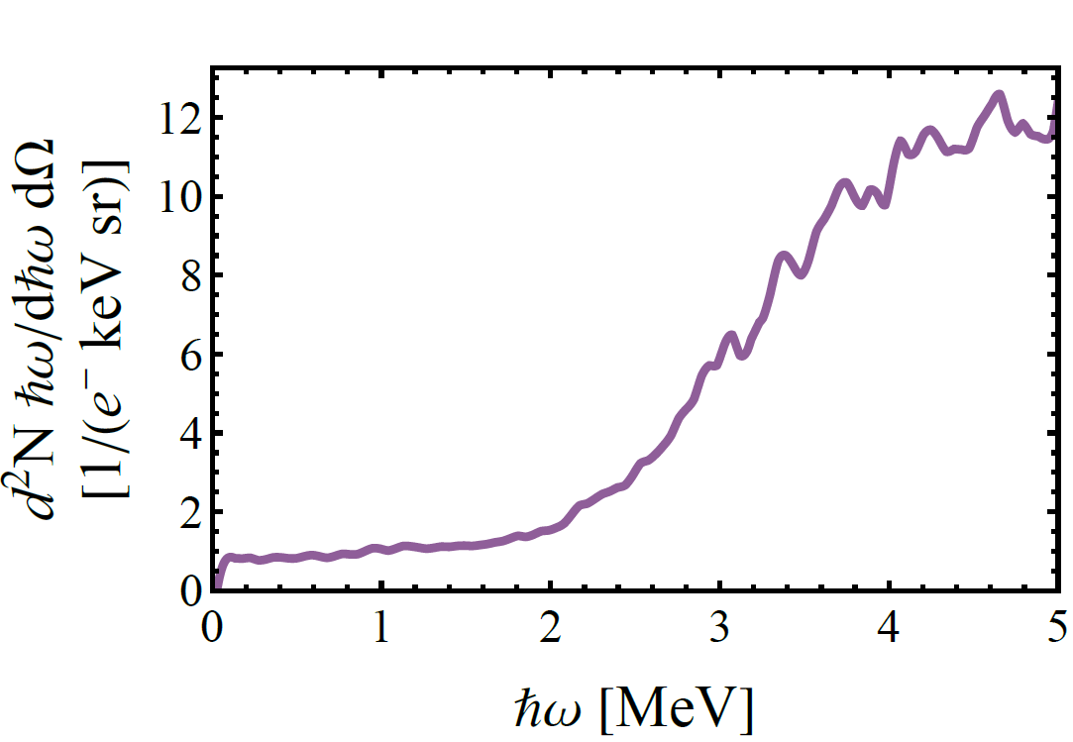
Comparison power spectra for 4-period undulator and 50 µm plane crystal (backing)
50 µm plane crystal (backing)
4-period undulator

Slide 22
Basic formalism
Calculation of the power spectrum
$$\frac{d^{2}I}{dℏω dΩ }=\frac{e^{2}}{4π^{2}}\frac{1}{γ^{2}{\left(1−\vec{β}⋅\hat{n}\right)}^{2}}{\left|\int_{0}^{∆z/βc}{\frac{a(t)}{c}e^{iω^{′}t}dt}\right|}^{2}= \frac{α}{4π^{2}}\frac{1}{γ^{2}{\left(1−\vec{β}⋅\hat{n}\right)}^{2}}\frac{dP(ω′/c)}{dω′/c}∆z$$
$a\left(t\right)$is acceleration as function of time from which the power spectrum as function of angular frequency $ω′$ was calculated with Mathematica standard program.
$$ℏω=\frac{ℏc}{\left(1−\vec{β}⋅\hat{n}\right)}ω′$$
$$\frac{1}{\left(1−\vec{β}⋅\hat{n}\right)}=\frac{1}{\left(1−β_{||}cosθ\right)}→2γ^{2}\left(1−{\left(γθ\right)}^{2}\right)$$
Transformation into the experimental relevant number spectrum
$$\frac{d^{2}N}{dℏω dΩ }=\frac{1}{ℏω}\frac{d^{2}I}{dℏω dΩ}$$

Slide 23
6. Conclusions
1. Collisions with atoms or electrons appear as noise in the acceleration spectra as function of time which appears as background at low photon energies
2. In calculation a peakstructure at 1.2 MeV appears with different significances
3. In the experiment no indication of such a peak was found (W.Lauth)
4. Either the calculations overestimate the effect or the undulator structures of the boron doped diamond undulator crystal has not the wanted structure
5. Experiments with the MAMI 500 MeV positron beam should contribute to solve the question
6. A lot of „parasitic background“ radiation accompanies the undulator peak

Slide 25
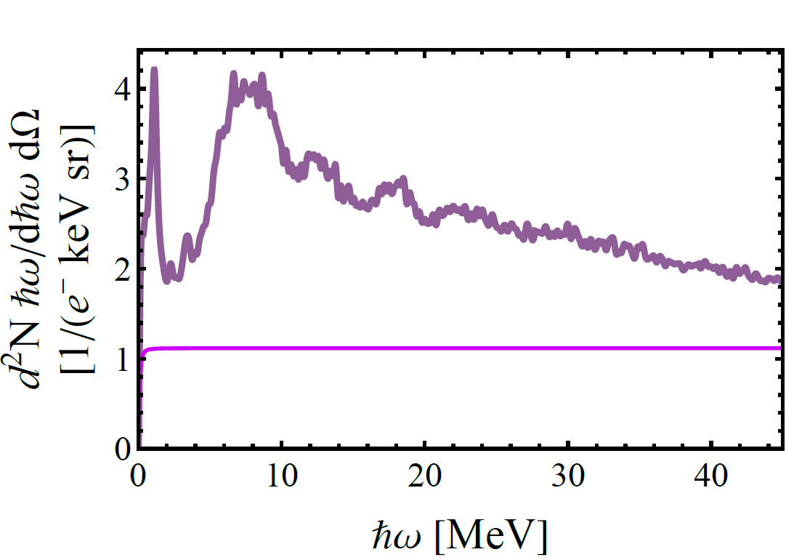
Analysis of background radiation
Photon energy 0.074 MeV per e in angle $θ$=1/$γ$ for
Channeling radiation + noice
$0.005 <ℏω/MeV<$45
bremsstrahlung
Photon energy 0.056 MeV per e in angle $θ$=1/$γ$

Slide 26
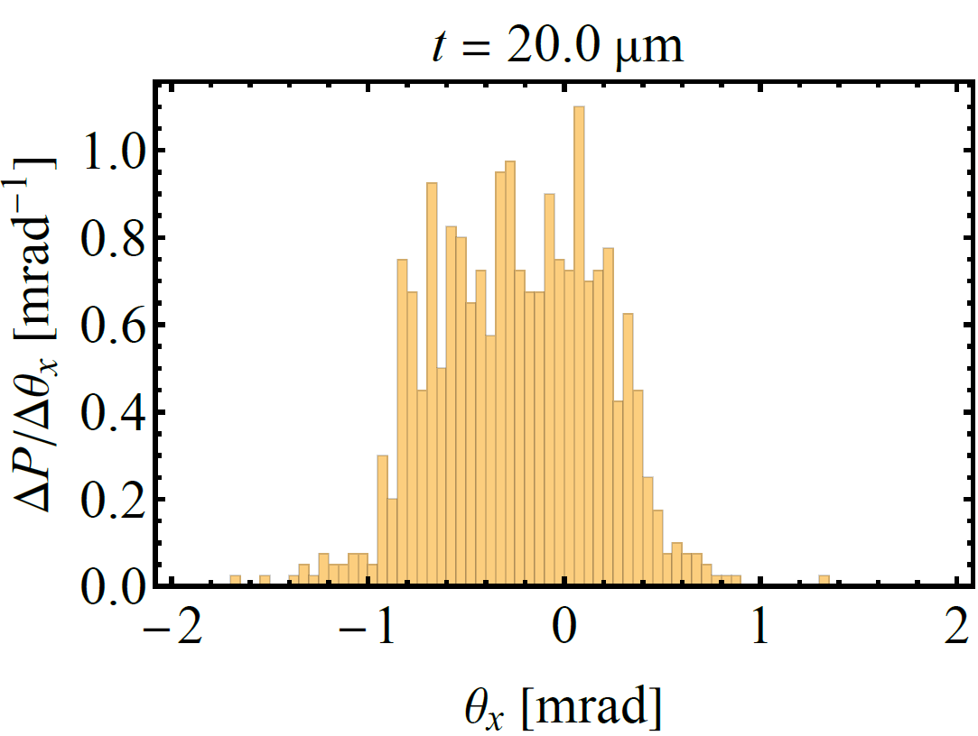
Window in the scattering distribution
Window

Slide 27
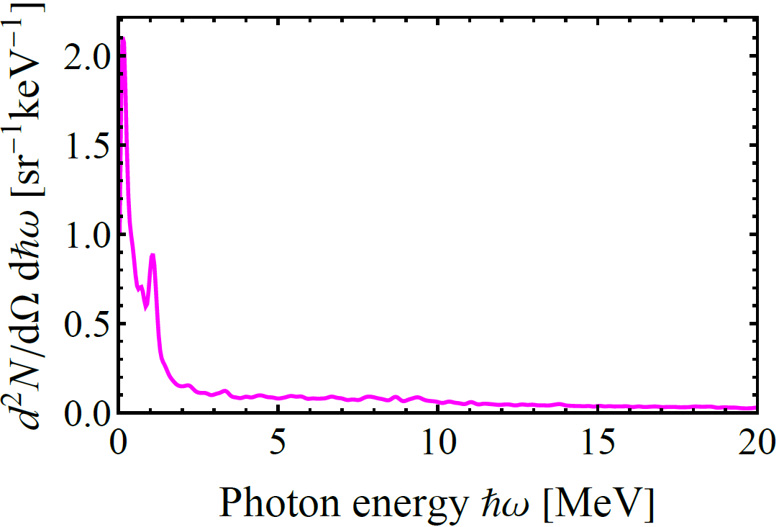
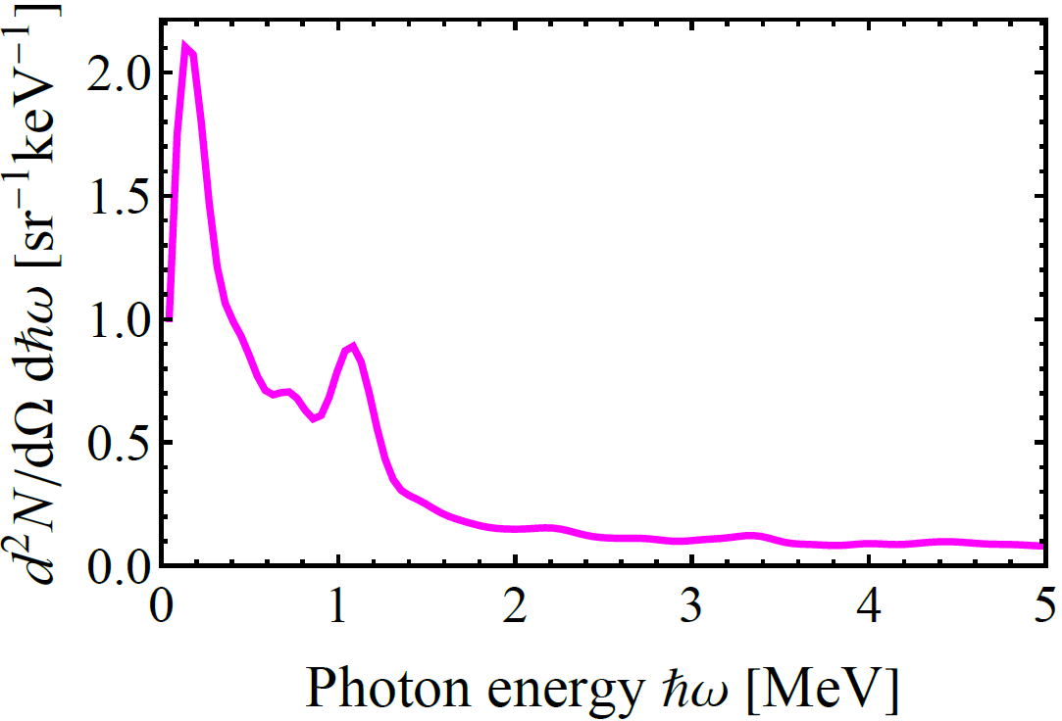
Photon number distribution with window

Slide 28
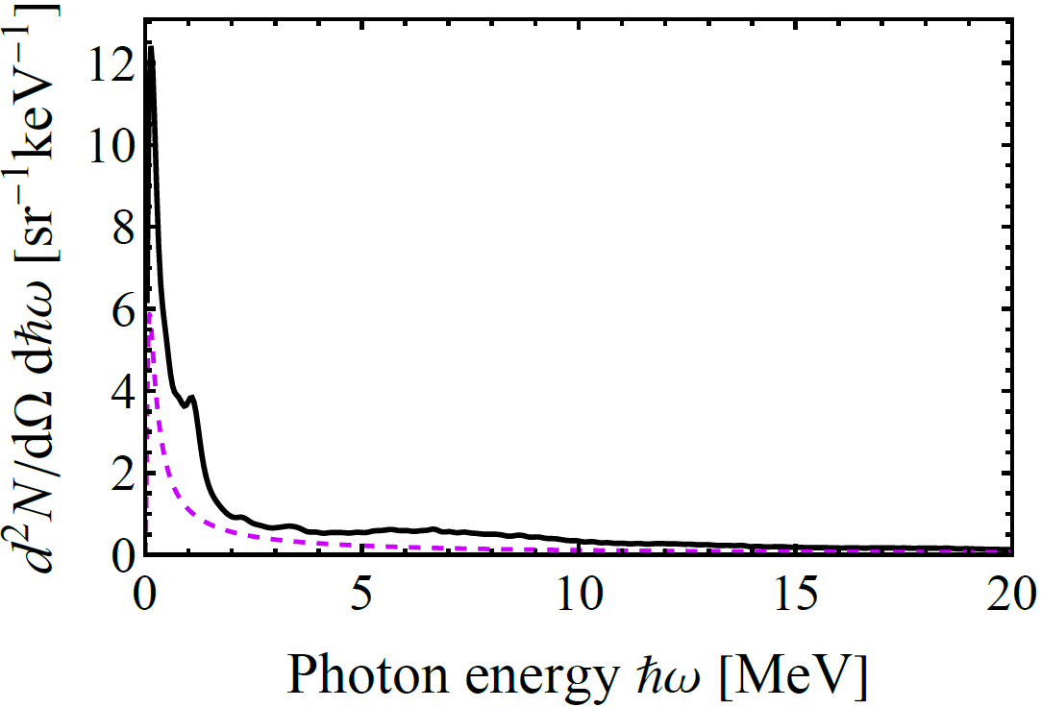
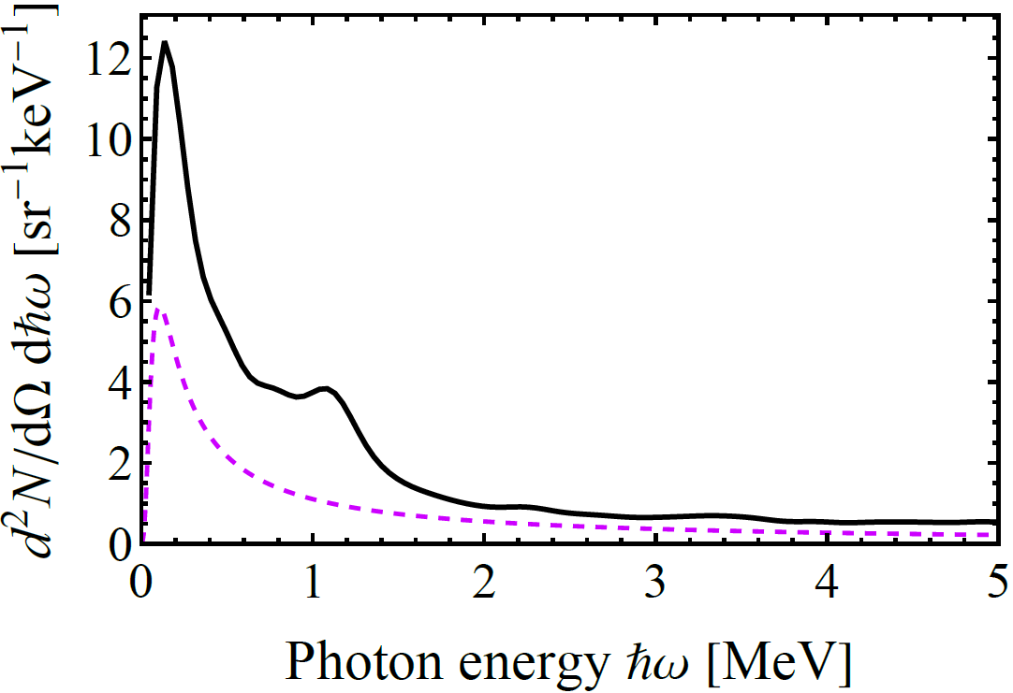
Number Spectra: Final result including bremsstrahlung from 50 µm backing

Slide 29
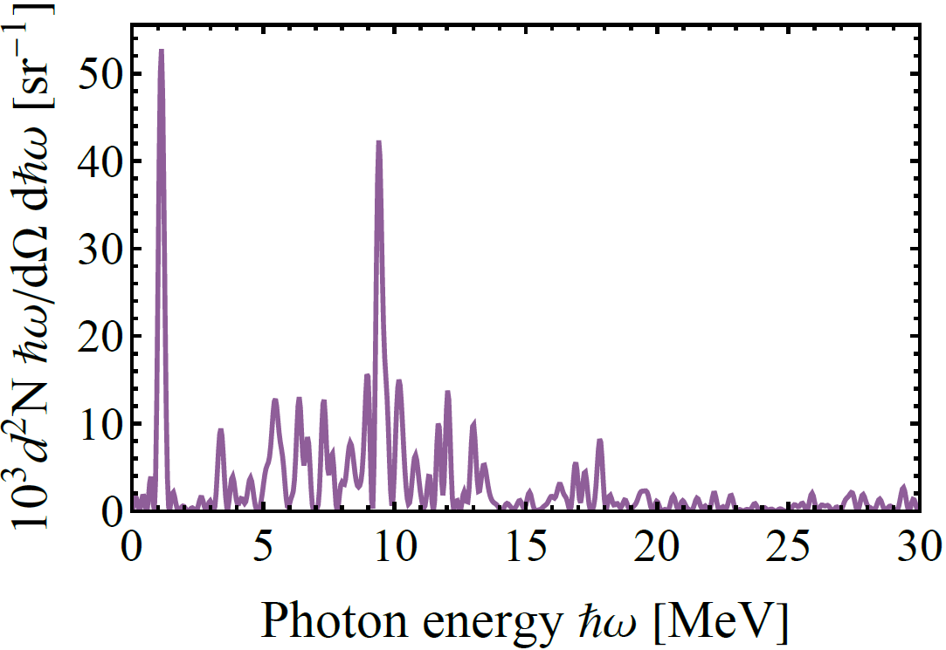
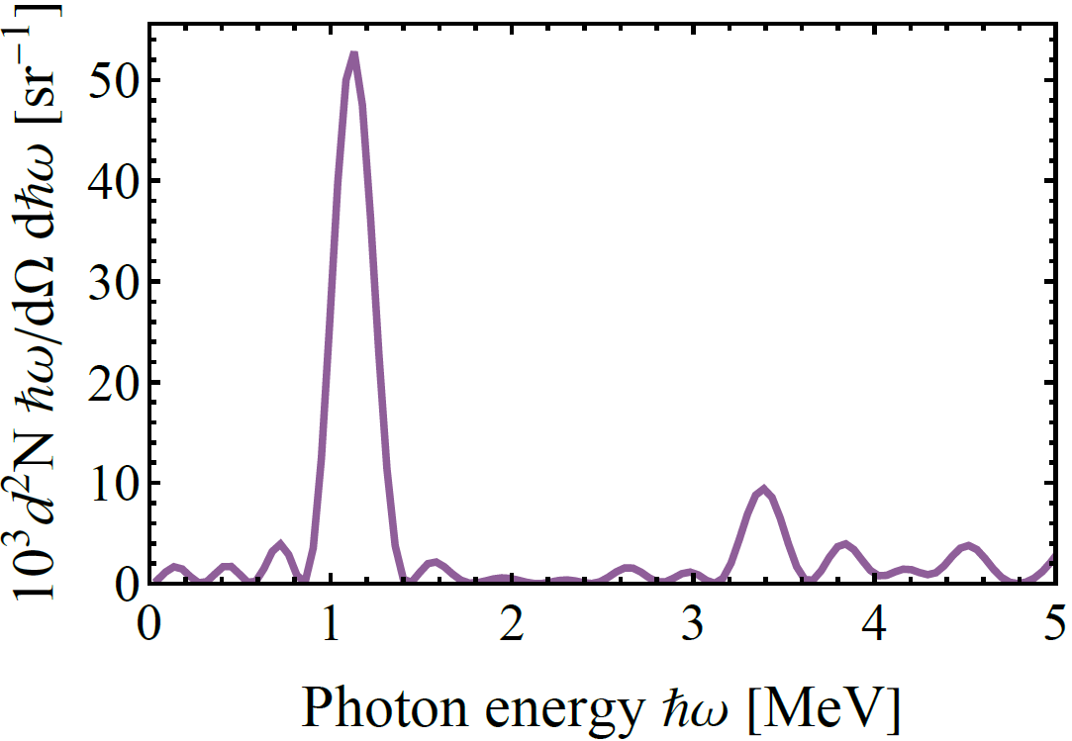
Power spectra for the full trajectory

Slide 30
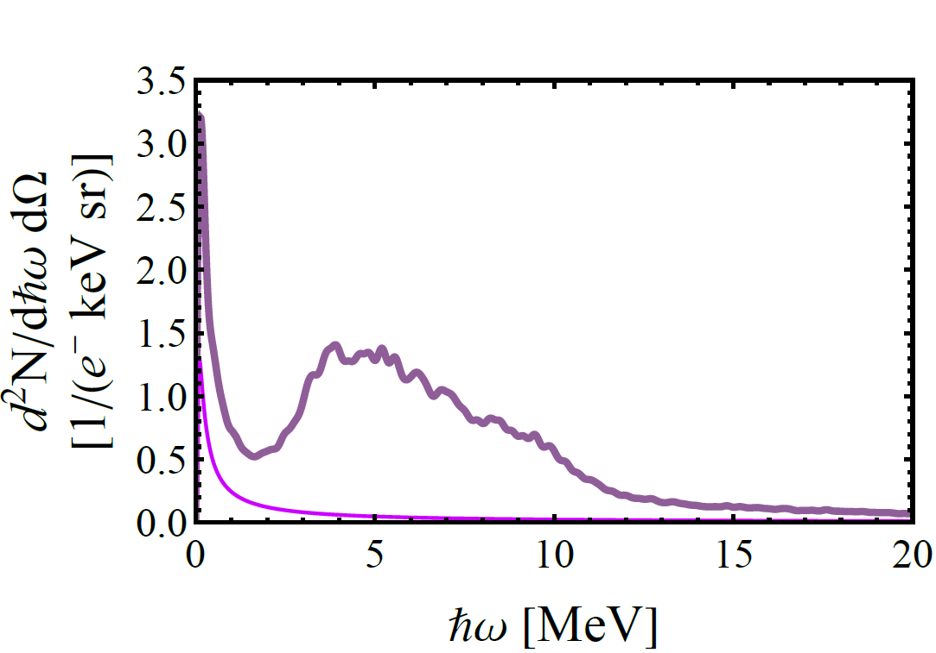
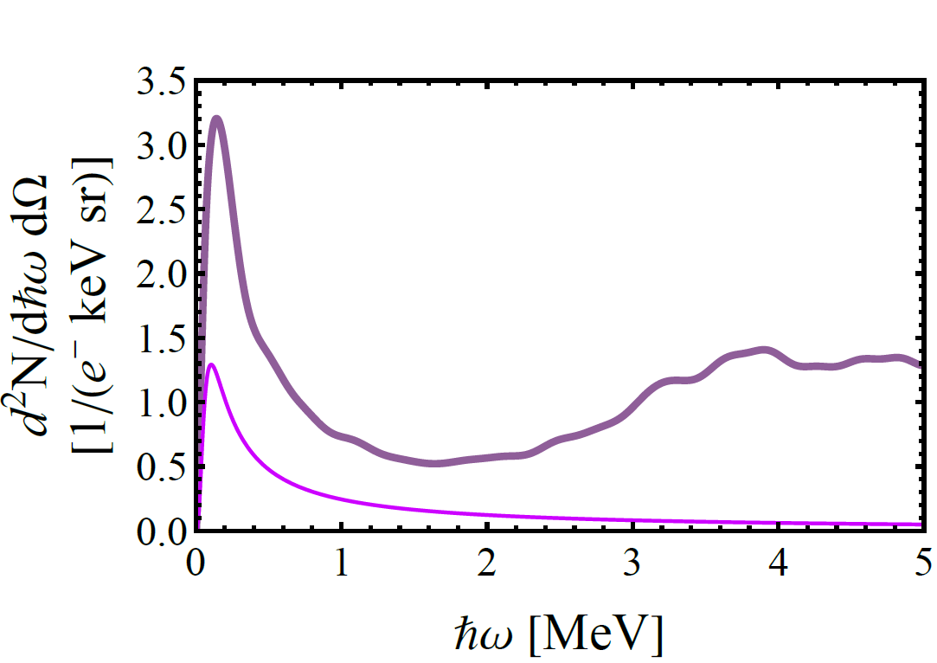
Number Spectra for a 20 µm thick flat crystal including bremsstrahlung

