Slide 1
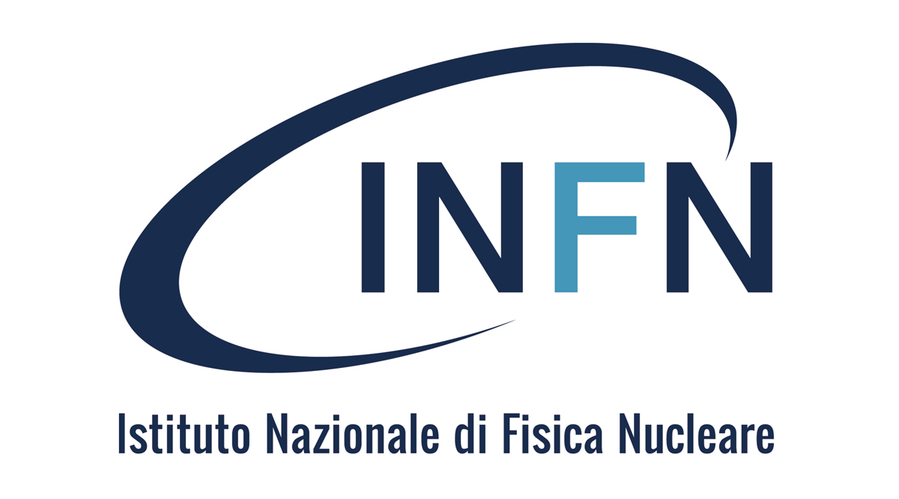

Pulsed laser melting as a tool for crystal bending in crystalline light source application
Semiconductor and Advanced Crystals group
D. De Salvador^{1,2}, F. Sgarbossa^{1,2}, D. Valzani ^{1,2}. G. Maggioni^{1,2} , C.Carraro^{1,2}, E. Napolitani^{1,2}
¹ Dipartimento di Fisica e Astronomia, Università di Padova, Via Marzolo 8, I-35131 Padova, Italy
davide.desalvador@unipd.it
² National Institute for Nuclear Physics INFN, Laboratori Nazionali di Legnaro, Viale dell’Università 2, 35020 Legnaro, Italy

Slide 2
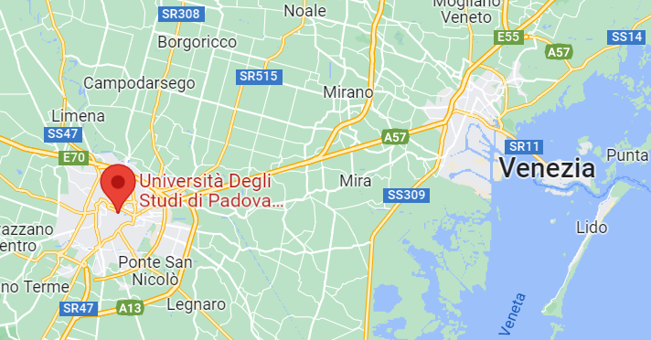

LNL-INFN

Slide 3

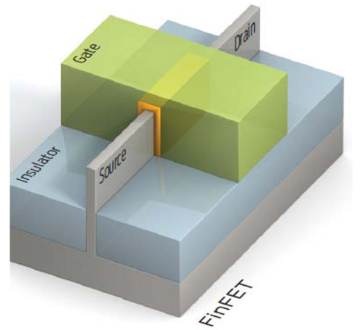

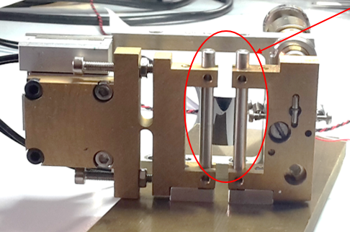
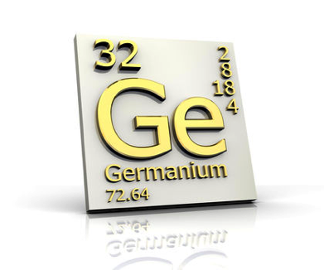
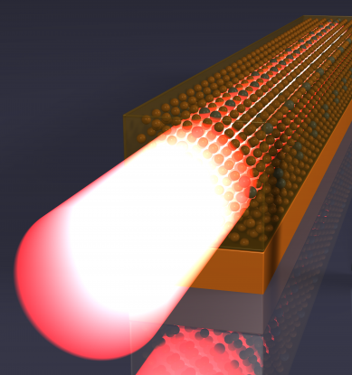

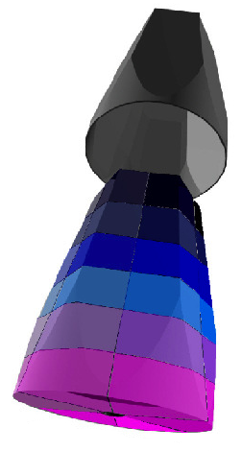
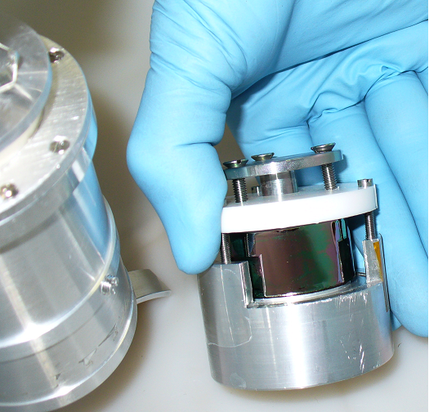
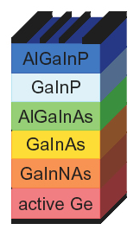
Ge applications
Nanoelectronics
Channeling
Plasmonic molecular sensors
γ-Ray detectors
Lasers
Photovoltaic/ThermoPV
D. De Salvador
Notes:
Germanium is one of the most studied semiconductor materials nowadays. In particular, there are already in commerce some germanium based device, but there are a lot of studies to implement Ge in others application. All of these application requires a high doping concentration and shallow junction; for these reason our research group try to develop new germanium doping methods.
thanks to its very good optical and electrical properties and also thanks to its compatibility with silicon technology.
The new technological request from all these application fields has some common ground and one of the most important is the needs of developing new doping methods, in order to have high doping concentration and shallow junction.
Moreover, Ge has the most high hole mobility of all semiconductors materials and also an higher electron mobility respect to silicon, making Ge the most interesting material for Complementary MOS devices, the units of all our electronical devices like computer, smartphones and all cpu based devices.

Slide 4
Ge application
Nanoelectronics
Channeling
Highest-z crystals with no dislocation
Plasmonic molecular sensors
γ-Ray detectors
Lasers
Photovoltaic ThermoPV
D. De Salvador

Slide 5
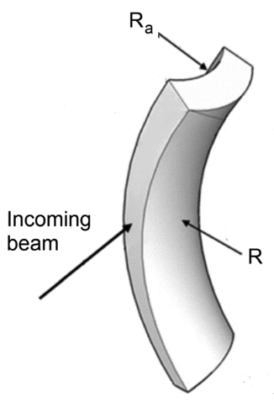
Ge channeling for 400GeV Protons
De Salvador et al.
De Salvador et al.

Slide 6
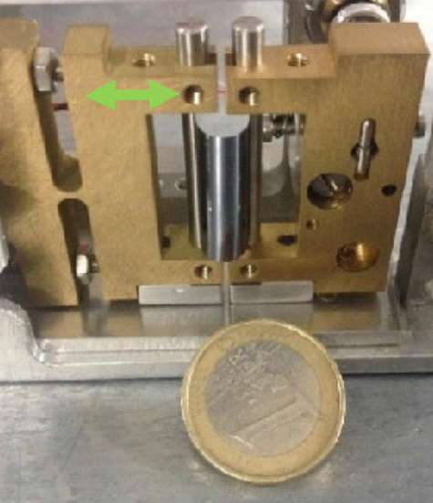
850MeV electrons, deflection and radiations with bent crystals at MAMI
Bandiera et al. Eur. Phys. J. C (2021) 81:284
Sytov et al. Eur. Phys. J. C (2017) 77:901

Slide 7
Doping issues - applications
Nanoelectronics
Channeling
High doping
Strain control
High purity
Plasmonic molecular sensors
γ-Ray detectors
Lasers
Photovoltaic cells
D. De Salvador

Slide 8
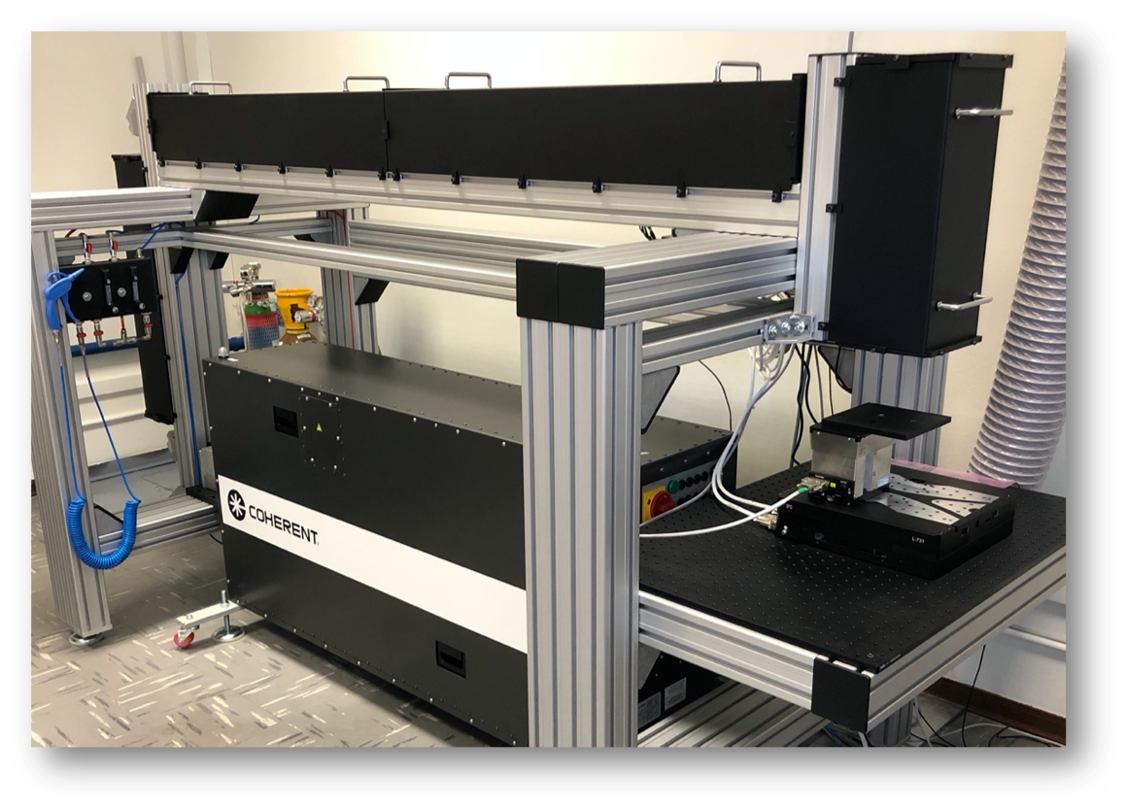
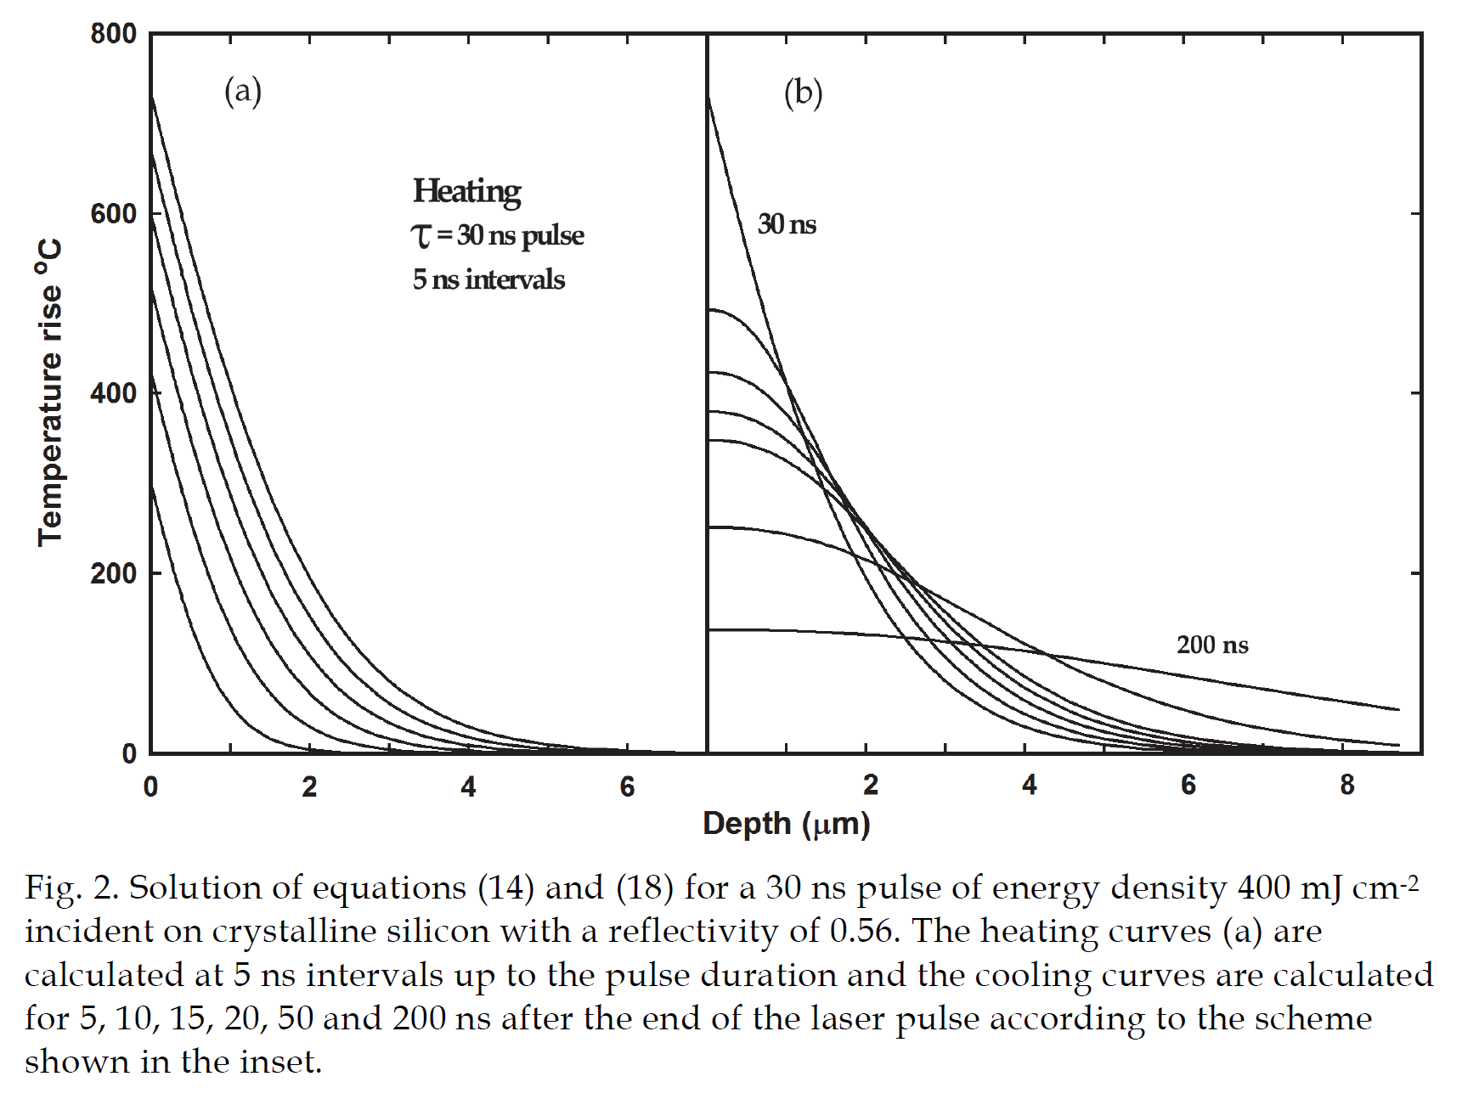
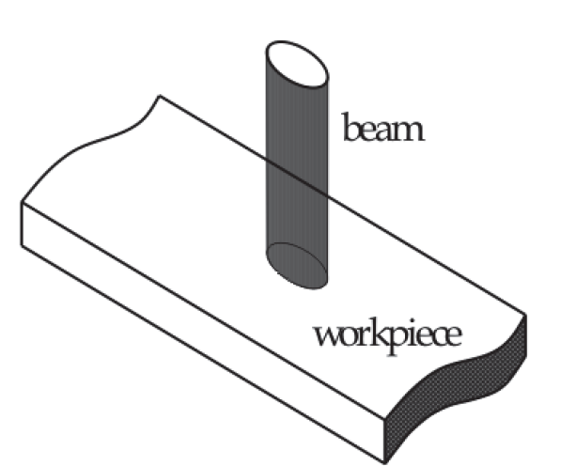
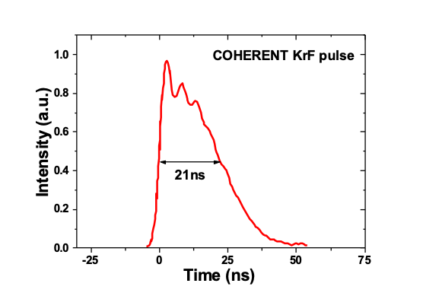
PLM – Pulsed Laser Melting technique
KrF Laser at DFA:
248 nm, ~1 J/cm2, 22 ns pulses
5x5 mm homogeneous spot
22ns
David Sands, DOI: 10.5772/28736

Slide 9
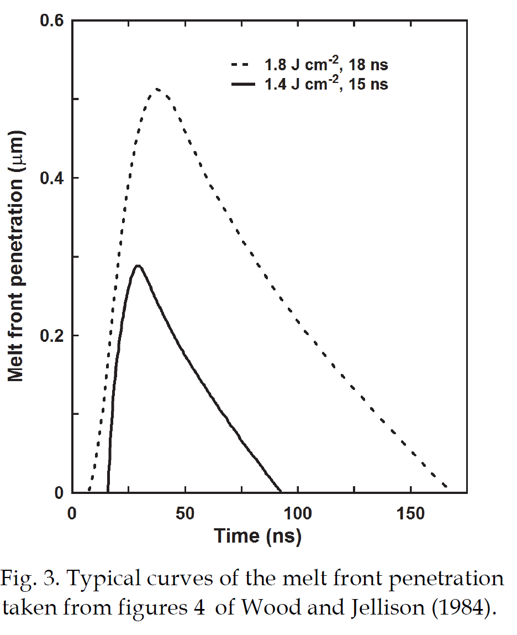
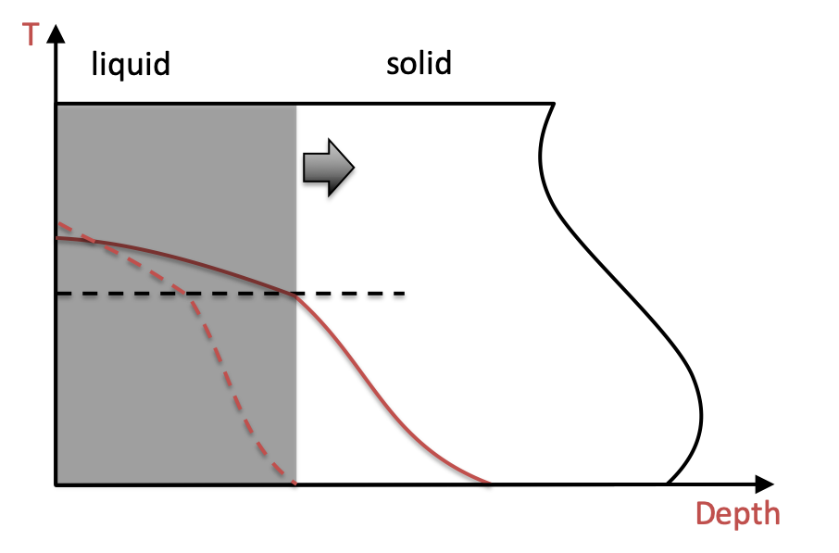
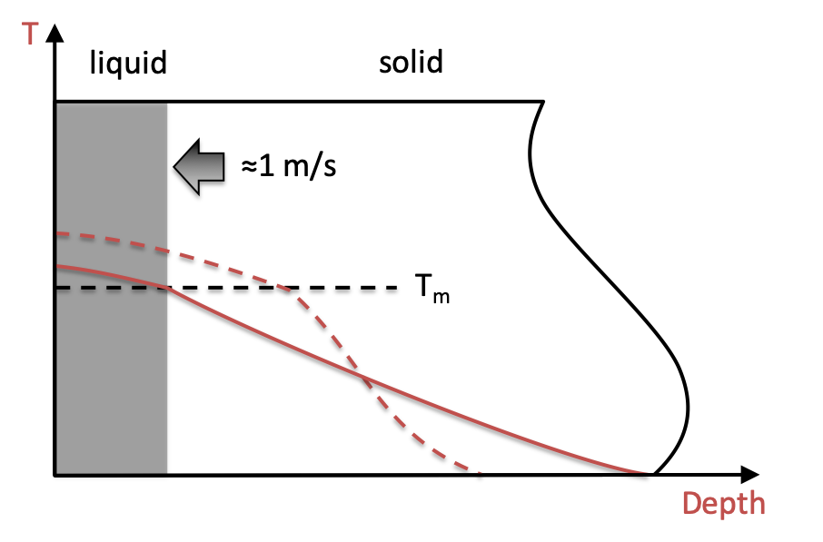

Melting regime
When laser energy density is high enough melting temperature T_{m} is exceeded, melting occurs.
David Sands, DOI: 10.5772/28736
Fast liquid phase epitaxy
$$v_{regroth}\sim m/s$$
T_{m}

Slide 10


Melting regime
If an impurity source in placed on the sample surface:
David Sands, DOI: 10.5772/28736
Fast liquid phase epitaxy
T_{m}
T
c
$$v_{regroth}\sim m/s$$
T_{m}
$$\frac{δc}{δt}=D∇^{2}c$$
Impurities fast diffuse in the liquid
$$D_{liquid}≫D_{solid}$$

Slide 11



Impurity diffusion and incorporation
If an impurity source in placed on the sample surface:
T_{m}
T
c
T
c
$$k_{eff}≫k_{0}$$
$$v_{regroth}\sim m/s$$
T_{m}
$$k_{eff}$$
$$\frac{δc}{δt}=D∇^{2}c$$
Impurities incorporate under non equilibrium conditions during fast regrowth
Impurities fast diffuse in the liquid
$$D_{liquid}≫D_{solid}$$
$v_{regroth} [m/s$]

Slide 12
Sb incorporation in Ge (100) by PLM
13 at%
Electrical activation
Carraro et al. Appl. Surf. Sci 509 145229 (2020).
Carraro et al. Appl. Surf. Sci 509 145229 (2020).

Slide 13
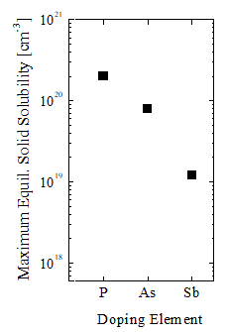
Sb incorporation in germanium by PLM
Electrical activation
Carraro et al. Appl. Surf. Sci 509 145229 (2020).
n-type
exp.
exp.

Slide 14
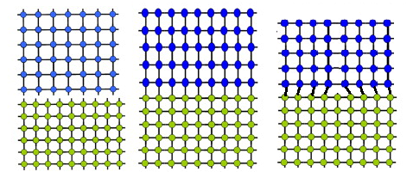
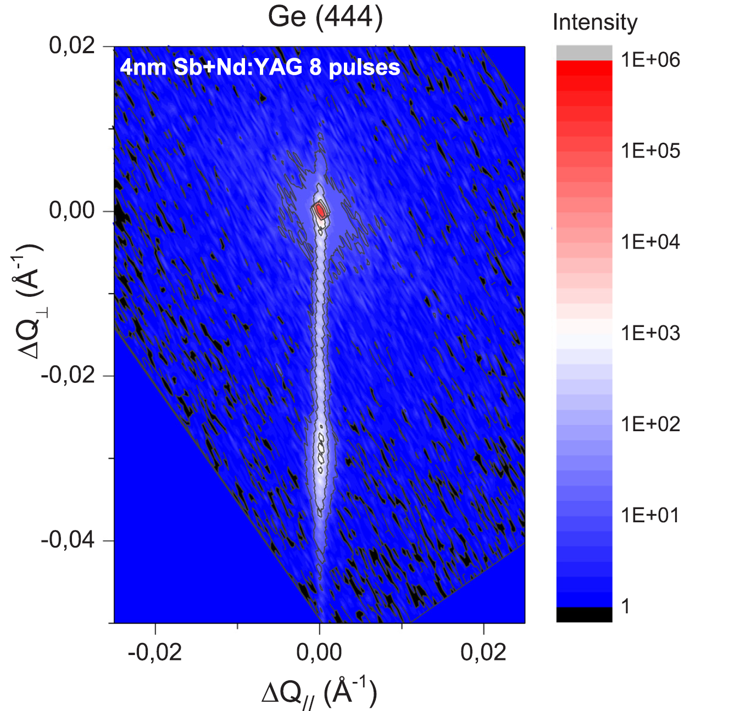
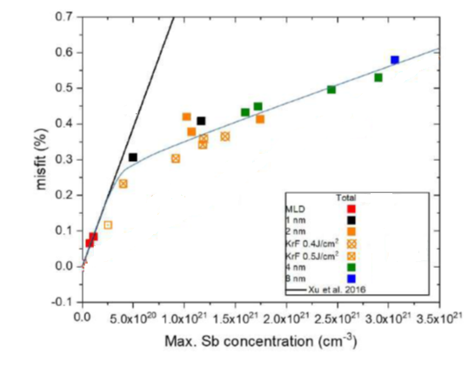

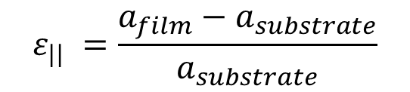
Sb strain in Germanium
$$ε_{||} =\frac{a_{film}−a_{substrate}}{a_{substrate}}$$
Strain defects
$$ε_{||} (\%)$$

Slide 15
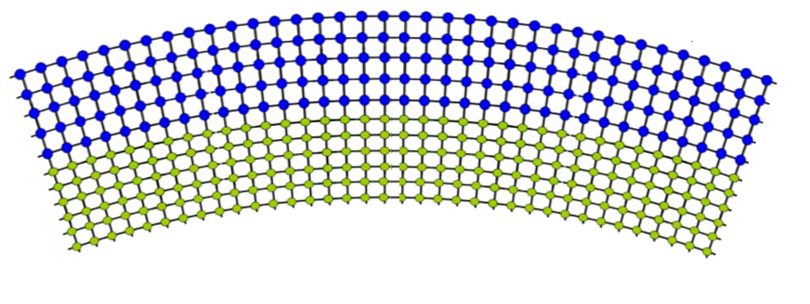
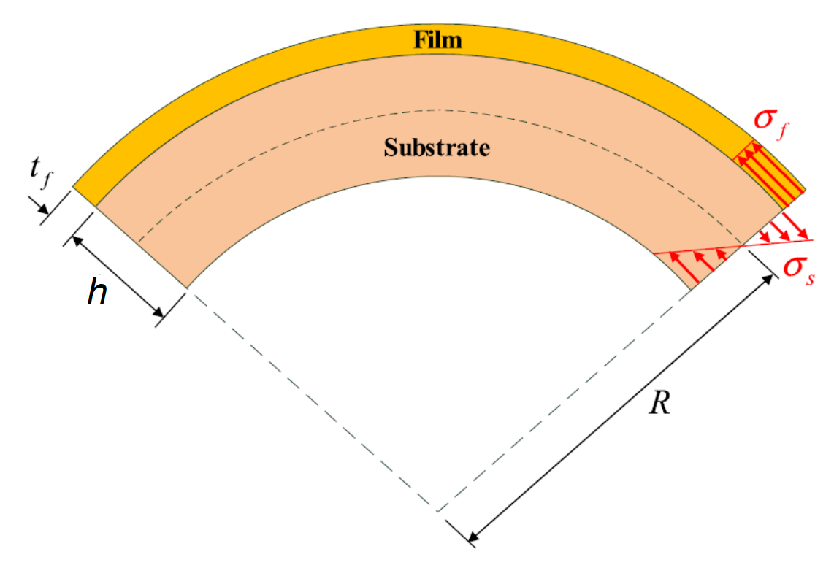
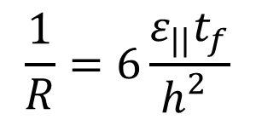
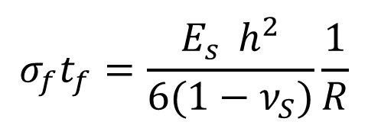
Substrate bending–Stoney formula for perfect epitaxial layers
$$σ_{f}t_{f}=\frac{{E_{s}^{}h}^{2}}{6(1−ν_{S})}\frac{1}{R}$$
For a pseudomorphic film with elastic properties similar to the bulk:
$$\frac{1}{R}=6\frac{ε_{||}t_{f}}{h_{}^{2}}$$

Slide 16
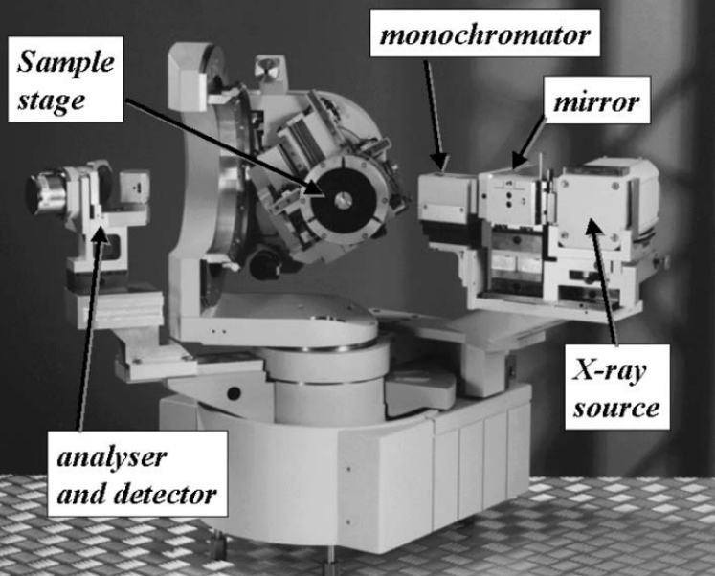
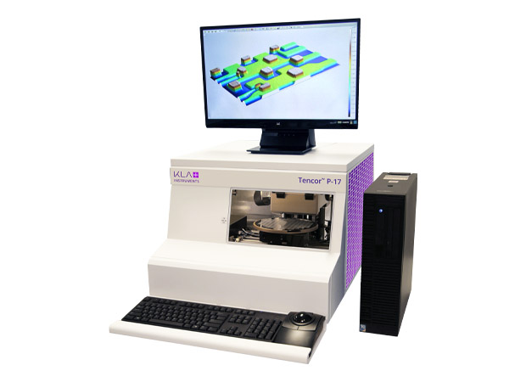
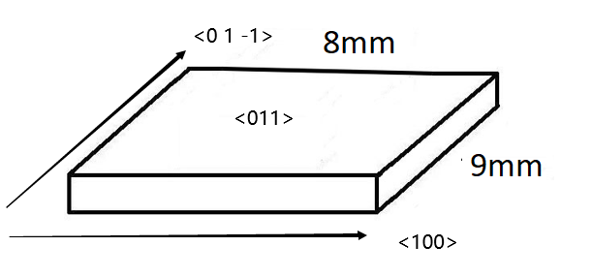


PLM strain optimization
8KeV HRXRD diffractometer
Multi-parametric optimization:
  Orientation (110) and (111) good channeling planes
  Sb precursor thickness
  Pulse Energy
  Number of Pulse repetitions
HRXRD analyses on thick (110) and (111) wafers
$$t_{S}=500 μm$$
Stylus profilometer
Bending analyses on thin (110) test samples
$$t_{S}=180 μm$$

Slide 17
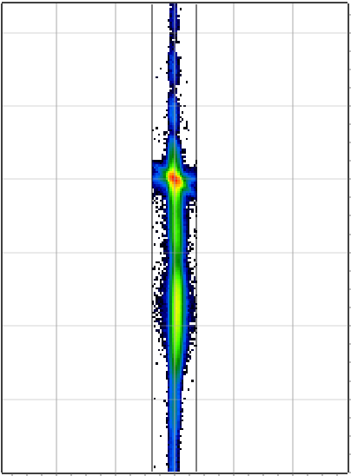
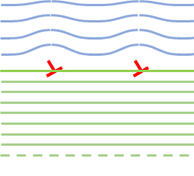

HRXRD reciprocal space mapping of the film
2nm Sb on (110) 700mj 8pls
7nm Sb on (110) 500mj 8pls
Lattice parameter deformation
Tilt due to defects
Bragg angle offset (°)
-0.15 -0.10 -0.05 0.00 0.05 0.10
Bragg angle offset (°)
-0.21 -0.14 -0.07 0.00 0.07
$$∝ε_{||}$$
Tilt
-0.09 -0.06 -0.03 0 0.03 0.06 0.09
Tilt (°)
-0.09 -0.06 -0.03 0 0.03 0.06 0.09
Tilt (°)

Slide 18
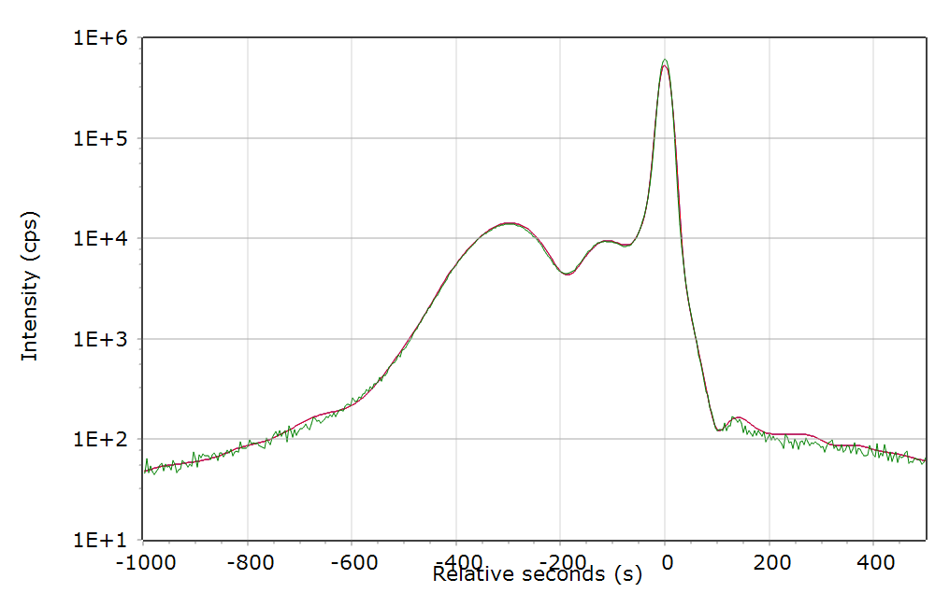
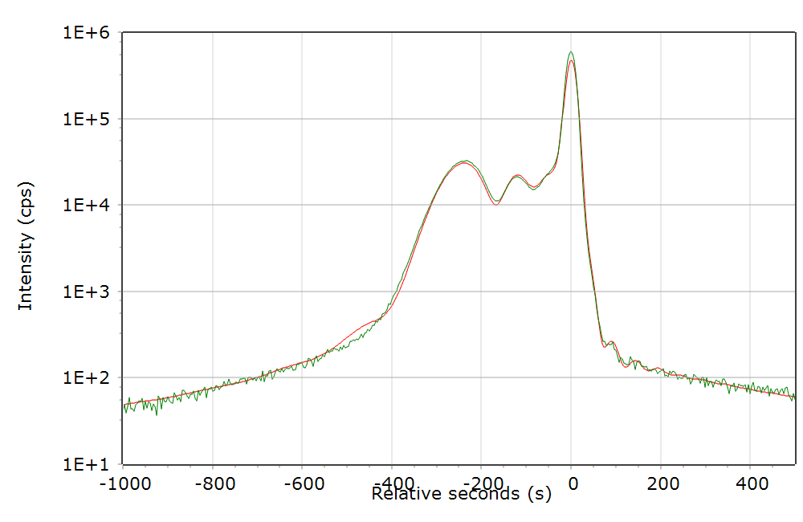
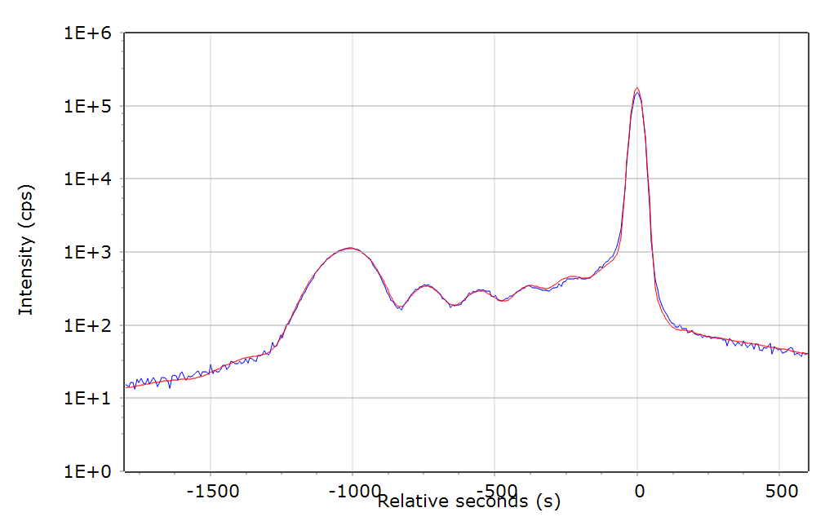
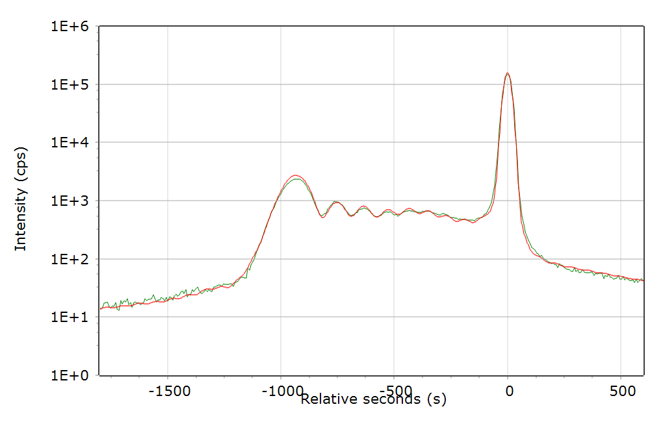

Rocking curve simulations
(110) 2nm 700mj/cm2
2pls
(110) 2nm 700mj/cm2
8pls
(111) 6nm 700mJ/cm2
2pls
(111) 6nm 700mJ/cm2
8pls
$$ε_{||}t_{f}=\int{ε_{||}{dt}_{f}}$$

Slide 19

$ε_{||}t=1nm$, no defects
defects

Slide 20

Curvature measurement on thin (110) samples
Parabolic fit
2nm Sb , (110) 500mJ 8pls
$$t_{S}=180 μm$$
2nm Sb , (110) 700mJ 8pls

Slide 21

Curvature measurement on thin (110) samples
Defects
$$t_{S}=180 μm$$

Slide 22
Curvature measurement on thin (110) samples
Defects
$$t_{S}=180 μm$$

Slide 23
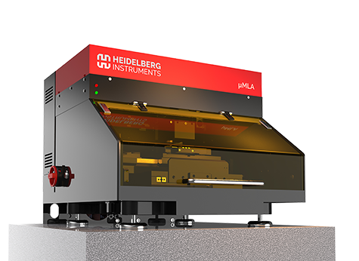
Lithography strategies with PLM for periodically bent crystals
Laser pattern lithography
Sample lithography
X4 image plane
Heidelberg μMLA,
Direct laser riter
1 μm resolution
Homogenizing optics
30 μm resolution is expected with actual optics

Slide 24
Lithography strategies with PLM for periodically bent crystals
Laser pattern lithography
Sample lithography
X4 image plane
Heidelberg μMLA,
Direct laser riter
1 μm resolution
Homogenizing optics
Suorce layer can be patterned by photolitography
30 μm resolution is expected with actual optics

Slide 25
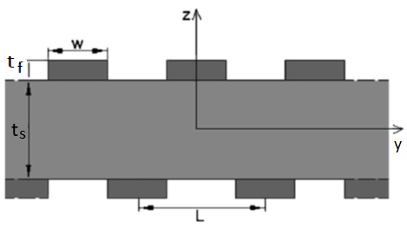

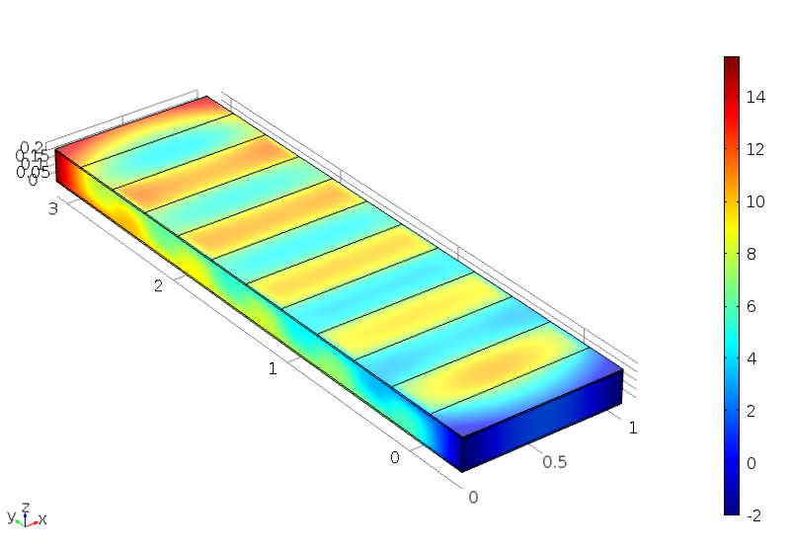
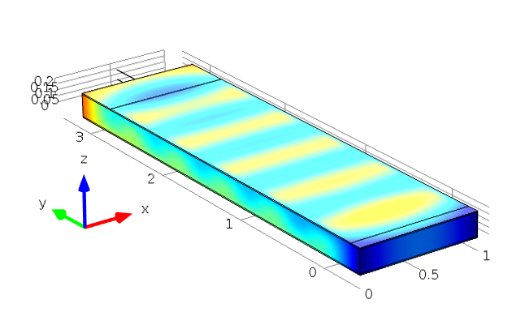
Patterning FEM simulations
ON/OFF patterning
COS patterning
u_{z}
(nm)

Slide 26
Conclusions
High quality homogenous straining layers can be created by PLM on (110) Ge. Even higher strain can be obtained in (111) Ge.
Lateral tailoring of layer patterning can be exploited by lithography techniques
Perspectives
Patterning fabrication
Curvature tests on thin (111) Ge
More detailed curvature test by synchrotron techniques.
Simulation of radiation emission starting by FEM deformation calculation of by PBC.

Slide 28
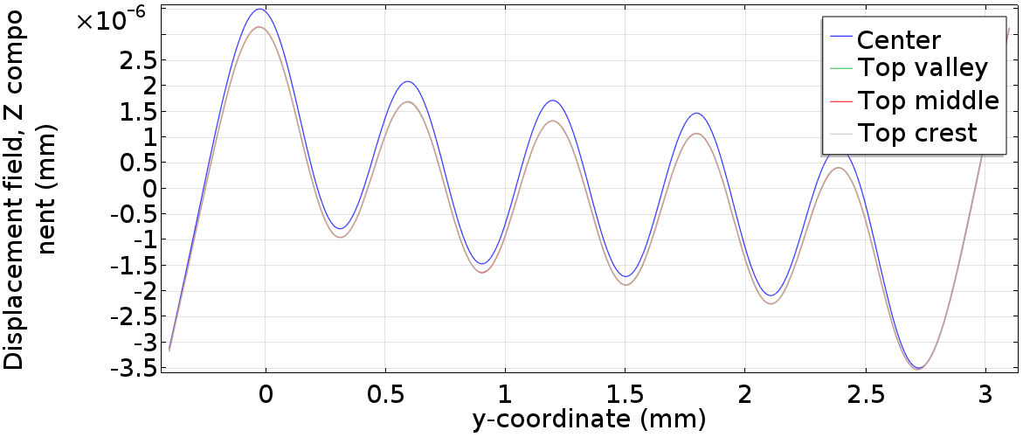
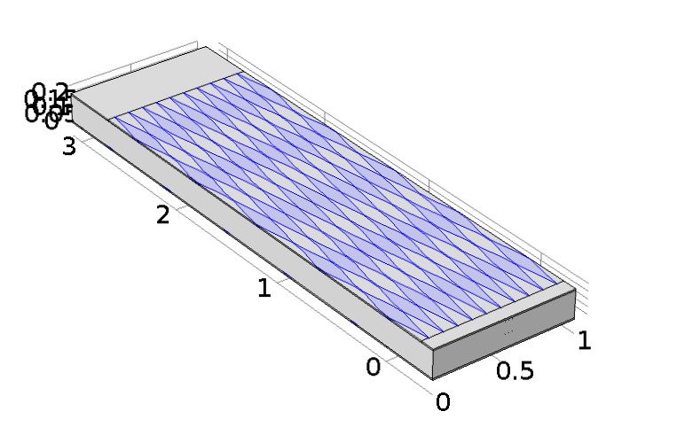
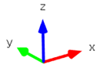
mm

