Slide 1
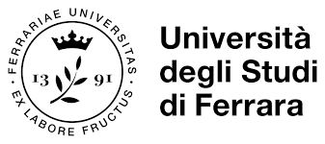
On the design of a crystalline undulator based on coactive patterning
Andrea Mazzolari

Slide 2
THE IDEA IN A FEW WORDS

Slide 3
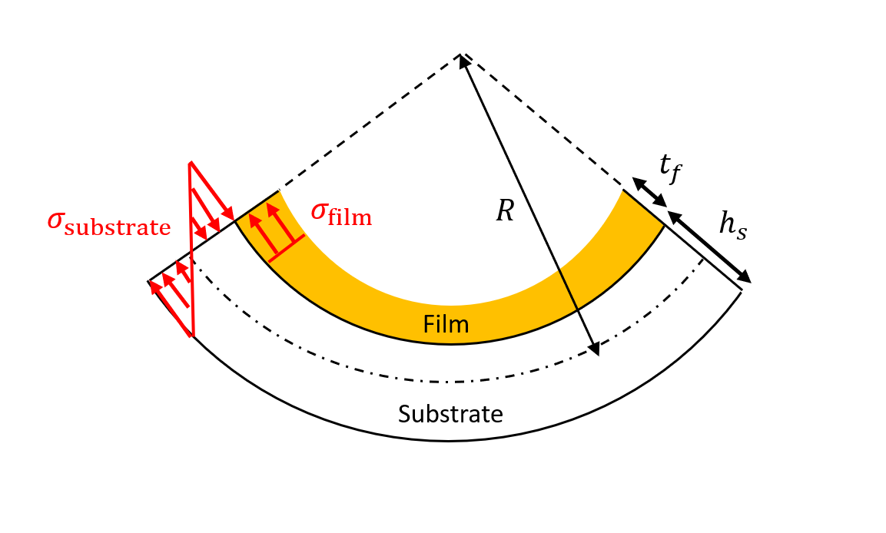
Bent Crystals with self-standing curvature
Deposition of a thin film layer occurring at high temperature (~1000 °C).
Mismatch in CTE between Si substrate and thin film give raise to a thermal stress.
Removal of the film from one of the two surfaces of the substrate generates a deformation.
Technology well knows since more than 1 century and exploited in microelectronics and optics.
In collaboration with
Notes:
Sigma_film stress dato dal film (Forza per unità di superficie -GPa)
Simga_substrato è la forza che deve compensare quella del film
Nu_substrate = coefficient di Poisson, è una delle due proprietà che descrive l’elasticità di un solido (valore adimensionale = deformazione trasversale/deformazione longitudinale).
E_substrate = modulo di young =sigma/epsilon (GPa)
Expsilon (axial strain) – proportional deformation

Slide 4
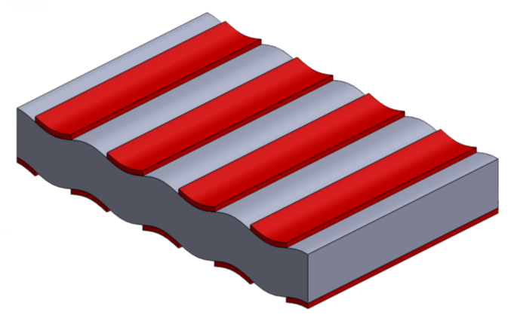
Crystalline undulator based on coactive patterning
Thin film (hundred of nm)
Thick substrate (hundred of um)

Slide 5
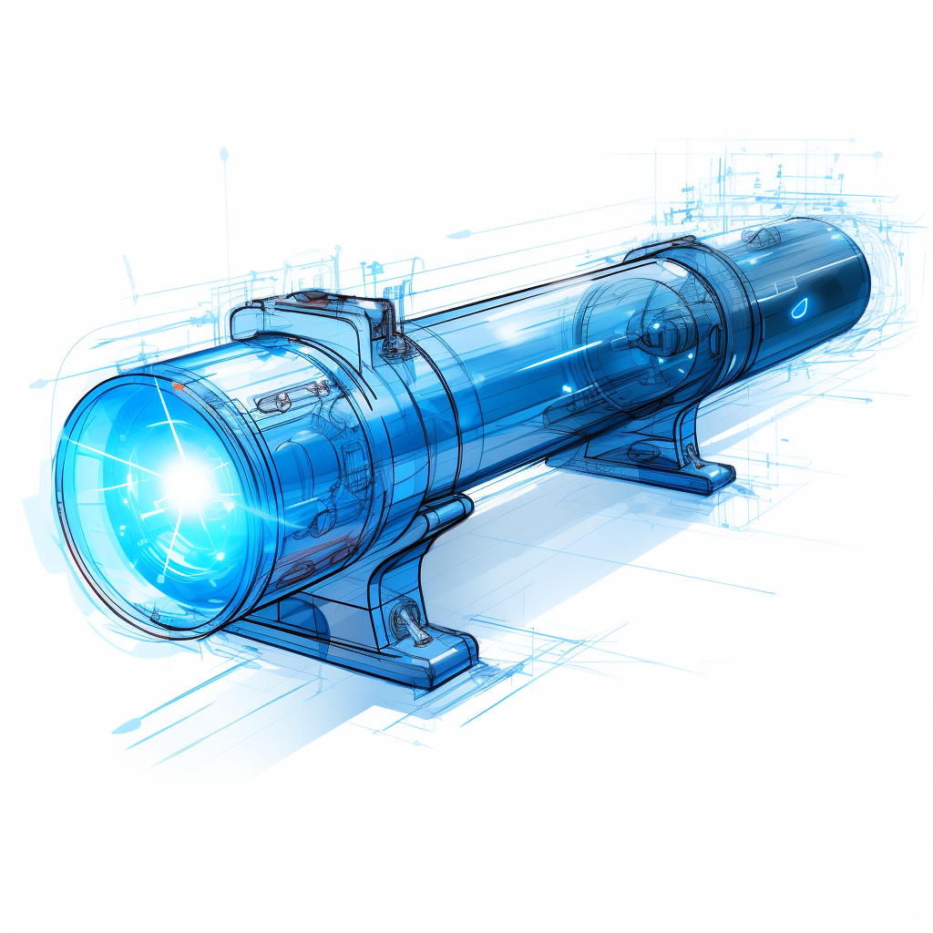
IN DEPTH DESIGN

Slide 6
IN DEPTH DESIGN
We aim to describe stress and deformational state of a crystalline undulator as a function of its geometry (substrate and film thickness, stress, period, etc…)
Key parameters: deformation amplitude and period (related to spectrum of radiation), substrate thickness (related to properties of particle beam).
Goals:
deformation amplitude > ~ 1 nm (5X the interplanar spacing for (110) Si planes).
Period of few hundred um
Substrate thickness: as much as possible

Slide 7
IN DEPTH DESIGN
Finite Element Method (FEM) modeling is a vital engineering tool. It dissects intricate structures into smaller elements for accurate real-world simulations.
Its applications range from structural engineering to aerospace and biomedical studies. By predicting stress distributions and deformations, FEM helps optimize designs effectively.

Slide 8
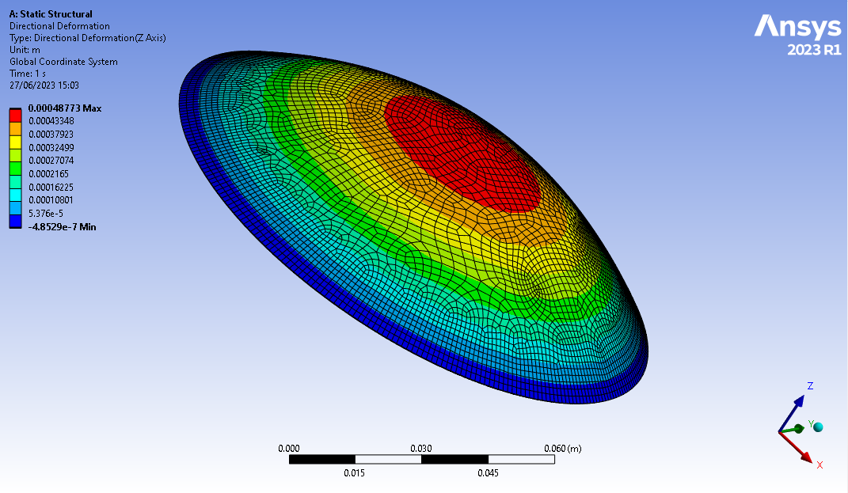
Bent Crystals with self-standing curvature
To validate our model we start simulating a silicon wafer: solution to this problem can be solved analytically (Stoney’s law)!
h substrate (um) | h film (nm) | Radius (FEM) | Radius (Analytical)
200 | 100 | 9.92 | 9.75
200 | 200 | 5.03 | 4.89
200 | 400 | 2.54 | 2.47
300 | 150 | 14.2 | 14.9
300 | 200 | 11.1 | 11.4
300 | 250 | 9.17 | 9.4
Very good agreement between FEM models and analytic well-assesed models
Notes:
Sigma_film_refernce è quella sigma che ho cercato di dare attraverso un delta di temperatura di 1570°C. In particolare a causa dei diversi coefficienti di dilatazione termica, il film introduce uno strato di tensione sul substrato.
L’accuratezza dello stato di tensione applicato è stato trovato attraverso la legge di stoney:
R = raggio di curvatura del mio silicio in formula di Stoney
1) Simulazione → risultati → deformazione lungo Z → trovo il raggio di curvatura data la deformazione lungo Z → sostituisco tutto in formula di Stoney ed ottengo Ansys Stoney Law che dovrebbe essere 1.2 e come si vede varia di poco

Slide 9
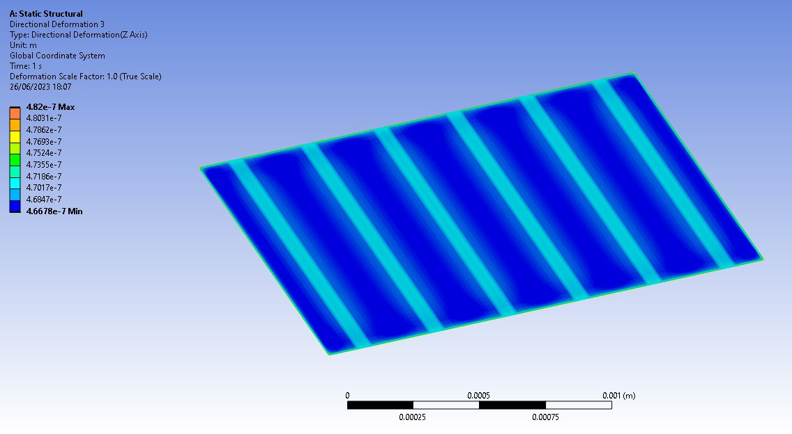
Simulation of stress deformation of tensile film
Ansys model to simulate bending by pattern of tensile films.
Good agreement with analytical models based on Stoney’s law
$f=\frac{3}{4}\frac{{σ_{f}h}_{f}a}{E_{s}h_{s}^{2}}(λ−a)$
$$a$$
$$\text{λ}$$
Notes:
Immagine nitrurata periodico una reference
+ aggiungi slide di vecchi cristalli grooved caratterizzati ad DIAMOND

Slide 10
WHERE WE ARE IN REAL LIFE…?

Slide 11
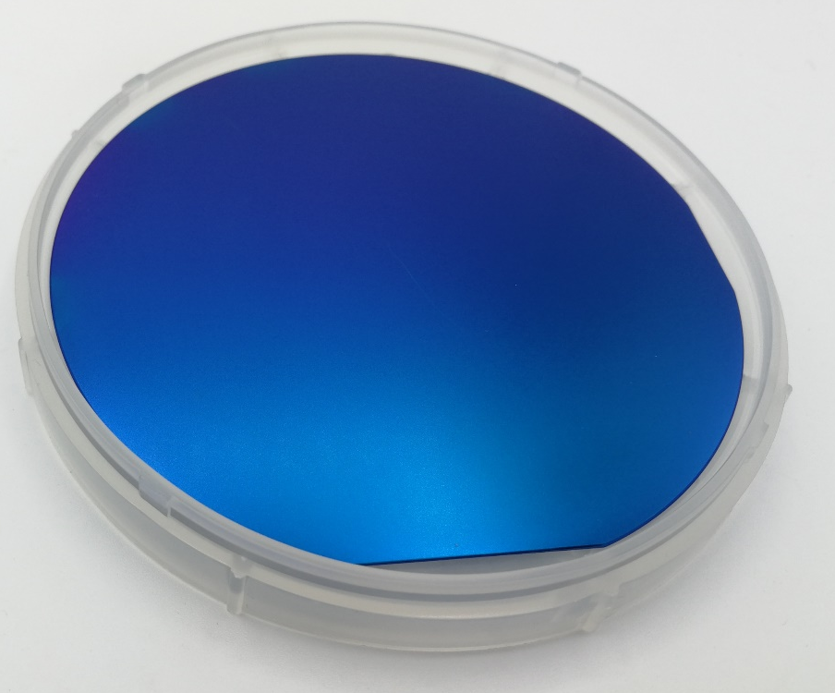
Bent crystal via tensile film deposition
Si₃N₄ film deposited on both wafer faces at high temperature: stress between film and silicon is induced while cooling caused by the different thermal expansion coefficient
Silicon Nitride film have been removed from one of the two faces: stress from the coated surface generate curvature
Notes:
Il nitruro di silicio è depositato ad alta temperature su tutte le superfici del wafer. Durante il raffreddamento a causa del differente ceof di espansione termica tra I 2 materiali si crea uno stress tra film e subrstato. La rimozione del film da una delle due face del wafer tramite attacchi chimici lascia la . Questo processo è molto delicato, in quanto necessita di un preciso tempismo per garantire la rimozione del film e la preservazione della superficie di silicio (necessaria per garantire affidabilità nelle fasi di microlavorazione).

Slide 12
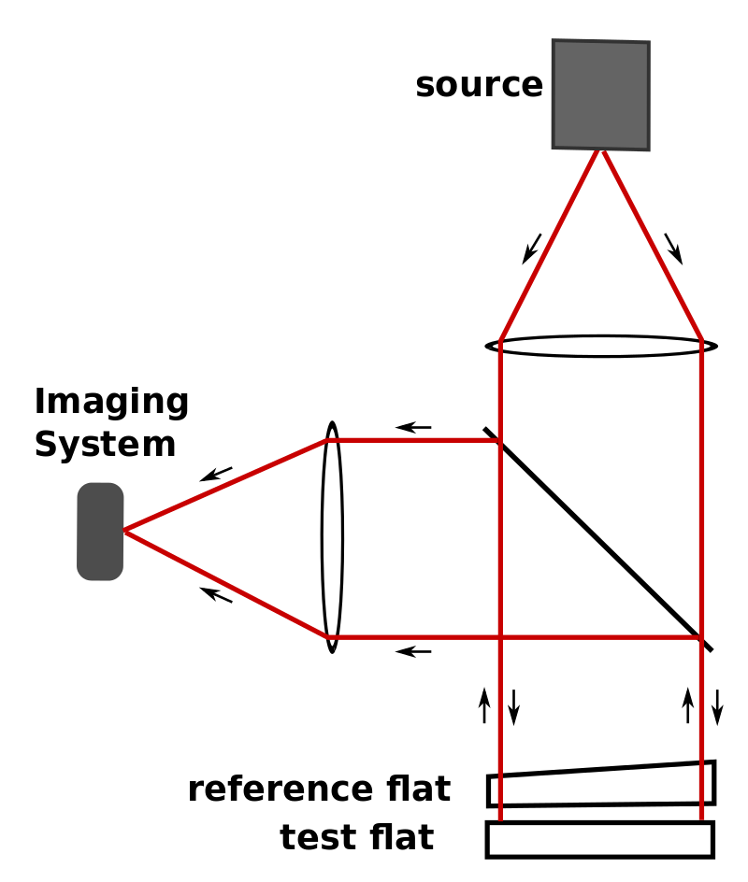
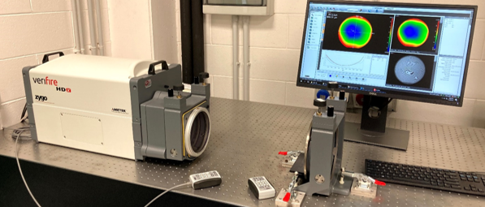
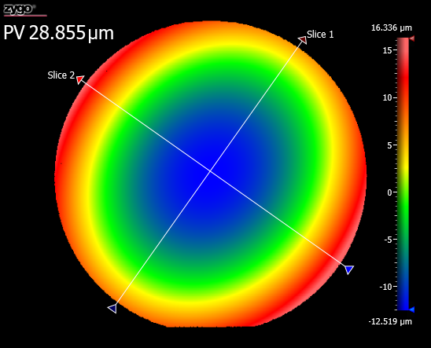
Optical interferometry
Optical interferometry is a versatile technique used in optics to characterize various optical components and systems.
By superimposing light waves and analyzing the resulting interference patterns, it enables precise measurements of topology of a surface.
Optical interferometry plays a vital role in research, aiding in the development of advanced optical systems for diverse applications, from microscopy to telecommunications.

Slide 13
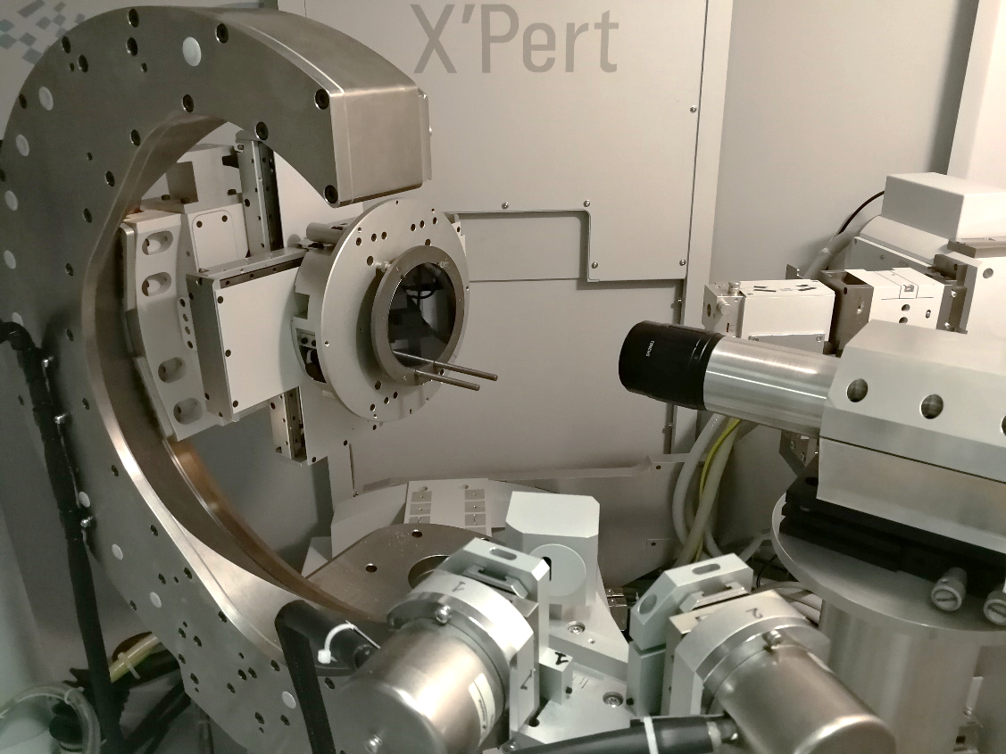
Measure of lattice plane curvature using x-rays diffraction
High-resolution X-ray diffraction is a powerful analytical technique used to investigate the crystallographic properties of materials at the atomic level.
It involves directing a monochromatic X-ray beam at a crystal, causing the X-rays to scatter in specific directions due to the ordered arrangement of atoms within the crystal lattice.
By measuring the angles and intensities of these diffracted beams we can determine deformation state of the crystal.
This technique finds widespread application in materials science, semiconductor research, and the characterization of thin films, allowing for precise control and optimization of material properties for various technological applications.

Slide 14
Model validation
How does simulations compare with real life ?
h substrate (um) | h film (nm) | Radius (FEM) | Radius (Analytical) | Measured (m)
300 | 150 | 14.2 | 14.9 | 14.7±0.5
300 | 200 | 11.1 | 11.4 | 10.5±0.1
300 | 250 | 9.17 | 9.4 | 9.3±0.1
Very good agreement!

Slide 15
WHAT’S NEXT…?

Slide 16
WHAT’S NEXT…?
Simulation
of radiation emission
First prototype manufacturing

Slide 17
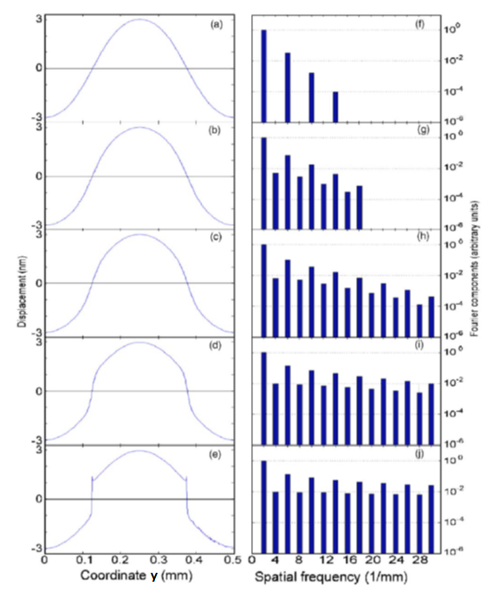
Simulation of radiation spectrum
Approaching the substrate-film interface, the deformation becomes un-harmonic. How this affect the spectrum of emitted radiation ?
Can MBN team answer this question ? (We can quickly provide deformation profiles)

Slide 18
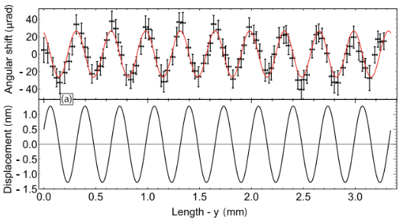
First prototype manufacturing
We aim to manufacture in a timescale of 8-10 month from now a first prototype ready for:
further characterizations (interferometry (?), x-ray @ ESRF/DIAMOND)
testing with particle beam.
Geometry of the undulator matching a sample already manufactured through mechanical grooving and characterized @ ESRF*
Substrate 160 um, film 400 nm, period: 334 um → amplitude: 1.3 nm
Suitable for 5-10 GeV positron beams *R. Camattari et al., Phys. Rev. Acc. and Beam 22, 044701 (2019)

Slide 19
CONCLUSIONS
An advanced modeling of a CU based on a coactive films is ready (FEM based).
Developed model have been experimentally validated.
We seek support from MBN team to investigate effect of un-harmonic deformation on radiation spectrum.
In parallel, we start manufacturing of a first prototype of crystalline undulator (delivery time 8-10 month from now). Sample optimized for positron beams of energy 5-10 GeV.

