Slide 1
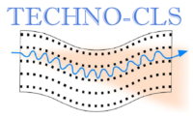





TECHNo-CLS experiment with 6 GeV electrons at CERN
G.A. 101046458
Laura Bandiera
bandiera@fe.infn.it
5/10/2023
TECHNO-CLS Workshop, Ferrara

Slide 2
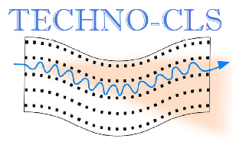

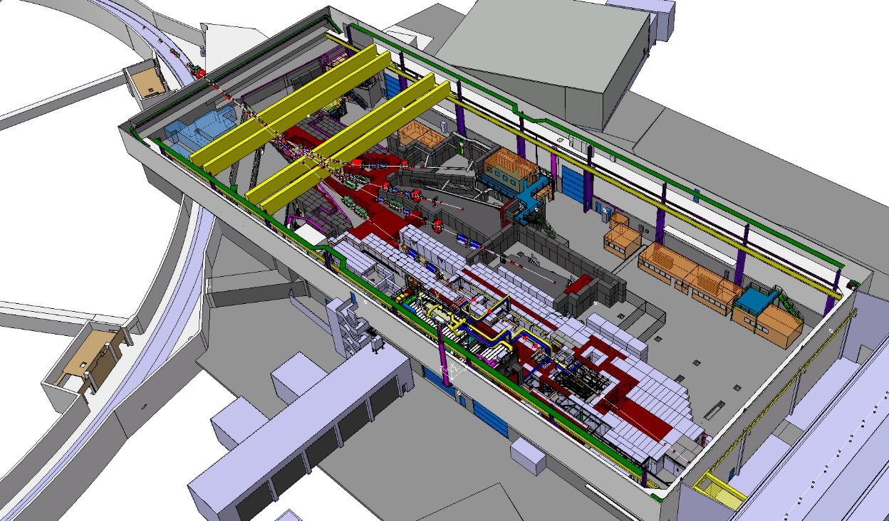

Why experiments at CERN Proton Synchrotron?
2
G.A. 101046458
1-15 GeV electrons and positrons available: currently (together with CERN SPS) the only available facility with positrons at energy > 10 GeV*.
Multi-GeV positrons would permit to test Large Period Large Amplitude Undulators realized within TECHNO-CLS
*see N. Charitonidis (CERN) talk this afternoon

Slide 3
Why experiments at CERN Proton Synchrotron?
3
G.A. 101046458
1-15 GeV electrons and positrons available: currently (together with CERN SPS) the only available facility with positrons at energy > 10 GeV*.
The beams are secondary and tertiary with parameters not ideal to test crystalline undulators
*see N. Charitonidis (CERN) talk this afternoon

Slide 4
Experiment at CERN PS T9 in August 2023
4
G.A. 101046458
Participation to the December 2022 call:
- requested 2 weeks with 5-10 GeV secondary electrons/positrons
Highly competitive call – we succeeded!!
Leader of the experimental RUN: E. Vallazza (INFN MiB) and L. Bandiera (INFN Ferrara)
T9 BEAMLINE

Slide 5
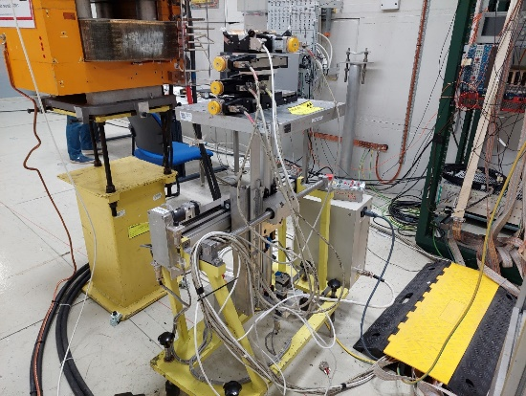
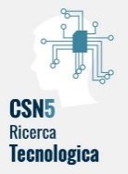
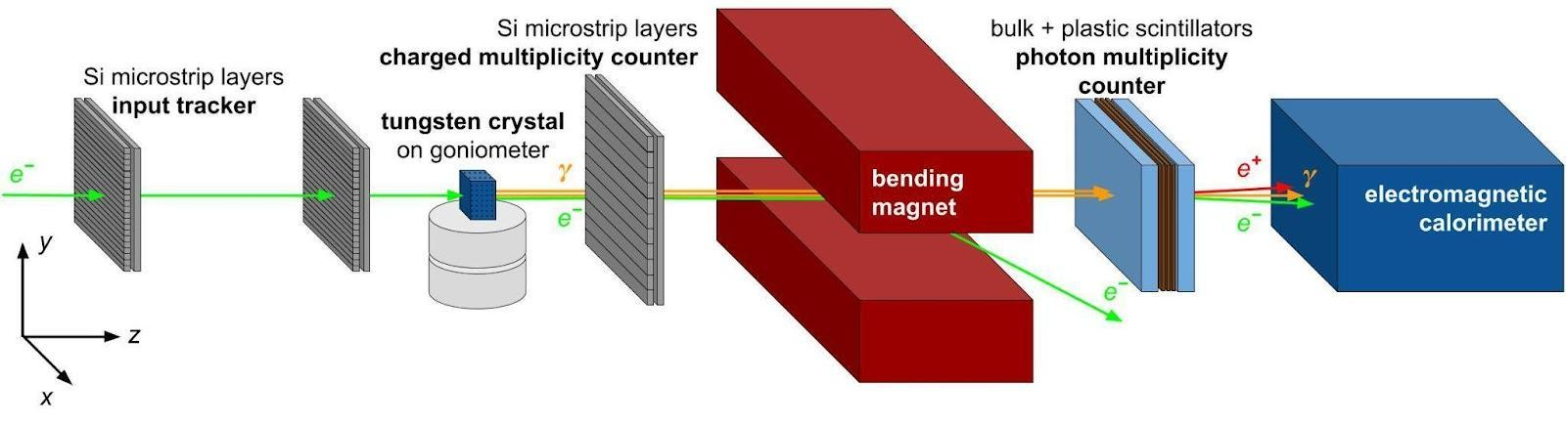
Experimental setup @CERN PS T9
Provided by the INFN Milano Bicocca team – Erik Vallazza & Michela Prest
Electron at 6 GeV/c
The setup is versatile and has already been used also at CERN SPS and at DESY Test Beam Facility

Slide 6
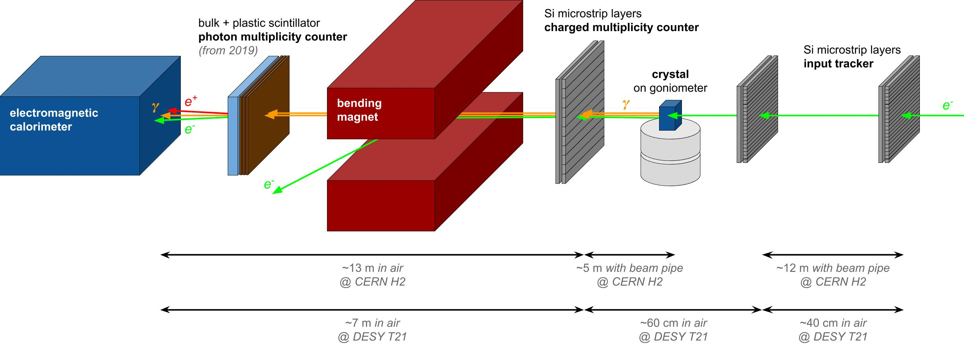
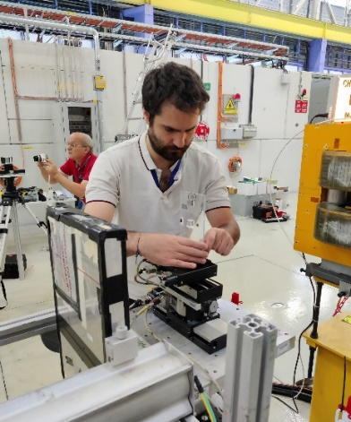
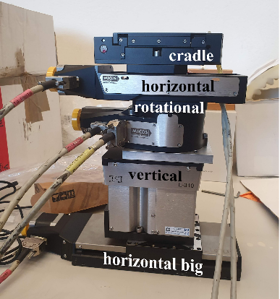
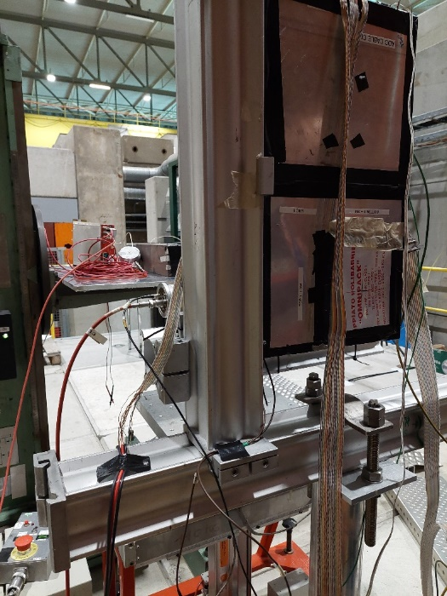
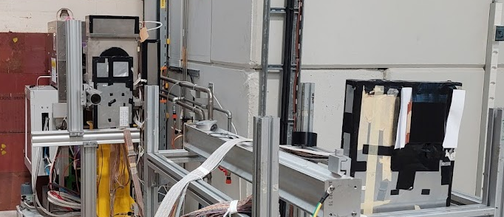
6
6
the setup input stage
output tracker &
G.A. 101046458
input tracker
~2⨉2 cm² xy double-sided Si microstrip sensors, with an overall ~10 μm single-hit resolution
output tracker & charged multiplicity counter
pair of ~10⨉10 cm² single-sided Si microstrip sensors, with an overall ~35 μm single-hit resolution
Goniometer @LNL &UNIPD
fine-grained, remote-controlled
movements along x, y, θ_{x} and θ_{y}
with ~5 μm/μrad resolution
BEAM

Slide 7
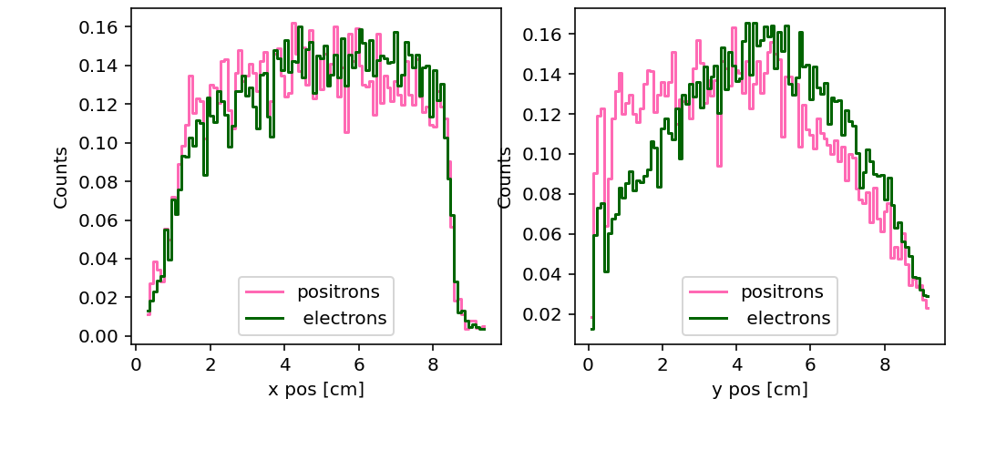
7
the setup the beams
output tracker &
G.A. 101046458
Beam distributions
(electron/positron beam, 6 GeV)
Rate
10²/10³ particles/spill
Spill duration 400 ms
4-6 spills per minute
The quality of the beam can be improved removing the upstream Cerenkov detectors and working in vacuum

Slide 8
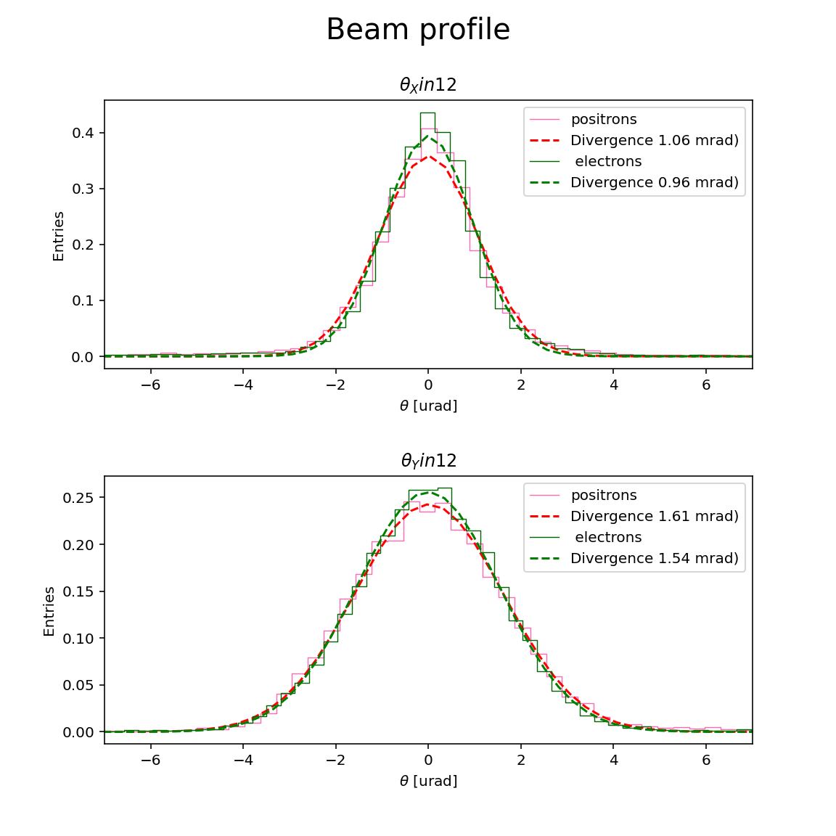
8
8
the setup the beams
output tracker &
G.A. 101046458
Input angle distributions
(electron/positron beam, 6 GeV)
Theta (mrad)
Theta (mrad)
The quality of the beam can be improved removing the upstream Cerenkov detectors and working in vacuum

Slide 9
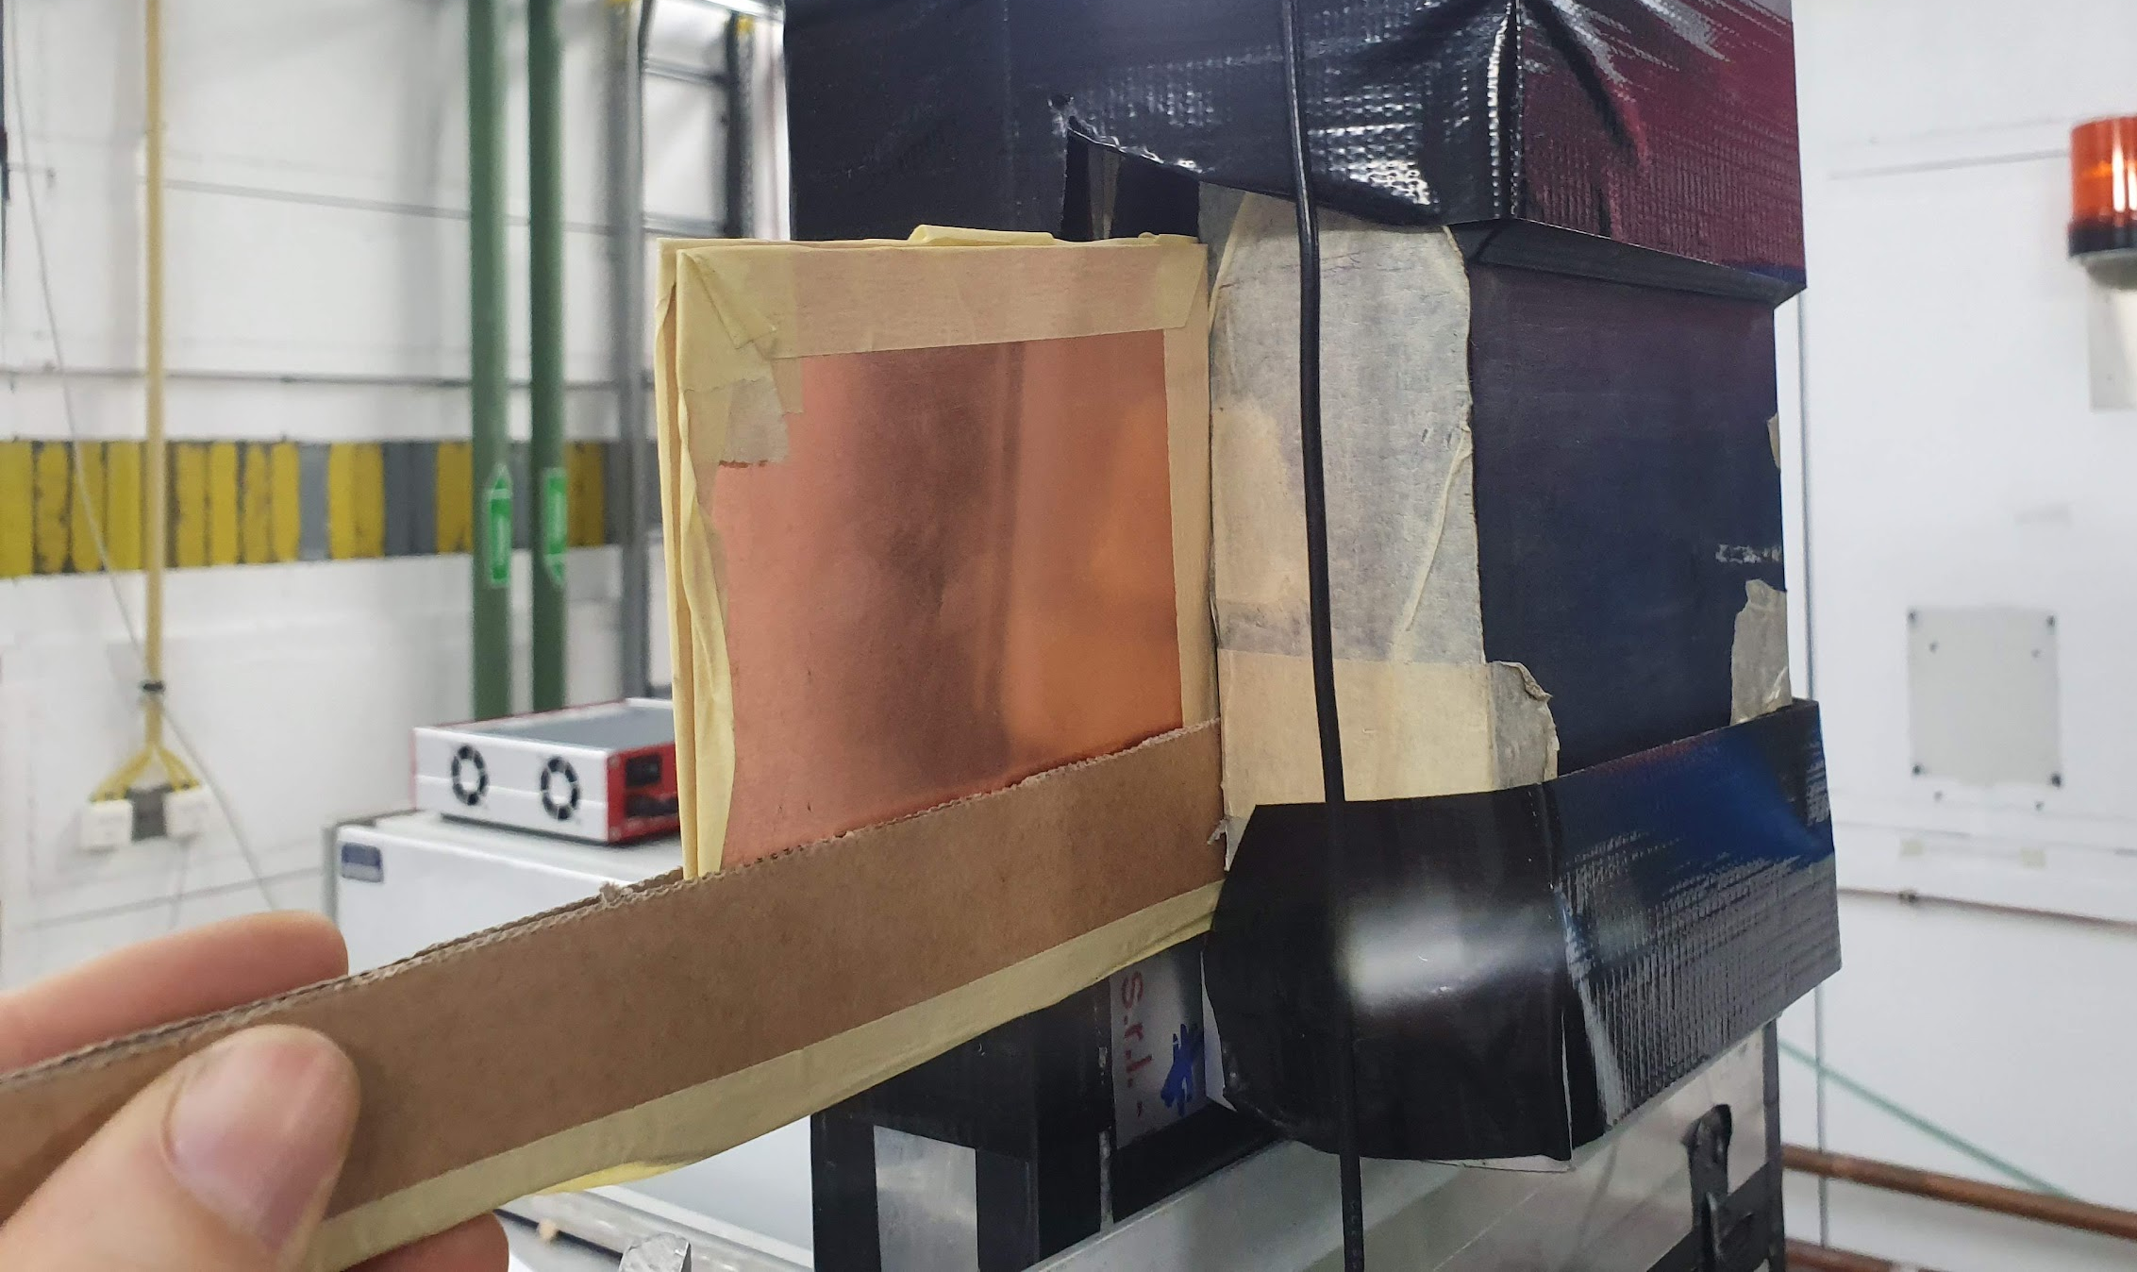
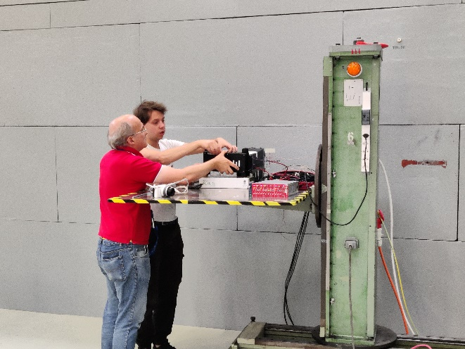
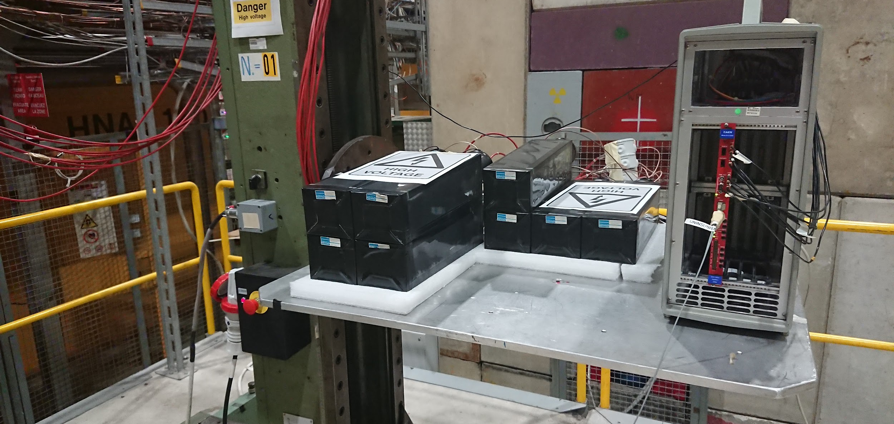
9
9
9
the setup output stage
G.A. 101046458
different calorimeters can been exploited:
3⨉3 matrix of PWO blocks from the CMS endcap, SiPM-based readout
(OPAL) Pb glass blocks read out by PMTs
3⨉3 matrix of BGO blocks, PMT-based readout
a Active Photon Converter (APC) based on plastic scintillators and thin layers of copper for photo conversion
Lead glass
APC

Slide 10
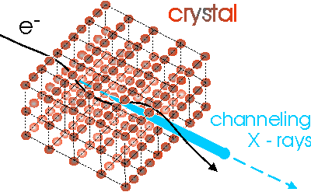
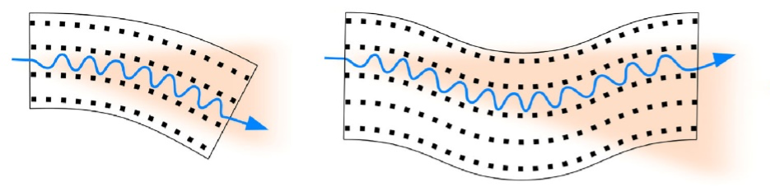
Which Crystal Light Source to test?
Linear bent periodically bent
10
10
10
G.A. 101046458

Slide 11
Which Crystal Light Source to test?
Linear bent periodically bent
11
11
11
G.A. 101046458
For the first test we focused on linear crystals:
Already available experimental setup;
Samples ready to be tested;

Slide 12
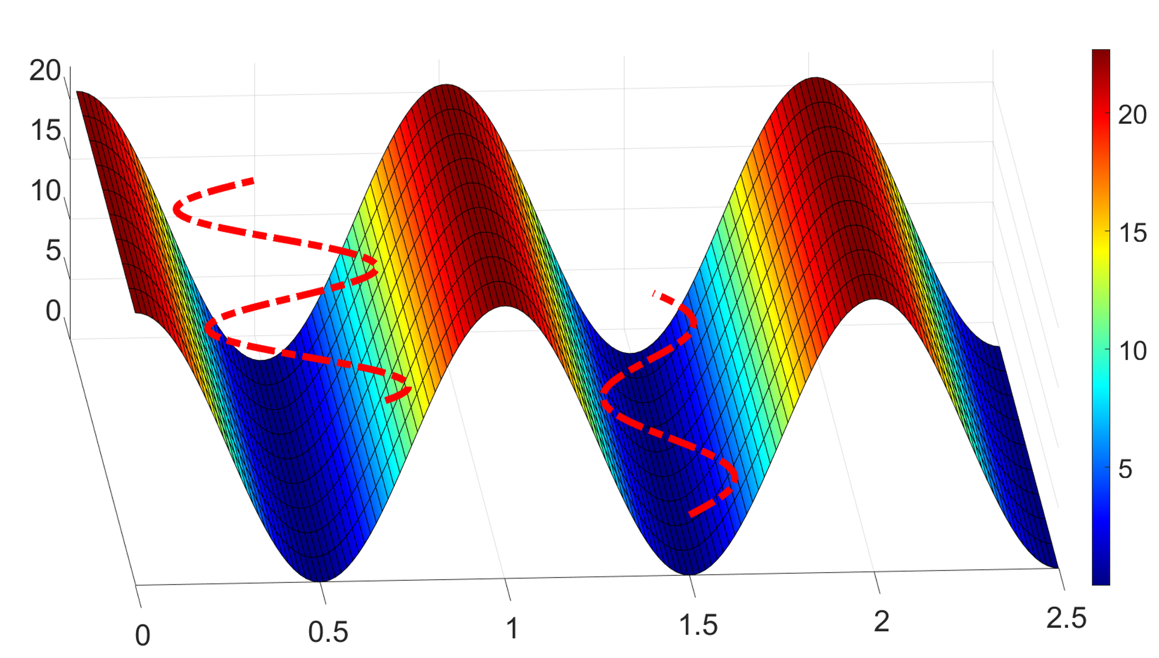
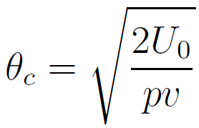
Channeling in linear crystals
12
12
12
G.A. 101046458
String of atoms
Single atom
e⁻
e⁻
Critical angle for channeling:
max of the potential well, U(x)
momentum*velocity
J. Lindhard, K. Dan. Vidensk. Selsk. Mat. Fys. Medd. 34 (1965) 14.
Notes:
Crystal-assisted collimation: a curved crystal deviates the halo directly to the primary absorber.
12

Slide 13
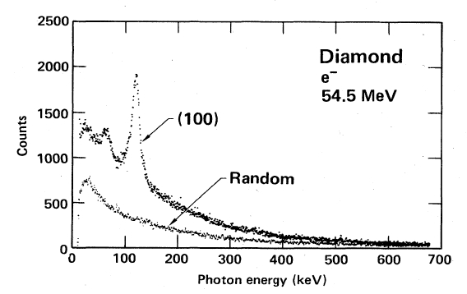
Channeling radiation in linear crystals
13
13
13
13
G.A. 101046458
String of atoms
Single atom
e⁻
e⁻
Channeling Radiation (1976, Kumakhov)
HE
e⁻
Notes:
Crystal-assisted collimation: a curved crystal deviates the halo directly to the primary absorber.
13

Slide 14
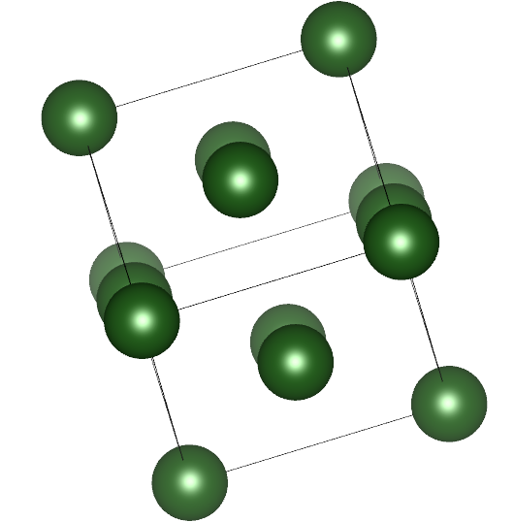
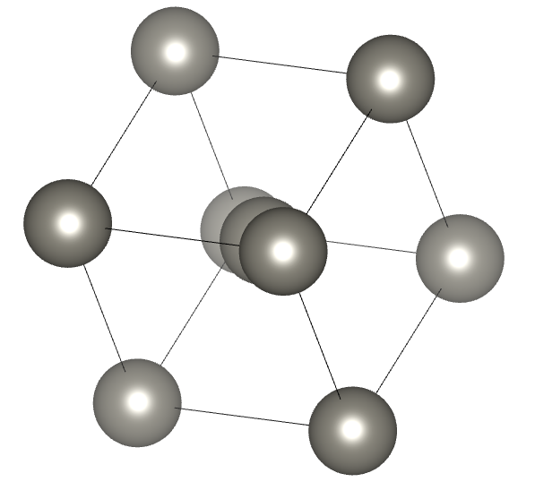
Exploration of NEW MATERIALS beside Silicon and Germanium
14
14
14
G.A. 101046458
High Z- atoms
Strong axial potential
(10 times Si <110>)
Huge radiation enhancement in axial channeling!
Tungsten
(111 axis)
Iridium
(110 axis)
Very high-density material!
Notes:
Mettere logo linerar crystal

Slide 15
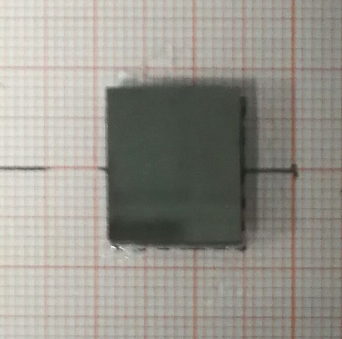
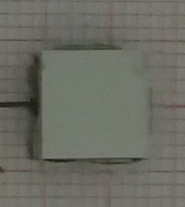
Exploration of NEW MATERIALS beside Silicon and Germanium
15
15
15
G.A. 101046458
1.
2.
Material: Tungsten
Channeling Axis: <111> (most efficient)
Axial potential: 1 keV
θ_{c} ≈ 0.6 mrad -> of the order of beam divergence
Lattice structure: Body Centered Cubic (BBC, space group #229)
Thickness: 2 mm (0.6 of W Radiation Lenght)
Material: Iridium (1x7x8 mm)
Channeling Axis: <110> (most efficient)
Axial potential: 1 keV
θ_{c} ≈ 0.6 mrad -> of the order of beam divergence
Lattice structure: Face Centered Cubic (FCC, space group # 225)
Thickness: 1 mm (0.3 of Ir Radiation Lenght)
Very high-density material!
Notes:
Mettere logo linerar crystal

Slide 16
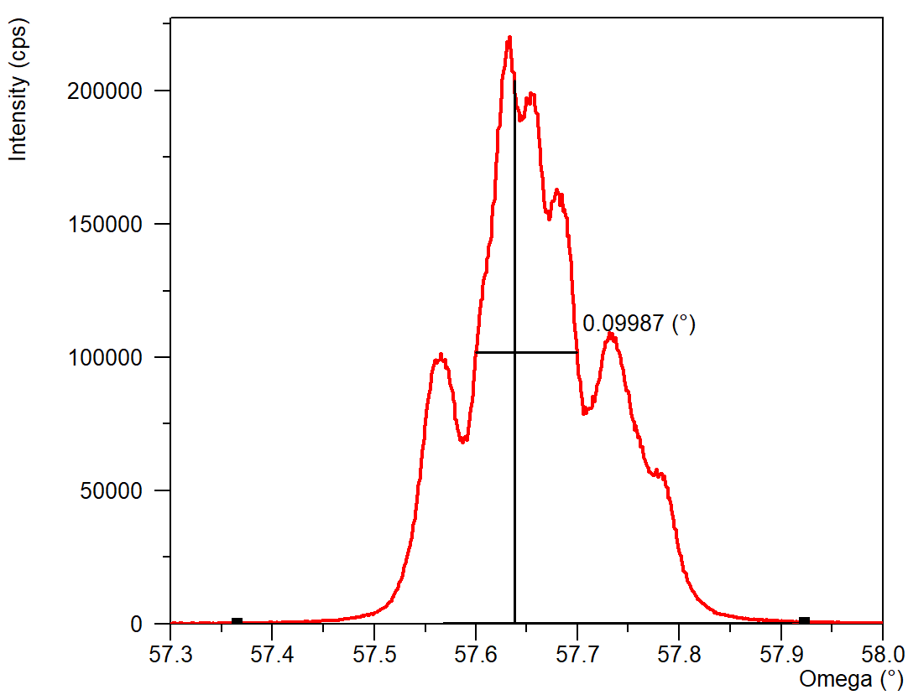
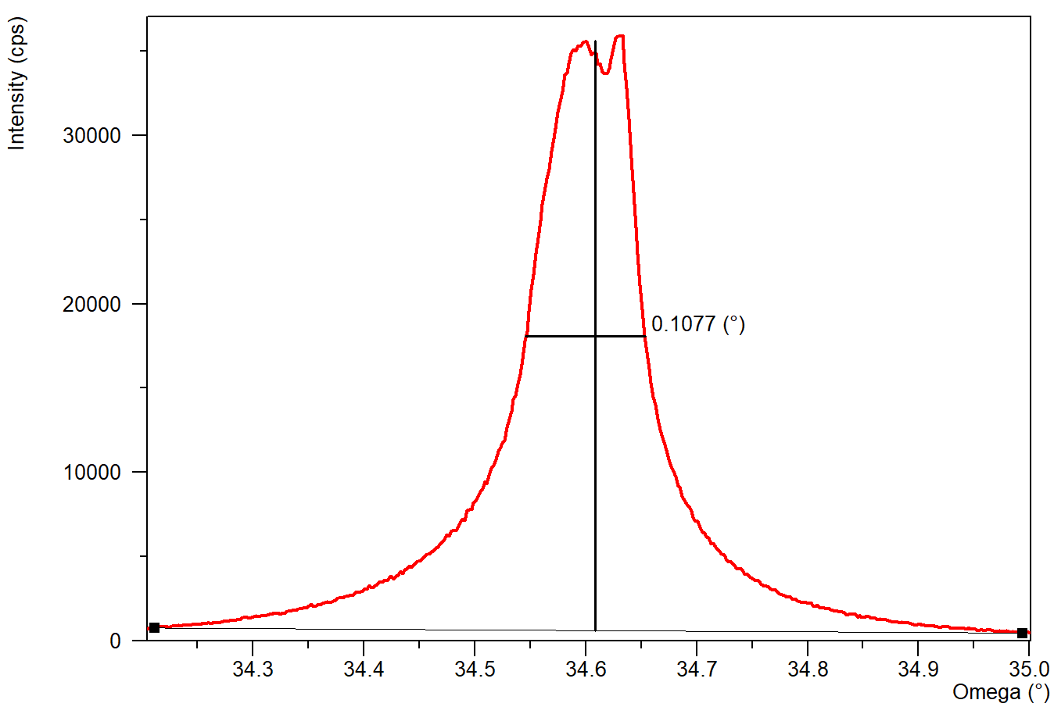
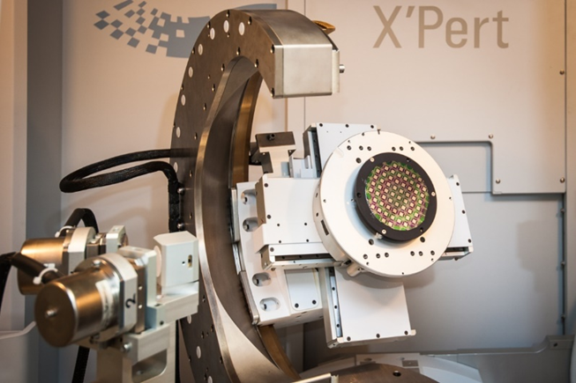
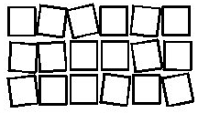
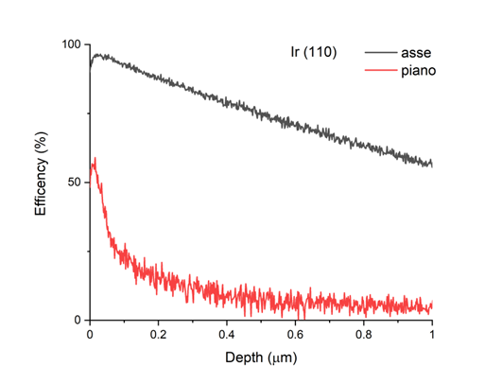
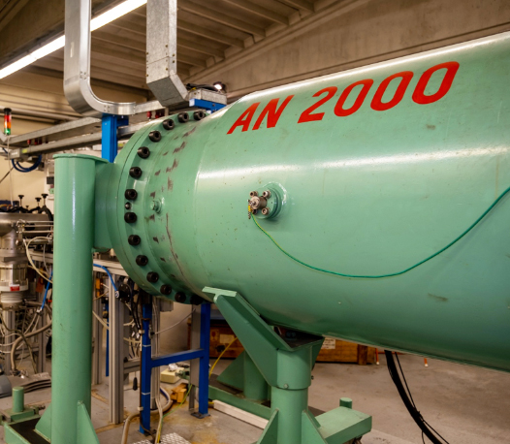

Samples Characterization
16
16
16
16
G.A. 101046458
Characterization of superficial mosaicity performed with High Resolution XRD at Ferrara lab (@8.04 keV)
FWHM ≤ 2 mrad – larger than Channeling Angle -> big contribution of quasi-channeled particles in radiation (low monochromaticity!)
X-ray diffraction Rocking Curve
Tungsten
Iridium
Rutherford BackScattering with 2 MeV alpha particles in channeling
axial
planar
Notes:
Ir 1.7 mrad W 1.9 mrad a bit larger than channeling angle at CERN

Slide 17
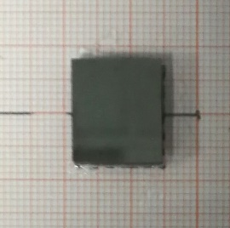
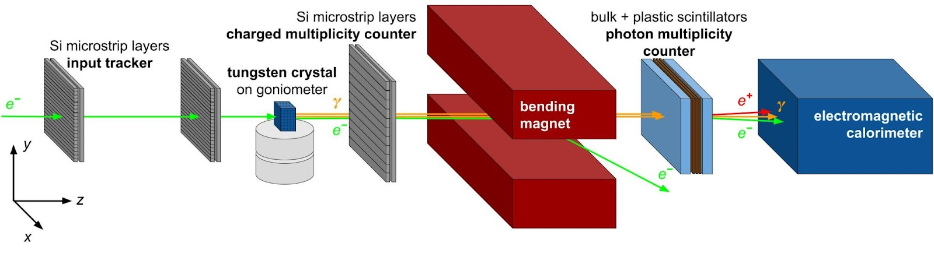
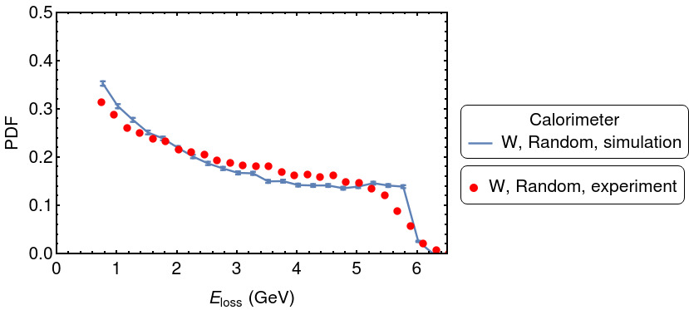
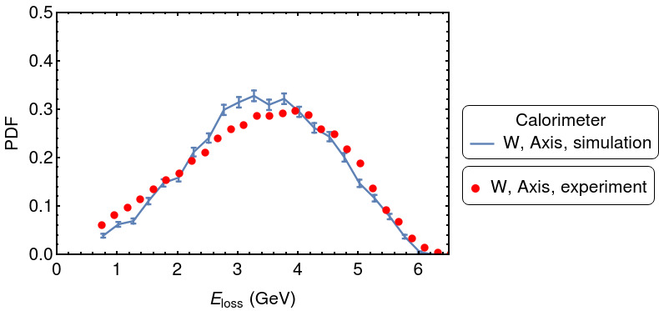

1. Radiated energy loss: calorimeter signal
W <111>
2 mm
e- @6 GeV
For the 2 mm long W aligned along the <111> axes the radiative energy loss distribution is peaked at 3.6 GeV, while for the random orientation is close to 0 as typical for Bremsstrahlung.
electromagnetic radiation in the Lead Glass calorimeter
PRELIMINARY
PRELIMINARY
East Area T9 line
Notes:
Nevertheless, W was used in past e+ source experiments and Ir in NA48. We also have an experience with W in collaboration with KLEVER/NA62.

Slide 18
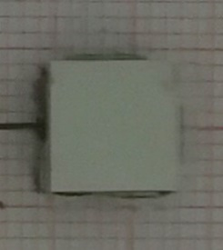
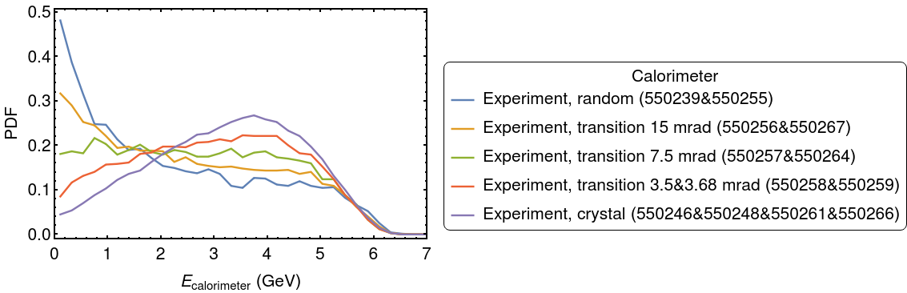
2. Radiated energy loss: calorimeter signal
Ir <110>
1 mm
e- @6 GeV
For the 1 mm long W aligned along the <110> axes the radiative energy loss distribution is peaked at 3.8 GeV, while for the random orientation is close to 0 as typical for Bremsstrahlung.
We also see an effect up to 15 mrad from the axes!
electromagnetic radiation in the Lead Glass calorimeter
PRELIMINARY
East Area T9 line
Notes:
Nevertheless, W was used in past e+ source experiments and Ir in NA48. We also have an experience with W in collaboration with KLEVER/NA62.

Slide 19
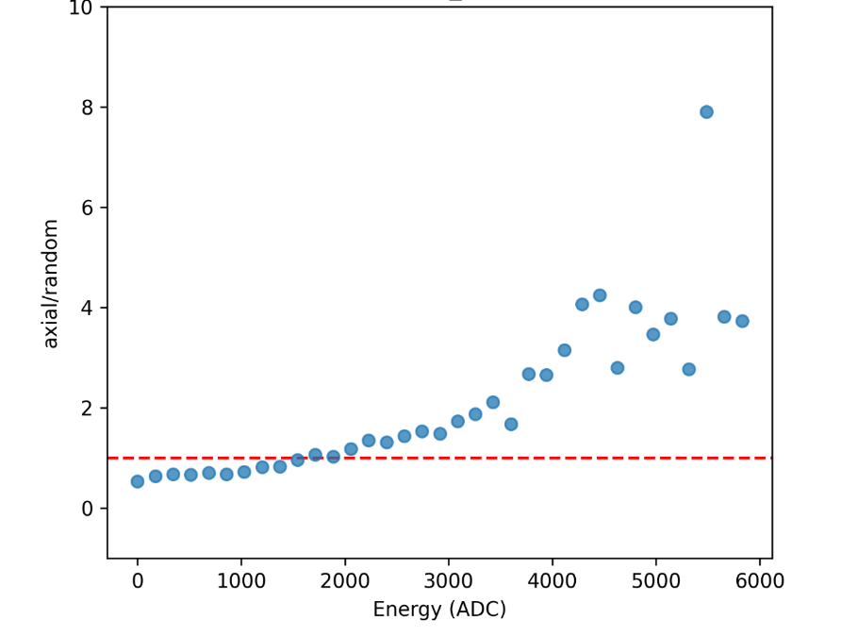
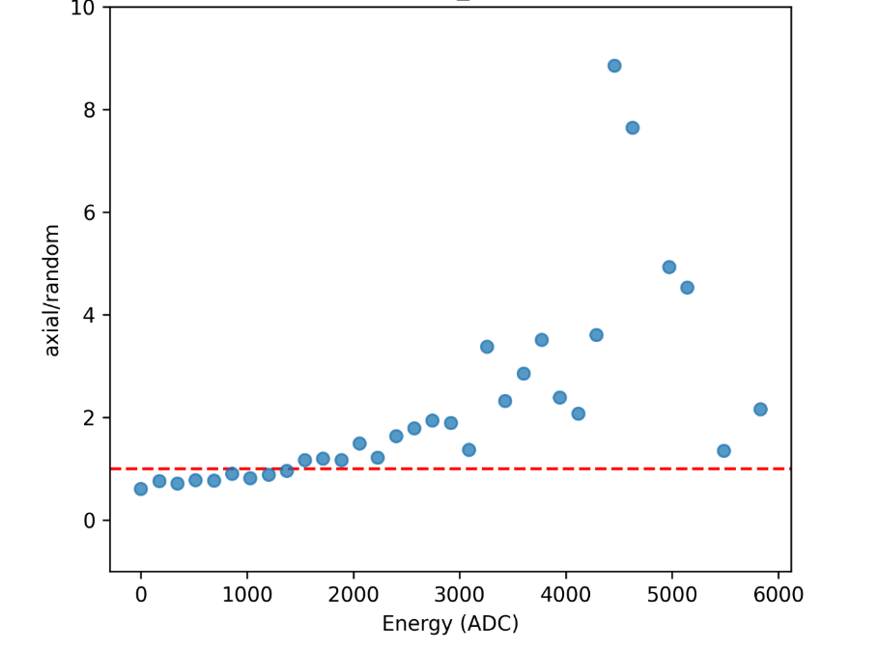
19
19
19
19
“Counting” the number of photons
G.A. 101046458
Enhancement of energy deposited in downstream scintillator S0 in case of axial orientation of the crystal related to the random orientation
W <111>
Ir <110>
PRELIMINARY
PRELIMINARY
An estimate of the number of photons that emerge from the crystal was obtained via an Active Photon Converter, which consisted of plastic scintillators placed upstream (for photon veto) and downstream (for electron-positron pair multiplicity measurement) with respect to a converter layer (0.2-0.4 radiation lengths of copper).
Increase in the average number of high-energy deposit events (i.e. in the average number of events featuring many output photons — more than 2) in case of axial alignment if compared to random.
The Single Photon spectrum can be extrapolated via simulation (we expect peak @ 10-100 MeV) -> will be carried out in the next future!
Notes:
il fattore di conversione ADC-MeV per lo scintillatore del preshower è ~1.68MeV/771ADC; visto che il picco di singola particella è a 771ADC, ne segue che nello spettro dello scintillatore si ha una particella ogni 1.68MeV

Slide 20
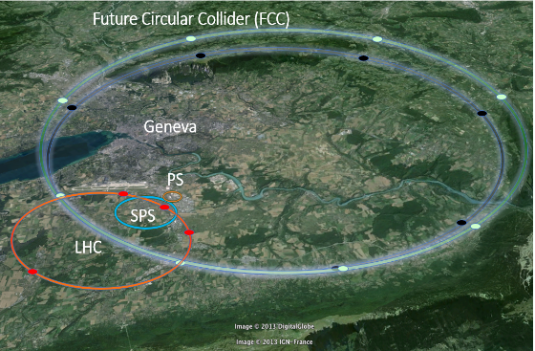
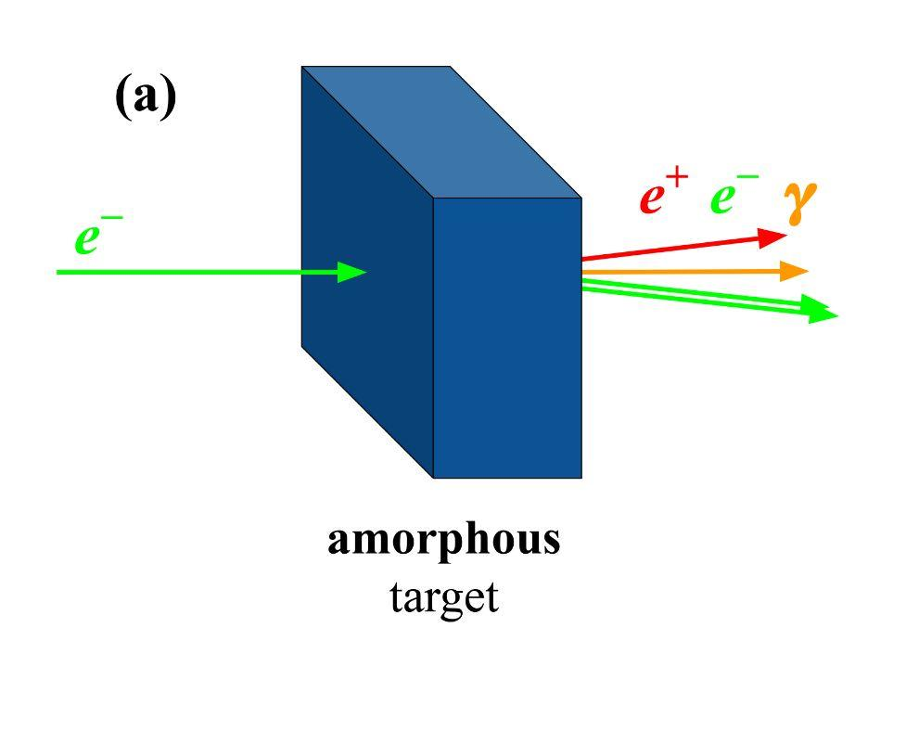
Possible applications
Conventional e+ source
Intense gamma-ray source exploiting the strong crystalline potential of a high-Z material;
Crystal radiator for intense e⁺ sources in current (SuperKEKB, FACET II, etc..) and future accelerators/colliders, such as the Future Circular Collider FCCee @CERN):
  Enhancement of photon generation in crystals ➔ enhanchement of pair production in the converter target
  High rate of soft photons ➔ creation of soft e⁺ easily captured in matching systems
  Decrease of the energy deposited in the converter target
usually made of high-Z material (W, Pb,..)
Hybrid crystal-based e+ source
R.Chehab/FCPPL-Clermont/2014
L. Bandiera et al., Eur. Phys. J. C 82 (2022) 699
Option for FCCee, ILC, CLIC..

Slide 21
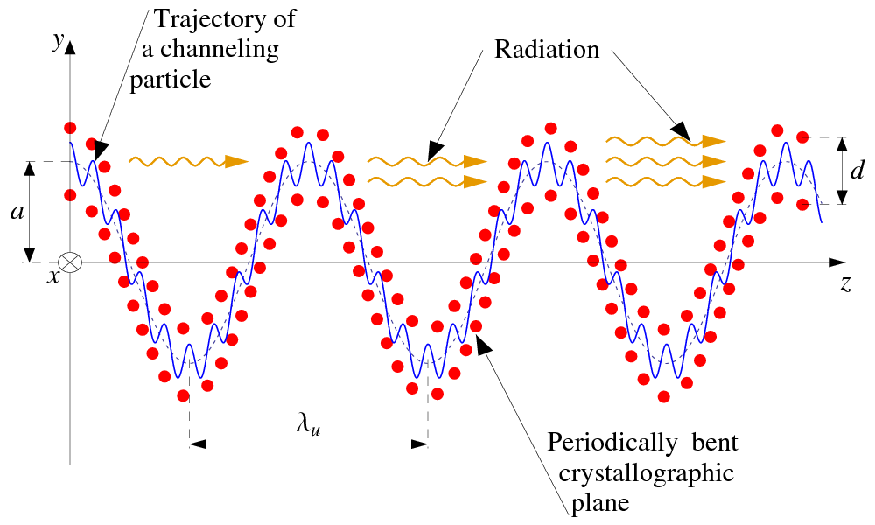
And with a crystalline undulator?
Conventional e+ source
Crystalline undulator
Hard X-rays and gamma rays
Exploiting a crystalline undulator as radiator may result in some advantages in terms of enhancement of soft photons
Interesting to be investigated
usually made of high-Z material (W, Pb,..)
Hybrid crystal-based e+ source
Courtesy of A. Solov’yov and A. Korol
R.Chehab/FCPPL-Clermont/2014
Option for FCCee, ILC, CLIC..
Idea of R. Chehab, V. Strakhovenko and A. Variola, NIM B 266 (2008) 3868

Slide 22
Summarizing
22
22
22
22
22
G.A. 101046458
An experiment on radiation emitted by 6 GeV electrons interacting with linear W and Ir crystals was carried out at CERN PS
  Radiation emission in axial potential (1 keV) is quite intense, but the quality of the crystals is low -> thereby decreasing its monochromaticity
  Monte Carlo simulation are necessary to extrapolate the Single Photon Spectrum
  Interesting for hard gamma-ray sources (10-100 MeV) and as radiators in a crystal-based positron source for future collider (e.g. the Future Circular Collider at CERN)
We characterized the 6 GeV positron beam, which is similar to the electron beam one (as expected). We checked that the energy can be increased up to 15 GeV, but the fraction of electrons/positrons in the beam is highly decreased.
Notes:
Simulazioni?

Slide 23

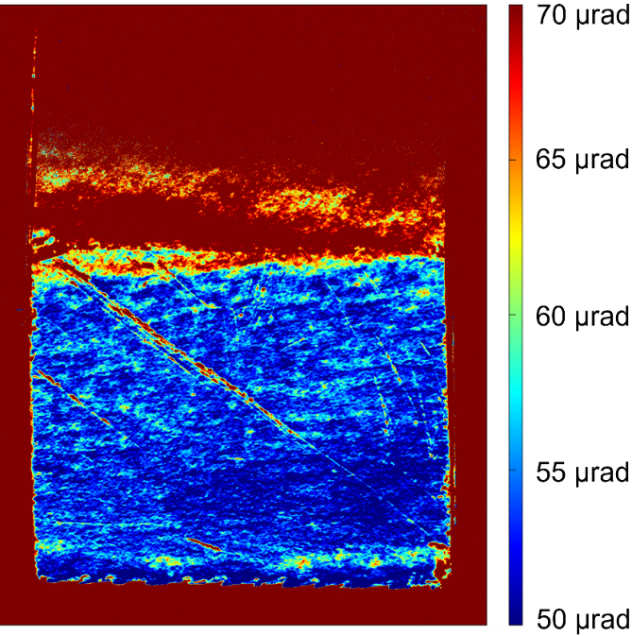
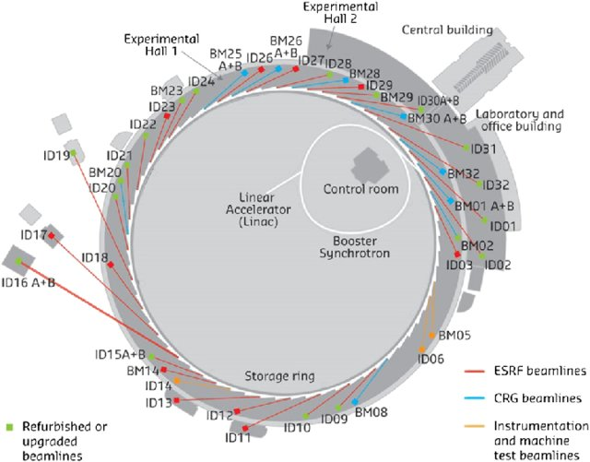
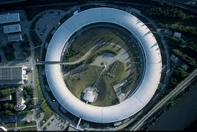
Future plans… complete the characterization
Maybe, topography can be performed at the synchrotron facility ESRF (beamline BM05). The facility allowed both high spatial (≈5μm) and angular (≈1μrad) resolution thanks to the high intensity and energy of the diffracting photons (20 keV).
Example of topography on a W sample
X-ray topography @BM05
Courtesy of Thu Nhi Tran CALISTE
L. Bandiera et al., Eur. Phys. J. C 82 (2022) 699

Slide 24
Future plans… new experiment
Linear bent periodically bent
24
24
24
24
24
G.A. 101046458

Slide 25
Future plans…. The Challenge!
All the setup is in air
Challenge 1. Work in vacuum?
Investigate with beam physicists in charge of the PS&SPS beamlines the possibility to work in vacuum or with He bag (to reduce MS in air), which is necessary to test thinner Bent Crystals and Periodically Bent Crystals of low-Z material;
Challenge 2. Is the rate and quality of the beam sufficient to test small samples?
We can trigger on the Si detectors to select only particles impinging on a small size crystal (BC or PBC).. Nevertheless it is fundamental to evaluate how many photons we can get in two weeks of data taking.
Challenge 3. Which detector for CU peak?
Plan: perform a Geant4 simulation of the experimental setup to understand if and which detector could be used to measure the gamma-ray peak of CU without being blinded by the harder channeling/bremsstrahlung radiation spectrum,

Slide 26
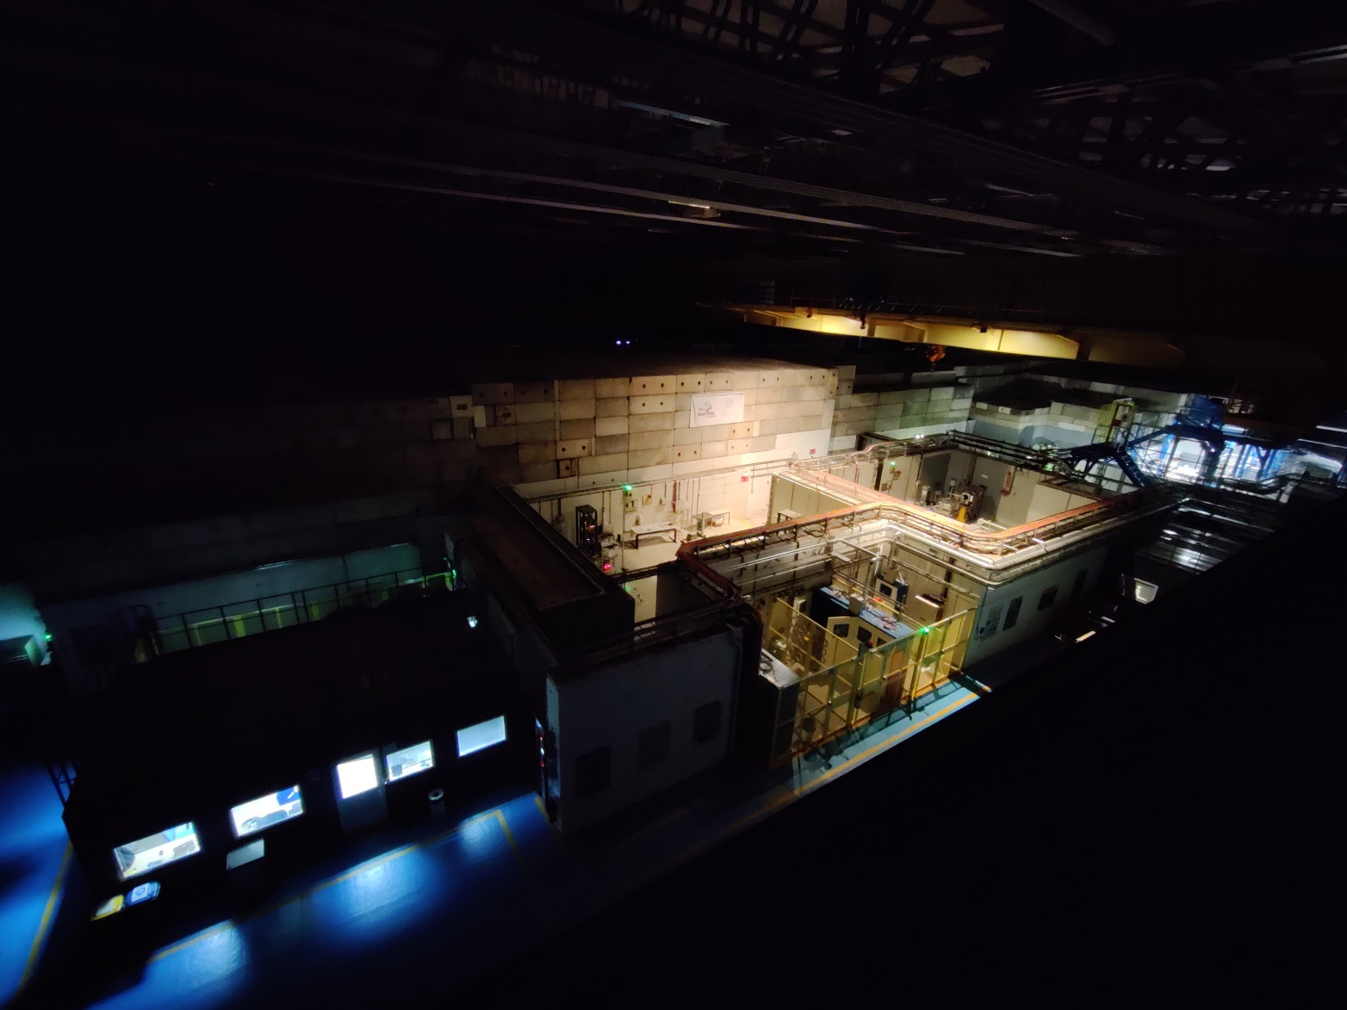
Thank you for the attention!
The PS T9 line area from above during the night shift

