Slide 1
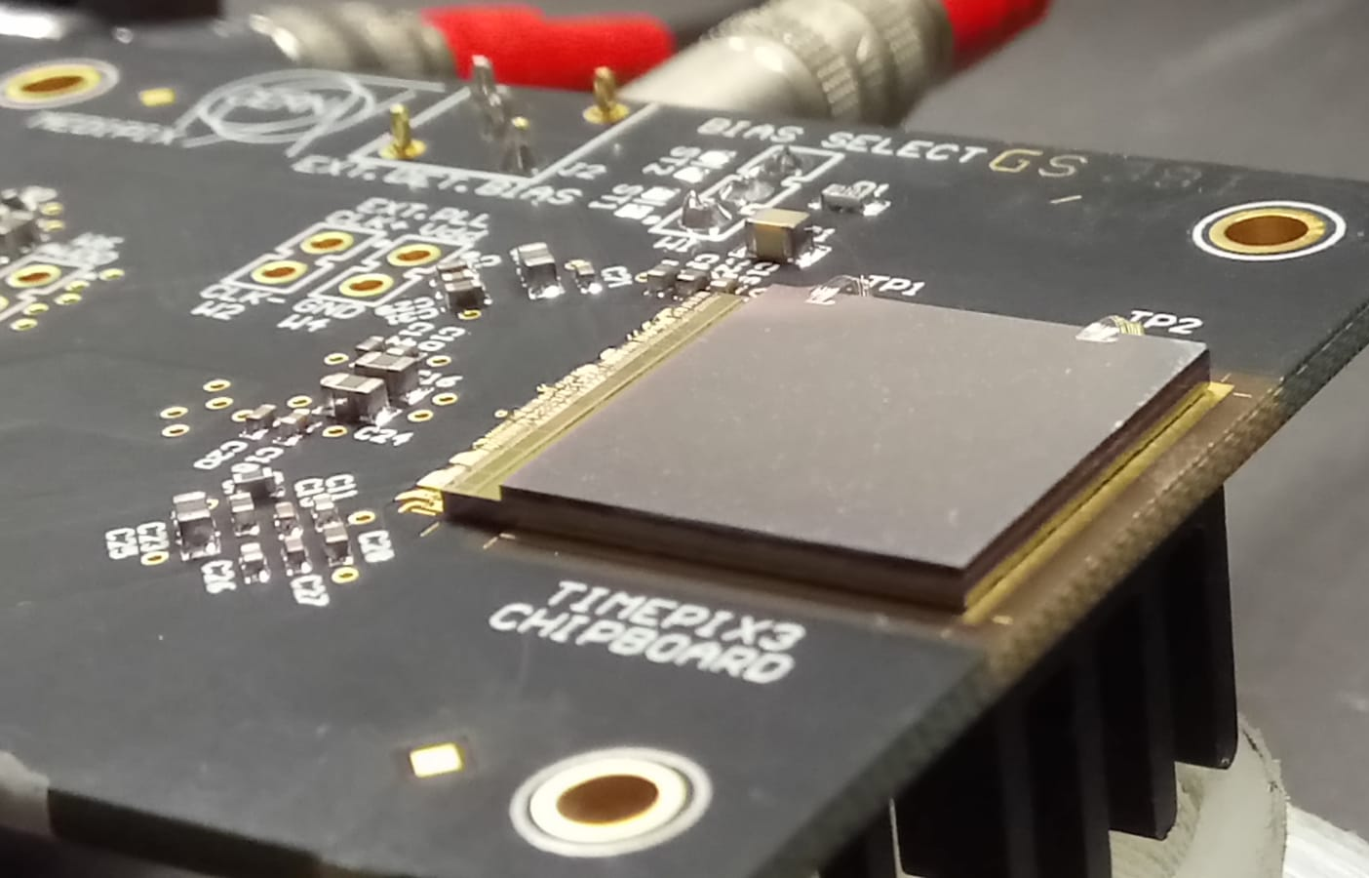
Diamond and converter based Timepix3 detectors
for fast and thermal neutron measurements in nuclear fusion
Antonella Tamburrino^{1,2,3} & G. Claps^{2,3}
¹DIAEE - Dipartimento di Ingegneria Astronautica, Elettrica ed Energetica, Sapienza Università di Roma, Piazzale Aldo Moro 5, 00185 Roma, Italia
²INFN - Laboratori Nazionali di Frascati (LNF), via E. Fermi 40, 00044 Frascati, Italia
³ENEA (FSN-PLAS-PAX) - C. R. Frascati, via E. Fermi 45, 00044 Frascati, Italia
Meeting nTOF, Trieste, 9 – 10 novembre 2023

Slide 2
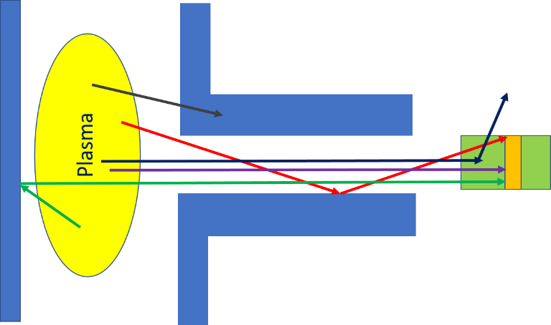
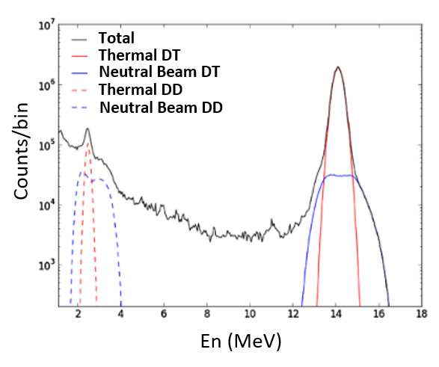
SCIENTIFIC BACKGROUND: Fast neutron detection in nuclear fusion
NEUTRON DIAGNOSTIC
Plasma physics, machine protection and control issues
Total emission strength, spatial emissivity and energy spectra
MAIN PARAMETERS PROVIDED BY NEUTRON DIAGNOSTIC:
Fusion reaction rates, fuel ion temperature and density
Beam plasma interaction
Neutron load on components (vacuum chamber and divertor)
REQUIREMENTS OF A NEUTRON DETECTION SYSTEM:
Diagnostic apparatus (collimation and shielding)
Resistance to harsh environment conditions
Detector requirements
Neutron discrimination from gammas rays
Good discrimination of the direct component
Time resolution
Rate capability
THE PROBLEM OF BACKGROUND CONTRIBUTION:
SCATTERED NEUTRON + GAMMA
It needs to be understood and controlled!

Slide 3
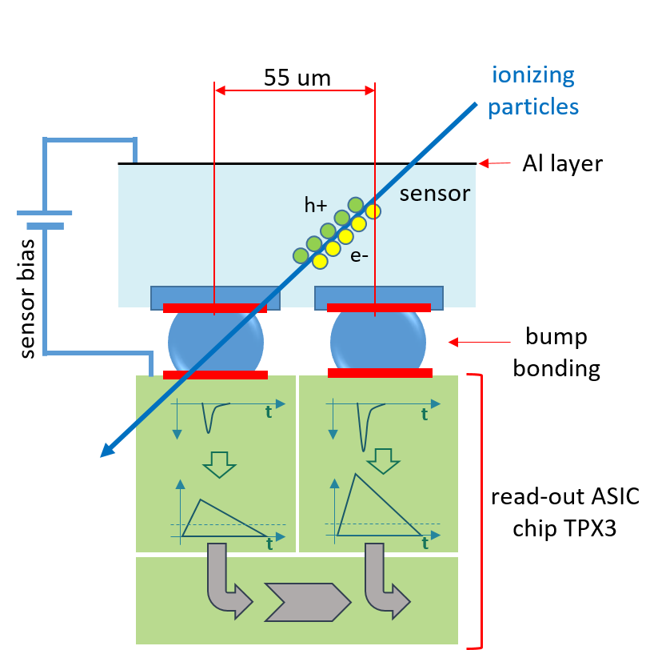
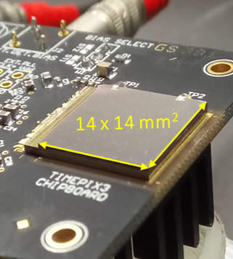
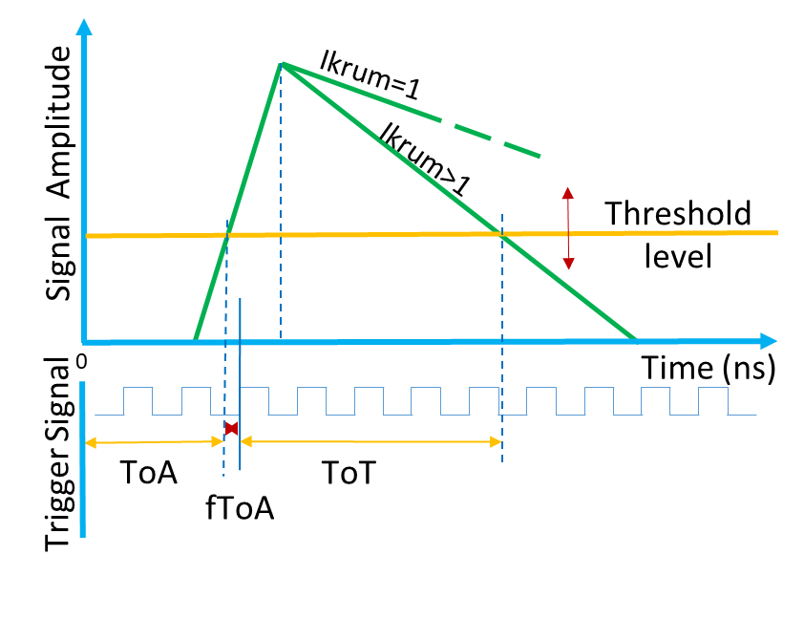
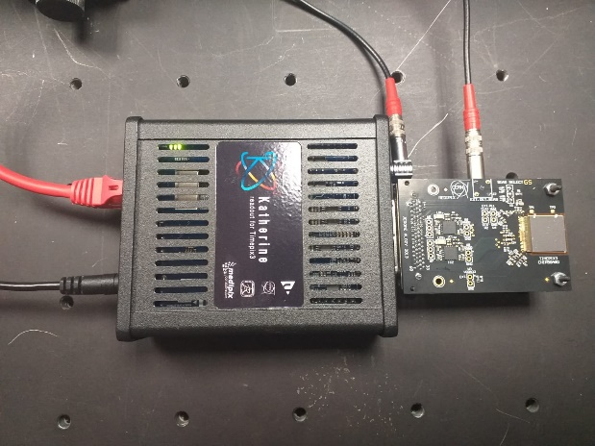
TIMEPIX3 chip
TIMEPIX3 chip
ACQUISITION MODES OF TPX3
Pixel by pixel, TPX3 provides a simultaneous measure of :
EVEN COUNTING
TIME (ToA mode)
CHARGE (ToT mode)
CHARACTERISTIC:
Detector 2D
Active area: 14 x 14 µm²
Pixel arrangement: 256 x 256 pixels
Pixel size: 55 x 55 µm²
Minimum Timing resolution: 1.6 ns
KATHERINE MODULE + TIMPEPIX3

Slide 4
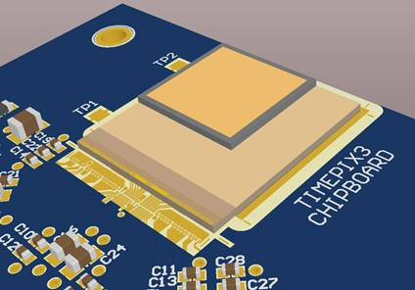
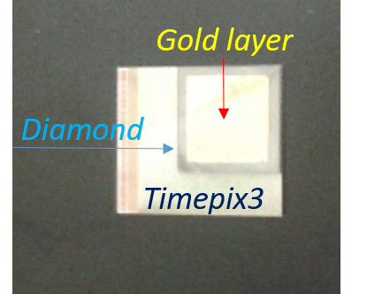
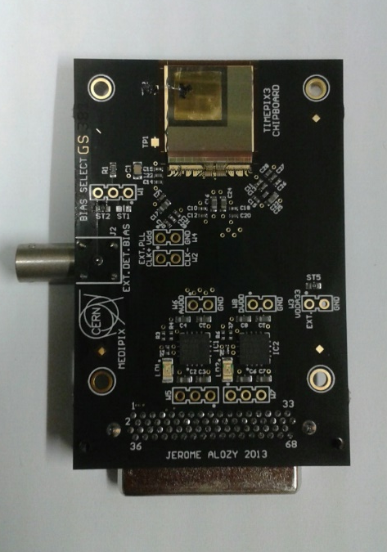
The new Diamond detector “DIAMONDPIX”
DETECTOR LAYOUT
DETECTOR 2D
SENSOR: CVD diamond
active area: 10 x 10 mm²
500 μm thick CVD diamond
300 nm thick Au layer
Bias: 300 V
10 x 10 mm²
10 x 10 mm²
14 x 14 mm²
DIAMOND PROPERTIES
PROPERTY | SILICON | DIAMOND | DIAMOND
Material | MCz, FZ, epi | Polycrystalline | Single crystal
Displacement [eV] | 13-20 | 43 | 43
Energy gap [eV] | 1.12 | 5.5 | 5.5
E_{breakdown} [V/cm] | 3×10⁶ | 10⁷ | 10⁷
µ_{e} [cm²/Vs] | 1450 | 1800 | >1800
µ_{h} [cm²/Vs] | 450 | 1200 | >1200
Saturate drift velocity [cm/s] | 0.8×10⁷ | 2.2×10⁷ | 2.2×10⁷
Atomic number Z | 14 | 6 | 6
Relative dielectric constant (ε_{r}) | 11.9 | 5.7 | 5.7
e-h energy [eV] | 3.6 | 13.0 | 13.0
Density [g/cm3] | 2.33 | 3.51 | 3.51
e-h/µm for mips | ~ 80 | 36 | 36
Max ccd [µm] | >500 | 300 | 800
Thermal conductivity [W/(mK)] | 150 | ~1900 | ~1900
It exploits specific reaction channels with charge products
Main reactions in ¹²C :
Diamondpix
¹²C(n, n)¹²C
¹²C(n, α)⁹Be
¹²C(n, α)2α

Slide 5
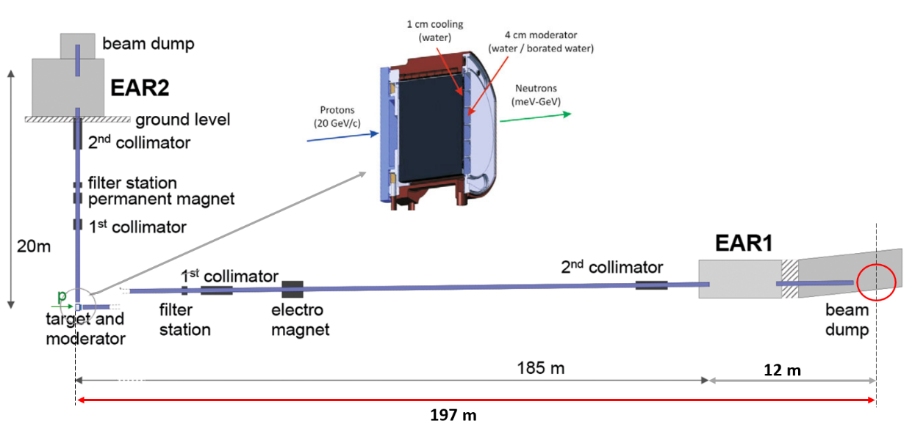
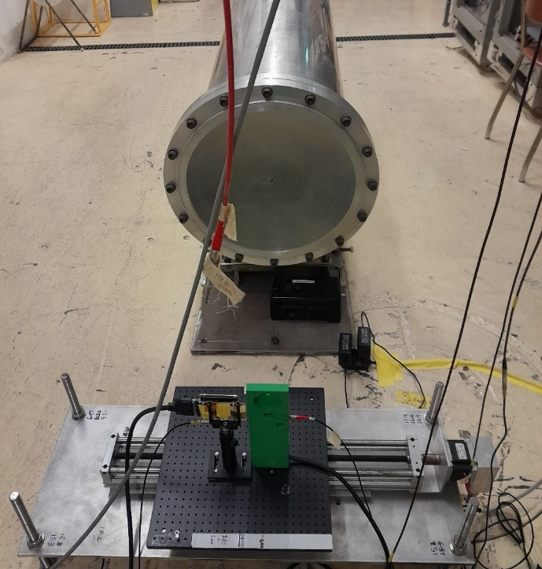
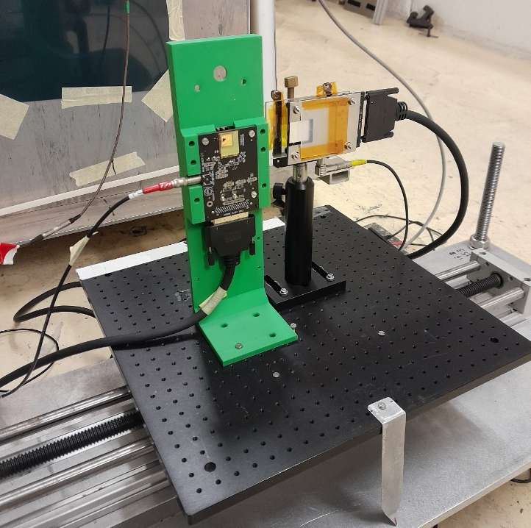
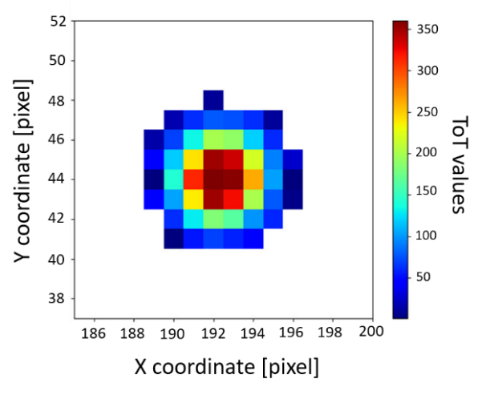
Diamondpix for neutron Time-of-Flight measurements: n_ToF (CERN, 2022)
EXPERIMENTAL SET-UP
ACQUISITION PROGRAM
nTOF facility
TPX3 has been checked with the katherine module by MMTrack program
DATA-DRIVEN MODE
ACQUISITION MODE: TOA&TOT
IKRUM: 5
DURATION: 150 ms neutron energy range (1 GeV – 10 meV)
A single particle interaction turns on a group of pixels (cluster) and, for each pixel, the ToT acquisition provides a measure of a fraction of the released charge.
BEAM DUMP
DIAMONDPIX
DIAMONDPIX
1000 triggers acquisition (no cut image)

Slide 6
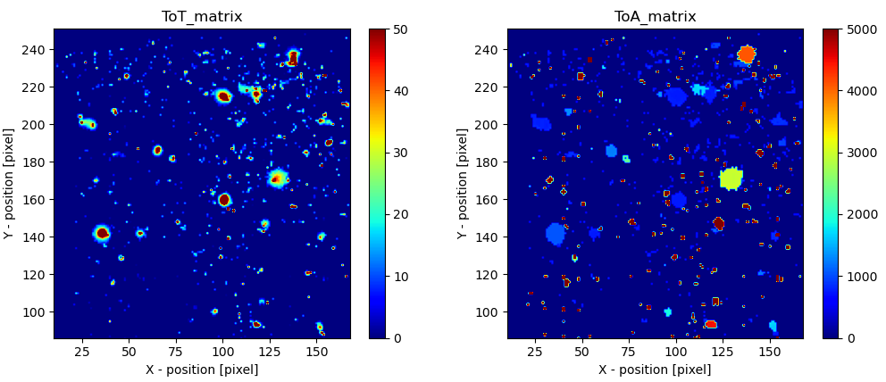
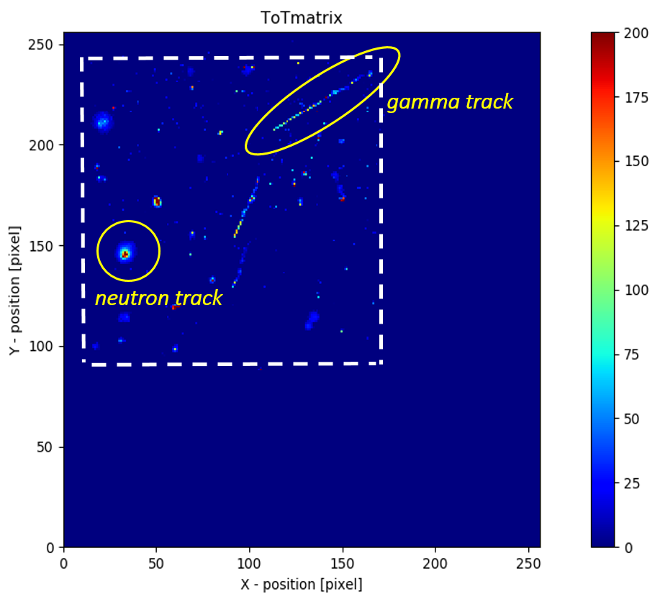
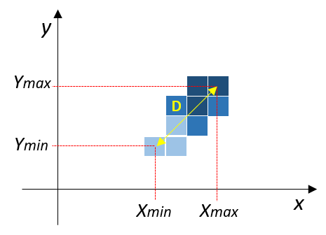
Track analysis
gamma background discrimination
Gamma rejection has been validated through a set of laboratory gamma sources.
SOME CLUSTER PARAMETERS:
Cluster Size (CS): the sum of all pixels forming the cluster
ToT volume (ToTv): sum of all pixel ToT values of the cluster
Roundness (Rnd):
$$Rnd= \frac{CS}{π∙{\left(D/2\right)}^{2}}$$
10 triggers acquisition

Slide 7
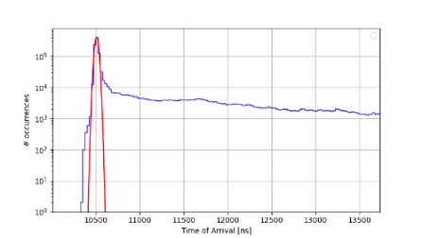
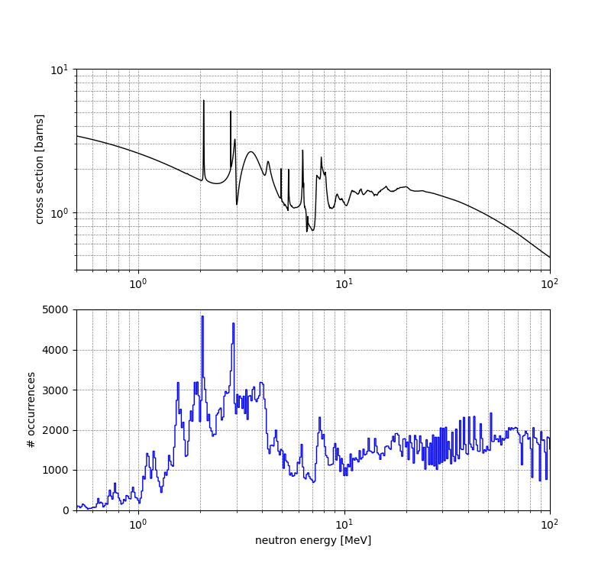
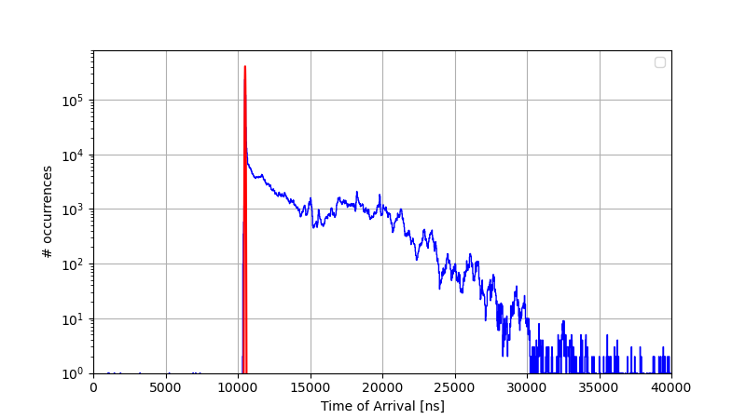
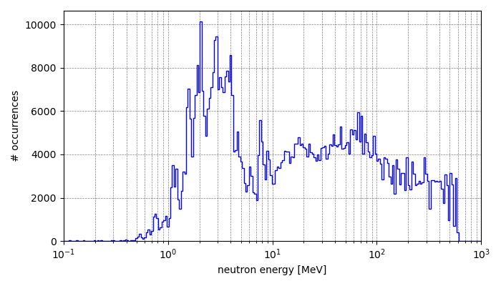
ToF spectrum reconstruction
ToA measurements
time @ gamma flash
10509 ns
CS > 3
The ToA measures highlights clearly the gamma flash peak, used as reference time to obtain the energy spectrum.
ToF neutron spectrum measured by Diamondpix
The measured N_TOF spectrum has been obtained through the minimum of ToA times in each cluster and correcting the delay due to time-walk
Some tof peaks are observed in correspondence of cross section resonances and validate the spectrum reconstruction

Slide 8
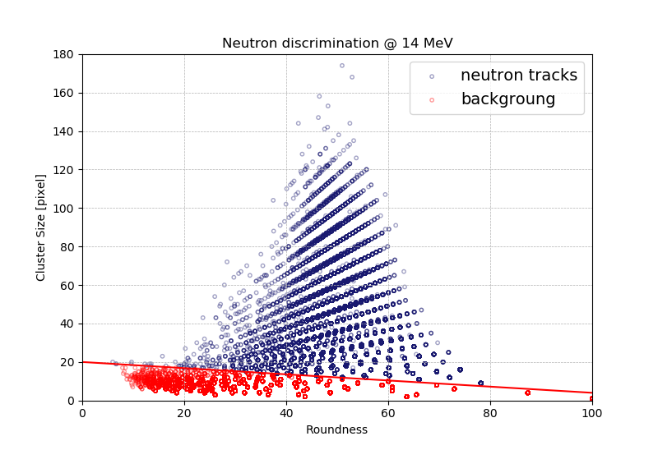
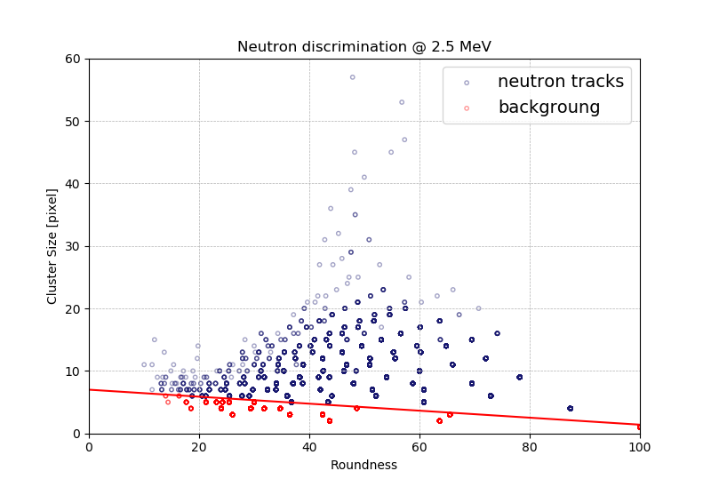
Neutron tracks discrimination and efficiency estimation at 2.5 and 14 MeV (FNG facility)
A neutron flux scan (from 6.0 × 10⁸ to 1.6 × 10¹⁰ n/s) on FNG allowed an efficiency estimation obtaining a value of 2.5 ± 0.1 ‰
A neutron flux scan (from 2.1 × 10⁸ to 2.5 × 10⁸ n/s) on FNG allowed an efficiency estimation obtaining a value of 6.8 ± 0.5 ‰

Slide 9
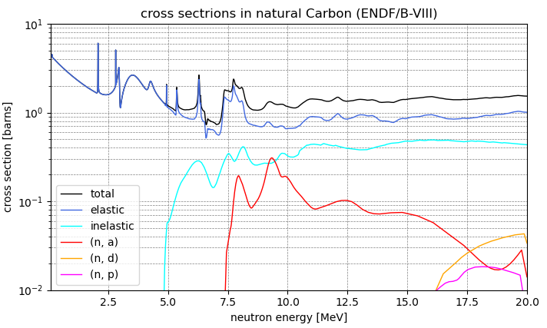
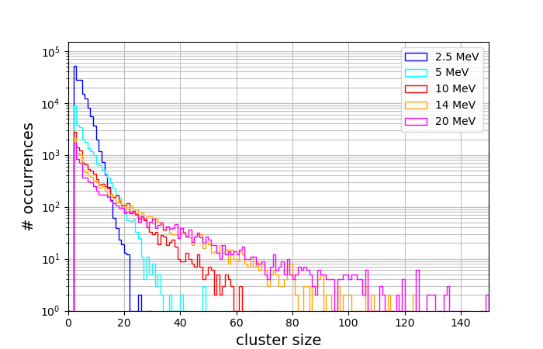
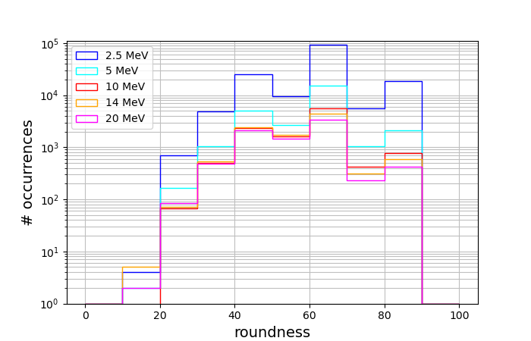
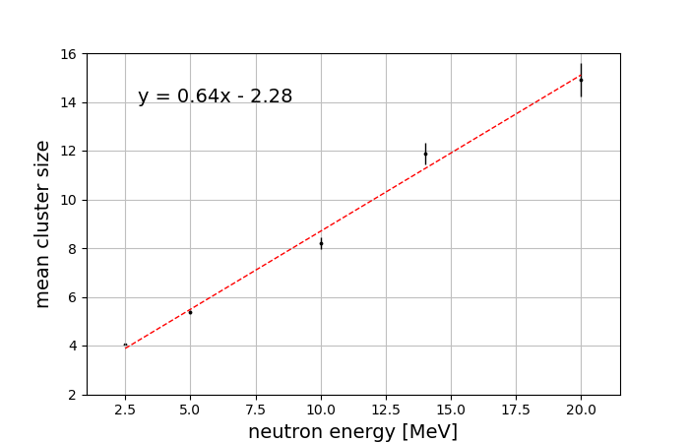
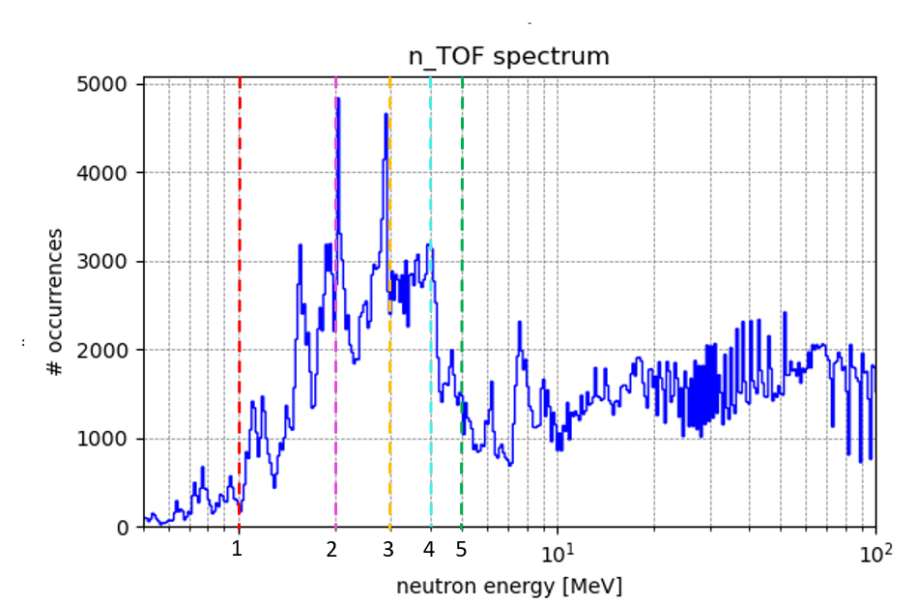
Energy calibration of Diamondpix
Study of Cluster Size and Roundness as a function of neutron energy
Energy calibration of Diamondpix with low neutron energies
Depending to the neutron energy, the mean CS values of all cluster follow a linear trend tha can be used to define the CS cut on the plane CS/Rnd.
Diamondpix has been calibrated exploiting the Carbon recoil for neutron energies lower than 5 MeV.

Slide 10
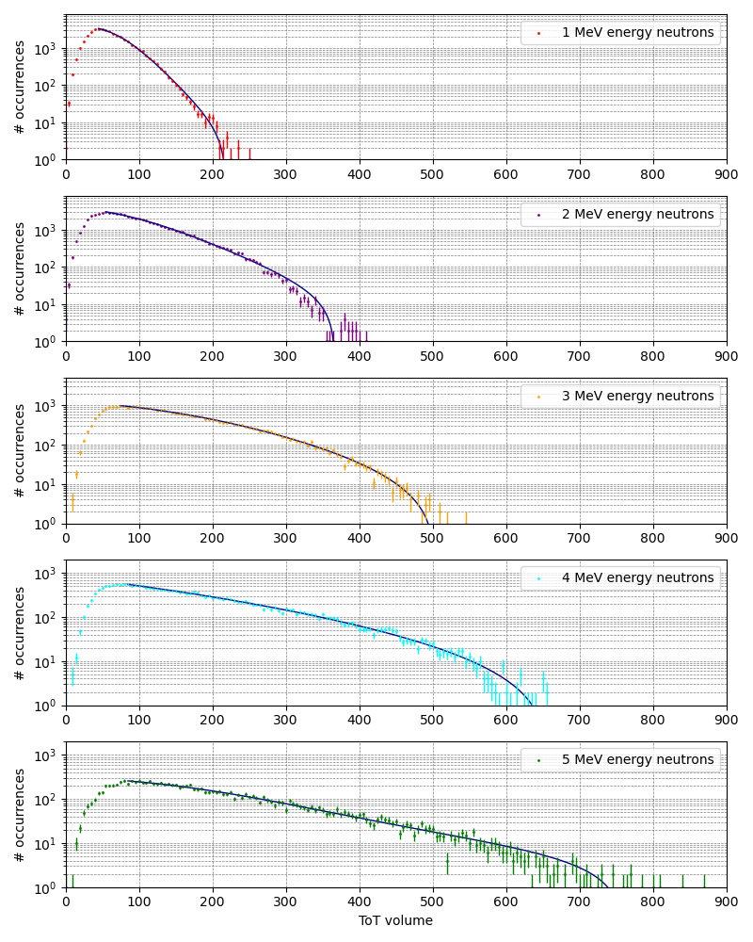
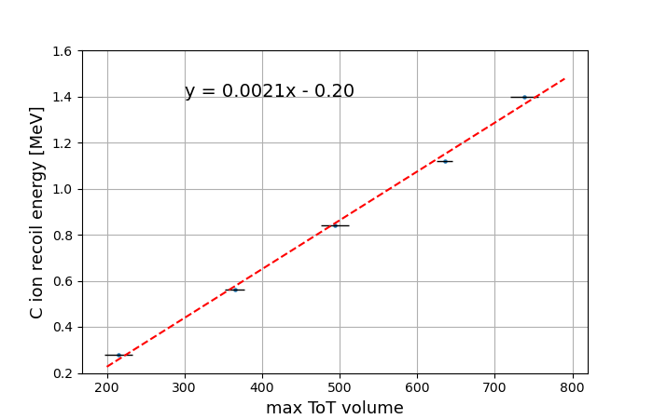
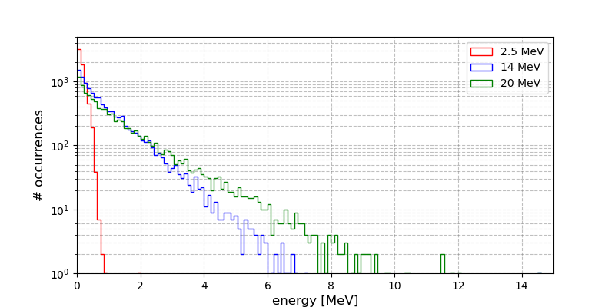
Calibration curve
The calibration curve has been applied to evaluate the deposited energy on charge responces of Diamondpix

Slide 11
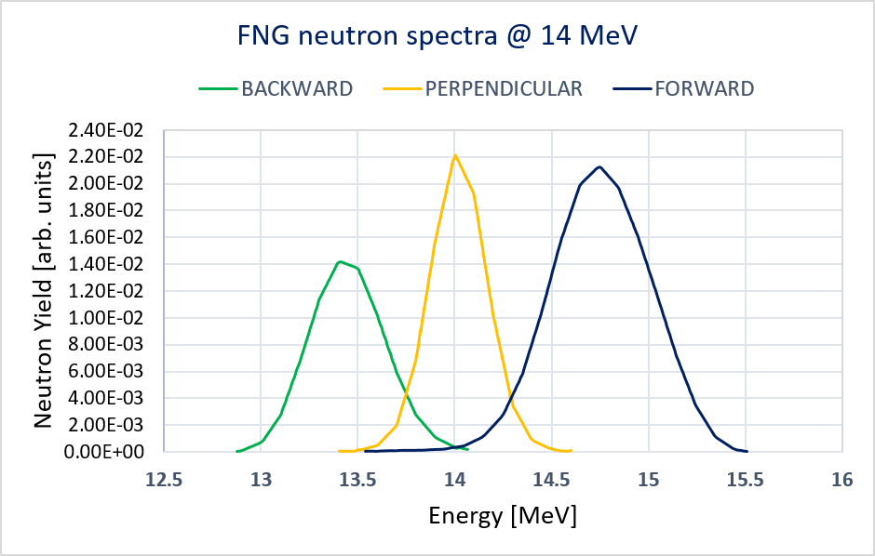
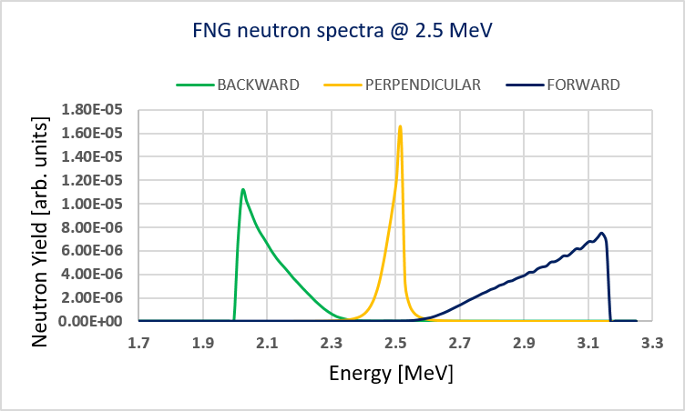
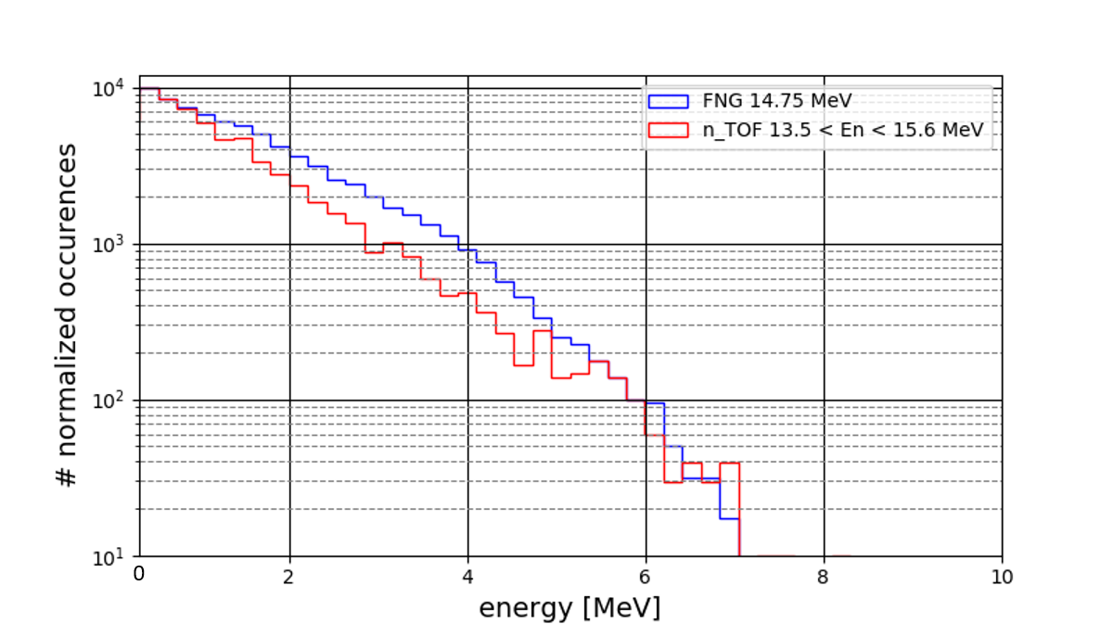
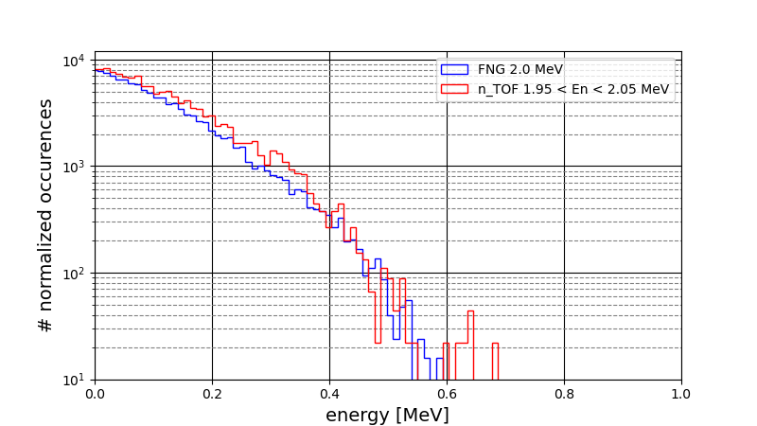
Comparison of the Diamondpix charge responce at 2.5 and 14 MeV between FNG and n_TOF

Slide 12
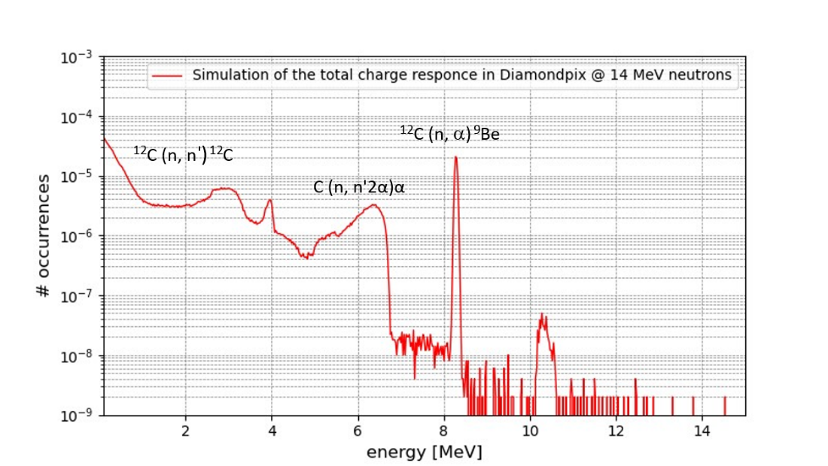
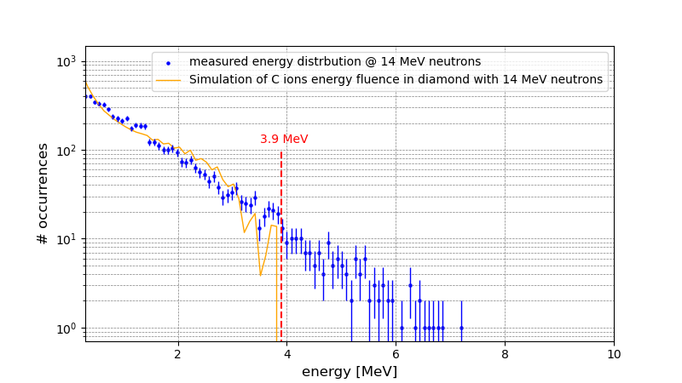
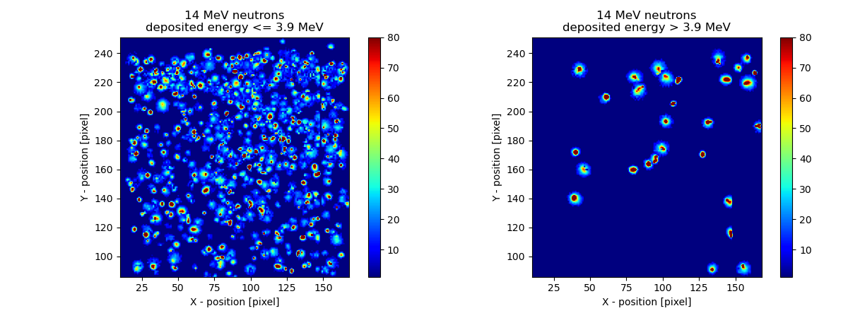
Analysis of charge profiles and comparison with Monte Carlo simulations
Neutrons - ¹²C REACTIONS:
Reactions | Q-value (MeV) | Threshold energy (MeV)
¹²C(n, n)¹²C | 0.0 | 0.0
¹²C(n, n’ γ)¹²C | 4.44 | 0.0
¹²C(n, γ)¹³C | 4.95 | 0.0
¹²C(n, α)⁹Be | -5.70 | 6.18
¹²C(n, n’ 2α)⁴He | -7.27 | 7.89
¹²C(n, n’ α)⁸Be | -7.37 | 7.99
¹²C(n, 2α)⁵He | -8.16 | 8.85
¹²C(n, p)¹²B | -12.59 | 13.64
¹²C(n,d)¹¹B | -13.73 | 14.89

Slide 13
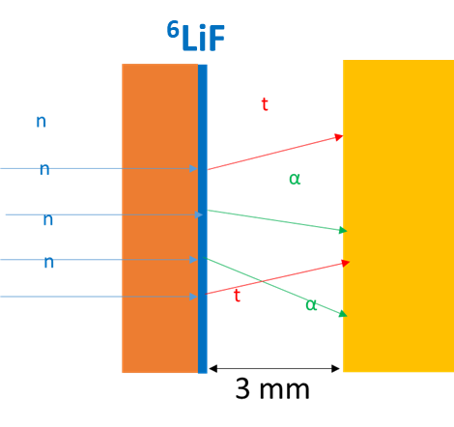
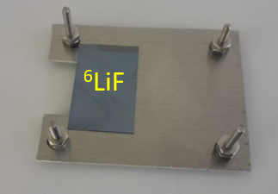
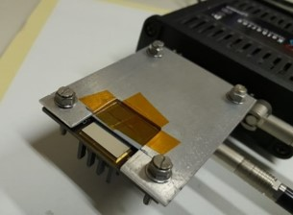
Thermal neutron detection by means of Timepix3
Thermal neutron detection in Radiation Protection & Nuclear reactors
⁶LiF CONVERTER
TPX3 with ⁶LiF CONVERTER
material | converter | Natural Isotopic Abundance | Neutron reactions | Reaction products energetic
LiF | ⁶Li enrichment 95 % | ⁶Li (7.5 %) ⁷Li (92.5 %) | ⁶L(n, α)³H | α (2.05 MeV) ³H (2.73 MeV)
⁶LiF converter enriched with 95% ⁶Li
Film deposited on a Silicon substrate
Thicknesses : 330 μm Si, 5 μm ⁶LiF

Slide 14
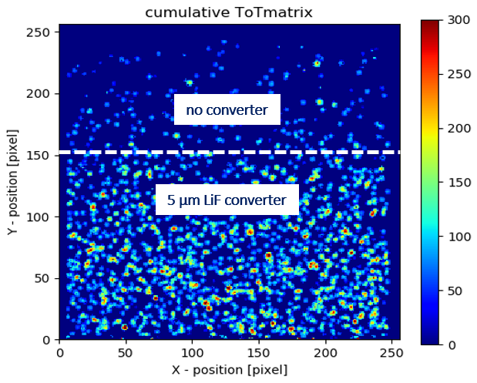
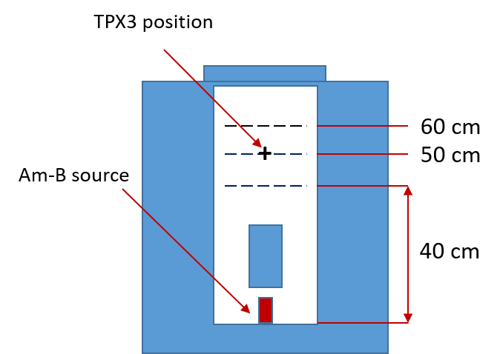
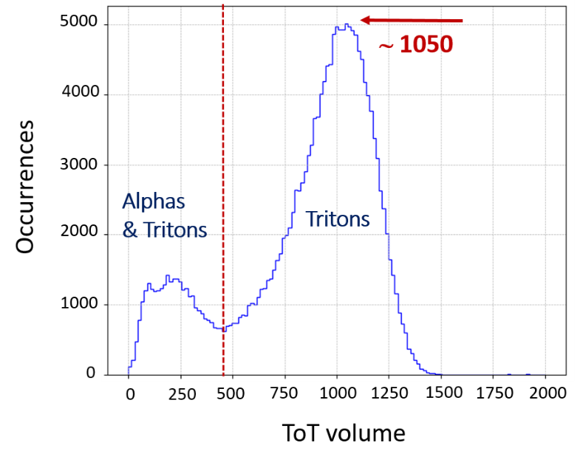
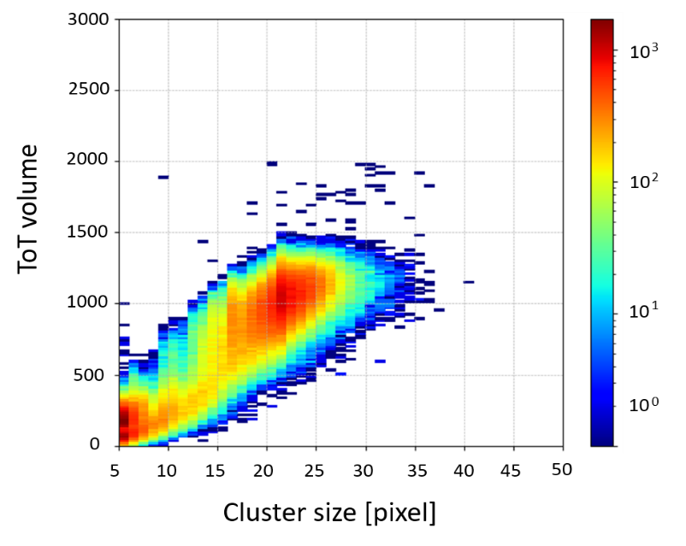
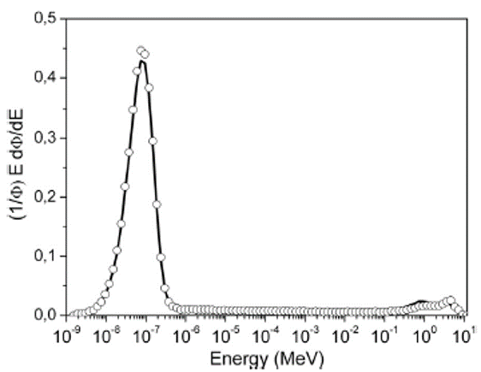
L’istogramma 2D del ToT volume in funzione della Cluster Size mostra due distribuzioni: una dovuta alla presenza simultanea di tracce da alfa e tritoni e l’altra relativa alla presenza di sole tracce da tritoni.
Experimental measurements at HOTNES facility & results
HOTNES
(HOmogeneous Thermal NEutron Source)
FACILITY
(ENEA FRASCATI)
Source: 241Am – B
Flux(Ref.point): 763 ± 11 n/(cm² s)
The 1D histogram of ToTv highlights the presence of the two energy contributions.
Simultaneous presence of alpha and triton tracks
Presence of only triton tracks

Slide 15
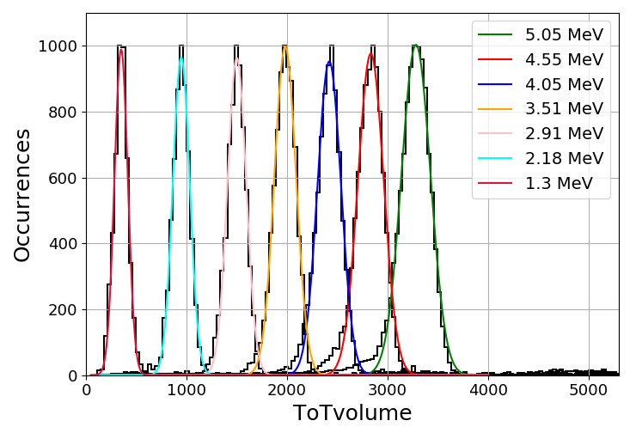
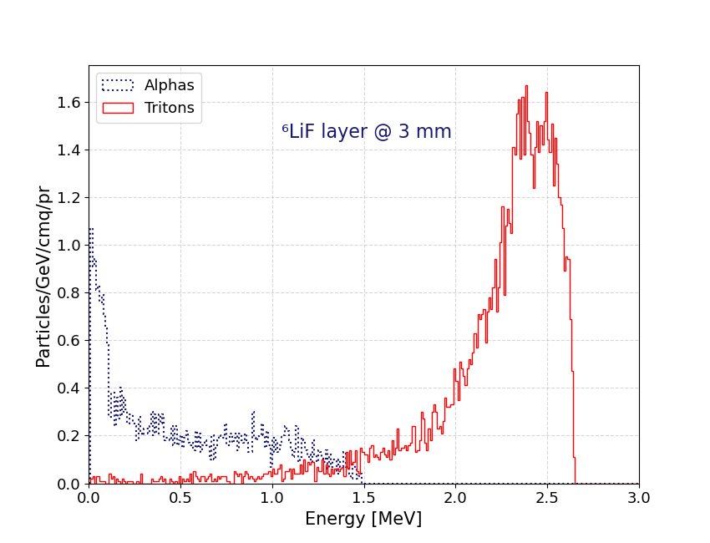
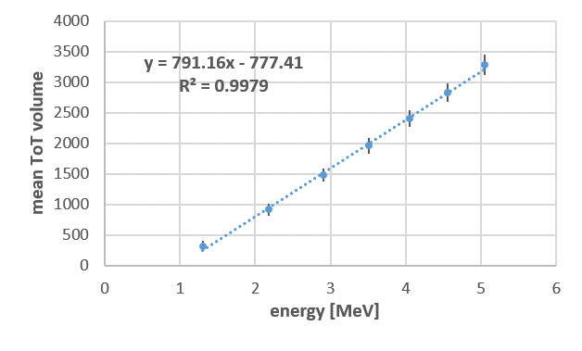
ToT energy calibration procedure & results
Energy response at different distances of the alphas source
ToT ∼ 1050
E (³H) ∼ 2.3 MeV

Slide 16
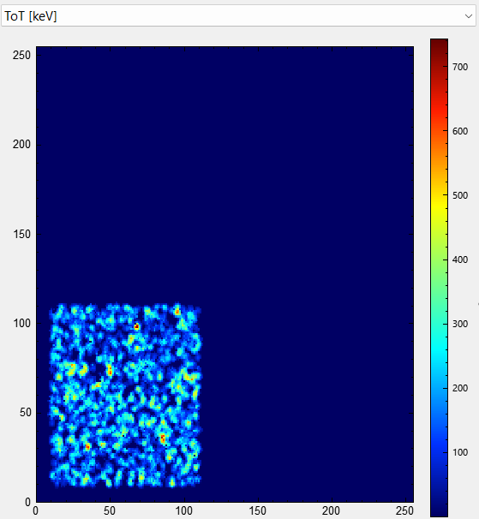
L’istogramma 2D del ToT volume in funzione della Cluster Size mostra due distribuzioni: una dovuta alla presenza simultanea di tracce da alfa e tritoni e l’altra relativa alla presenza di sole tracce da tritoni.
Estimated measured efficiency & measurements at n_TOF facility
nToF (neutron Time of Flight) FACILITY (CERN, Ginevra)
Neutron Flux$\text{ : 763 }± \text{11 }\text{n}\text{/(}\text{cm}\text{2} \text{s}\text{)}$
Time-of-flight measurements, after appropriately selecting the reference times for thermal neutrons:
CS > 5
Rnd > 70
X cent: 10-100
Y cent: 10-100
ToT: 0 - 4500
Energy range: 5 meV – 0.5 eV
Estimated efficiency (Tritons & alphas)
$≅0. 9 \%$
CdTe TPX3
Alpha and Triton tracks
CS > 5
Rnd > 70
X cent: 10-100
Y cent: 10-100
ToT > 450
Estimated efficiency
(Tritons)
$≅0. 7 \%$
10 frame
1000 frame
WORK IN PROGRESS…

Slide 17
Thanks for attention
Dedicated to Fabrizio Murtas

