Slide 1
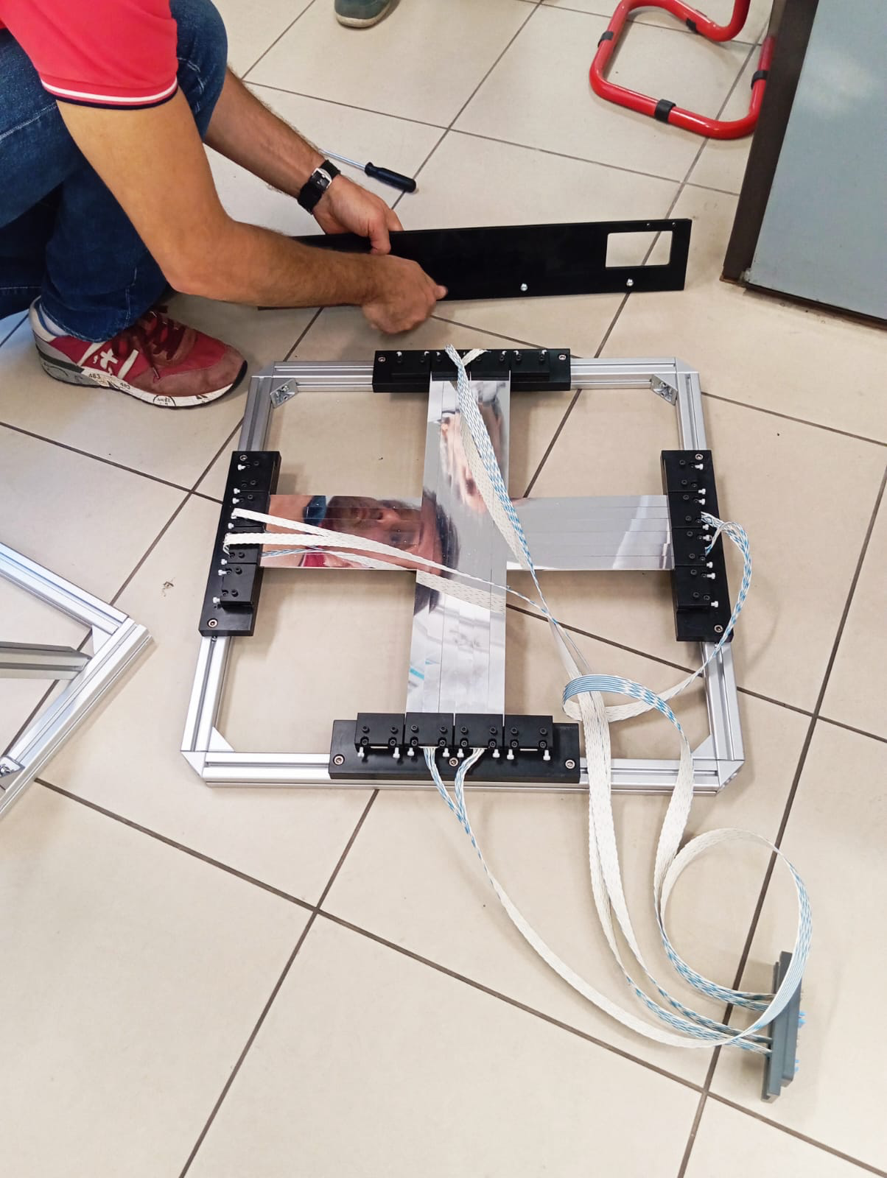
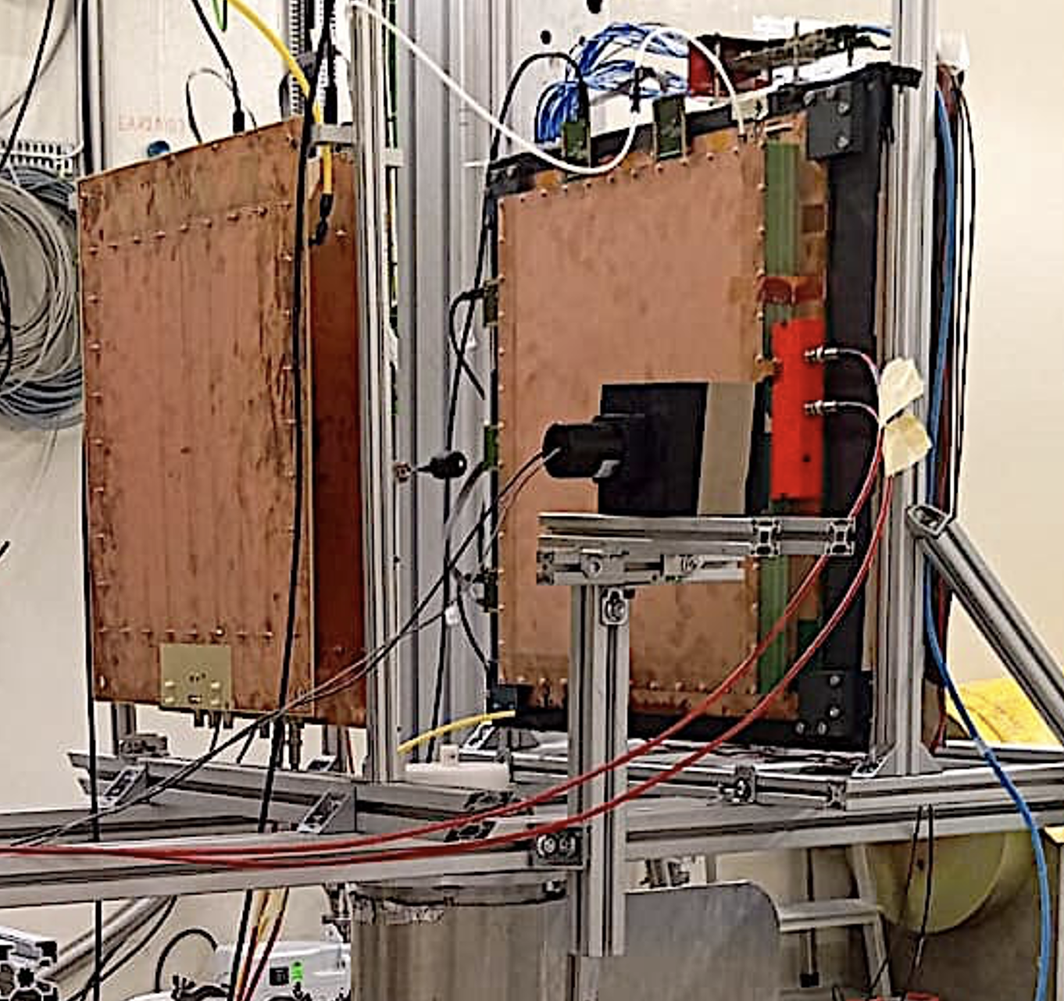
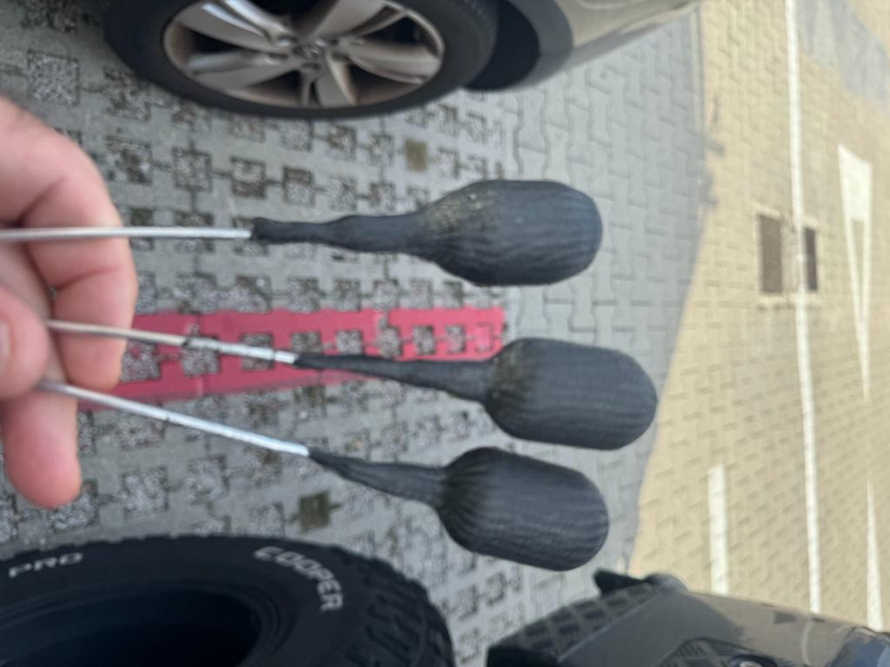
X17 TEST AT EAR2 oct 2023
Array of
Scintillator
bars
uRwell
40x40x3 cm³
Array of
Scintillator
bars
uRwell
30x30x1,5 cm³
target
Cubic scintillator
10x10x10 cm³
Target capsule realised with 3D printer

Slide 2
X17 TEST AT EAR2 oct 2023
Setup:
-Demonstrator, composed by a large uRwell and an array of scintillator bars
-Small uRwell
-Cubic scintillator
-target is an Al and Carbon_fibre capsule projected to contain ³He at high pressure (~380 bar)
Readoutand DAQ:
-uRwell: APV25 cards + SRS
-Scint array: SiPM+ FERS (from CAEN)
-CUBE: Hamamatsu PMT+main DAQ
Goal:
Evaluation of NOISE AND SATURATION EFFECTS in the demonstrator as a function of:
-Target type
-Demonstrator distance from the beam (10, 20, 30 cm):
-Time from gamma-flash (0, 500, ….→10.000 ns)
uRwell
40x40x3 cm³
beam
target
Array of Scintillator bars 50x1,7x0,3 cm³
uRwell
30x30x1,5 cm³
Cubic
Scintillator
10x10x10 cm³

Slide 3
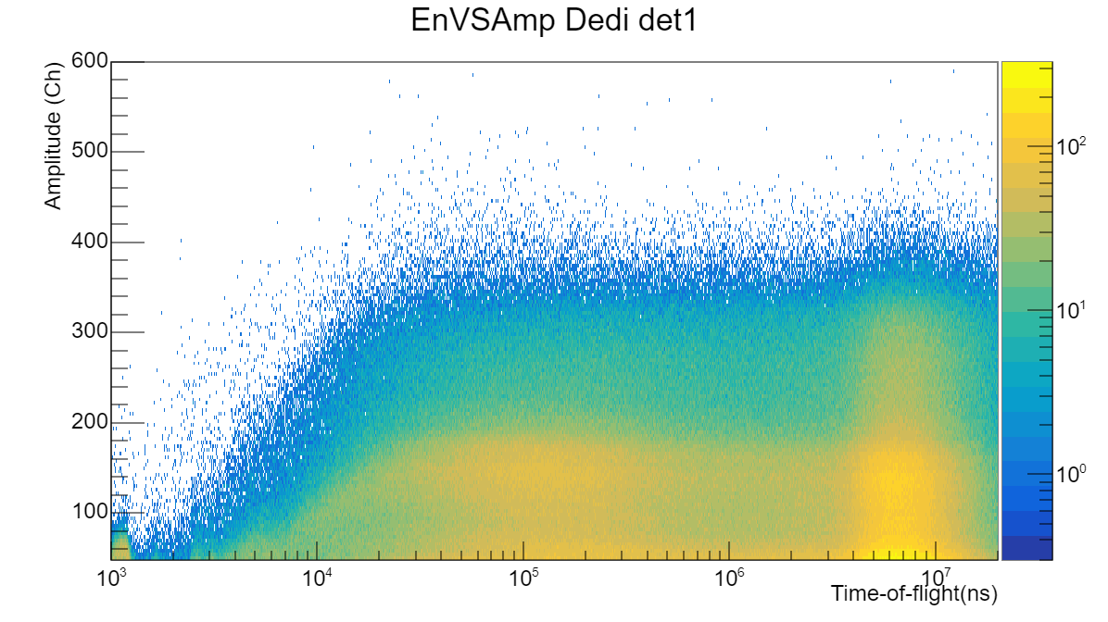
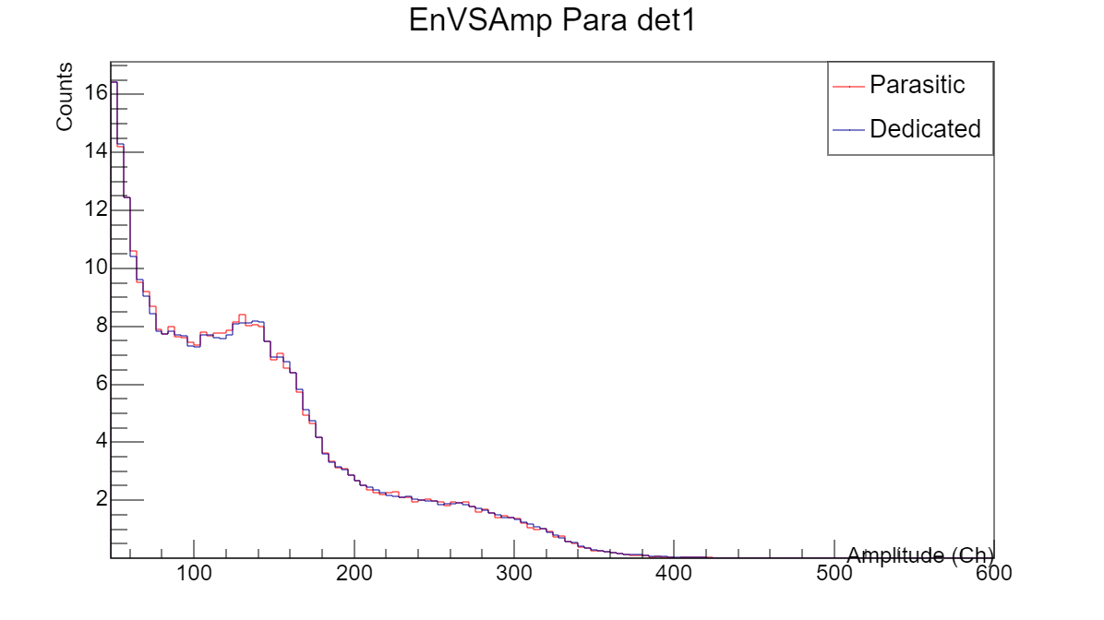
Cubic Scintillator 10x10x10 cm³
The peak of n+p→d+γ (Q=2.2 MeV)
Clearly visible
Resolution ~ 20%
→10% at 10 MeV
Saturation close to the γ-flash
uRwell
40x40x3 cm³
beam
target
Array of Scintillator bars 50x1,7x0,3 cm³
uRwell
30x30x1,5 cm³
Scintillator
10x10x10 cm³

Slide 4
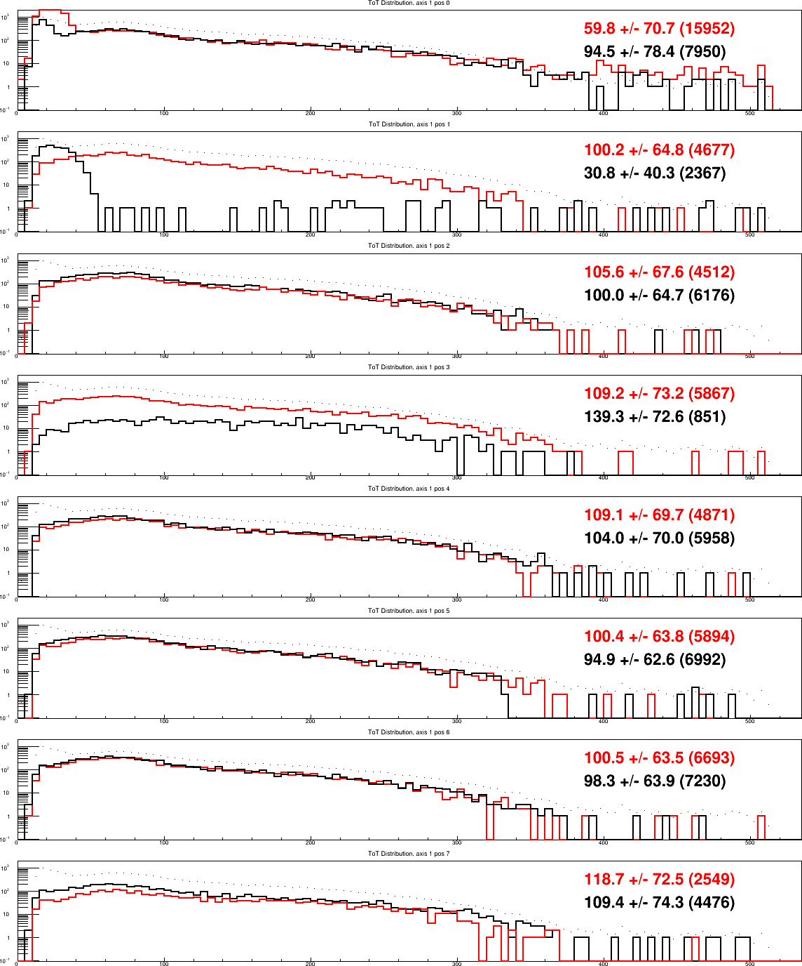
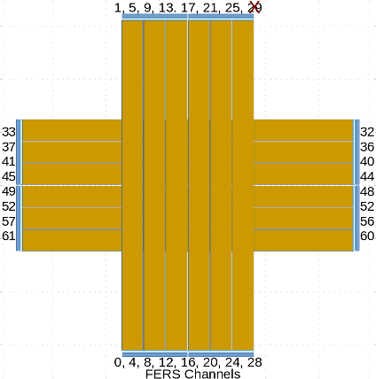
Array of scintillator bars
Coincidences:
H-Signal → Left & Right (e.g. 36&37)
V-Signal → Bot & Top (e.g. 20&21)
Timing and Spectroscopy
acquistion modes
Time Over Threshold single channel distributions
10 us delay from g-flash
horizontal bars
Good
Likely
Bad cabling
Good
Likely
bad coupling
Good
Good
Good
Good

Slide 5
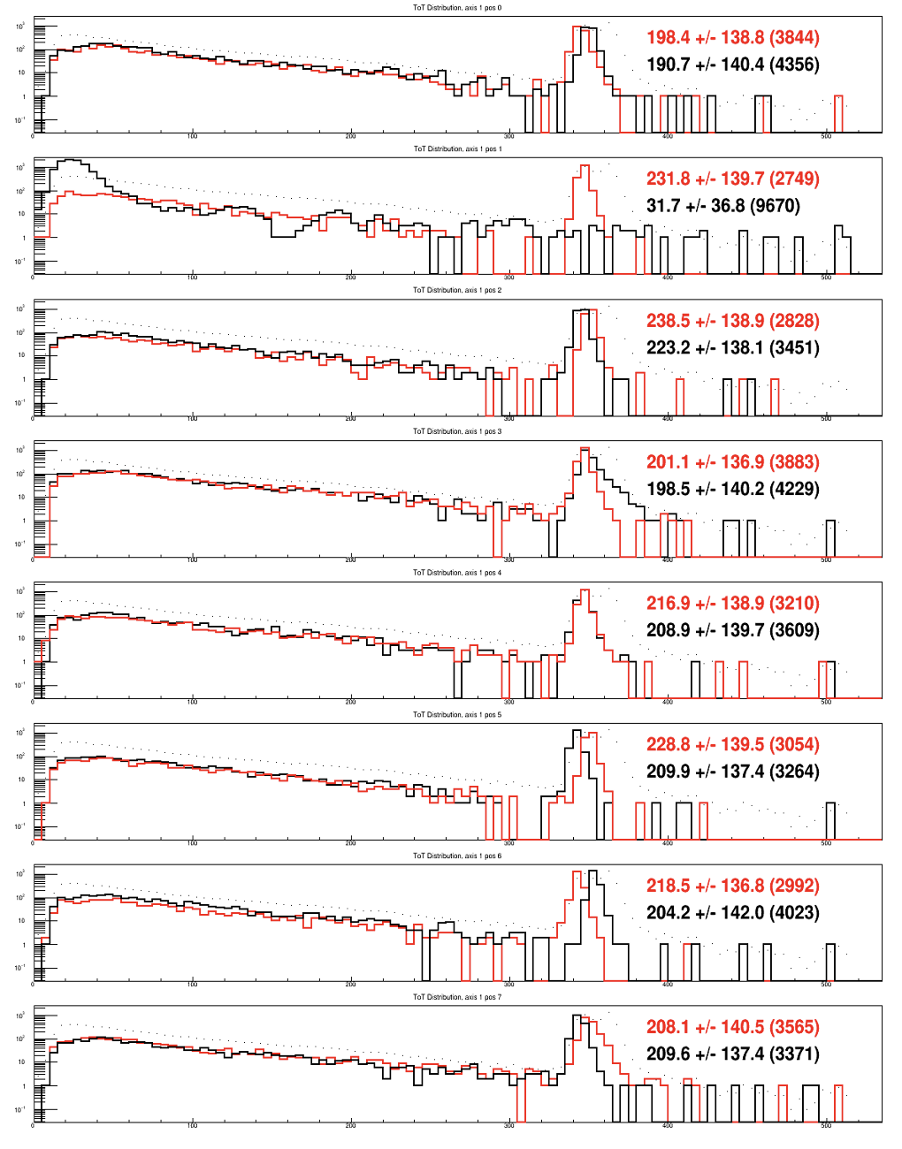
Array of scintillator bars
Coincidences:
H-Signal → Left & Right (e.g. 36&37)
V-Signal → Bot & Top (e.g. 20&21)
Timing and Spectroscopy
acquistion modes
Time Over Threshold single channel distributions
0 us delay from g-flash
horizontal bars
Good
Likely
Bad cabling
Good
Likely
bad coupling
Good
Good
Good
Good

Slide 6
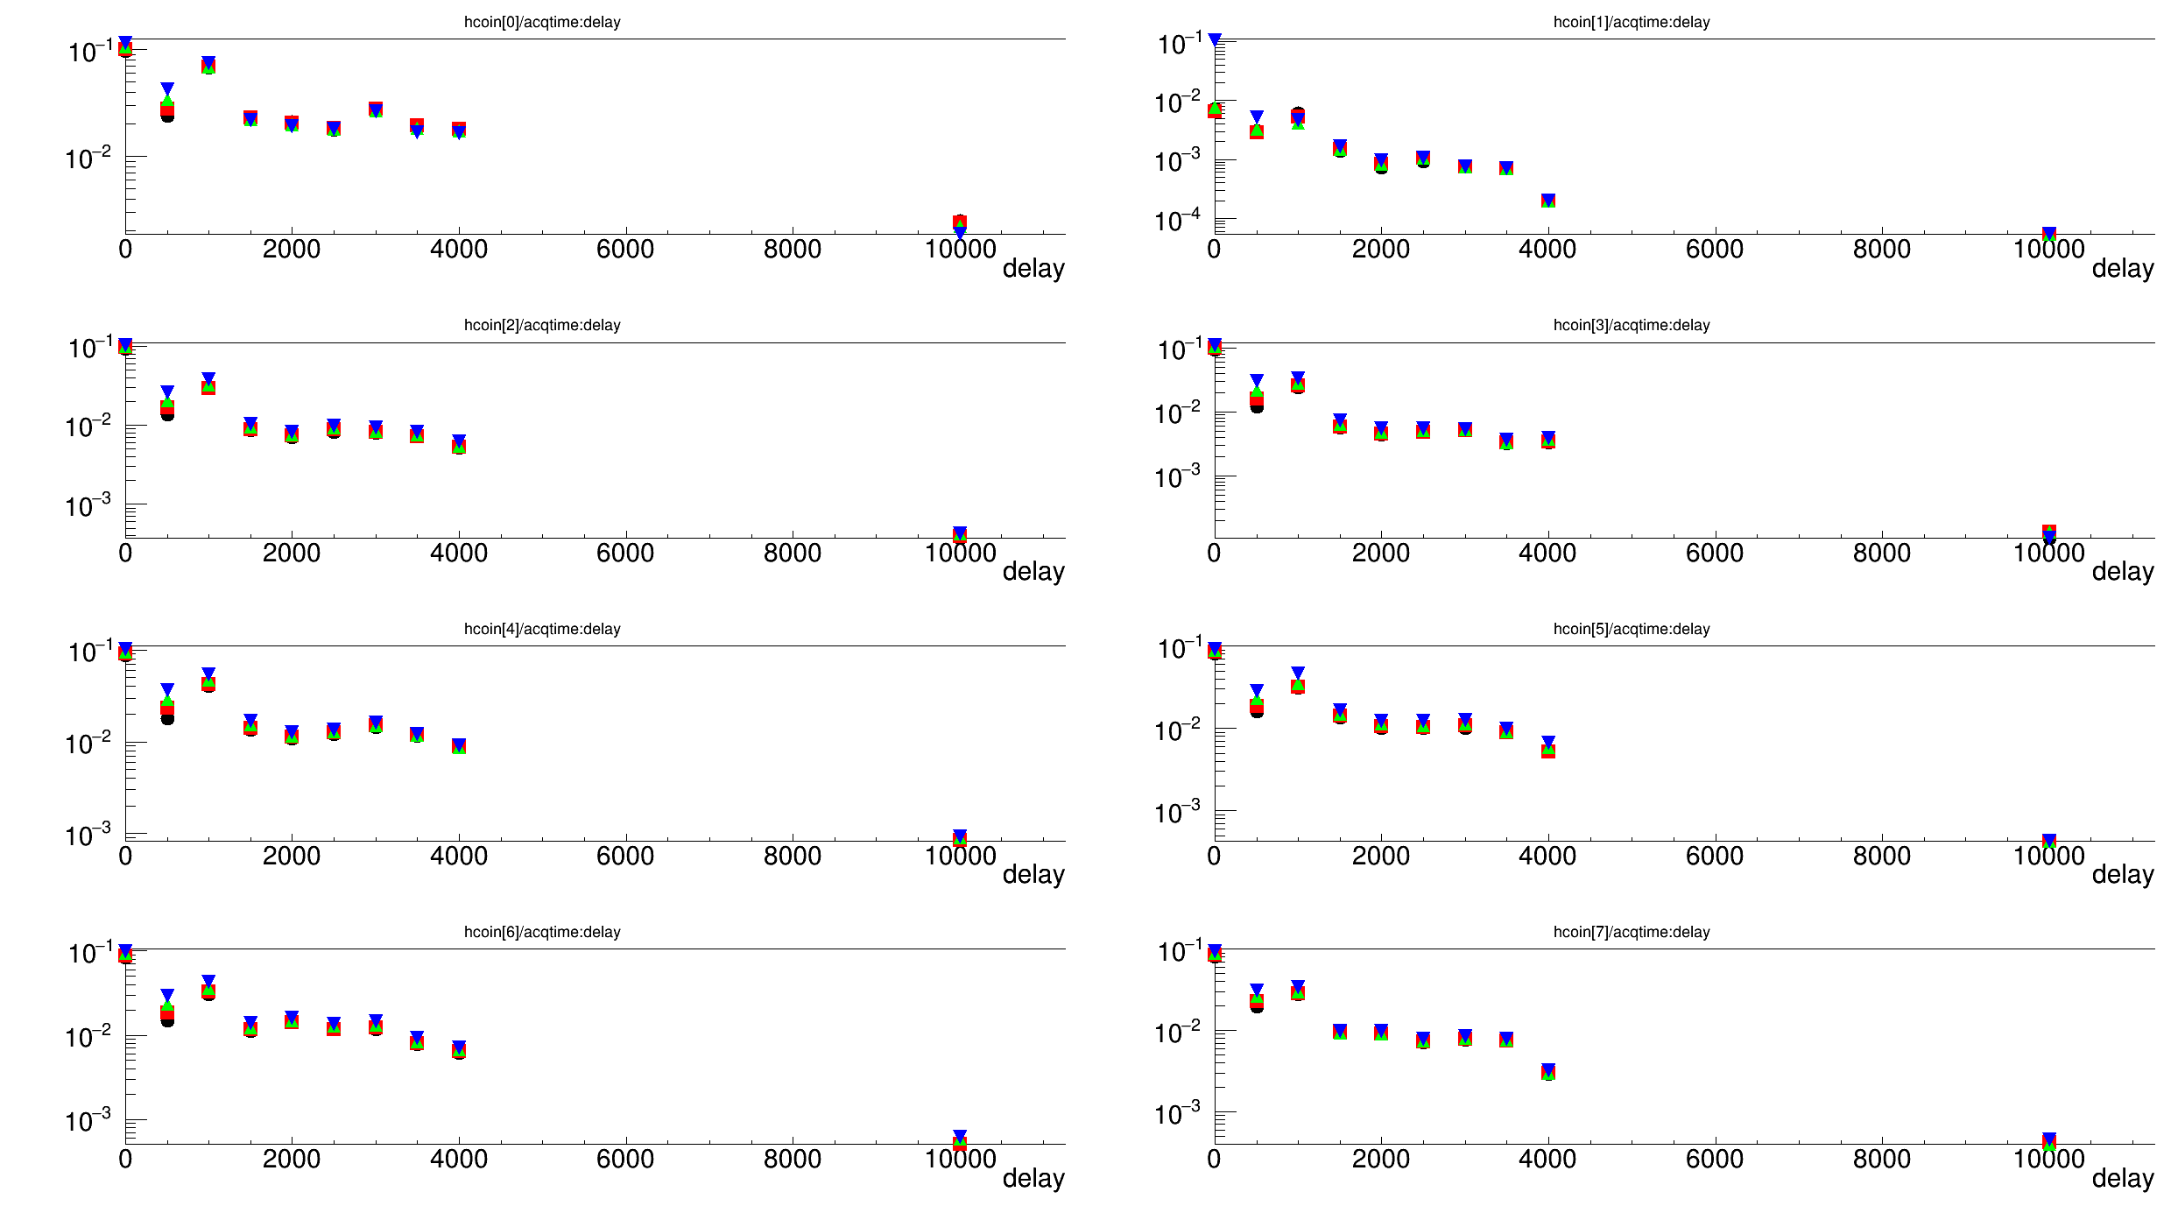
Array of scintillator bars
Signals over threshold within 50 us from time reference (gamma flash delayed)

Slide 7
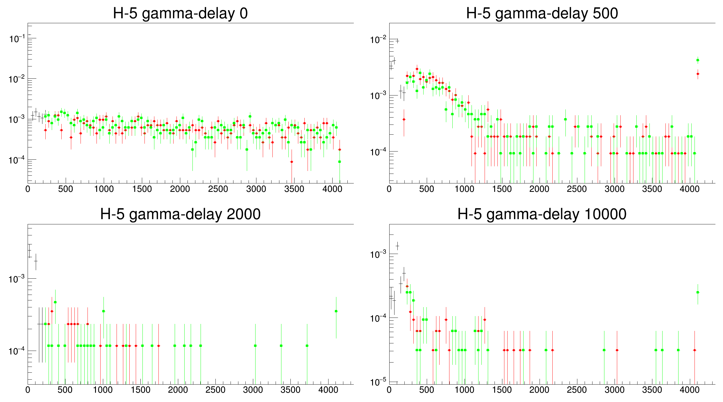
Array of scintillator bars
charge→
“good response” V-1,6 and H0,2,3,4,5,6,7 look similar

Slide 8
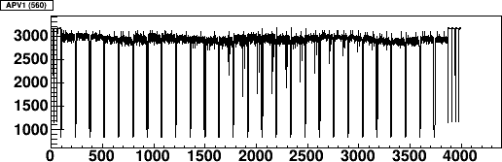
uRwell signals
The APV25 stores the charges of 128 strip every 25 ns (one time sample)
128
strips
the same
128 strips
after 25 ns
675 ns time window
baseline
Charge
(ADC unit)
128 strips * 27 time samples
marker between
time samples
signals
(few strips)

Slide 9
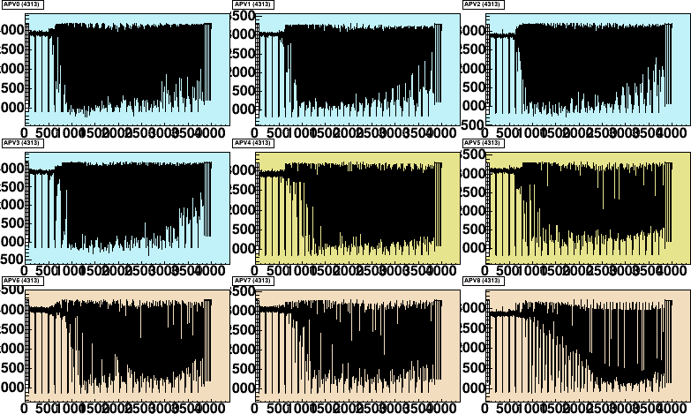
uRwells (C and D)
0 ns from g-flash
C-x
D-y
D-x

Slide 10
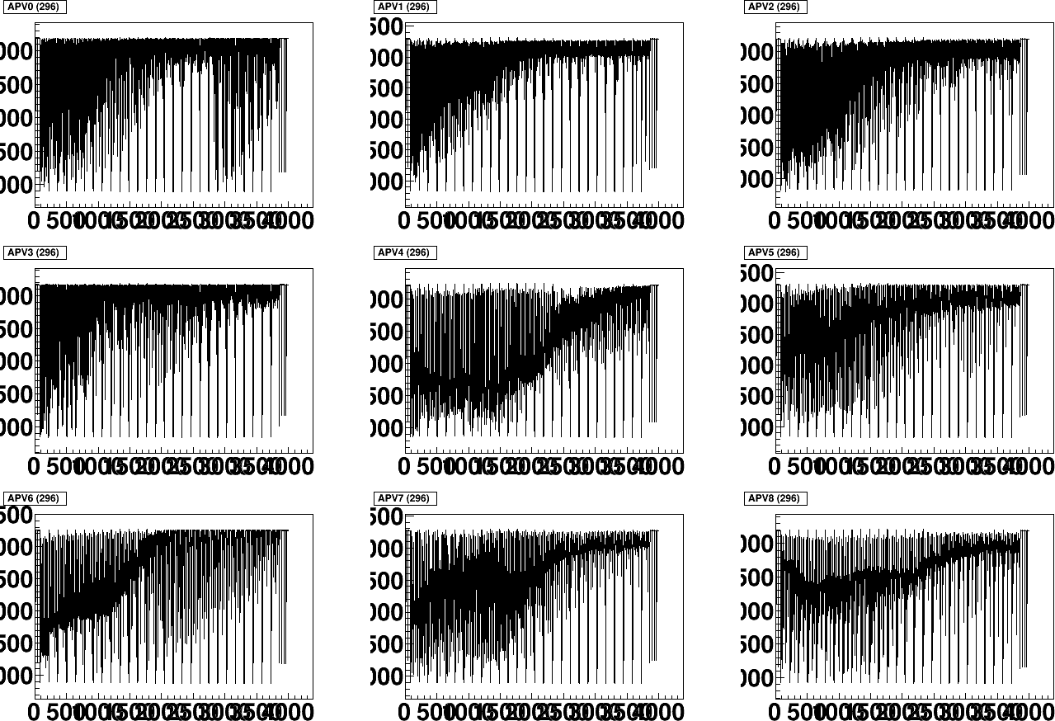
uRwells (C and D)
500 ns from g-flash
3cm drift uRwells
“usable” after ~700 ns from gflash

Slide 11
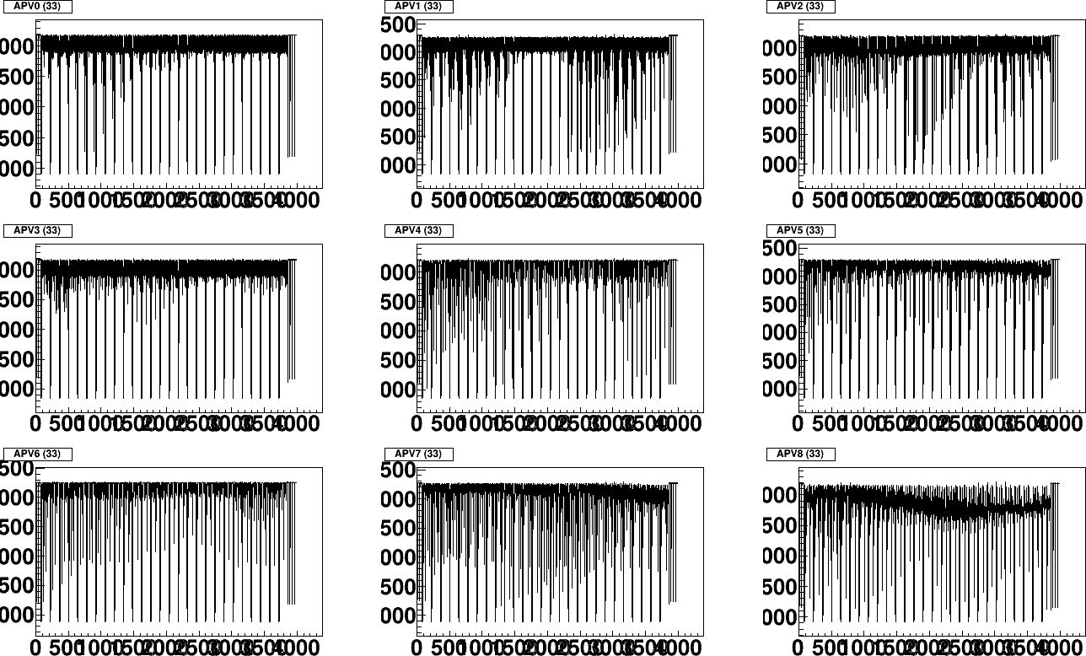
uRwells (C and D)
1000 ns from g-flash

Slide 12
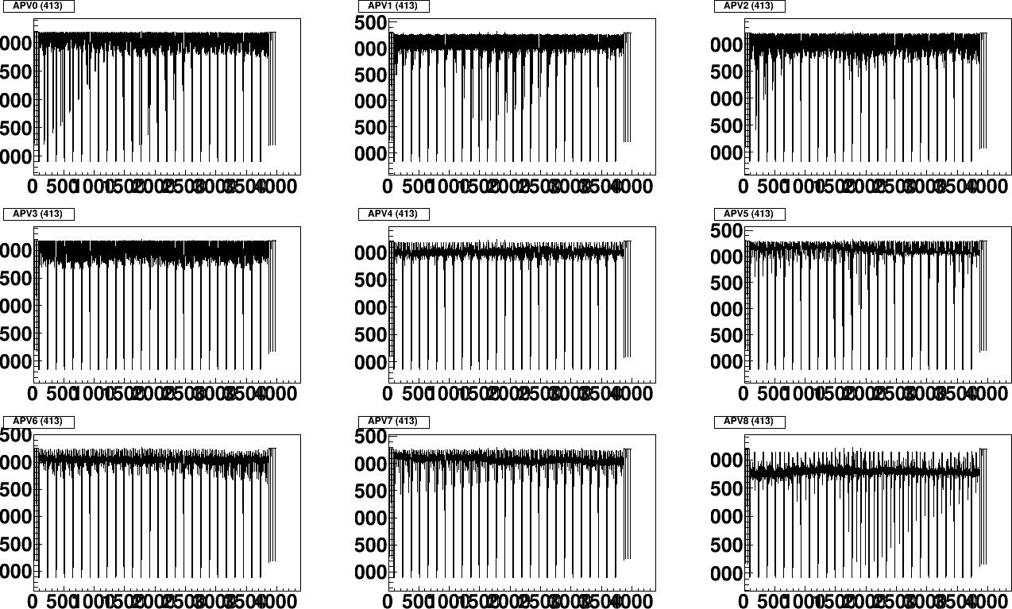
uRwells (C and D)
3000 ns from g-flash

Slide 13
To Do
Continue/Improve FERS analysis
Start looking at uRwell data
Get g-flash type from NTOF acq (use time to correlate to FERS/SRS acquisition)
Try to combine SiPM and uRwell
...

