Slide 1
Magnetic field simulations X17 @ n_TOF
Riccardo mucciola

Slide 2
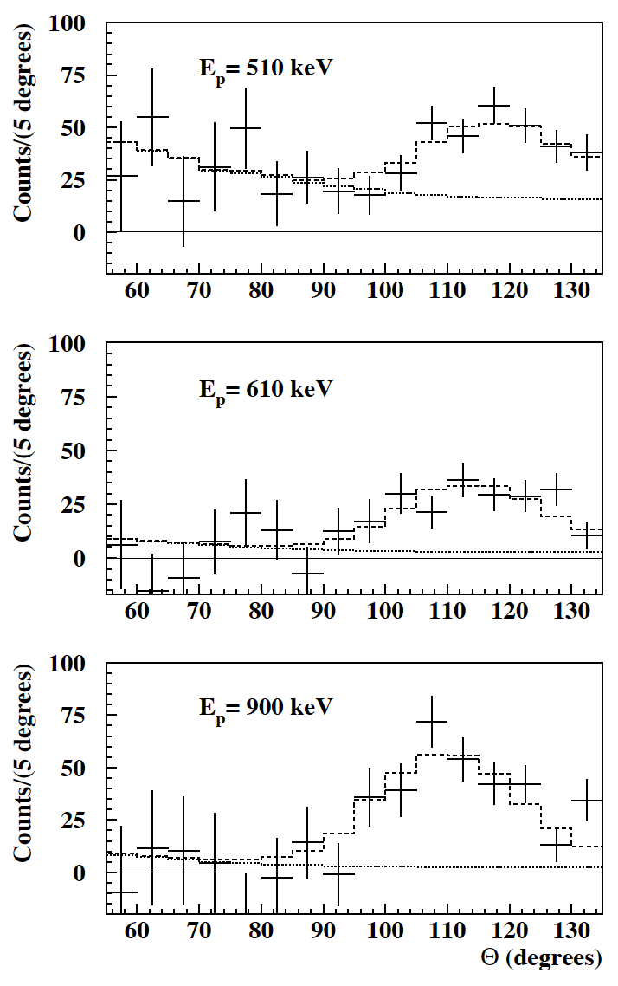
X17 ATOMKI results
A significant anomaly has been recently in the emission of electron-positron pairs in the ⁷Li(p,e⁺e⁻)⁸Be and ³H(p,e⁺e⁻)⁴He reactions:
Krasznahorkay, A.J.; et al.:
"Observation of Anomalous Internal Pair Creation in 8Be: A Possible Indication of a Light, Neutral Boson".
Physical Review Letters. 116 (42501): 042501 (2016).
Krasznahorkay, A.J.; et al.:
"A new anomaly observed in 4He supports the existence of the hypothetical X17 particle".
Physical Review C 104, 044003 (2021).
This anomaly has been interpreted as the signature of a BOSON (hereafter X17) not foreseen in the standard model of particle physics.
X17 boson could be a mediator of a fifth force, characterized by a strong coupling suppression of protons compared to neutrons.
This evidence/scenario is presently not confirmed or excluded by other experiments or groups.

Slide 3
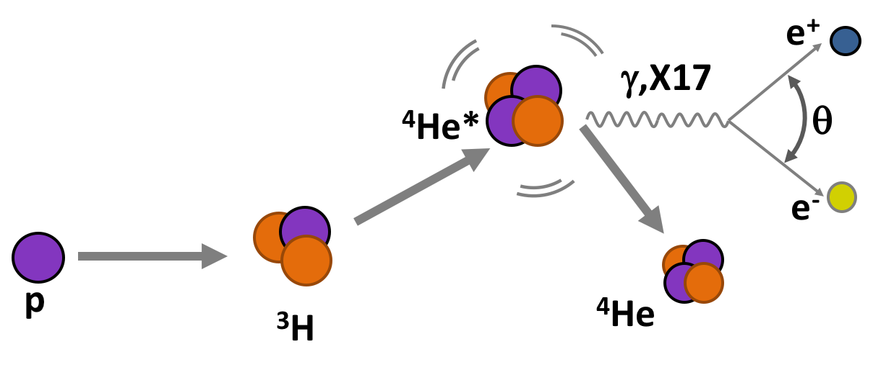
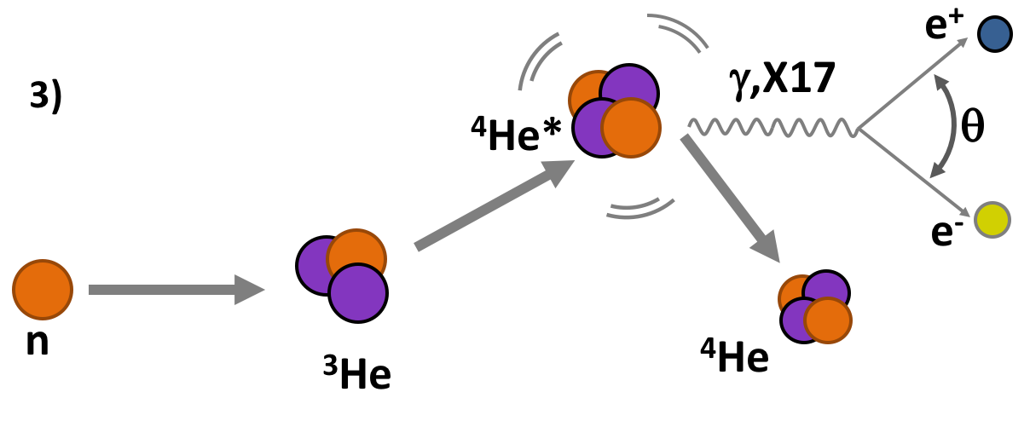
X17 @ n_TOF
Basic idea: new study of excited ⁴He exploiting the conjugated reactions:
³H(p,e⁺e⁻)⁴He
³He(n,e⁺e⁻)⁴He
OBJECTIVES:
Probing X17 existence
X17 Mass, quantic numbers, coupling, life-time, ..
Proto-phobic nature of the fifth force.
Data Vs Theoretical nuclear physics

Slide 4
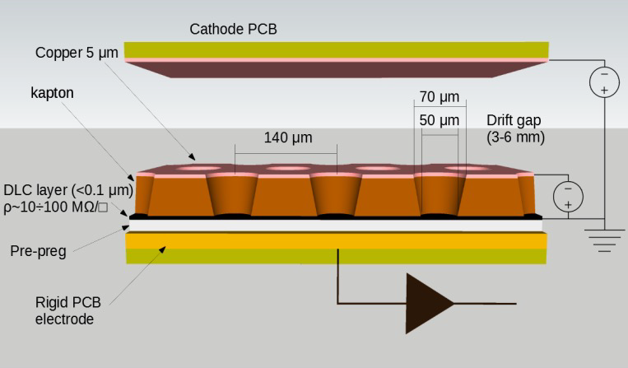
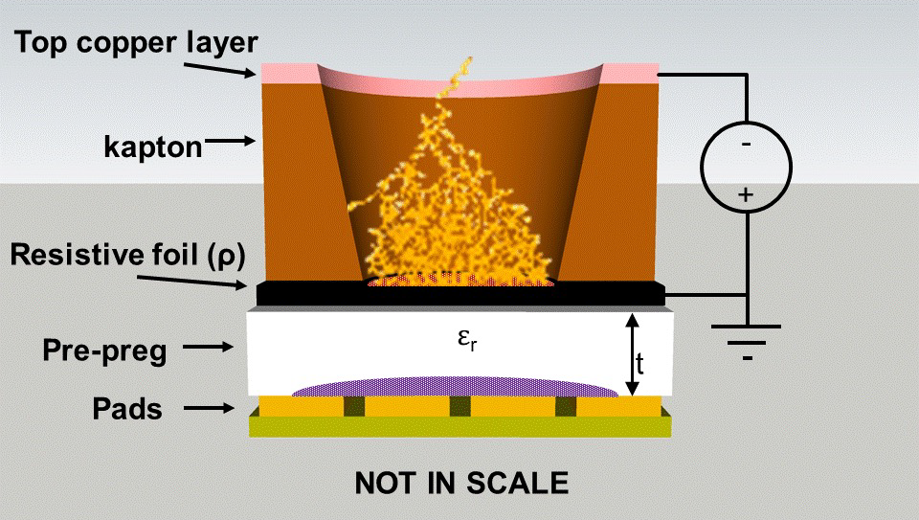
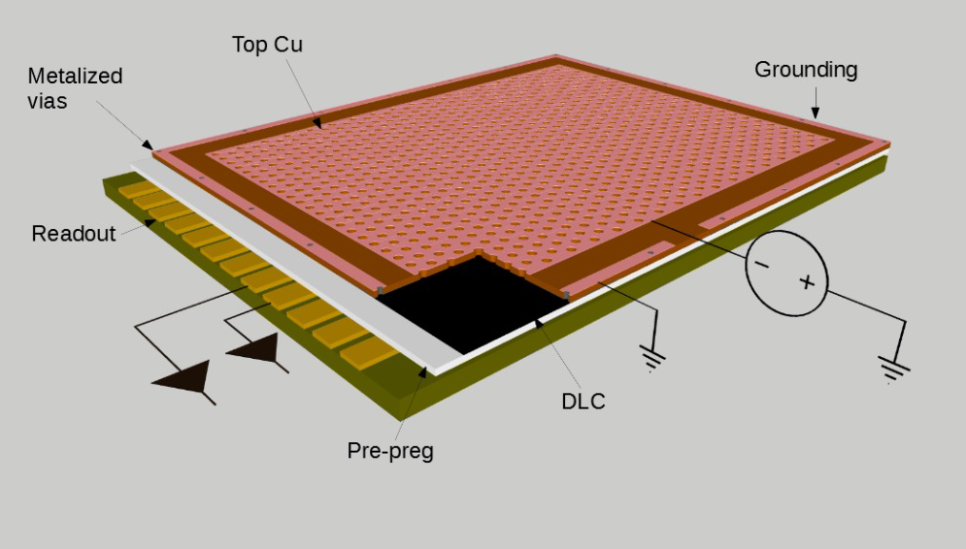
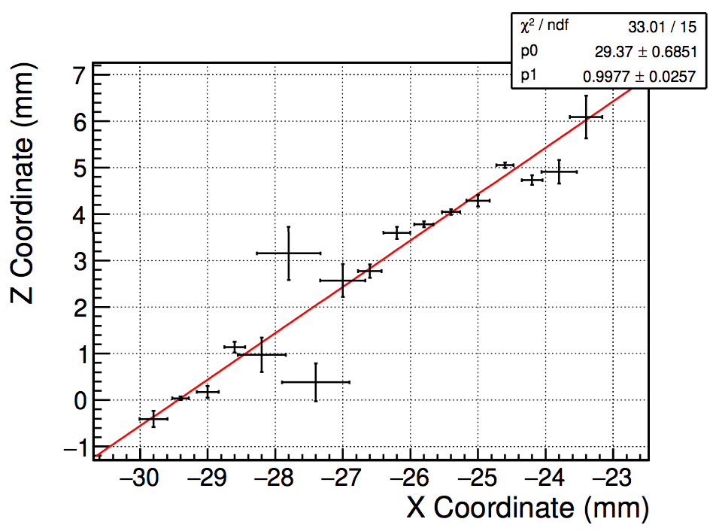
uRwell detector
uTPC with drift gap and uRwell
Active area of 38x46 cm2
Ar/CF4/CO2 (60:20:20) gas mixture
3D track reconstruction

Slide 5
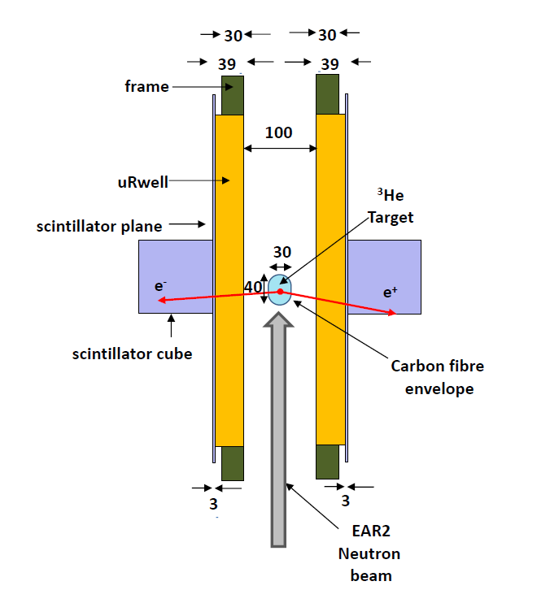
Initial demonstrator
Initial demonstrator for the setup
Two uRwell detectors and two scintillator cubes
Capsule holding ³He gas
No e+/e- discrimination, scintillator cubes could suffer from large background in EAR2.

Slide 6
uRwell simulations - Garfield
Detectors constructed in simulation code Garfield;
Pitch of resistive wells of 140µm in hexagonal pattern;
Resistive and conductive layer implemented in simulation;
3000V were placed in the drift region while 500V were used in the wells.
Signal of avalanche recorded only with multiplications higher than 500;
Magnetic filed of different magnitude tested, maximum field of 500G;
Spatial resolution of each event given by pitch of detectors, no additional effect on the resolution included in the simulation.

Slide 7
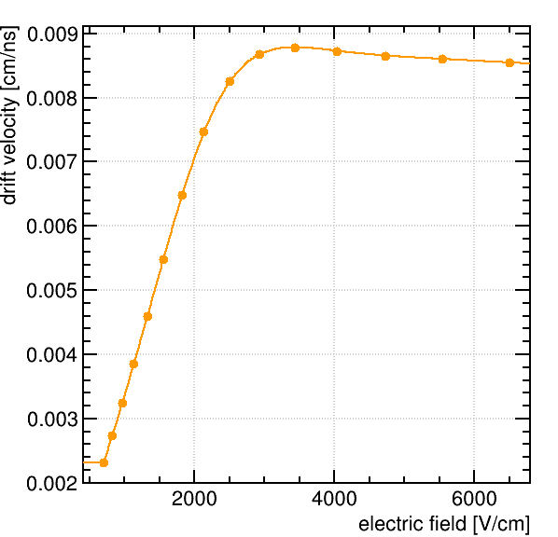
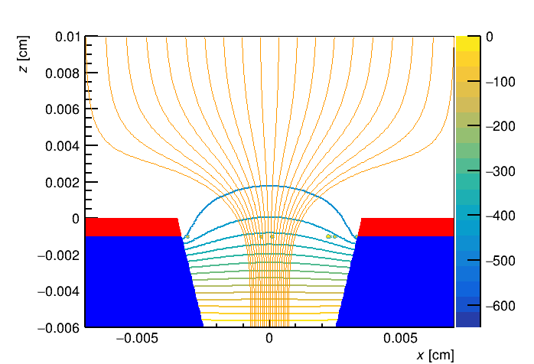
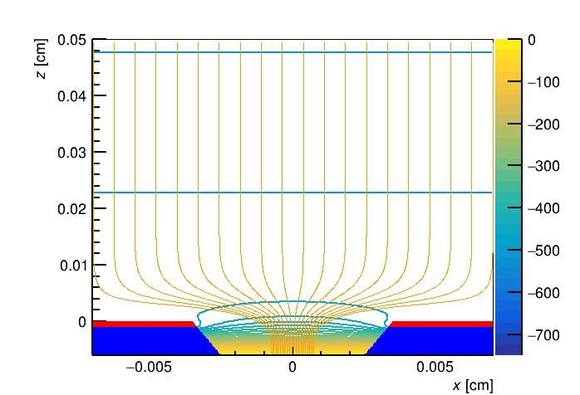
uRwell Simulations - Garfield
GARFIELD simulations to study detector performances
Ar/CO2/CF4 gas mixture simulated
Electric field and electrons drift velocities simulated
Track reconstruction in a constant magnetic field

Slide 8
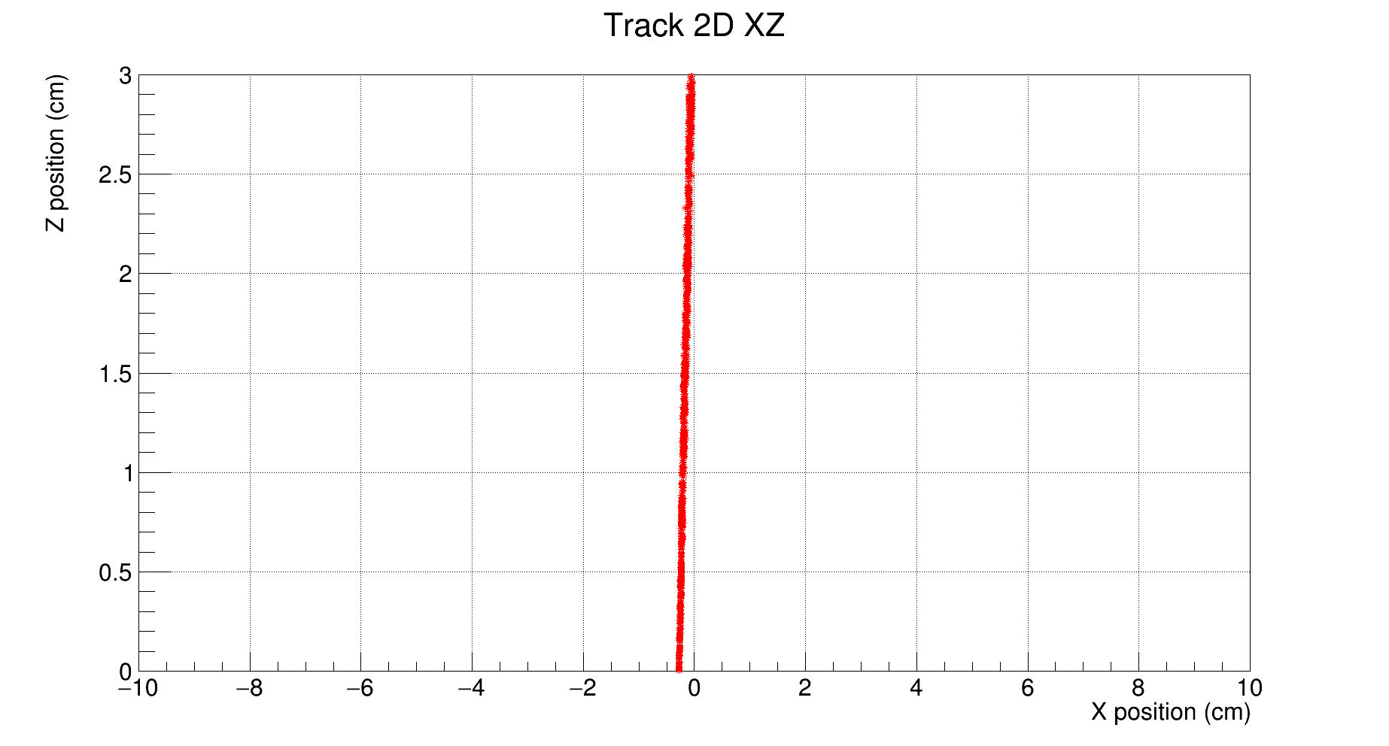
Garfield tracks
Tracks of electrons of different energies (2-18 MeV)
Magnetic field of 500 G
No visible curvature in the perpendicular plane
Not possible to use curvature inside a 3cm gap uRwell to obtain the energy, longer arm needed

Slide 9
Geant4 simulations
Since the simulation with Garfield are computationally intensive, for a full simulation of many X17-like events we decided to use Geant4.
To study the effect of the magnetic field we performed additional simulations using Geant4 code;
Detector active volumes made only of Ar/CO2/CF4 for simplicity;
Hit inside active volumes recorded using resolution given by detector pitch (140µm). All the hits are recorded in the position of the single well;
Detectors of 40x40 cm with a gap of 3cm.
Events are generated from axis origins with a vertex spread similar by the dimension of the target (~1cm radius sphere).
Events of IPC and X17 decay obtained from calculation of M. Viviani.

Slide 10
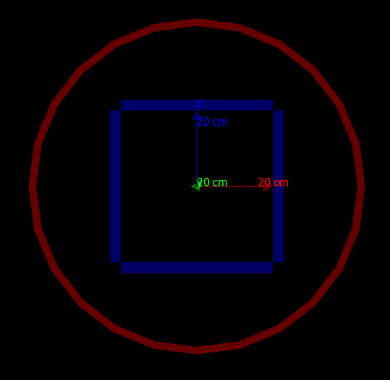
Geant4 setup
Simulations performed with Geant4 to study high number of events:
2/4 uRwell detectors,
20 cm from beam,
Magnetic field of max 500 G parallel to beam direction.
Acceptance of four chambers placed at 20cm is comparable to the one obtained with two chambers at 10cm

Slide 11
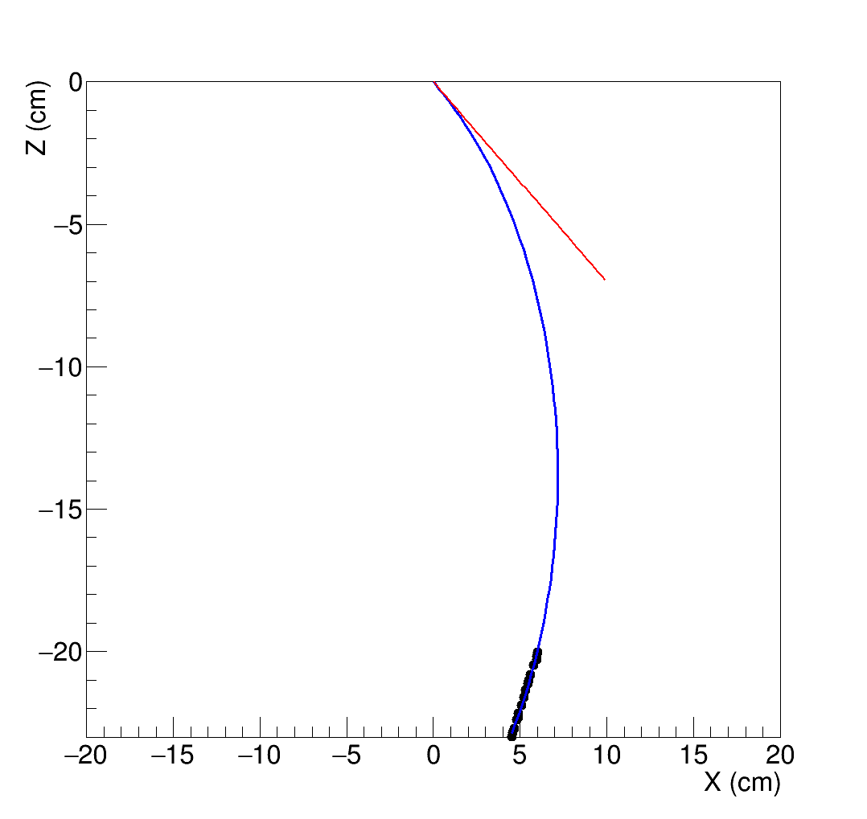
Energy reconstruction
Assume interaction vertex at the origin
Fit circumference arc using straight track and vertex
Tangent (red line) used for angle determination (see later)

Slide 12
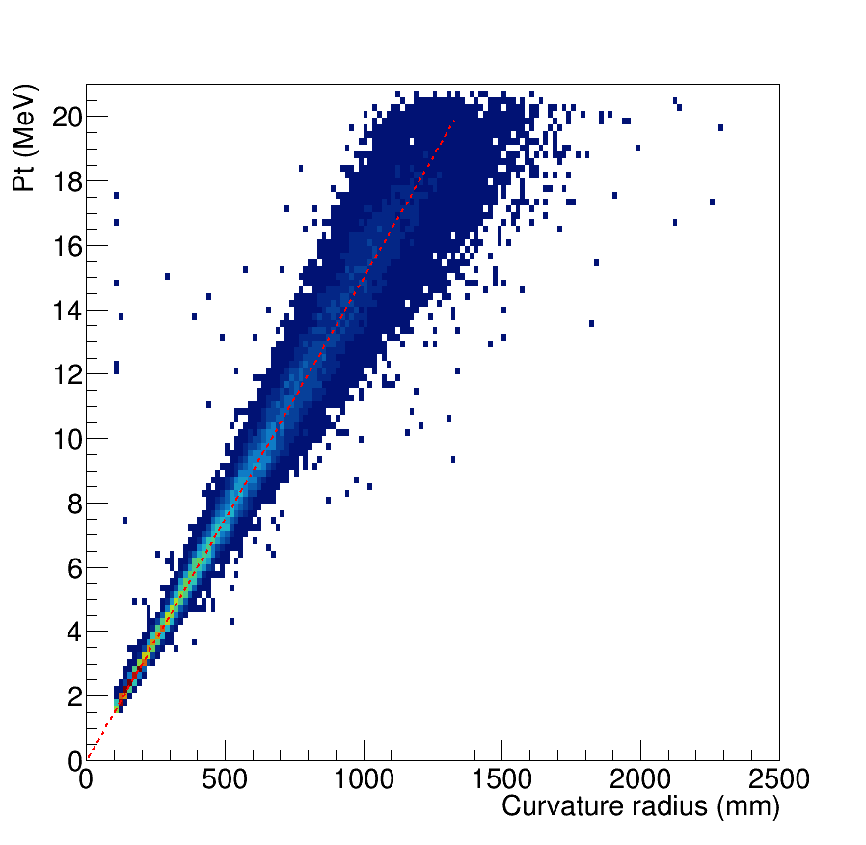
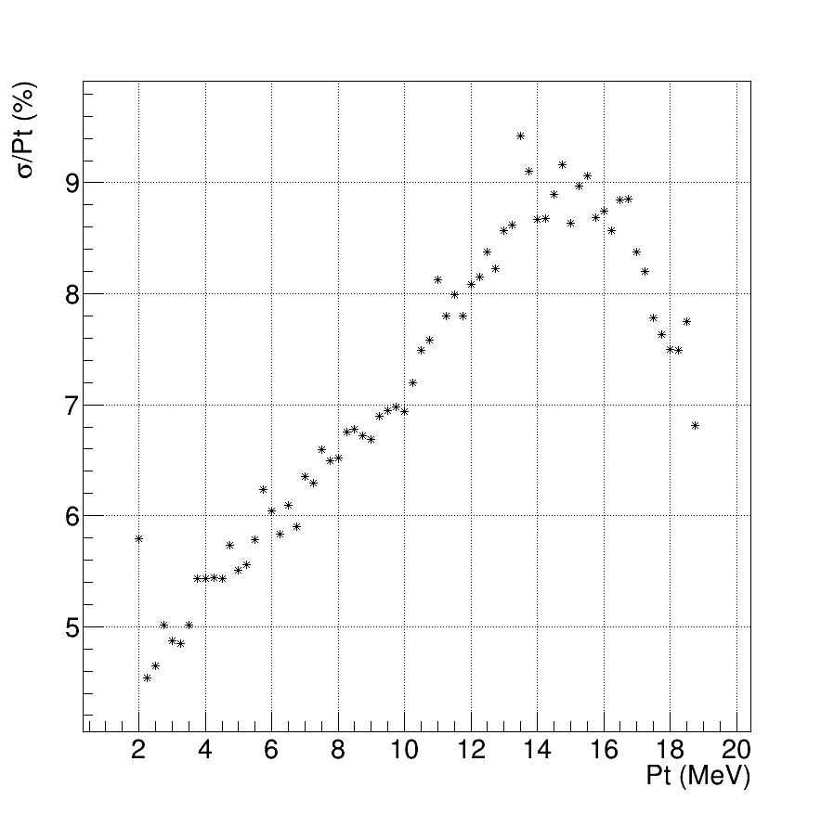
Energy reconstruction
Energy of the track reconstructed using curvature radius in magnetic field
Resolution estimated at different energies with a gaussian fit of the projection of the 2D plot

Slide 13
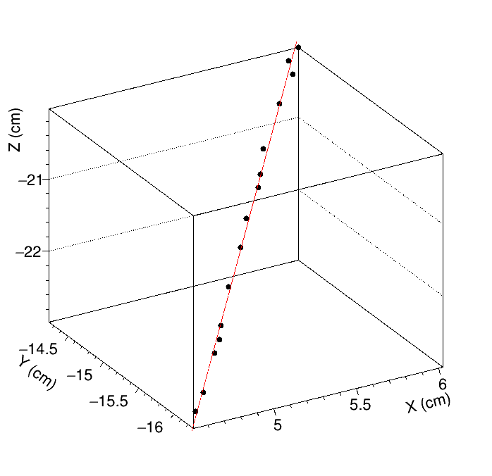
Emission Angle Reconstruction
Theta reconstructed using linear fit of the track in 3D inside of the uRwell detecotr
Phi reconstructed using tangent to circumference at emission vertex (origin of axis)

Slide 14
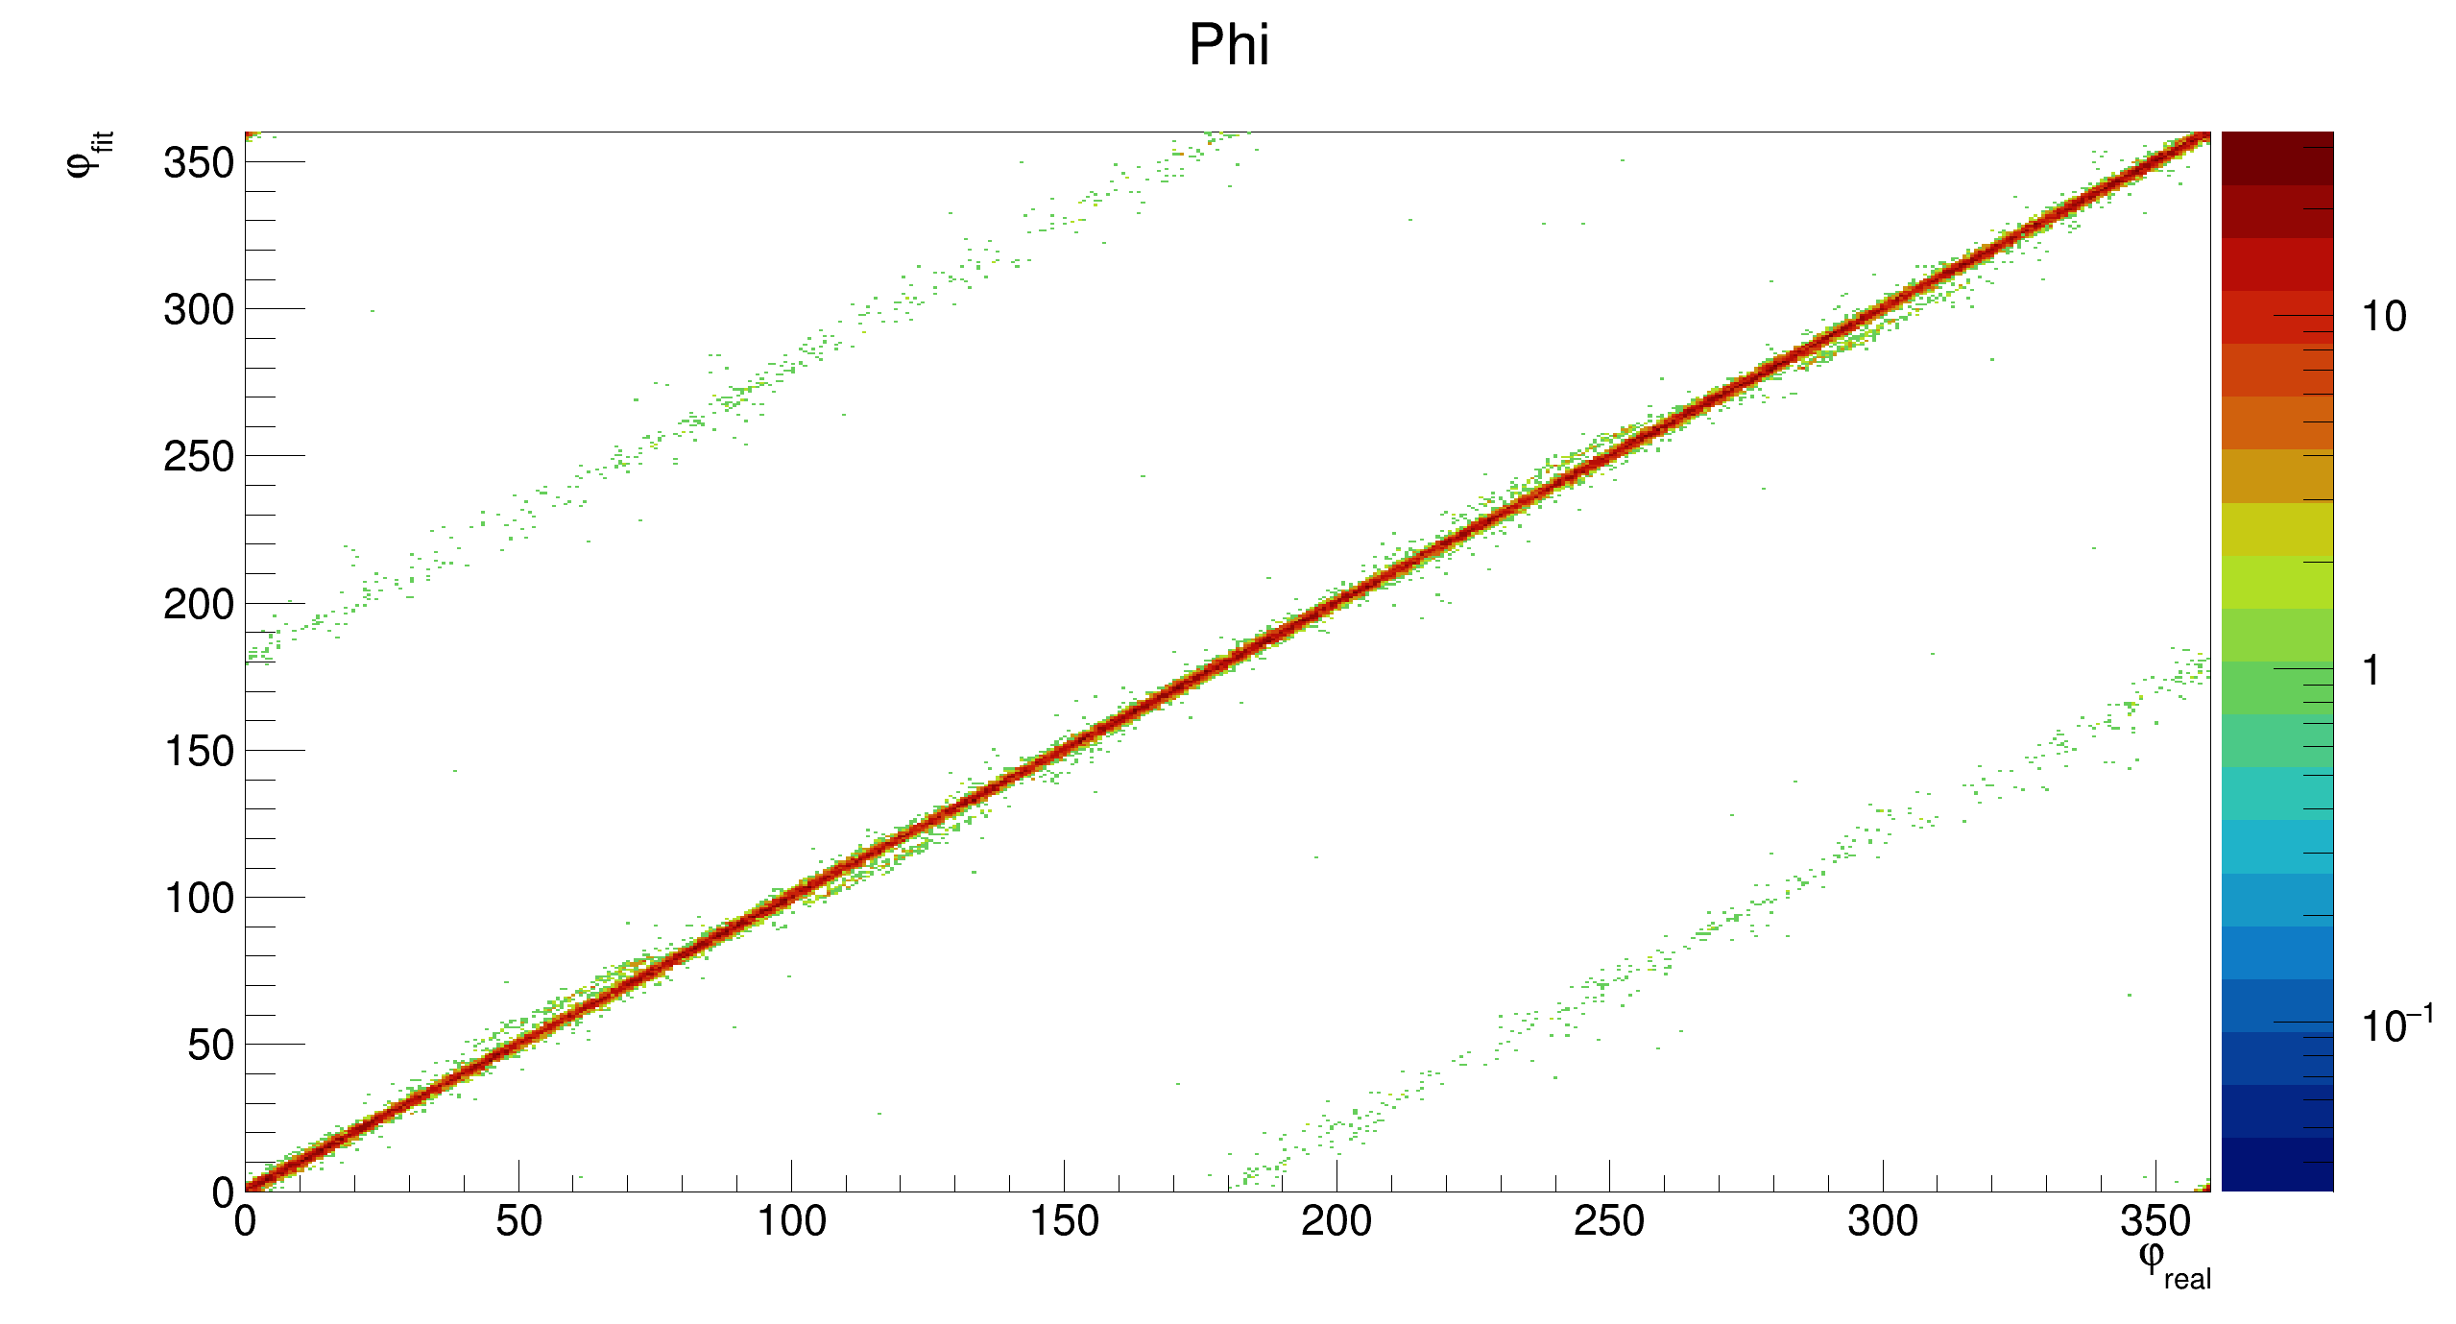
Angles Reconstruction performance
Comparison of reconstructed and real phi of the track
Good agreement of >95% of the events, few events are reconstructed with phi shifted of 180°

Slide 15
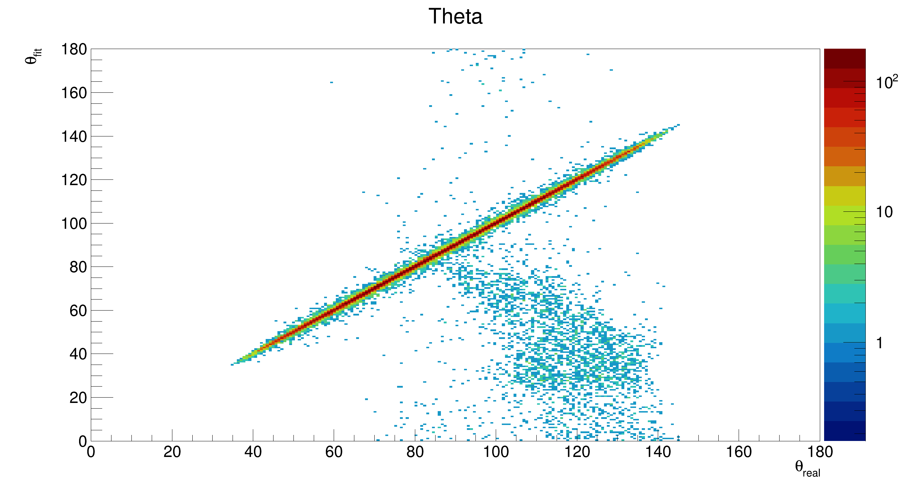
Angles Reconstruction performance
Comparison of reconstructed and real theta of the track
Small number of tracks reconstructed with wrong angle

Slide 16
Conclusions
New detection setup for X17 based on uRwell to reach high angular acceptance and energy estimation using magnetic field;
Preliminary simulations to study the feasibility of measurements with magnetic field were performed;
Only effect of the pitch added to the spatial resolution of the chambers;
Simulations performed for a setup consisting of 4 uRwell chambers placed at 20 cm from the target and a uniform magnetic field of 500G parallel to the beam
With these conditions, is possible to evaluate the curvature of the track and thus its energy with a precision of 10%.
From the track in the detector is possible to estimate the emission direction of the particle at interaction vertex.

Slide 17
The X17 Team
E. Cisbani (ISS ROMA)
N. Colonna (INFN BARI)
G. De Angelis (ISS ROMA)
M. D'incecco (LNGS)
G. Gervino (UNITO)
C. Gustavino (INFN ROMA)
C. Massimi (UNIBO)
P. Mastinu (INFN LNL)
B. Ali Mohammadzadeh (INFN ROMA)
A. Mengoni (ENEA BO)
R. Mucciola (UNITO)
C. Petrone (IFIN-HH)
F. Santavenere (ISS ROMA)
M. Viviani (INFN PISA)
And others...
Thank you
for your attention!

Slide 18
Backup

Slide 19
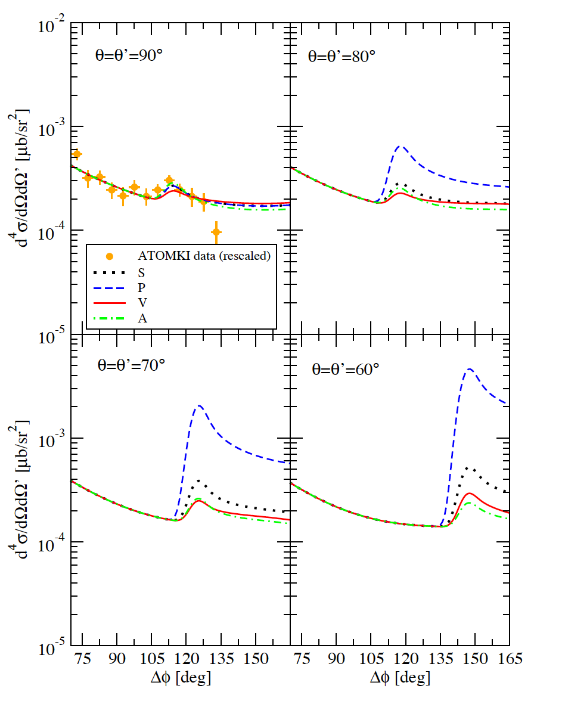
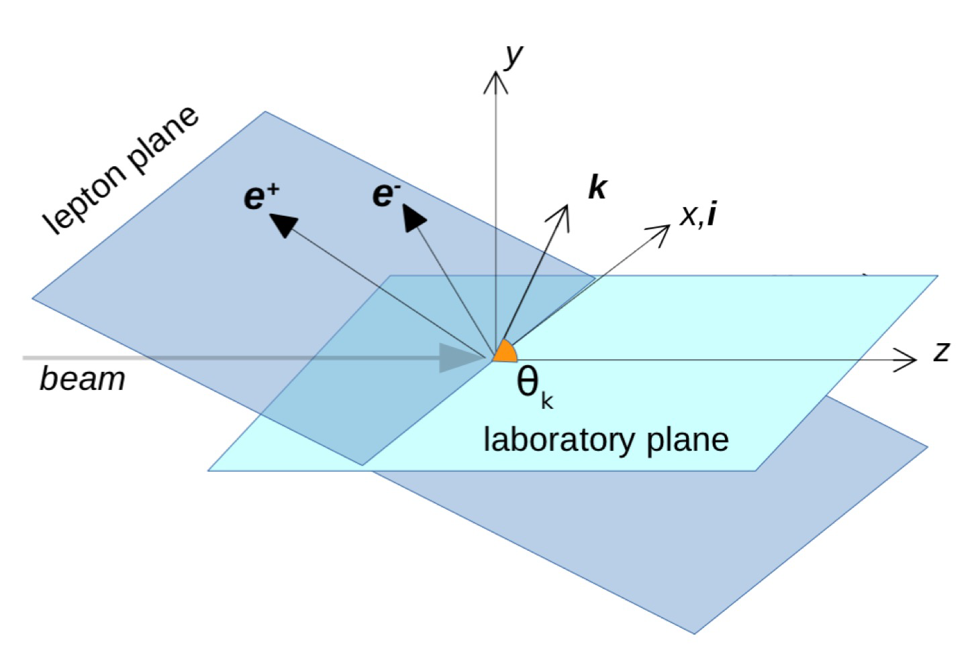
Theoretical calculations
M. Viviani et al.: PRC 105, 014001 (2022)
Theoretical calculations for kinematical signature for different X17 boson (scalar, pseudo-scalar, vector, axial).,
Calculation for different center-of-mass energies.

Slide 20
Theoretical calculations
M. Viviani et al.: PRC 105, 014001 (2022)
Theoretical calculations of expected counts at different lepton plane angles,
Calculation for different natures of the X17 boson (scalar, pseudo-scalar, vector, axial).
Wide energy range (protons and neutron beams) to explore all resonances with different J^{π}
Large detector acceptance for statistics and kinematics

Slide 21
Simulations
SIMULATION:
SETUP with all used materials
Realistic n_TOF beam
IPC/X17 events rate (normalized to ATOMKI data)
OUTPUT:
Acceptance/efficiency/MS
Signal/Noise
Detector performance
e+e- ID and 4-momenta
X17 invariant mass

Slide 22
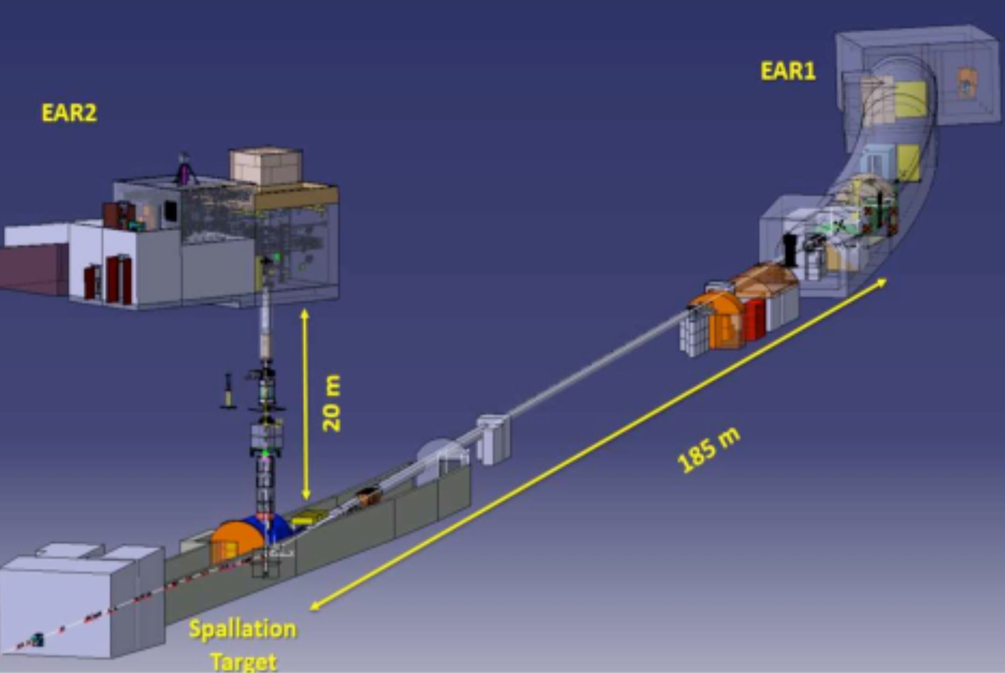
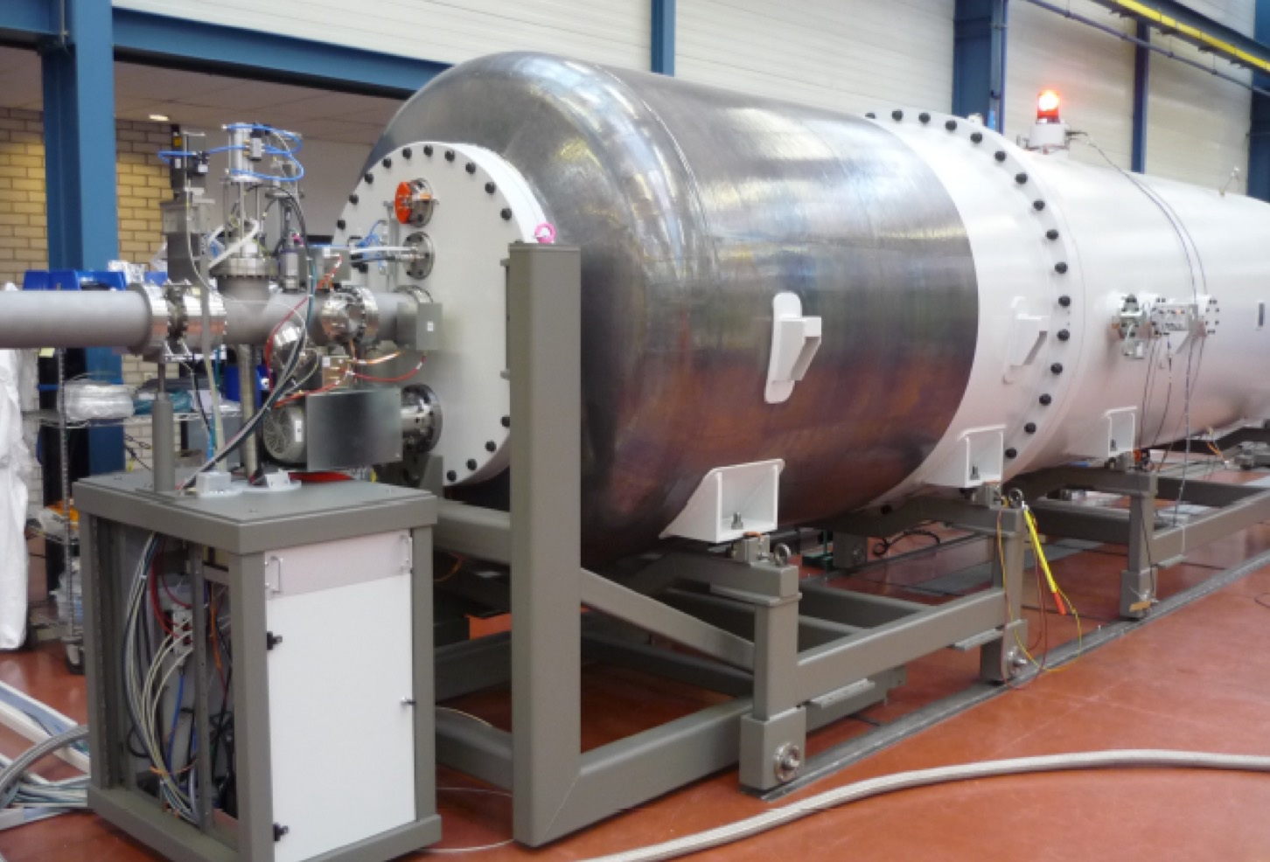
Facilities
n_ToF @ CERN: pulsed neutron beam in a wide energy range (thermal<En<100 MeV).
Time of flight to establish the single neutron energy (10-108 eV)
LUNA-MV @ LNGS: high intensity proton beam and low background
Terminal Voltage ~ 0.2 – 3.5 MV
I max ~ 100 μA of protons
Underground operation
³He(n,X17)⁴He
Measurements:
2022-24 (CERN LoI approved)
³H(p,X17)⁴He
Measurements:
2023-25 (LoI in preparation)

