Slide 1
⁶⁴Ni(n,γ) & ³⁰Si(n,γ)
n_TOF Italian Collaboration Meeting – Trieste 9th - 10th November 2023
Motivations and Preliminary Results
Michele Spelta

Slide 2
Outline
Motivations
State of the art
Measurements
Preliminary Results (ToF spectra)
Ongoing analysis
⁶⁴Ni(n,γ) & ³⁰Si(n,γ): Motivations and Preliminary Results
2

Slide 3
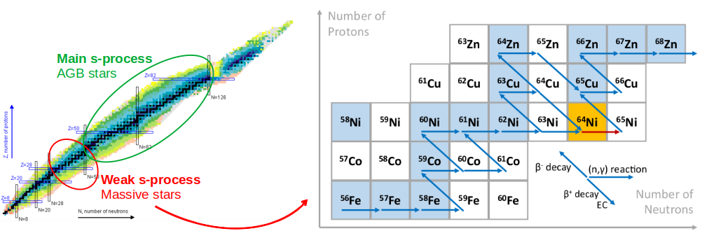
⁶⁴Ni(n,γ): Motivations
⁶⁴Ni is one of the seeds of the s-process and the knowledge of its capture cross section is essential to simulate the weak s-process in massive stars.
⁶⁴Ni(n,γ) & ³⁰Si(n,γ): Motivations and Preliminary Results
3

Slide 4
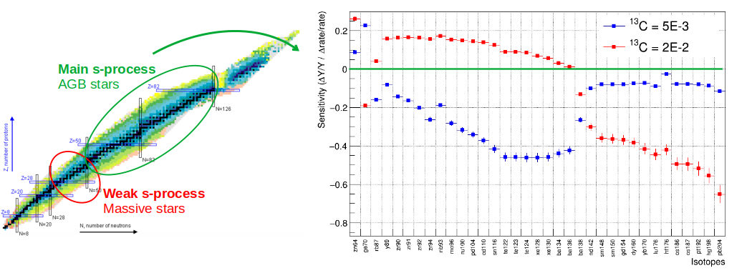
⁶⁴Ni(n,γ): Motivations
As a “bottleneck”, ⁶⁴Ni(n,ɣ) was also found to affect the isotopic abundances of many isotopes from the main s-process in AGB stars.
Cescutti et al., MNRAS 478, 4101 – 4127 (2018)
⁶⁴Ni(n,γ) & ³⁰Si(n,γ): Motivations and Preliminary Results
4

Slide 5
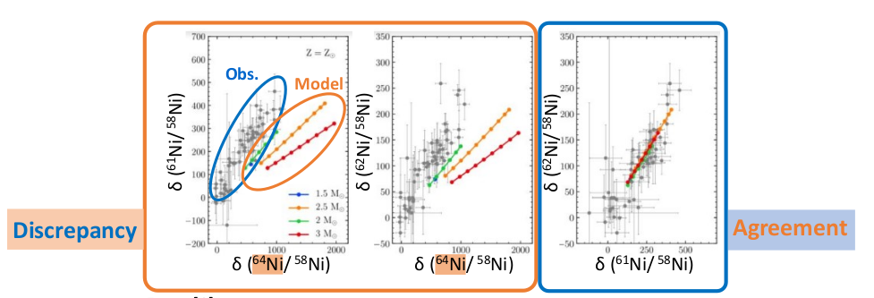
⁶⁴Ni(n,γ): Motivations
Discrepancy observed in SiC grains between measured isotopic ratios and predictions from magnetic-buoyancy induced mixing models in AGB stars.
D. Vescovi et al., ApJ Lett., 897 (2020) 25
⁶⁴Ni(n,γ) & ³⁰Si(n,γ): Motivations and Preliminary Results
5

Slide 6
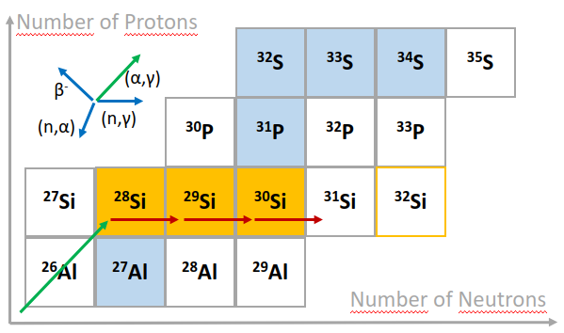
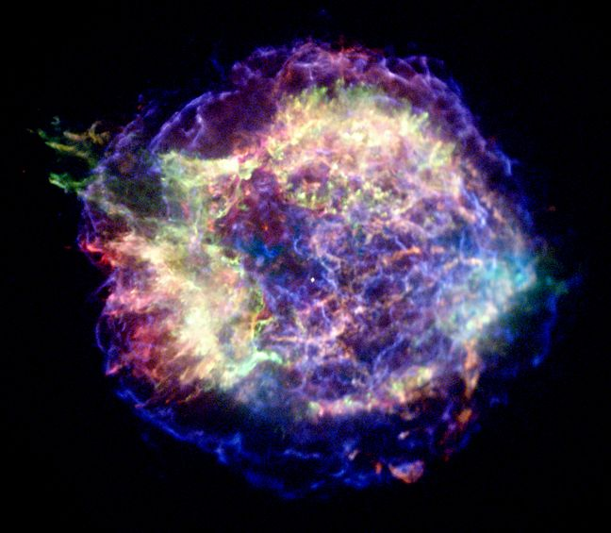
³⁰Si(n,γ): Motivations
²⁸Si is mainly produced by α process, ²⁹Si and ³⁰Si are produced by neutron capture reactions mainly in the convective carbon shell of massive stars and released in SN explosions.
⁶⁴Ni(n,γ) & ³⁰Si(n,γ): Motivations and Preliminary Results
6

Slide 7
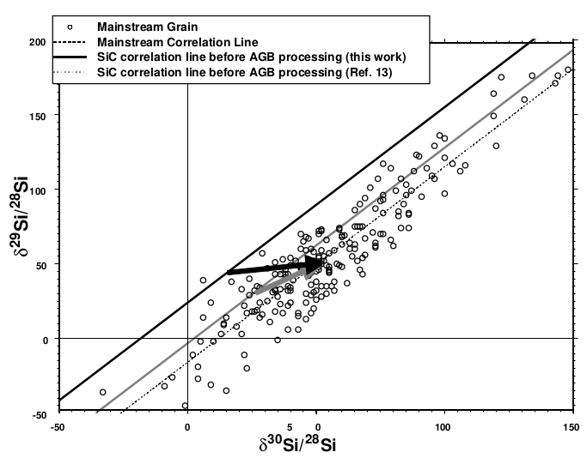
³⁰Si(n,γ): Motivations
²⁸Si, ²⁹Si, ³⁰Si(n,ɣ) are important to explain the isotopic ratios measured in SiC grains (acc. < 5%)
GCE
Mainstream SiC
from AGB
s - process
GCE vs s-process
K. Guber et al., Phys. Rev. C 67, 062802 (2003)
⁶⁴Ni(n,γ) & ³⁰Si(n,γ): Motivations and Preliminary Results
7

Slide 8
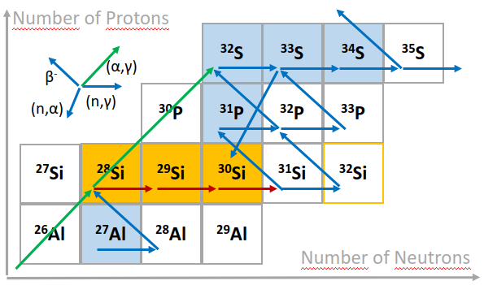
³⁰Si(n,γ): Motivations
²⁸Si, ²⁹Si, ³⁰Si(n,ɣ) are important to explain the isotopic ratios measured in SiC grains (acc. < 5%)
Type C SiC
from SN explosions
Constrain on neutron density in SN
⁶⁴Ni(n,γ) & ³⁰Si(n,γ): Motivations and Preliminary Results
8

Slide 9
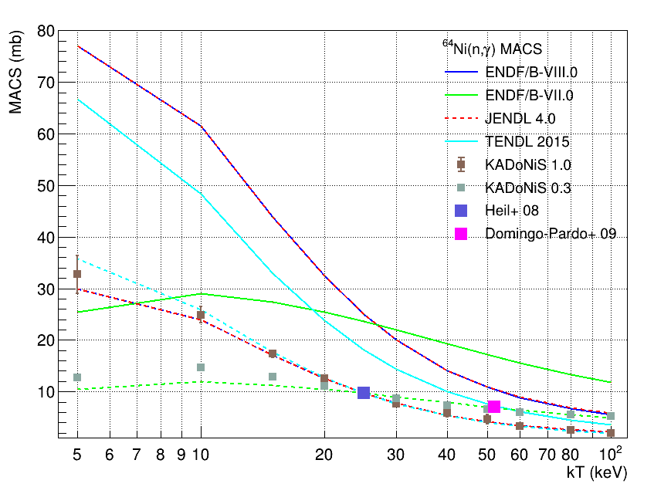
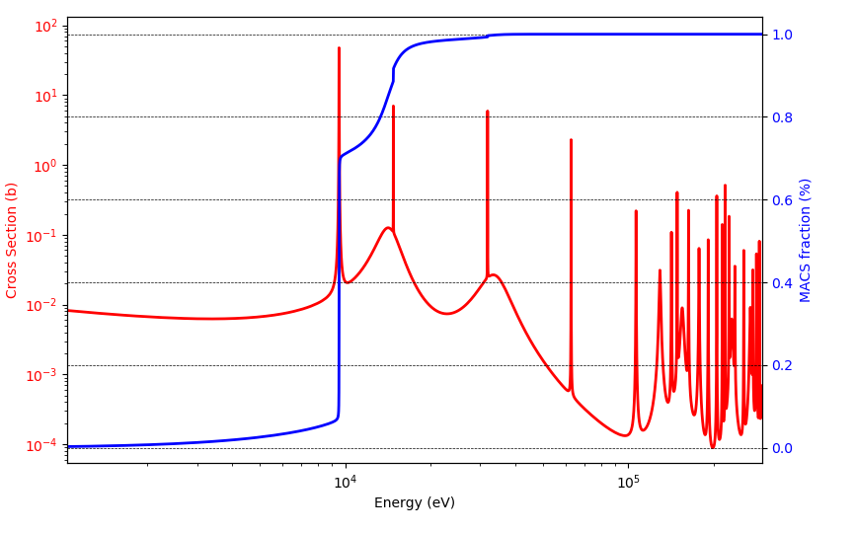
⁶⁴Ni(n,γ): State of the art
Only a few discrepant measurements available in literature, leading to discrepant MACS
Hockenbury et al., Phys. Rev. 178 (1969) 4
9.52 keV
MACS @ 5 keV
⁶⁴Ni(n,γ) & ³⁰Si(n,γ): Motivations and Preliminary Results
9

Slide 10
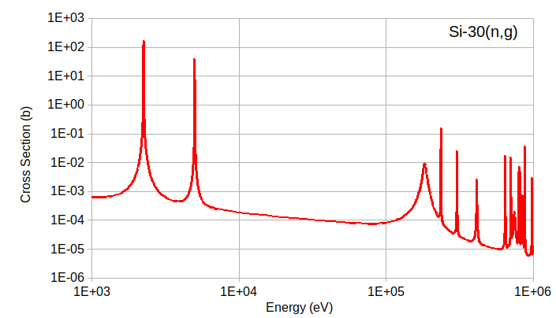
³⁰Si(n,γ): State of the art
Only a few discrepant measurements available in literature, leading to discrepant MACS
H. Beer et al., Nucl. Phys. A 453, 062802 (2002)
4.98 keV
K. Guber et al., Phys. Rev. C 67, 062802 (2003)
2.235 keV
⁶⁴Ni(n,γ) & ³⁰Si(n,γ): Motivations and Preliminary Results
10

Slide 11
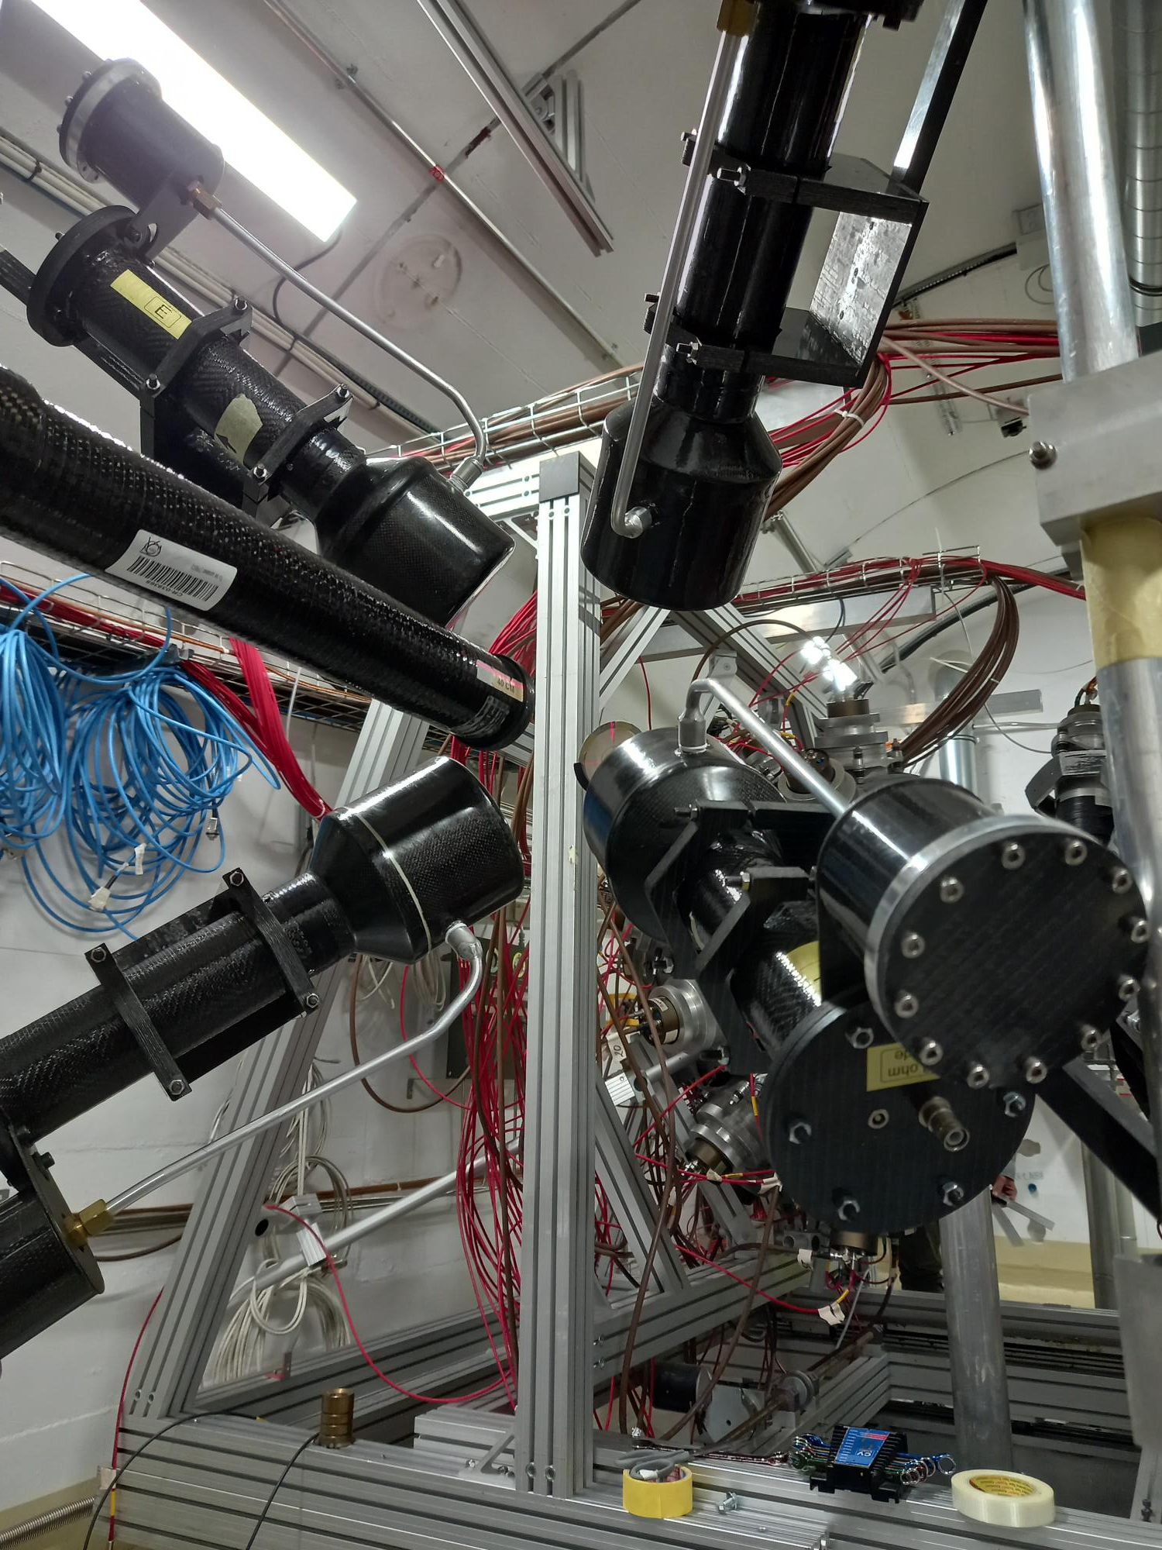
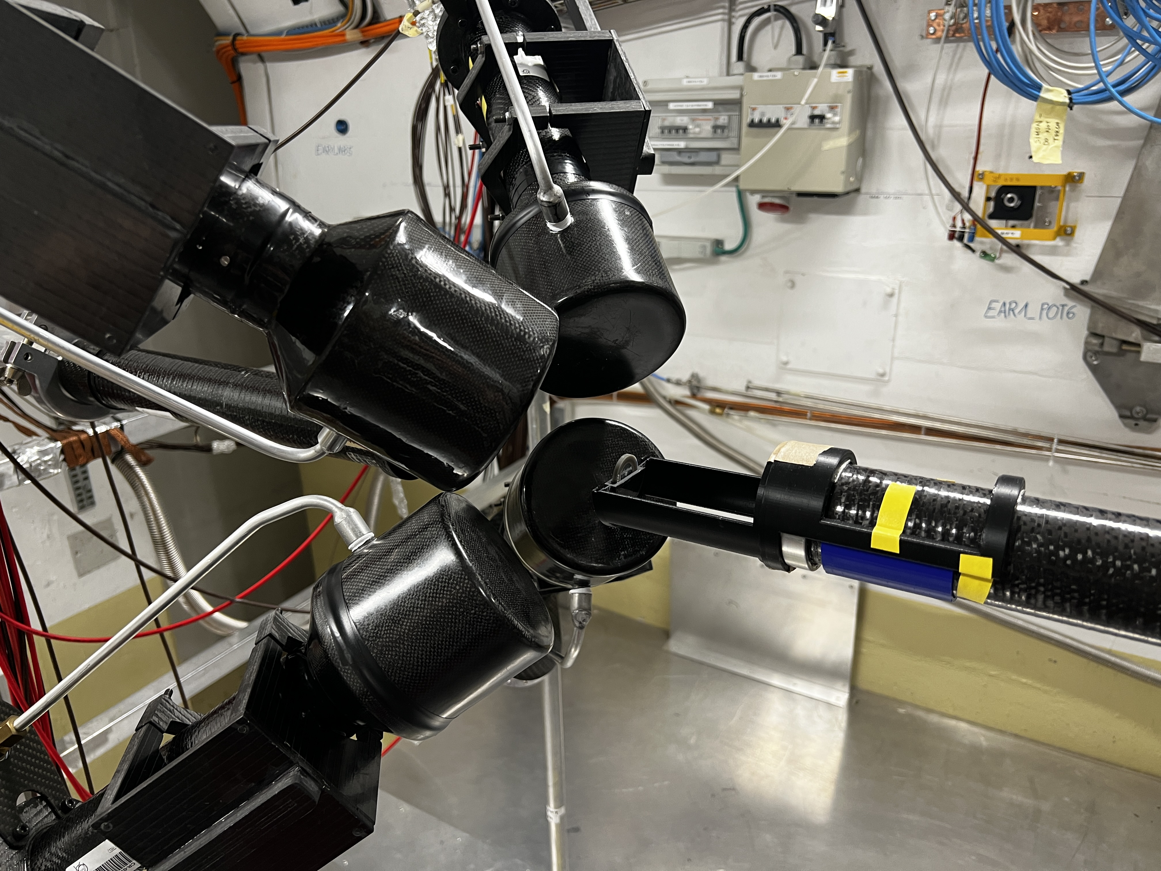
Measurement in EAR1
June – July: ³⁰Si(n,ɣ), ^{nat}Si(n,ɣ) -> 3.81E+18 p
125°
45°
35°
9 cm
⁶⁴Ni(n,γ) & ³⁰Si(n,γ): Motivations and Preliminary Results
11

Slide 12
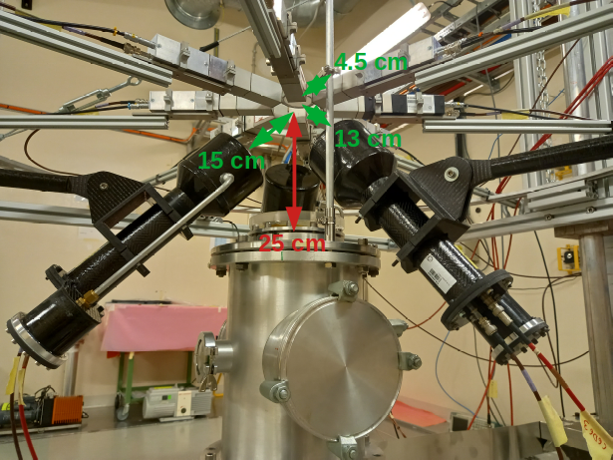
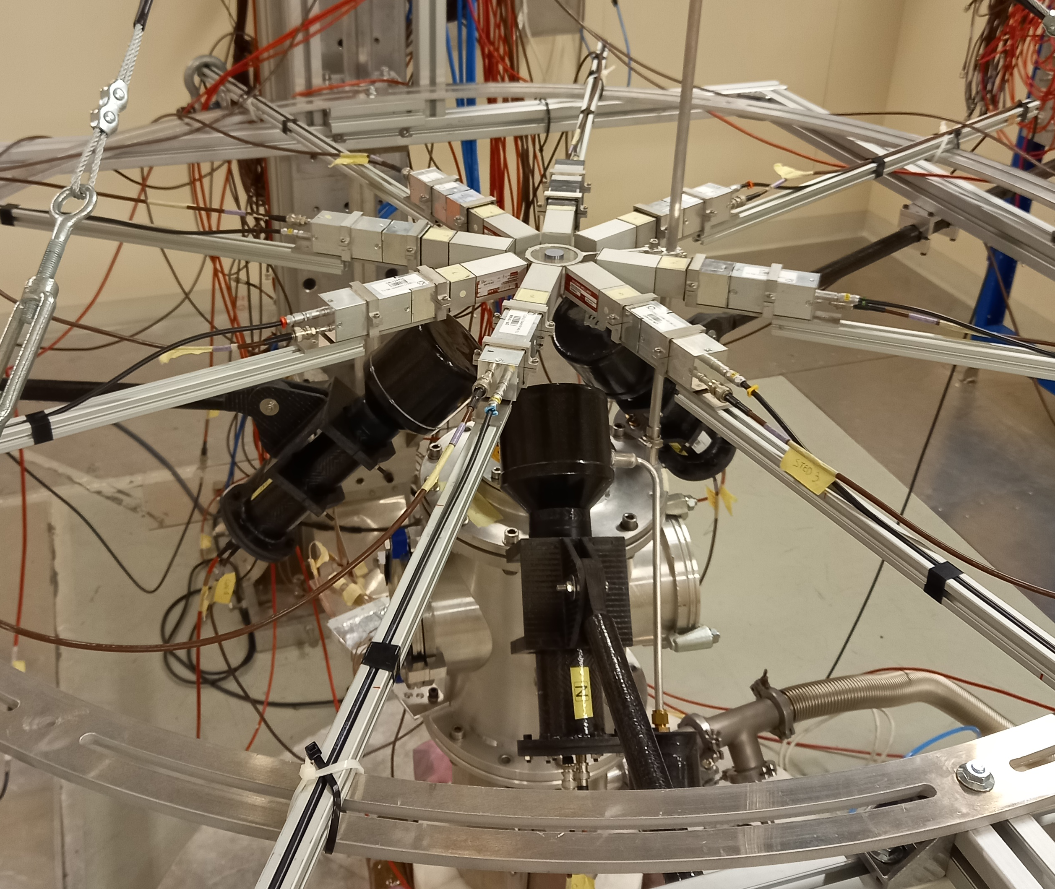
Measurement in EAR2
July-August
⁶⁴Ni(n,ɣ) -> 2.34E+18 p (+56 %)
³⁰Si(n,ɣ), ^{nat}Si(n,ɣ) -> 8.13E+17 p (+11 %)
⁶⁴Ni(n,γ) & ³⁰Si(n,γ): Motivations and Preliminary Results
12

Slide 13
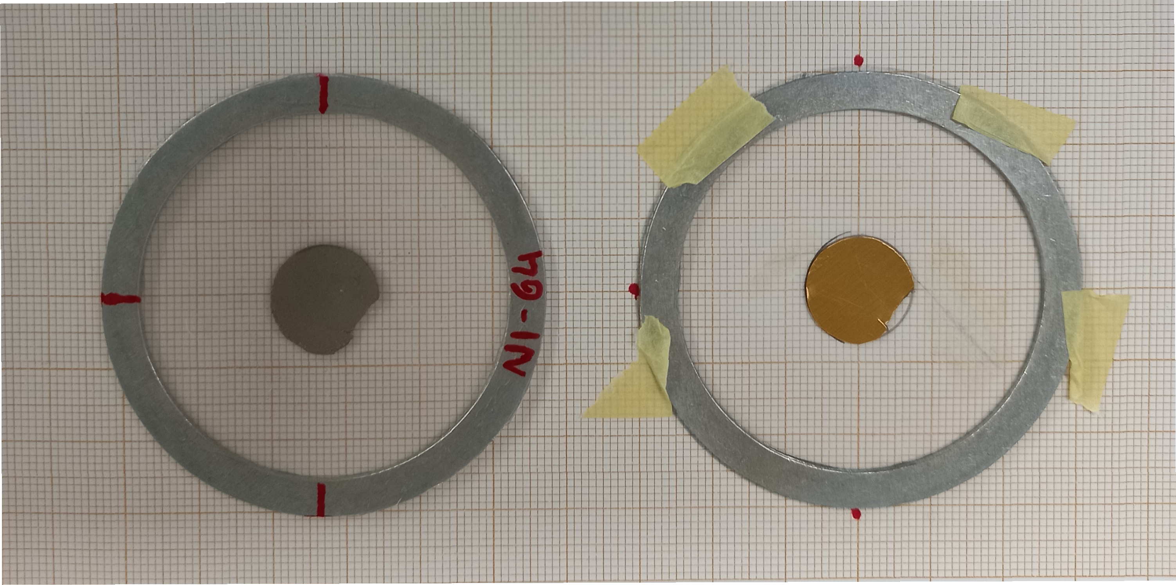
Measurement
^{nat}Si
³⁰Si
>99 %
⁶⁴Ni
Au
d = 20 mm
d = 22 mm
d = 14.6 mm
m = 2.932 g
m_{pre} = 0.75 g
R.Reifarth
D. Plonka
(University Frankfurt)
m = 0.43 g
m_{post} = 0.99 g
⁶⁴Ni(n,γ) & ³⁰Si(n,γ): Motivations and Preliminary Results
13

Slide 14
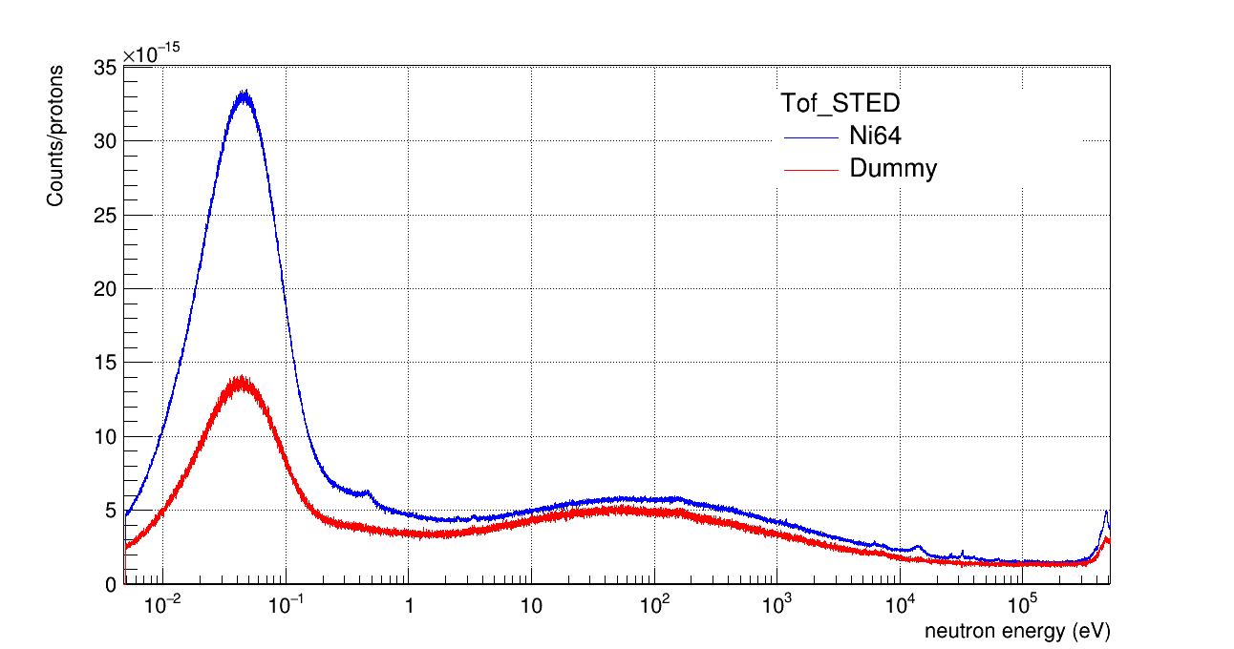
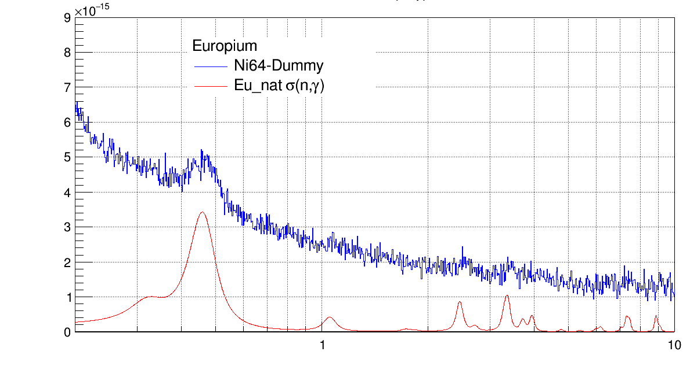
⁶⁴Ni(n,γ): Preliminary Results
Preliminary ToF spectra from sTED
𝝈 ≈ 5E+3 b @ 25 meV
1000 bpd
Contamination of Europium (≈ 0.003 % -> 35 µg)
⁶⁴Ni(n,γ) & ³⁰Si(n,γ): Motivations and Preliminary Results
14

Slide 15
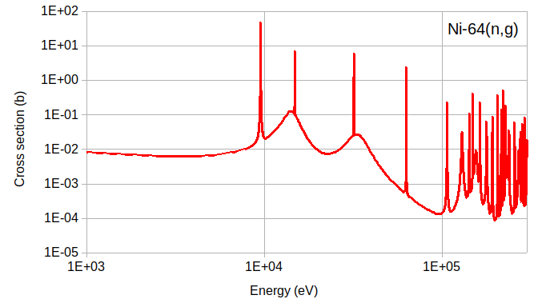
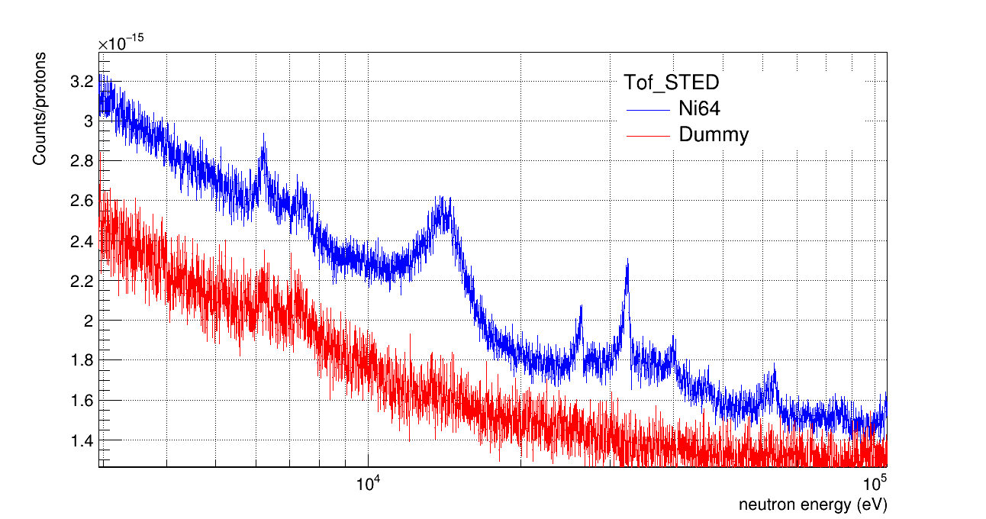
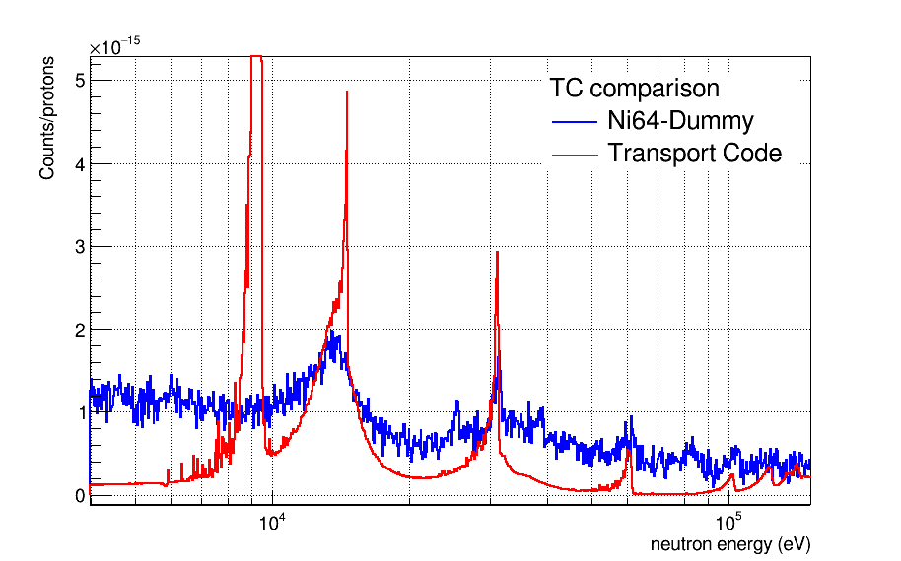
⁶⁴Ni(n,γ): Preliminary Results
Preliminary ToF spectra from sTED
Comparison with the Transport Code:
1000 bpd
A
B
C
No resonance at 9.52 keV
P-resonance at 14.8 keV ?
Interference of Al dip
⁶⁴Ni(n,γ) & ³⁰Si(n,γ): Motivations and Preliminary Results
15
9

Slide 16
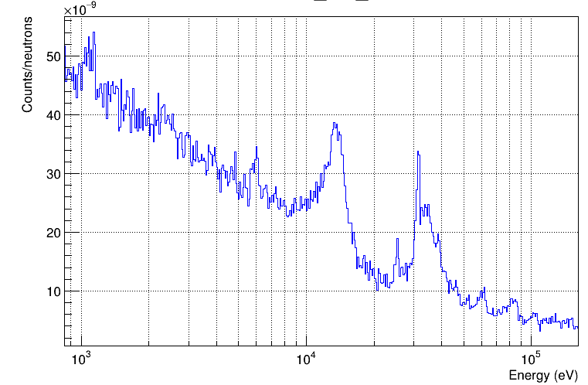
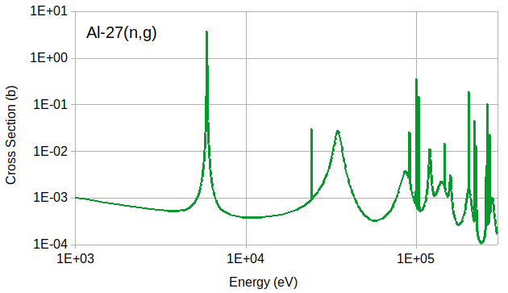
⁶⁴Ni(n,γ): Preliminary Results
Preliminary yield from sTED
250 bpd
14.3 keV
31.9 keV
33.8 keV
5.9 keV
62.8 keV
24.3 keV
34.8 keV
86.3 keV
⁶⁴Ni(n,γ) & ³⁰Si(n,γ): Motivations and Preliminary Results
16
9

Slide 17
⁶⁴Ni(n,γ): Preliminary Results
MACS from Kadonis 0.3 seems more in agreement with our data.
⁶⁴Ni(n,γ) & ³⁰Si(n,γ): Motivations and Preliminary Results
17
9

Slide 18
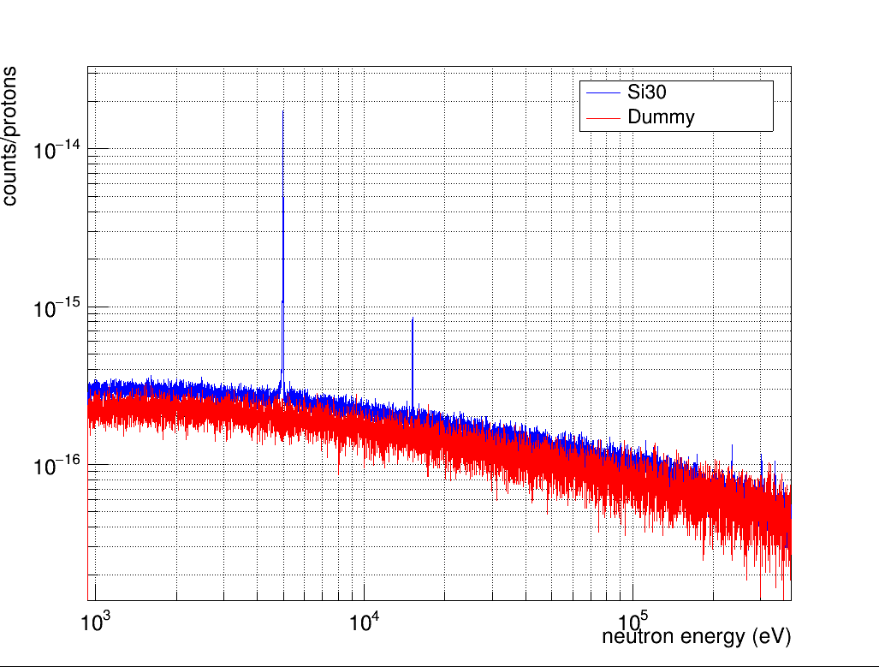
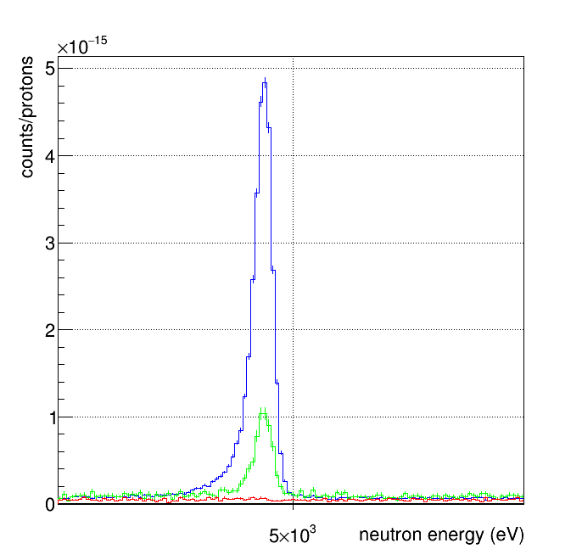
³⁰Si(n,γ): Preliminary Results
Preliminary ToF spectra
B
B
5000 bpd
C
D
A
Si-nat
No resonance at 2.235 keV
Resonance at 4.98 keV
⁶⁴Ni(n,γ) & ³⁰Si(n,γ): Motivations and Preliminary Results
18
9

Slide 19
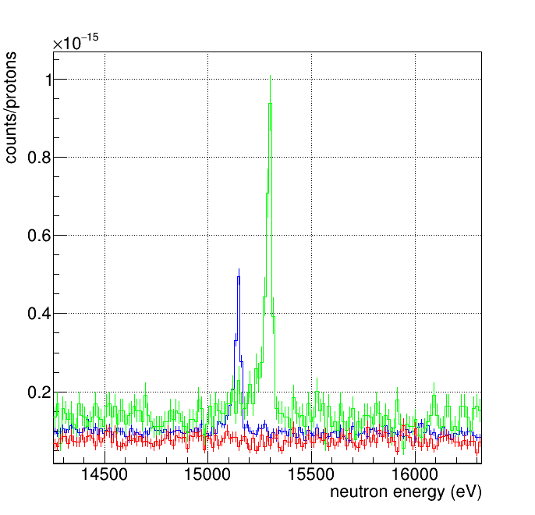
³⁰Si(n,γ): Preliminary Results
C. Resonance at 15.14 keV
J. Boldeman et al.,
Nucl. Phys. A252, 62 (1975)
C
15.29 keV
(Si-29)
Si-nat
Si-30
Dummy
B
5000 bpd
15.14 keV
C
D
A
⁶⁴Ni(n,γ) & ³⁰Si(n,γ): Motivations and Preliminary Results
19
9

Slide 20
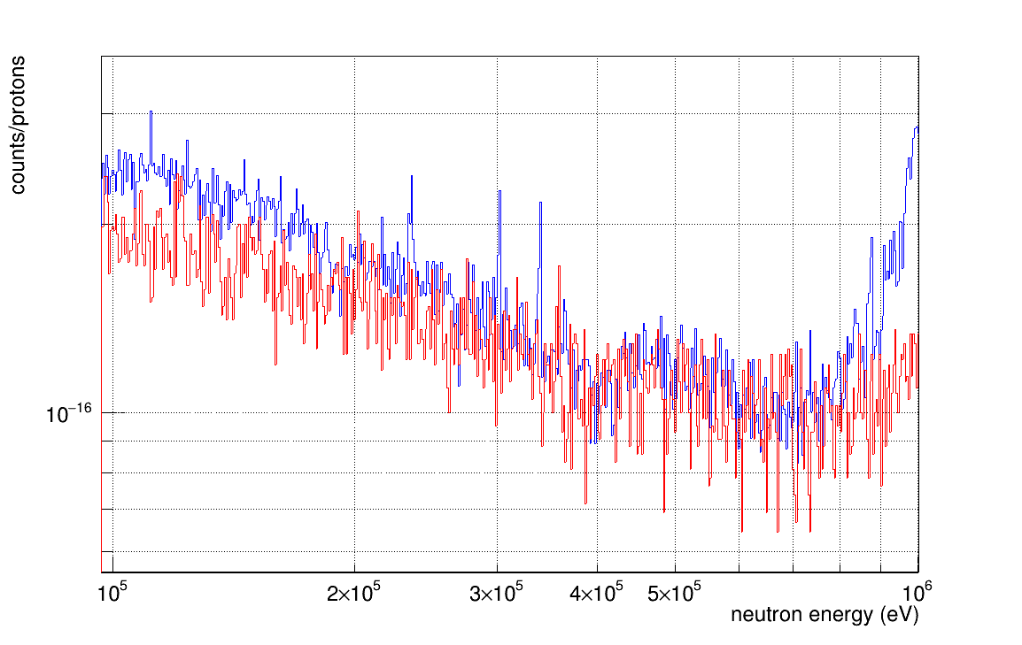
³⁰Si(n,γ): Preliminary Results
Preliminary ToF spectra
D
B
5000 bpd
C
D
A
235 keV
303 keV
?
⁶⁴Ni(n,γ) & ³⁰Si(n,γ): Motivations and Preliminary Results
20
9

Slide 21
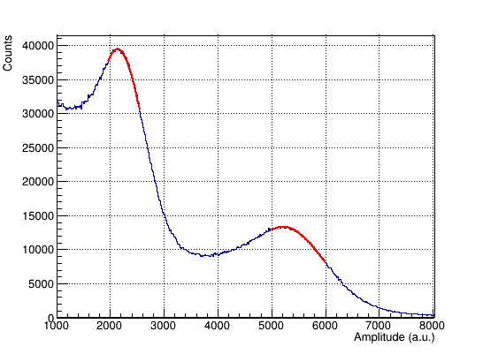
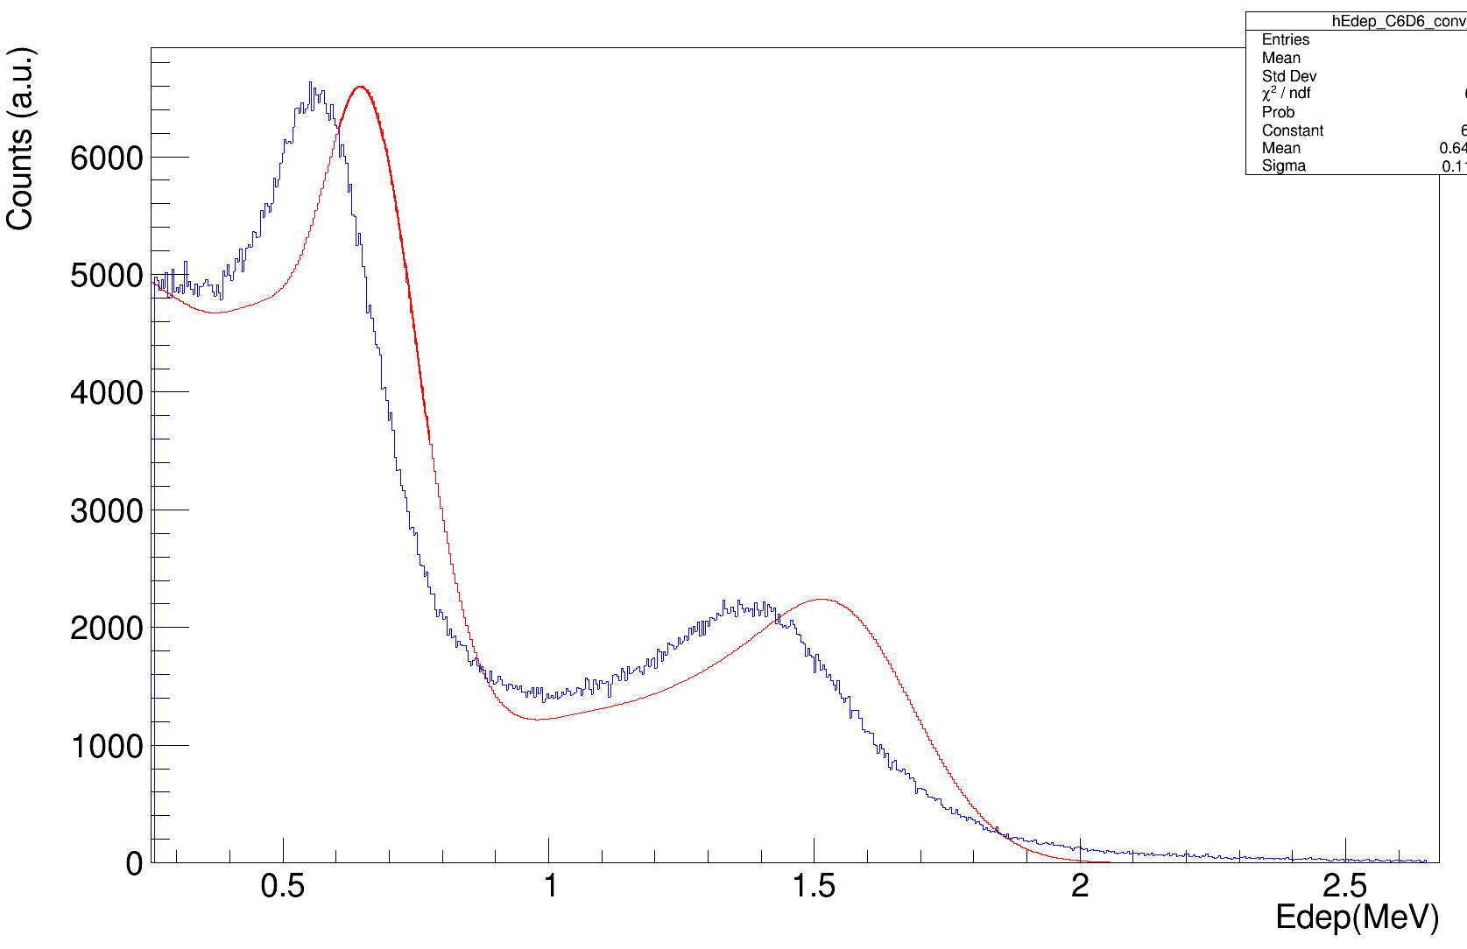
³⁰Si(n,γ): Ongoing Analysis
The analysis is currently devoted to detector calibration with G4 simulations.
First guess with gaussian fitting of the Compton edge:
Data
⁸⁸Y, C6D6 E (#2)
Simulation
⁶⁴Ni(n,γ) & ³⁰Si(n,γ): Motivations and Preliminary Results
21

Slide 22
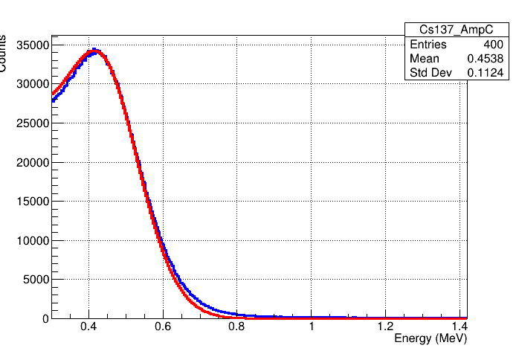
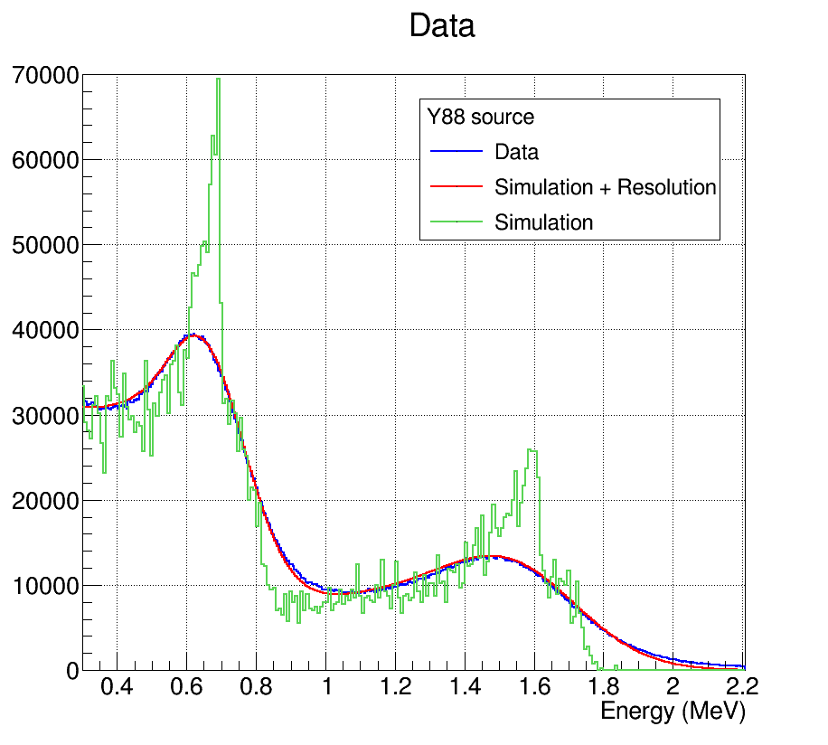
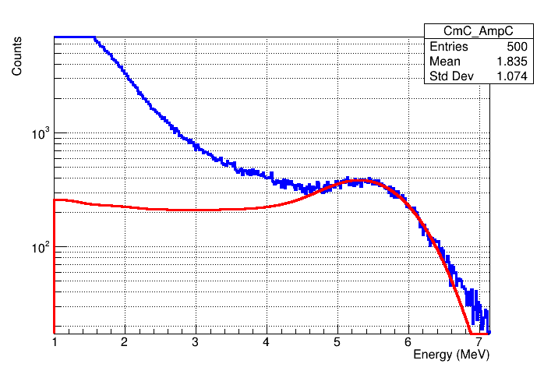
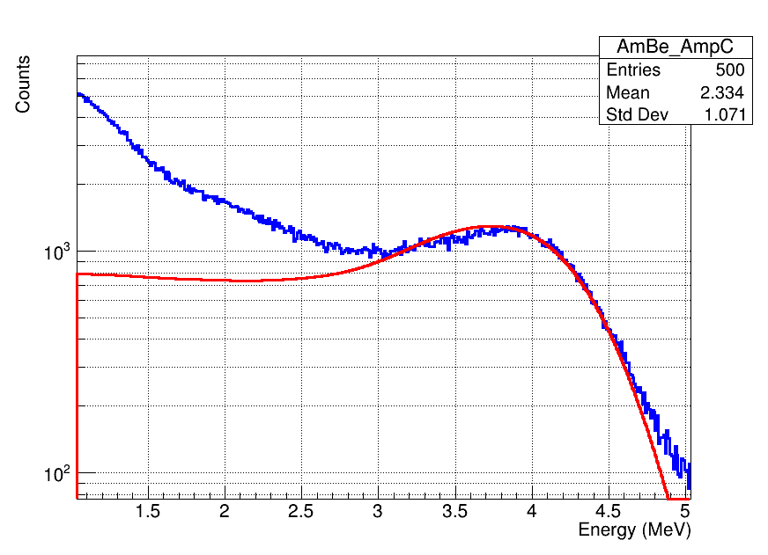
³⁰Si(n,γ): Ongoing Analysis
The analysis is currently devoted to detector calibration with G4 simulations.
Second guess with direct comparison with resolution convoluted simulations.
¹³⁷Cs
CmC
C6D6 E (#2)​
AmBe
⁶⁴Ni(n,γ) & ³⁰Si(n,γ): Motivations and Preliminary Results
22

Slide 23
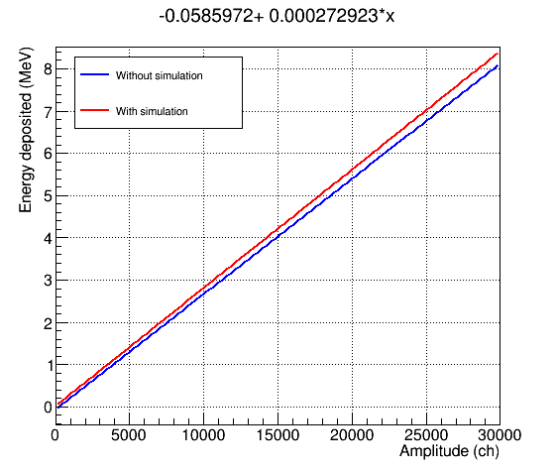
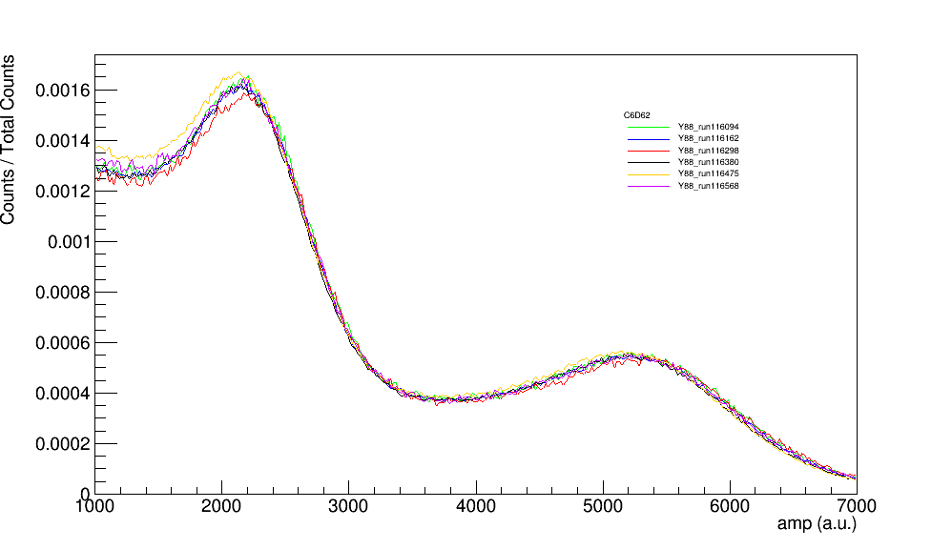
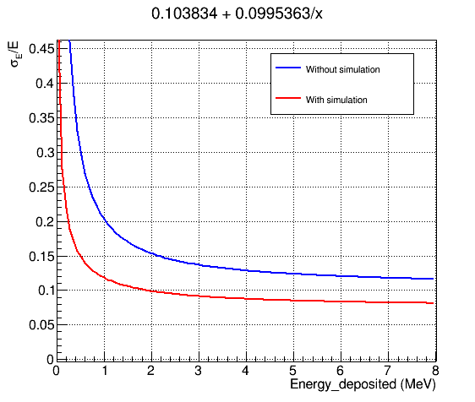
³⁰Si(n,γ): Ongoing Analysis
The analysis is currently devoted to detector calibration with G4 simulations.
Evaluation of the uncertainty on the calibration and gain shift during the measurement.
C6D6 E (#2)​
0.7 %
⁶⁴Ni(n,γ) & ³⁰Si(n,γ): Motivations and Preliminary Results
23

Slide 24
Summary
⁶⁴Ni(n,ɣ) and ³⁰Si(n,ɣ) are important measurement to accurately model s-process and explain the isotopic ratios measured in SiC.
⁶⁴Ni(n,ɣ)
³⁰Si(n,ɣ) ^{nat}Si(n,ɣ)
Measurement EAR2
Preliminary results
Detector calibrations
WF
Yield
Resonance Fitting
Measurement EAR1 & EAR2
Preliminary results EAR1
Detector calibrations EAR1
WF EAR1
Yield EAR1
Resonance Fitting EAR1
Analysis EAR2 (thermal)
Measurement of ³⁰Si,²⁹Si(n,ɣ)
⁶⁴Ni(n,γ) & ³⁰Si(n,γ): Motivations and Preliminary Results
24

Slide 25
⁶⁴Ni(n,γ) & ³⁰Si(n,γ)
n_TOF Italian Collaboration Meeting – Trieste 9th - 10th November 2023
Motivations and Preliminary Results
Michele Spelta

Slide 26
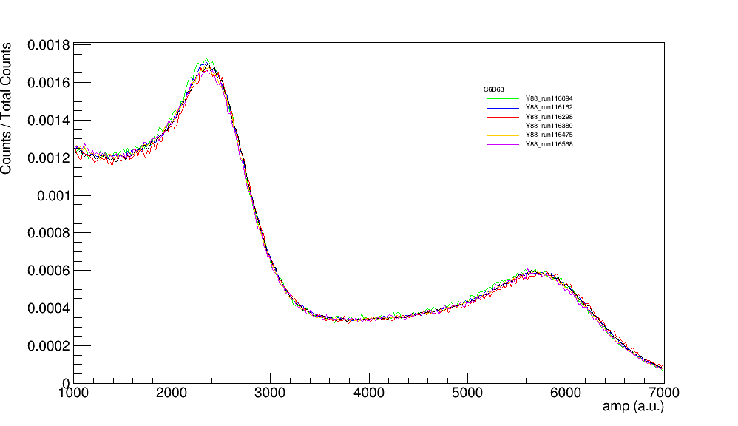
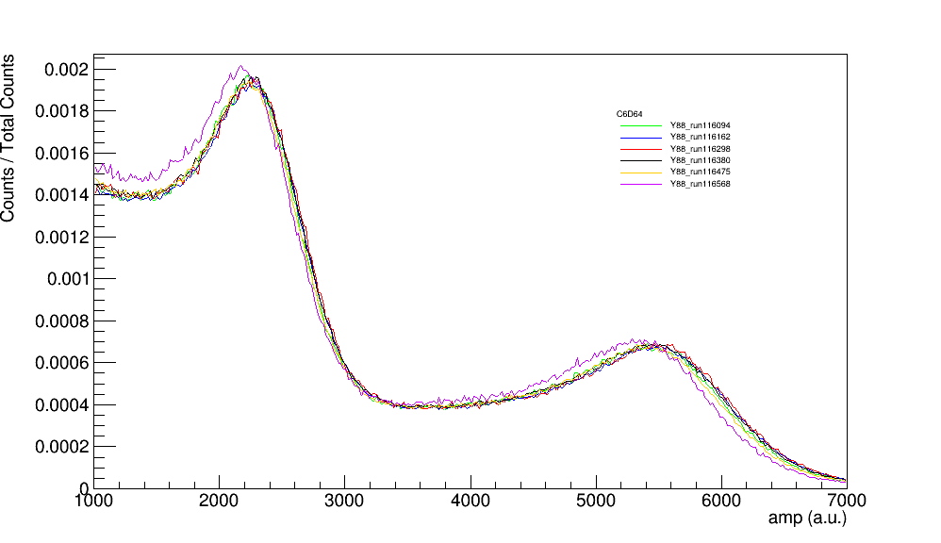
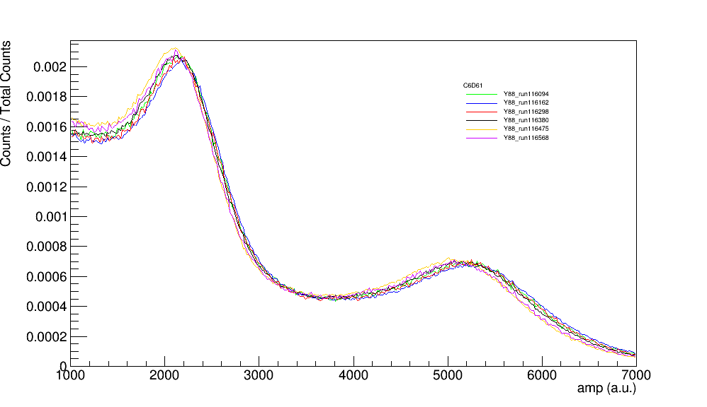
Gain shift C6D6 (Si-30)

Slide 27
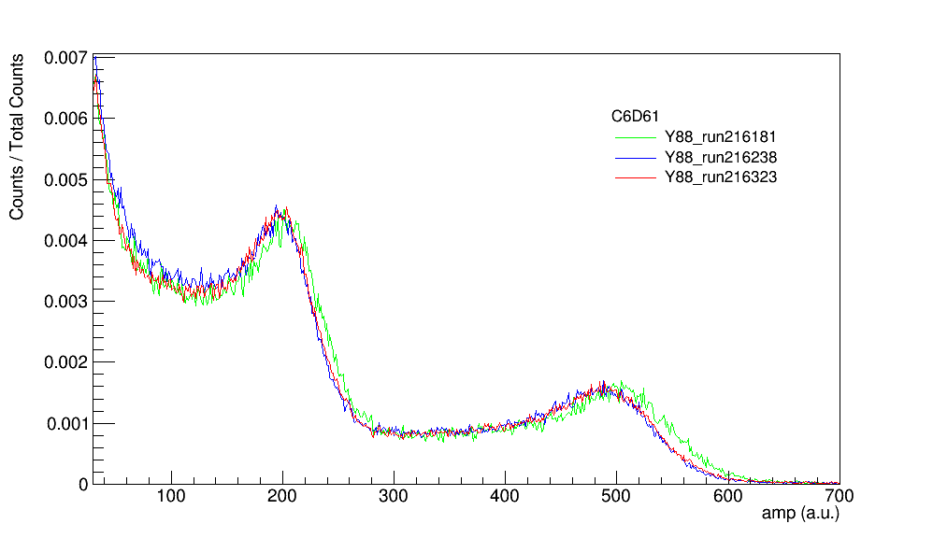
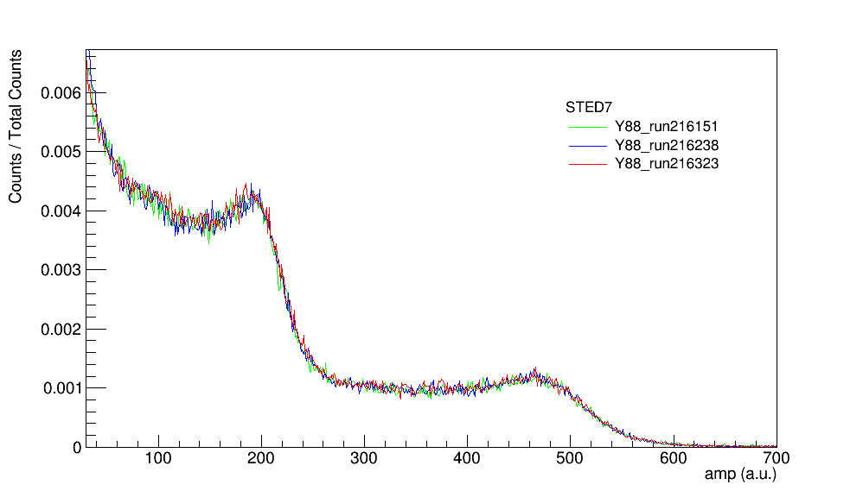
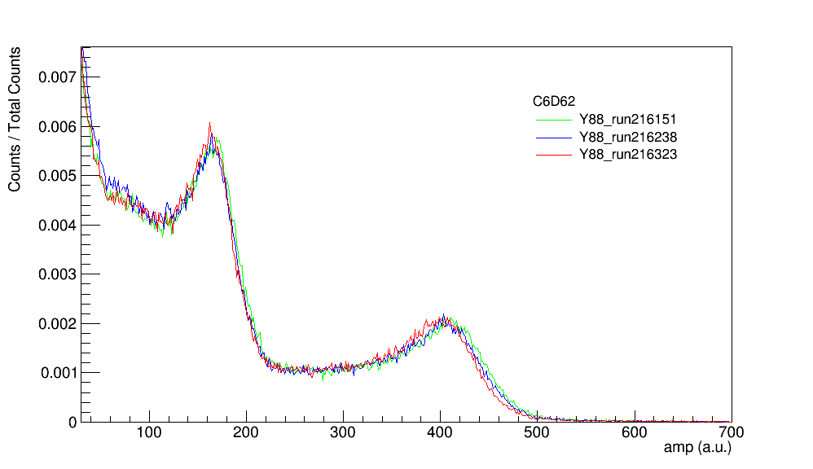
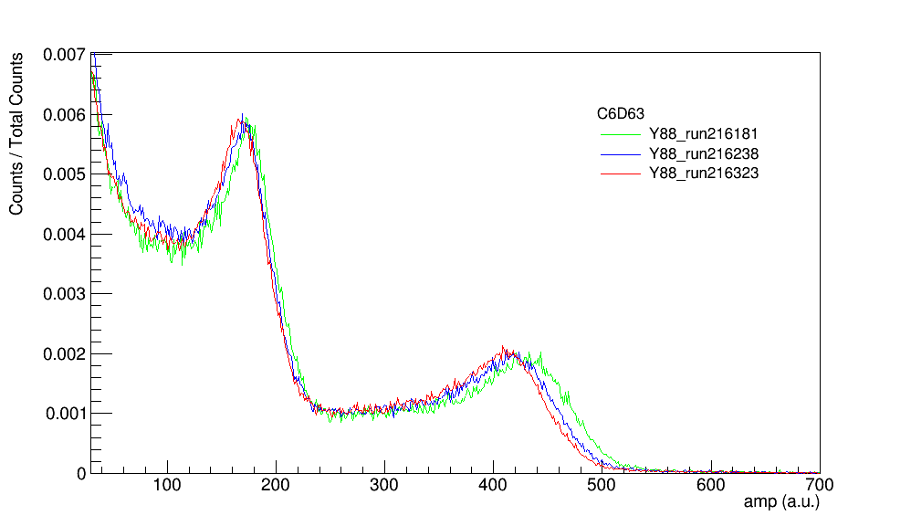
Gain shift STED - C6D6 (Ni-64)

Slide 28
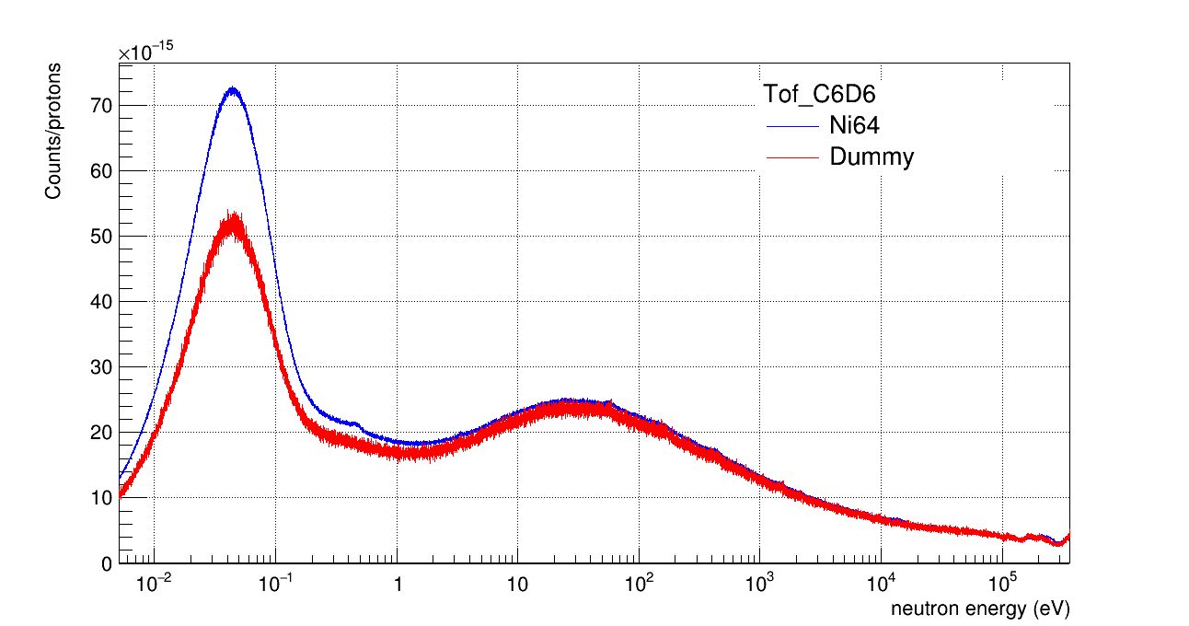
C6D6 (Ni-64)

Slide 29
Protons (Ni-64)
Protons (Si)

