Slide 1
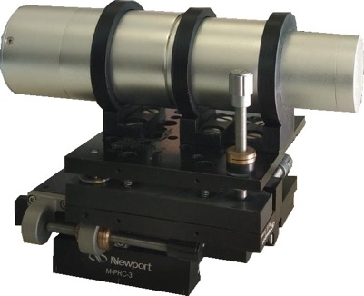
Possible use of LaBr₃ scintillators for (n,xn) reactions at n_TOF
Paolo Finocchiaro

Slide 2
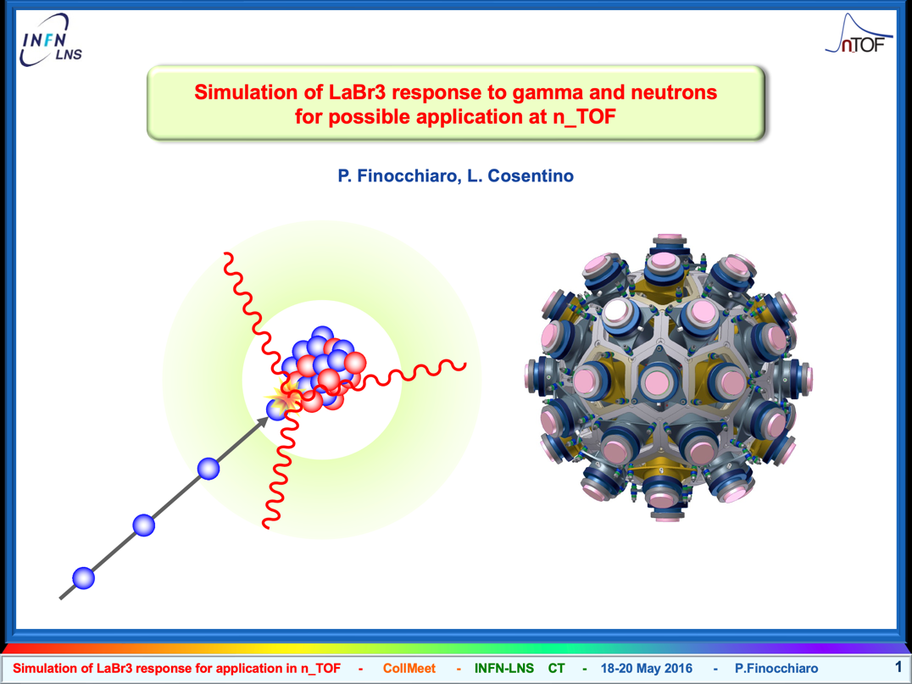
A short historical recall
proposed in May 2016
basically rejected with the statement:
"LaBr₃ was tested and cannot be used at n_TOF"

Slide 3
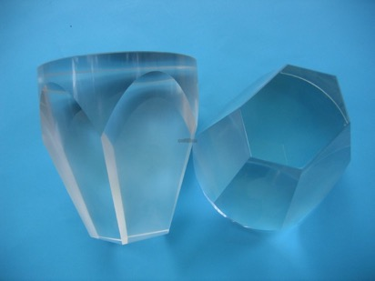
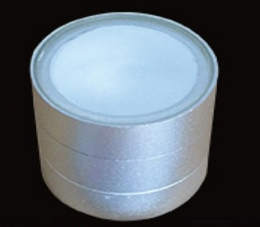

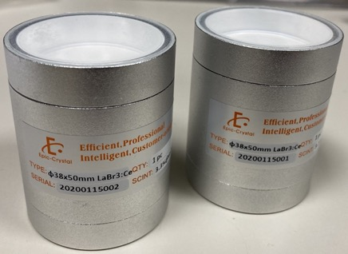

Main features of LaBr3 as compared to BaF₂
Material | BaF₂ |  | LaBr₃(Ce)
Density (g/cc) | 4.88 |  | 5.1
< Z > | 24.7 |  | 40.5
Light yield (photons/MeV) | 10000 | 2000 | 70000
Decay time (ns) | 620 | 0.6 | 30
Emission Peak (nm) | 310 | 220 | 375
Hygroscopic | NO |  | YES
NUMEN LaBr₃ detector samples

Slide 4
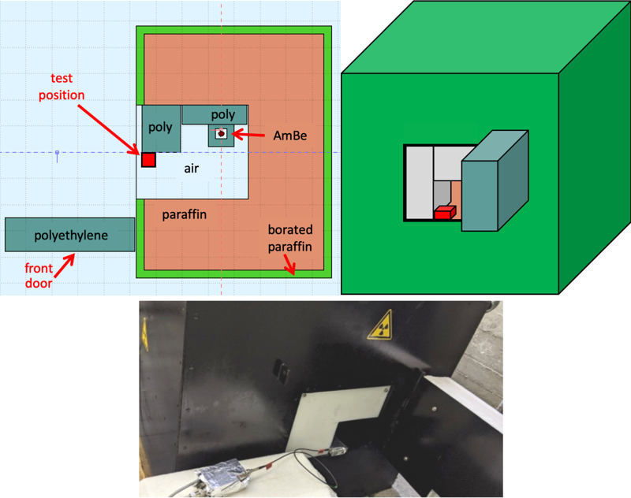
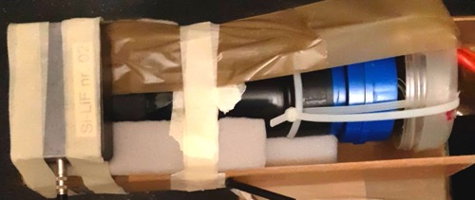
High rate NUMEN test (active PMT base)
Detection of 473 keV gamma from n+¹⁰B in coincidence with the alpha
SiB = Silicon + ¹⁰B
SiB
0.84 MeV
0.473 MeV
1.47 MeV
LaBr₃
AmBe 1.5·10⁶ n/s emitted
59 keV gamma from Am (34 GBq)
4.4 MeV gamma from ⁹Be(α,n)
2.2 MeV gamma from H(n,γ)D

Slide 5
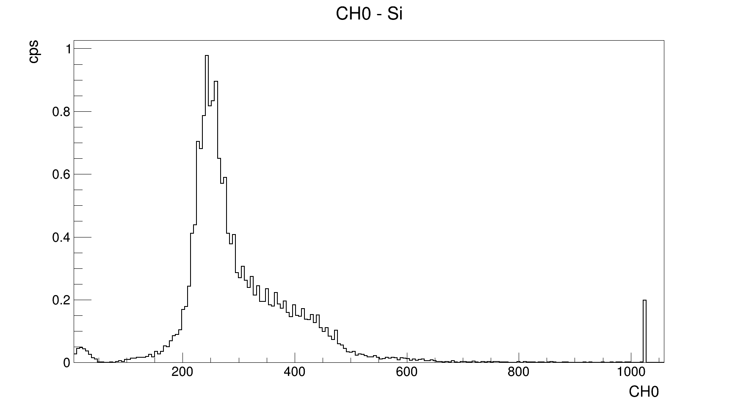
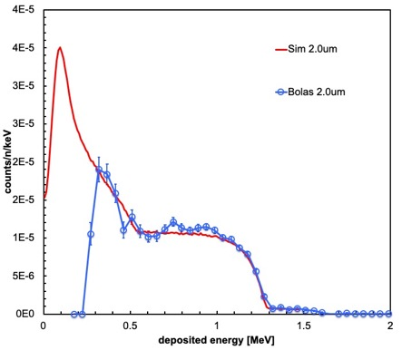
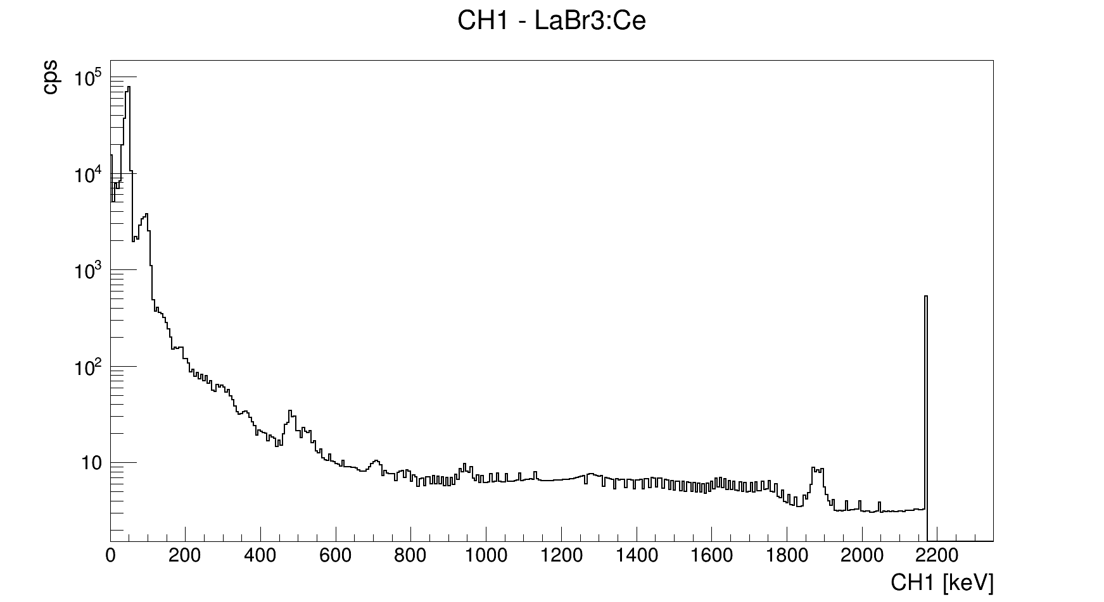
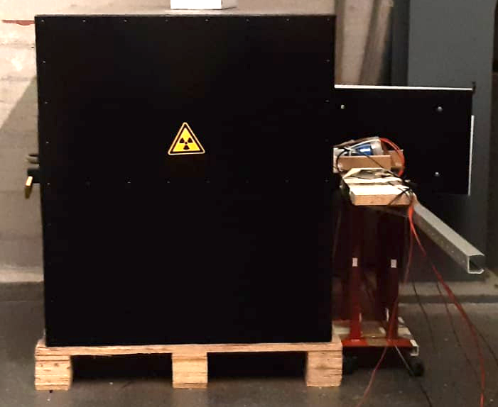
High rate NUMEN test
SiB spectrum, simulated and measured
free run
free run

Slide 6
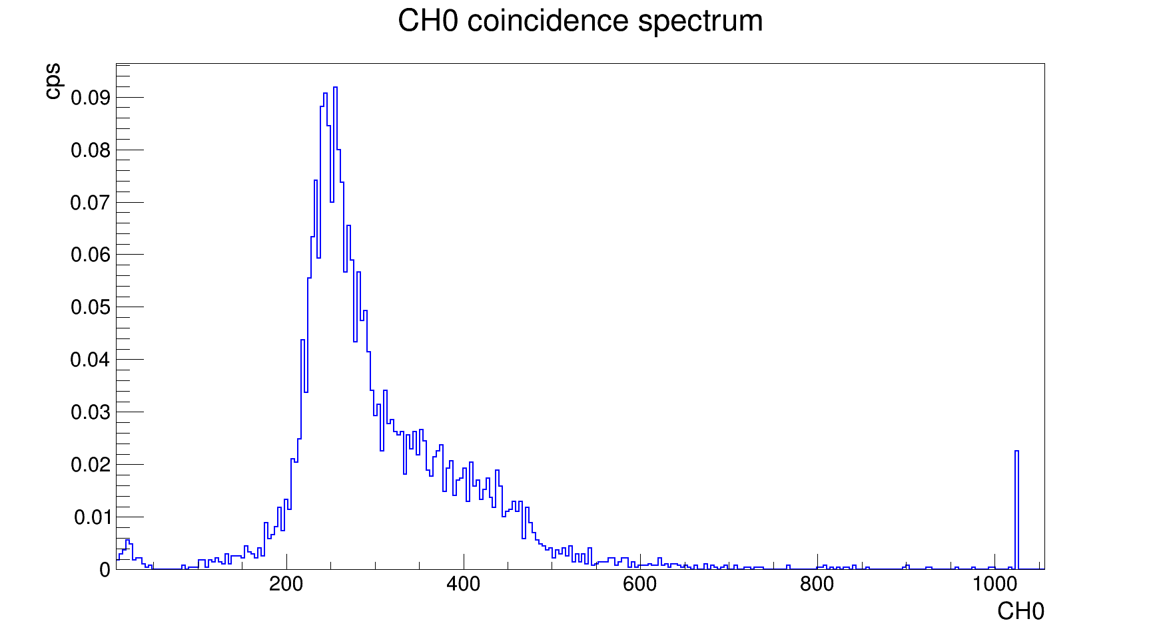
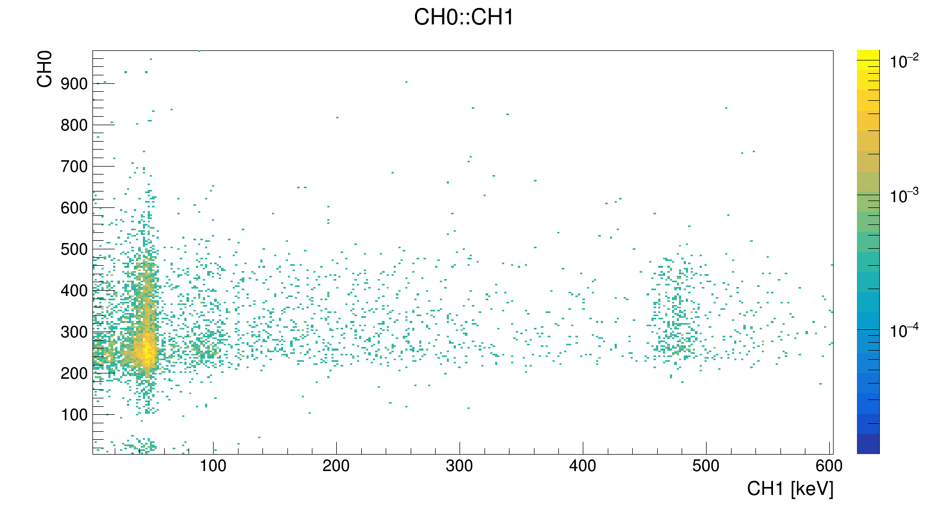
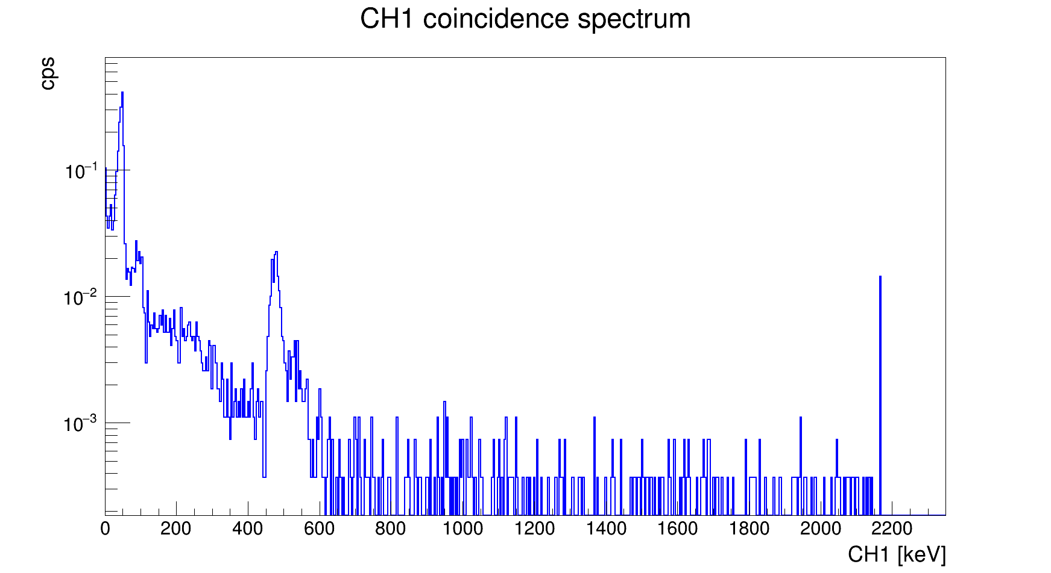
High rate NUMEN test
coincidence run
coincidence scatter plot
473 keV
473 keV
coincidence run

Slide 7
Energy calibration
quite linear at low HV
non-linearity at high HV and/or high rate
may need a better active base

Slide 8
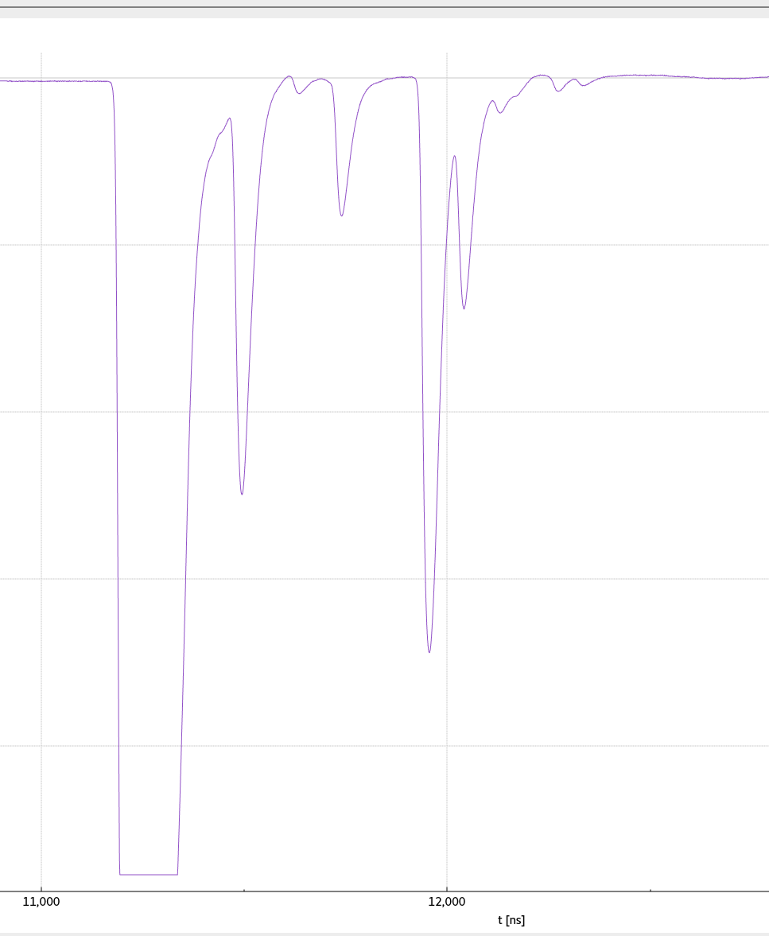
287ns
E_{n} = 350 MeV
sample waveform from a preliminary test at n_TOF

