Slide 1
Using LaBr₃ crystals for measurements of (n,inel) and (n,xn) reactions
Motivations
n_TOF ideal facility for measurements of inelastic and (n,xn) reactions up to high energy.
Main applications: fission reactors, nuclear medicine, fusion reactors. Also important for refining theoretical models.
Technique
Measurements of (n,inel) and (n,xn) reactions typically performed by counting specific γ-rays emitted in the deexcitation of the residue.
Need high efficiency and high resolution detectors -> ideally HPGe
Efforts have been going on at n_TOF since the beginning (2001) to operate HPGe in the EAR1.
However, the presence of the γ-flash and the slow response of HPGe detectors, has hampered the use of these detectors so far, above a few hundred keV.
A fast switch circuit on the detector preamplifier has improved the situation, but the maximum neutron energy is still around a few MeV (too low considering the n_TOF potentialities).
Idea
LaBr₃ crystal have high efficiency, reasonable resolution, and especially have fast signals.
They could allow to go much higher in energy then HPGe.

Slide 2
Using LaBr₃ crystals for measurements of (n,inel) and (n,xn) reactions
To investigate the use of LaBr₃ crystals for measurements of inelastic and (n,xn) reactions, different tests have been performed and a LoI has been submitted (discussed in the INTC meeting few days ago).
First test in 2022: 1x1” crystal with PMT, both in EAR 1 and beam dump
Results
detectors recover fast from γ-flash, but ringing in EAR1 prevented from getting a clear indication of the maximum energy that can be reached
very clean signal in beam dump, indication that hundreds of MeV neutron energy can be reached
resolution of 3% as expected
Second test in 2023: two larger crystals 1.5x1.5” and 1.5x2” with PMT, EAR1 only (capture position)
Test with all detectors at the end of this year campaign (Oct. 2023)
In the meanwhile:
used ENTE (Electronic Noise Testing Environment), setup by Nino Amato, to identify a possible source of ringing in the LaBr3
bad shielding of the Voltage Divider and connectors
fixed by wrapping the PMT+VD+connectors in an ²⁶Al foil (laying on the floor …).

Slide 3
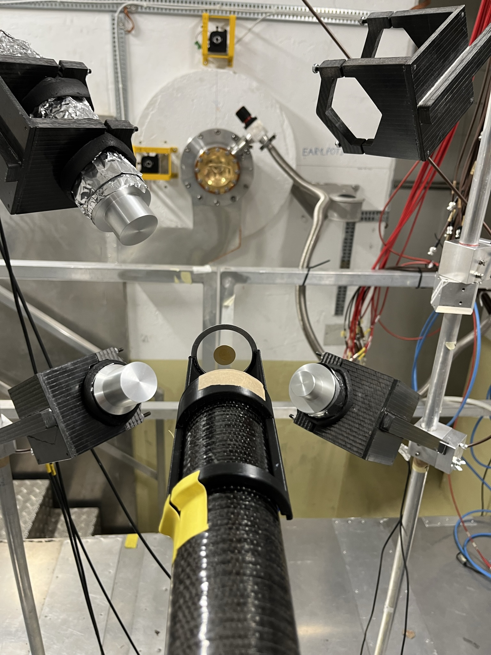
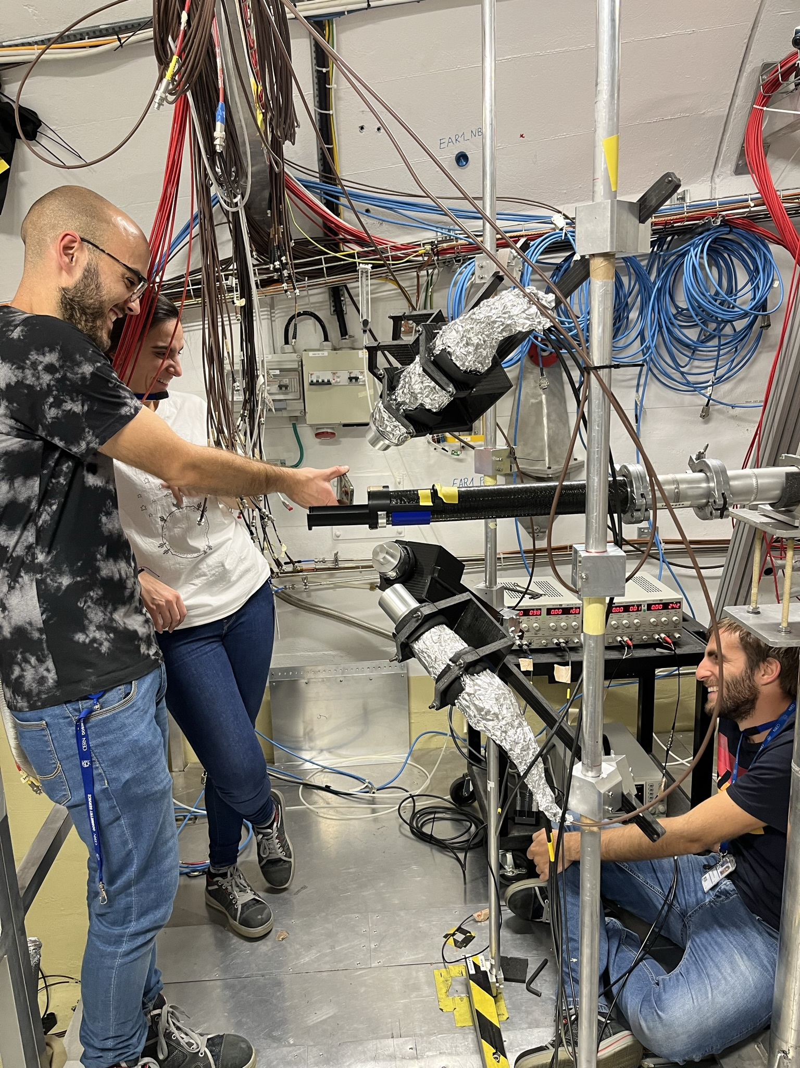
2023 test of LaBr₃ crystals
Three LaBr3 detectors looking at an Fe sample.
Capture position and supports.
Test performed by: Nikolas, Fran, Riccardo, Michele, Alice, Matt, Michi
Different geometries investigated:
3 angular positions (wrt beam): 135, 90, 45 degree
3 distances from the target: 11, 15 and 20 cm
Samples: Fe, Li, Au and empty
Data collected over 2 days, mostly 20 minutes for each geometrical/sample configuration.

Slide 4
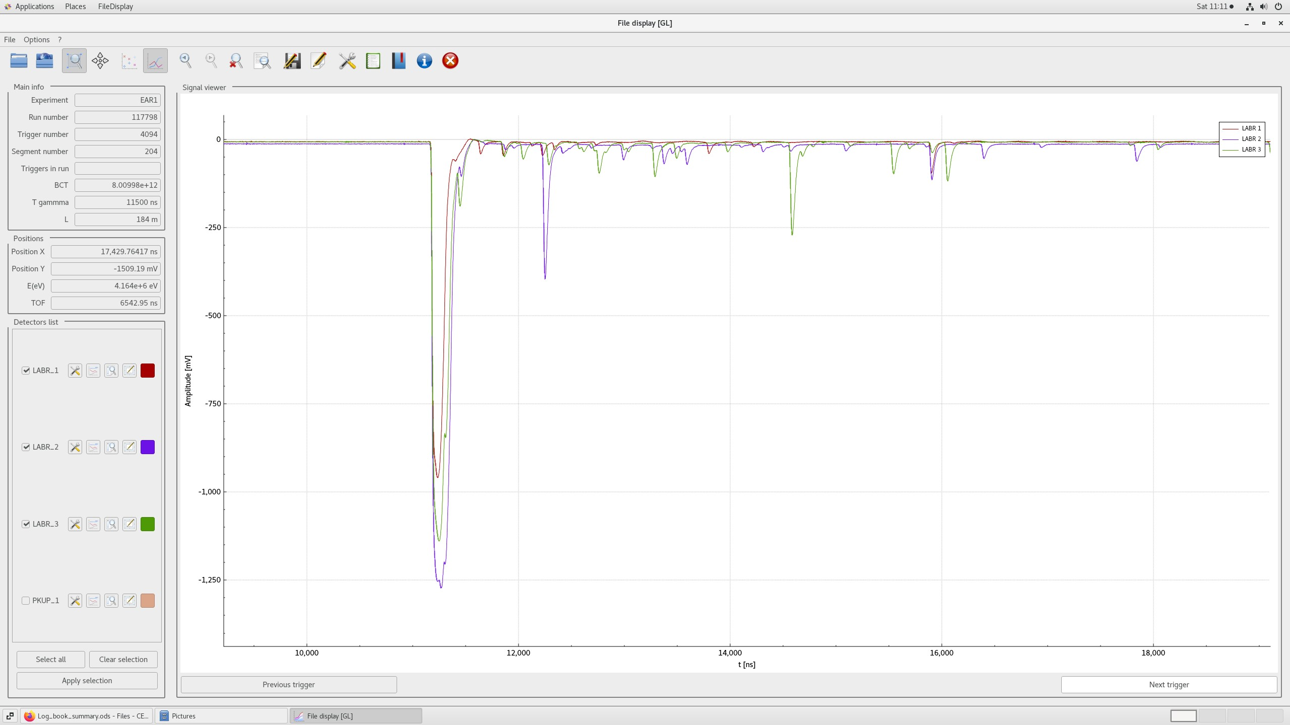
On-line plots and preliminary conclusions
The ringing problem has essentially disappeared !!
Clear (but not strong) dependence of the γ-flash on the detector dimension.
Need a dedicated analysis for precise characterization of maximum energy reachable with the different sizes.

Slide 5
LOI: validation of the use of LaBr₃ detectors for (n,inel) and (n,xn) reactions
We propose to use a combination of HPGe and LaBr₃ detectors to investigate the possibility of measuring (n,inel) and (n,xn) reactions up to several tens of MeV (and even higher in some cases)
HPGe: high resolution, but limited neutron energy range (up to a few MeV, currently, due to γ-flash response)
LaBr₃: possible to go up to high neutron energy (up to hundreds of MeV), but with limited resolution.
A combination of the two might allow to extend the energy range well above current limits in data and evaluations.

