Slide 1
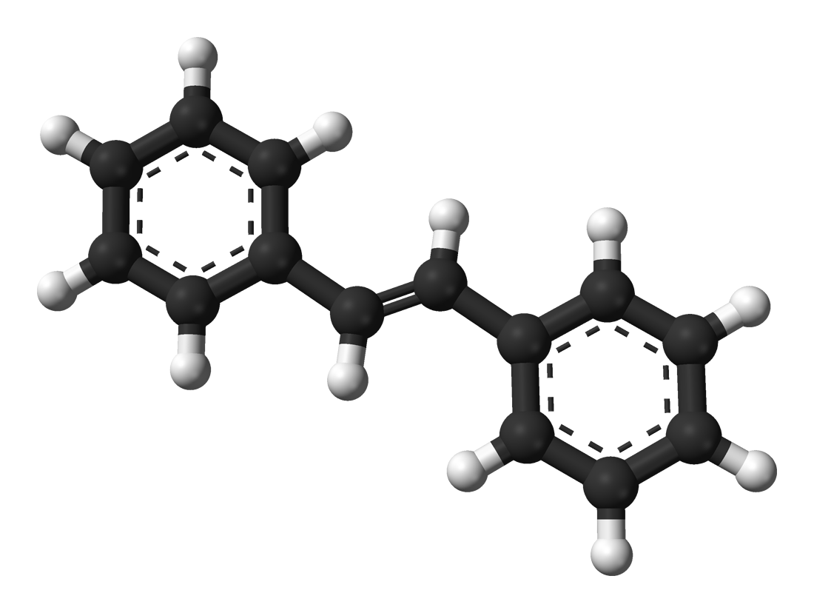


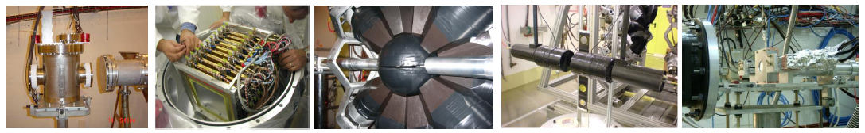
d,p
S t i l
Rivelatori a stilbene per reazioni (n,γ) e (n,n’)
M.G. Pellegriti¹, A. Musumarra^{1,2}, C. Massimi³, N. Patronis⁴, J. Balibrea⁵
R. Mucciola⁶, M. Spelta⁷, D. Papanikolau⁴
¹INFN-Sezione di Catania
²Università di Catania
³Università di Bologna and INFN-Sezione di Bologna
⁴University of Ioannina
⁵ISIC-Valencia
⁶INFN-Sezione di Bari
⁷Università di Trieste
Notes:
Good evening
Thanks to the organizer of the workshop for the invitation

Slide 2


Outlook
Motivation for developing the prototype:
- Study of the d-stilbene active target TaraT for the n-n scattering length LoI
- A new detector to replace C6D6 for n-γ
- n-n’ measurements
Stilbene scintillators developed at INFN-Sezione di Catania
The Stilbene–D12 developed for TARAT, LLNL crystal tested with SiPM at Demokritos in 2021 and at CERN
The d-Stil prototype, INRAD Crystal
The p-stil detectors (n. 4) INRAD ScintinelTM crystals
Issues arisen in performing an INFN indipendent analysis and pulse shape analysis on the last tests @ n_TOF
New stilbene crystal provider found !!
n. 4 p-stil detectors (n. 4) PROTEUS crystals assembly and test ongoing @ INFN CT
n_TOF Meeting Collaborazione Italiana, Trieste, 9-10 Novembre 2023

Slide 3
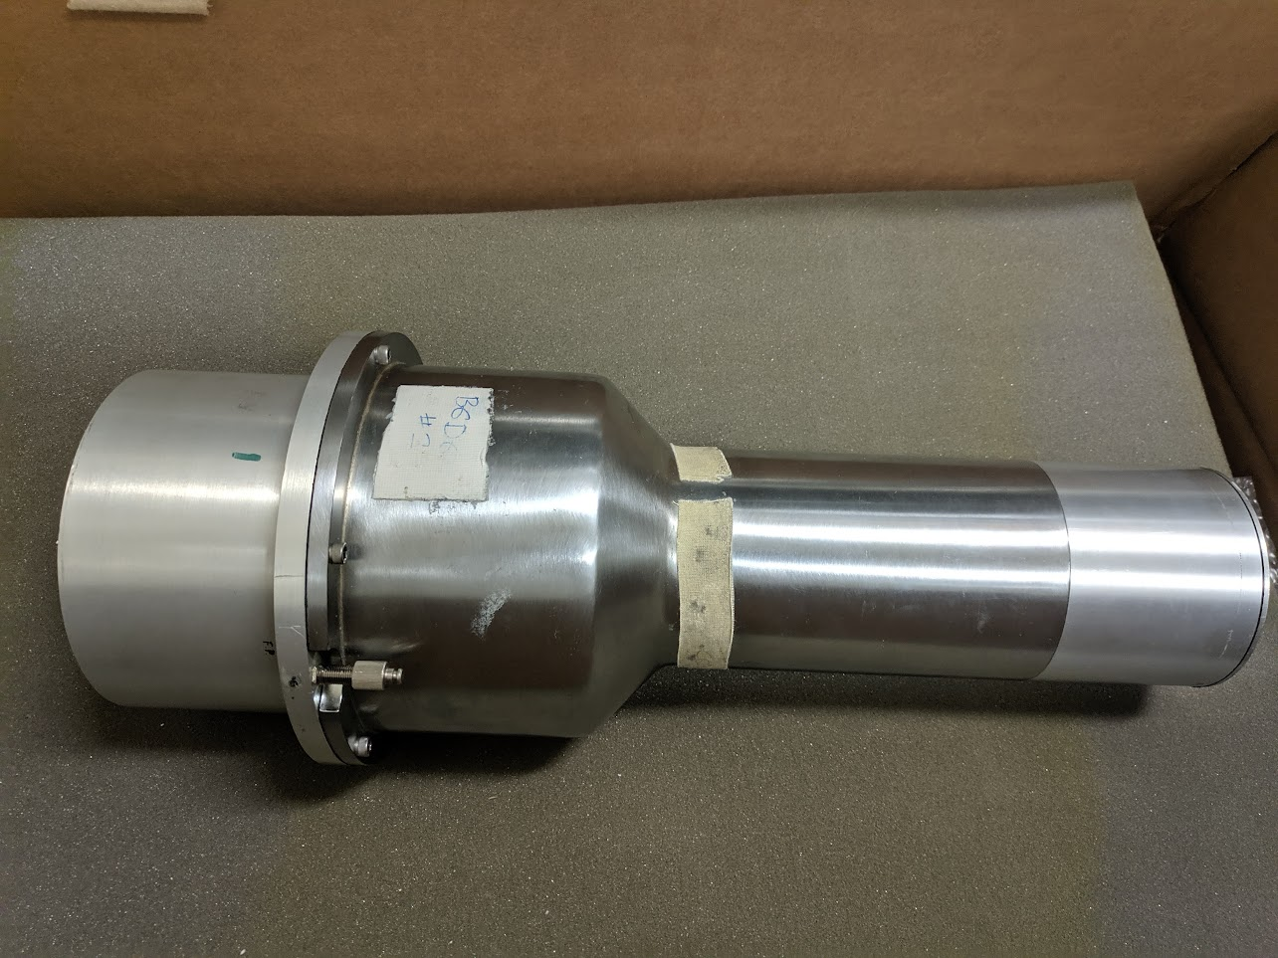
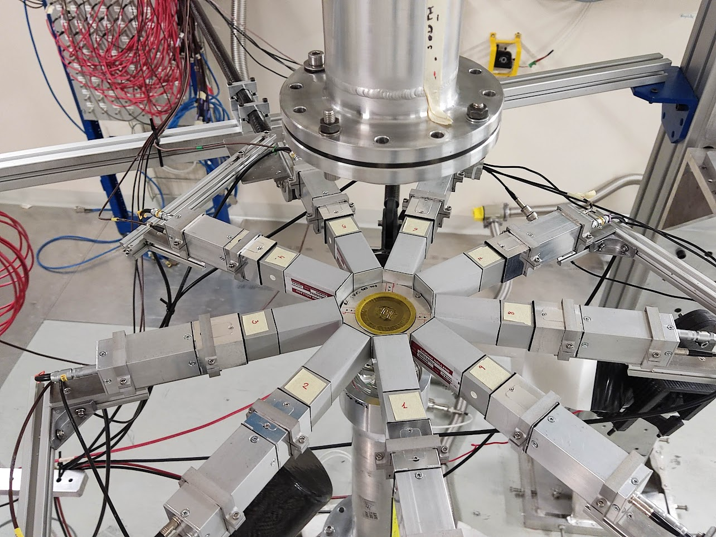
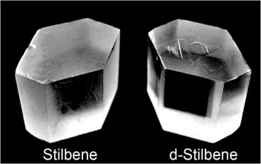
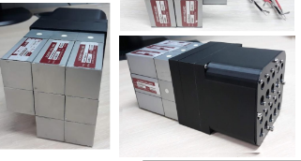
Motivation for developing the prototype
“Big” C₆D₆ Liquid scintillators
Compact array of small C₆D₆
Large & segmented C₆D₆
Solid organic scintillators
Read-outs/Power supplies
Solid
Higher density
No Chemical hazard
n/γ discrimination

Slide 4
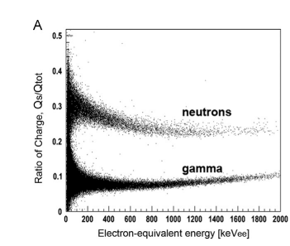
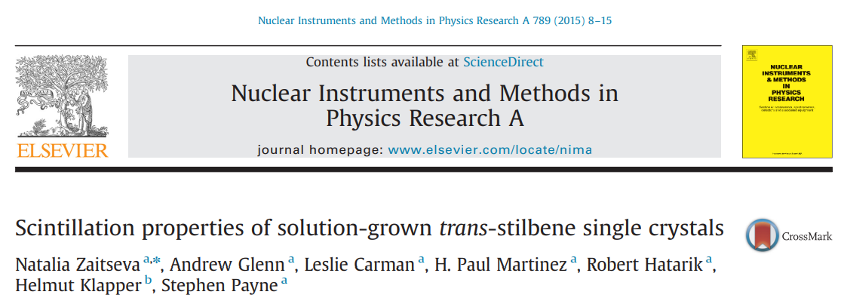
Stilbene characteristics
γ / n discrimination
Linear response in energy
n_TOF Meeting Collaborazione Italiana, Trieste, 9-10 Novembre 2023

Slide 5
Stilbene scintillators developed @ INFN-Sezione di Catania
Name | Crystal | Producer | Dimension | Sensor | INTC-LoI | Spokes
TARAT | deuterated | LLNL | 26 x 23 x 11 mm³ | n. 4 SiPM | INTC-I-220 | Massimi, Musumarra Patronis
d-stil | protonated | INRAD | 31.75mmx 10mm | PMT |  | Massimi, Musumarra Patronis
p-stil (n. 4) | protonated | INRAD-ScintinelTM | 1inchx1inch | PMT | INTC-I-254 | Musumarra Balibrea
p-stil (n.4) | protonated | PROTEUS | 1inchx1inch | PMT
Brand new !!
n_TOF Meeting Collaborazione Italiana, Trieste, 9-10 Novembre 2023

Slide 6
Activities timeline
 | 2020 |  | 2021 |  | 2022 |  | 2023
 | 1sem | 2sem | 1sem | 2sem | 1sem | 2sem | 1sem | 2sem
TARAT Stilbene D12 SiPM – LoI CERN n-n scattering lenght: Cristian, Agatino, Nikolas
Crystal Procurement: Nikolas from N. Zaitseva @ LLNL
Active Target Development: Agatino
Test @ Demokritos: Agatino, Cristian + test @ CERN |  |  | Demokritis | EAR2-EAR!
Analysis of Demokritos data: Cristian, Agatino, Maria Grazia
Geant4 Simulations: Cristian, Riccardo – D break-up M.G.
Draft on Demokritos data: Cristian, Nikolas, Agatino, Maria Grazia
d-stil (INRAD) → protonato
Crystal Procurement: Nikolas from INRAD for n-n LoI
Development-Assembly: Agatino
Test @ CERN: Agatino, Nikolas
Analysis: Javi, Cristian, Riccardo
p-stil (INRAD- ScintinelTM) n.4
Procurement - Assemblaggio: INFN CT
CERN LoI: Agatino, Javi and test@CERN: Agatino, Javi, Cristian
Analysis: Javi, Cristian, Michele
p-stil (new provider - PROTEUS) n. 4
Procurement – Assemblaggio: INFN CT
Test: gamma source @ INFN CT
Analisi: Dimitris (Erasmus Training student )

Slide 7
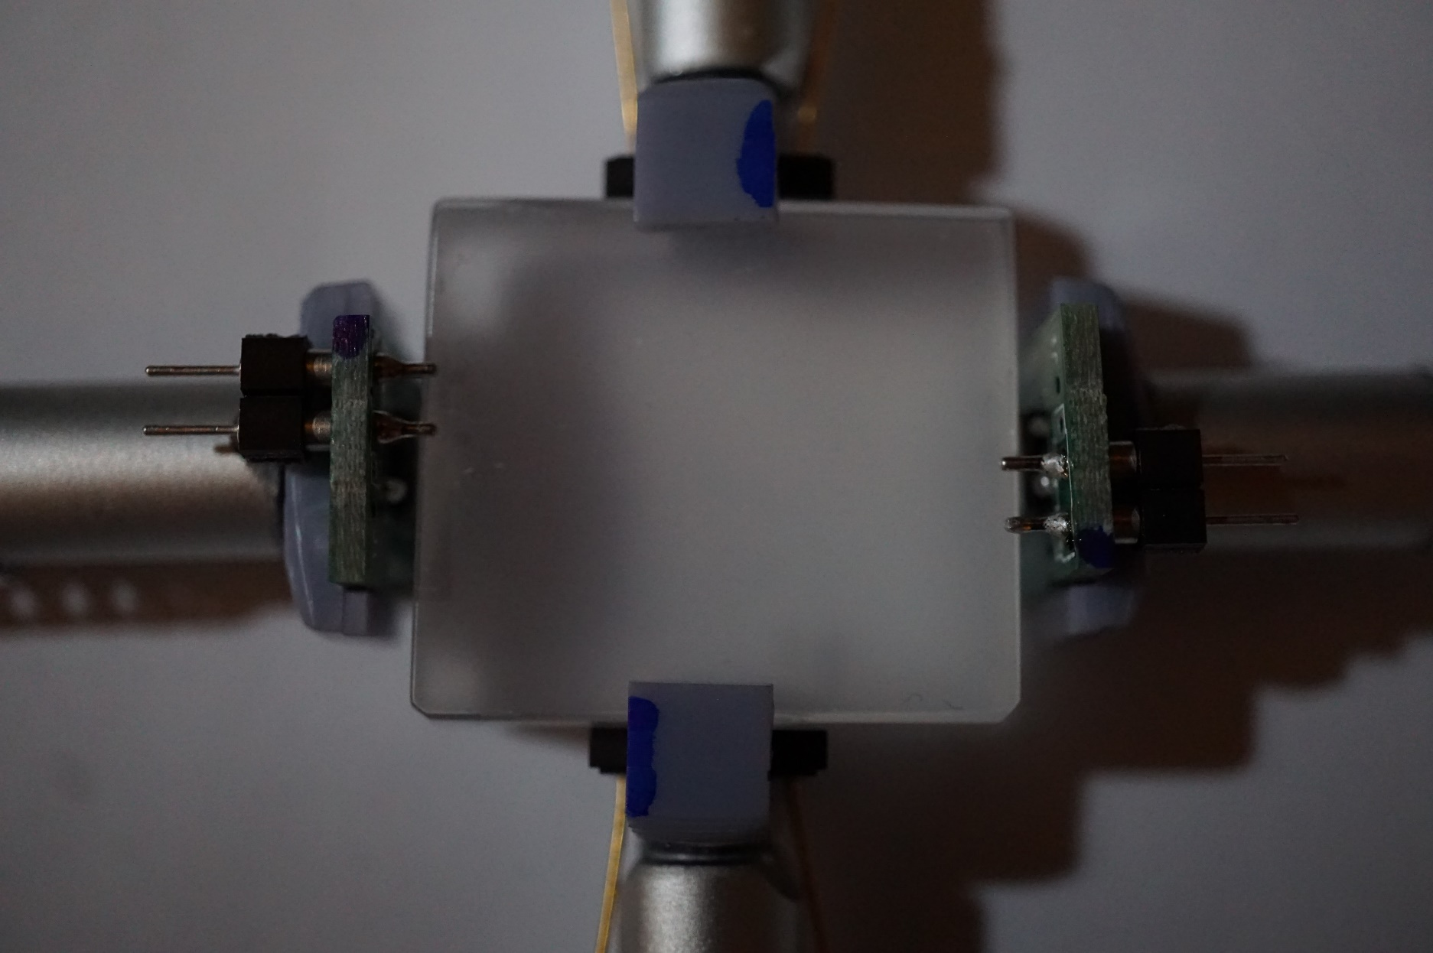
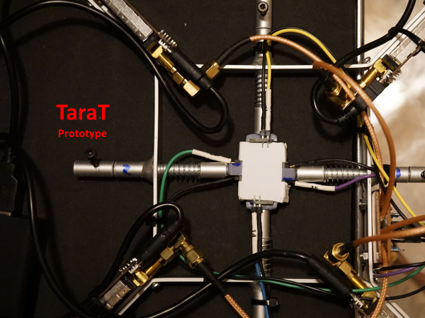
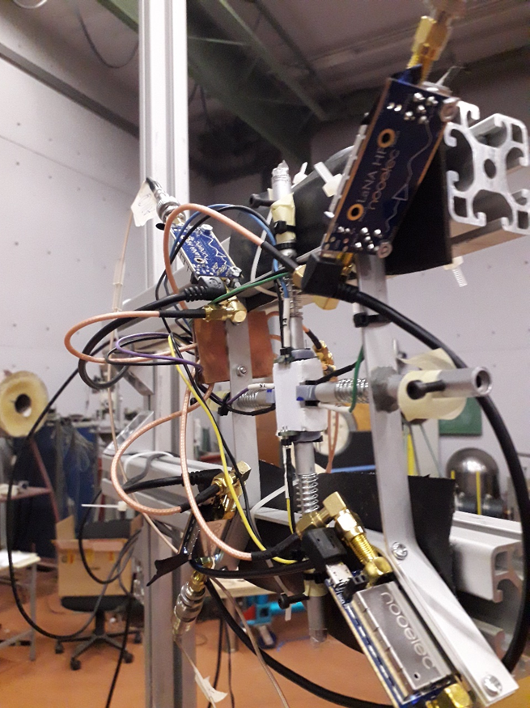
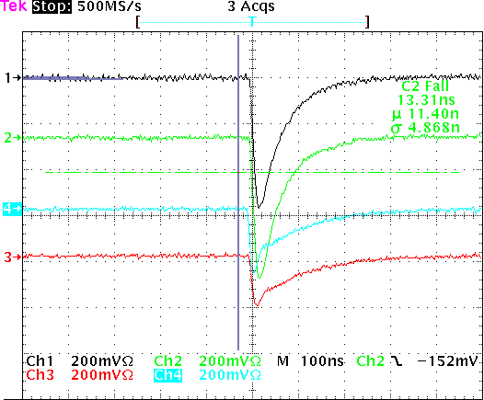
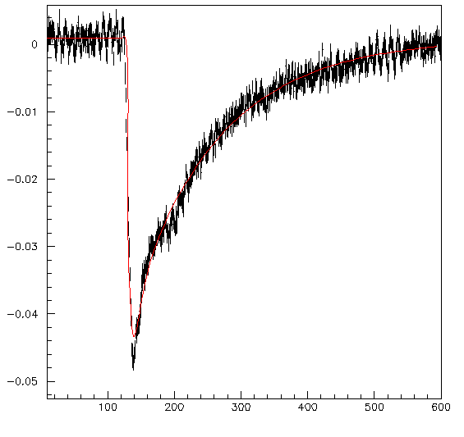
TaraT test run at NCSR Demokritos (Athens) June 2021
d-Stilbene
26 x 23 x 11 mm³
thanks to
Natalia P. Zaitseva
LLNL
Signal parametrization
$f\left(t\right)=P0+A∗(⍴ ∗(exp⁡(−\frac{t+t0}{τ_{r1}}$) -$exp⁡(−\frac{t+t0}{τ_{d1}}$)) + (1-⍴) *($exp⁡(−\frac{t+t0}{τ_{r2}}$) -$exp⁡(−\frac{t+t0}{τ_{d2}}$)))
2 HAMAMATSU 6x6
2 AdvanSid 4x4
n_TOF Meeting Collaborazione Italiana, Trieste, 9-10 Novembre 2023

Slide 8
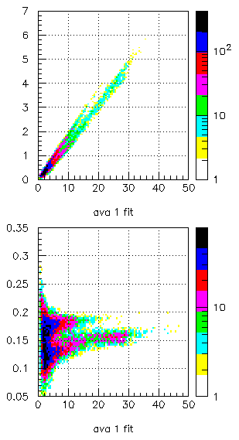
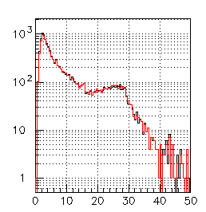
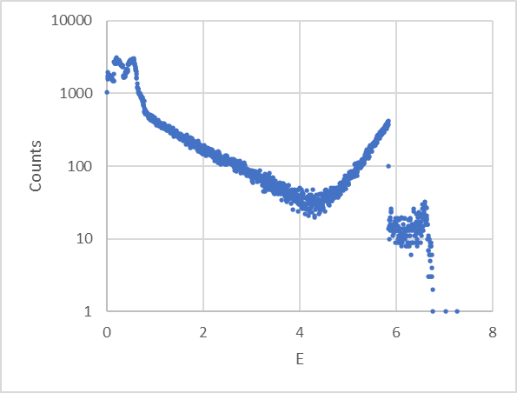
Neutron gate
Fast/Slow analysis
Windows from leading-edge: 25 ns for Q_{FAST} and 430 ns for Q_{TOT}
E_{beam}=15MeV
AVANSID 1
Q_{FAST}
AVANSID 1
Integral of Fit function
Q_{TOT}
Q_{FAST/}Q_{TOT}
Q_{TOT}
----FIT
----No FIT
SIMULATION by Riccardo
Detector response conv. must be included
Q_{TOT}
Draft to be finished and submitted at the begininng of 2024!
N_TOF Collaboration Meeting, Edinburgh, 13-14 December 2022

Slide 9
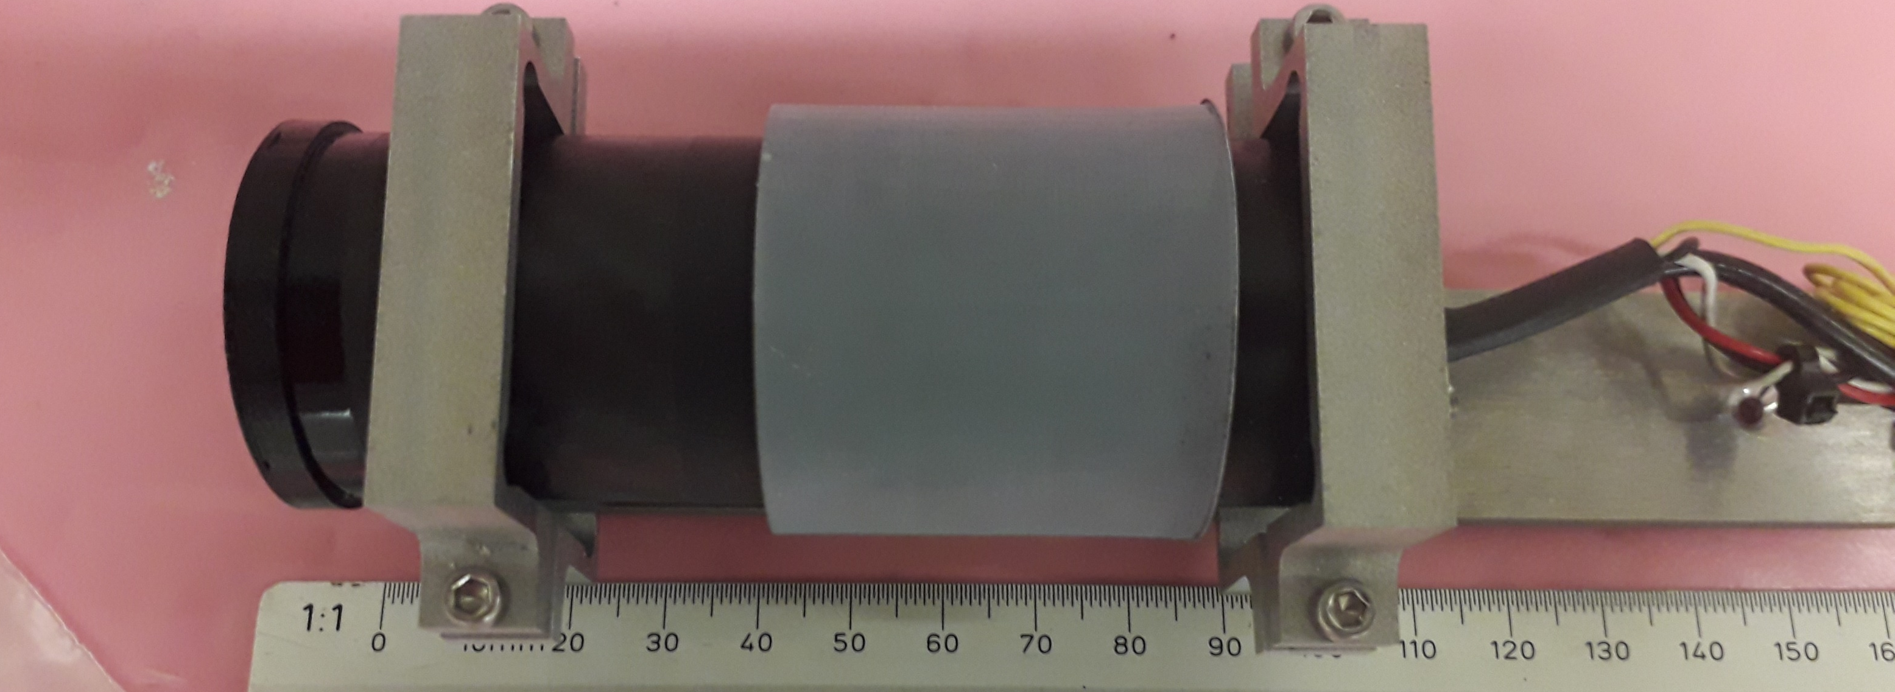
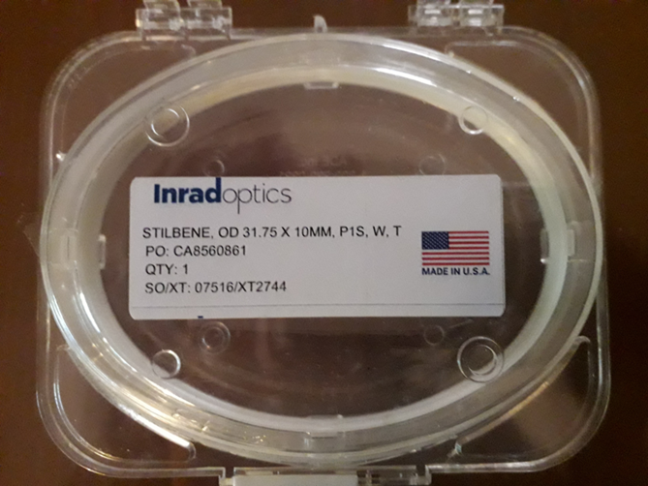
d-stil prototype
3.5 cm
HAMAMATSU R1924A
Sens-Tech PS1807
Ultra compact active base
with DC-DC converter
no HV needed
n_TOF Meeting Collaborazione Italiana, Trieste, 9-10 Novembre 2023

Slide 10
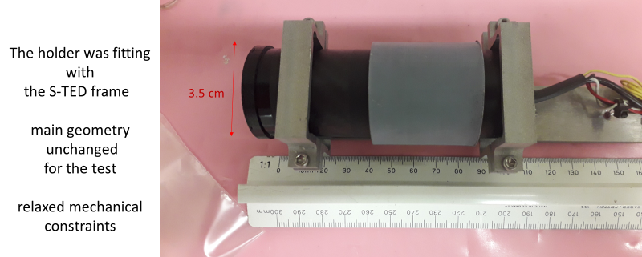
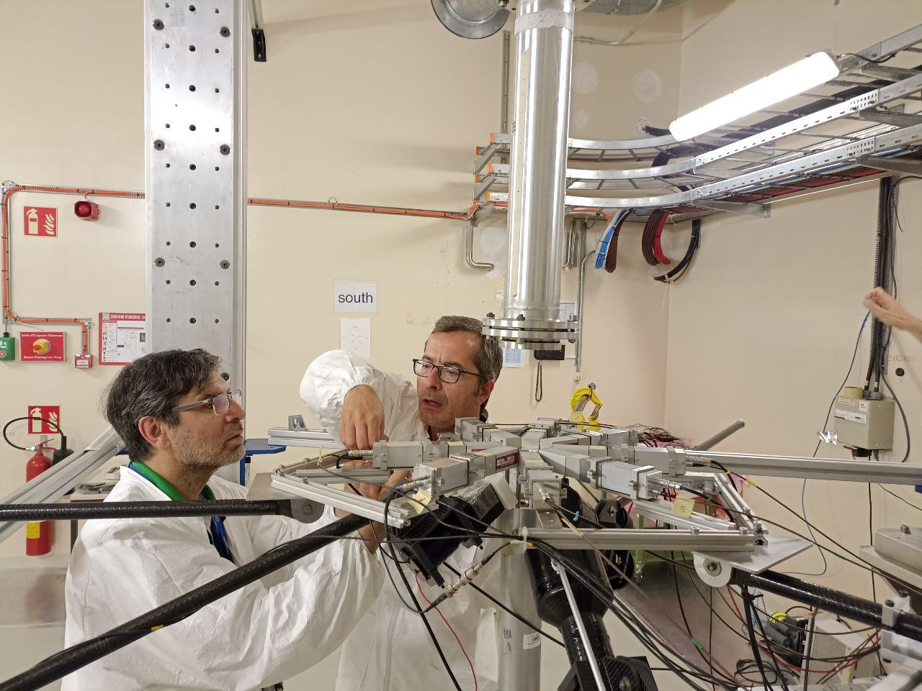
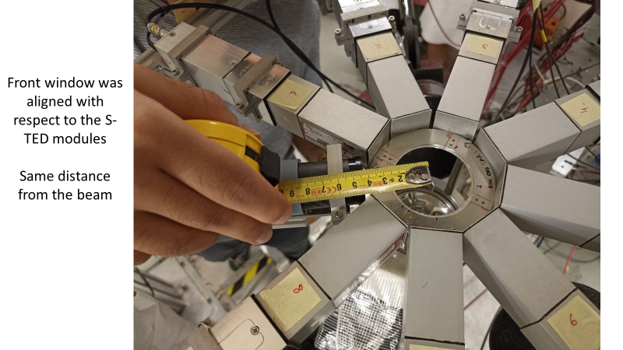
First test @ EAR2 – June 2022
N_TOF Collaboration Meeting, Edinburgh, 13-14 December 2022

Slide 11
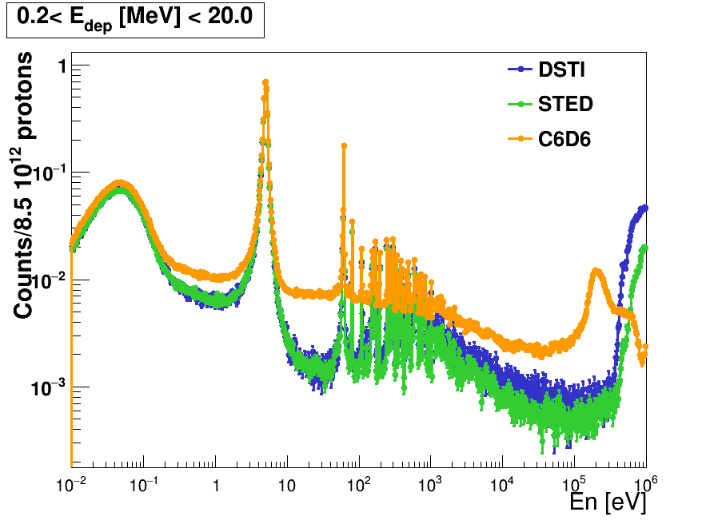
Analysis
ToF spectra normalized to saturated resonance
ToF spectras for DSTI and STED have similar shape
By Javi Balibrea
n_TOF Meeting Collaborazione Italiana, Trieste, 9-10 Novembre 2023

Slide 12
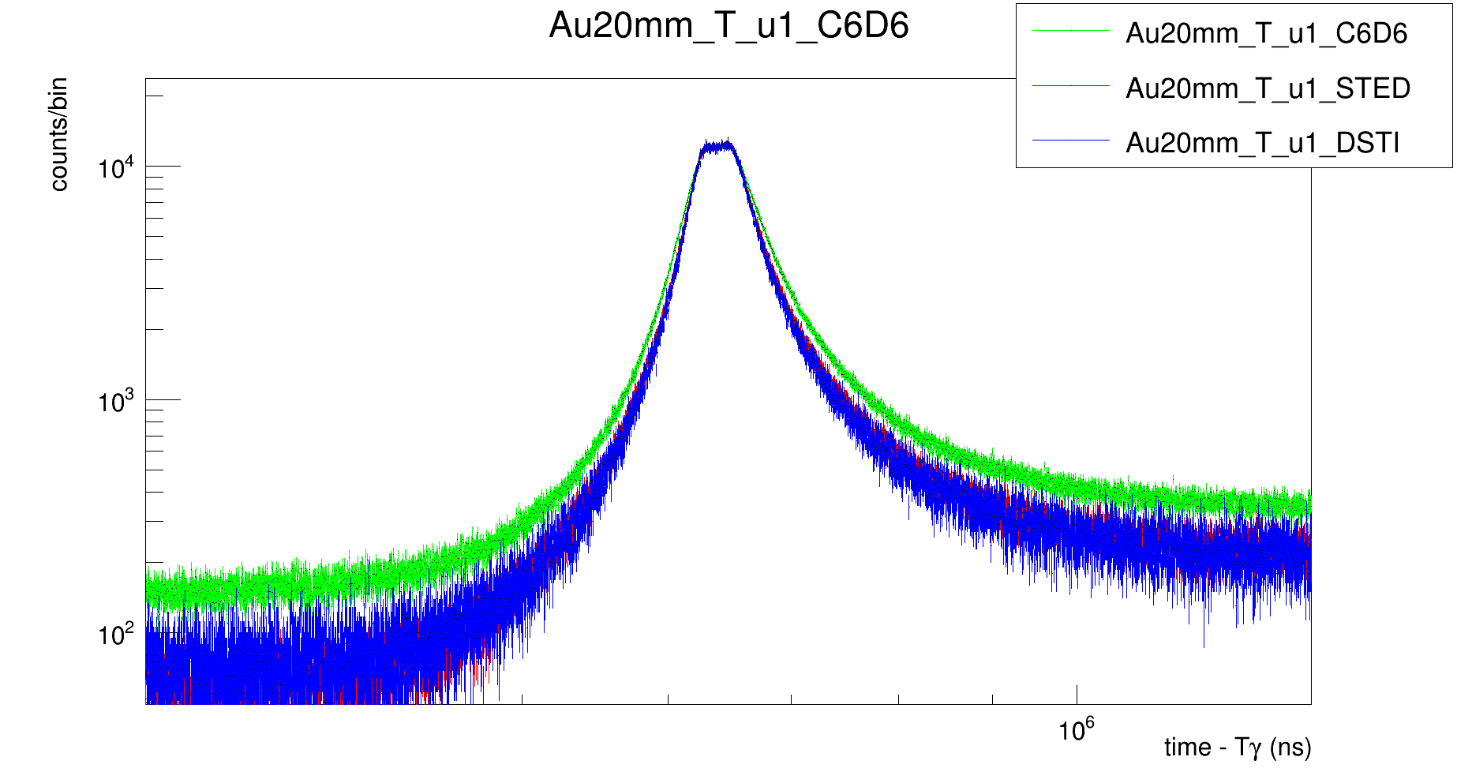
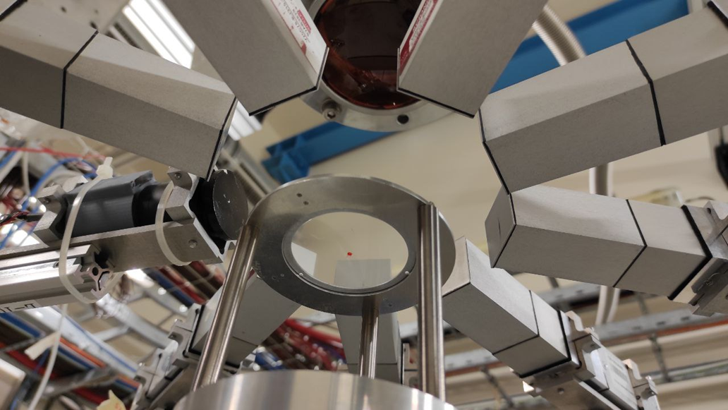
Second test during Mo(n,γ) measurement in EAR2
New setup HV=600 V
By Riccardo Mucciola
n_TOF Meeting Collaborazione Italiana, Trieste, 9-10 Novembre 2023

Slide 13
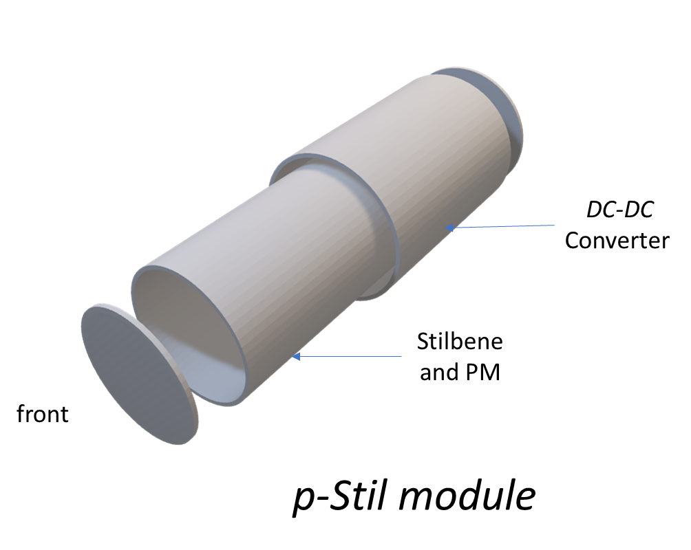
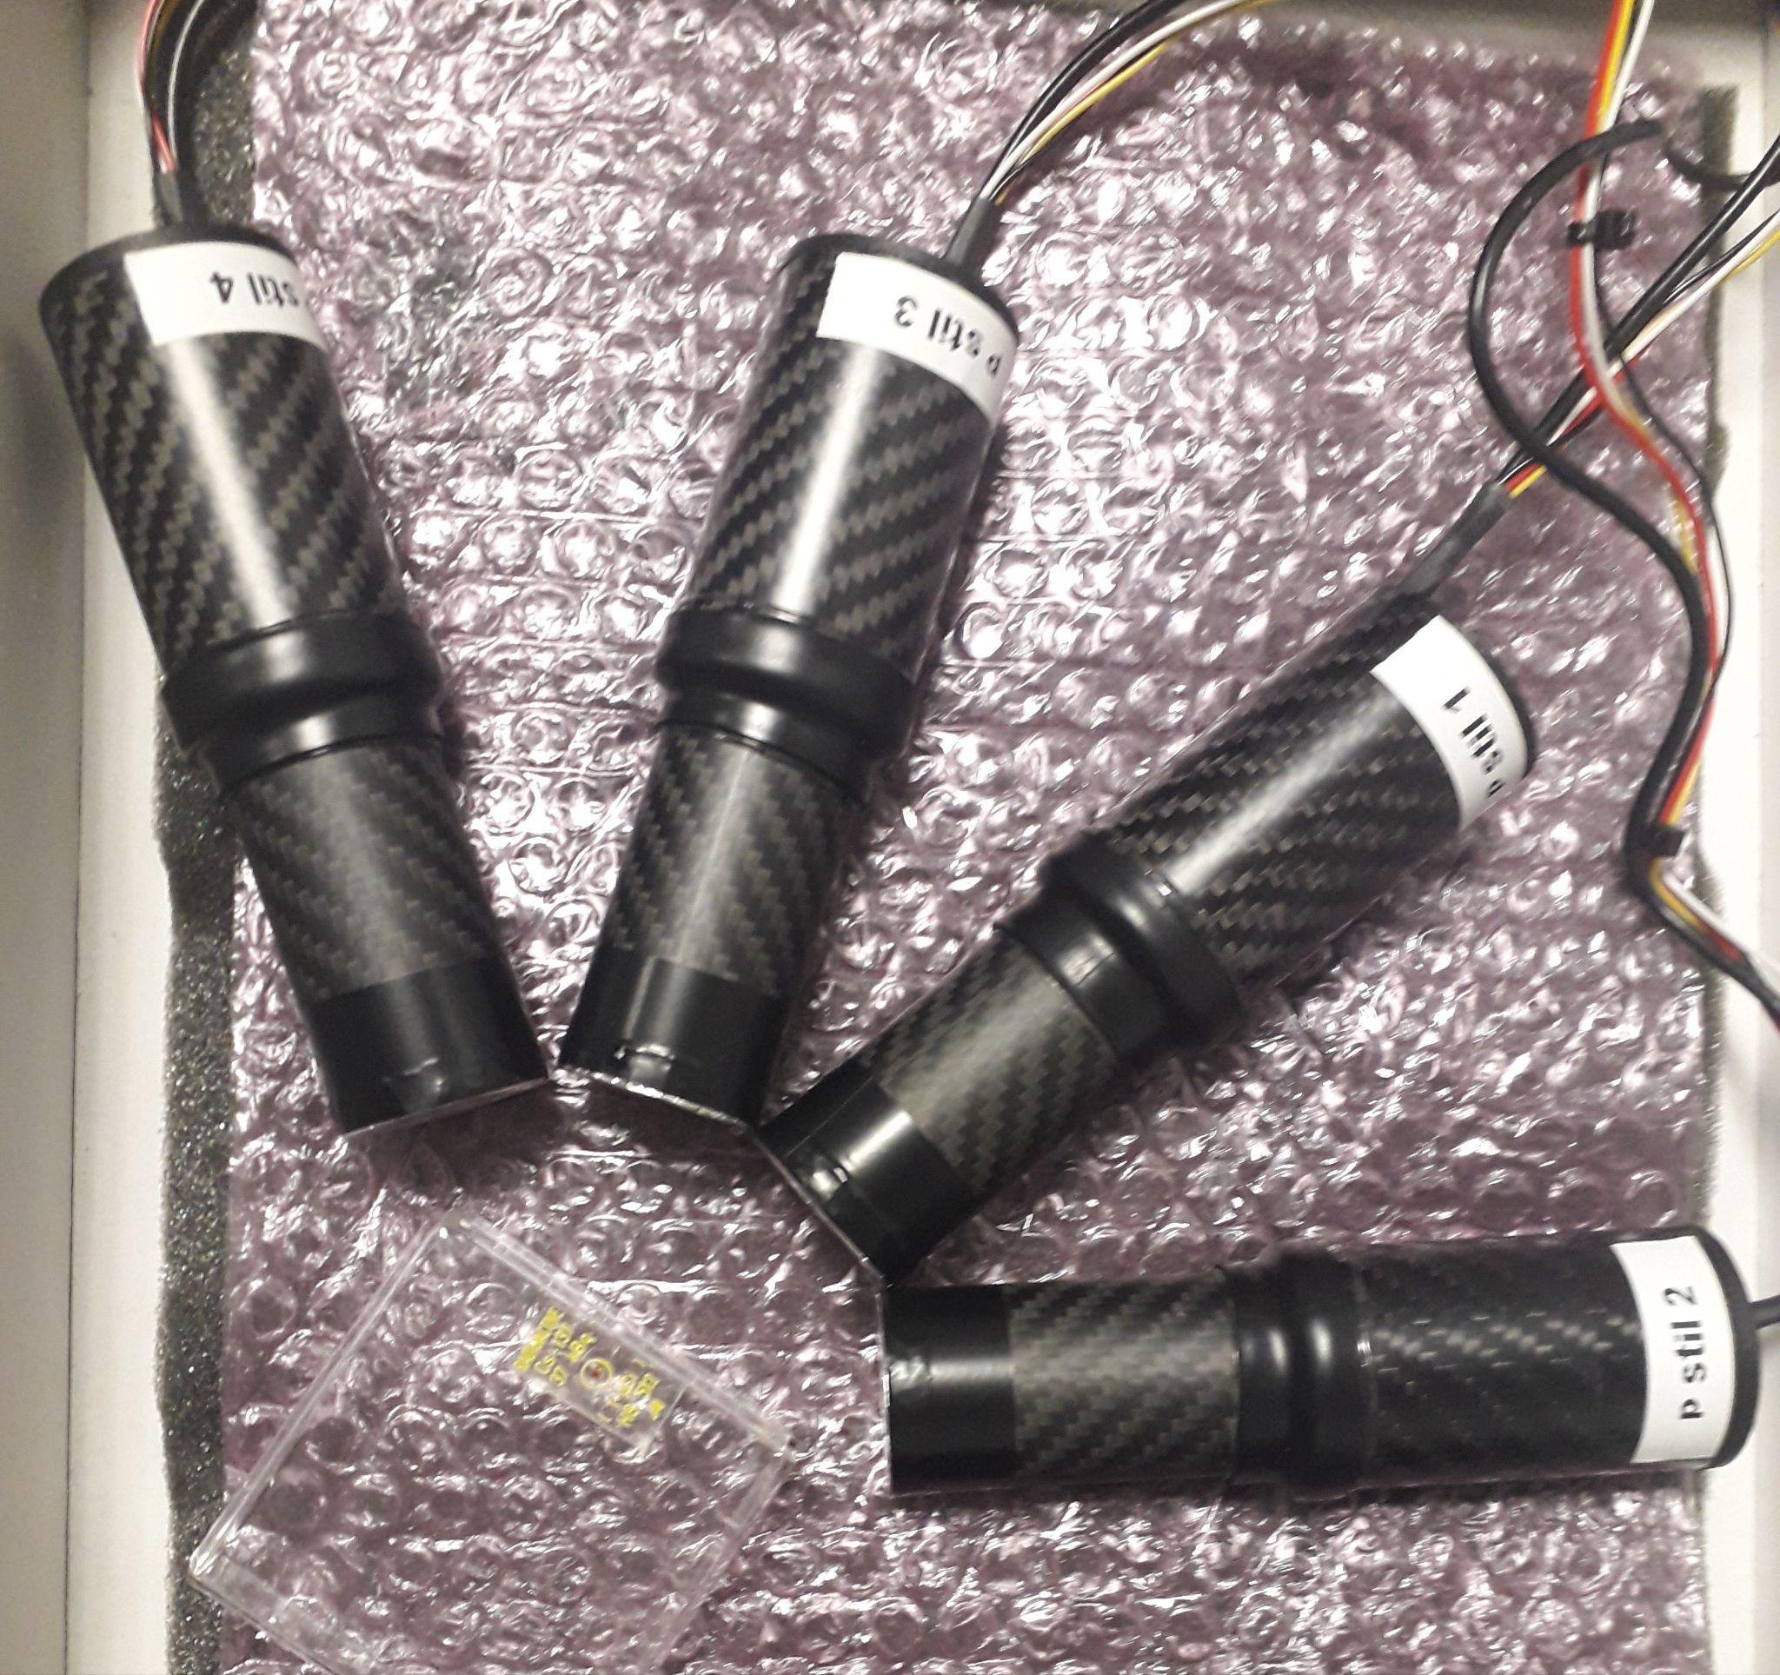
The p-stil detectors (n. 4) INRAD ScintinelTM crystals
¹³⁷Cs
1”x 1” 4 cylindrical INRAD p-stilbene detectors +
1 d-stilbene assembled in carbon fiber housing
N_TOF Collaboration Meeting, Edinburgh, 13-14 December 2022

Slide 14
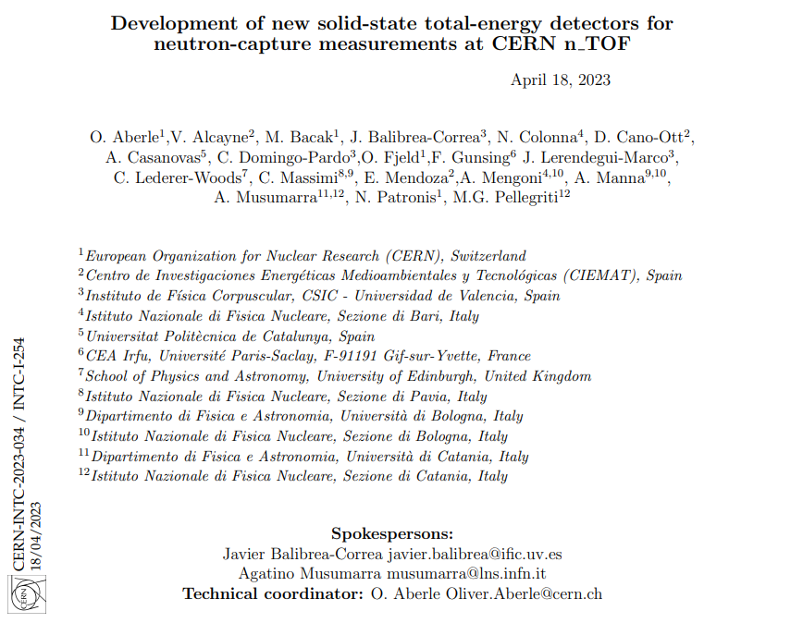
LoI for stilbene detector development @ n_TOF – April 2023
n_TOF Meeting Collaborazione Italiana, Trieste, 9-10 Novembre 2023

Slide 15
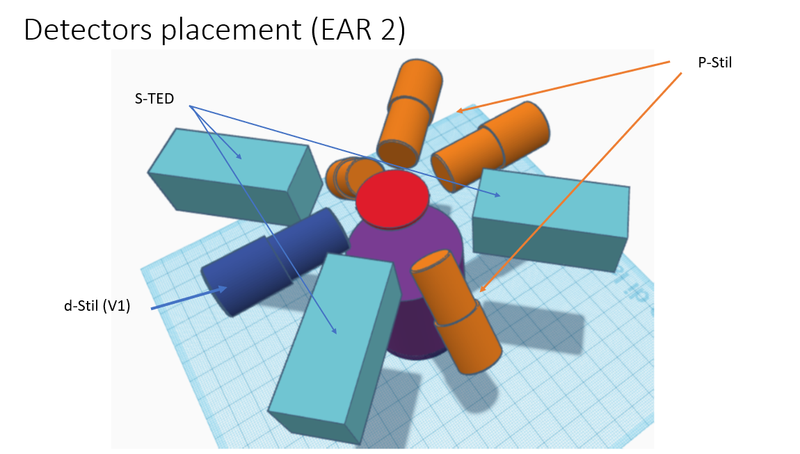
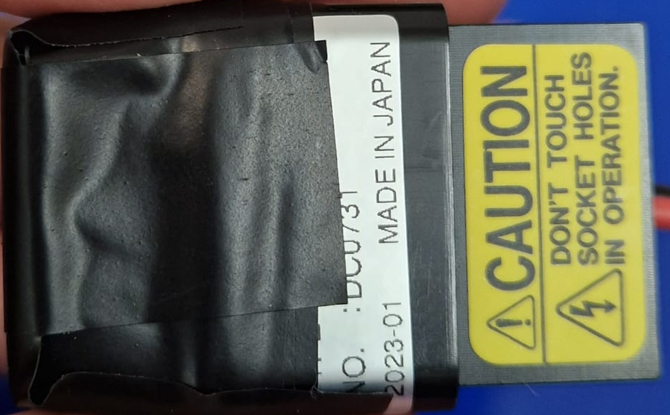
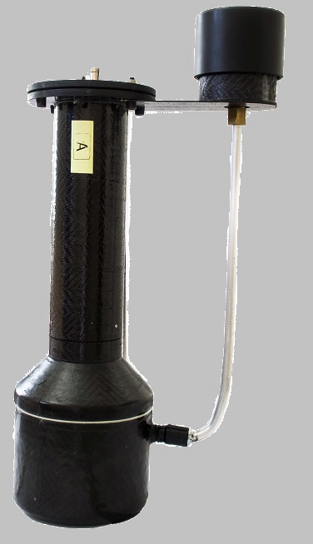
EAR2 proposed set-up - May 2023
LLNL d-stilbene
Legnaro C₆D₆

Slide 16
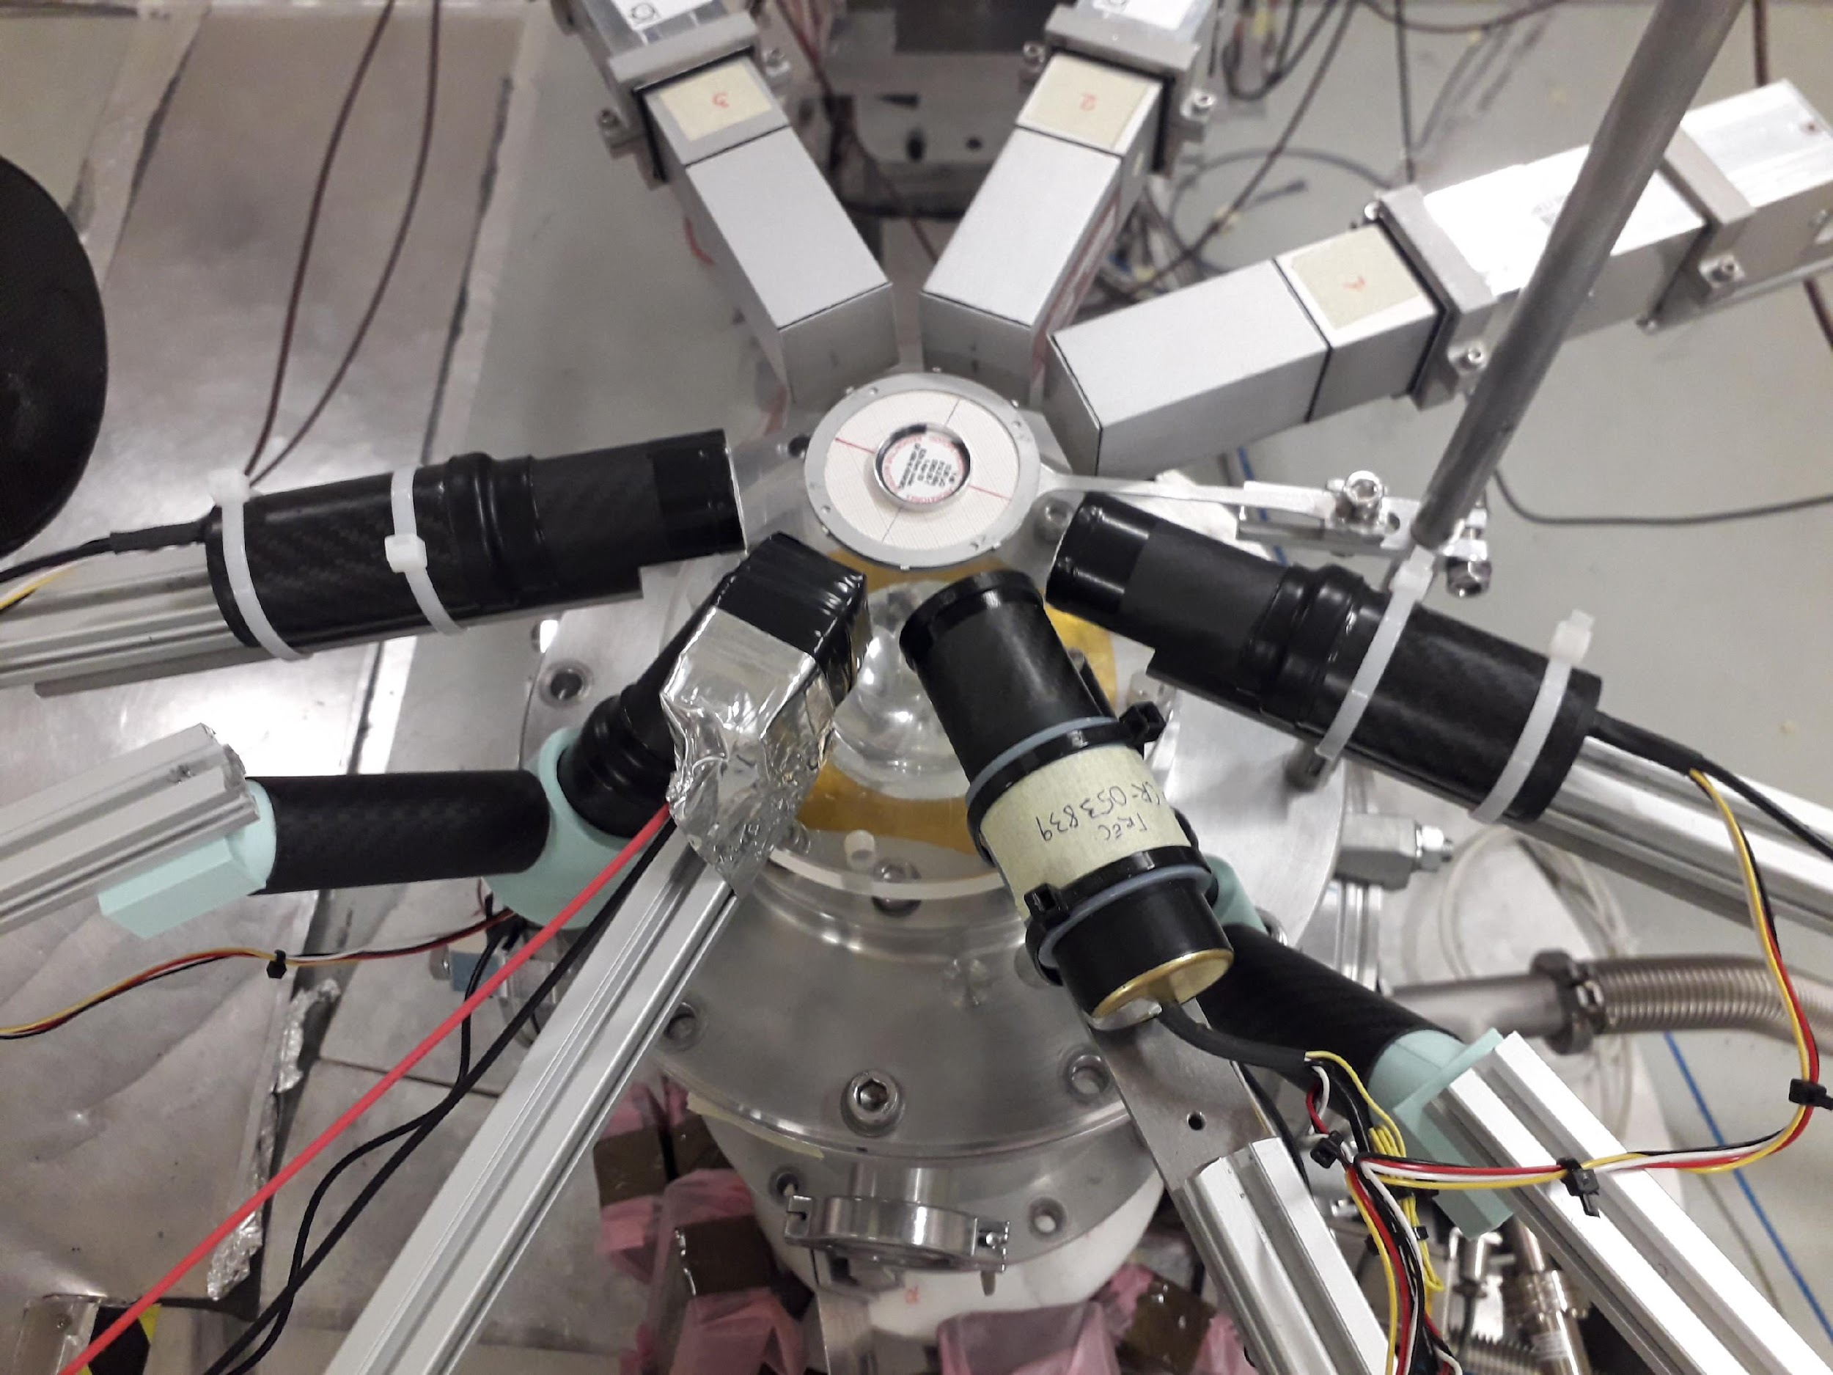
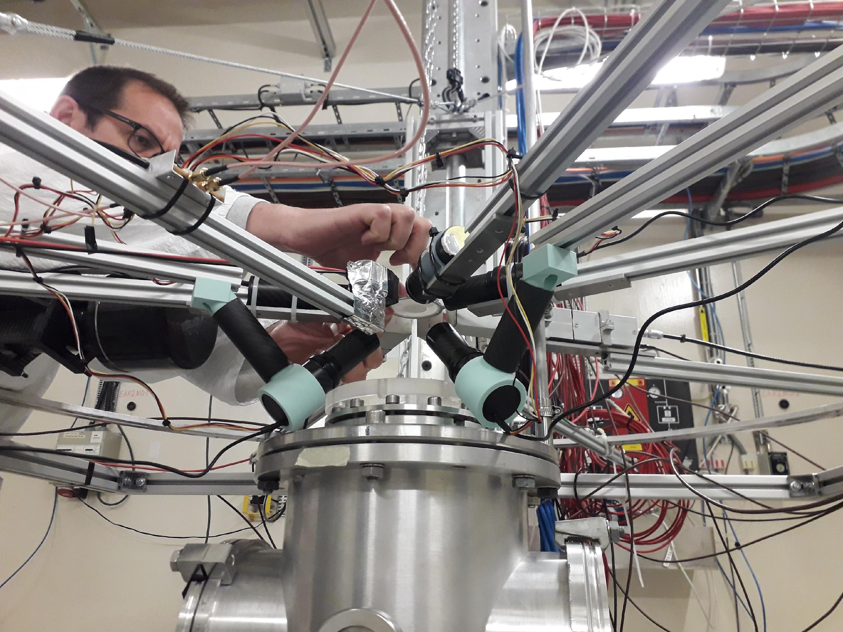
EAR2 May 2023 set-up
n_TOF Meeting Collaborazione Italiana, Trieste, 9-10 Novembre 2023

Slide 17
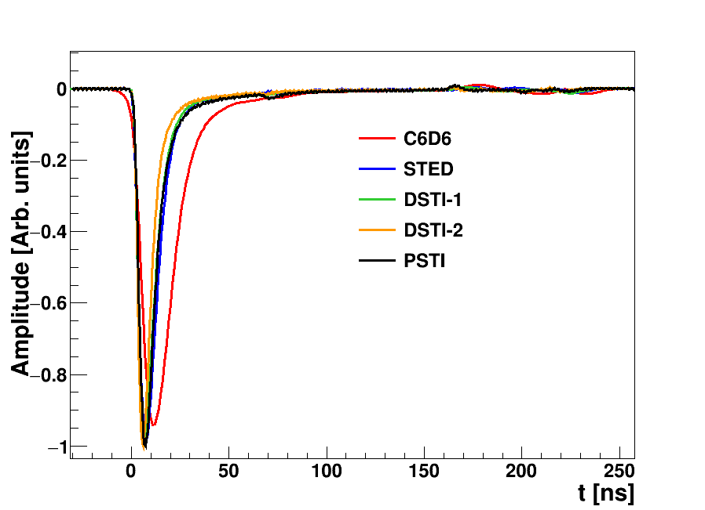
Detectors’ pulse shape analysis (only ɣ)
by Javi Balibrea – talk n_TOF coll. meeting May 2023
Average pulse shape calculated from ⁸⁸Y calibration source
Pulse Width: 10% →10%
Detector | Rise time [ns] | Pulse width [ns]
L6D6 | 8 | 40
sTED | 4.4 | 24
DSTI-1 | 3 | 23
DSTI-2 | 3.3 | 19
PSTI | 4.4 | 24
LLN –ISIC
Rise time: 10%-->90%
1stINRAD
^{2nd}INRAD
3.8-3.9ns
by Dimitris Papanikolau
Catania-October 2023

Slide 18
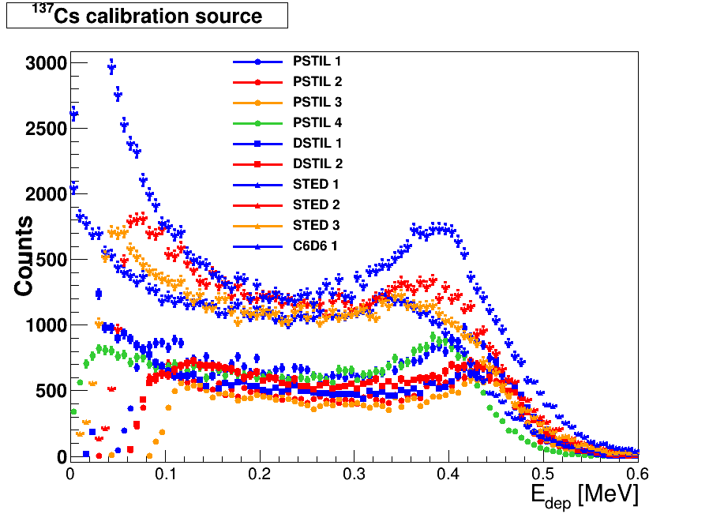
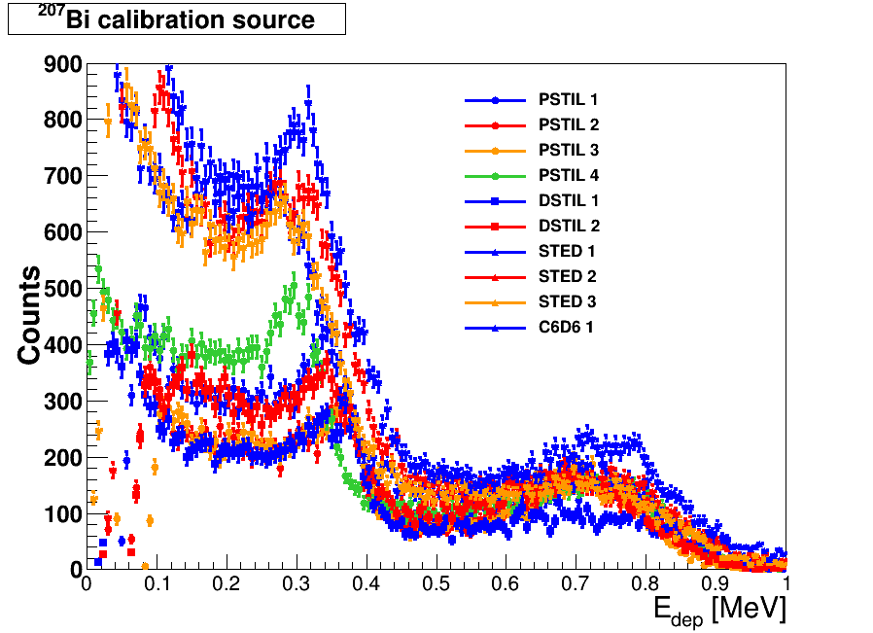
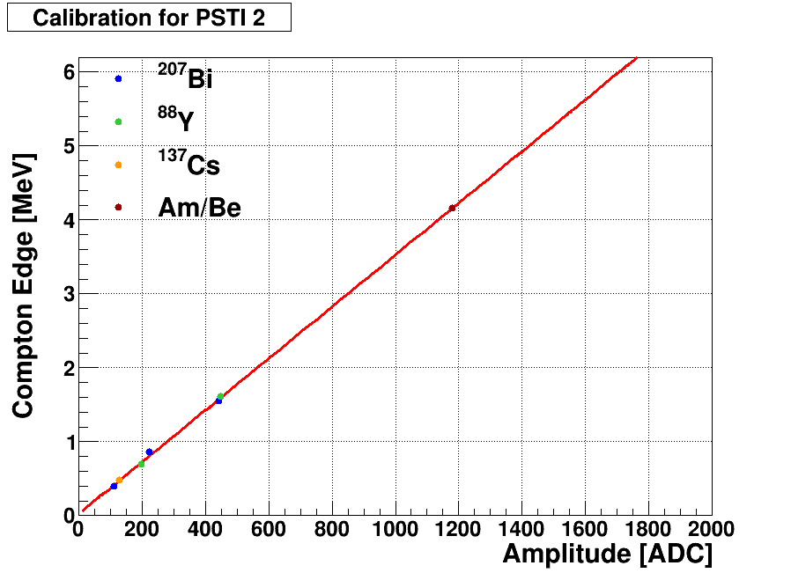
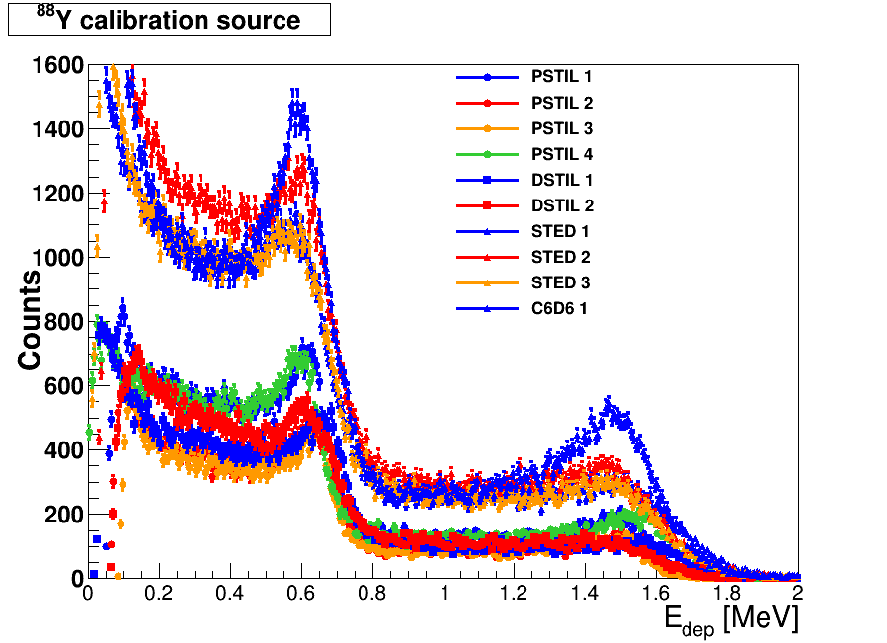
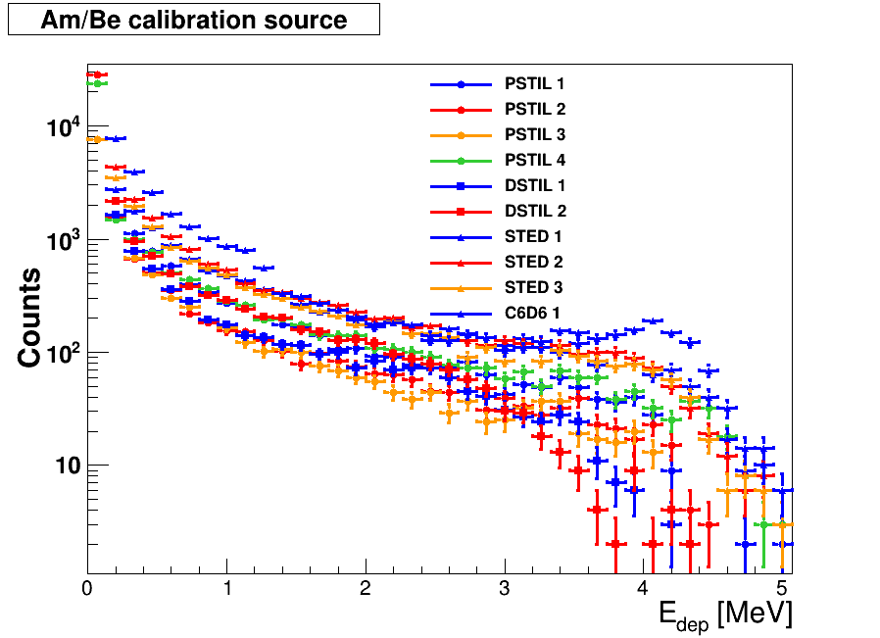
Deposited energy calibration
by Javi Balibrea – talk n_TOF coll. meeting May 2023
All linear Energy calibrated!
Small crystals→ Low threshold

Slide 19
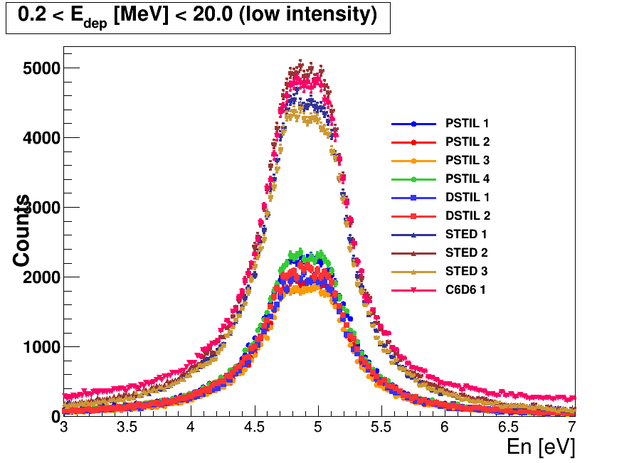
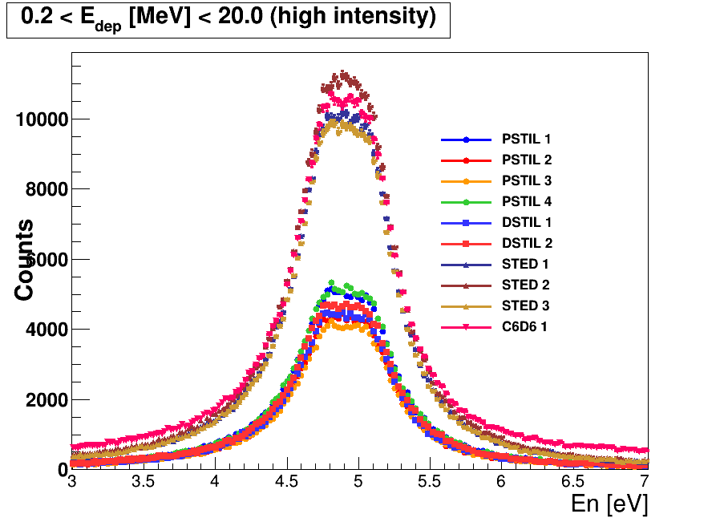
¹⁹⁷Au(n,ɣ) saturated resonance
¹⁹⁷Au(n,ɣ) saturated resonance to establish relative efficiency between detectors
by Javi Balibrea – talk n_TOF coll. meeting May 2023

Slide 20
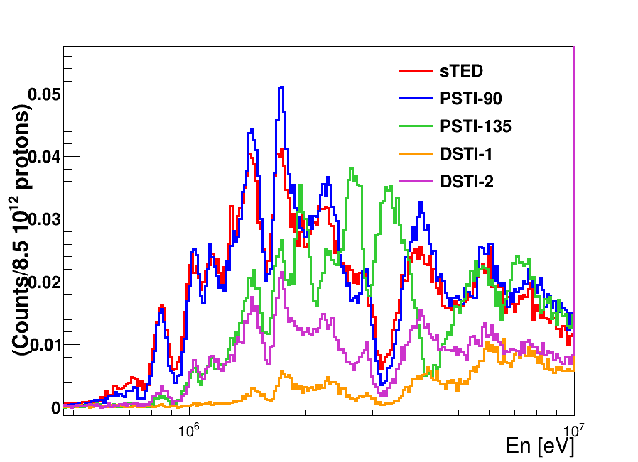
Carbon target
Empty subtracted C low intensity pulses
-agreement of PSTI-90 with STED
-angular distribution effects shown by PSTI-135!
-still no pulse shape analysis still provided
-need of an INFN independent analysis to evaluate
the performance of the detectors with respect to
Spanish group analysis (very fast and efficient)
-limit in neutron discrimination for future n.n’ exp.
2x10⁶
3x10⁶
4x10⁶
7x10⁶
by Javi Balibrea – n_TOF coll. meeting May 2023
n_TOF Meeting Collaborazione Italiana, Trieste, 9-10 Novembre 2023

Slide 21
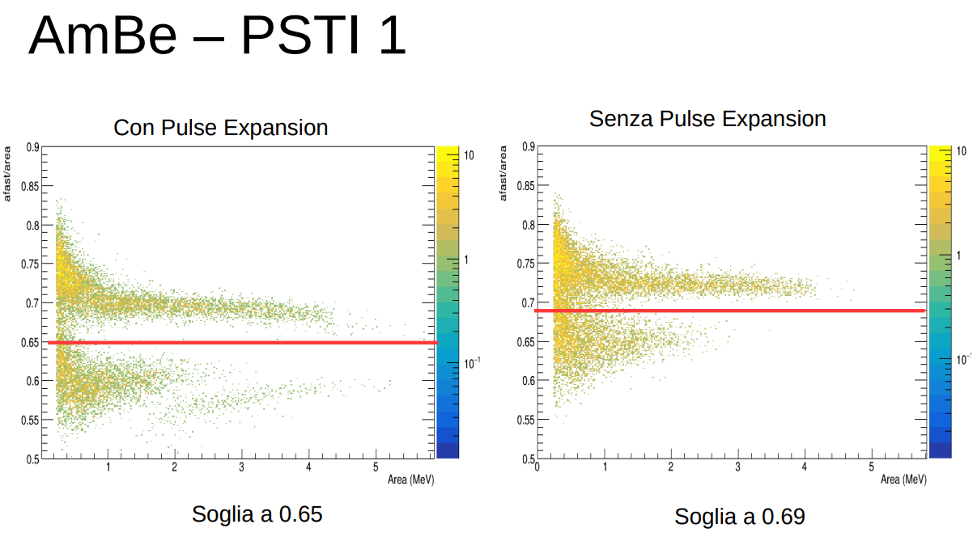
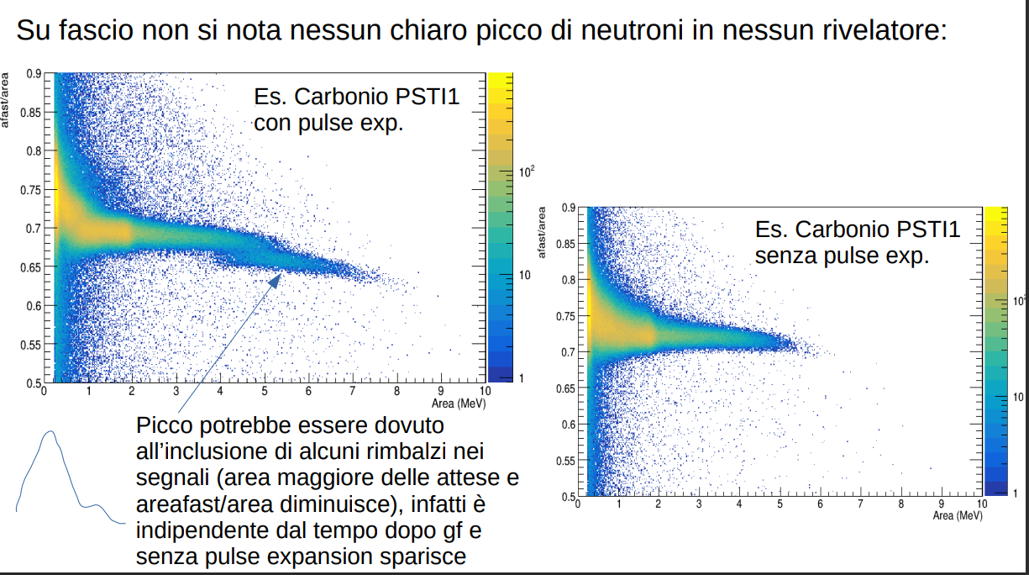
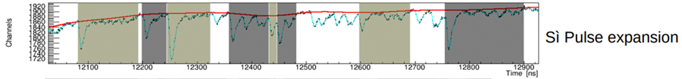
Fast/slow analysis on AmBe source file (test EAR2 – May 2023)
by Michele Spelta
n_TOF Meeting Collaborazione Italiana, Trieste, 9-10 Novembre 2023

Slide 22
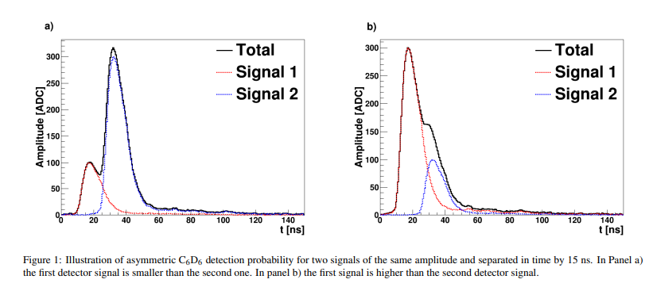
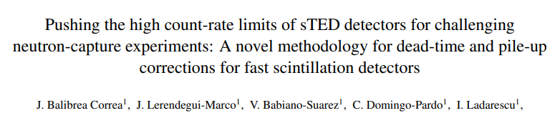
Open issues on analysis of stilbene test
-agreement of PSTI-90 with STED!
-angular distribution effects already shown by PSTI-135!
-still no pulse shape analysis provided to perform n/γ discrimination for background subtraction
or n, n’ measurements
-need for an independent analysis to evaluate the performance of the detectors
n_TOF Meeting Collaborazione Italiana, Trieste, 9-10 Novembre 2023

Slide 23
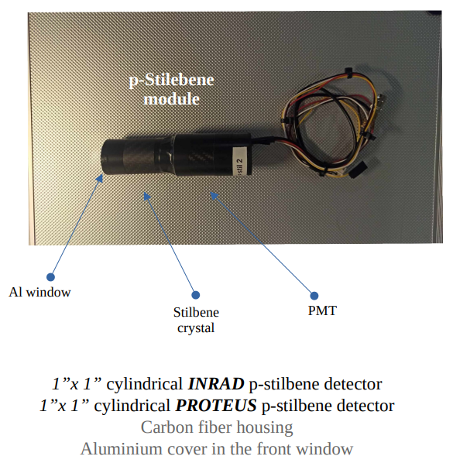
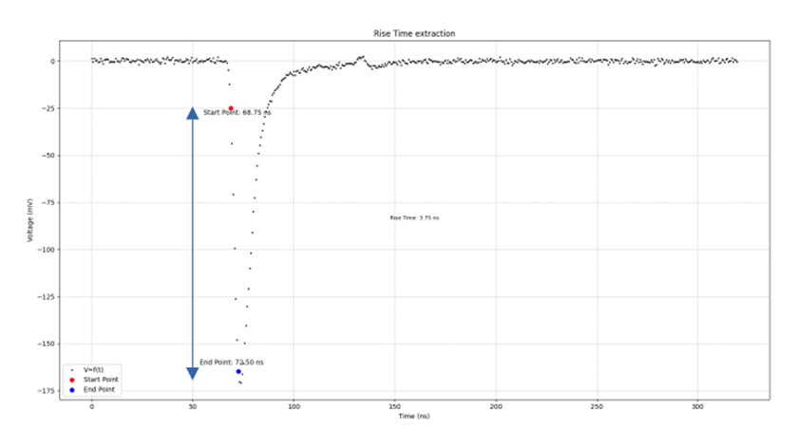

New stilbene crystals from PROTEUS: first tests October 2023
by Dimitris Papanikolau
n_TOF Meeting Collaborazione Italiana, Trieste, 9-10 Novembre 2023

Slide 24
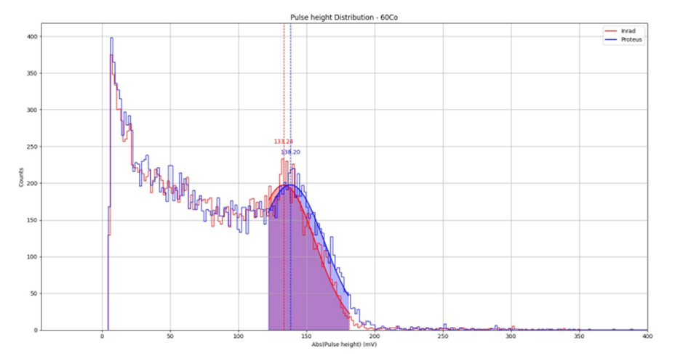
New stilbene crystals from PROTEUS: first tests October 2023
by Dimitris Papanikolau
Agreement between INRAD and PROTEUS Crystal concerning the shape of deposited energy obtained by 60Co or 137Cs
n/γ pulse shape analysis to be tested with AmBe
n_TOF Meeting Collaborazione Italiana, Trieste, 9-10 Novembre 2023

Slide 25
Conclusions
p-stilbene are new promising detectors to replace C6D6 for n-γ and to perform n-n’ measurements
N. 4 INRAD + n.4 PROTEUS modules soon avaliable
TO DO:
To finish the analisyis of the n.4 INRAD crystal (June test in EAR2): estimate background and signal characterization, in particular to check pulse shape analysis
Assembly and Characterize the new p-stil detectors (n. 4) PROTEUS crystals (new provider!!)
- BUT no new proposal or LoI can be supported in EAR2 or EAR1 before finishing the present analysis!
n_TOF Meeting Collaborazione Italiana, Trieste, 9-10 Novembre 2023

