Slide 1
Determination of the neutron flux by activation
Dr. Elizabeth Musacchio Gonzalez
TRIESTE-2023

Slide 2
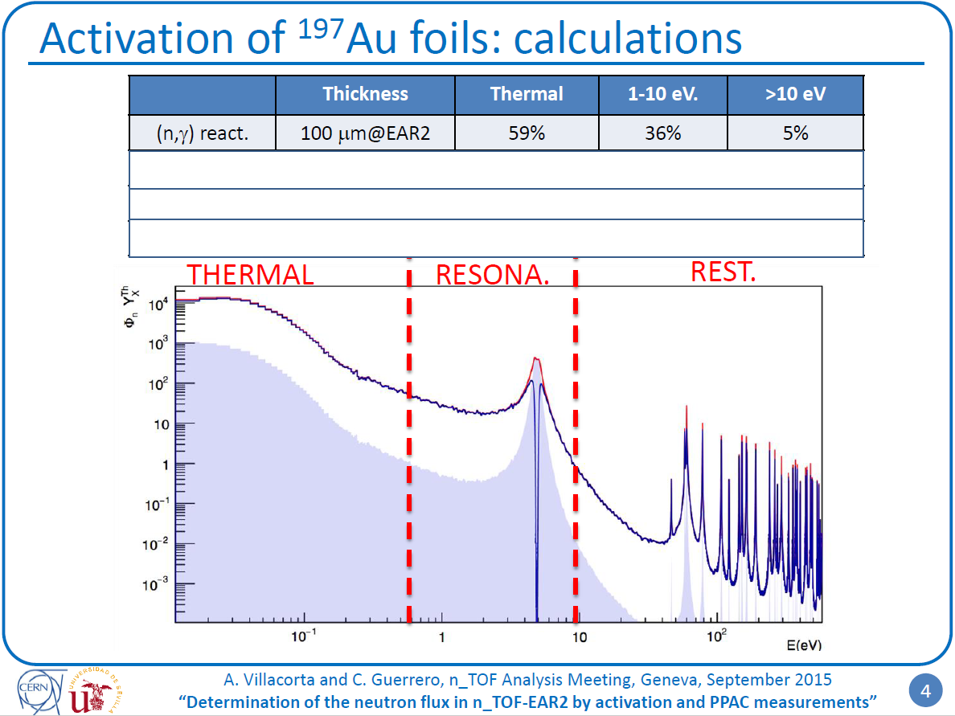





Work of A. Villacorta and C. Guerrero
After the activation of two foils with the same thickness making the difference in neutron captures the estimation of the flux can be determined as:
$$A_{first}−A_{second}=σ Φ N$$
$$A$$
Number of capture reactions (n/pulse)
$$σ$$
Cross section at the resonance (barn)
$$Φ$$
Flux at the resonance (n/pulse)
$$N$$
Sample thickness (at/barn)

Slide 3






Work of A. Villacorta and C. Guerrero
After the activation of two foils with the same thickness making the difference in neutron captures the estimation of the flux can be determined as:
$$A_{first}−A_{second}=σ Φ N$$
$$A$$
Number of capture reactions (n/pulse)
$$σ$$
Cross section at the resonance (barn)
$$Φ$$
Flux at the resonance (n/pulse)
$$N$$
Sample thickness (at/barn)
RESULTS FOR BOTH EXPERIMENTAL AREAS

Slide 4
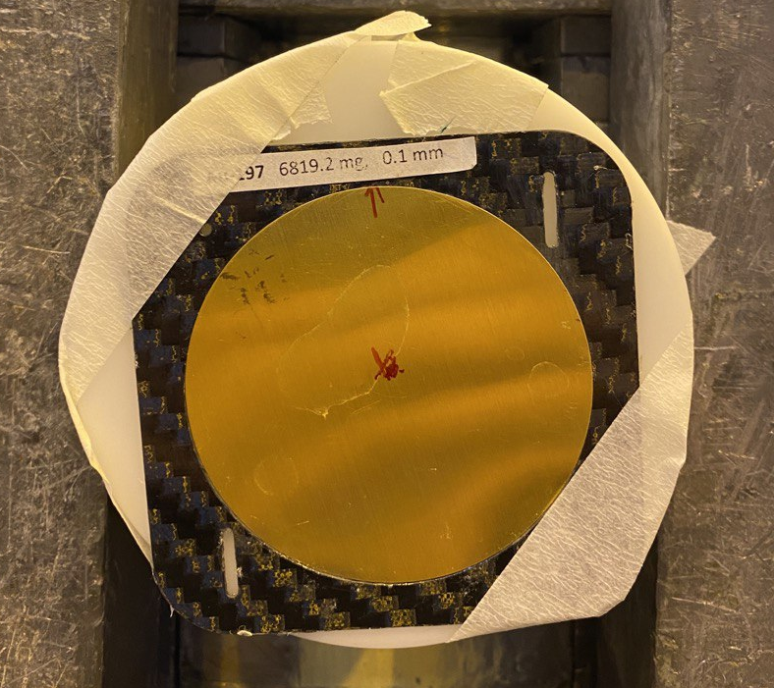
EAR2 (2021)
Activation of two 197- Au foils back-to-back:
80 x 0.1090 mm (upstream, bottom)
65 x 0.1064 mm (downstream, top)
Mylar foil between the gold samples (0.006 mm)
Irradiation time: Start @ 23/09/2021 21:00:26
Stop @ 24/09/2021 08:34:45
Total: 11:34:19 h 41659 s
In the HPGe detector: 3 measurements per foil

Slide 5
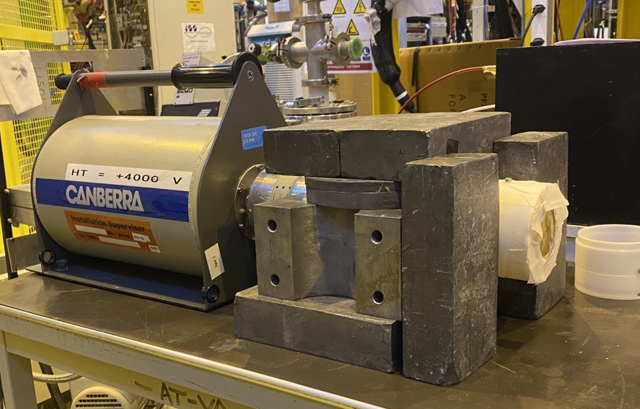
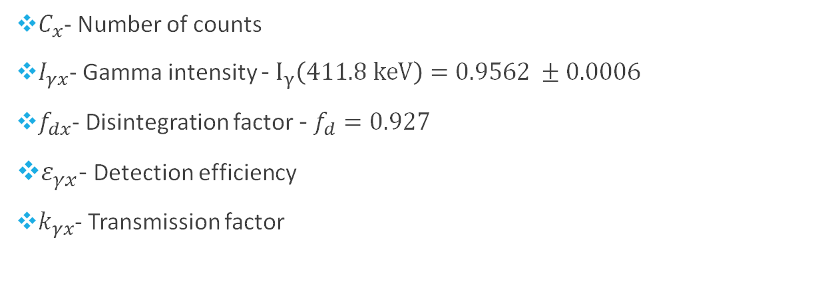
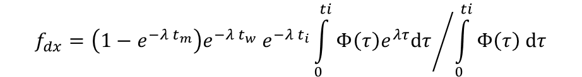
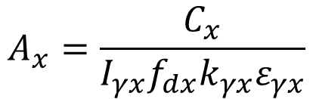
Activation analysis
The number of activations after the irradiation:
$$f_{d}$$
$$A_{x}=\frac{C_{x}}{I_{γx}f_{dx}k_{γx}ε_{γx}}$$
$$f_{dx}=\left(1−e^{−λ t_{m}}\right)e^{−λ t_{w}} e^{−λ t_{i}}{\int_{0}^{ti}{Φ\left(τ\right)e^{λτ}dτ}}/{\int_{0}^{ti}{Φ\left(τ\right) dτ}}$$
$C_{x}$- Number of counts
$I_{γx}$- Gamma intensity - $I_{γ}\left(411.8 keV\right)=0.9562 ±0.0006$
$f_{dx}$- Disintegration factor - $f_{d}=0.927$
$ε_{γx}$- Detection efficiency
$k_{γx}$- Transmission factor

Slide 6
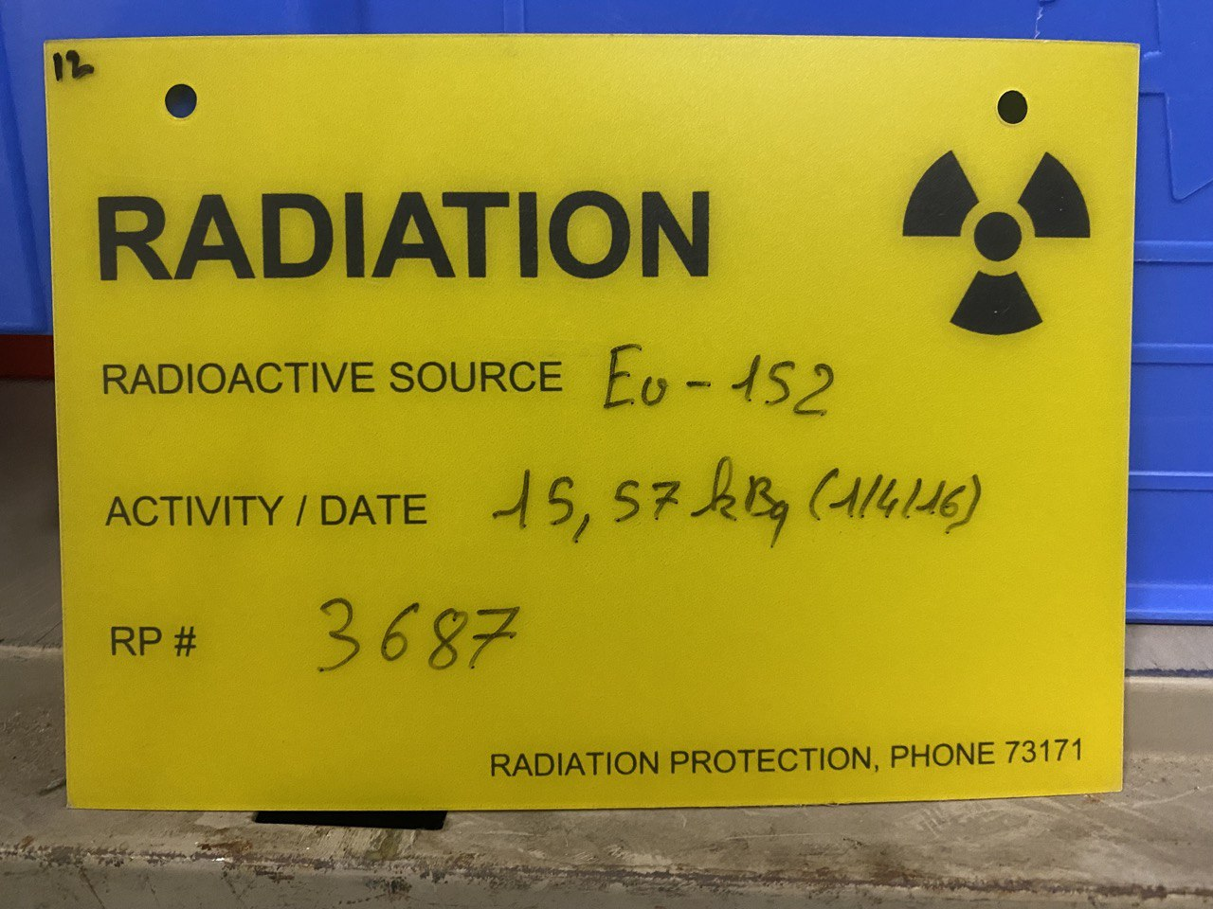
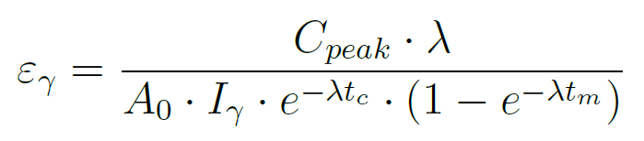
Detection efficiency (¹⁵²Eu source)

Slide 7
Efficiency of HPGe detector (¹⁵²Eu source)
Eu-152 spectrum
Relation Channel-Energy
$$ε_{γx}\left(411.8 keV\right)=\text{7.}\text{54}\text{E}\text{−03}±\text{2.}\text{63}\text{E}\text{−04}$$
Experiment
$$ε_{γx}\left(411.8 keV\right)=\text{7.}\text{56}\text{E}\text{−03}±\text{2.}\text{65}\text{E}\text{−04}$$
Simulation

Slide 8
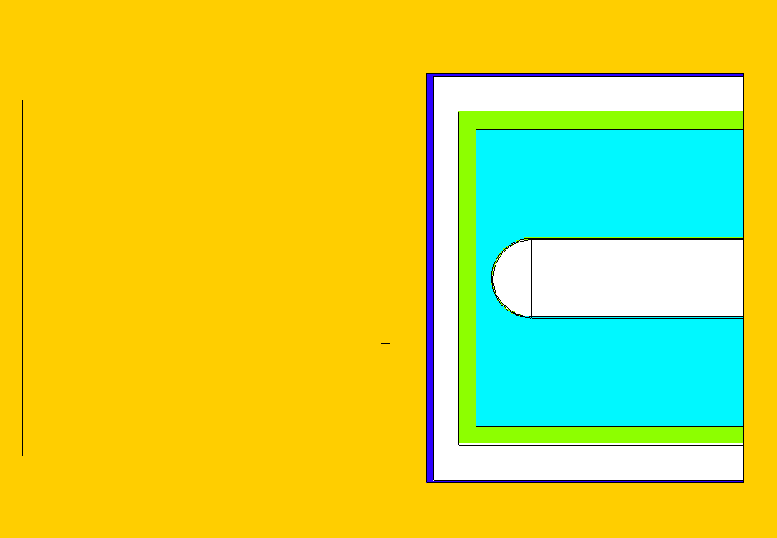
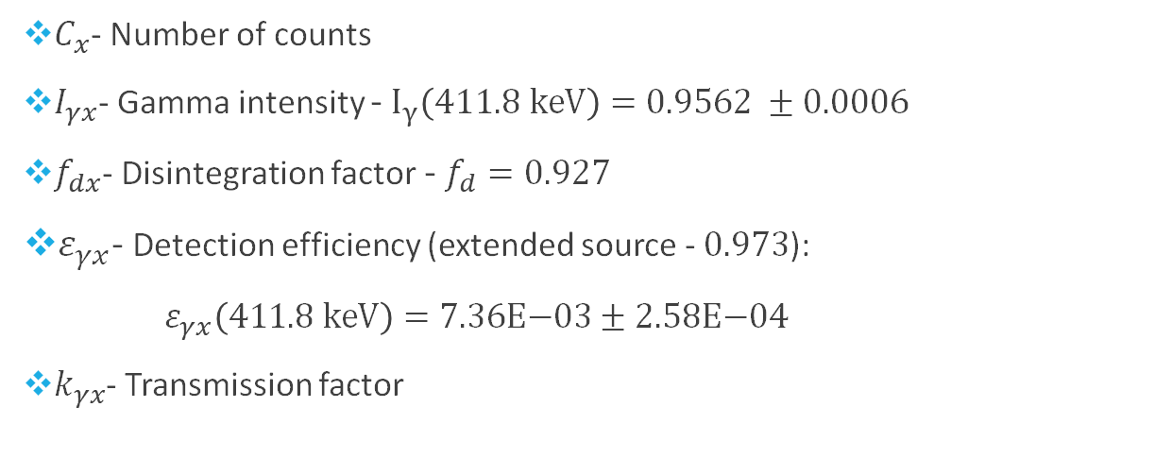



Activation analysis
The number of activations after the irradiation:
HPGe geometry MCNP (by Francisco)
$$A_{x}=\frac{C_{x}}{I_{γx}f_{dx}k_{γx}ε_{γx}}$$
9 cm
$C_{x}$- Number of counts
$I_{γx}$- Gamma intensity - $I_{γ}\left(411.8 keV\right)=0.9562 ±0.0006$
$f_{dx}$- Disintegration factor - $f_{d}=0.927$
$ε_{γx}$- Detection efficiency (extended source - $0.973$):
$ε_{γx}\left(411.8 keV\right)=\text{7.}\text{36}\text{E}\text{−03}±\text{2.}\text{58}\text{E}\text{−04}$
$k_{γx}$- Transmission factor
Gold sample
Considering complete geometry (gold)
$$k_{γ}(80)=0.984±0.004$$
$$k_{γ}=\frac{ε_{γ}}{ε_{γ}}$$
Considering empty geometry (void)
$$k_{γ}(65)=0.985±0.004$$

Slide 9


Activation analysis
$$A=A_{80}− A_{65}$$
$$δA_{x}=\sqrt{{{δA}_{exp}}^{2}+ {{δA}_{stat}}^{2}}$$

Slide 10
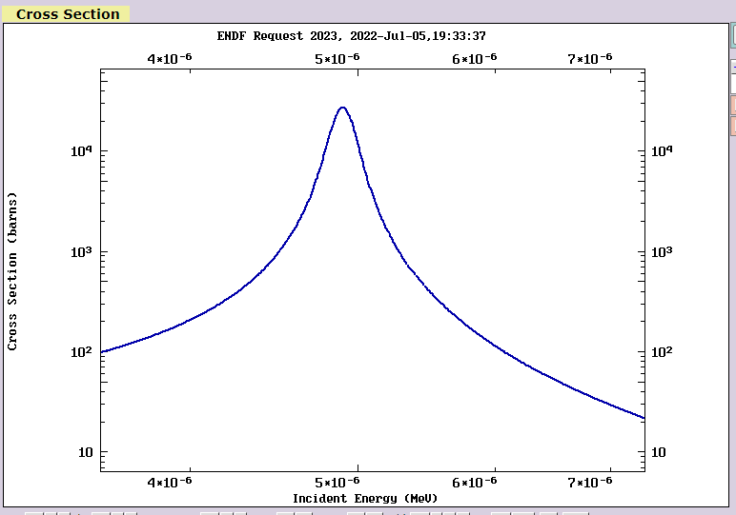
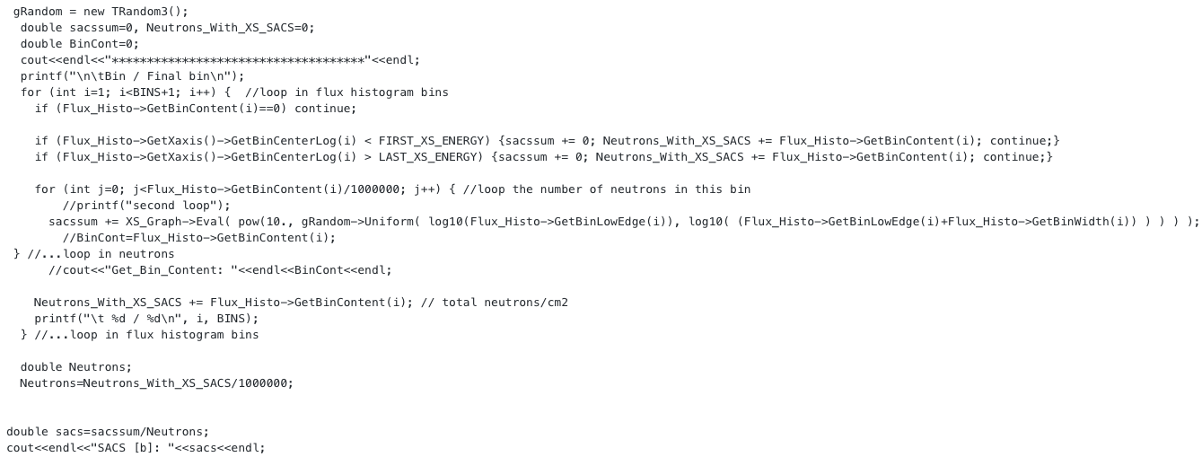






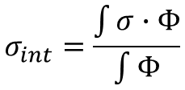
Flux and Neutron captures
$$A=σ Φ N$$
How to if the cross section change a lot?
$$A$$
Number of capture reactions
$$σ$$
Cross section (barn)
$$Φ$$
Neutron Flux
$$N$$
Sample thickness (at/barn)
$N=6.43E−04$ at/barn
$$A=A_{80}−A_{65}=6.460E+08±5.48E+07$$
Part of the code: thanks to Elisso!!!
$$σ_{int}=\frac{\int{σ∙Φ}}{\int{Φ}}$$
$σ_{int}=1708.96$barn

Slide 11
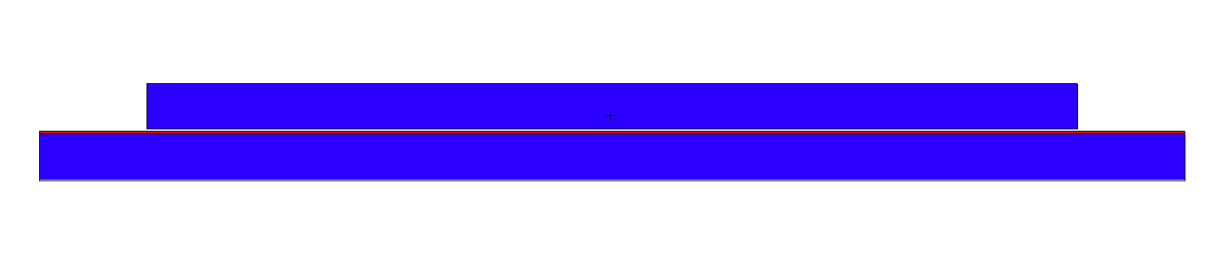
Simulations: Flux and Neutron captures
Input geometry:
The output file contain the number of capture reactions (Tally F4).
Gold foils
neutrons
The flux was used as input in the MCNPX file with the geometry.

Slide 12
Simulations: Flux and Neutron captures
Input geometry:
The output file contain the number of capture reactions (Tally F4).
Gold foils
neutrons
48.2 % of the captures are in the resonance region (4.67-5.12 eV)
The flux was used as input in the MCNPX file with the geometry.

Slide 13
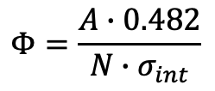
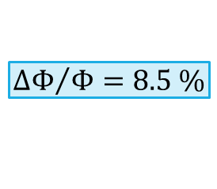








Final Flux from the activation measurement
$$A=σ Φ N$$
$$Φ=\frac{A∙0.482}{N∙σ_{int}}$$
$$Φ=5.99E+05±5.08E+04$$
$$A$$
Number of capture reactions
$${ΔΦ}/Φ=8.5 \%$$
$$σ$$
Cross section (barn)
$$Φ$$
Flux
$$N$$
Sample thickness (at/barn)
$N=6.43E−04$ at/barn
$$A=A_{80}−A_{65}=6.46E+08±5.48E+07$$
$σ_{int}=1708.96$barn

Slide 14
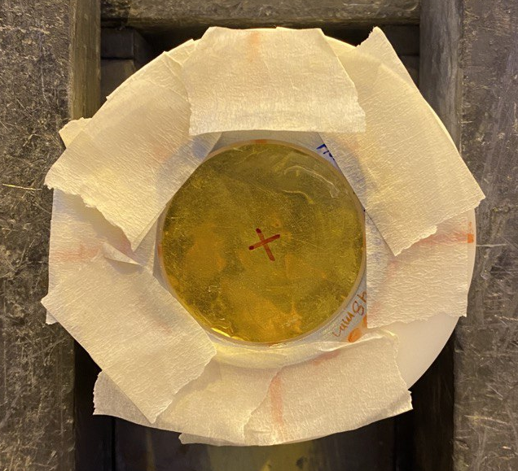
EAR1 (2021)
Activation of two 197- Au foils back-to-back:
45 x 0.0509 mm (upstream, bottom)
48 x 0.1033 mm (downstream, top)
Mylar foil between the gold samples (0.006 mm)
Irradiation time: Start @ 13/10/2021 19:09:26
Stop @ 15/10/2021 15:09:51
Total: 158425 s
In the HPGe detector: 3 measurements per foil

Slide 15
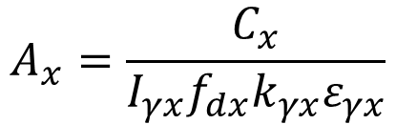

Activation analysis
$$A_{x}=\frac{C_{x}}{I_{γx}f_{dx}k_{γx}ε_{γx}}$$
$$f_{dx}=\left(1−e^{−λ t_{m}}\right)e^{−λ t_{w}} e^{−λ t_{i}}{\int_{0}^{ti}{Φ\left(τ\right)e^{λτ}dτ}}/{\int_{0}^{ti}{Φ\left(τ\right) dτ}}$$
$C_{x}$- Number of counts
$I_{γx}$- Gamma intensity - $I_{γ}\left(411.8 keV\right)=0.9562 ±0.0006$
$f_{dx}$- Disintegration factor - $f_{d}=0.799$
$ε_{γx}$- Detection efficiency
$k_{γx}$- Transmission factor

Slide 16
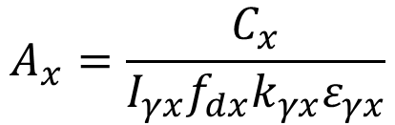
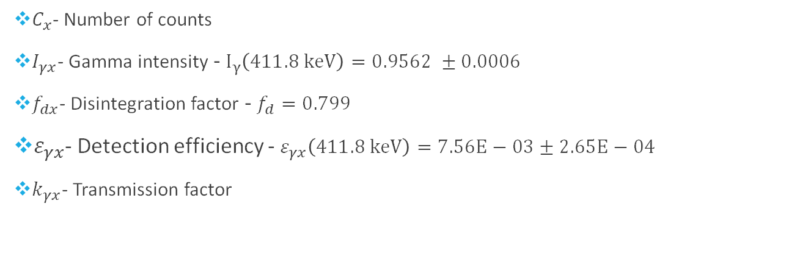


Activation analysis
$C_{x}$- Number of counts
$I_{γx}$- Gamma intensity - $I_{γ}\left(411.8 keV\right)=0.9562 ±0.0006$
$f_{dx}$- Disintegration factor - $f_{d}=0.799$
$ε_{γx}$- Detection efficiency - $ε_{γx}\left(411.8 keV\right)=7.56E−03±2.65E−04$
$k_{γx}$- Transmission factor
$$A_{x}=\frac{C_{x}}{I_{γx}f_{dx}k_{γx}ε_{γx}}$$
$$k_{γ}(45)=0.993±0.004$$
$$k_{γ}(48)=0.983±0.004$$

Slide 17

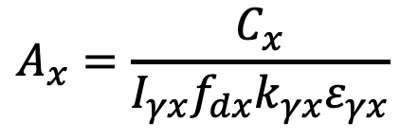
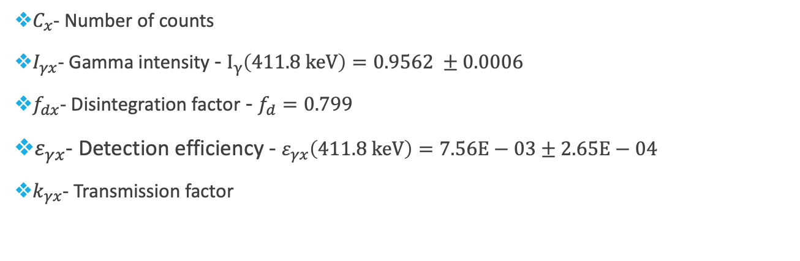


Activation analysis
$C_{x}$- Number of counts
$I_{γx}$- Gamma intensity - $I_{γ}\left(411.8 keV\right)=0.9562 ±0.0006$
$f_{dx}$- Disintegration factor - $f_{d}=0.799$
$ε_{γx}$- Detection efficiency - $ε_{γx}\left(411.8 keV\right)=7.56E−03±2.65E−04$
$k_{γx}$- Transmission factor
$$A_{x}=\frac{C_{x}}{I_{γx}f_{dx}k_{γx}ε_{γx}}$$
$$k_{γ}(45)=0.993±0.004$$
$$k_{γ}(48)=0.983±0.004$$

Slide 18
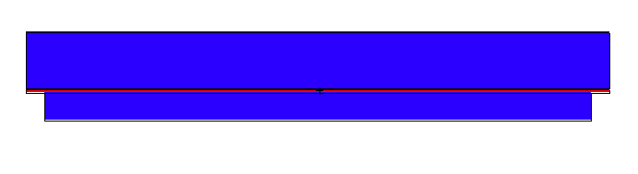
Simulations: Flux and Neutron captures
Input geometry:
The output file contain the number of capture reactions (Tally F4).
Gold foils
The two foils did not have the same thickness.
neutrons
The flux was used as input in the MCNPX file with the geometry.

Slide 19
Simulations: Flux and Neutron captures
New simulation assuming two foils with the same thickness (50 μm) to find a normalization factor for the second foil. (A48=A48*0.48)
Gold foils
neutrons
69 % of the captures are in the resonance region (4.67-5.12 eV)

Slide 20




Final Flux from the activation measurement
$$A=σ Φ N$$
$$Φ=\frac{A∙0.69}{N∙σ_{int}}$$
$$Φ=2.23E+04±1.04E+03$$
$$A$$
Number of capture reactions
$$σ$$
Cross section (barn)
$$Φ$$
Flux
$$N$$
Sample thickness (at/barn)
$N=3.00E−04$ at/barn
$$A=A_{45}−A_{48}=3.68E+07±1.71E+06$$
$σ_{int}=1756.26$barn

Slide 21

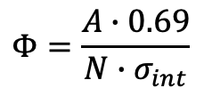






Final Flux from the activation measurement
$$A=σ Φ N$$
$$Φ=\frac{A∙0.69}{N∙σ_{int}}$$
$$Φ=2.23E+04±1.04E+03$$
$$A$$
Number of capture reactions
$$σ$$
Cross section (barn)
$$Φ$$
Flux
$$N$$
Sample thickness (at/barn)
Since this result is an assumption a new measurement was done!!!
$N=3.00E−04$ at/barn
$$A=A_{45}−A_{48}=3.68E+07±1.71E+06$$
$σ_{int}=1756.26$barn

Slide 22
EAR1 (2023)
Activation of two 197- Au foils back-to-back:
80 x 0.1090 mm (upstream, bottom)
65 x 0.1064 mm (downstream, top)
No Mylar foil between the gold samples
Irradiation time: Start @ 10/04/2023 00:10:00
Stop @ 12/04/2023 10:00:00
Total: 208200 s
In the HPGe detector (NEW):
Same Au foils from EAR2 measurement (2021)

Slide 23
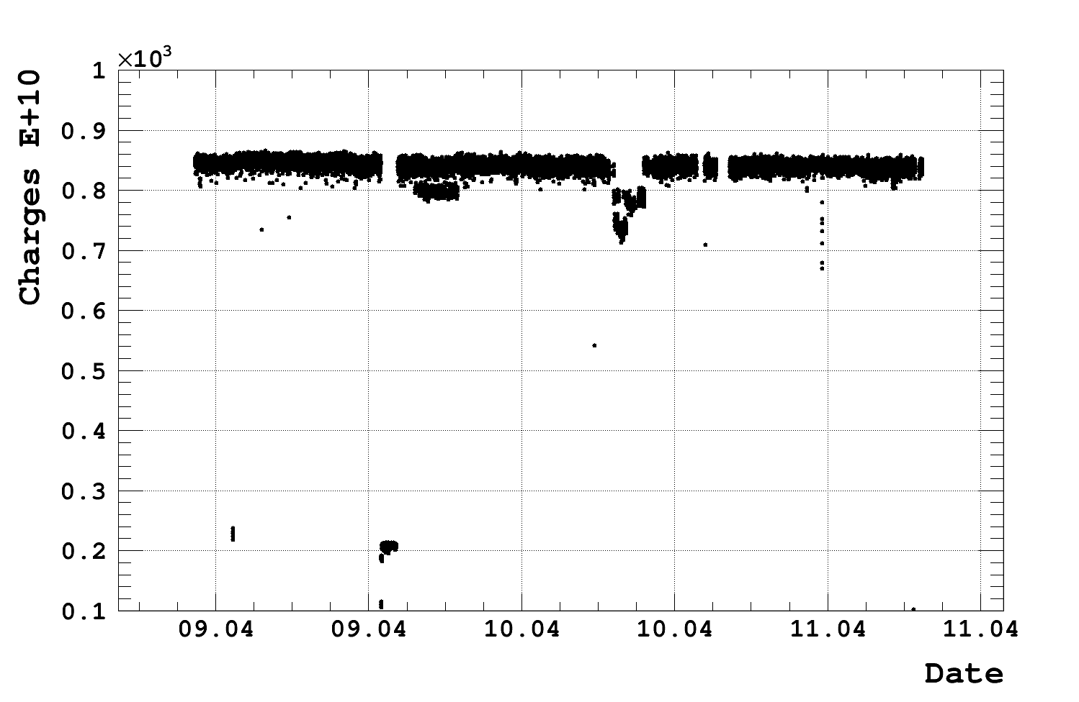
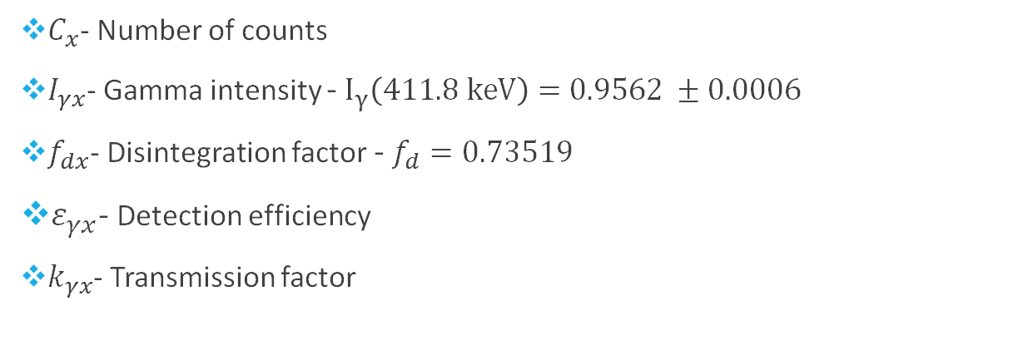

Activation analysis
The number of activations after the irradiation:
$$f_{d}$$
$$A_{x}=\frac{C_{x}}{I_{γx}f_{dx}k_{γx}ε_{γx}}$$
$$f_{dx}=\left(1−e^{−λ t_{m}}\right)e^{−λ t_{w}} e^{−λ t_{i}}{\int_{0}^{ti}{Φ\left(τ\right)e^{λτ}dτ}}/{\int_{0}^{ti}{Φ\left(τ\right) dτ}}$$
$C_{x}$- Number of counts
$I_{γx}$- Gamma intensity - $I_{γ}\left(411.8 keV\right)=0.9562 ±0.0006$
$f_{dx}$- Disintegration factor - $f_{d}=0.73519$
$ε_{γx}$- Detection efficiency
$k_{γx}$- Transmission factor

Slide 24
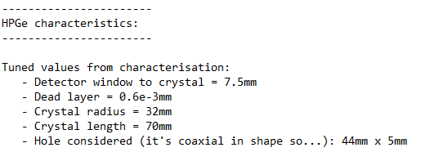
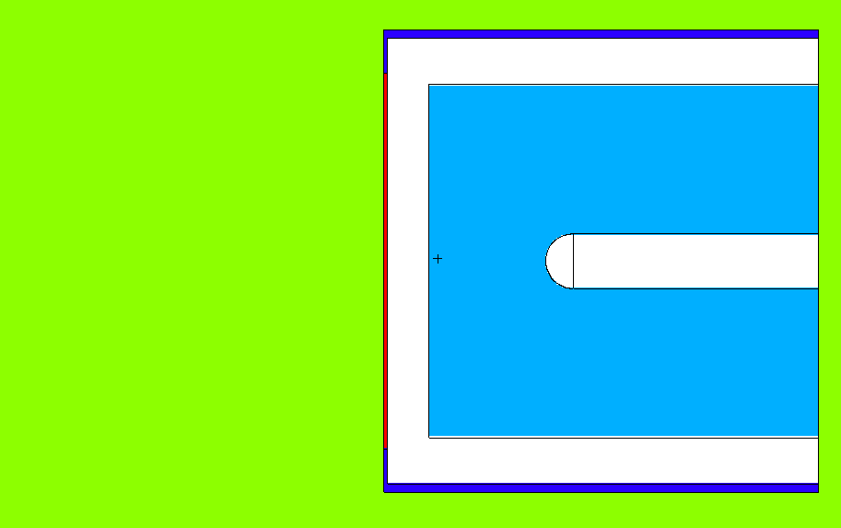
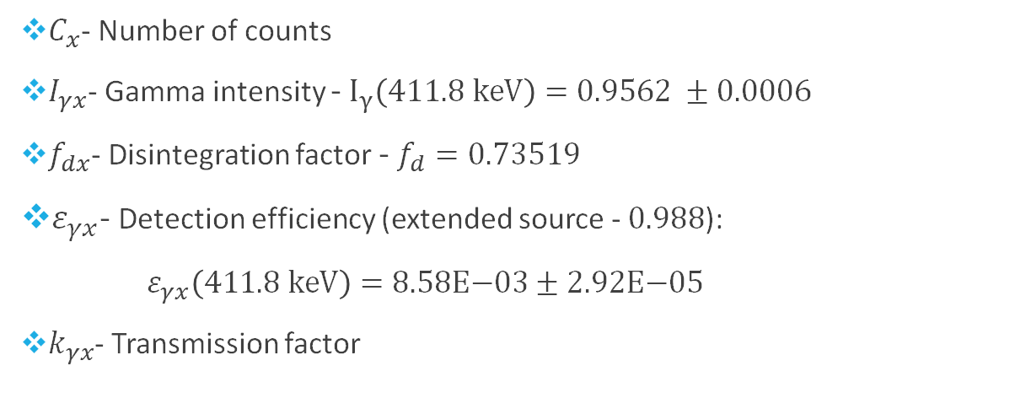


Activation analysis
The number of activations after the irradiation:
HPGe geometry MCNP
(by Elisso)
$$A_{x}=\frac{C_{x}}{I_{γx}f_{dx}k_{γx}ε_{γx}}$$
9.39 cm
$C_{x}$- Number of counts
$I_{γx}$- Gamma intensity - $I_{γ}\left(411.8 keV\right)=0.9562 ±0.0006$
$f_{dx}$- Disintegration factor - $f_{d}=0.73519$
$ε_{γx}$- Detection efficiency (extended source - $0.988$):
$ε_{γx}\left(411.8 keV\right)=\text{8.58}\text{E}\text{−03}±\text{2.}\text{92}\text{E}\text{−0}\text{5}$
$k_{γx}$- Transmission factor
Gold sample
Considering complete geometry (gold)
$$k_{γ}(80)=0.976±0.004$$
$$k_{γ}=\frac{ε_{γ}}{ε_{γ}}$$
Considering empty geometry (void)
$$k_{γ}(65)=0.977±0.004$$

Slide 25


Activation analysis
$$A=A_{80}− A_{65}$$
$$δA_{x}=\sqrt{{{δA}_{exp}}^{2}+ {{δA}_{stat}}^{2}}$$

Slide 26
Simulations: Flux and Neutron captures
Input geometry:
The output file contain the number of capture reactions (Tally F4).
Gold foils
neutrons
The flux was used as input in the MCNPX file with the geometry.
54.8 % of the captures are in the resonance region (4.67-5.12 eV)

Slide 27

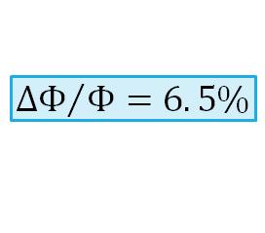


Final Flux from the activation measurement
$$A=σ Φ N$$
$$Φ=\frac{A∙0.548}{N∙σ_{int}}$$
$$Φ=1.19E+04±7.67E+02$$
$$A$$
Number of capture reactions
$${ΔΦ}/Φ=6. 5\%$$
$$σ$$
Cross section (barn)
$$Φ$$
Flux
$$N$$
Sample thickness (at/barn)
$N=6.43E−04$ at/barn
$$A=A_{80}−A_{65}=8.73E+07±5.64E+06$$
$σ_{int}=1756.26$ barn

Slide 28
Conclusions
The absolute flux at was determined from an activation measurement for both experimental areas.
A good agreement was found with the simulated flux & evaluated flux.
EAR1
EAR2

Slide 29
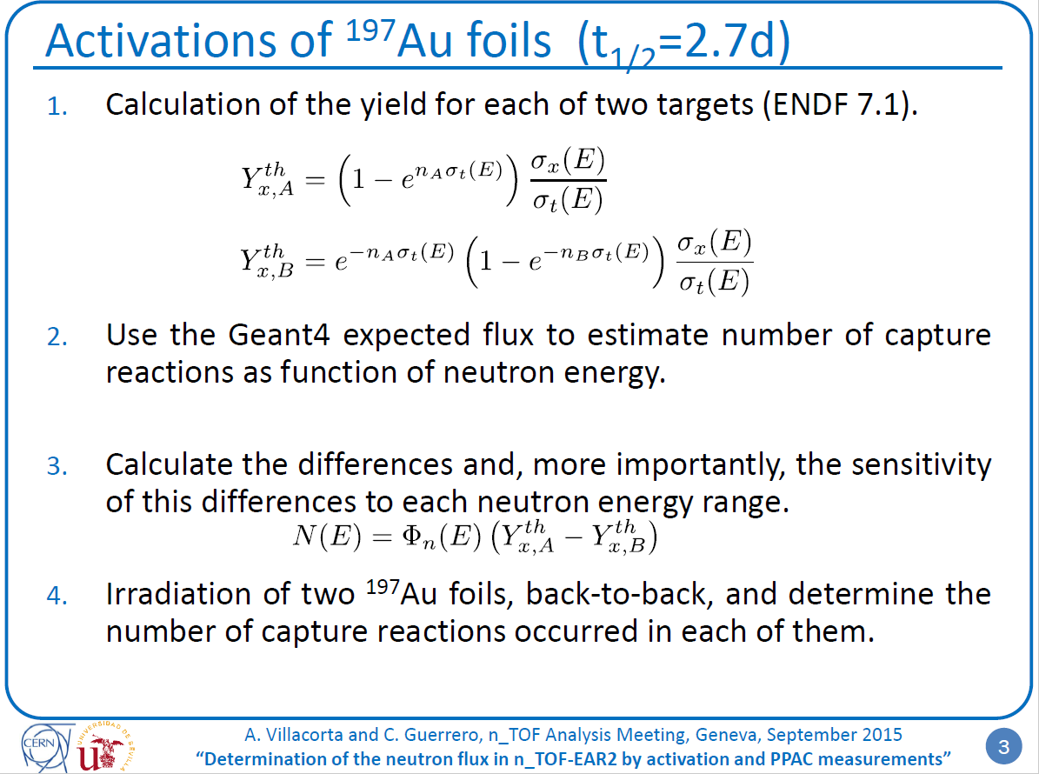
Work of A. Villacorta and C. Guerrero

