Slide 1
Status of the analysis of ^{94,95,96}Mo(n,γ)
Riccardo Mucciola

Slide 2
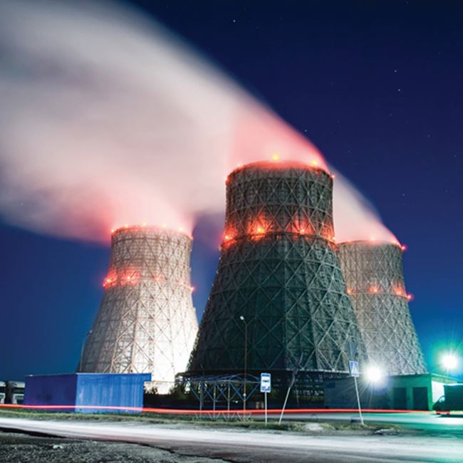
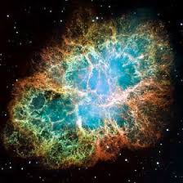
Importance of molybdenum
Fission product in nuclear power plants;
Transport casks, irradiated fuel storage;
Research reactors and Accident Tolerant Fuels;
Stellar nucleosynthesis;

Slide 3
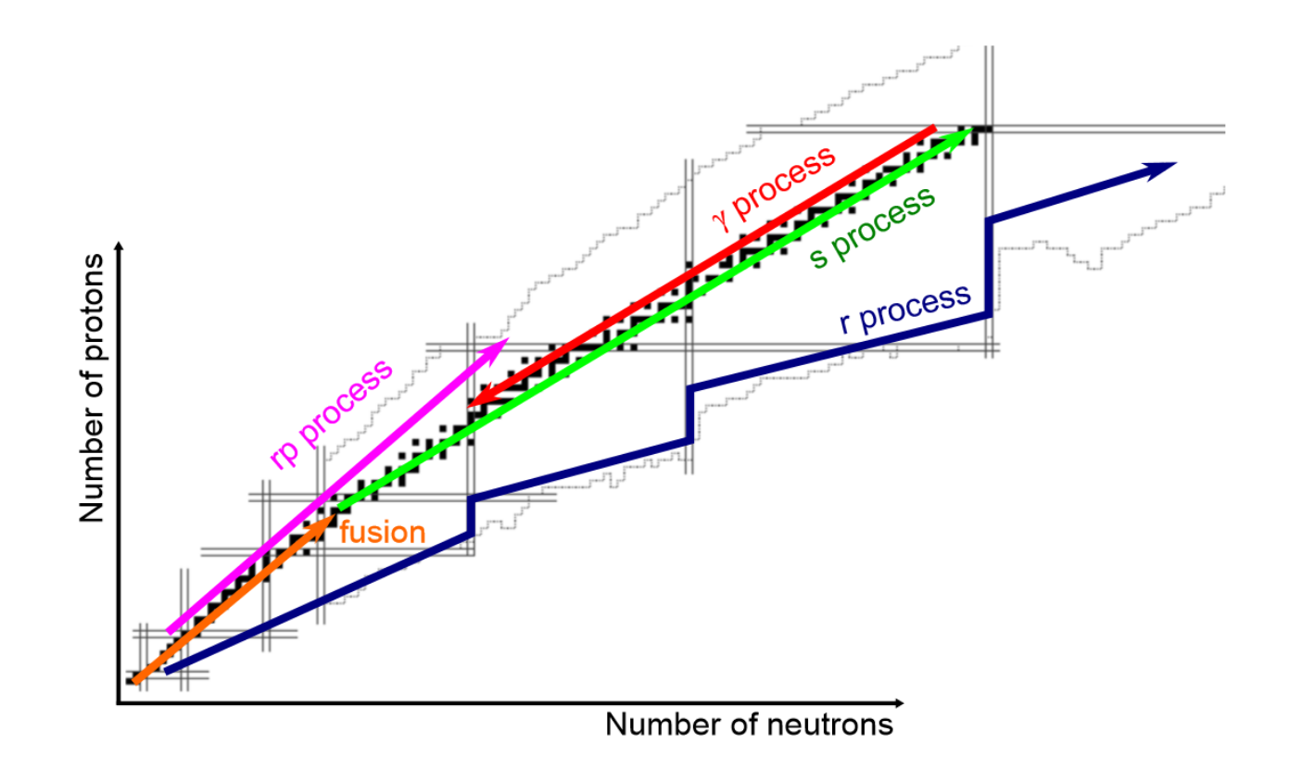
Stellar nucleosynthesis
Four main nucleosynthesis processes for elements heavier than iron: s-process, r-process, i-process, and p-process;
Some isotopes can be synthetized only by one process (e.g., ⁹⁶Mo by s-process);
Possible to set constraints on intensity of the processes.
s-process path around molybdenum

Slide 4
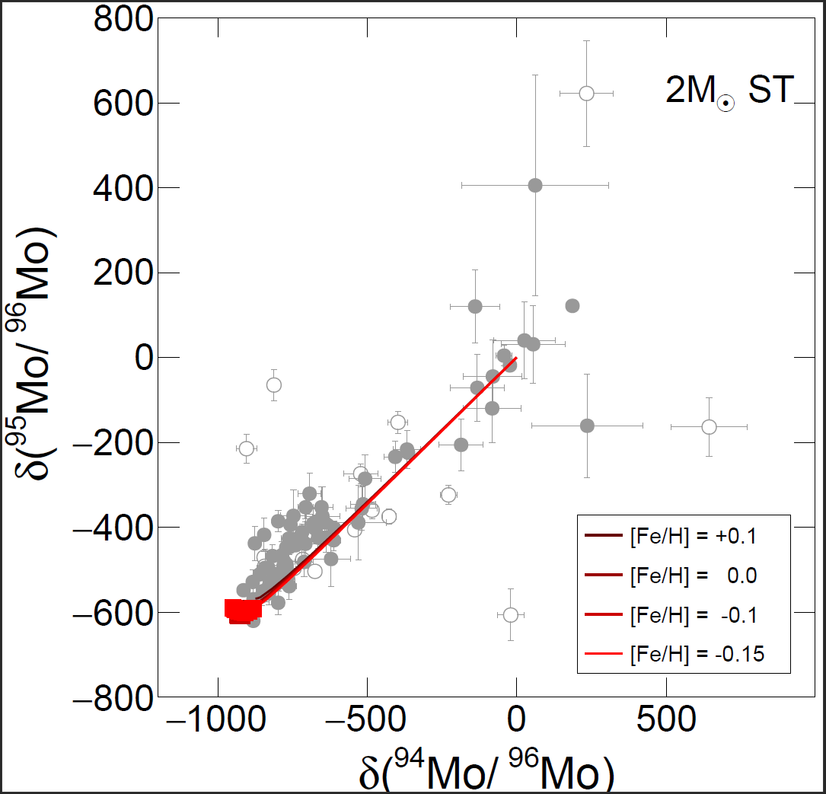
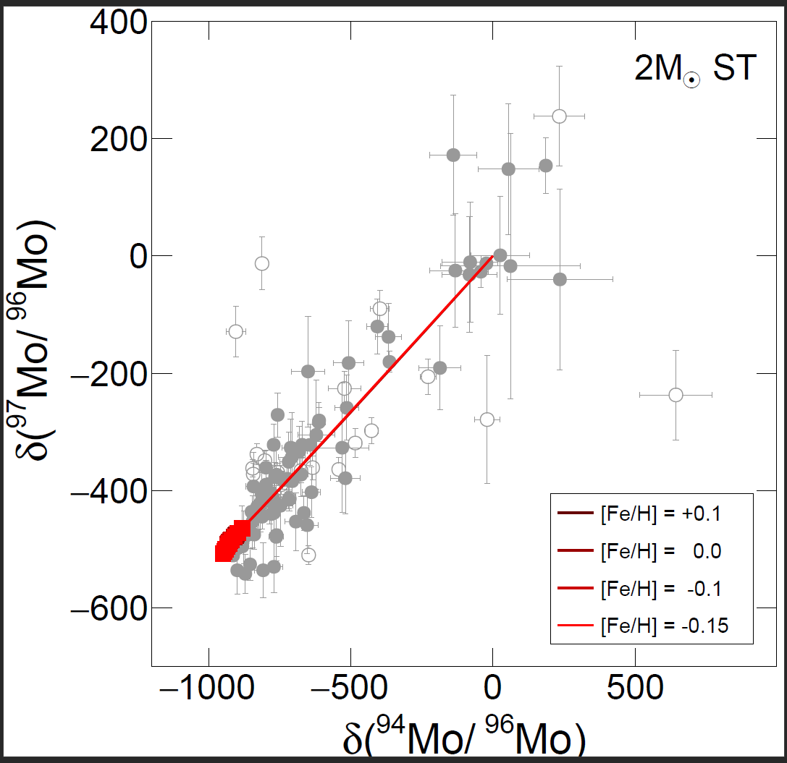
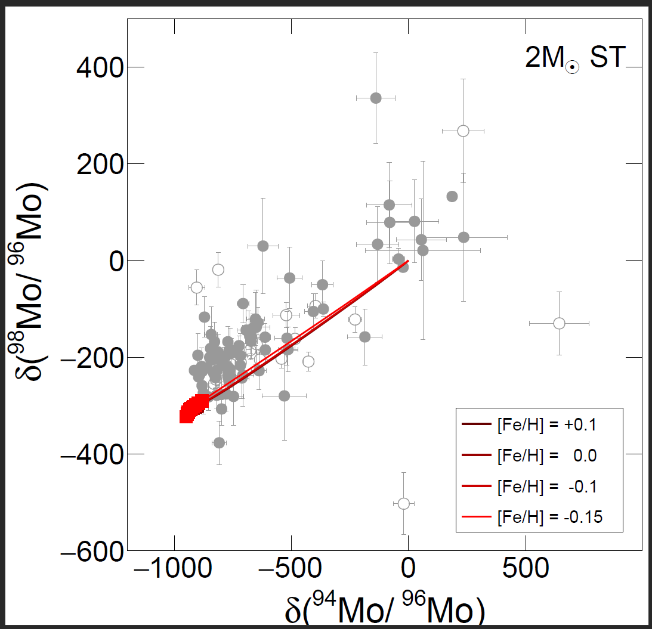
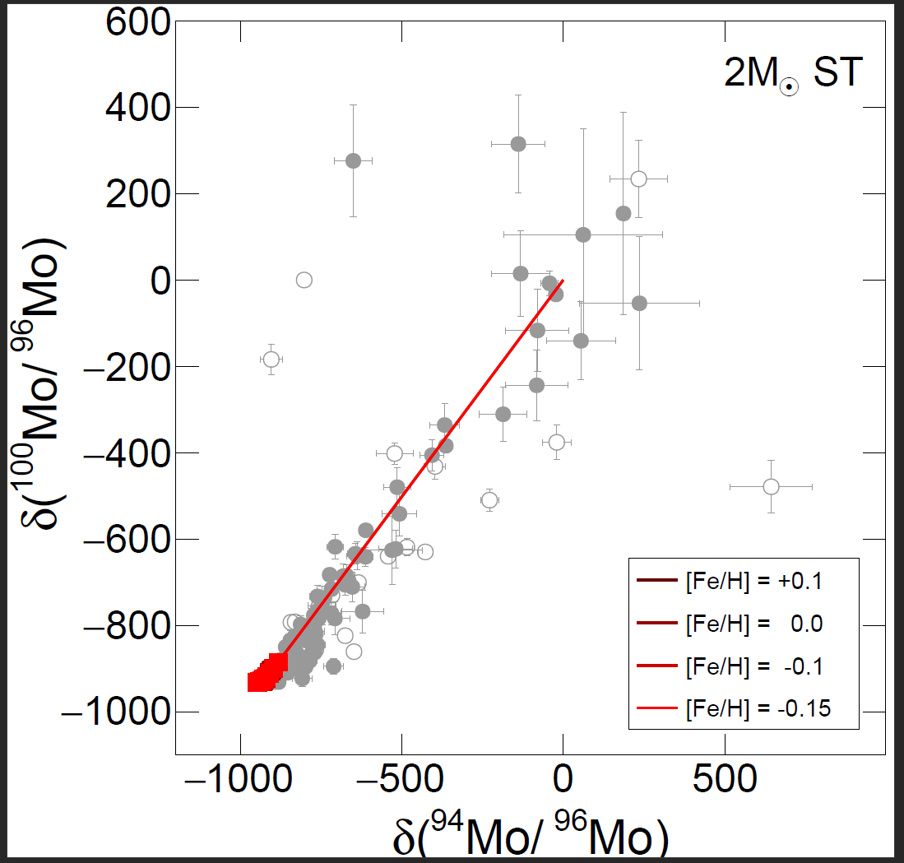
Presolar grain composition
Comparison of SiC grains composition versus stellar model (FRANEC) using delta notation:
MACS from KADoNiS v1.0 database,
Slight discrepancies between model and isotopic composition,
Possible overestimation of MACS in KADoNiS.
S. Palmerini et al., ApJ 921 7 (2021)
$$δ\left(\frac{95Mo }{96Mo}\right)={10}^{3}×\left[{\left(\frac{95Mo }{96Mo}\right)}/{{\left(\frac{95Mo }{96Mo}\right)}_{⊙}}−1\right]$$

Slide 5
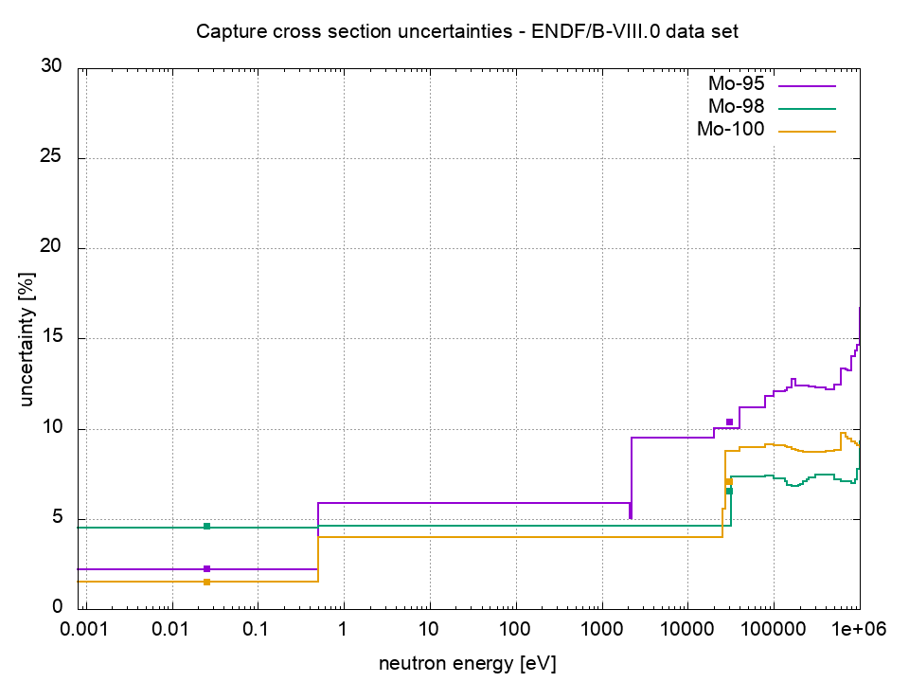
Cross section uncertainties in ENDF/B-VIII
ENDF/B-VIII: D. Brown et al., Nucl. Data. Sheets 148 (2012)

Slide 6
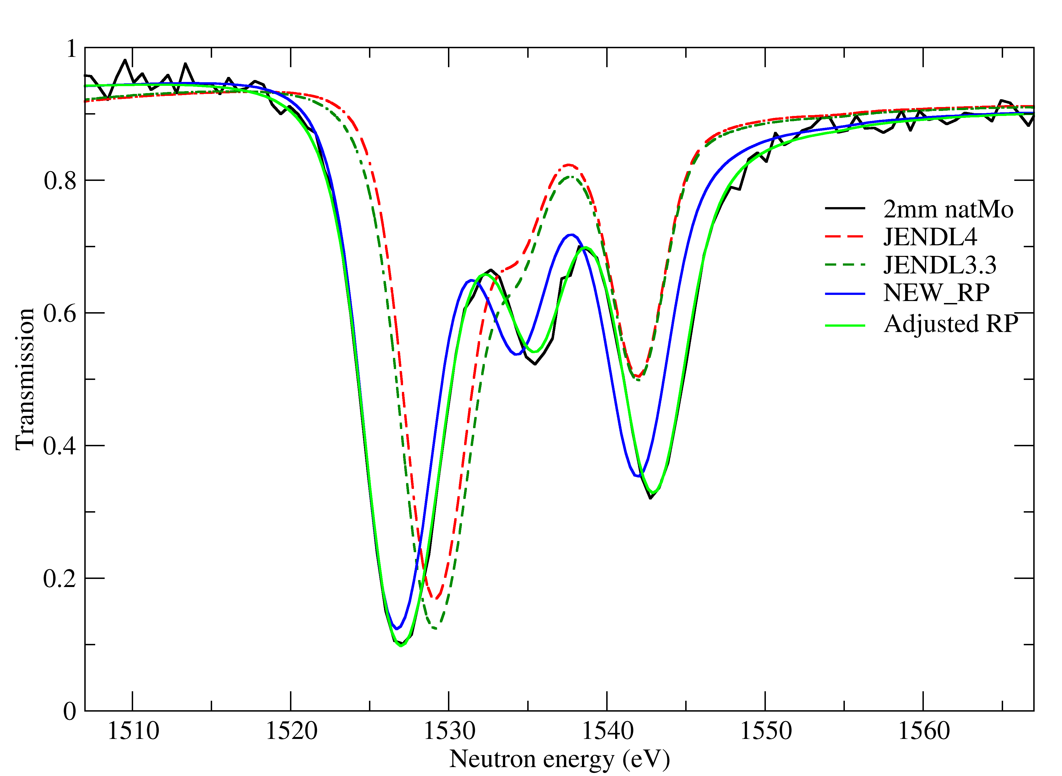
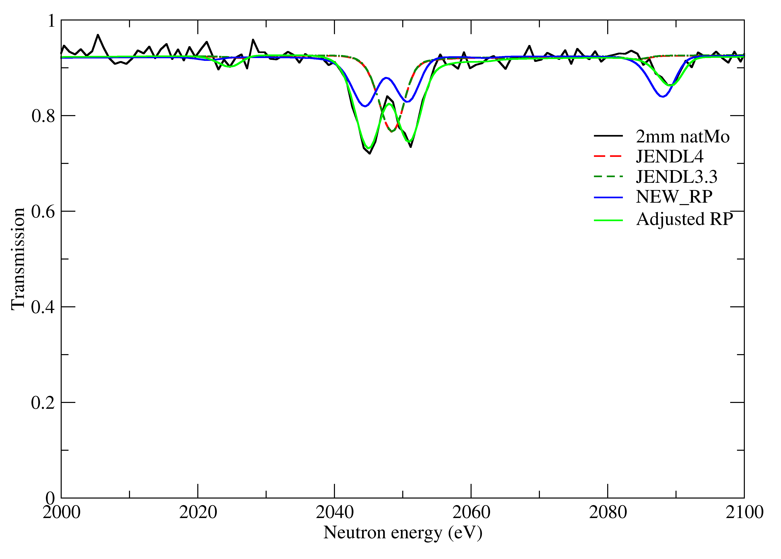
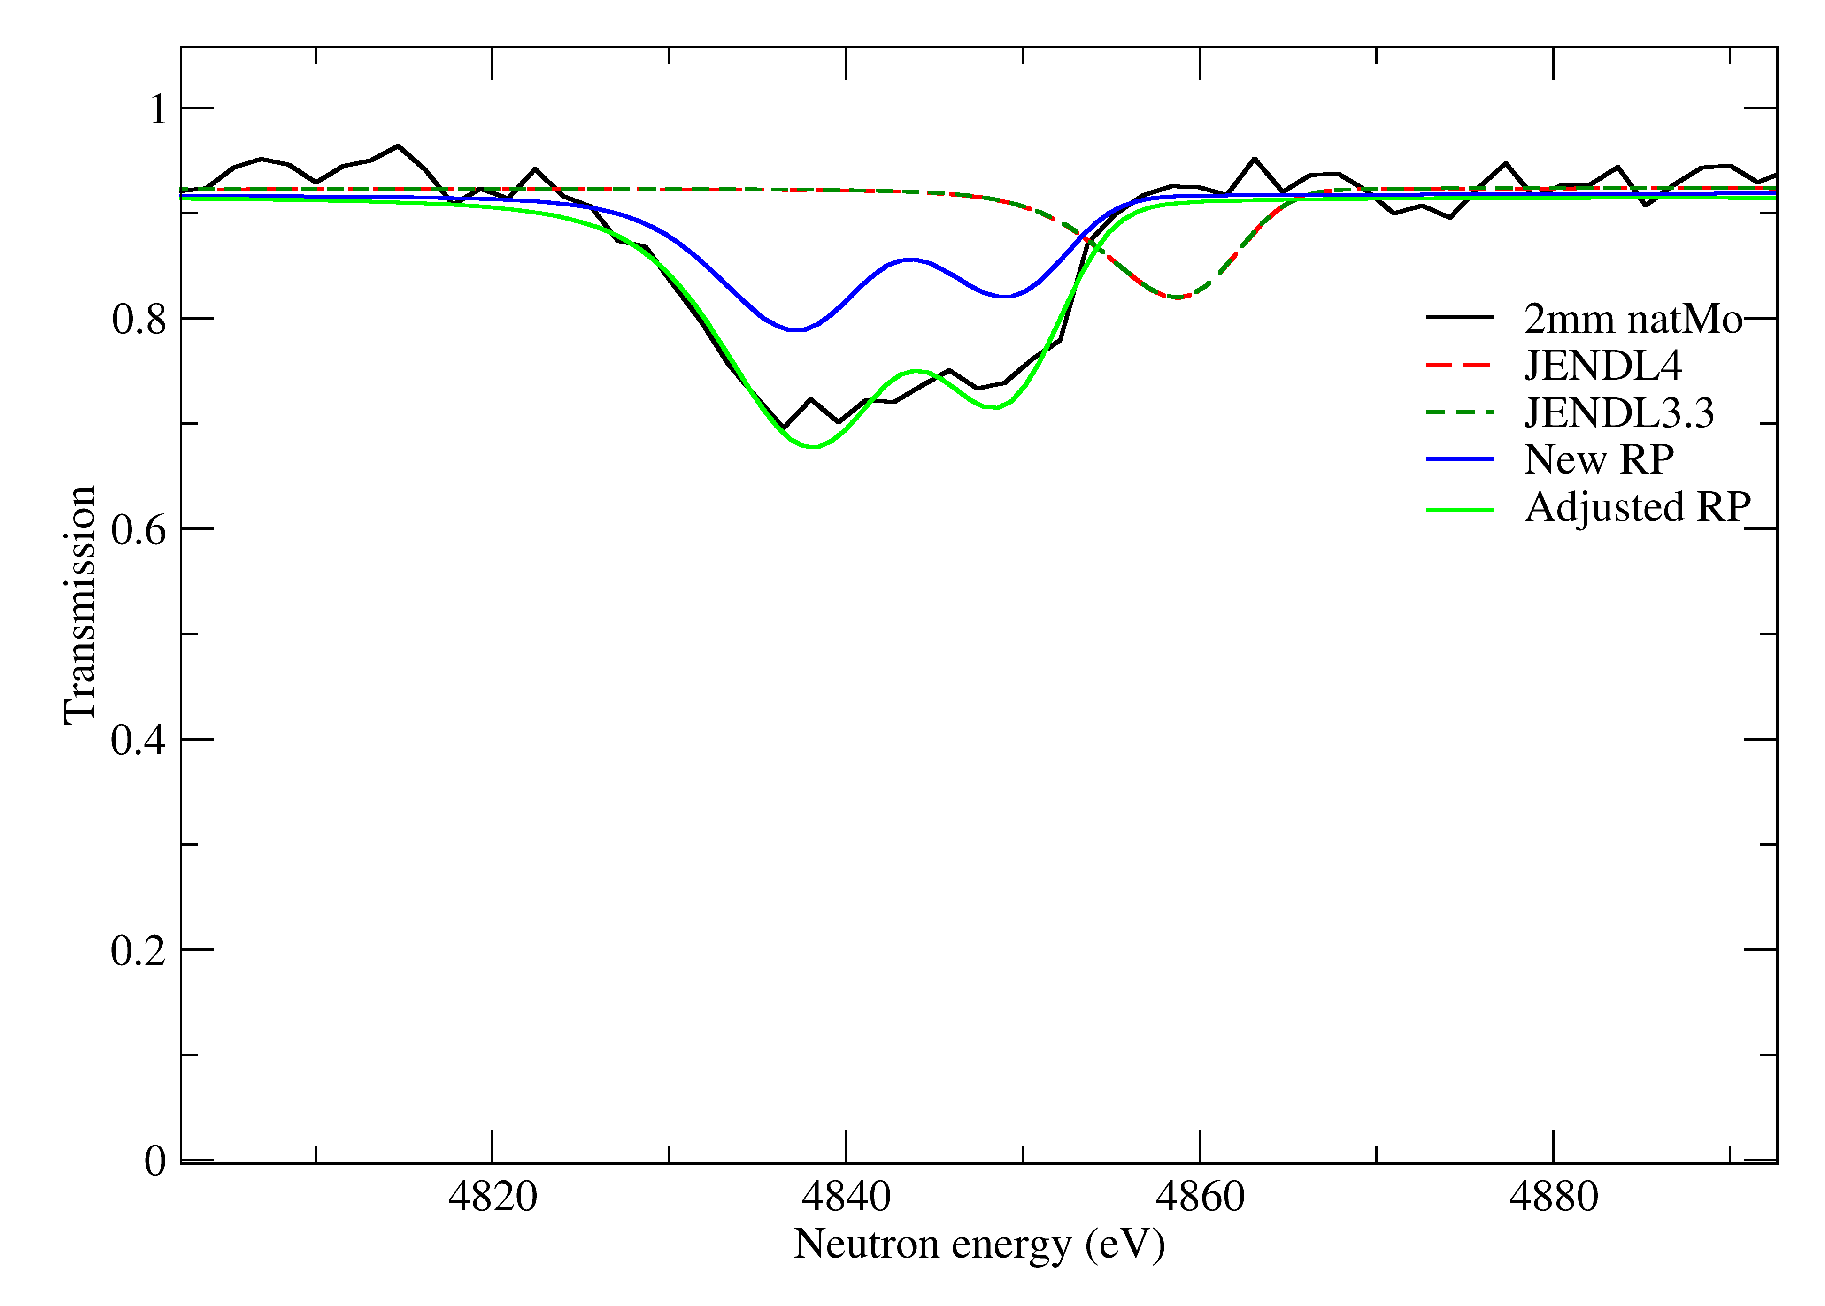
Improvement of RP file
RP file improved by an adjustment to transmission data using REFIT
Fit of resonances up to 5 keV
Details showed in last Collaboration meeting
R. Mucciola et al., NIMB 531 (2022) 100
2mm ^{nat}Mo
JENDL 4
JENDL 3
RP file
PhD thesis
2mm ^{nat}Mo
JENDL 4
JENDL 3
RP file
PhD thesis
2mm ^{nat}Mo
JENDL 4
JENDL 3
RP file
PhD thesis

Slide 7
n_TOF measurements
Last meeting
This talk
EAR2_2021 | EAR1_2022 | EAR2_2022
1.7 10¹⁸ protons | 6.0 10¹⁸ protons | 1.7 10¹⁸ protons
3 B6D6, 1 L6D6, 1 STED | 4 C6D6 | 8 STED, 2 L6D6, 1 DSTI
Powder sample in aluminum canning | Pressed pellets in plastic bags | Pressed pellets in plastic bags
+ additional transmission measurement with enriched pellets at 10m station of GELINA
+transmission measurements with natural samples at 50m station of GELINA

Slide 8
Experimental conditions @ EAR1
Detection setup
samples
Setup:
4 C6D6,
8 cm from sample.
Samples:
Pressed pellets in thin plastic bags,
Samples mounted in sample exchanger.

Slide 9
Background estimation

Slide 10
Background of capture measurements
The background of a capture measurements can be expressed as:
Where $b_{0}$ is the time independent background, $b_{s}\left(t\right)$ is the time-dependent sample-independent background, $b_{n}\left(t\right)$ is the sample dependent neutron scattering and $b_{γ}(t)$ is the sample dependent in-beam gamma scattering.
$b_{0}$ can be estimated with a beam-off measurement;
$b_{s}\left(t\right)$ can be estimated with a measurement with an empty sample;
$b_{n}\left(t\right)$ and $b_{γ}(t)$ can be estimated via additional measurements with “perfect scattering” samples (materials with negligible capture cross-section), like lead and carbon.
$$B=b_{0}+b_{s}\left(t\right)+b_{n}\left(t\right)+b_{γ}(t)$$

Slide 11
Background measurements
Set of measurements performed during the campaign
Plotted in counts/ns to better understand the shape

Slide 12
Neutron and gamma component estimation
Both lead and carbon sample are perfect neutron scatterers;
Due to high Z, lead sample has a high gamma scattering cross-section;
Empty counts removed from lead and carbon;
Carbon spectra can be used to estimate neutron scattering component at higher energies;
Carbon normalized to lead spectra below ~20 eV

Slide 13
Fit of background components
Neutron scattering and in-beam gamma component fitted with analytical functions;
Neutron component fitted with three exponentials;
In-beam gamma fitted using exponential function;
Fit functions can reproduce the experimental spectra.

Slide 14
Background fit uncertainty
Uncertainty on the fit estimated using 95% confidence interval extracted from Root.
Almost constant uncertainty around 5% for Empty fit.
Uncertainties around 15% for in-beam gamma at high energy and neutron scattering at low energies
Fit uncertainty used as bin uncertainty in estimated background.

Slide 15
Total background
Neutron scattering and in-beam gamma component scaled to reproduce effect of molybdenum samples:
$$B_{n}\left(Mo\right)=\frac{σ_{Mo}^{el}}{σ_{Pb}^{el}}\frac{n_{Mo}}{n_{Pb}}B_{n}\left(Pb\right)$$
$$B_{γ}\left(Mo\right)=\frac{Z_{Mo}}{Z_{Pb}}\frac{n_{Mo}}{n_{Pb}}B_{γ}\left(Pb\right)$$
Different components added together to obtain total background of each sample.

Slide 16
Background subtraction
Background subtracted from each sample count spectra.
Quality of background estimated with gold sample measurements in both resolved and unresolved regions (see later).

Slide 17
Reaction yield

Slide 18
Reaction yield of capture measurements
For a capture experiment the observable of the measurement is the capture yield defined as:
Where $N$ is a normalization factor and $φ\left(t\right)$is the neutron flux while at the numerator we have the experimental weighted counts and the background.
The normalization factor can be extracted from the saturated resonance of gold.
The neutron flux per proton pulse was evaluated during the commissioning.
$$Y_{exp}=N\frac{C_{γ}\left(t\right)−B_{γ}(t)}{ φ\left(t\right)}$$

Slide 19
Resolution Function
The resolution function to be used in SAMMY was estimated using the Transport code;
The flight-path to use was estimated by comparing the simulation with the gold spectra;
The 2D histogram was converted in a SAMMY input using the RF2SAMMY code.

Slide 20
Time-to-Energy conversion
To obtain the reaction yield as a function of energy an accurate knowledge of the flight-path length is needed.
The flight-path length can be fitted using SAMMY and the first resonances of gold (<100 eV) to avoid effect of T0.
Starting value of flight-path estimated using Transport Code
L=183,9254 m

Slide 21
Normalization
Normalization obtained from top flat region of saturated gold resonance at 4,9 eV.
Normalization factor obtained for each detector individually.
Normalization in agreement within 3%
C6D6 1 | C6D6 2 | C6D6 3 | C6D6 4
0,710056 | 0,701284 | 0,71994 | 0,688226

Slide 22
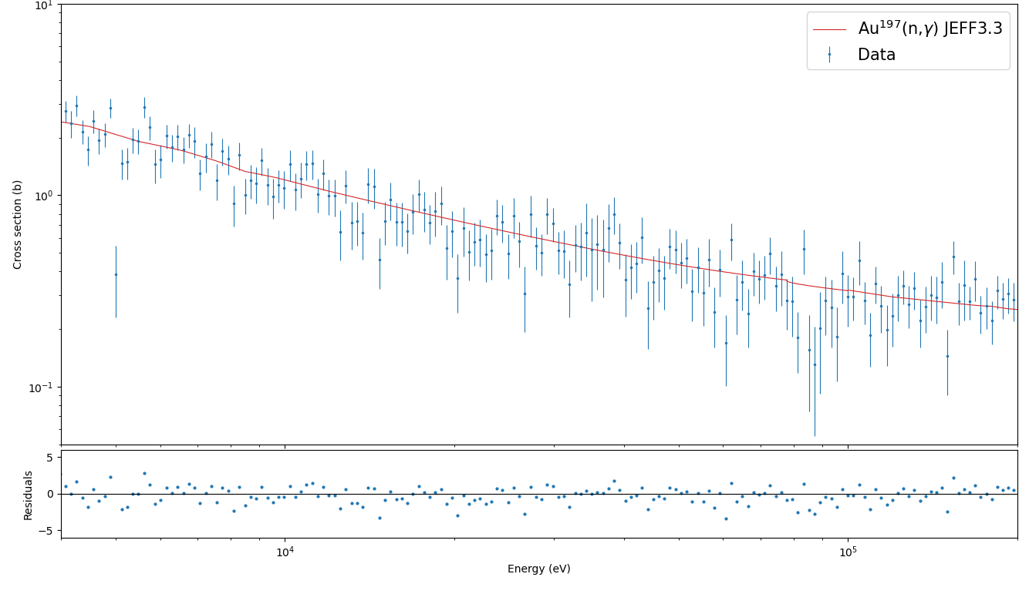
Comparison of Au spectra with literature
The reaction yield obtained with the gold sample was compared with the literature values for the resolved and unresolved resonance region.
The good agreement of our spectra with the literature validate the correctness of the procedure used.

Slide 23
Background Mo samples - RRR
Comparison of measured yield with calculation of SAMMY for ⁹⁵Mo;
Background level higher than expected between 50 eV and ~5 keV;
Same effect, with smaller magnitude, visible in ⁹⁶Mo;
⁹⁴Mo sample seems almost unaffected;
Investigation on possible causes still ongoing.

Slide 24
Background Mo samples - Thermal
Comparison of measured yield with calculation of SAMMY for ⁹⁵Mo at thermal energies;
Good agreement down to ~200meV
Effect of small contaminants (~1E-4) of W and Ta visible at low energies
Same good agreement can be seen in ^{94,96}Mo

Slide 25
Preliminary resonance fit

Slide 26
Simultaneous fit with SAMMY
Resonance parameters for ⁹⁴Mo can be obtained using SAMMY by fitting capture data in parallel with transmission data with enriched and natural samples obtained at GELINA.
The resolution function of GELINA has been converted from the REFIT format and added to SAMMY.
The resonance parameters used as starting point are the ones obtained from literature and corrected with transmission at 50m with ^{nat}Mo samples.
The parameters above 5keV were taken from JENDL5. A bound level was added to all the isotopes (except ⁹⁶Mo) to reproduce the thermal cross-section of JEFF4.

Slide 27
Preliminary adjustments – T0 correction
A disagreement between the resonance energies obtained with capture and transmission data was observed.
The disagreement is present also between transmission data at 10 and 50m.
To better match the energies between the different datasets a T0 was applied to the n_TOF and 10m transmission data using the transmission at 50m as a reference.

Slide 28
Preliminary adjustments – T0 correction
The T0 was fitted using many different isolated resonances of different Mo isotopes.
The resonance energy of the 50m transmission was further adjusted above 5keV.
An average value of T0 was obtained from the different resonances.
A value of 50ns and -7ns was obtained for n_TOF and 10m transmission, respectively.
With this correction a good agreement between the different dataset can be observed in all the energy range

Slide 29
Preliminary resonance parameters ⁹⁴Mo
Resonance parameters have been adjusted in all the resolved resonance region (<21 keV);
Example of fit showed here compared to the calculation performed with JENDL5 parameters
Good agreement between transmission and capture data with enriched samples

Slide 30
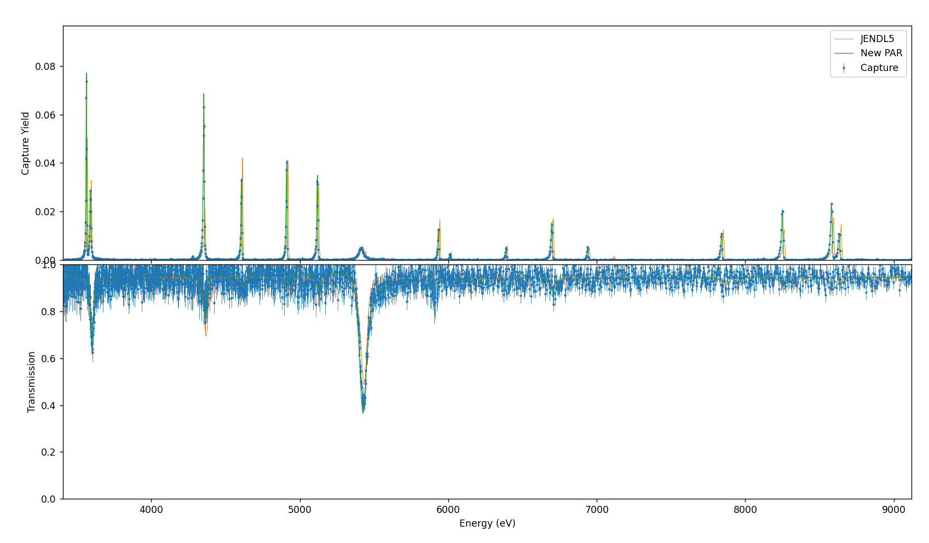
Preliminary resonance parameters ⁹⁴Mo

Slide 31
Extending resolved resonance region
Resolved resonance region in JENDL5 stops at ~20keV;
Using n_TOF data is possible to extend the RRR at higher energies;
Few resonances visible also in transmission measurement;
The RRR could be extended up to ~50keV.

Slide 32
Kernel ratio with literature
The preliminary kernels obtained with SAMMY were compared to the ones in literature (Weigmann and Musgrove capture measurements);
Systematic deviation of around 20% observed
Possible causes still under investigation

Slide 33
Possible proposal of new Mo isotopes measurements
Overall
Rank | isotope
5 | 92
1 | 94
4 | 95
2 | 96
3 | 97
6 | 98
7 | 100
Ranking of interest of different Mo isotopes based on the role in astrophysics, nuclear technology and cross-section uncertainties in literature,
Three isotopes already measured,
⁹²Mo has low priority for astrophysics (p-only isotope),
Possible addendum to measure ^{97,98,100}Mo to be prepared for next INTC.

Slide 34
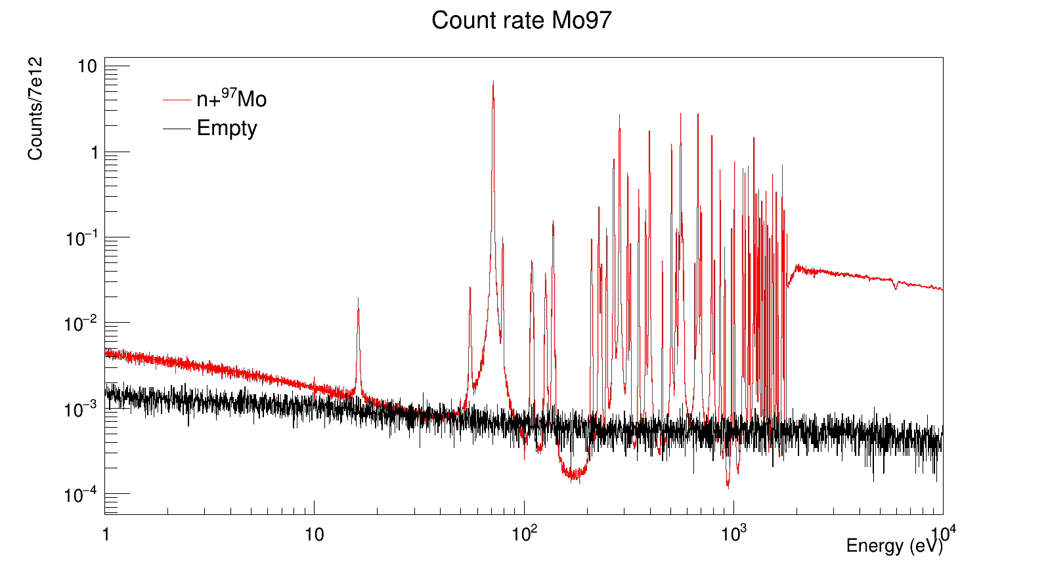
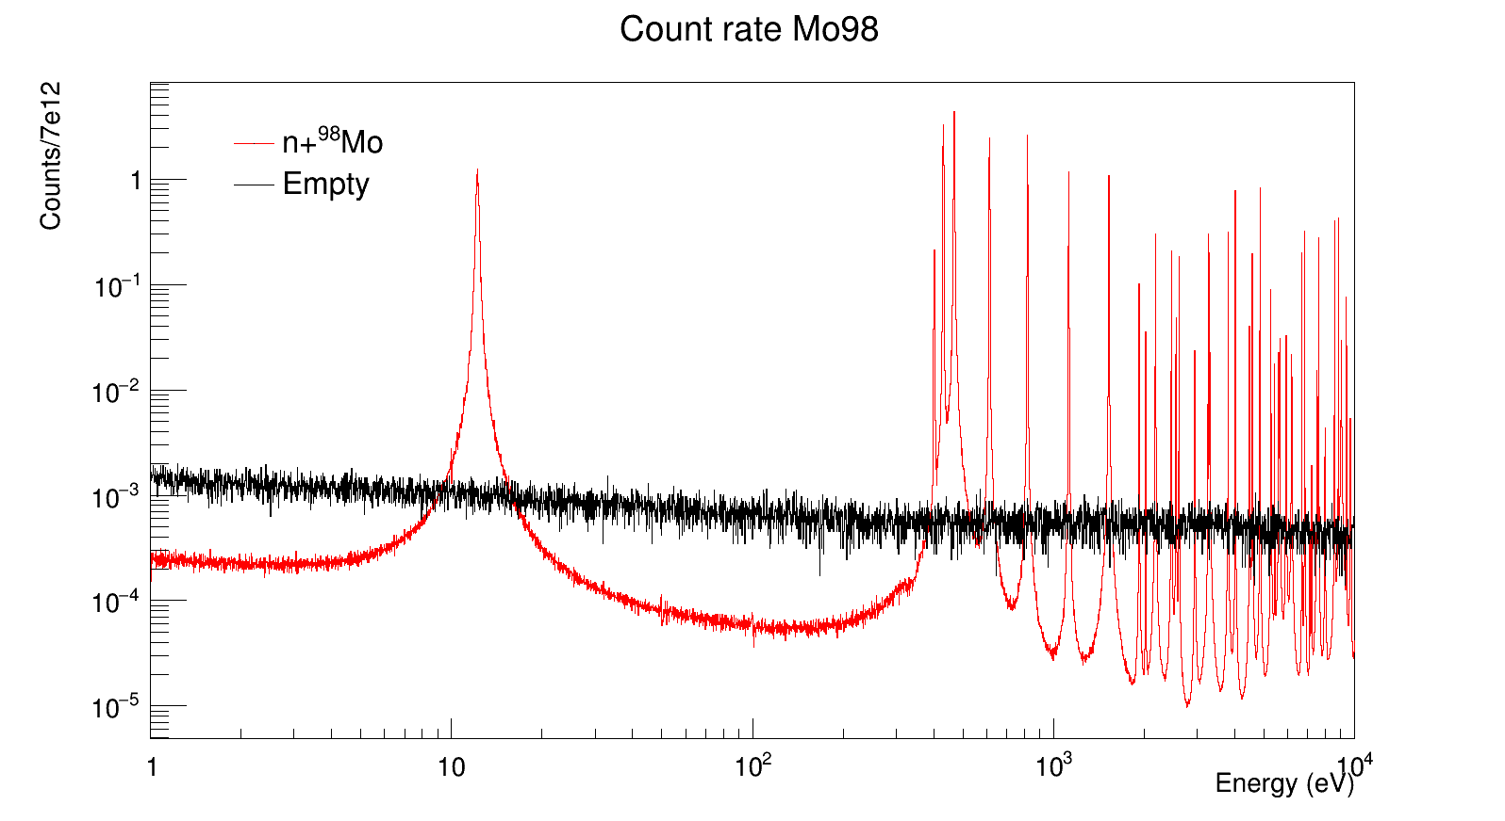
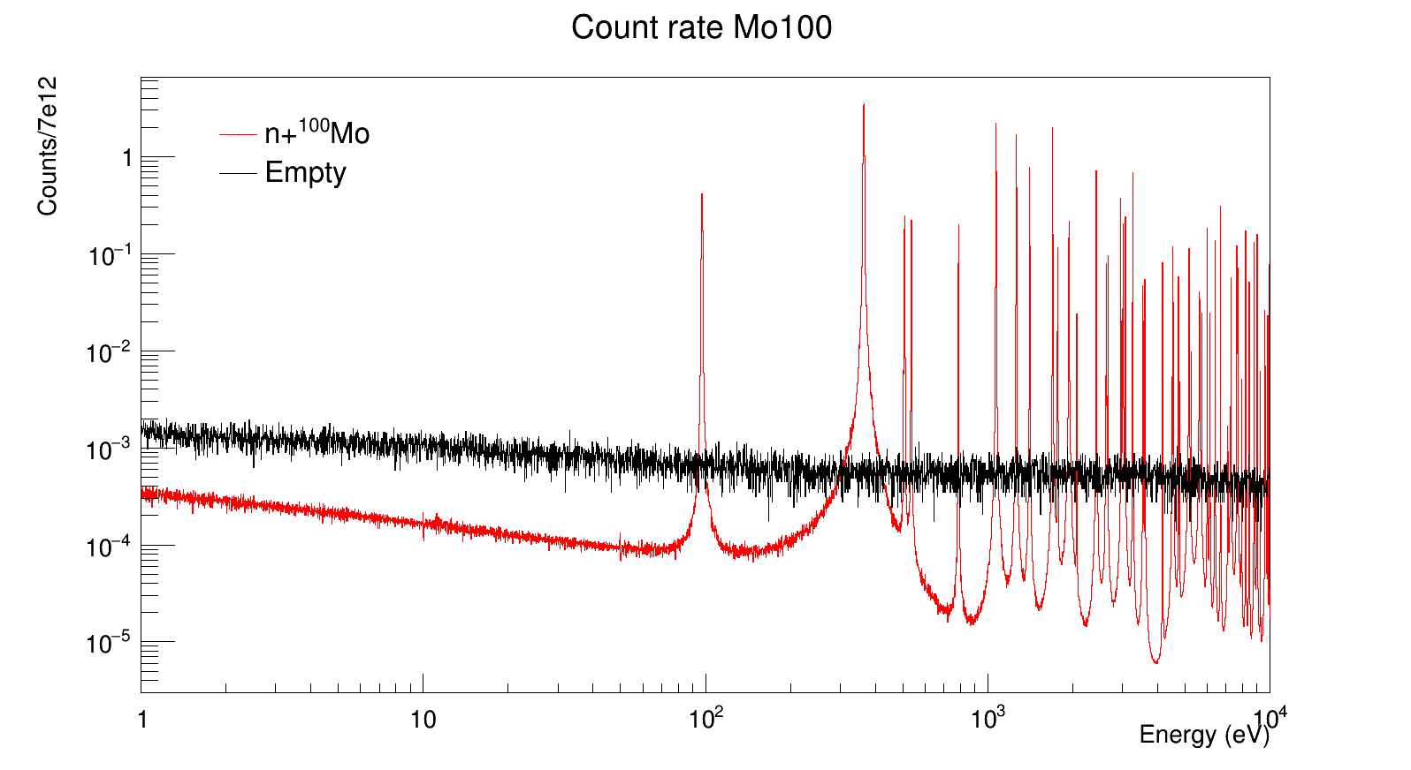
Count rate estimate
Count rate estimate for 2g samples in EAR1
Empty measured during Mo campaign,
New evaluated flux used in estimation

Slide 35
Summary and outlook
What has been done:
Full background estimation and subtraction for all the detectors;
Reaction yield calculation;
Preliminary resonance analysis of ⁹⁴Mo using capture and transmission data simultaneously.
What is left to do:
Correction of additional background in Mo samples;
Final resonance analysis of ^{94,95,96}Mo;
Analysis of EAR2 data of 2022;
R-Matrix analysis together with EAR2 data.

Slide 36
Thank you for your attention

Slide 37
Backup

Slide 38
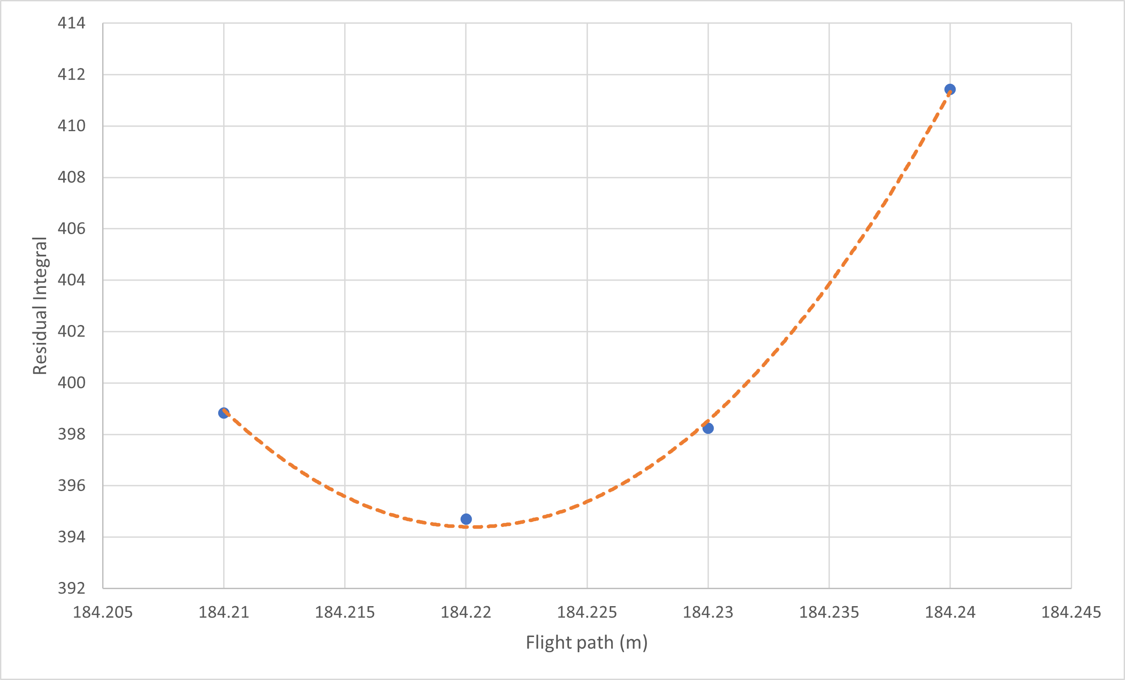
Transport code Flight-path
Comparison of time-of-flight spectra measured with gold and the one obtained with the Transport code;
Best flight-path was found by minimizing the residuals at different L_{TC}.
L_{TC}=184,22 m

Slide 39
T0 resonance fit
⁹⁴Mo | T0 fit
¹⁵⁴² | ^{0.0578}
²¹⁷⁶ | ^{0.1452}
⁴³⁶⁰ | ^{0.0360}
⁵⁴³³ | ^{0.0575}
¹⁰⁷⁵⁷ | ^{0.0505}
¹³⁵¹⁵ | ^{0.0588}
⁹⁵Mo | T0 fit
¹²⁰³ | ^{0.0604}
¹⁷⁶⁷ | ^{0.0305}
³⁶²³ | ^{0.0368}
³⁷²³ | ^{0.0375}
⁴⁰³⁰ | ^{0.0407}
⁹⁶Mo | T0 fit
³⁵⁷¹ | ^{0.0557}
³⁷⁵⁶ | ^{0.0070}
⁴³²⁰ | ^{0.0740}
⁵³⁸⁴ | ^{0.0337}
⁹³⁹³ | ^{-0.0171}
¹⁰⁰⁰⁰ | ^{0.0420}

Slide 40
Background Mo samples – 96Mo

Slide 41
Background Mo samples – 94Mo

Slide 42
Background Mo samples – 96Mo

Slide 43
Background Mo samples – 94Mo

Slide 44
Mo pellet samples
Atomic % | ⁹²Mo | ⁹⁴Mo | ⁹⁵Mo | ⁹⁶Mo | ⁹⁷Mo | ⁹⁸Mo | ¹⁰⁰Mo
⁹⁴Mo | 0,63% | 98,97% | 0,36% | 0,01% | 0,01% | 0,01% | 0,01%
⁹⁵Mo | 0,31% | 0,69% | 95,40% | 2,24% | 0,51% | 0,65% | 0,20%
⁹⁶Mo | 0,28% | 0,24% | 1,01% | 95,90% | 1,00% | 1,32% | 0,25%
Isotope | Mass (g) | Areal density (atoms/b)
⁹⁴Mo | 1,9526 | 3,9592E-03
⁹⁵Mo | 1,9745 | 3,9558E-03
⁹⁶Mo | 1,9175 | 3,8064E-03
^{nat}Mo-5 μm | 2,014 | 4,0059E-03
^{nat}Mo-350 μm | 1,989 | 3,9584E-03

Slide 45
^{nat}Mo abundances
Isotope | Abundance
⁹²Mo | 14.84%
⁹⁴Mo | 9.25%
⁹⁵Mo | 15.92%
⁹⁶Mo | 16.68%
⁹⁷Mo | 9.55%
⁹⁸Mo | 24.13%
¹⁰⁰Mo | 9.63%

Slide 46
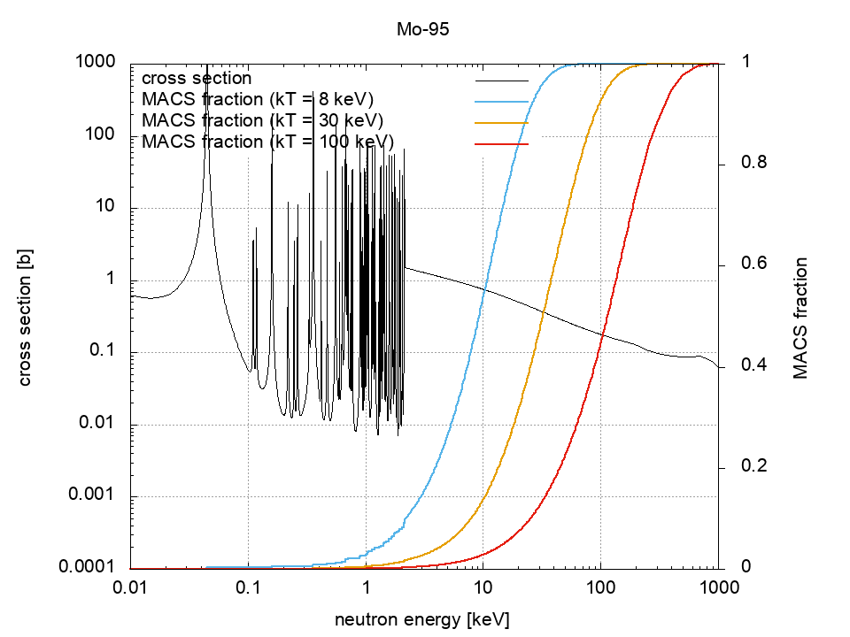
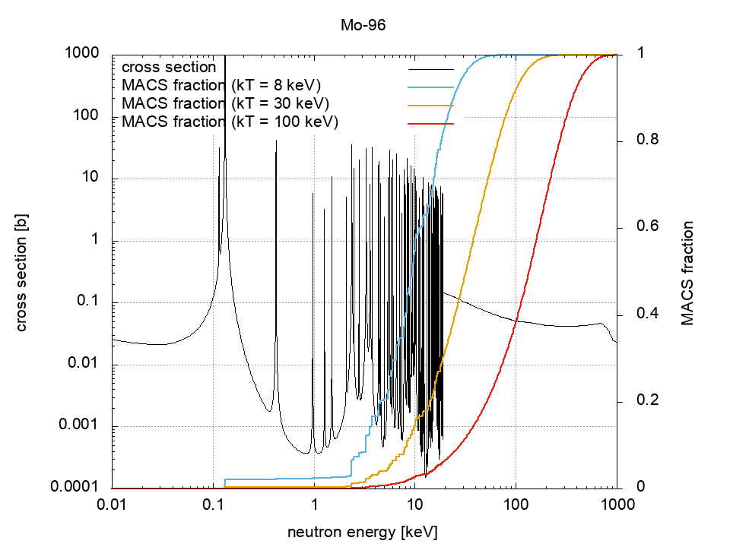
MACS fractions

Slide 47
Capture cross section ENDF/B-VIII
⁹⁴Mo
⁹⁵Mo
⁹⁶Mo
Thermal cross section:
⁹⁴Mo ~ 350mb
⁹⁵Mo ~ 13b
⁹⁶Mo ~ 620mb

Slide 48
Transmission with enriched Mo
Transmission at 10 m station of GELINA
Preliminary results of transmission at 10 m with enriched pellets;
Resonance parameters from new compilation;
Deviation on ⁹⁵Mo sample thickness from expected one;
Abundance of biggest contaminants fitted with REFIT.
⁹⁴Mo
⁹⁵Mo
⁹⁶Mo

