Slide 1

News from CERN

Slide 2
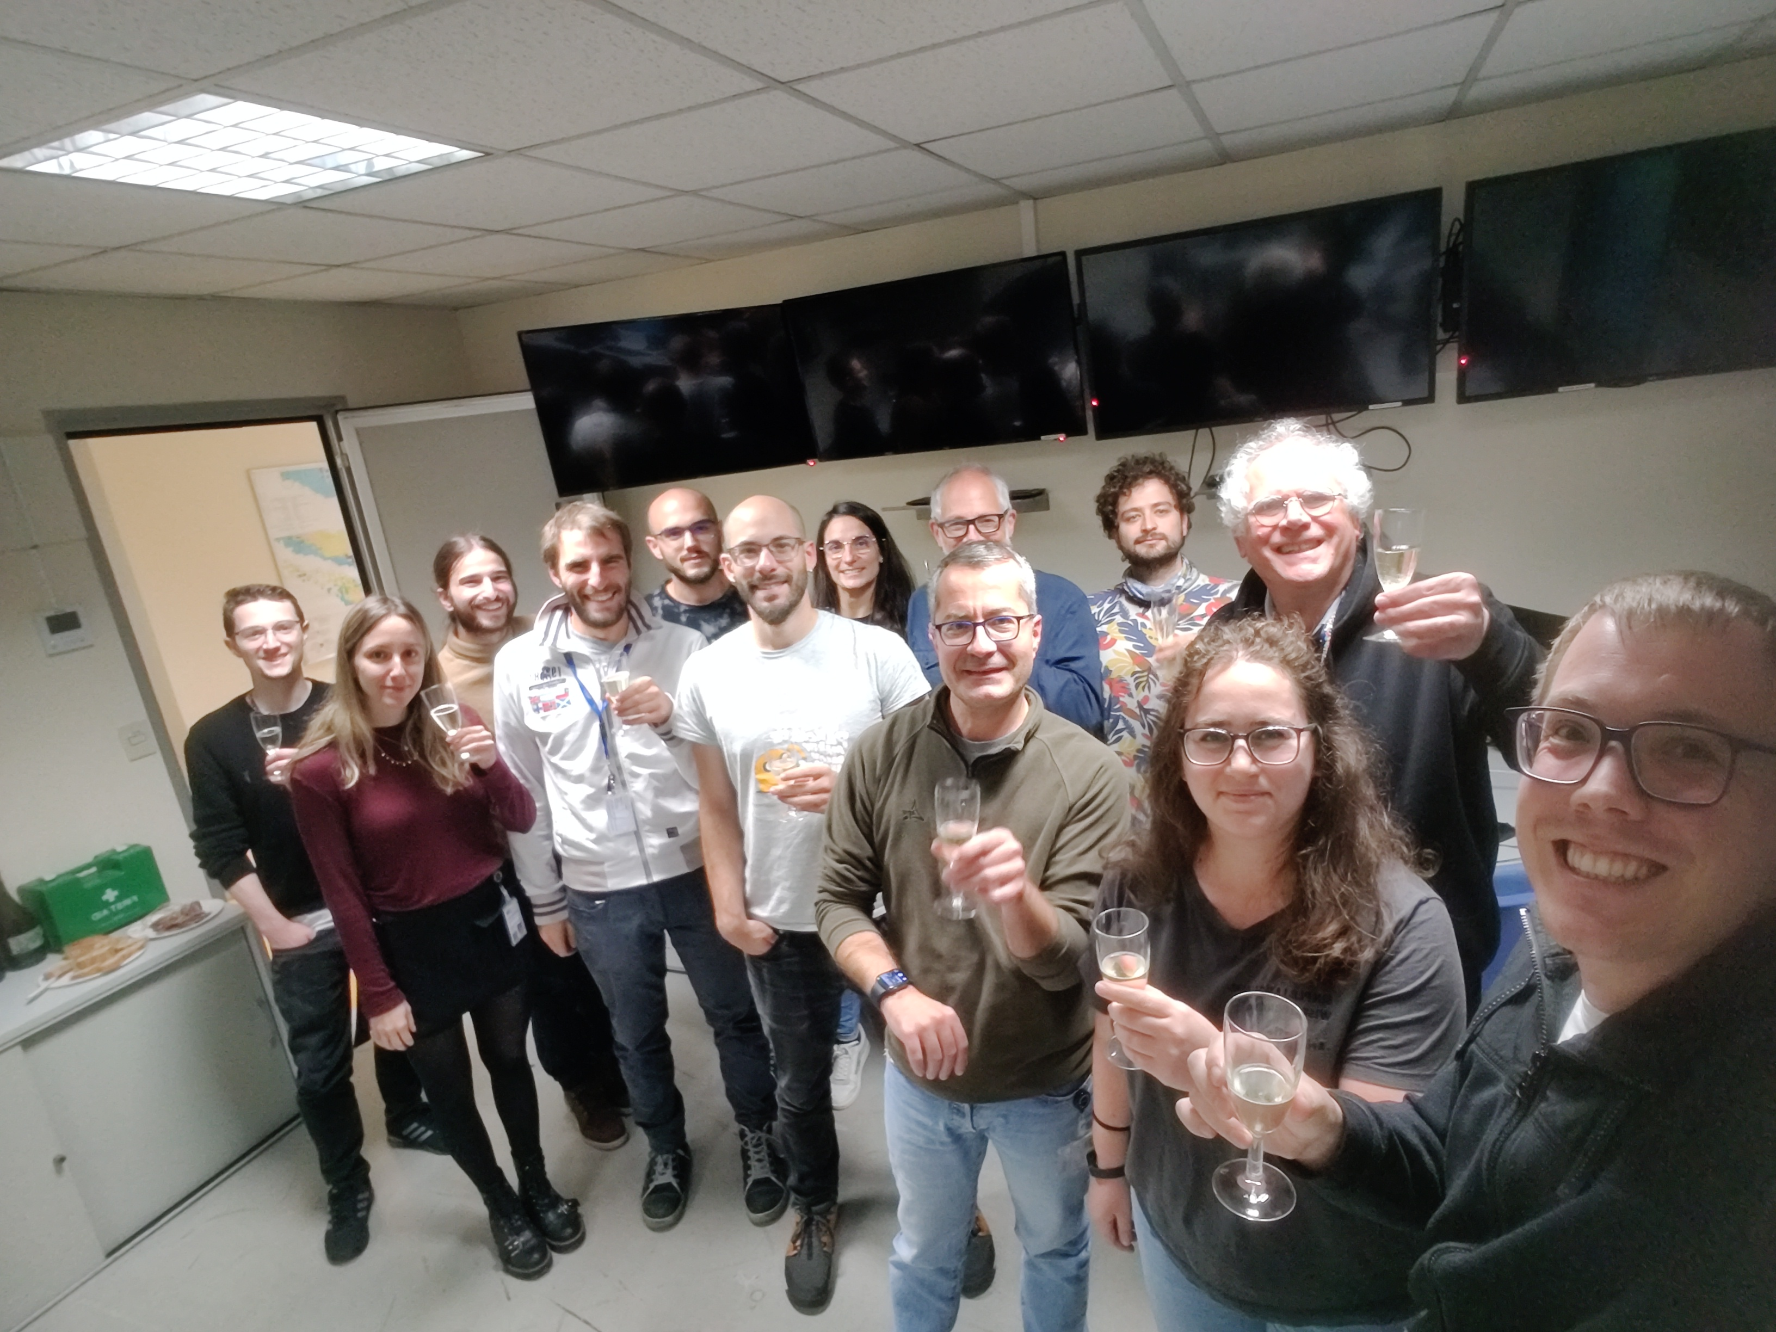
News from CERN
Control Room
30 October 2023

Slide 3
News from CERN
Notes:
Inizio con le misure della posizione del fasci (talk di Gerardo)

Slide 4
News from CERN

Slide 5
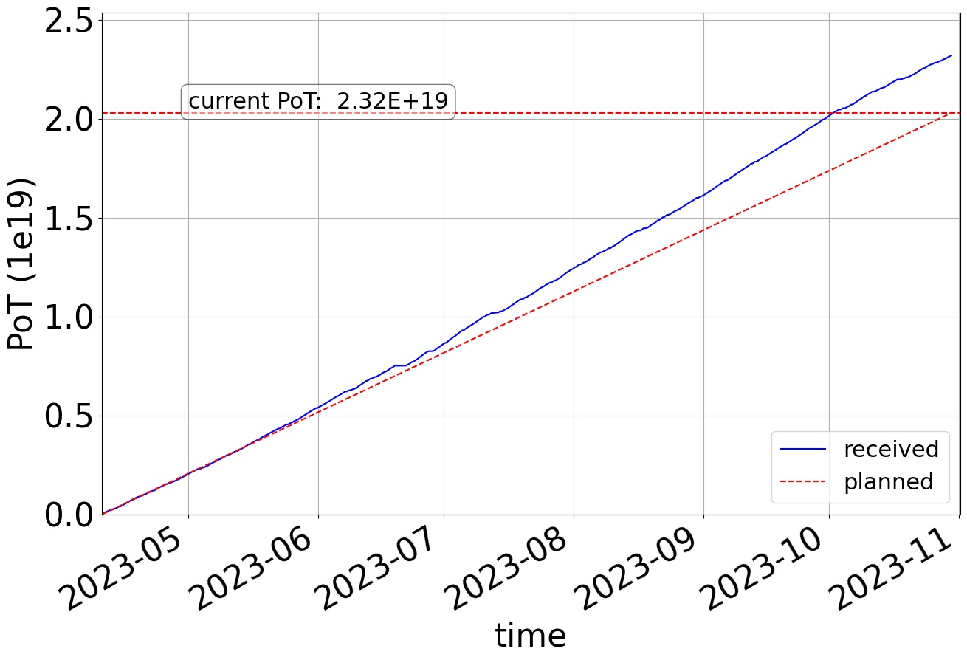
News from CERN
Physics start:
10 April 2023
Physics ends:
30 October 2023
203 days of run

Slide 6
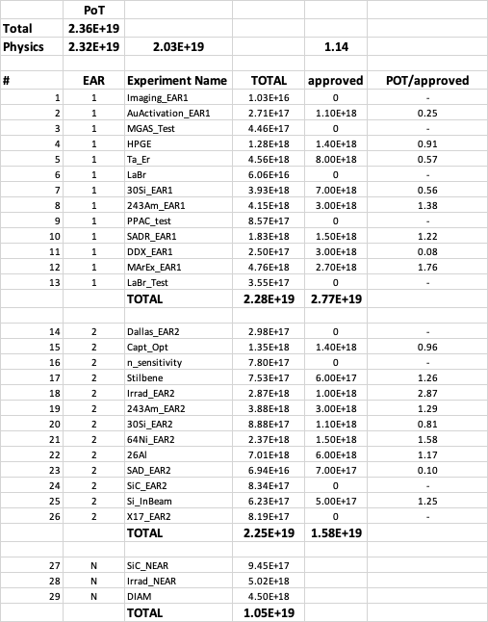
News from CERN
PoT 2.36E+19
Physics 2.32E+19
Expected 2.03E+19
Ratio 1.14 (average PoT/day [1.E+17])
source: Michi Bacak

Slide 7
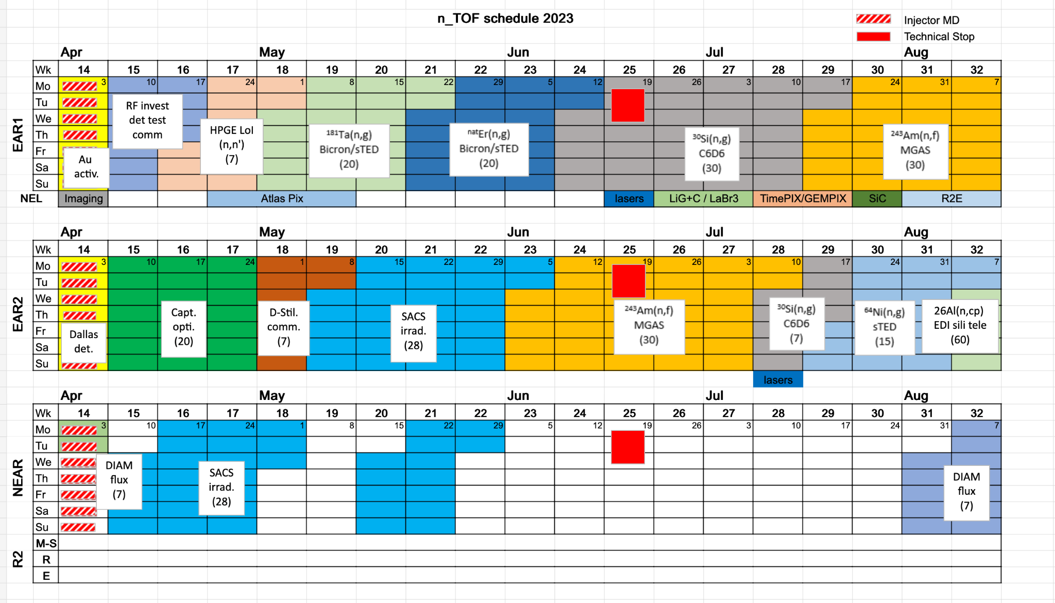
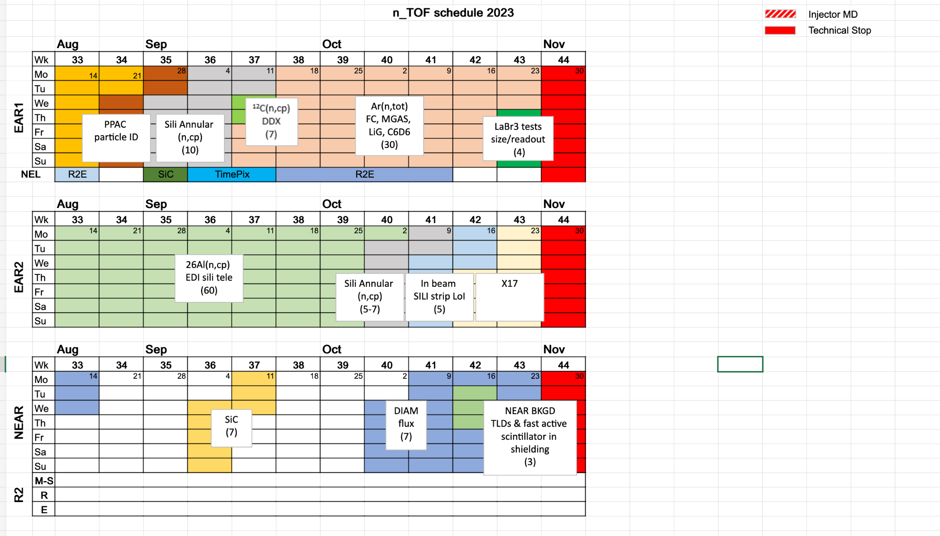
2023 run
EAR1 | EAR2 | NEAR
HPGe test ¹⁸¹Ta(n,γ) ^{nat}Er(n,γ) ³⁰Si(n,γ) ²⁴³Am(n,f) ¹²C(n,p/d/a) SADR ¹²C(n,p/d/a) DDX Ar-transmission | (n,γ) optimization study d-stilbene test ¹⁹⁷Au(n,γ) with 1cm & 2cm B4C ⁷⁶Ce(n,γ) with 1cm & 2cm B4C ²⁴³Am(n,f) ³⁰Si(n,γ) ⁶⁴Ni(n,γ) ²⁶Al(n,p/a) (n,p/d/a) SADR Si det. test for (n,cp) X17 2nd part of in-beam test | ¹⁹⁷Au(n,γ) ¹⁴⁰Ce(n,γ) ⁹⁴Zr(n,γ) Diamond det. test SiC Background
4 neutron capture reactions
2 (n,cp) reactions
²⁴³Am fission
2 neutron capture reactions have been (further) studied at NEAR and EAR2 with different B4C filter configurations; Activation technique; MACS for different stellar temperatures
NEAR beam profile, flux and background measurements
9 detector development projects have been accomplished successfully
First transmission measurement at n_TOF

Slide 8
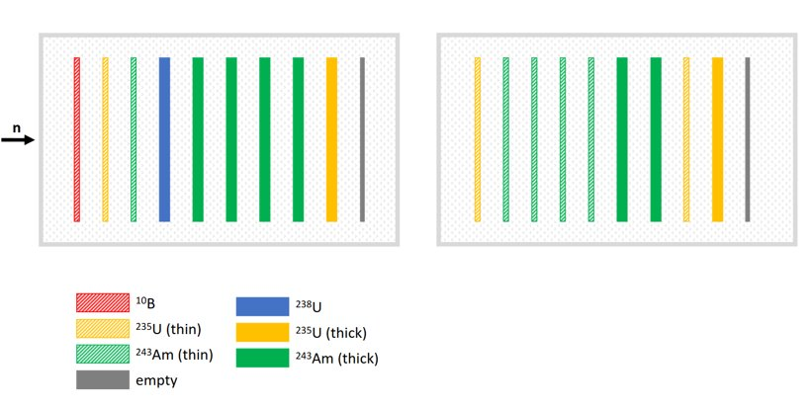
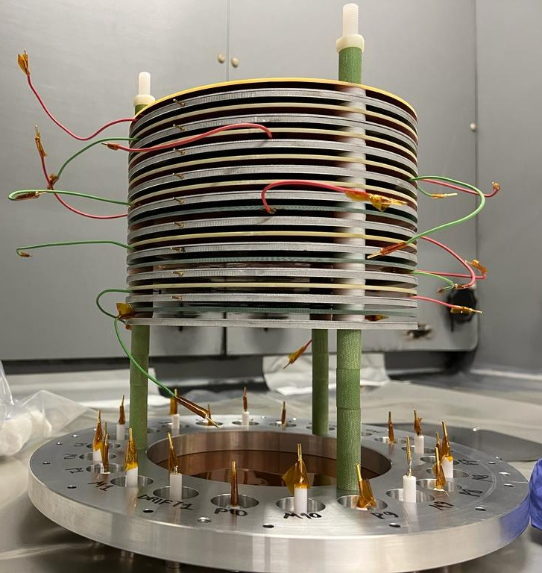
²⁴³Am(n,f)
Setup/Conditions
20 uMegas
²⁴³Am thin: 0.64 MBq per sample
²⁴³Am thick: 27 MBq pes sample
Total activity ~164 MBq
6E18 protons equally shared at EAR1 and EAR2
Nikos KYRITSIS, Zina ELEME, Veatricki MICHALOPOULOU, et al.

Slide 9
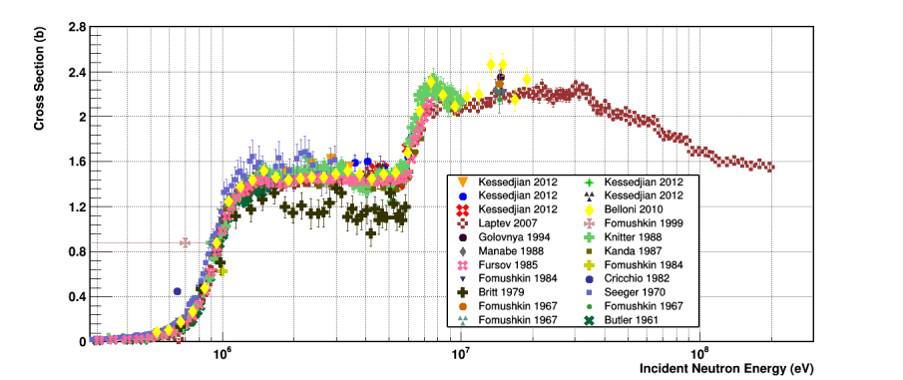
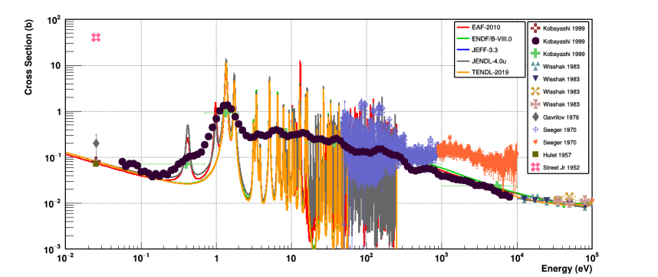
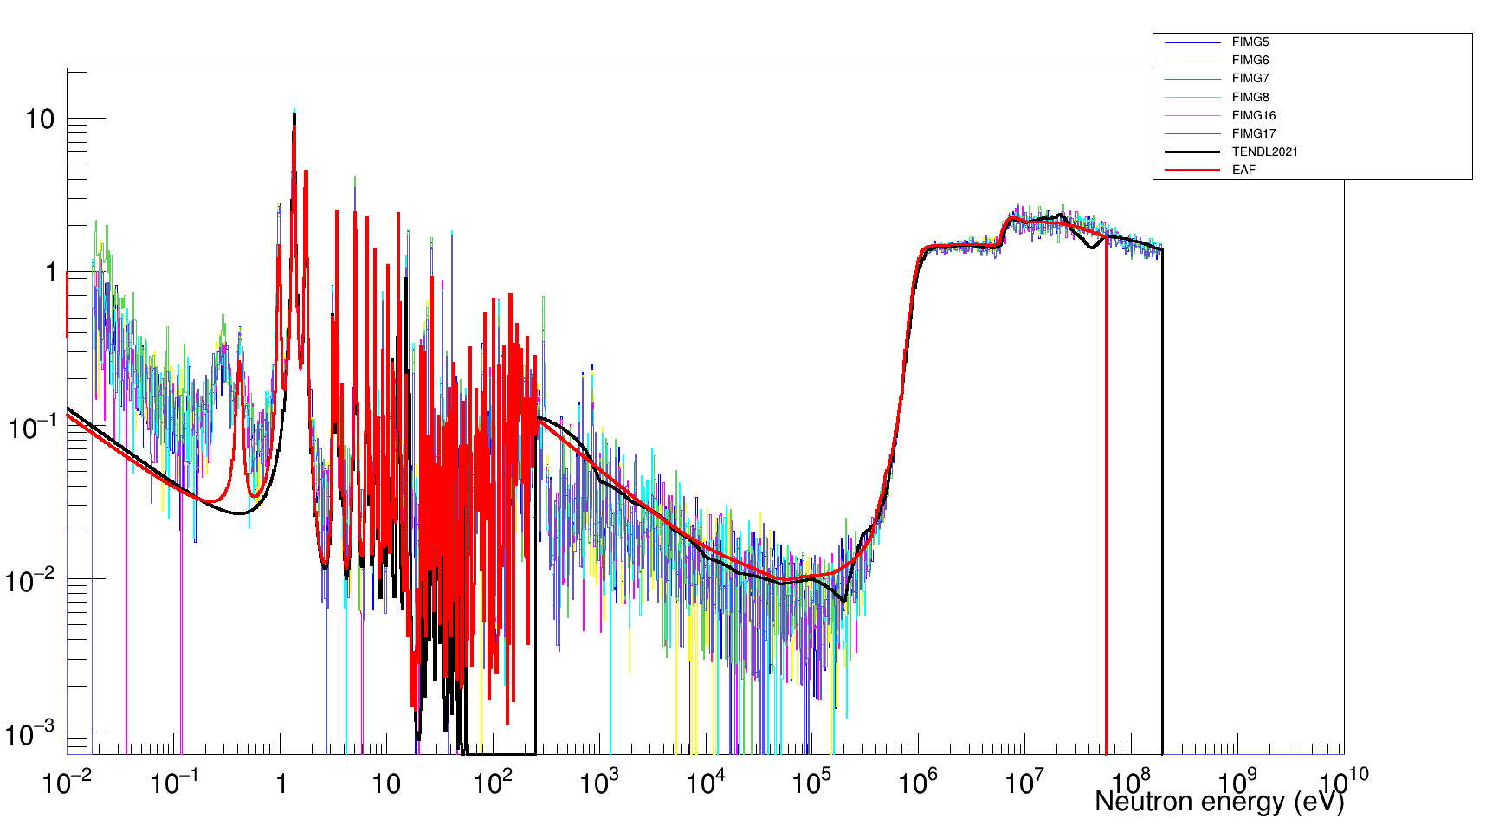
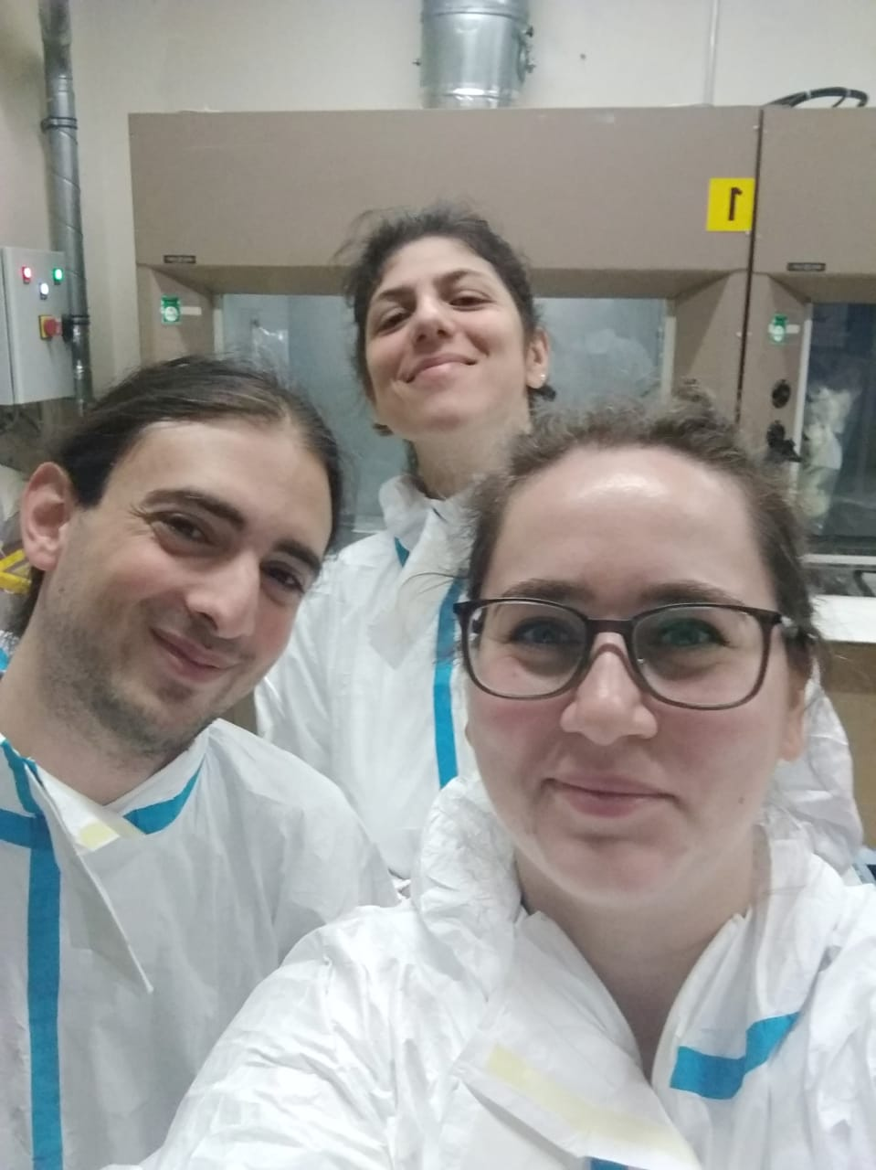
²⁴³Am(n,f)
Important deviations between evaluations can be resolved!
Nikos KYRITSIS, Zina ELEME, Veatricki MICHALOPOULOU, et al.

Slide 10
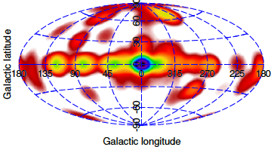
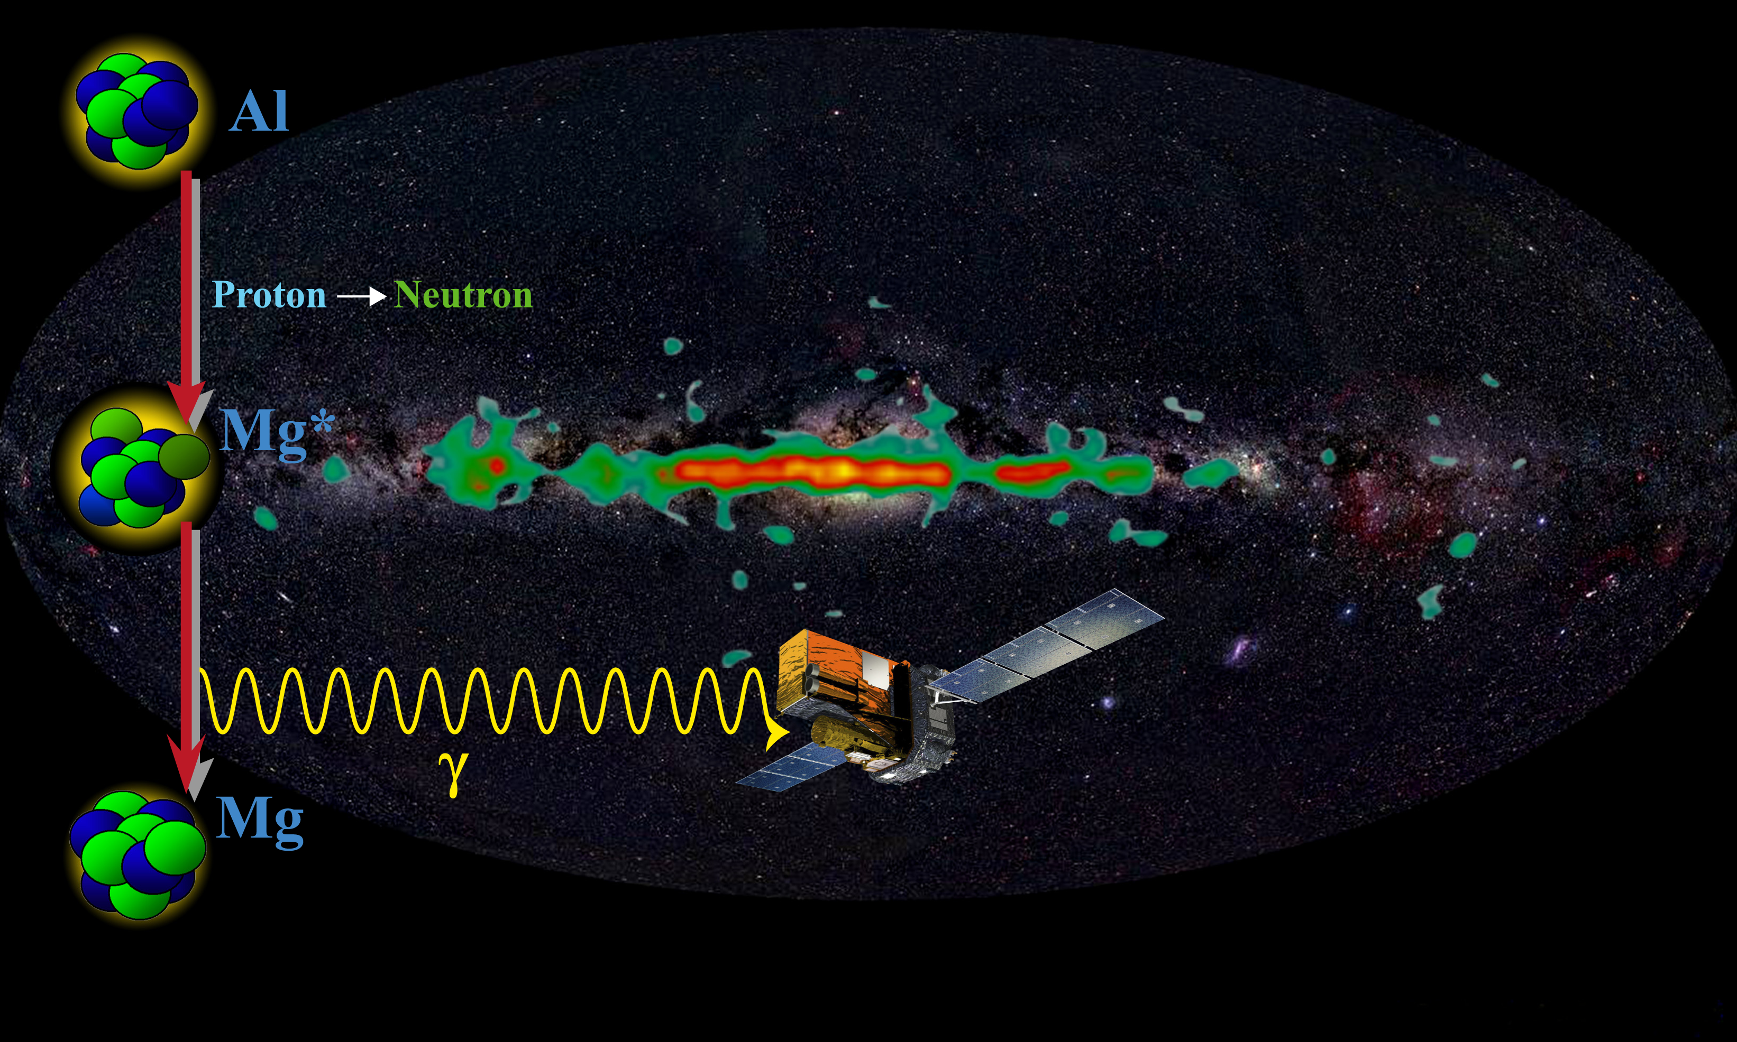
²⁶Al and the chemical elements production in our Galaxy
²⁶Al is a radioactive nucleus produced in massive stars
The ²⁶Al half-life, 720 thousand years, very short
with respect to the age of Universe of 13.8 billion years
Each ²⁶Al nucleus decay produces one highly energetic
γ-ray of 1.8 MeV. The interstellar medium is transparent to this ”light”
By recording these γ-rays we have a ”snapshot” of the
on-going nucleosynthesis in our Galaxy. Accordingly, we can trace the dynamics of the Milky Way (rotational speed, expansion, star-formation rates, etc.)
From the total production and destruction of ²⁶Al, we can understand how the cosmo-chemical element factories (stars) are producing energy and matter
The distribution of the ²⁶A “light “(1.8 MeV γ-rays) across the Milky Way. This is a “snapshot” of the ongoing chemical elements production in our Galaxy
Nuclear reaction data are necessary to quantify
the ²⁶Al net yield: production & destruction
Claudia Lederer-Woods et al. (The n_TOF Collaboration)
The Physical Review C 104, L032803 & L022803 (2021)
ESA INTEGRAL mission detects ²⁶Al γ-rays

Slide 11
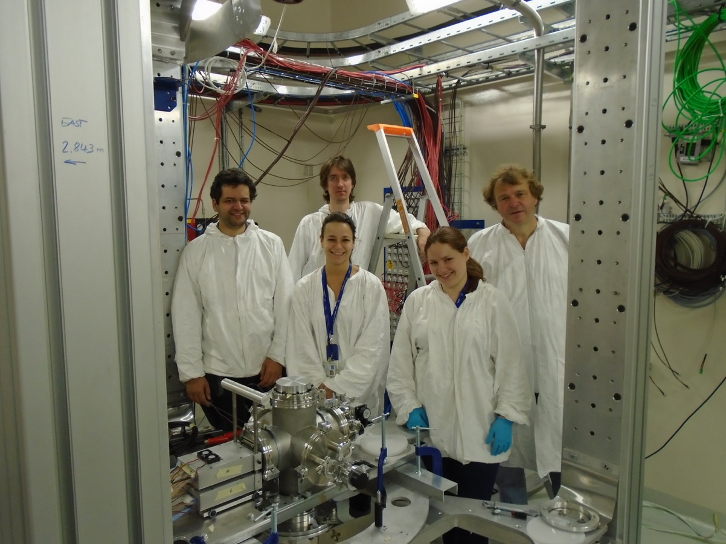
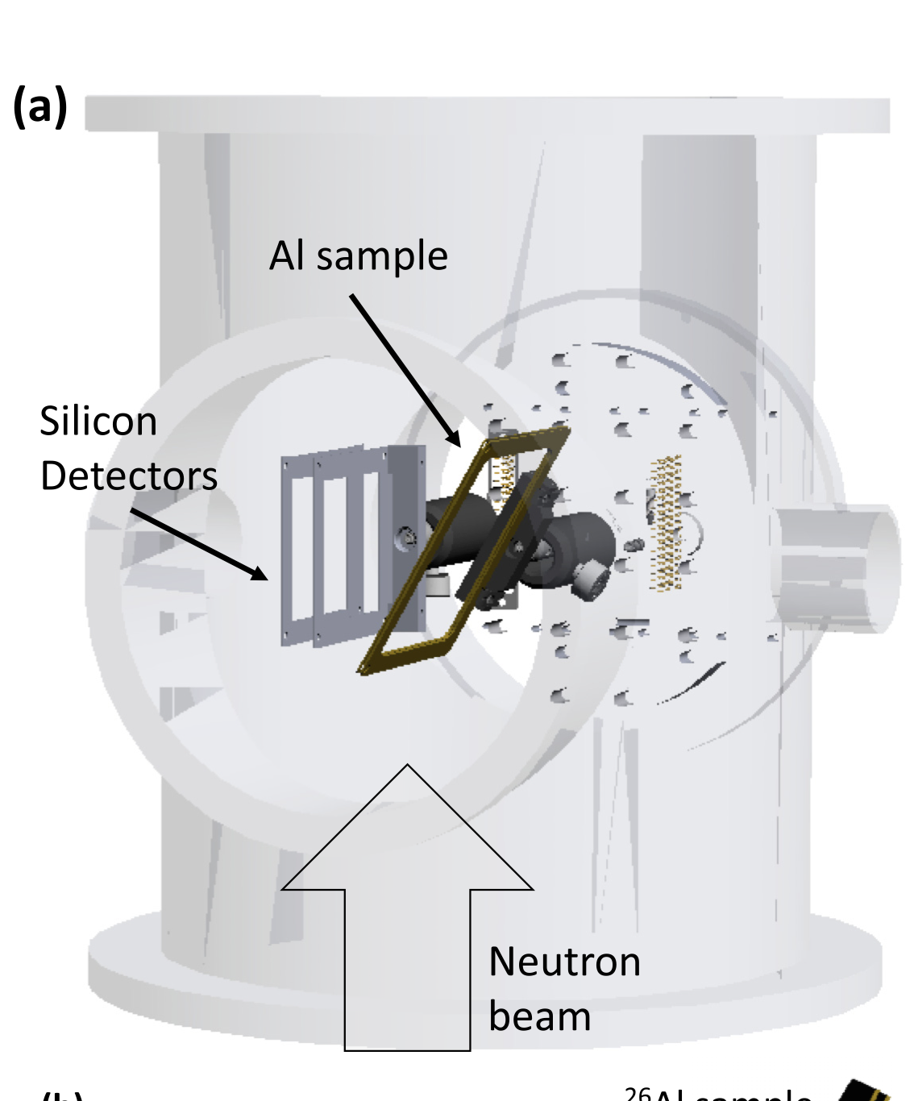
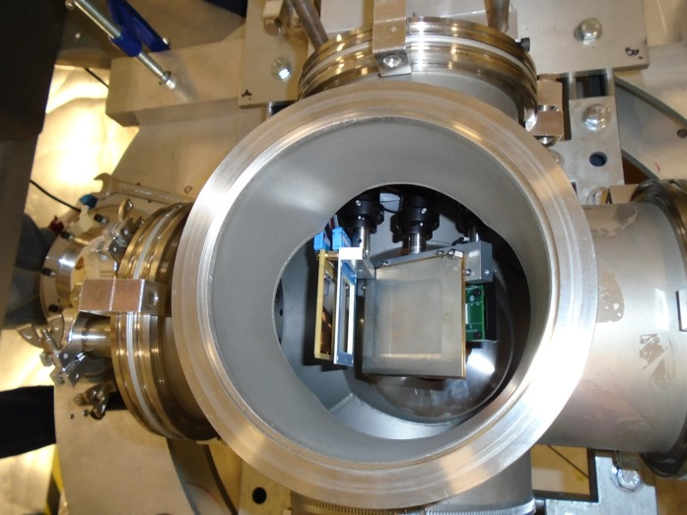
²⁶Al and the chemical elements production in our Galaxy
The ²⁶Al(n,p) and ²⁶Al(n,α) reactions are responsible for the destruction rate of ²⁶Al
in our Galaxy.
From previous(*) and current n_TOF measurements we can improve our understanding on the ongoing galactic
chemical element production
n_TOF EAR2: The University of Edinburgh team
in front of the experimental setup, ready to launch the measurement! (August 2023)
(*) Claudia Lederer-Woods et al. (The n_TOF Collaboration)
The Physical Review C 104, L032803 (2021) & L022803 (2021)
ESA INTEGRAL mission

Slide 12
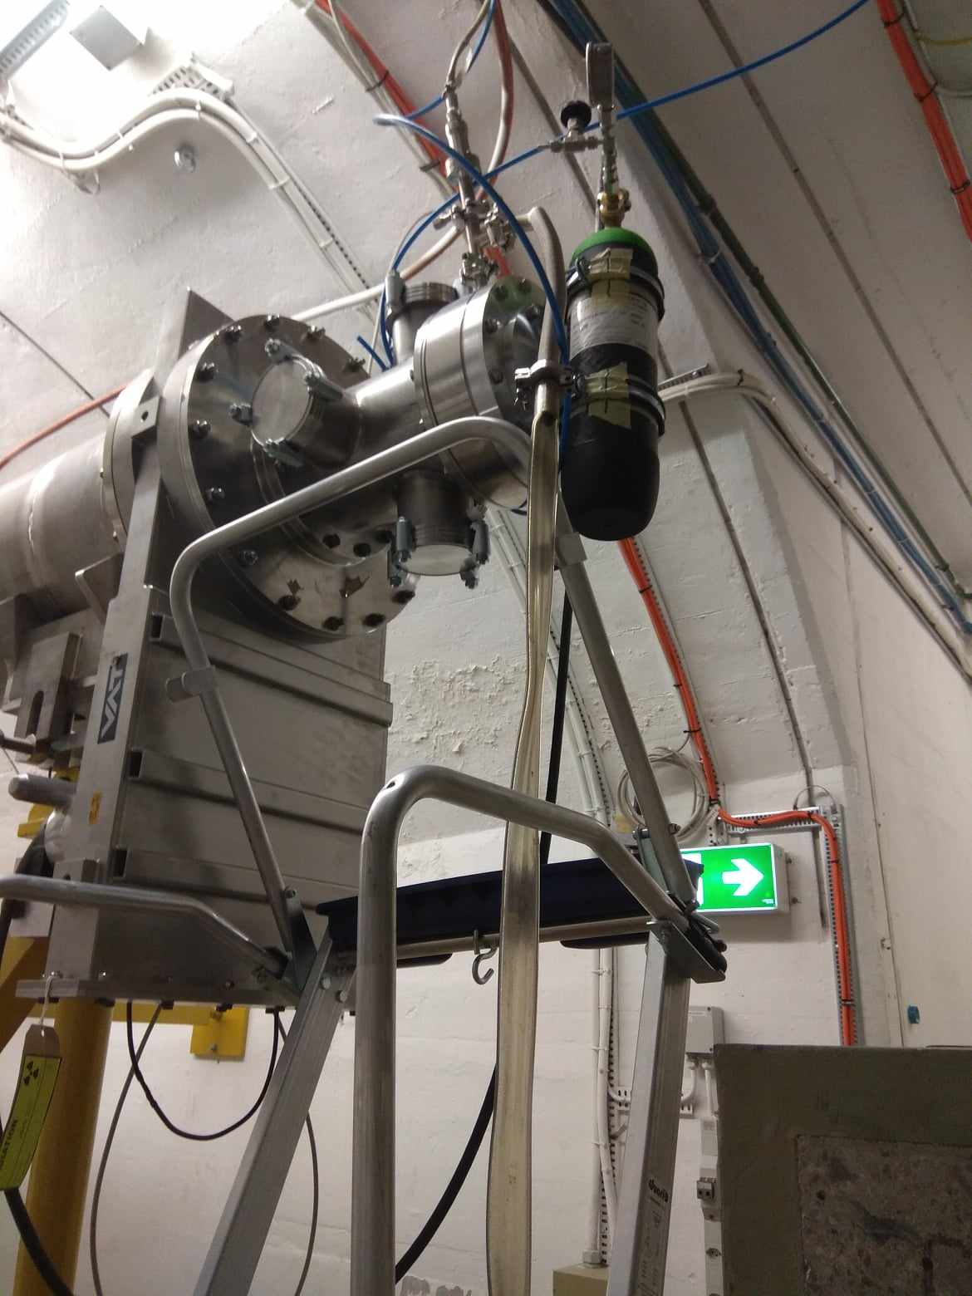
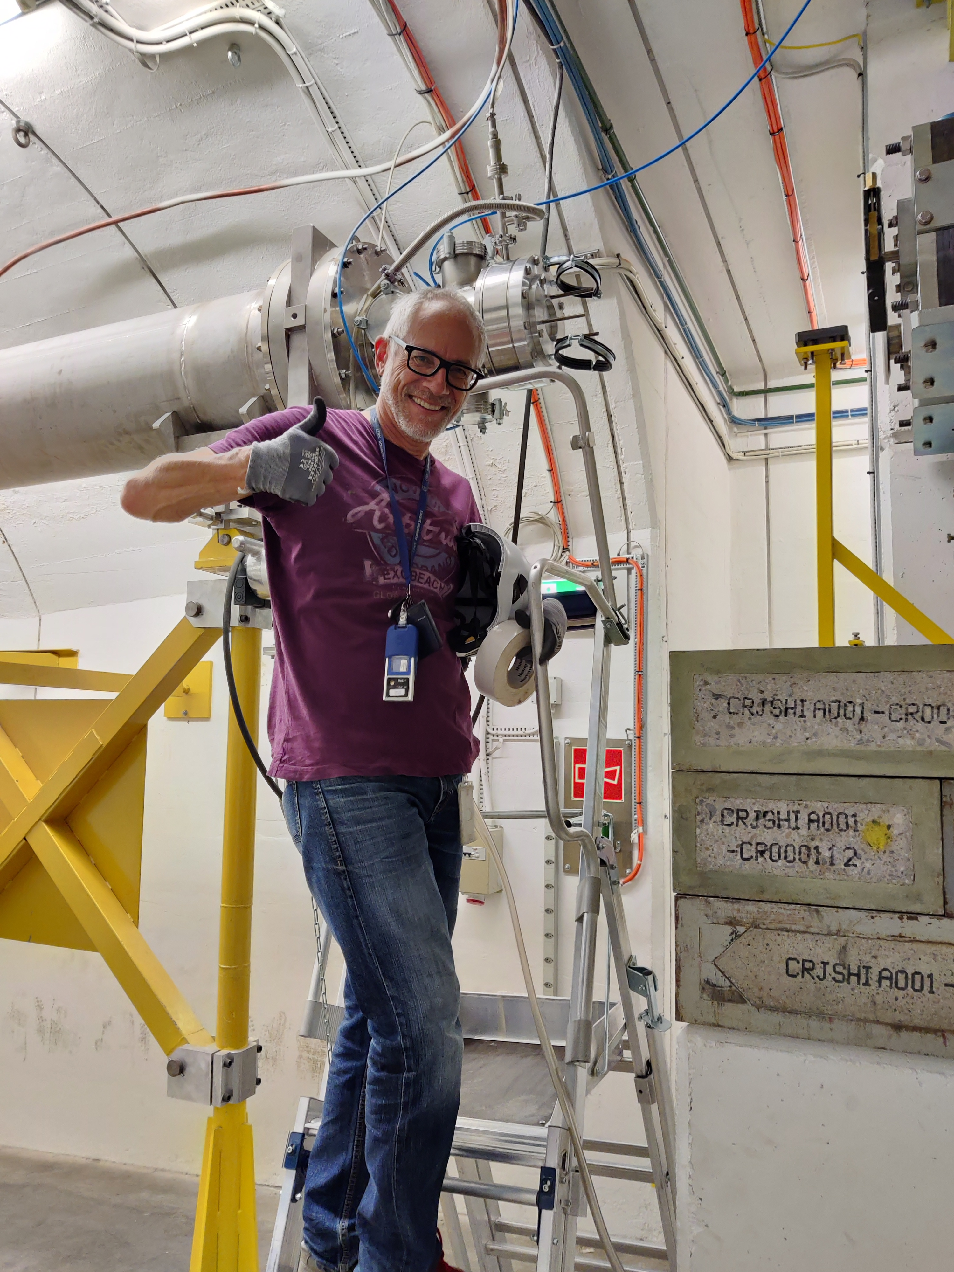
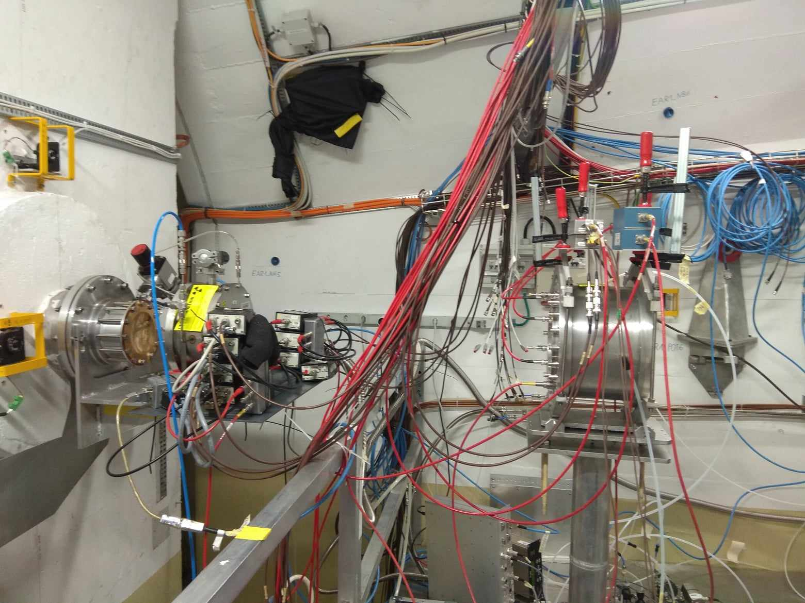
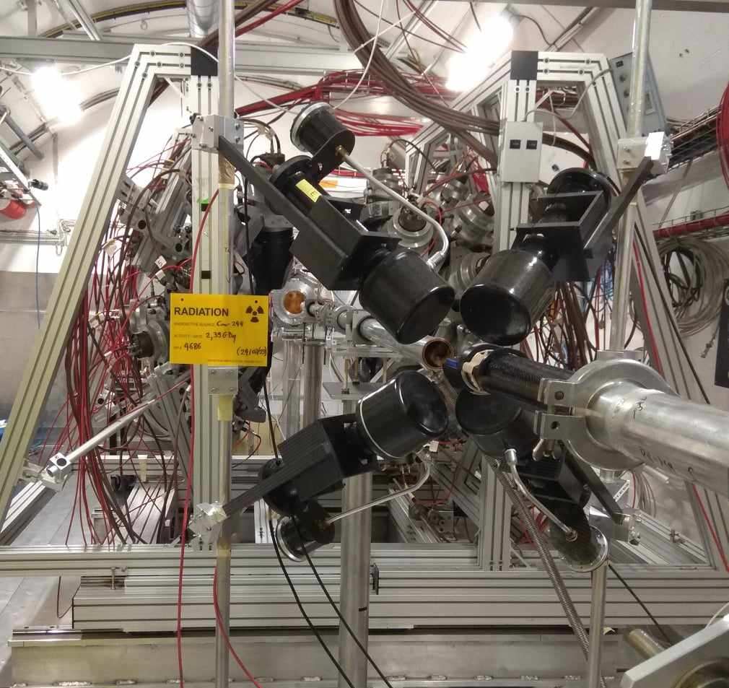
The MArEX initiative
Beam line to EAR1: Proof of concept with the filter station (Bi, Al)
Samples (Bi, Al, C) at the transmission station
Ar gas bottle (Carbon Fiber)
ESA INTEGRAL mission detects ²⁶Al γ-rays

Slide 13
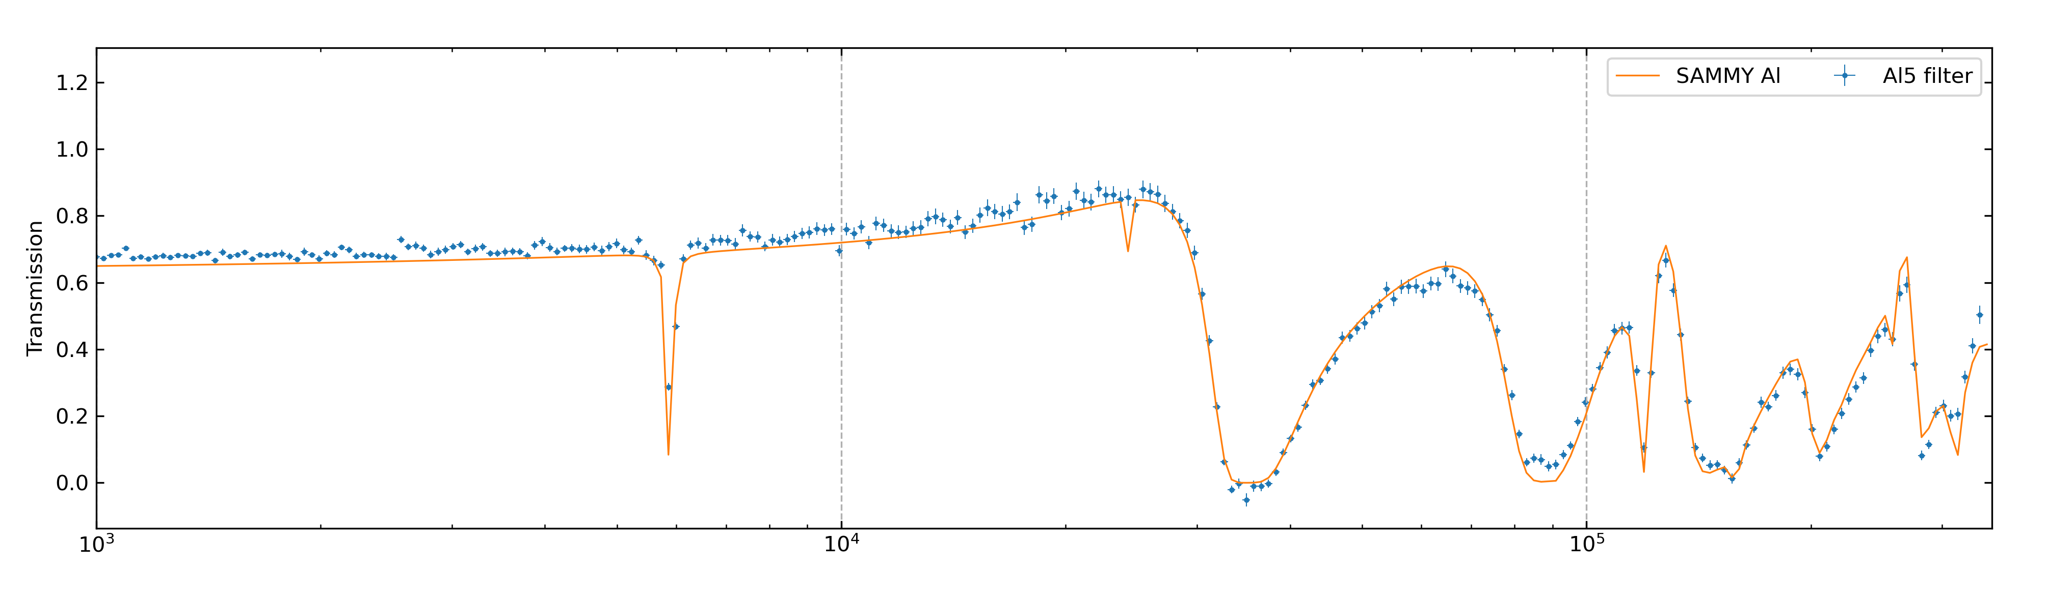
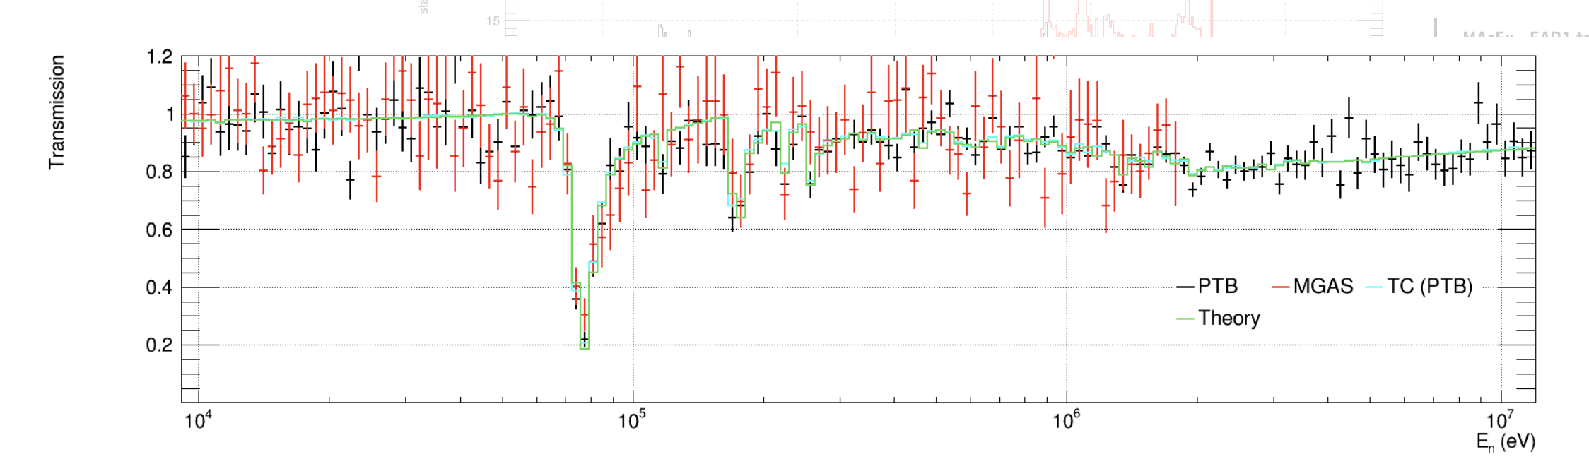
News from CERN
Al-filter
Capture setup
Ar gas
PTB + MGAS

Slide 14
News from CERN: 2023 run

Slide 15
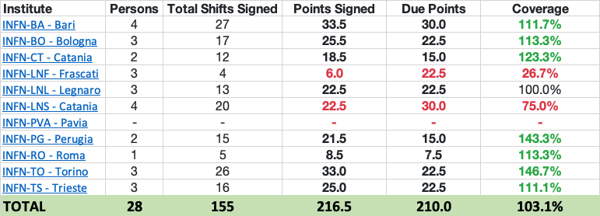
News from CERN: 2023 run

Slide 16
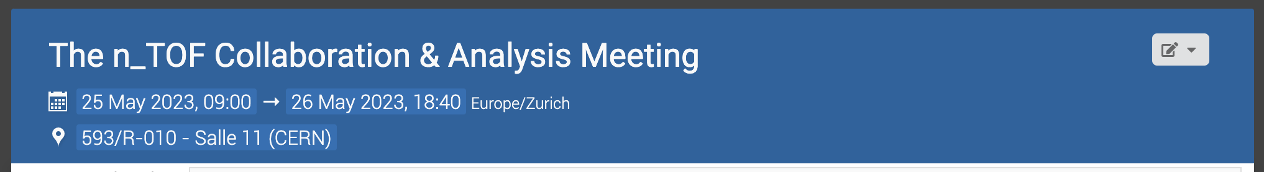
News from CERN
https://indico.cern.ch/event/1279454/

Slide 17
EAR1

Slide 18
EAR2

Slide 19
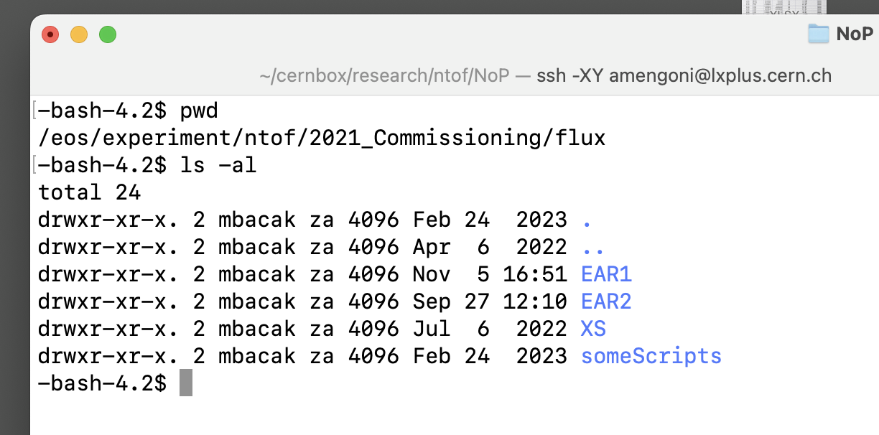
News from CERN
/eos/experiment/ntof/2021_Commissioning/flux

Slide 20
News from CERN

Slide 21
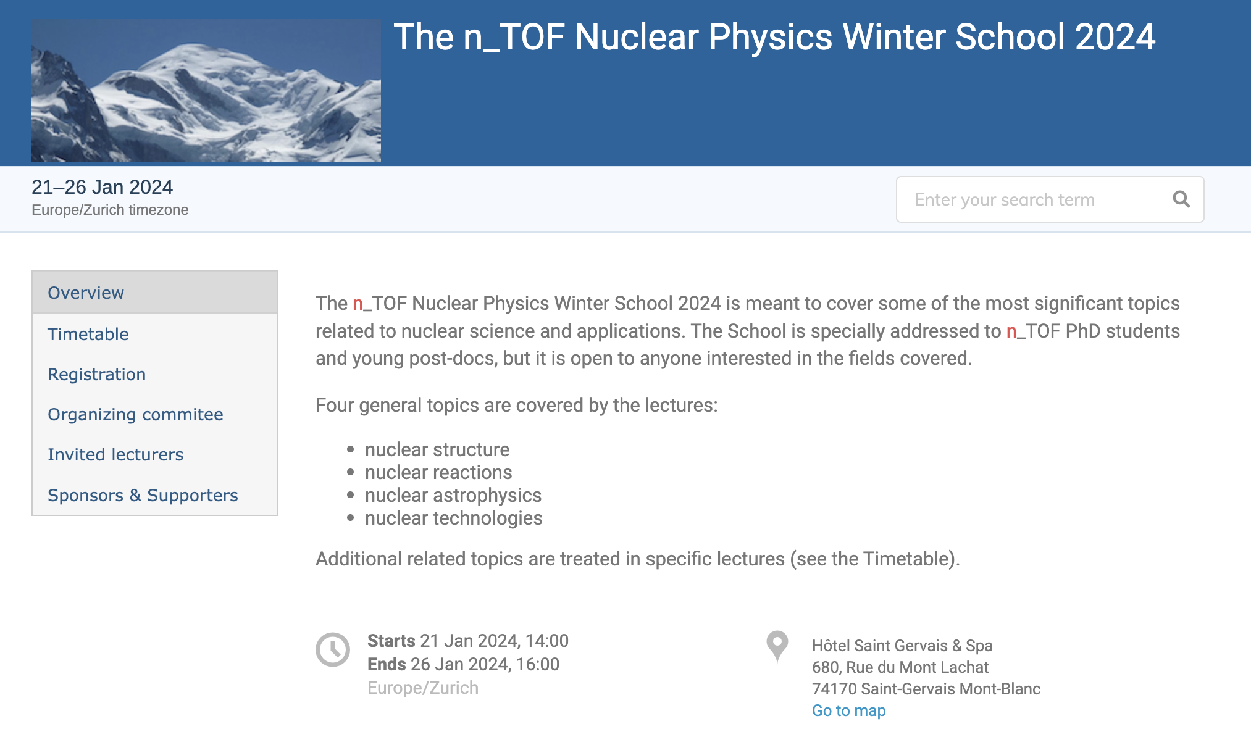
News from CERN

Slide 22


News from CERN

Slide 23

News from CERN

Slide 24
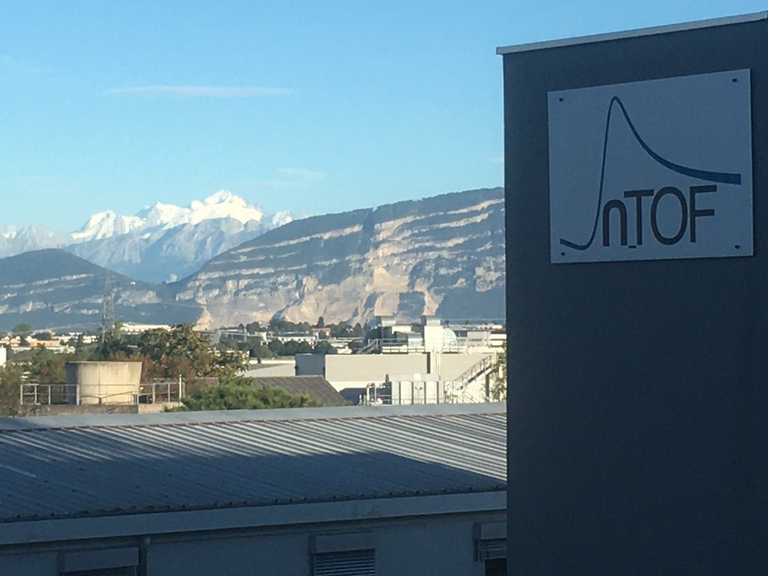
The End

Slide 25
News from CERN

Slide 26
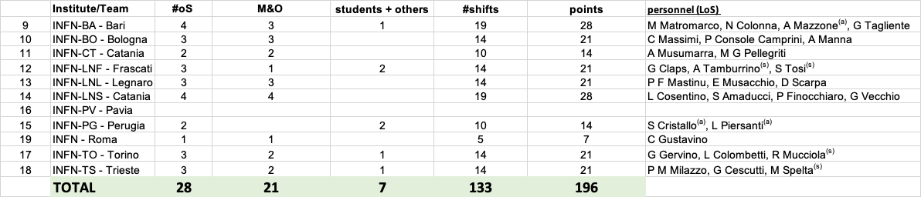
News from CERN

Slide 27
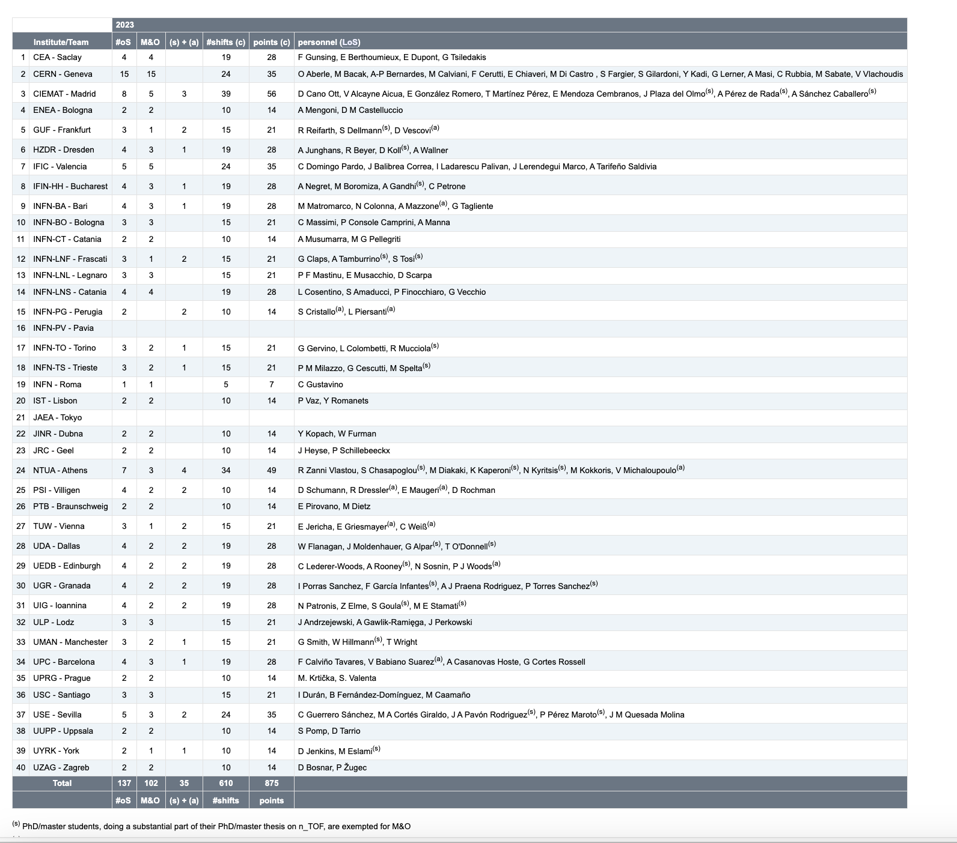
News from CERN

