Slide 1
Proposal for benchmarking FCC-ee collimation simulation tools at DAΦNE
G. Broggi ^{1,2,3}, A. Abramov ² , M. Boscolo ³, R. Bruce ²
¹ Sapienza University of Rome, Rome, Italy
² CERN, Meyrin, Switzerland
³ INFN-LNF, Frascati, Italy
3rd FCC@LNF meeting – INFN Laboratori Nazionali di Frascati, Frascati, Italy 15/09/2023

Slide 2
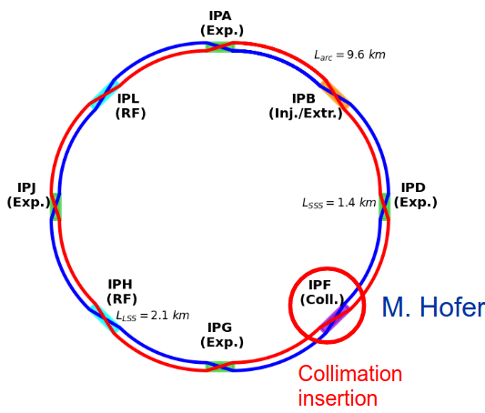
FCC-ee: collimation requirements
FCC-ee will have an unprecedented stored beam energy for a lepton collider
Up to 17.8 MJ (Z mode) → highly destructive beams
Collimation system indispensable
Reduce the background in the experiments
Protect the machine from unavoidable losses
Dedicated halo collimation system in PF (A. Abramov – FCC week 23)
Two-stage betatron and off-momentum collimation in one insertion
Synchrotron radiation collimators around the Interaction Points (IPs) (K. André – FCC week 23)
Suitable collimation simulation tools are essential in the collimation design phase to converge on an optimum performace
FCC-ee
4IP layout
particle beam
collimator jaw
15-09-2023
G. Broggi | Proposal for benchmarking collimation simulation tools at DAΦNE

Slide 3
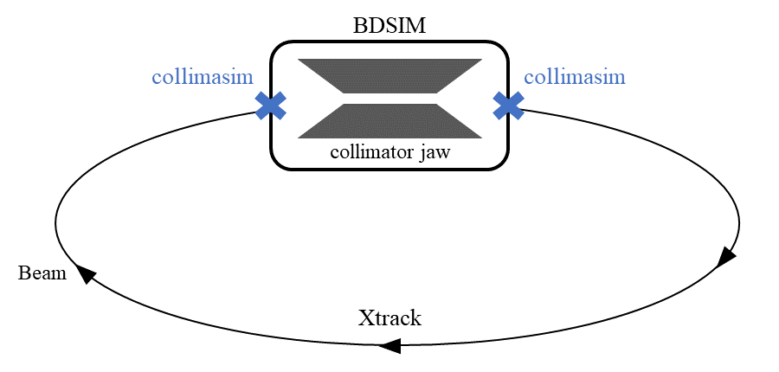
Simulation tool
Xtrack-BDSIM simulation tool used to evaluate beam losses along the accelerator ring
Xtrack: single particle tracking library belonging to the Xsuite collection of Python packages
BDSIM: C++ software package based on the Geant4 toolkit to simulate radiation transport in accelerators and beam lines
Can be used together for studies including particle tracking and particle-matter interaction
Other tools available, e.g., Xsuite (Xtrack-Xcoll), Xtrack-FLUKA (soon)
15-09-2023
G. Broggi | Proposal for benchmarking collimation simulation tools at DAΦNE

Slide 4
Simulation tool benchmark
To test the degree of reliability of such simulation tools a benchmark with existing tools and (especially) measurements is needed
Xtrack-BDSIM coupling already benchmarked against:
Existing tools: Sixtrack-FLUKA, K2, PyAT-BDSIM
Measured data from proton machines: LHC, PS
For the FCC-ee needs this is not fully satisfactory (different particle type and energy)
Benchmark with data from a lepton machine is needed
DAΦNE could be an excellent candidate (SuperKEKB is also being considered)
A benchmarked simulation tool could also be beneficial for DAΦNE
Better understanding of beam losses and of the machine in general
However, for a succesfull benchmark, some requirements are needed
Simulation model
Experimental measurements
15-09-2023
G. Broggi | Proposal for benchmarking collimation simulation tools at DAΦNE

Slide 5
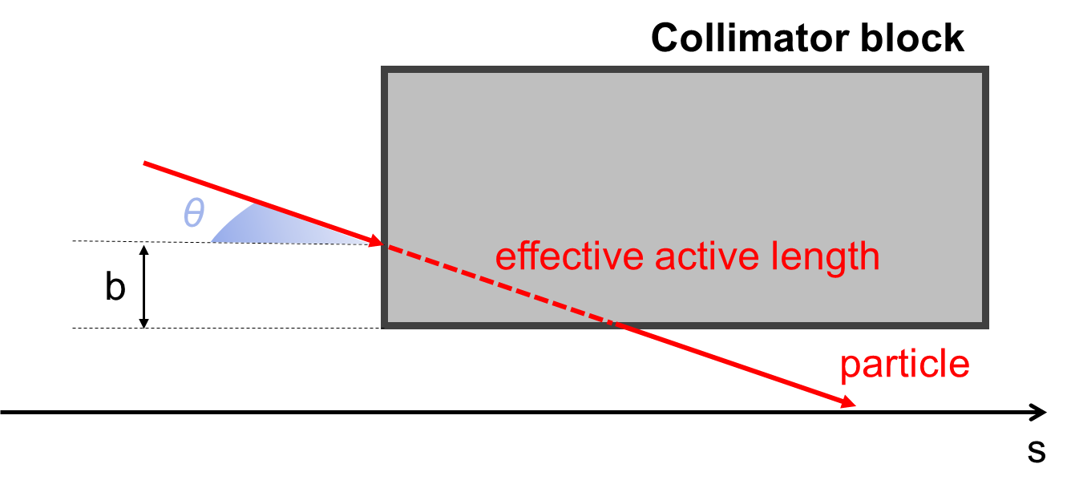
Simulation tool benchmark: simulation model
To succesfully run a Xtrack-BDSIM simulation, the following inputs are required:
Accelerator parameters: beam energy, emittance, …
Accelerator optics: optical parameters and magnetic strengths for the accelerator under study
Aperture model
Beam Intercepting Devices (BID) database: database containing BID specifics (geometry, opening, material, movable / not movable ?)
Different loss scenario can be simulated
Given beam distribution impacting a BID ← simplest case
(top-up) injection losses
BID scraping (if movable BIDs are present)
Known beam excitation
Touschek / beam-gas losses (to be implemented)
1st step to check feasibility: perform pure tracking simulations (no particle matter interactions with BIDs) with Xtrack to reproduce equilibrium conditions
Some regions (e.g., IRs) could be challenging to be modelled (SuperKEKB case)
b: impact parameter
θ: angle of incidence
15-09-2023
G. Broggi | Proposal for benchmarking collimation simulation tools at DAΦNE

Slide 6
Simulation tool benchmark: experiment
Xtrack-BDSIM tool good for simulating particle-BID interactions and track the outscattered particles
To succesfully perform a measurements that can be compared with simulations:
Particle losses on a BID*: possibly generated on purpose in a controlled way
Beam loss monitors (BLM): to record signals that can be related to beam losses on the aperture of the accelerator under study
*e.g., collimator, scraper, aperture restriction
Beam intensity monitor: to properly normalize our measurements (LHC BCT like)
Ideally perform single beam measurements (NO collisions)
Possible caveats (and possible solutions)
Challenging regions to be modelled (e.g., IRs)
Accuracy of aperture model
Absence of beam loss monitors / not reliable BLM response along the accelerator
Use collider detectors (if present) to record the outscattered particles («target experiment»)
Place a movable detector in a relevant position along the accelerator
Low sensitivity on setting collimators/scrapers opening
Beam based settings (BPM resolution ?)
15-09-2023
G. Broggi | Proposal for benchmarking collimation simulation tools at DAΦNE

Slide 7
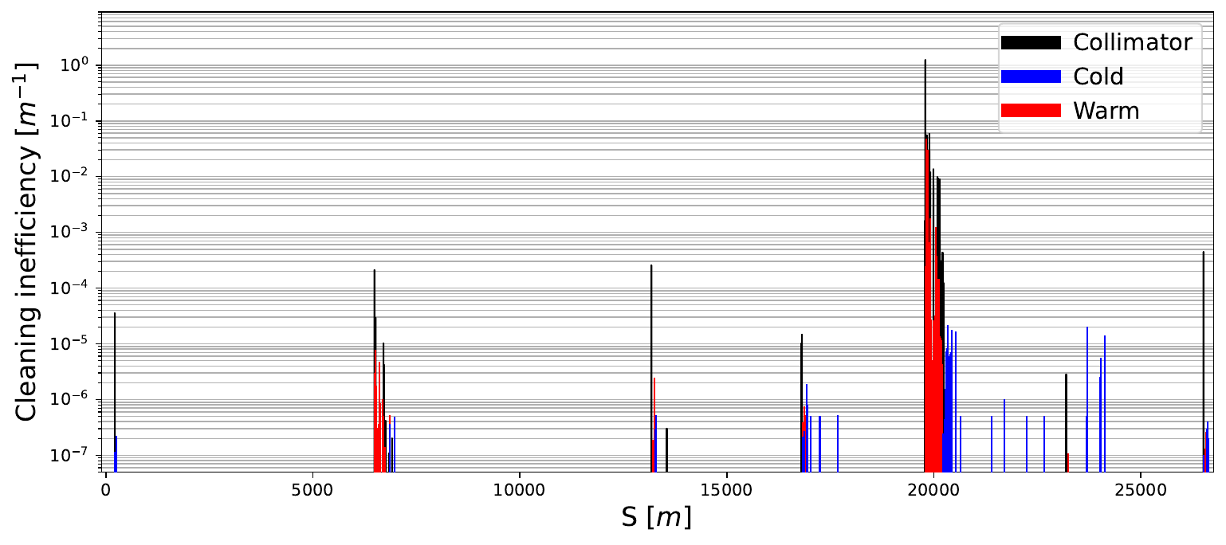
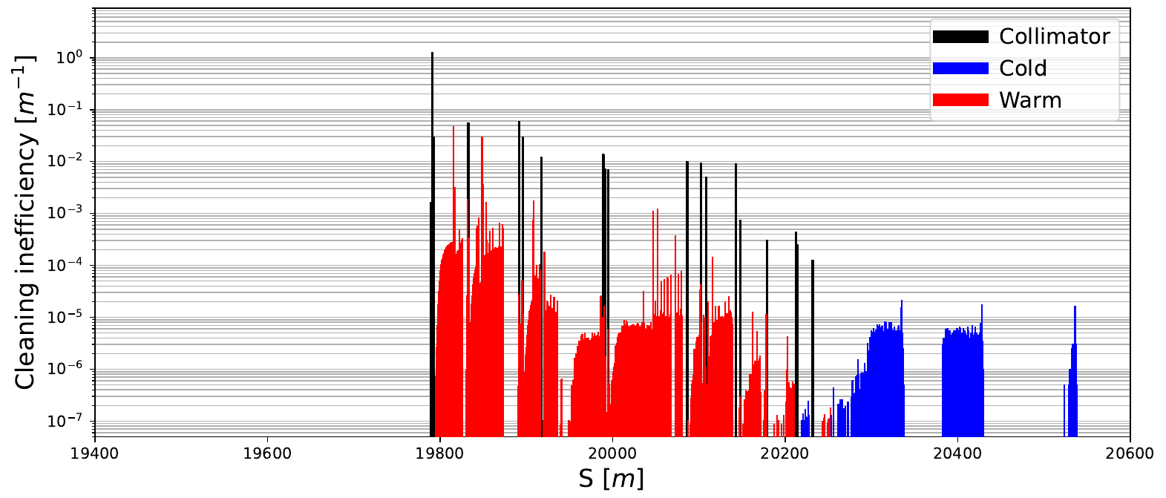
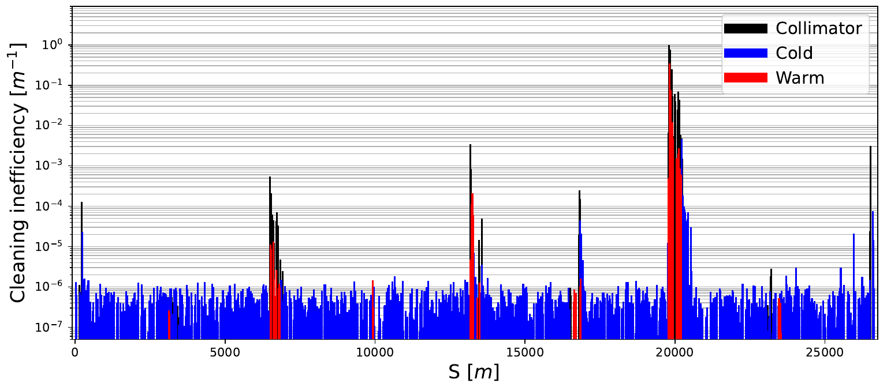
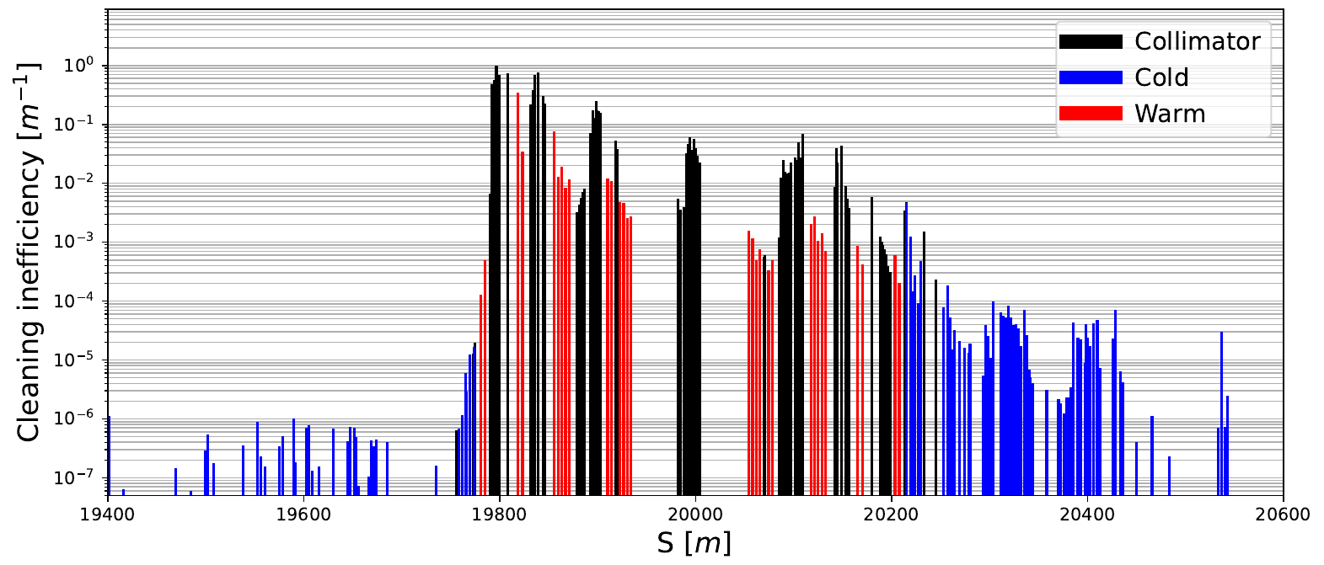
Example: benchmark of Xtrack-BDSIM at the LHC
full ring (27 km)
IR7 (betatron collimation)
Xtrack
BDSIM
Xtrack
BDSIM
measured
measured
B1H (protons in LHC), stable beams, XRP_IN, 6.8 TeV, β*=30 cm
From G. Broggi, Master’s thesis
15-09-2023
G. Broggi | Proposal for benchmarking collimation simulation tools at DAΦNE

Slide 8
Summary
Simulation tools to evaluate FCC-ee collimation performance are available
Essential in the collimation design phase to converge on an optimum performance
Benchmarked with existing tools (Sixtrack-FLUKA, K2, PyAT-BDSIM)
Benchmarked with data from proton machines (LHC, PS)
A more satisfacory benchmark with data from lepton machines is needed
DAΦNE could be an excellent candidate (SuperKEKB is also considered)
Benchmarked simulation tool useful to better understanding the machine: FCC-ee/DAΦNE win-win
For a successfull benchmark some ingredients are needed
Simulation model: accelerator parameters, accelerator optics, aperture model, BID database (geometry, opening, material, movable / not movable ?)
Experiment: losses on a BID*, reliable diagnostic system for particle losses, beam intensity monitor
*e.g., collimator, scraper, aperture restriction, …
15-09-2023
G. Broggi | Proposal for benchmarking collimation simulation tools at DAΦNE

Slide 9
Thank you!
15-09-2023
G. Broggi | Proposal for benchmarking collimation simulation tools at DAΦNE

