Slide 1



A GMVFN scheme for Z boson production associated with a heavy quark at hadron colliders
Marco Guzzi,
Kennesaw State University
with
P. Nadolsky, L. Reina, D. Wackeroth, K. Xie
QCD@work 2024: XXXI International Workshop on QCD Theory and Experiment. Trani, June 18–20, 2024. June the 18th, 2024.

Slide 2
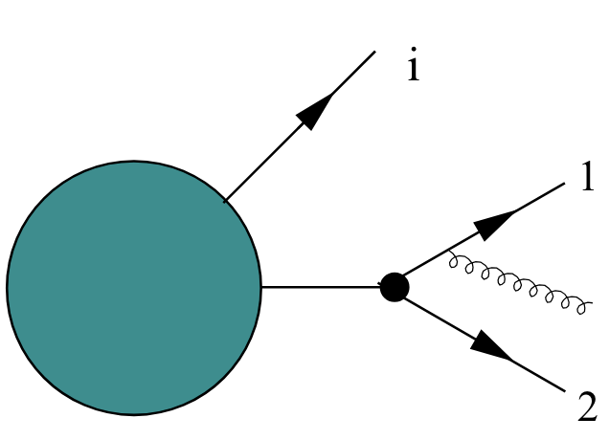
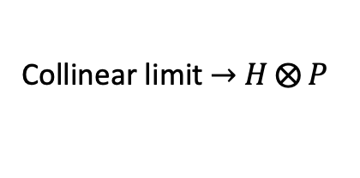


This talk discusses aspects of QCD factorization
$$H$$
$$P$$
Collinear limit$→$ $H⨂{P}$

Slide 3


This talk discusses aspects of QCD factorization. In particular, when collinear partons are heavy quarks (c,b,t)
$$H$$
$$A$$
Collinear limit$→$ $H⨂{A}$
Recipe/s needed to correctly account for heavy-flavor dynamics in DIS as well as in hadron-hadron collisions

Slide 4
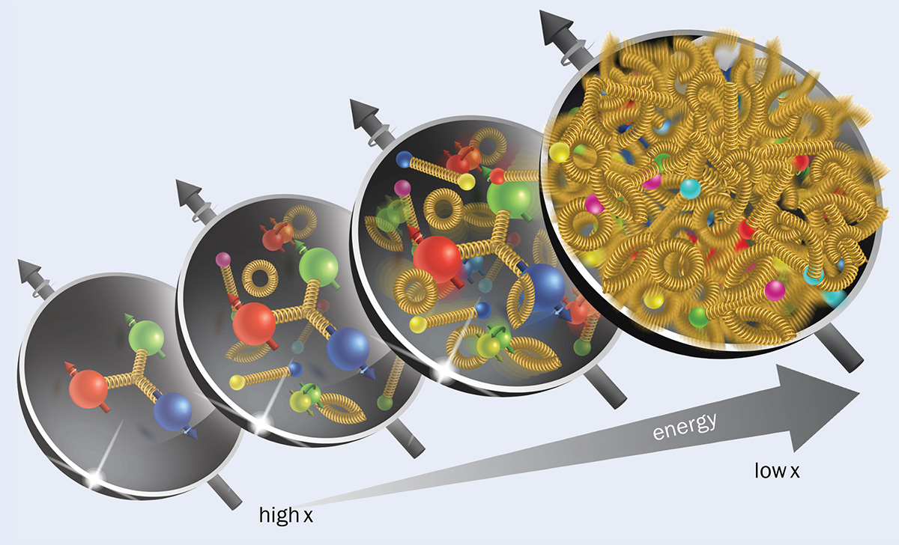

Motivations
Modern Parton Distribution Function (PDF) analyses: extend on wide range of collision energies. Sensitive to mass effects, e.g., phase space suppression, large radiative corrections to collinear $Q\overline{Q}$ production. Magnitude comparable to NNLO and N3LO corrections.
Natural to evaluate all fitted cross sections in a factorization (GMVFN) scheme, which assumes that the number of (nearly) massless quark flavors varies with energy, and at the same time includes dependence on heavy-quark masses in relevant kinematical regions.

Slide 5
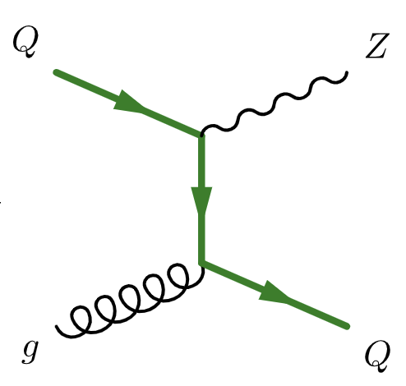
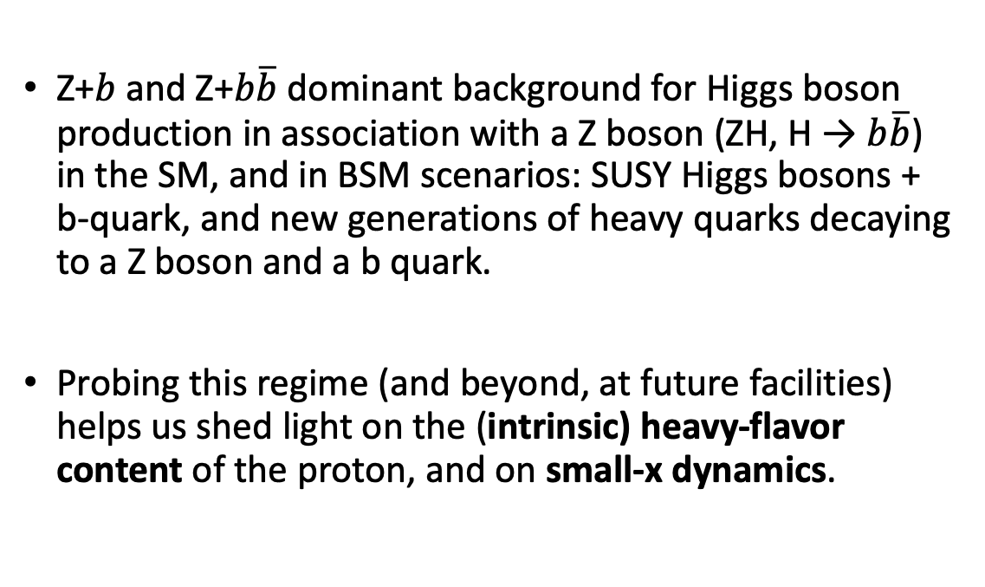
Motivations
Z+$b$ and Z+$b\overline{b}$ dominant background for Higgs boson production in association with a Z boson (ZH, H → $b\overline{b}$) in the SM, and in BSM scenarios: SUSY Higgs bosons + b-quark, and new generations of heavy quarks decaying to a Z boson and a b quark.
Probing this regime (and beyond, at future facilities) helps us shed light on the (intrinsic) heavy-flavor content of the proton, and on small-x dynamics.

Slide 6
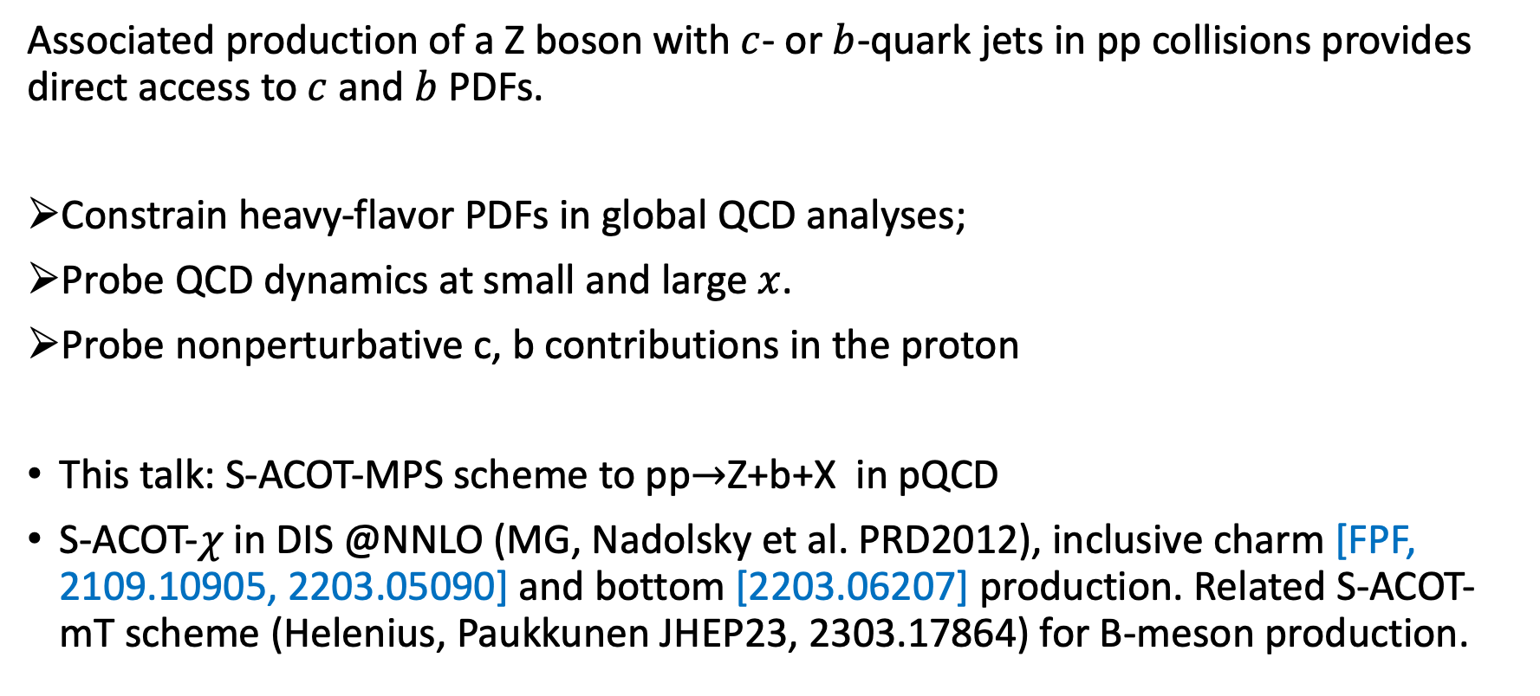
Goals
Simplify implementation of GMVFN schemes in (N)NLO QCD calculations
using the formalism of subtracted PDFs
Associated production of a Z boson with $c$- or $b$-quark jets in pp collisions provides direct access to $c$ and $b$ PDFs.
Constrain heavy-flavor PDFs in global QCD analyses;
Probe QCD dynamics at small and large $x$.
Probe nonperturbative c, b contributions in the proton
This talk: S-ACOT-MPS scheme to pp$→$Z+b+X in pQCD
S-ACOT-$χ$ in DIS @NNLO (MG, Nadolsky et al. PRD2012), inclusive charm [FPF, 2109.10905, 2203.05090] and bottom [2203.06207] production. Related S-ACOT-mT scheme (Helenius, Paukkunen JHEP23, 2303.17864) for B-meson production.

Slide 7
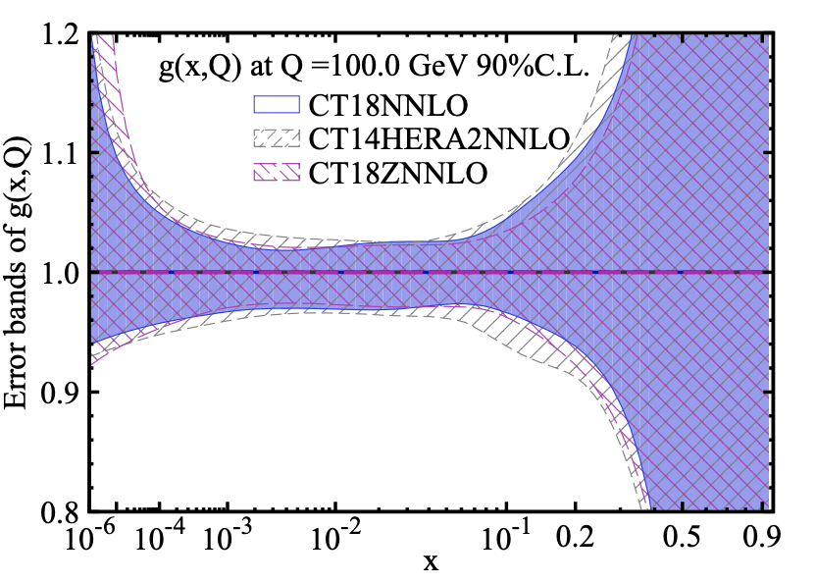
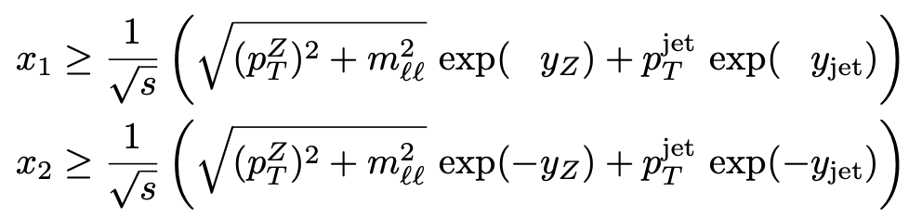
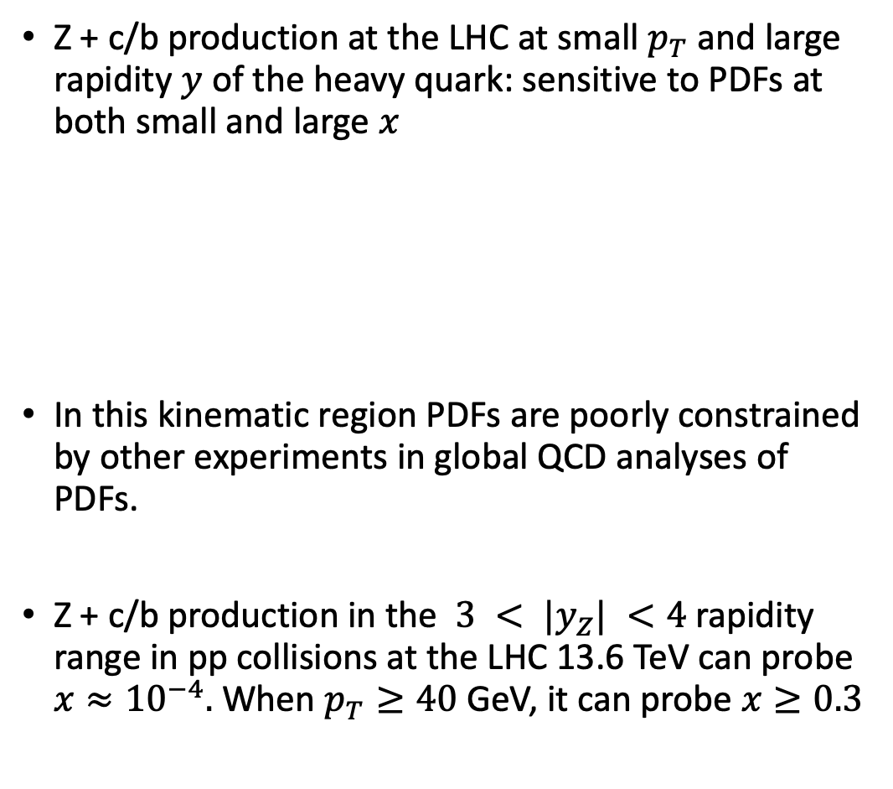

PDF Kinematics
Z + c/b production at the LHC at small $p_{T}$ and large rapidity $y$ of the heavy quark: sensitive to PDFs at both small and large $x$
In this kinematic region PDFs are poorly constrained by other experiments in global QCD analyses of PDFs.
Z + c/b production in the $3 < |y_{Z}| <4$rapidity range in pp collisions at the LHC 13.6 TeV can probe $x≈{10}^{−4}.$ When $p_{T}≥40$ GeV, it can probe $x≥0.3$
The CT18 gluon PDF Phys.Rev.D 103 (2021).
Small- and large-$x$ regions have wide uncertainty bands.
(See also: The PDF4LHC21 combination of global PDF fits
for the LHC Run III, 2203.05506 [hep-ph].)

Slide 8
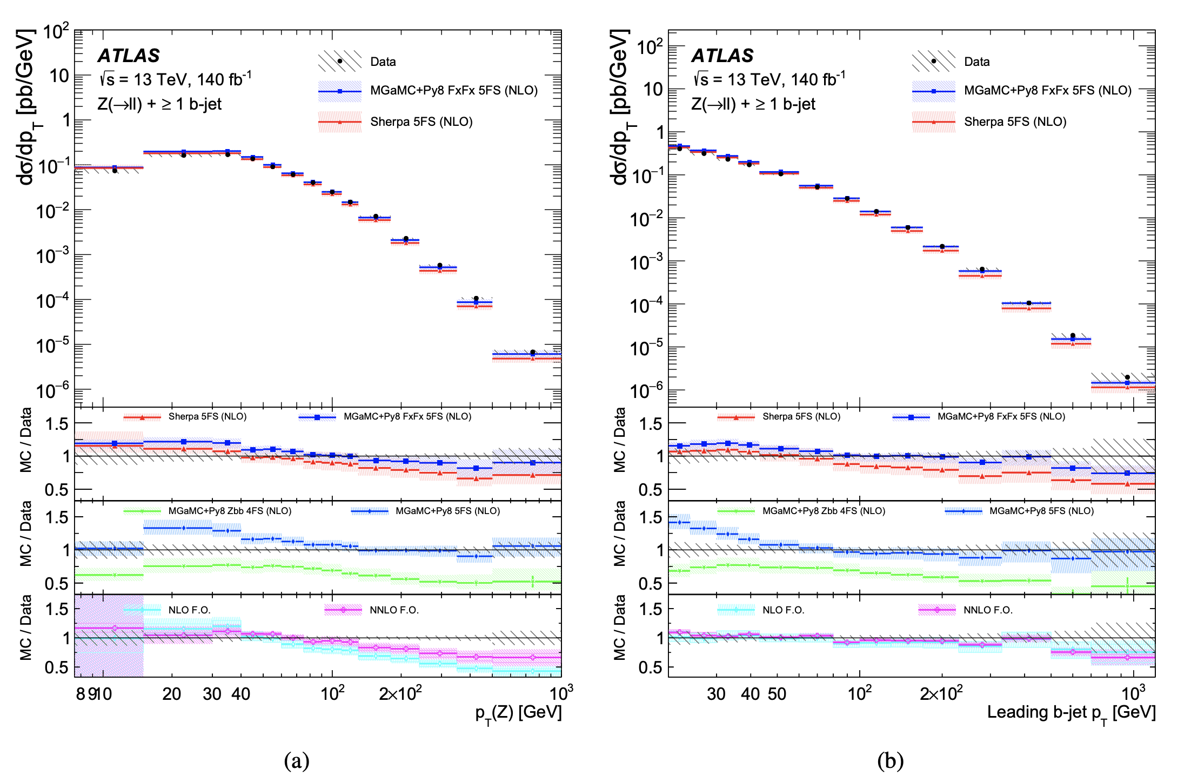
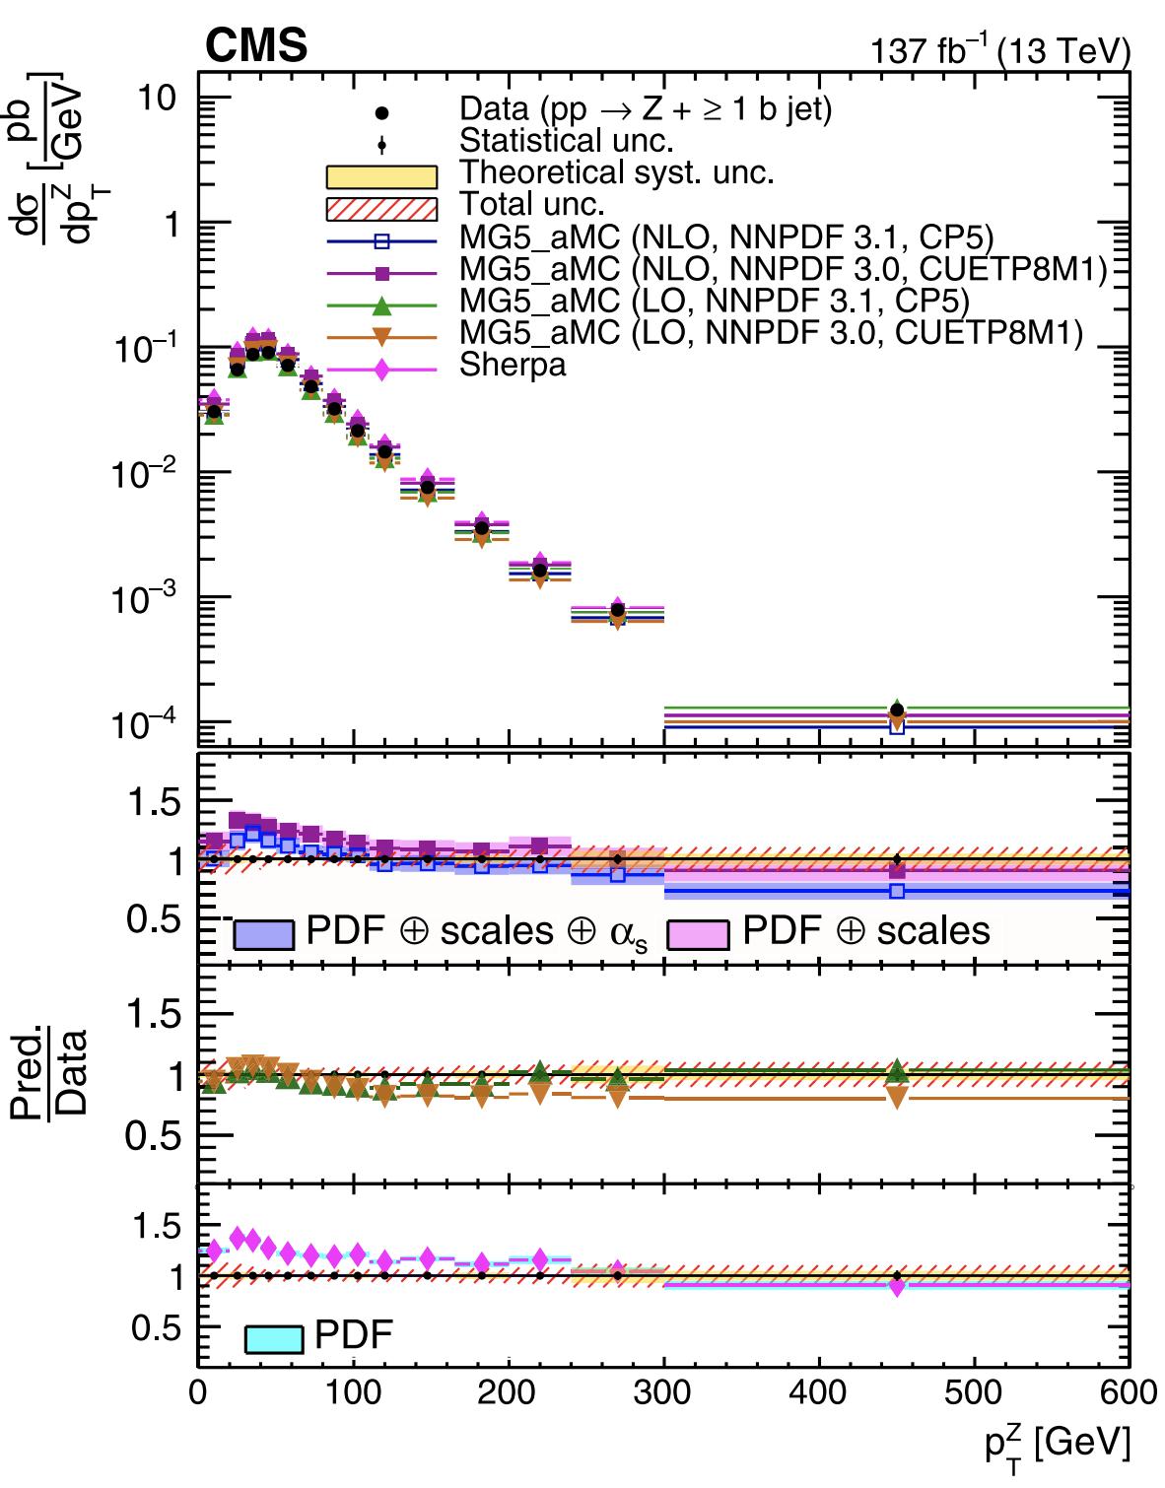
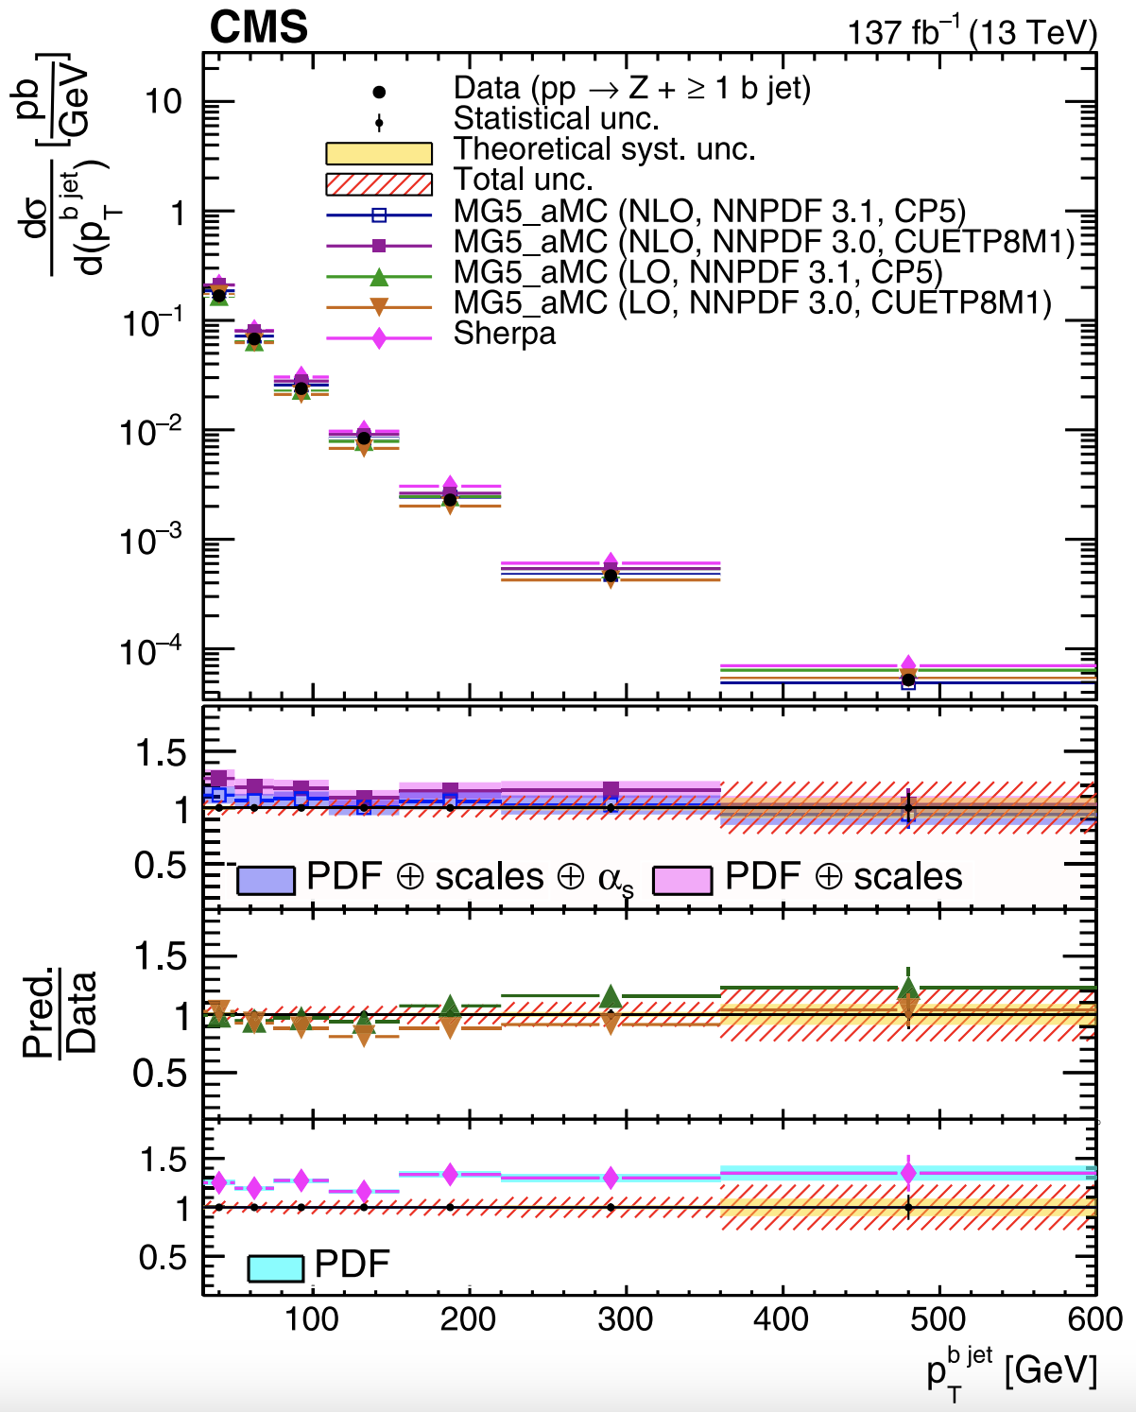

Large inflow of new measurements @LHC
Precise measurements Z + c/b-jets available from the ATLAS, CMS and LHCb collaborations at the LHC
ATLAS13 TeV, Z+b-jet, 140 ${fb}^{−1}$ 2403.15093
CMS13 TeV, Z+b-jet, 137 ${fb}^{−1}$2112.09659 PRD 105 (2022)

Slide 9
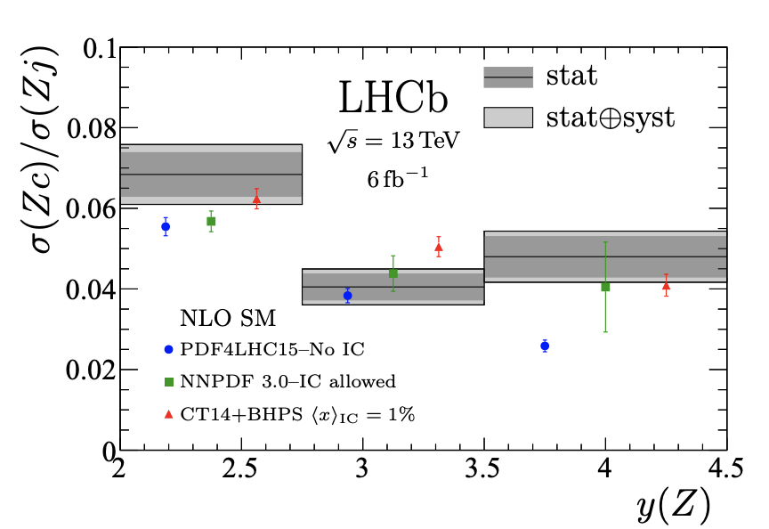
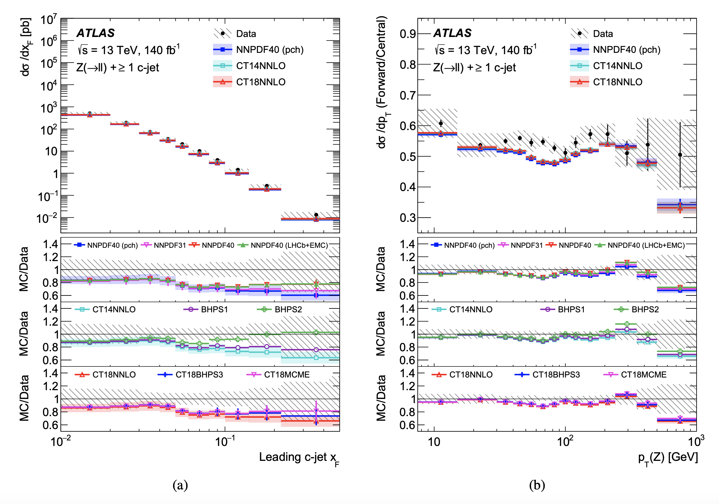

Probing Heavy Quarks in the proton
LHCb 13 TeV, arXiv:2109.08084, PRL128 (2022)
Played/will play an important role in recent analyses of IC:
-NNPDF coll., Nature 2022,
-CT18 PLB 2023, 2211.01387
-NNPDF coll., 2311.00743
ATLAS13 TeV, Z+c-jet, 140 ${fb}^{−1}$ arXiv:2403.15093

Slide 10
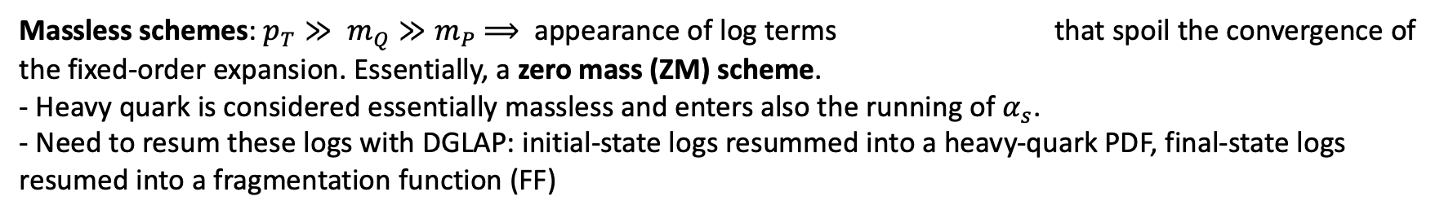
GMVN schemes in a nutshell
Heavy-flavor production dynamics is nontrivial due to the interplay of massless and massive schemes which
are different ways of organizing the perturbation series
Massive Schemes: final-state HQ with $p_{T}≤m_{Q}⟹$ $p_{T}$-spectrum can be obtained in the fixed-flavor number (FFN) scheme.
- No heavy-quark PDF in the proton. Heavy flavors generated as massive final states. $m_{Q}$is an infrared cut-off.
- Power terms ${\left(p_{T}^{2}/m_{Q}^{2}\right)}^{p}$ are correctly accounted for in the perturbative series.
Massless schemes: $p_{T}≫ m_{Q}≫m_{P}$ $⟹$ appearance of log terms that spoil the convergence of the fixed-order expansion. Essentially, a zero mass (ZM) scheme.
- Heavy quark is considered essentially massless and enters also the running of $α_{s}$.
- Need to resum these logs with DGLAP: initial-state logs resummed into a heavy-quark PDF, final-state logs resumed into a fragmentation function (FF)
Interpolating (GMVFN) schemes: composite schemes that retain key mass dependence and efficiently
resum collinear logs, so that they combine the FFN and ZM schemes together. They are crucial for:
a correct treatment of heavy flavors in DIS and PP,
accurate predictions of key scattering rates at the LHC,
global analyses to determine proton PDFs.

Slide 11
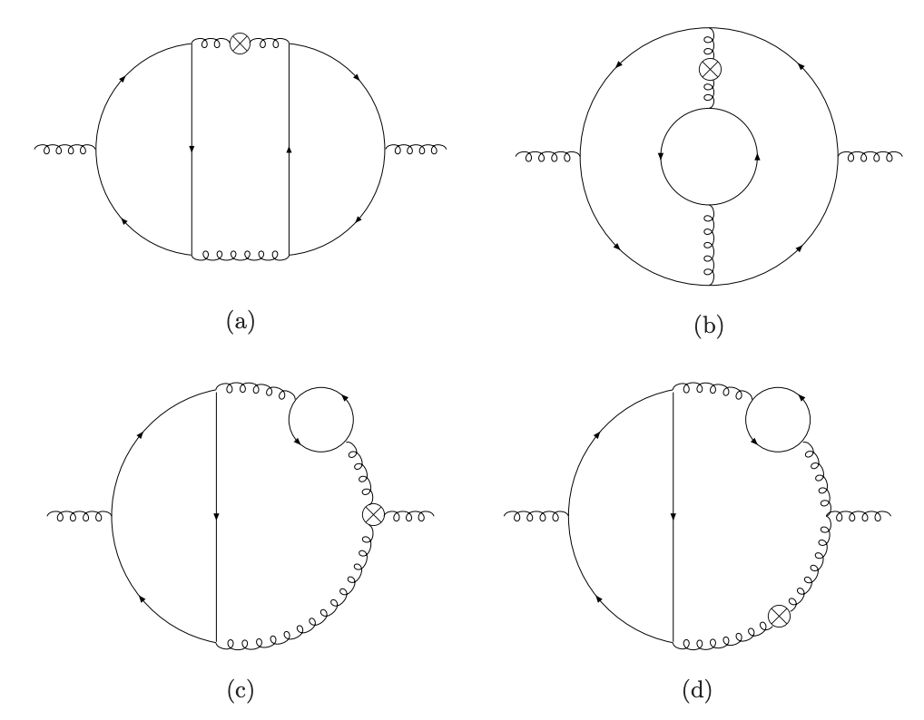
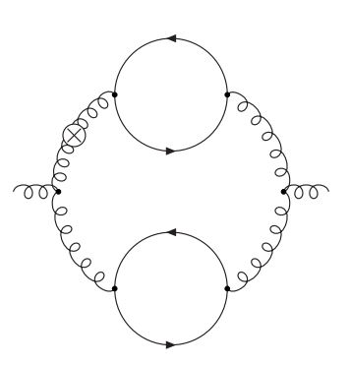
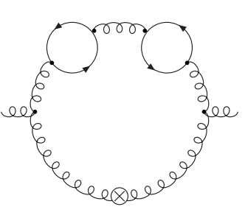
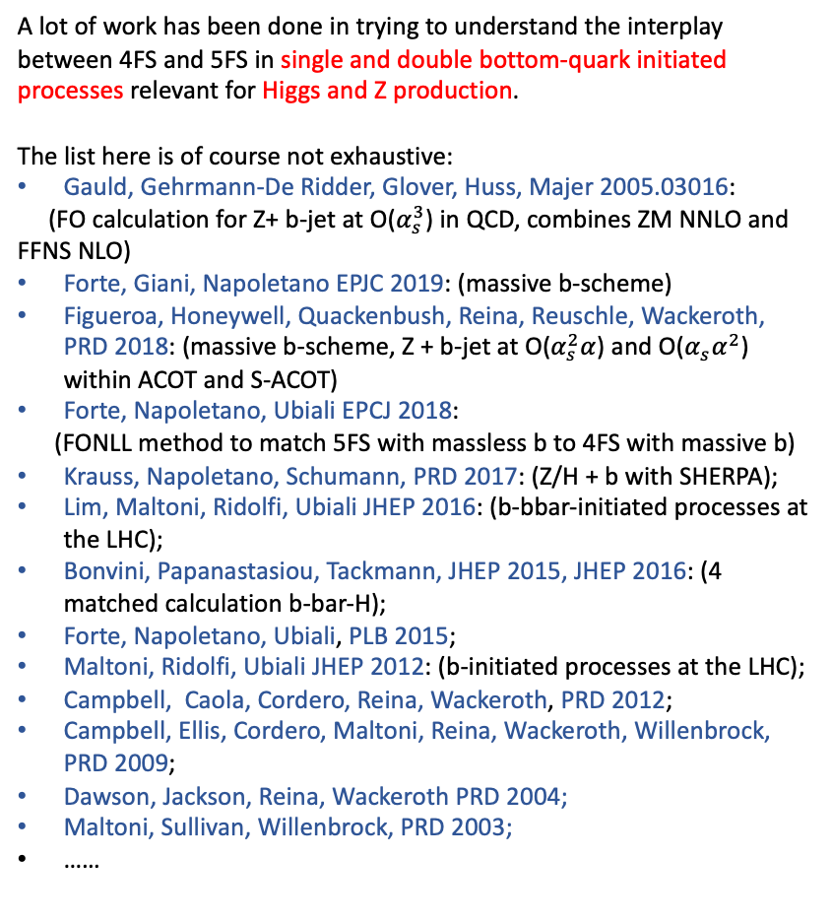
Matching GM schemes in Z/H+b
Progress on OMEs calculations
A lot of work has been done in trying to understand the interplay between 4FS and 5FS in single and double bottom-quark initiated processes relevant for Higgs and Z production.
The list here is of course not exhaustive:
Gauld, Gehrmann-De Ridder, Glover, Huss, Majer 2005.03016:
(FO calculation for Z+ b-jet at O($α_{s}^{3}$) in QCD, combines ZM NNLO and FFNS NLO)
Forte, Giani, Napoletano EPJC 2019: (massive b-scheme)
Figueroa, Honeywell, Quackenbush, Reina, Reuschle, Wackeroth, PRD 2018: (massive b-scheme, Z + b-jet at O($α_{s}^{2}α$) and O($α_{s}α^{2}$) within ACOT and S-ACOT)
Forte, Napoletano, Ubiali EPCJ 2018:
(FONLL method to match 5FS with massless b to 4FS with massive b)
Krauss, Napoletano, Schumann, PRD 2017: (Z/H + b with SHERPA);
Lim, Maltoni, Ridolfi, Ubiali JHEP 2016: (b-bbar-initiated processes at the LHC);
Bonvini, Papanastasiou, Tackmann, JHEP 2015, JHEP 2016: (4 matched calculation b-bar-H);
Forte, Napoletano, Ubiali, PLB 2015;
Maltoni, Ridolfi, Ubiali JHEP 2012: (b-initiated processes at the LHC);
Campbell, Caola, Cordero, Reina, Wackeroth, PRD 2012;
Campbell, Ellis, Cordero, Maltoni, Reina, Wackeroth, Willenbrock, PRD 2009;
Dawson, Jackson, Reina, Wackeroth PRD 2004;
Maltoni, Sullivan, Willenbrock, PRD 2003;
……
J. Ablinger, A. Behring, J. Blumlein, A. De Freitas, et al., NPB(2024), arXiv:2311.00644.
J. Ablinger, A. Behring, J. Blumlein, A. De Freitas, et al., JHEP(2022), arXiv:2211.05462.
J. Ablinger, A. Behring, J. Blumlein, A. De Freitas, et al., NPB(2014), arXiv:1409.1135
J. Ablinger, J. Blumlein, A. De Freitas, A. Hasselhuhn, et al., NPB(2014), arXiv:1402.0359
J. Blumlein, J. Ablinger, A. Behring, A. De Freitas, et al., PoS, QCDEV2017(2017), arXiv:1711.07957
A. Behring, I. Bierenbaum, J. Blumlein, A. De Freitas, et al., EPJC(2014), arXiv:1403.6356.
J. Ablinger, J. Blumlein, A. De Freitas, A. Hasselhuhn, et al., NPB(2014), arXiv:1405.4259.
J. Ablinger, A. Behring, J. Blumlein, et al, NPB(2014), arXiv:1406.4654.
J. Ablinger, J. Blumlein, S. Klein, et al., NPB(2011), arXiv:1008.3347.
I. Bierenbaum, J. Blumlein, and S. Klein, PLB(2009), arXiv:0901.0669.
I. Bierenbaum, J. Blumlein, S. Klein, and C. Schneider, NPB(2008), arXiv:0803.0273.
I. Bierenbaum, J. Blumlein, and S. Klein, NPB(2009), arXiv:0904.3563.

Slide 12

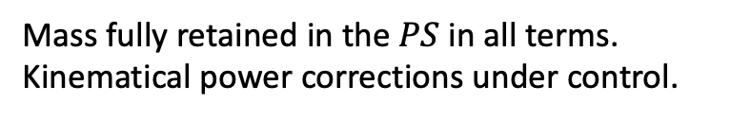
Main idea behind S-ACOT-MPS (massive phase space)
``Residual FE’’
FC = Flavor creation contributions with full mass dependence
FE = Flavor excitation contribution with approximate mass dependence
(available from public codes)
Mass fully retained in the $PS$ in all terms.
Kinematical power corrections under control.
Subtraction well defined at the quark mass threshold
allows us to get (FE-Subtraction ) in one step
FE and Subtraction facilitated by introducing residual PDF:
Subtracted and Residual PDFs are provided in the form of LHAPDF
grids for phenomenology applications: https://sacotmps.hepforge.org/downloads?f=PDFs
at LO
More details in K. Xie PhD Thesis: “Massive elementary particles in the standard model and its supersymmetric triplet higgs extension.”
https://scholar.smu.edu/hum_sci_physics_etds/7, 2019.

Slide 13
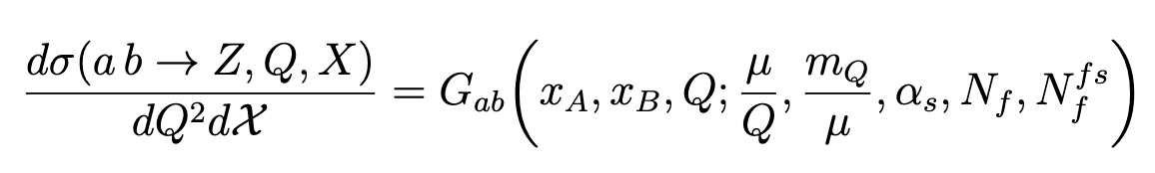
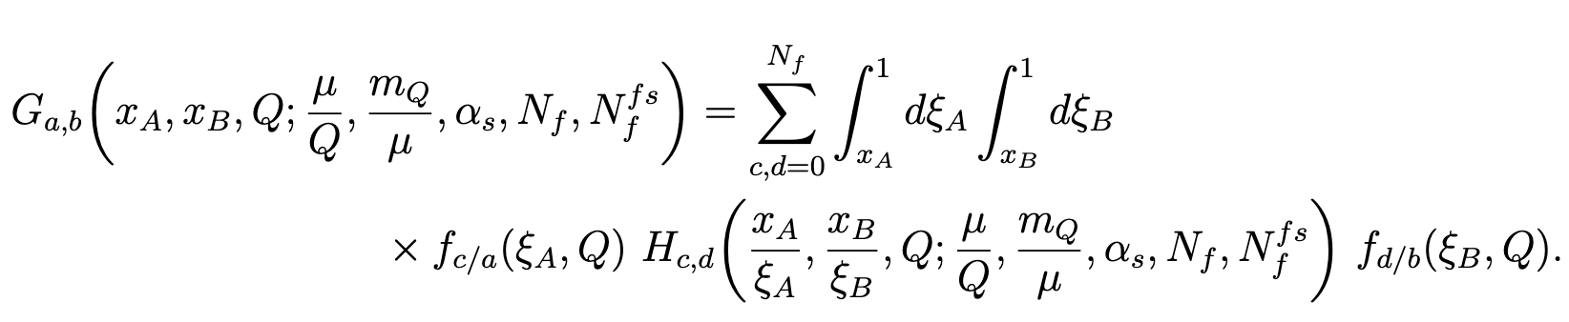

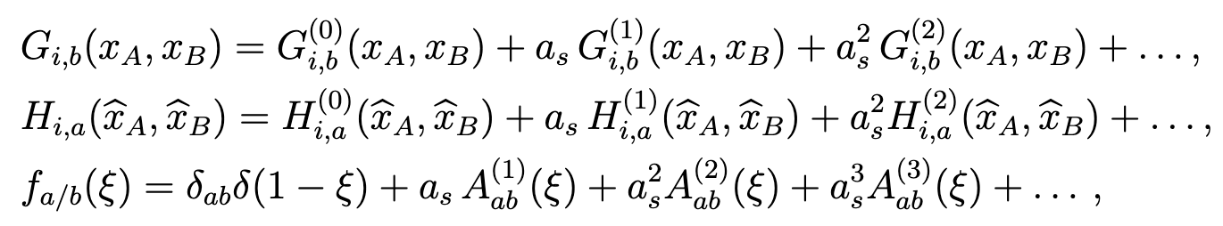



S-ACOT-MPS Theory framework
The differential cross section for parton a + parton b → Z + Q + X with a, b having zero mass can be written as follows
The factorization formula can be written as
Perturbative expansion of terms leads to
OME’s
For $g→Q\overline{Q}$

Slide 14
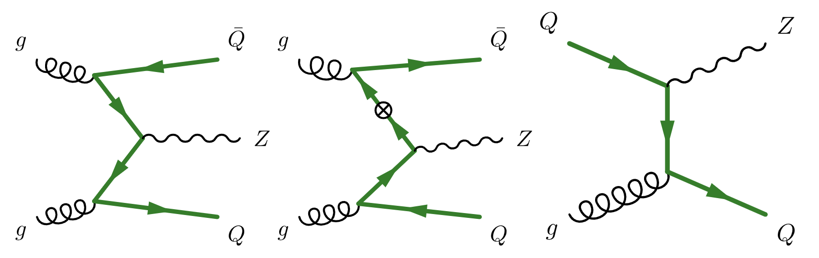

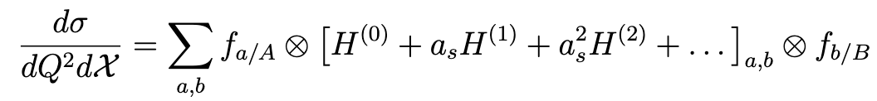
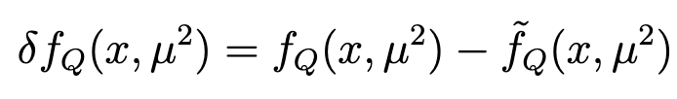


S-ACOT-MPS cancellation pattern at the lowest order
(for $a+b→Z+b+X$ this is $O(α_{s}^{2})$)
FC term
FE term
$$0$$
Residual PDF
Subtracted PDF at LO
Subtracted and Residual PDFs are provided in the form of LHAPDF grids for phenomenology applications:
https://sacotmps.hepforge.org/downloads?f=PDFs

Slide 15
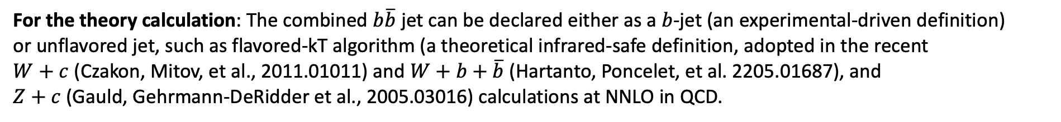
MZb distribution at the lowest order
PRELIMINARY
PRELIMINARY
Cancellation between the various terms is clearly visible.
For the theory calculation: The combined $b\overline{b}$ jet can be declared either as a $b$-jet (an experimental-driven definition)
or unflavored jet, such as flavored-kT algorithm (a theoretical infrared-safe definition, adopted in the recent
$W+c$ (Czakon, Mitov, et al., 2011.01011) and $W+b+\overline{b}$ (Hartanto, Poncelet, et al. 2205.01687), and
$Z+c$ (Gauld, Gehrmann-DeRidder et al., 2005.03016) calculations at NNLO in QCD.

Slide 16
pT of b and pT of Z at lowest order
Matching of terms
affected by PS
integration and cuts
PRELIMINARY
PRELIMINARY
PRELIMINARY
PRELIMINARY

Slide 17
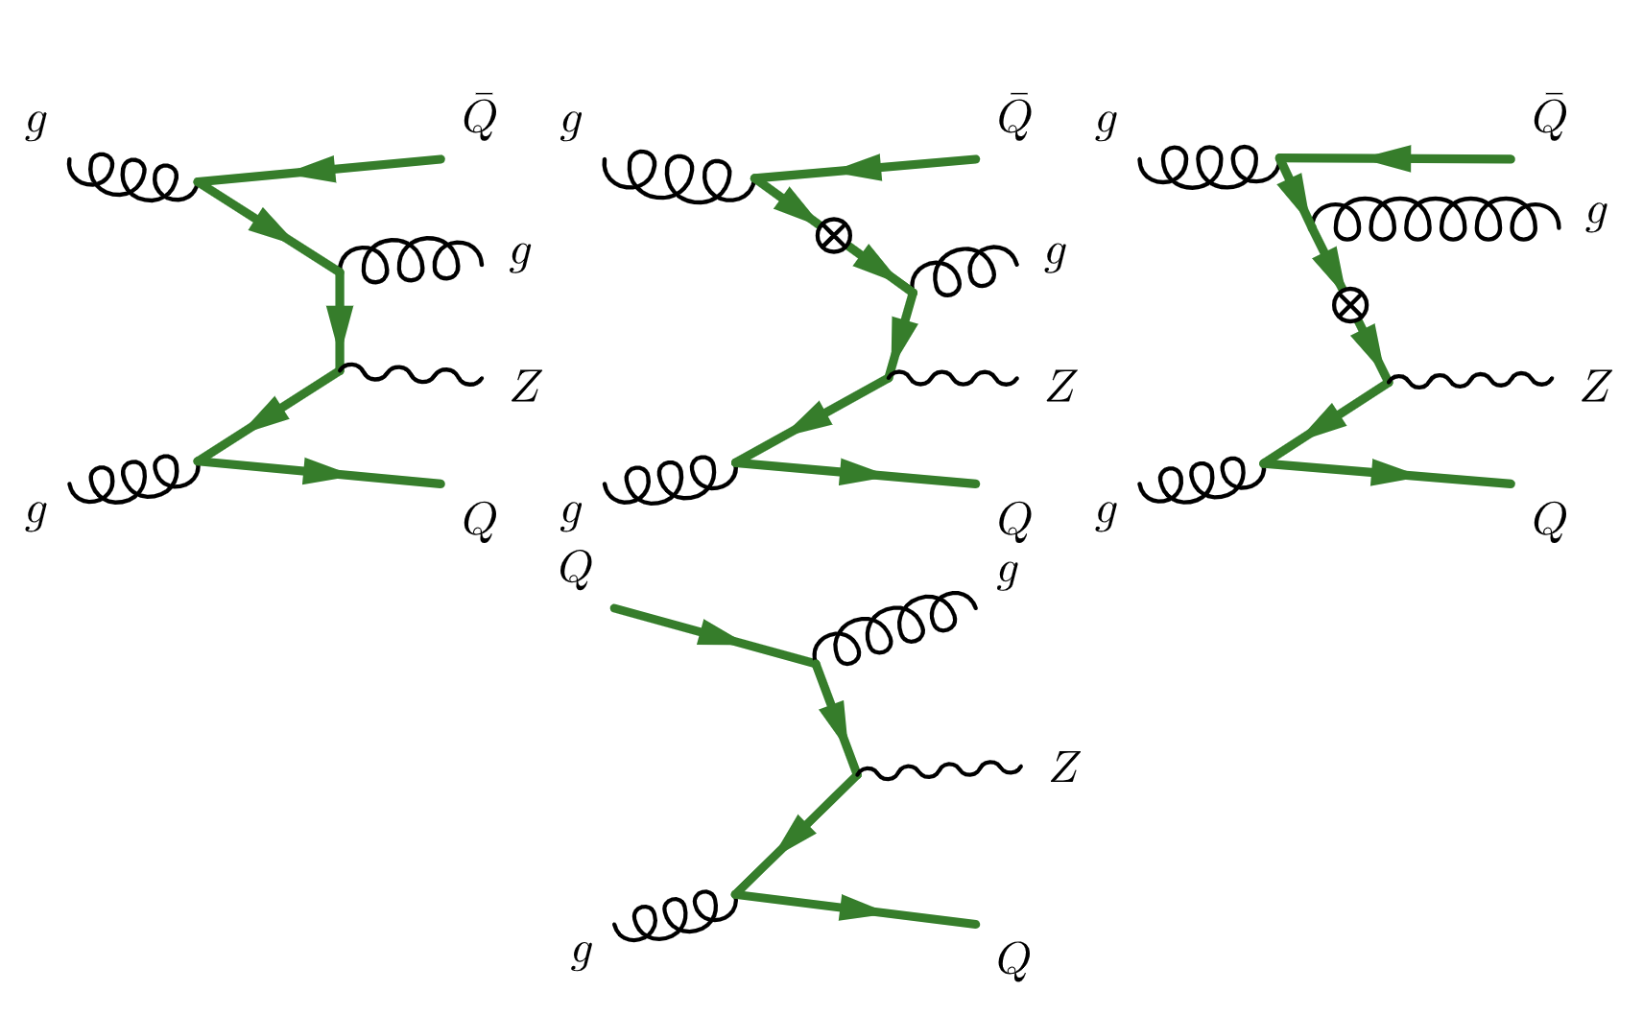
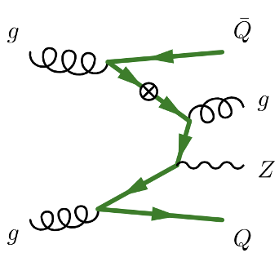
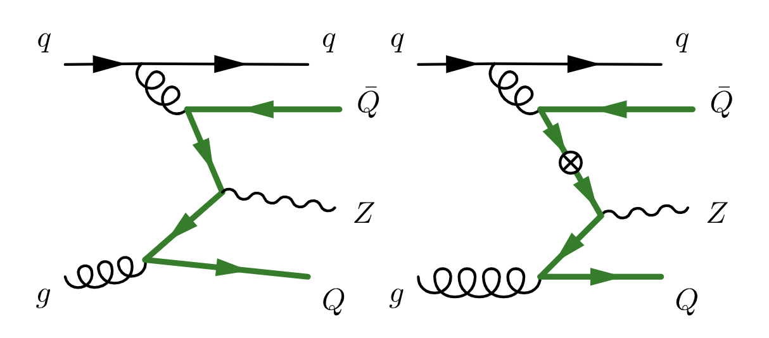


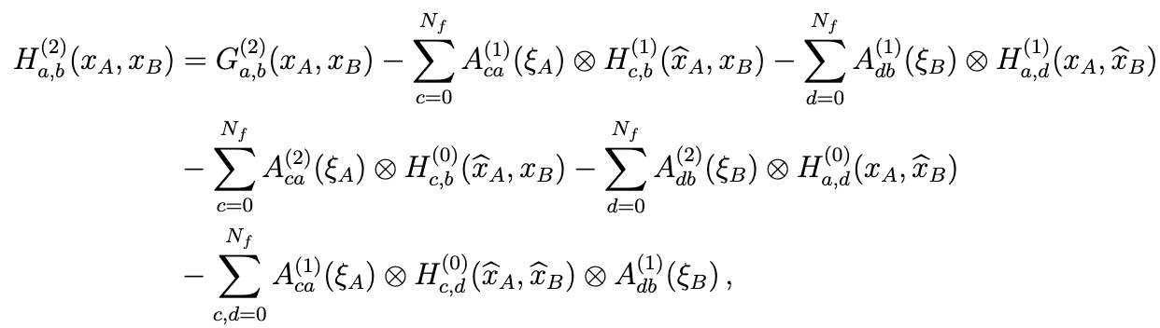


S-ACOT-MPS cancellation pattern at NLO
(for $a+b→Z+b+X$ this is $O(α_{s}^{3})$)
Subtracted PDFs at NLO
$+ (q→$ $\overline{q})$

Slide 18
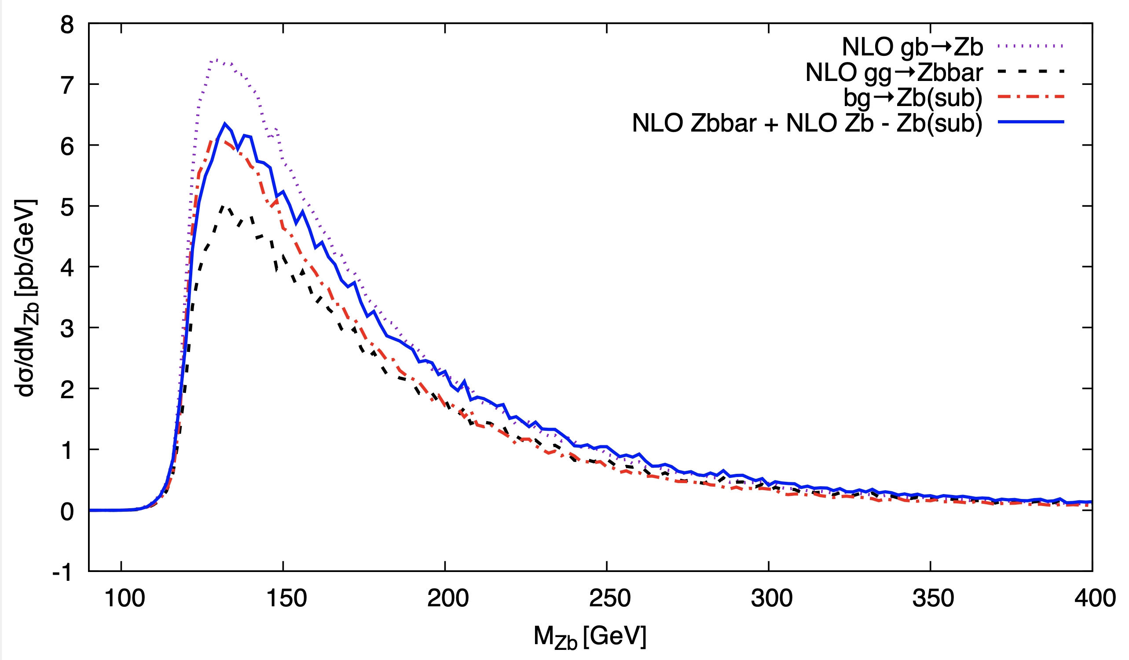
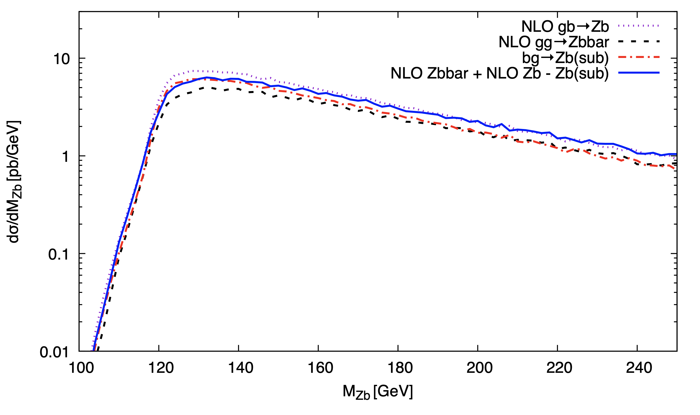


MZb distribution at NLO
Theory predictions for Z+at least one b jet obtained with an in-house code +
NLOX for virtual [Figeroa, et al. CPC(2022) arXiv:2101.01305; Honeywell, et al. CPC(2020) arXiv: 1812.11925]
$$N_{f}=5$$
PRELIMINARY
PRELIMINARY
$$N_{f}=4$$

Slide 19
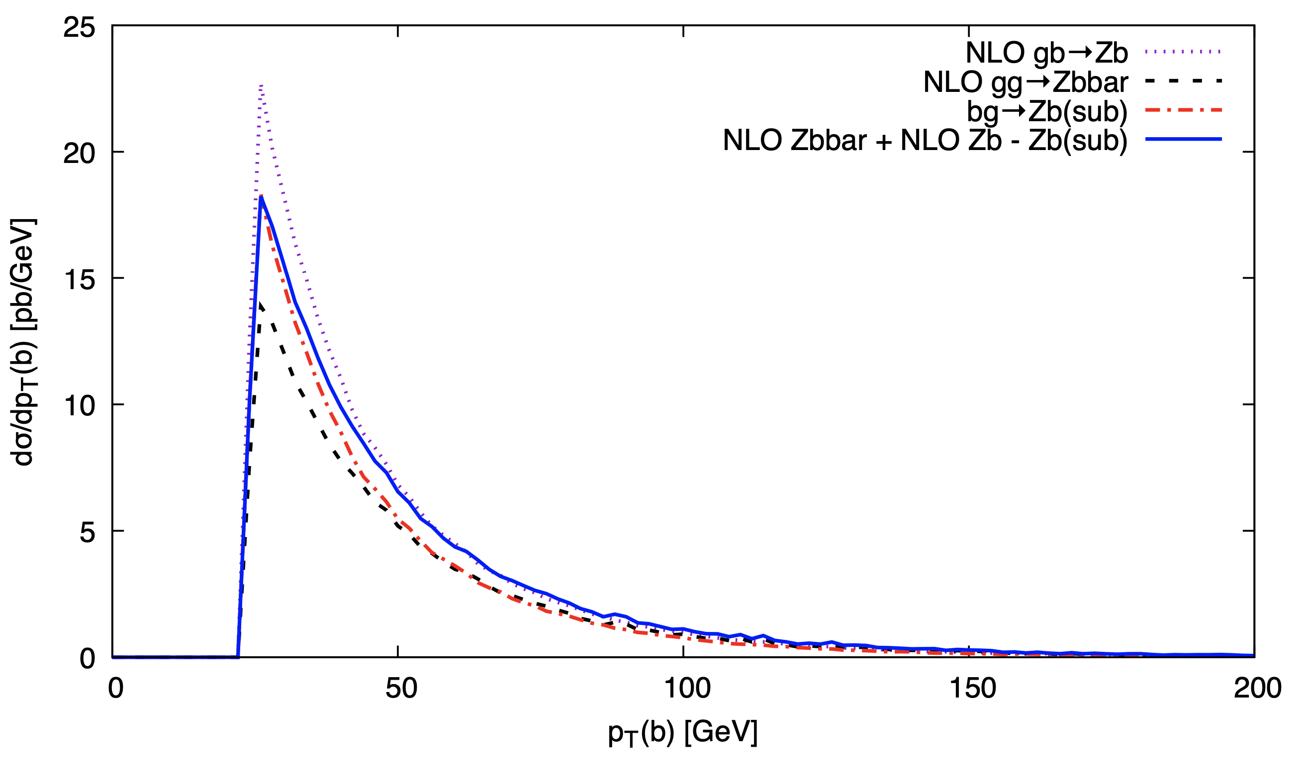
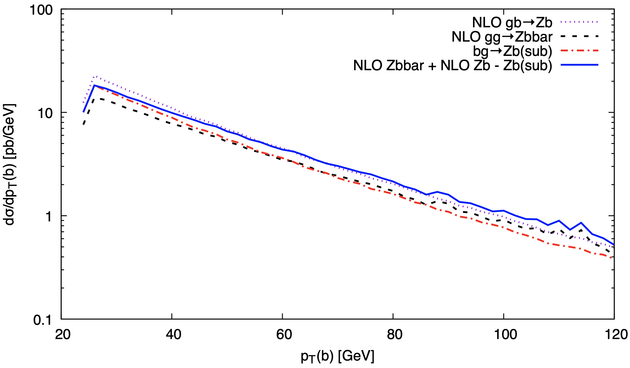
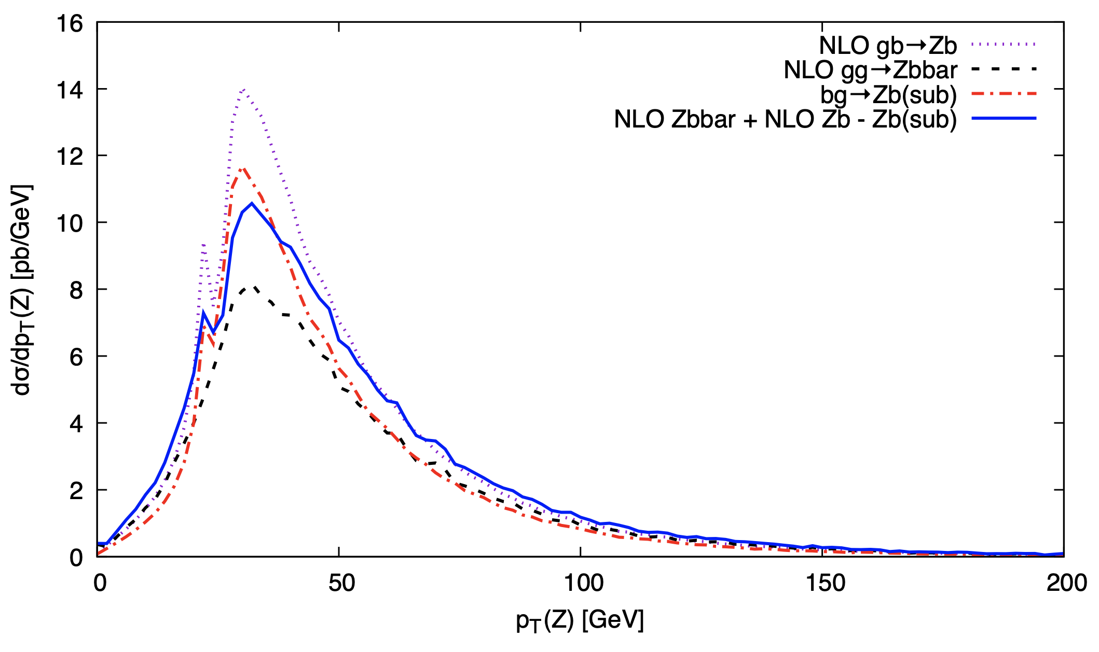
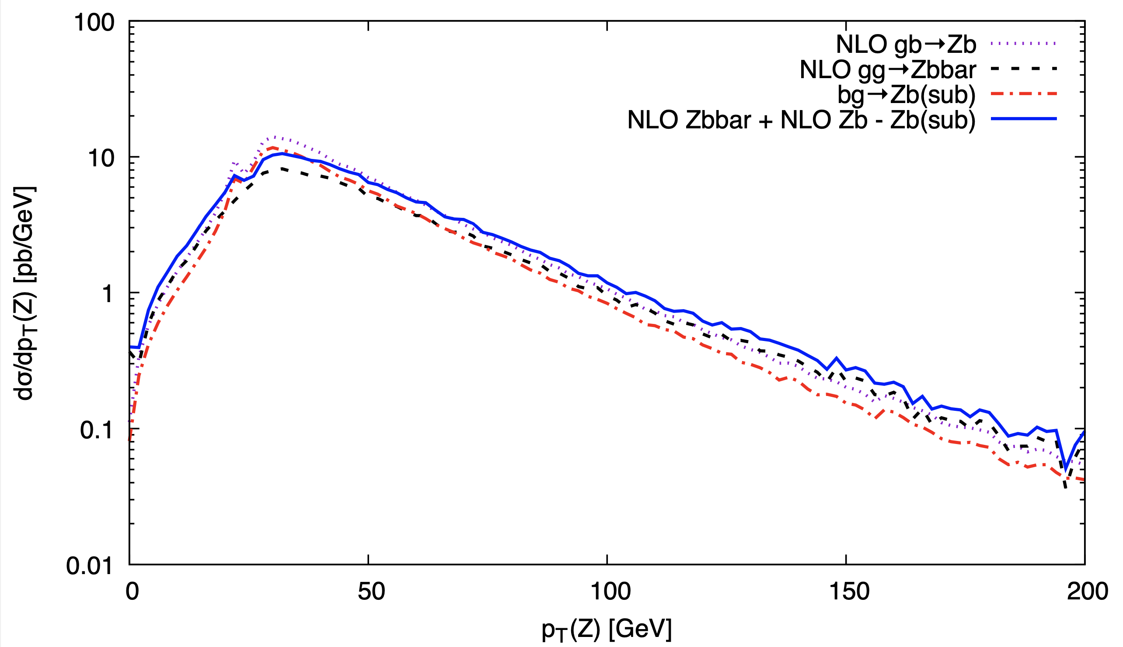
pT of b and pT of Z at NLO
Theory predictions for Z+at least one b jet obtained with an in-house code +
NLOX for virtual [Figeroa, et al. CPC(2022) arXiv:2101.01305; Honeywell, et al. CPC(2020) arXiv: 1812.11925]
Again, matching of terms
affected by PS
integration and cuts
PRELIMINARY
PRELIMINARY
MC errors will further
be reduced
PRELIMINARY
PRELIMINARY

Slide 20
Concluding remarks
We applied S-ACOT-MPS at NLO to Z+Q production in pp collisions at the LHC
S-ACOT-MPS developed at NLO: used to describe Z+Q production differentially
Technically possible to generate predictions within the S-ACOT-MPS scheme at NNLO with K-factors (NNLO/NLO) at hand.
Direct access to c/b-PDF: Important to constrain heavy-flavor PDFs.
Subtracted PDFs are provided in the form of LHAPDF grids to allow users for multiple pheno applications
Work toward simplifying implementation of GMVFN schemes in (N)NLO QCD calculations using the formalism of subtracted PDFs

