Slide 1
UPDAte on The mechanical structure of the drift chamber for the IDEA experiment at FCC-ee
Francesco Massimiliano Procacci
On behalf of INFN of Bari and Lecce

Slide 2
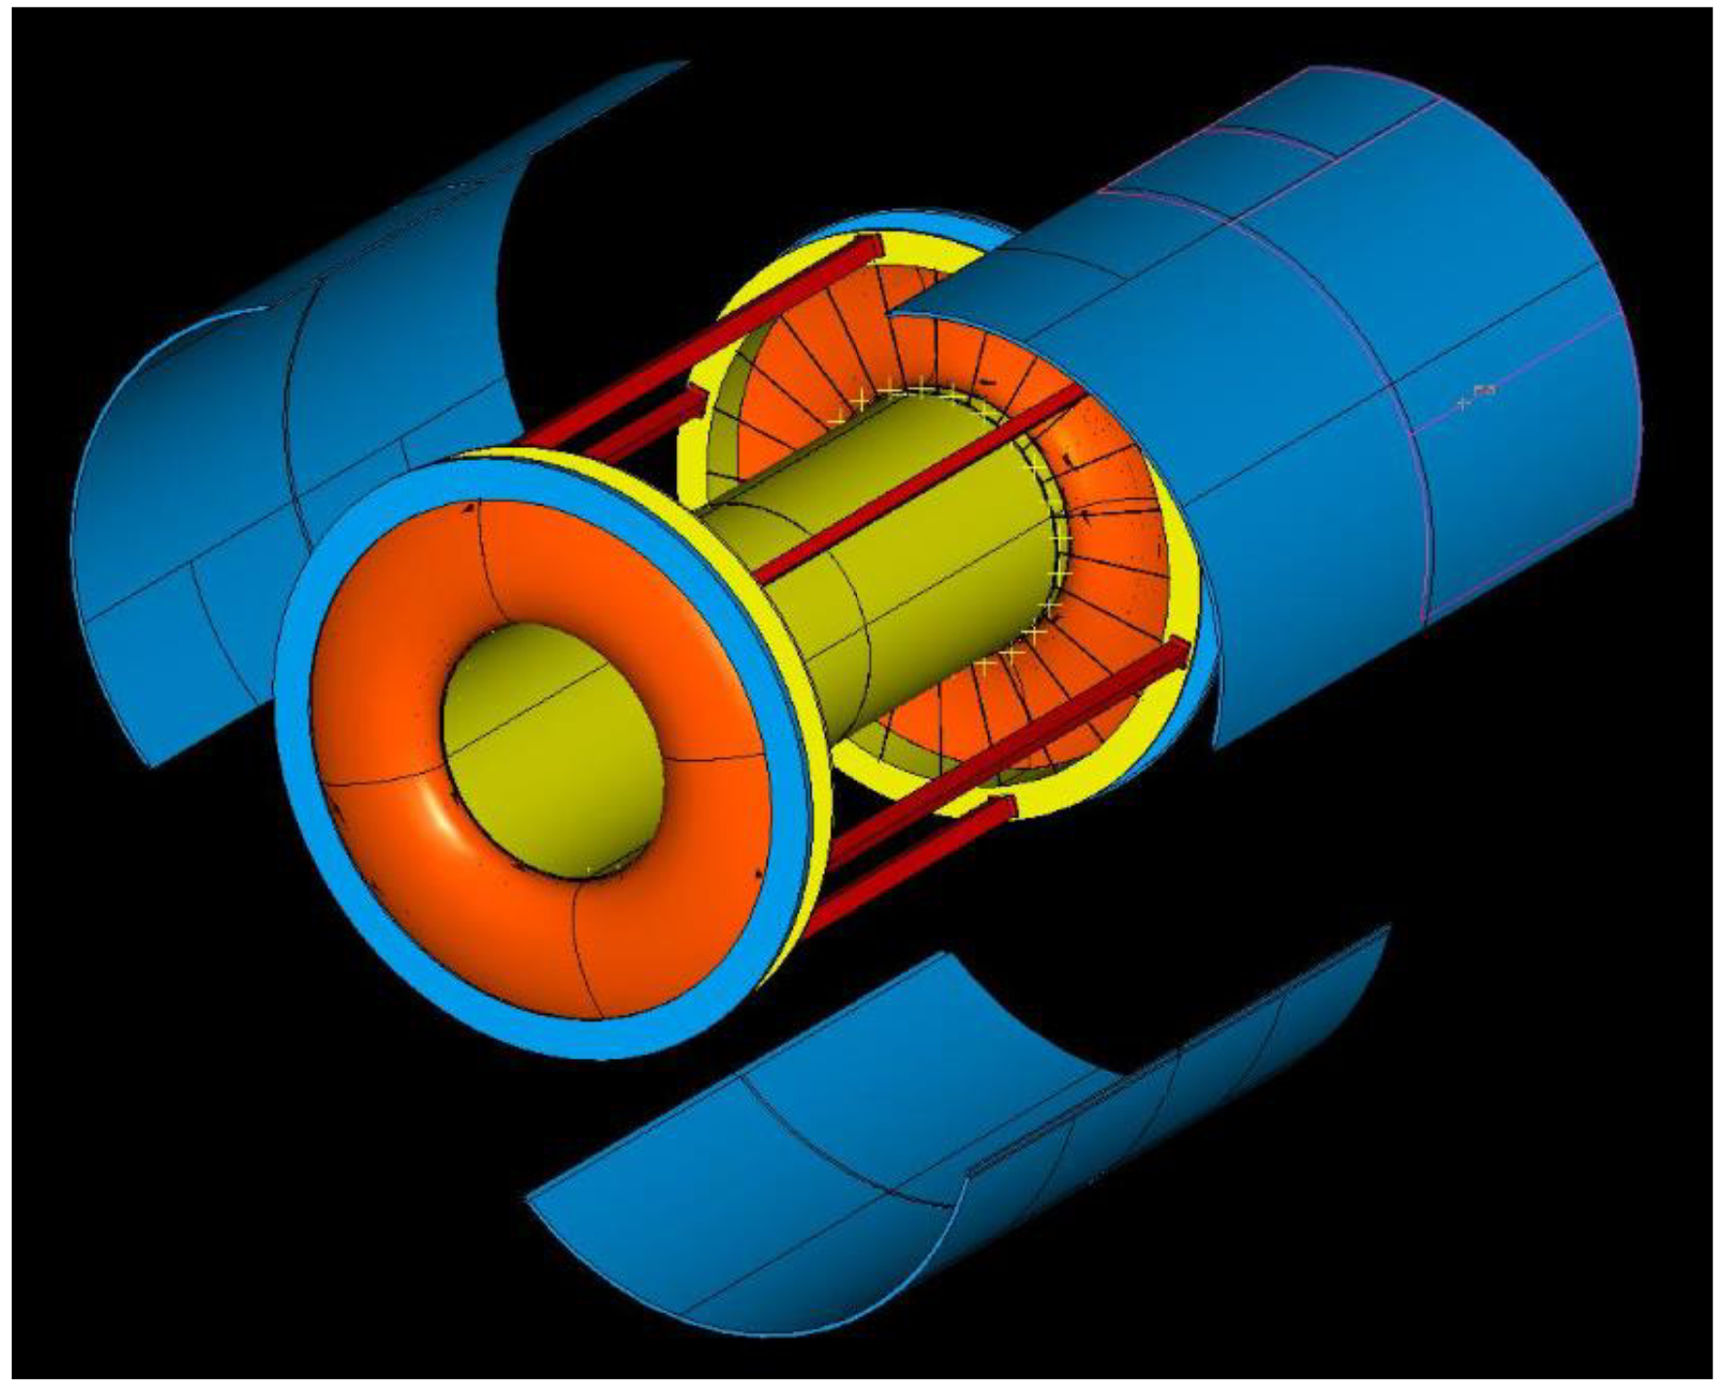
Drift chamber details
Low mass cylindrical with 2T solenoid field and a gas mixture He 90% - iC₄H₁₀ 10%
Inner radius R_{in} = 35 cm, outer radius R_{out} = 200 cm, length L = 400 cm
112 co-axial layers, at alternating-sign stereo angles, arranged in 24 identical azimuthal sectors
343968 wires in total:
56448 sense wires – 20 µm diameter W(Au)
229056 field wires – 40 µm diameter Al(ag)
58464 field and guard wires – 50 µm diameter Al(ag)
Drift length ~ 1 cm, drift time ~150 ns, σ_{xy} < 100 µm σ_{z} < 1 mm
Thin wires → increase the chamber granularity → reducing both multiple scattering and the overall tension on the end plates
Cluster counting allows to reach dN_{c}/dx resolution < 3% for particle identification

Slide 3
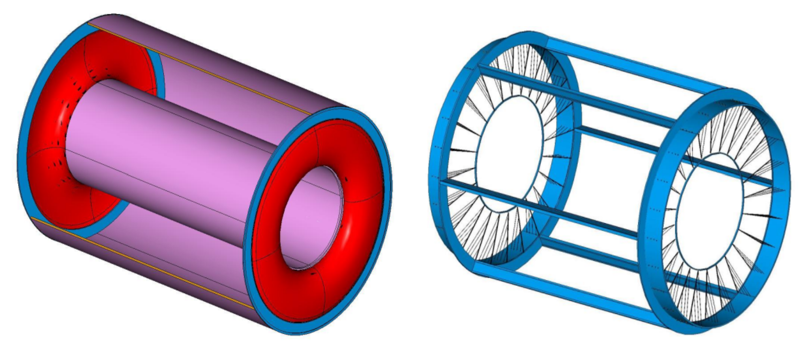
Drift chamber: separation of functions
Gas containment
Gas vessel can freely deform without affecting the internal wire position and mechanical tension.
Wire cage
Wire support structure not subject to differential pressure can be light and feed-through-less.

Slide 4
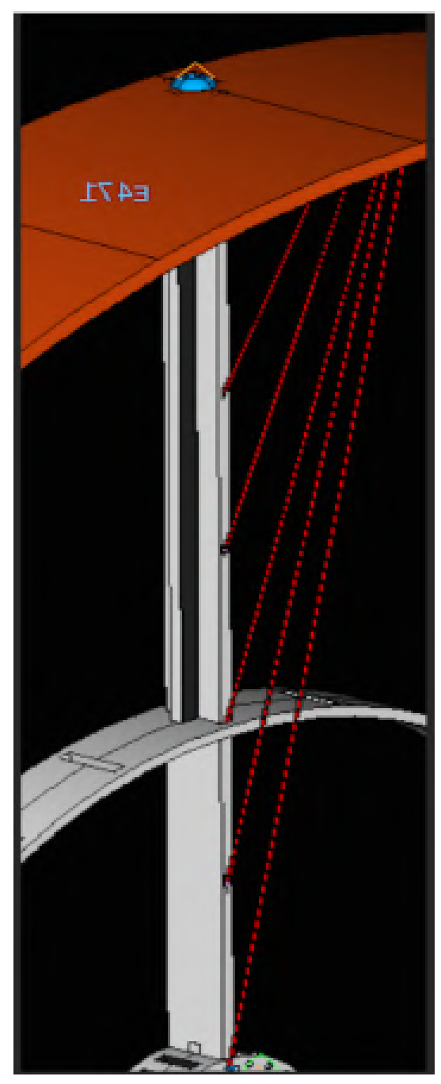
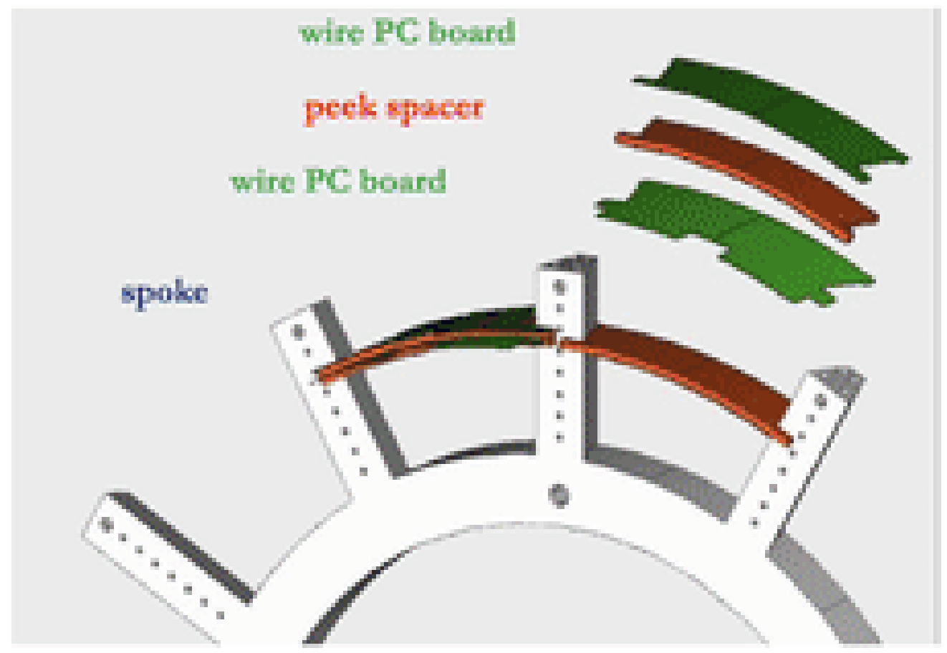
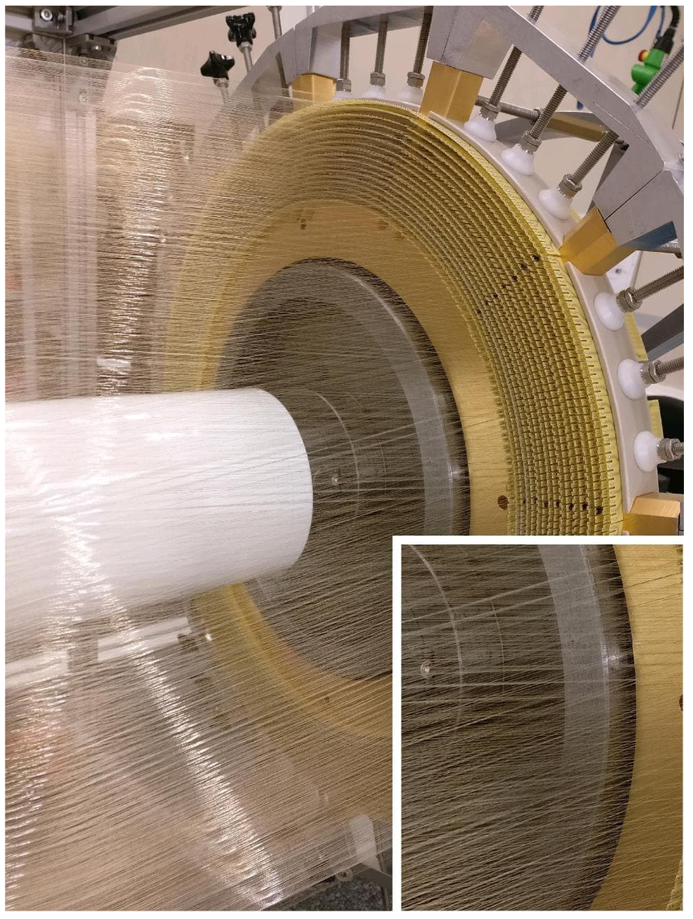
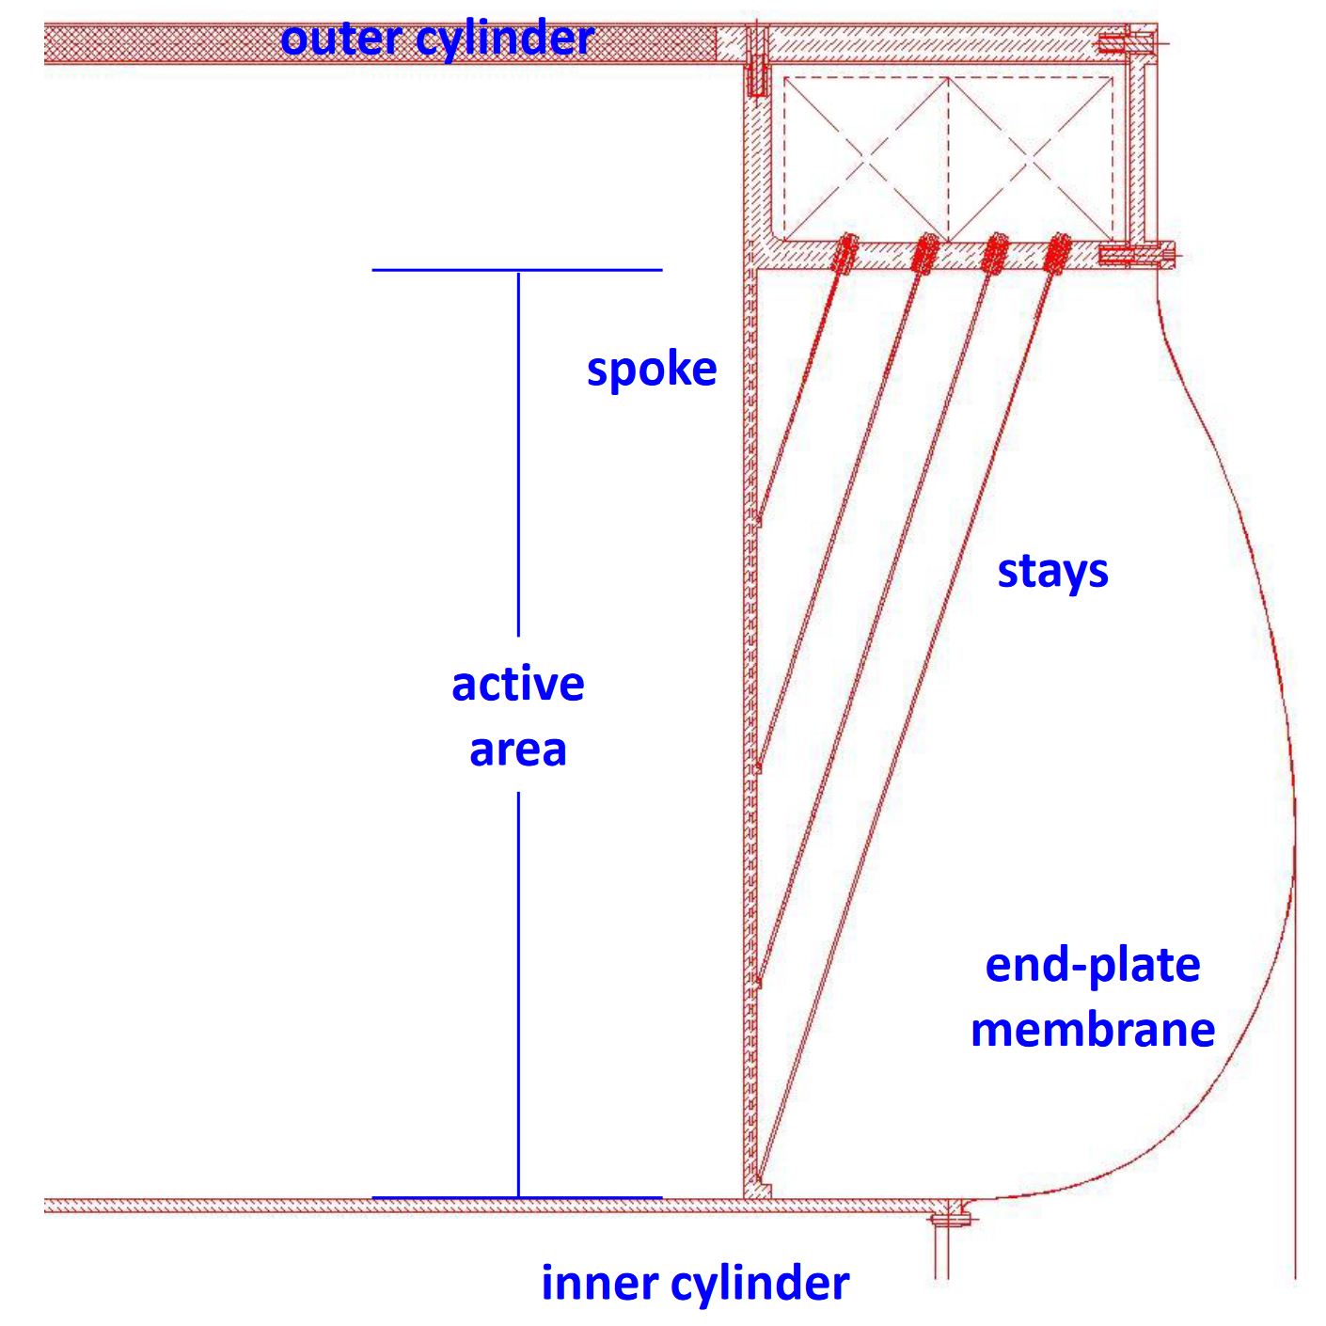
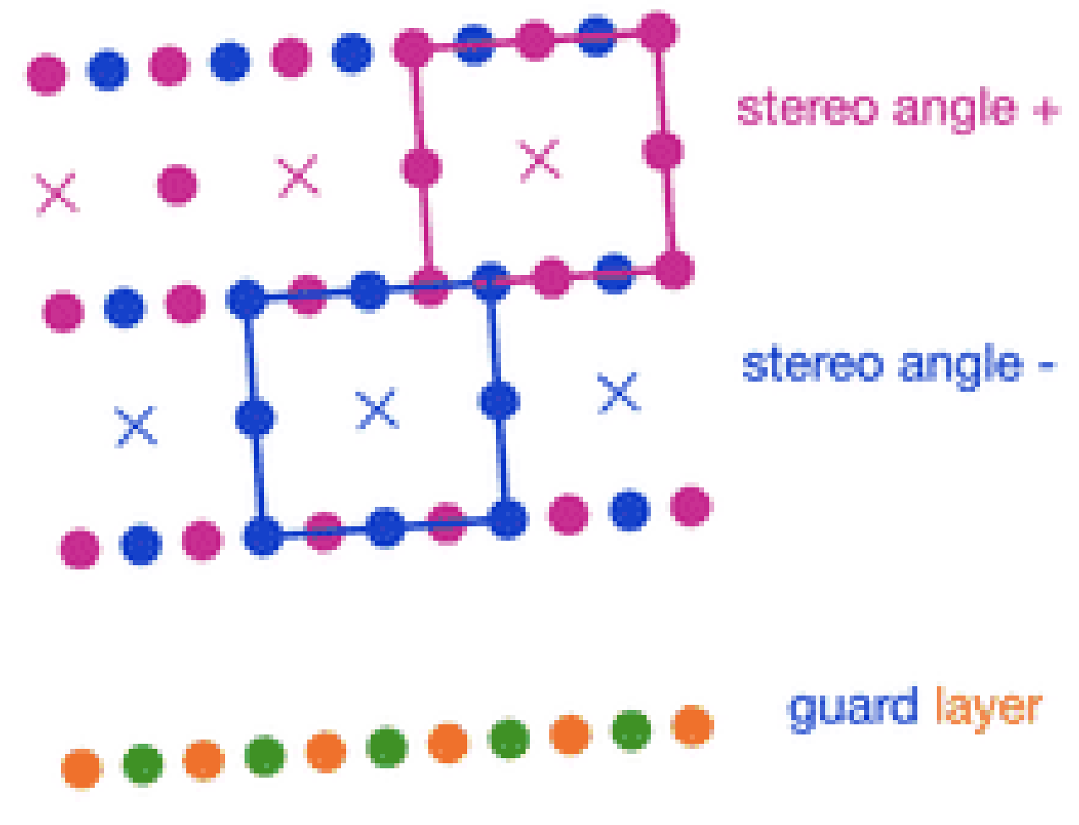
Drift chamber: a closer eye on wire cage

Slide 5
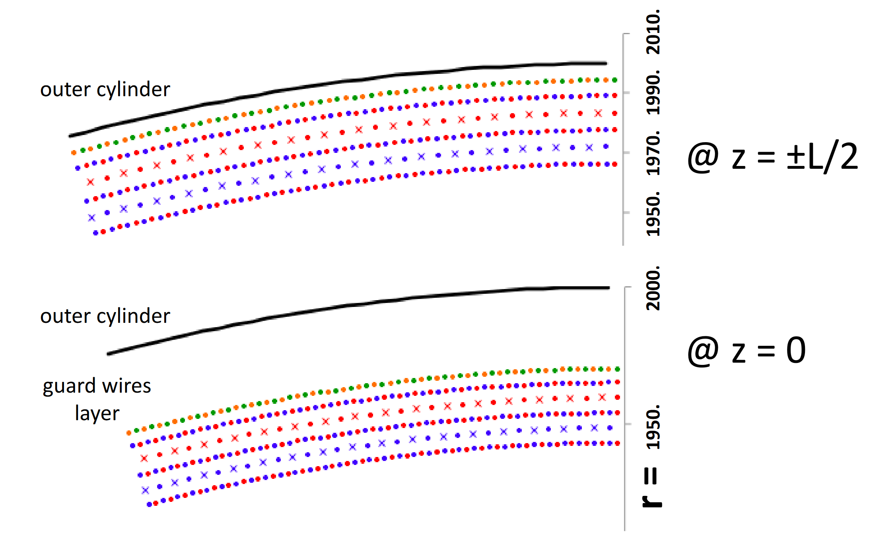
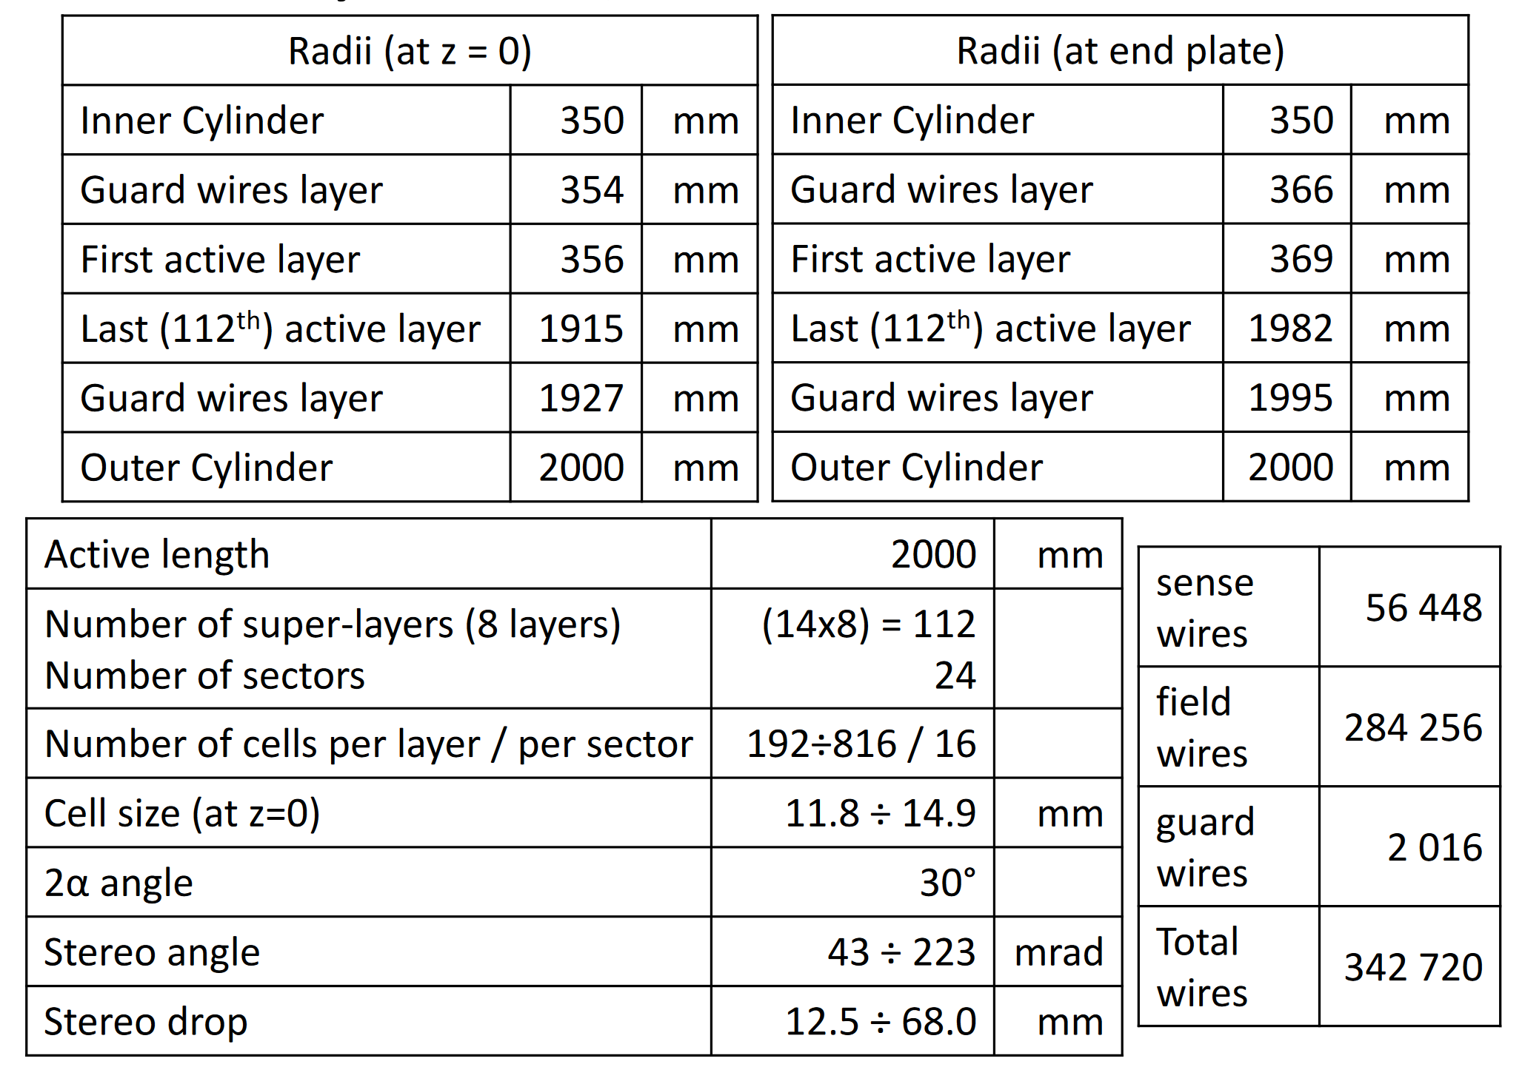
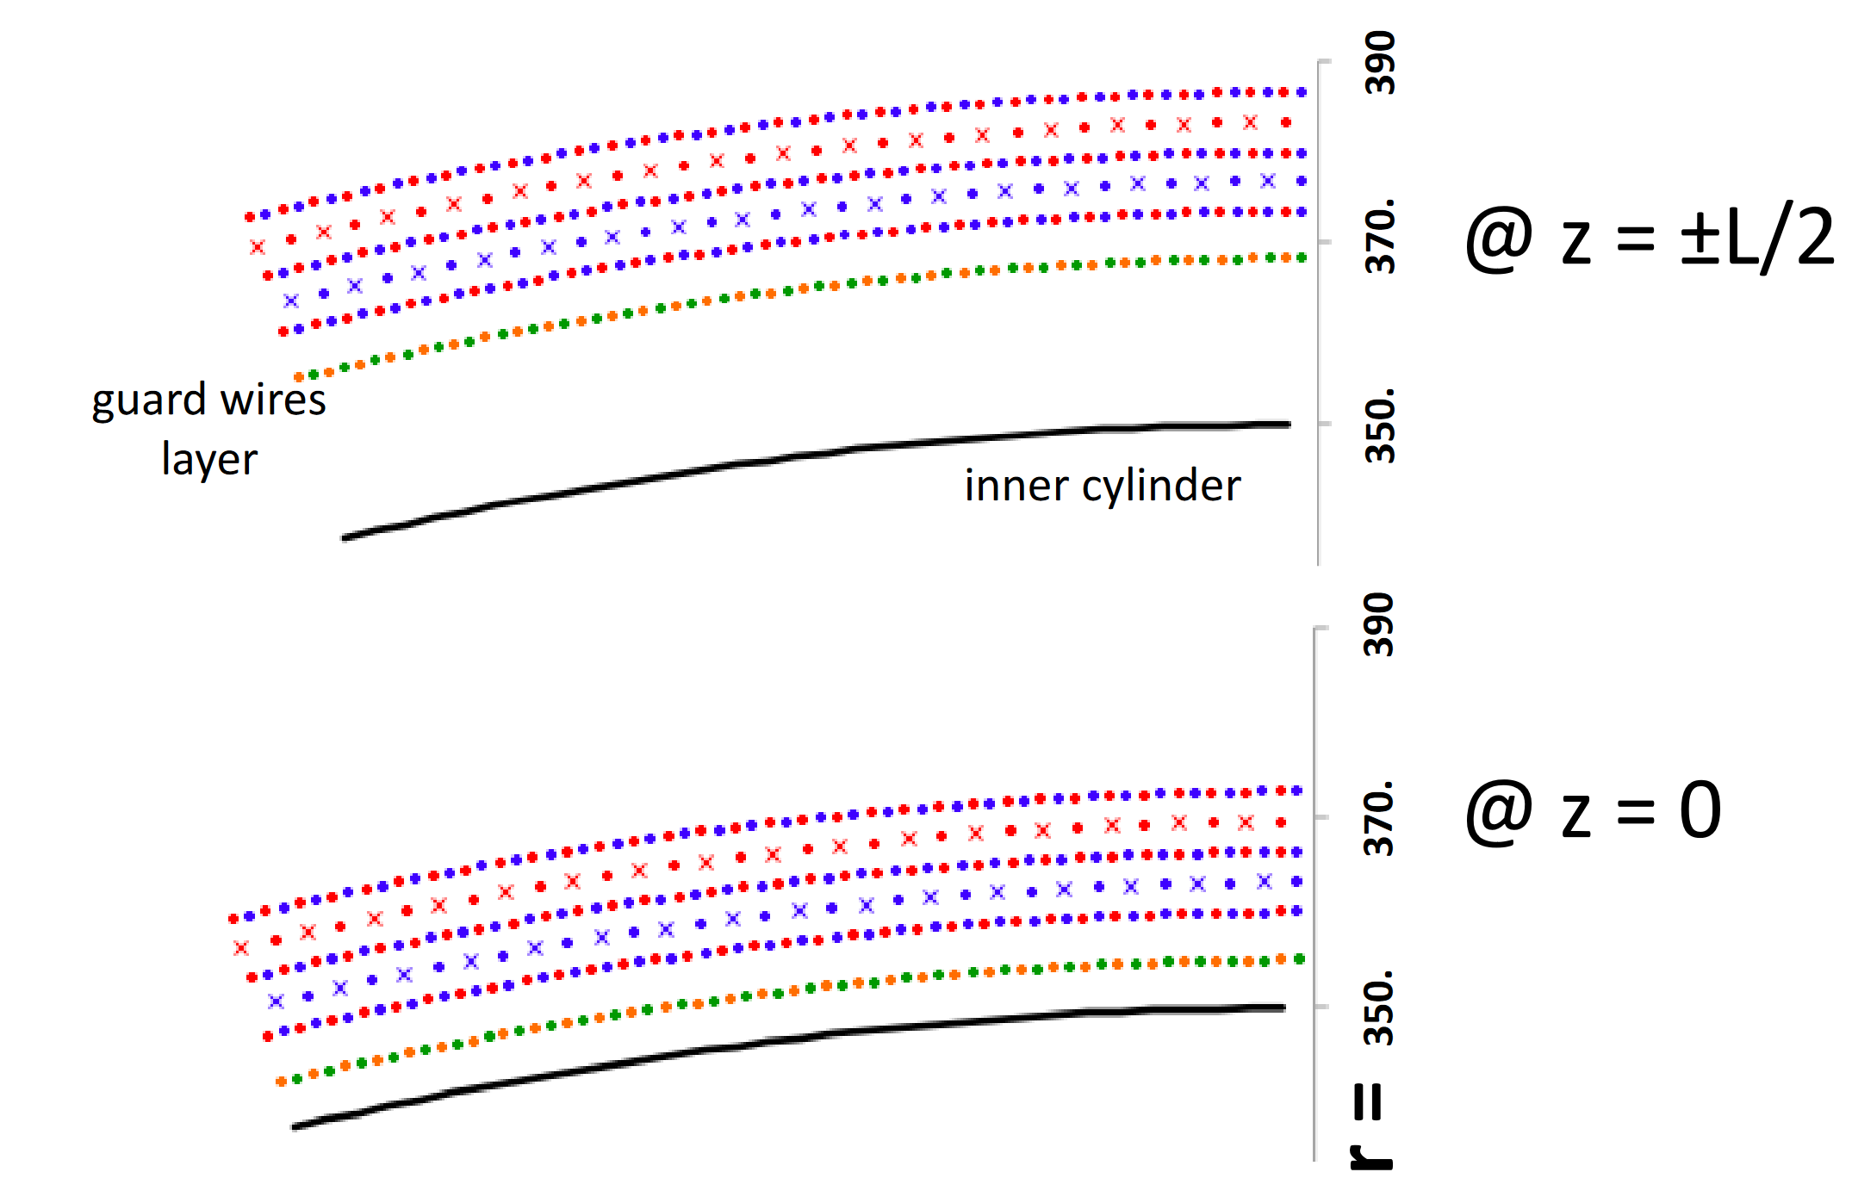
Drift chamber layout

Slide 6
Big Problem to manage!
The accuracy of the position is in the range of 100-200 µm.
The position of the anodic wire in space must be known with an accuracy better than 50 µm at most.
The anodic and cathodic wires should be parallel in space to preserve the constant electric field.
A 20 µm tungsten wire, 2 m long, will bow about 100 µm at its middle point, if tensioned with a load of approximately 30 grams
30 gr tension for each wire → 10 tonnes of total load on the endcap

Slide 7
Simulation studies

Slide 8
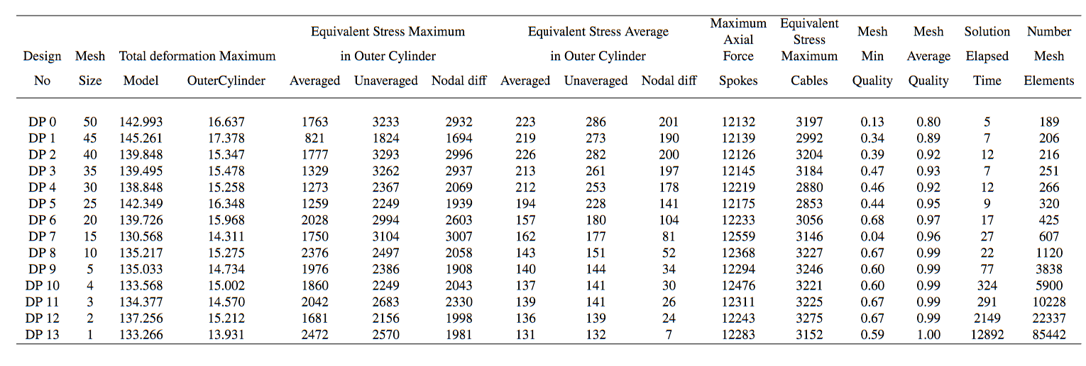
Finite Element Method
Development of the Finite Element Method
Element to test: surface body modelled with Shell element, spokes with Beam element and cables with Truss element
Loading to apply: uniformly distributed line pressure
Boundary conditions: fixing the face of the outer cylinder (undeformable) or fixing the edge of the outer cylinder (deformable)
Parametric study on mesh size
1 mm mesh size is numerically accurate

Slide 9
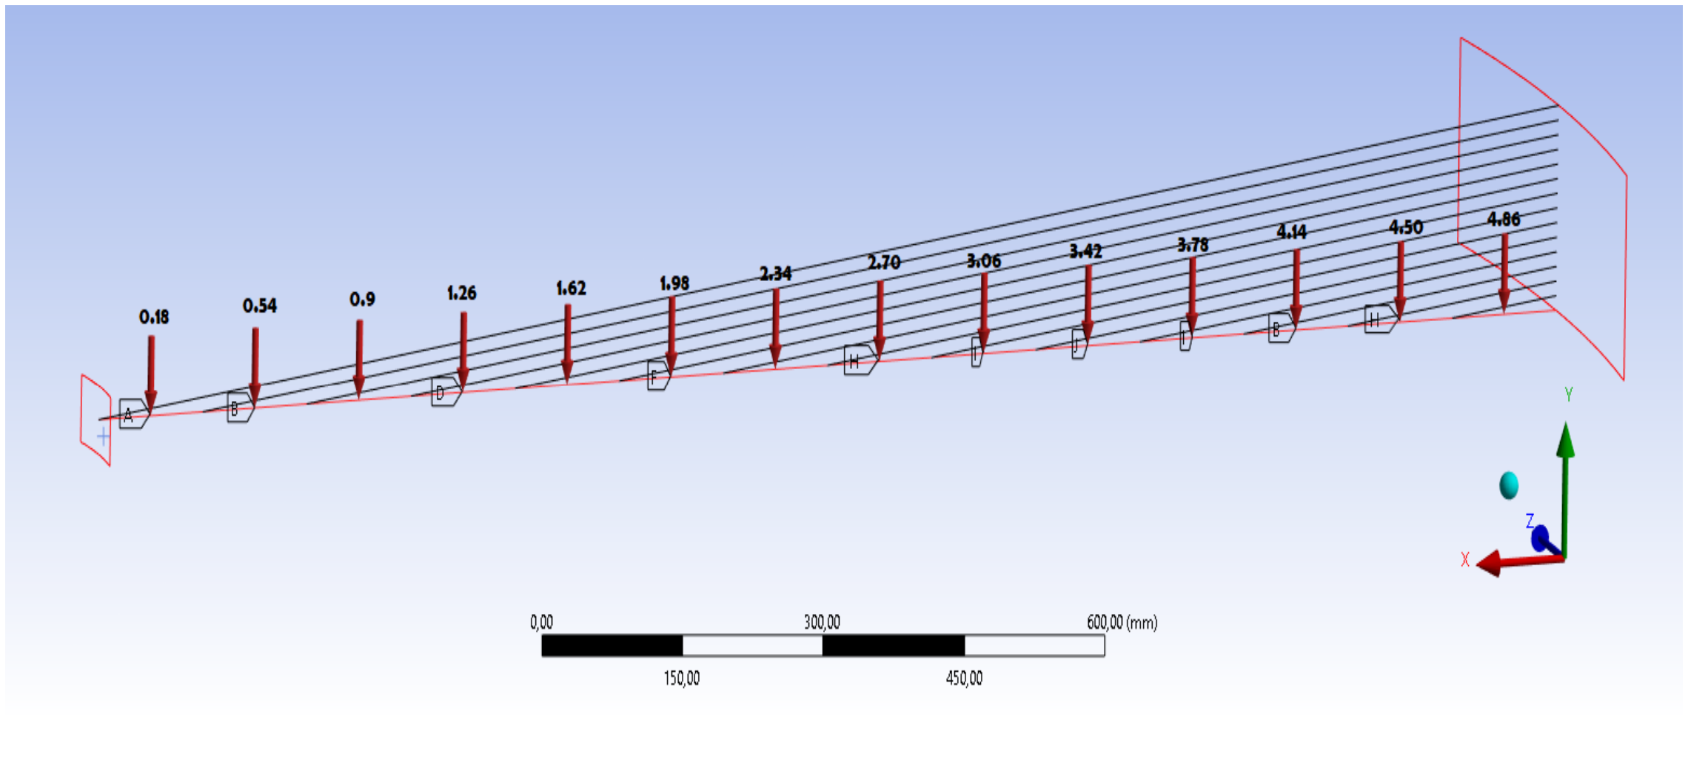
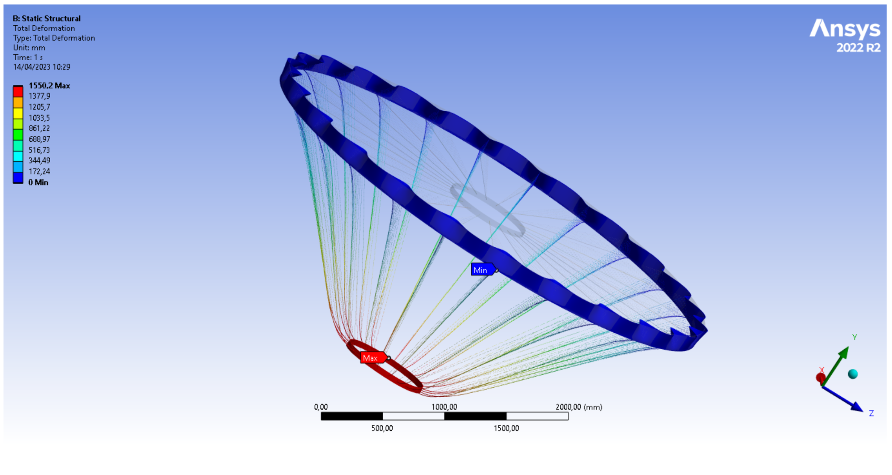
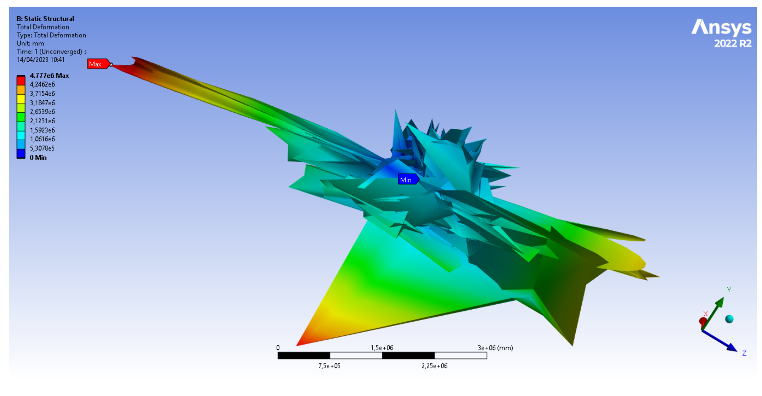
FEM analysis: preliminary stage
A full scale model is built with ANSYS Workbench and loaded with uniformly distributed line pressure.
Materials: carbon for spoke, stainless stell for cables
Linear analysis
HP: small deformations
Non-Linear analysis
HP: Large strain, rotation, stress stiffening
The maximum deformation occurs on inner cylinder 1550,2 mm
Non-convergent solution

Slide 10
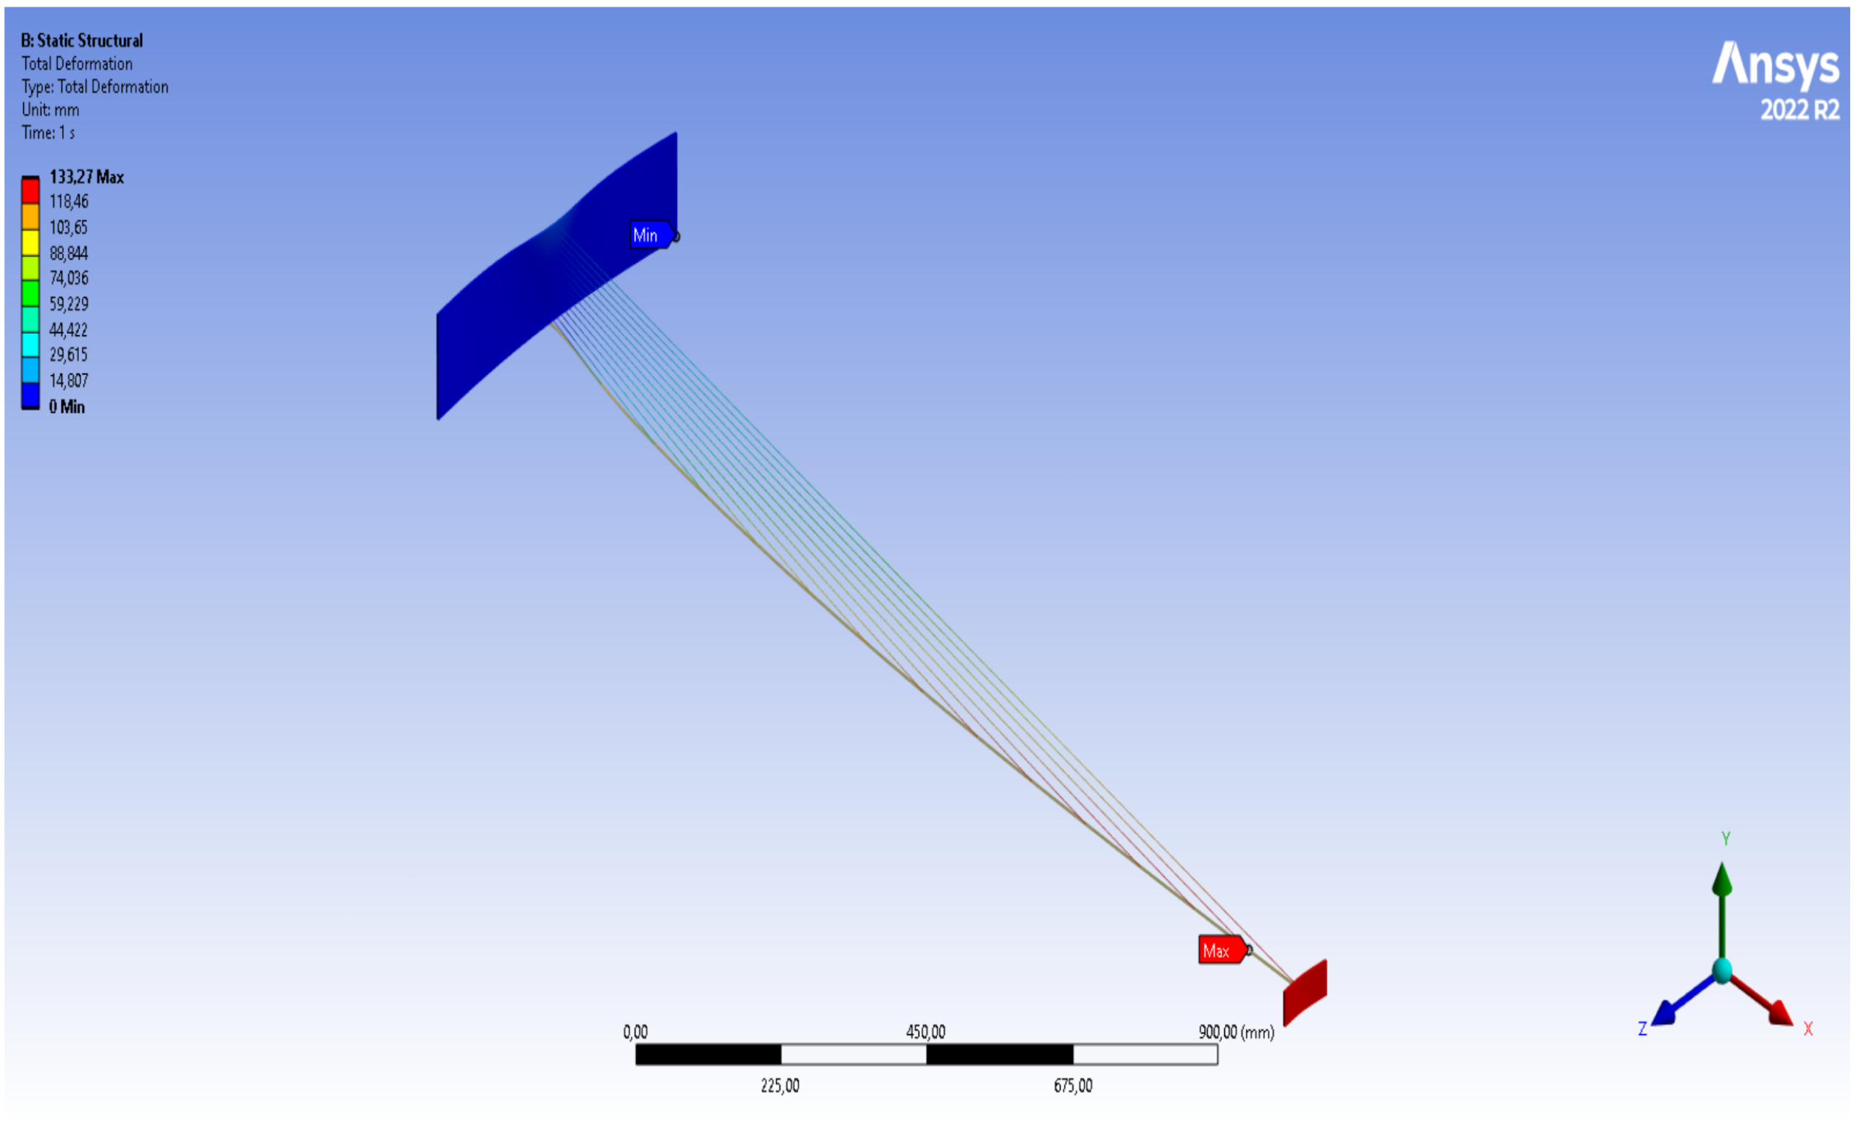
FEM analysis: preliminary stage
Time stepping algorithm
the time step size are automatically determined in response to the current state of the analysis under consideration.
estimate the next time step size Δt_{n+1}, based on current t_{n} and past analysis Δt_{n} conditions, and make proper load adjustments
The maximum deformation occurs on inner cylinder 133,27 mm

Slide 11
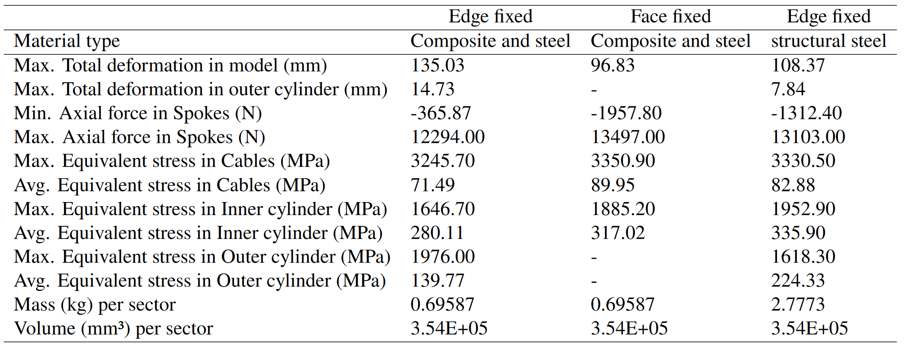
FEM analysis: preliminary stage conclusion
Model validation with 3 different models.
Materials: composite and steel Boundary conditions: fixing the lower edge of the outer cylinder.
Materials: composite and steel Boundary conditions: fixing the face of the outer cylinder.
Materials: Structural steel Boundary conditions: fixing the lower edge of the outer cylinder
Conclusion
The goal is to improve the stiffness of the outer cylinder.
Good behaviour of the system
Structure collapsed in terms of stresses as well as meeting the deformation criteria.

Slide 12
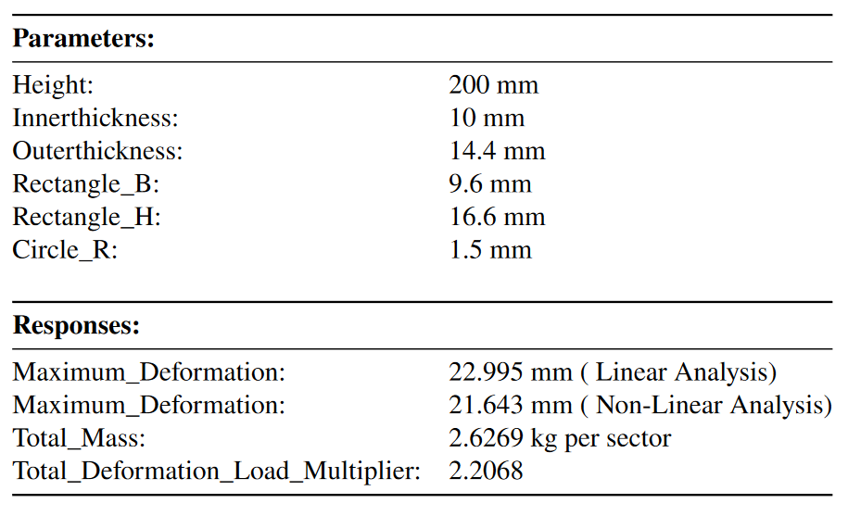
FEM analysis: Parametric Design Exploration
Design exploration: varying input parameters in some possible ranges in order to see how the system responds - Response Surface Methodology (RSM) is used.
The input parametric variables are:
Height and thickness of the outer cylinder;
Dimensions (breadth and depth) of the spokes;
Dimensions (radius) of the cables;
Thickness of the inner cylinder.
Change the material: from carbon fiber to o Epoxy Carbon Unidirectional Prepeg
Conclusion
Select the optimal dimensions of the drift chamber
Total deformation of the model from 135,03 mm to 21,64 mm.
It is still too high!

Slide 13
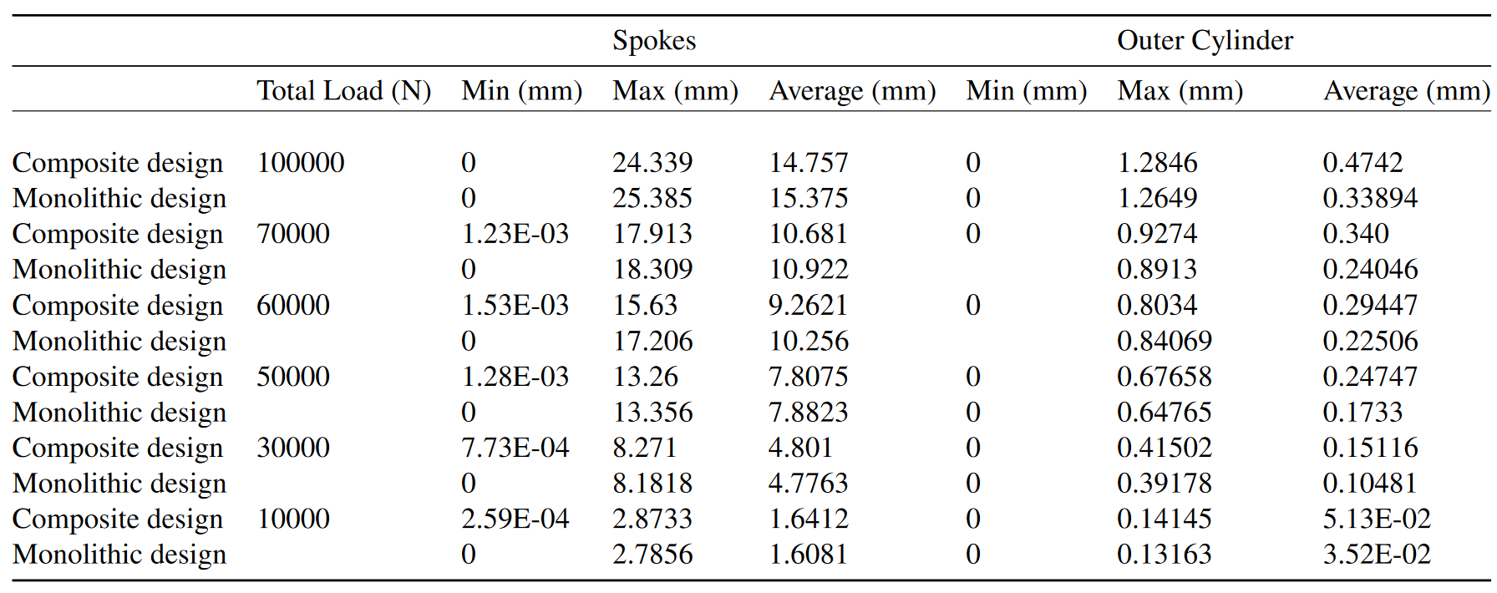
FEM analysis: Composite material
We develop, validate and calibrate a Layered Composite Material made from Epoxy carbon prepeg with the fibres oriented at 0°

Slide 14
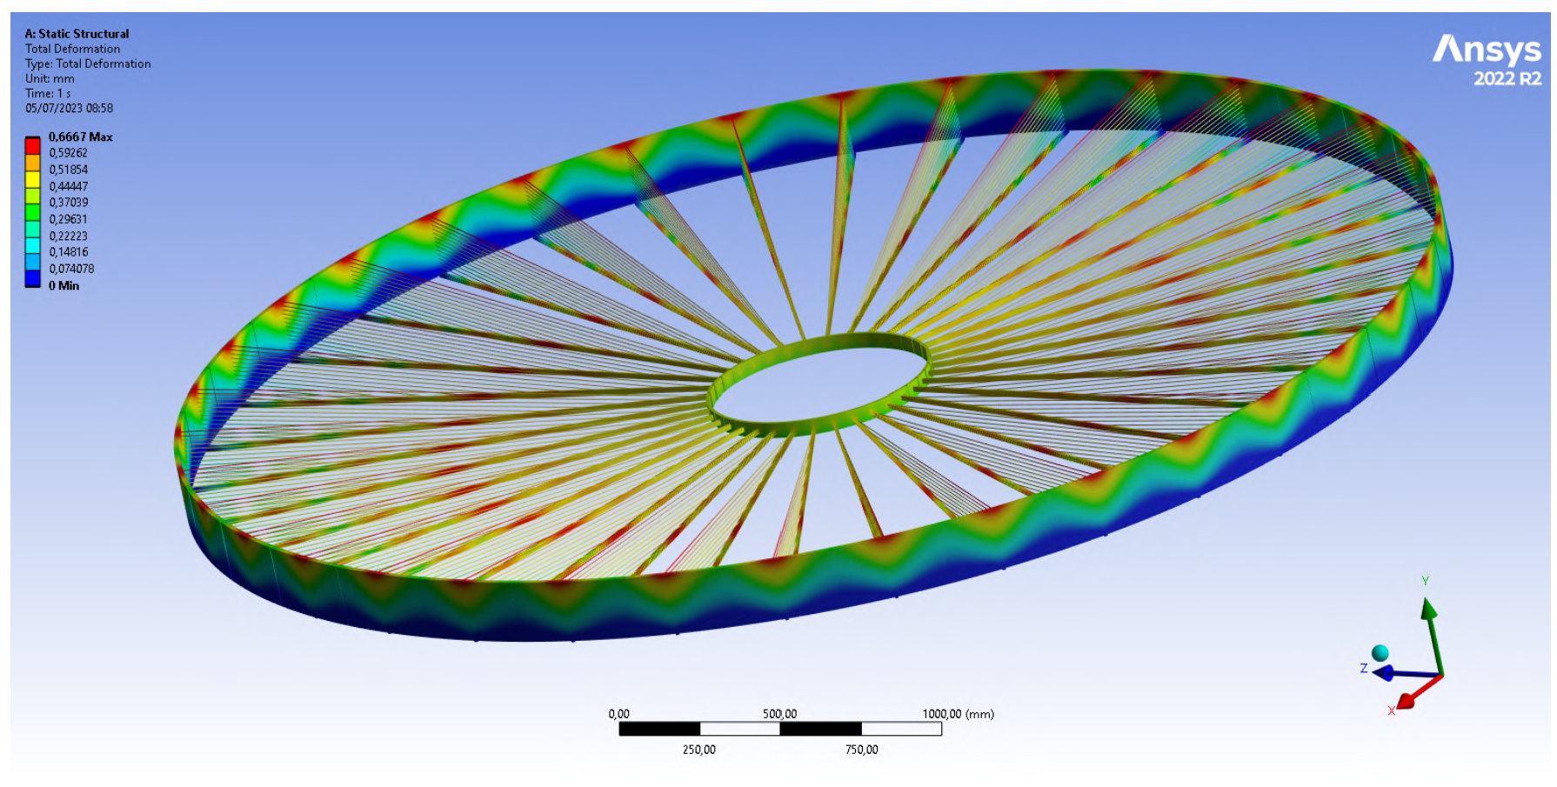
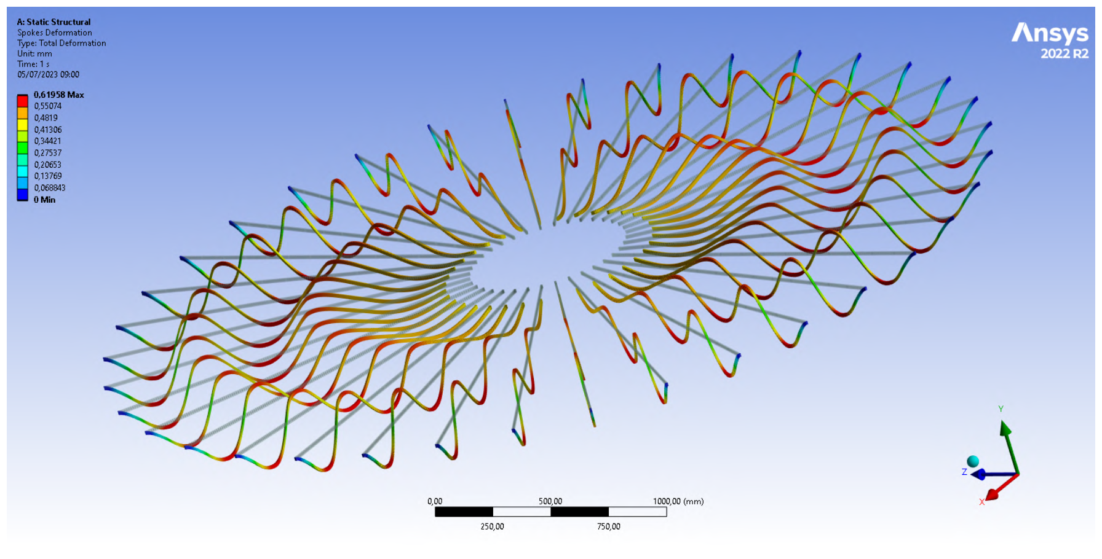
FEM analysis: Prestressing
Goal: minimizing the deformation of the spokes using prestressing force in the cables
Finding the correct prestressing force in 14 cables → solving 15 dimensional optimization problem
Total deformation (mm) of the drift chamber with the edge of the outer cylinders fixed
No prestress | Outer cylinder | Prestress in the cables
Spokes | Outer cylinder | Spokes | Outer cylinder
14.099 | 0.63 | 0.62 | 0.67

Slide 15
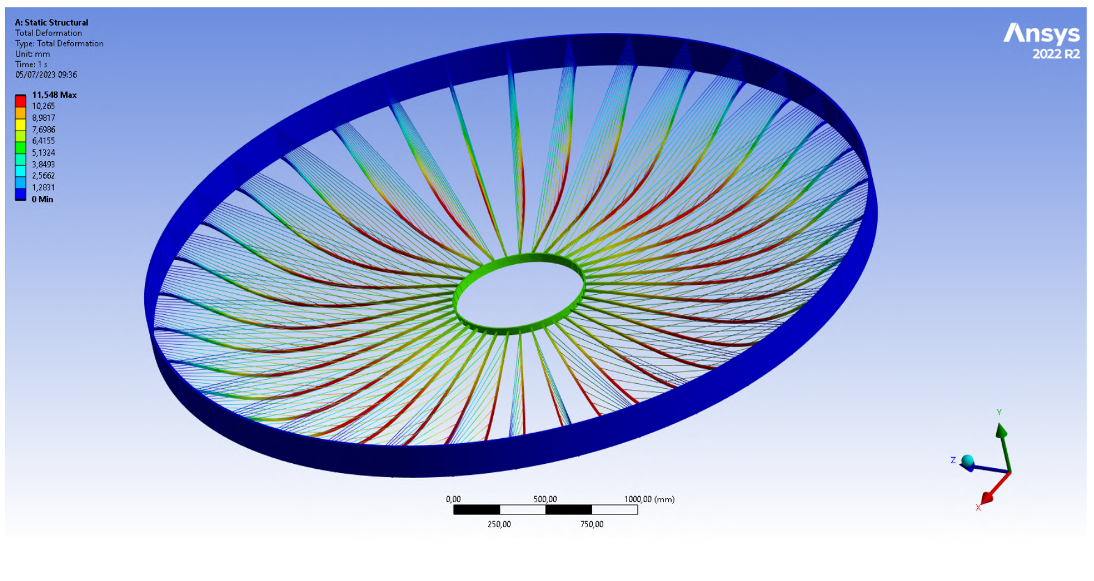
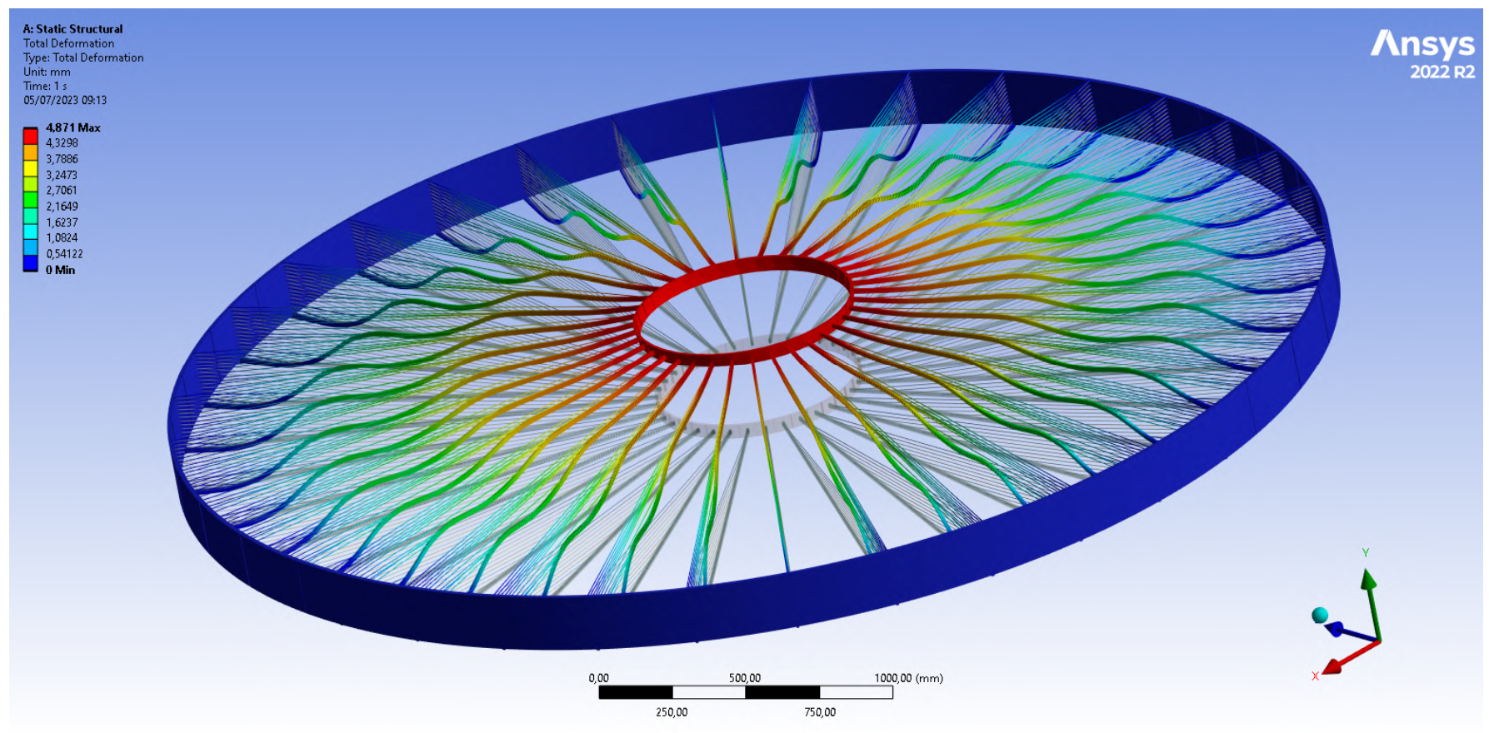
FEM analysis: Prestressing
Constraint: face of the outer cylinders fixed
drift chamber pulled upwards
very high total deformation
Total deformation (mm) of the drift chamber with the face of the outer cylinders fixed
No prestress | Prestress in the cables
Drift chamber | Drift chamber
11.54 | 4.871
Accurate definition of boundary conditions on the overall deformation of the spoke

Slide 16
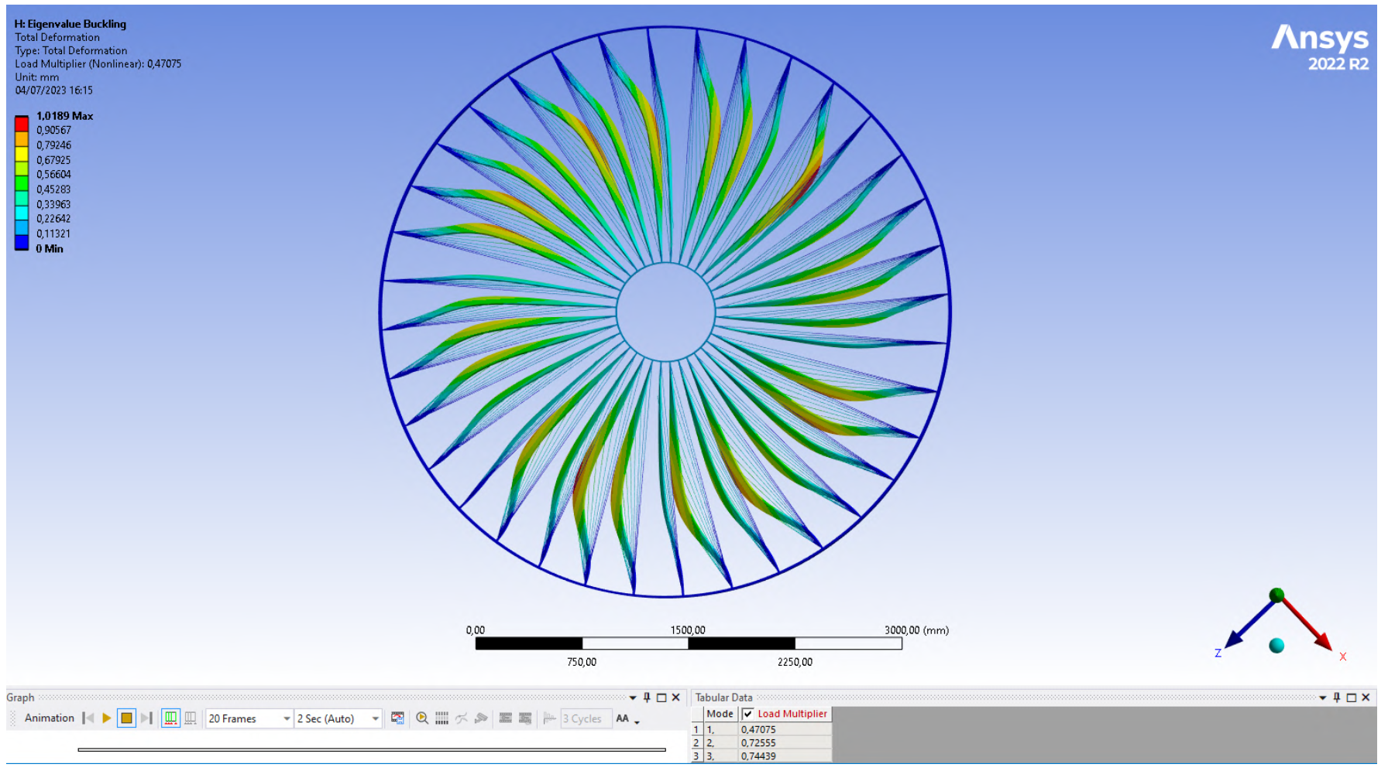
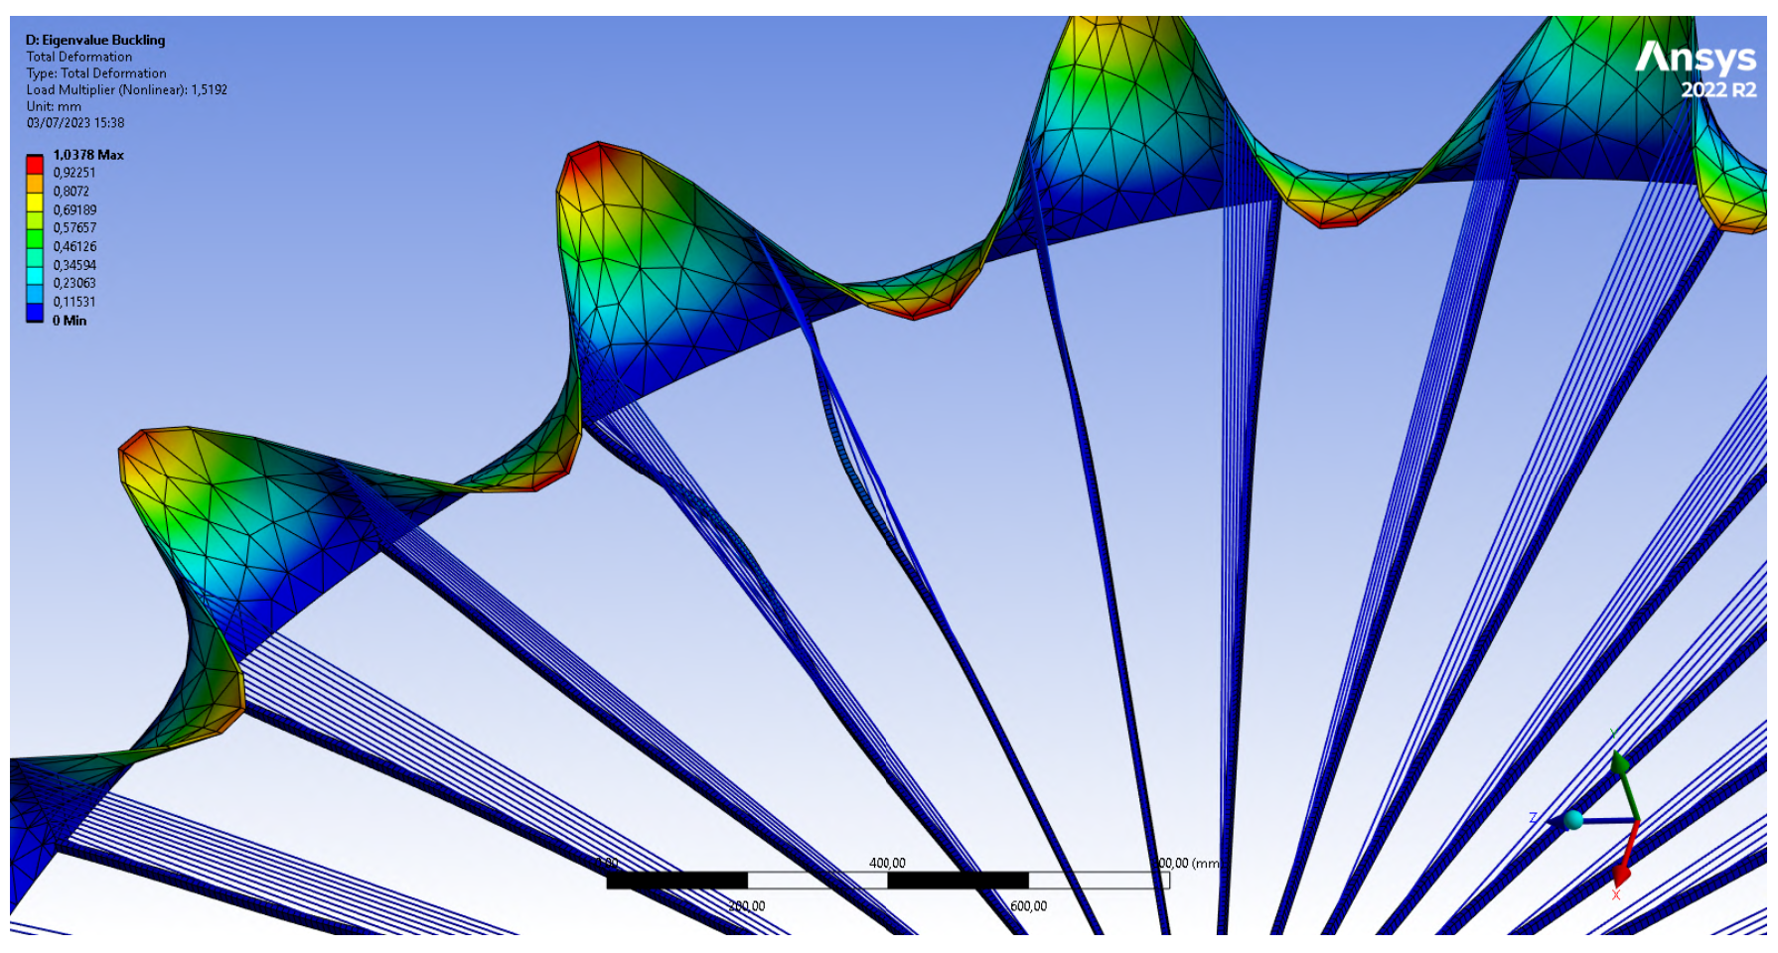
FEM analysis: Buckling analysis
Buckling behaviour is essential for us to ensure the safety and reliability of this drift chamber.
Linear buckling analysis assumes small deflections and linear material behavior.
Failure primarily occurs in the spokes while the outer cylinder remains undamaged (right).
Spokes interact with the cylinder
Deformation near the outer cylinder (left)

Slide 17
Realistic model (ongoing)

Slide 18
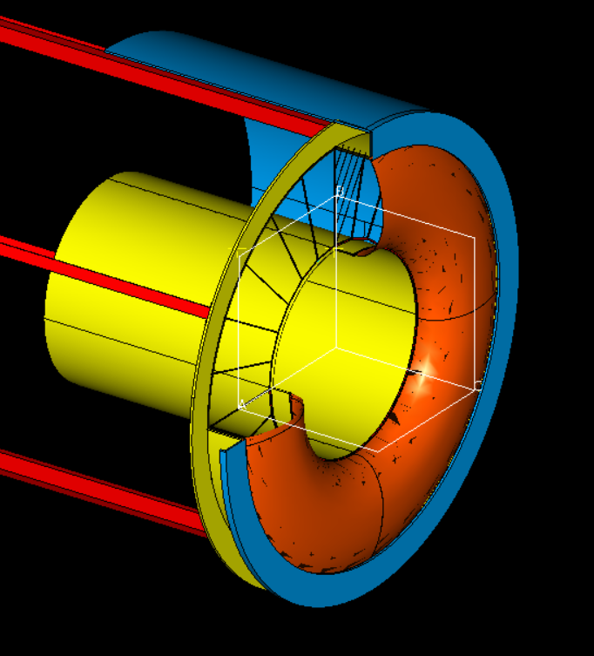
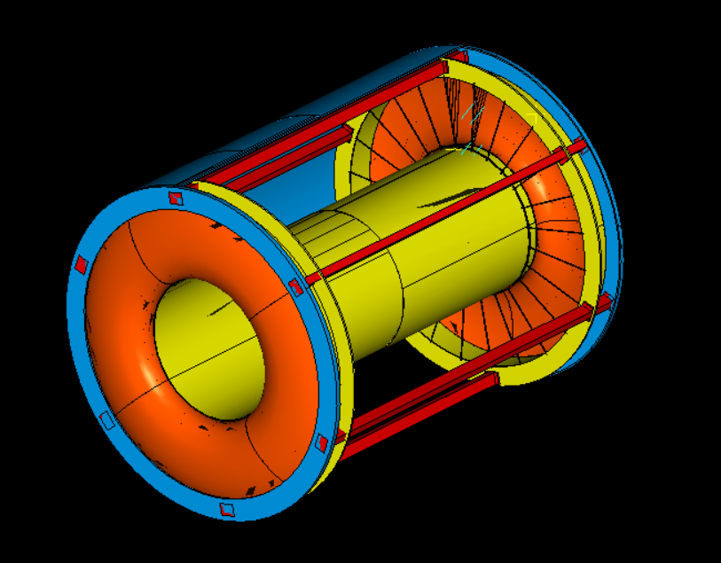
Realistic model: overview
Mechanically accurate
Precise definition of the connections of the cables on the structure
Connections of the wires on the PCB
Location of the necessary spacers
Connection between wire cage and gas containment structure

Slide 19
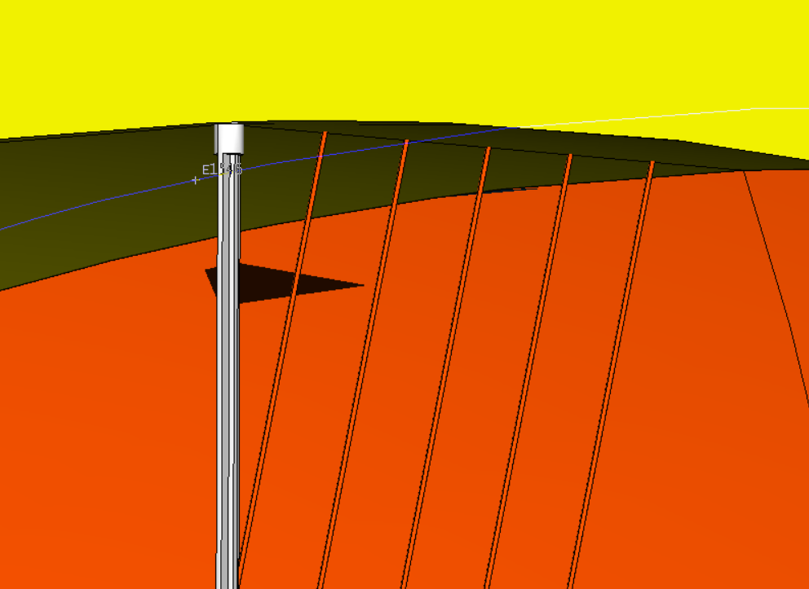
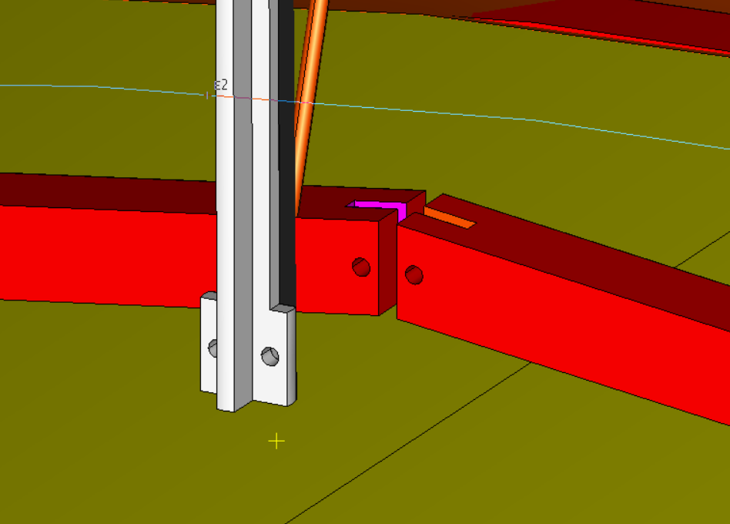
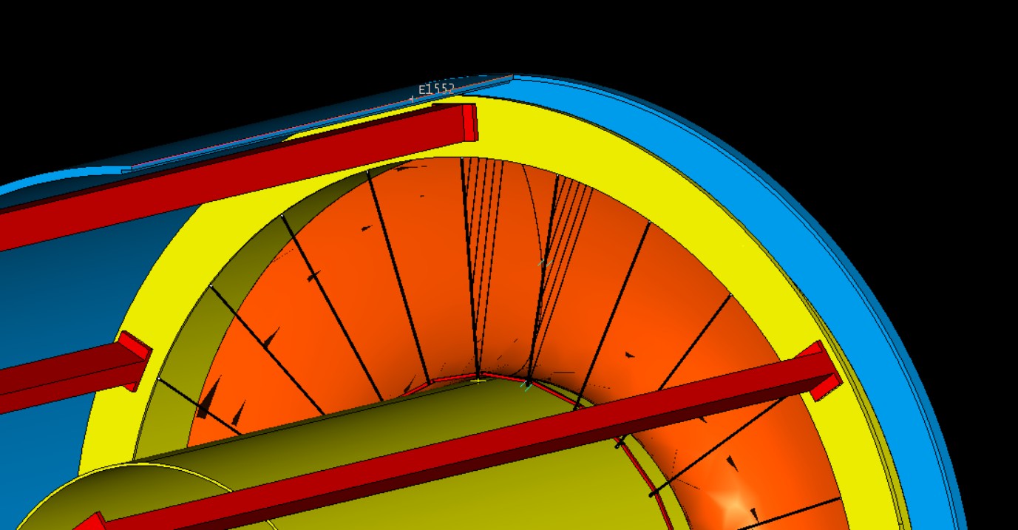
Realistic model: details
Upper junction: cross profile spoke and supporting cables
Lower junction: joint design

Slide 20
Future studies

Slide 21
What happens now?
Our main goal was to limit the deformation of the spokes to 200 µm while ensuring the structural integrity.
The structure exhibited a deformation of 600 µm
Next developments
Try alternative approaches, including prestressing of spokes
Investigate various composite failure criteria
Extend nonlinear buckling analysis
Depth understanding of our composite structure
Real model design in collaboration with EnginSoft

