Slide 1
Closing Remarks

Slide 2
Some Numbers
131 Partecipating (42 Women=32%)
14 invited
27 oral
27 flash talks
50 poster

Slide 3
Expanding Connections in Nuclear Physics
NP
Fundamental
Theoretical
Experimental
Applied

Slide 5
Special Thanks to the entire OC!
Hadronic Physics
Subpanel: Alessia Fantini (chair), Raffaella De Vita, Elena Santopinto, Giuseppe Bruno
Nuclear Structure and Reactions
Subpanel: Carlotta Giusti (chair), Xavi Roca Maza, Francesco Pederiva, Winfried Leidemann, Luca Girlanda
Nuclear Astrophysics
Subpanel: Alessandro Roggero (chair), Rosanna Depalo, Alba Formicola, Pierpaolo Figuera, Massimo Mannarelli
Symmetries and fundamental interactions
Subpanel: Roberto Brusa (chair), Marzia Nardi, Giusi Bisogni, Luca Girlanda
Quark Gluon Plasma
Subpanel: Enrico Scomparin(chair), Giuseppe Bruno, Marzia Nardi
Applications of Nuclear Physics
Subpanel: Giusi Bisogni (chair), Cristina Vaccarezza, Raffaella De Vita, Francesco Tommasino, Emanuele Scifoni

Slide 6
..and to the Locals
Local Organizing Commettee
Roberto Sennen Brusa (co-chair) (Università di Trento &
INFN-TIFPA)
Emanuele Scifoni (co-chair) (INFN-TIFPA)
Winfried Leidemann (Università di Trento & INFN-TIFPA)
Francesco Pederiva (Università di Trento & INFN-TIFPA)
Alberto Quaranta (Università di Trento & INFN-TIFPA)
Alessandro Roggero (Università di Trento & INFN-TIFPA)
Francesco Tommasino (Università di Trento & INFN-TIFPA)
Technical Support
Piero Spinnato (INFN-TIFPA)
Isabella Martire (INFN-TIFPA)
Roberta Beraldo (INFN-TIFPA)
Thanks to Cooperazione Trentina Staff!

Slide 7
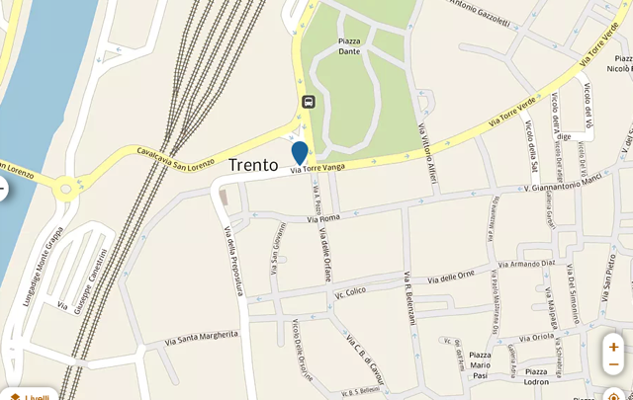
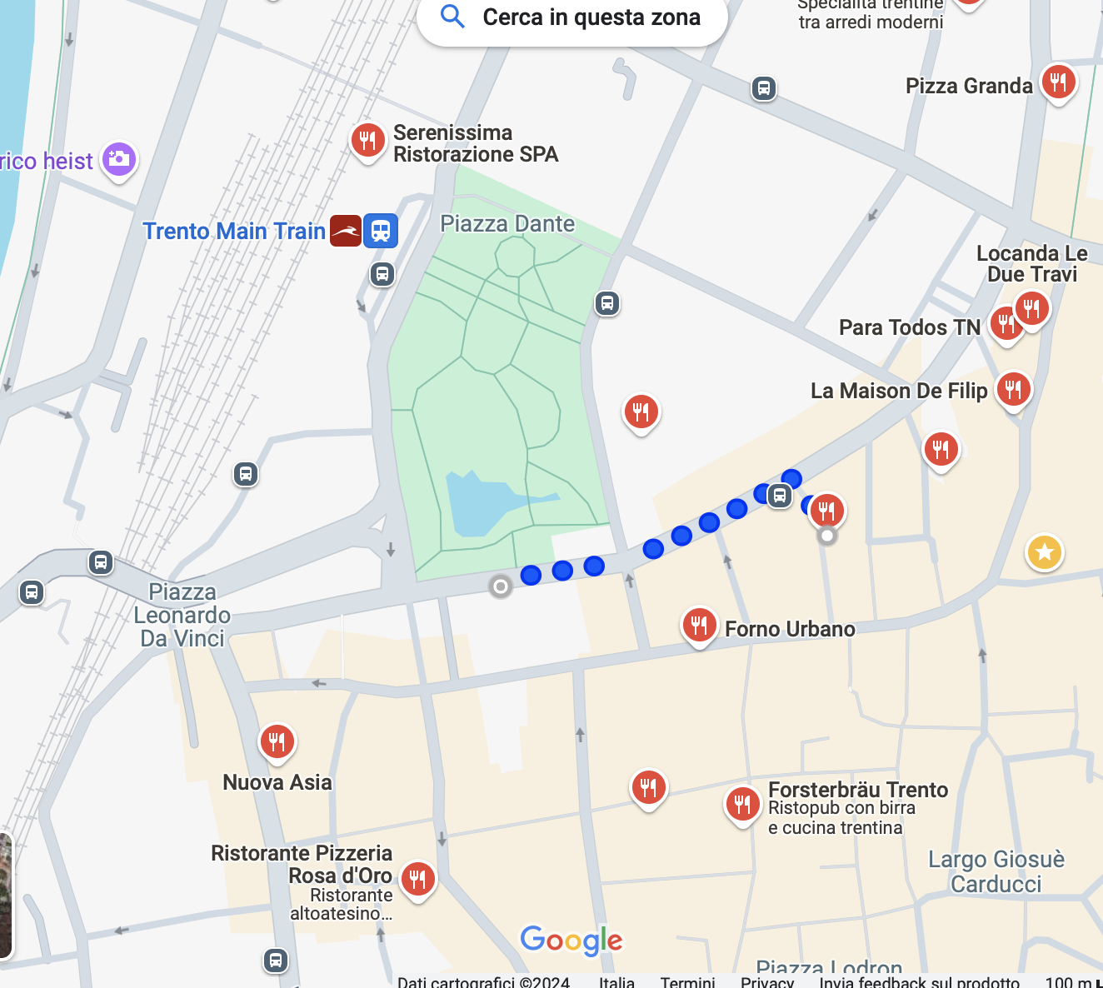
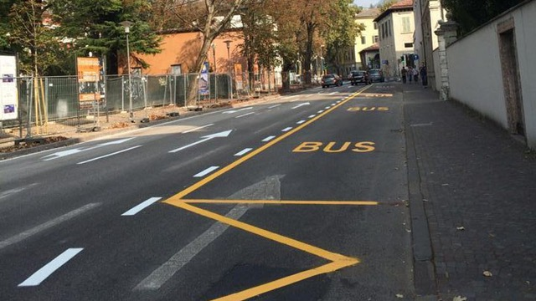
Bus for Decennale starting sharp at
15.00 form via Torre Vanga 18
(in a side of the Place of the station)
BUS STOP
Via Torre Vanga 18
BUS STOP

Slide 8
Incontri Nazionali di Fisica Nucleare: History
I - 2012 LNS
II - 2014 LNL/Pd
III - 2016 LNF (incuding CSN5)
IV - 2018 LNS
V -2022 LNGS
VI - 2024 TIFPA
VII – See you again in 2026 in ?

