Slide 1
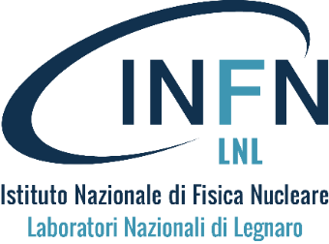
Application in Nuclear Physics
Radionuclides: state of the art, INFN research and perspectives in production and medical applications
Gaia Pupillo
Istituto Nazionale di Fisica Nucleare, Laboratori Nazionali di Legnaro (INFN-LNL), Italy
gaia.pupillo@lnl.infn.it

Slide 2
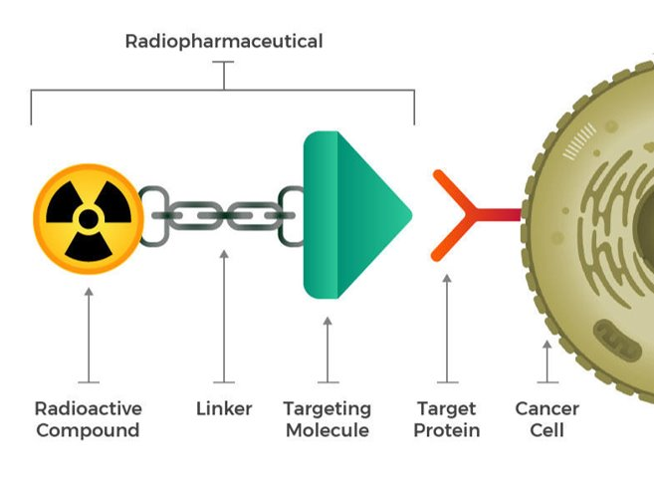
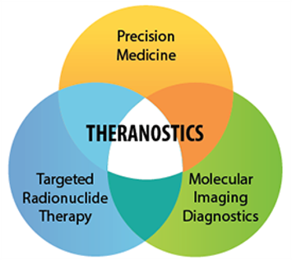
State of the art
In nuclear medicine, a wide variety of radioisotopes is needed to provide: diagnostic, therapeutic and (possibly) theragnostic capabilities.

Slide 3
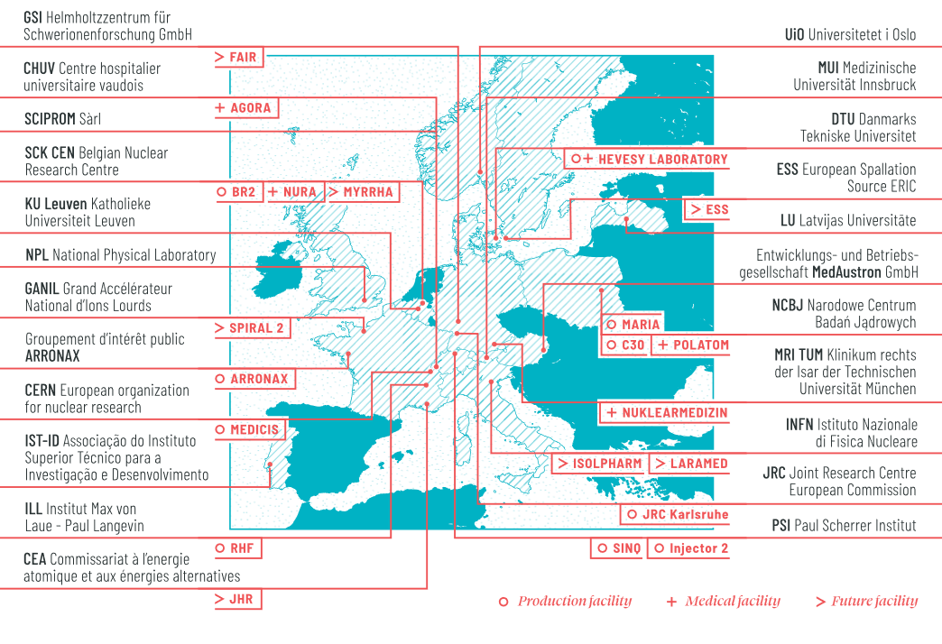
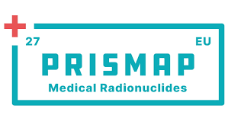
State of the art
In Europe, a recent consortium called «PRISMAP» gathered the community working on medical radionuclides and radiopharmaceuticals: https://www.prismap.eu/

Slide 4
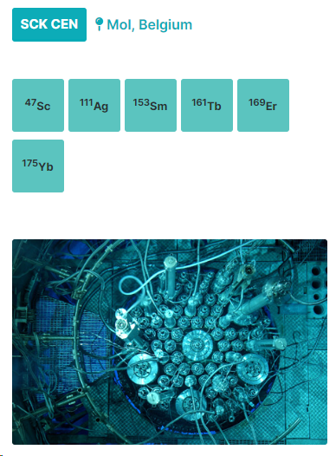
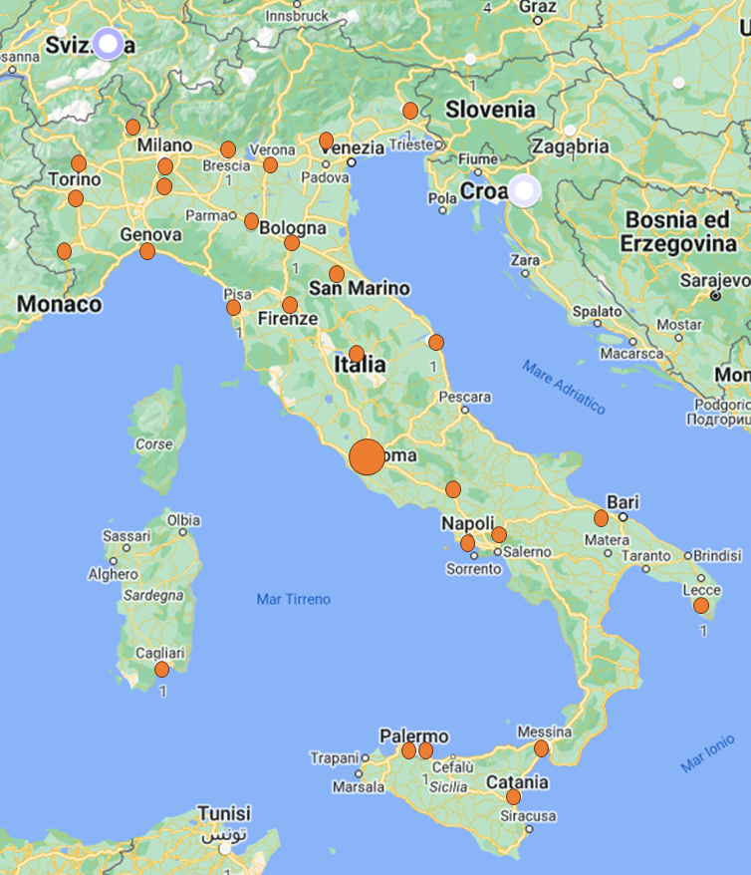
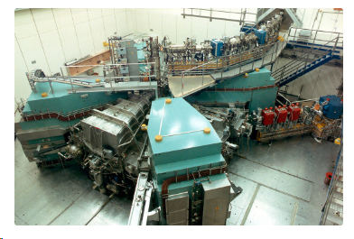
State of the art
The production of medical radionuclides relies on the network of hospital cyclotrons (Ep < 20 MeV),
on the use of nuclear reactors and on research facility (charged particles accelerators)
No. 46 Italian hospital cyclotrons
https://nucleus.iaea.org/sites/accelerators/Pages/Cyclotron.aspx
¹⁸F
Mainly FDG but also others, depending on the specific facility

Slide 5
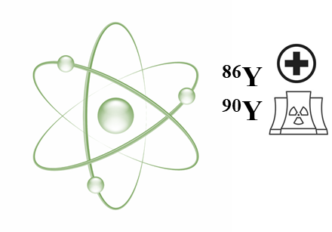
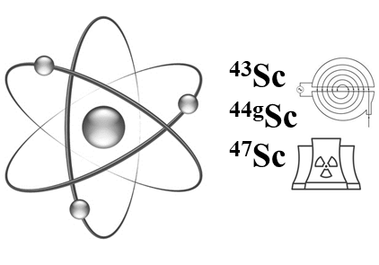
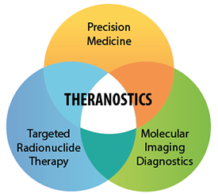
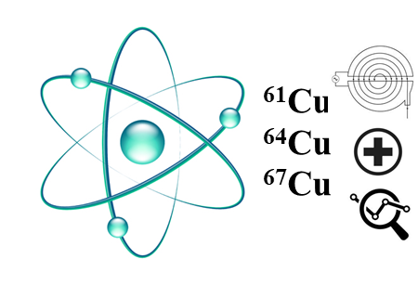
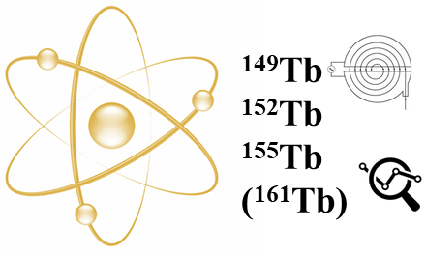
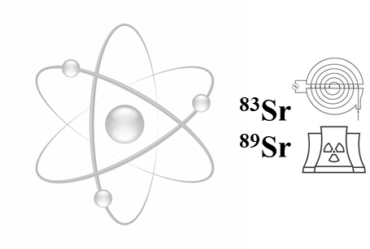
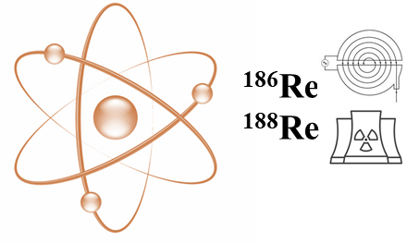
State of the art: Theranostic radionuclides
.. Some examples

Slide 6
State of the art: Theranostic radionuclides
.. We are working on these radionuclides

Slide 7
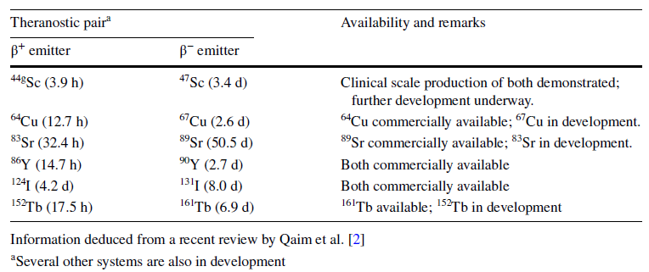
State of the art: Theranostic radionuclides

Slide 8
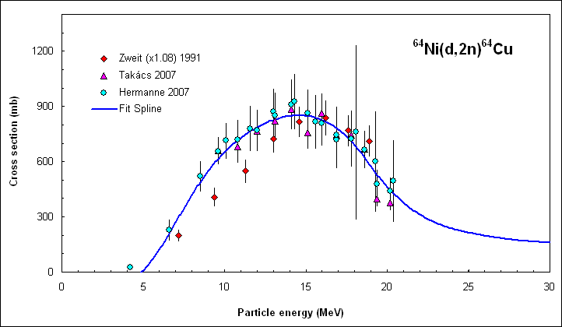
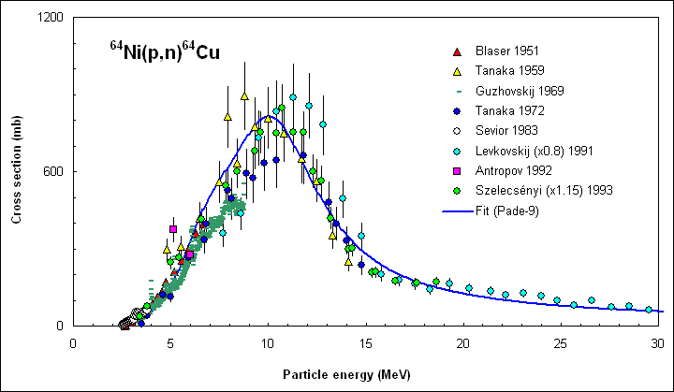
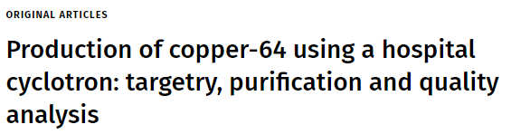
State of the art: Theranostic radionuclides
⁶⁴Cu can be produced with particle accelerators
both in research centers and in hospitals
⁶⁴Ni(d,2n)⁶⁴Cu
⁶⁴Ni(p,n)⁶⁴Cu
IAEA REPORT (2016)
https://journals.lww.com/nuclearmedicinecomm/Fulltext/2021/09000/Production_of_copper_64_using_a_hospital.12.aspx
https://www-pub.iaea.org/MTCD/Publications/PDF/Pub1717Web-25315812.pdf

Slide 9
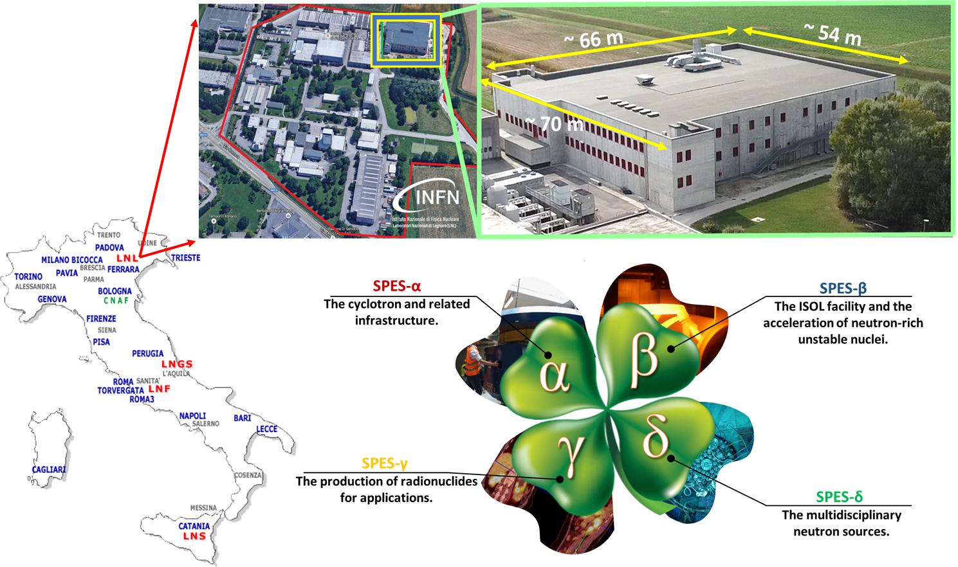
INFN Research
The study of medical radionuclides production started decades ago, mainly at the Milan-division
Since 2012, the LARAMED project was funded by MUR at the INFN-LNL as part of the SPES facility

Slide 10
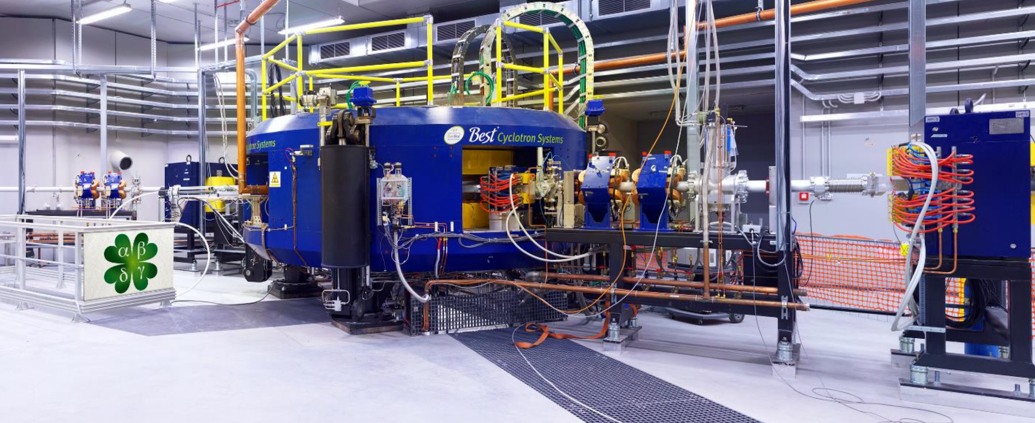
The SPES Project at INFN-LNL
Features:
A new building at Legnaro National Laboratories
A commercial cyclotron (BEST P70: 35-70 MeV, 750 mA)
An innovative ISOL facility, in-house developed (15 yrs of R&D)
Innovative research projects for radioisotopes production
Industrial capabilities

Slide 11
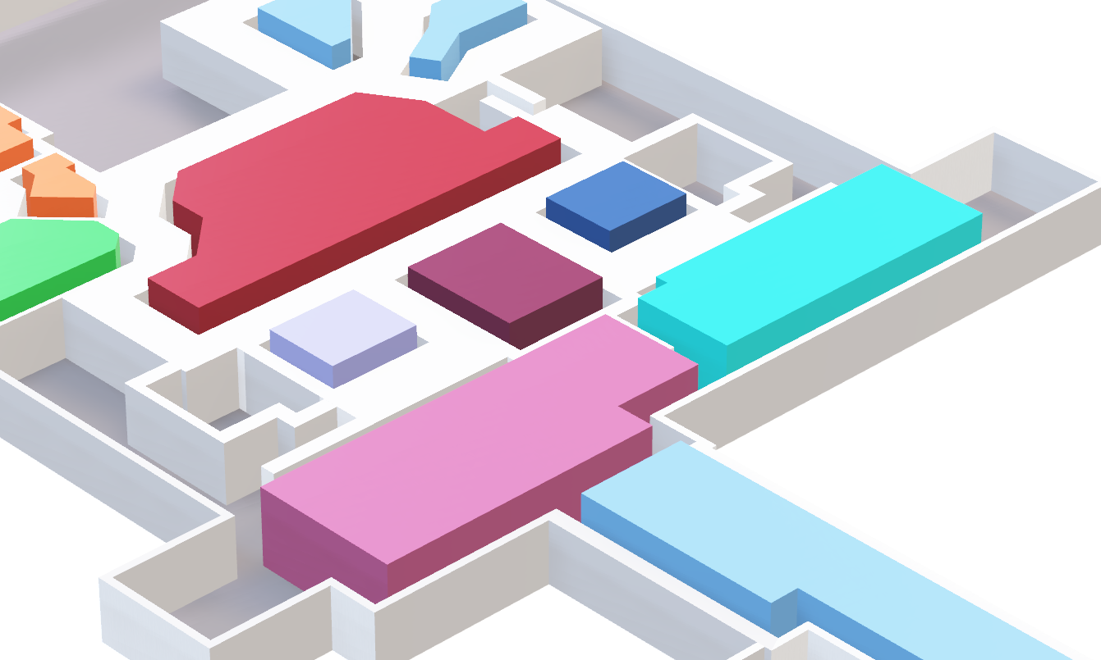
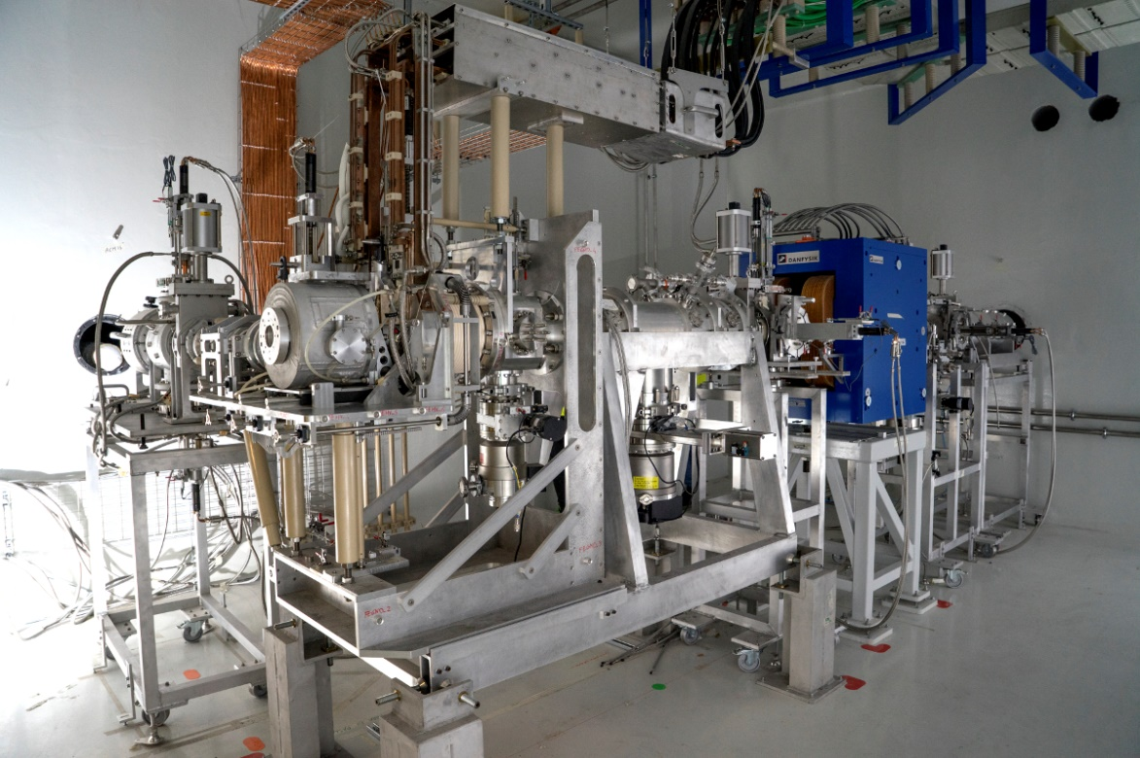
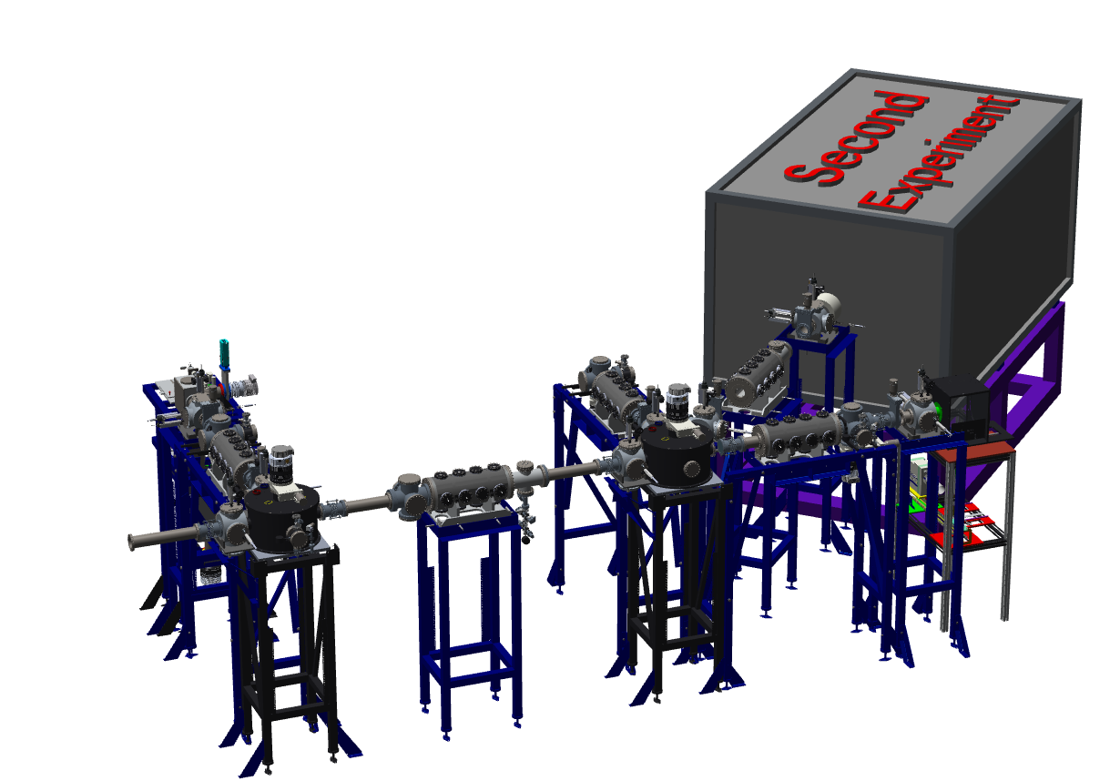
SPES-β: The ISOL facility
Low energy beams
Proton beam
Exotic Ion Beam
Cyclotron primary beam
ISOL
FRONT- END
HRMS – transfer line to post-acceleration

Slide 12
The “Radioisotopes for Medicine and Applied Physics” service
ISOL-2 temporarily dedicated to nuclear cross section measurements
RILAB
DIRECT technology
LAboratory of Radiouclides for MEDicine
ISOL technology
Possible collaboration with industry for production
RIFAC

Slide 13
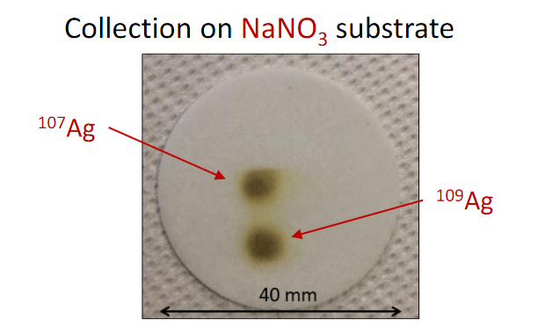
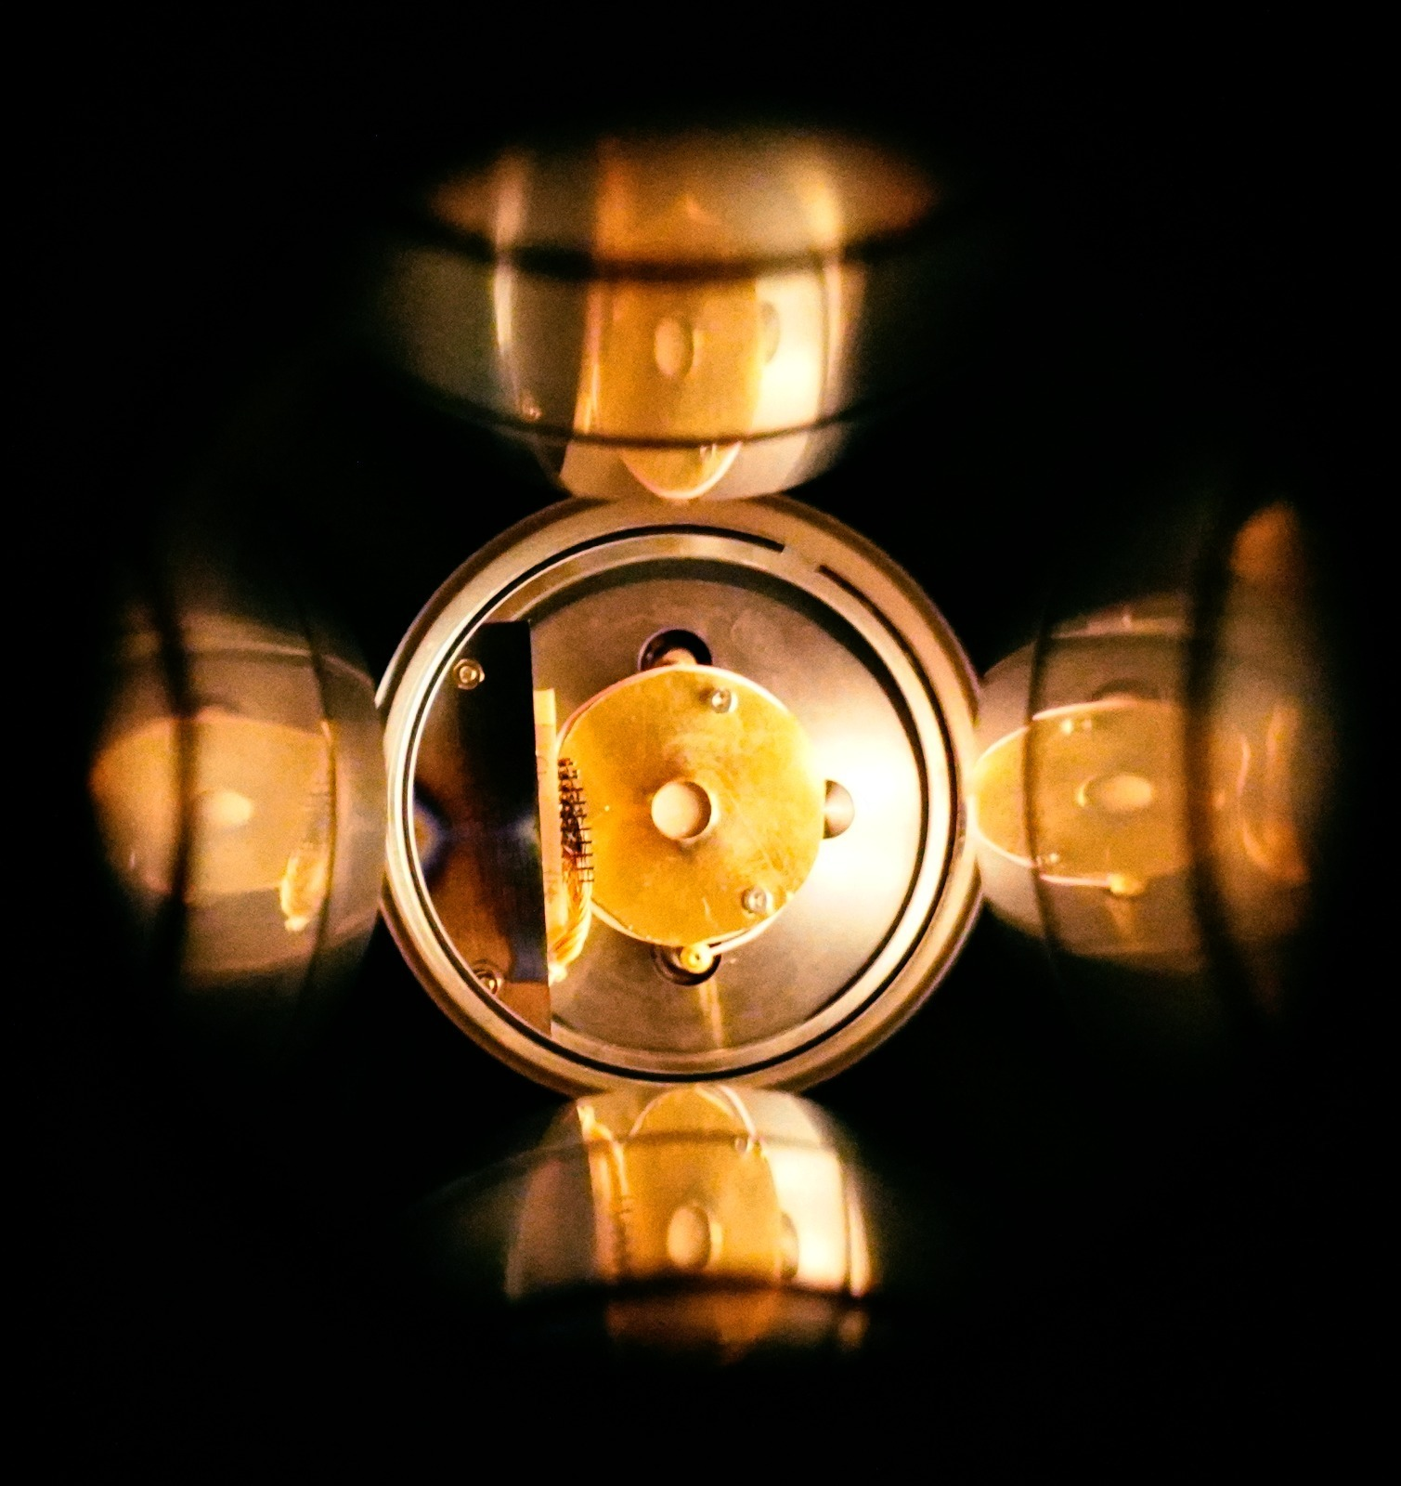
The ISOLPHARM method
https://isolpharm.pd.infn.it/web/

Slide 14
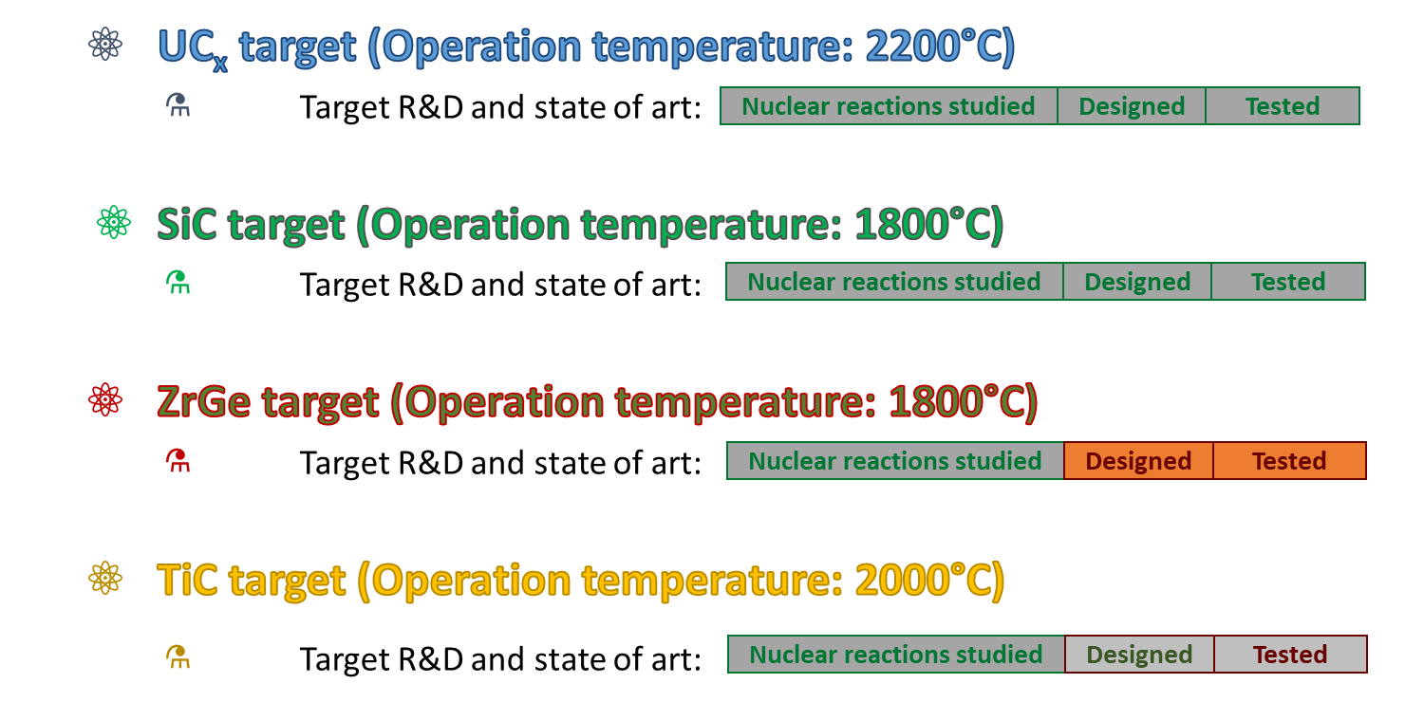
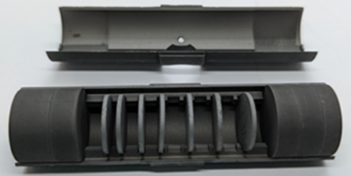
ISOLPHARM: R&D on Targets
Primary targets
Secondary targets

Slide 15
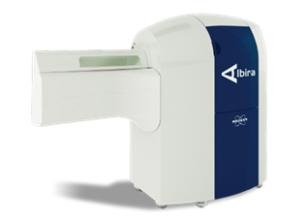
ISOLPHARM: The case of ¹¹¹Ag
Ongoing ISOLPHARM activities: ¹¹¹Ag production and radiopharmaceuticals studies
Production of a ¹¹¹Ag-based radiopharmaceutical
Choice of a target and targeting agent
Development of chelators
In-vivo and in-vitro testing (with ⁶⁸Ga, ⁶⁴Cu and ¹¹¹Ag)
Imaging tests @ CAPIR, Catania

Slide 16
LARAMED project: The direct activation method
2 (maybe soon 3 ) International INFN patents on production methods and targets

Slide 17
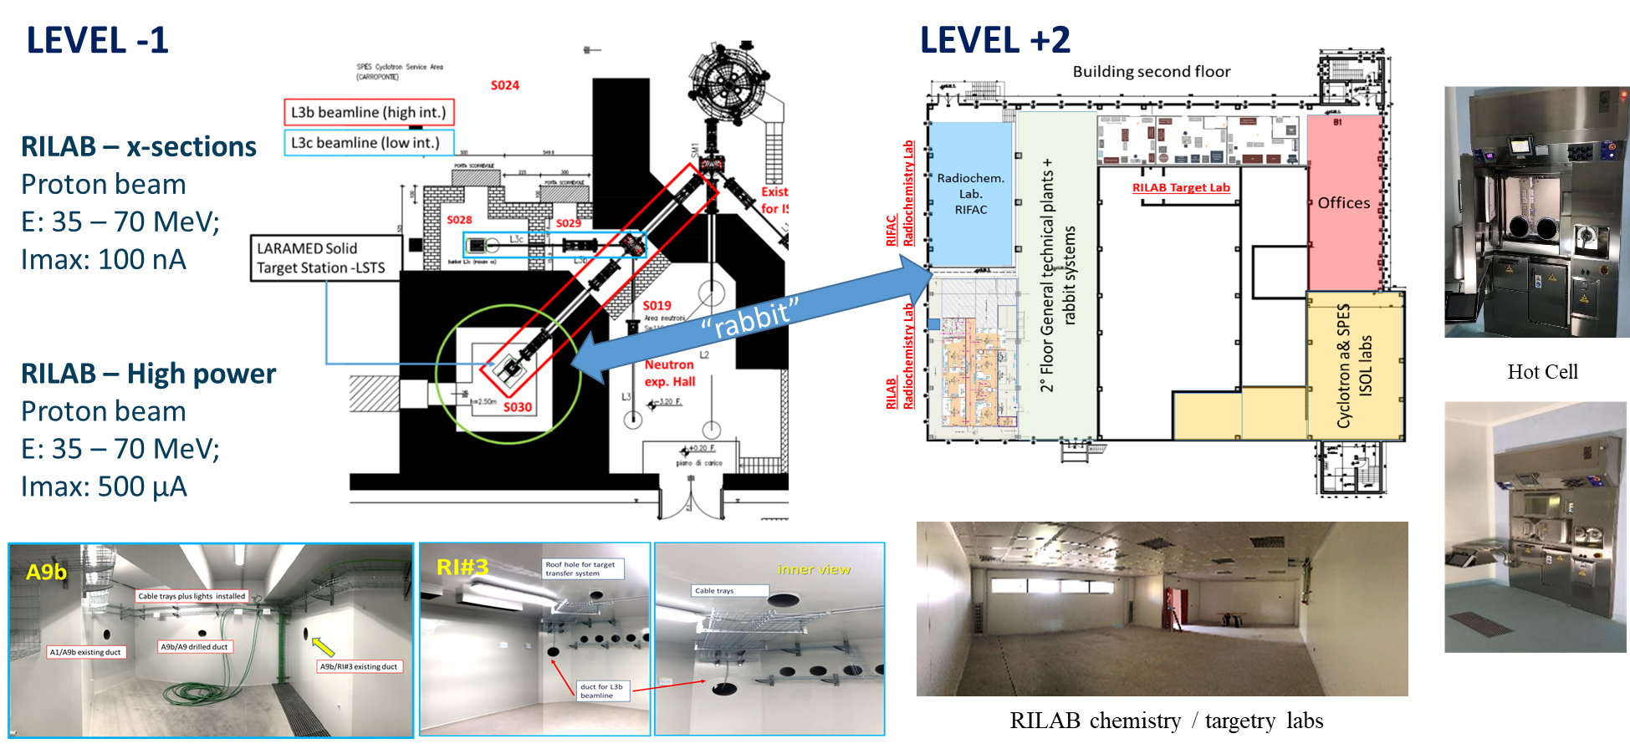
The LARAMED facility

Slide 18
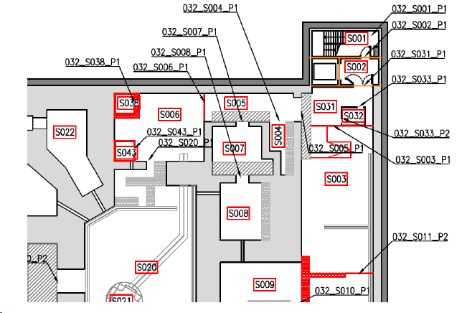
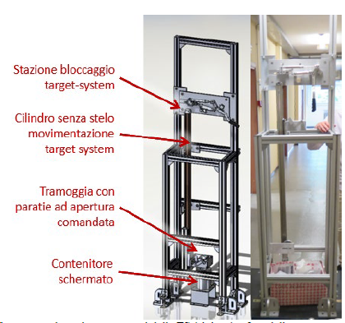
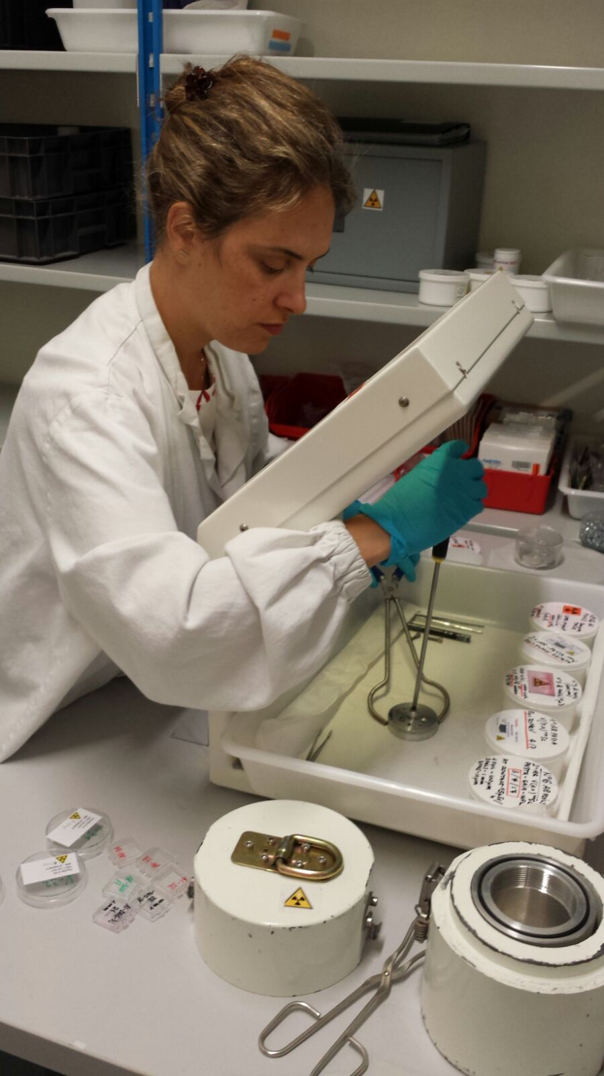
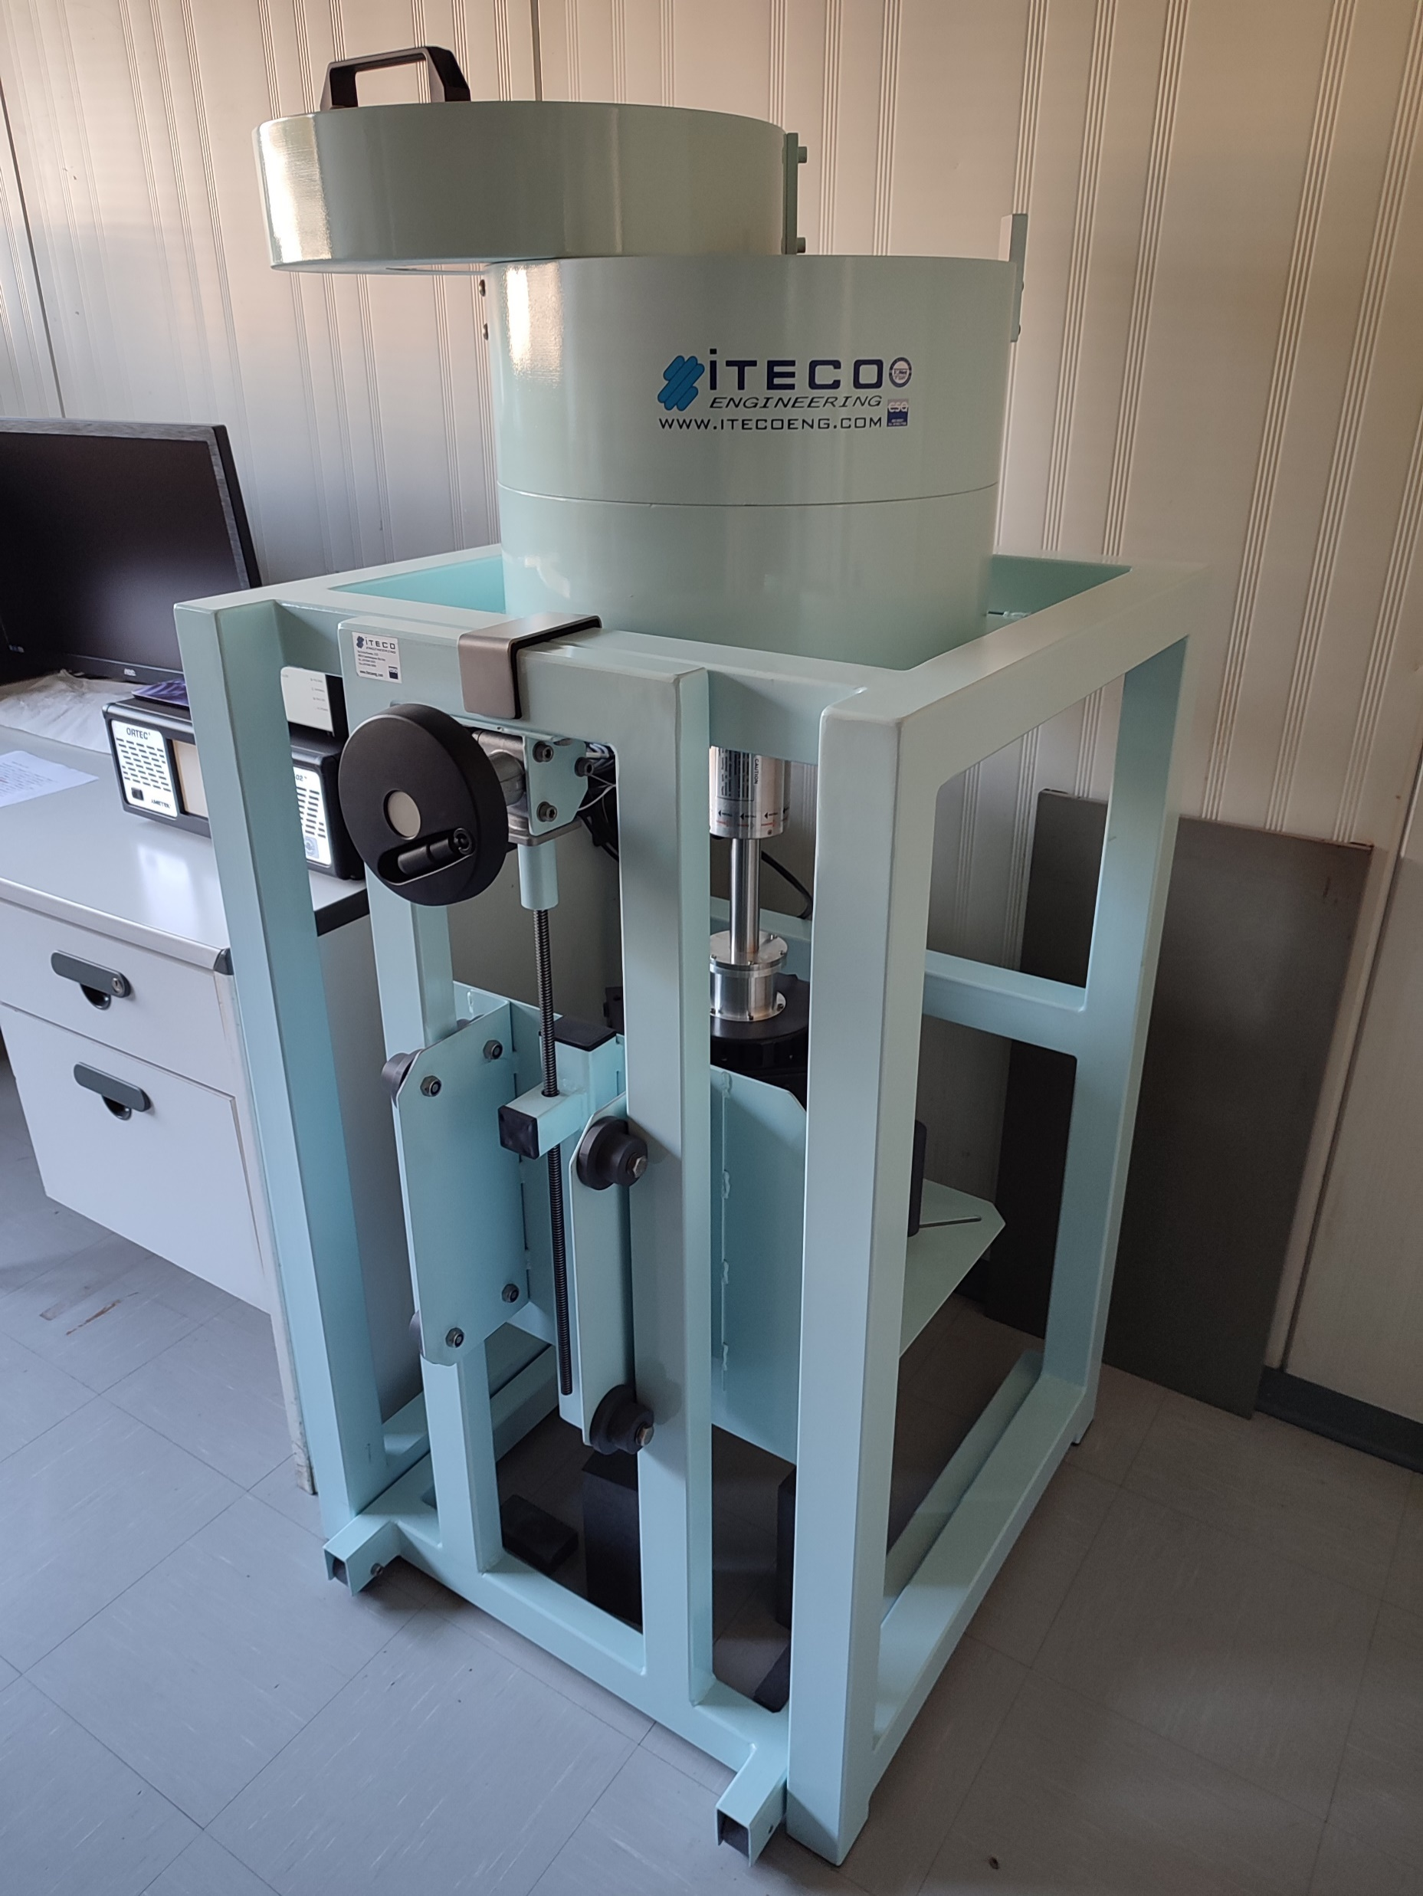
Cross section measurements in ISOL-2
Experimental area to recover the irradiated samples
Experimental area for
γ-spectrometry (2 HPGe detectors)
Target Station (TS)
Cyclotron

Slide 19
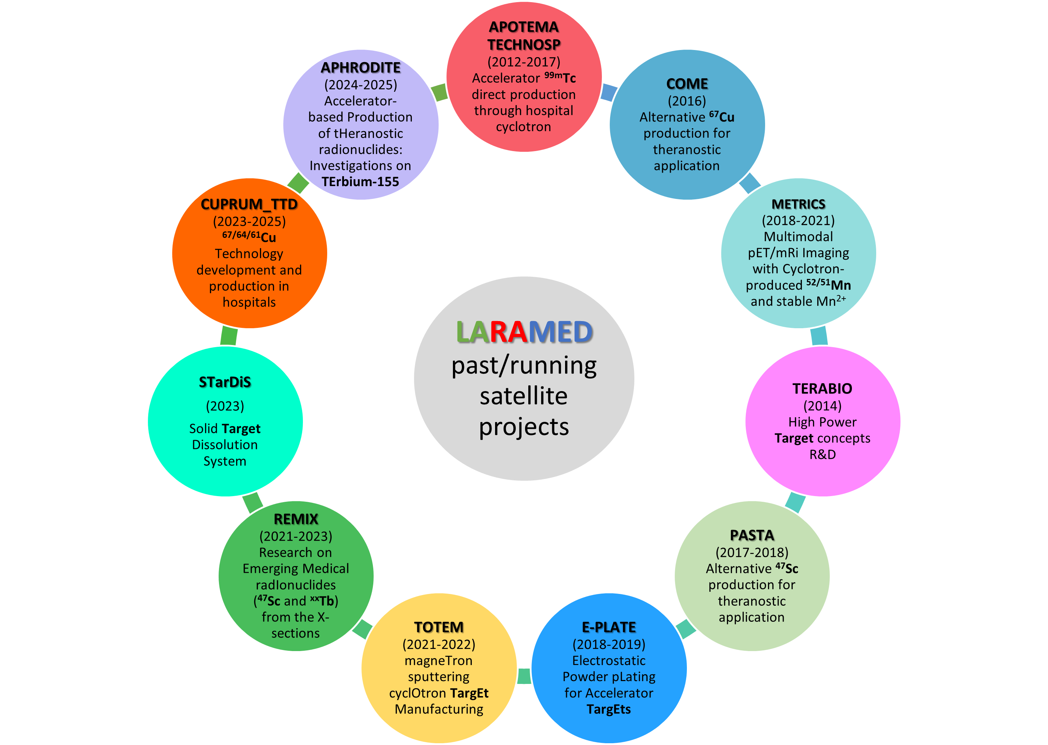
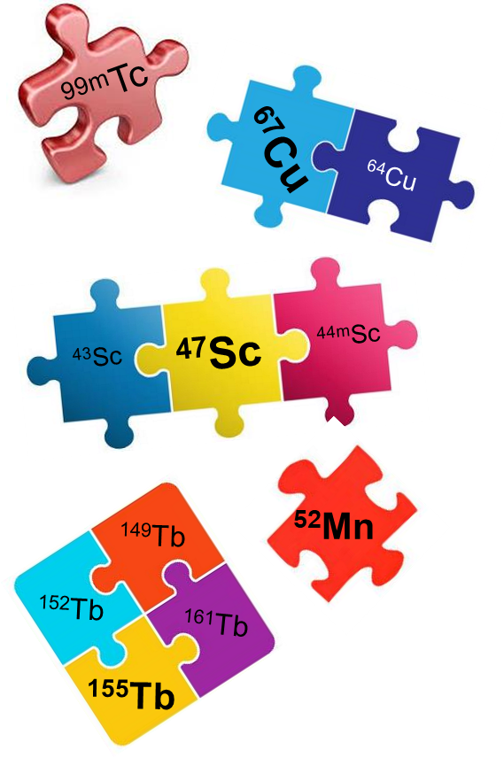
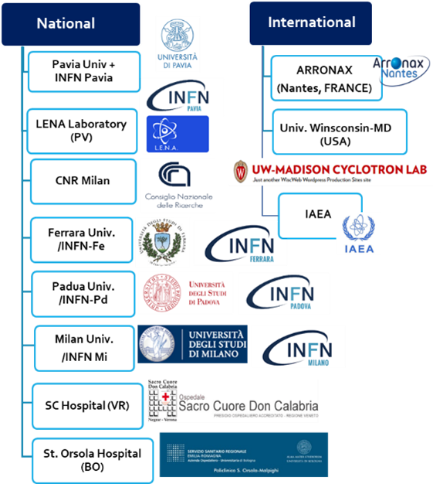
The LARAMED (net)work
https://web.infn.it/LARAMED/

Slide 20
LARAMED target developments

Slide 21
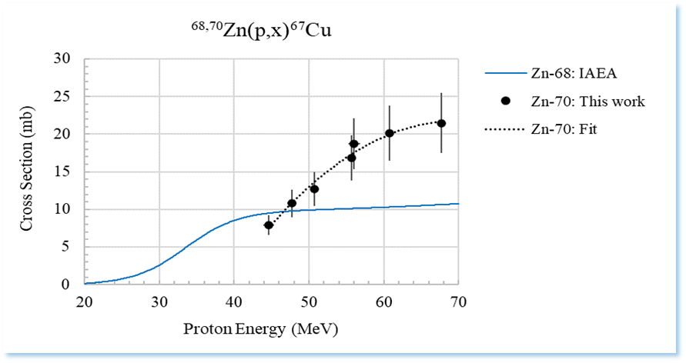
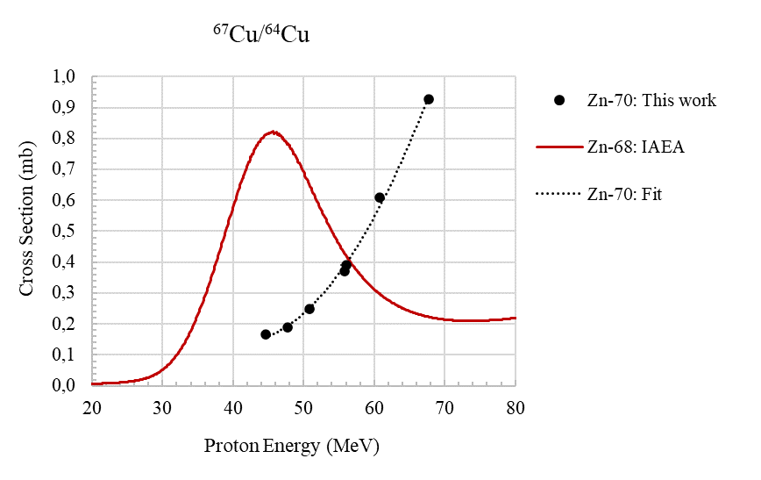
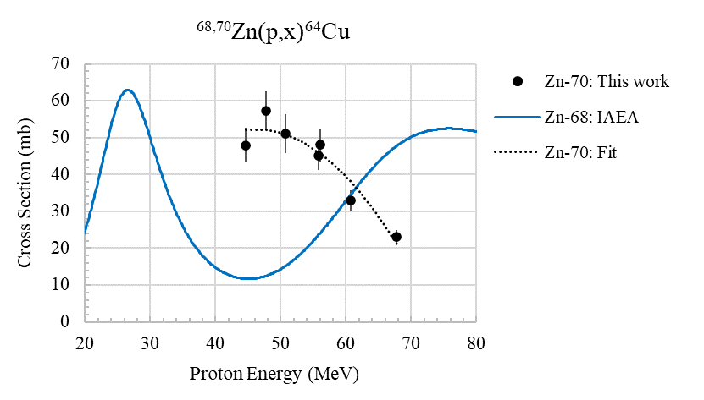
LARAMED Nuclear cross-section measurements
Cross section ratio ⁶⁷Cu/⁶⁴Cu
⁶⁷Cu/⁶⁴Cu ratio favourable from ⁷⁰Zn target above 56 MeV
a.d.u.
“A method and a target for the production of ⁶⁷Cu”
Mou, Pupillo, Martini, Pasquali
International Patent
n° WO 2019/220224 A1
November 2019
G. Pupillo et al., Production of ⁶⁷Cu by enriched ⁷⁰Zn targets…, Radiochimica Acta 108 (8) 2020

Slide 22
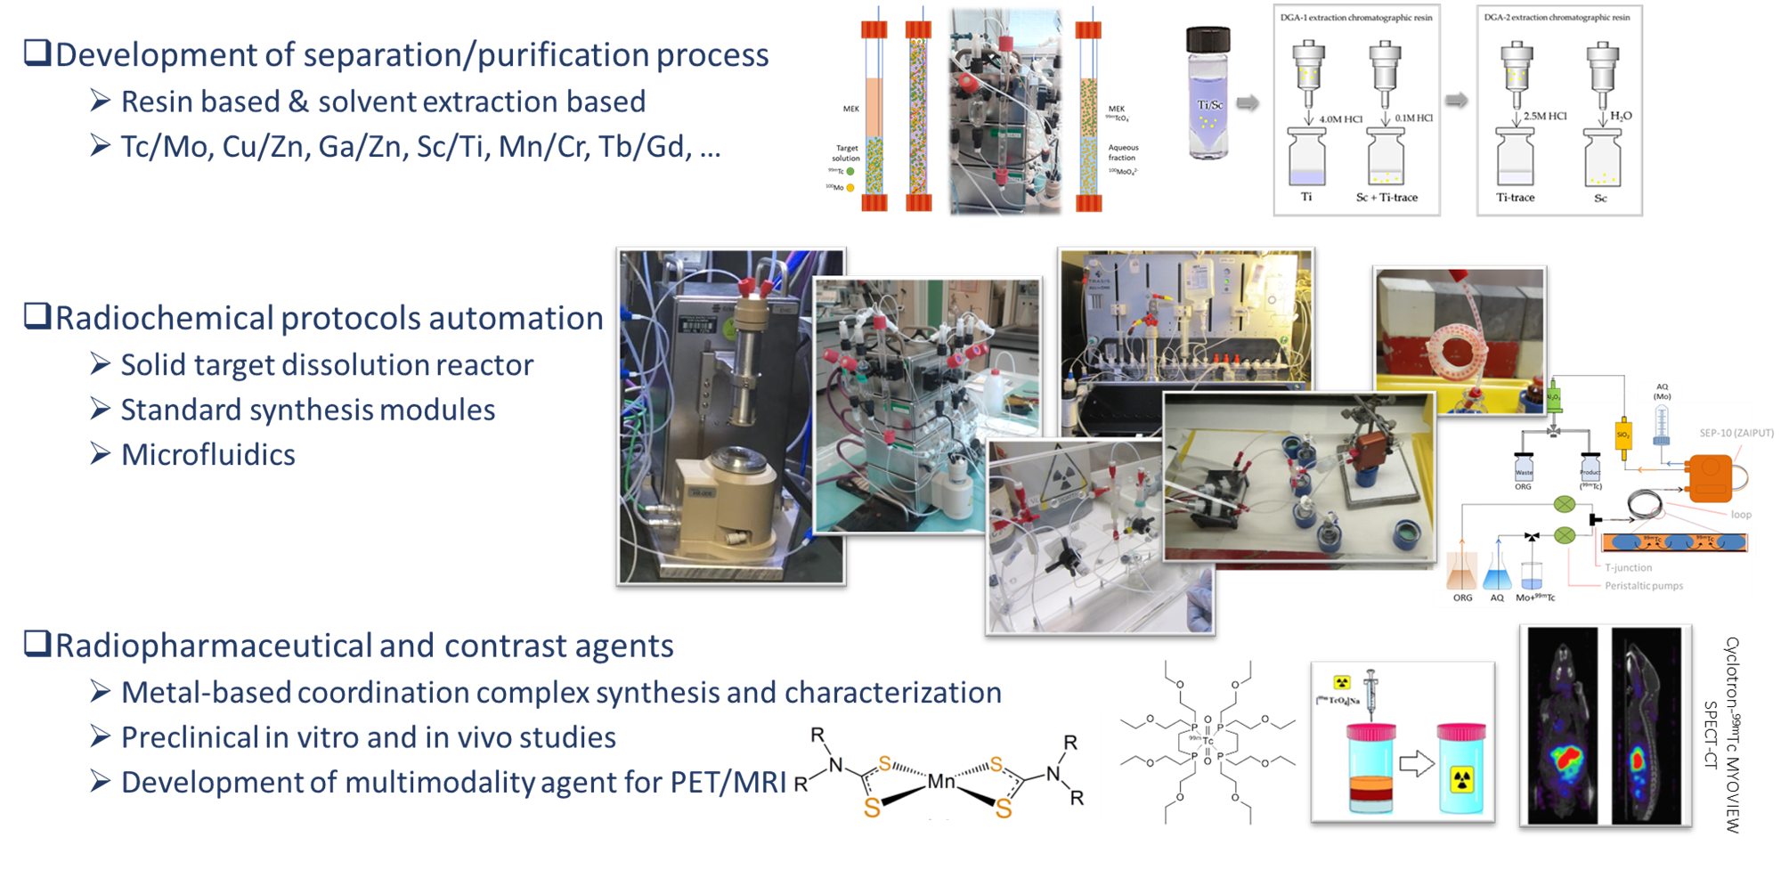
LARAMED Radiochemistry and radiopharmacy

Slide 23
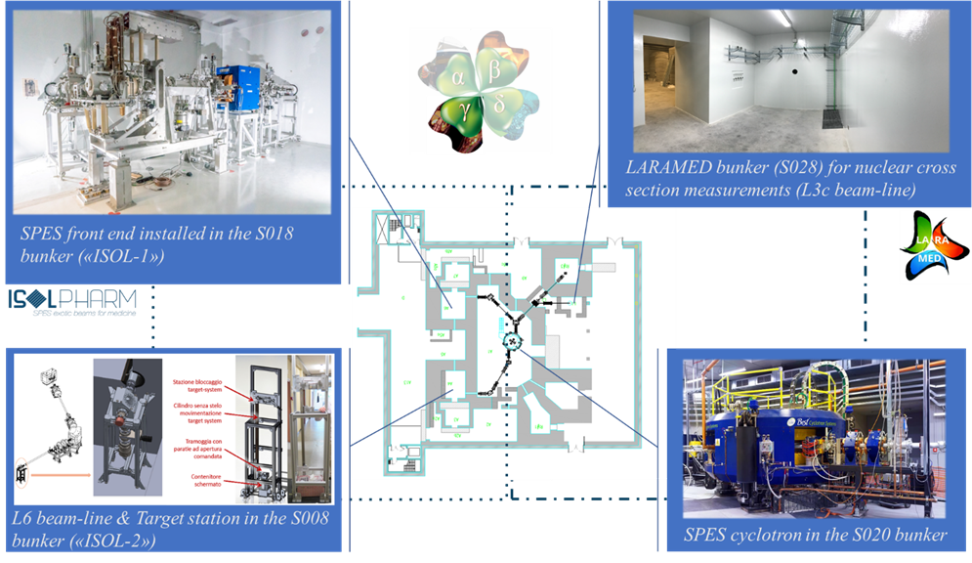
Future perspectives
SPES_MED is a new proposal in CSN3 for the years 2025-2027
PI (Resp. Nazionale): Emilio Mariotti, Università di Siena and INFN-PISA
INFN divisions: LNL, PD, MI, PV and PI organized in Working Package (WP):
WP1: Nuclear cross section measurements for medical radionuclide production
(Lucia De Dominicis and Michele Colucci)
WP2: ISOL production yield measurement
(Alberto Arzenton and Paolo Delogu)
WP3: Nuclear modeling and MonteCarlo simulations
(Francesca Barbaro and Lisa Zangrando)

Slide 24
Future perspectives: Young researches
+ Posters’ sessions!

Slide 25
Conclusions
Many medical radionuclides of interest!
Young team of researchers with different expertise
(targetry, nuclear physics, engineering, radiochemistry, etc.)
Wide national & international network of collaborations &
High potential impact exploiting both ISOL and DIRECT production
Future possibility to also have an off-line mass-separator

Slide 27
WP1:Nuclear cross sections (LNL and MI) 1
The measurement of unexplored nuclear reactions leading to the production of both the radionuclide of interest and its contaminants, to find out the best irradiation parameters
○ ⁴⁹Ti(d,x)⁴⁷Sc up to 30 MeV in collaboration with the ARRONAX facility (LNL team, 1 year)
○ ⁶⁸Zn,⁷⁰Zn(p,x)⁶⁷Cu,⁶⁴Cu for proton beams with energy higher than 70 MeV, in collaboration with the i-Themba facility (LNL team, 1 and 2 year)
○ ⁷⁰Zn(p,x)⁶⁷Cu,⁶⁴Cu in the energy range 25-50 MeV at SPES (LNL team, 3 year)

Slide 28
WP1:Nuclear cross sections (LNL and MI) 2
○ ¹⁵⁹Tb(p,5n)¹⁵⁵Dy →¹⁵⁵Tb up to 70 MeV at SPES, also in the framework of the PRIN PNRR 2022 entitled “APHRODITE-155” and focused on ¹⁵⁵Tb production (LNL and MI team, 1 year)
○ ^{nat}Eu(a,x)¹⁵⁵Tb in the energy range 10-30 MeV in collaboration with ARRONAX facility (1 year) and with Czech Nuclear Physics Institute CAS (MI team, 1 and 2 year)
○ ^{nat}Gd(p,x)^{152,149}Tb in the energy range 40-70 MeV at SPES (LNL and MI team, 2 and 3 year) and at energies up to 200 MeV in collaboration with i-Themba facility (LNL and MI team, 2 and 3 year)
○ ^{nat}Gd(a,x)^{152,155}Tb in the energy range 10-70 MeV in collaboration with ARRONAX facility (MI team, 1 and 2 year) and CAS (MI team, 2 and 3 year)

Slide 29
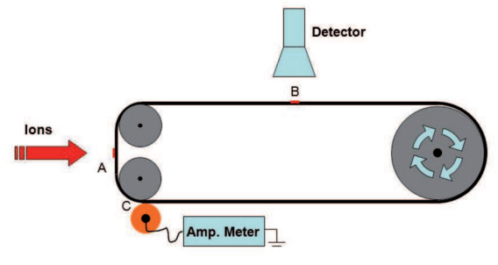
WP2:ISOL production yield (LNL, PD, PV and PI)
The goal is to measure the ISOL production yield with a newly developed detection system and acquire in-depth understanding of the elements that increase production. Besides, the measurements will help establish the yield database of SPES facility.
○ SiC targets will be tested (1 and 2 year)
○ TiC targets will be tested (2 and 3 year)
○ UCx targets will be tested (3 year )
Schematic representation of a moving tape system for yield measurement

Slide 30
WP3:Nuclear modeling and MonteCarlo simulations
Support, explanation and optimization for the experimental WP1 and WP2
○ Nuclear modeling for nuclear cross section measurements (TALYS, EMPIRE, FLUKA and PHITS codes) to find out the best irradiation parameters considering IP, RNP, SA and dosimetric impact of contaminant radionuclides. Genetic algorithms can be also used to optimized the modeling description.
○ MonteCarlo simulations (Geant4, MCNPX and PHITS) for ISOL yield measurements, that can be seen as two sequential processes: (a) isotope diffusion from the crystal lattice to the grain boundary coupled with diffusion through the target matrix to the surface (b) atomic effusion to the ion source.

