Slide 1
Characterization of SiPMs and performance studies for the dRICH detector of the ePIC experiment
Luisa Occhiuto, University of Calabria & INFN Cosenza
luisa.occhiuto@cern.ch INFN 2024

Slide 2
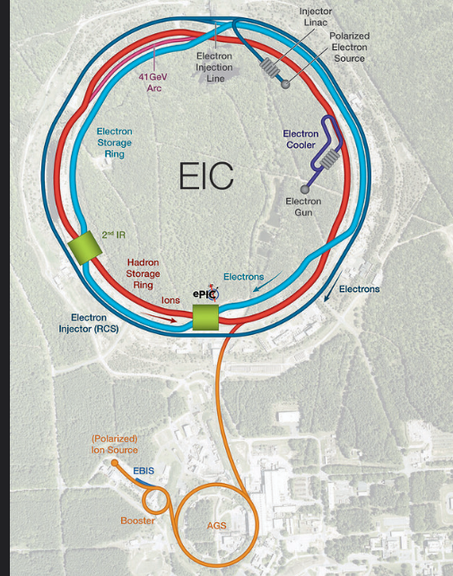
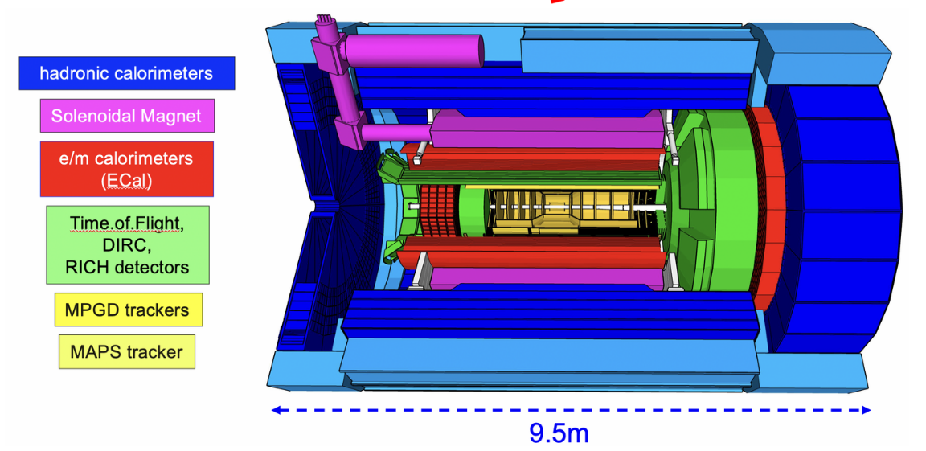
THE ELECTRON-ION COLLIDER AND THE ePIC EXPERIMENT
Key capability: particle tracking and identification (PID), aiming to separate electrons from pions, kaons and protons.
Two radiators: aerogel ($n \sim 1.02$), C2F6($n \sim 1.008$)
Mirrors: 6 large open sectors with radius 220 cm
SiPM sensors
dRICH detector
luisa.occhiuto@cern.ch INFN 2024 1

Slide 3
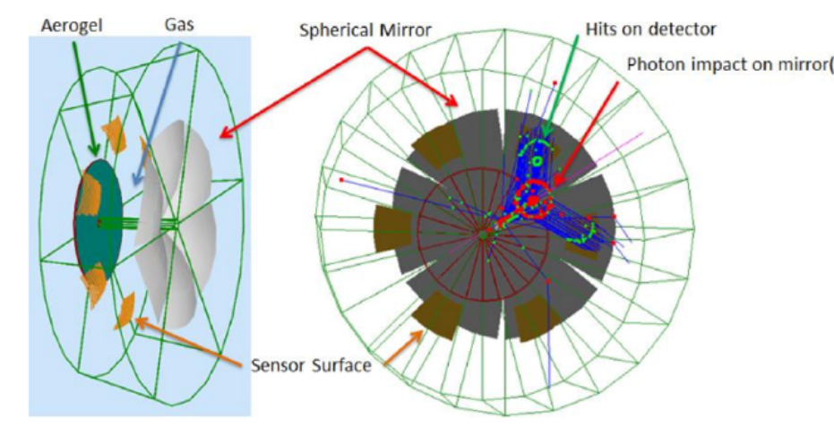
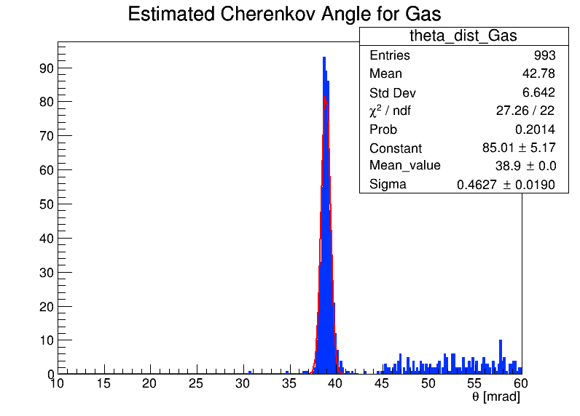
Nσ SEPARATION OF π AND K
Identification of particles with momentum from a few GeV/c up to about 50 GeV/c.
$$η=−\ln\left(\tan\left(\frac{θ}{2}\right)\right)$$
Momentum for the gas $→$ [13.0 , 60.0] GeV in steps of 5 GeV.
Momentum for the aerogel $→$ [1.0 , 19.0 ] GeV in steps of 2 GeV.
Pseudorapidity ($η$) $→$ [1.5, 2.0] , [2.0, 2.5] , [2.5, 3.5].
From geometrical consideration $→$ Cerenkov angles.
Gaussian fit on distribution of Cerenkov angle.
Mean and sigma from these fits.
Evaluation of the separation between pions and kaons as a function of the particle momentum with:
N$σ= \frac{Mπ−M_{k}}{σ_{πk}}$
luisa.occhiuto@cern.ch INFN 2024 2

Slide 4
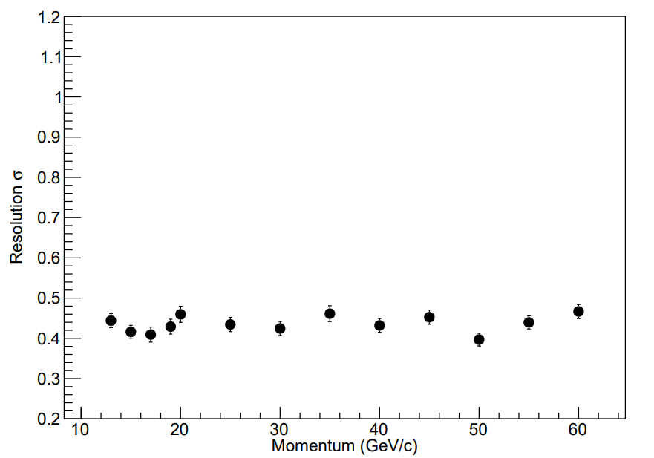
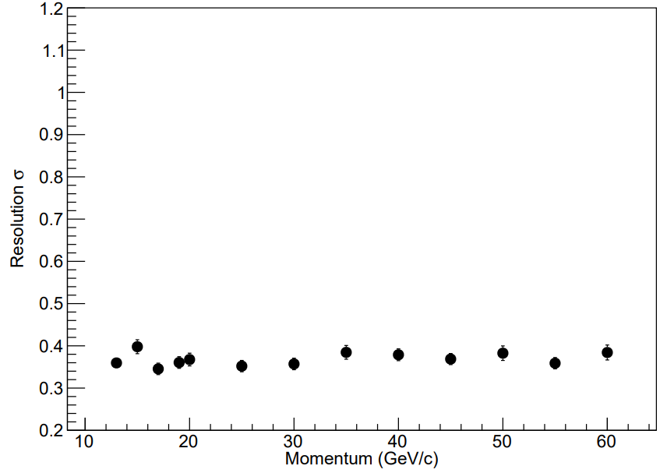
N$σ$
N$σ$
N$σ$
Momentum (GeV/c)
Momentum (GeV/c)
Momentum (GeV/c)
$$η=[2.0, 2.5]$$
$$η=[2.5, 3.5]$$
Resolution of Cerenkov angle (π)
luisa.occhiuto@cern.ch INFN 2024 3

Slide 5
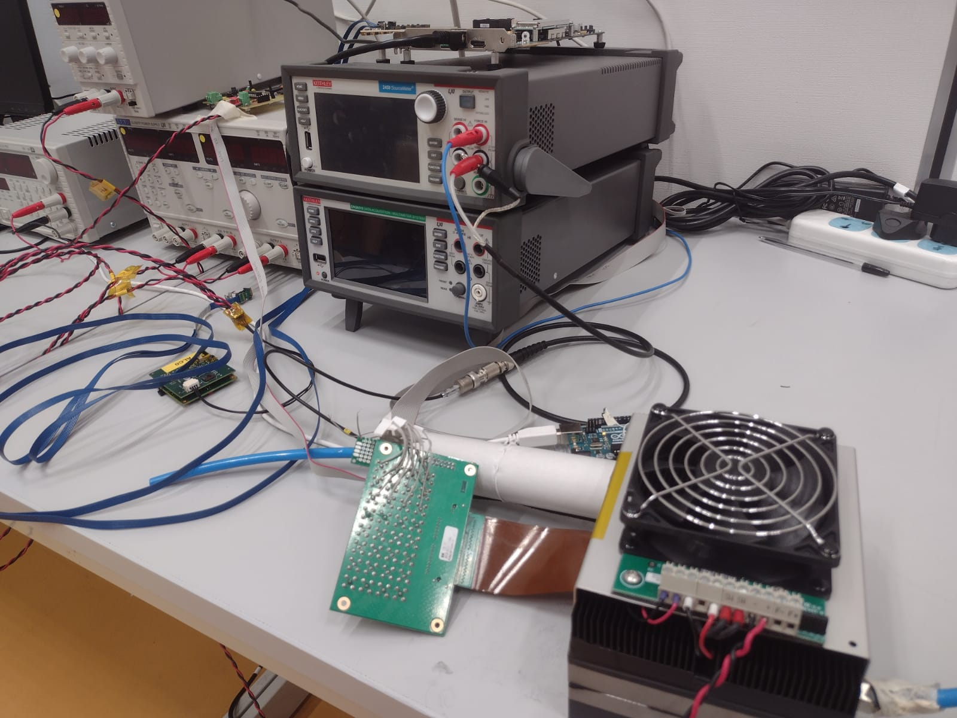
I-V CHARACTERIZATION
Characterization setup for I-V characteristic installed in Cosenza, University of Calabria.
PRO
Single photon detection;
High Photon Detection Efficiency;
Good time resolution;
Insensitive to magnetic field.
Cheap
Low voltage operation
CONS:
Large Dark Count Rate
Prone to radiation damage
Costum made portable Peltier box
Ultra pure air tanks
Multiplexer
Source Meter
Power supplies
Adapter board
SiPM board
1° set of measurements
HAMA S13360-3050
5 boards analyzed.
Data acquisition of I-V characteristic @ 253 K.
HAMA S13360-3075
HAMA S14160-3050
luisa.occhiuto@cern.ch INFN 2024 4

Slide 6
Characterization setup for I-V characteristic installed in Cosenza, University of Calabria.
Irradiation with different energies @ fixed fluence, ${10}^{9} p/cm^{2}$.
To lower energy: IBA Solid Plate Phantom (RW3).
PRO
Single photon detection;
High Photon Detection Efficiency;
Good time resolution;
Insensitive to magnetic field.
Cheap
Low voltage operation
CONS:
Large Dark Count Rate
Prone to radiation damage
#Board | Energy scan (MeV) | RW3 thickness (mm)
1 | 138 | 0
2 | 73 | 88
3 | 41 | 116
4 | 20 | 127
5 | 13 | 131
Costum made portable Peltier box
Ultra pure air tanks
Multiplexer
Source Meter
Power supplies
Adapter board
SiPM board
2° set of measurements
1° step of measurements
HAMA S13360-3050
5 boards analyzed.
Data acquisition of I-V characteristic @ 253 K.
HAMA S13360-3075
HAMA S14160-3050
luisa.occhiuto@cern.ch INFN 2024 4

Slide 7
Characterization setup for I-V characteristic installed in Cosenza, University of Calabria.
Irradiation with different energies @ fixed fluence, ${10}^{9} p/cm^{2}$.
To lower energy: IBA Solid Plate Phantom (RW3).
PRO
Single photon detection;
High Photon Detection Efficiency;
Good time resolution;
Insensitive to magnetic field.
Cheap
Low voltage operation
CONS:
Large Dark Count Rate
Prone to radiation damage
Oven annealing: 150 h @ 150 °C
#Board | Energy scan (MeV) | RW3 thickness (mm)
1 | 138 | 0
2 | 73 | 88
3 | 41 | 116
4 | 20 | 127
5 | 13 | 131
Costum made portable Peltier box
Ultra pure air tanks
Multiplexer
Source Meter
Power supplies
Adapter board
SiPM board
3° set of measurements
2° step of measurements
1° step of measurements
HAMA S13360-3050
5 boards analyzed.
Data acquisition of I-V characteristic @ 253 K.
HAMA S13360-3075
HAMA S14160-3050
luisa.occhiuto@cern.ch INFN 2024 4

Slide 8
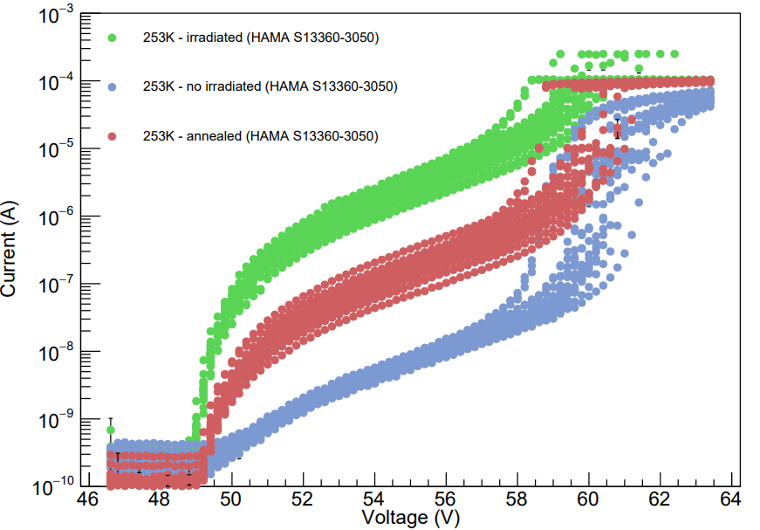
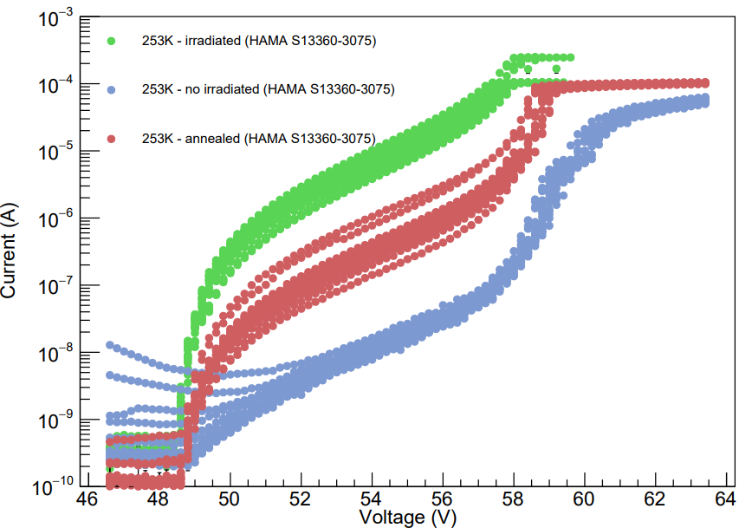
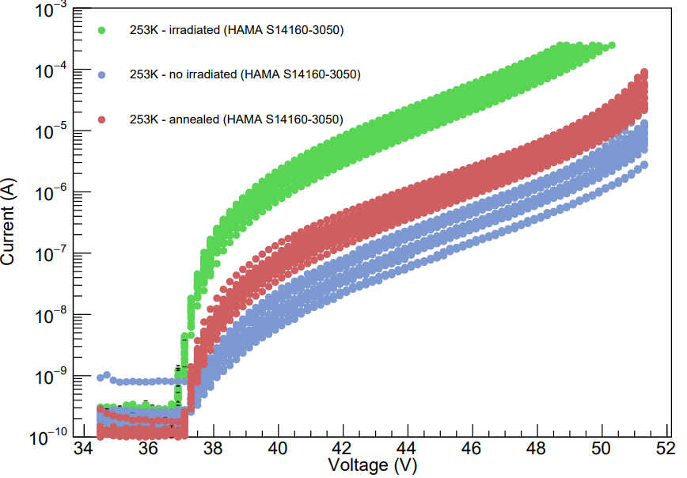
I-V CHARACTERISTIC
253K- no irradiated
253K- annealed
253K- irradiated
luisa.occhiuto@cern.ch INFN 2024 5

Slide 9
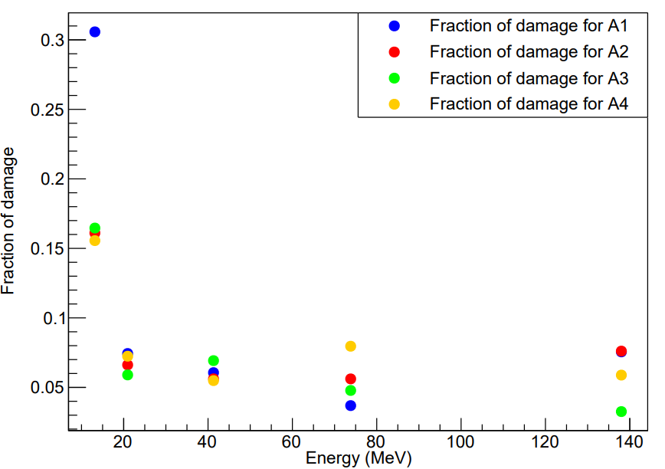
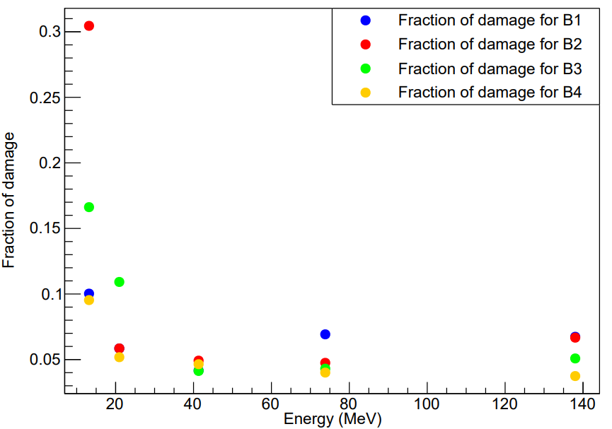
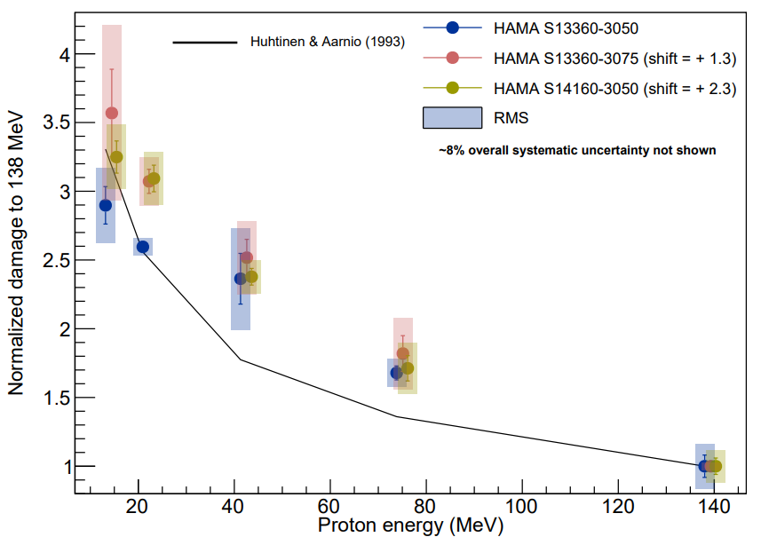
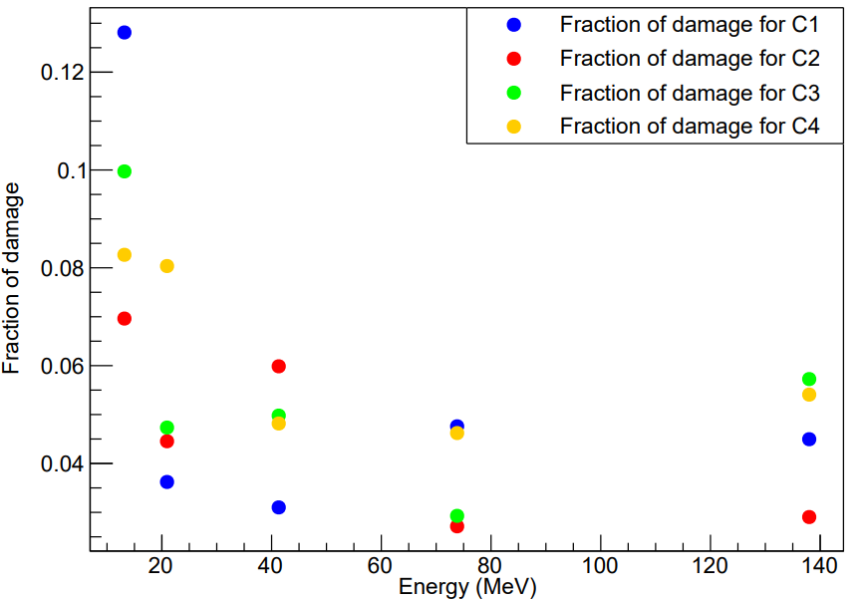
ENERGY SCAN
Overvoltage = Dark current - Vbd
PRELIMINARY
Fraction of damage for each sensor
$$\frac{{(I}_{ann}−I_{noirr})}{{(I}_{irr}−I_{noirr})} \frac{1}{ε}$$
Displacement damage for each sensor. A proton at 13 MeV is more harmful than a proton at 138 MeV.
For semplicity we call:
HAMA S13360-3050 == A
HAMA S13360-3075 == B
HAMA S14160-3050 == C
$$\frac{{(I}_{irr}−I_{noirr})}{{(I}_{irr}−I_{noirr})(138 MeV)} \frac{1}{ε}$$
$ε$ =efficiency of degrader.
luisa.occhiuto@cern.ch INFN 2024 6

Slide 10
CONCLUSION AND OUTLOOK
SIMULATION
OUTLOOK
SiPMs
OUTLOOK
Nσ SEPARATION
NOISE
CHARACTERIZATION
γ RAYS
Pions, kaons can be separated up to 50 GeV for a large range of pseudorapidity.
Below $η<2.0$ the focalization is not optimal.
The next step is to add noise and see how the Nσ separation and the resolution change.
Radiation damage is in agreement with the NIEL model.
With annealing there is a recovery of the performance of the sensors independent of the energy used to irradiate them.
The next step is to irradiate the sensors with gamma rays and see how the damage changes
luisa.occhiuto@cern.ch INFN 2024 7

Slide 11
THANKS!
luisa.occhiuto@cern.ch INFN 2024 8

Slide 12
Backup
luisa.occhiuto@cern.ch INFN 2024 9

Slide 13
SiPM SENSORS
The Dark Dount Rate (signal per unit of time observed in absence of a photon beam) can be reduced by operating at low temperatures ($\sim \left[−20, −30\right] °C$).
Effect of radiation on SiPMs depends of various factor:
Type of radiation
Energy of the particles
Radiation dose
Duration of exposure
Radiation damage by Non-Ionizing Energy Loss (NIEL) leads to displacement damages and build up of crystal defects that results basically in increased DCR http://rd50.web.cern.ch/NIEL/default.html.
Different particles $→$ different interaction $→$ different damage.
Sensors: 3x3 $mm^{2}$ pixel
PRO:
Single photon detection;
High Photon Detection Efficiency;
Good time resolution;
Insensitive to magnetic field.
Cheap
Low voltage operation
CONS:
Large Dark Count Rate
Prone to radiation damage
HAMA S13360-3050
HAMA S13360-3075
HAMA S14160-3050
luisa.occhiuto@cern.ch INFN 2024 10

Slide 14
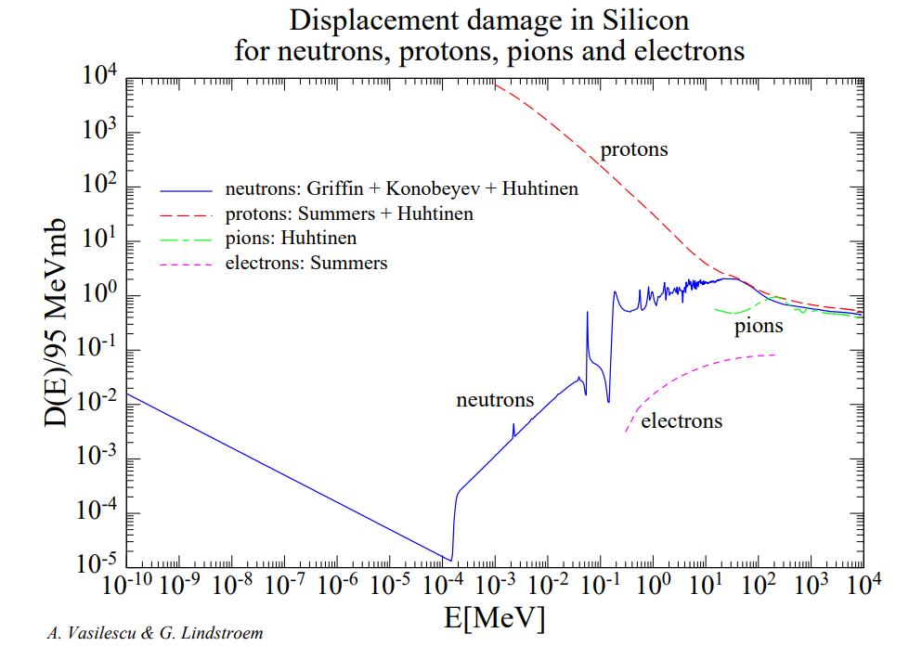
SiPM SENSORS
The hardness factor k is used to normalize the damage caused by different incident particles relative to a reference particle, in this case a 1 MeV neutron.
This allows us to compare the damage caused by particles with different energies on a common scale.
In other words, it tells us how much energy a 1 MeV neutron beam would have to have to cause the same damage.
Sensors: 3x3 $mm^{2}$ pixel
PRO:
Single photon detection;
High Photon Detection Efficiency;
Good time resolution;
Insensitive to magnetic field.
Cheap
Low voltage operation
CONS:
Large Dark Count Rate
Prone to radiation damage
HAMA S13360-3050
HAMA S13360-3075
HAMA S14160-3050
$$k=\frac{D_{particle}}{D_{n}\left(1 MeV n_{eq}\right)}=\frac{D_{particle}}{95 MeV mb}$$
A few MeV proton is more harmful than a 1 MeV neutron. From $\sim$100 MeV damage seems to be compatible between neutrons and protons.
luisa.occhiuto@cern.ch INFN 2024 11

Slide 15
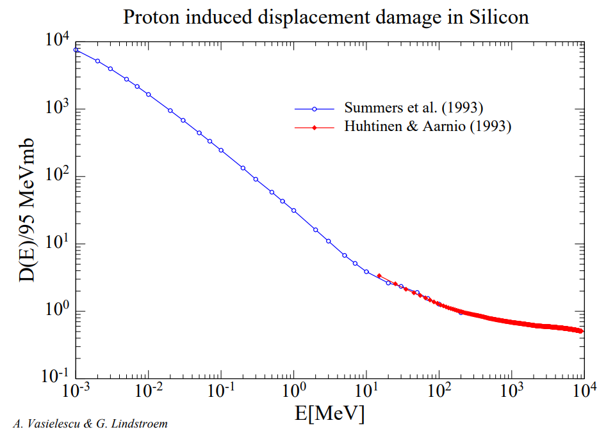
SiPM SENSORS
The hardness factor k is used to normalize the damage caused by different incident particles relative to a reference particle, in this case a 1 MeV neutron.
This allows us to compare the damage caused by particles with different energies on a common scale.
In other words, it tells us how much energy a 1 MeV neutron beam would have to have to cause the same damage.
Sensors: 3x3 $mm^{2}$ pixel
PRO:
Single photon detection;
High Photon Detection Efficiency;
Good time resolution;
Insensitive to magnetic field.
Cheap
Low voltage operation
CONS:
Large Dark Count Rate
Prone to radiation damage
HAMA S13360-3050
HAMA S13360-3075
HAMA S14160-3050
$$k=\frac{D_{particle}}{D_{n}\left(1 MeV n_{eq}\right)}=\frac{D_{particle}}{95 MeV mb}$$
Where D is the displacement damage cross section.
luisa.occhiuto@cern.ch INFN 2024 12

Slide 16
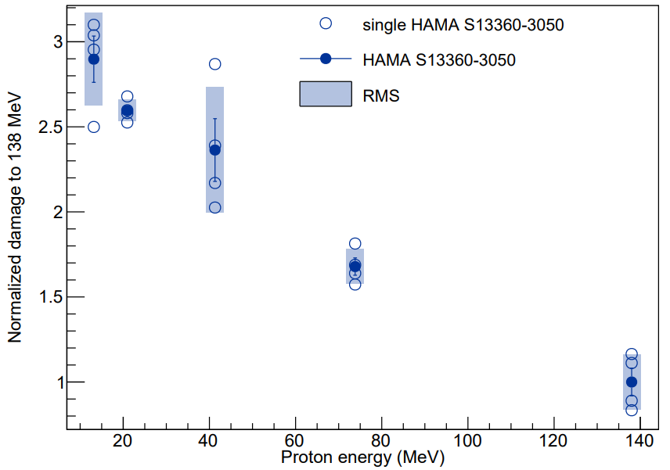
ENERGY SCAN
Overvoltage = Dark current - Vbd
Evaluation of breakdown voltage (Vbd).
Evaluation of current at 3 Overvoltage.
Evaluation of difference between current post and pre irradiation.
Uniform distribution assumption.
$$\frac{{(I}_{irr}−I_{noirr})}{{(I}_{irr}−I_{noirr})(138 MeV)} \frac{1}{ε}$$
$ε$ =efficiency of degrader.
luisa.occhiuto@cern.ch INFN 2024 13

