Slide 1
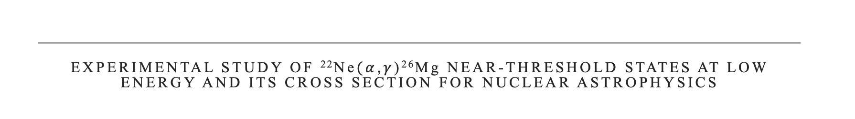





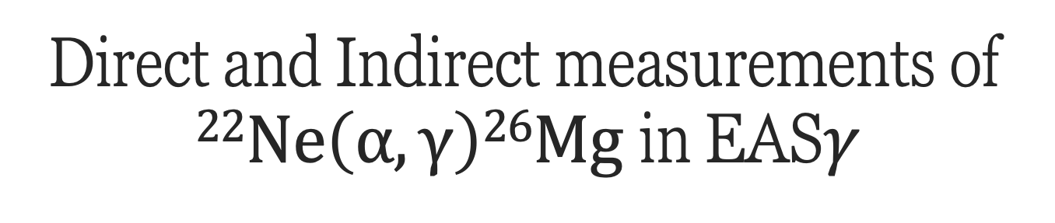
Direct and Indirect measurements of $22Ne\left(α,γ\right)26Mg$ in EAS$γ$
Daniela Mercogliano
Unina & INFN-Na
daniela.mercogliano@unina.it

Slide 2
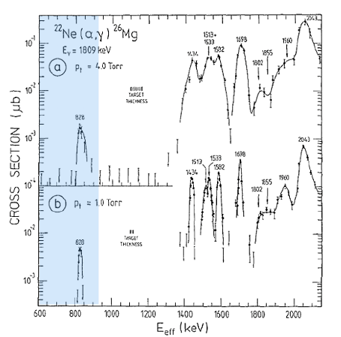
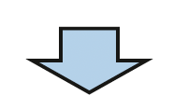
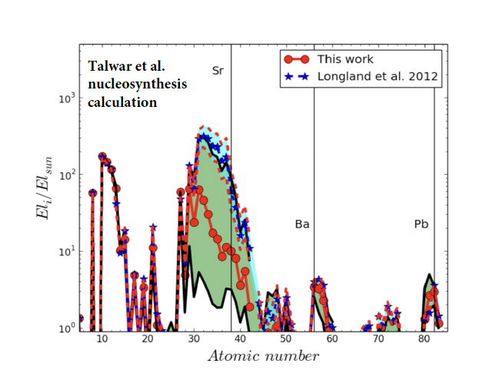
$22Ne\left(α,γ\right)26Mg$- Astrophysical motivation
  He-burning of ²²Ne
  ²²Ne(α,n)²⁵Mg ²²Ne(α,γ)²⁶Mg
  Q=-478 keV Q=10614.7 keV
  Need to determine the reaction rates for both channels
    - High level density of ²⁶Mg
    - Low value of energy and cross-section
    No data from direct measurements below 830 keV
    Discrepancies in indirect data
    • Γ_{α} known only as UL
Wolke et al

Slide 3
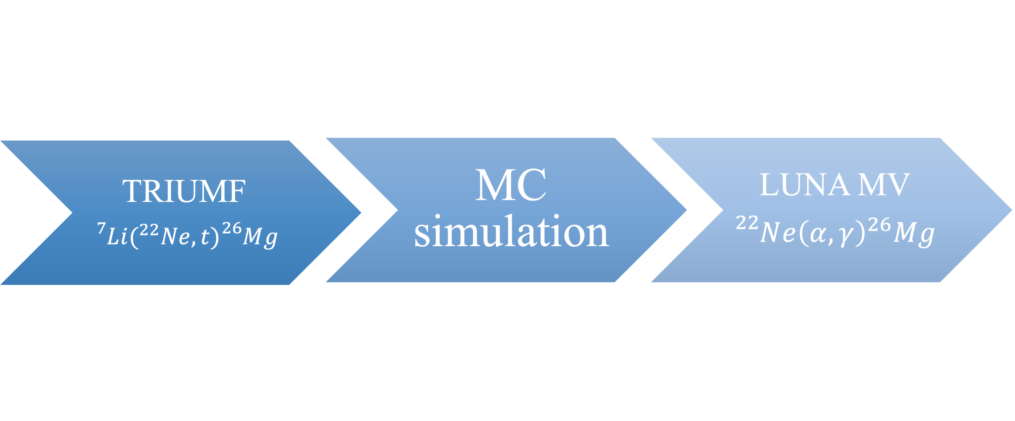

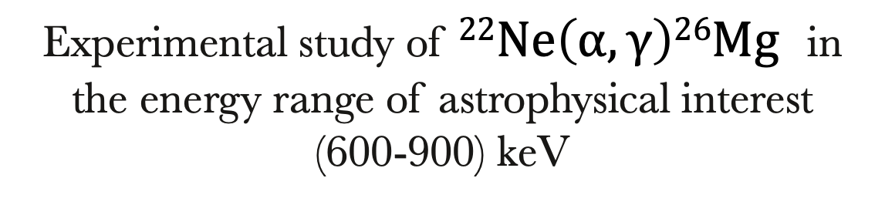
$22Ne\left(α,γ\right)26Mg$ – The EASγ project
Purpose
Experimental study of $22Ne\left(α,γ\right)26Mg$ in the energy range of astrophysical interest
(600-900) keV

Slide 4
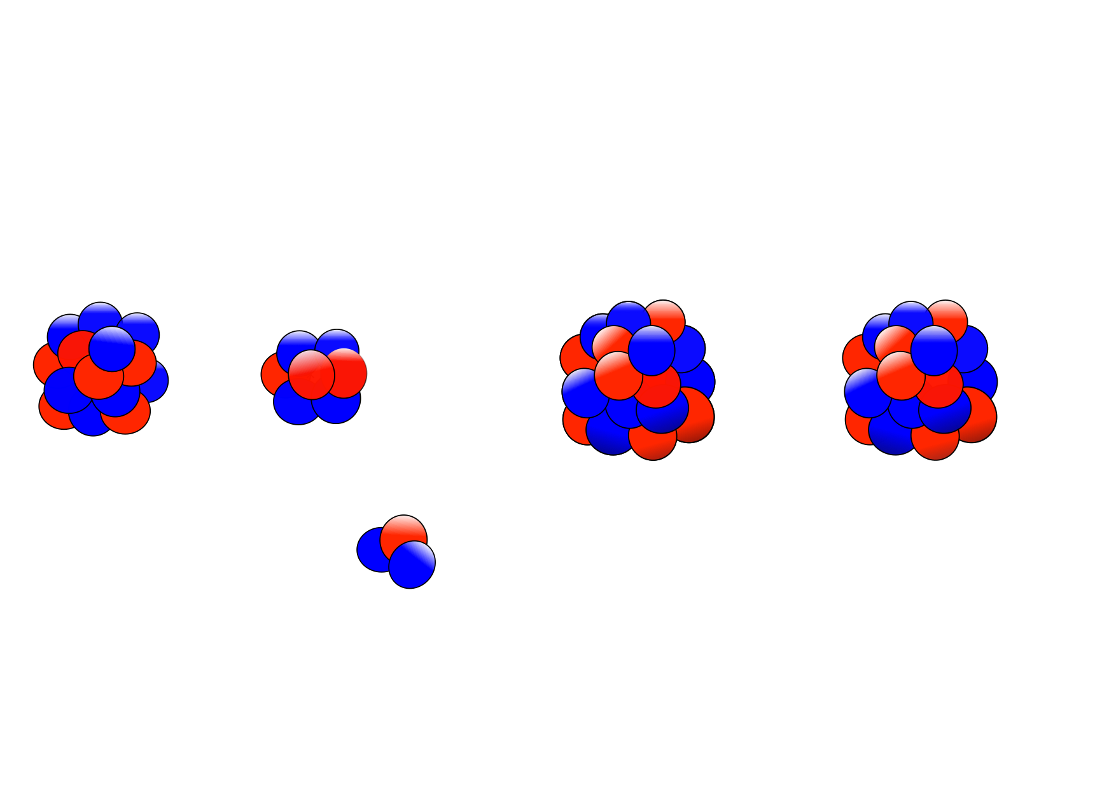


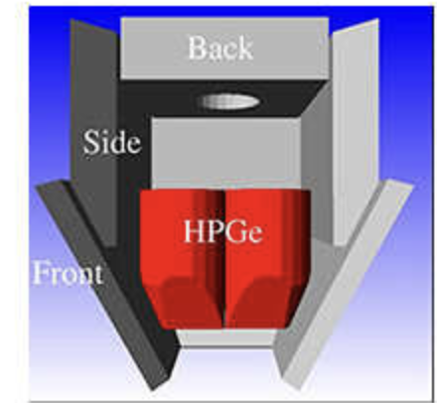
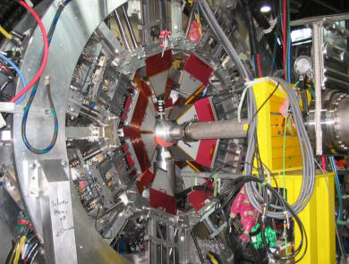
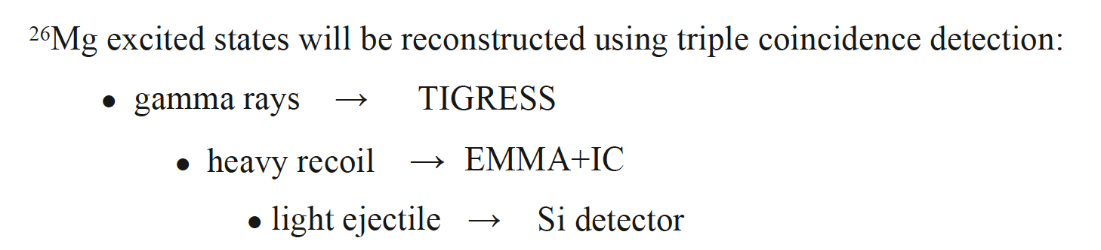
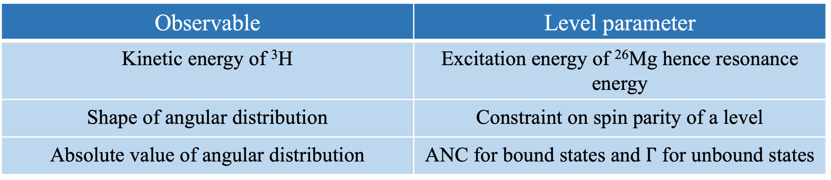

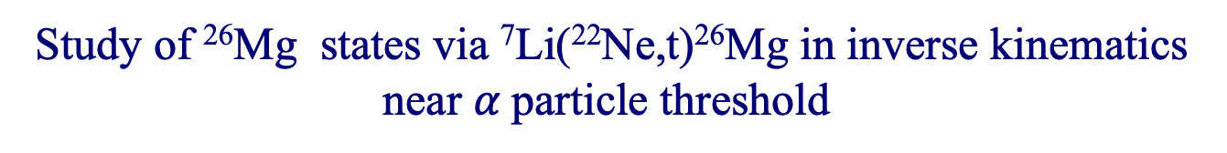
$22Ne\left(α,γ\right)26Mg$with EASγ – Indirect measurement
Study of ²⁶Mg states via ⁷Li(²²Ne,t)²⁶Mg in inverse kinematics near $α$particle threshold
²²Ne
⁷Li
²⁶Mg*
²⁶Mg
³H
$(E_{x}≃$11MeV)

Slide 5



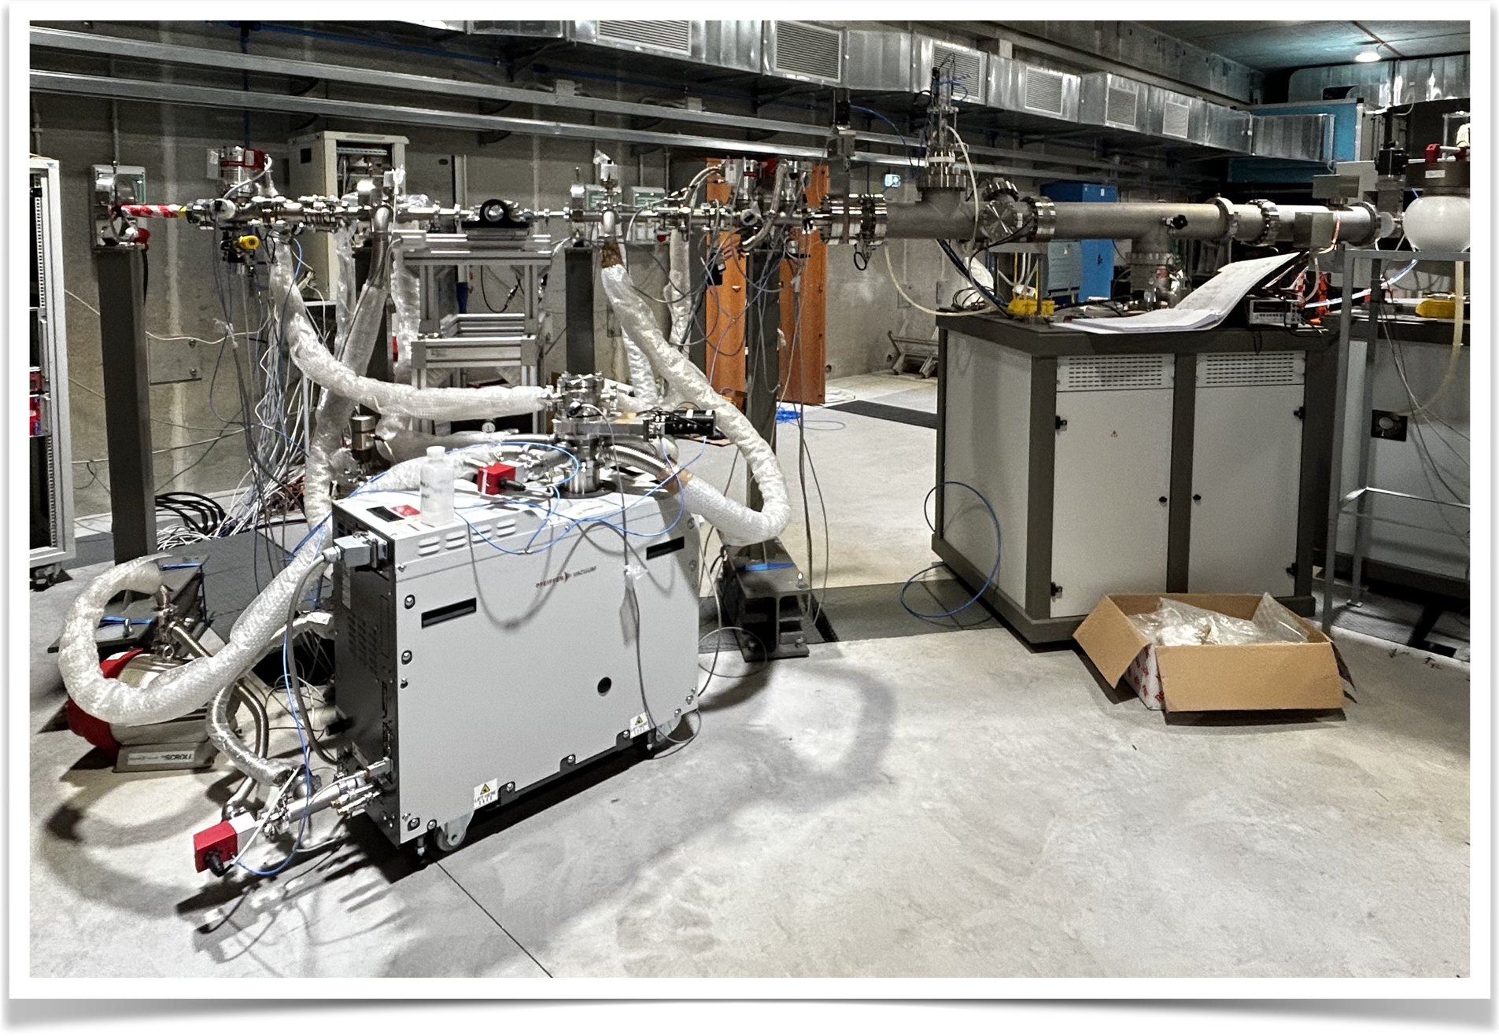

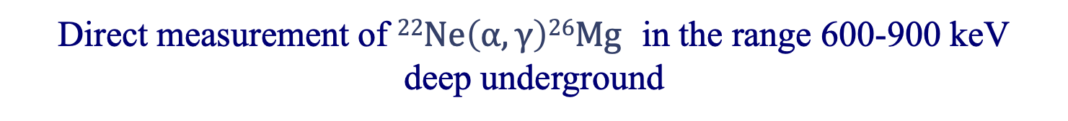
$22Ne\left(α,γ\right)26Mg$with EASγ – Direct measurement
Direct measurement of $22Ne\left(α,γ\right)26Mg$ in the range 600-900 keV
deep underground
Environmental radioactivity
E_{γ} = 1461keV
⁴⁰K
Cosmic rays
E_{γ} = 2615keV
²⁰⁸Tl
$η_{FEP}=10\%$ for E_{γ} = 4 MeV

Slide 6
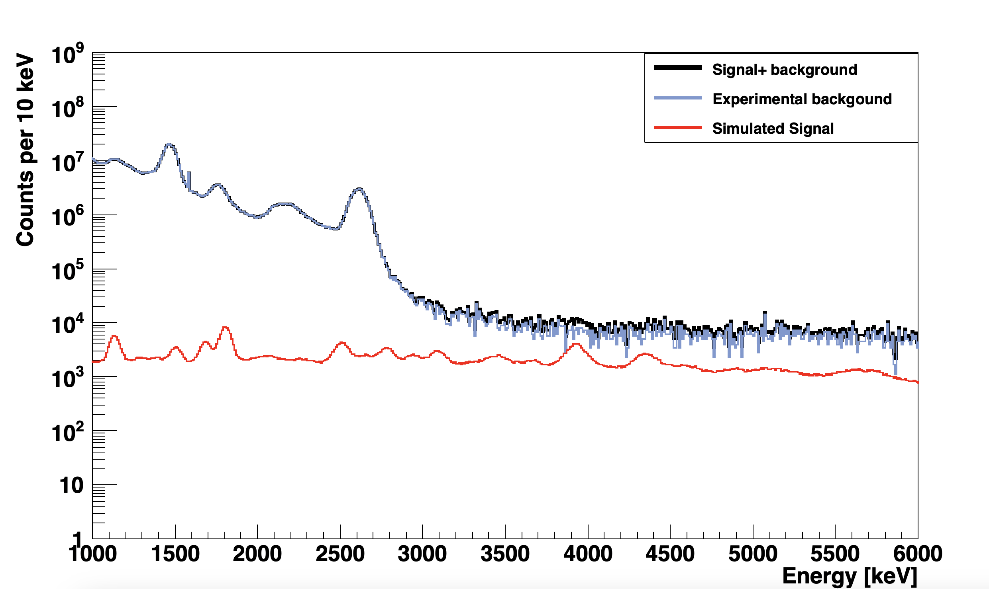
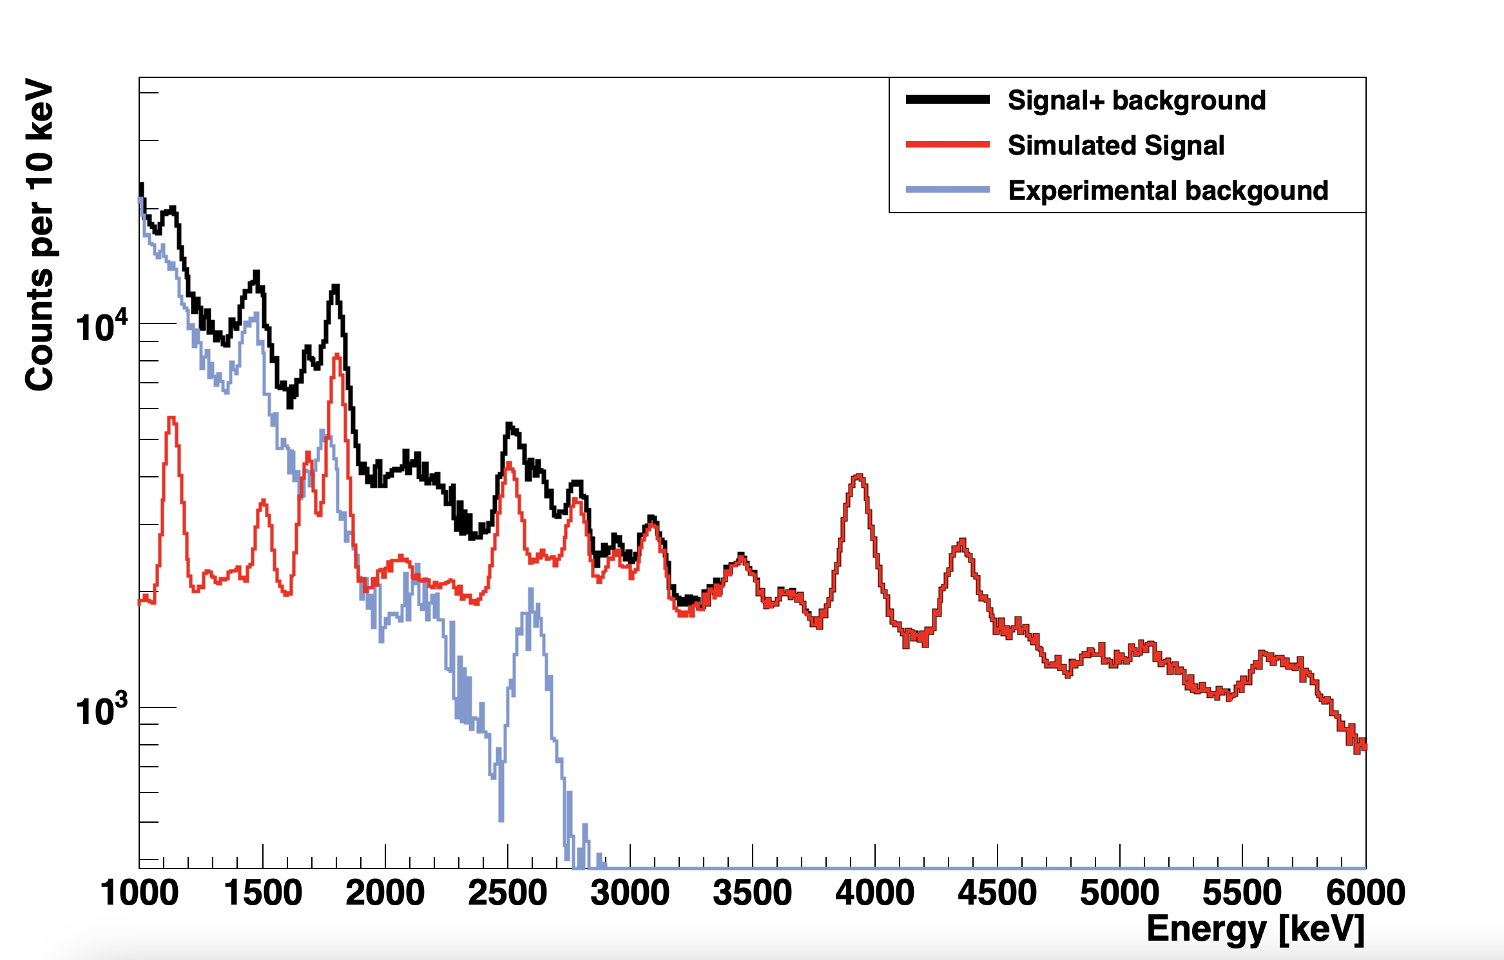

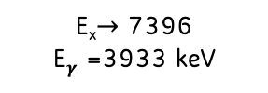



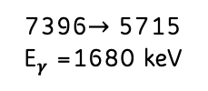

$22Ne\left(α,γ\right)26Mg$with EASγ – Ex =11329.1 keV
Surface vs underground measurements
7396$→$ 5715
E$γ$ =1680 keV
E_{x}$→$ 7396
E$γ$ =3933 keV
E_{x}$→$ 7396
E$γ$ =3933 keV
E_{x}$→$ 7396 keV
E$γ$ =3933
Ex $→$ 6878
E$γ$ = 4350 keV
Ex $→$ 6878
E$γ$ = 4350 keV
Ex $→$ 6878 keV
E$γ$ = 4350 keV

Slide 7
THANKS FOR THE ATTENTION !

