Slide 1
VI Incontro Nazionale di Fisica Nucleare – INFN 2024
Studies on ²⁰Ne(p,γ)²¹Na and status of
²¹Ne(p,γ)²²Na reactions at LUNA
February 26-28, 2024
Fausto Casaburo
on behalf of LUNA collaboration

Slide 2
Astrophysical motivations

Slide 3
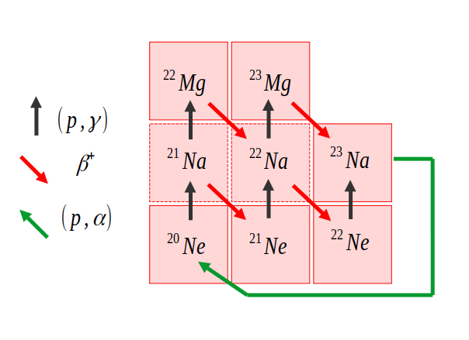
Astrophyisical motivations-NeNa cycle
NeNa provides isotopical abundance of elements between ²⁰Ne and ²³Mg.
²⁰Ne(p,γ)²¹Na:
First and slower reaction of the cycle (step-maker).
Astrophysical interest in RGB, AGB, novae, massive stars (T~0.05-1GK).
²¹Ne(p,γ)²²Na:
²²Na production in novae and supernovae (T~0.1-0.7GK).
NeNa cycle.
²⁰Ne(p,γ)
²¹Ne(p,γ)

Slide 4
State of the art

Slide 5
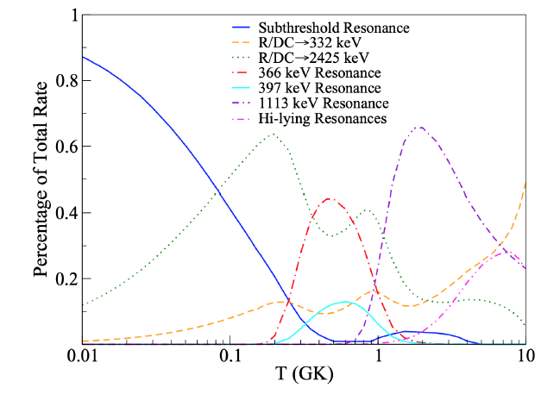
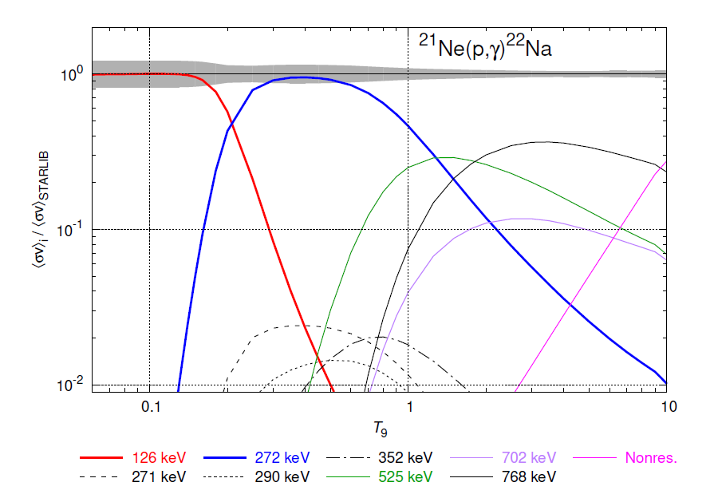
State of the art
²⁰Ne(p,γ)²¹Na:
At T~0.05-1GK, most relevant contributions from resonances at E_{p}=-7.4keV, E_{p}=386keV and direct capture.
Few previous measurements (missing at lower energies).
²¹Ne(p,γ)²²Na:
At T~0.1-0.7GK, most relevant contributions from resonances at E_{p}=126keV and E_{p}=272keV.
Few previous measurements (missing at E_{p}=126keV).
E_{p}=-7keV
E_{p}=272keV
E_{p}=366keV
E_{p}=126keV
DC
²⁰Ne(p,γ) Reaction rate vs temperature.
²¹Ne(p,γ) Reaction rate vs temperature.

Slide 6
Experimental setup

Slide 7
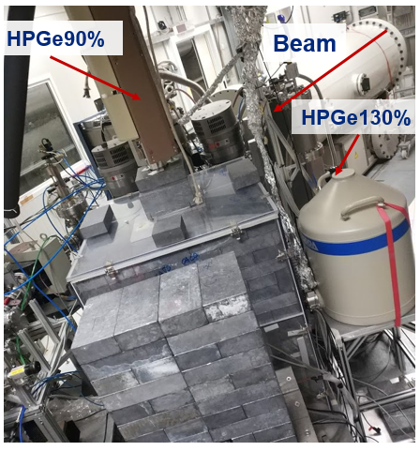
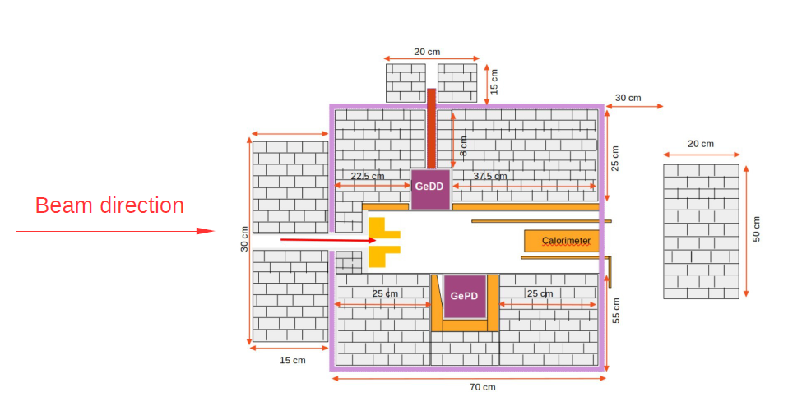
Experimental setup
LUNA-400kV accelerator (LNGS-INFN);
Collimator.
Gas target:
Natural neon (90.48% ²⁰Ne, 0.27% ²¹Ne and 9.25% ²²Ne).
Enriched neon (5.53% ²⁰Ne, 59.1% ²¹Ne and 35.37% ²²Ne)
HPGe detectors:
HPGe130%.
HPGe90%.
Calorimeter.
Pb and Cu shields.
E. Masha et al. Phys. Rev. C 108, 052801 (2023)
²⁰Ne(p,γ)²¹Na and ²¹Ne(p,γ)²²Na reactions recently measured at LUNA.

Slide 8
Measurement method

Slide 9
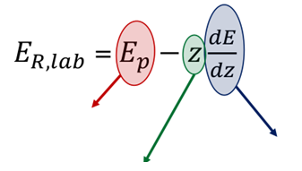
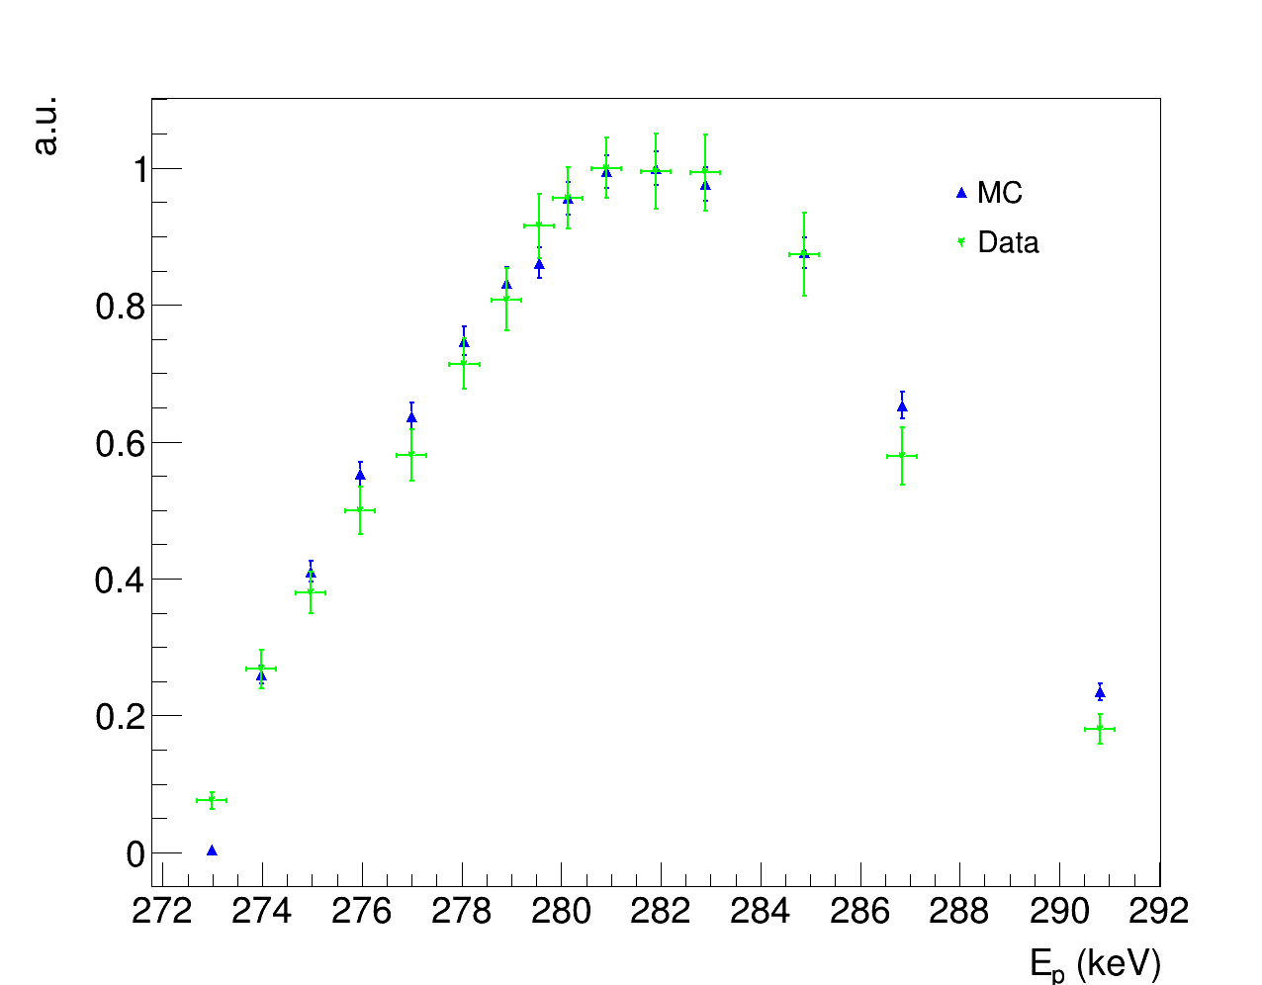
Measurement method
Depending on the beam energy, the resonance is populated in different points of the camera (different efficiency).
Detection efficiency has been estimated by a MC simulation.
Corrections summing and stragglings effects from simulations.
Proton energy
Energy loss
Maximum of yield
PRELIMINARY
Resonance population in the chamber
²¹Ne(p,γ) resonance at E_{p}=272keV- Yields (Ge130%)

Slide 10
²¹Ne(p,γ)²²Na

Slide 11
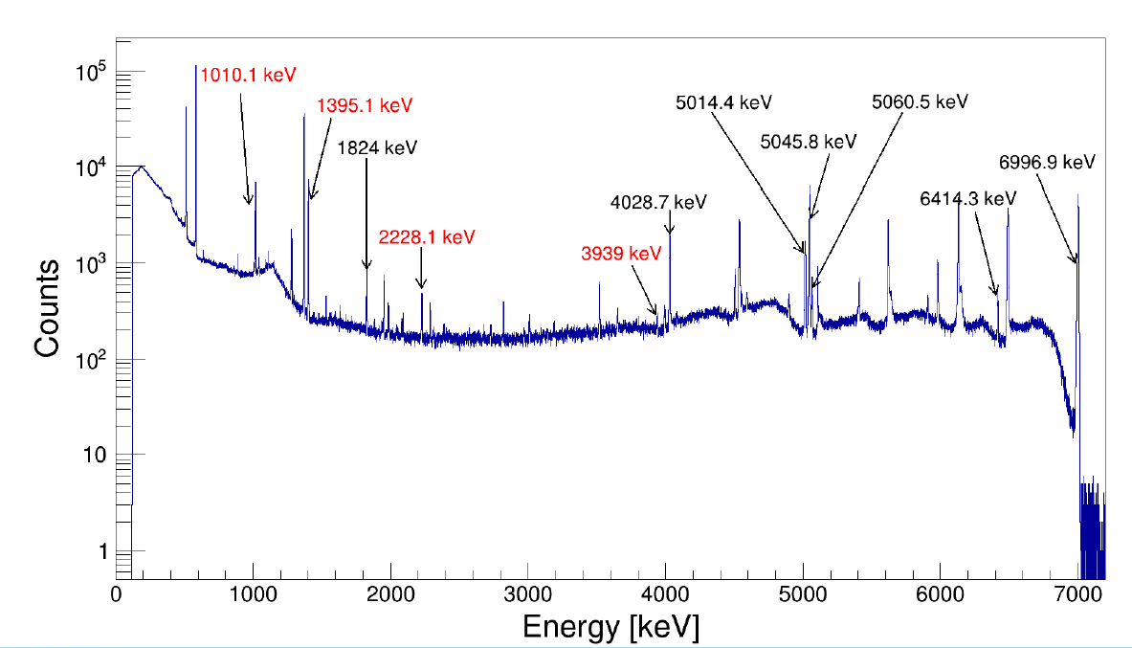
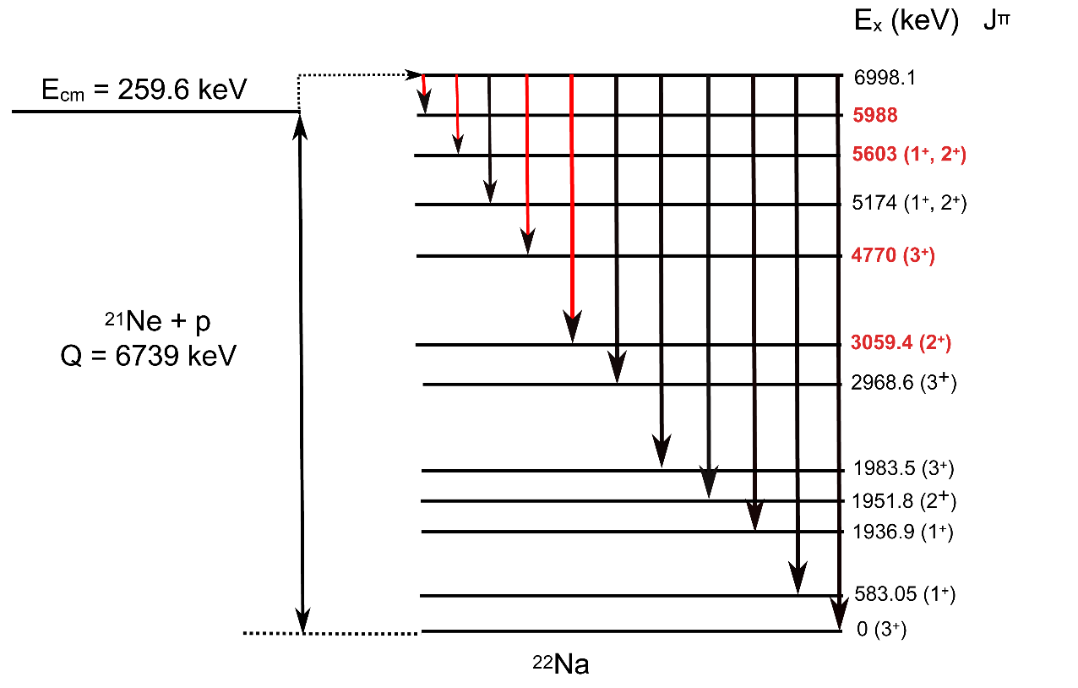
Resonance E_{p}=272keV (Q=6739keV)
PRELIMINARY
Excited ²²Na level: E_{x}=6998keV.
7 transitions already known, observed 4 new ones.
E_{x}=6998keV
²²Na level scheme.
Energy spectrum

Slide 12
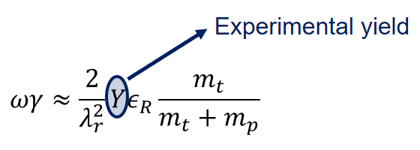
Results E_{p}=272keV (Q=6739keV)
PRELIMINARY
4 new transitions have been observed (E_{γ}=1010, 1395, 2228 e 3939 keV).
Measured resonance energy:
E_{p}=(272.37 ± 0.22)keV (NUDAT 271.56keV).
Resonance strength:
New transitions→higher resonance strenght.
ωγ=(122.3±2.6)meV (Gorres et al. (82 ± 12)meV ).
Astrophysical impact.
PRELIMINARY
E_{p}=272keV
²¹Ne(p,γ) Reaction rate vs temperature.

Slide 13
Conclusions

Slide 14
Conclusions
²¹Ne(p,γ)²²Na (ongoing analysis):
E_{p}=126keV, 271keV,E_{p}=272keV, 292keV and 352keV resonances have been measured:
New evaluations of resonance strenghts, BRs and resonance energies:
Resonance strength at E_{p}=272keV was found higher than literature ωγ=(122.3±2.6)meV (Gorres et al. (82 ± 12)meV ).
Observed new transitions for resonances at E_{p}=126keV, E_{p}=272keV, 292keV and 352keV
First direct study of resonance at E_{p}=126keV.
E_{p}=(127.34±0.54)keV
ωγ=(0.0375±0.0011)meV.
PRELIMINARY

Slide 15
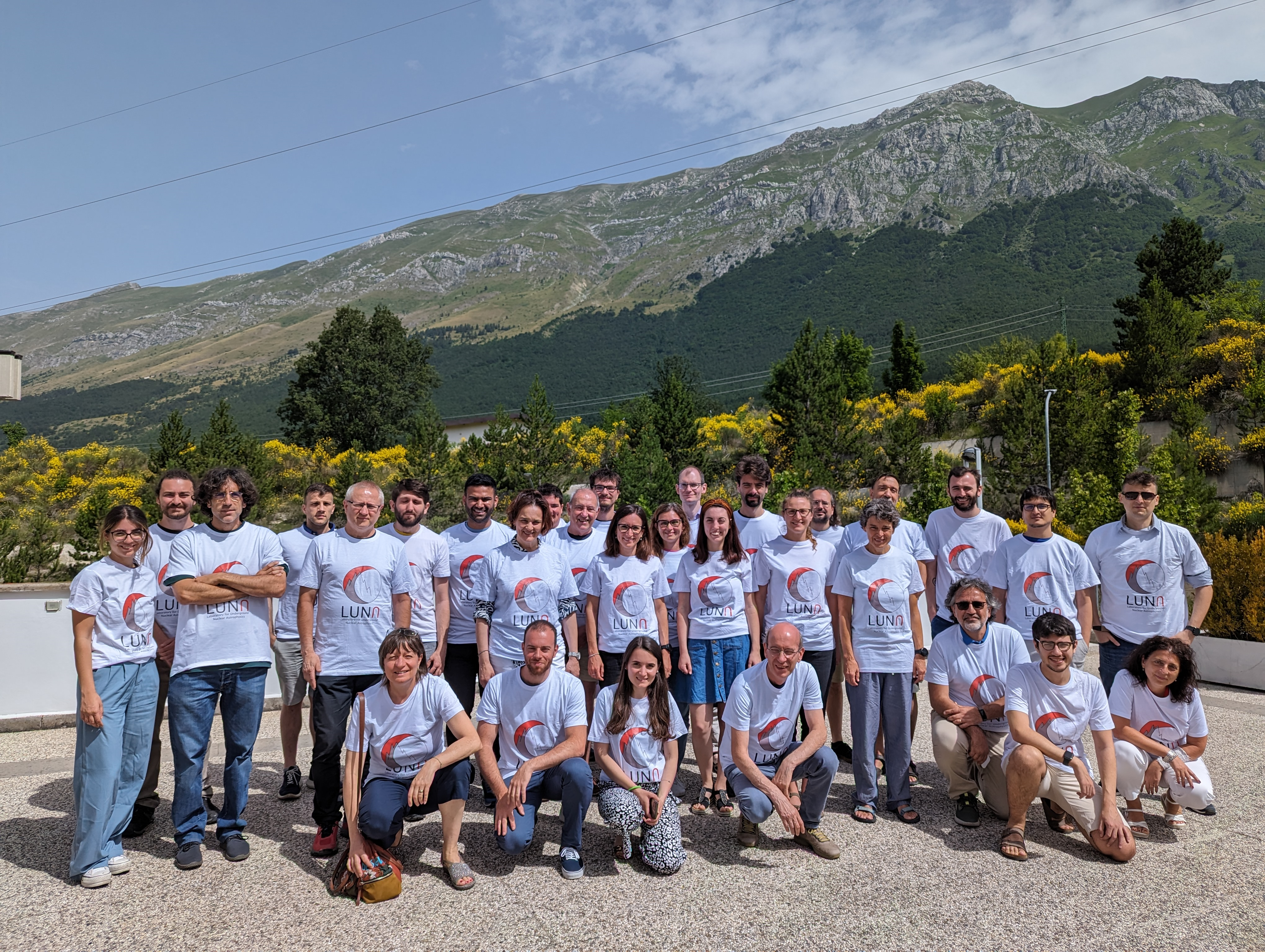
Thank you for your attention!!
LUNA collaboration
INFN LNGS e GSSI, Italia: A. Compagnucci, F. Ferraro, R. Gesuè, M. Junker
INFN Roma1, Italia: A. Formicola, C. Gustavino
HZDR Dresden, Germania: D. Bemmerer, A. Boeltzig, E. Masha
MTA-ATOMKI Debrecen, Ungheria: L. Csedreki, Z. Elekes, Zs. Fülöp, Gy. Gyürky, T. Szücs
INFN and Università di Padova, Italia: C. Broggini, A. Caciolli, P. Marigo, R. Menegazzo, D. Piatti, J. Skowronski
Konkoly Observatory, Hungarian Academy of Sciences, Ungheria: M. Lugaro
INAF Teramo, Italia: O. Straniero
INFN Lecce, Italia: R. Perrino
Università di Milano e INFN Milano, Italia: R. Depalo, A. Guglielmetti
Università di Genova and INFN Genova, Italia: F. Casaburo, P. Corvisiero, P. Prati, S. Zavatarelli
Università di Napoli e INFN Napoli, Italia: C. Ananna, A. Best, D. Dell’Aquila, A. Di Leva, G. Imbriani, D. Mercogliano, D. Rapagnani
Università di Torino e INFN Torino, Italia: F. Cavanna, P. Colombetti, G. Gervino
University of Edinburgh, Regno Unito: M. Aliotta, L. Barbieri, C.G. Bruno, T. Davinson, J. Marsh, D. Robb, R. Sidhu, M. Wiescher
Università di Bari e INFN Bari, Italia: F. Barile, G.F. Ciani, V. Paticchio, L. Schiavulli
INFN LNL, Italia: M. Campostrini, V. Rigato
LUNA General meeting – July 12-14 2023

