Slide 1





Cross-section measurements of different reactions leading to the production of 155Tb for medical applications
M. Colucci, F. Bolchini, L. Confalonieri, E.Nigron, F. Haddad, F. Groppi, S. Manenti
28|feb|2024

Slide 2


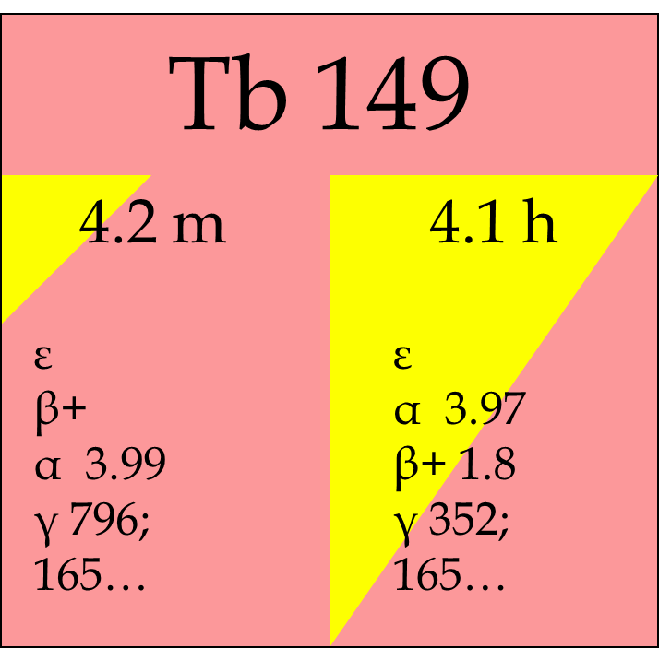
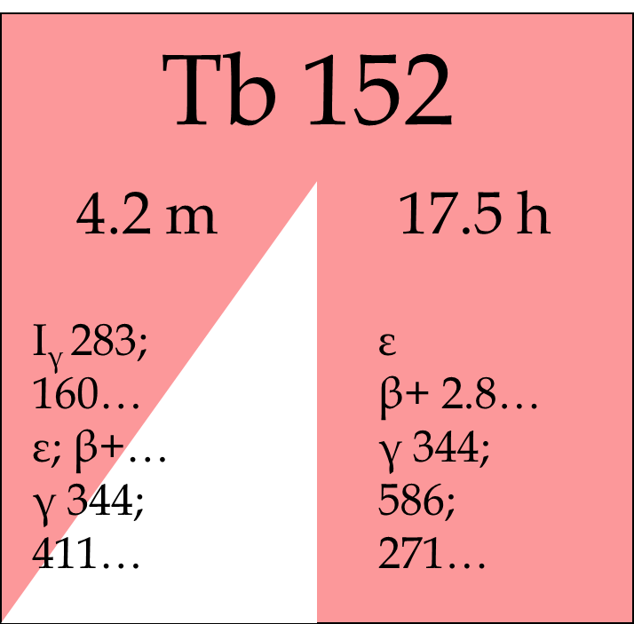
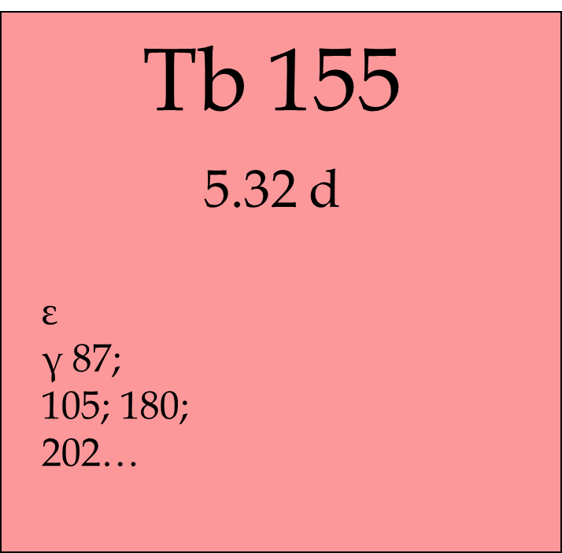
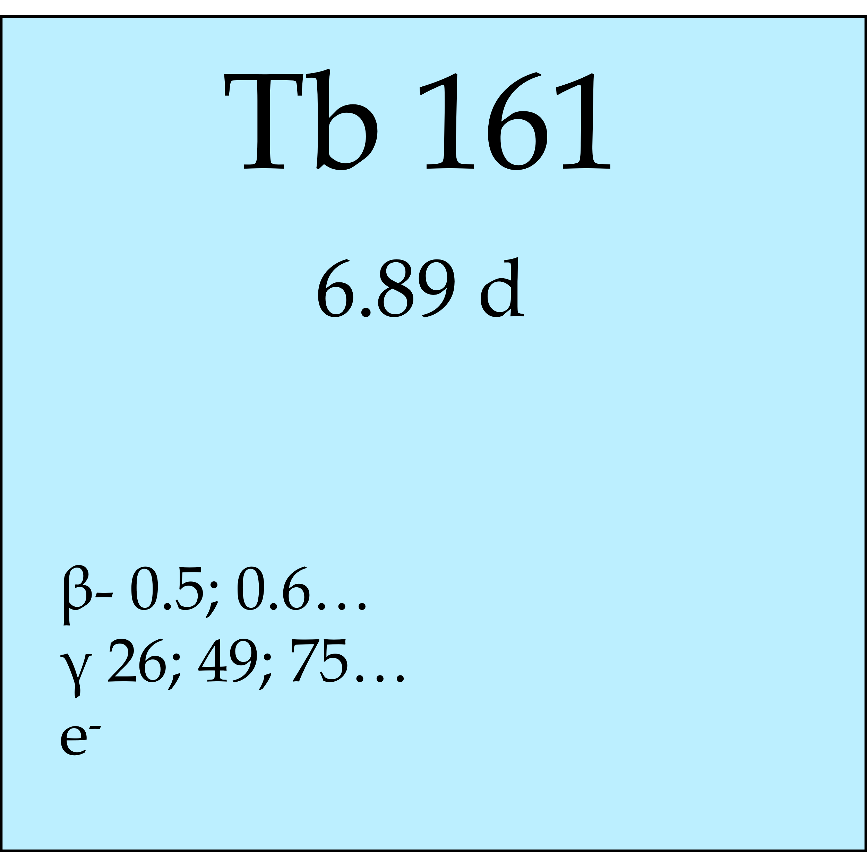

Why Terbium-155
Half-life: 5.32 d
Decay modality: ε (100%)
Main gamma emissions [keV]: 86.545 (32.03%), 105.305 (25.1%), 180.103 (7.45%)
No associated emissions of β+/β-
«The swiss army knife of nuclear medicine»

Slide 3
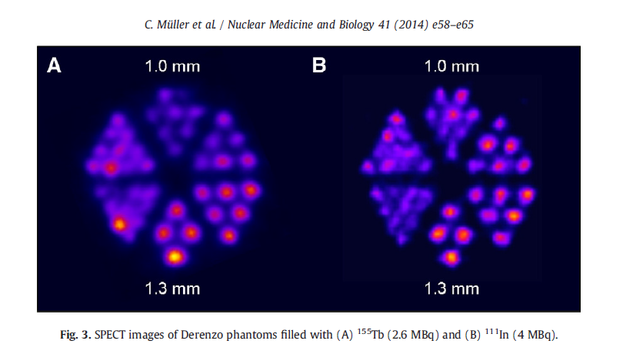
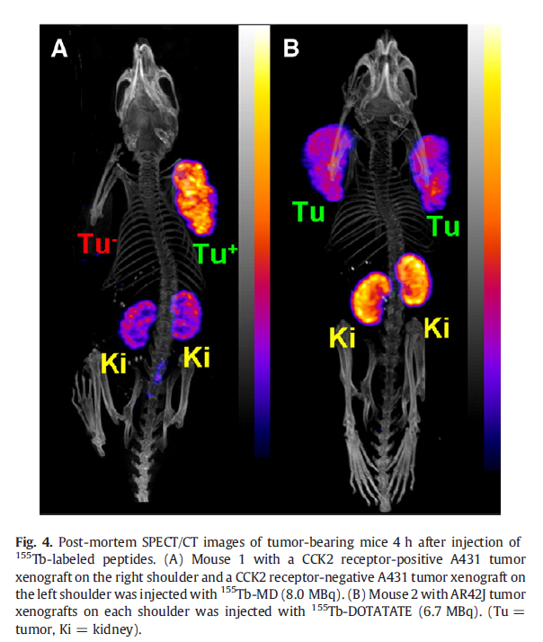
Why Terbium-155
Half-life: 5.32 d
Decay modality: ε (100%)
Main gamma emissions [keV]: 86.545 (32.03%), 105.305 (25.1%), 180.103 (7.45%)
No associated emissions of β+/β-

Slide 4
Why Terbium-155
Half-life: 5.32 d
Decay modality: ε (100%)
Main gamma emissions [keV]: 86.545 (32.03%), 105.305 (25.1%), 180.103 (7.45%)
No associated emissions of β+/β-
C. Muller et al. / Nuclear Medicine and Biology 41 (2014) e58-e65

Slide 5
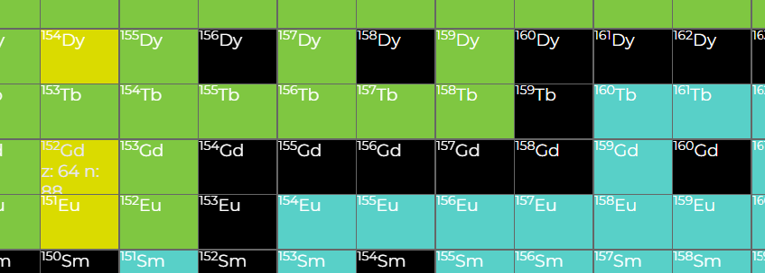
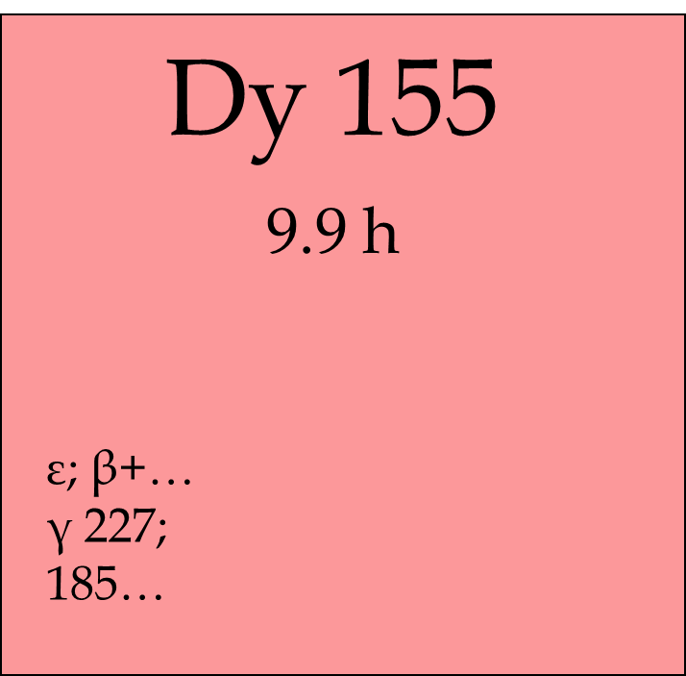
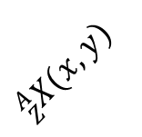
Investigated production routes
Direct production
Indirect production
$${}_{Z}^{A}{X(x,y)}$$
REMIX PROJECT (2021-2023, CSN5 INFN)
5 different combination target/projectile investigated
REMIX PROJECT (2021-2023, CSN5 INFN) and APHRODITE-155 (2024-2025, PRIN PNRR)

Slide 6
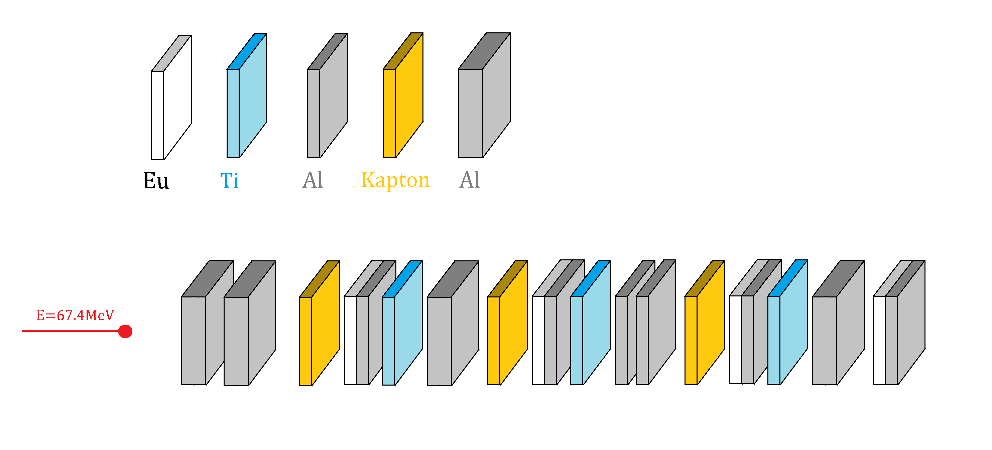
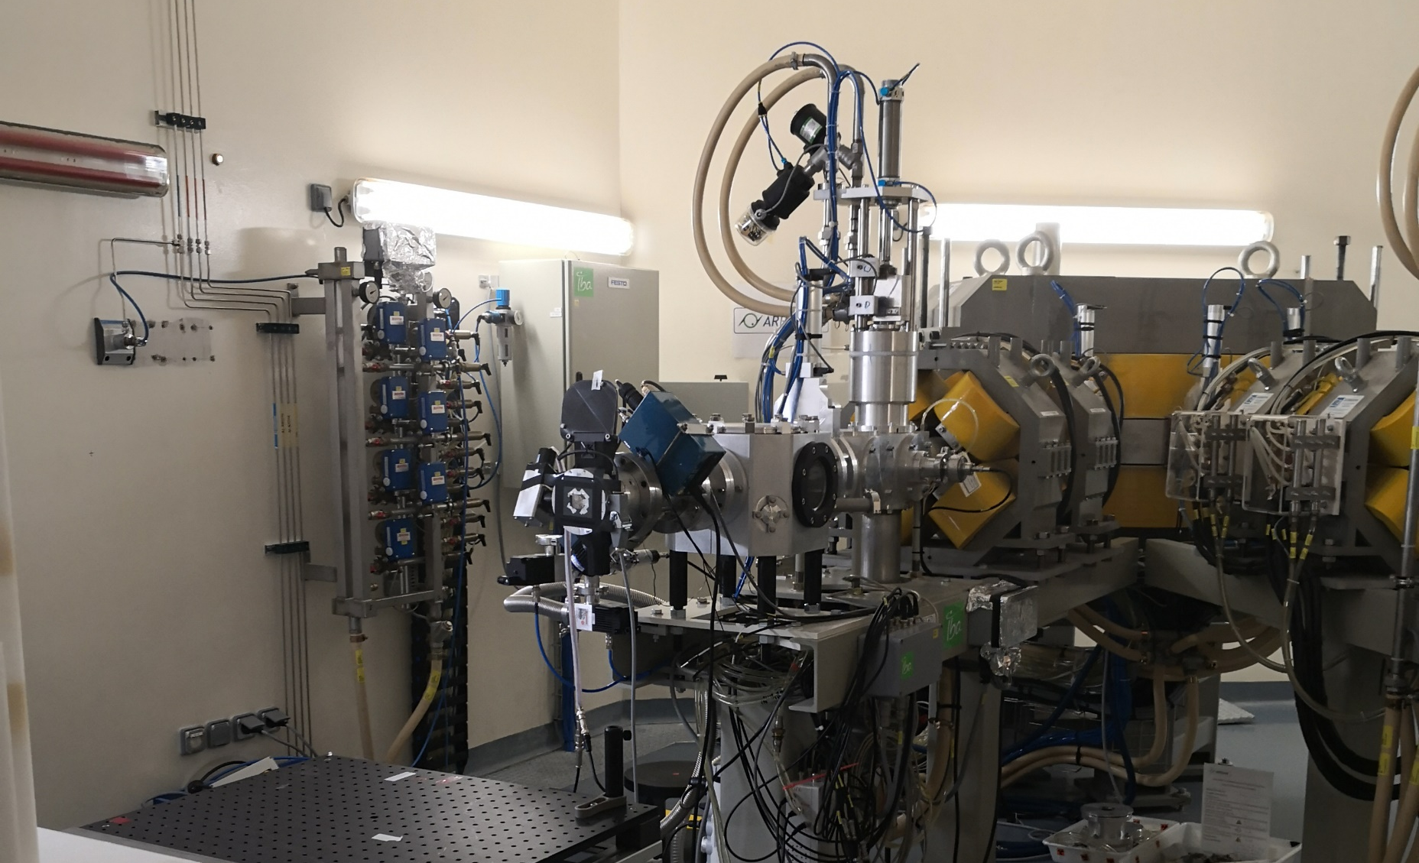
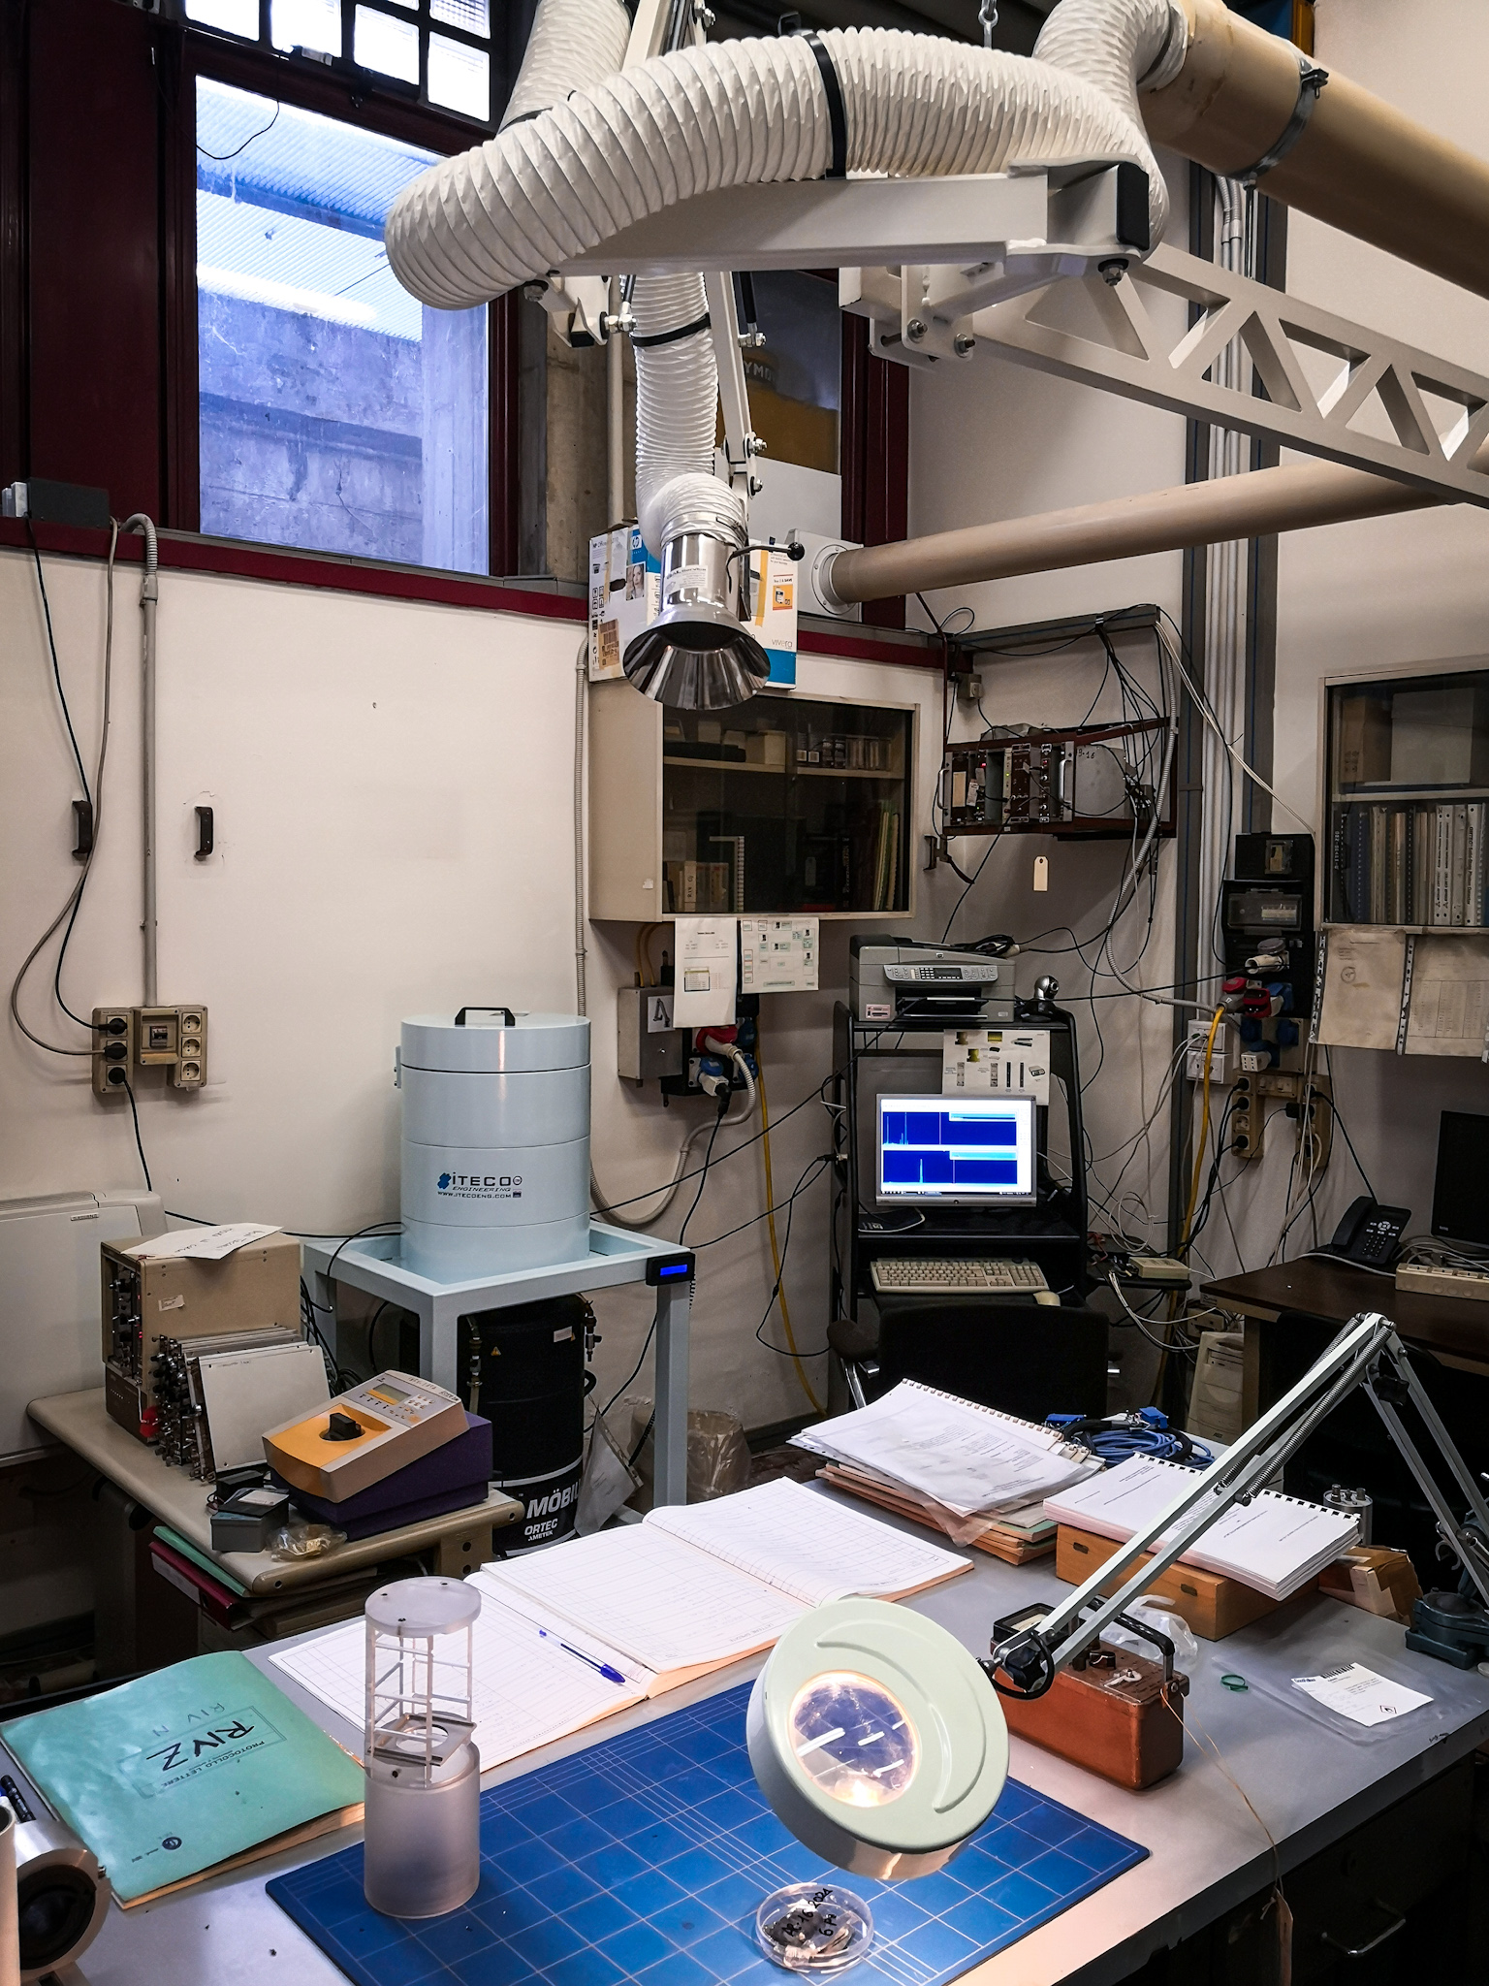
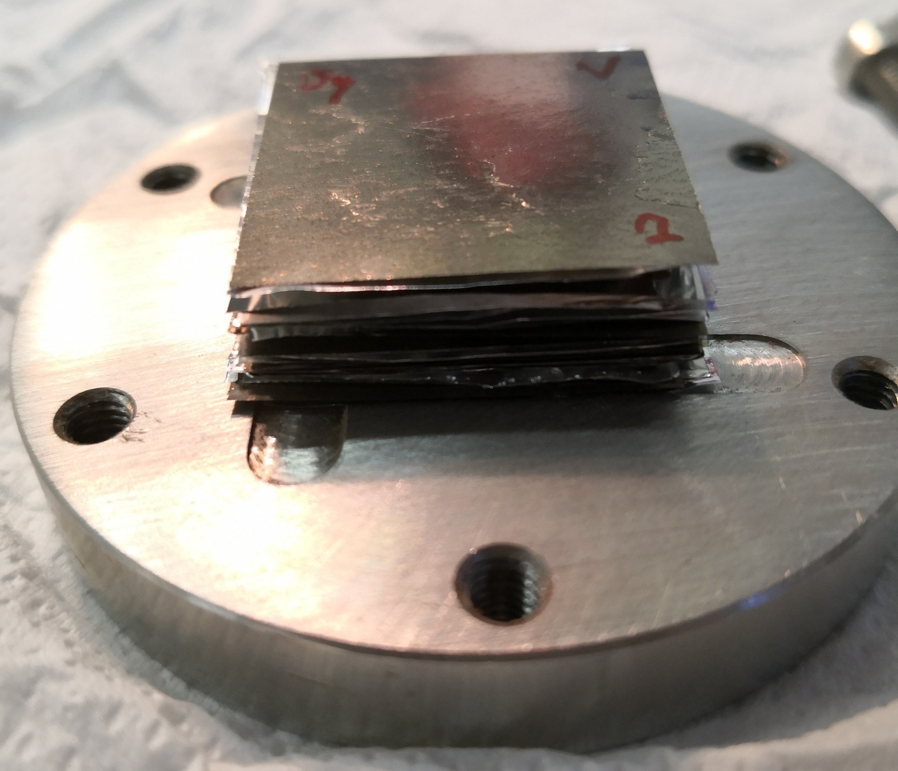

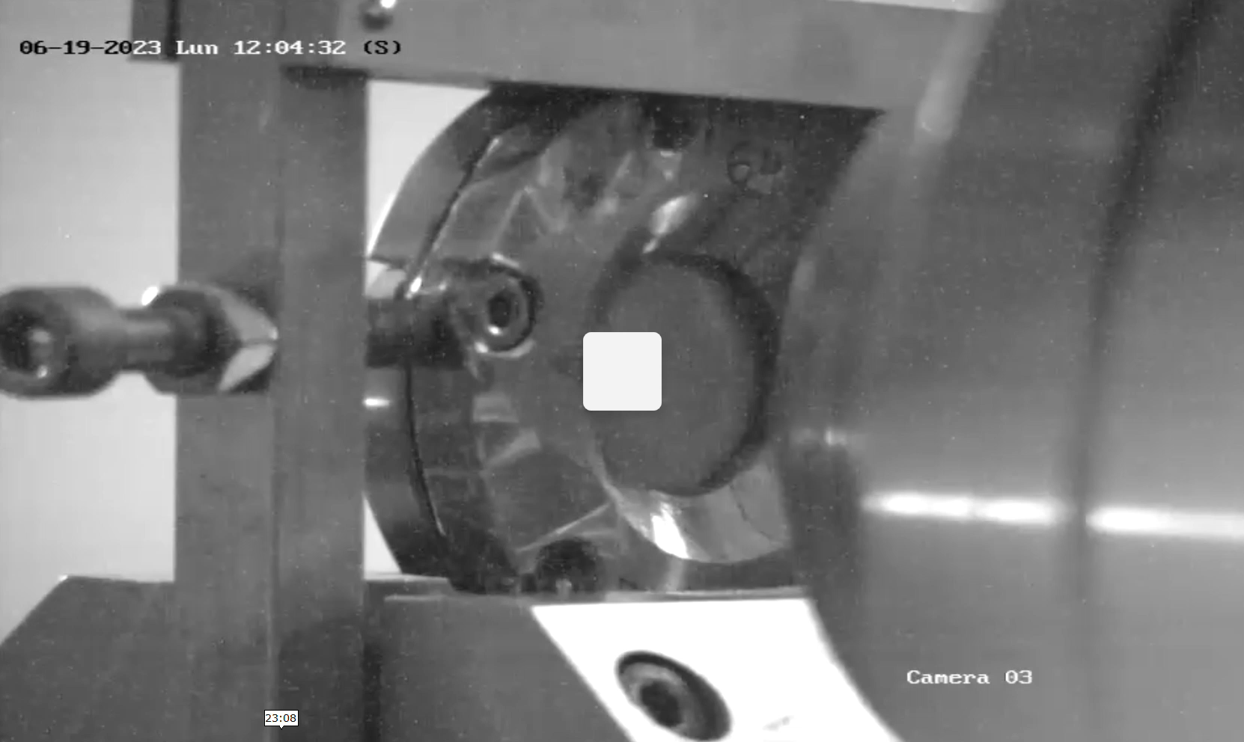
Experimental
Gamma/beta/alpha spectrometry at
LASA Laboratories, Segrate (MI)
Radioactive
transport
Stack design and realization
Irradiation at GIP ARRONAX, Nantes (FR)

Slide 7
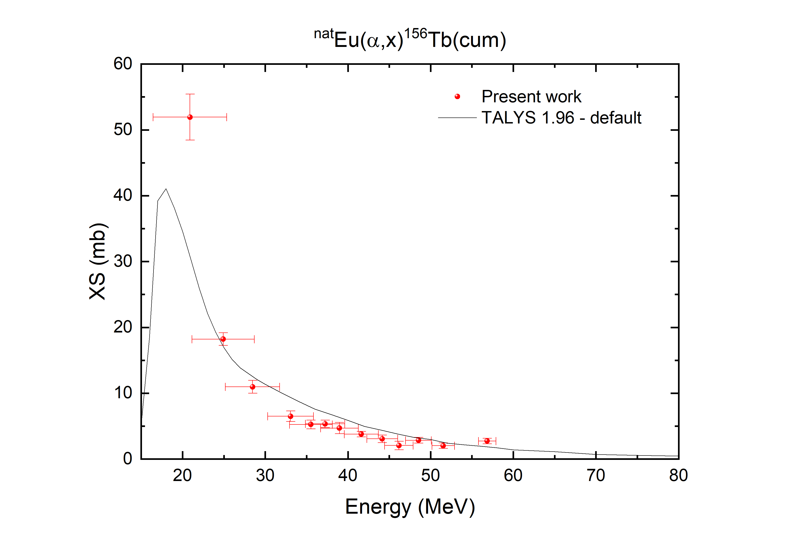
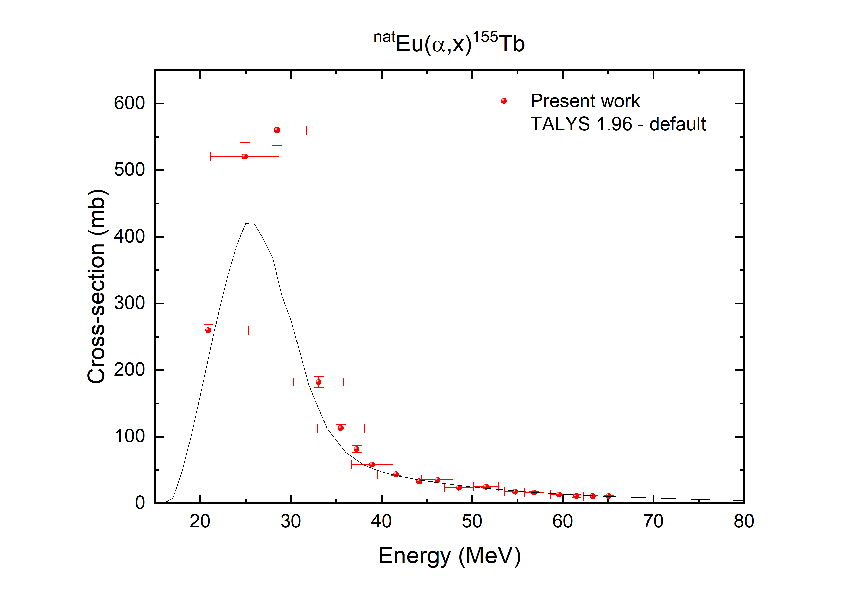
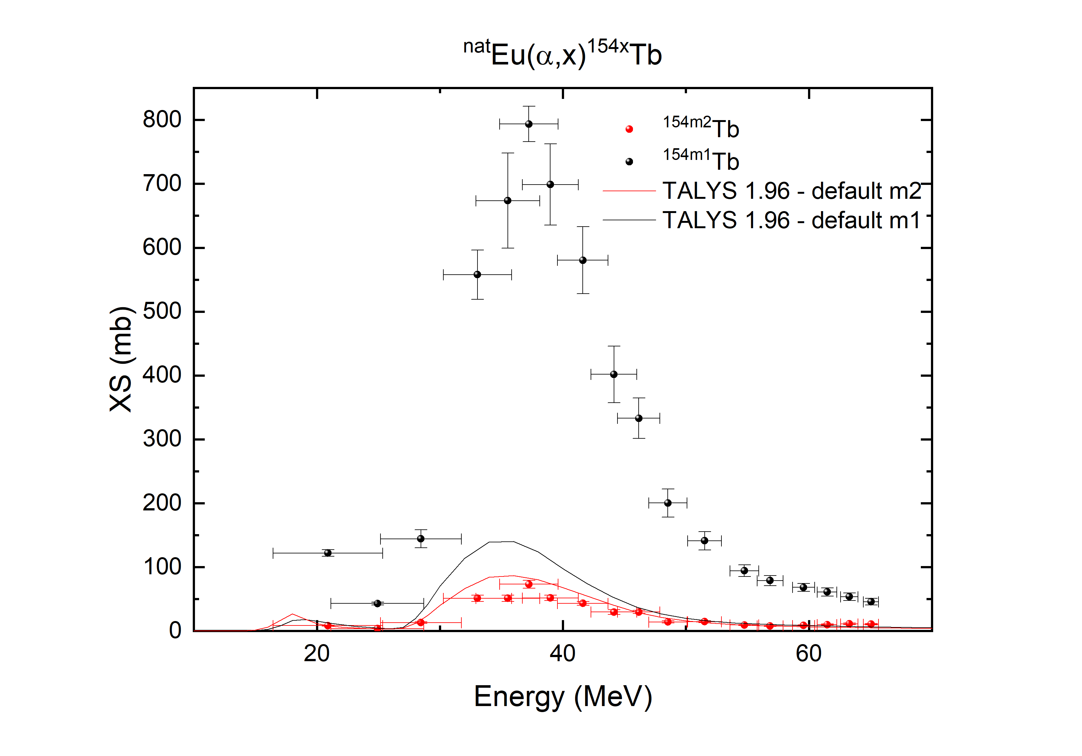
^{nat}Eu(a,x)¹⁵⁵Tb
M. Colucci – 28/02/2024

Slide 8
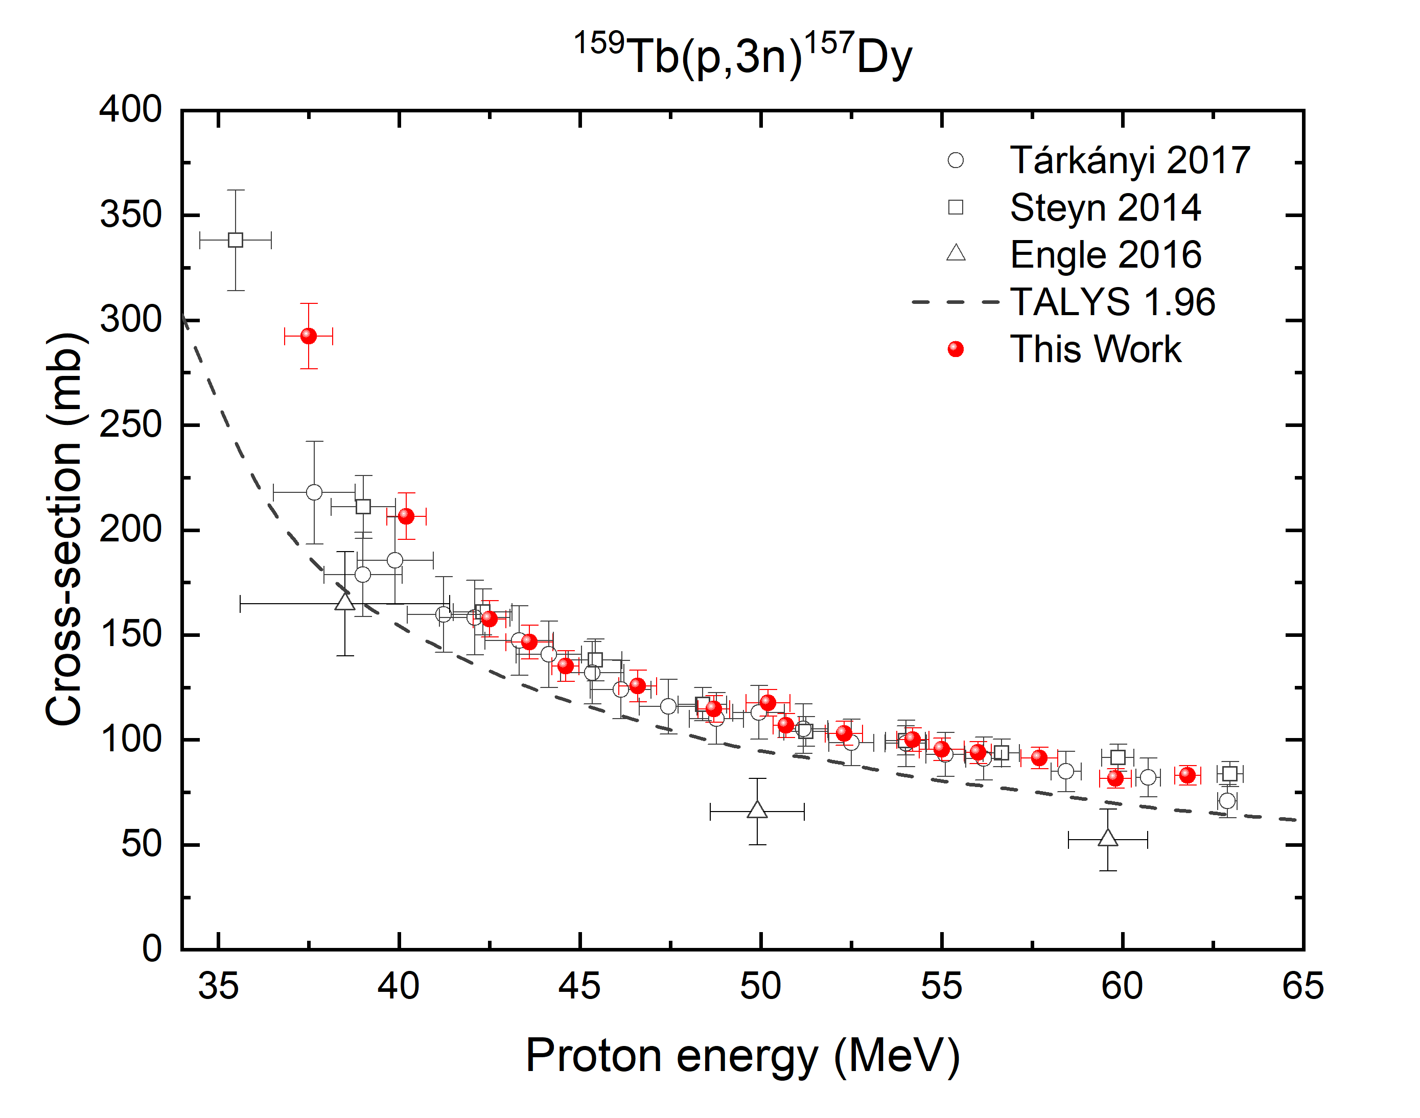
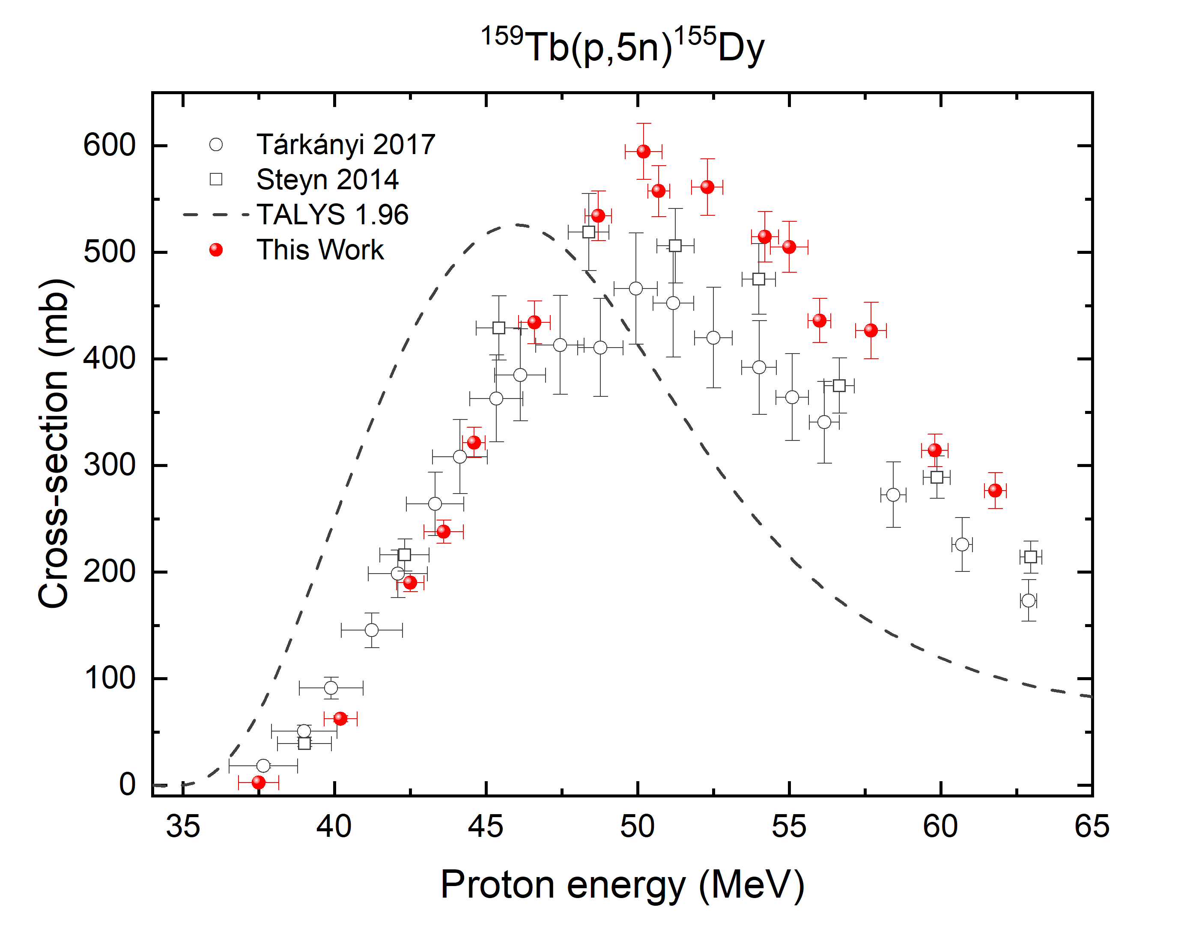
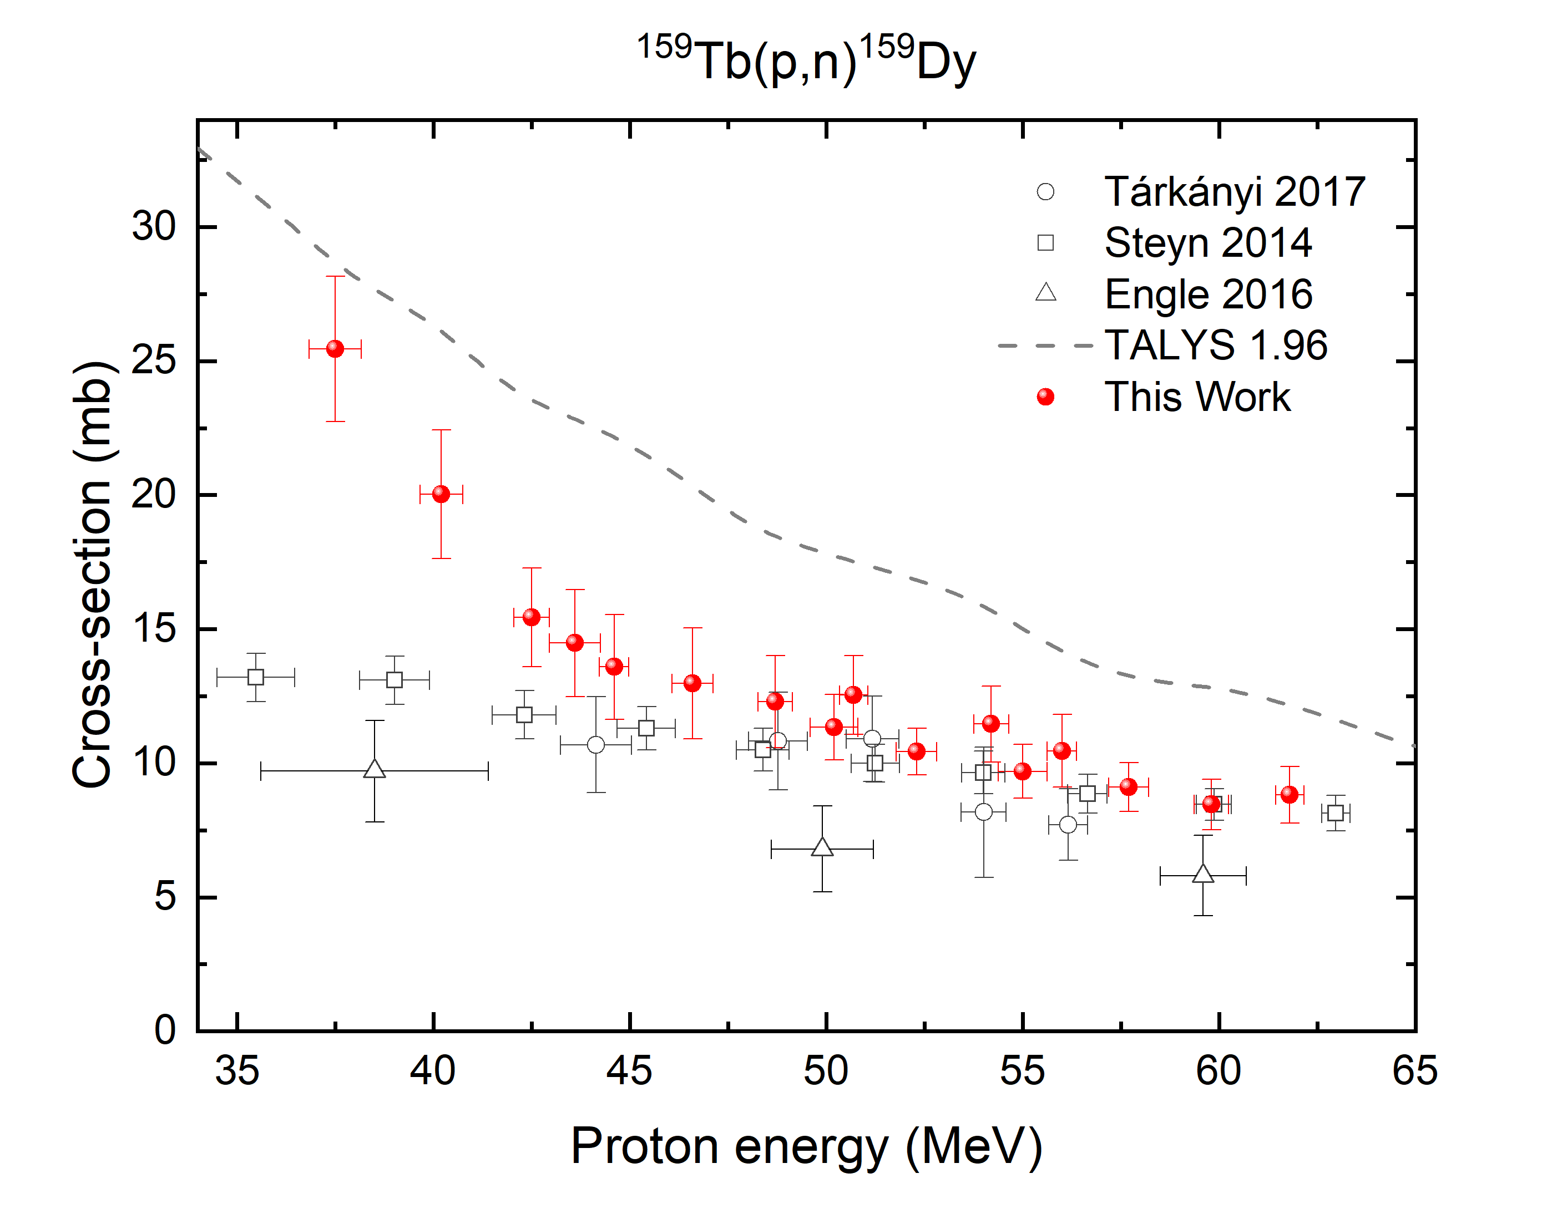

¹⁵⁹Tb(p,5n)¹⁵⁵Dy$→$¹⁵⁵Tb

Slide 9
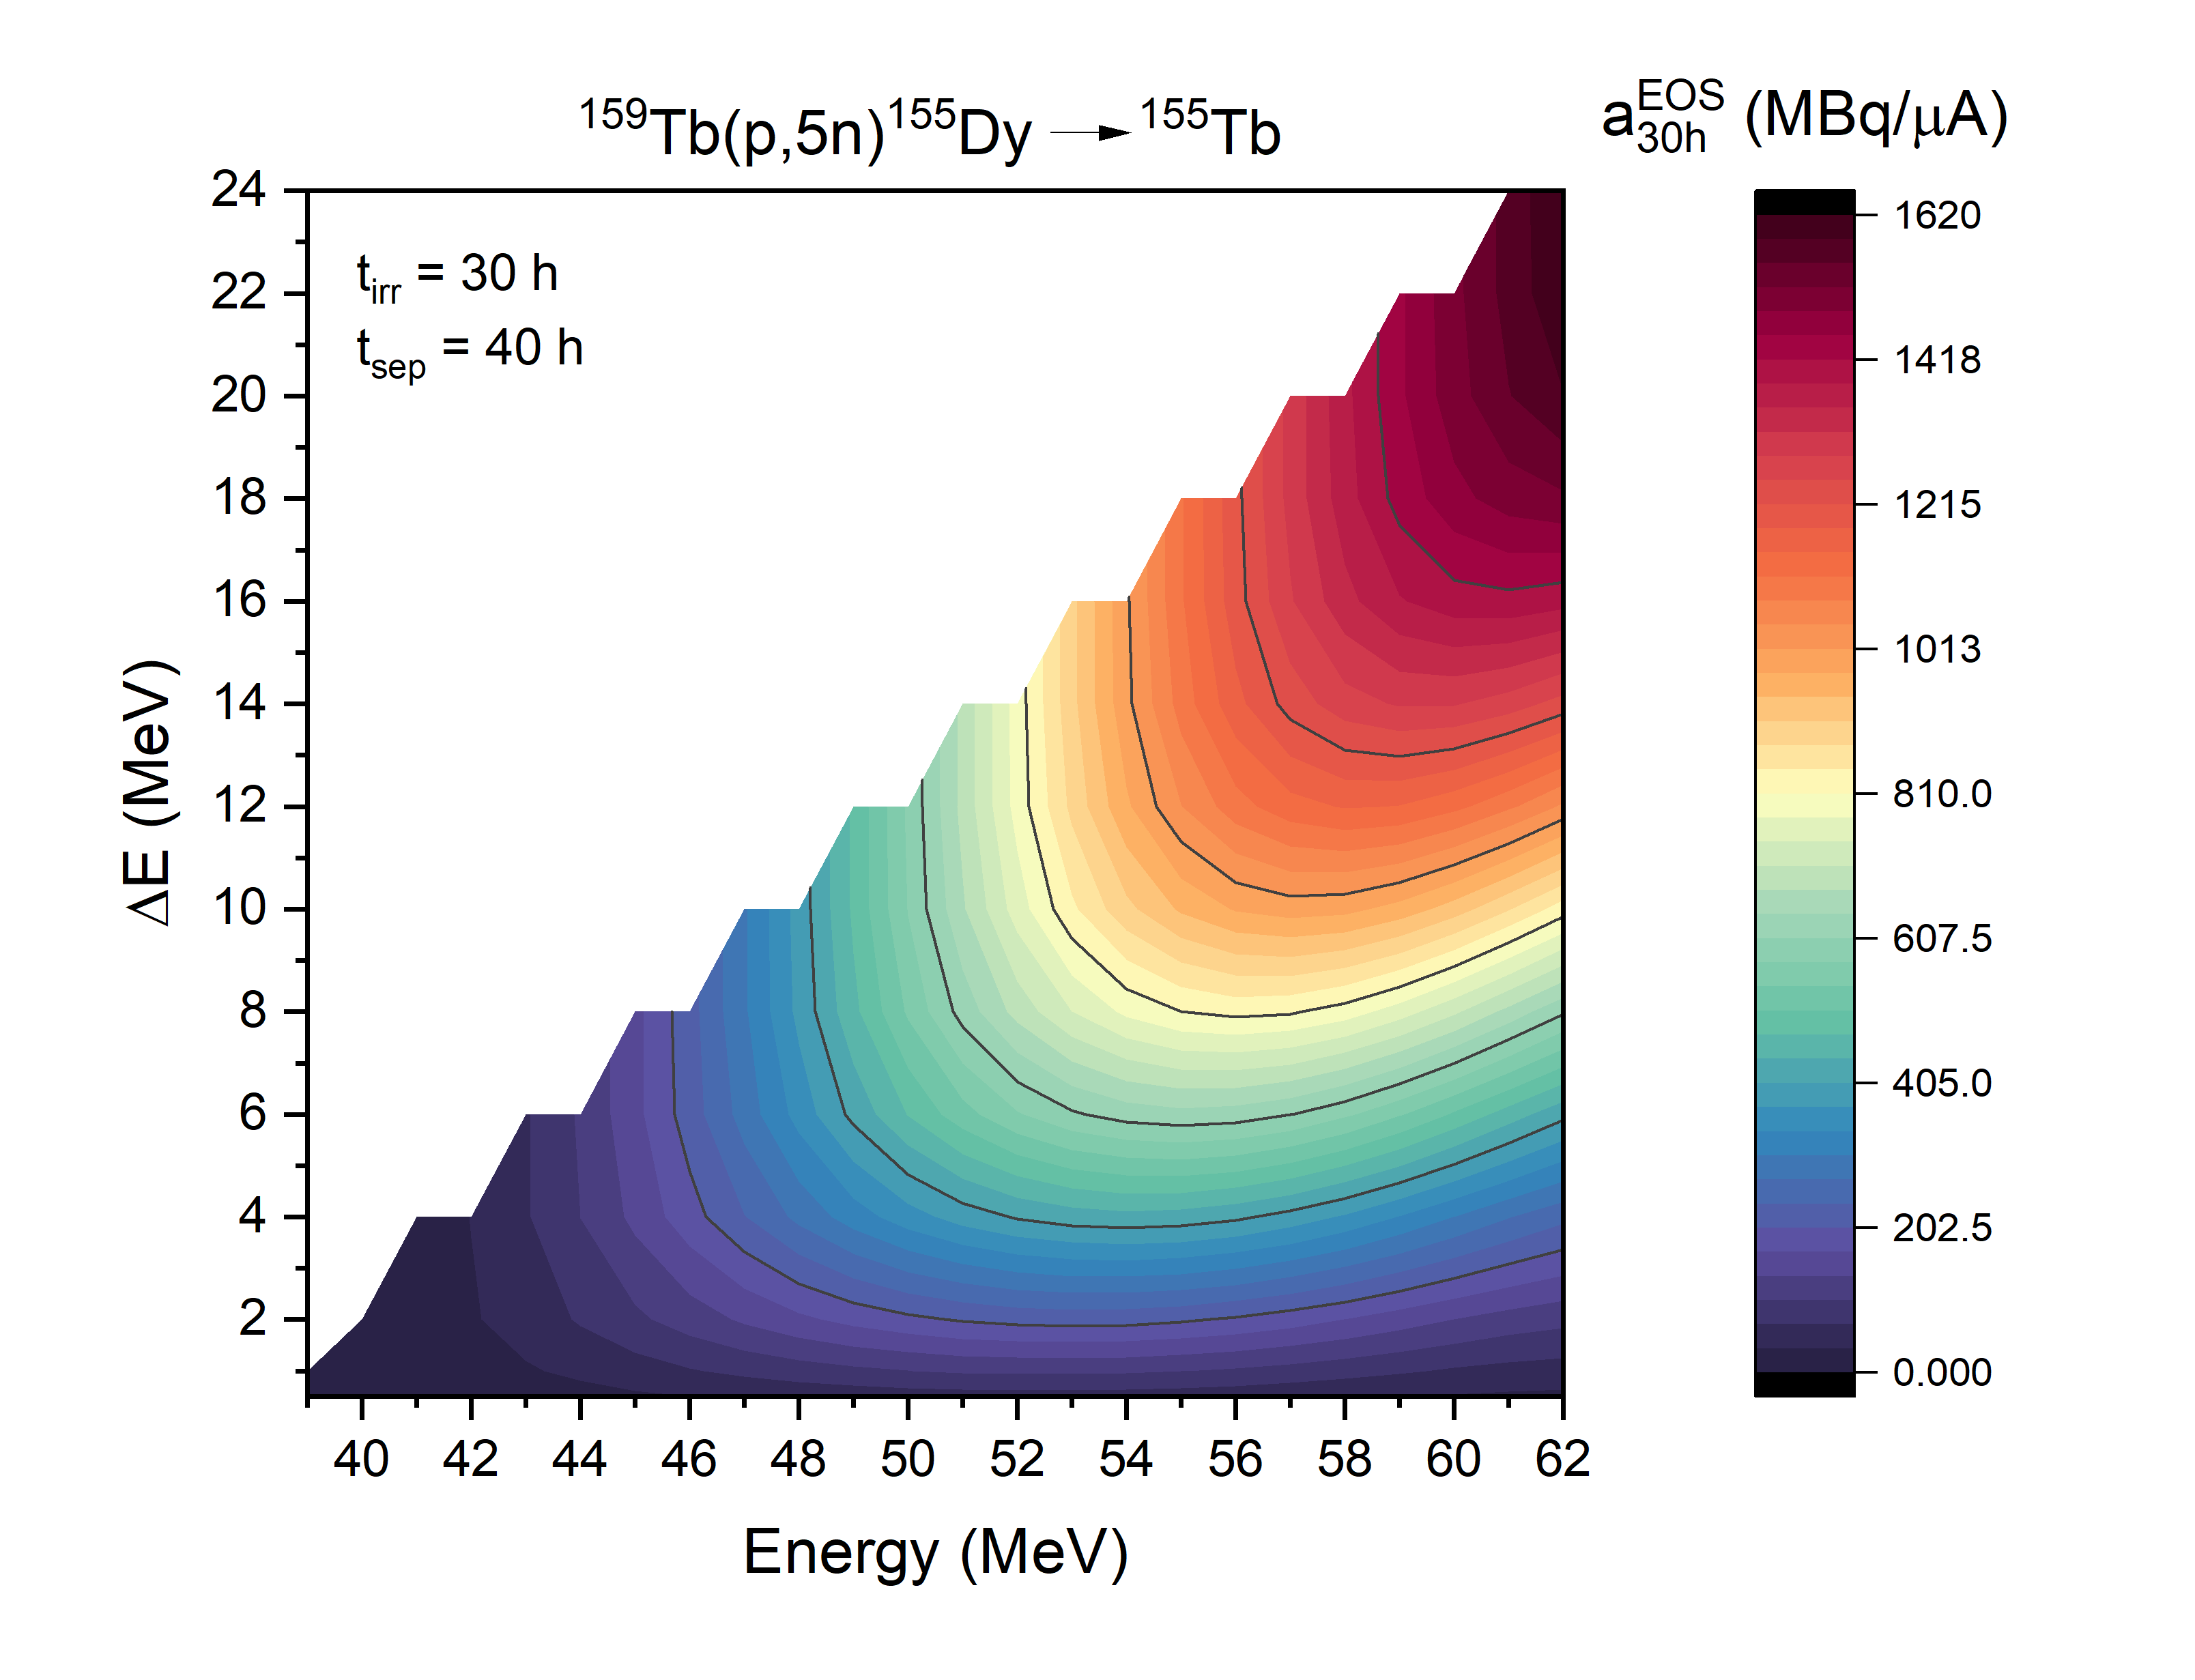

¹⁵⁹Tb(p,5n)¹⁵⁵Dy$→$¹⁵⁵Tb
First elution
Second elution
M. Colucci – 28/02/2024

Slide 10

Thank you for your attention
Contact: michele.colucci@unimi.it

