Slide 1
Imaging methods for in-vivo Boron Neutron Capture Therapy
N. Ferrara, D. Ramos, G. Pugliese G. Iaselli, N. Amoroso, C. Gong, V. Pascali , S. Altieri, and N. Protti
nicola.ferrara@ba.infn.it

Slide 2
Outline
BNCT introduction and dose measurement
Compton Camera Imaging
Imaging reconstruction with Maximum Likelihood Expectation Maximisation method
Innovative imaging method by using Deep Learning technic

Slide 3
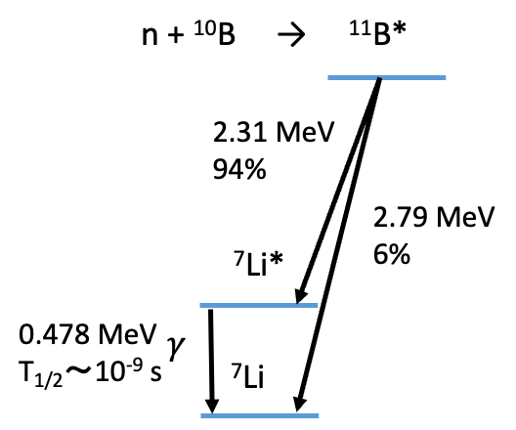
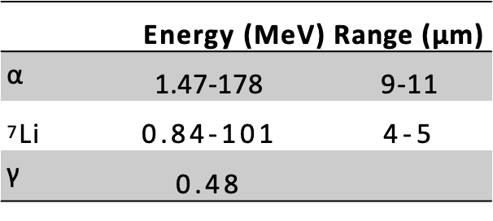
Boron neutron capture therapy
Boron Neutron Capture Therapy (BNCT) is an innovative hadrontherapy with high selectivity over cancer tissue based on the neutron capture reaction ¹⁰B(n, α)7Li
BNCT technique:
Tumour cells are loaded with ¹⁰B-enriched molecules and then irradiated with thermal neutrons
Neutron undergoes to capture reaction with boron-10
Energetic charged particles (α and 7Li*), released by reaction, produce damage to the tumour cells
The excited lithium nucleus decays emitting a prompt gamma ray of 478 keV

Slide 4
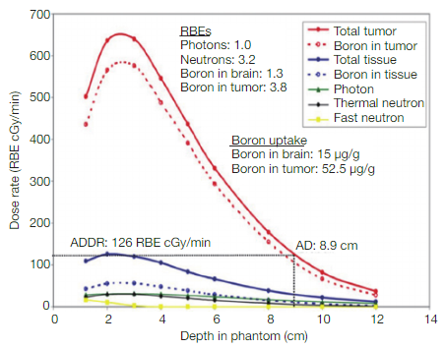
Dosimetry within BNCT and project scope
Tumor-to-tissue boron concentration ratio (T/N) > 3
In BNCT we have to take into account four separate radiation components:
Dtotal =
DB +
Dp +
Dn +
D𝛄
Therapeutic dose from ¹⁰B(n,⍺)⁷Li (𝛔=3837 b)
From ¹⁴N(n,p)¹⁴C reactions (Ep=630 keV, 𝛔=1.9 b) due to thermal neutron
Altieri S, Protti N. A brief review on reactor-based neutron sources for boron neutron capture therapy. Ther Radiol Oncol 2018;2:47.
Due to epithermal and fast neutron elastic scattering daily with H nuclei
From ¹H(n,𝛄)²H (E=2.2 MeV, 𝛔=0.33 b) & reactor background
The main contribution to the dose is coming from the Boron
Dose distribution: dD(x,y,z) ≈ n¹⁰_{B}(x,y,z) Φ(x,y,z) dV
Nowadays dose estimation by blood test before, meanwhile and after irradiation
Project aims to develop an on-line dose estimation method by using Compton imaging
Notes:
n is the boron concentration

Slide 5
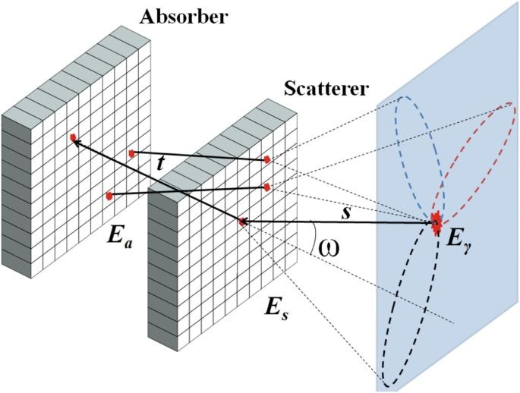
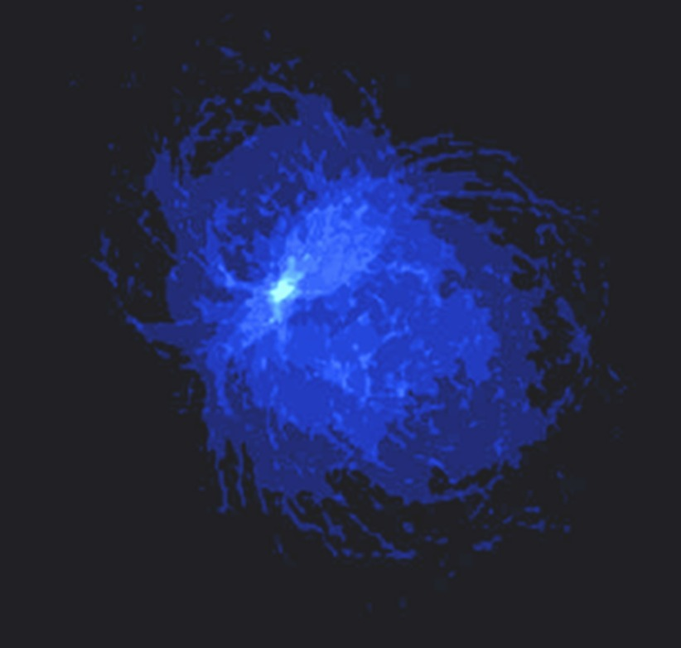
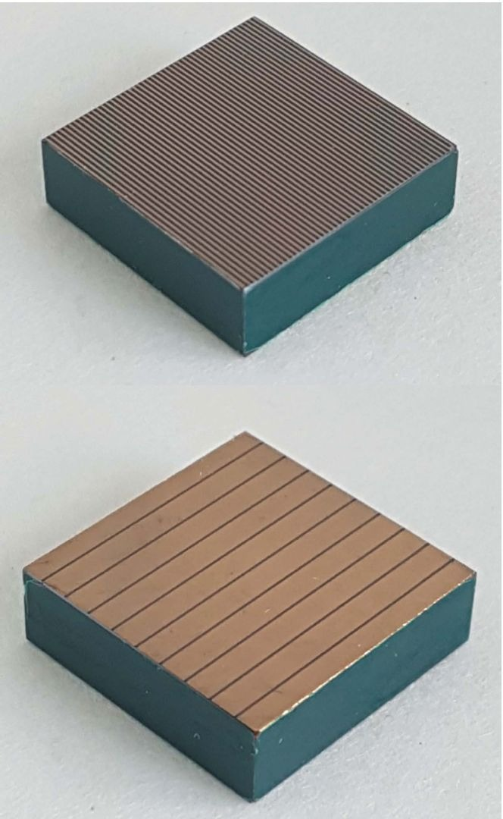
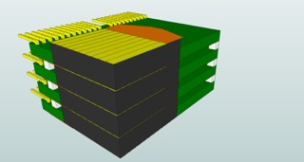
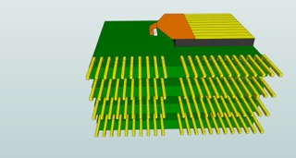
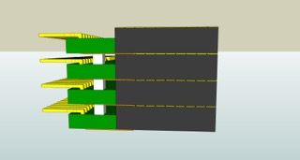
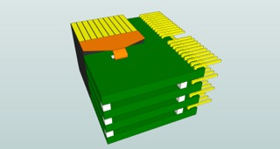
Compton method for imaging
Two sensitive layers are needed to evaluate the Compton angle
SCATTERER layer to promote the compton interaction of the incident gamma
ABSORBER layer to stop, by photoelectric effect, the scattered photon
$$cos\left(ω\right)=1 −m_{e}c^{2}\left(\frac{1}{E_{a}}−\frac{1}{E_{γ}}\right)$$
$$E_{γ}=E_{a}+E_{s}$$
Reconstruction is done by overlapping all cones, defined by the Compton angle, and interaction positions
(called back projection image)
Proposed detector is 3D CZT Compton camera
Room-temperature gamma-ray spectroscopic
Sub-millimetre spatial resolution and excellent energy resolution (<1% FWHM at 661.7 keV)
Abbene l., et. al. High-resolution 3D CZT drift strip detector, J. Synchrotron Rad. (2020). 27, 1564-1576
CZT single unit: 20x20x5 mm³, planar transversal field (PTF), orthogonal drift strip electrodes
Notes:
CZT =

Slide 6
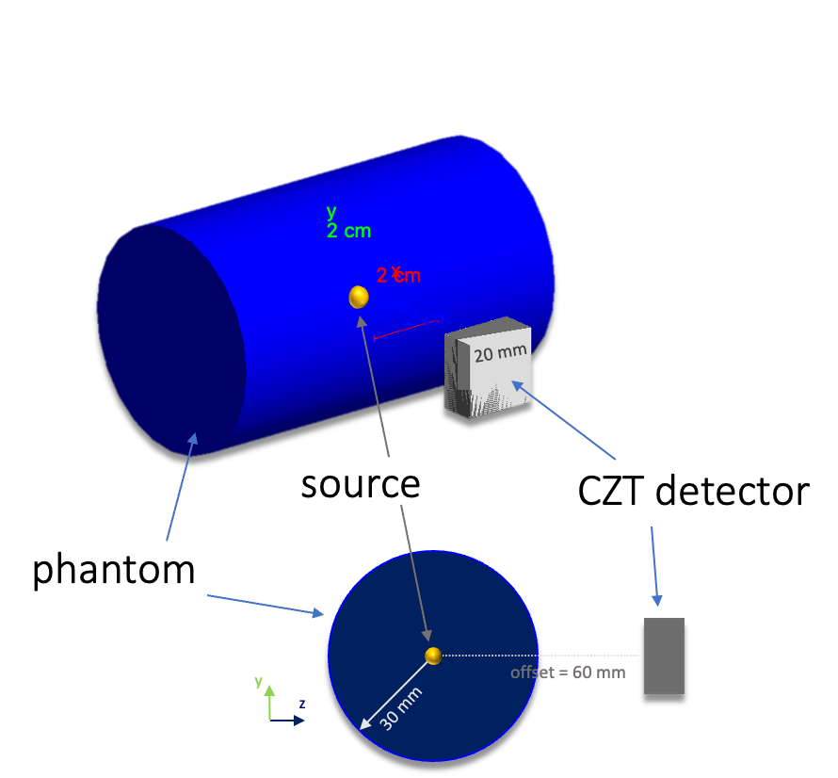
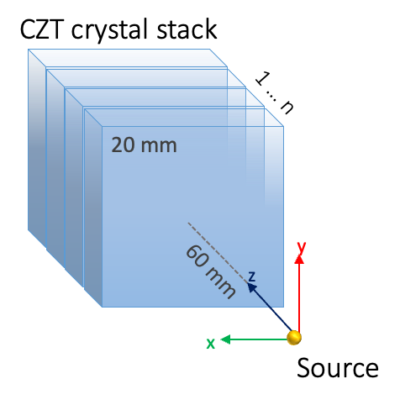
Simulation layout description
Detector
CZT crystal stack (5mm thickness each), 60 mm apart from the source
Phantom material: Air or soft tissue
Simulated sources: 5-points like and spheric
Detector
Tomography: cube 120 mm side centered with source

Slide 7
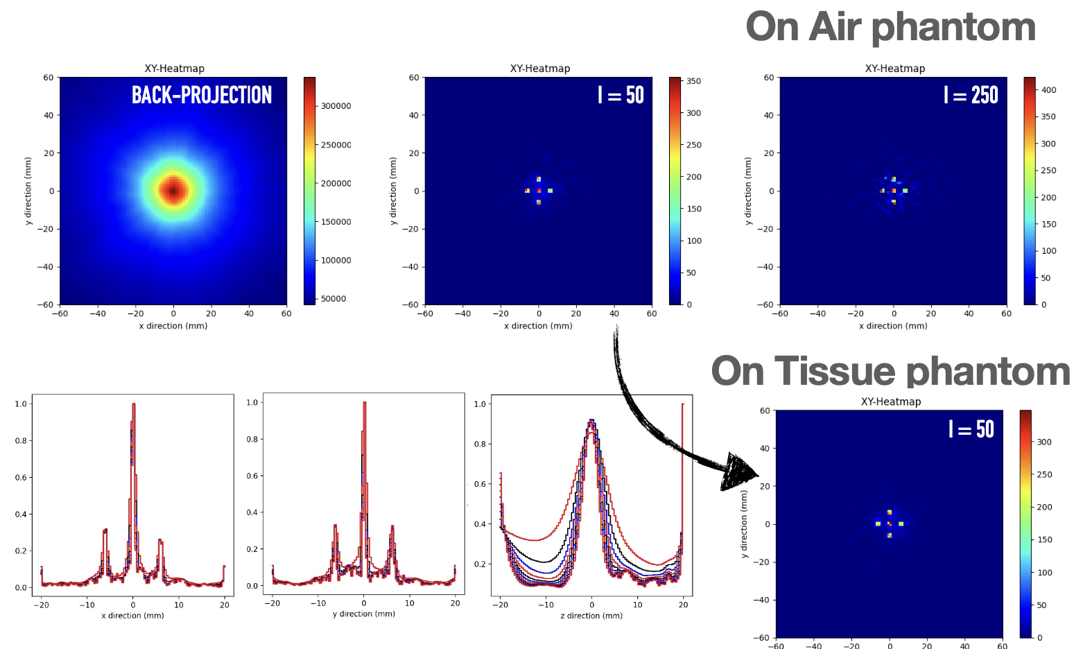
MLEM reconstruction method validation
5-point like source
Maximum Likelihood Expectation Maximisation (MLEM) → Iterative method to reconstruct the most probable source distribution
$$λ_{j}^{n}=\frac{λ_{j}^{n−1}}{s_{j}}\overset{N}{\underset{i=1}{∑}}\frac{t_{ij}}{∑_{k}^{}t_{ik}λ_{k}^{n−1}}$$
λ^{n}j = calculated amplitude of pixel j at the nth iteration
sj = sensitivity, i.e. the probability that a gamma ray originating from pixel j is detected anywhere
tij = imaging response matrix, i.e. the transition probabilities generated by the measured events(first estimation: based on back-projection, λ0)
Good resolution in x and y profiles, slighly worse in z direction
No image interference when material phantom is added
Notes:
With only the
Back projection are not distinguished.
After 50 iterations …

Slide 8
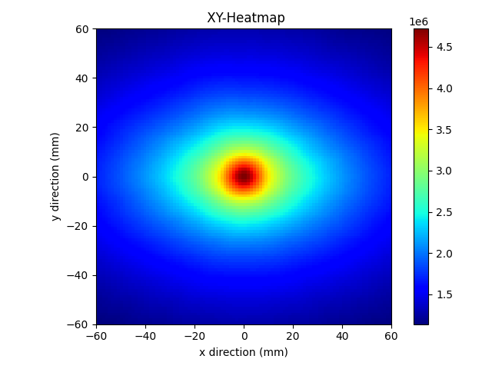
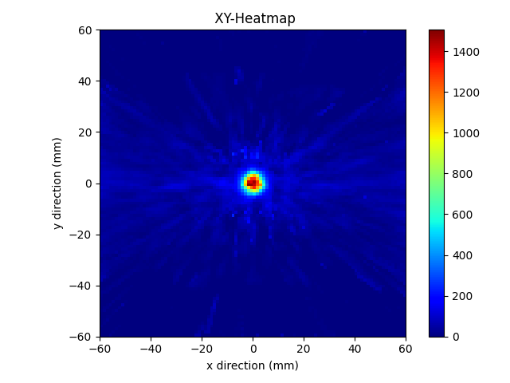
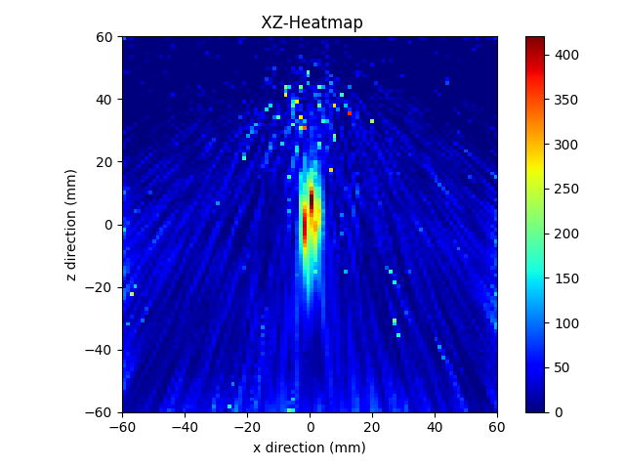
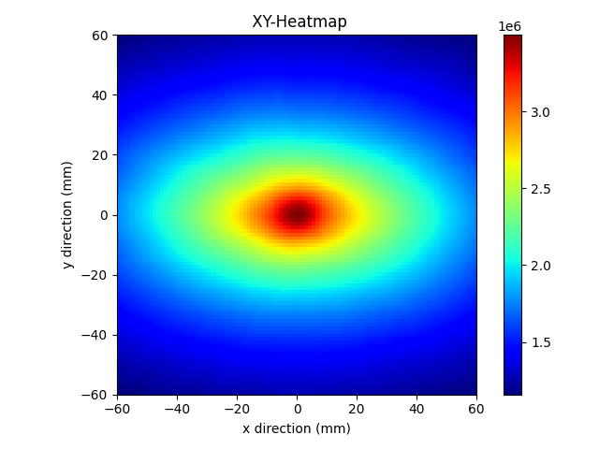
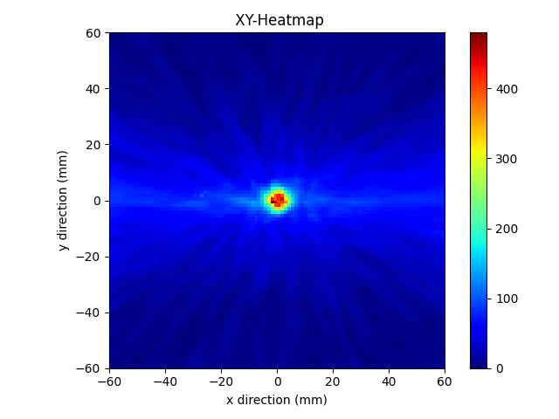
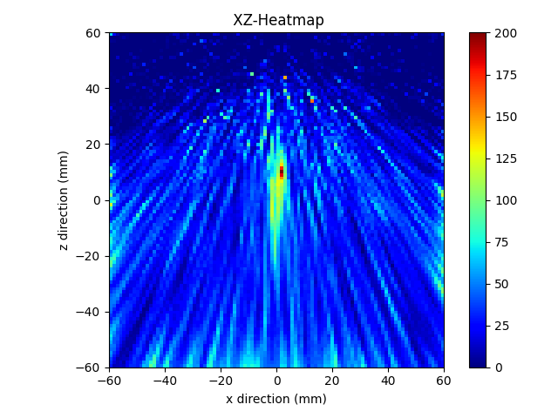
Boron ratio study
More realistic condition:
Spheric source to simulate the tumor
Two boron ratios: ideal case (T/N=5) and (T/N=2) extreme case (clinical values are T/N>3)
Both situations resoluted
More iterations needed to solve the image in z (≈250)
in Tissue phantom, T/N = 5.0
Back-projection
I = 50
I = 250
in Tissue phantom, T/N = 2.0
Back-projection
I = 50
I = 250

Slide 9
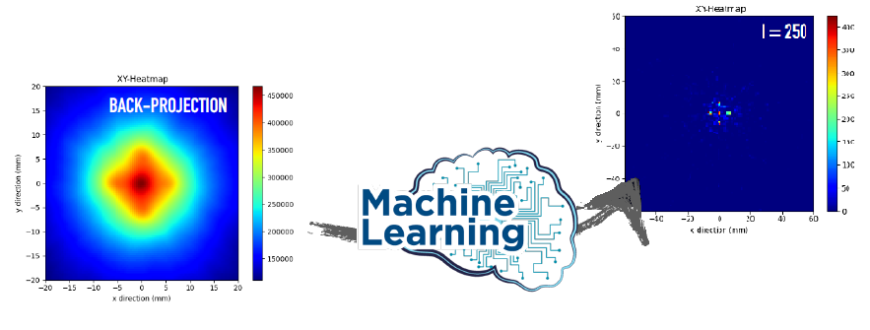
Novel Deep Learning approach
Limitation: MLEM works only post-irradiation (not online), tomography takes few mins (≈ 20 min)
New method for an online reconstruction to go from the back-projection image to the tomography dose using ML procedure
Training Deep Learning model with back-projection and tomography image sets to make tomography reconstruction
Without availability of Compton images databases within BNCT, the approach was to identify the tumor by segmentation using Transfer Learning

Slide 10
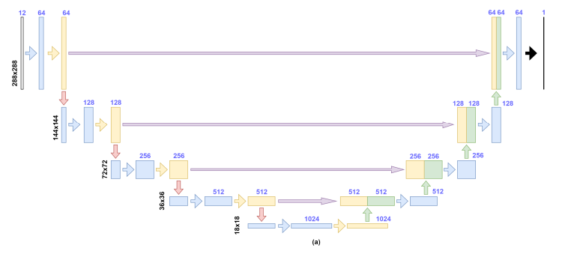
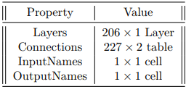
Deep learning model
Matlab pipe-line for segmentation of images
Use of Convolutional Neural Network model with a Residual U-net Architecture (ResNet), widely used for segmentation
Test metrics: accuracy and sensitivity
$$Accuracy=\frac{TP}{TP+FP}$$
$$Sensitivity=\frac{TP}{TP+FN}$$
Resnet U-net architecture
Notes:
We used a CNN model available in the Matlab
And we used as matrics (because a digital images)
True Positive and faulce negative

Slide 11
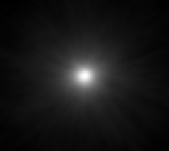
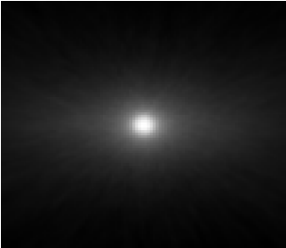
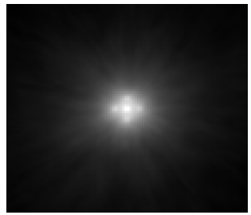
Model performance results
Normalized back projections
Case 1: Spheric source in Air
Case 2: Spheric source in Tissue (T/N=2)
Case 3 Spheric source in Tissue (T/N=5)
Case 4: 5 point-like source in air
CNN segmentation

Slide 12
Conclusions
A Compton camera imaging approaches for dose tomography within Boron Neutron Capture Therapy was studied
The iterative method (MLEM) allows the dose reconstruction, but it is not applicable in in-vivo therapy situations
Deep Learning (DL) is promising as first approach for tumor monitoring with good accuracy/sensitivity compromise
Next steps:
Enrich Compton camera image database
New DL model development for tomography reconstruction

Slide 13
THANKS!
nicola.ferrara@ba.infn.it

