Slide 1
INFN Padova November 21st 2023

Slide 2
Muon Hunter (CAEN)
Two Detection Systems are included in the Cosmic Hunter.
The Detection System consists of:
a plastic scintillator;
a photodetector;
a small front-end electronic board.
The charged particles that pass through the unit desposit energy inside the scintillators due to ionization, producing a light signal.
The light produced in the scintillator is collected and then converted into an electrical signal via a photosensor unit.
The information is elaborated by the Coincidence Module which shows the number of coincidence signals that occur in a period of time.

Slide 3
how cosmic rays are measured
Data collection:
We measured the number of particles (muon) passing through scintillators.
select the angles (between -70° and +70°, every 10°)
start the chronometer (2 min) and the measuring tool at the same time
after the time passed stop the measurement
write down the number obtained (select only the number of muons that passed through both of the scintillators)
For each angle selected we repeated the measurement 2 times.

Slide 4
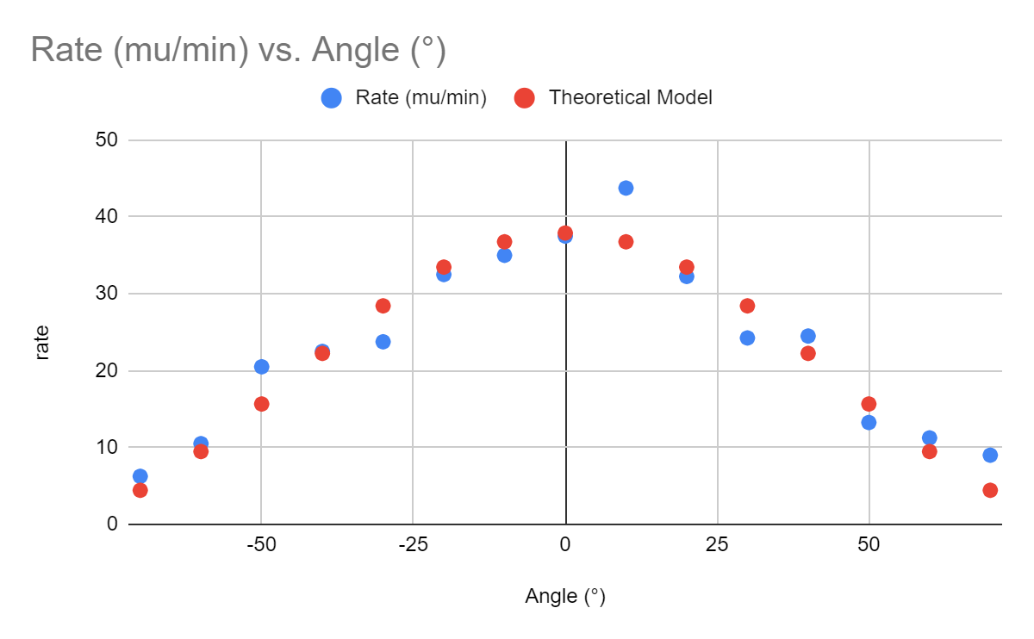
Conclusions
The graph of the distribution of the data is shown to be compatible with the theoretical model, according to the law:
N/∆t=Acos²Ѳ
where A is the normalization constant.

