Slide 1
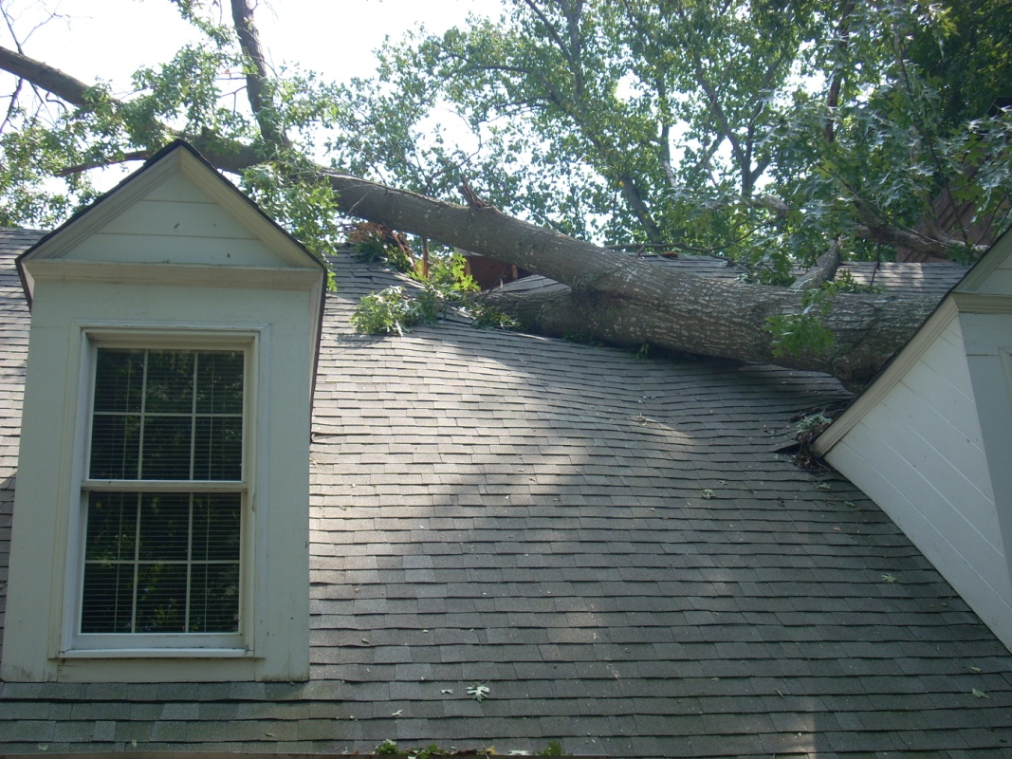
Qweak Target Performance
Greg Smith, JLab
September 7, 2011 PAVI 11, Rome
Collaborators: S. Covrig, D. Meekins, J. Dunne, A. Subedi
At PAVI 10, discussed conceptual design of a high power, low noise PVES tgt
At PAVI 11, we present msrd performance of this tgt
  As built design, novel features
    Problems experienced
  Measured cooling power
  Measured target noise (boiling)
  Implications for next generation (MOLLER tgt)
Design document:
  http://qweak.jlab.org/doc-public/ShowDocument?docid=1041

Slide 2

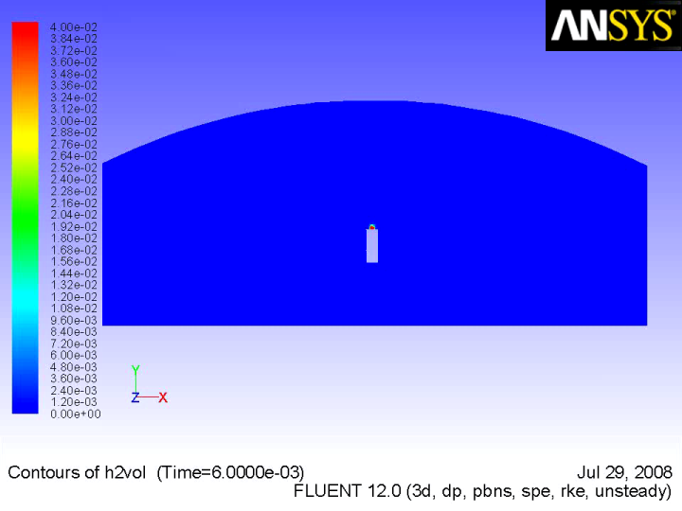
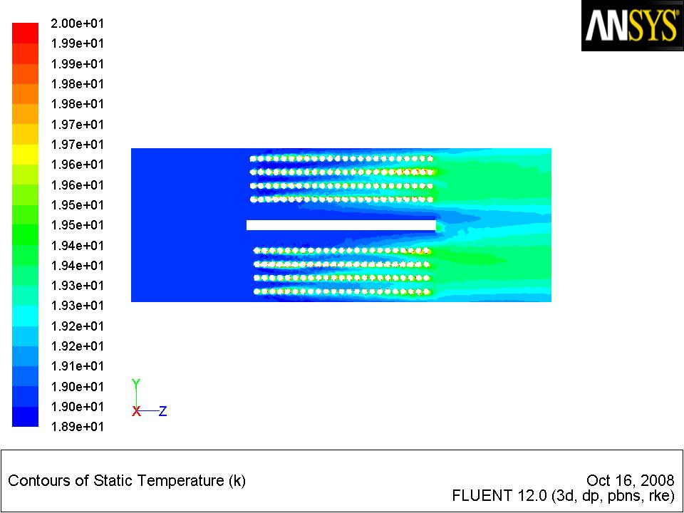
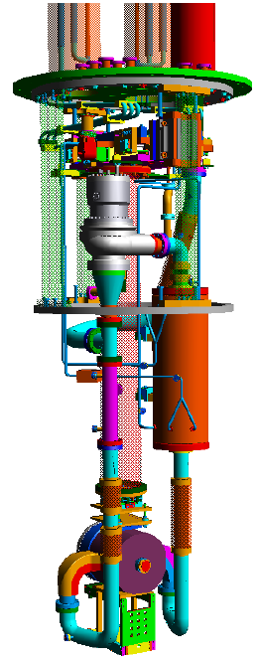
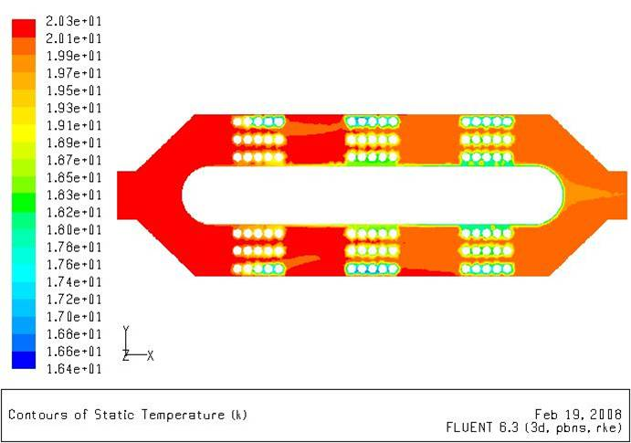
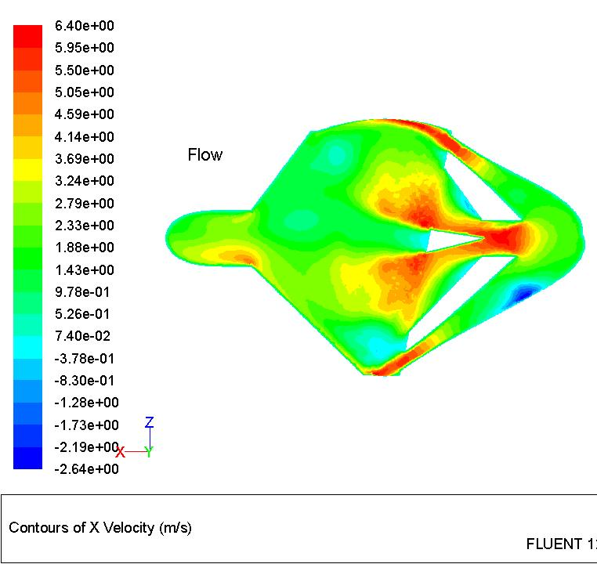
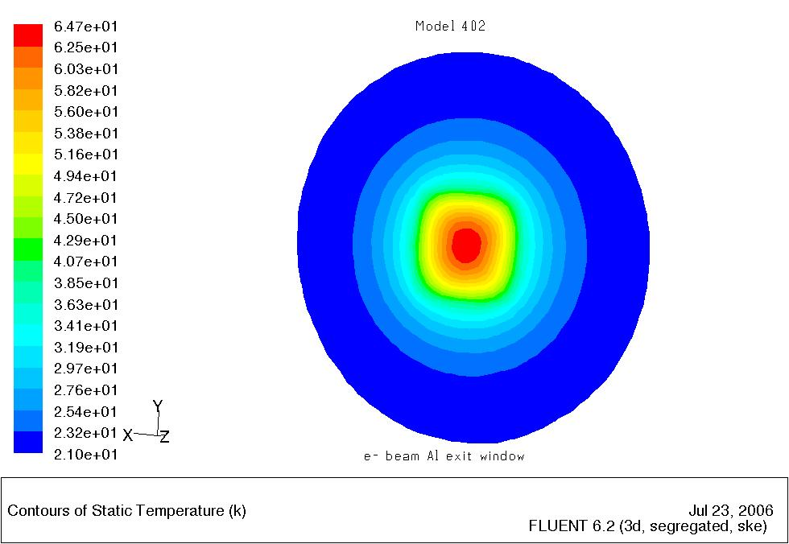
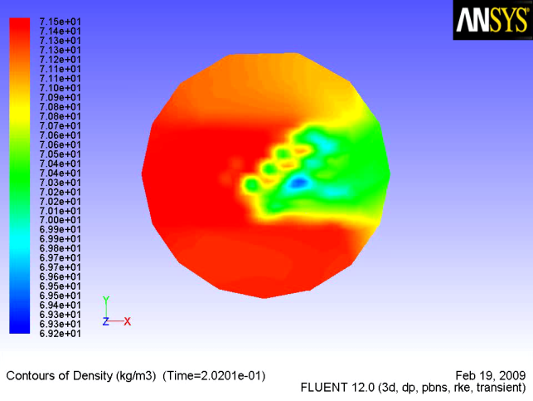
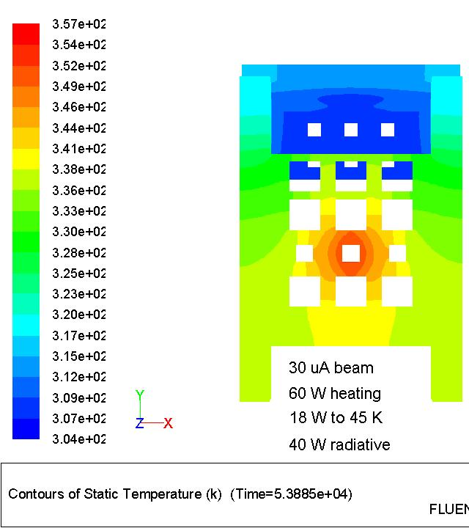
Design by CFD
H2 Release/
Safety
CFD calculations
by S. Covrig (Jlab)
Heater
Heat Exchanger
Windows
Cell
beam
Raster
Dummy/Bkg Tgts

Slide 3
LH2 Target Specifications
LH2 (35 cm cell):
T = 20 ± 0.01 K
  (T_{F} = 13.8 K, T_{B} = 23.6 K)
P~30-35 psia (20 psig)
P_{beam} ~ 2.1 kW @ 180 µA
P_{total} ~ 2.8 kW @ 180 µA
  Reserve power ~ 150 W
Fan ν = 30 Hz
3x3 ≤ raster ≤ 5x5 mm²
2 axis motion
Noise < 50 ppm
4.5 K
15 K
Coolant mass flow (g/s)
Cooling Power (W) for a 20 K Target
Heaters must provide P_{beam} + P_{reserve} ~ 2.3 kW (@ 180 µA)
Coolant must provide P_{beam} + P_{reserve} + P_{pump} + P_{other} ~ 2.8 kW

Slide 4
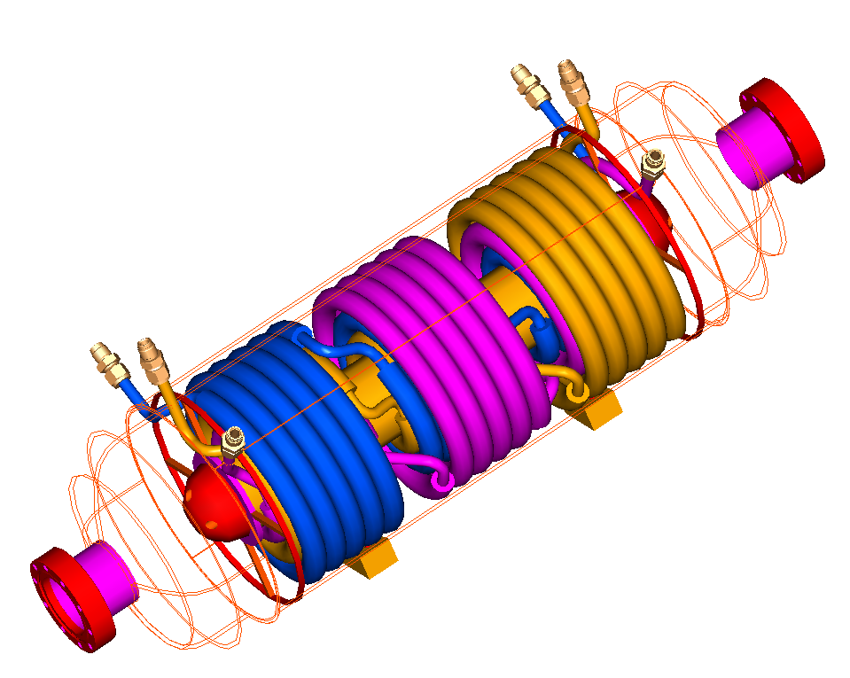
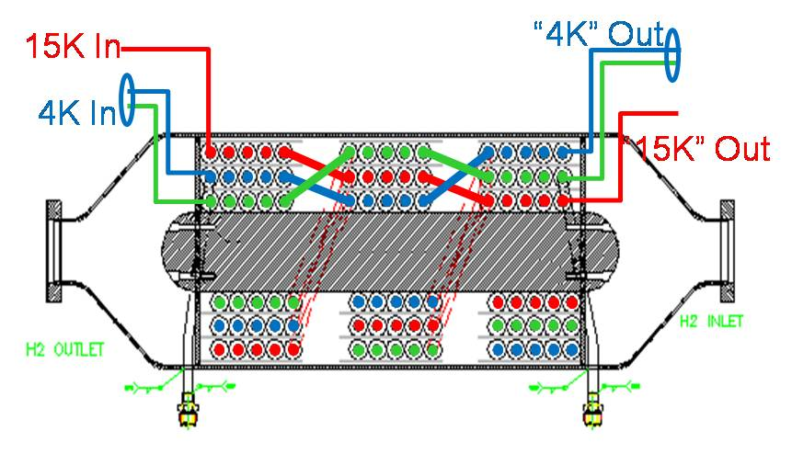
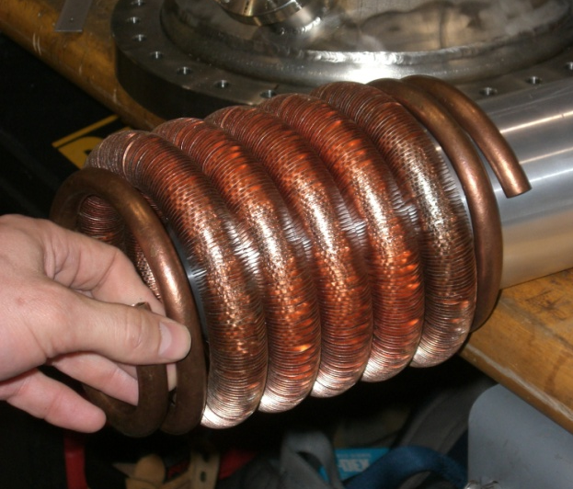
Hybrid 3 kW HX
½” Cu fin tube,
16 fpi.
87.4 cm
Uses 15 K from ESR (has its own 20 K return)
Uses 4 K from CHL (20 K return on xfer line shield)
Danger: 4 K << 14 K. H2 freezes at 14 K!
    4 K supply JT valve PID on loop temperature
    4 K supply heater at HX inlet (500 W), on PID
    4 K supply bypass JT valve to the 4 K return

Slide 5
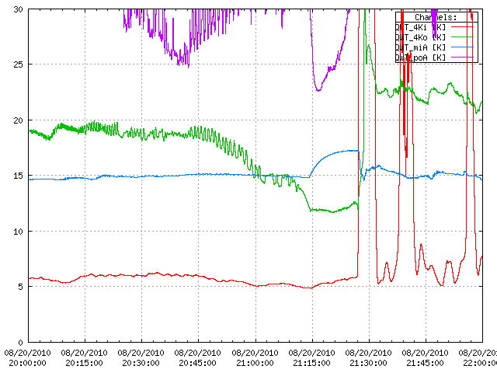
Freezing the HX is all too easy...
(only a problem during cool-down)
LH2 temp suddenly rises as HX ices up
4K coolant T out of HX starts to drop
Temperature (K)
14 K = T_{freeze}(H2)
4K coolant T out of HX suddenly drops well below freezing
TO throttles 4K JT, causing coolant supply temp to rise, defrosting HX
TIME

Slide 6

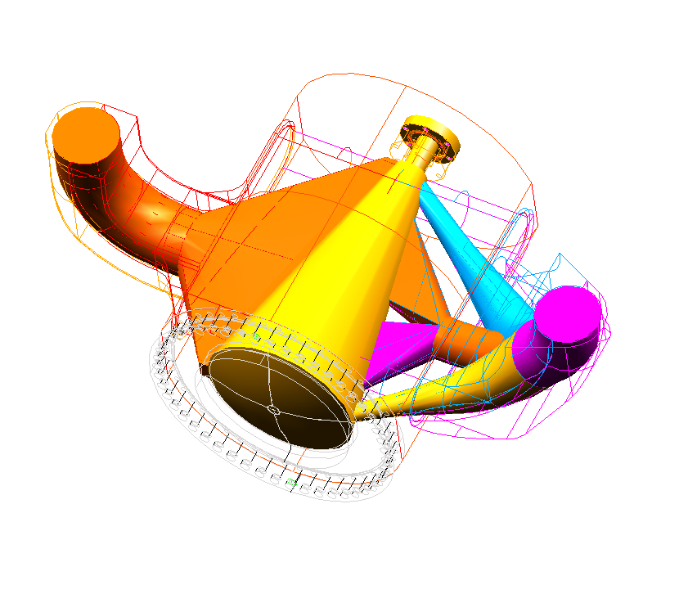
Cell
LH2 Transverse Flow:
1.1 kg/s
15 L/s
3-7 m/s
13.9°
13.9°
Cell 35 cm long
Al entrance window ~0.1 mm thick, 22.2 mm Φ
Al exit window ~0.125 mm thick over 15 mm Φ,
0.635 mm thick over 173.5 mm
Scattered electron acceptance ±13.9°
Electron Beam
180 μA, 4x4 mm²

Slide 7
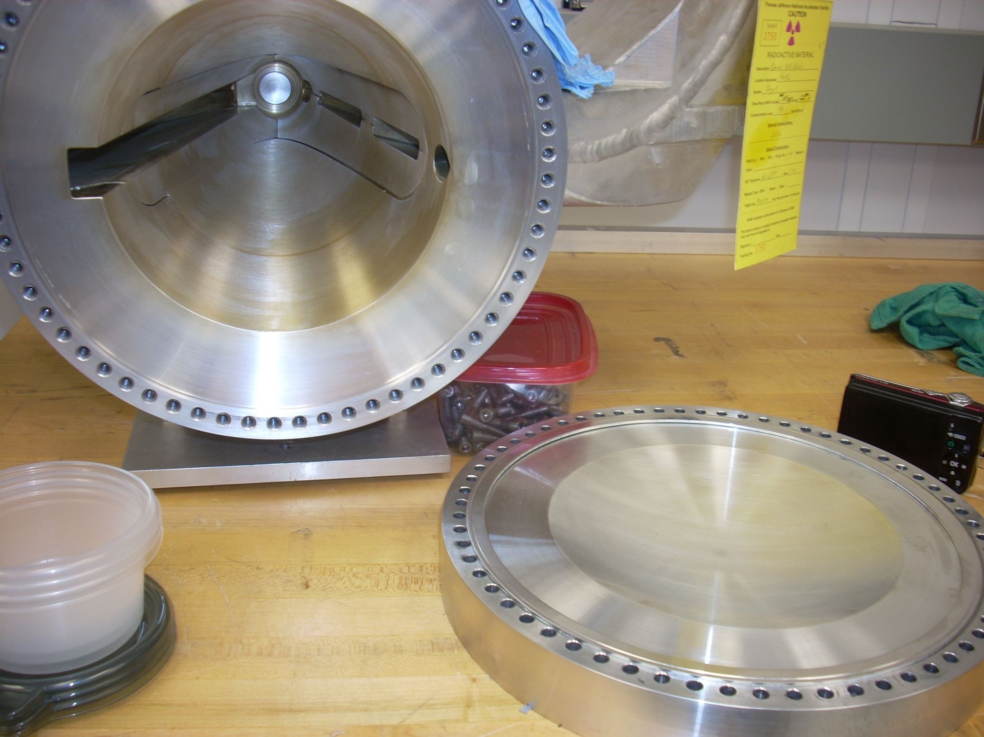
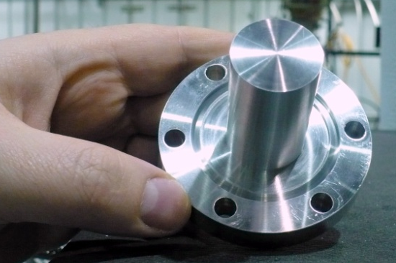
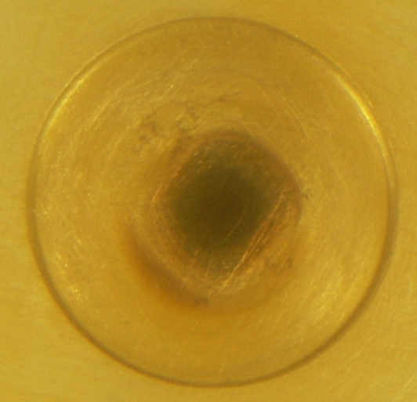
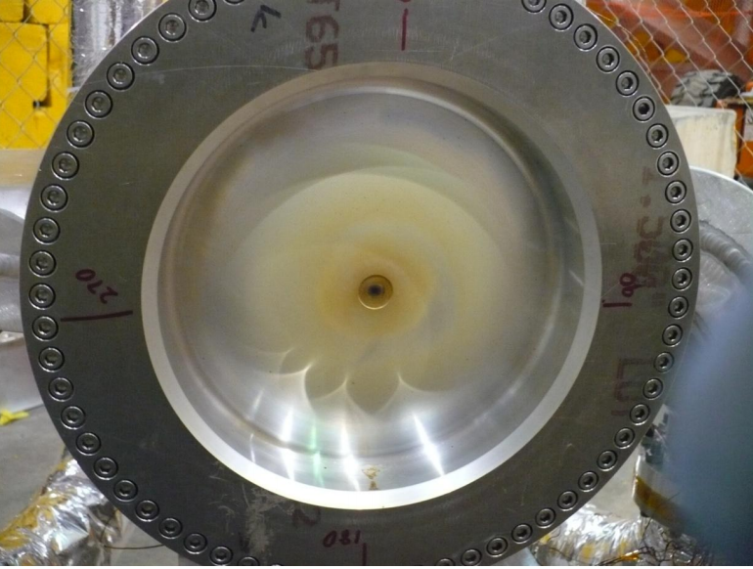
LH2 Cell & Windows (after 6 months running)
entrance window 0.097 mm thick
flow
exit window vacuum side
beam
15 mm Φ, 0.127 mm thick
exit window vacuum side
7.5”
12”
1”
exit window, LH2 side

Slide 8
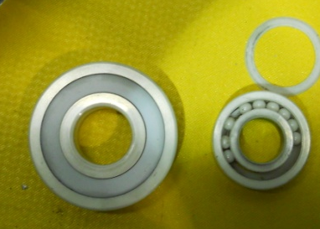
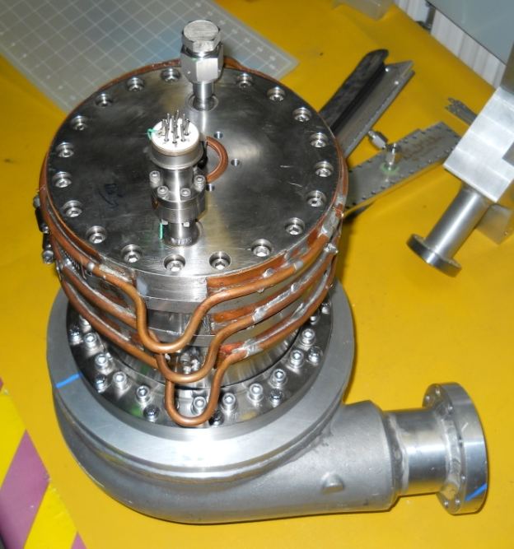
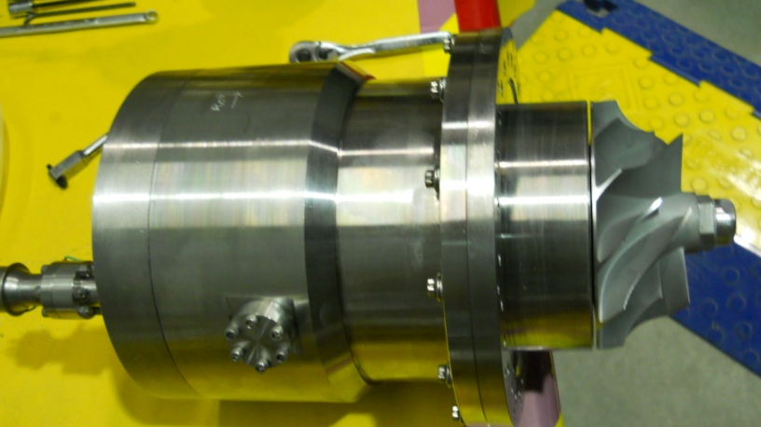
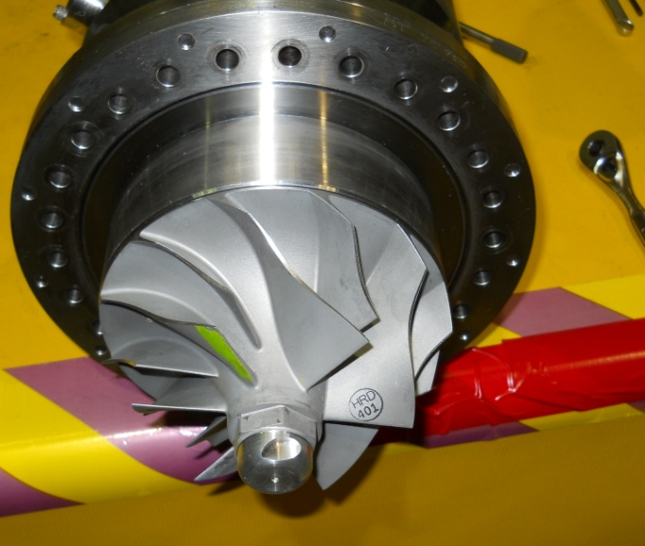
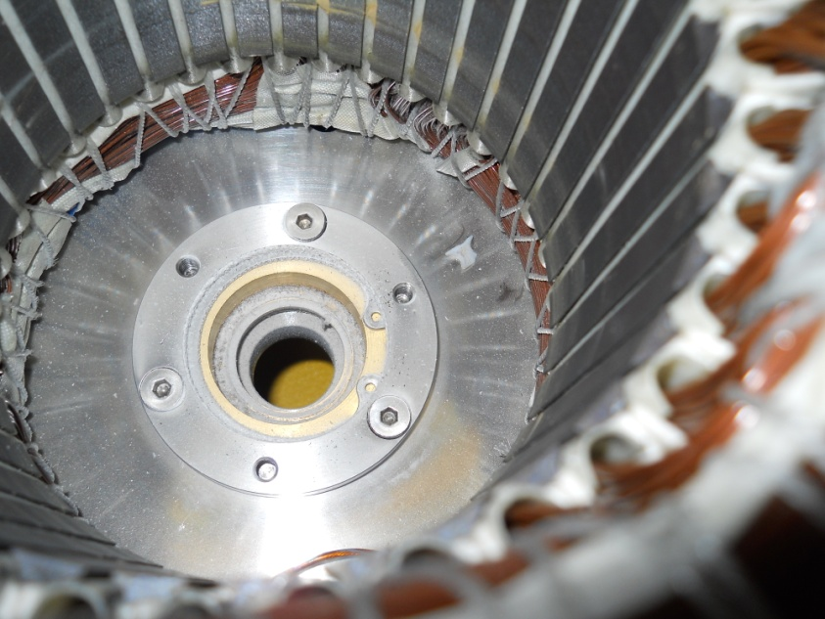
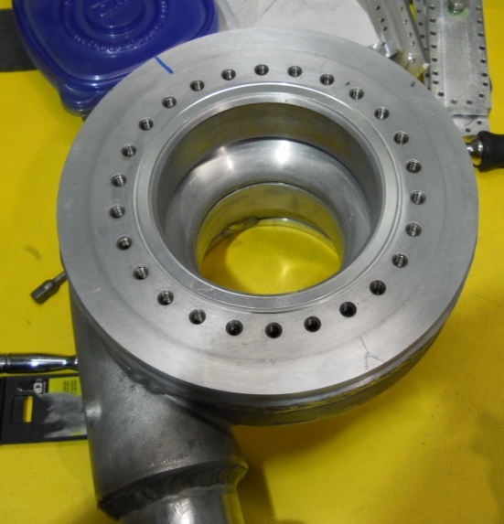
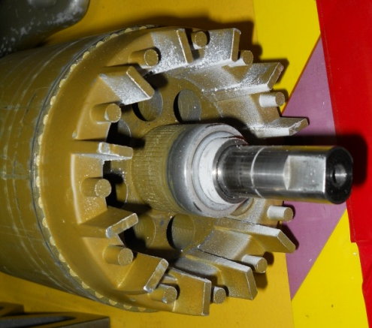
1 hp Centrifugal Pump
All-ceramic bearing failed
Motor housing cooled with 4K return
Early bearing failure.
Mitigated by promoting H2 flow past bearing & across the pump.
Piece of bearing retainer
Impeller
Rotor
Stator
Volute

Slide 9
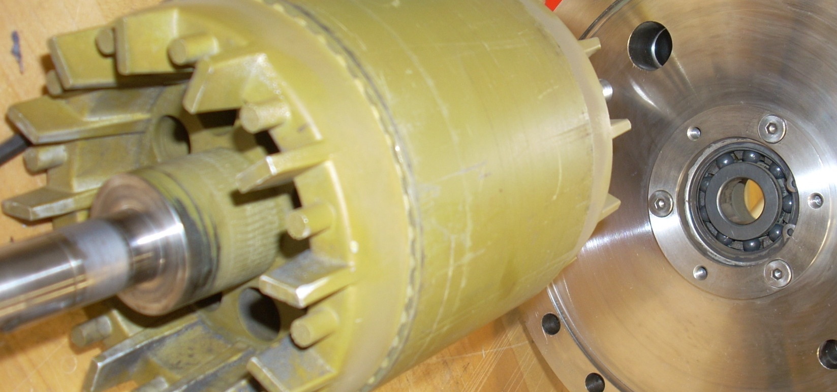
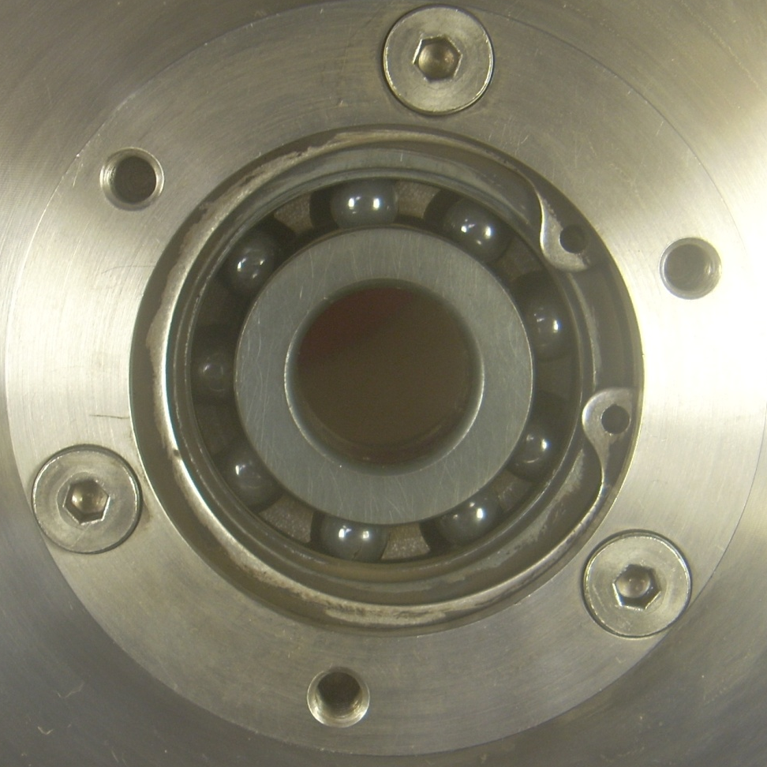
Signs of pump wear (after 6 months)
scoring
Rotor will be replaced
New bearings will be press fit onto a precision turned rotor shaft (outside)
Original bearings: ceramic balls & race, teflon retainer (failed)
New bearings: ceramic balls, SS race, with vespel retainer (graphite impregnated)
Retainer still wears:
  big gaps between balls
  visible debris

Slide 10
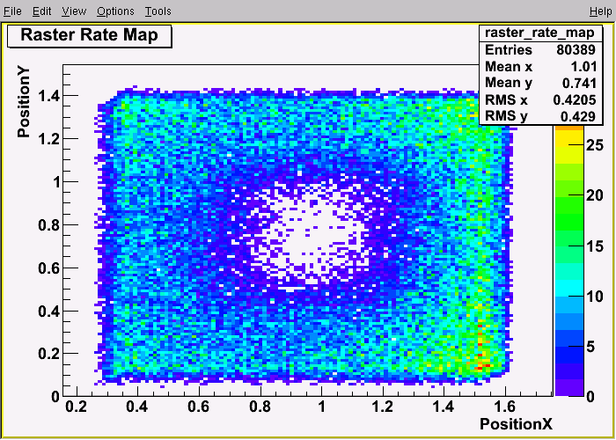
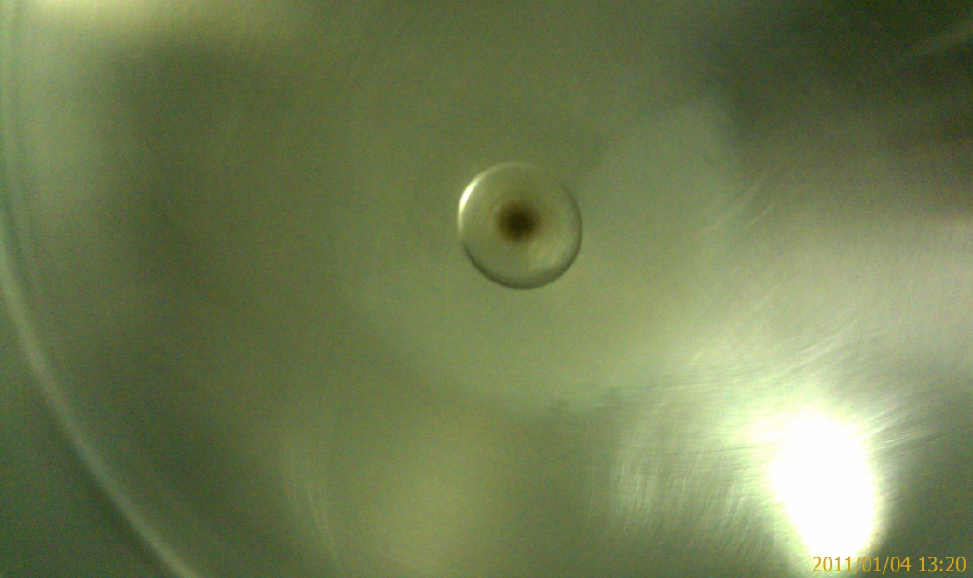
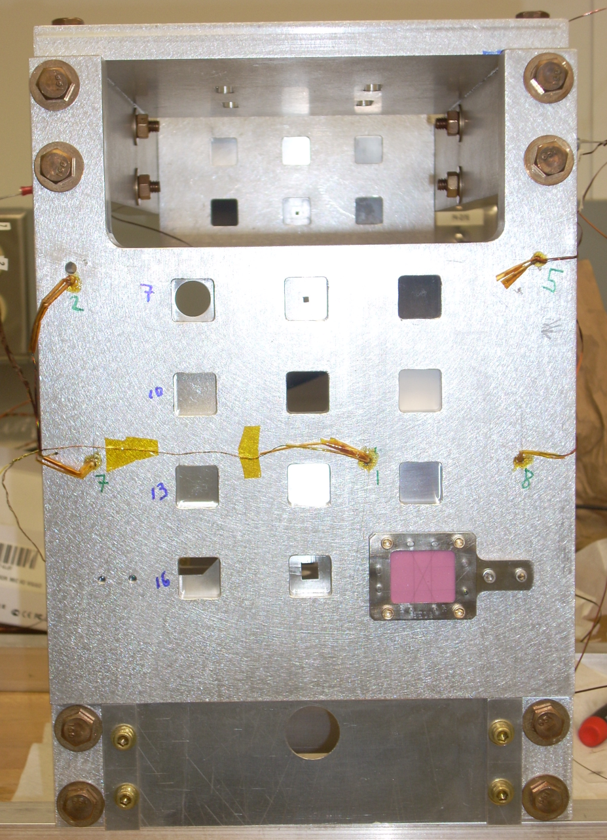
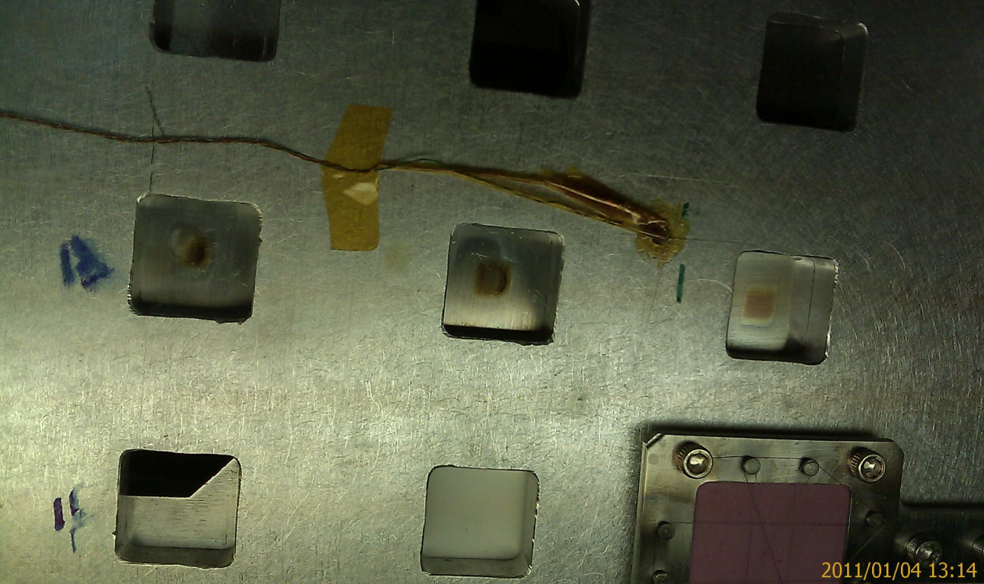
Target centering strategy works well
2 mm
Dynamic 2 axis motion system (x,y).
Manual cell adjustment mechanism (pre-cooldown) allows adjustment of z, roll, pitch & yaw.
LH2 Exit window with thin central nipple
Aluminum background targets
15 mm

Slide 11
Lessons from First Test Cooldown
Added:
  Manual 4K bypass valve to pre-cool xfer lines
  4K PID to automatically close 4K supply if loop temp drops (deadman switch)
  4K heater on PID (500 W) to quickly & automatically reduce 4K cooling power
  Low power heater (50 W) to keep motion system at 300K (counteracts cold leaks)
Problems:
  Pump at top of vertical loop is hard to prime
  Use of 4K coolant makes it easy to freeze LH2 during cooldown (stable once liquified)
  Had to improve pump bearing cooling after they seized
  Pump motor heat load larger than expected

Slide 12
Qweak Tgt Performance: Design vs Reality
Design mass flow 1.1 kg/s
  Measured mass flow 1.1 ± 0.1 kg/s. GOOD!
Design head 1.2 psi (@ 15 l/s = 1.1 kg/s)
  Measured head 1.1 psi. GOOD!
Heater: design goal 3 kW
  Measured up to 2.4 kW (didn’t need more) GOOD!
HX: design goal 3 kW
  Measured up to 2.9 kW so far! GOOD!
Target Noise: design goal < 50 ppm
  Measured 46 ppm at 180 µA, 4x4 mm² raster, 28.5 Hz pump, 960 Hz helicity reversal GOOD!

Slide 13
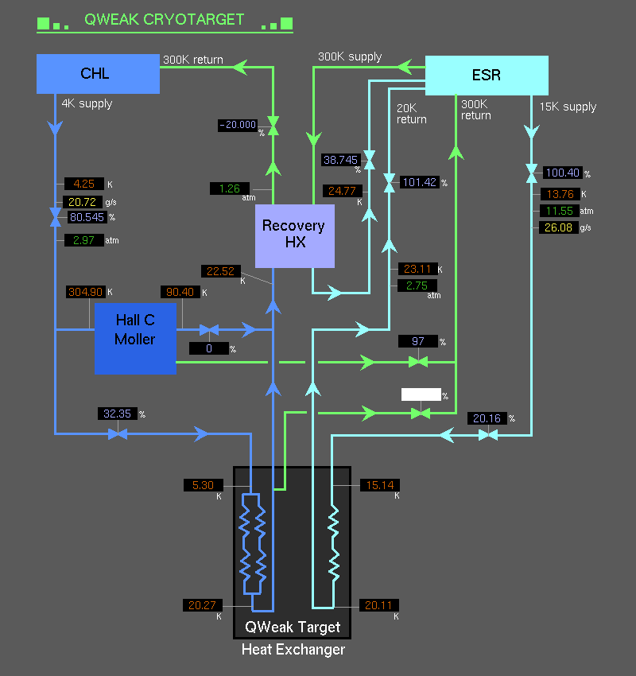
Coolant Scheme
(4K)
(15K)
Hybrid scheme working beyond expectations:
  Otherwise wasted enthalpy of returning 4K used to boost 15K plant’s performance!
    > 2 !
  Novel use of existing xfer line infrastructure works!
    4K returned in LN2 supply (shield) space
Xfer Line
15K Out
4K Out
15K In
4K In

Slide 14
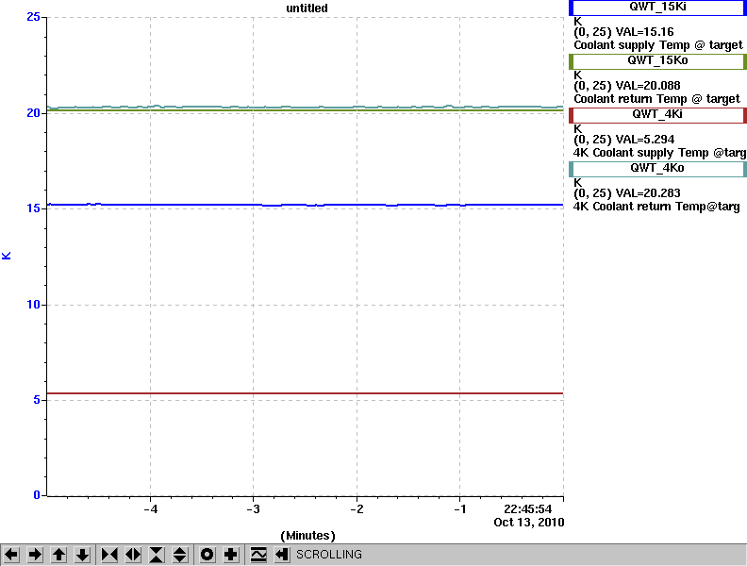
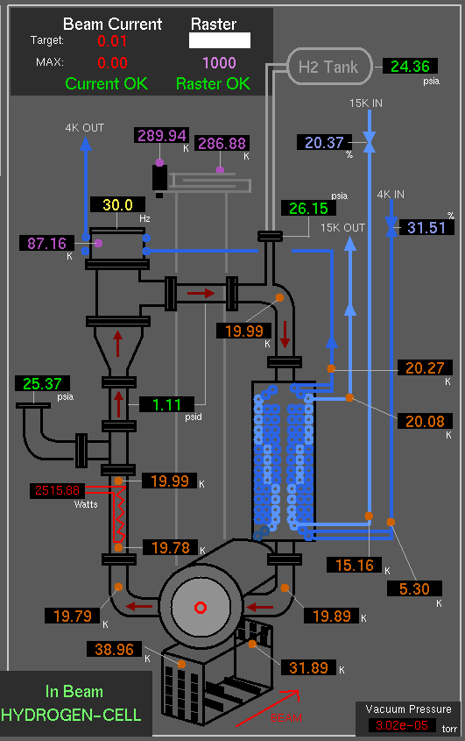
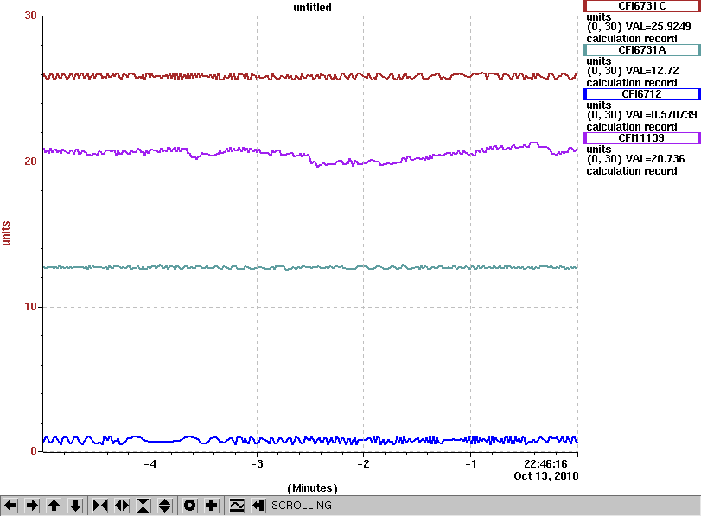
Cooling Power: Great!
25
15 K ΔT = 4.9°
20
15
Coolant Temp (K)
4K ΔT = 15°
10
5
0
Time
•
Q_{tot}=880 W (15K) + 2050 W (4K) = 2930 W
Heater 2515 W. 415 W “missing”, but
Viscous heating = 6.9 * 17.7 l/s * 1.1 psi / ε
= 270 W @ 50% effi
30
15K flow:
26 g/s to Hall C
13 g/s to Hall A
20
m (g/s)
10
4 K flow:
20 g/s to Hall C
0
Time

Slide 15
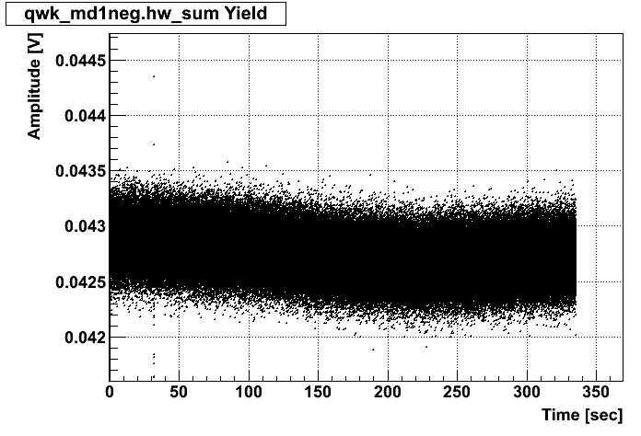
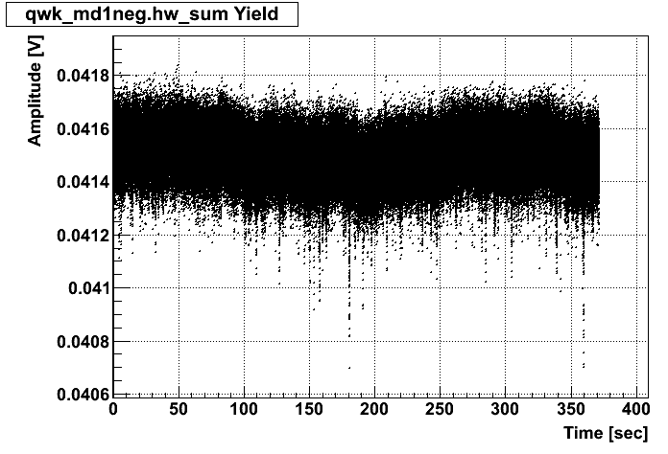
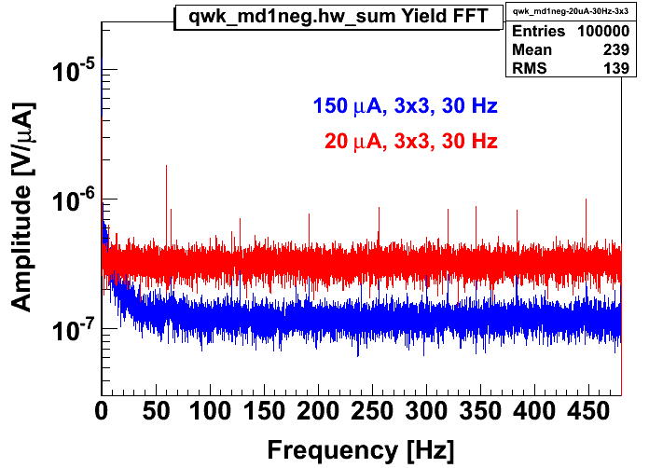
MD Yield (time)
20 µA
LH2 @ 3x3 mm² & 30 Hz
Target noise
(not near helicity reversal frequency,
so it’s not a problem)
FFT: Tgt noise/bubbles at ν < 40 Hz.
Fast helicity reversal avoids tgt noise!
~
FFT
~1%
150 µA

Slide 16
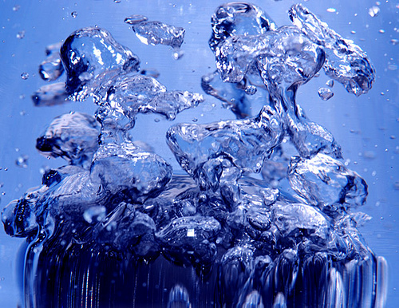
Target Noise (aka boiling)
Extracted in quadrature from msr’d main detector asymmetry widths by varying:
  LH2 pump speed (cleanest: only tgt noise changes)
  Raster area (bkg can potentially also change)
  Beam current (must account for changing statistical widths, BCM, etc.)
Repeated these for different conditions
  Results are consistent within a few ppm

Slide 17
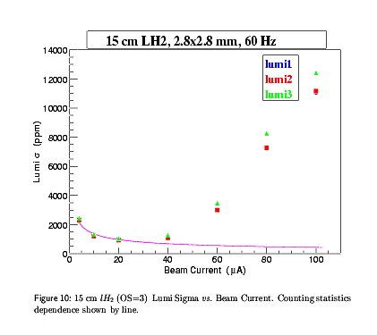

Standard Target Performance
Standard
pivot tgt
(NOT Qweak!)
Msr’d width
Tgt Boiling!
DA, RS, BM Boiling tech note (2003)
Standard pivot targets
Pure Statistics

Slide 18
Beam Current Scan
4 parameter fit:
  Stats ~ 1/√I_{beam}
  BCM ~ 1/I_{beam}
  Tgt Noise ~ 1/I³_{beam}
  Other ~ constant
Msrmnts obtained with relatively small raster, before shielding improvements
46 ppm
  (@ 169 µA, scaled to 4x4 mm² raster)
No boiling
Tgt Boiling!

Slide 19
Pump Scans
3 parameter fit
Msrmnts obtained after many bkg improvements (cleaner)
42 ppm (@169 µA, 4x4 mm² raster, 28.5 Hz)
Exponent fixed at 2
Hypothesis: flow velocity falls off outside 5 mm vertically (flow is horizontal). Consistent with FLUENT guidance.
____ assumes 1/f
Exp. 2
XxY raster,
flow in X

Slide 20
182 μA Raster Scan
226 ppm floor
Only 46 ppm at
182 µA & canonical
4x4 mm² raster!
Expected shape based on lower current behaviour

Slide 21
Explicitly Measured Dependence on Helicity Reversal Frequency
Scaled 480 Hz MD results by √2 to remove trivial statistics effect
Tgt noise is worse at 480 Hz, but not by as much as simulation indicated
Do we still win at 480 Hz anyway?

Slide 22
Comparison of Different Flip Rates
480 Hz Reversal:
960 Hz Reversal:
Slower reversal:
  improved livetime
  better BCM width
  worse boiling
    but this term makes a larger relative contribtion
  Net loss (slight: 249 ppm vs 238 ppm)
    need 4.5 x 4.5 mm² raster to break even
Follows ν^{(-0.4)} power law determined from early tests!

Slide 23
Moller Target Specifications
150 cm LH2 (17.5% X₀) at 20K, 35 psia
5x5 mm² raster area
85 µA beam current
Total cooling power required 5 kW
2 kHz helicity reversal frequency
Target noise contribution to asymmetry width ΔA ~ 26 ppm
< ~ 5% contribution to ΔA
Minimize window bkg

Slide 24
Film Boiling @ Windows
Total Heat Flux
(dE/dx) / A_{raster}
Threshold for film boiling
MOLLER looks promising: careful design may eliminate film boiling @ windows!
Convective part
Predicted by CFD

Slide 25
Scaling Qweak Target performance
Moller target needs tgt noise < 25 ppm (85 μA, 5x5 mm², 2 kHz)
Msr’d Qweak tgt noise ~ 7 ppm at 85 μA, 3.5x3.5 mm² raster.
With a 5x5 mm² raster, expect only 3.4 ppm !
But Moller target ~ 4 times longer. If scaling with length ~ scaling with current, expect ~27 ppm for Moller target.
  But this is way too harsh! Scaling should be much less because window boiling (dominant effect) does not increase with tgt length!
    Moller also plans twice the helicity reversal frequency
Qweak
Conclusion: Scaling Qweak performance, it should be possible to more than meet requirements for MOLLER target.

Slide 26
Summary
Qweak target is world’s highest power, lowest noise PVES target:
  46 ppm @ 182 μA, 4x4 mm² raster
Design goals were achieved
  Validates CFD as a design tool for the future
Operated successfully for 6 months
  Late start. Initial pump bearing failure.
  Six months to go, after planned refurbishment
Successful prototype for next gen tgts
  MOLLER

Slide 27

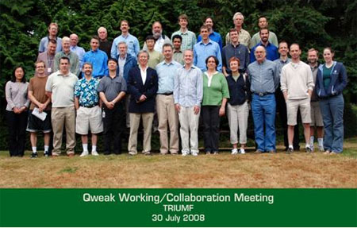


The Qweak Collaboration
A. Almasalha, D. Androic, D. Armstrong, A. Asaturyan, T. Averett, J. Balewski, R. Beminiwattha, F. Benmokhtar, J. Benesch, J. Birchall, C. Capuano, R. D. Carlini¹ (Principal Investigator), G. Cates, J. Cornejo, S. Covrig, M. Dalton, C. A. Davis, W. Deconinck, J. Diefenbach, K. Dow, J. Dowd, J. Dunne, D. Dutta, R. Ent, J. Erler, W. Falk, J.M. Finn¹*, T. A. Forest, M. Furic, D. Gaskell, M. Gericke, J. Grames, K. Grimm, D. Higinbotham, M. Holtrop, J.R. Hoskins, E. Ihloff, K. Johnston, D. Jones, M. Jones, R. Jones, K. Joo, J. Kelsey, C. Keppel, M. Khol, P. King, E. Korkmaz, S. Kowalski¹, J. Leacock, J.P. Leckey, A. Lee, J.-H. Lee, L. Lee, N. Luwani, S. MacEwan, D. Mack, J. Magee, J. Mammei, J. Martin, M. McHugh, D. Meekins, J. Mei, R. Michaels, A. Micherdzinska, A. Mkrtchyan, H. Mkrtchyan, N. Morgan, K. E. Myers, A. Narayan, N. Nuruzzaman, A. K. Opper, SA Page¹, J. Pan, K. Paschke, S. Phillips, M. Pitt, M. Poelker, W. D. Ramsay, M. Ramsey-Musolf, J. Roche, B. Sawatzky, T. Seva, R. Silwal, N. Simicevic, G. Smith², T. Smith, P. Solvignon, P. Souder, D. Spayde, A. Subedi, R. Subedi, R. Suleiman, E. Tsentalovich, V. Tvaskis, W.T.H. van Oers, B. Waidyawansa, P. Wang, S. Wells, S. A. Wood, S. Yang, R. Young, S. Zhamkochyan
¹Spokespersons *deceased ²Project Manager
Notes:
27

