Slide 1

Hadronic Parity Violation
and
Neutron Capture Reactions
Michael Gericke
PAVI 2011
Rome, September 5-9 2011

Slide 2
Outline
PV and the hadronic weak interaction
Meson Exchange Picture
EFT and Hadronic PV
The Experimental Program
Shi-Lin Zhu, et al. , Nuclear Physics A 748 (2005) 435–498
M.J. Ramsey Musolf and S. Page, Annu. Rev. Nucl. Part. Sci. 2006. 56:1–52
C.-P. Liu, Nuclear Physics Phys. Rev. C 75, 065501 (2007)

Slide 3
Parity violating processes between nucleons are used as a tool to study the hadronic weak interaction (HWI) as well as how it is modified by the strong interactions from the simple Standard Model prediction.
Two (common) ways to study HWI:
Flavor changing ΔS=1 hyperon and meson decay
  Decay amplitudes, asymmetries, ...
Flavor conserving ΔS=0 PV interactions at low energy
  Mostly asymmetries, analyzing power, rotation angles

Slide 4
Flavor changing decay of mesons and hyperons:
Much theoretical progress from EFT, χPT, heavy quark EFT
Structure of operators from effective Lagrangians incorporate the symmetries of QCD
Not so, in hyperon decay:
Unresolved ΔI= ½ rule puzzle
Anomalously large PV asymmetries in hyperon radiative decays
Etc.

Slide 5
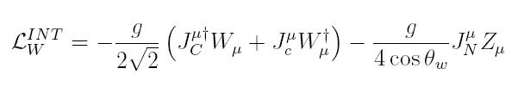
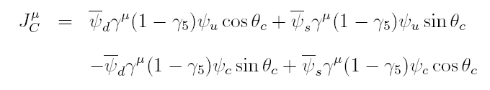
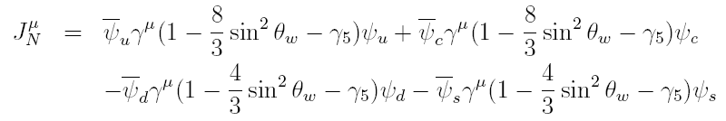
Do the unexpected observations in the ΔS=1 sector come from a dynamical strange quark or some other process ?
Look at the ΔS=0 sector
Standard Model:
Charged currents:
Neutral currents:

Slide 6
Do the unexpected observations in the ΔS=1 sector come from a dynamical strange quark or some other process ?
Look at the ΔS=0 sector
Standard Model:
Charged currents:
Neutral currents:

Slide 7
Goals of ΔS=0 HWI studies:
Answer how the symmetries of QCD characterize the HWI in strongly interacting systems The HWI is just a residual effect of the q-q weak interaction for which the range is set by the mass of the Z,W bosons which is much smaller than the size of nucleons, as determined by QCD dynamics HWI probes short range qq correlations at low energy
Shed light on the puzzles in the ΔS=1 sector of the HWI

Slide 8
Applications of ΔS=0 HWI studies:
Atomic Parity Violation (anapole moment)
Parity Violation in Nuclei
Parity Violating Electron Scattering

Slide 9
ΔS=0 HWI studies:
The ΔS=0 HWI can only be isolated experimentally via PV observables, to isolate the weak interaction from the much larger EM and strong interactions.
Weak e-N scale
Weak N-N scale
Very challenging !

Slide 10
ΔS=0 HWI studies:
So people started to look for nuclear many-body (large A) systems for which there exists some fortuitous enhancement of the size of the observable:
coming from nearly degenerate opposite parity state mixing and interference with the much larger parity allowed transition in nuclear excited states.
e.g. TRIPLE collaboration:
parity violation in compound nuclei from neutron-nucleus resonant scattering with longitudinal cross section asymmetries of order 10⁻³–10⁻¹ (up to 10 ⁶ enhancement)
G.E. Mitchell et al. Phys. Rep. 354, 157 (2001)

Slide 11
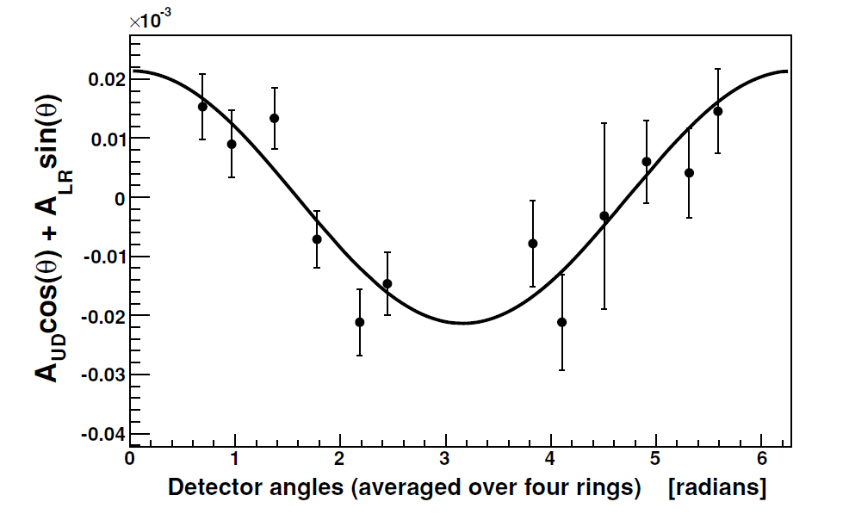
You can get the weak spreading width (weak mixing amplitude) from statistical analysis of this data:
Can also have large(r) asymmetries from neutron radiative capture (here Cl):
M.T. Gericke et al. Phys. Rev. C 74, 065503 (2006)
n-capture on Chlorine
(CCl₄)

Slide 12
ΔS=0 HWI studies:
However, many-body systems are hard to deal with when it comes to interpretation of the results in a non-statistical fashion.
There is no transparent connection to the SM.
So back to few body systems
            No nuclear structure physics
            Low nucleon momentum (≤ ~40 MeV)
            allows for EFT momentum expansion
            But no enhancement of asymmetries
            Need better experiments

Slide 13
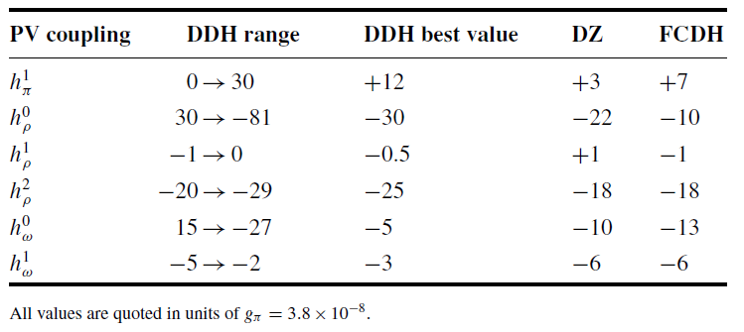
DDH Model – Benchmark
Arrive at 7 weak meson-nucleon couplings:
B. Desplanques, J.F. Donoghue, B.R. Holstein, Annals of Physics 124:449-495 (1980)
DZ: Dubovik VM, Zenkin SV. Ann. Phys. 172:100 (1986)
FCDH: Feldman GB, Crawford GA, Dubach J,Holstein BR. Phys. Rev. C 43:863 (1991)

Slide 14
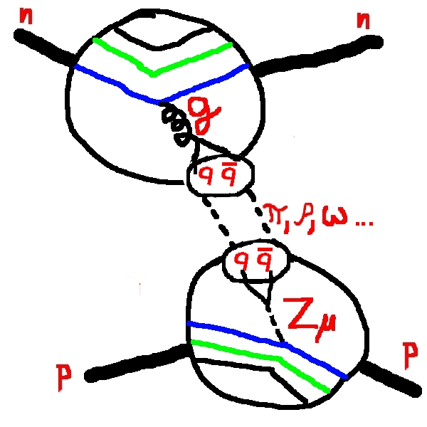
The Nucleon-Nucleon Weak Interaction
Meson Exchange “Traditional” Picture
Solutions to the Lippmann-Schwinger equation -
Essentially the first order term in a Born series:
Weak π-Nucleon Coupling
(ρ,ω not shown)
Notes:
The descriptive cartoon illustrates the process by which nucleons are thought to interact weakly (only the neutral current is shown) via meson exchange.
For this interaction, the first order transition matrix element is a product of the interaction potential with the free particle propagator or Green’s function.
An integration of this term over the pion and nucleon degrees of freedom produces the so called weak pion-nucleon potential.
Similar potentials exist for the other mesons.

Slide 15
Meson exchange picture cont.

Slide 16
Meson exchange picture cont.
Relationship to quark degrees of freedom:

Slide 17
Meson exchange picture cont.
Relationship to quark degrees of freedom:
DDH use SU(6), quark model, and measured hyperon decay amplitudes instead !

Slide 18
DDH Model – Benchmark
In general, a measured PV NN observable can be expanded in terms of these:
E. G. Adelberger and W. C. Haxton, Ann. Rev. Nucl. Part. Sci. 35, 501 (1985).
DDH Weak Coupling | (A_{γ}) np → dγ | (A_{γ}) nd → tγ | (φ_{PV}) n-p (μrad/m) | (φ_{PV}) n-α (μrad/m) | p-p | p-α | (A^{p}_{Z}) n³He →tp
a_{π}¹ | -0.107 | -0.92 | -3.12 | -0.97 | 0 | -0.340 | -0.189
a_{ρ}⁰ | 0 | -0.50 | -0.23 | -0.32 | 0.079 | 0.140 | -0.036
a_{ρ}¹ | -0.001 | 0.103 | 0 | 0.11 | 0.079 | 0.047 | 0.019
a_{ρ}² | 0 | 0.053 | -0.25 | 0 | 0.032 | 0 | 0.0006
a_{ω}⁰ | 0 | -0.160 | -0.23 | -0.22 | -0.073 | 0.059 | -0.033
a_{ω}¹ | 0.003 | 0.002 | 0 | 0.22 | 0.073 | 0.059 | 0.041
Viviani et al.
PRC 044001

Slide 19
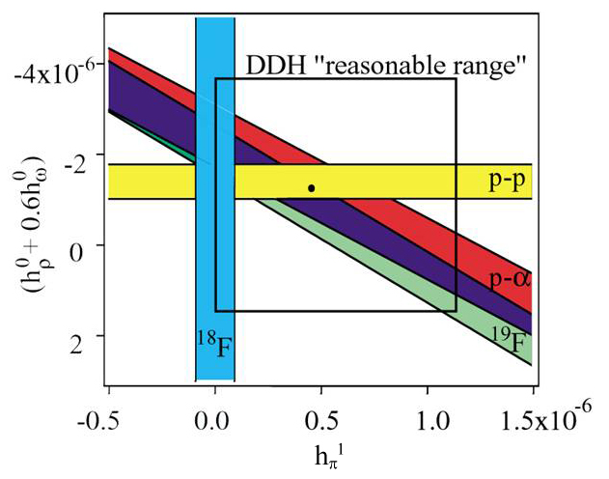
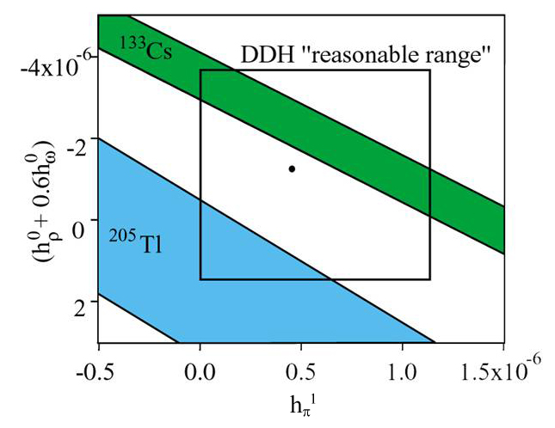
Experimental results generally agree with the DDH ranges, but:
  Uncertainties are large
  Some experimental results produce conflicting values for coupling constants (e.g. Values for h_{π}¹ from ¹⁸F and ¹³³Cs differ by several σ)
p-p scat. 15, 45 MeV A_{z}^{pp}
p-p scat. 221 MeV A_{z}^{pp}
p-α scat. 46 MeV A_{z}^{pp}
¹³³Cs, ²⁰⁵Tl anapole moments

Slide 20
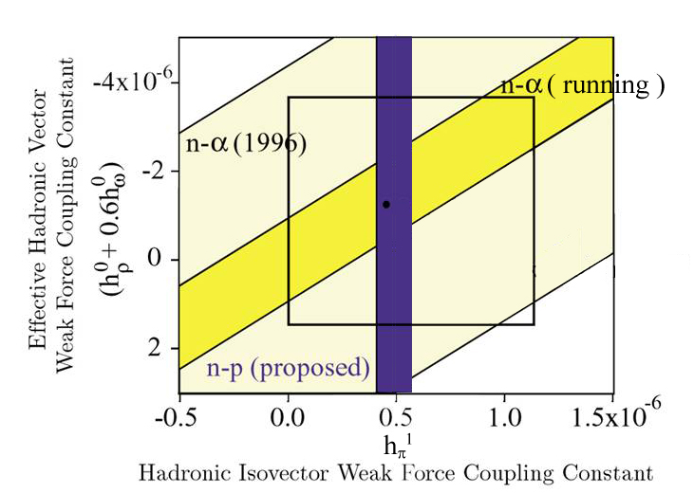
Completed
n+p→d+γ A_{γ}^{d}
n-α spin rot. dφ^{nα}/dz =[+1.7±9.1(stat.)±1.4(sys.)]×10⁻⁷ rad/m
W. M. Snow et al. Phys. Rev. C 83, 022501(R) (2011)

Slide 21
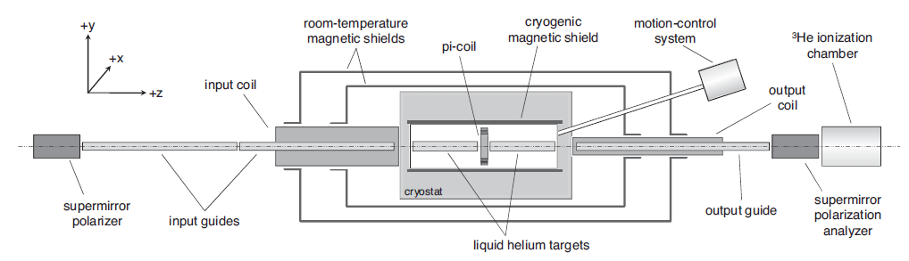

n⁴He Spin Rotation
NIST Experiment:
Vertically polarized neutrons
Enter liquid helium target with four chambers
Neutrons rotate in helium in a spin dependent way
Neutrons are rotated in the x-y plane after acquiring the PV rotation
Neutrons are analyzed in another supermirror polarizer
Transmitted neutrons are detected in the ion chamber

Slide 22
EFT Calculations (Upshot)
The ΔS=0 HWI can be parameterized in terms of 5 (8 with pions) low energy phenomenological constants.
At very low momenta (≤ ~50 MeV) the constants essentially reduce to the 5 Danilov parameters:
originally determined from NN scattering theory (Born approximation)
write down simplest S-P amplitudes with PV and CP cons. amplitudes in addition to singlet and triplet strong …
At higher momentum include explicit pions.

Slide 23
EFT Calculations
Write down 12 possible general P violating and CP conserving current-current terms with all isospin changes up to ΔI=2:
etc…
The NN contact potentials are expressed in terms of 12 parameters, but no mesons:
Shi-Lin Zhu, et al. , Nuclear Physics A 748 (2005) 435–498

Slide 24
Appropriate linear combinations of these reproduce the 5 Danilov coupling constants to be determined by experiment:
Shi-Lin Zhu, et al. , Nuclear Physics A 748 (2005) 435–498

Slide 25
Experimental Program
We need at least 5 (8) few body experiments to completely determine the EFT parameters.
Some have already been done:
Longitudinal Asymmetries in PV proton scattering:
Bonn: P.D. Evershiem et al. Phys. Lett. 256 (1991) 11
PSI: S. Kistryn et al. Phys. Lett. 58 (1987) 1616
R. Balzer et al. Phys. Rev. C. 30 (1984) 1409
Bonn: J. Lang et al. Phys. Rev. Lett. 54 (1985) 170

Slide 26
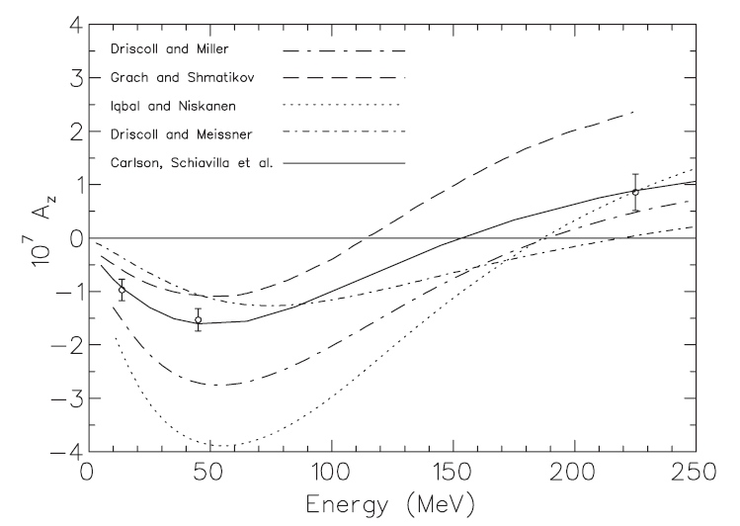
Experimental Program
The TRIUMF 220 MeV pp experiment
Of order Q³ in EFT
- no calculation yet ?
TRIUMF: A.R. Berdoz et al. Phys. Rev. C 68 034004 (2003)

Slide 27
Experimental Program
New experiments (or repeats):
  Neutron capture:
    Circ. Polarization:
    Gamma Asymmetry in np radiative capture:
    Gamma Asymmetry in nd radiative capture:
    Proton Asymmetry in n³He capture
Very challenging!
LANSCE compl. SNS 2010
Hard, SNS planned
Relatively easy, SNS approved ~2011

Slide 28
Experimental Program
New experiments (or repeats):
  Neutron spin rotation:
    In helium:
    In hydrogen LH2
W.M. Snow et al,
Completed (NIST)
SNS planned

Slide 29
Experimental Program
New experiments:
  Longitudinal asymmetry in proton scattering:
    p-d :

Slide 30
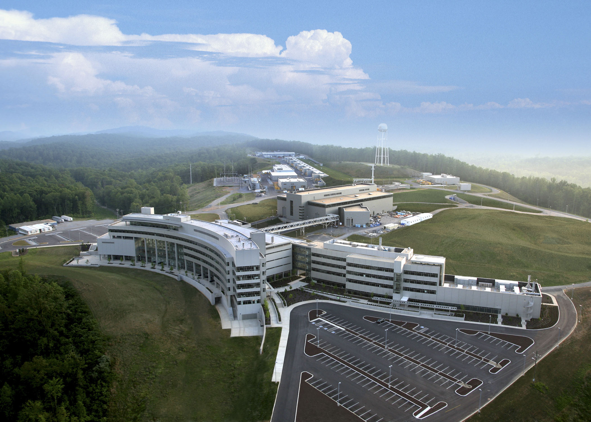
Spallation Neutron Source (SNS)

Slide 31
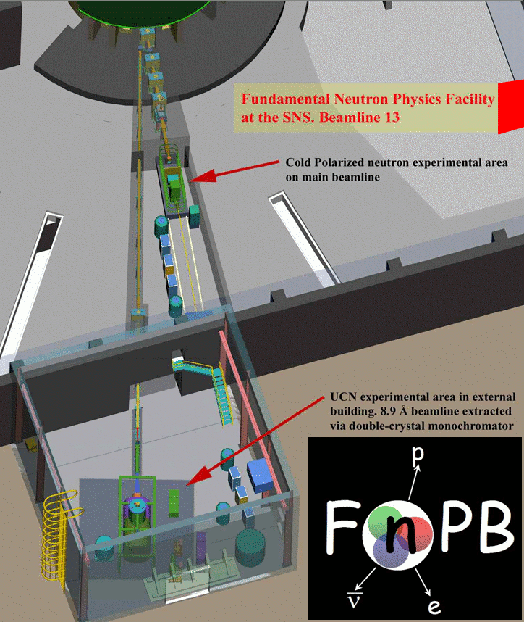
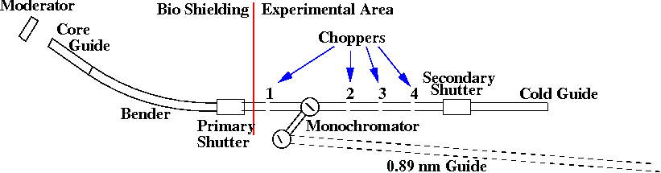
The Fundamental Neutron
Physics Beam (FnPB)
LH2 moderator
15 m long guide ~ 18 m to experiment
one polyenergetic cold beam line
one monoenergetic (0.89 nm) beam line
~ 40 m to nEDM UCN source
4 frame overlap choppers
60 Hz pulse repetition

Slide 32
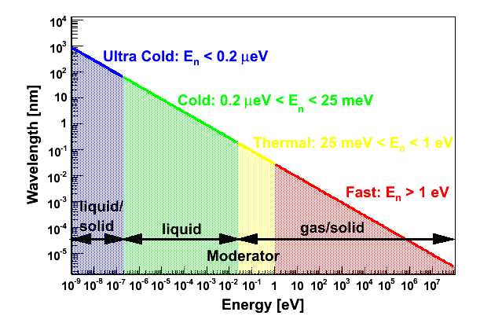
The Neutron Energy Scale

Slide 33
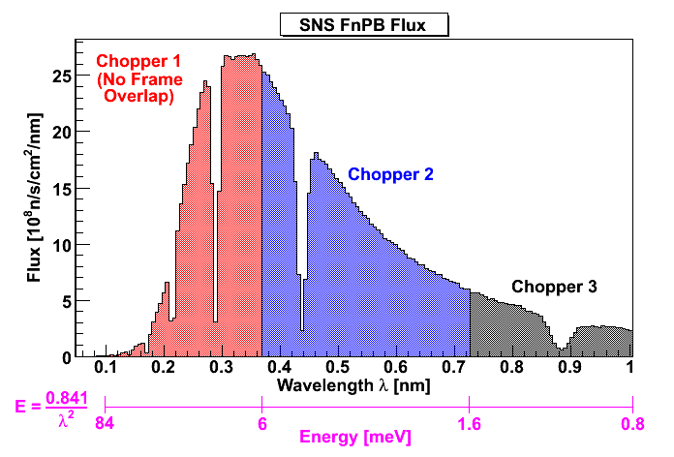
SNS Beam Properties
total ~ 1.1 x 10¹¹ neutrons/second
4.1 x 10¹⁰ n/s , 5.4 x 10¹⁰ n/s, 1.1 x 10¹⁰ n/s
for three example regions with no frame overlap

Slide 34
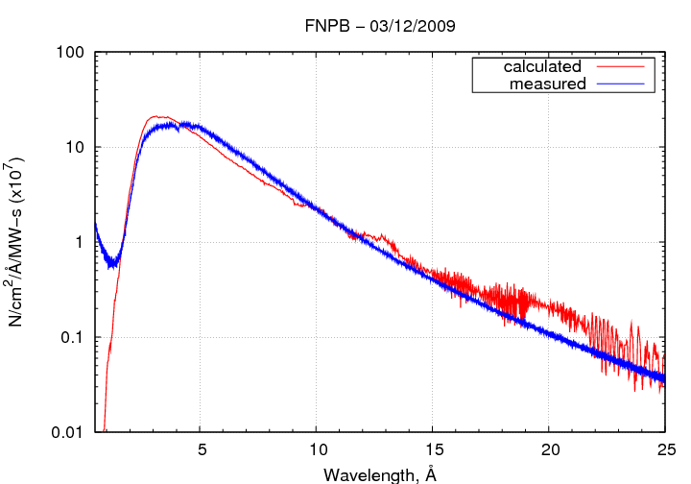

Slide 35
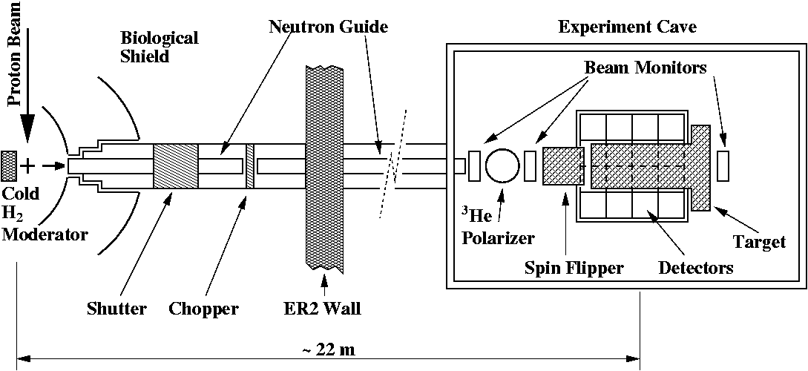
The NPDGamma Collaboration
Oak Ridge National Laboratory, Indiana University,
University of Kentucky University of Virginia,
UNAM, University of Tennessee,
University of Manitoba, TRIUMF,
University of Michigan, Los Alamos National Laboratory TJNAF, Institute for Nuclear Research, Dubna,

Slide 36
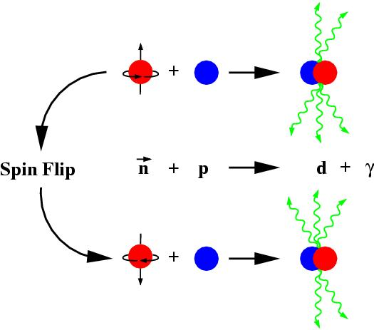
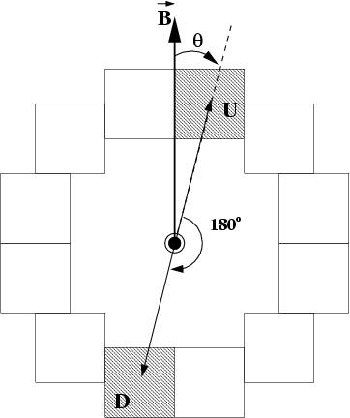
The NPDGamma Observable / Theory
The main NPDGamma observable is the up-down asymmetry in the angular distribution of gamma rays with respect to the neutron spin direction:
DDH:
EFT:

Slide 37
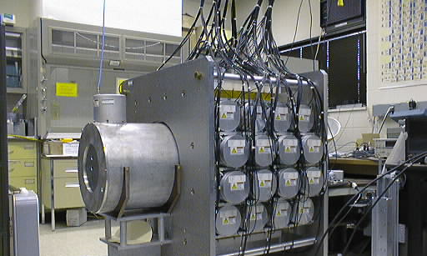
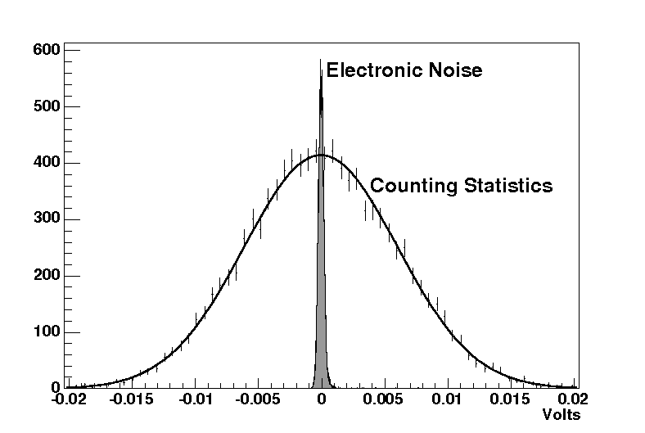
LH₂ target and CsI detector array
30 cm
30 cm
3π acceptance
Current-mode experiment
γ-rate ~100MHz (single detector)
Low noise solid-state amplifiers
20L vessel of liquid parahydrogen
Ortho-hydrogen scatters the neutrons and leads to beam depolarization
Notes:
Scintillation light from the cyrstals is converted to current signals using vacuum photo diodes (vpd) and the photocurrents are converted to voltages and amplified by low-noise solid-state electronics.

Slide 38
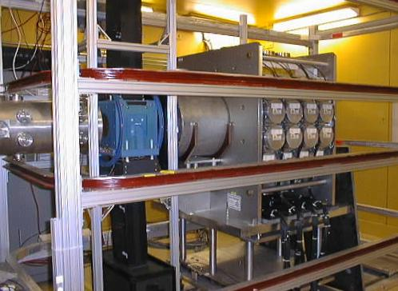
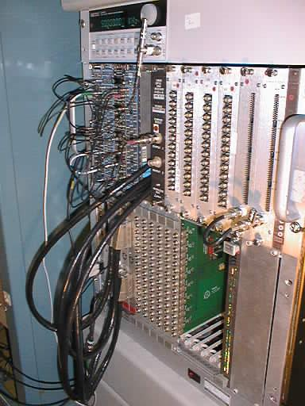
LANL Setup
(essentially same as SNS)
NPDGamma successfully took about 48 days of continuous production data in 2006.

Slide 39
Data Summary from 2006 LANL run
Number of good runs (8.5min long)
Neutron Polarization
Spin Flip Efficiency
Para fraction in LH₂ target
Al background
Depolarization
Stern-Gerlach steering Asym
γ-ray circ.pol. Asym
~5000
53±2.5%
98.8±0.5%
99.98±0.2%
~25% (ave)
2%
10⁻¹⁰
10⁻¹⁰
Notes:
Depolarization of neutron via spin flip scattering from the protons and nuclie in other materials (aluminum, mostly) – dilutes the asymmetry.
Depolarization is monitored with bm behind the target.

Slide 40
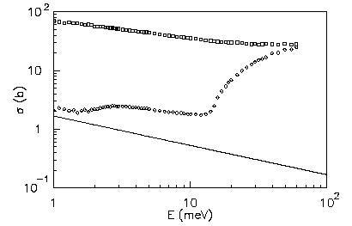
Data Summary from 2006 LANL run
Number of good runs (8.5min long)
Neutron Polarization
Spin Flip Efficiency
Para fraction in LH₂ target
Al background
Depolarization
Stern-Gerlach steering Asym
γ-ray circ.pol. Asym
~5000
53±2.5%
98.8±0.5%
99.98±0.2%
~25% (ave)
2%
10⁻¹⁰
10⁻¹⁰
para
capture
useful range 1-15 meV
Notes:
Depolarization of neutron via spin flip scattering from the protons and nuclie in other materials (aluminum, mostly) – dilutes the asymmetry.
Depolarization is monitored with bm behind the target.

Slide 41
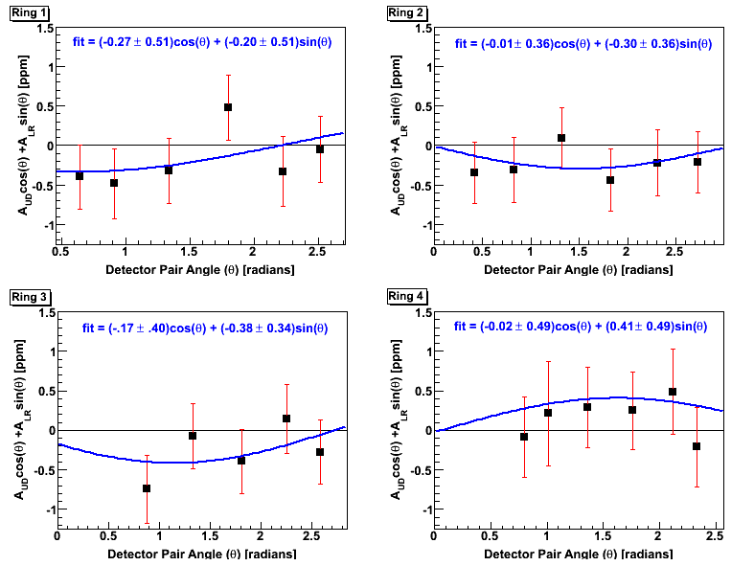
2006 LANL Hydrogen Results:
Total statistical error:
Total systematic error: a (very) conservative 10% mostly due to pol.

Slide 42

What’s new for the SNS run
New and improved safety and engineering rules !!!
Supermirror Polarizer replaces the ³He Polarizer (x4.1)
Higher moderator brightness (x12) => more neutrons
New LH2 target – thinner windows, smaller background
Predicted size -5x10⁻⁸ - NPDGamma can make a 20% measurement in
Installation began in … (before time)
Commissioning started in December 2010
Production hydrogen data expected to begin December 2012

Slide 43
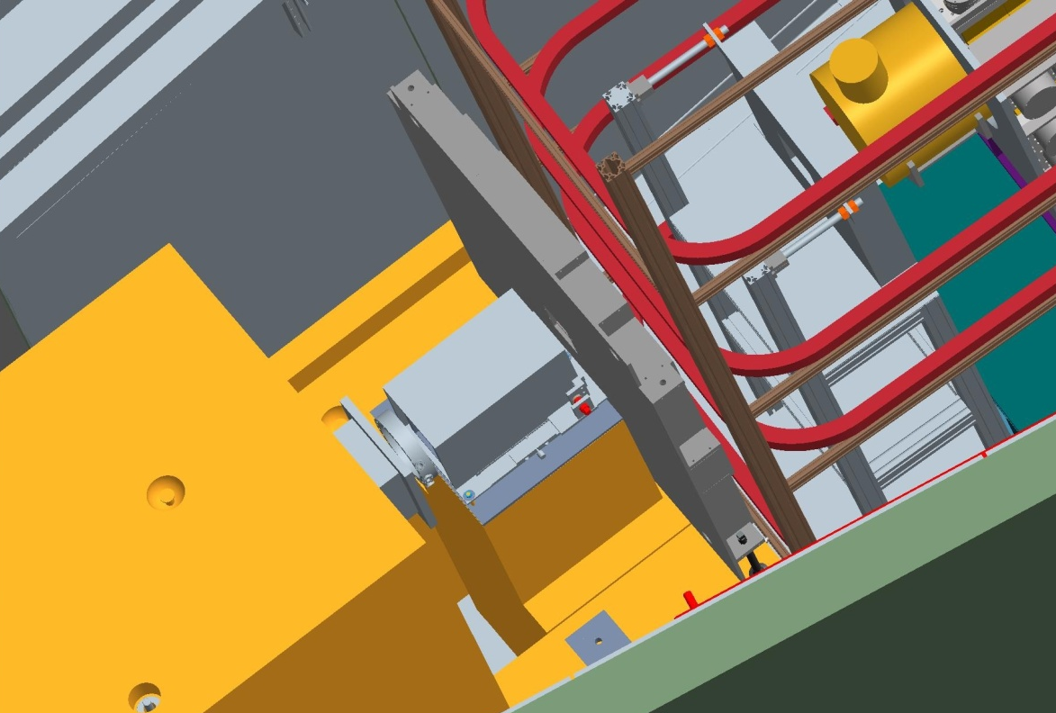
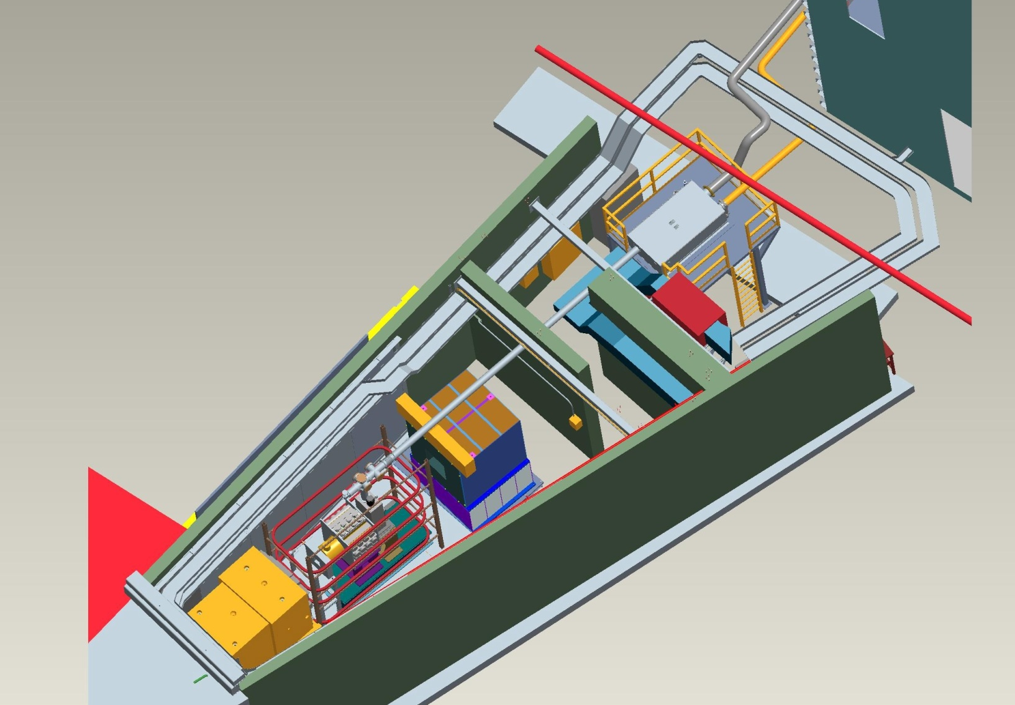
SNS Layout
RFSF
Lead Walls
3He Ion Chamber –M1
Supermirror Polarizer
Beam Stop
CsI detector array and LH₂ target

Slide 44
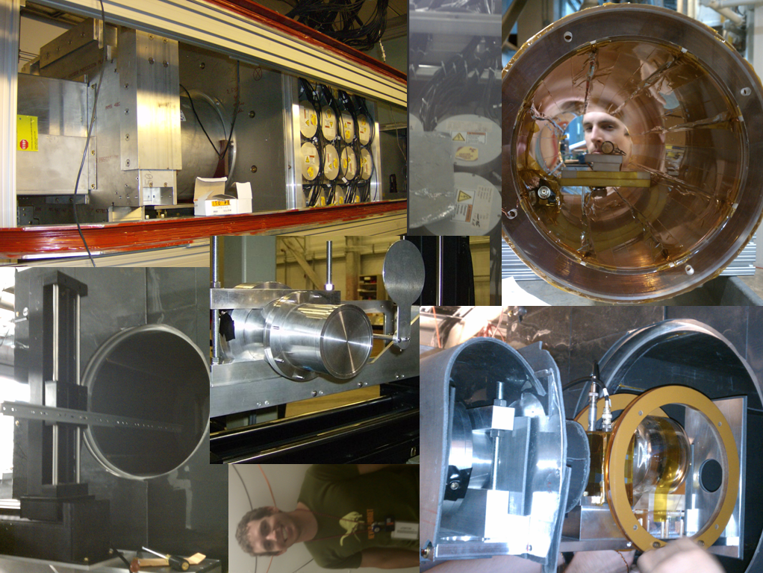

Slide 45
What has been measured to date:
Beam flux at the experiment: Expected: 2×10¹⁰ n/s (based on facility flux) Measured: 5×10⁹ n/s 5×10⁹ / 2×10¹⁰ = 25% (consistent with polarizer transmission
Beam Polarization: ~ 0.96
Aluminum Asymmetry: ~± 0.4 × 10⁻⁷
Counting Statistics and Runtime Estimate: δA_{γ} = 10⁻⁸ N = 10¹⁶ 160 days

Slide 46
The Parity Violating Longitudinal Asymmetry in
Polarized Cold Neutron Capture on Helium 3
n³He
J.D. Bowman, S.I. Penttilä Oak Ridge National Laboratory
R. Carlini Jefferson National Laboratory
M. Gericke, S.A. Page University of Manitoba
C. Crawford University of Kentucky
V. Gudkov University of South Carolina
J. Martin University of Winnipeg
C. Gillis Indiana University
C .Gould NC State University
P-N. Seyo Duke
P. Alacorn, T. Balascuta Arizona State University
S. Baessler University of Virginia
M. Viviani INFN, Sezione di Pisa
Anna Hayes, Gerry Hale,
and Andi Klein Los Alamos National Laboratory

Slide 47
Experimental Setup
10 Gauss
solenoid
1010 steel
flux return
μ-metal
shield
FnPB cold
neutron guide
supermirror
bender polarizer
(transverse)
³He Beam
Monitor
transition field
(not shown)
RF spin
rotator
³He target /
ion chamber
FNPB
n-³He
~ 3 m
longitudinal holding field – suppressed PC asymmetry
RF spin flipper – negligible spin-dependent neutron velocity
³He ion chamber – both target and detector

Slide 48
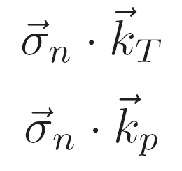
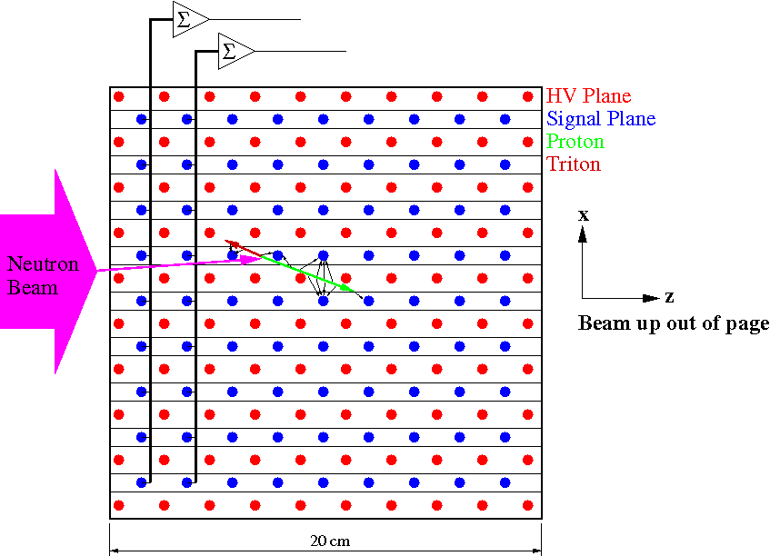
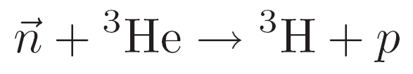
n³He Principle of Measurement
Measure the asymmetry in the number of forward going protons in a ³He wire chamber as a function of neutron spin:
Directional PV asymmetry in the number of tritons
Directional PV asymmetry in the number of protons
(much larger track length)
wire chamber is both target and
detector
wires run vertical or horizontal
no crossed wire: keep the field
simple to avoid electron
multiplication (non-linearities)

Slide 49


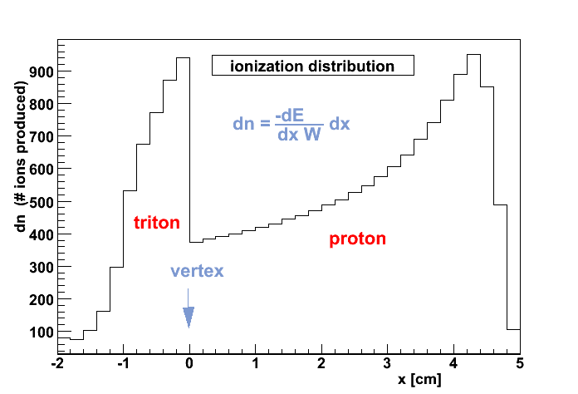
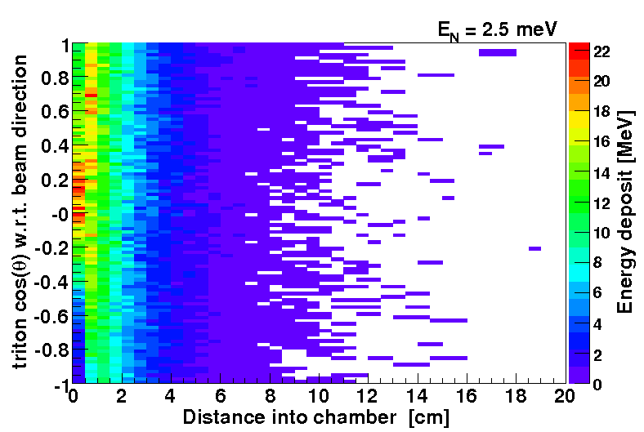
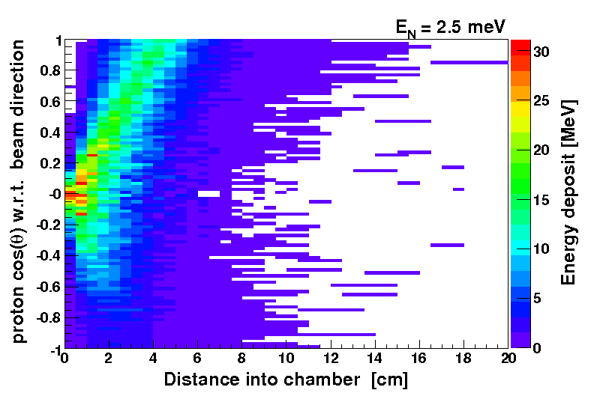
MC simulations of sensitivity to proton asymmetry
  including wire correlations
  δA ~ 6 /√N
tests at LANSCE FP12
  fission chamber flux calibration
  prototype drift chamber R&D
  new beam monitors for SNS
tritons

Slide 50
MC simulations of sensitivity to proton asymmetry
  including wire correlations
  δA ~ 6 /√N
tests at LANSCE FP12
  fission chamber flux calibration
  prototype drift chamber R&D
  new beam monitors for SNS
protons

Slide 51
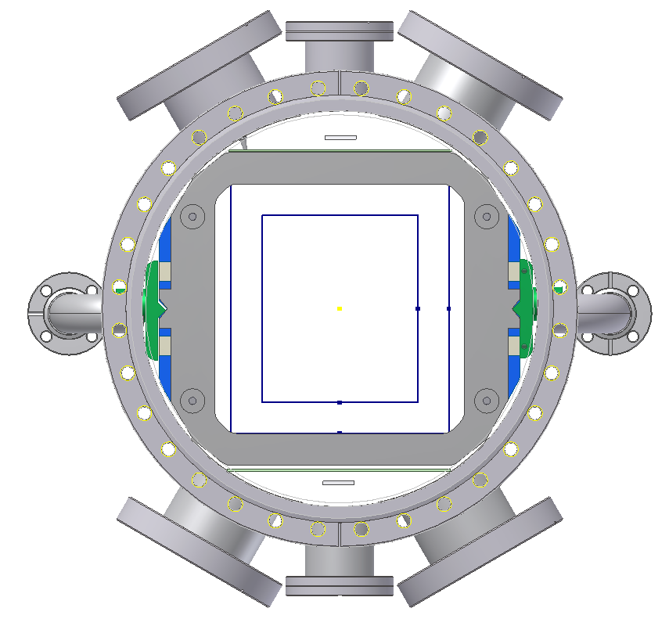
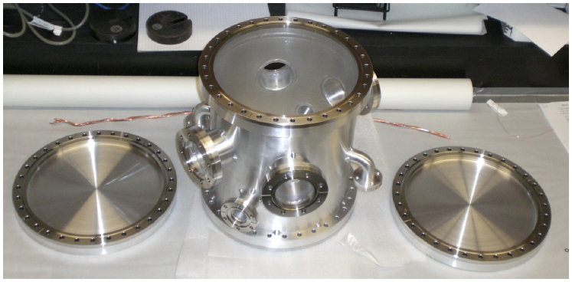
Chamber design finished in 2010
Delivered to U. of Manitoba Fall of 2010.
The chamber has:
- 4 data ports for up to 200 readout
channels.
2 HV ports
2 gas inlets/outlets
12 inch conflat aluminum windows (0.9
mm thick).
Chamber made completely from aluminum except for the knife edges.

Slide 52
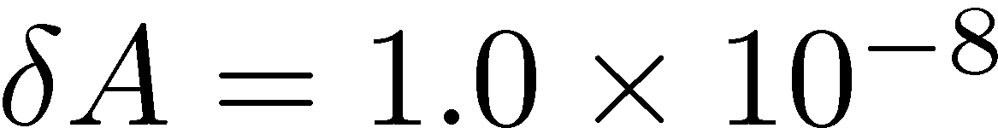
Status/Schedule
n-³He experiment approved by the FnPB PRAC, 2008-01-07
  first measurement of PV in the n-³He reaction
  large asymmetry ~10⁻⁷
  proposed measurement accuracy
recent progress in experimental design
  full 4-body calculation of PV observable
  R&D projects on target/detector design at LANL
  new spin flipper design permitting compact / less expensive layout
  preliminary holding field design
leverage existing hardware / technology
  major components based on similar NPDGamma instrumentation
  can reuse NPDGamma electronics / power supplies
FnPB infrastructure
  no safety hazards, no LH₂ target, new power or cooling requirements
  minimal modification of FnPB cave – stand for n-³He solenoid
  technician support for readiness review preparation, setup of experiment
Tentative Schedule
  2010-2012 Design and development
  Late 2012 Installation
  2013 Run

Slide 53
Thanks!

Slide 54
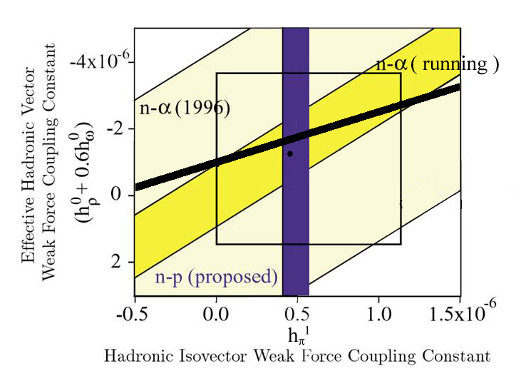
with n³He
(preliminary)
n+p→d+γ A_{γ}^{d}
n-α spin rot. dφ^{nα}/dz
Unfortunately , the connection between the PV observables and the SM is essentially unknown.

Slide 55
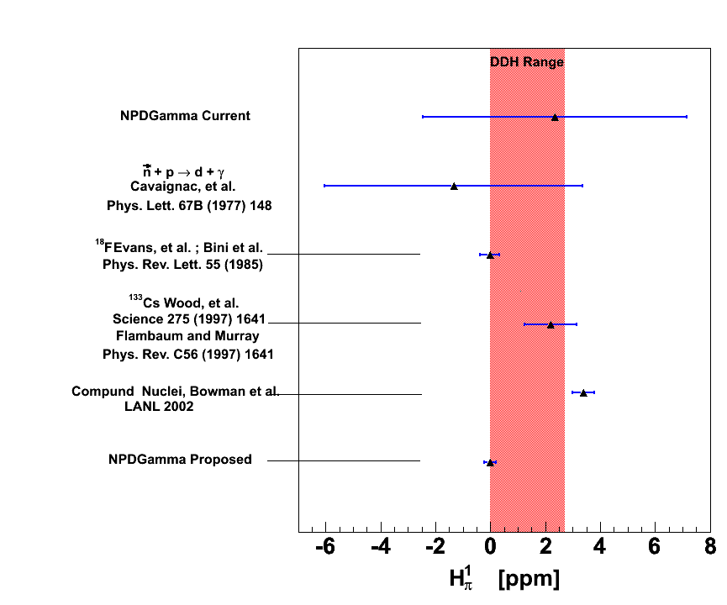
2006 Hydrogen Results:

Slide 56
n³He Relevance
5 EFT parameters :
Correspond to:
n3He asymmetry
relation to EFT constant:
M. Viviani, R. Schiavilla, calculation in progress
DDH:

Slide 57
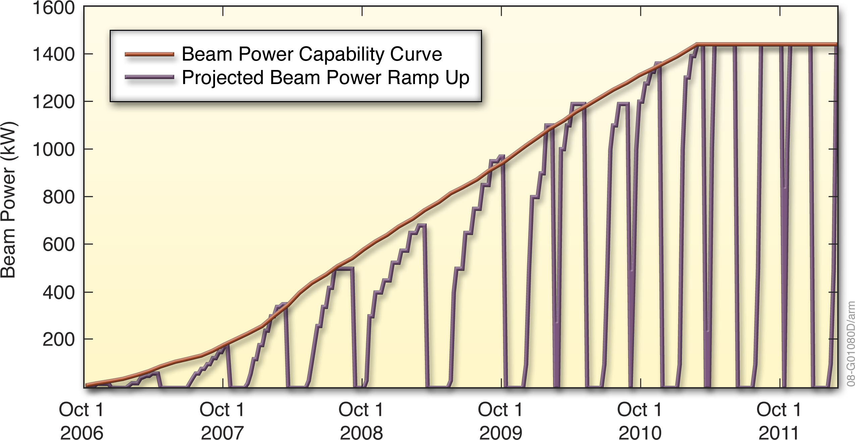
SNS Ramp-Up Plan
Start of NPDG
Now
LANSCE

Slide 58
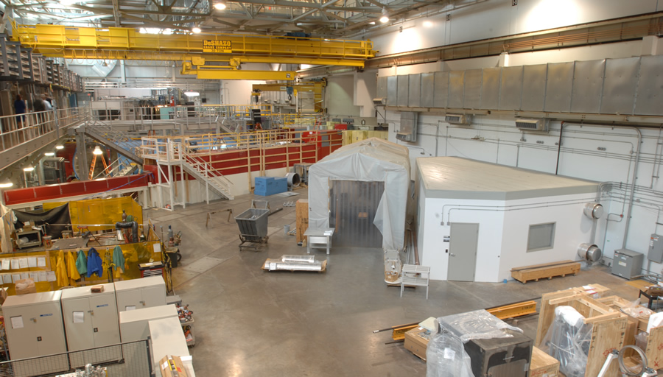

Slide 59
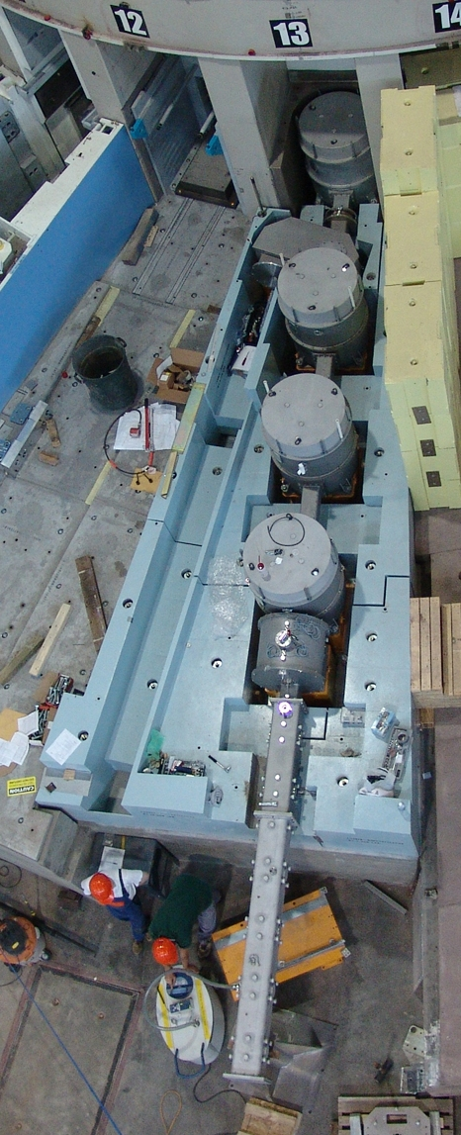
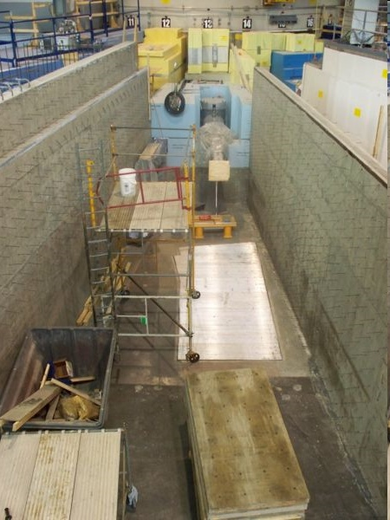
Cold Beamline - Realized

Slide 60
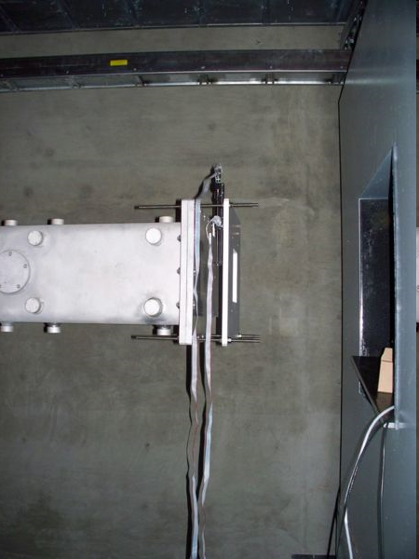
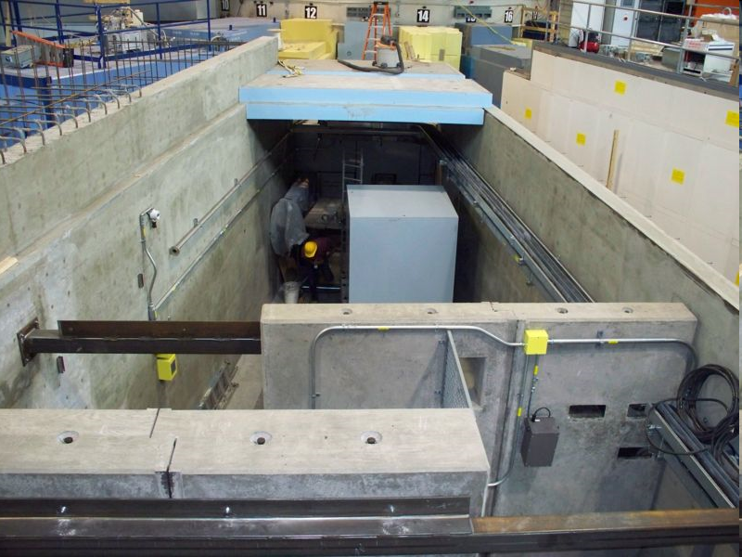
Flight path 13 – top view
UCN
Guide
Beam Stop

Slide 61


Slide 62
Thank You!

