Slide 1
The MOLLER Experiment
Juliette M. Mammei
Measurement Of a Lepton Lepton Electroweak Reaction

Slide 2
Outline
The Physics
Search for physics beyond the Standard Model
Interference of Z boson with single photon in Møller scattering
Measure the weak charge of the electron and sin²θ_{W}
Sensitivity comparable to the two high energy collider measurements
The Experiment
High rate, small backgrounds – 150 GHz, 8% backgrounds
Novel toroid design, with multiple current returns
Full azimuthal acceptance, scattering angles from 5.5-19 mrads, 2.5-8.5 GeV
150cm (5 kW) target, detectors 28m downstream
Status
DOE proposal prepared
Simulation and design efforts ongoing
Begin commissioning in 2016

Slide 3
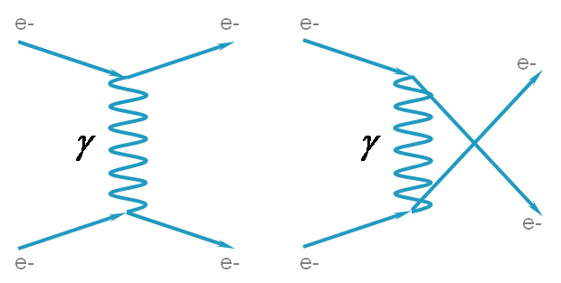
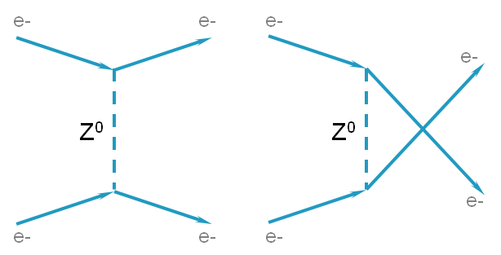
The Physics
$$A_{PV}=\frac{σ_{+}−σ_{−}}{σ_{+}+σ_{−}}≈$$
$$≈1×{10}^{−8}$$
$$2$$
$${∝m}_{e}E_{lab}\left(1−4\sin^{2}θ_{W}\right)$$
e-
e-
$$\frac{δ\sin^{2}{θ_{W}}}{\sin^{2}{θ_{W}}}≃.05\frac{{δA}_{PV}}{A_{PV}}$$
$$Q_{W}^{e}G_{F}$$
A_{PV} = 35.6 ± 0.73 ppb
e-
e-
$$δQ_{W}^{e}=2.3\%, \sim 5×smaller$$
$than E158 ({δQ}_{W}^{e}=10.9\%)$
$$𝓛_{e_{1}e_{2}}^{PV}=𝓛_{SM}^{PV}+𝓛_{NEW}^{PV}$$

Slide 4
Contact Interactions
$$ℒ_{NEW}^{PV}=\sum_{i,j=L,R}{\frac{g_{ij}^{2}}{2Λ_{ij}^{2}}\overline{e_{i}}{γ_{i}e}_{i}\overline{e_{j}}{γ_{}^{μ}e}_{j}}$$
Coupling constants
$$g_{ij}=g_{ij}^{∗}$$
$$e_{L,R}=\frac{1}{2}\left(1∓γ_{5}\right)ψ_{e}$$
Mass scale
$$g_{LR}=g_{RL}$$
$$=\frac{Λ}{\sqrt{{\sqrt{2}G}_{F}\left|ΔQ_{W}^{e}\right|}}$$
$$\frac{Λ}{\sqrt{\left|g_{LL}^{2}−g_{RR}^{2}\right|}}$$
2.3% MOLLER uncertainty
$$→7.5 TeV$$
e-
e-
LEP2 (g_{LR} and sum) mass scale sensitivity ~5.2 and 4.4 TeV
e-
e-
Lepton compositeness – strong coupling – 47 TeV

Slide 5
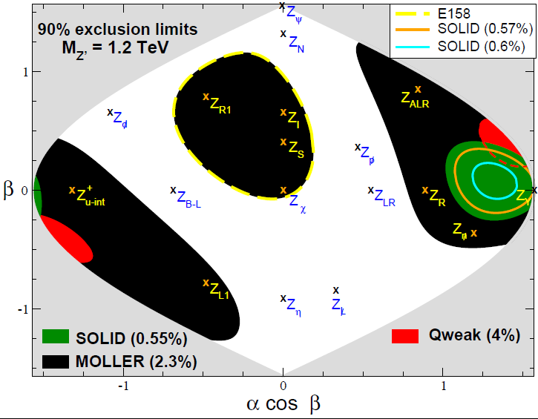
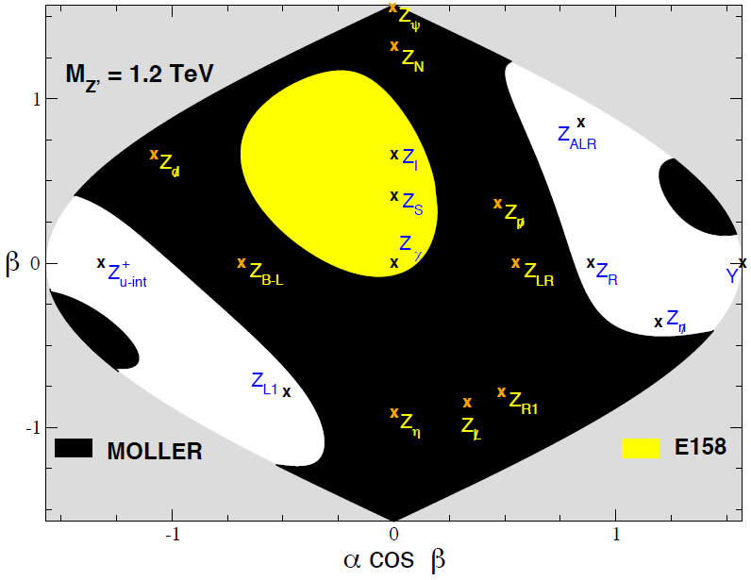
Complementary to the LHC - Z΄
Assume LHC discovers a new spin 1 gauge boson with M =1.2 TeV
Half-way between SM and E158 central value
If the SM value is measured
MOLLER can distinguish between models
Erler and Rojas
$$α=0→E6 models, α≠0 describes kinetic mixing$$
$$β=0→SO\left(10\right)\left(including those based on LR symmetry\right)$$

Slide 6
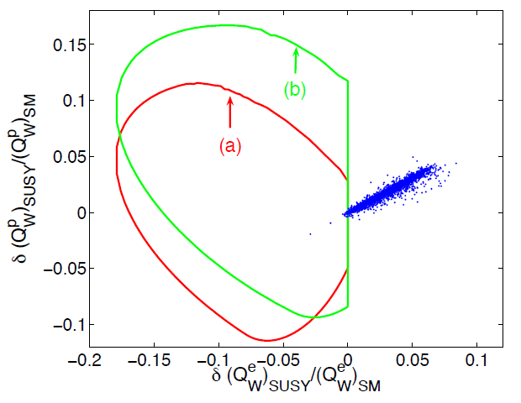
Other Models
2.3% MOLLER
SUSY and RPV SUSY
If RPC, possible dark matter candidate
4% Qweak
Ramsey-Musolf, Su
Doubly-charged scalars
(reach of 5.3 TeV compared
to 3 TeV at LEP2)

Slide 7
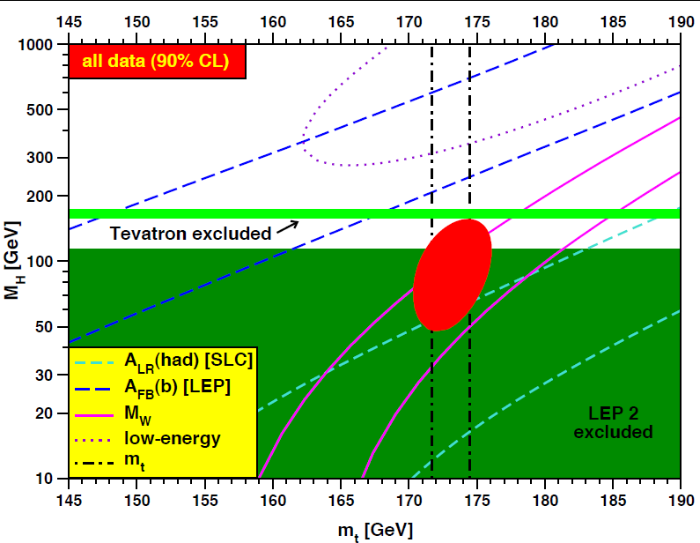
Higgs Mass
MOLLER would dominate this ellipse
All precision EW data
Direct Searches (Excluded)
Tevatron
LEP2
Erler

Slide 8
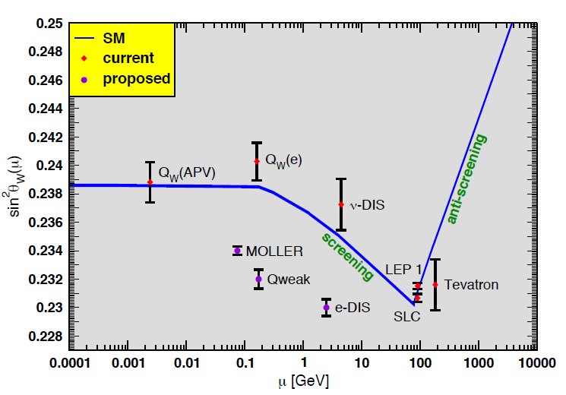
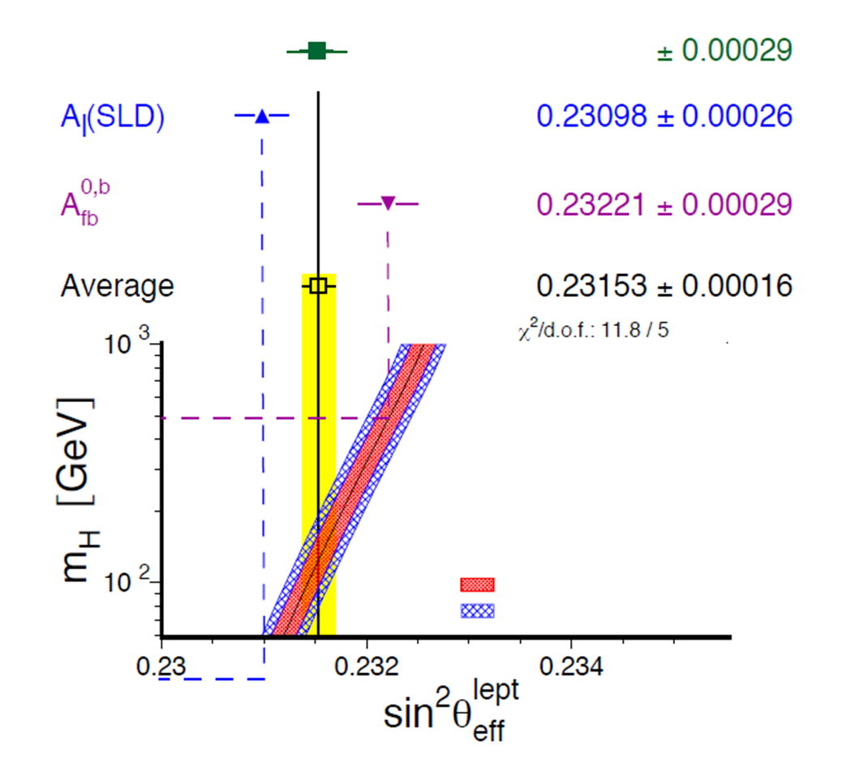
Measurement of sin²θ_{W}
MOLLER
Z-pole
MOLLER
Erler, Kurylov, Ramsey-Musolf
$$∆α_{had}^{(5)}=0.02758±0.00035$$
$$m_{t}=172.7±2.9 GeV$$
Erler

Slide 9
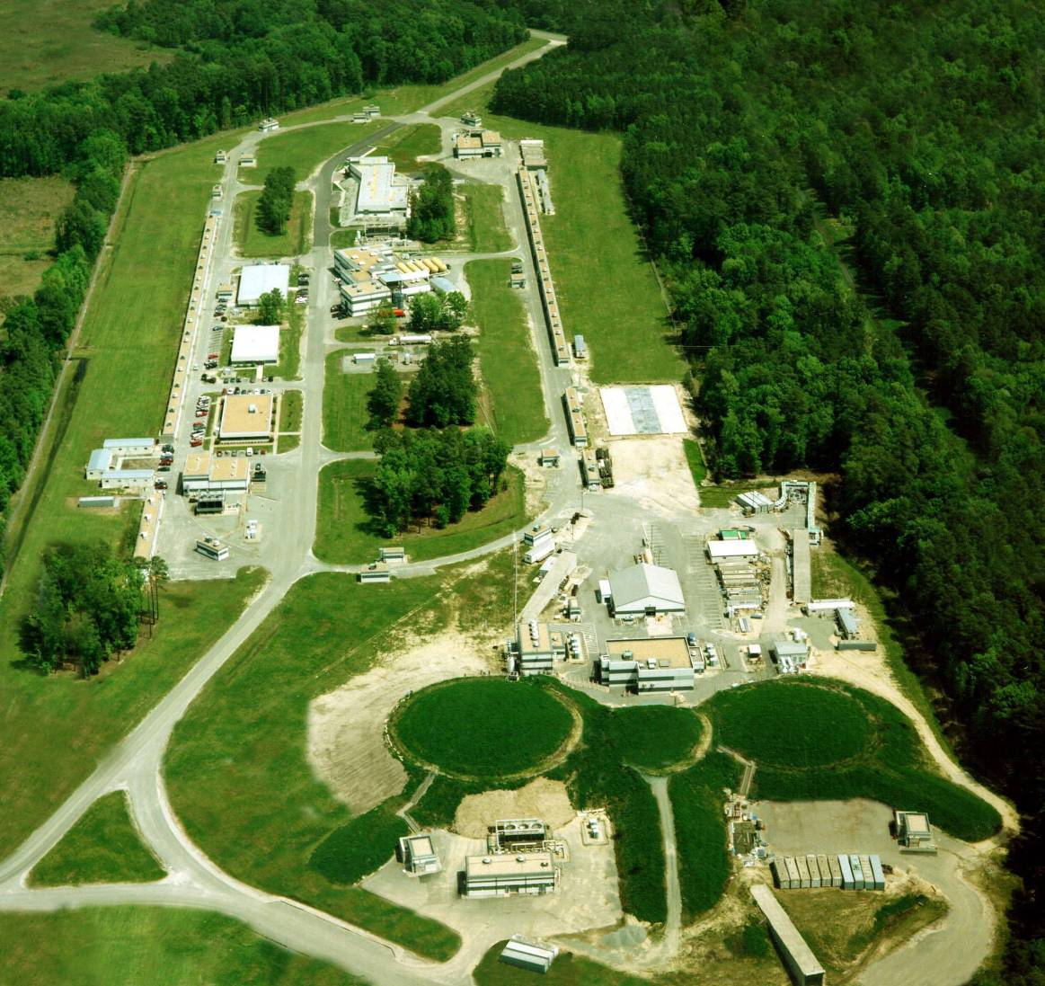
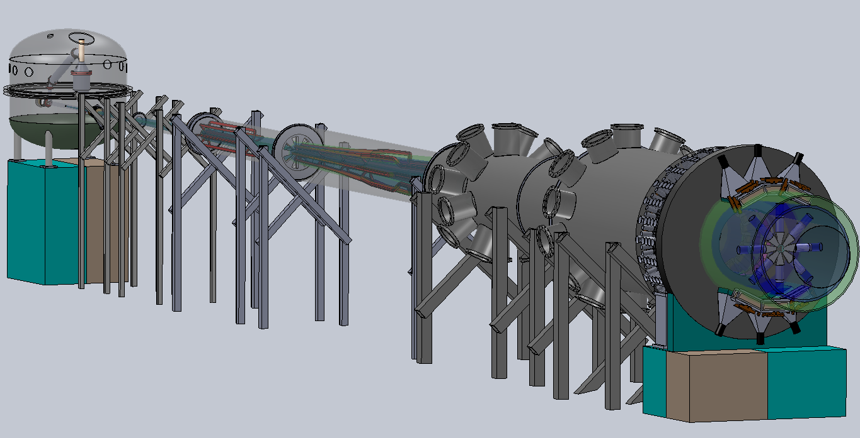
The Experiment
SOLIDWORKS STUDENT EDITION
Picture thanks to Patrick Rogan, UMass undergrad
Parity quality beam >85% using strained GaAs photocathodes
After upgrade to 12 GeV beam energy, addition of a new Hall D
MOLLER will run in Hall A with an 11 GeV, 75 μA beam
150 cm high power (5kW) liquid hydrogen target
detectors located 28 m downstream (~150 GHz rate, <10% bkgd)
two-toroid spectrometer (focus Møller electrons from 5.5-19 mrads, 2.5 to 8.5 GeV)

Slide 10
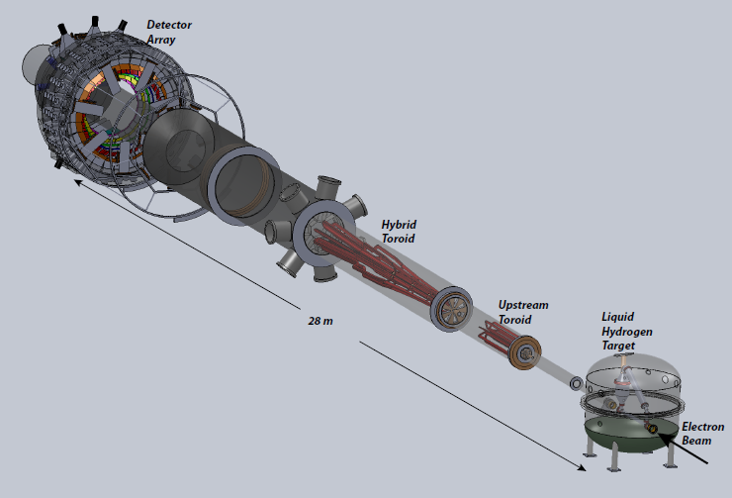
The Experiment
Detector Array
Roman Pots
(for tracking detectors)
Hybrid Torus
Upstream Torus
Scattering Chamber
Target
28 m
Collimators
Incoming Beam

Slide 11
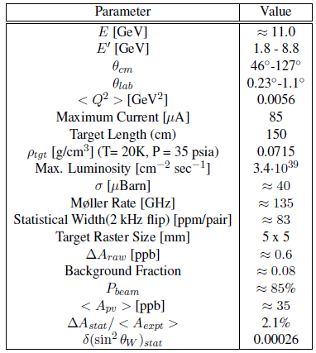
The Experiment
EM cross-section minimum, asymmetry maximum for
θ_{CM} = 90°
Large range of angles centered around θ_{CM} = 90°

Slide 12
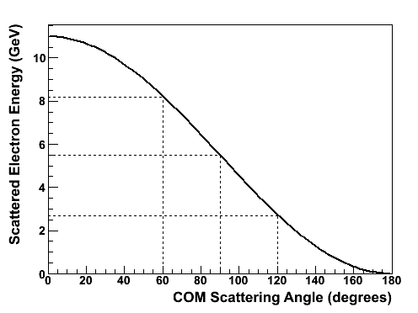
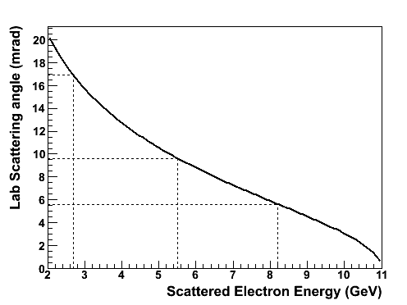
100% Azimuthal Acceptance
e-
e-
Forward
Backward
e-
e-
COM Frame
Any odd number of coils will work
e-
e-
e-
e-
Lab Frame
Backward
Forward
Notes:
There is a strong energy dependence on scattering angle, with forward scattered electrons having lower lab scattering angles and higher energies.
I have drawn electrons after a Moller scattering event in the COM frame on the top, and the lab frame on the bottom. Now consider an event where the forward electron scatters into the opposite sector in the COM frame, in this case in the plane of the page, and in the lab frame. Now I’ll block the electrons going into the bottom sector. In fact, looking downstream, I am going to block every other sector. Now I will put a detector in the open sector. For the forward scattered electrons that I don’t detect in this sector, I will actually measure the event because I measure the backward scattered electron in the open sector.
Which conveniently leaves room for the coils – any odd number of coils will work.
To put it another way – if I were to count these electrons, and these electrons, I would be double-counting, because they are describing the same event.
The result is that in an open sector we have to accept a large range of scattered electron angles and energies.

Slide 13
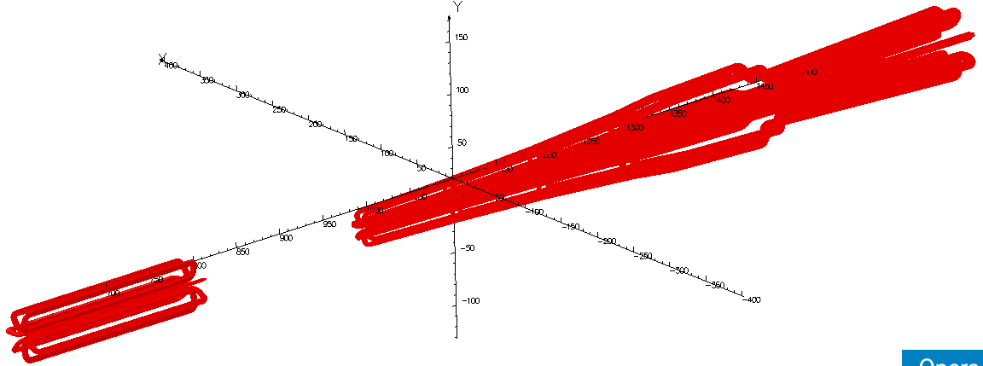
Spectrometer
Property | Upstream | Hybrid | Qweak
Field Integral (T·m) | 0.15 | 1.1 | 0.89
Total Power (kW) | 40 | 765 | 1340
Current per wire (A) | 298 | 384 | 9500
Voltage per coil (V) | 19 | 285 | 18
Current Density (A/cm²) | 1200 | 1550 | 500
Wire cross section (ID: water hole, in) | 0.229x0.229 (0.128) | 0.229x0.229 (0.128) | 2.3x1.5 (0.8)
Weight of a coil (lbs) | 44 | 555 | 7600
Magnetic Forces (lbs) | 100 | 3000 | 27000

Slide 14
Conductor Layout
Biot-Savart calculation optimized current returns
Actual conductor layout
3L
3R
4L
4C
4R
2L
2R
1BL
1BR
1AL
1AR

Slide 15
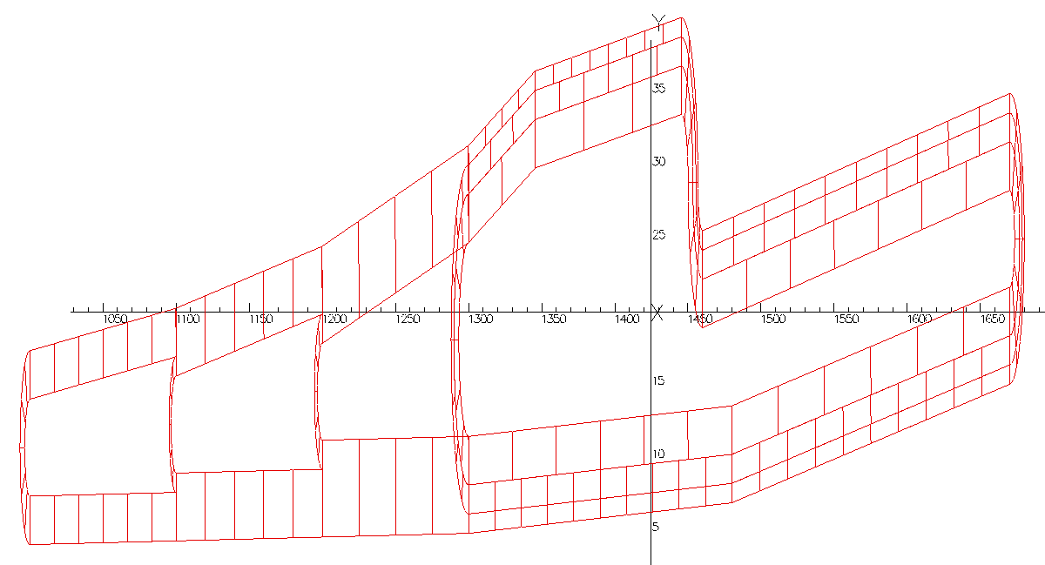
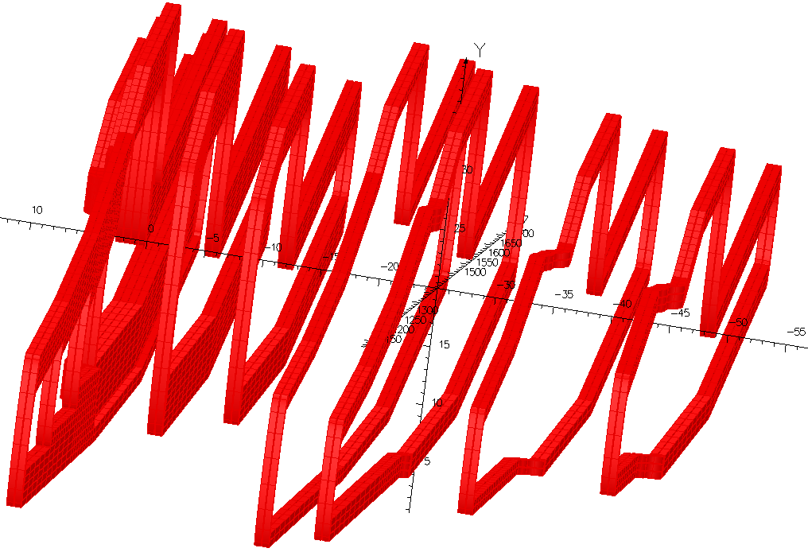
Hybrid Coil Construction
3L
3R
4L
4C
4R
2L
2R
1BL
1BR
1AL
1AR

Slide 16
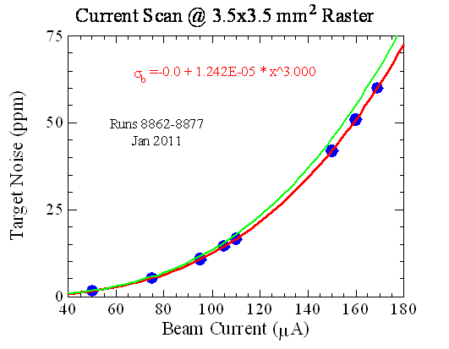
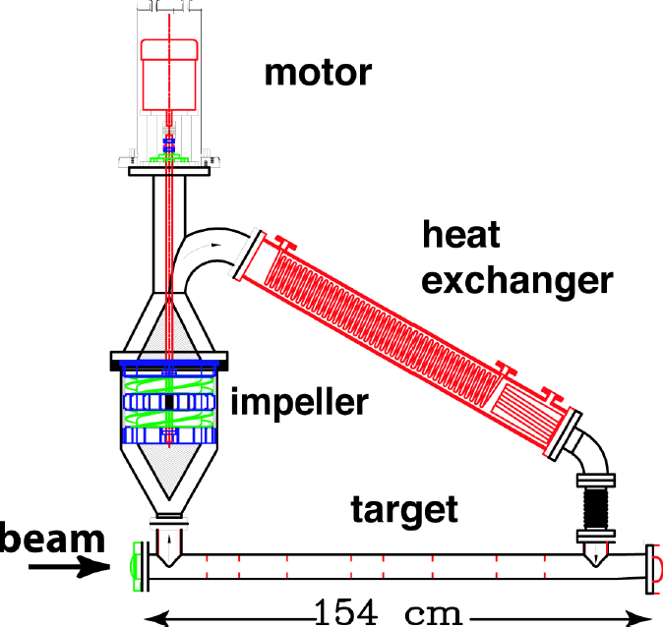
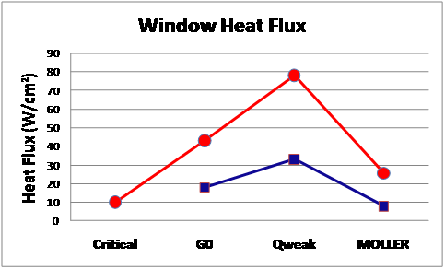
Target
Qweak Target Performance
MDAllbar Detector widths ~250ppm
E158 Target Cell

Slide 17
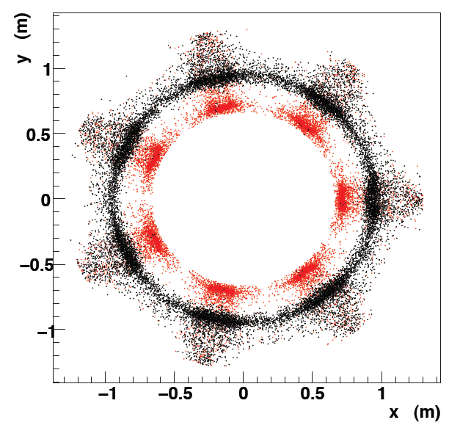
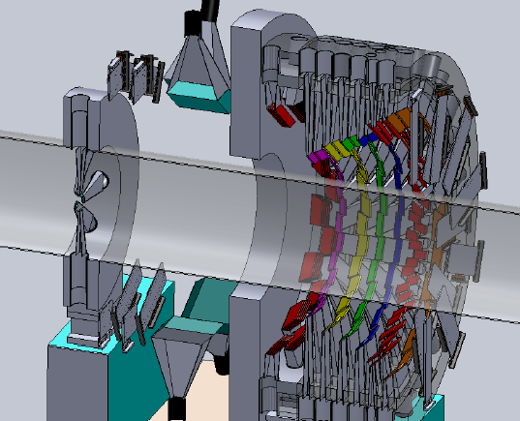
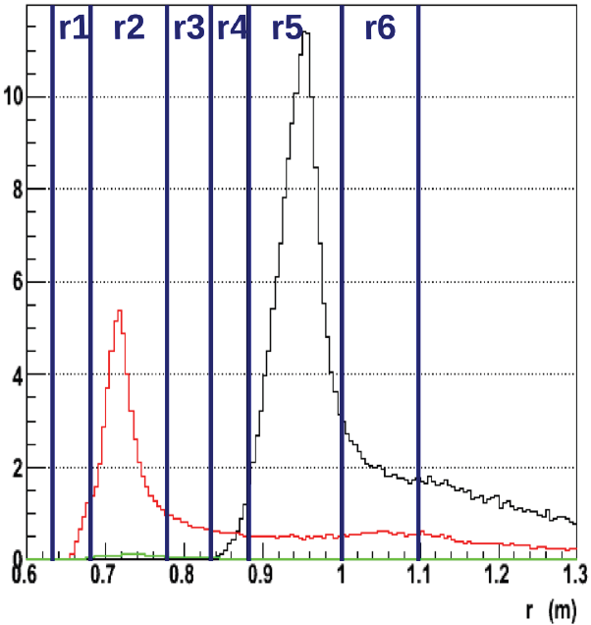
Detectors
Moller envelope
Elastic ep envelope

Slide 18
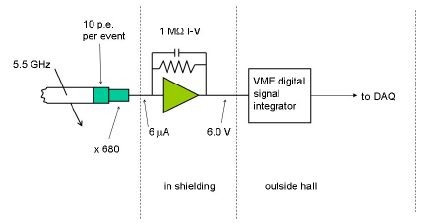
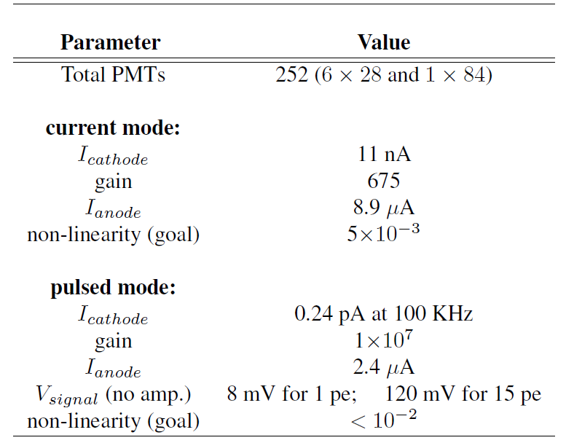
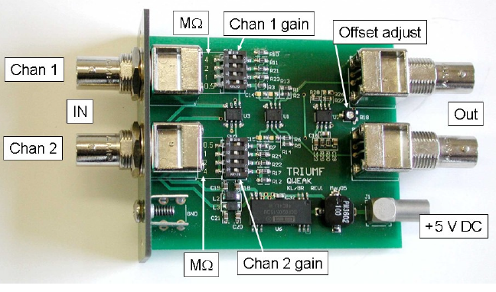
Detector Electronics
Electronics chain
Qweak-style electronics with few or no modifications will be suitable
TRIUMF Amplifier

Slide 19
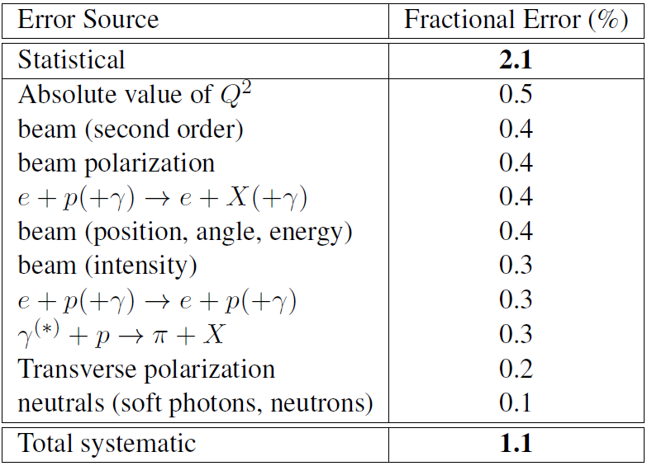
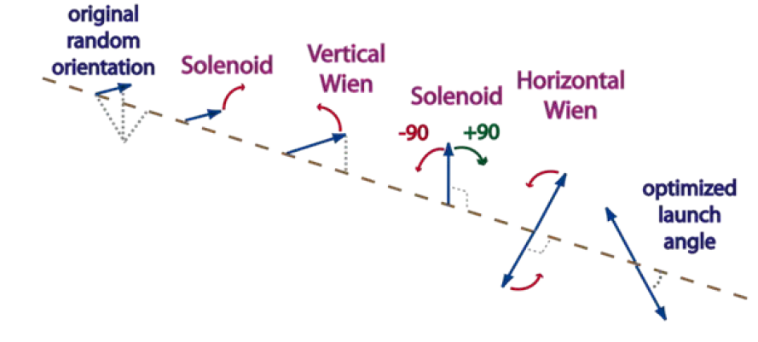
Polarized Beam

Slide 20
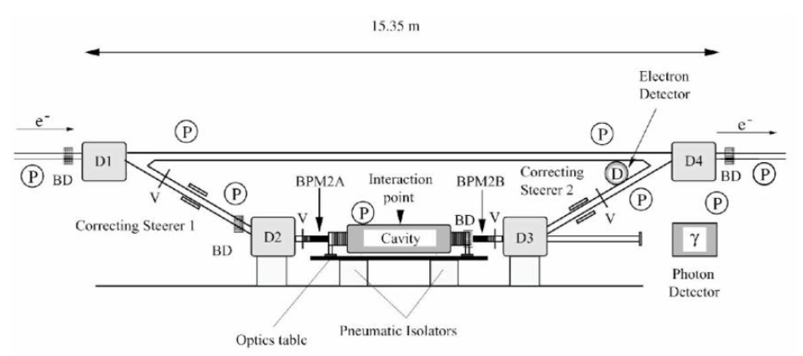
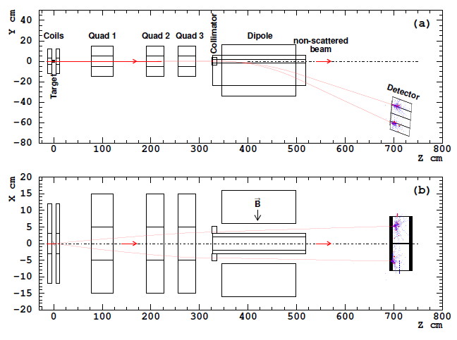
Polarimetry
Need to measure to 0.4%
Compton – non-invasive,
continuous
Moller - invasive

Slide 21
Status
Approved by JLAB PAC with an A rating for 334 days
International collaboration from over 40 institutions and 100 collaborators
Simulation and Design
Ongoing work on collimators, optics optimization (minimize photon, elastic ep backgrounds)
Detector and background simulations will begin soon
Engineering Design
Magnet review meetings (1 held, another planned)
Participation of JLAB engineers ramping up
DOE Proposal with JLAB for review
Commissioning to begin in 2016

Slide 22
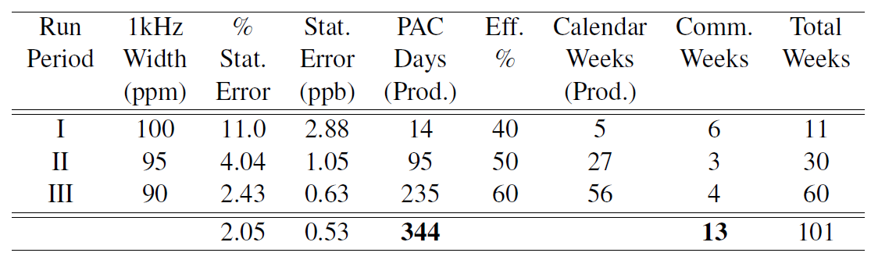
Run Plan
Assume 80% polarization
Run I – commissioning
Run II – 25% statistical measurement
Run III – Full statistical measurement
Experience has taught us:
The breaks are useful!

Slide 23
Collaboration
J. Benesch, P. Brindza, R.D. Carlini, J-P. Chen, E. Chudakov, S. Covrig, C.W. de Jager, A. Deur, D. Gaskell, J. Gomez, D.W. Higinbotham, J. LeRose, D. Mack, R. Michaels, B. Moffit, S. Nanda, G.R. Smith, P. Solvignon, R. Suleiman, B. Wojtsekhowski (Jefferson Lab) , H. Baghdasaryan, G. Cates, D. Crabb, D. Day, M.M. Dalton, C. Hanretty, N. Kalantarians, N. Liyanage, V.V. Nelyubin, B. Norum, K. Paschke, M. Shabestari, J. Singh, A. Tobias, K. Wang, X. Zheng (University of Virginia), J. Birchall, M.T.W. Gericke, W.R. Falk, L. Lee, R. Mahurin, S.A. Page, W.T.H. van Oers, V. Tvaskis (University of Manitoba), S. Johnston, K.S. Kumar, J. Mammei, L. Mercado, R. Miskimen, S. Riordan, J. Wexler (University of Massachusetts, Amherst),
V. Bellini, A. Giusa, F. Mammoliti, G. Russo, M.L. Sperduto, C.M. Sutera (INFN Sezione di Catania and Universita' di Catania), D.S. Armstrong, T.D. Averett, W. Deconinck, J. Katich, J.P. Leckey (College of William & Mary), K. Grimm, K. Johnston, N. Simicevic, S. Wells (Louisiana Tech University), L. El Fassi, R. Gilman, G. Kumbartzki, R. Ransome (Rutgers University), J. Arrington, K. Hafidi, P.E. Reimer, J. Singh (Argonne National Lab), P. Cole, D. Dale, T.A. Forest, D. McNulty (Idhao State University), E. Fuchey, F. Itard, C. Muñoz Camacho (LPC Clermont, Universitè Blaise Pascal), J.H. Lee, P.M. King, J. Roche (Ohio University), E. Cisbani, S. Frullani, F. Garibaldi (INFN Gruppo Collegato Sanita' and Istituto Superiore di Sanitá), R. De Leo, L. Lagamba, S. Marrone (INFN, Sezione di Bari and University di Bari), F. Meddi, G.M. Urciuoli (Dipartimento di Fisica dell'Universita' la Sapienza and INFN Sezione di Roma), R. Holmes, P. Souder (Syracuse University), G. Franklin, B. Quinn (Carnegie Mellon University), W. Duvall, A. Lee, M. Pitt (Virginia Polytechnic Institute and State University), J.A. Dunne, D. Dutta (Mississippi State University), A.T. Katramatou, G. G. Petratos (Kent State University), A. Ahmidouch, S. Danagoulian (North Carolina A&T State University), S. Kowalski, V. Sulkosky (MIT) , P. Decowski (Smith College), J. Erler (Universidad Autónoma de México) , M.J. Ramsey-Musolf (University of Wisconsin, Madison), Yu.G. Kolomensky (University of California, Berkeley), K. A. Aniol (California State U.(Los Angeles)) , C.A. Davis, W.D. Ramsay (TRIUMF) , J.W. Martin (University of Winnipeg), E. Korkmaz (University of Northern British Columbia) ,T. Holmstrom (Longwood University), S.F. Pate (New Mexico State University), G. Ron (Hebrew University of Jerusalem), D.T. Spayde (Hendrix College), P. Markowitz (Florida International University), F.R. Wesselmann ( Xavier University of Louisiana), F. Maas(Johannes Gutenberg Universitaet Mainz), C. Hyde(Old Dominion University), F. Benmokhtar (Christopher Newport University), E. Schulte (Temple University), M. Capogni (Istituto Nazionale di Metrologia delle Radiazioni Ionizzanti ENEA and INFN Gruppo Collegato Sanitá), R. Perrino (INFN Sezione di Lecce)
*Spokeperson

Slide 24
Extra Slides

Slide 25
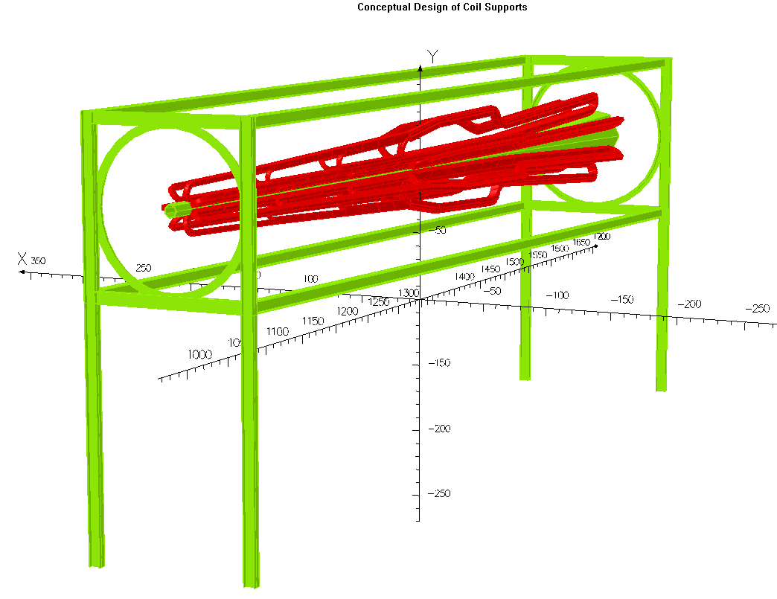
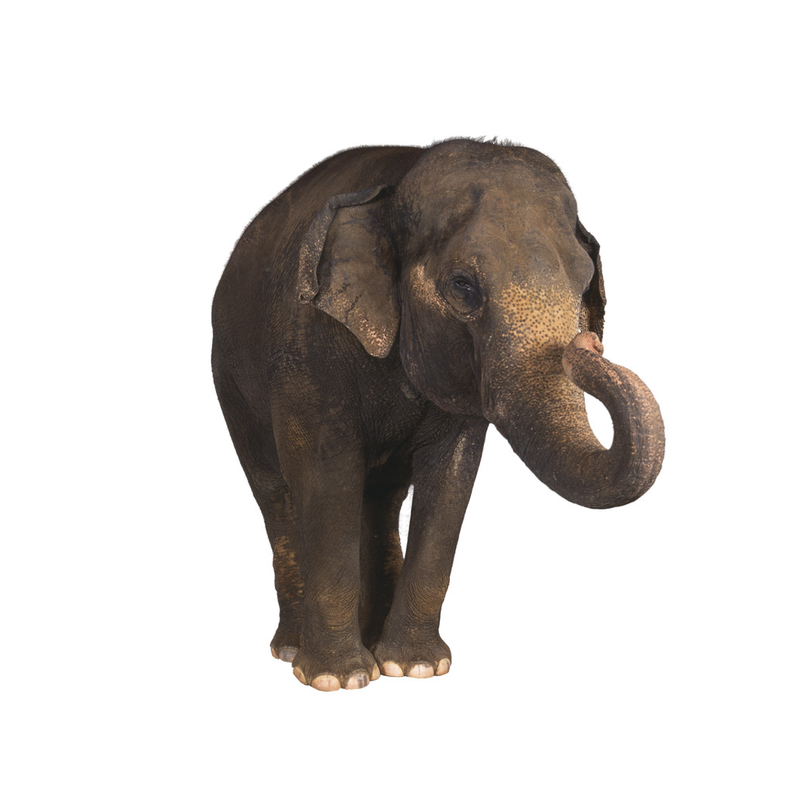
Support Structure
3.6 m
7 m
3.6 m

Slide 26
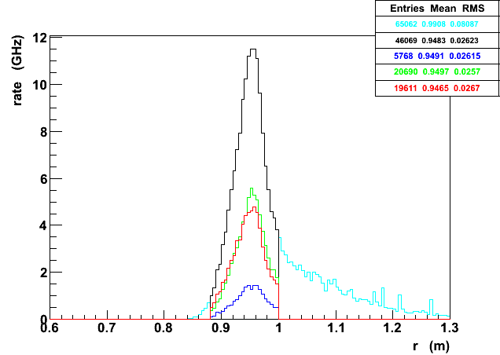
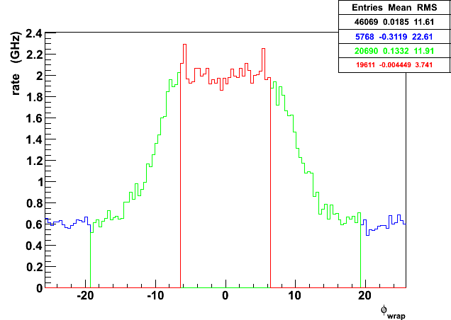
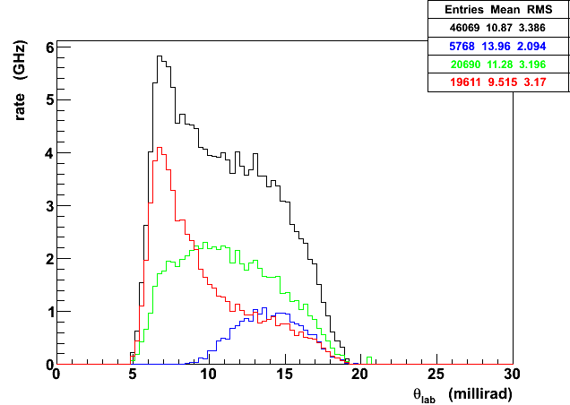
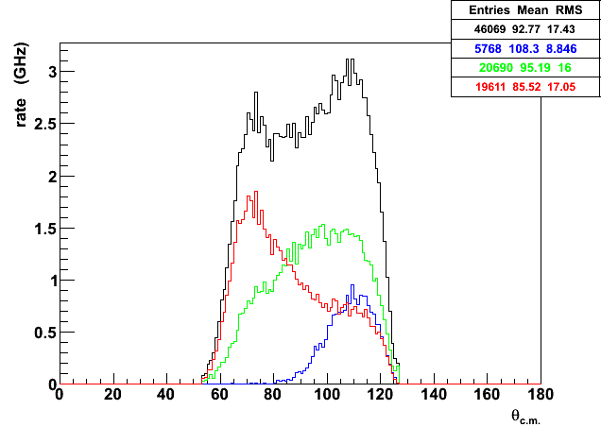
GEANT4 Results (Original Proposal Model)
Radius
(m)
ϕ
(degrees)
θ_{lab}
(degrees)
θ_{cm}
(degrees)

Slide 27
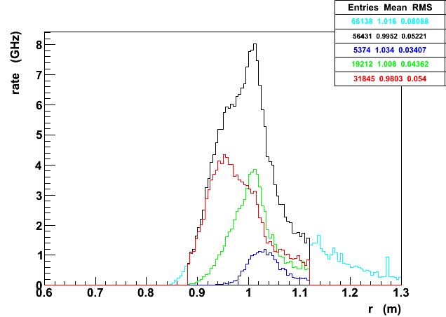
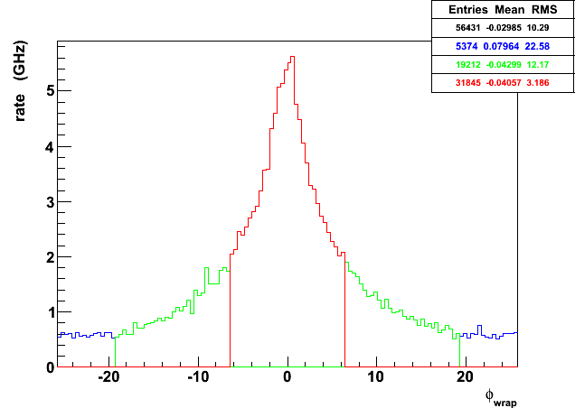
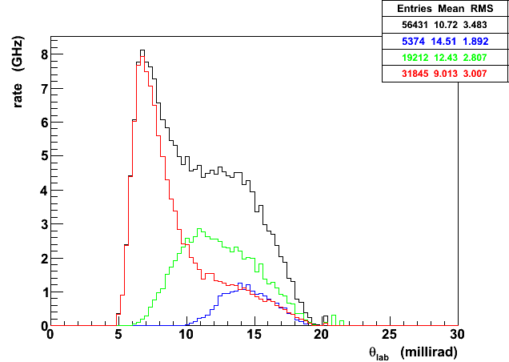
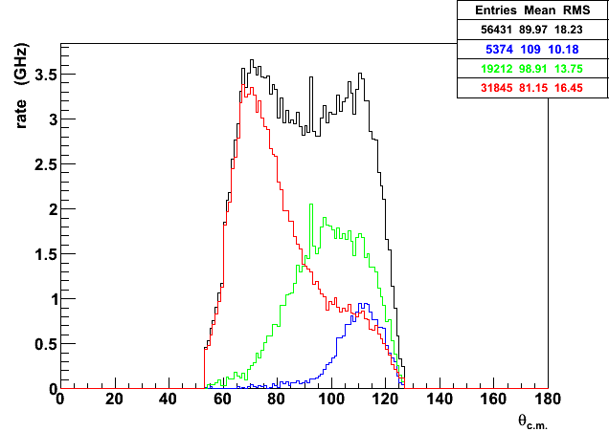
GEANT4 Results (TOSCA Model – actual Conductor Layout)
Radius
(m)
ϕ
(degrees)
θ_{lab}
(degrees)
θ_{cm}
(degrees)

Slide 28
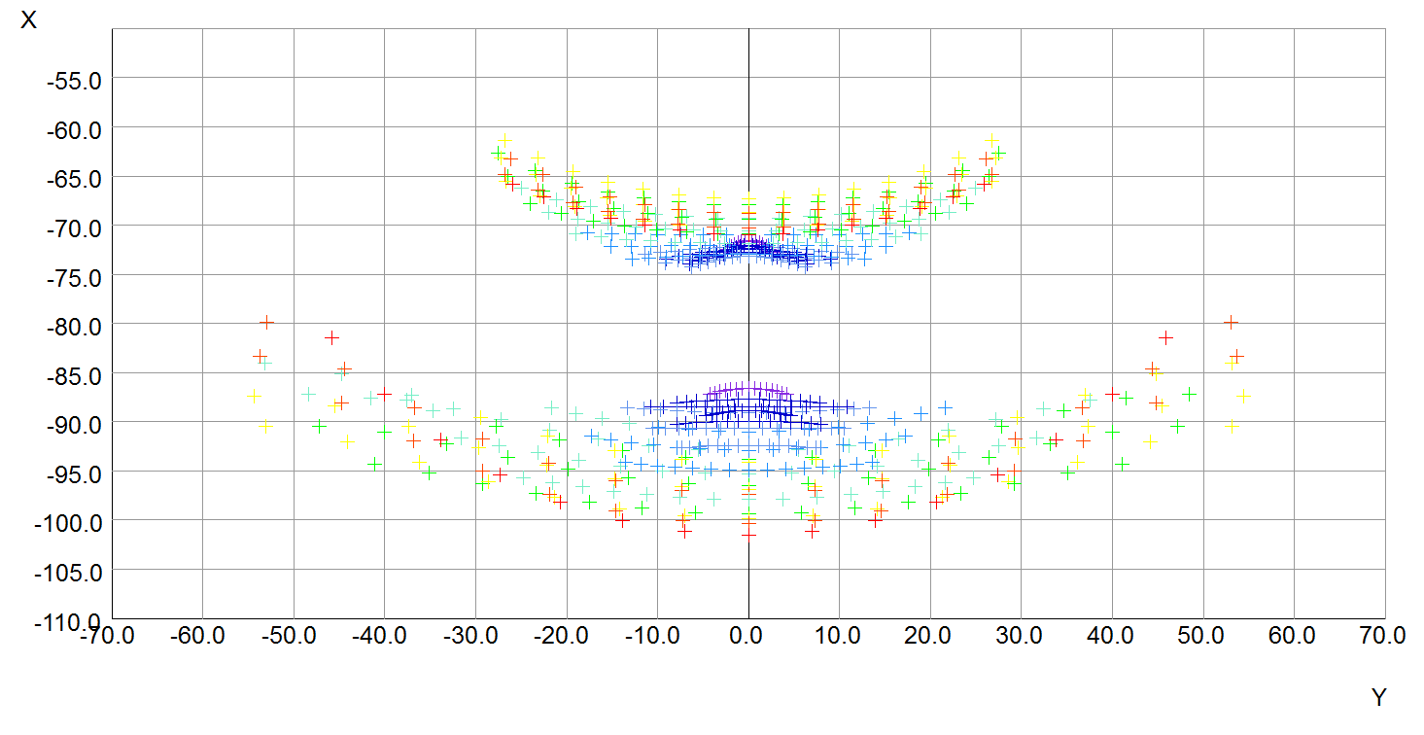
Tweaking the optics
Beam (centered at x=0, y=0)
Mott (ep)
Moller (ee)

Slide 29
Backgrounds
Field Map | Moller (GHz) | Elastic ep (GHz) | Inelastic ep (GHz) | Background (%)
Proposal | 133 | 12 | 0.4 | 9
TOSCA (Original) | 162 | 18 | 0.6 | 10
TOSCA (after tweaks) | 155 | 14 | 0.5 | 8
Other sources of background include:
scattering from aluminum target windows
multiple-bounce photons (minimize 1-bounce)
neutrons
weak decays with large analyzing power
To be studied with GEANT4 simulation!

