Slide 1
A Diamond Micro-strip Electron Detector for Compton Polarimetry
Amrendra Narayan
Mississippi State University
on behalf of Hall – C Compton Team

Slide 2
Outline
Qweak Polarimetry requirements
Hall – C Compton Overview
Electron detector
Data Acquisition
Analysis approach
Preliminary results

Slide 3
Qweak and Polarimetry
The Qweak experiment aims to measure the weak charge of the proton with a precision of 4.1%, by measuring the parity violating asymmetry in polarized e-p elastic scattering with a precision of 2.5%
Qweak Error Budget
Uncertainty | δAPV/APV | δQw/Qw
Statistical (~2500 hours at 150 μA) | 2.1% | 3.2%
Systematic: |  | 2.6%
Hadronic structure uncertainties |  | 1.5%
Beam polarimetry | 1.0% | 1.5%
Effective Q² determination | 0.5% | 1.0%
Backgrounds | 0.5% | 0.7%
Helicity-correlated beam properties | 0.5% | 0.7%
Total: | 2.5% | 4.1%
Qweak talk: Katherine Myers, Sept 8
one of the largest experimental contribution to the error budget
The Hall-C Moller polarimeter is the highest precision polarimeter at JLab, however it is periodic, invasive and operates only at low currents..
The new Compton polarimeter is continuous, non invasive and can operate at high currents.

Slide 4
Overview: Compton Layout
Parameter | Value
Beam Energy | 1.16 GeV
Laser Wavelength | 532 nm
Chicane bend angle | 10.1 deg
Electron free drift distance | 1.6 m
Max. Electron Displacement | 17 mm
Compton edge energy | 46 MeV

Slide 5
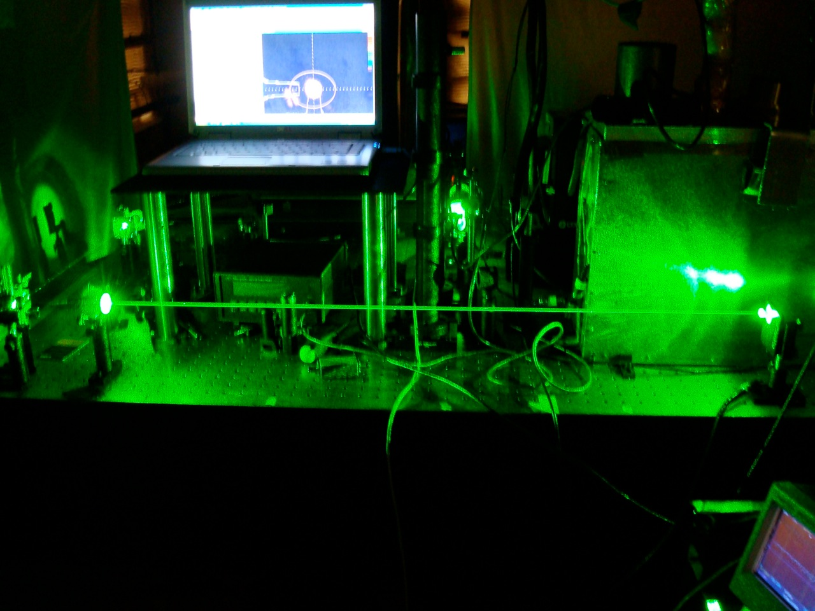
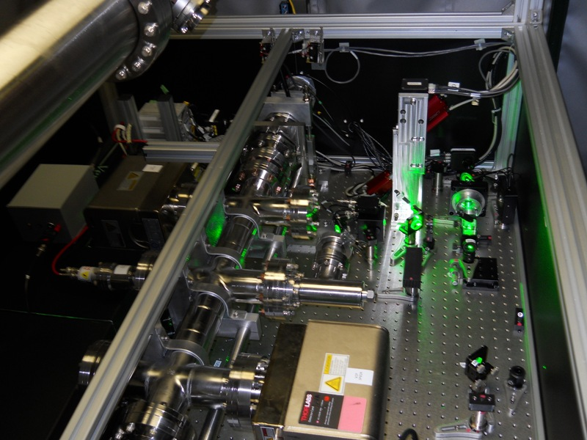
Overview: Laser Table
Installed laser table
Test setup for Fabry-Perot cavity
Photon target at center of chicane is Coherent Verdi 10W laser locked to low gain Fabry-Perot cavity
Power in the cavity is ~ 1kW
laser polarization > 99%
low reflectivity mirror in Fabry-Perot cavity allows robust measurement of laser polarization
Installed laser table
courtesy: Donald Jones, University of Virginia

Slide 6
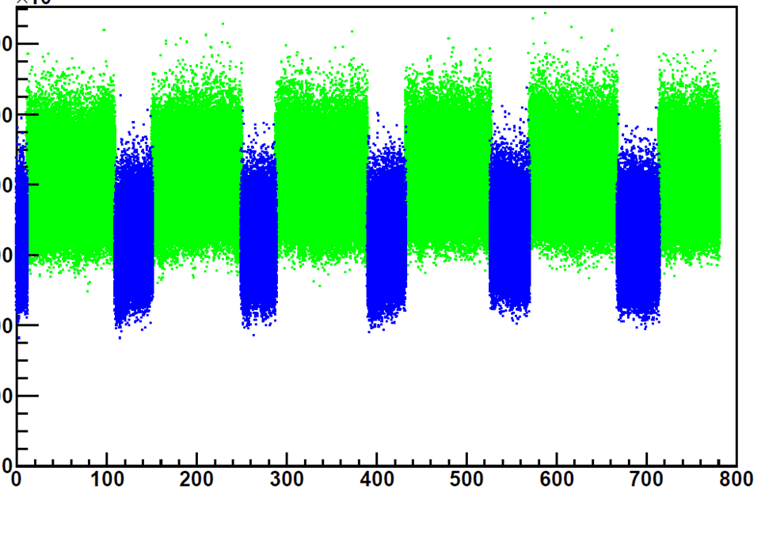
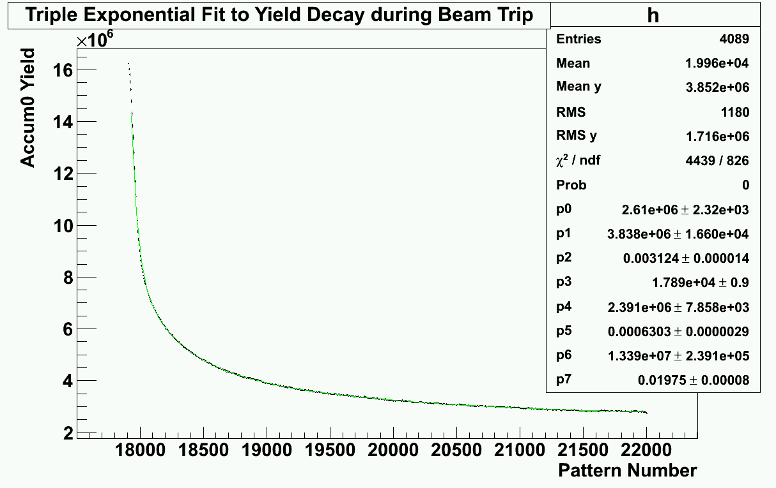
Overview: γ-Detector
Laser cycled on and off with a period of ~ 140 s
γ - detector signal is integrated with no threshold to eliminate sensitivity to gain drift
Tried CsI crystal at first but found that phosphorescence with ms to second timescales diluted our measurement
Currently using PbW crystal detector. Less energy resolution but for signal integration this is not an issue.
Achieving <1% statistical uncertainty in a few hours.
Integrated Yield (a.u.)
Laser On
Laser Off
Time (seconds)
Fit to Yield from CsI during Beam Trip
Time Constants
0.2s (20%)
1.3s (12%)
6.3s (68%)
Integrated yield (a.u.)
Time (a.u.)
courtesy: Donald Jones, University of Virginia

Slide 7
Overview: e-detector
Through the γ-detector and e-detector we have two independent measurements having different uncertainties hence being a good cross-check on each other
We use diamond micro-strip detector for detecting the Compton scattered electrons
We have 4 planes of the detector to allow coincidence measurements
e

Slide 8
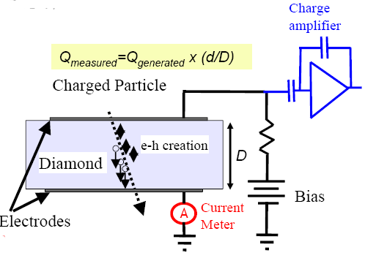
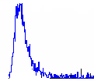
e-detector: working
The detector uses Diamond which is artificially grown using Chemical Vapor Deposition
How does it work as a detector ?
Operation of Diamond Detectors
Bias voltage ~ 1000 V,
Charge collection distance (d) ~ 250 μm

Slide 9
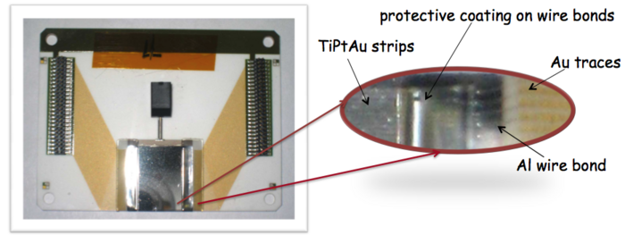
Diamond micro-strip detectors
alumina (ceramic) used for carrier board
metallization (on diamond) done with TiPtAu
detector dimensions : 21 mm x 21 mm
detector thickness: 500 µm
each detector plate has 96 strips
strip pitch is 200 µm.

Slide 10
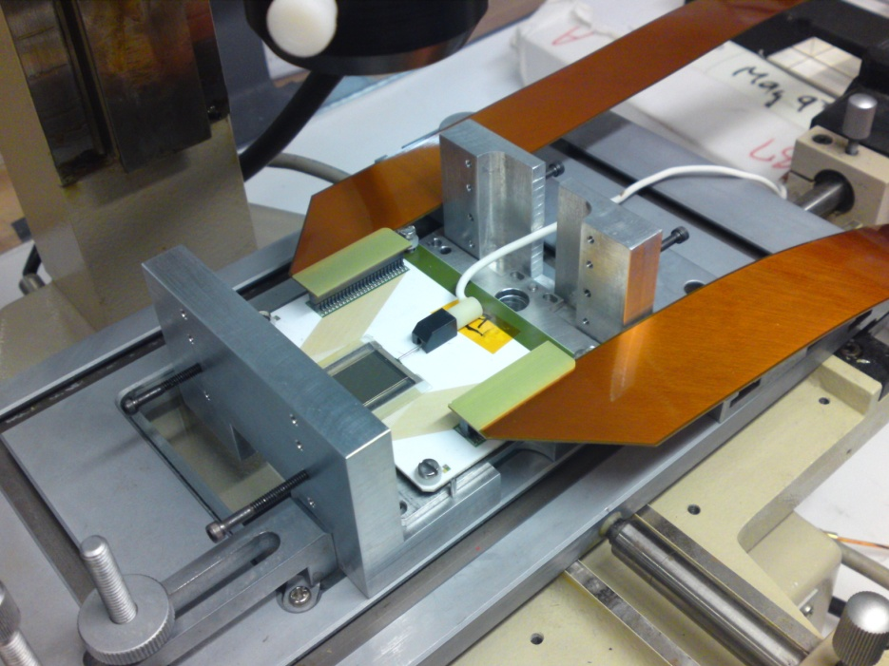
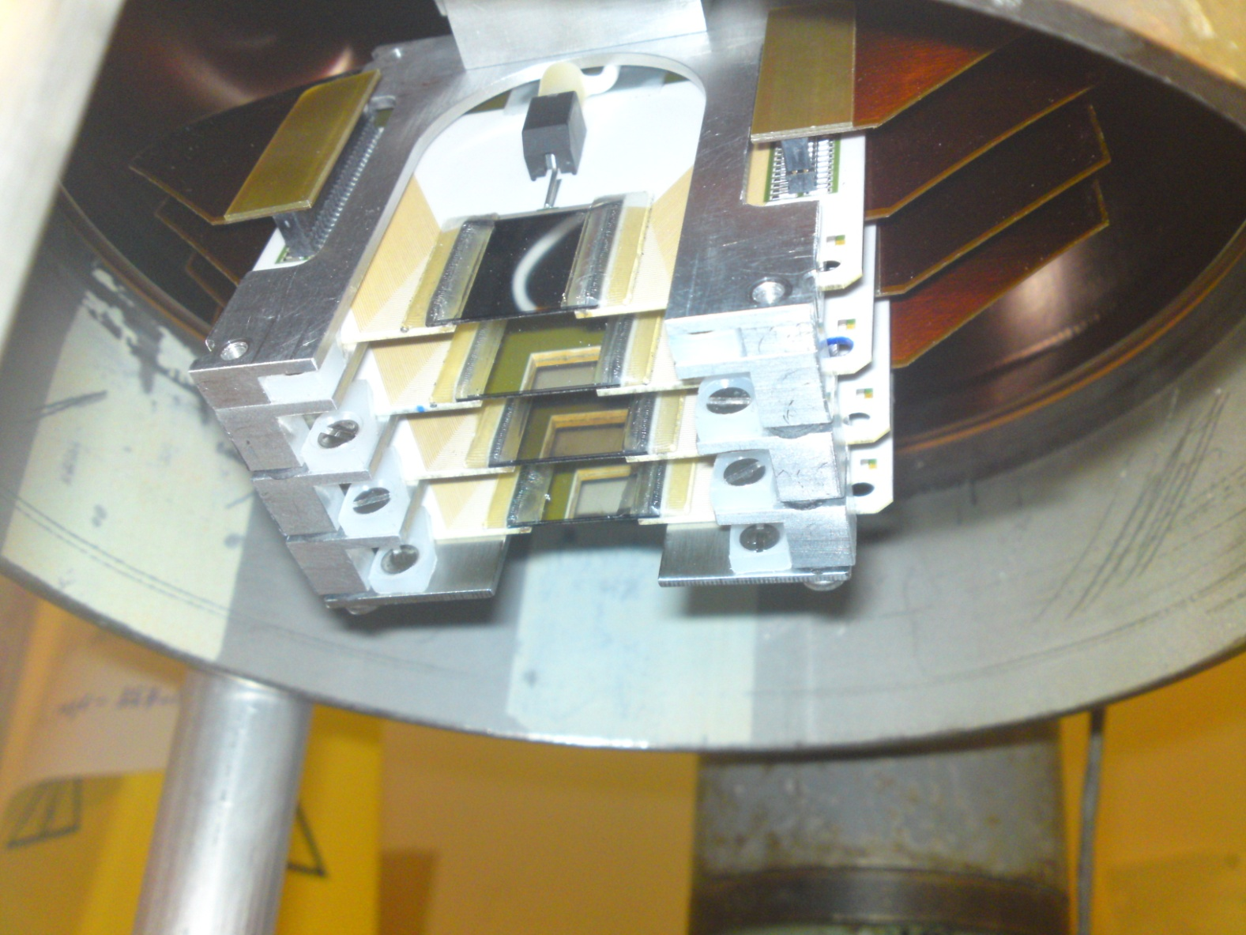
e-detector: installation

Slide 11
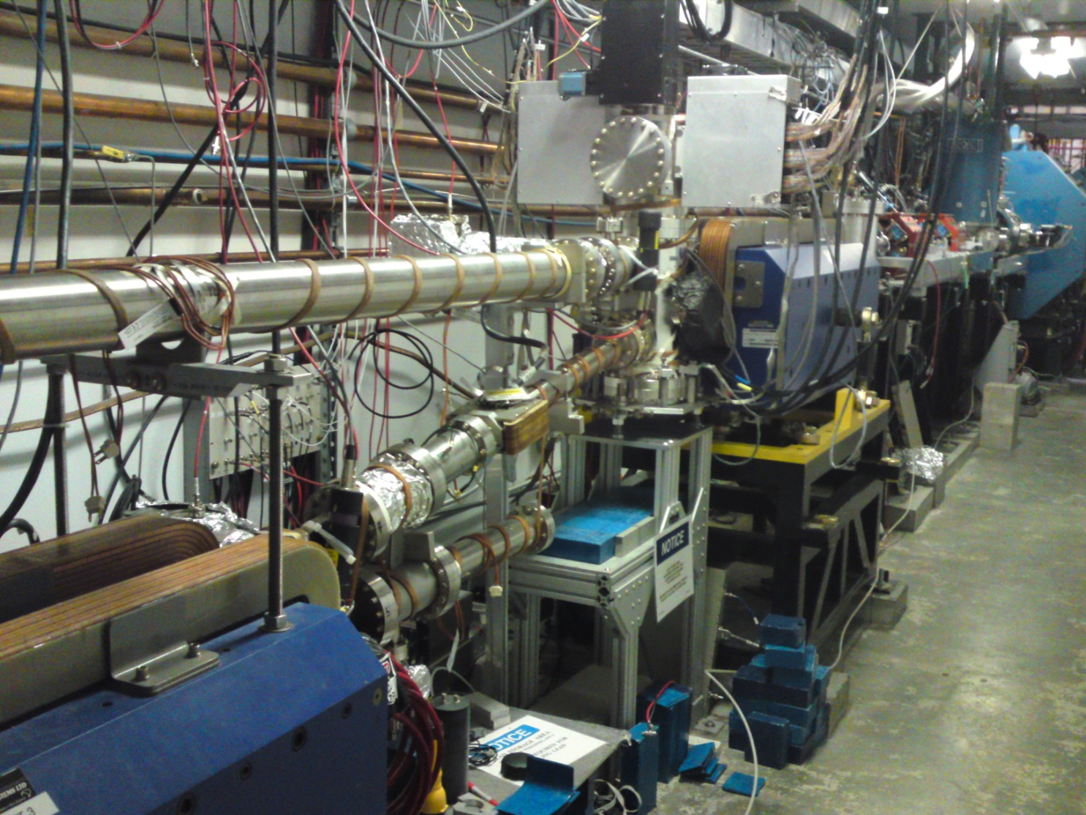
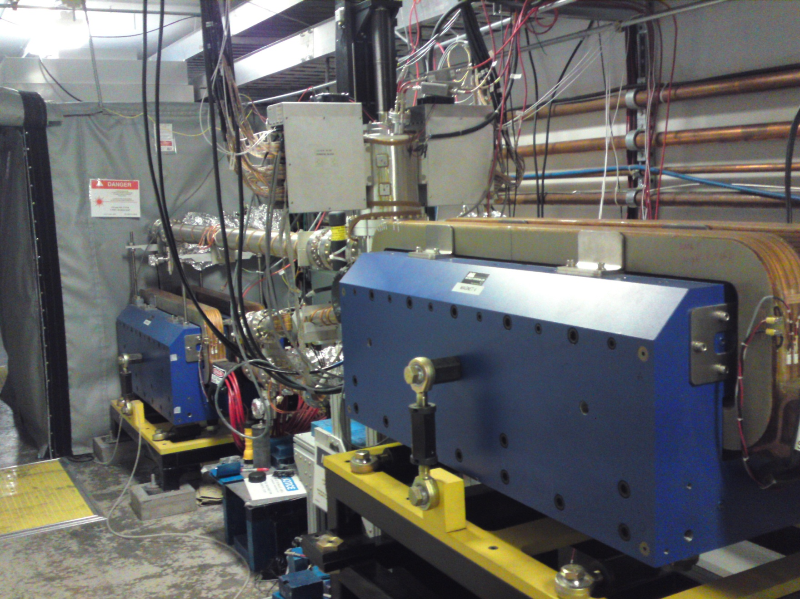
e-detector: installed
upstream view
downstream view

Slide 12
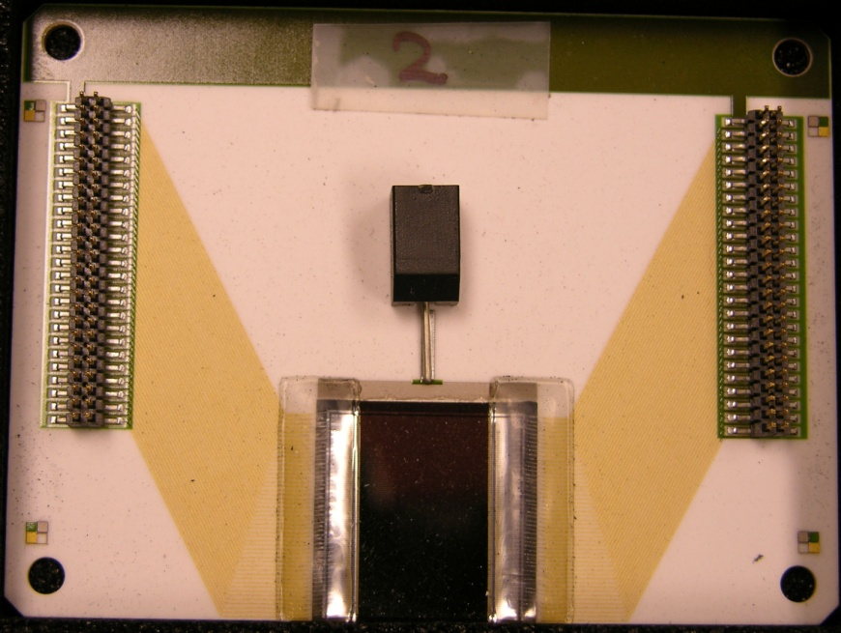
e-detector DAQ
Diamond micro - strip detectors
Amplification, shaping and digitization of the signal
Trigger processed using FPGA based v1495
This is the first Diamond micro-strip detector to be used as a tracking device in an experiment

Slide 13
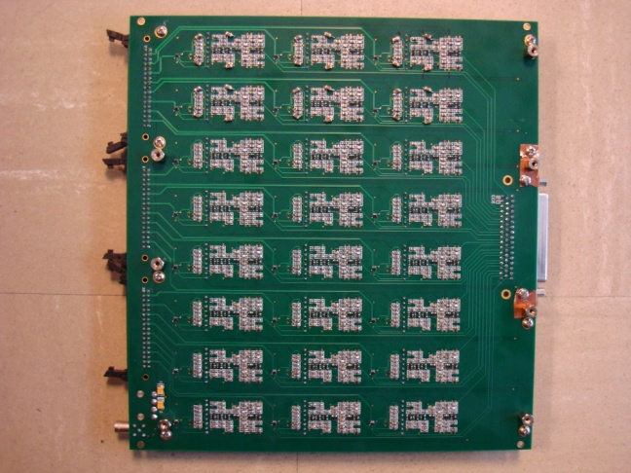
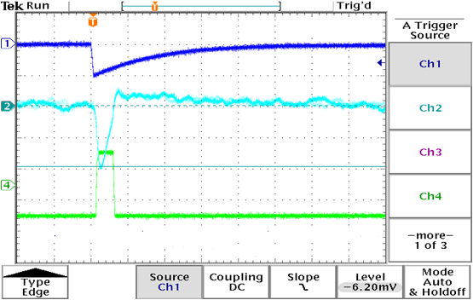
e-detector DAQ
Diamond micro - strip detectors
Gain : 200 mV
(10x10³) x (1.6x10⁻¹⁹)
= 120 mV / fC
Amplification, shaping and digitization of the signal
QWAD boards custom made by TRIUMF
test input
~ 1 mV
Trigger processed using FPGA based v1495
after charge integration & amplification
~ 200 mV
digital output
LVDS out

Slide 14
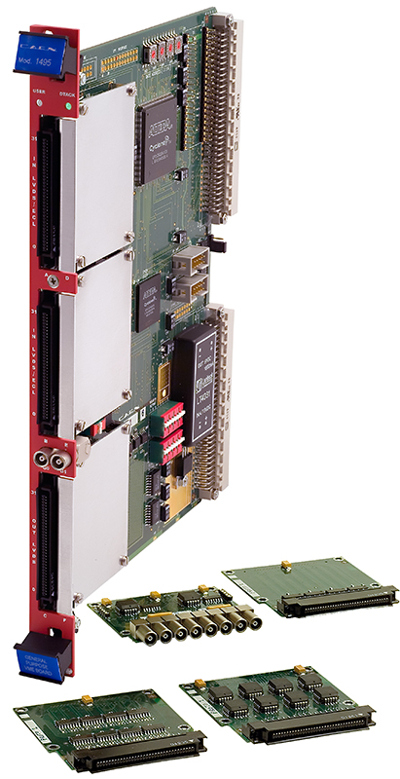
e-detector DAQ
Diamond micro - strip detectors
Amplification, shaping and digitization of the signal
Trigger processed using FPGA* based v1495
v1495 : CAEN general purpose logic modules. The module was programmed for trigger generation and data readout using VHDL
* Field Programmable Gate Array

Slide 15
e-detector DAQ : schematic
Conditions the signal to avoid overlap of successive events, hence avoiding false triggers
typically ~9000 electrons
Based on the decision of Trigger Logic, the corresponding signal is accepted/rejected at the P. buffer
amplifies, shapes and digitizes the detector pulse
Decides if a pulse corresponds to a real event
Trigger
Logic
charge pulse
from
detector
Digitization
of signal (QWAD)
Signal
Reconditioning
0.56 m flex cable
Pattern Buffer
Read out
Delay
Line
The Pattern Buffer acts as a temporary storage to allow the slow Readout process through the VME backplane
~ 60 m shielded
twisted pair cable
Delays the input signal for the trigger decision to be made.
detector
Qweak Amplifier Discriminator
FPGA board
CPU

Slide 16
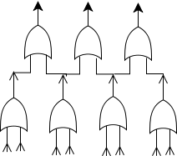
e-detector DAQ: Trigger
signals from two consecutive strips
in a detector plane
o
o
o
o
o
o
Plane 1
o
o
o
Plane 2
Trigger condition:
(2 in 4 planes)
o
o
o
Plane 3
o
o
o
o
o
o
Plane 4
The fundamental repetitive logic unit
to suppress background, we require a coincidence between multiple planes
default trigger is hits on 2 out of 4 planes
we localize the trigger in a single detector plane to 4 consecutive strips

Slide 17
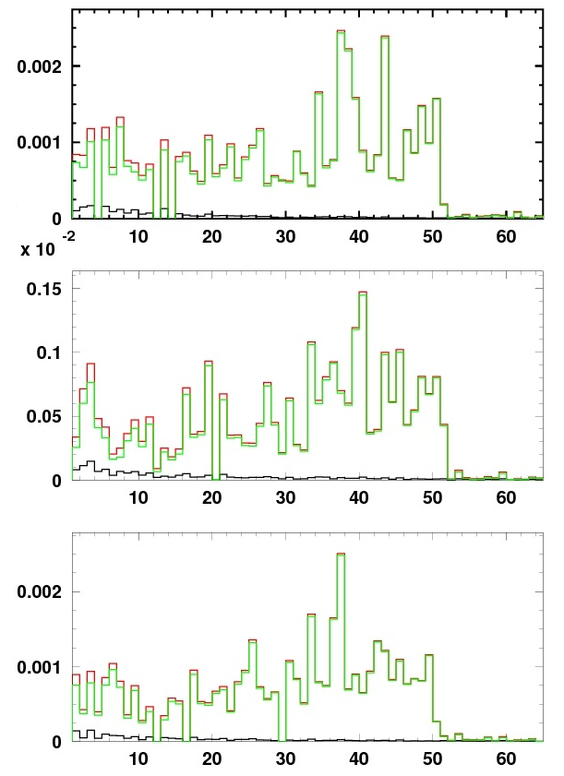
Charge normalized strip hit
plane 2
Beam Current: 150 μA
Red: Laser On
Black: Laser Off
Green: Background subtracted
plane 3
charge normalized hits
we had 3 active planes during Qweak Run 1
plane 4
Compton edge at Strip 50
Strip number

Slide 18
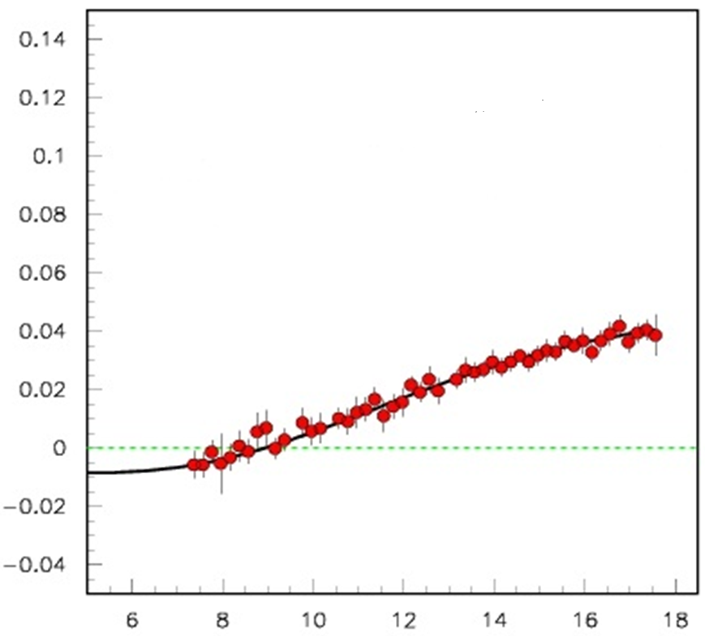
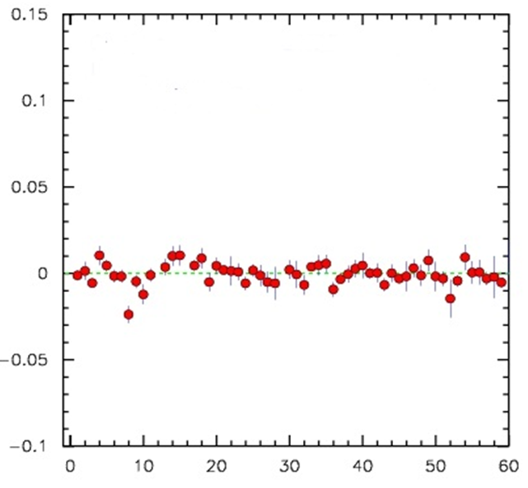
Asymmetry
Laser on : Laser off :: 2 : 1
Run time : 84 min
Run # : 21325
Beam : 150 μA
IHWP : in
Theory
Polarization: 90.4 % +/- 0.7%
using Plane-2
where
and
Laser OFF
Asymmetry (A)
Distance from beam (mm)
Strip number

Slide 19
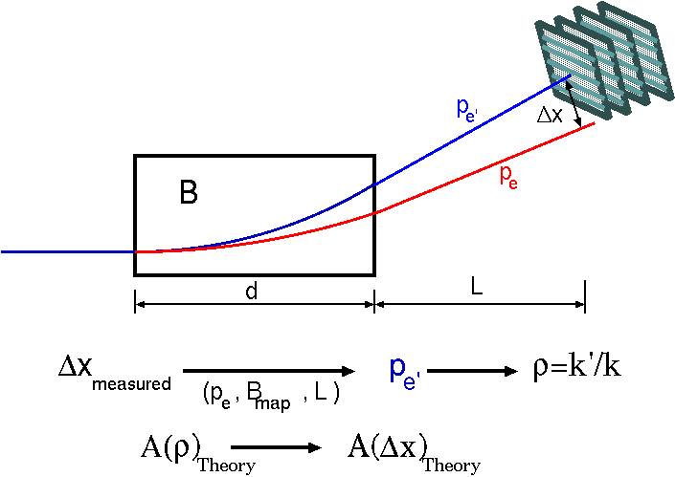
Calculating Polarization
we know:
e-beam energy,
magnet field map,
detector location & geometry
deviation from nominal e-beam
momentum of Compton recoil e⁻
Compton asymmetry is precisely known from QED as a function of momentum
Fitting the calculated asymmetry to the measured asymmetry gives us the beam polarization
Notes:
Since we are aware of the beam energy, the magnet field map and other geometrical considerations at the detector, we can convert the distance of a given detector strip from e-beam into the scattered electron energy at that strip.

Slide 20
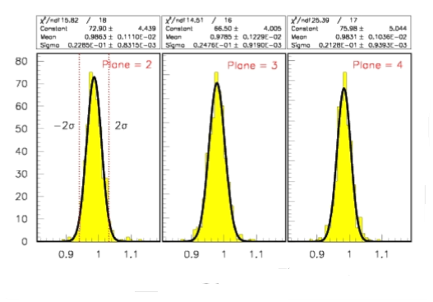
Calculating Polarization
The Compton edge for the theoretical Compton asymmetry is fixed at 17.6 mm from the beam (based on known beam parameters and detector geometry)
Polarization is obtained by performing a two parameter fit with polarization and effective pitch
where
Plane 2
Plane 3
Plane 4
Theory
Polarization:
90.4 % +/- 0.7%
Asymmetry (A)
Distance from beam (mm)
effective pitch parameter fit

Slide 21
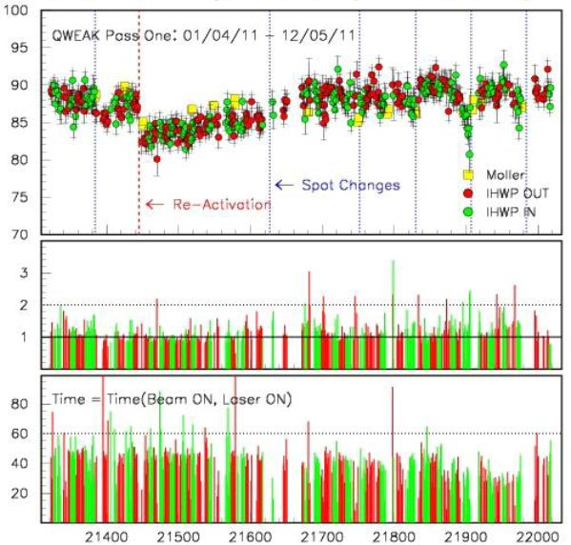
Preliminary Polarization
PRELIMINARY
42 days of Compton data
each point represents a ~ 1 hr run
only Partial systematic error (due to strip – pitch) included
the dotted vertical lines represent spot changes on the photocathode
the dashed vertical line represents Re-activation
on an average the beam current was ~ 160 μA
Polarization(%)
Spot change
reactivation
Error (%)
time in min
42 days
Run Number
Apr 1, 2011
May 12, 2011

Slide 22
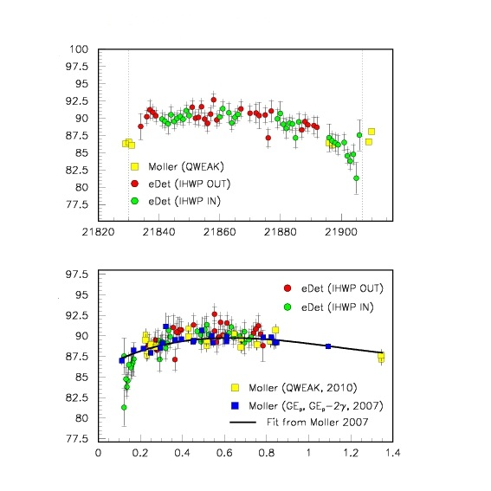
Quantum efficiency
Zooming into a region of consecutive spot changes:
Polarization(%)
Polarization was found to drop significantly before the spot move
Time (a.u)
Polarization(%)
Quantum Efficiency (%)

Slide 23
Systematic errors
Error Contribution | (~)Value
Due to detector strip size | 0.2 %
Detector geometry | 0.15 %
Difference between planes | 0.2 %
Magnetic field | ?
Beam & Laser Position | ?
Dead time | ?
TBD | ?
Laser Polarization | 99.5 +/- 0.4% (overall)
Total | 0.50 %
We don’t expect the unknown in the above table to be very large

Slide 24
Summary
Accomplished:
This is the first Diamond micro-strip detector to be used as a tracking device in an experiment
Despite several challenges posed by the electronic noise environment, leading to strict trigger condition, we achieved the design goal of < 1% statistical uncertainty and projected low systematic
Next:
In our preparation for Qweak run-2, We have 4 active planes (already installed)
Adapting from experiences of run-1, we are using more noise-robust electronics, with a better control over signal correlations in adjacent channels.
All set to provide an independent absolute polarization measurement for Hall-C beam

Slide 25
Compton Team
Institutions involved:
College of William and Mary (γ - detector)
Jefferson Lab (all subsystems)
Mississippi State University (e - detector)
MIT Bates (magnets, vacuum – can, detector holder, previous CsI crystal for γ - detector)
TRIUMF (Qweak Amplifier Discriminator boards)
University of Manitoba (e - detector)
University of Virginia (laser and γ - detector)
University of Winnipeg (e - detector)
Yerevan Physics Institute (γ - detector and help with e - detector)
Alphabetical order
This presentation was made possible due to significant contribution from
Dipangkar Dutta, Vladas Tvaskis and Donald Jones
This work was supported by U.S. DoE, Grant Number: DE-FG02-07ER41528

Slide 26
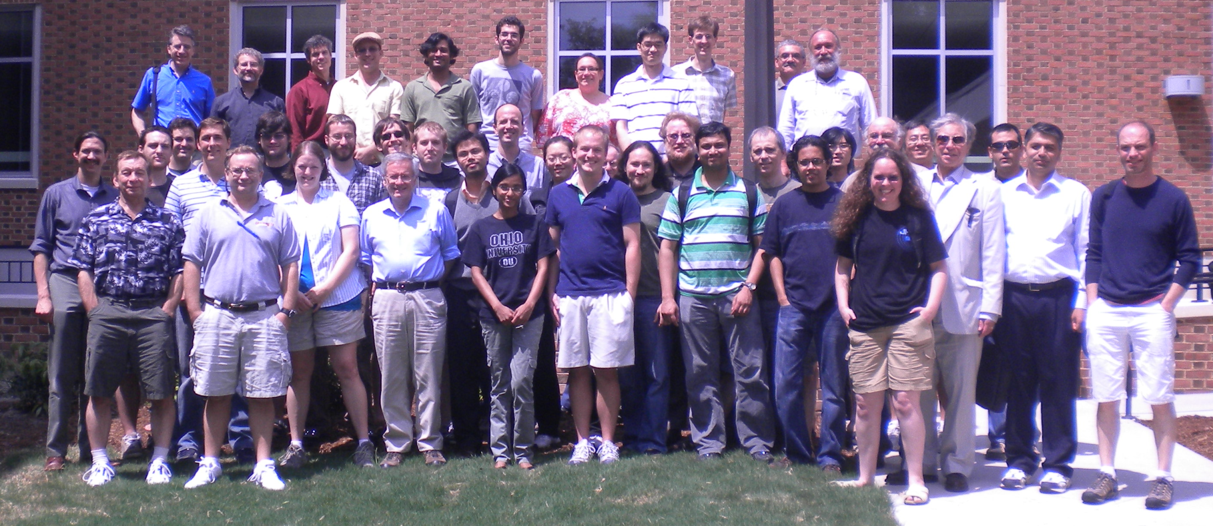
Thanks
Qweak Collaboration, July 2011 @ College of William and Mary
The author can be contacted at narayan@jlab.org

Slide 27
Extras

Slide 28
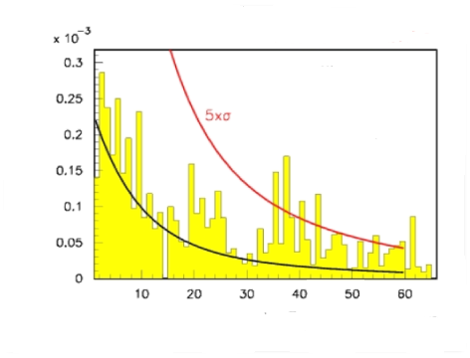
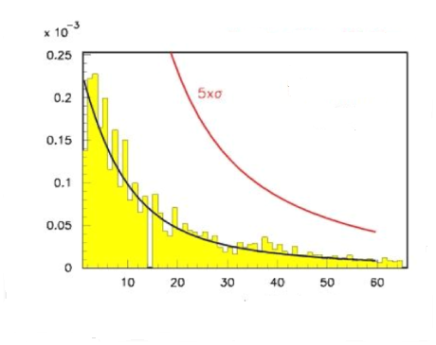
Background subtraction
before electronic noise subtraction
After electronic noise subtraction
Run # 21327
Beam ON
Laser Off
Run # 21327
Beam ON
Laser Off
charge normalized laser off hits
charge normalized laser off hits
strip number
strip number

Slide 29
why diamond ?
Property | Silicon | Diamond
Band Gap (eV) | 1.12 | 5.45
Electron/Hole mobility (cm²/Vs) | 1450/500 | 2200/1600
Saturation velocity (cm/s) | 0.8x10⁷ | 2x10⁷
Breakdown field (V/m) | 3x10⁵ | 2.2x10⁷
Dielectric Constant | 11.9 | 5.7
Displacement energy (eV) | 13-20 | 43
e-h creation energy (eV) | 3.6 | 13
Av. e-h pairs per MIP per micron | 89 | 36
Charge collection distance (micron) | full | ~250
Low leakage
current, short noise
Fast signal
collection
Low capacitance,
noise
Radiation hardness
Smaller
signal

Slide 30
2 parameter fit
x = 17.6 - (strip # of edge - strip # of histogrammed bin)*strip_pitch
x = 17.6 - (strip # of edge - strip # of histogrammed bin)*strip_pitch * P2

Slide 31
Input Reconditioning Stage
Pulse Width
Adjustment
of Trigger output
(counting circuit)
Input to
Trigger Logic
Circuit
Trigger width
Input from
Detector
Rising Edge Detection
Pulse Width
Adjustment
of Pipeline Delay
(counting circuit)
Input to
Pipeline Delay Circuit
Disable
Pipeline width
Hold Off decision
(counting circuit)
Hold Off

Slide 32
DAQ
We accumulate the counts in the detector over a given Helicity window and read it out at the end of the Helicity window
Our Helicity reversal rate is ~ 960 Hz
wait time for Helicity stabilization ~ 76 μs

